Slide 1


Αρτηριακή Υπέρταση
Δ. Β. Βλαχάκος, M.D., Ph.D.
Καθηγητής Παθολογίας-Νεφρολογίας
Νεφρολογική Μονάδα
Β’ Προπαιδευτική Παθολογική Κλινική
Πανεπιστημιακό Γενικό Νοσοκομείο «ΑΤΤΙΚΟΝ»
Χαϊδάρι

Slide 2
EFFECTIVE VOLUME
1 L/min
30 kg
1 L/min
0.3 kg

Slide 3
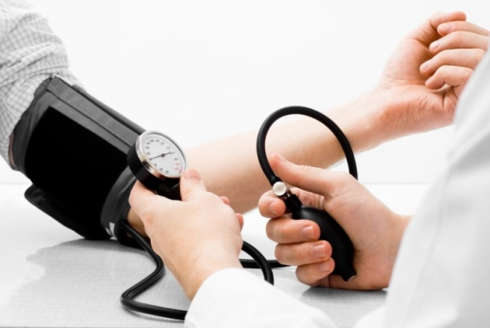
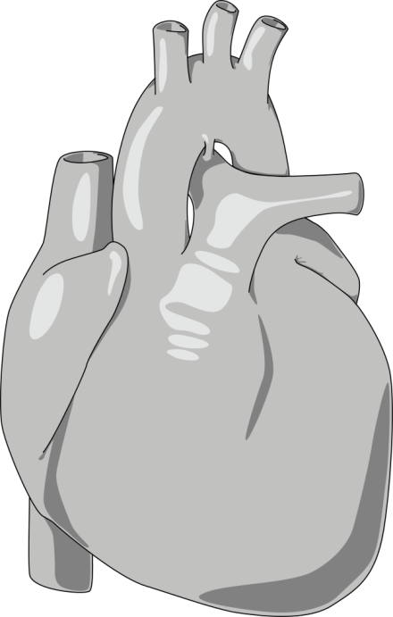
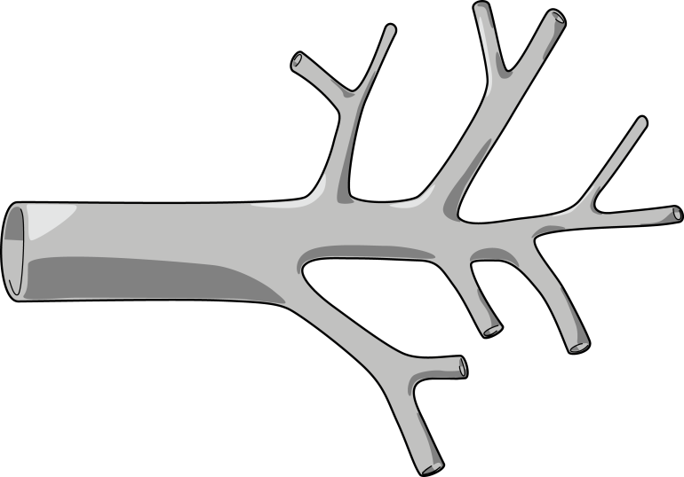
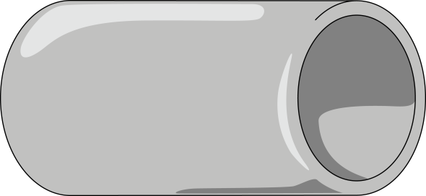
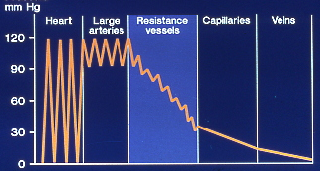
V = I x R
Blood Pressure = Cardiac Output x Peripheral Vascular Resistance
Heart
(cardiac output)
Arteries
(blood pressure)
Arterioles
(peripheral resistance)
Beevers G et al. BMJ 2001; 322:912-916
Notes:
Maintenance of a normal blood pressure is dependent on the balance between the cardiac output and peripheral vascular resistance. Most patients with essential hypertension have a normal cardiac output but a raised peripheral resistance.
Peripheral resistance is determined not by large arteries or the capillaries but by small arterioles, the walls of which contain smooth muscle cells. Contraction of smooth muscle cells is thought to be related to a rise in intracellular calcium concentration, which may explain the vasodilatory effect of drugs that block the calcium channels. Prolonged smooth muscle constriction is thought to induce structural changes with thickening of the arteriolar vessel walls possibly mediated by angiotensin, leading to an irreversible rise in peripheral resistance.
It has been postulated that in very early hypertension the peripheral resistance is not raised and the elevation of the
blood pressure is caused by a raised cardiac output, which is related to sympathetic overactivity. The subsequent rise in peripheral arteriolar resistance might therefore develop in a compensatory manner to prevent the raised pressure being transmitted to the capillary bed where it would substantially affect cell homeostasis.
Reference:
Beevers G et al. ABC of hypertension. The pathophysiology of hypertension. BMJ 2001; 322:912-916.

Slide 4
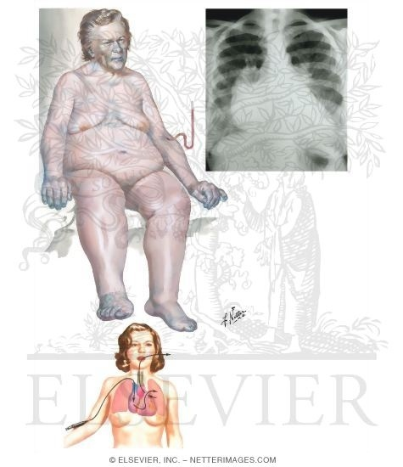
Μάζα Να κ.φ.
ευογκαιμία
ΚΛΟΑ
ΧΡΟΝΙΩΣ
ΟΞΕΩΣ
Μάζα Να
Μάζα Να
υπερογκαιμία
υποογκαιμία
Πίεση ενσφηνώσεως

Slide 5
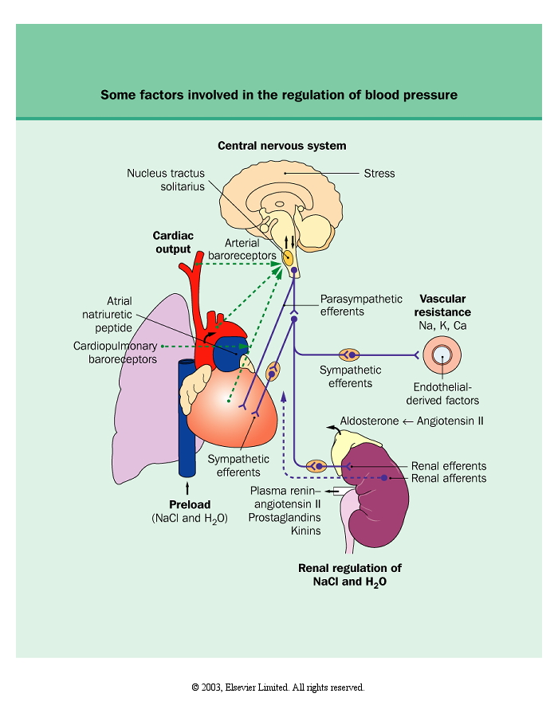
ADH
SNS
RAAS

Slide 6
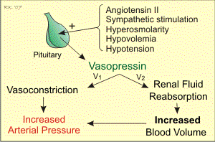

Slide 7
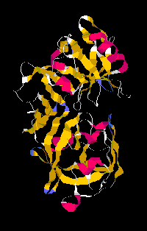
Renin-Angiotensin-Aldosterone System
Arteries
Ang I
Ang II
ACE1
RAAS
Angiotensinogen
Adrenal
gland
Renin
Na⁺
Na⁺
Na⁺ retention
Aldosterone
Na⁺
Na⁺
Kidney

Slide 8
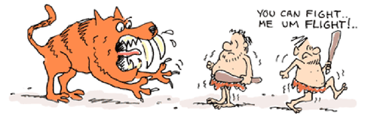
Sympathetic Nervous System
Sympathetic system activation produces
  vasoconstriction
  reflex tachycardia
  increased cardiac output
The actions of the sympathetic system are rapid and account for second to second blood pressure control

Slide 9
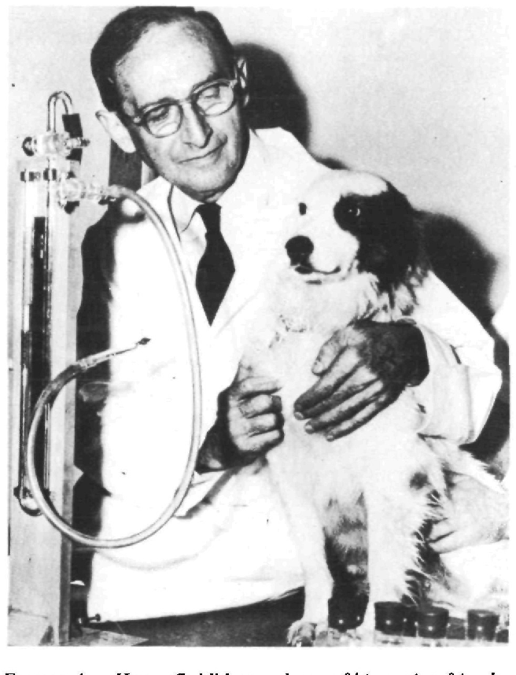
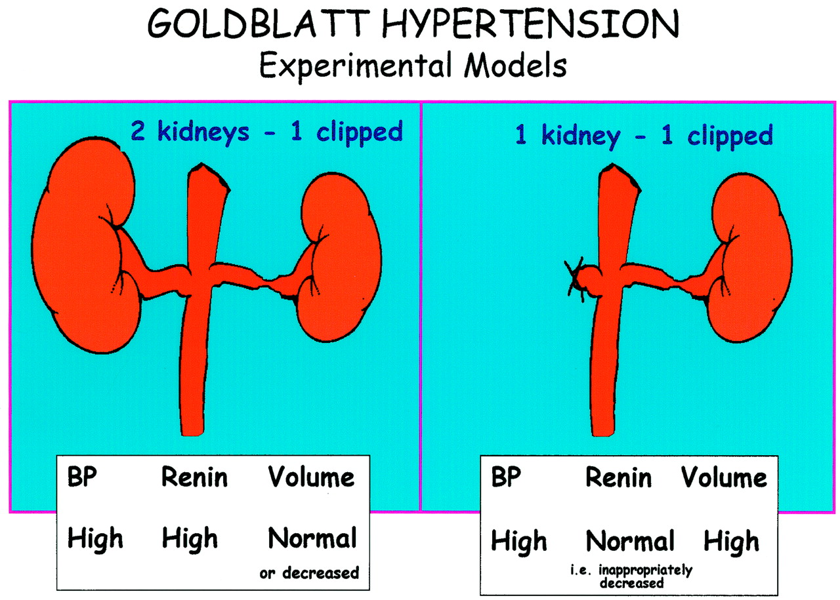

Slide 10
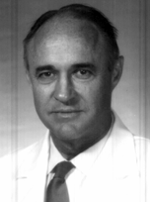

Slide 11
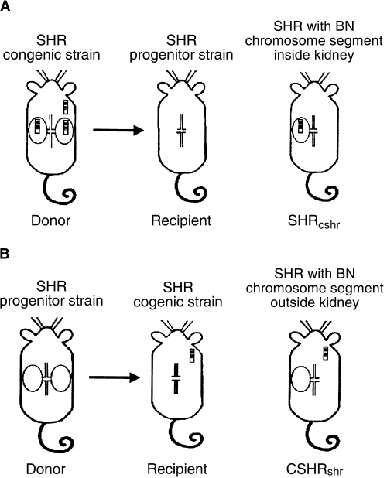
Hypertension travels along with the kidney!
ΗΤ ΝΤ ΗΤ
PHR PNR HTN
ΝΤ ΗΤ ΝΤ

Slide 12
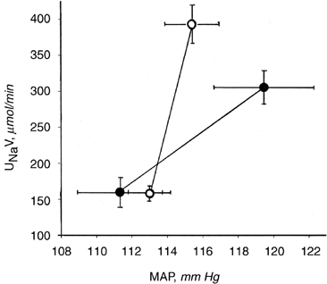

Slide 13
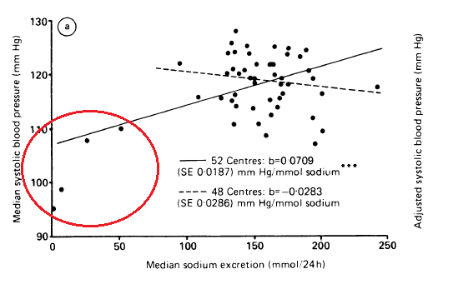

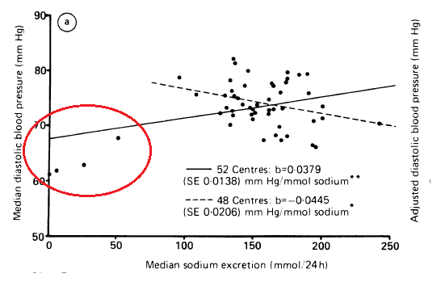

Notes:
blood pressure is regulated by a complex homeostatic system: sodium affects it, but so do potassium, calcium, caloric intake, sex, age, and race.

Slide 14
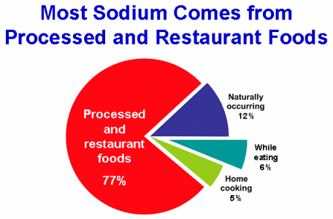

Slide 15
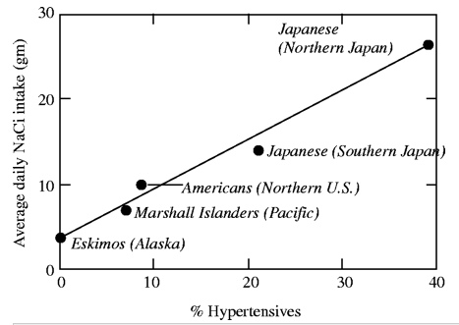

Slide 16
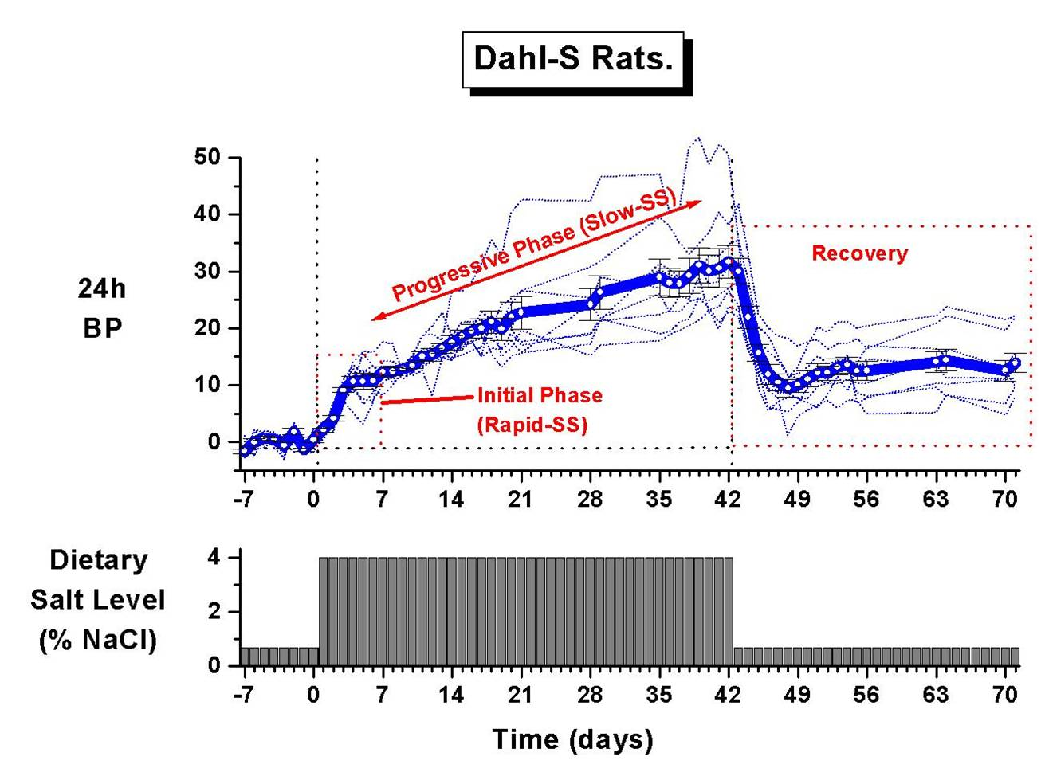

Slide 17

Denton D et al. The effect of increased salt intake on blood pressure in chimpanzees.
Nat Med 1995;1:1009-16.
Humans share 98.4% genetic identity with chimpanzees
By adding up to 15 g of NaCl daily, SBP increased by 33 mm Hg and DBP by 10 mm Hg
The increases were reversed after withdrawal of the sodium chloride supplement.

Slide 18
Relatively salt-sensitive groups of people
Individuals > 50-60 yo
Blacks
Hypertensive patients
Obese people with metabolic syndrome and DM
Patients with CKD

Slide 19

Prevalence of Hypertension in US by Obesity Class and Sex
70
%
60
50
40
men
30
women
20
10
0
BMI(kg/m²) <18.5 18.5-24.9 25-29.9 30-34.9 35-39.9 ≥40
normal
overweight
underweight
obesity class 1
obesity class2
obesity class 3
Must A et al. JAMA 1999; 282:1523-1529
Notes:
This is a national representative cross-sectional survey using data from the Third National and Nutrition Examination Survey (NHANES III), which was conducted in 2 phases from 1988 to 1994.
A total of 16884 adults, 25 years and older, classified as overweight and obese (body mass index [BMI] ≥25 kg/m²⁾ based on National Institute of Health recommended guidelines.
Sixty three precent of men and 55% of women had a body mass index of 25 kg/m² or greater. A graded increase in the prevalence of hypertension was observed with increasing severity of overweight and obesity.
Reference: Must A et al. JAMA 1999; 282:1523-1529

Slide 20
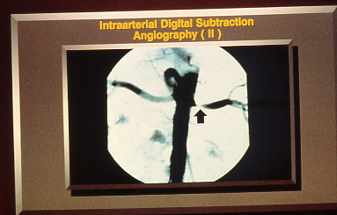
Notes:
Νεφραγγειακή υπέρταση είναι αυτή που οφείλεταια σε στένωση της μιάς ή και των δύο νεφρικών αρτηριών. Σε νεαρές γυναίκες η συχνότερη αιτία είναι η ινομυϊκή δυσπλασία, ενώ σε ηλικιωμένους άνδρες η αθηρωματική νόσος.

Slide 21
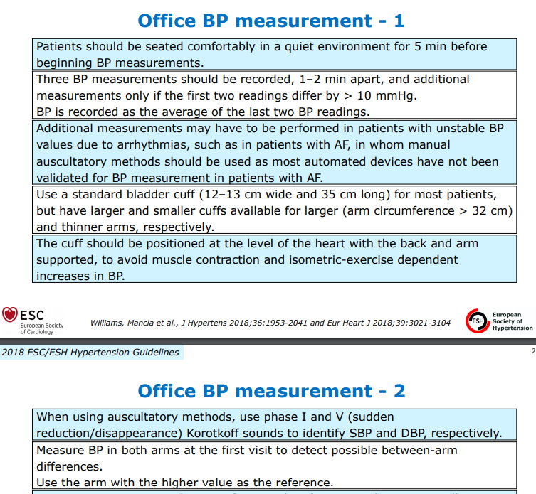

Slide 22
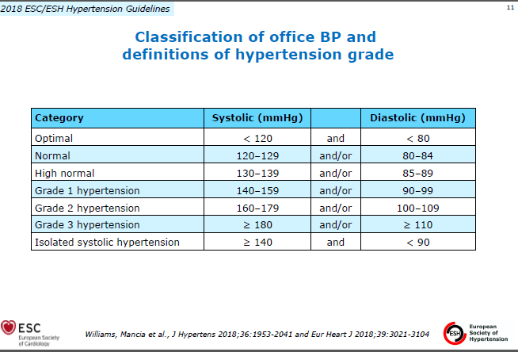

Slide 23
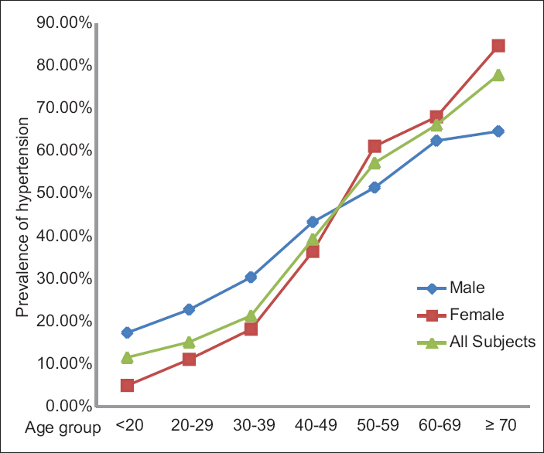

Slide 24
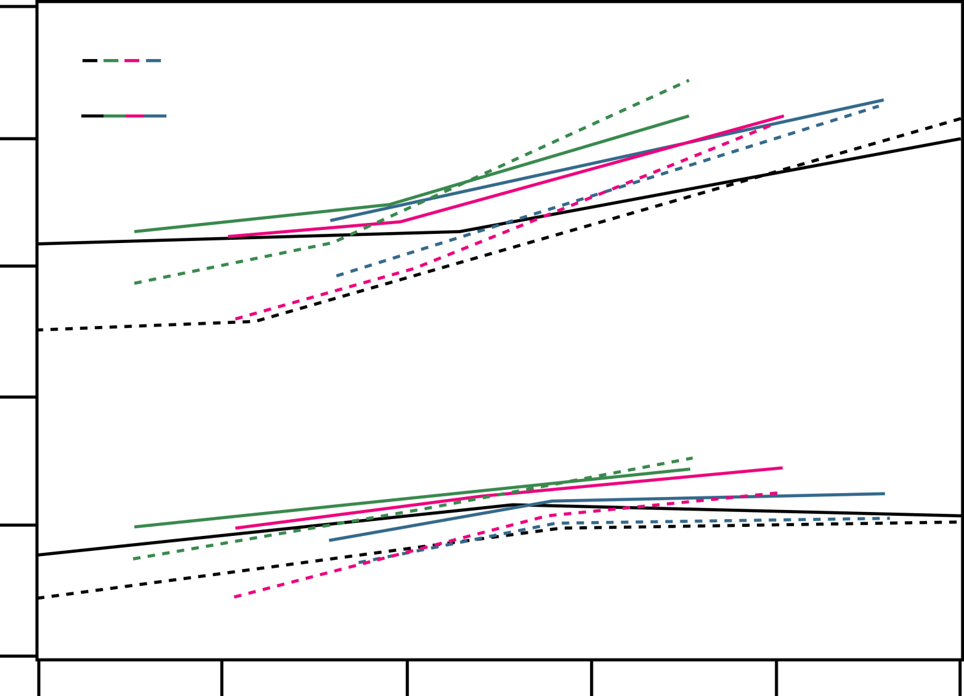
Association Between Age and Average Levels of Systolic and Diastolic Blood Pressure in Four Economically Developed Countries
160
140
120
100
80
60
BP
(mmHg)
women
men
systolic
Unites States (1976-80)
Italy (1976)
Japan (1980)
Australia (1980)
diastolic
20 30 40 50 60 70
Age (years)
Lip G and Bakris G. Handbook Hypertension Management. CMG
Notes:
Both SBP and DBP rise progressively with advancing age, until the age of 60 years. At that point, DBP tends to reach a plateau while SBP (and consequently the pulse pressure [PP]) continues to rise, representing a more reliable predictor of CVD at that age (see Figure 1.6). While this has been observed in most western countries, the age-associated increase in BP may be of environmental rather than biological origin. Isolated non-Western societies do not show an increase in BP with advancing age, but if they start to adopt the ‘modern’ way of life, they begin to develop a profile similar to that found in western countries.
Reference:
Lip G and Bakris G. Handbook Hypertension Management. CMG.

Slide 25
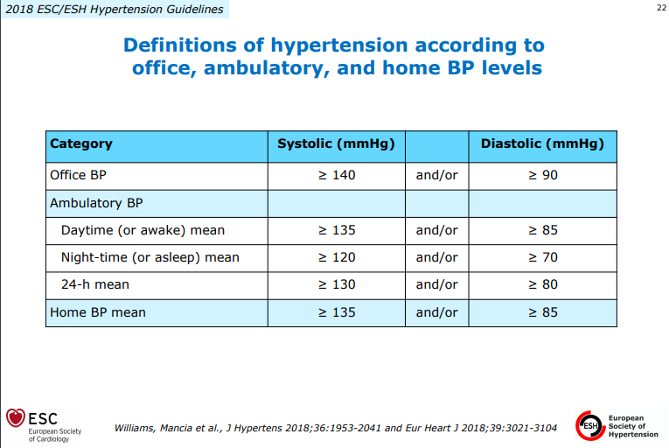

Slide 26
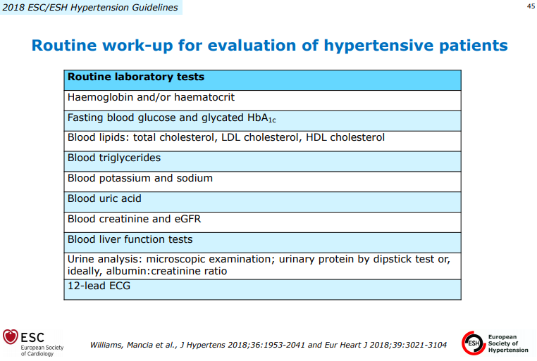

Slide 27
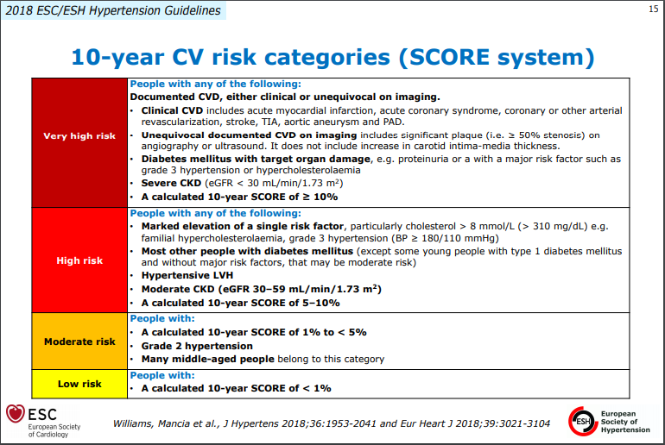

Slide 28
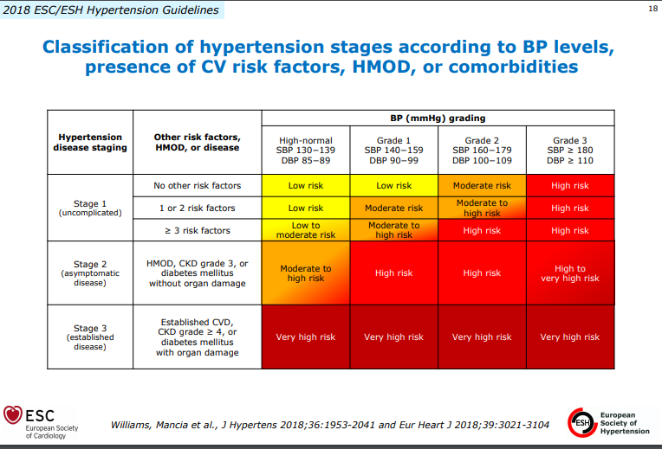

Slide 29
Hypertension Treatment Effect
Mirrors Observational Data
Observational Data
Incidence of cardiovascular disease
Treatment Effect
120
140
160
180
200
220
Systolic blood pressure (mmHg)
Notes:
Hypertension Treatment Effect Matches Observational Data
Observational data indicate that risk for a variety of hypertension related outcomes rises with increasing levels of blood pressure. A key question to be answered in clinical trials is: To what extent does blood pressure treatment reduce the increase in cardiovascular disease risk associated with hypertension?

Slide 30
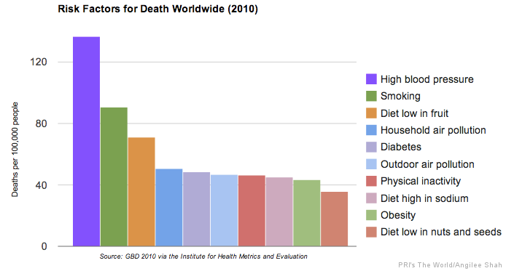
Apart antibiotics, anti-hypertensives are the single most important therapy contributing to rising life expectancies.

Slide 31
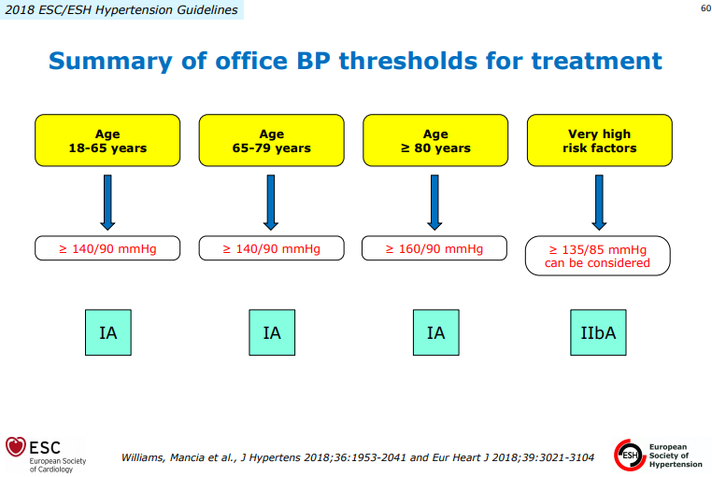

Slide 32
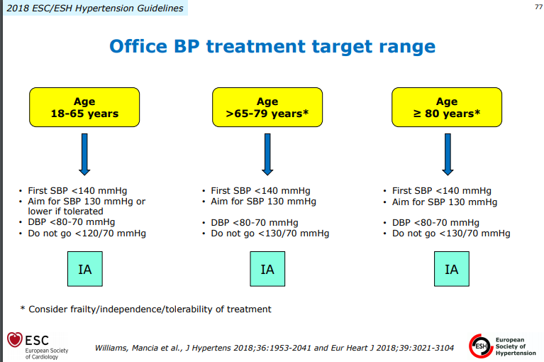

Slide 33
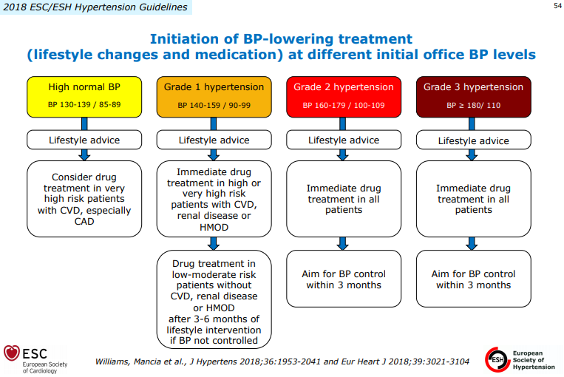

Slide 34
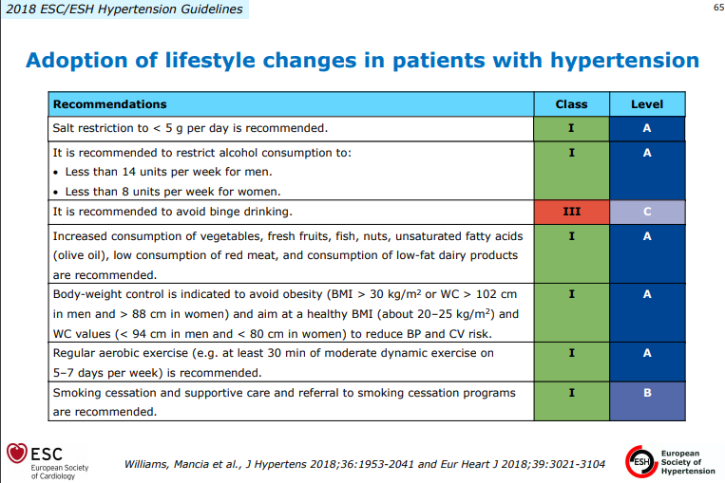

Slide 35


Slide 36

Επιλογή 1^{oυ} Φαρμάκου:
Συνήθως δεν έχει τόσο μεγάλη σημασία
Η επίτευξη άριστης ρύθμισης έχει μεγαλύτερη σημασία στη μείωση του κινδύνου
Στις περισσότερες περιπτώσεις χρειάζονται 2-3 φάρμακα
Θειαζιδικά διουρητικά
Αναστολείς ΜΕΑ
Ανταγωνιστές Ca
Ανταγωνιστές αγγειοτασίνης
β-Αποκλειστές ***
Φάρμακα
1^{ης} γραμμής
***
ΠΡΟΤΙΜΗΣΗ: σε ειδικές ενδείξεις ΑΠΟΦΥΓΗ: σε ↑ κίνδυνο εμφάνισης διαβήτη, ηλικιωμένους

Slide 37
Το διαβητογόνο δυναμικό των συνδυασμών θειαζιδικού τύπου διουρητικού και β-αποκλειστή σε ασθενείς με υπέρταση
Με συνδυασμό β-αποκλειστή και θειαζιδικού
→ RR = 1.19 (1.14-1.23) για διαβήτη Τ2 συγκριτικά με άλλες αντιυπερτασικές θεραπείες που δεν χρησιμοποιούν αυτό το συνδυασμό
Mason JM, J Hypertens. 2005

Slide 38
Αντιϋπερτασικά φάρμακα
Επιλογή φαρμάκων
Φάρμακα δεύτερης γραμμής
(Λιγότερες αποδείξεις από μεγάλες μελέτες)
Α1 αποκλειστές
Κεντρικώς δρώντα φάρμακα ( α2 αγωνιστές, τροποποιητές της ιμιδαζολίνης)
Ανταγωνιστές της αλδοστερόνης

Slide 39
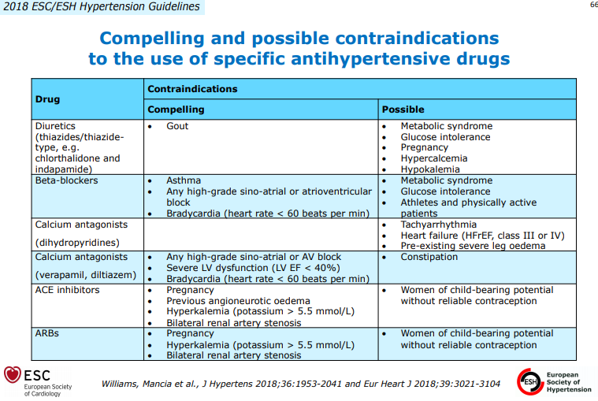

Slide 40
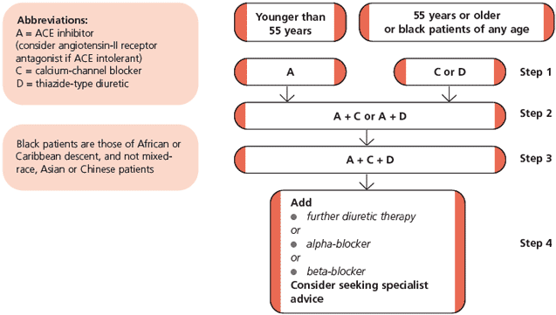

Slide 41
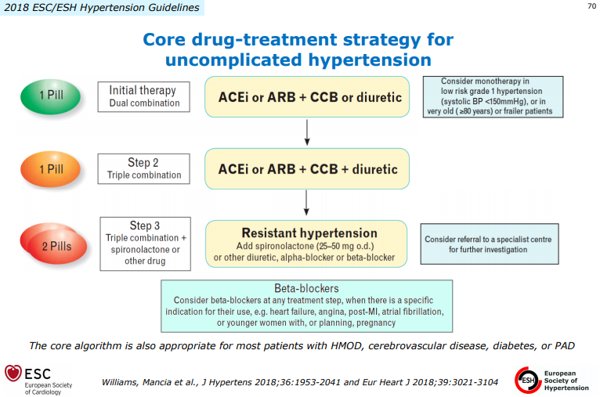

Slide 42
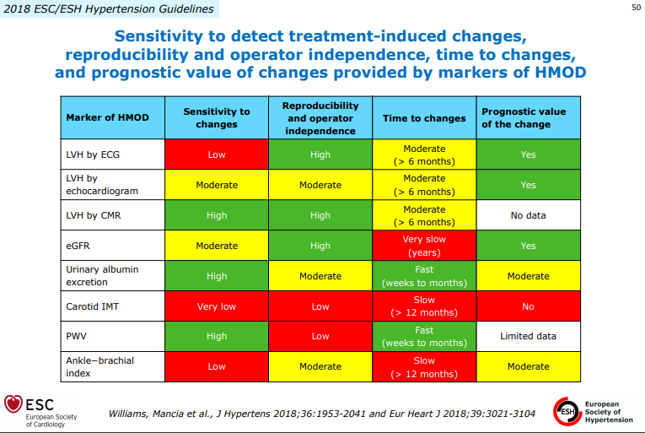

Slide 43
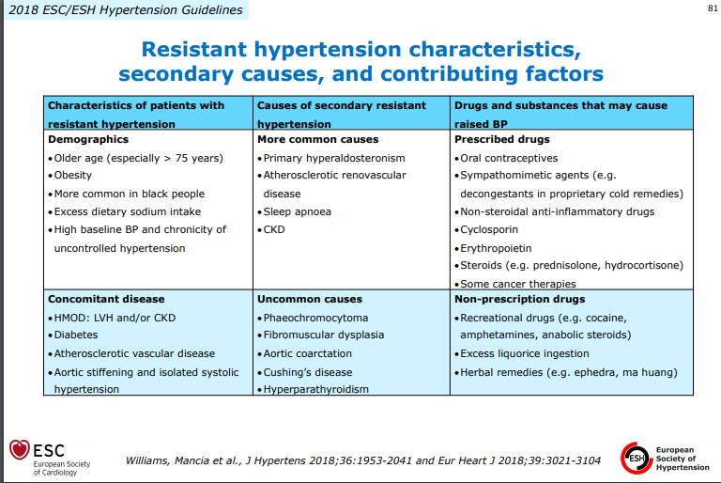

Slide 44
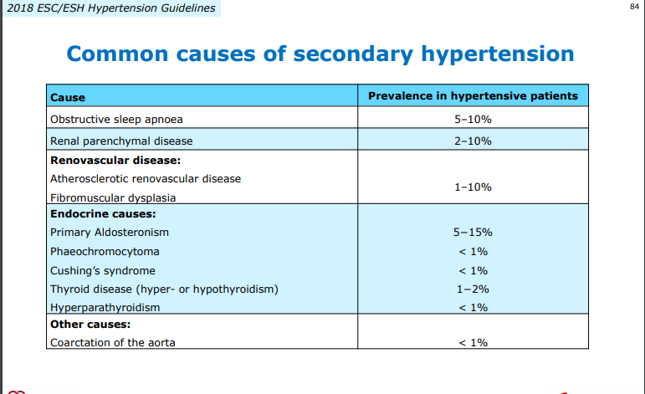

Slide 45
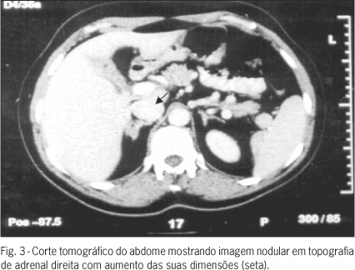
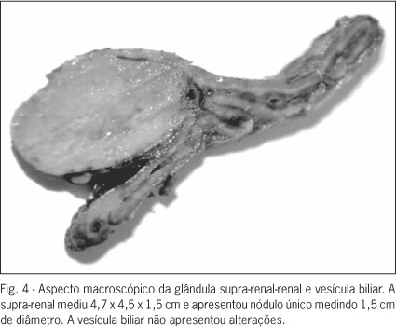
Primary hyperaldosteronism
2/3 bilateral hyperplasia,
1/3 adenoma (Conn’ syndrome)
M:F => 1:2, 30-50 yo
-Hypertension
-Hypokalemia (95%) ή Κ+ 3.4-3.7 meq/L
-Μetabolic Alkalosis
-Low Renin - High Aldo

Slide 46
Pheochromocytoma
0.01-0.1% of HTN population
    Found in 0.5% of those screened
M = F
3rd to 5th decades of life
Rare, investigate only if clinically suspicion:
    Signs or Symptoms
    Severe HTN, HTN crisis
    Refractory HTN (> 3 drugs)
    HTN present @ age < 20 or > 50 ?
    Adrenal lesion found on imaging (ex. Incidentaloma)

Slide 47
Pheo: Signs & Symptoms
The five P’s:
    Pressure (HTN) 90%
    Pain (Headache) 80%
    Perspiration 71%
    Palpitation 64%
    Pallor 42%
        Paroxysms (the sixth P!)
The Classical Triad:
    Pain (Headache), Perspiration, Palpitations
    Lack of all 3 virtually excluded diagnosis of pheo in a series of > 21,0000 patients

Slide 48
Pheo: ‘Rule of 10’
10% extra-adrenal (closer to 15%)
10% occur in children
10% familial (closer to 20%)
10% bilateral or multiple (more if familial)
10% recur (more if extra-adrenal)
10% malignant
10% discovered incidentally

Slide 49
Localization: Imaging
CT abdomen
    Adrenal pheo SEN 93-100%
    Extra-adrenal pheo SEN 90%
MRI
    > SEN than CT for extra-adrenal pheo

Slide 50
Pheo Management
Prior to 1951, reported mortality for excision of pheochromoyctoma 24 - 50 %
    HTN crisis, arrhythmia, MI, stroke
    Hypotensive shock
Currently, mortality: 0 - 2.7 %
    Preoperative preperation, α-blockade?
    New anesthetic techniques?
        Anesthetic agents
        Intraoperative monitoring: arterial line, EKG monitor, CVP line, Swan-Ganz
Experienced & Coordinated team:
    Endocrinologist, Anesthesiologist and Surgeon

Slide 51
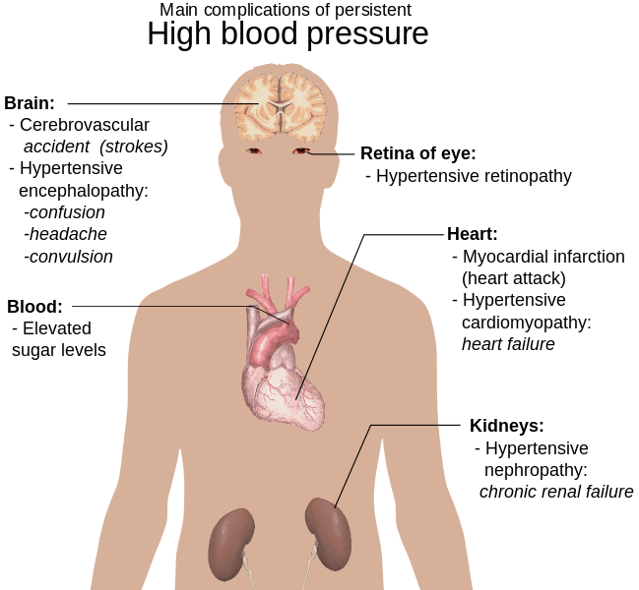

Slide 52
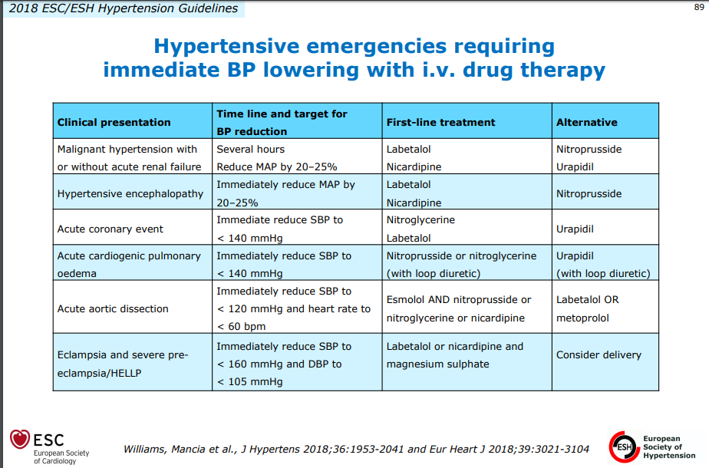

Slide 53
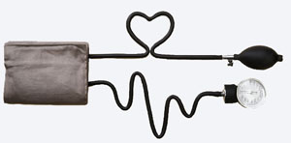
Ευχαριστώ για την προσοχή σας!

