Slide 1
Vaginal Intraepithelial Neoplasia
(VaIN)
Invasive vaginal carcinoma
Δ. Χαϊδόπουλος
Επίκουρος Καθηγητής
Μαιευτικής – Γυναικολογίας – Γυναικολογικής Ογκολογίας
Εθνικού και Καποδιστριακού Πανεπιστημίου Αθηνών
Γ.Ν.Α. «Αλεξάνδρα»

Slide 2
Vaginal Intraepithelial Neoplasia (VaIN)
0.5% the precancerous lesions of the female Lower Genital Tract
100 times less common than CIN
Risk Factors: HPV, RTX, chemotherapy, immunosupression
Patients with VaIN 60% had in the past and 30% have
simultaneously CIN and/or VIN
↑ incidence due to better screening and actual rise in the incidence
of VaIN
Aho et al Cancer 1991, Yalcin et al Eur J Obstet Gynecol RB 2003

Slide 3
Vaginal Intraepithelial Neoplasia (VaIN)
Natural History
Low grade (VaIN 1) simple HPV infection (??), small chances of progression
Moderate dysplasia (VaIN 2)
definetely precancerous lesions
Severe dysplasia (VaIN 3)
McLeod et al Gynecol Oncol 1997, Aho et al Cancer 1991

Slide 6
Vaginal Intraepithelial Neoplasia (VaIN)
Situation
Majority in upper third of vagina (60-70% upper, 20% lower, 15% middle)
Posterior wall 60%, anterior 25%, lateral 15%
Association of lower third with endometrial cancer ?

Slide 7
Vaginal Intraepithelial Neoplasia (VaIN)
Invasive potential
VaIN and vaginal cancer biologically extremely similar
Part of “ a lower genital tract neoplastic syndrome”
In a series of women who were followed without treatment
- persistent disease 13%
- progression to invasion 9%
Long-term follow-up of 292 patients treated by laser vap or excision
- 13 pts with invasive disease (4.5%)
Aho et al 1991, Yalcin et al 2003, Indermaur et al 2005

Slide 10
Vaginal Intraepithelial Neoplasia (VaIN)
Symptoms and signs
Generally asymptomatic disease
Positive smear
Dyspareunia, pruritus, vaginal discharge
Condylomata, reddish – fragile lesions of the vagina
White lesions of the epithelium
Lenehan et al Obstet Gynecol 1986, Petrilli et al Am J Obstet Gynecol 1980

Slide 11
Vaginal Intraepithelial Neoplasia (VaIN)
Diagnosis
Colposcopy + multiple biopsies
Use of 5% acetic acid
Indication for the use of Lugol’s sol
Rule out invasive disease
Most common in the upper third of vagina (80%)
Audet-Lapointe et al Gynecol Oncol 1990, Ruiz-Moreno et al Int J Gynecol Obstet 1987

Slide 12
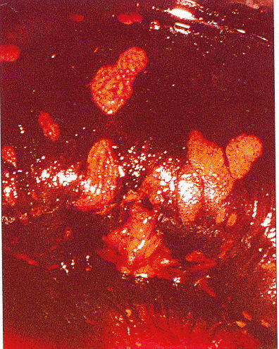
Unifocal lesion
Multifocal lesions

Slide 13
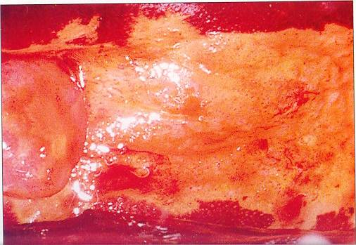
Extended VaIN 3 lesion

Slide 14
Vaginal Intraepithelial Neoplasia (VaIN)
Indications for Colposcopy
Positive smear following hysterectomy
Positive smear with negative cervical colposcopy
Positive smear following successful treatment of CIN
Suspicious vaginal lesions
Patients with VIN 2/3 and AIN 2/3
Immunosuppressed patients with CIN 2/3, VIN 2/3, AIN 2/3
Morrison et al Br J Cancer 1996, Brinton et al Gynecol Oncol 1990

Slide 15
Vaginal Intraepithelial Neoplasia (VaIN)
Categories
Primary VaIN lesion without simultaneous or past CIN lesion
VaIN related to CIN or invasive Ca, simultaneously or not
VaIN following external beam radiotherapy or brachytherapy
VaIN related to simultaneous CIN and VIN lesions
Random histological finding in specimen
Woodruff et al Gynecol Oncol 1975

Slide 16
Vaginal Intraepithelial Neoplasia (VaIN)
Treatment: not easy

Slide 17
Vaginal Intraepithelial Neoplasia (VaIN)
Treatment
Objective is to eradicate the disease while maintaining the sexual
function of the vagina
Management is challenging as the vagina in close proximity with
the cyst and the rectum. Adequate treatment must reach a depth
of 14 mm

Slide 18
Vaginal Intraepithelial Neoplasia (VaIN)
Treatment
Laser
Colpectomy
WLE
Radiotherapy
5-FU
Cryotherapy
Electrocauterization
CUSA (Cavitational Ultrasonic Surgical Aspiration)
Singer & Monaghan Lower Genital Tract Precancer 2003, Yalcin et al Eur J Obstet Gynecol RB 2003

Slide 19
Vaginal Intraepihelial Neoplasia (VaIN)
Laser vaporization
Multifocal lesions
Rule out invasive disease
Completely visible lesion
Histological evaluation
Attention to the depth of vaporization
Stuart et al Am J Obstet Gynecol 1988, Volante et al Eur J Gynecol Oncol 1992

Slide 21
Vaginal Intraepithelial Neoplasia (VaIN)
Colpectomy
Indications:
- following hysterectomy
- in not completely visible lesions of upper third
- VaIN 3
- early invasive disease
Better success rates (>80%) – fewer recurrences
BUT…
Difficult procedure
Increased complication rates (vaginal-bladder and vaginal-rectal fistulas)
Diakomanolis et al Gynecol Obstet Inv 2002, Hoffman et al Am J Obstet Gynecol 1992

Slide 22
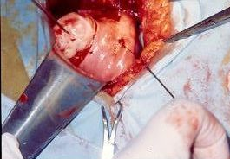
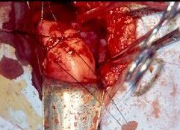
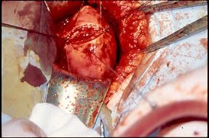
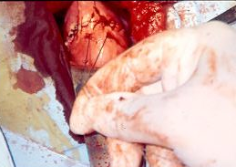

Slide 23
Vaginal Intraepithelial Neoplasia (VaIN)
WLE (Wide local excision)
Use of cold-knife or laser
In young women with completely visible, unifocal lesions
Use of lidocaine+epinephrine as local anaesthesia
Excision of the lesion with at least 1cm disease-free tissue
Intact vagina, easy follow-up
Diakomanolis et al Gynecol Obstet Inv 2002, Sherman et al J Reprod Med 1990

Slide 26
Vaginal Intraepithelial Neoplasia (VaIN)
Imiquimod as alternative treatment ??
Treatment of High-Grade Vaginal Intraepithelial Neoplasia (VaIN 2-3) with imiquimod cream
E.Diakomanolis, D.Haidopoulos, K.Stefanidis
New England Journal of Medicine 2002 Aug 1;347(5):374
Can local application of imiquimod cream be an alternative mode of therapy for patients with
high-grade intraepithelial lesions of the vagina?
D. Haidopoulos, E. Diakomanolis, A. Rodolakis, Z. Voulgaris, G. Vlachos, A. Antsaklis
International Journal of Gynecological Cancer 2005 Sep-Oct;15(5):898-902

Slide 27
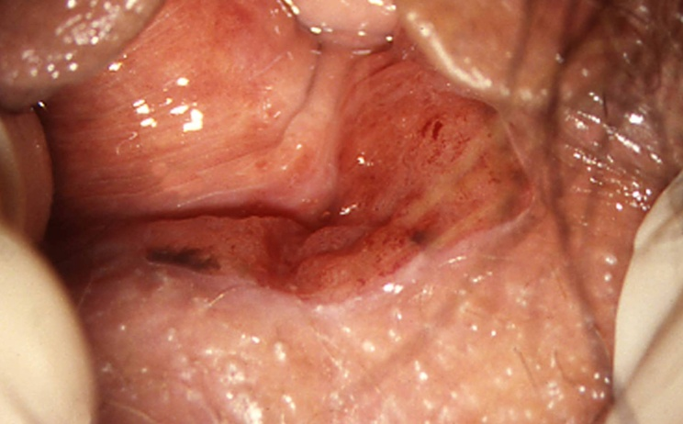
Invasive vaginal carcinoma
Squamous (85%), adenocarcinoma, sarcoma, malanoma
Rule out Ca Cx
Lymph meta according to location of disease
More often metastatic (endometrium, cervix, ovary, bowel, vulva)
Asymptomatic, usually vaginal bleeding
Rx: RTX, RH + PLND when in upper vagina (?)

Slide 28
Staging
Stage Ι: tumor invading only the vaginal epithelium
Stage ΙΙ: tumor not extending to the pelvic sidewall
Stage ΙΙΙ: tumor extending to the pelvic sidewall
Stage ΙV: tumor extending to bladder or bowel

Slide 29
Prognostic factors
Tumor size
Stage
5-year survival
Stage Ι 77%
Stage ΙΙ 45%
Stage ΙΙΙ 31%
Stage ΙV 18%

