Slide 1
Surgery in Endometrial cancer
Dimitrios Haidopoulos
Gynecological Oncologist
Alexandra Hospital, Athens, Greece

Slide 2

Endometrial Ca
4th most common Ca in women (US)
61.000 new cases, 11.000 deaths (US)
Armenia 3d highest rate after Barbados and FYR Macedonia (26,7/100.000)

Slide 3
Cutting-edge issues
Influence of surgery by the condition of the patient
Ovarian preservation in young patients ?
Lymphadenectomy ??
Radicality of surgery according to stage
Low, intermediate, high intermediate and high risk endometrial Ca
Adjuvant therapy
Laparoscopy
Sentinel node
Surgery in advanced disease

Slide 4
Physical status of the patient
Status of patient defines the extent of the procedure
- obesity
- hypertension
- DM
- respiratory issues
- cardiac issues
- age

Slide 5
Alternatively ??
In cases where no laparotomy or laparoscopy can be performed
VH + BSO in low-risk patients
EBRT + brachy or hormone treatment

Slide 6
Ovarian preservation
In young patients, ovarian preservation has no impact on OS
- <45yrs, MI<50%, grade 1 and no ovarian disease
- salpingectomy should be performed
- not in patients with family history(BRCA, LS)

Slide 7
Lymphadenectomy
Complete lymphadenectomy > 15 LN
Mayo clinic experience
281 patients w endometrial Ca and lymphadenectomy
(22% w high-risk disease w LN(+)
- 51% PLN + PAALN
- 33% PLN only
- 16% PAALN only
77% of patients with (+) PAALN had disease above the IMA
Lymphadenectomy up to the renals ??

Slide 8
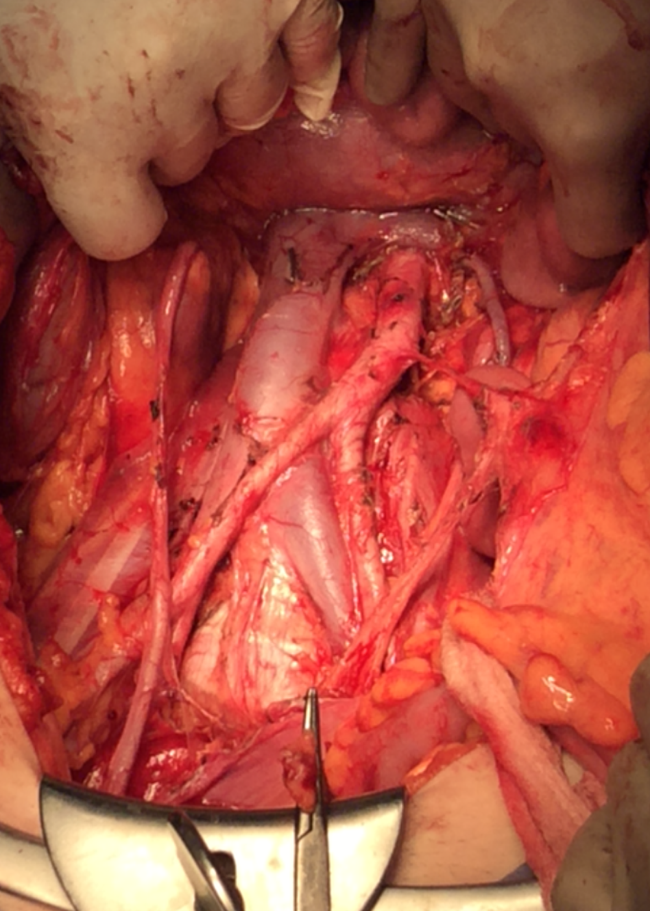

Slide 9
Lymphadenectomy in stage I ?
Systematic lymphadenectomy in low-risk stage I disease ?
Not improving DFS and OS
Benedetti-Panici J Natl Cancer Inst 2008
Kitchener et al Lancet 2009
Systematic lymphadenectomy in intermediate and high-risk stage I patients has a benefit in OS
2 RCT’s, 7 observational studies: 16995 pts
Kim HS et al Jpn J Clin Oncol 2012

Slide 10
Recommendations for LN in stage I
For staging purposes, tailors adjuvant therapy
Pts w low-risk (St Ia, g 1-2): ↓% (+) LN thus NO LND recommended
Pts w intermediate risk (st Ib or Ia g3): YES for staging
Pts w high-risk (st Ib g3): YES (improved OS)
Pts inadequately staged MUST undergo LND for tailoring adjuvant therapy

Slide 11
Stage II – RH ??
Stage ΙΙ
300 pts
74 RH
112 modified RH
114 SH
prognostic factors for OS: age, grade, cytology, LN (+)
Takano M et al Br J Cancer 2013
Type of hysterectomy is not a prognostic factor and should be performed only for obtaining clear margins of the specimen

Slide 12
Classification
Based on prognostic factors
- FIGO stage
- myometrial invasion
- grade
- histological type
- LVSI
(size of tumor has no clinical importance)
PORTEC-1, GOG 99, ASTEC/EN5

Slide 13
Low-risk patients
Stage I endometrioid, grade 1-2, <50% MI, LVSI (-)
Risk of recurrence: <5%
No benefit from RTX or brachytherapy
No adjuvant treatment

Slide 14
Intermediate-risk patients
Stage I endometrioid, grade 1-2, >50% MI, LVSI (-)
EBRT reduced of pelvic recurrence but not OS benefit
Low-risk for regional and distant recurrence
Risk of local recurrence decreased by brachy
Adjuvant brachytherapy to decrease vaginal recurrence
No adjuvant treatment is also an option

Slide 15
High-intermediate risk patients
Stage I endometrioid, grade 3, <50% MI, regardless of LVSI
Stage I, endometrioid, grade 1-2, LVSI(+), whatever MI
LND with (-) nodes – brachytherapy or nothing
No LND
- EBRT when LVSI (+) to decrease pelvic recurrence
- only brachy for grade 3 w LVSI (-) to decrease vaginal recurrence

Slide 16
High-risk patients
Stage I, endometrioid, grade 3, MI>50%
LND (-)
EBRT + brachytherapy recommended
No LND
EBRT recommended
EBRT + chemo in combination than either modality alone
(RTOG 9708, PORTEC-3, GOG 258, ENGOT-EN2-DGCG, EORTC 55102)

Slide 17
Considerations for laparoscopy
Technically feasible
Surgical safety
Quality of life (QoL)
Oncological safety
Cost effectiveness
Limitations

Slide 18
Procedures
Hysterectomy
Salpingo-oophorectomy
+/- pelvic lymph node dissection
+/- omentectomy
+/- para-aortic lymphadenectomy up to left renal vein

Slide 19
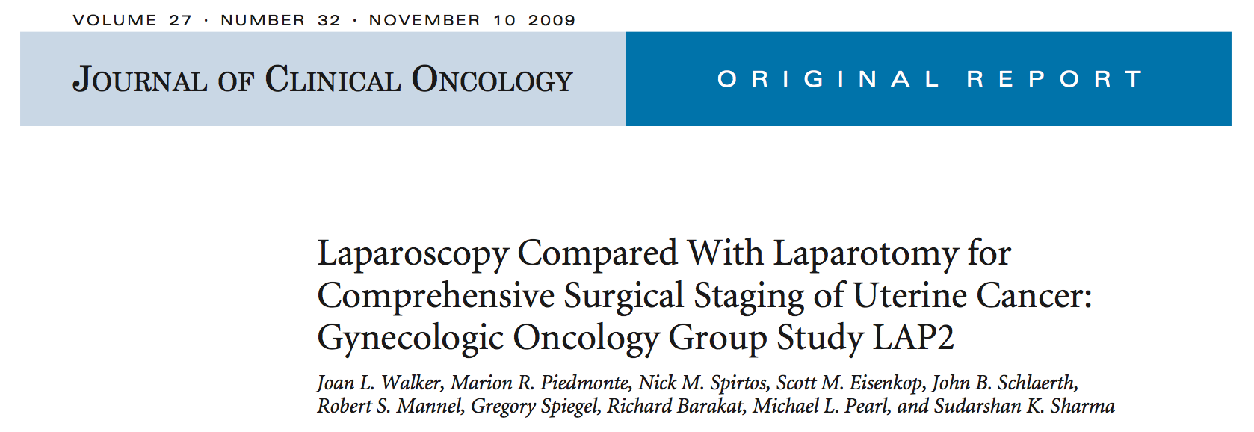
GOG LAP-2 trial

Slide 20
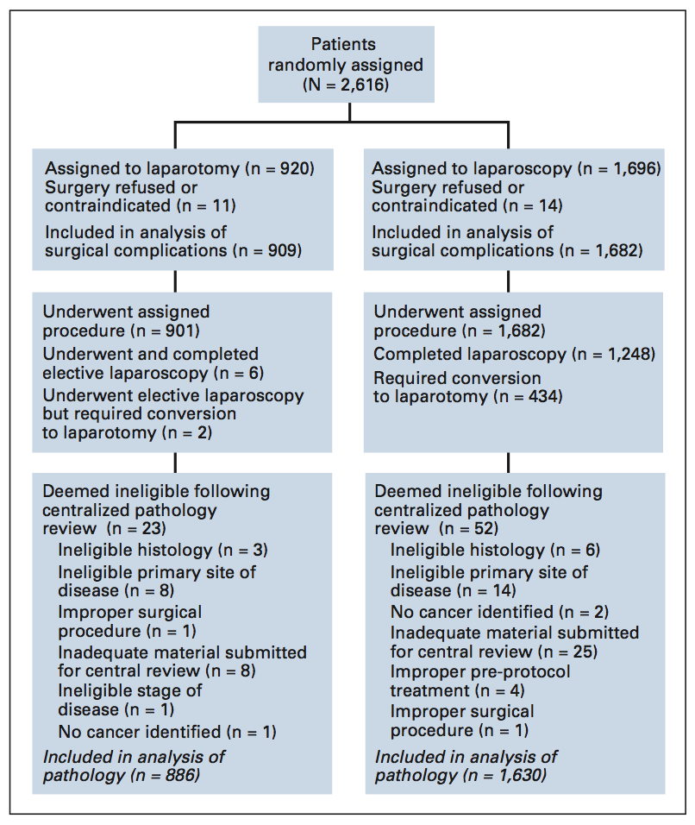
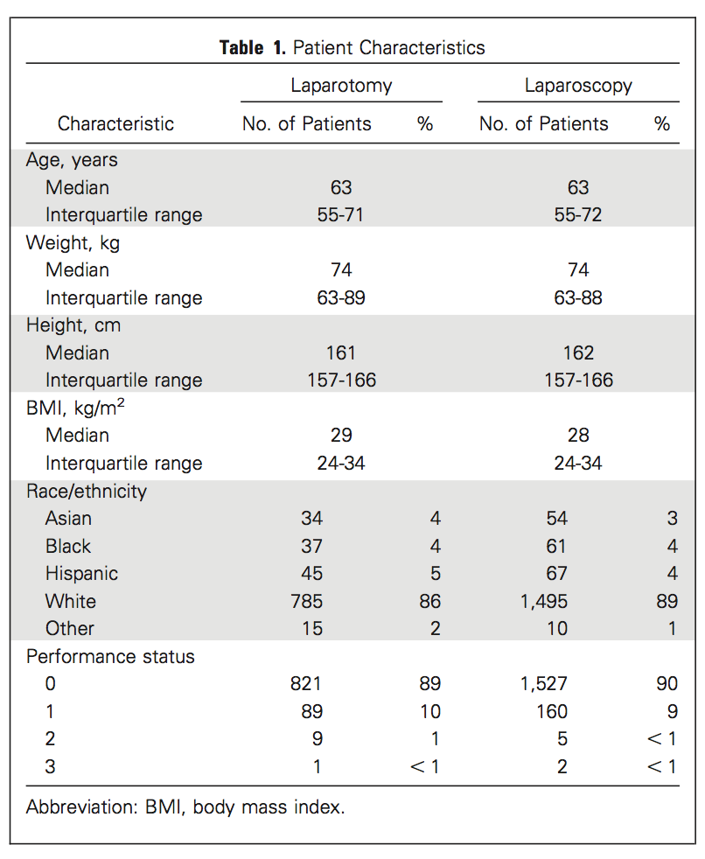
GOG LAP-2 trial

Slide 21
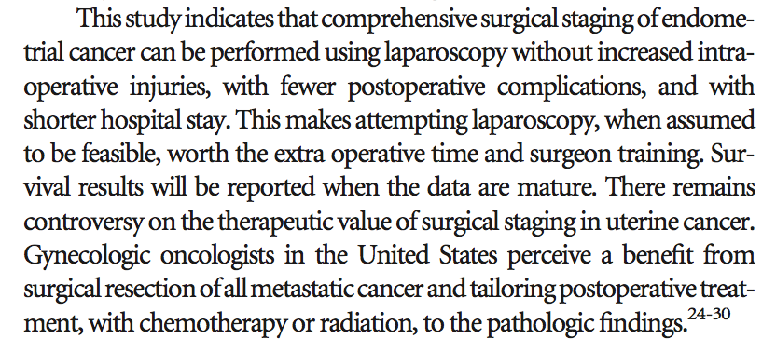
GOG LAP-2 trial

Slide 22


Dutch trial

Slide 23
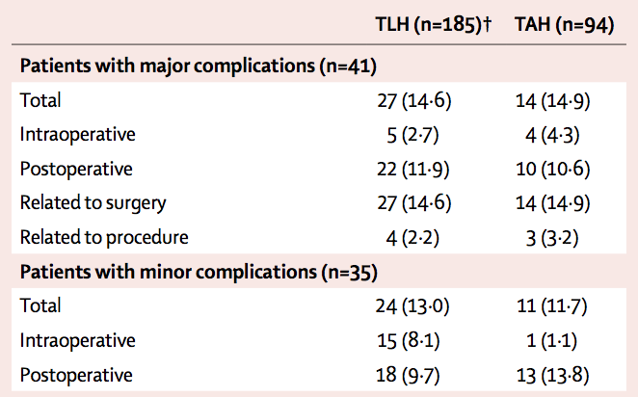
Dutch trial

Slide 24
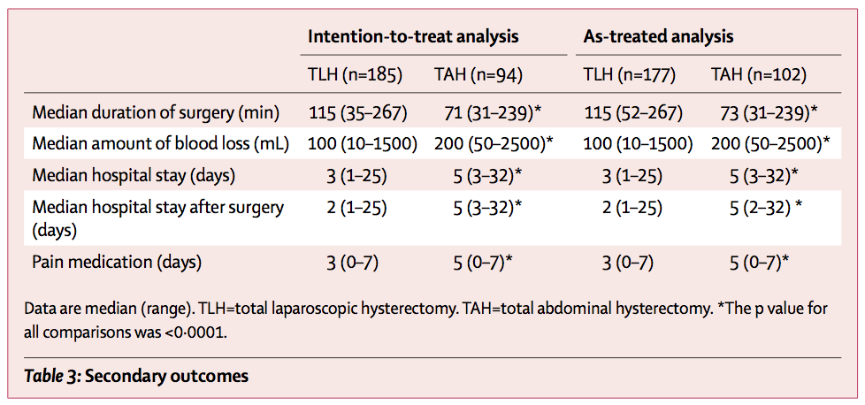
Dutch trial

Slide 25
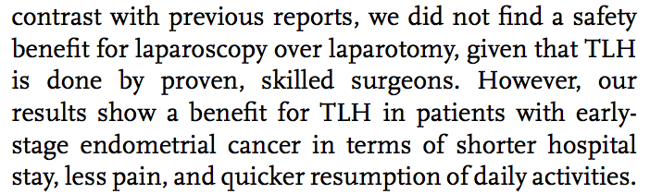
Dutch trial

Slide 26
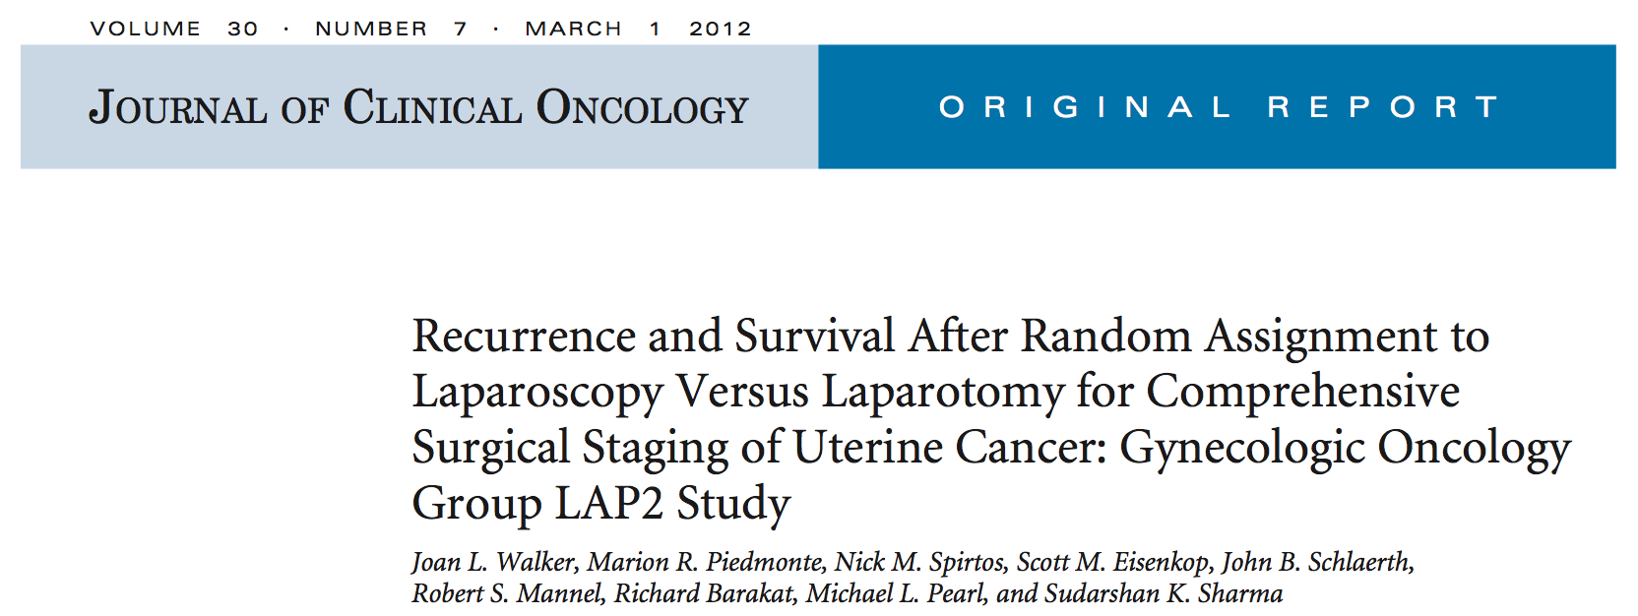
GOG LAP-2 trial

Slide 27
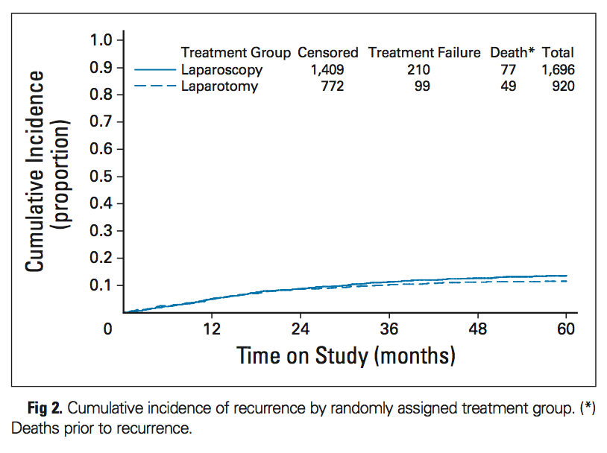
GOG LAP-2 trial

Slide 28
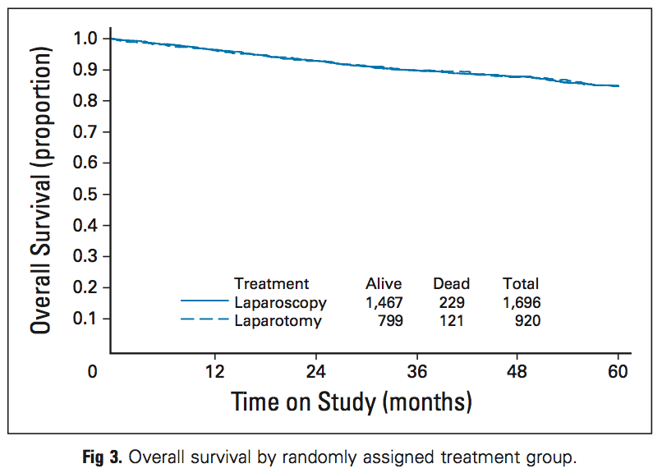
GOG LAP-2 trial

Slide 29
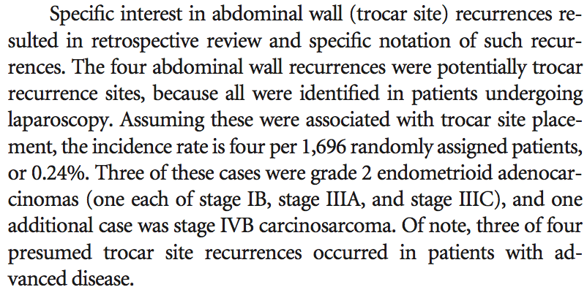
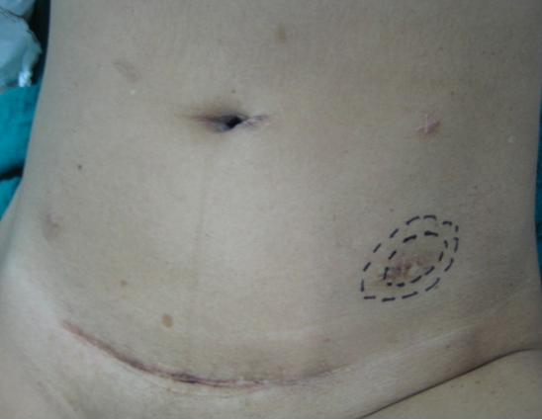
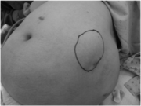
GOG LAP-2 trial

Slide 30
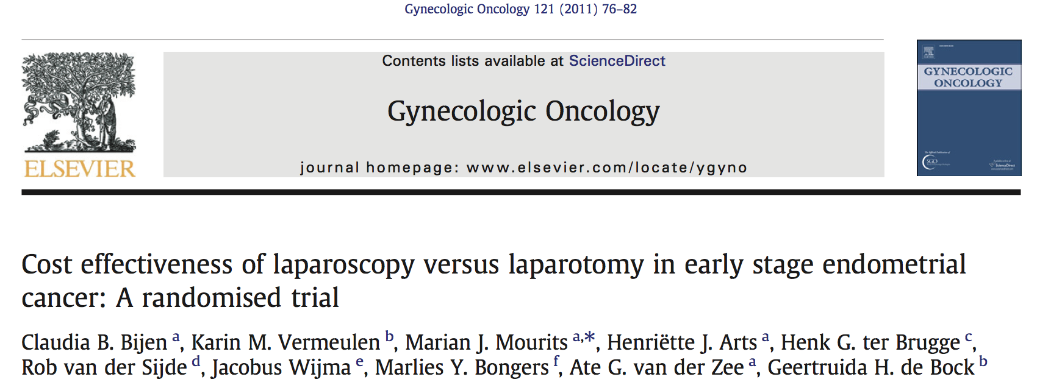
Cost

Slide 31
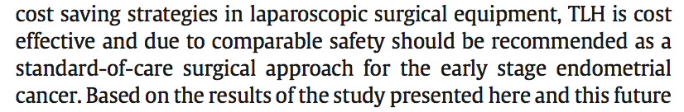
Cost

Slide 32
Limitations
BMI ???
Anesthetic challenges / Co-morbidities
Peritoneal disease
Size of uterus > 10cm …???
Bulky nodes ???
Patient’s wish !!!

Slide 33
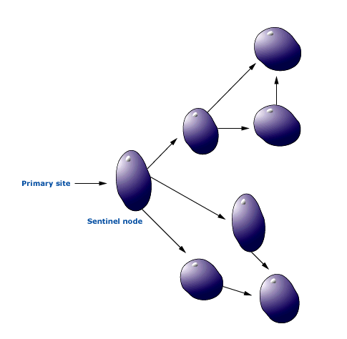
Sentinel node (SN)
“Sentinel node is defined as the first lymph node in a chain of lymph nodes within a lymphatic basin, that receives drainage from the primary tumor. Therefore, if the SN is negative, the remainder of the LN should be free of disease as well”

Slide 34
SN in endometrial Ca
15% patients w stage Ι and presumed G1 will have ↑ G
Currently: overtreatment w LND in St 1 G1 and subtreatment in pts w G1 (in curretings) which prove to be > G1
Future: use of SN for tailoring surgical staging and thus decreasing morbidity

Slide 35
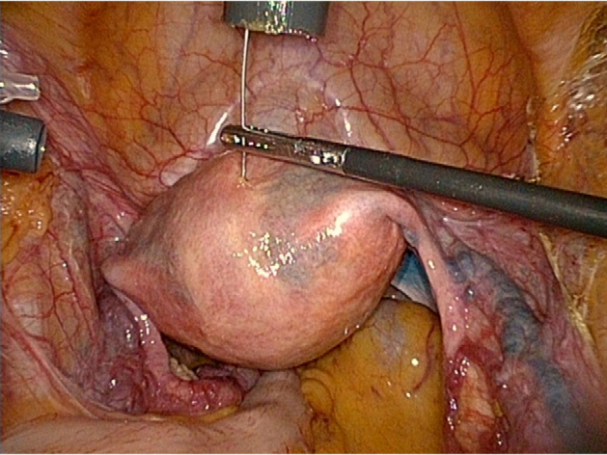
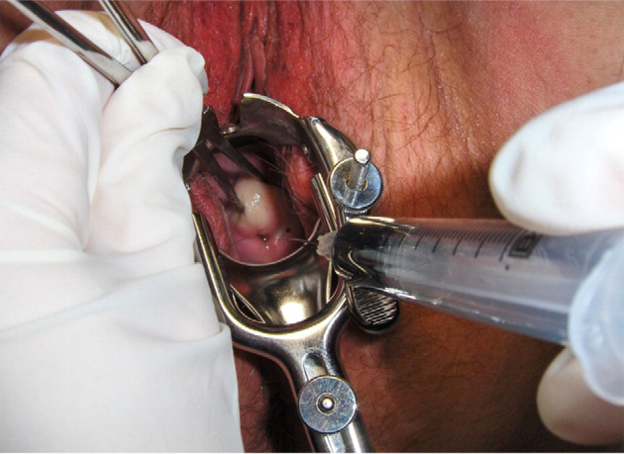
SN in endometrial Ca
blue dye (cervix)
Injection in anterior and posterior parts of uterus (laparoscopically)
Systematic lymphadenectomy in all patients

Slide 36
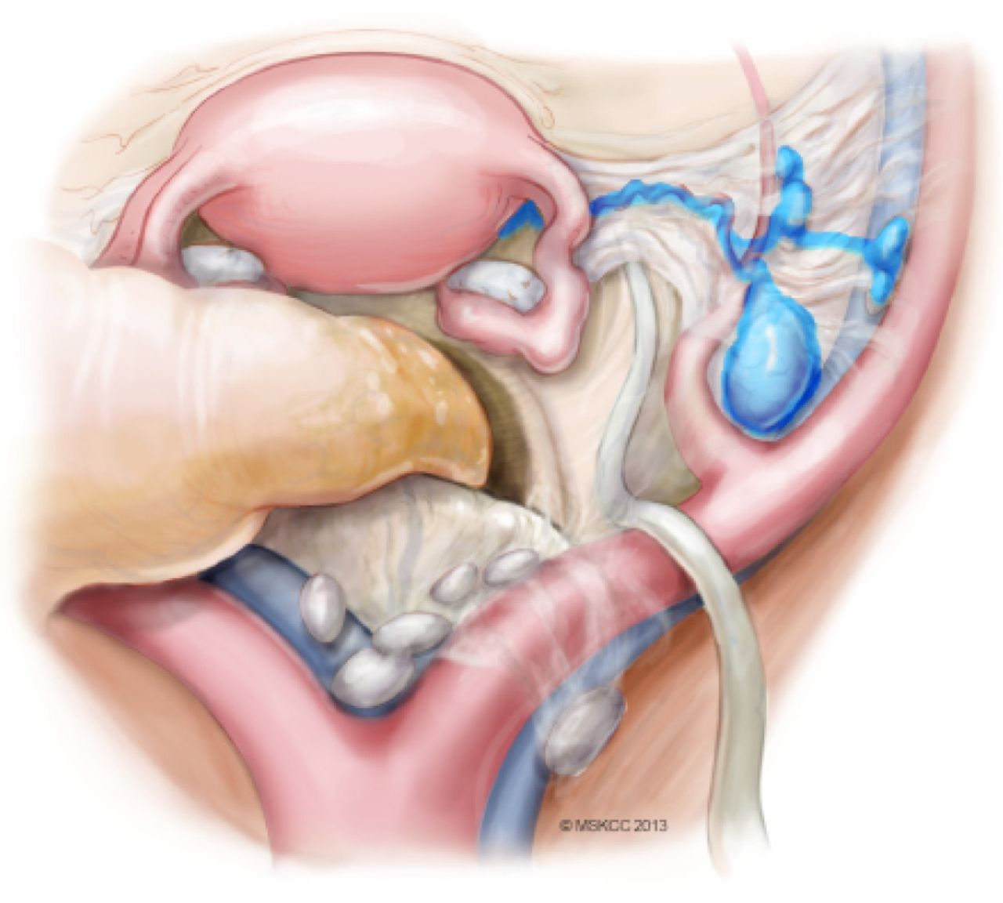

Slide 37
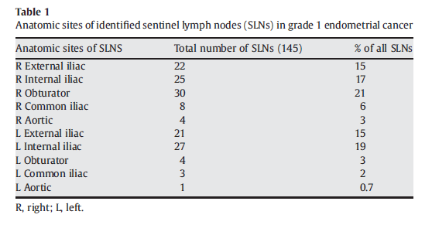
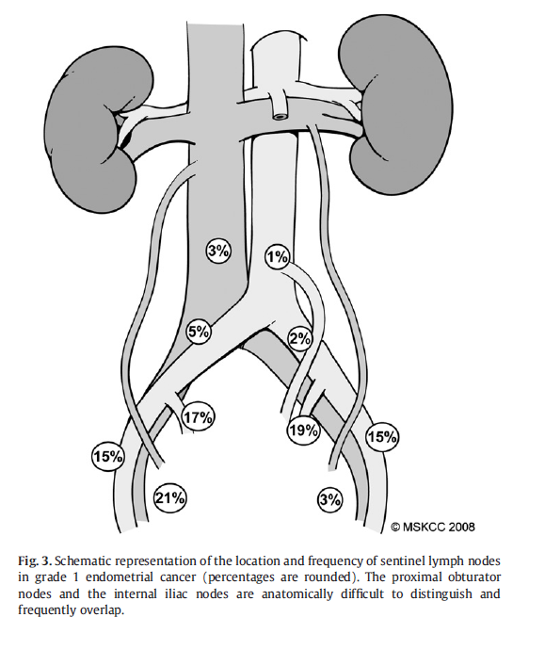
Topography of SN in endometrial Ca

Slide 38
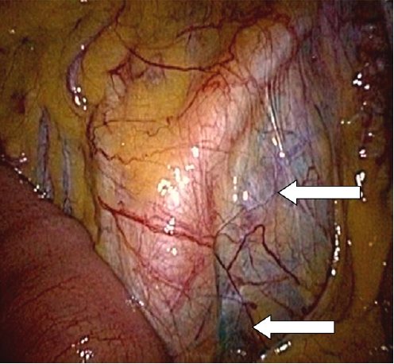
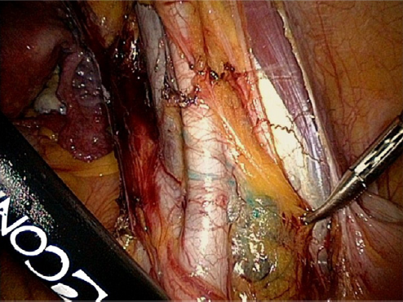

Slide 39
Conclusions – SN in endometrial Ca
Applicable mostly for St I (low-intermediate) pts to decrease morbidity
Debate for the site of injection
Need for more trials with ↑ number of patients

Slide 40
Surgery for stages III-IV
No RCT’s
MSKCC (1977-2003) 58pts
- 9(16%) no disease after surgery (OS: 42m)
- 11(19%) RD<1cm (OS: 19m)
- 32(55%) RD>1cm (OS: 19m)
- 6(10%) no cytoreduction attempted (OS: 2m)
Shih KK et al Gynecol Oncol 2011
In advanced stages of endometrial Ca complete cytoreduction to R0 should be attempted

Slide 41
Surgery for stages III-IV
Cytoreduction:
- improves performance status of the patient
- decreases the hypermetabolic burden of the disease
- improves vascularization and thus chemo effectiveness
- decreases the mutative potential which leads to chemo tolerance
Bristow R et al Gynecol Oncol 2000

Slide 42
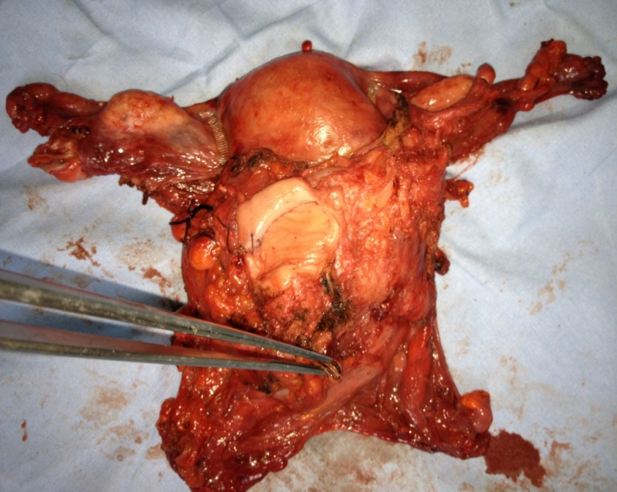
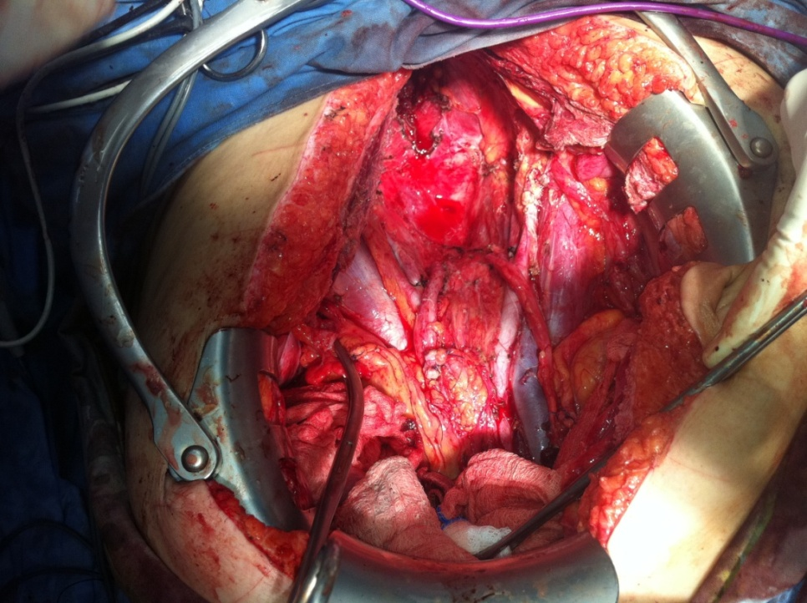
Surgery in recurrent endometrial Ca
Secondary debulking depends on:
- recurrence type (single lesion vs diffuse disease)
- ability to achieve R0
- time interval between primary surgery and recurrence
OS: 39-57 m following surgery
In pts after RTX and central pelvic disease: exenteration

Slide 43


