Slide 1
ISPP 2022 Annual Meeting
14-17 July 2022
Athens, Greece
Challenges, paradoxes, and the emotionality of democracy
Nicolas Demertzis
National Centre for Social Research (EKKE)
National and Kapodistrian University of Athens

Slide 2
Basic perspectives
the history of democracy is still being made
resists any sort of totalization, suture and closing-up
peaceful mediation of overt and covert societal conflicts
Theories/models (Schmidt 2000; Held 1996; Tilly 2007; Vanhanen 1997; Dahl 1971, 1998; Kean 2010)
methods addressing and assessing democracy (V-Dem Institute 2020; Freedom House 2022)
democracy is an essentially contested concept
democracy as a regime: relations between state and citizens (demos) as well as between state and organized political actors and stakeholders
Preliminary

Slide 3
Queries about democracy
“existential crisis of liberal democracy”, “decline of democracy”, “slow-motion death of democracy Era of Democratic Anxiety”
[Freedom House, V-Dem, Pew Research Center, and the Bertelsmann Stiftung ]
Marshall Plan for the recovery of Democracy
Challenge #1 : Democracy in the wane?

Slide 4
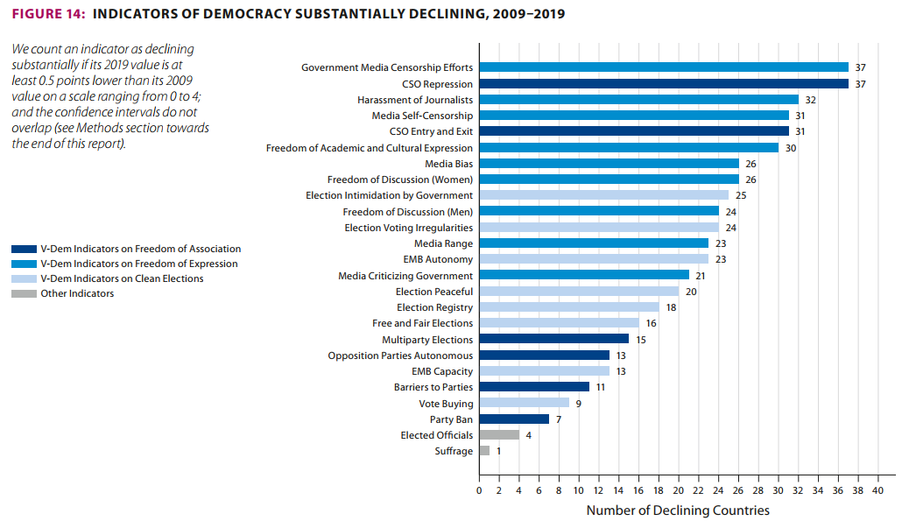
V- Dem

Slide 5
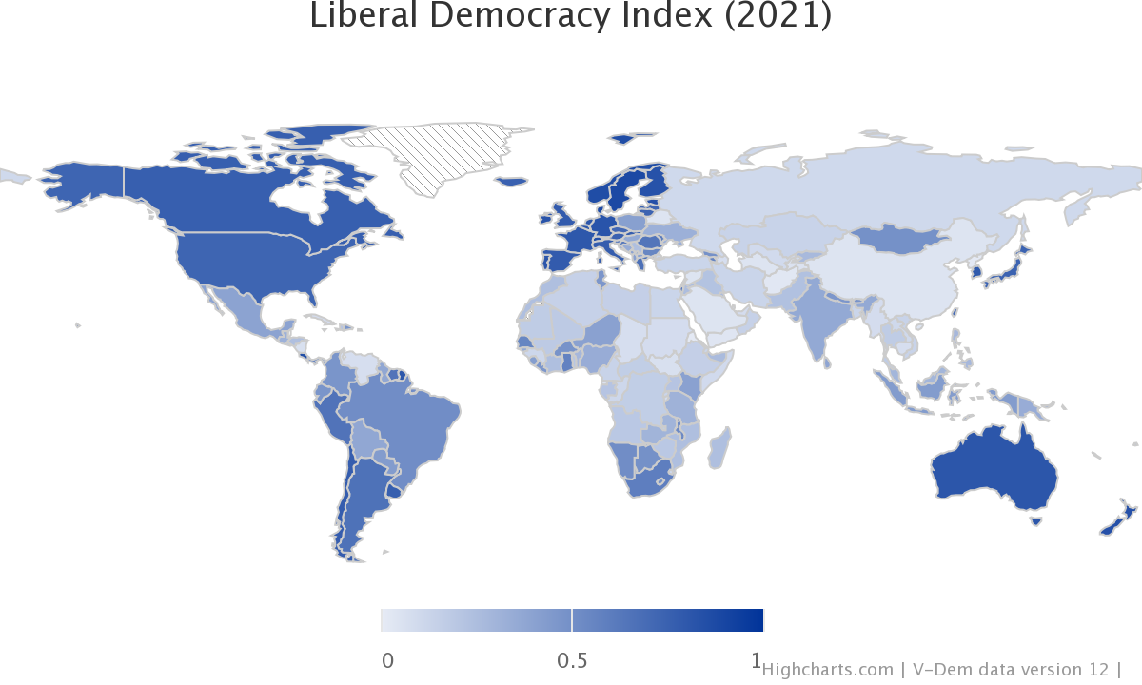

Slide 6
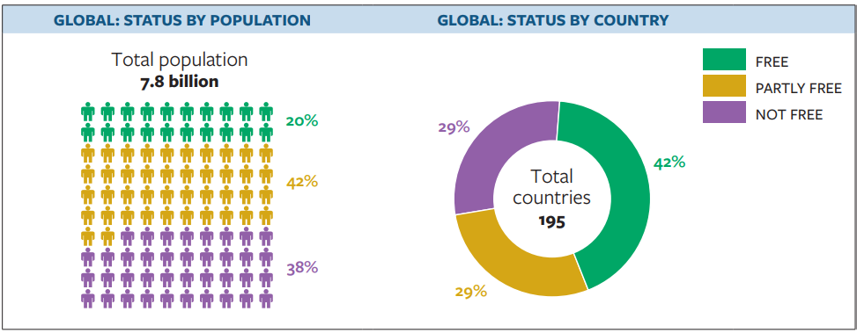
Freedom House (2022)

Slide 7
Old and new concerns
Marxist critique
Michels, Mosca, Pareto
“community of masses» Mills (1956)
«Manufactured Will» (Schumpeter 2003/1943)
“inverted totalitarianism” (Wolin 2008)
“post-democracy” (Crouch 2004)
“phantom democracy” (Bloggs 2011)
“competitive authoritarianism” (Levitsky and Way 2010)
“ “New Despotism” (Kean 2020)
authoritarian statism” (Poulantzas 1978)
Challenge #1: Democracy in the wane?

Slide 8
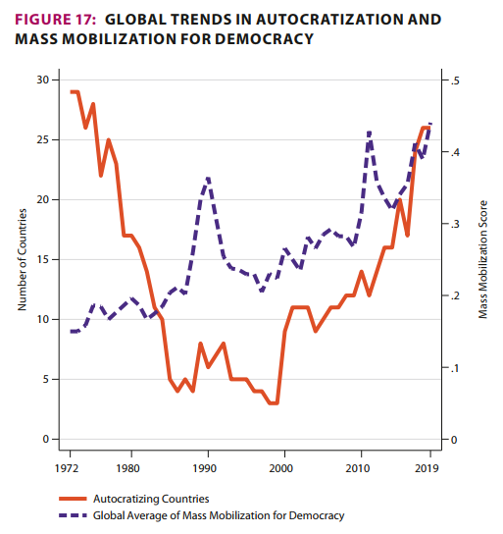
A third wave of autocratization ?
(V-DEM)

Slide 9
Old and new concerns
Marxist critique
Michels, Mosca, Pareto
“community of masses» Robert Michels (1915)
«Manufactured Will» (Schumpeter 2003/1943)
“inverted totalitarianism” (Wolin 2008)
“post-democracy” (Crouch 2004)
“phantom democracy” (Bloggs 2011)
“competitive authoritarianism” (Levitsky and Way 2010)
“ “New Despotism” (Kean 2020)
authoritarian statism” (Poulantzas 1978)
Challenge #1: Democracy in the wane?

Slide 10

Stacey Abrams (former senior state legislator and key voting rights activist)
“in the USA 600 bills undermining minority votes and voices are moving through 48 states”
(https://www.nytimes.com/2021/10/07/world/stacey-abrams-vote-right.html).

Slide 11
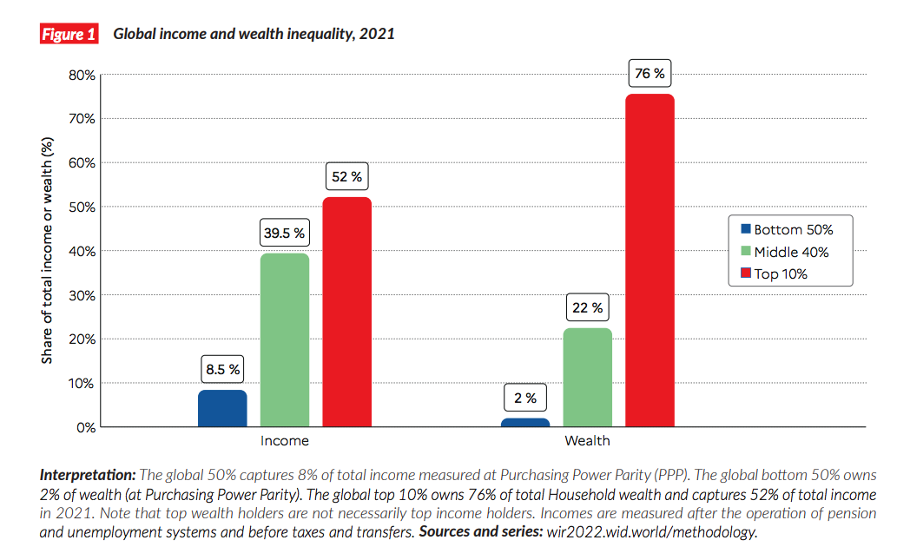
The richest 10% of the global population currently take 52% of global income
Bases of injustice and grievance politics
Challenge #2: Discrepancy between political and socio-economic equality

Slide 12

felt social injustice and victimization
Discontent, disillusionment, distrust, anger, hopelessness, low internal and external efficacy, political apathy and alienation.
Ressentiment : Unpleasant complex moral
sentiment with no specific addressees,
experienced by relegated individuals
including a chronic reliving of
repressed and endless vengeance,
hostility, hatred, envy, Schadenfreude,
and resentment due to the powerlessness
of the subject in expressing them, and
resulting, at the level of moral values,
in the disavowal of what is unconsciously
desired.

Slide 13
(political) cynicism as an emotional climate not reduced to distrust
sarcasm, irony, mocking, nihilism, bad faith, aloofness, resignation, indignation, fatalism, hopelessness, and powerlessness.
legitimation through disbelief
Goldfarb (1991)

Slide 14
Infodemic / Post-truth
Challenge #3: The crisis of public knowledge and public communication

Slide 15
The iron cage of digital era
GAFAM (Google, Amazon, Facebook, Apple, and Microsoft)
affinity profiling
surveillance advertising
surveillance capitalism/platform capitalism’ - dataveillance and the datafication of society (Srnicek 2017; Zuboff 2021)
privacy paradox (Norberg et al. 2007)

Slide 16
Era of unpeace
Mark Leonard (2021)
Challenge #4: New world war confrontation
intertwining of natural disasters, disease, poverty, climate change and war
“new wars” (Kaldor 2006; Münkler 2003)
“moral tribes” (Haidt 2013)
“political tribalism” (Krekó 2021)
authoritarian reflexes (Inglehart 1997)

Slide 17
Freedom vs equality (Bobbio 199; Macpherson 1977; Mouffe 2000)
Illiberal values vs desire for democracy (Welzel & Kirsch 2017; Kruse, Ravlik & Welzel 2017; Welzel and Moreno Alvarez 2014)
The “tripling” of the citizen (Aglietta 2000; Katsoulis 2012)
Paradoxes in democracy

Slide 18
Basic tenets about democracy and its future
open-ended political project wavering between democratization and de-democratization (Tilly 2007).
neo-liberalism is at pains to fulfil its promises regarding the satisfaction of citizens’ needs, demands and preferences
Need for lowering wealth disparities and redistribution of esteem premised on equal opportunities but and equal conditions (Sandel 2020)
as democrats we have to rapport with ambivalence, ambiguity and undecidability
“emotional public sphere” and “parliament of feelings” (Richards 2007)
Towards
an appraisal

Slide 19
Democratic emotional reflexivity I
The freedom which we enjoy in our government extends also to our ordinary life. There, far from exercising a jealous surveillance over each other, we do not feel called upon to be angry with our neighbour for doing what he likes, or even to indulge in those injurious looks which cannot fail to be offensive, although they inflict no positive penalty. But all this ease in our private relations does not make us lawless as citizens. Against this fear is our chief safeguard, teaching us to obey the magistrates and the laws, particularly such as regard the protection of the injured, whether they are actually on the statute book, or belong to that code which, although unwritten, yet cannot be broken without acknowledged disgrace.
Pericles’ Epitaph
430 BC

Slide 20
The emotional regime of democracy
feeling rules facilitating the combination of closeness and distance, phronesis and pathos, toleration and solidarity
Bringing back the republican virtues of toleration, humility, dignity of work, solidarity, and justice
democratic emotionality vis-à-vis demagogic emotional manipulation- emotional public sphere (Richards 2007)
democracy is the regime that we do not love albeit we cannot but want it
Wendy Brown (2007); Revault d’ Allonnes (2010)
demokratische Sittlichkeit
Wellmer (2001)
Against post-modern ‘emocracy’

