Slide 1
SUMMER SCHOOL ON REFUGEE AND MIGRATION STUDIES 2022
19 July 2022
The refugee problem as a social construction: An agenda theory perspective
Nicolas Demertzis
National Centre for Social Research (EKKE)
National and Kapodistrian University of Athens

Slide 2
Social Construction of Reality
Thomas theorem : “If men define situations as real, they are real in their consequences” (Thomas and Thomas 1928).
Peter Berger and Thomas Luckmann (1966): society is created by humans and human interaction = habitualization - we construct our own society but we also accept it as it is because others have created it before us (moral codes and social norms).
Social constructionism : discursive constitution of social reality – social reality is independent of each particular individual but not external or extrinsic ort exogenous to her

Slide 3
FRAMING
Erving Goffman (1974). Frame Analysis. An essay on the organization of experience
Frame analysis is about how we make sense of things. How we understand “what is going on?” This process involves framing, which is the application of certain cognitive procedures onto given situations.

Slide 4
Framing R. Entman (1993)
To frame is to select some aspects of a perceived reality and make them more salient in a communicating text, in such a way as to promote a particular problem definition, causal interpretation, moral evaluation, and/or treatment recommendation for the item described.

Slide 5
Media Frames Typologies I
Master frames – generic frames
broad interpretations of reality e.g., politics as a game, democracy as a way of human association
Subframes – issue specific frames
lower-ranged interpretations of reality specifying mega frames; e.g., politics as horse-race or strategy

Slide 6
Media Frames Typologies II
(Iyengar 1991)
The thematic news frame, by contrast, depicts political issues more broadly and abstractly by placing them in some appropriate context-historical, geographical, or otherwise. A thematic report on poverty might present information about recent trends in the rate of poverty and the areas with the greatest concentration of poor people.
The episodic news frame depicts issues in terms of specific instances- for example, a terrorist bombing, a homeless person, or a case of illegal drug usage. Episodic reports are essentially illustrations of issues.

Slide 7
Media Frames Typologies III
(Semetko and Valkenburg 2000)
Conflict frame. This frame emphasizes conflict between individuals, groups, or institutions as a means of capturing audience interest.
Human interest frame. This frame brings a human face or an emotional angle to the presentation of an event, issue, or problem.
Economic consequences frame. This frame reports an event, problem, or issue in terms of the consequences it will have economically on an individual, group, institution, region, or country.
Morality frame. This frame puts the event, problem, or issue in the context of religious tenets or moral prescriptions.
Responsibility frame. This frame presents an issue or problem in such a way as to attribute responsibility for its cause or solution to either the government or to an individual or group.

Slide 8
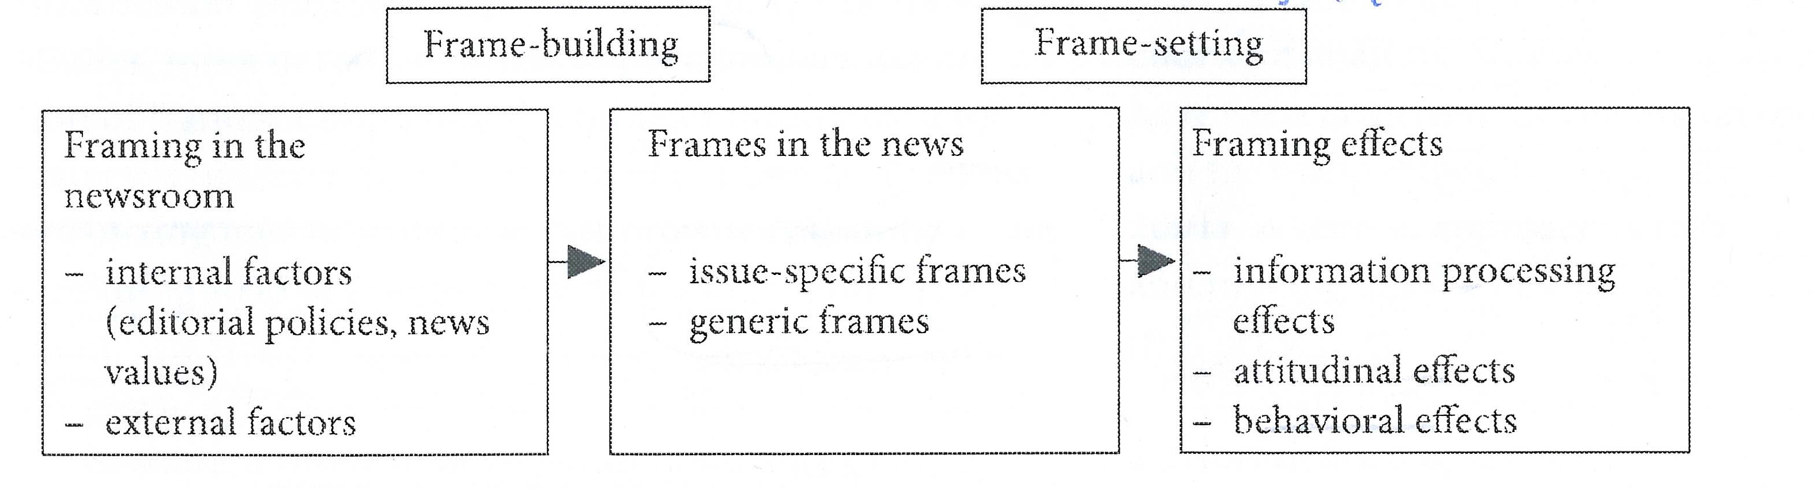

Slide 9
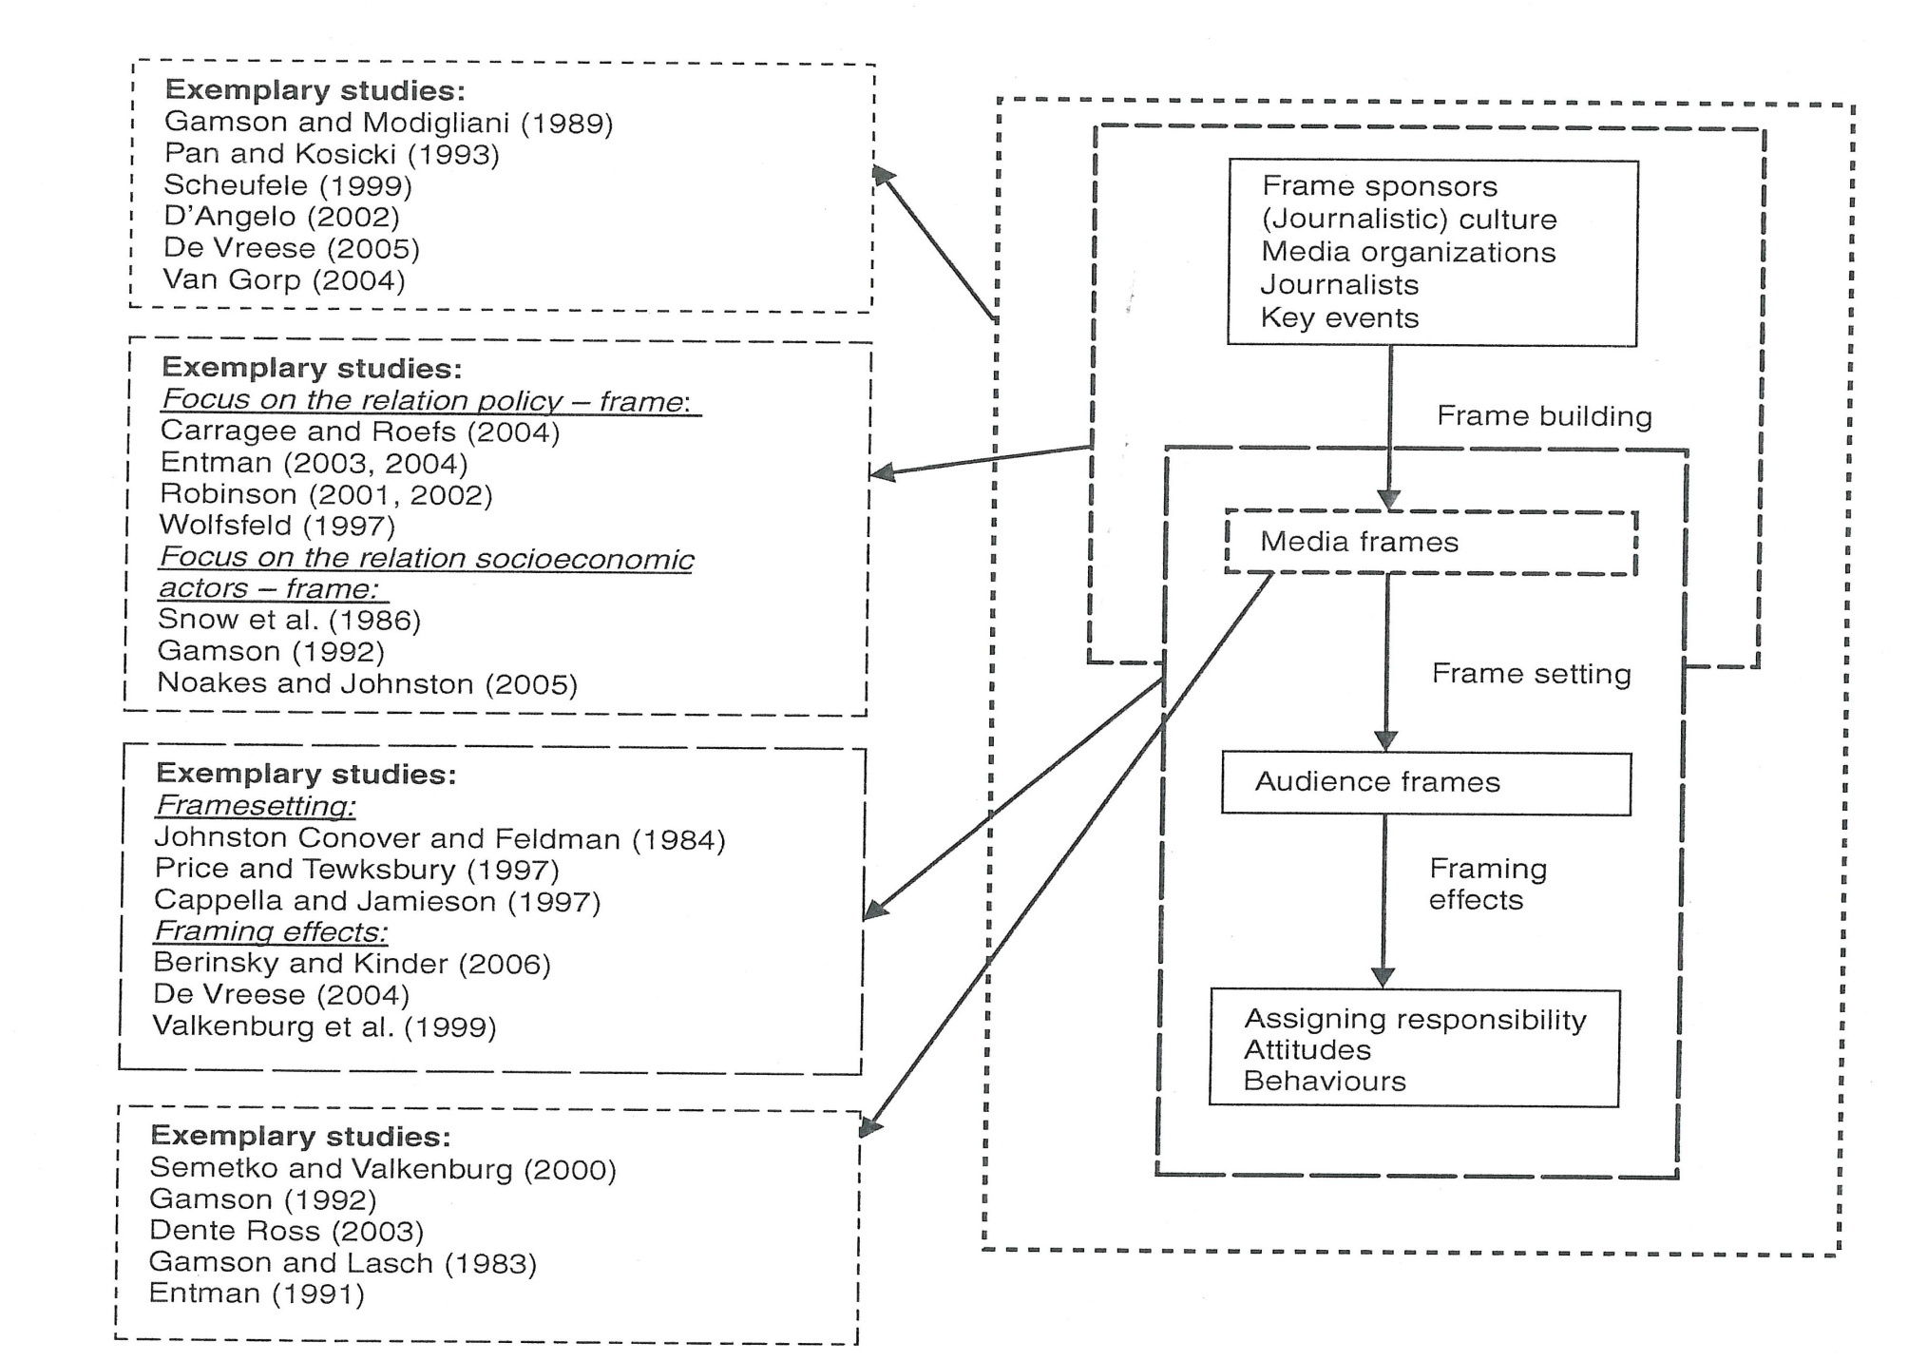
Examples of frames and media framing

Slide 10
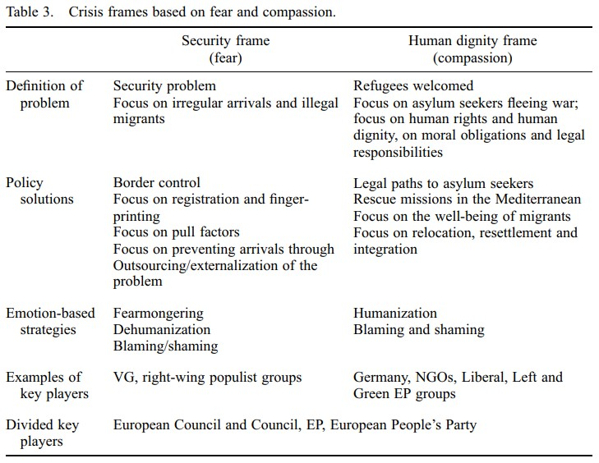
Rosa M. Sanchez Salgado (2021): Emotions in the European Union's decision making: the reform of the Dublin System in the context of the refugee crisis, Innovation: The European Journal of Social Science Research, DOI: 10.1080/13511610.2021.1968355

Slide 11
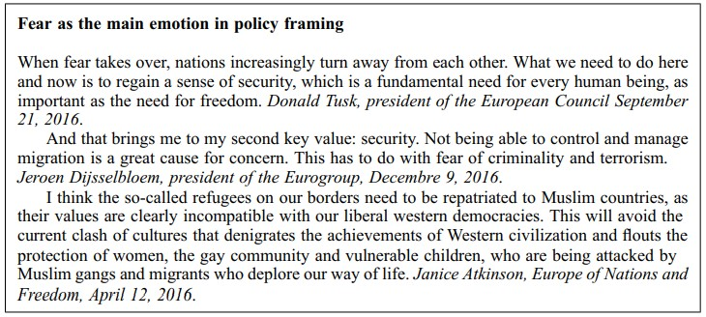
Rosa M. Sanchez Salgado (2021): Emotions in the European Union's decision making: the reform of the Dublin System in the context of the refugee crisis, Innovation: The European Journal of Social Science Research, DOI: 10.1080/13511610.2021.1968355

Slide 12
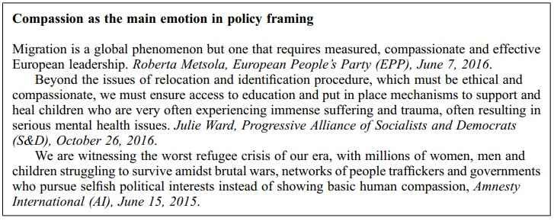
Rosa M. Sanchez Salgado (2021): Emotions in the European Union's decision making: the reform of the Dublin System in the context of the refugee crisis, Innovation: The European Journal of Social Science Research, DOI: 10.1080/13511610.2021.1968355

Slide 13
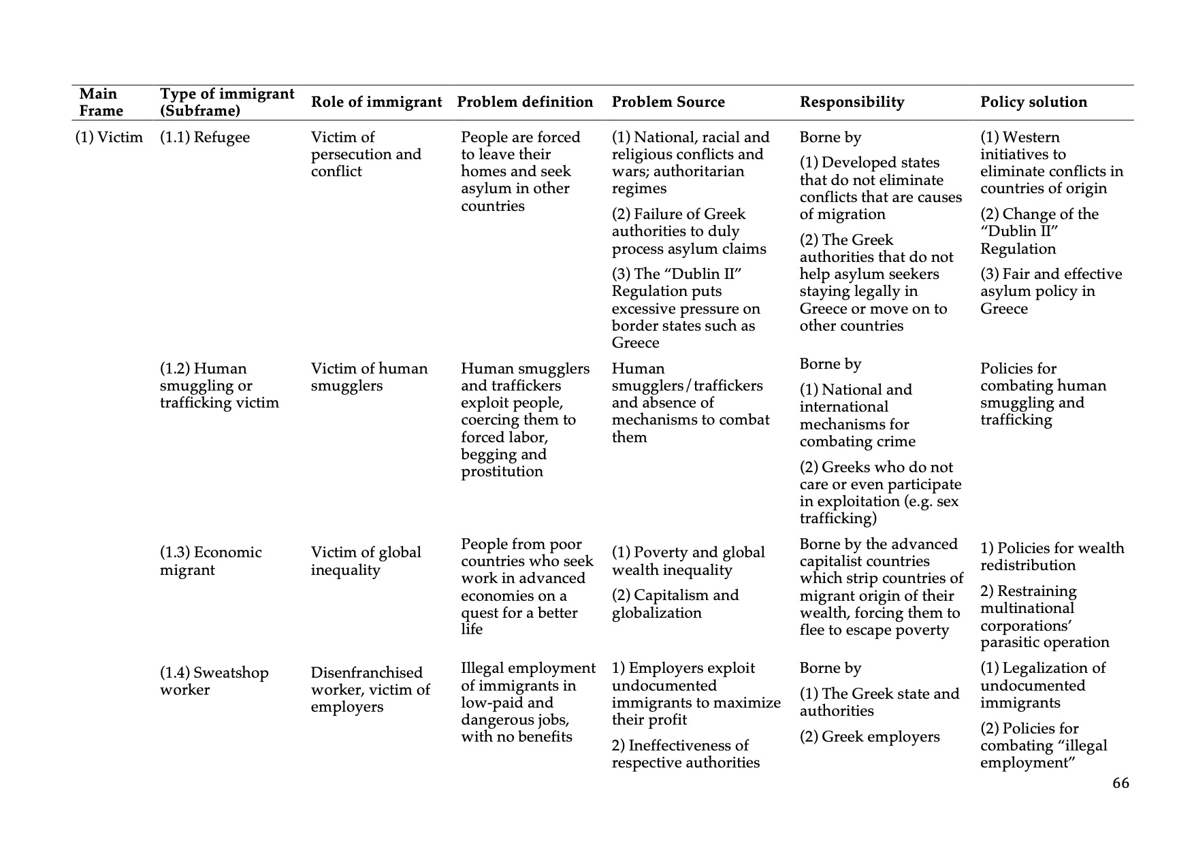
Milioni, Dimitra L. & Konstantinos Vadratsikas (2016). The (golden) dawn of audiences? Assessing the audience empowerment thesis through a framing analysis of immigration in the Greek media. Interactions: Studies in Communication & Culture, 7(1) 59-83, doi: 10.1386/iscc.7.1.59_1.

Slide 14
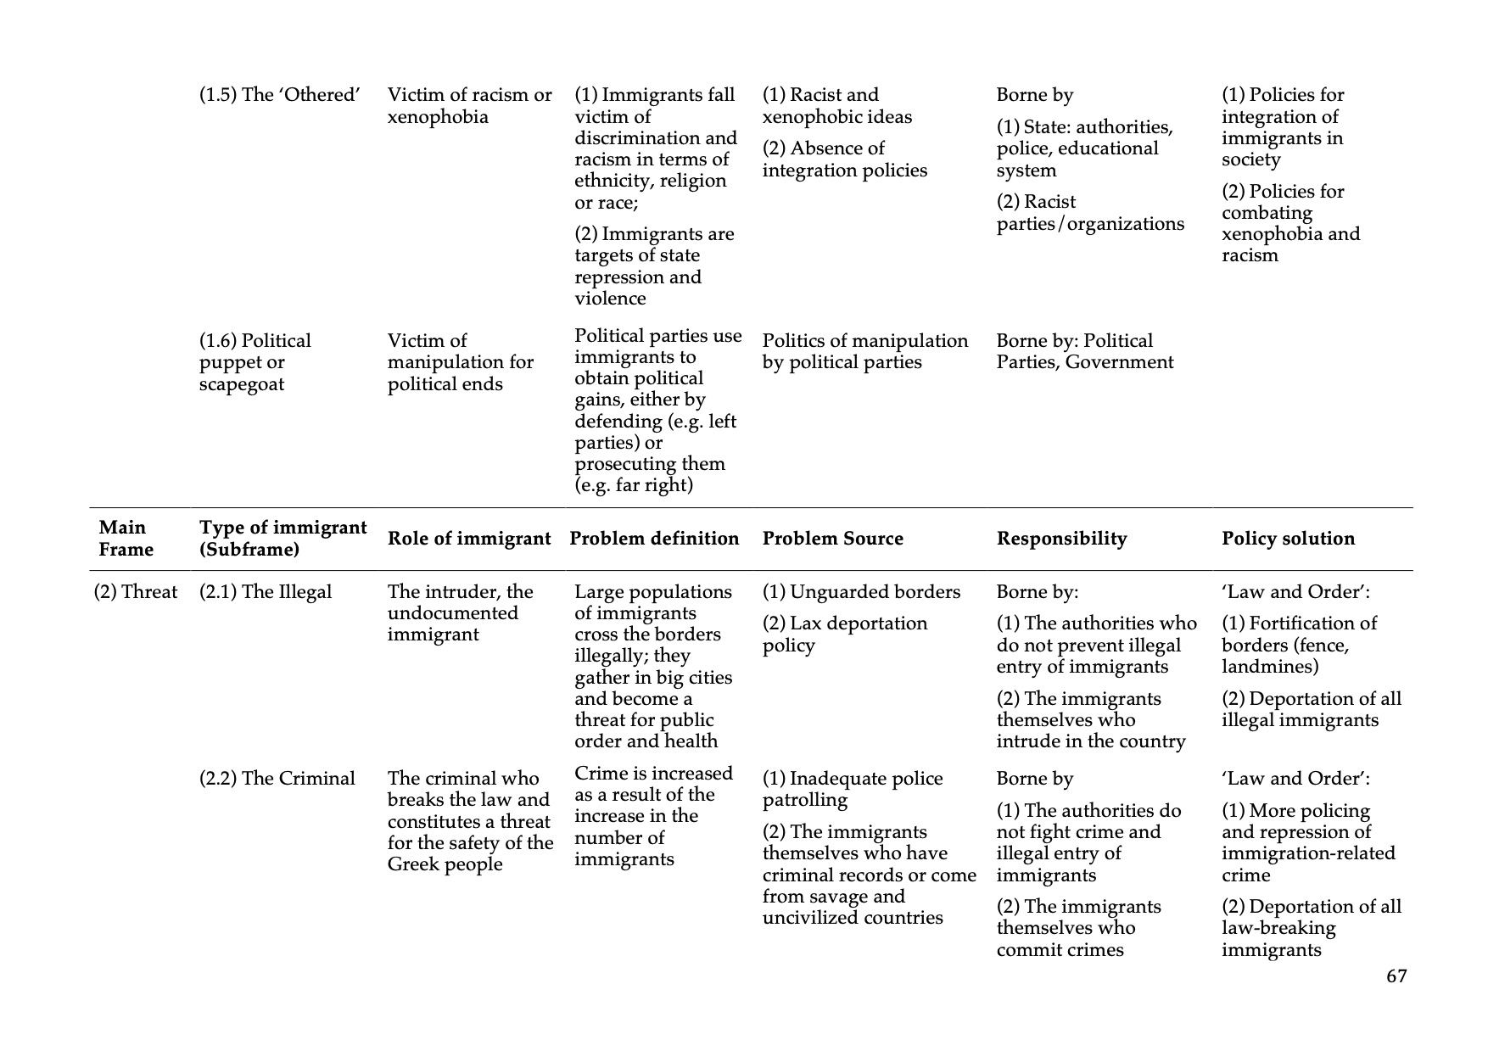

Slide 15
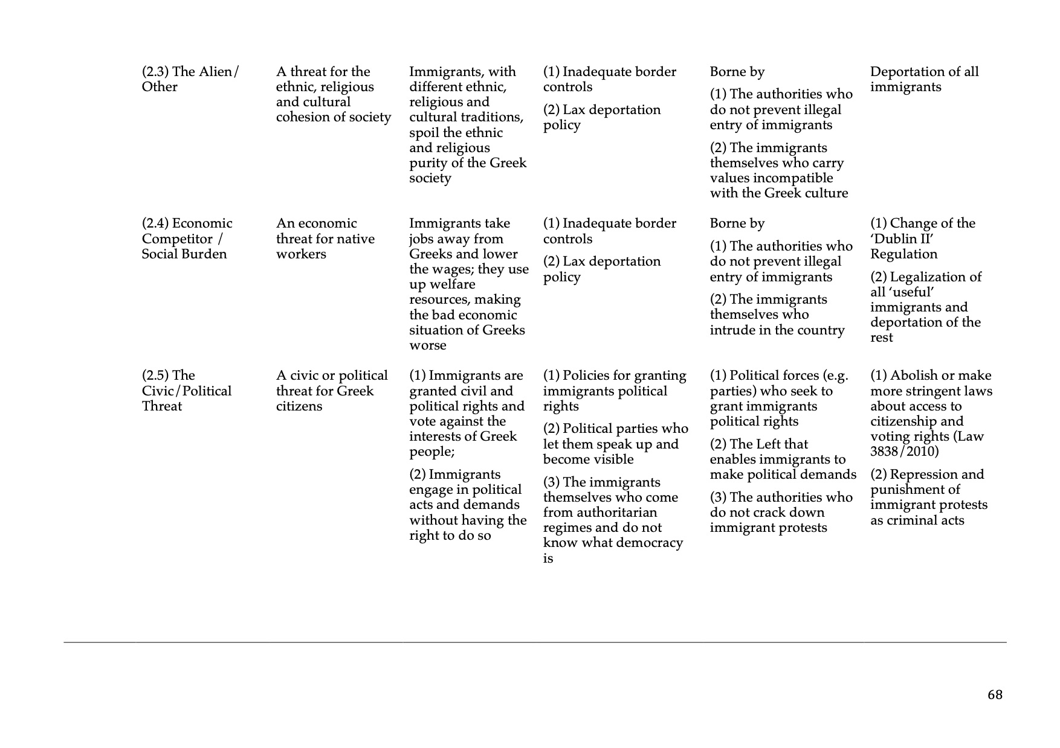

Slide 16
