Slide 1
Nationhood: Εθνικισμός, Εθνική ταυτότητα και ΜΜΕ
Δρ. Δέσποινα Χρονάκη

Slide 2
To begin with….
Αθήνα 2004
2000 and 4 - ...is Athens
My number 1
LocoMondo Goal

Slide 3
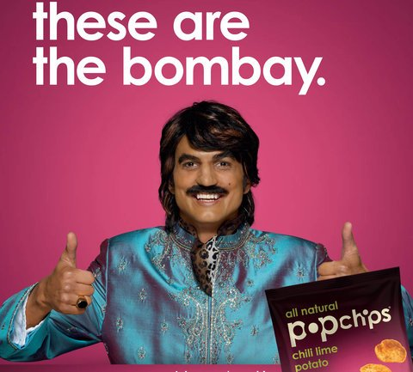

Nation and national identity in ads
Amita Πρωινό

Slide 4


Nation is calling...(Mondo)

Slide 5


Slide 6
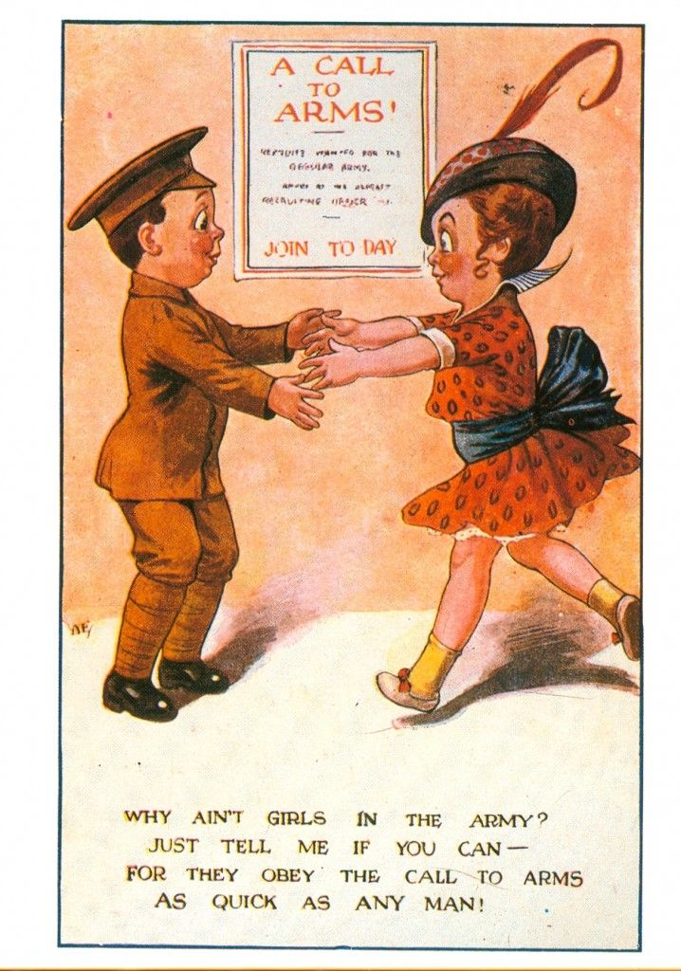

Nation is calling … World War I post cards

Slide 7

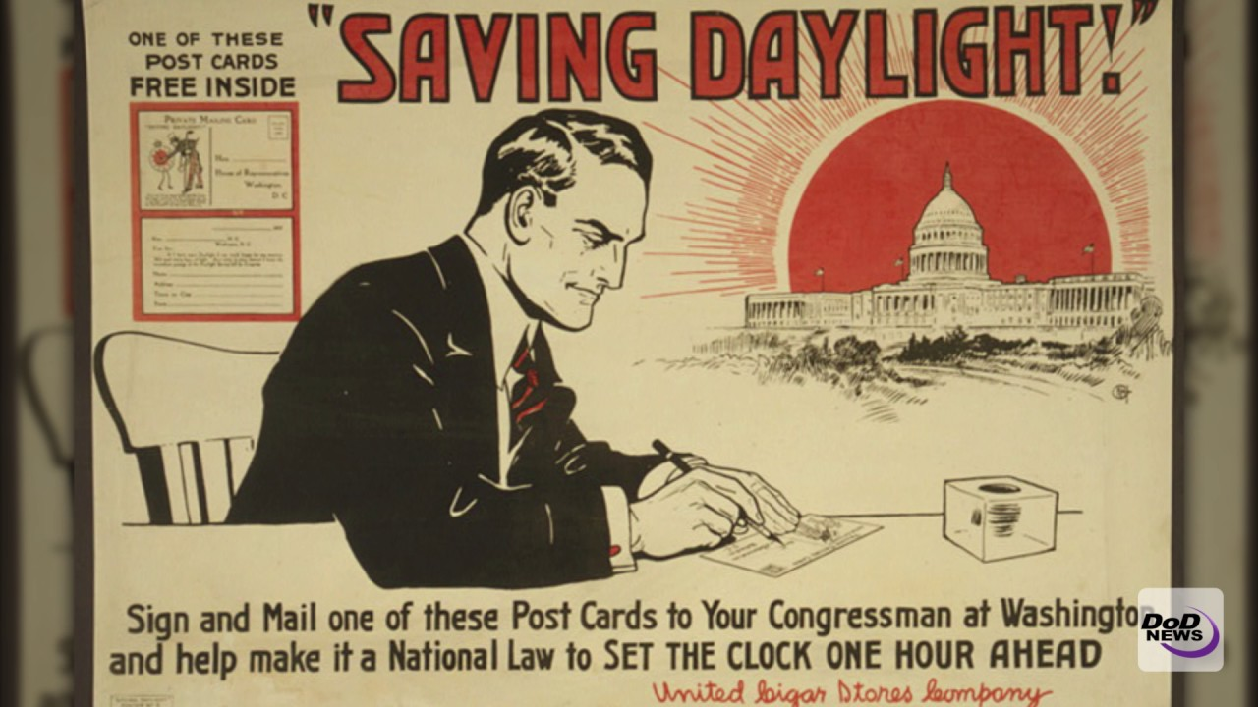
Peace eras…US

Slide 8
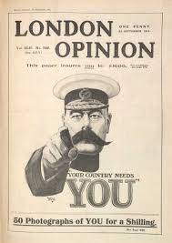

Something from the UK (World War I)

Slide 9


Europe against Nazism and the power of the Imperial Britain (World War II)

Slide 10

Cool Britannia

Slide 11
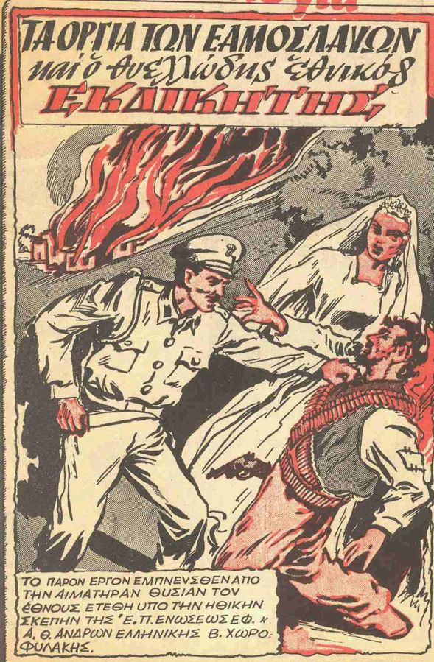
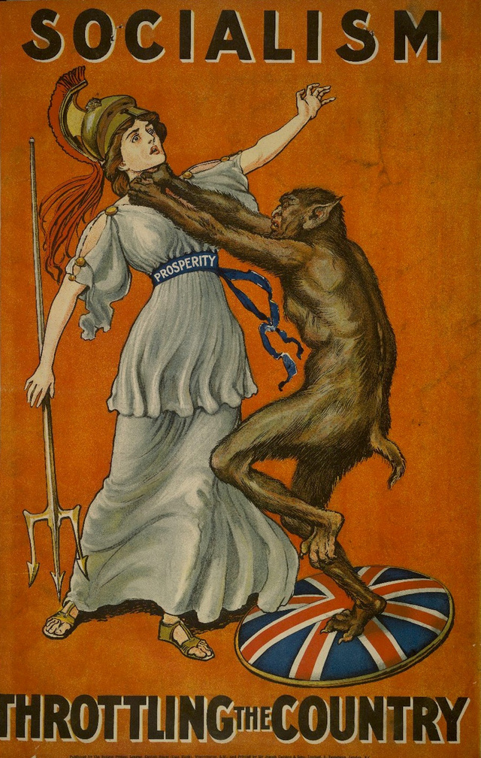
Σε ελληνικό κόντεξτ

Slide 12


Σε ελληνικό κόντεξτ

Slide 13
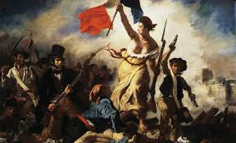


The gendered aspect of nationhood

Slide 14
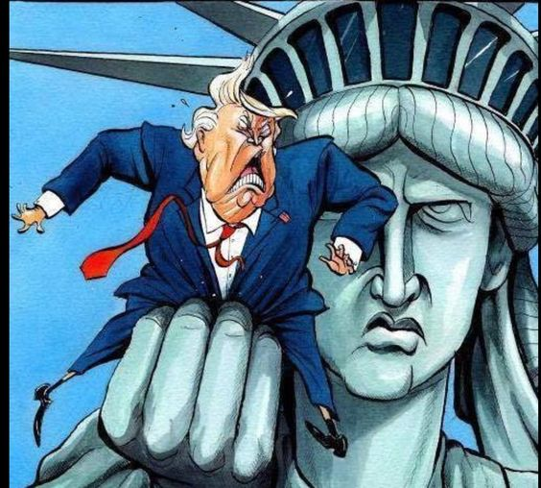
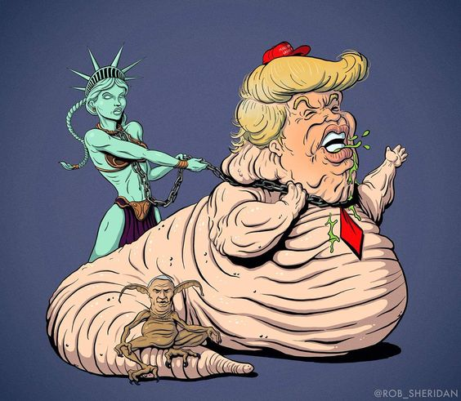
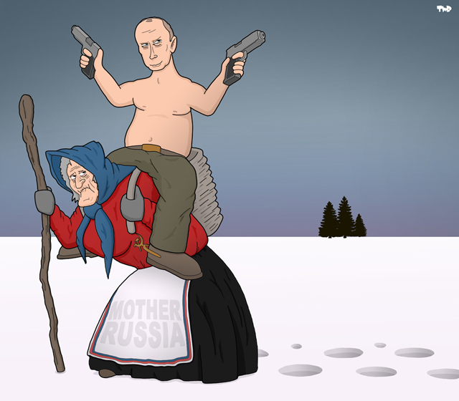
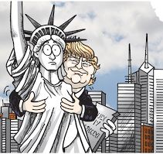
The gendered aspect of nationhood

Slide 15
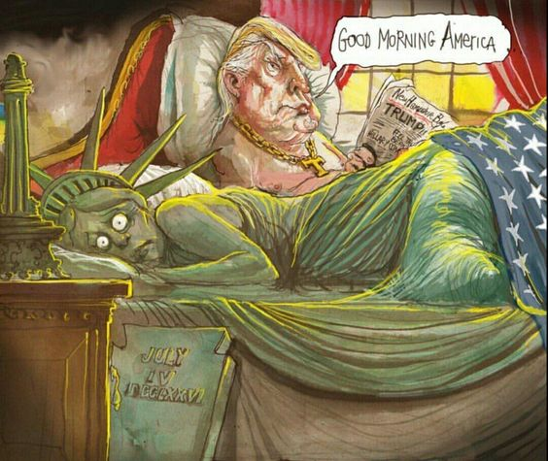
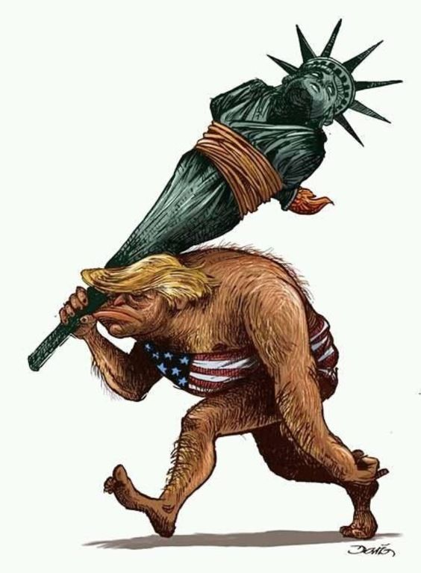
The gendered aspect of nationhood

Slide 16
Nation Branding
Incredible India
Cyprus in your heart
Live your myth in Greece

Slide 17


Euro 2004: Reconstructing national identity
https://www.youtube.com/watch?v=E4mdrjzheuE
https://www.youtube.com/watch?v=KOdO4IbLFbM

Slide 18
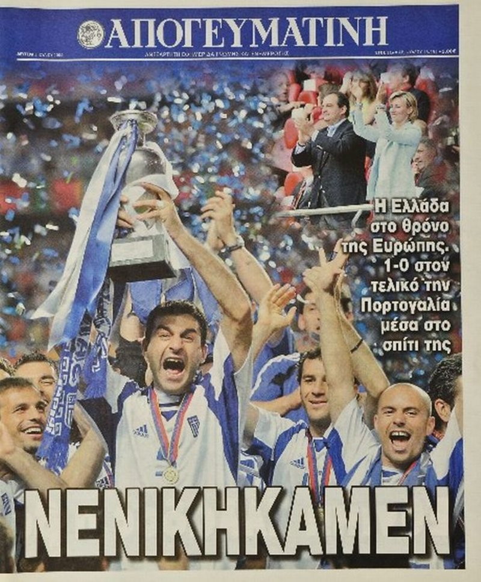

Euro 2004: Reconstructing the national identity

Slide 19
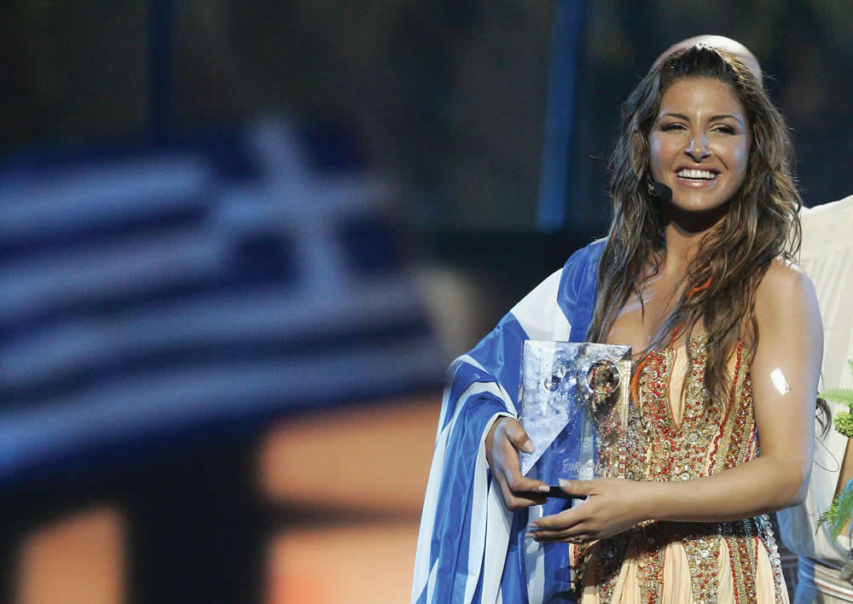
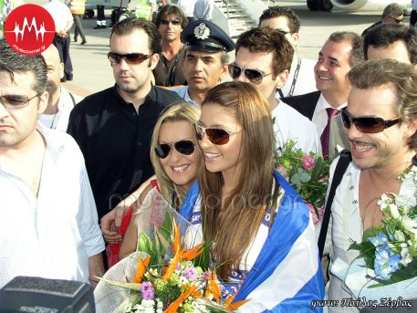
Eurovision 2005
You ‘re my number one

