Slide 1
Digital Storytelling
Professor Michel Meimaris
Director, New Technologies Laboratory
Faculty of Communication and Media Studies
University of Athens

Slide 2
Tous nous avons une histoire,
Tous nous ecrivons une histoire,
Tous nous sommes une histoire
“…life must be lived forwards but can only be understood backwards”
Søren Kierkegaard

Slide 3
Storytelling
« Innombrables sont les récits du monde...
» Sous ses formes presque infinies le récit est présent dans tous les temps, dans tous les lieux, dans toutes les sociétés il n'y a pas, il n'y a jamais eu nulle part aucun peuple sans récit. [...] Toutes les classes, tous les groupes humains ont leurs récits, et bien souvent ces récits sont goûtés en commun par des hommes de cultures différentes, voire opposées : le récit se moque de la bonne et de la mauvaise littérature : international, transhistorique, transculturel,
le récit est là comme la vie. »
Roland Barthes (1981) Introduction a l’ analyse structurale du recit , Seuil

Slide 4
Introduction
Journalism
Conclusions
Marketing
Culture
Education
Games
Storytelling

Slide 5
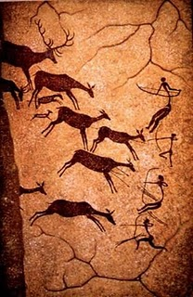
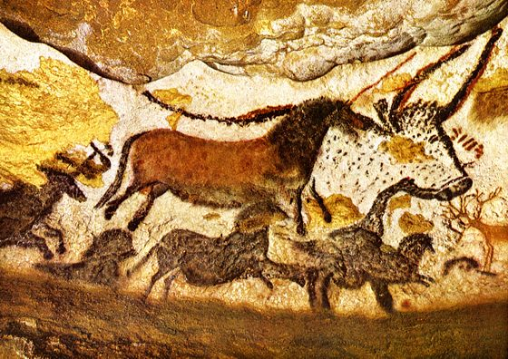
Lascaux cave, France

Slide 6
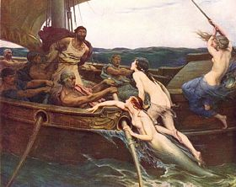
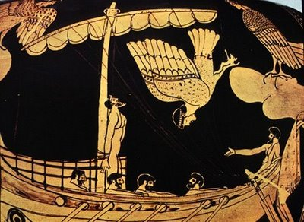
Odysseus and the sirens, Herbert James Draper, 1909
Ferens Art Gallery, Hull

Slide 7

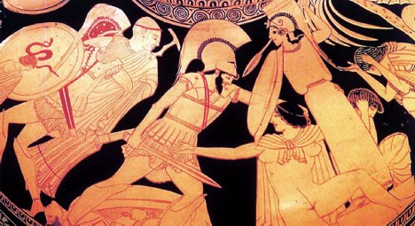

Slide 8

Mahabharata
Ancient India, like ancient Greece, boasts of two great Epics.
One of them, the Mahabharata, relates to a great war in which all the warlike races of Northern India took a share.

Slide 9

Beowulf
Old English heroic epic poem
8^{th-} 11th century
Unknown author

Slide 10

Epic of Gilgamesh
2500 b.c.

Slide 11
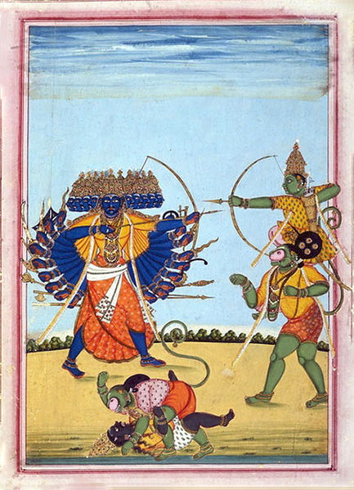
Ramayana
5 th b.c. – 3rd a.c.

Slide 12

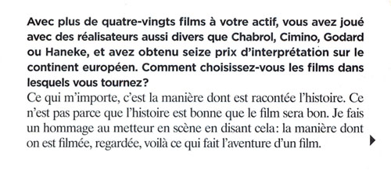

Slide 13




Slide 14
George Brassens “Dans l’eau de la claire fontaine” (1)
Big Fish (trailer) (2)
Obama’s speech (3)

Slide 15
Blogs

Slide 16
Perezhilton
Once called 'Hollywood's most hated website', Perezhilton (authored by Mario Lavandeira since 2005) is the gossip site celebrities fear most. Mario, 29, is famous for scrawling rude things over paparazzi photos and outing closeted stars.
Lavandeira is considered as one of the most powerful opinion leaders –as far as the star system is considered. His reality show premiered in 2008, and his blogsite is peppered with snaps of him cuddling Paris Hilton at premieres.

Slide 17
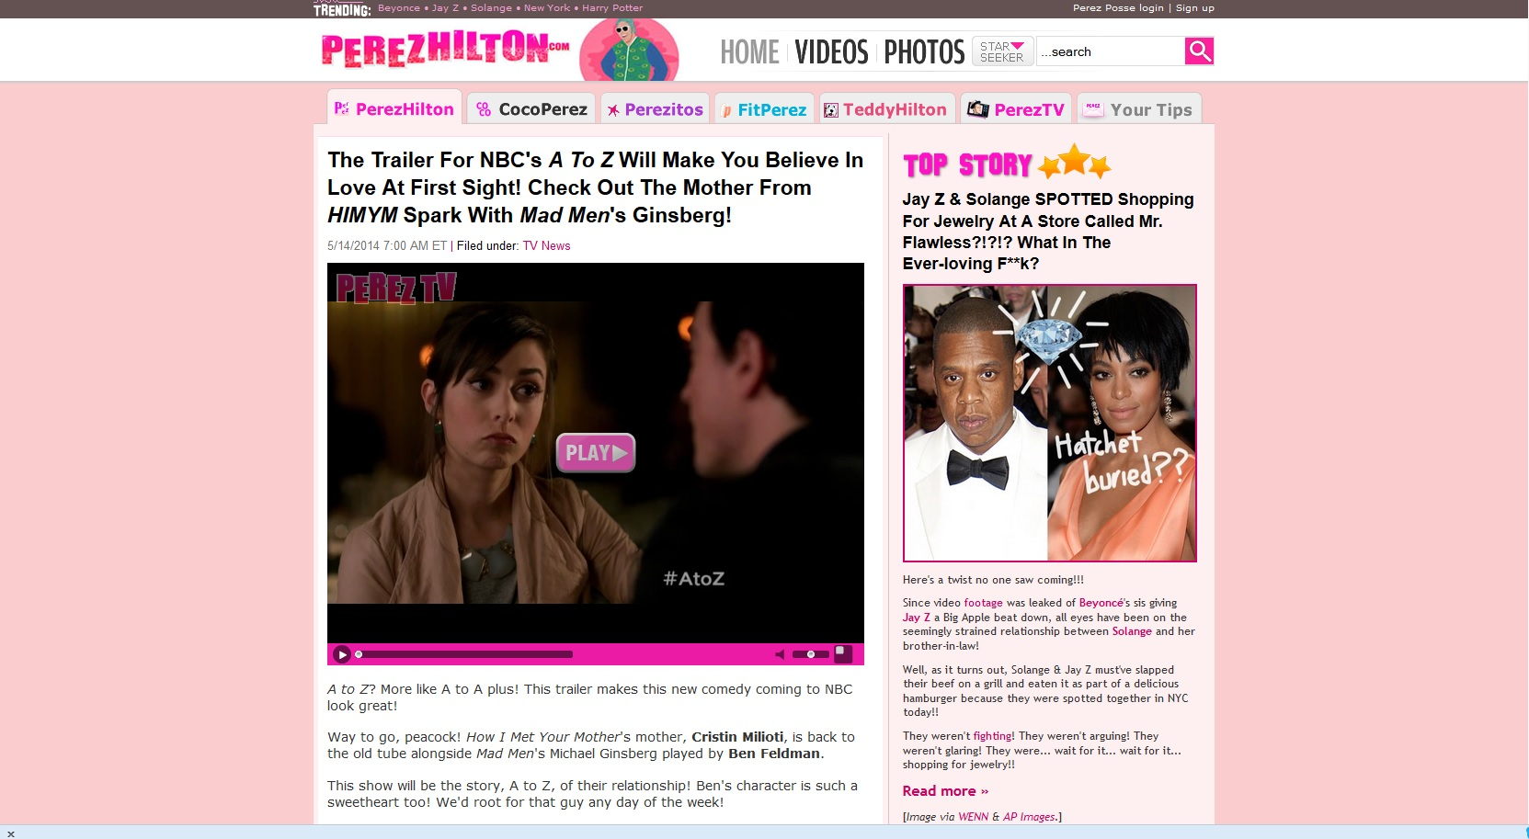
http://perezhilton.com/

Slide 18
Treehugger
Treehugger is a green consumer blog with a mission to bring a sustainable lifestyle to the masses. Its ethos, that a green lifestyle does not have to mean sacrifice, and its positive, upbeat feel have attracted over 1.8m unique users a month.
Treehugger began as an MBA class project six years ago and says it now generates enough revenue from sponsorship and advertising to pay all its staffers and writers. It has developed a highly engaged community and has added popular services like TreeHugger.tv, and a user-generated blog, Hugg. It was bought by the Discovery Channel last year for a rumoured $10m.

Slide 19
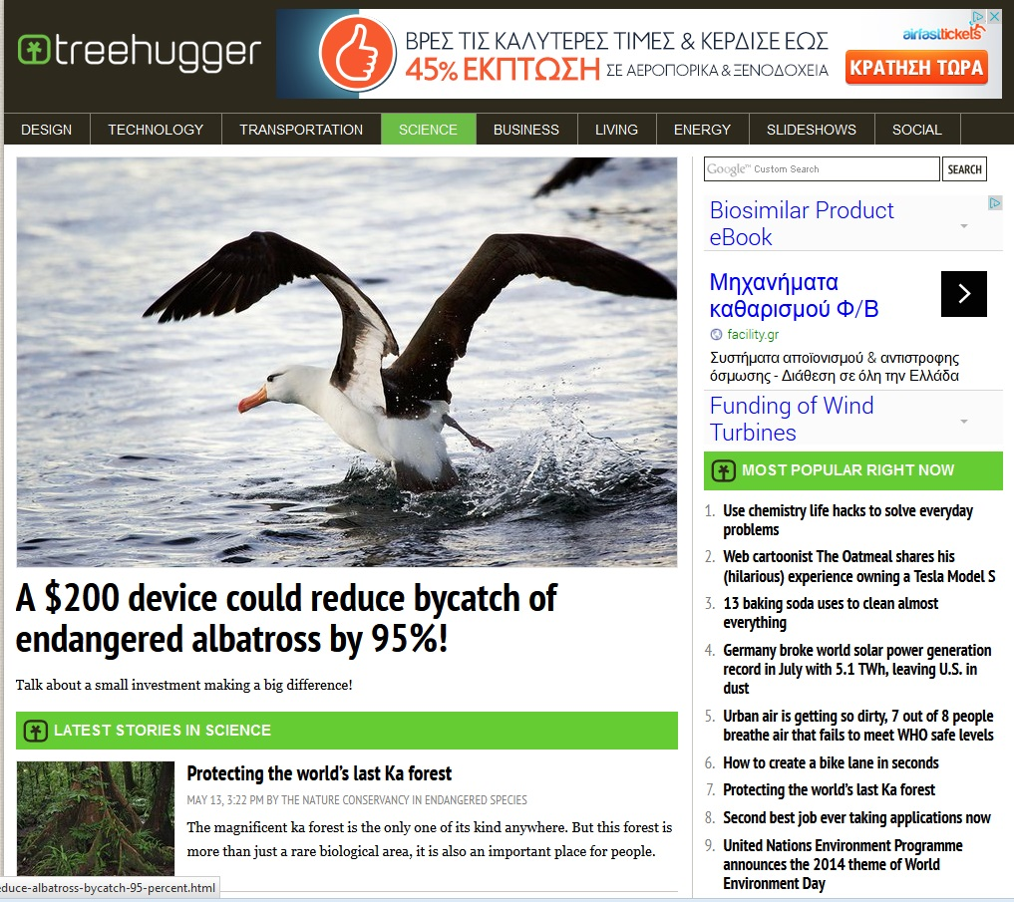
http://www.treehugger.com/

Slide 20
Digital storytelling
An open-end definition
An education oriented definition
Ιt is an interactive experience that reaches its audience through digital technology.
Interactivity + Entertainment
Ιt is a movement which defined digital storytelling as a narrated piece of personal writing, still images, video and musical soundtrack.
Personal expression

Slide 21


Center of Digital Storytelling http://www.storycenter.org/
Defined digital storytelling as a means of personal expression and fulfillment, as an act of communication using digital technology.
Encouraging people in artistic self-expression can inspire individual and community transformation.

Slide 22
Sharing stories
internet
social media
local communities
the sharing of stories
has the power to make a real difference
http://silencespeaks.org/

Slide 23
Beyond the Dirty Window
http://vimeo.com/8786868
A story from Leah Harris about mental health recovery.
About overcoming a legacy of oppression.
About reclaiming her life and defining herself on her own terms.
About being part of a global movement working for rights, dignity, and justice for people labeled with mental illness, mad people, and people living with emotional distress.

Slide 24
The story of the Center
The Creative Wave
Artists explore new software and users have new access to media production
The Literacy Wave
ICT discovers DST as an engaging tool for computer literacy

Slide 25
The story of the Center
The Methodological Wave
Facilitation method formalized
BBC Wales Project
The Ethos Wave
Silence Speaks and Ethics of Participatory Media
Purposing of Media Practices for Mindful Awareness

Slide 26
Digital Storytelling workshop

Slide 27
Interactive experience
Long before digital world, human beings all over the world devised and participated in interactive storytelling experiences through linear forms of expression
Books
Homer (8th b.c.) Odyssey
James Joyce (1882-1941) :Ulysses
Theatre
Pirandello(1867-1936):Six Characters in Search of an Author

Slide 28



Interactive experience in a linear medium
Run Lola Run (4)
Sliding Doors (4)
Rashomon (4)

Slide 29
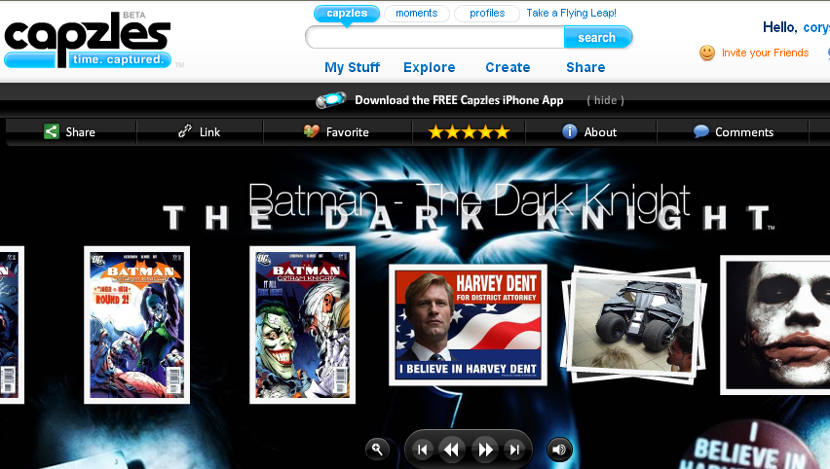
Non linear timeline
http://www.capzles.com/#/8032e523-70ed-4671-adee-08ad48563681/
Capzles.com
Linear presentation of events
Non linear reading
Uses film reel as the main tool

Slide 30
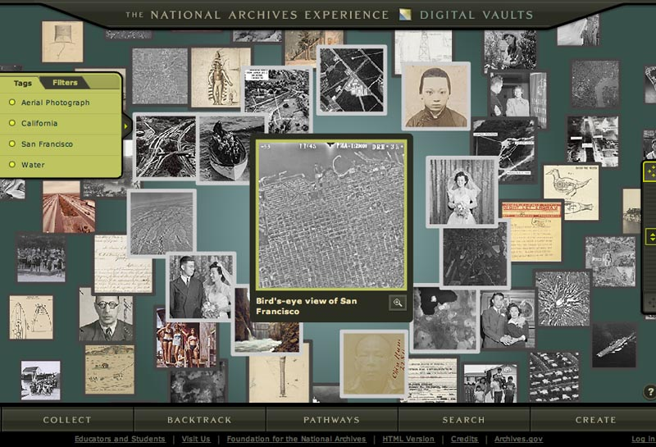
Hypertext experience
http://www.digitalvaults.org/
‘‘Every reading becomes a new text. Hypertext narratives become virtual storytellers.’’ Michael Joyce (1995) Of Two Minds: Hypertext, Pedagogy, and Poetics
Narration takes place in the mind of the viewer, as an interpretation of the connections he makes throughout his digital storytelling experience. Hyper-links are considered to be the digital narrative of our times.

Slide 31
Interactivity
Viewer to user
Interactivity has changed our perception of the viewer, because it transformed him into a user who can manipulate the content, and accomplish great interference within the content
Choices
There could be one fixed story that comes to the reader in many different ways, depending on which path is chosen through the network. It is the reader who constructs the story out of the textual segments.
Multimodality
Producing, uploading a homemade video, taking and sharing pictures, publishing our own recordings, playing a game, watching a movie, and all the above within the same story.

Slide 32
The future of storytelling
Immersion
Can I go deeper into the story-world, by learning more about it?
Interactivity
Can I change or influence elements of the story?
Can I interact with other people around the story?

Slide 33
Integration
Is a cohesive story being told across platforms?
Can it interface with the real world in any way?
Impact
Does the story inspire me to take action in my own life, such as making a purchase or supporting a good cause?

Slide 34



Convergence
The tendency for different technological systems to evolve towards performing similar tasks
Convergence can refer to previously separate technologies such as voice (and telephony features), data (and productivity applications), and video that now share resources and interact with each other synergistically.
Media content is autonomous and in the same time interdependent of others

Slide 35
New tools of presenting stories
Cross-media communications are integrated, interactive experiences that occur across multiple media, with multiple authors and have multiple styles.
The audience becomes an active part in a cross-media experience
Davidson, D et al (2010)Cross media Communications: Introduction to the Art of Creating Integrated Media Experiences - Pittsburgh, PA: ETC Press, 2010.
internet
Dvd,
film
Cross media experience

Slide 36
Cross media experience
One big media experience that supports a lot of other related media experiences.
For example
Star Wars movie trilogy is the tent pole that supports the Expanded Universe.

Slide 37
Crossmedia # Transmedia
Game
Book
Movie
Game
Book
Movie
Whole is less than the sum of parts
Whole is more satisfying than the sum of parts

Slide 38



Transmedia storytelling :
Story packages offering different entry points to the story
They are structured from the beginning to have multiple platforms

Slide 39

“A story that unfolds across multiple media platforms with each new text making a distinctive and valuable contribution to the whole”
“Transmedia storytelling is experienced as an amusement park”
Henry Jenkins, (2006) Convergence Culture

Slide 40

Transmedia interactive storytelling
http://showcase.noagencyname.com/INSIDE/media/
Inside is a live entertainment experience, blending film and social media
Players can develop a relationship with the film's protagonist.
For the first time, a director could not only direct the film's lead character but the audience as well by weaving several elements of social media into the story.

Slide 41
References
Jenkins,Henry, (2006) Convergence culture where old and new media collide, New York University Press
Handler Miller, Carolyn (2004) Digital Storytelling, Elsevier
Chen-Chung Liu, Kuo-Ping Liu, Collaborative storytelling with linear and non linear approaches, Procedia - Social and Behavioral Sciences, Innovation and Creativity in Education, Vol.2, Issue 2, Pages 4787-4792(2010)
Ryan, Marie-Laure ( 2002) Beyond Myth and Metaphor: Narrative in Digital Media,Poetics Today,23:3, pp 581-609
Ulrike Spierling, Nicolas Szilas,eds (2008) Interactive Storytelling, First Joint International Conference on Interactive Digital Storytelling, ICIDS 2008 Erfurt, Germany, November 26-29, Proceedings
Ido A. Iurgell, Nelson Zagalo, Paolo Petta, eds.(2009) Interactive Storytelling
Second Joint International Conference on Interactive Digital Storytelling, ICIDS 2009, Guimarães, Portugal, December 9-11, 2009. Proceedings
Ruth Aylett, Mei Yii Lim, Sandy Louchart, Paolo Petta and Mark Riedl, eds. (2010) Interactive Storytelling, Third Joint Conference on Interactive Digital Storytelling, ICIDS 2010, Edinburgh, UK, November 1-3, 2010. Proceedings
Mei Si, David Thue, Elisabeth André, James C. Lester, Joshua Tanenbaum and Veronica Zammitto,eds.(2011) Interactive Storytelling Fourth International Conference on Interactive Digital Storytelling, ICIDS 2011, Vancouver, Canada, November 28 – 1 December, 2011. Proceedings

Slide 42
Introduction
Journalism
Conclusions
Marketing
Culture
Education
Games
Storytelling

Slide 43

Narrative in video games

Slide 44
A problem narrative games or playable stories
Design problem of integrating user’s activity into a framework that fulfills the basic concepts of narrativity
characters conflict resolution

Slide 45
games
stories
interactive narrative systems of formal play.
How games can be narrative systems in ways that other media cannot.

Slide 46
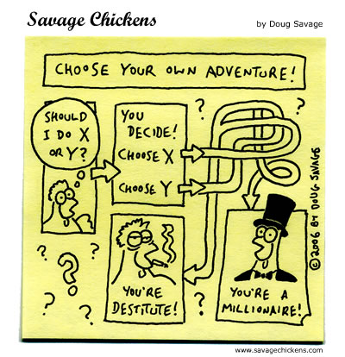
Non linear narrative

Slide 47

Role playing games
In The Sims, a story may emerge from the actions of the player. But the player is given so much control that they are more creating a story than interacting with a story.
8 year old girl said: “Guess what I managed to do with my Sims? I made the father and mother drown in the pool, and now the kids are alone in the house and they can do whatever they want.”

Slide 48
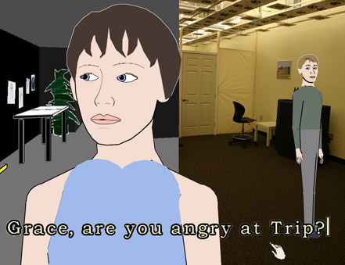
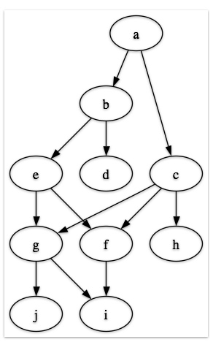
Branching storylines
Players may interact at critical points in the game
Façade has so many branching paths that player cannot predict the outcome
http://www.youtube.com/watch?v=jx20hiISwRQ

Slide 49
References
Eric Zimmmerman, http://www.ericzimmerman.com/texts/Four_Concepts.html, last retrieved 21/4/2013
Ernest Adams (2010) Fundamentals of Game Design, New Riders
Ryan, Marie-Laure(2009)From narrative game to playable stories, Story worlds: A Journal of Narrative Studies, Vol. 1.

Slide 50
Introduction
Journalism
Conclusions
Marketing
Culture
Education
Games
Storytelling

Slide 51
Storytelling in Business
All companies tell a story about their philosophy, products, history and mission through their advertisements, corporate site, salespeople, employees, packaging, etc.
The correct story is the one that connects the company or the product with the “right” values and feelings. The better the story, the stronger becomes the connection between the company and its stakeholders, i.e. the company’s profitability increases.

Slide 52
The value of stories in marketing
Stories are a powerful way to structure marketing campaigns
They are more effective since:
  Attract people’s interest
  Capture attention and encourage involvement
  Keep the client engaged
  Give the time to people to read and comprehend an interesting story at their availability and as long or as many times they want in relation to the 30sec paid ad
  Avoid triggering people’s resistance and self defense mechanisms
  Enable readers to learn by example
  Convey the benefits and features of a product in the proper context – the context of a customer who is using the product
  Provide all the information people need to make up their minds
  People are more inclined and have more means to pass an interesting story along to others

Slide 53
Situation Overview I
Decision making in consumption of products/services has always been affected by peer reviews and word of mouth
The Social Media have increased the access to “other people’s” opinion which is more powerful that the company’s opinion
Word of mouth has become more powerful
Therefore, today more than ever…
Brands don’t sell Brands
People are the ones who sell the Brands

Slide 54
Situation Overview II
Traditional Advertising no longer works…ALONE
People are “consumers” of more and different media than before
People are bombarded by a huge amount of information and advertising messages
Marketers have recognized that they want to make their customers to:
  engage, respond and create powerful brands rather than
  simply sell stuff or create more unwanted noise
Successful campaigns are not the commercial ones but the rewarding ones
  Those that provoke the audience to:
    Think, laugh, cry, anger
    Become emotionally engaged
    Interact and motivate them to move to action
The role of today’s marketing is to:
  Transform Passive Viewers Active Brand Advocates
  Make advertising not looking as advertising – act beyond the stereotypes

Slide 55
Who tells a brand’s story?
Brand storytellers fall into four (4) categories:
The company itself, mostly through advertising.
Cultural industry (example: product placement in movies as in the case of fashion labels in Sex and the City).
Go-betweens such as retailers, journalists, etc.
Customers (especially in the case where they form communities).

Slide 56
The value of digital storytelling I
Digital storytelling marries:
  the power of multimedia technology,
  the global reach of the Net, and
  the emotional appeal of personal stories
Digital storytelling aims to build customer communities
  By letting customers share their brand experiences with each other, stories become more authentic and interactive than just another ad.
Customers become part of the marketing experience.
'Seeing customers talk about the product and what it means to their lives helps our brand managers and clients learn things about them and their values that they never would have picked up in a PowerPoint presentation of raw facts and numbers,'' says LHC creative director Frank Campion.
''Digital storytelling helped us to pop the lid on a lot of emotional ties that we just hadn't been able to capture in our marketing before the Net,'' says Coke chief archivist Phil Mooney.

Slide 57
The value of digital storytelling II
''By listening and sharing with your customers, you're essentially having them co-write your brand. And they're doing it for nothing, or next to nothing,'‘
says Kit Laybourne, chief of Oxygen's digital storytelling project
''Stories are both ads and content for Web sites,''
  says Bob Johansen, director of the Menlo Park, California based Institute for the Future, an Internet think tank.
''The stories that people are telling on the Web around corporate brands are astounding . Knowledge is best shared and remembered through a good story, and companies are just starting to catch on to all that this can mean.'‘
says Atchley
''Now you need to establish far deeper, interactive connections with customers if you hope to keep them,''
says Eric Almquist, an Internet expert with Mercer Management Consulting Inc..

Slide 58
Advertising: The Strongest Storyteller
Advertising probably is the purest form of storytelling in the context of any entrepreneurial activity. Advertisements, by definition, tell a story and this story is “translated” across a vast array of communication tools: print, radio, TV and viral ads, social media campaigns, below-the-line events, mobile marketing campaigns, etc.

Slide 59
Case 1: Unilever/Dove
In some cases, ads do not describe a fantasy world, they don’t just tell a fairytale about “mythical” products and “perfect” people. Even a beauty and health care products company can tell a true, compelling story about imperfect, beautiful people.

Slide 60

Corporate Profile
Unilever is a global corporation, owning more than 400 brands in food, health, beauty, home and personal care products. One of its most successful brands is Dove, which started in 1957 as a beauty soap and now provides a wide range of cleansing and personal care products.
In 2004 Unilever launched the marketing Campaign for Real Beauty and since then it has developed a series of successful tools, advertisings, workshops and films.

Slide 61


Campaign for Real Beauty
The Dove Campaign for Real Beauty, a worldwide marketing campaign was launched by Unilever in 2004 including advertisements, videos, workshops and events. All the advertisements showcased photographs of ordinary women in place of models.

Slide 62
The campaign’s strategic goals
The purpose of the campaign was to encourage women to appreciate their natural beauty and inspire them to be confident and comfortable with themselves. As mentioned in the campaign description:
“At Dove we want to help free ourselves and the next generation from beauty stereotypes.”

Slide 63
Dove “Evolution” (1)
Dove “Evolution, a 75-second viral film produced by Ogilvy & Mather, an international advertising agency, as part of Dove Campaign for Real Beauty was launched by Unilever, under the slogan:
“No wonder our perception of beauty is distorted”

Slide 64

Dove “Evolution” (2)
The advertisement targeted young women and teenage girls and became one of the most successful branding stories, winning a number of awards in the advertising industry, including two Cannes Lions Grand Prix awards for Viral Marketing and an Epica D'Or in the Interactive category.

Slide 65
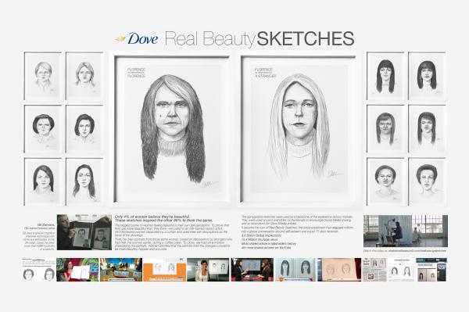
Dove Real Beauty
https://www.youtube.com/watch?v=XpaOjMXyJGk

Slide 66
Case 2: Guinness/Diageo
Can everyday people become heroes, even for just a minute? A beer tells a true story about male friendship, adrenaline, patience and perseverance, with the help of two other storytellers: a famous painter and a great writer. What happens when, 10 years after a campaign launch, consumers decide to publicize their own version of the brand’s story?

Slide 67

Corporate Profile (1)
(Ex Guinness UDV). The company’s current form was the result of a 1997 merger between GrandMet and Guinness. The company is based in London, UK.
Diageo plc is considered as the most powerful multinational company in the alcoholic beverages, wine and beer market and its product portfolio includes more than 800 products.

Slide 68
Corporate Profile (2)
The corporate brand name derives from the Latin “dia” (day) and the Greek «γεω» (“geo”). The corporate brand name suggests that each day around the planet people are celebrating by using one or more of the company’s portfolio brands.

Slide 69
“Good Things Come to Those Who Wait” Campaign
The campaign was launched in 1998 with the “Swimblack” spot. Its target group were bartenders in both UK and Ireland and its strategic goal was to reverse negative impressions and ironic remarks concerning the time that Guinness needs to “rest” in the beer glass before drinking (119,5 seconds).
In total, eight (8) spots were launched between 1998-2007 under the concept “Good Things Come to Those Who Wait”.

Slide 70
Guinness “Surfer” Advertisement
The spot was produced by the advertising company Abbott Mead Vickers BBDO and was voted as the best TVC (TV Commercial) for 1999, as well as the best ad of all times in 2002 by UK viewers.

Slide 71
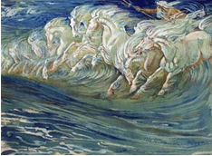

Sources of Inspiration
The spot celebrates male friendship, bonding and the joy of taking risks and succeeding. The main sources of inspiration for the spot were the painting “Neptune’s Horses” (1892) by British painter Walter Crane, as well as the book “Moby Dick” (1851) by Herman Melville.

Slide 72
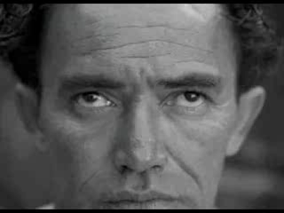

Slide 73
Case 4: T-Mobile UK / Royal wedding viral ad
In some cases, corporate storytelling is used to share and spread joyous feelings about a true story that moves a whole nation and billions of people around the world. But what if a corporate story about a true story is based on another true story? The mix of different, existing stories may give birth to a new one…

Slide 74

Corporate Profile
T-Mobile is a German wireless services provider, owned by Deutsche Telekom. It operates several GSM networks in Europe and the United States. T-Mobile also has financial stakes in mobile operators in Central and Eastern Europe.
Globally, T-Mobile has some 150 million subscribers, making it the world's tenth largest mobile phone service provider by subscribers and the third largest multinational after the United Kingdom's Vodafone and Spain's Telefónica.

Slide 75
A unique marketing strategy
In terms of marketing strategy, T-Mobile UK is hugely investing in “spontaneous” large scale, real time dancing and singing events that involve by-passers in big public spaces such as Heathrow Airport, London Liverpool Street Train Station, Trafalgar Square, etc.
The events are recorded and circulated as viral videos through YouTube.

Slide 76
“Heathrow Terminal 5 – Welcome Back” viral ad (9)
“T-Mobile Sing-along Trafalgar Square ” viral ad (10)
“The T-Mobile Dance – Liverpool Street Station” viral ad (11)

Slide 77
The royal wedding viral ad
The video is a humorous version of Prince William’s and Katherine Middleton’s wedding ceremony.
It features a number of uncanny look-alikes grooving down the aisle to the song House of Love by 1990s boy band East 17.
The advertisement received 3.5 million views on YouTube in just two days. T-Mobile said the ad was "a congratulatory message to William and Kate, as well as a way of capturing the nation's celebratory mood."

Slide 78
The royal wedding viral ad (12)

Slide 79
Source of Inspiration
The ad was based on the now famous Jill and Kevin’s wedding processional clip that shows a wedding party dancing up the aisle and which has been viewed more than 65 million times.
http://www.youtube.com/watch?v=4-94JhLEiN0

Slide 80

Viral campaigns
Company : Unilever
Produced by : Lowe Brindfors and B-Reel
Soundtrack by Plan8
All the assets were post-produced and put together in a custom built game engine in Flash.
The goal was to blend game-like interaction and controls, with larger than life storytelling that play with the dimensions and concept of the web.
http://pleasurehunt.mymagnum.com/
http://pleasurehunt2.mymagic.gr/

Slide 81

Viral campaigns
Fake interactive experience that went viral
http://www.youtube.com/user/skittlespage?feature=iv&annotation_id=annotation_850818&src_vid=eDlaJlb1ezg

Slide 82
Case 5: Tipp-Ex Interactive YouTube video
Is there anything common between a correction fluid, a bear, a hunter and a YouTube user?
When it comes to interactivity, the answer is “yes”!

Slide 83

Corporate Profile
Tipp-Ex is a brand of correction fluid and other related products that is popular throughout Europe. It was also the name of the German company (Tipp-Ex GmbH & Co. KG) that produced the products in the Tipp-Ex line.
Tipp-Ex is a trademark for correction products. It has become so popular that it has become an English genericised trademark: to tippex or tippex out means to erase, either generally or with correction fluid.

Slide 84
The Tipp-Ex interactive viral video
In September 2010, a wildly popular interactive viral video was released through YouTube depicting a hunter's dilemma when confronted with the decision of whether or not to shoot a bear that wanders into a campsite. The video has been hailed by internet analysts as a novel, creative and entertaining form of advertising.
More than 16 million people have watched it.

Slide 85
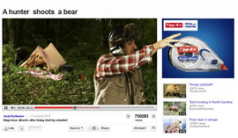
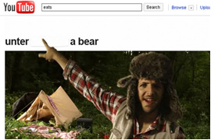
http://www.youtube.com/watch?v=4ba1BqJ4S2M

Slide 86
Case 6: Aegean Airlines
An airline does not only carry passengers. It also carries their hopes, dreams and expectations, their own unique stories that blend with the company’s values and aspirations.

Slide 87

Corporate Profile
Aegean Airlines S.A. is the largest Greek airline by total number of passengers carried. A Star Alliance member since June 2010, it operates scheduled and charter services from Athens and Thessaloniki to other major Greek destinations as well as to a number of European destinations.
In 2008, it carried 5,978,083 passengers surpassing for the first time its rival Olympic Airlines, which carried 5,265,729 passengers. In 2009 Aegean Airlines carried 6,600,000 passengers.

Slide 88
The “Stories” campaign
“Each passenger has a unique story. These are the stories we carry. With dedication”.
In 2009 Aegean Airlines has launched the “Stories” TV campaign. The spot was produced by one of the most successful advertising companies in Greece, UPSET!.
The spot depicts the thoughts, feelings and dreams of 8 different passengers, who are being carried by the airline.

Slide 89
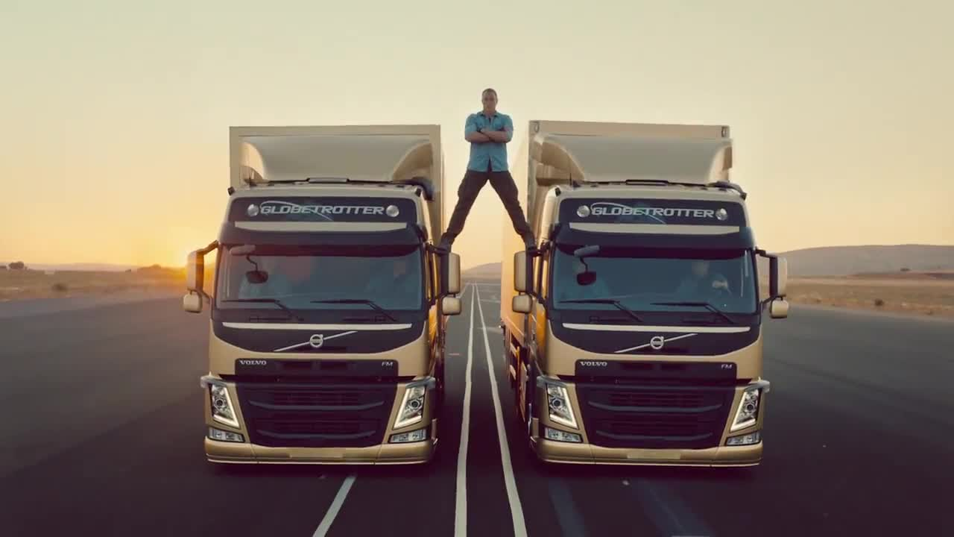
Volvo trucks
http://casestudies.se/live-test-series-335a980
The creative idea was to carry out extreme tests of relevant product features, in a live set up.

Slide 90
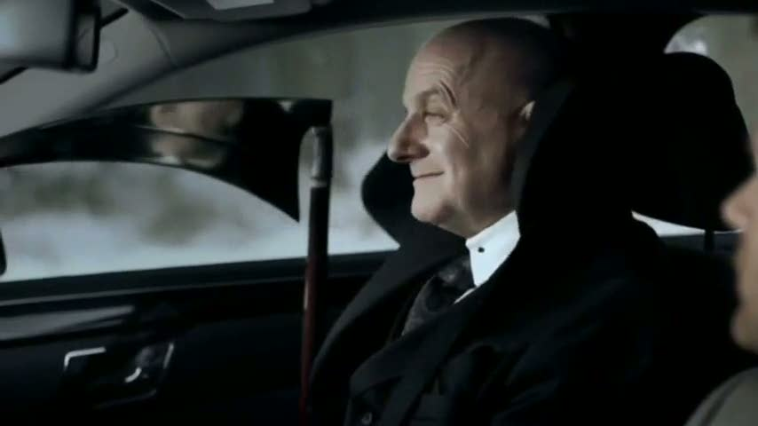

https://www.youtube.com/watch?v=9PzOt5zD7hg
This was the response Mercedes was looking for, from its creativity and striking simplicity with the ad.
Often, technical features are communicated too technically and don’t move customers emotionally.
The “sorry ad” stays close to the lives of consumers, allowing them to experience the effect of the benefit.

Slide 91
Conclusions
Brand stories are a very powerful tool in terms of engaging consumers.
Digital storytelling constitutes a valuable means of interaction between consumers and brands, thus establishing a strong relationship between them.
In the context of a highly competitive market, good stories are a valuable tool in order to retain and to augment a brand’s market share.

Slide 92
References
Brown, J.S. et al (2005) Storytelling in organizations: why storytelling is transforming 21st century, US: Butterworth-Heinemann.
Fog, K., C. Budtzand B. Yakaboylu (2005) Storytelling: branding in practice, Berlin: Springer
Hartley, J. and K. McWilliam (2009) Story circle: digital storytelling around the world, London: John Wiley and Sons
Holt, D. B. (2004) How brands become icons: the principles of cultural branding, Harvard Business Press.
Ma, K.F &Keppell, M. (2004), Knowledge management: The relevance of storytelling in the management of knowledge in organizations., in R. Atkinson, C. McBeath, D. Jonas-Dwyer & R. Phillips (Eds), Beyond the comfort zone: Proceedings of the 21st ASCILITE Conference (p. 571). Perth, 5-8 December. http://www.ascilite.org.au/conferences/perth04/procs/ma-poster.html

Slide 93
Introduction
Journalism
Conclusions
Marketing
Culture
Education
Games
Storytelling

Slide 94
Journalism is...
  §“... organized gossip”
  §“...the ability to meet the challenge of filling space.”
  §“...the first rough draft of history.”
  §“... history on the run.”
  §“...largely consists of saying "Lord Jones is Dead" to people who never knew that Lord Jones was alive.”
  §“...a tension between getting it first and getting it right”

Slide 95
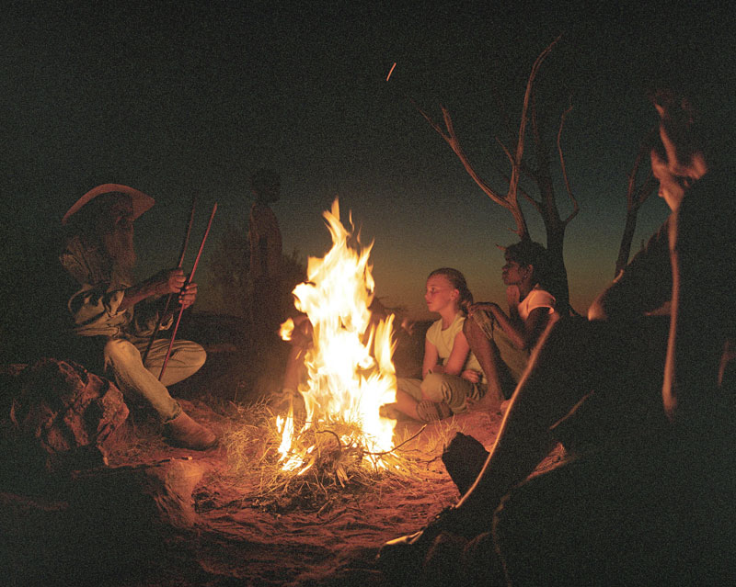
Journalism was, is and will be...
“Storytelling!!!”
...because...
“The universe is made up of stories, not atoms!”
Muriel Rukeyser

Slide 96

New ways of “telling the story” are emerging
¨Use more than just audio, video or text
¨Readers/Viewers can participate
¨Unlimited “space” to tell the story
¨Non-linear structure

Slide 97
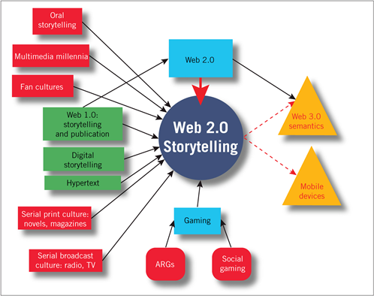
Web 2.0 is all about Storytelling

Slide 98

Where is digital storytelling in Journalism
  Cloud computing + Real World/Real Life
  Cloud is both the transmitter and the receiver of the message

Slide 99
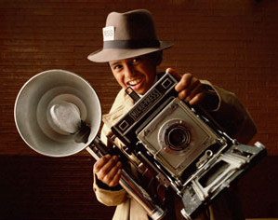
Who is the digital storyteller?
  The Journalist
  The Citizen

Slide 100
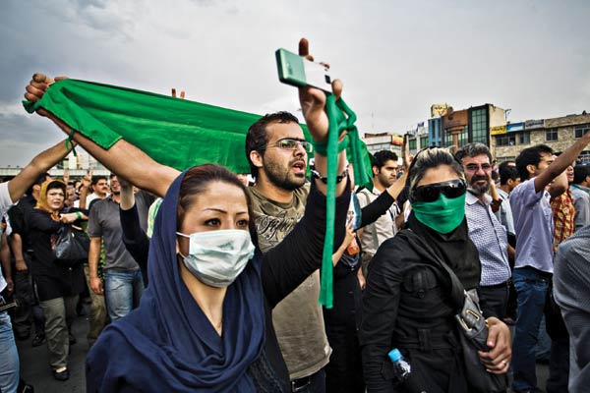
Who is the digital storyteller?

Slide 101
Who is the digital storyteller?
  Journalist: knows a lot about the process (journalism), but not about the topic.
  Citizen: is passionate about the topic, but doesn’t know the process.
  Together: Can tell GREAT stories!

Slide 102
Journalists and Citizens
  In linear narrative, journalist was the transmitter
  Citizen (audience) was the receiver
  In digital storytelling journalist works as a content manager and curator
  Citizens can be both transmitter and receiver. The witness and the reporter

Slide 103
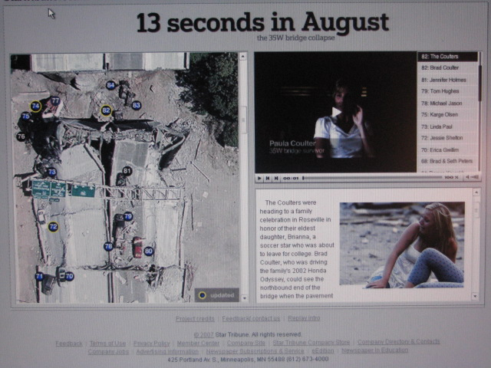
http://www.startribune.com/local/12166286.html
A great example of journalists becoming the content managers, where the witness is both the narrator and the only source of information.

Slide 104
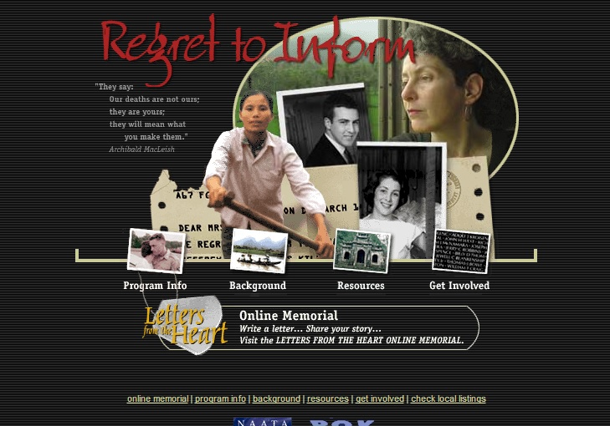
http://www.pbs.org/pov/archive/regrettoinform/index.html
My hope in making REGRET TO INFORM is that by hearing these women's stories from both sides, viewers will begin to see that the enemy is war itself.
Barbara Sonneborn
Producer/Director, REGRET TO INFORM

Slide 105
The Basic Principles of a News Story
  5Ws & 1H
    Who is it about?
    What happened (what's the story)?
    Where did it take place?
    When did it take place?
    Why did it happen?
    How did it happen?

Slide 106
Journalism and digital storytelling
  None of the 5W and 1H can be answered with just a simple "yes" or "no" (or 01)
  All the answers should be included in the beginning of the Digital Storytelling Journalism
  It is difficult for the audience to answer in a specific time limit
  We NEED the Jurno/Curator

Slide 107

The principle
  Digital Storytelling Journalism is based in Cicero’s Principle

Slide 108
  The basic journalistic goal remains the same
  The transformation of the data to knowledge
  Data>>>(info)>>>(news)>>>
  (knowledge)>>>(wisdom)<<<

Slide 109
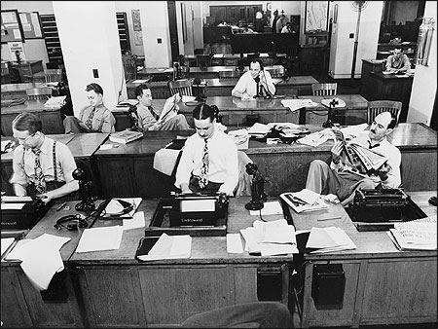
The News Room remains the same!
Well...
Almost!

Slide 110

The News Room: Where Journalists Making Stories

Slide 111
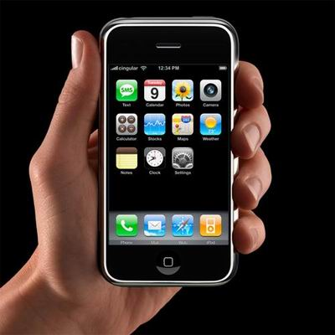
And the Citizen's News Room

Slide 112
Differences to traditional Journalism
  Differences mainly focus to the tools that the journalist uses
    Search tools (google.com, recordedfuture.com)
    Monitoring tools (Seesmic.com, tweetdeck.com, netvibes.com, google.com/reader)
    Production Tools (Content Management Tools, Collaborative tools-Share Docs Tools)

Slide 113
Differences to traditional Journalism
    Multimedia Transmitting Tools
    Composing narrative tools (Storify.com, paper.li etc.
    Classification Tools (Dropbox.com, Sugar Sync)
    Wide Use of the social Networks as a means of transmitting the message

Slide 114


Available in i pad
http://touchingstories.toolprototype.com/
http://vimeo.com/17941145

Slide 115

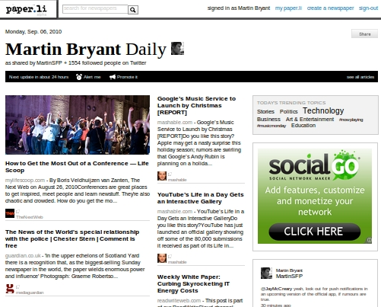
Publish Twitter, Facebook, Google+ or any web content into an online newspaper.
http://paper.li/

Slide 116
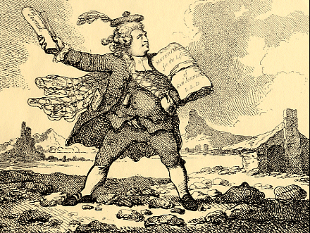
Differences to traditional Journalism
  The journalist is not the spotlight of the narrative and he is not the only transmitter

Slide 117
Differences to traditional Journalism
  The content Sources are both traditional and digital (Traditional sources are enriched with digital)

Slide 118
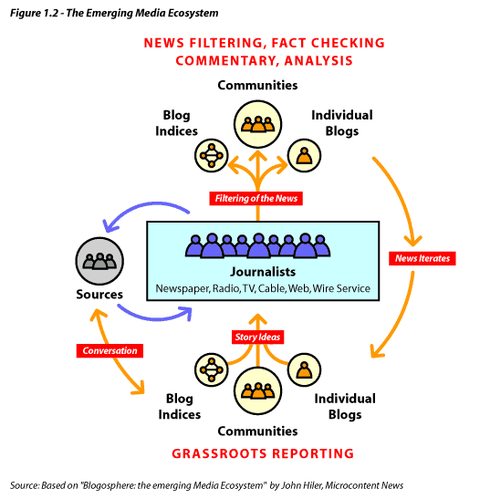
The New Media Ecosystem

Slide 119
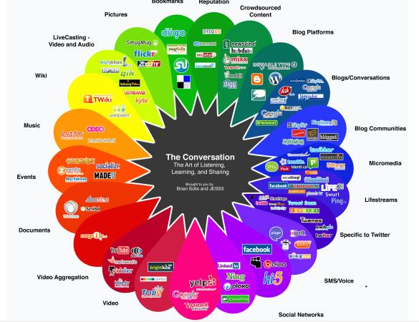
Social media
Any online technology or practice that lets us share (content, opinions, insights, experiences, media) and have a conversation about the ideas we care about.

Slide 120
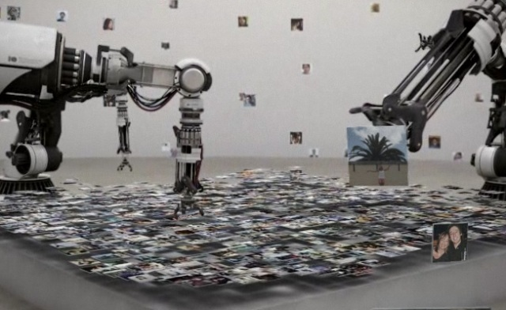
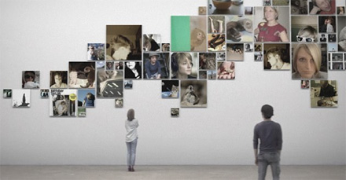
Museum of me (Intel)
http://www.youtube.com/watch?v=qfd54nYPhXk

Slide 121
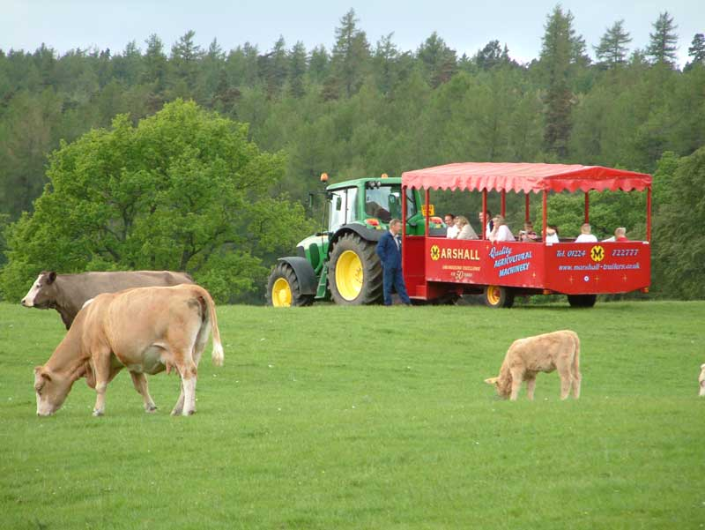
Social Media for Journalism is...
...A Content Farm!!!

Slide 122
Social Media and News
  Social media are disrupting traditional News Media models.
  Internet and social media have changed balance of power between people and Old Media Journalism.
  Social Media changed Storytelling!!!

Slide 123

http://stories.twitter.com/
http://stories.twitter.com/en/myra_mcentire.html
http://stories.twitter.com/en/huseyin_cakir.html
MYRA MCENTIRE
wrote a book and landed a movie deal.
HÜSEYIN ÇAKIR
heated his dorm room with a Tweet

Slide 124
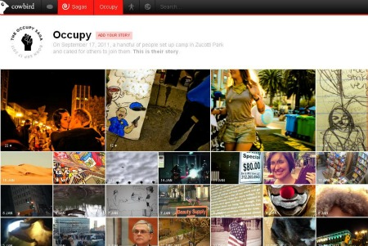
Cowbird
http://cowbird.com/
A new emerging storytelling platform
Focused on deeper and more personal storytelling.

Slide 125
Old Journalism - New Journalism
Lecture
Passive audience
One to many
Autocratic
Centralized
Elite professionals
Exclusive
Remote voice
Heavily filtered
Conversation, participation
Empowered users
Many to many
Democratic, collaborative
Distributed
Grassroots
Personal voice
Unfiltered/lightly filtered

Slide 126
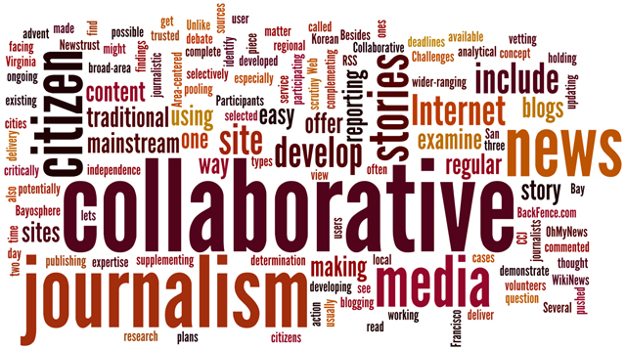
Old Journalism - New Journalism
...was building an audience
...is building a community!!!

Slide 127
Journalism and Interactivity
  Social Media are both the source and in some cases the narrative
  Social media work as a new medium of communication and information

Slide 128
“Crowdsourcing”
n A collaborative form of reporting
n Each contributor researches and contributes a component to the overall piece
n The actual story may or may not be written by a collaborator
n Content is usually overseen by a centralized editor
The first crowdsourcing documentary film in Greece “Debtocracy” was online in 2011
http://www.debtocracy.gr/indexen.html

Slide 129

Boston story through twitter
(how people and state agencies turned to social media
fake Twitter account was made for the Boston Marathon bomber.
CNN and the AP incorrectly reported that a Boston Marathon suspect had been arrested on April 15.
The New York Post wrongly identified two innocent men as the suspects
5:24 p.m. 18 April, Boston Police Department’s Twitter asks for citizens help to identify
MIT’s Twitter was providing updates about what was happening on campus
People are twitting about it

Slide 130
“Pro-Am” Journalism
n Crowdsourcing is often referred to as “pro-am journalism”
¨A combination of both professional and amateur contributions

Slide 131
Before the Digital Narrative Journalism
  Transmission:
Society>>>Journalists>>>Mass Media>>>Audience >>>Dead End (Passive Information)
  Intake:
Audience<<<Mass Media

Slide 132
After the Digital Narrative Journalism
  Transmission and Intake
Audience/Journalists>>>Society>>>Audience/Journalists>>> Social Media/Μass Media>>> Audience/Journalists >>>Loop (Active Information and Update)

Slide 133
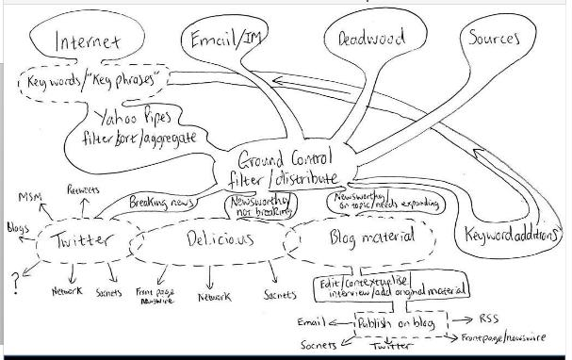
How the New News Storytelling looks like?

Slide 134
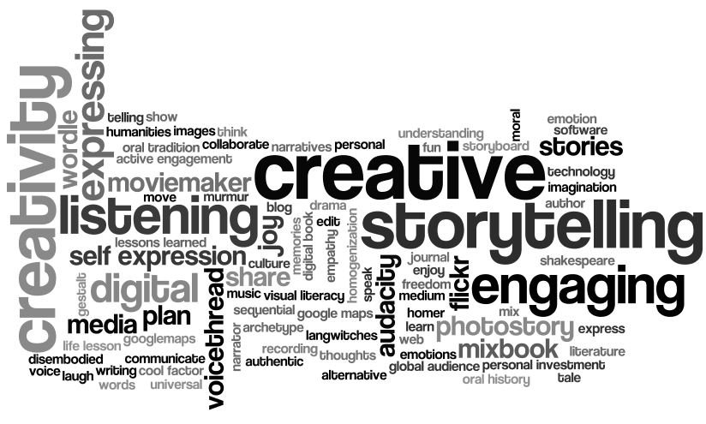
How the New News Storytelling looks like?

Slide 135
Trends
  The evolution of the digital narrative journalism is mainly based to three «H»
  Hypertext
  Hyperlocation
  Hashtags#

Slide 136
Hyperlocal
n Micro-reporting of events and developments normally missed by mainstream media
¨ “Hyper-local” reporting

Slide 137

Hashtags#
Tweet this Talk! Hashtag #dst
Hashtags are a community-driven convention for adding additional context and metadata to your tweets. They're like tags on Flickr, only added inline to your post. You create a hashtag simply by prefixing a word with a hash symbol: #hashtag.

Slide 138
“Moblogging”
n Mobile phone blogging
¨ Instant “on location” blogging via one’s mobile phone
¨ Photo share publishing “on the go”
¨ Uses camera phones to see what the publisher sees instantly

Slide 139

Journalism tools
Essential tech and kit
§LAPTOP
§MP3 RECORDER
§MIFI/WIFI HOTSPOT GENERATOR
§VIDEO – HD, FLIP ETC
§NOTEPAD AND PENCIL
SmartPhones
If I could only take on piece of kit out of the office, I’d take my smartphone

Slide 140
Journalism tools
Online apps and sites
●Data visualisation – Flowchart
●Data collation – Tableau
●Collaboration – Google Docs
●Photography – Flickr
●Video – Vimeo and YouTube
●Word clouds – Wordle
●Word trees - ManyEyes,
●Strip panels – Stripgenerator
●Animation – Xtranormal
§Online surveys – SurveyMonkey and Ask500people.com
§Livestreaming (mobile) - Bambuser/qik
§Liveblogging – Coveritlive
§Audio – Ipadio/ Audioboo
§Uploading multi-site content in the field – Pixelpipe
§Interactive timelines – Dipity
§Maps – Google Maps, Umapper
§RSS mashups – Yahoo pipes
If I could only take on piece of kit out of the office, I’d take my smartphone

Slide 141
And as Jason Ohler said...
“I know only one thing about the technologies that awaits us in the future: We will find ways to tell stories with them.”
http://www.jasonohler.com/index.cfm

Slide 142
END...
“In the end, folks, we ain’t nothing but a song.. a story”
Joe Lambert
http://www.storycenter.org

Slide 143
Conclusions
  In digital storytelling a journalist works as a content manager and curator.
  Citizens can be both transmitters and receivers, witnesses and reporters.
  Internet and social media have changed the balance of power between people and Old Media Journalism.
  Social media constitute a powerful medium of communication and information.

Slide 144
Introduction
Journalism
Conclusions
Marketing
Culture
Education
Games
Storytelling

Slide 145


Other Worlds is an exhibition of intriguing new storytelling partnerships. Writers, visual and other creative artists, will bring these rooms to life in an exciting installation, inspired by the distinctive character of the building.

Slide 146
“There have been great societies that did not use the wheel, but there have been no societies that did not tell stories.”
Ursula LeGuin
http://www.storymuseum.org.uk/the-story-museum/chooseastory/listen
1001 stories organized by
theme
origin
age group

Slide 147

“it’s your story”
http://iys.nmajh.org/
Visitors to the Museum can record their own stories, thoughts, ideas and reflections, after having experienced the entire exhibition.
Personal narratives are becoming a part of Jewish history seen as living history.

Slide 148

A century of games
http://www.bl.uk/playtimes
‘Children’s Games and Songs’ project seeks to explore how games continue to be a part of the lives of children living in the age of computer games and the internet.
What does this oral tradition borrow from the media?
How might it connect with the entertainment and information technologies of the age of new media?

Slide 149
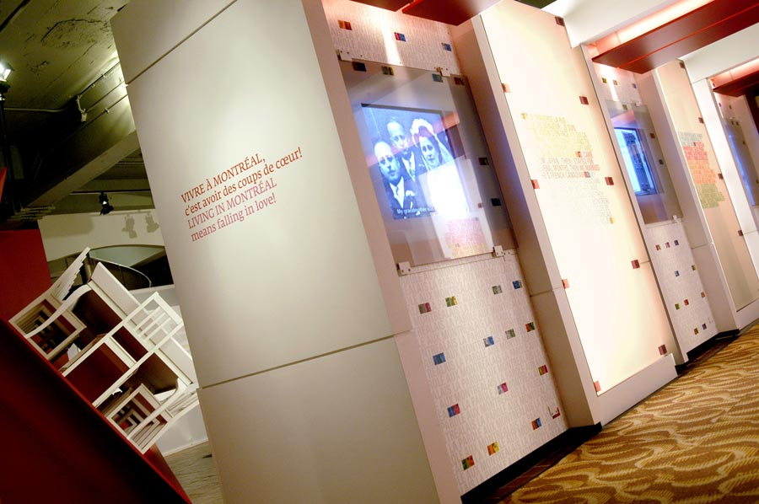
Montreal love stories
http://pacmusee.qc.ca/en/exhibitions/montreal-love-stories
City of Montreal through the eyes of its citizens
The stories themselves are the museum exhibits
Personal portraits of men and women who fell in love in Montreal and chosen to live there.
Living in Montreal means falling in love

Slide 150
Culture shock
Alex Henry Project Coordinator Tyne & Wear Archives & Museums
Culture Shock! has been an exciting two year project based in North East England collecting digital stories from people across the region.
Over 550 people have engaged in digital storytelling workshops
Nearly 600 digital stories have become museum objects for future generations. The stories have also helped improve our knowledge of existing collections and objects

Slide 151
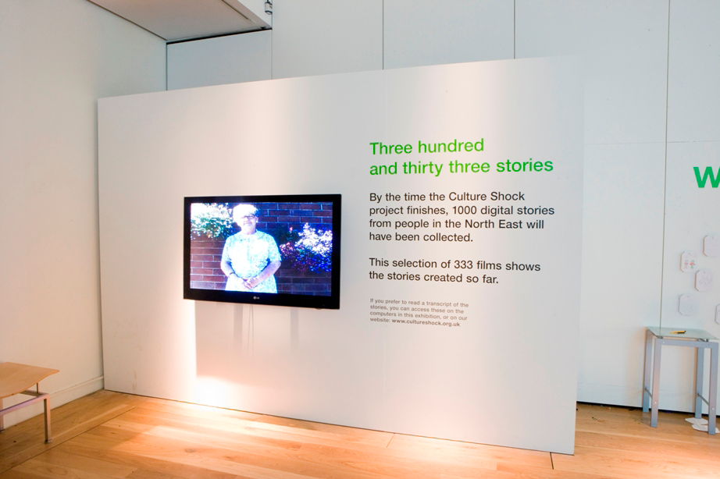
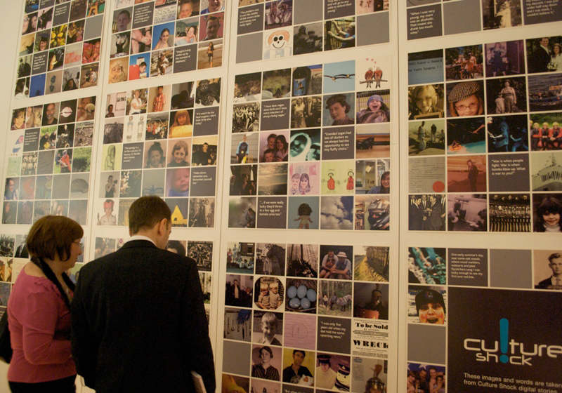
“His speech impediment evaporated when he told his story.” NHS care professional
http://video.bobdylan.com/desktop.html
“I wish I was here in 100 years’ to see what’s happened to me [my story]” Participant
http://www.cultureshock.org.uk/stories/the-day-my-life-changed.html

Slide 152
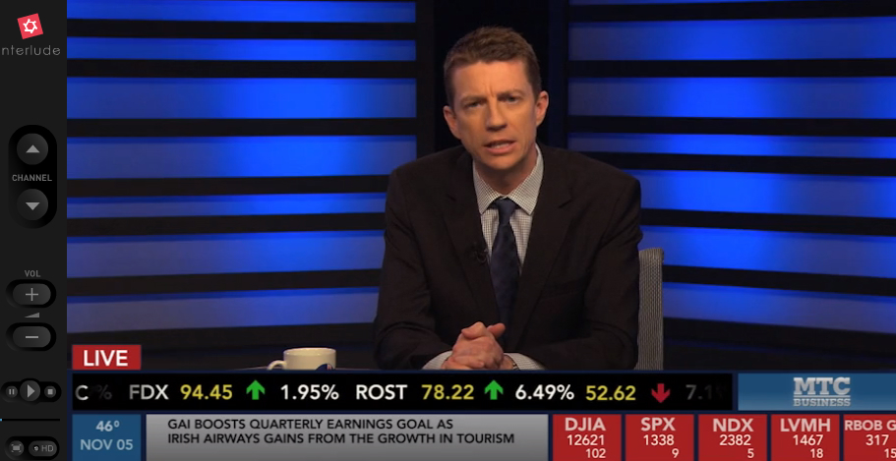
In music
http://video.bobdylan.com/desktop.html

Slide 153
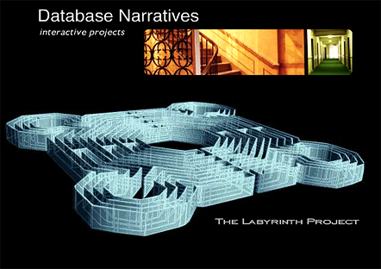
The Labyrinth project
http://dornsife.usc.edu/labyrinth/about.html
The Labyrinth Project is a research initiative on interactive narrative at the University of Southern California’s School of Cinematic Arts
Multimedia projects that juxtapose fictional and historical story elements in provocative ways.
“A Labyrinth is a multicursal maze representing alternate paths to the source of being.”

Slide 154
Bleeding through , Layers of Los Angeles 1920-1986
http://dornsife.usc.edu/labyrinth/klein/klein.html
This ethnically complex location (Los Angeles) is documented through archival stills and films and through contemporary images that either reproduce or evoke them.

Slide 155
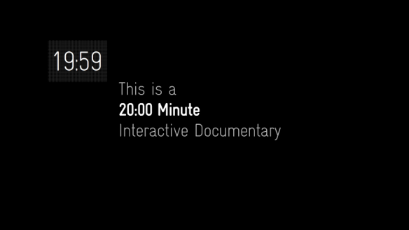
Interactive Storytelling in film
http://bear71.nfb.ca/#/bear71
Produced by National Film Board of Canada (NFB), 2012
Directed by Leanne Allison and Jeremy Mendes.
The webdoc features a map of Banff National Park that allows users to follow Bear 71’s movements by scrolling over the cameras, and look at other users by activating the computer’s webcam.

Slide 156
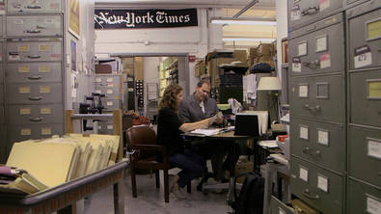
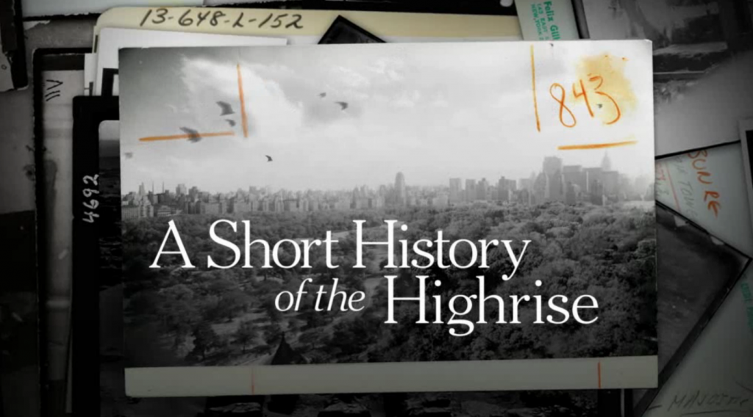
Interactive documentary
http://highrise.nfb.ca/

Slide 157
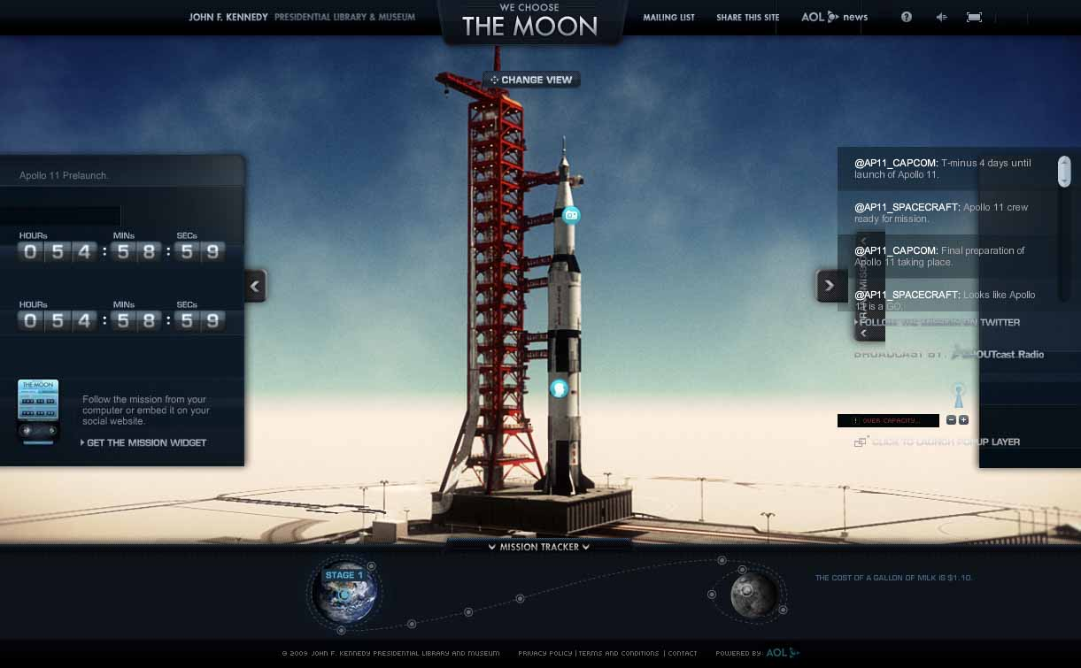
http://wechoosethemoon.org/
Non linear way of watching
Moon project footage
Real time travel to the moon

Slide 158

http://www.exquisiteforest.com/

Slide 159
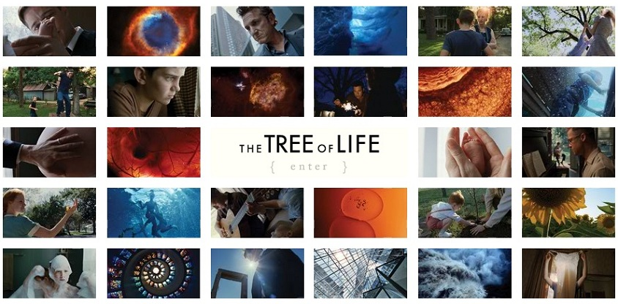
http://www.twowaysthroughlife.com/

Slide 160
Introduction
Journalism
Conclusions
Marketing
Culture
Education
Games
Storytelling

Slide 161

http://www.smories.com/
Stories read by kids for kids and everyone.
Why not listen to your favorite story by a child-narrator?

Slide 162

http://www.inanimatealice.com/index.html
https://www.facebook.com/InanimateAlice
A reading-from-the-screen experience for the digital generation
Interactive: The user drives the action forward
Multimedia: text, images, music, sound effects, puzzles and games
Educational: Provides teaching guidelines and the digital assets of the story to create your own story

Slide 163

http://ed.ted.com/
Ted-ed made a great story out of every teacher.
Presents these stories –best practices in their site and encourages other teachers to share.

Slide 164
Seven Steps of Digital Storytelling
Lambert, J. (2010), Digital Storytelling Cookbook, US: Digital Dinner Press
http://www.storycenter.org/cookbook.pdf

Slide 165


Slide 166
Step 1: Owning Your Insights
In traditional storytelling, it is commonly understood that the purpose of a story is to teach a lesson or moral.
However, artificial intelligence theorist Roger Schank tells us that through storytelling it is in fact the teller, rather than the listener, who seeks to learn from the story told. And through the teller’s repeated sharing of their story, listeners ask questions, make comments, and tell their own stories in response, which then provide the missing pieces to help the teller find a deeper meaning in their own story.

Slide 167
Step 2: Owning Your Emotions
Having an awareness of the contrasting and complex nature of a story’s emotional content will not only help get us in touch with the core of the story’s meaning, but also determine which emotions to include, and in what sequence to present them to help the audience understand the story.
Taking ownership of the emotions contained within a story will also help the audience connect on a deeper level.

Slide 168
Step 3: Finding The Moment
Compelling stories reproduce the insight and experience of the storyteller while prompting the audience to ask questions about their own experiences and look for larger truths.
Over the course of a three to five minute piece, a digital story can consist of a single scene, or it can consist of several. Because the format is relatively short, it’s important to select your scenes with care and establish them concretely to ensure that they are contributing to the overall piece.

Slide 169
Step 4: Seeing Your Story
Explicit imagery is useful for conveying the necessary details of your story or helping to set the scene for your audience.
Implicit imagery is useful for implying or representing another meaning beyond an image’s explicit or literal meaning. Two common techniques for a storyteller to convey their meaning through the use of implicit imagery are visual metaphor and juxtaposition.
The images you choose and the way you combine them will work to create additional layers of meaning.

Slide 170
Step 5: Hearing Your Story
Digital stories that have the recorded voice as the only audio track can be tremendously powerful at conveying tone and meaning.
When we listen to the scenes in our stories, they may include sounds that exist in the background of everyday life -traffic, birds, airplanes, voices, for example. These types of sounds (ambient sounds) help create a sense of place for the audience.
As with ambient sound, storytellers can consider how the minimal use of music can enhance a story by giving it rhythm and character.

Slide 171
Step 6: Assembling Your Story
The process of telling stories and reading the audience’s reaction is critical to understanding story structure.
Knowing which pieces of information are necessary to include allows us to then determine the best way to order those pieces and keep our audience engaged. Don’t give away too much information all at once. Allow your audience to enjoy the challenge.
Once the basic structure of the story is outlined, the next step is scripting and storyboarding, or in other words, laying out how the visual and audio narratives will complement each other over the duration of the piece to best tell the story

Slide 172
Step 7: Sharing Your Story
Before the final version of your story is exported, consider the audience once more, but this time in terms of how you will present the digital story.
Considering your audience at this point in the production process may alter how you complete the final edits. If you know who the audience will be for your piece and what they know about you, then it will help determine how much context you decide to provide about the story.
If you know the presentation setting in which your audience will view your digital story, then it will help you determine what kind of contextualizing materials should accompany the piece, and will also provide more time during the digital story to focus on other content in the story.

Slide 173
Finally…
Always remember that the storytelling process is a journey –enjoy it!

Slide 174
Storytelling
Pain, Ahn Vuong
Home movies, Dana Atchley
How are you? David Gill
http://www.patientvoices.org.uk/index.htm

Slide 175

Story first

Slide 176

How about writing your story
http://www.bbc.co.uk/scotland/pinball/dotdash/

Slide 177


The Periodic Table of Storytelling
http://designthroughstorytelling.net/periodic/

Slide 178
Free Tools for digital storytelling

Slide 179

Photo story 3
Tutorials on youtube
http://www.youtube.com/watch?v=k1rJm5HqN9A

Slide 180

Windows Live Movie Maker
Tutorial
http://www.youtube.com/watch?v=3ZZij3NNyVg
Download
http://www.microsoft.com/download/en/windows.aspx?q=windows

Slide 181

i-movie
http://www.apple.com/ilife/imovie/

Slide 182




Slide 183
References
Frazel, M., (2010) Digital Storytelling Guide for educators, USA
Ohler, J., (2008) Digital Storytelling in the Classroom New media pathways to Literacy, Learning and Creativity, Corwin Press
Vaucelle,C, Ishi,H. (2009) Play-it-by-eye! Collect movies and improvise perspectives with tangible video objects, Artificial Intelligence for Engineering Design, Analysis and Manufacturing , 23, 305–316. USA. Cambridge University Press
Vaucelle, C., & Davenport, G. (2003). Textable Movie: improvising with a personal movie database. Proc. SIGGRAPH ’03. New York: ACMPress

Slide 184
Introduction
Journalism
Conclusions
Marketing
Culture
Education
Games
Storytelling

Slide 185
Conclusions I
Stories are a very effective tool in terms of expressing thoughts, feelings, ideas and experiences and sharing them with other people and/or bigger audiences.
Stories are becoming so convincing, that they may transform to a dangerous substitute of true facts, history and reasonable arguments.

Slide 186
Conclusions II
Storytelling is a means of revealing the truth, of reacting, of uniting people against injustice, of organizing activist action.
Storytelling is a means of control and power that is used by governments, corporations and organizations in order to effectively distort the truth and mislead people.

Slide 187
New Technologies Laboratory in Communication, Education and the Mass Media
National and Kapodistrian University of Athens
http://www.media.uoa.gr/medialab

