Slide 1
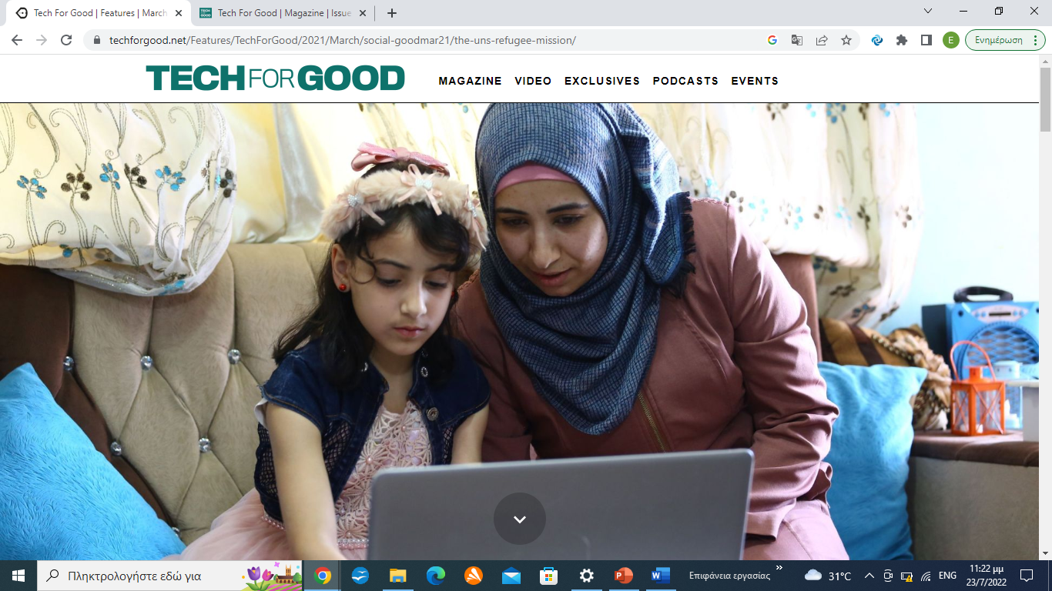

Slide 2
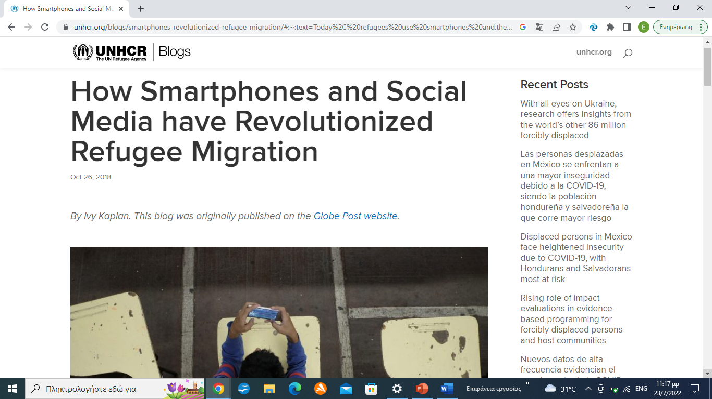

Slide 3
‘A Dark Digital Underworld’
Refugees use smartphones and social media platforms in five primary ways – communication, translation, information, navigation and representation

Slide 4
responsible / ethical / for good technology and data
human dignity, participation and autonomy
positive disrupt the aid system

Slide 5
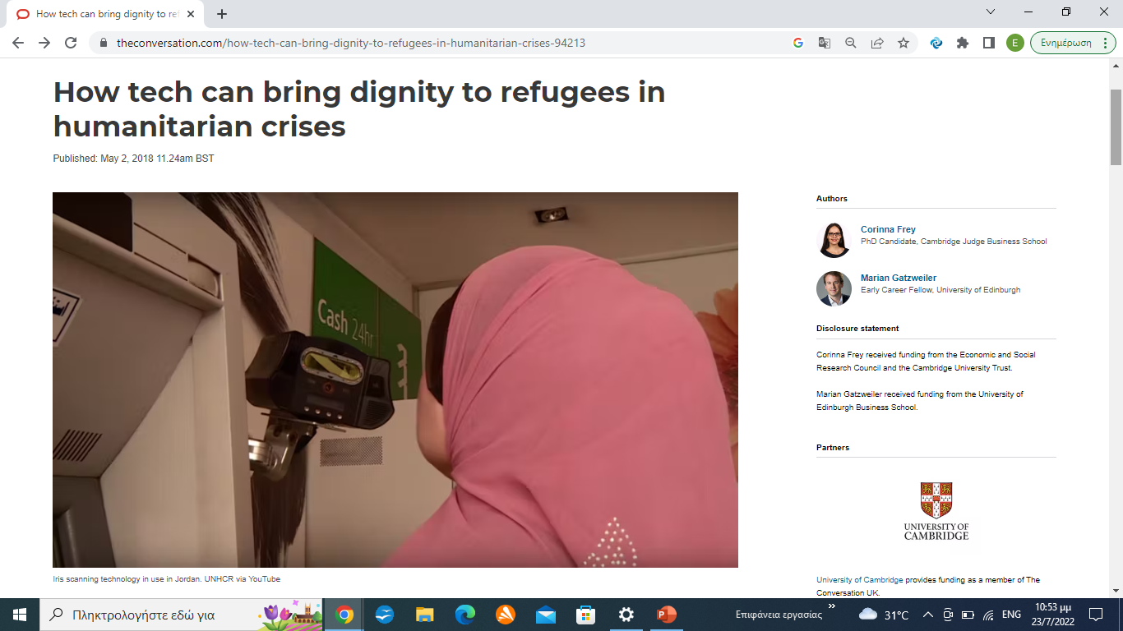

Slide 6
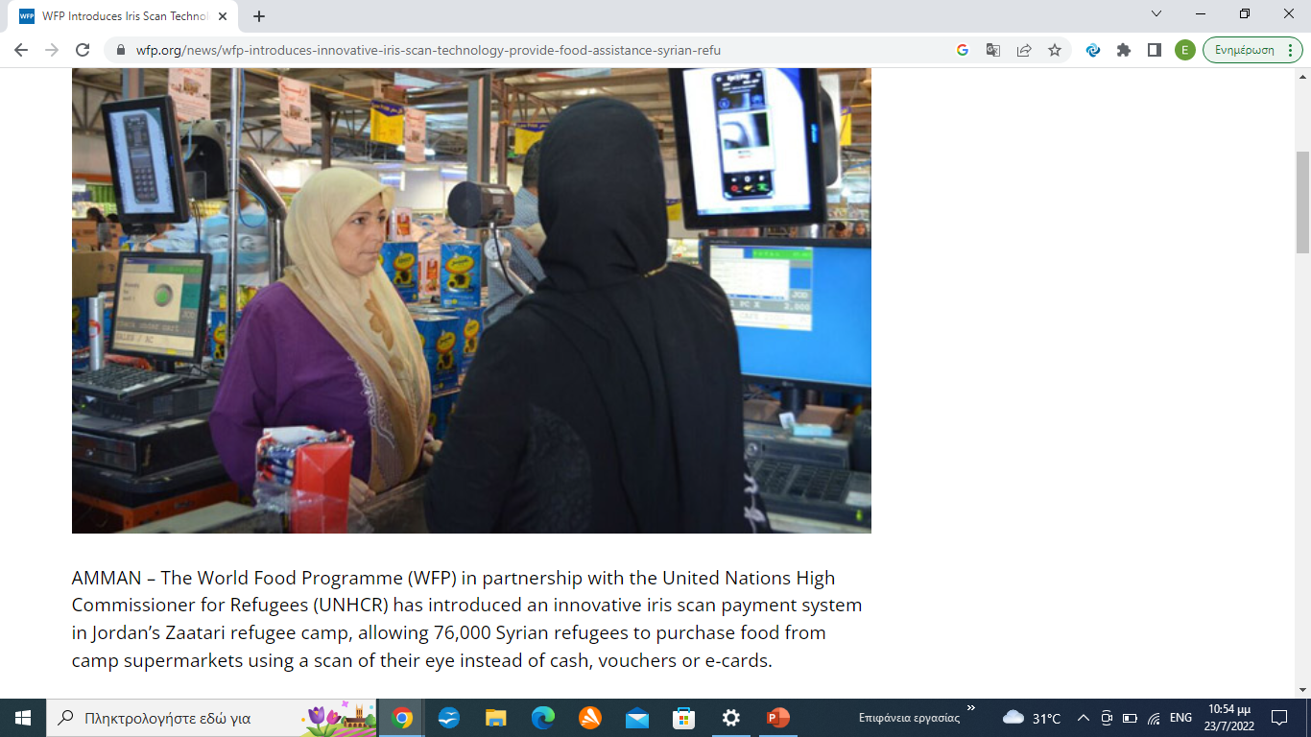

Slide 7
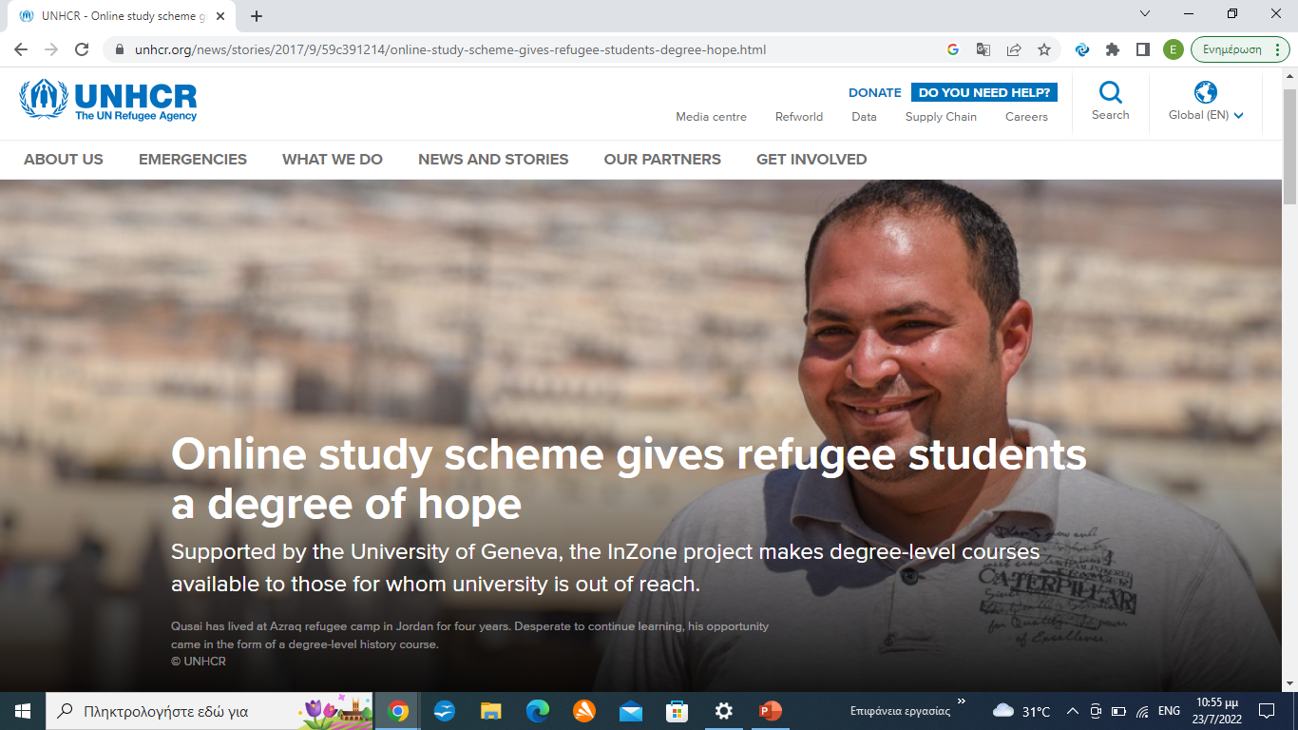

Slide 8
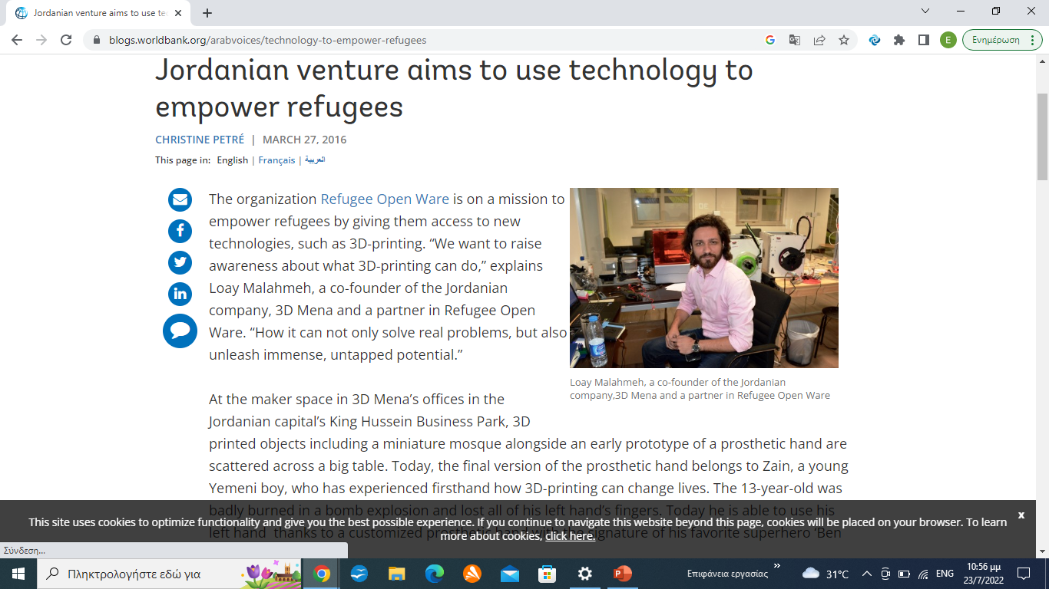

Slide 9
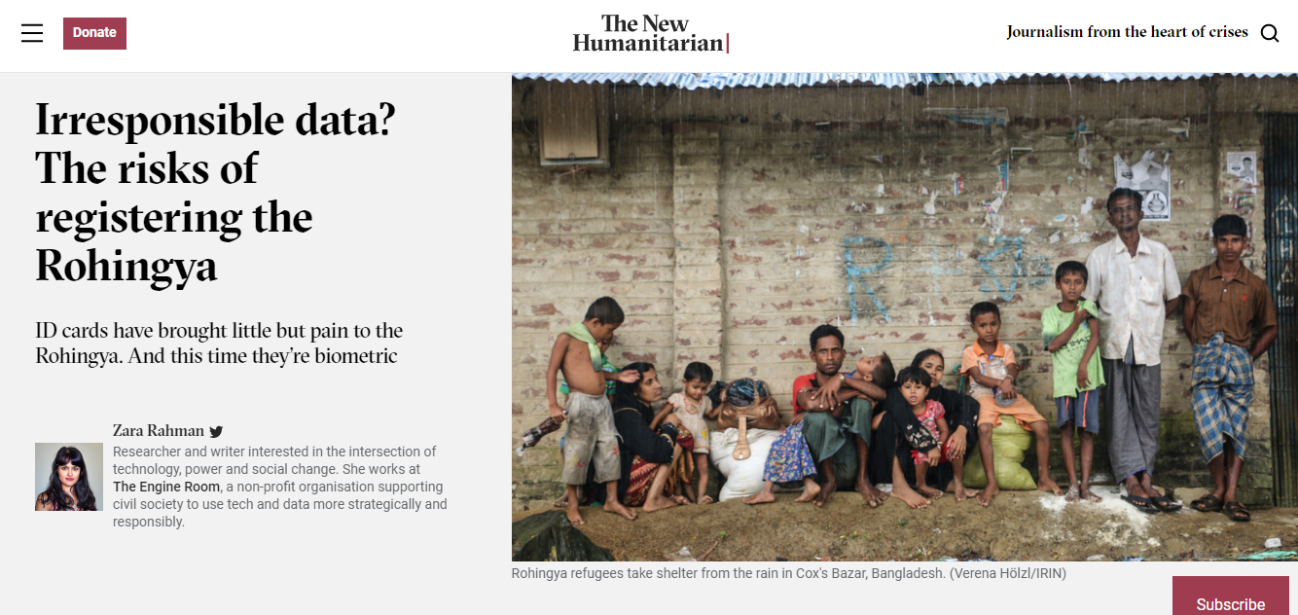

Slide 10
The responsible data considerations are numerous and complex.
What data should be collected, by whom? Who has access to it? In case of machine or human error, what processes are in place to review and make changes? What could be the unintended consequences of these growing databases? How could the data be abused?

Slide 11
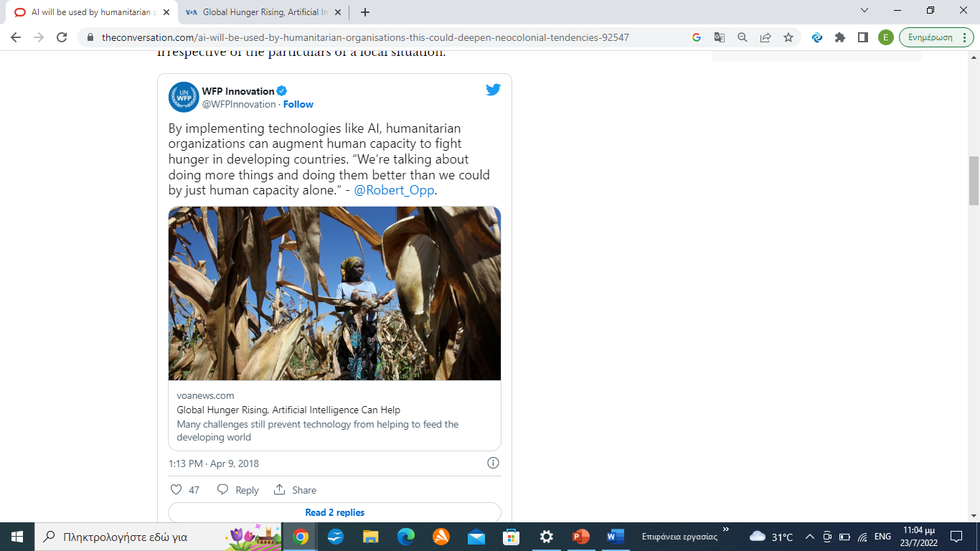

Slide 12
AI is broadly understood as “a collection of technologies that combine data, algorithms and computing power”
AI in support of a paradigm change: From reactive to anticipatory approaches to humanitarian action
Three main areas are of particular relevance in the context of humanitarian action: data quality, algorithmic bias, and the respect and protection of data privacy.

Slide 13
In general terms, poor data quality leads to equally poor outcomes.

Slide 14
Bias is considered here not only as a technological or statistical error, but also as the human viewpoints, prejudices and stereotypes that are reflected in AI systems and can lead to unfair outcomes and discrimination

Slide 15
As is internationally agreed, “the same rights that people have offline must also be protected online”
Surveillance - protectionism

Slide 16
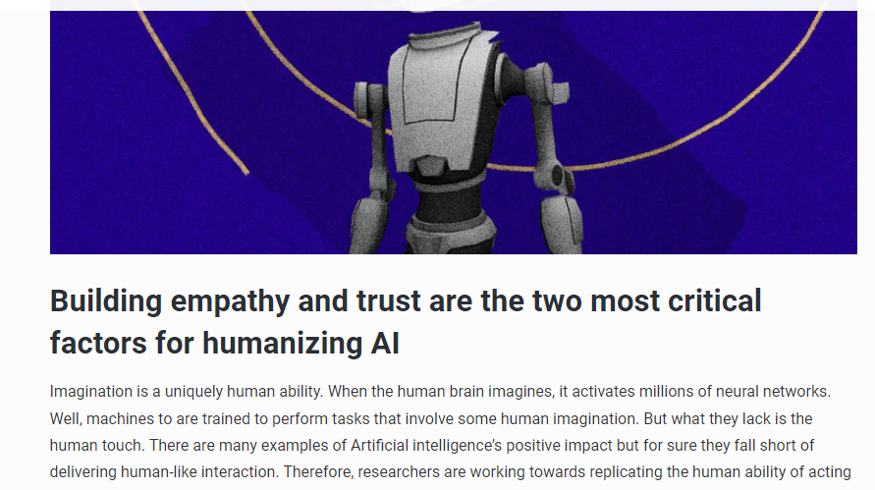

Slide 17
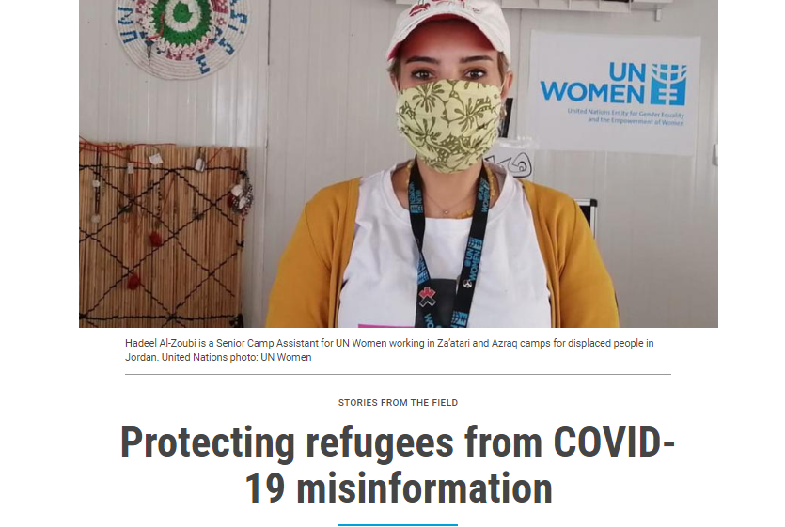

Slide 18
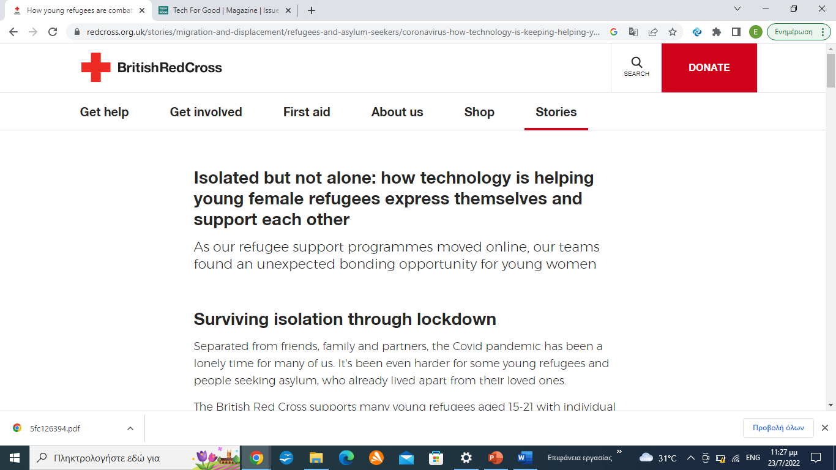

Slide 19
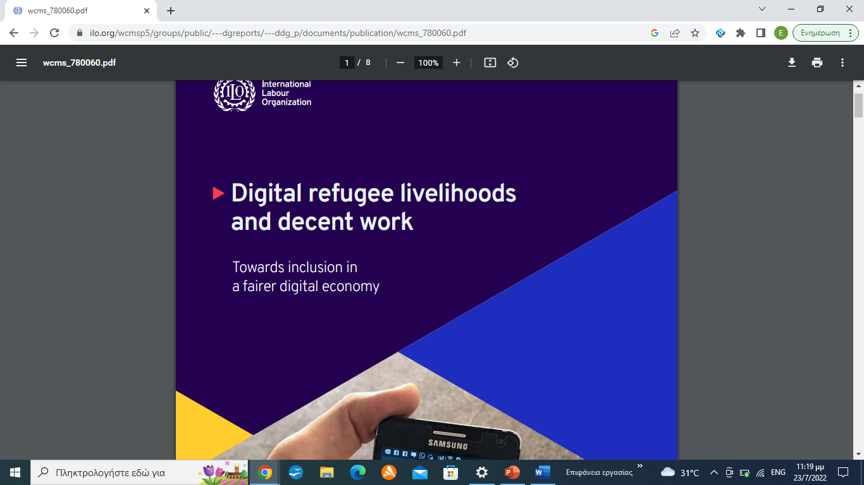

Slide 20
