Slide 1
Refugee / Migration Flows Old and New Media
Agenda setting and Framing Immigration in the News
Professor emerita Roy Panagiotopoulou
Department of Communication and Media Studies
National and Kapodistrian University of Athens
rpanag@media.uoa.gr

Slide 2
Lectures: Friday 16:00-19:00, room 302
17.10. Agenda setting, Framing Immigration in the News
24.10. Media as an additional source of negative attitudes towards immigration
31.10. European media discourse on immigration. Journalism culture, migration integration policy and public opinion
07.11. Migration and populist rhetoric

Slide 3
Student performance evaluation for the next 5 lessons
This module is covering 30% of the total grade of this course.
All students will have to prepare and upload on e-class a paper of no less than 1000 and no more than 1500 words on the given topic below and delivered latest on 19.1.2026. The other two modules will cover 30% of the total grade each. Finally, 10% of the total grade will be covered by active participation in class.

Slide 4
Topic of required paper
Please examine a newspaper or news site of your choice from 1.10.2025 to 31.10.2025 regarding the news coverage of Israel / Palestine war, especially the negotiations on ceasefire and peace (?). The source should be in either English, or Greek, or German or Spanish and please provide all URL of the used articles. The number of cases (articles) should be between minimum 50 and maximum 100 articles.
Please build frames (categories) and sub-frames (sub-categories) to classify the text content. Write your own text explaining the categorization selected, justify, discuss your choice, and give a short description on what kind and how information was provided.

Slide 5
Content of this module
Agenda setting
Concept of agenda setting (McCombs and Shaw)
Media agenda setting
Indicative criteria for news selection
Framing definitions, theories, paradigms (Goffman, Gitlin, Entman, D’Angelo)
Framing of immigration in the News
Negative discourse, emotions
Reports and research on migration ‘crisis’ in the EU
Framing immigration a research (frame building)

Slide 6
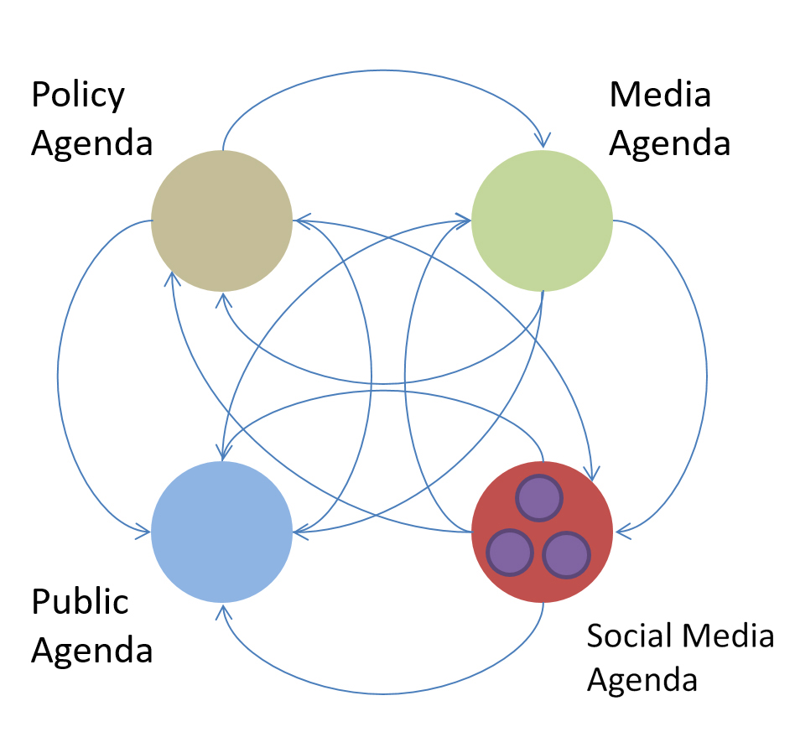
Agenda setting

Slide 7
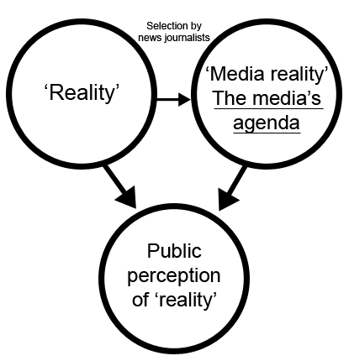
Agenda setting
The concept of agenda-setting is founded in the study of the media, and particularly the press, and is linked to the famous aphorism that the media ‘cannot tell you what to think, only what to think about’ (McCombs and Shaw, 1972)
The agenda is, at the simplest level, what is the news; at a more sophisticated level, how that news is reported.
Agenda setting describes the process by which the news media shows the public what is important by giving more salience to certain events and issues more than others.

Slide 8
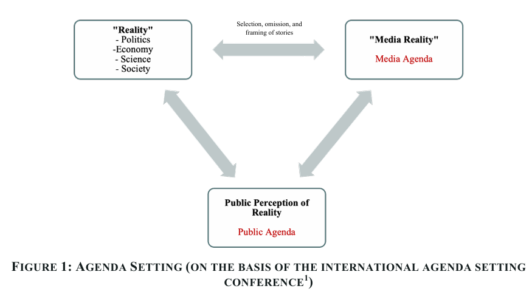
Agenda setting – Reality - Perceptions
Source: https://www.agendasetting.com/agenda-setting-research

Slide 9
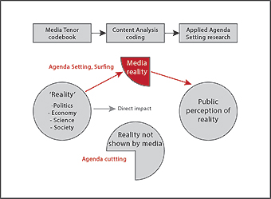
Agenda setting – Reality - Perceptions
Source: https://www.agendasetting.com/agenda-setting-research

Slide 10
Agenda setting
In a mediated democracy, politicians often battle to determine what is on the front page of the newspapers, or the leading item on the news. The agenda is the news of a particular day, more specifically the story, and how the news is told. Not only do politicians battle with each other, they also battle with the media, who may have opposing news values and wish to treat a story differently to that which the politician desires.

Slide 11
Agenda setting
Agenda-setting is the important part of any campaign, but can have a negative impact on civic society and the public sphere due to the public becoming cynical about the information it receives.
Governments or political parties can restrict public access to the facts and enforce the notion of the hegemonic model in an information society.
Agenda-setting plays a key role in any political organization's news management strategy, it provides work for spin-doctors and is a key feature of the public relations state. Recently it plays a major role on fake news construction and dissemination.

Slide 12
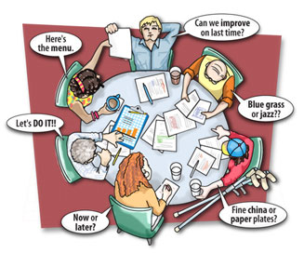
Agenda setting
In a pluralist democracy, where there are a number of competing voices on any issue, it seems obvious that all of these will also compete over the media agenda.
Pressure groups can find themselves excluded from the agenda, while others suspect that corporations pay for greater control.
It has long been noted that there are insider and outsider groups in any society, and that the insider groups have far greater access to the news agenda than those outside.
Many posit that it is the media that set the agenda, and that each media organisation has its own agenda; therefore the political communicators are compelled to respond with news management techniques.

Slide 13
Indicative criteria for news selection
Personal e.g., Journalist preference for certain topics, journalist’s personal engagement, ideological position.
Journalistic based on journalism values and codes of conduct that can differ among news agencies (e.g., information importance, “commercial value” of information, etc.)
Organisational priorities and working conditions in media enterprise, routines, disposable time for research, ideological premises, specialization in certain kind of themes, pressure from outside, fulfilling of interests.
Institutional if a topic deals with specific institutions of social or political organization, (e.g., state, government, political parties, international relations, etc.).
Social how far does a topic concerns social life, affects peoples lives, how many are affected, etc.

Slide 14

Framing

Slide 15

Framing

Slide 16

The notion of a frame
The notion of a frame derives from the cinema and from architecture. It is used as a metaphor schema to interpret the role of media in the process of information production and dissemination. Furthermore, to underline this process for the public.
The frame as a metaphor is used similarly as the frame of a photography. It isolates a certain part of an icon and puts emphasis on it while the other part of the icon remains unseen.
This notion is used in different ways in various scientific fields and themes to describe different meanings or concepts or attitudes and finally to lead to different research and scientific results.

Slide 17
Framing approaches and definitions
In his initial and widely quoted definition, Erving Goffman characterized frames as follows:
“I assume that definitions of a situation are built up in accordance with principals of organization which govern events […] and our subjective involvement in them; frame is the word I use to refer to such of these basic elements as I am able to identify” (Goffman 1974: 10f).
In other words, frames are basic cognitive structures which guide the perception and representation of reality. On the whole, frames are not consciously manufactured but are unconsciously adopted in the course of communicative processes. On a very banal level, frames structure, which parts of reality become noticed.

Slide 18
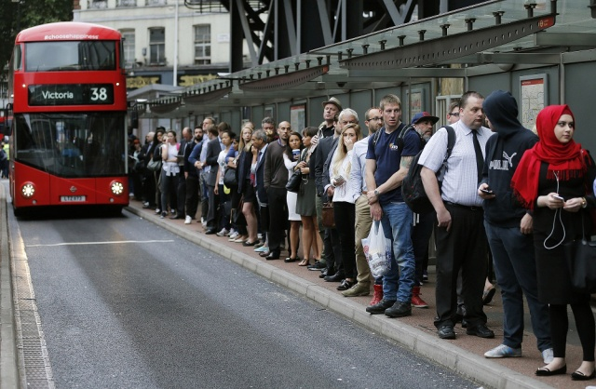
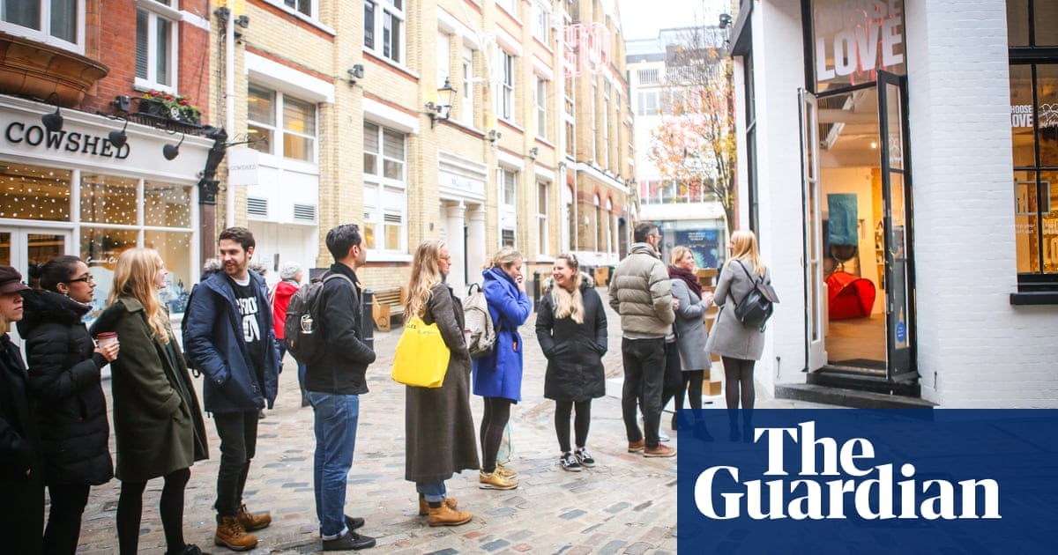
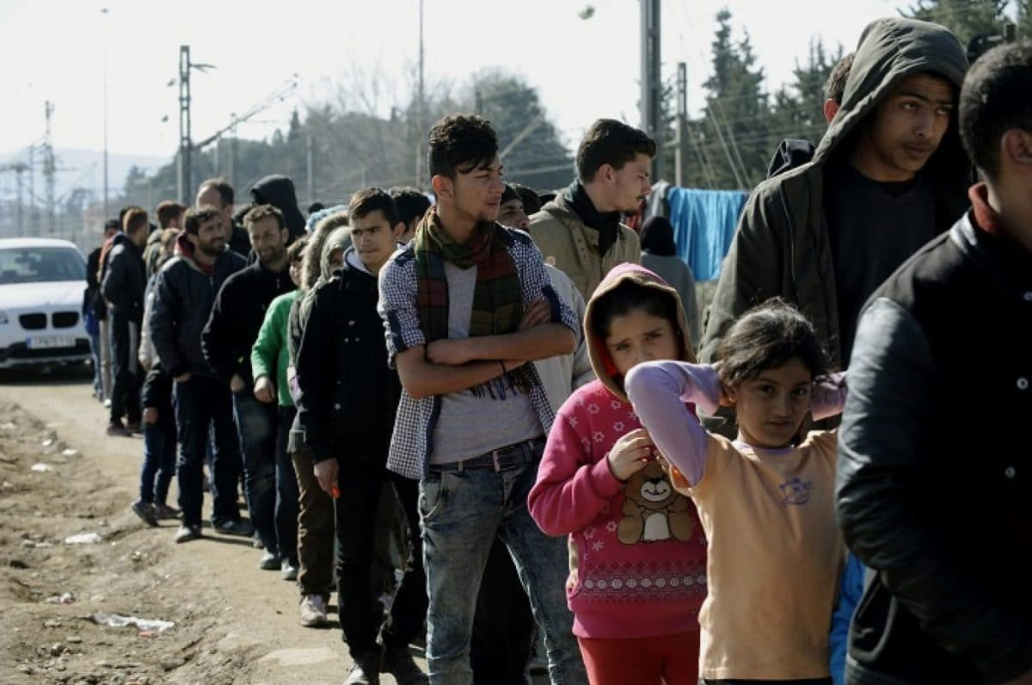
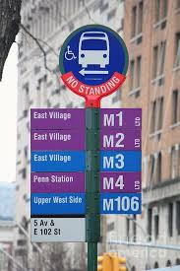
Queuing for….
Bus queuing in UK (bus queue frame)
Shopping queue frame
Refugees queue frame for what???
Refugees queuing for the bus (bus queue frame)

Slide 19
Framing definitions I
Todd Gitlin (1980: 6) has summarized the following frame elements most eloquently in his widely quoted elaboration of the frame concept:
“Frames are principles of selection, emphasis and presentation composed of little tacit theories about what exists, what happens, and what matters."
While it is hard to improve theoretically on this definition, the trouble starts, when it comes to the identification and measurement of frames. Precisely because frames consist of tacit rather than overt conjectures, notorious difficulties to empirically identify frames arise.
The difficulty of measuring latent frames could partially explain the gradual theoretical shift towards a conceptualization of frames as being more actively adopted and manufactured.
Gitlin suggest to analyze framing in two levels:
as a selection process by journalists or
as the consequences of these selections to the individuals (information receivers).

Slide 20
Framing definitions II
Particularly in media studies, it has become commonplace to treat the choice of frames as a more or less deliberate process. Entman's famous definition of frames led the way. For Entman,
“[t]o frame is to select some aspects of a perceived reality and make them more salient in a communicating text, in such a way as to promote a particular problem definition, causal interpretation, moral evaluation, and/or treatment recommendation.” (Entman 1993: 52)

Slide 21

Entman’s framing approach I
Entman distinguishes two different kind of frames:
The media frames: characteristic for news production
The individual frames: as schemata of information elaboration.
While it is argued that the frames act as heuristics, cognitive shortcuts, emerging from within the audience, that enable the easy processing of information, this is countered by arguments that information becomes oversimplified and distracts the public from the important issues.
Each of the above frames are heavily criticised for their effect upon the audience, and their corresponding relations with and perceptions of the political system. Frames can receive a strong persuasion power.

Slide 22
Entman’s framing approach II
Entman noted that most events are covered globally; however, the way in which events are covered and presented to each audience can lead to a dominant perception emerging.
While linear and direct media effects are contested, concerns remain that stories which concentrate purely on the negative consequences, for example, of joining the European Monetary Union in Denmark and the UK result in the public voting against joining without being given access to objective facts, referendum for Brexit / remain, refugees are taking away jobs from natives, etc., have a more durable effect.

Slide 23
Entman’s framing approach III
Audiences may also create their own frames for news items, as well as a wide range of other forms of political communication, marketing communication and popular culture. The idea is that, like the media, they link any event to their knowledge of similar past events; therefore the way they perceive events, interpret their consequences and then organise their thoughts on events are all linked to their consciousness.

Slide 24
Framing reality?
Media frames shape public opinion by highlighting certain aspects of an issue while downplaying others through language, visuals, and narrative.
When we talk about the effects of framing or the framing theory in the context of media, the basis is that certain events are focused by the media heavily and these events are placed within certain contexts. The audience is presented with certain information (known as the frame) and based on that information the audience chooses how to process that information.

Slide 25
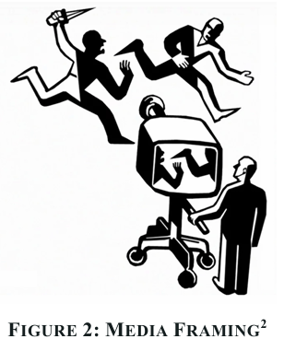
Framing reality?
Source: Psychology Magazin, \https://www.psychologs.com/why-should-we-talk-about-media framing/

Slide 26
Migration Frames: An example
Economic dimension
Welfare state deconstruction, rise of unemployment
Rising costs for immigration, asylum, care and shelter
Political dimension
Increase of far-right parties (political dissatisfaction, aggression)
Euro-sceptics vs Euro-optimist, EU integration policy (national priority vs European, solidarity among member states)
European Solidarity vs national particularity (interest)
Schengen agreement (refugee routes, closed borders, stranded refugees, hot spots, responsibility to guard the border)
Migrations control (common policy, securitization)
Efforts to shape common migration policy vs national measures (Relocation, reunion)
Social dimension
Anti-immigrant attitudes, authoritarian attitudes (threat, xenophobia, fear, uncertainty, criminalization of irregular migration, neighborhood protection)
Favorable in group attitudes (national superiority)
Human rights protection (refugee, asylum policy, against xenophobia)
Humanitarian crisis (deaths, Mare Mortem, smugglers, camps conditions)
Demonstrations pro – contra migration

Slide 27
Public discourse about migration shaped by the Media
Given the central role of migration, it appears important to consider the role of mass media in (re)shaping public discourse and possibly public opinion about migration.
Over the past two decades, migration has become one of the decisive socio-political topics worldwide.
Publications and debates over:
Effective border controls
Social integration of migrants
Social consequences of migration for host societies
Political consequences (right wing, populist or anti-immigration parties)

Slide 28
A multi-paradigmatic research program.
Particularly in media studies, it has become commonplace to treat the choice of frames as a more or less deliberate process.
D’Angelo’s (2002) frame approach is a multi-paradigmatic research program. He elaborates three sub-paradigms (Kuhn):
The cognitive paradigm which deals with frames influence in the elaboration of information. The negotiation that occurs when the frame interplays with previous knowledge is considered as decisive. The creation of coherence among the cognitive schemata of the individual is also important.

Slide 29
The critical paradigm and prevailing frames
The critical paradigm focuses on the relationship between journalists and political or economic elites as well as on labor values and on journalist working conditions. These elements determine the selection and processing of political information.
The prevailing frames in the news broadcasting prevail also as interpretation frames for the public.

Slide 30
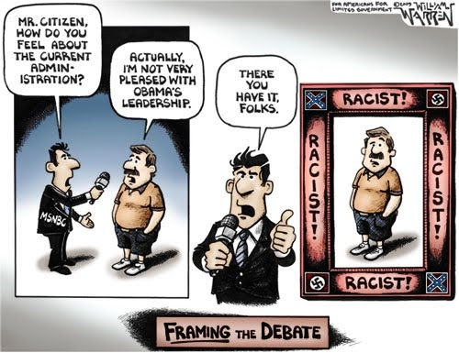
The constructionist paradigm
In the constructionist paradigm, journalists are seen as information processors and as creators of interpretative packages which partly derive from their sponsors. Frames in this concept act as mirrors and as creators of the examined topic at the same time.

Slide 31

Framing paradigms (Semetko, Valkenburg)
Semetko, Valkenburg (1991) identify five popular ways for framing news stories (fundamental components):
Conflict: this focuses on disagreement and division, often within political parties. E.g., TV debates between candidates. Correspondingly, conflict between parties, especially in the US media, can be prioritised, as opposed to the actual decisions made.

Slide 32
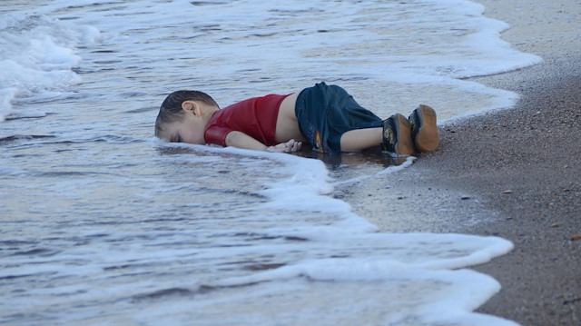
Framing paradigms (Semetko, Valkenburg)
Human Interest / Personalisation: this introduces emotionalisation to news reporting and usually provides a story with a human face. Individual victims of natural disasters, wars or humanitarian crises are argued to have greater impact than facts and figures that are impossible to comprehend. While this can personalise politics by showing the effects of policy, it can also mean personality is promoted over other more important aspects.
Consequences: while often focusing on economic ramifications of events (Semetko and Valkenburg, 2000), consequences can be wide ranging. Pursuing a policy may be unwise in terms of unity within a party or coalition or in terms of the status of a nation globally.

Slide 33
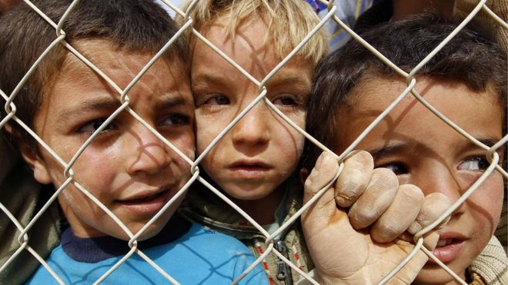
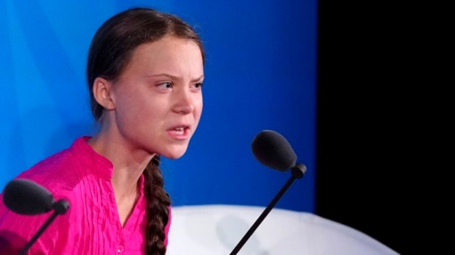
Framing paradigms (Semetko, Valkenburg)
Morality: media coverage can often moralise, sometimes due to the indiscretions of political actors; or alternatively, policies can be seen to be morally questionable (the encounter of migrants from Mexico by President Tramp, or of prisoners in Guantanamo Bay, take a moral tone). Equally, the drowning of many migrants in their effort to cross the Mediterranean was characterized as Mare Mortum ‘deadly sea crossing’.
Responsibility: this frame attributes responsibility, either for a cause or a solution. In the wake of the Asian tsunami one frame was ‘global responsibility’ for finding solutions as well as blaming the lack of preparedness on the local governments. The same applies for climate change and Greta Thunberg’s campaign, or “EU migration policy: Evolving ideas of responsibility and protection”.

Slide 34
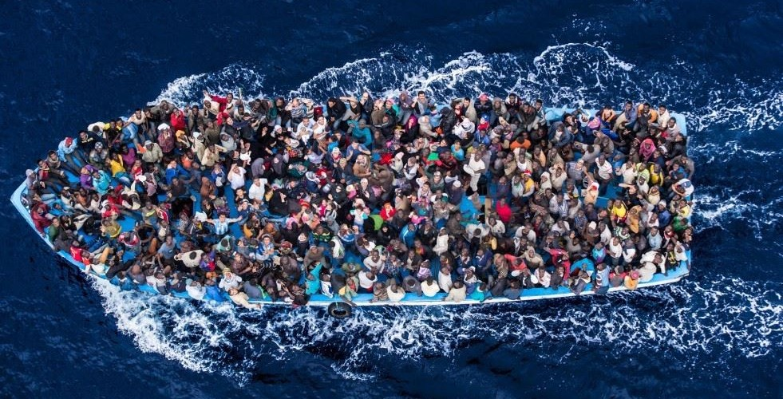
Familiar contextualisation
Framing describes the practice of thinking about news items and story content within familiar contexts. The media can be instrumental in creating these frames by introducing news items with predefined and narrow contextualisation. Frames can be designed to enhance understanding, or are used as cognitive shortcuts to link stories to the bigger picture.
The refugee ‘crisis’ is a good example of frame creation and of introduction into a new predefined contextualisation (refugees / migrants, ethnic / multicultural identity, criminal / legal, danger / security, enrichment of receiving societies, multiculturalism, etc.).

Slide 35
Comparison of Media Effects between Agenda setting and Framing
Media Effect | Type of Media | Specific effect | Examples | Influence varies by:
Agenda setting | Increases the amount of news coverage (e.g. # of stories) | Importance of issue | “It’s the economy, stupid” (B. Clinton’s 1992 electoral campaign) | Media trust, Political knowledge
Framing (Issue or Emphasis) | Changes in the content (frames) of a story about an issue | Criteria used to evaluate the issue | Headlines, pictures interpret “meaning” of story (e.g. Migrants: How many more can we take? – Daily Mail 28.8.2015) | Predisposition Source Competing frames
Source: https://www.slideshare.net/mpeffl/475-media-effects-framing-etc-2012-up-15549363

Slide 36

Framing of immigration in the News

Slide 37
Media representation of migration
The migration issue is vastly multidimensional. The literature on the subject is, so far, fragmented and geographically biased.
Media representation of migration has dramatically changed during recent years, and is impacted by larger developments (e.g. digitalization, rise of populism).
The way media treat the migration topic may have strong influences on parts of the citizenry - causing a detrimental spiral of negative attitudes and outgroup thinking.

Slide 38
Main topics in studies on migration
How to control migration flows into certain regions by improving development aid
Combating human trafficking
Improving border control mechanisms
Streamlining procedures to differentiate legal and illegal migration
Decide about distributions of migrants within and across receiving countries
How to make sure migrants are cared for after coming into the host countries
Including initiatives for social and economic integration
Language and integration courses
Management of work opportunities and training programs
Housing programs
Education of minors
Values and potential clashes between the receiving country’s culture and value system and that of new migrants
Possible threats of migration to the cultural integrity of the host country
The role of religion, in particular Islam
Possible perceived or real economic and security threats
Emigration and associated brain drain affecting the sending countries.

Slide 39
Framing Immigration in the News
For mainstream news media, political bloggers, professional political communicators, emerging players and engaged citizens (social media) are all part of the dynamic media system of political communication, which is to an extent displacing or destabilising the concentration of media or communication power from elites and distributing it in a wider albeit unpredictable manner (Chadwick 2013, Siapera 2019 :2).
Looking at the media discourses on refugees, two things emerge:
first that such discourses follow a time honored tradition of being negative and skeptical towards refugees, and
second that such coverage is occasionally disrupted by unexpected media events.

Slide 40
Negative discourse – framing
Research has highlighted the negative discourses congealing around refugees/migrants/asylum seekers since at least the 1980s. Media have demonizing migrants and asylum seekers: they have become the contemporary ‘folk devils’ (UK).
Refugees - migrants were seen as ‘invaders’ ‘flooding the country’ in order to ‘steal’ from social welfare. Any resistance by the refugees, who were generally constructed as passive and reactive, was seen as ungratefulness.

Slide 41
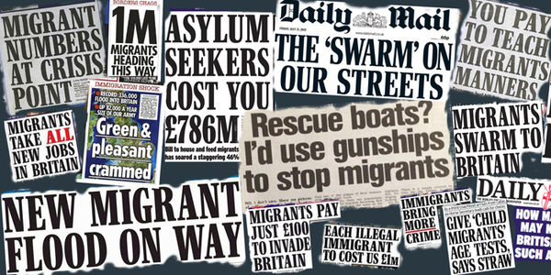
Front-pages from British Press

Slide 42
UNHCR Report: Press Coverage of the Refugee and Migrant Crisis in the EU
In a report (spring 2015, before the big rise in numbers later that year) to the United Nations, Berry et al. (2016) analysed mainstream media coverage of the refugee crisis in five countries: the UK, Germany, Italy, Spain and Sweden.
The report found variation in the coverage, with the British press being most aggressive towards refugees and Sweden focusing more on humanitarian issues. Top sources were politicians, political institutions, experts, NGO actors.
Although there were differences between the five, coverage tended to focus on the pull factor, that is, the reasons Europe is found an attractive destination, rather than the push factor, that is, the situation in the refugees’ home countries.

Slide 43
UNHCR Report: Press Coverage of the Refugee and Migrant Crisis in the EU
Media were in effect ‘making’ a ‘crisis’ through producing almost exclusively negative stories, often using unreliable statistics and hostile politicians.
German media make divisions between deserving refugees and undeserving migrants. There are humanitarian discourses in the media, these are within a moral context in which refugees must always show gratitude while Germans/Europeans are constructed as humanitarian heroes.

Slide 44
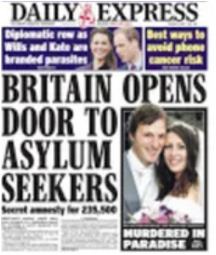
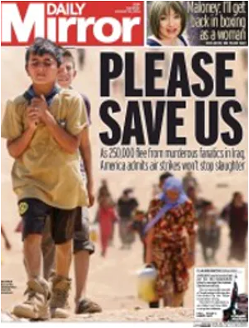
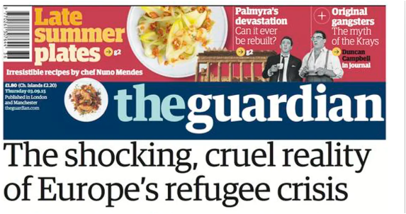
Humanitarian discourse on the front-page

Slide 45
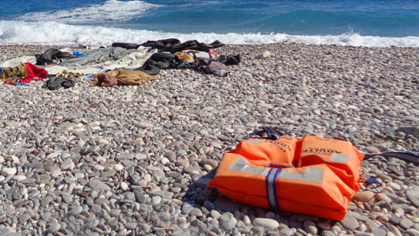
Refugees objects of pity or fear?
Overall, mainstream media appear to construct a negative and problematic narrative of the refugee issue, in which the figure of the refugee appears as an object of pity or an object of fear (Siapera 2019:4). In Hannah Arendt’s (1990: 88) famous formulation, pity is the opposite of solidarity.
Themes such as war and humanitarian crisis prevailed at the beginning of 2015 migration flows. After a few months the discourse shifted around themes such as illegal trafficking.
A new narrative on solidarity as the bonds which hold society together (migrants social integration, etc.) and as an act towards a humanitarian solution of the ‘crisis’ has emerged shortly after the culmination of the migration flows.

Slide 46
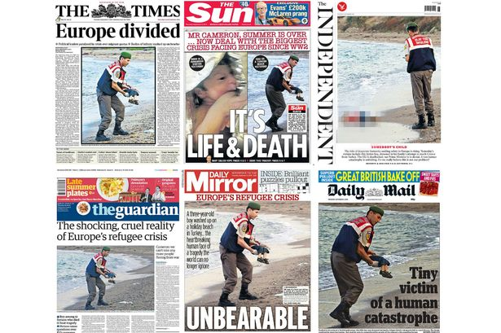
Media and the death of Aylan Kurdi (media event)

Slide 47
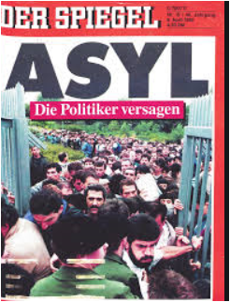
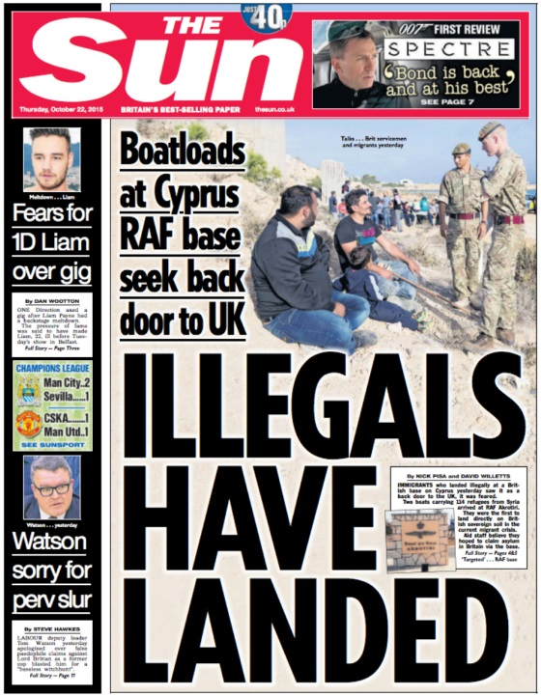
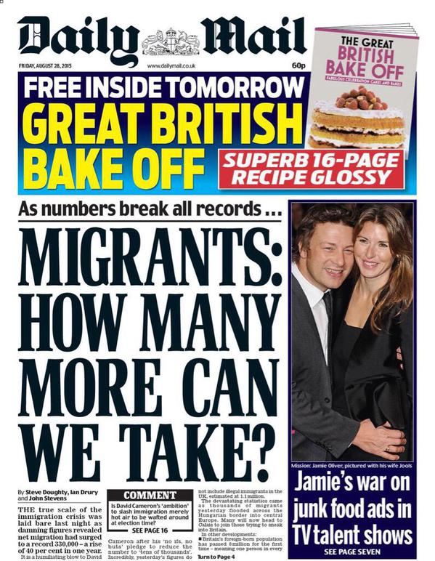
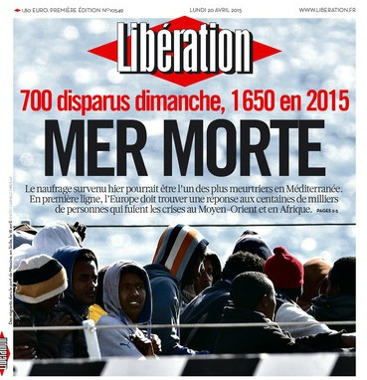
Framing immigration: a research
Example of frame building in a research project on
Representations of migration ‘crisis’ in the Press in three EU countries (France, Germany, Greece) from 1.10.2015 to 31.5.2016.

Slide 48
Newspaper articles regarding migration crisis during the period 1.10.2015 – 31.5.2016
Newspaper | France | Germany | Greece | Examined articles
Liberation | 940 |  |  | 108
Süddeutsche Zeitung |  | 2000 |  | 189
Kathimerini |  |  | 1773 | 103
To Vima |  |  | 465 | 42
Total number of articles | 940 | 2000 | 2238 | 5178/442 (8.5%)

Slide 49

Frames
Economic dimension
Welfare state deconstruction, rise of unemployment
Rising costs for immigration, asylum, care and shelter
Political dimension
Increase of far-right parties (political dissatisfaction, aggression)
Euro-sceptics vs Euro-optimist, EU integration policy (national priority vs European, solidarity among member states)
European solidarity vs national particularity (interest)
Schengen agreement (refugee routes, closed borders, stranded refugees, hot spots, responsibility to guard the border)
Migration control (common policy, securitization)
Efforts to shape common migration policy vs national measures (relocation, reunion)
Social dimension
Anti-immigrant attitudes, authoritarian attitudes (threat, xenophobia, fear, uncertainty, criminalization of irregular migration, neighborhood protection)
Favorable in-group attitudes (national superiority)
Human rights protection (refugee, asylum policy, against xenophobia)
Humanitarian crisis (deaths, Mare Mortum, smugglers, camps conditions)
Demonstrations pro –contra migration

Slide 50
Euro-sceptics vs Euro-optimist, EU integration policy
Selected article titles:
Migrants: l’égoïsme dangereux des membres de l’UE Liberation, 26.2.2016
Will the EU survive? To Vima 3.1.2016[Θα επιβιώσει η Ευρωπαϊκή Ένωση;]
Euroscepticism and xenophobia To Vima 1.11.2015 [Ευρωσκεπτικισμός και ξενοφοβία]
Dutch Presidency in a eurosceptic athosphere. Migration crisis is a major problem according B. Kenders To Vima 30.12.2015 [ Ολλανδική προεδρία σε κλίμα ευρωσκεπτικισμού. Μείζον θέμα η προσφυγική κρίση σύμφωνα με τον ΥΠΕΞ, Μπερτ Κέντερς]
Esthonia‘s President: EU: Fear of dilution Süddeutsche Zeitung 19.5.2016 [Estlands Präsident Angst vor dem Kollaps der EU]
Asselborn is warning of Europe‘s dilusion cause of migration policy, Süddeutsche Zeitung 26. Oktober 2015 [Asselborn warnt vor Zerbrechen Europas durch Flüchtlingspolitik]
M. Vals: Migration crisis is threatening the idea of European Union Kathimerini 22.01.2016 [Μ. Βαλς: Η προσφυγική κρίση απειλεί την ιδέα της Ευρωπαϊκής Ένωσης]
F. Mogerini: EU is threatened of dissolution due to migration crisis Kathimerini 29.10.2015 [Φ. Μογκερίνη: Η ΕΕ κινδυνεύει με διάλυση από το προσφυγικό]
Steinmeyer: EU will disintegrate if she fails to deal migration crisis united Kathimerini 10.12.2015 [ Σταϊνμάγερ: Η E.E. θα καταρρεύσει αν δεν αντιμετωπίσει ενωμένη το προσφυγικό]
EU divided in migration crisis Kathimerini 18.2.2016 [Διχασμένη η Ε.Ε. στο προσφυγικό]

Slide 51
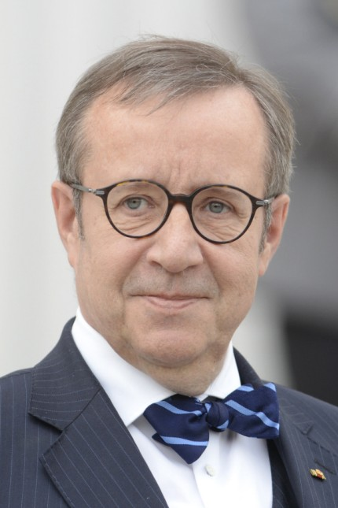
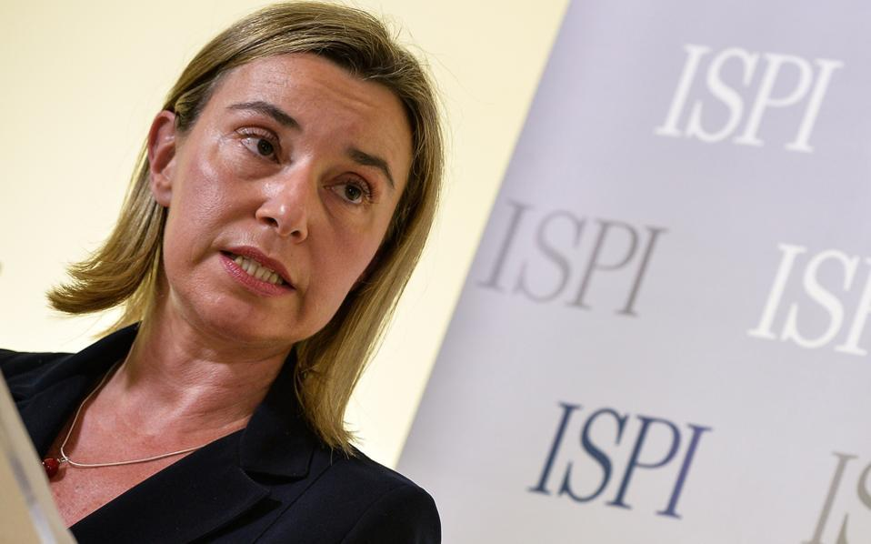
Euro-sceptics vs Euro-optimist, EU integration policy
Migration
Asselborn is warning of Europe‘s dilusion cause of migration policy, Süddeutsche Zeitung 26. Oktober 2015 [Asselborn warnt vor Zerbrechen Europas durch Flüchtlingspolitik]
Éditorial
Migrants: l’égoïsme dangereux des membres de l’UE,
Liberation, 26 février 2016
Esthonia‘s President: EU, Fear of dilution Süddeutsche Zeitung 19.5.2016 [Estlands Präsident Angst vor dem Kollaps der EU]
F. Mogerini: EU is threatened of dissolution due to migration crisis Kathimerini 29.10.2015 [Φ. Μογκερίνη: Η ΕΕ κινδυνεύει με διάλυση από το προσφυγικό]

Slide 52
European solidarity vs national particularity
Selected article titles:
Fin de l’Europe: la responsabilité française, Liberation 1.3.2016
Martin Schulz: «S’il y avait plus de solidarité entre nous, il n’y aurait pas de problème», Liberation 8.2.2016
La noyade des démocraties européennes Liberation 7.2.2016
Migration: Griechenland stößt in der Migrationskrise an seine Kapazitätsgrenzen Süddeutsche Zeitung 27.02.2016
Schuldenkrise und Flüchtlinge Geschundenes Griechenland Süddeutsche Zeitung 27.02.2016
G 20 Schäuble spielt den Flüchtlingsjoker Süddeutsche Zeitung 25.02.2016
Außenansicht Gerechtigkeit für Griechenland Süddeutsche Zeitung 21.02.2016
Flüchtlinge Visegrad-Staaten beraten über Balkanroute und «Brexit» Süddeutsche Zeitung 14.02.2016
Idomeni is frightening but they don’t have the courage to provide a solution. The debate in Germany to evacuate the camp remained only in words due to fear of uncontrolled migrant flows, To Vima 20.3.2016 [Η Ειδομένη φοβίζει, αλλά δεν αντέχουν να δώσουν λύση. Η συζήτηση στη Γερμανία για εκκένωση του καταυλισμού έμεινε στα λόγια υπό τον φόβο να ξαναρχίσει η ανεξέλεγκτη ροή προσφύγων]
Le Monde: Greeks fill betrayed by Europe To Vima 7.3.2016 [Οι Έλληνες αισθάνονται προδομένοι από την Ευρώπη].
FT: Europe is turning its back on Greece over refugees To Vima 29.2.2016 [FT: Η Ευρώπη γυρνά την πλάτη της στην Ελλάδα για τους πρόσφυγες. Ανθρωπιστική κρίση εν όψει]

Slide 53
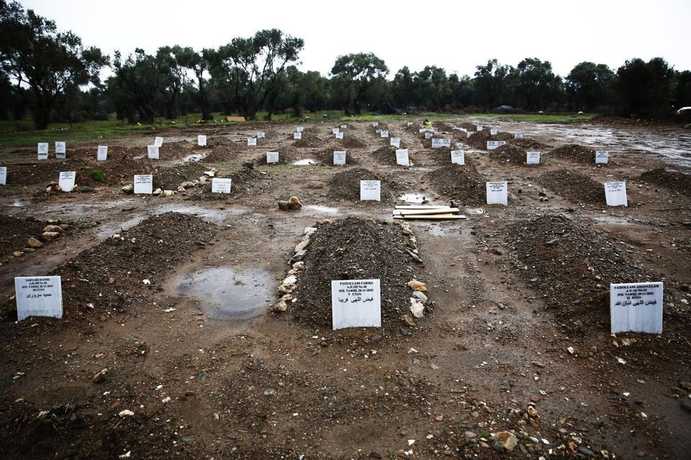
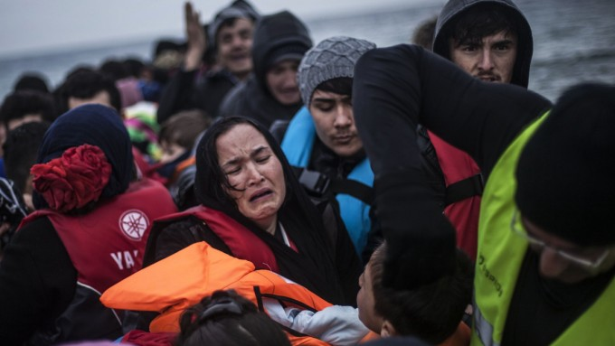
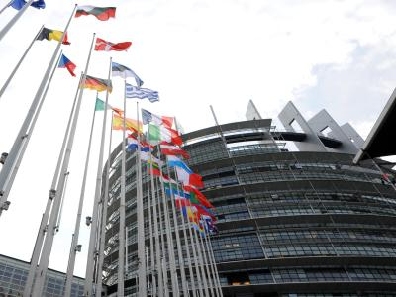
European solidarity vs national particularity
End of Europe: Frances’ responsability Liberation 1.3.2016 [Fin de l’Europe: la responsabilité française]
Debt crisis and migrants: Flayed Greece Süddeutsche Zeitung 27. 2.2016 [Schuldenkrise und Flüchtlinge Geschundenes Griechenland ]
EU Parliament: All EU countries should accept refugees, Süddeutsche Zeitung 12.4.2016
[EU-Parlament: Alle EU-Staaten müssen Flüchtlinge aufnehmen]

Slide 54
Schengen agreement at stake
Selected article titles:
Balkans: chaos sur la route des migrants Liberation 24.2.2016
Pourquoi ne peuvent-ils pas aller où ils veulent? Liberation 13.11.2015
La Grèce, le nouveau camp de rétention pour migrants de l'Union européenne? Liberation 3.3.2016
En 2015, plus d'un million de migrants sont arrivés en Europe, Liberation 22.12.2015
Bohuslav Sobotka: "Am Anfang muss die Kontrolle stehen" Süddeutsche Zeitung 22.12.2015
EU states should give up sovereignty to protect external borders Süddeutsche Zeitung 15.12.2015 [EU-Staaten sollen für Schutz der Außengrenzen Souveränität abgeben}
Austria and Western Balkans encircle refugees in Greece To Vima 24.2.2016 [Αυστρία και Δυτικά Βαλκάνια εγκλωβίζουν τους πρόσφυγες στην Ελλάδα]
Doctors Without Borders: EU failure over refugee crisis. They ask for safe routes To Vima 19.1.2016 [Γιατροί Χωρίς Σύνορα: Καταστροφική αποτυχία της ΕΕ για το προσφυγικό Ζητά δημιουργία «ασφαλών περασμάτων»]
Time of crisis for Schengen agreement To Vima 6.2.2016 [Ήρθε η ώρα της κρίσεως για τη Συνθήκη Σένγκεν]
Can we live locked? Kathimerini 23.3.2016 [Μπορούμε να ζήσουμε «κλειδωμένοι»;]

Slide 55
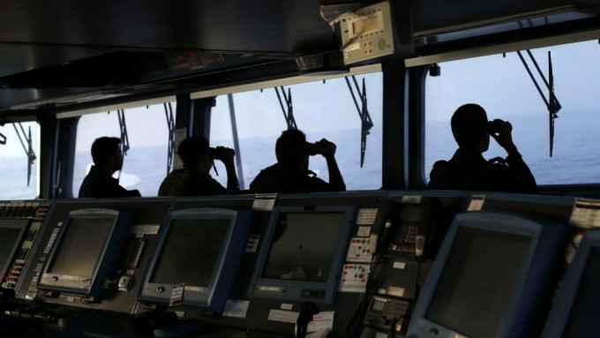
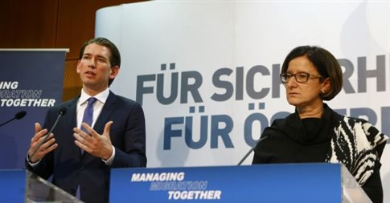
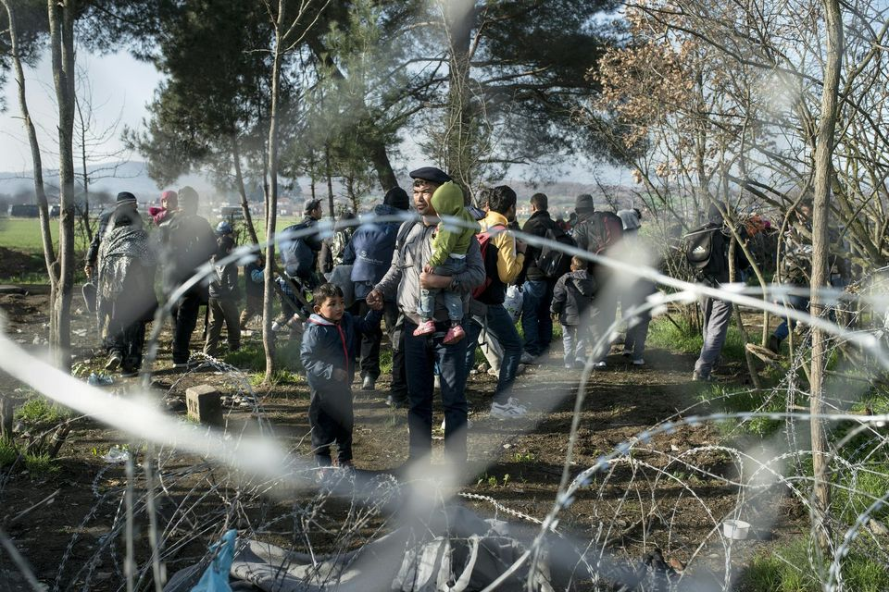
Schengen agreement at stake
EU states should give up sovereignty to protect external borders, Süddeutsche Zeitung 15. 12.2015 [EU-Staaten sollen für Schutz der Außengrenzen Souveränität abgeben]
Austria and Western Balkans cage refugees in Greece To Vima 24.2.2016 [Αυστρία και Δυτικά Βαλκάνια εγκλωβίζουν τους πρόσφυγες στην Ελλάδα]
Balkans: chaos sur la route des migrants Liberation 24.2.2016

Slide 56
Anti-immigrant attitudes, authoritarian attitudes
Selected article titles:
Dans la jungle de Calais: «On va nous prendre pour des terroristes», Liberation 17.11.2015
Hotspots shouldn’t become butter on bread of xenophobia and racism To Vima 12.2.2016 [Να μην γίνουν τα hotspots «βούτυρο στο ψωμί» της ξενοφοβίας και του ρατσισμού]
Migration Calais macht hilflos: Camerons Angstthema Migration Süddeutsche Zeitung 31.07.2015
Studie Vorbehalte gegen Flüchtlinge wachsen Süddeutsche Zeitung 07.03.2016
Migration Begeisterung für «Willkommenskultur» hat abgenommen Süddeutsche Zeitung 07.03.2016
Organized racists attacks Kathimerini 13.1.2016 [Οργανωμένες ρατσιστικές επιθέσεις]
Germany: For the first time 10% for AfD which takes an anti-refugees stance Kathimerini 10.11.2015 [Γερμανία: Για πρώτη φορά στο 10% τo ΑfD, που τάσσεται κατά της μετανάστευσης]
Orbans’ believes about migration gain territory Kathimerini 22.12.2015 [Οι απόψεις Ορμπαν για το προσφυγικό κερδίζουν έδαφος]
Anti –migration demonstrations of Pegida in European cities Kathimerini 6.2.2016 [Αντιμεταναστευτικές συγκεντρώσεις του Pegida σε πόλεις της Ευρώπης]

Slide 57
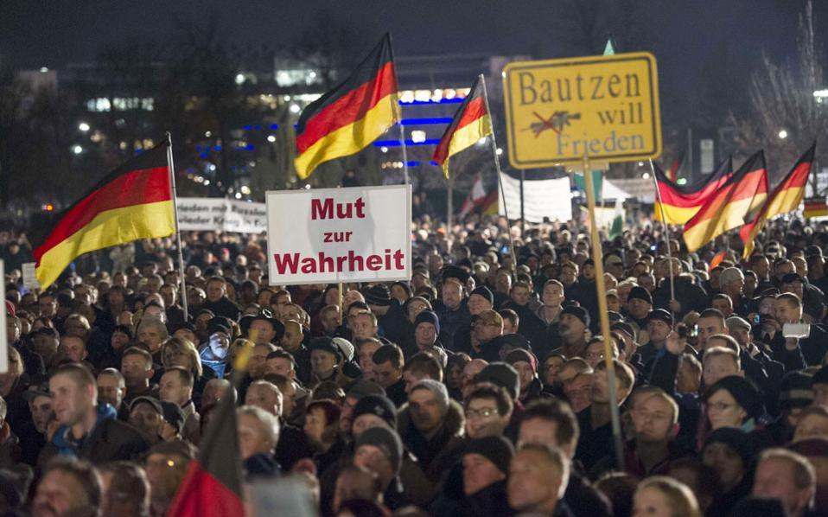
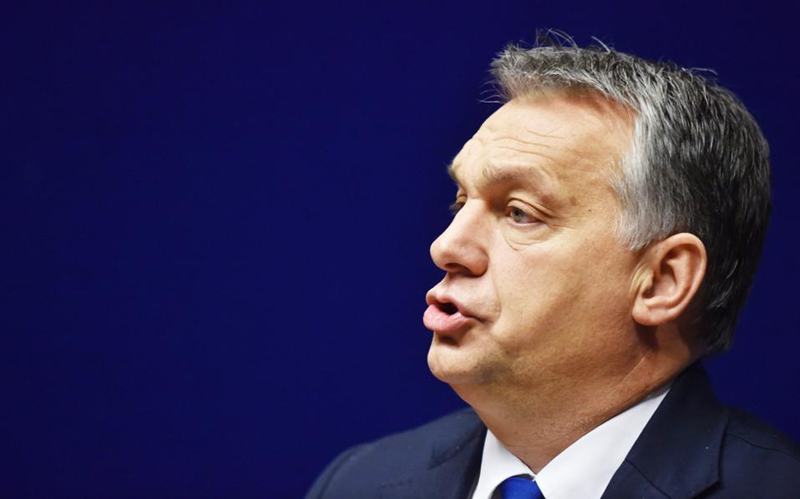
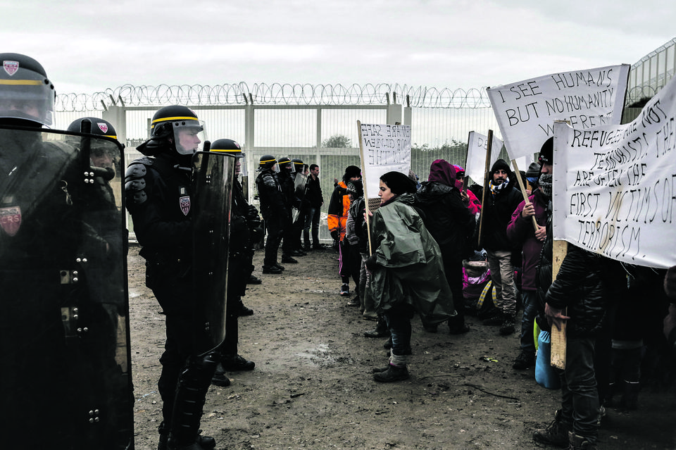
Anti-immigrant attitudes, authoritarian attitudes
Anti –migration demonstrations of Pegida in European cities Kathimerini 6.2.2016 [Αντιμεταναστευτικές συγκεντρώσεις του Pegida σε πόλεις της Ευρώπης]
Orbans’ believes about migration gain territory Kathimerini 22.12.2015 [Οι απόψεις Ορμπαν για το προσφυγικό κερδίζουν έδαφος]
Dans la jungle de Calais : «On va nous prendre pour des terroristes» Liberation, 17.11.2015

Slide 58
Increase of far-right parties
Selected article titles:
Poland: Extreme right cocktail of euroscepticism and populism. To Vima 01.11.2015
Causes of far right invasion To Vima 13/12/2015
Marin Le Pen is not alone: In Belgium, Austria, Netherlands, Denmark, Sweden, Switzerland Hungary and Poland far right Eurosceptic parties gain power due to migration and financial crisis To Vima 13.12.2015
Junker: Populism brings rage but no solutions for the migration crisis. To Vima 27.1.2016
AfD against foreign intervention in Syria [AfD gegen Auslandseinsatz in Syrien] Süddeutsche Zeitung 29.11.2015
Europhobic extreme right syndroms in Europe Kathimerini 25.3.2016 [Ευρωφοβικά, ακροδεξιά σύνδρομα στην Ευρώπη]
Patriotism, nationalism, euroscepticism Kathimerini 3.1.2016 [Πατριωτισμός, Eθνικισμός, Eυρωσκεπτικισμός ]
Commentary: The far right, the swamp, the fear and the leadership deficite Kathimerini 20.3.2016 [ Αποψη: Η ακροδεξιά, το τέλμα, ο φόβος και το έλλειμμα των ηγετών]
Nationalist fronts against Europe Kathimerini 10.1.2016 [Πατριωτικά μέτωπα κατά της Ευρώπης]

Slide 59
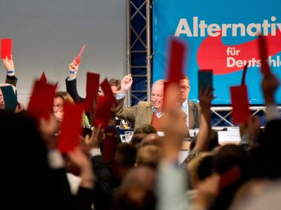
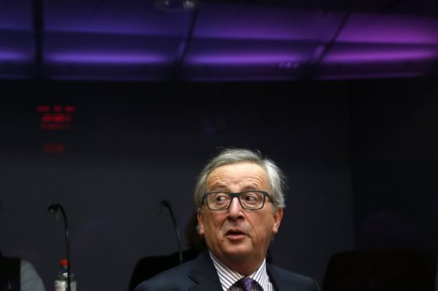
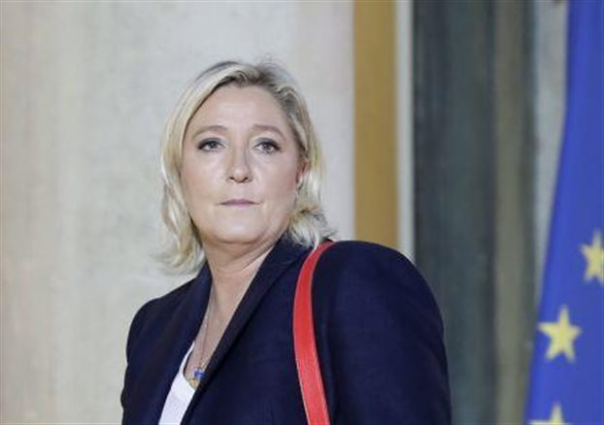
Increase of far-right parties
AfD against foreign intervention in Syria Süddeutsche Zeitung 29.11.2015 [AfD gegen Auslandseinsatz in Syrien]
To Vima 27.1.2016 [Junker: Populism brings rage but no solutions for the migration crisis]
To Vima 13.12.2015 [Marin Le Pen is not alone: In Belgium, Austria, Netherlands, Denmark, Sweden, Switzerland, Hungary and Poland far right Eurosceptic parties gain power due to migration and financial crisis]

Slide 60
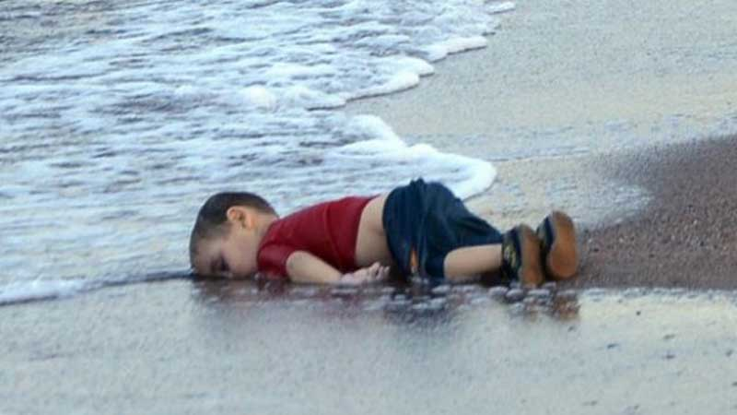
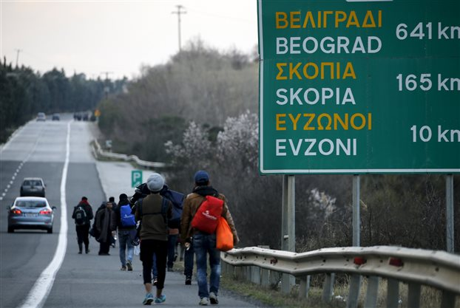

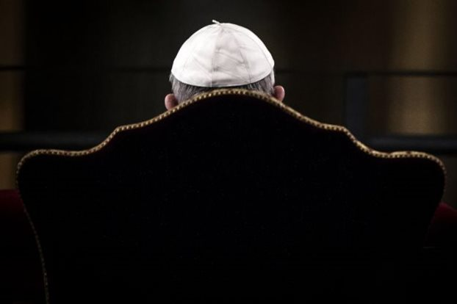
Humanitarian crisis
The phantom of a humanitarian crisis dissect the EU, To Vima 26.2.2016 [Τo φάντασμα της ανθρωπιστικής κρίσης διαμελίζει την Ευρωπαϊκή Ένωση]
Aylan Kurdi drowned on
2 September 2015
Pope: Mediterranean and Aegean Sea are an unsaturated refugee grave, To Vima 26.3.2016 [Πάπας: Μεσόγειος και Αιγαίο είναι ένα ακόρεστο κοιμητήριο προσφύγων]
Deux Aylan par jour, ça continue Liberation 19.2. 2016

Slide 61
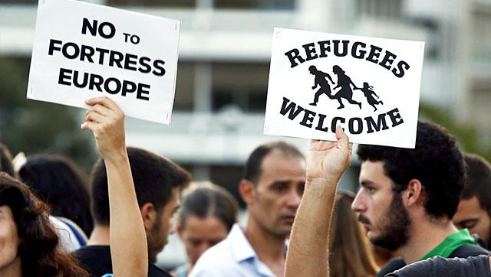
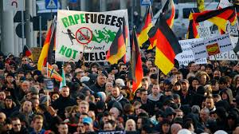
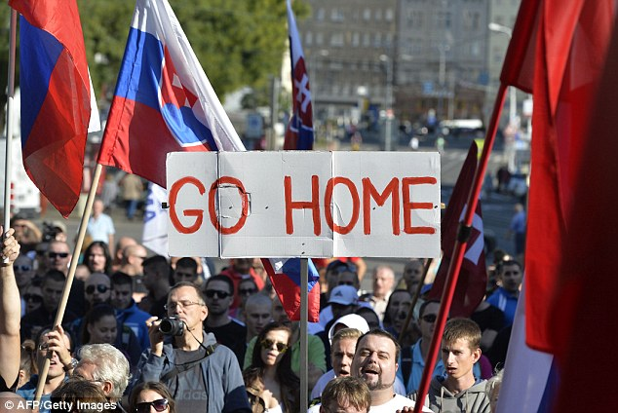
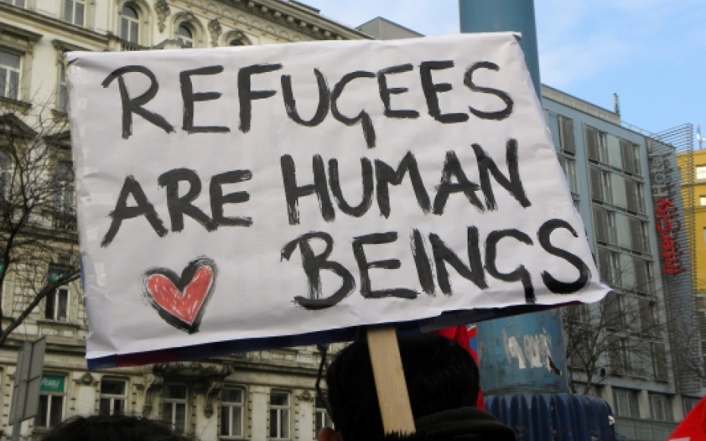
Demonstrations pro –contra migration
Pro
Contra

Slide 62
Bibliography
Arendt H (1990) On Revolution. London: Penguin
Berry M, Garcia-Blanco I and Moore K (2016) Press Coverage of the Refugee and Migrant Crisis in the EU: A Content Analysis of Five European Countries. UNCHR. Available at: http://www.unhcr.org/56bb369c9.pdf
Entman, R. M. (1993). Framing: Toward a clarification of a fractured paradigm. Journal of Communication, 43, 51–58.
Gitlin, T. (1980). The whole world is watching: Mass media in the making and unmaking of the new left. Berkeley: University of California Press.
Goffman, E. (1974). Frame analysis: An essay on the organization of experience. Cambridge, MA: Harvard University Press.
Greenwood K. & Thomson TJ (2019) Framing the migration: A study of news photographs showing people fleeing war and persecution, The International Communication Gazette, 0(0), 1–24.
McCombs, M., & Shaw, D. L. (1972). The agenda-setting function of the press. Public Opinion Quarterly, 36, 176–187.
Semetko and Valkenburg, (2000) The Effects of News Frames on Readers, Communication Research 26(5): 550-569
Siapera E. (2019) Refugee solidarity in Europe: Shifting the discourse, European Journal of Cultural Studies ﻿1–22
Tankard, J. W., Jr., Hendrickson, L., Silberman, J., Bliss, K. A., & Ghanem, S. (1991). Media frames: Approaches to conceptualization and measurement. Paper presented to Association for Journalism and Mass Communication, Boston.

Slide 63
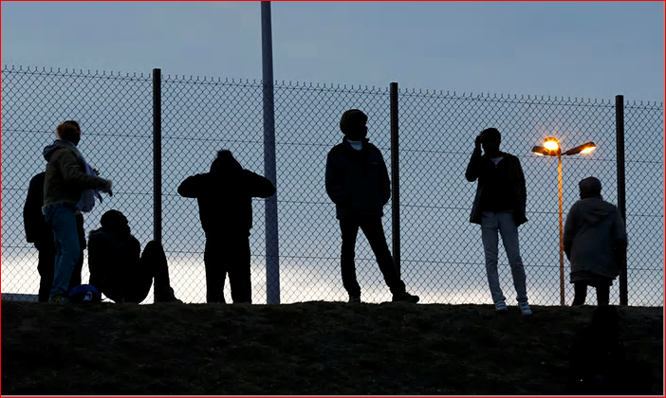
Feuerbach's 11th thesis: "Philosophers have hitherto only interpreted the world in various ways; the point is to change it."
Thank you!

