Slide 1
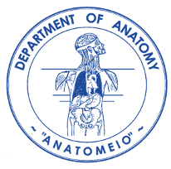
Neck/ Cervical vertebrae Muscles classification Vessels, and Nerves Triangles and landmarks.
Dimosthenis Chrysikos
Surgeon
Assistant Professor
Department of Anatomy, School of Medicine, National and Kapodistrian University of Athens, Greece

Slide 2
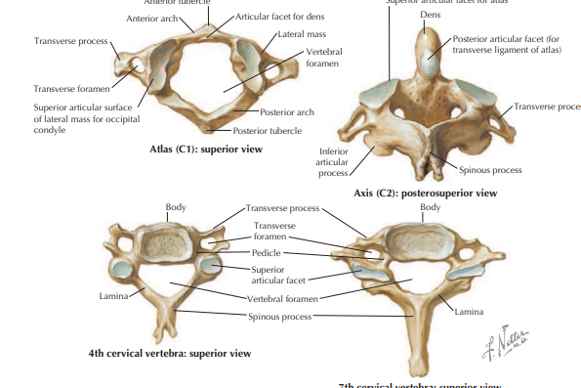

Slide 3
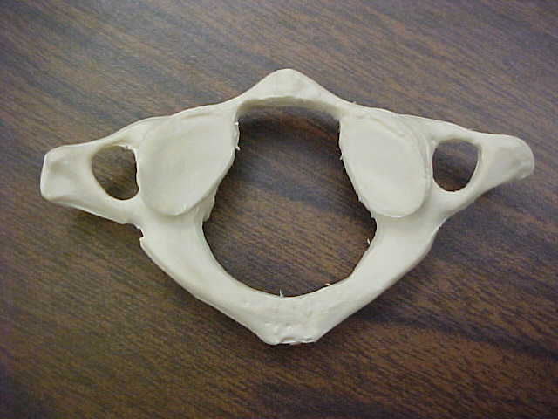
steven lee
M.S. Pathology
FTCC

Slide 4
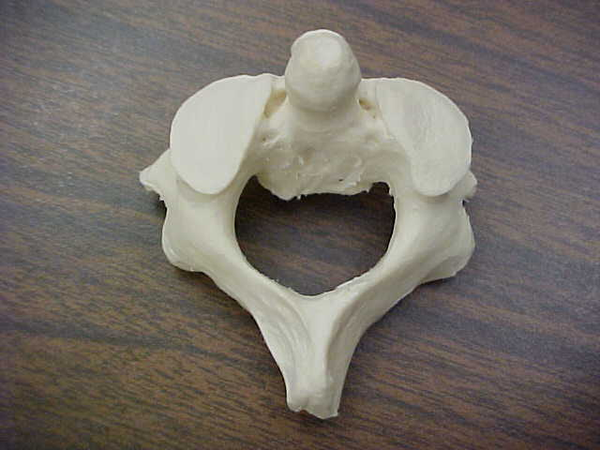
steven lee
M.S. Pathology
FTCC

Slide 5
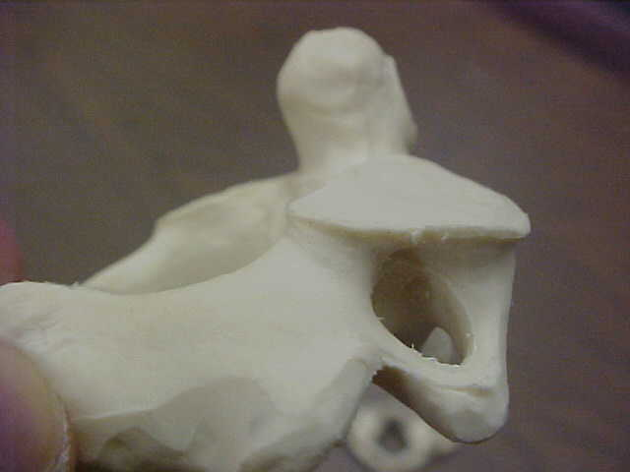
steven lee
M.S. Pathology
FTCC
Dens
(odontoid process)
Axis, C2 cervical vertebrae
Groove for atlantal
ligament attachment
Vertebral foramen
Superior
articular
facet
Transverse
foramina
Spinous
process
Superior arterior process

Slide 6
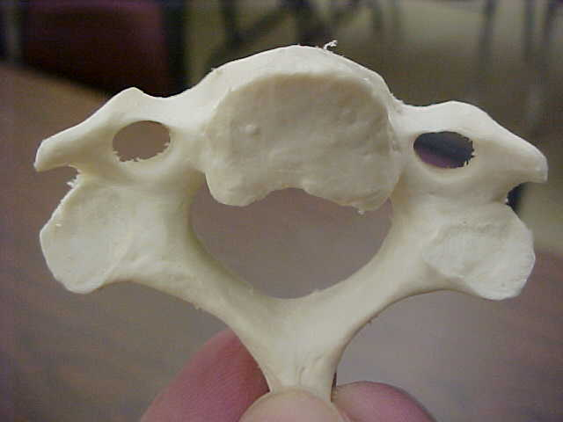
steven lee
M.S. Pathology
FTCC

Slide 7
Anterior tubercle of transverse process
Posterior tubercle of
transverse process
Transverse
process
Transverse
foramen
pedicle
body
Inferior
articular
process
Vertebral foramen
facet
Spinous
process
Cervical vertebrae
Inferior view
steven lee
M.S. Pathology
FTCC

Slide 8
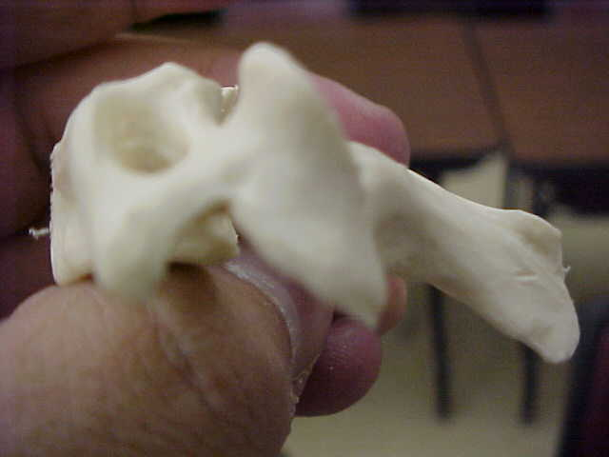
Articular pillar
Transverse foramen
a
Transverse
process
Spinous
process
Sulcus for nerve
Cervical vertebrae
lateral view
steven lee
M.S. Pathology
FTCC

Slide 9
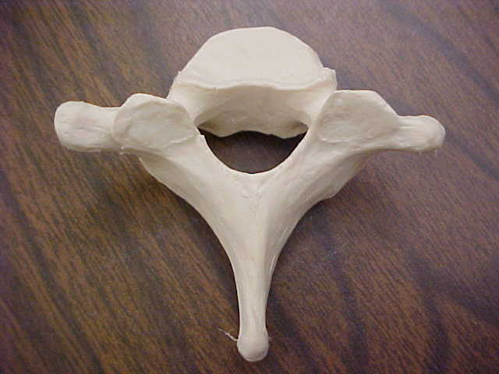
steven lee
M.S. Pathology
FTCC

Slide 10
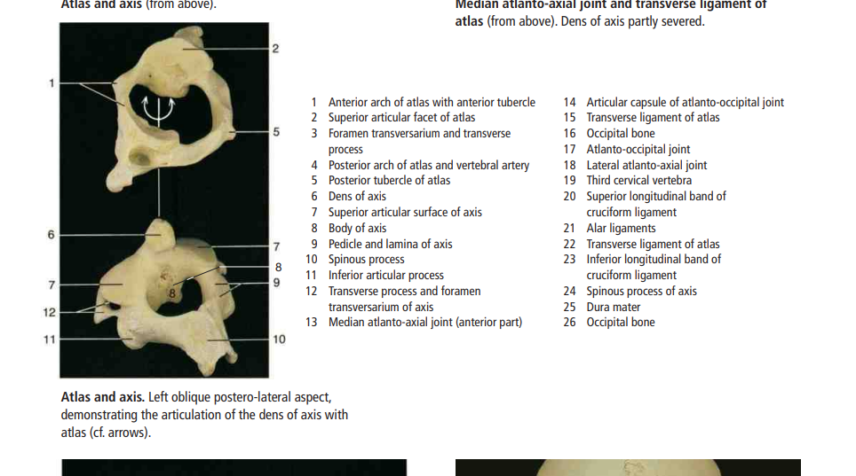

Slide 13
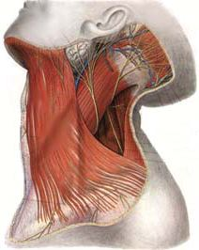
The platysma muscle runs from the superficial fascia of the chest across the anterior and lateral neck over the mandible to intercalate with the lower lip depressors and retractors.
It is innervated by the cervical branch of the facial nerve.

Slide 14
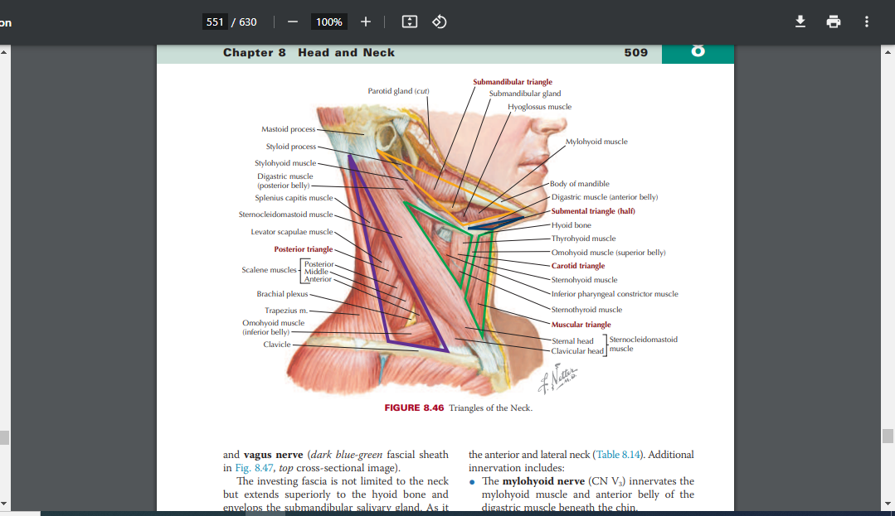

Slide 15
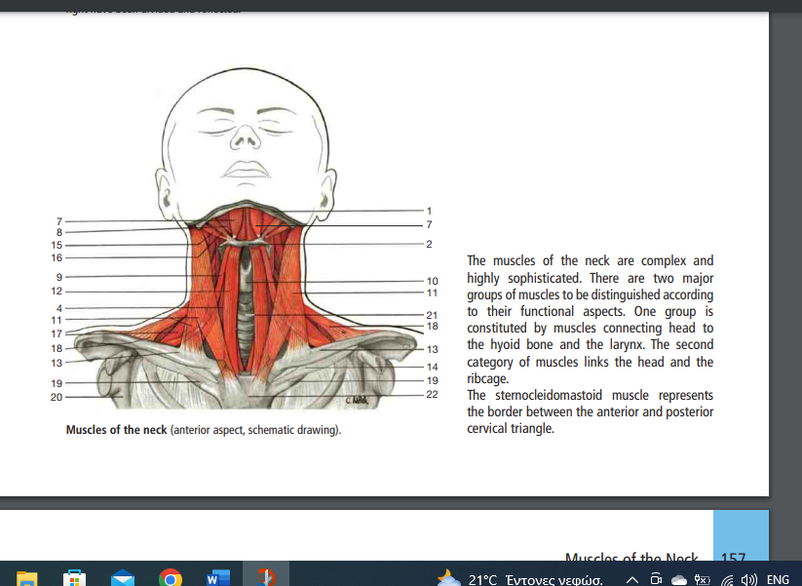

Slide 16
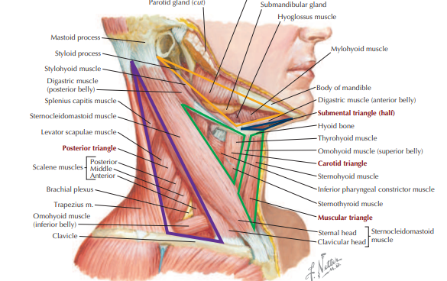

Slide 17
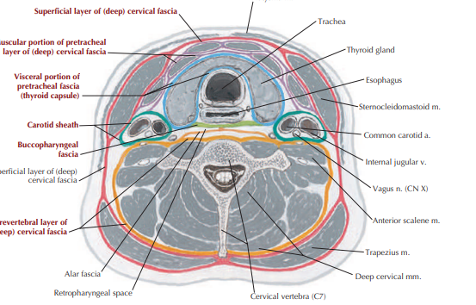

Slide 18
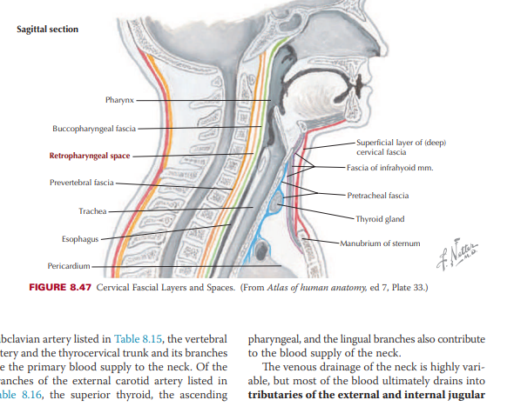

Slide 19
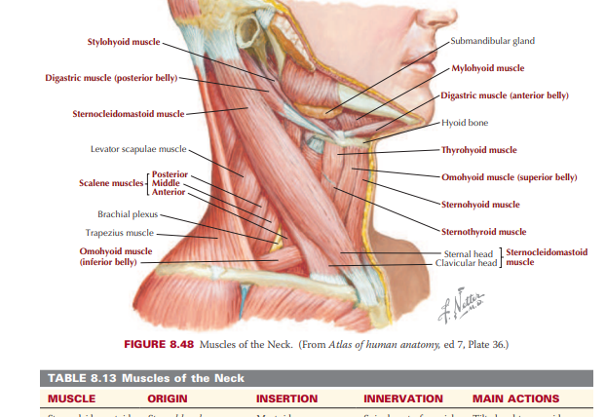

Slide 21
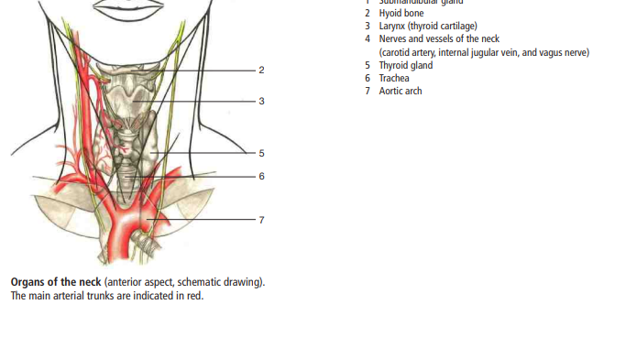

Slide 22
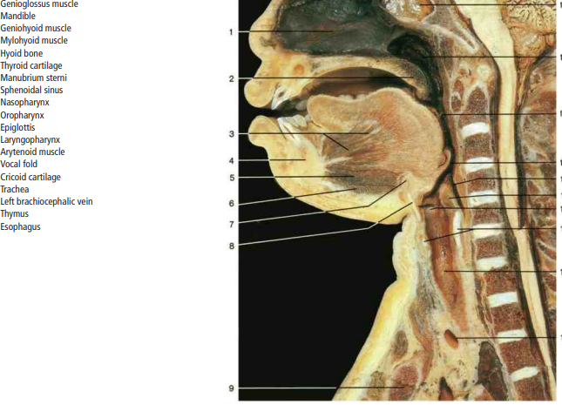

Slide 23
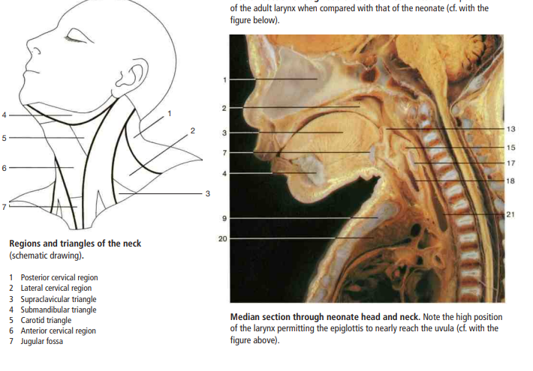

Slide 24
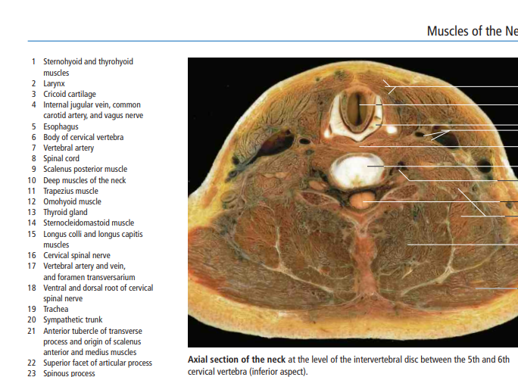

Slide 25
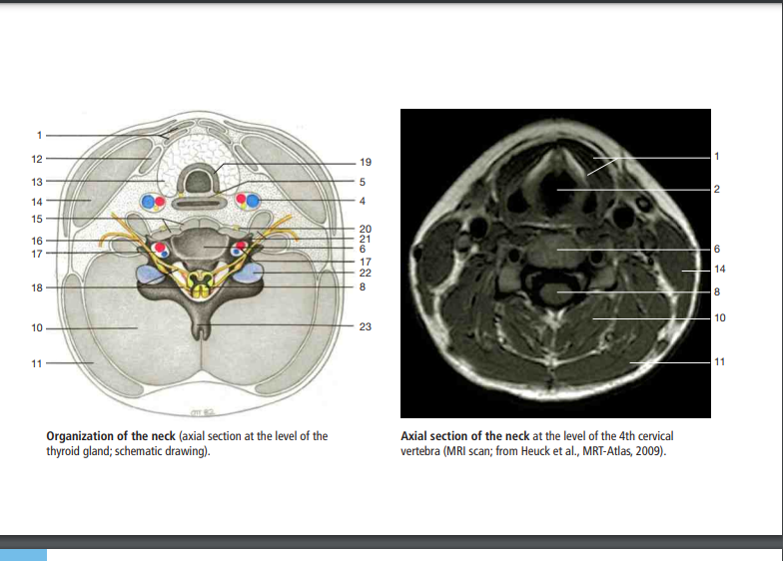

Slide 26
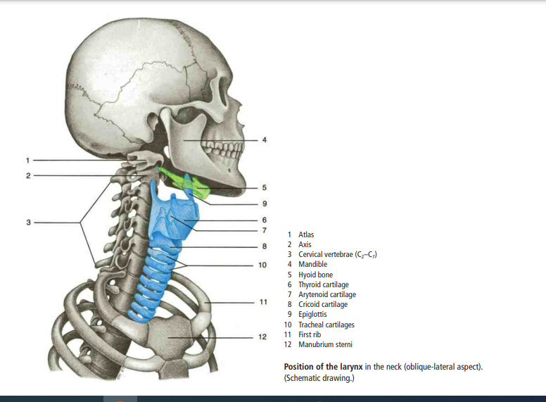

Slide 27
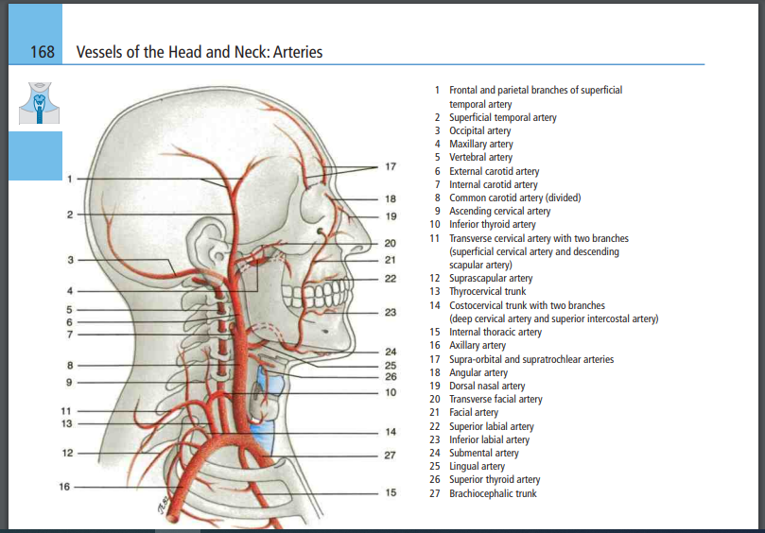

Slide 28
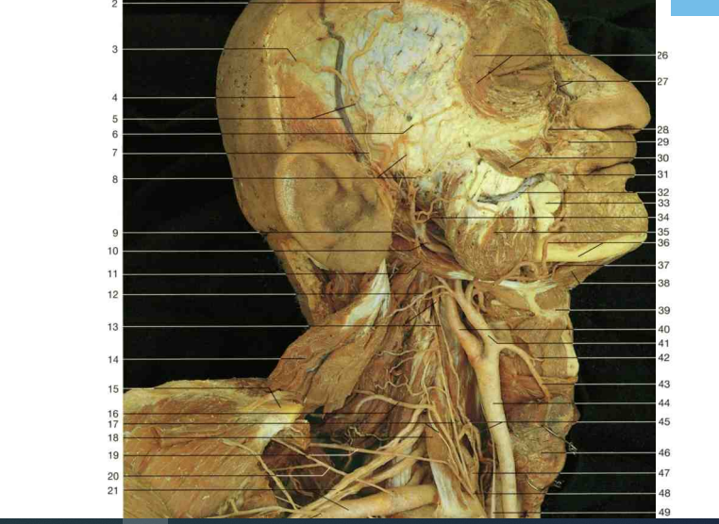

Slide 29
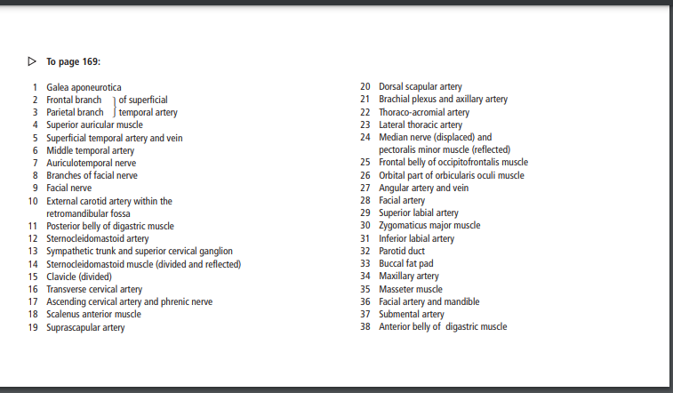

Slide 30
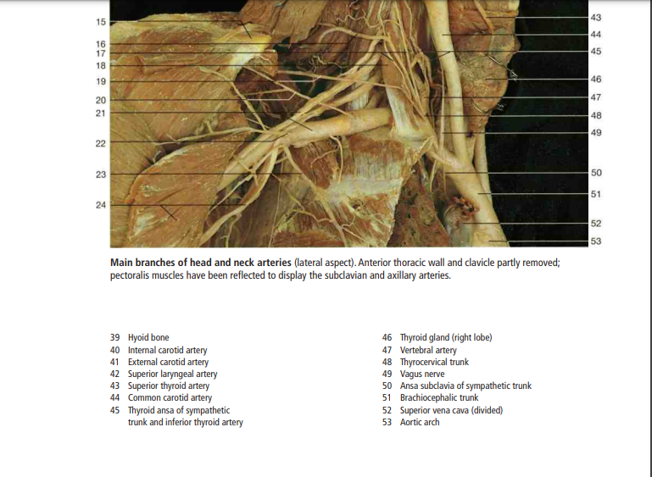

Slide 31
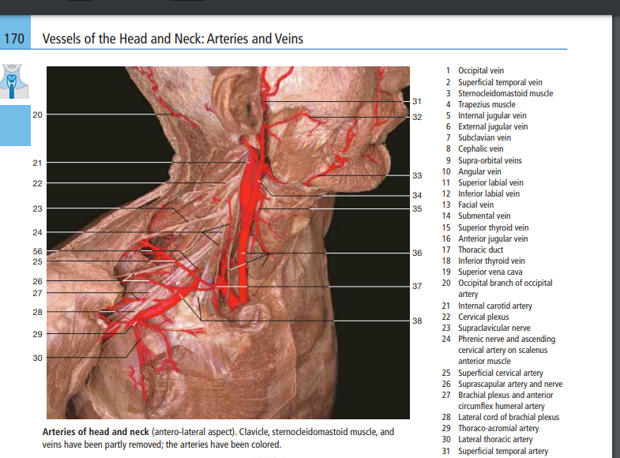

Slide 32
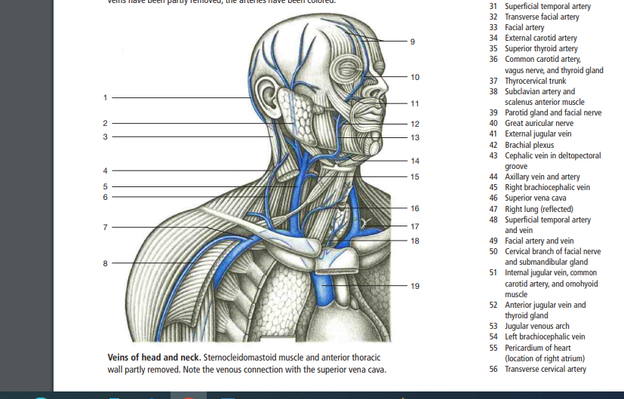

Slide 33
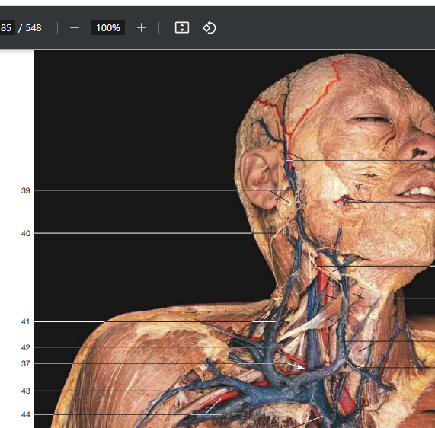

Slide 34
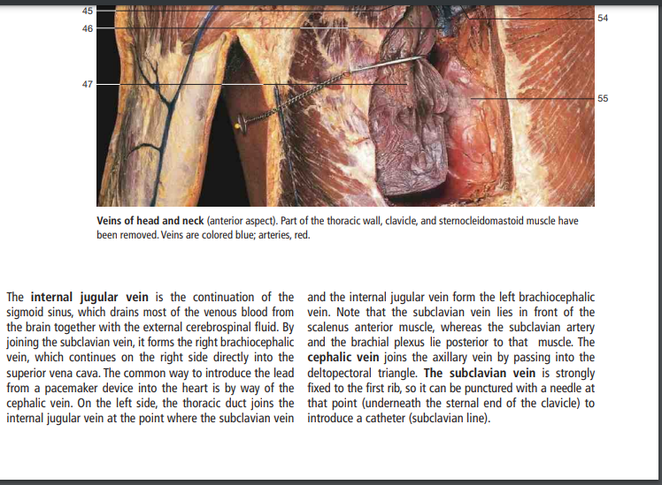

Slide 35
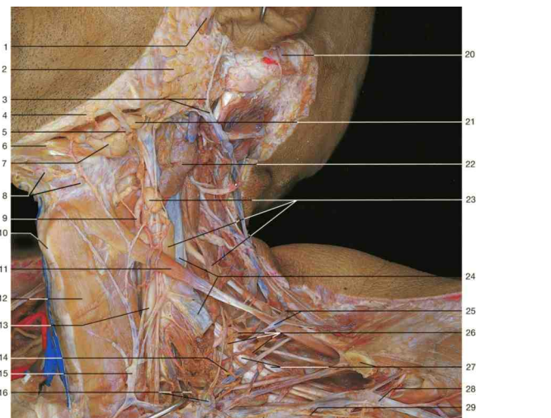

Slide 36
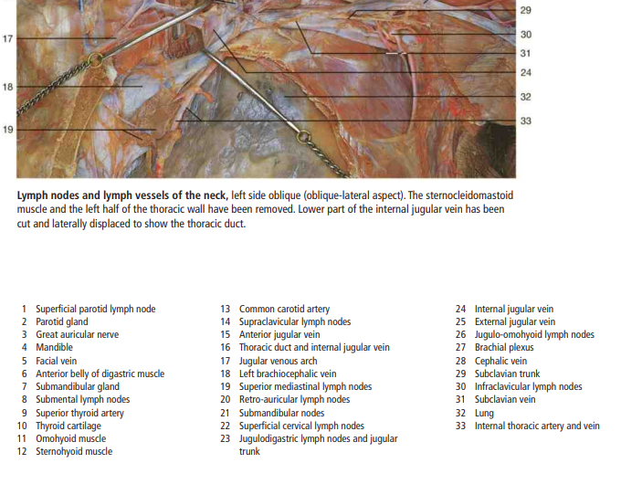

Slide 37
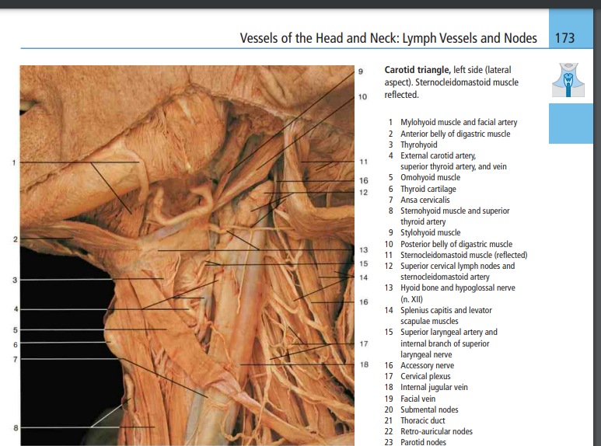

Slide 38
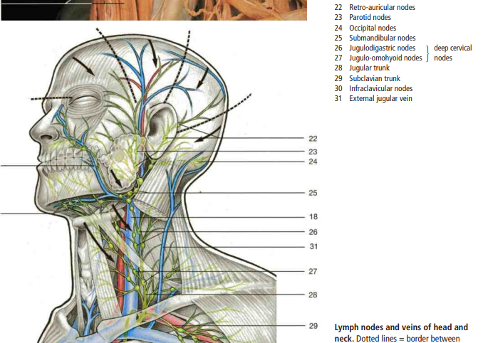

Slide 39
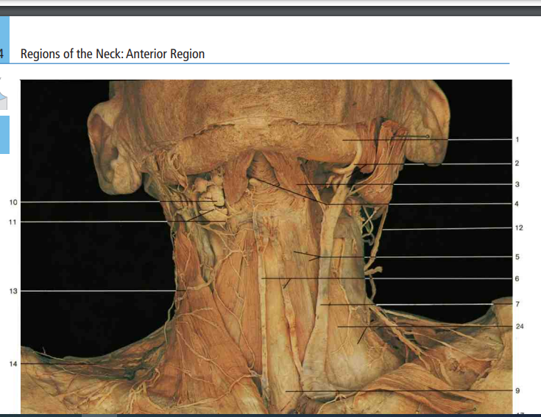

Slide 40
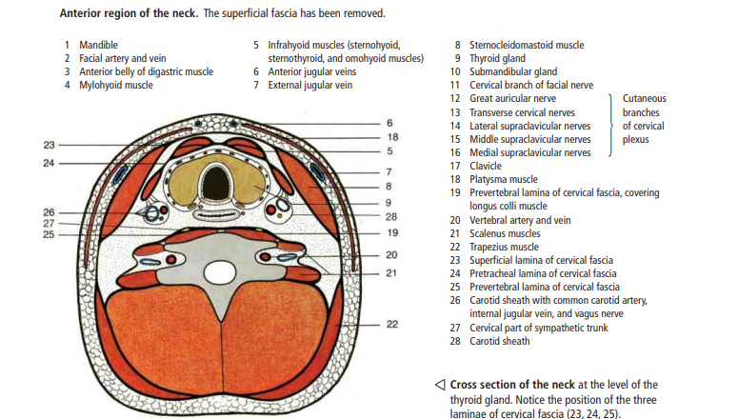

Slide 41
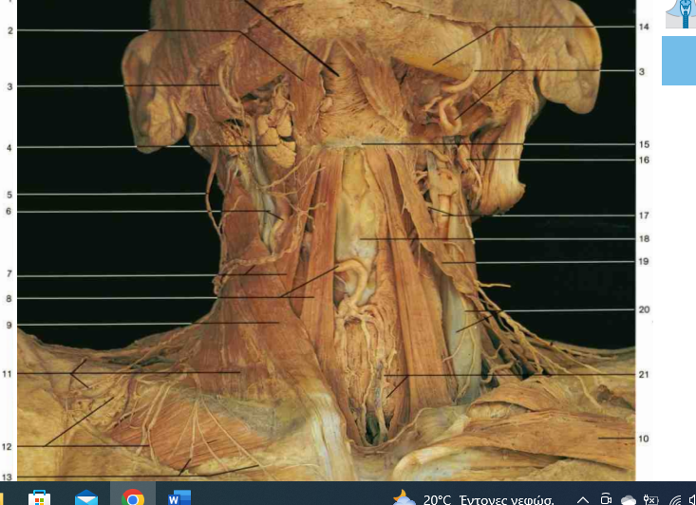

Slide 42
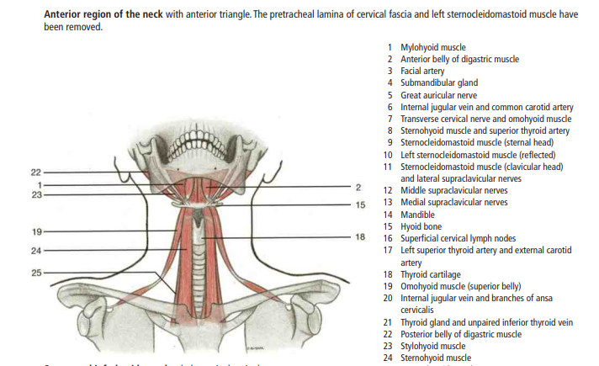

Slide 43
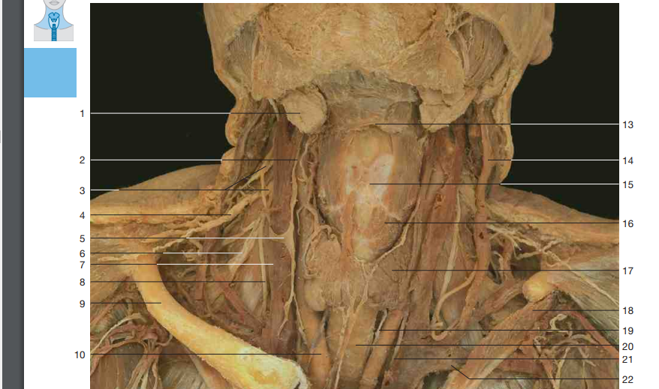

Slide 44
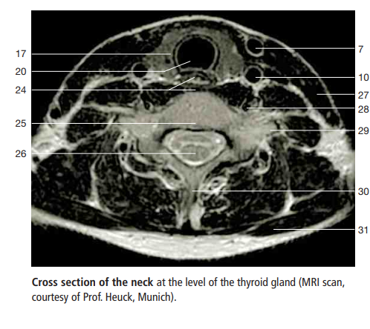

Slide 45
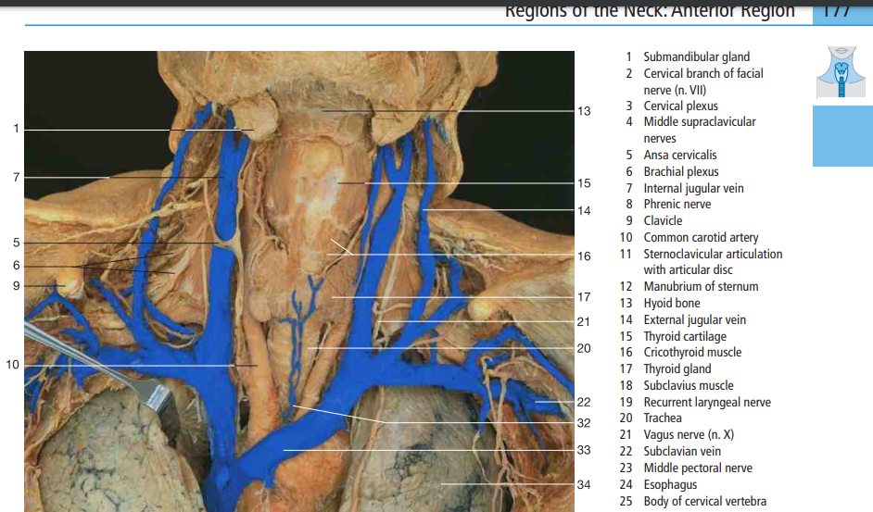

Slide 46
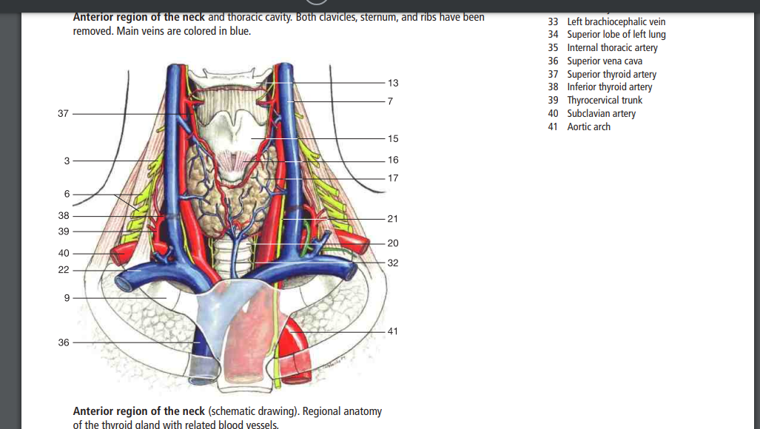

Slide 47
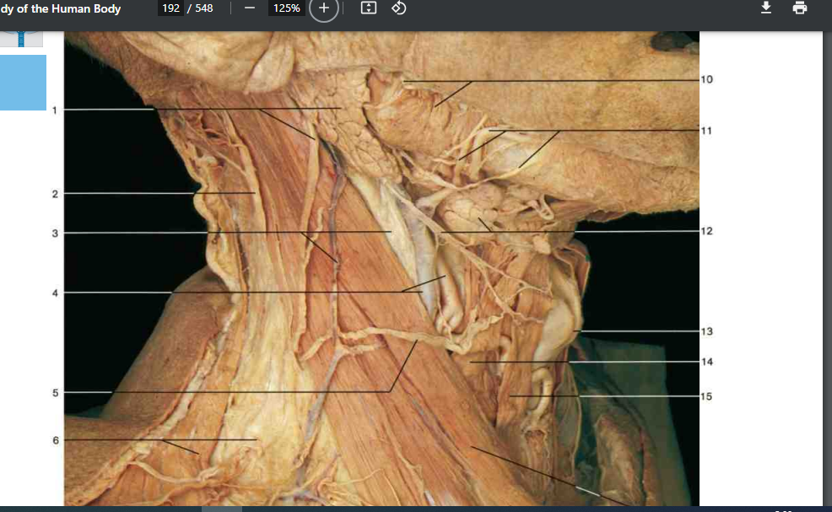

Slide 48
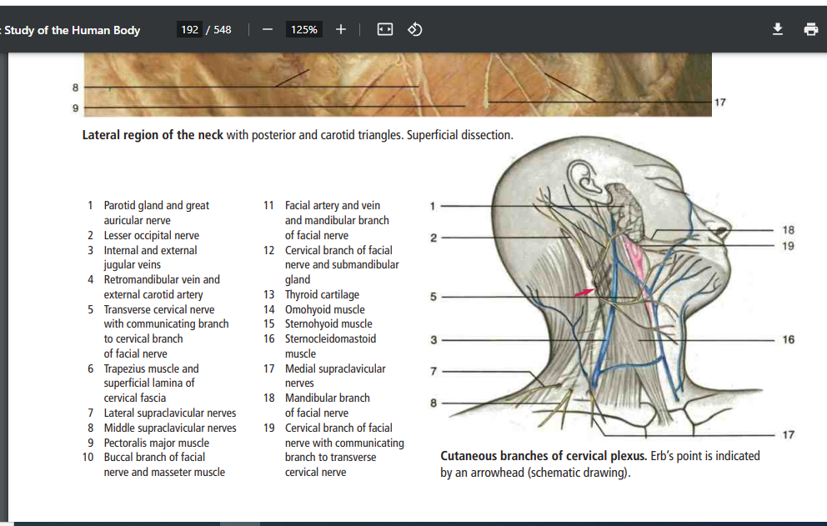

Slide 49
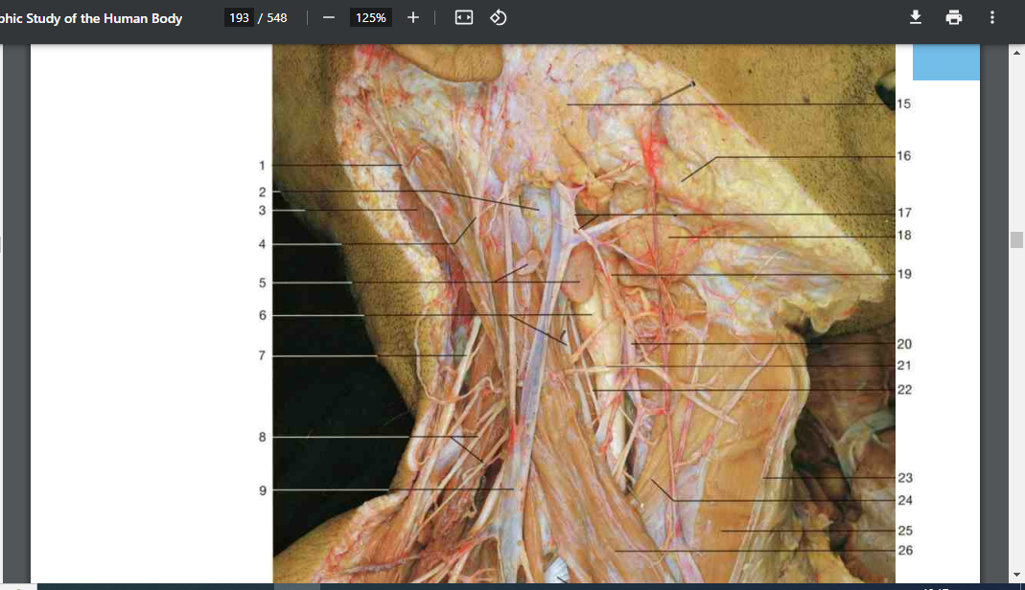

Slide 50
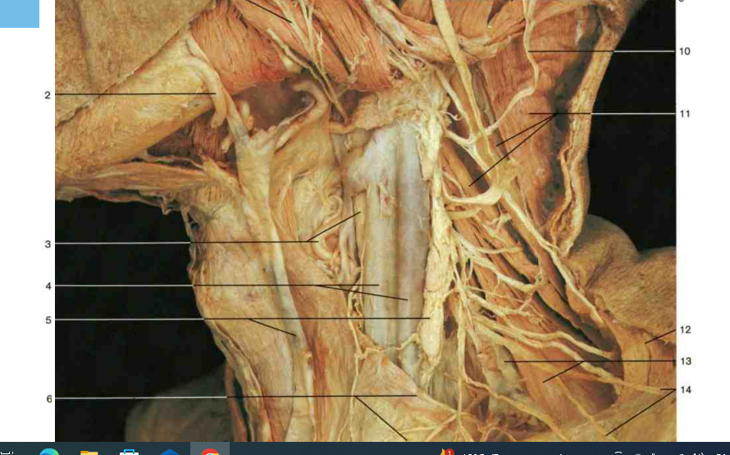

Slide 51
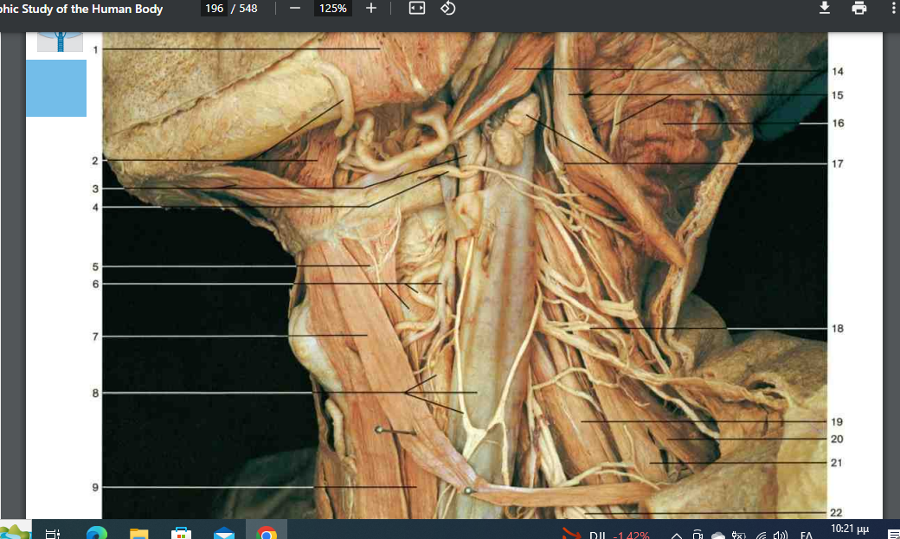

Slide 52
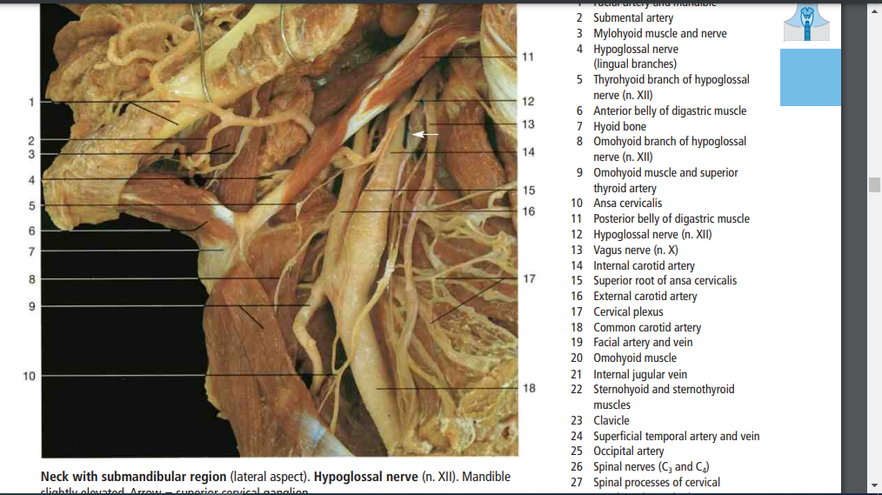

Slide 53
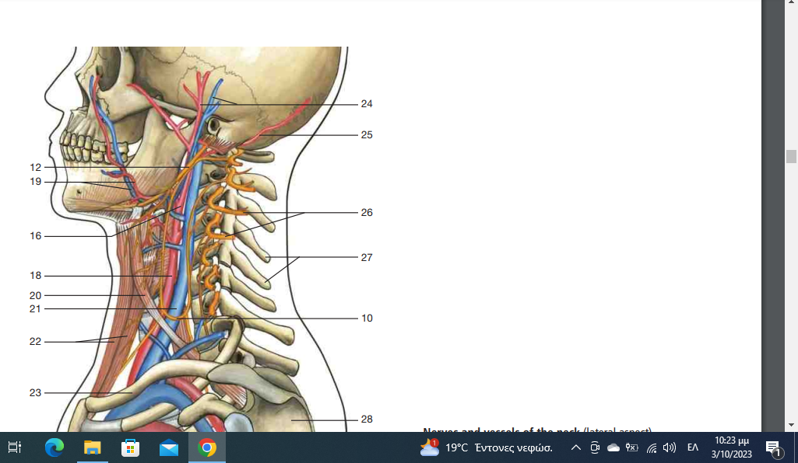

Slide 54
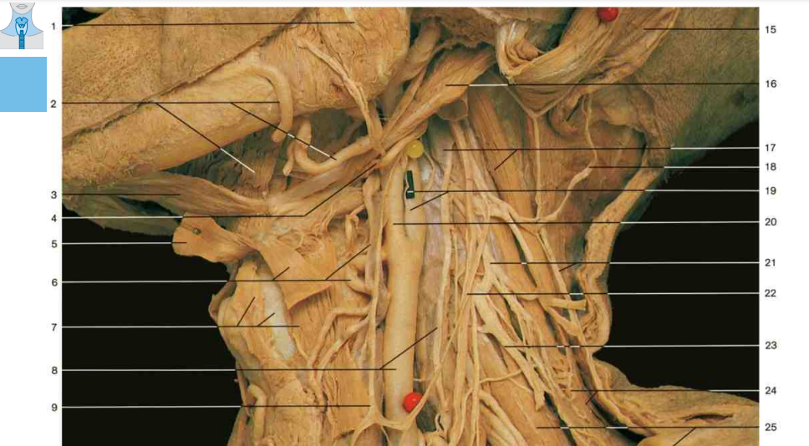

Slide 59
The cervical plexus
The cervical plexus is a network of arborizing and anastomosingnerve branches of the ventral rami of the four most superior cervical nerves.
It emerges from the mid-posterior margin of the sternocleidomastoid (SCM) muscle at Erb's point to give off three branches, designated as C2, C3 and C4. C2 and C3 compose the greater auricular nerve, which runs from the posterior edge of the SCM towards the earlobe in the same plane and path as the external jugular vein.
It innervates the skin of the lateral neck, angle of the jaw, and part of the auricular and postauricular skin.

Slide 60
The lesser occipital nerve (C2) emerges from the same point at the SCM and assumes a course parallel to the SCM upward to innervate the skin of the neck and postauricular scalp.
The transverse cervical nerve (C2 and C3) likewise emerges from behind the SCM and arcs anteriorly around and across the SCM in a transverse direction. Its many terminal branches supply the skin of the anterior neck.
The supraclavicular nerve (C3 and C4) emerges from the same point at the SCM posterior margin, then courses inferiorly until it reaches the supraclavicular region, where it terminates, and provides sensory innervation to the anterior chest and shoulder skin

Slide 61
Perineural invasion of cutaneous tumors such as basal cell carcinomas, neuropathic melanomas and squamous cell carcinomas may be encountered by the clinician.
Patients are often asymptomatic from dermal nerve twig infiltration by tumor cells, with the diagnosis made only by histopathologic tissue examination.
Some patients may experience sensory abnormalities and, rarely, motor dysfunction.
Most of these scenarios occur in the setting of squamous malignancies (incidence rates range from 3% to 14%), with less than 1% of basal cellcarcinomas showing any histologic evidence of perineural spread.
Knowledge of the neuroanatomy of the head and neck assists the surgeon in planning adjuvant therapy, such as radiation, for patients with nerve involvement.

Slide 62
LYMPHATIC DRAINAGE OF THE HEAD AND NECK

Slide 63
.
Before any surgical endeavor is undertaken for a malignancy in this region, palpation of regional lymph nodes and basins should be performed.
Head and neck cancers usually spread to adjacent lymph nodes in a diagonal direction from cephalad to caudad .
There is a large degree of variability in drainage pathways, but the anatomic location of individual lymph nodes is more consistent from patient to patient.
Cutaneous neoplasms that breach the papillary dermis may spread from small lymph capillaries to progressively larger and deeper lymphatic trunks in the area.
Lymph channels often course along the same directional pathway as the head and neck veins.
They are more numerous and often more superficial than the corresponding veins and lie predominantly between the superficial and deep fascial layers.

Slide 64
Important primary lymphatic drainage patterns of the head and neck region include the following:
parotid nodes often collect from the forehead and eyelids (upper lateral face);
submandibular nodes from the lower and medial face or from the submental nodes;
submental nodes from the central lower lip and chin.
Lateral cervical nodes are the common subsequent lymph collection site from these areas.
Parotid nodes may be extraglandular or intraglandular.
The extraglandular channels are invested within the parotid sheath.
Two-thirds of all people will also have one to three pretragal and infra-auricular lymph nodes that are considered part of the parotid node basin

Slide 66
These pre-and infra-auricular nodes drain the ear, the lateral lower cheek, the frontolateral scalp and the forehead, as well as the nasal root.
Drainage of the parotid unit may then follow the external or internal jugular vein in the jugular lymph node chain; therefore, palpation for nodes from the site of the cutaneous lesion to the supraclavicular and even axillary nodal basins is recommended.
Submandibular nodes should be examined as the patient relaxes the neck muscles and tilts the chin down.
This nodal group drains the gingival and mucous membranes, lower eyelids, anterior two-thirds of the tongue, lips, nose and medial cheeks.

Slide 67
The submental nodes (up to eight) of the neck lie beneath the platysma and drain the anterior third of the tongue and floor of the mouth, in addition to the lower middle lip, chin and medial lower cheeks.
They are best examined by elevating the chin and asking the patient to engage the platysma.
Submental nodes frequently drain bilaterally or contralaterally and empty into the submandibular basin or directly into the internal jugular lymphatic chain.
Note that up to one-quarter of healthy people have small (less than 1 cm) non-fixed palpable submental nodes.

Slide 68
The superficial lateral cervical nodes are adjacent to the infraauricular parotid nodes and lie near the high external jugular vein. Use the sternocleidomastoid muscle as a landmark to palpate these nodes (up to four) over its cephalad portion.
Deeper lateral cervical nodes include the spinal accessory, internal jugular and transverse cervical chains, which form a triangle on the neck. The internal jugular chain is the main lymphatic collection trunk of the head and neck and may contain up to 25 lymph nodes in each patient. The internal jugular chain on the right often drains into the subclavian vein, whereas the left-sided lymphatic chain empties into the thoracic duct.
These nodes can be palpated by rolling two fingers over the area of the carotid triangle.

Slide 69
Acute or chronic lymphedema :after transection of larger lymphatic channels or nodes, or smaller channels in areas (e.g. infraorbital) with limited or vulnerable lymphatic drainage.
Adequate drainage can be achieved by :orienting flaps in the same direction as lymphatic patterns.
The surgeon must be mindful of the variability in drainage patterns and sites and the fact that malignancies do not respect the midline
Since cross-communication between lymphatics may result in contralateral drainage, bilateral examination for lymphadenopathy should be undertaken before a neoplasm is excised.

Slide 81
Triangles of the neck
The neck is divided by the sternocleidomastoid muscle, which run obliquely downward and forward from the mastoid process and the occipital bone to the clavicle and the sternum, into an anterior and posterior triangle.

Slide 82
Triangles of the neck
The posterior triangle:
Anterior:
posterior border of sternocleidomastoid muscle
Posterior:
anterior border of trapezius
Base:
the clavicle.
Apex:
Occipital bone.

Slide 83
Triangles of the neck The posterior triangle:
The triangle is subdivided by the inferior belly of the omohyoid muscle into an occipital and supraclavicular triangles.
The roof:
the skin and deep cervical fascia.
The floor:
the prevertebral fascia
The content:
Occipital lymph nodes, accessory nerve, greater auricular nerve and the cervical plexus.

Slide 84
Triangles of the neck
The anterior triangle:
Posteriorly:
the anterior border of sternocleidomastoid
The base:
the inferior border of the mandible and a line from the angle of the mandible to the mastoid process.
Anteriorly:
The anterior median line of the neck
The apex is at the sternum.

Slide 85
The anterior triangle:
It is bounded superiorly by the lower border of the mandible (the base), posteriorly by anterior border of sternocleidomastoid muscle and medially by the midline of the neck.
It is covered by the skin, superficial fascia, platysma and investing layer of deep fascia.

Slide 86
The anterior triangle:
Under the fascia, two groups of longitudinal muscles extend from the inferior border of the mandible to the sternum.
The hyoid bone, at the level of C3 vertebra, provide an attachment for the two groups.
The muscles are called the strap muscles from their flat shape and they are in the same plane as the body wall musculature, rectus abdominis

Slide 87
The anterior triangle:
The suprahyoid muscles:
Above the hyoid bone, are four in number
Digastric
Stylohyoid, superficial
The mylohyoid
The geniohyoid deep to it.

Slide 88
The anterior triangle:
The infrahyoid muscles:
Below the hyoid bone, are four in number:
Sternohyoid
Omohyoid, superficial
Thyrohyoid
Sternothyroid deep to them

Slide 89
The anterior triangle:
The triangle is subdivided into:
Digastric triangle:
Boundary:
Mandible.
Anterior and posterior belly of digastric muscles.
Content:
Submandibular salivary gland and lymph node.
Facial, submental and mylohyoid vessels.
hypoglossal &mylohyoid nerve.

Slide 90
The anterior triangle:
Carotid triangle:
Boundary:
Sternocleidomastoid, posterior belly of digastric and superior belly of omohyoid muscles
Content:
Common carotid, branches of external carotid,
Hypoglossal, internal and external laryngeal nerves
lymph nodes.

Slide 91
The anterior triangle:
Submental triangle:
Boundary:
Anterior belly of digastric and body of the mandible
Content:
Anterior jugular vein and lymph nodes

Slide 92
The anterior triangle:
Muscular triangle:
Boundary
Sternocleidomastoid, superior belly of omohyoid, midline from hyoid bone to jugular notch
Content:
Larynx, thyroid gland and lymph nodes

Slide 93
The anterior triangle:
Suprahyoid Muscles:
Digastric Muscle:
Digastric notch on the medial surface of the mastoid process and the digastric notch on the inner surface of the mandible, taper down to an intermediate tendon, attached to the lesser horn of the hyoid bone
Nerve supply:
Posterior belly, facial nerve
Anterior belly, nerve to mylohyoid
Action:
Depress and retract the chin
Assist lateral pterygoid in mouth opening

Slide 94
The anterior triangle: Suprahyoid Muscles
Stylohyoid muscle:
Arise from the back of the styloid process to insert by two slips into the base of greater horn of the hyoid bone.
Nerve supply:
Facial nerve
Action:
Retract and raise the hyoid bone when swallowing

Slide 95
The anterior triangle:
Geniohyoid Muscle:
Arise from the genial tubercle of the mandible to the upper border of the hyoid bone
Nerve supply:
hypoglossal nerve, C1 fibres
Action:
Elevate the hyoid or fix the mandible during swallowing

Slide 96
The anterior triangle: Suprahyoid Muscles
Mylohyoid muscle:
Arises from the mylohyoid line on the inner surface of the mandible as far as the posterior surface of last molar
Slope toward each other, and the posterior quarter is inserted into the anterior surface of the body of the hyoid bone.
The anterior two third interdigitate in a midline raphe extending from the chin to hyoid bone.

Slide 97
The anterior triangle: Suprahyoid Muscles
Nerve supply:
Nerve to mylohyoid
Action:
Form a mobile but stable floor
Support the weight and thrust of the tongue
The two muscles form a shallow gutter elevating the tongue and hyoid bone during swallowing.

Slide 98
The anterior triangle: Infrahyoid muscles:
Sternohyoid muscle:
Extend from the lower border of the hyoid bone to the sternoclavicular joint and adjoining part of the clavicle
Nerve supply:
Branch from ansa cervicalis

Slide 99
The anterior triangle: Infrahyoid muscles:
Omohyoid:
Lie edge to edge with the sternohyoid on the lateral part of the inferior border of the hyoid bone
It diverge and pass beneath the sternocleidomastoid over the carotid sheath, replaced by fibrous tendon
Inferior belly pass horizontally back to be inserted in the transverse scapular ligament and upper border of the scapula.
Nerve supply:
Ansa cervicalis

Slide 100
The anterior triangle: Infrahyoid muscles:
Thyrohyoid:
Broad muscle, arise from the greater horn of the hyoid, undercover of the other muscles and is inserted into the oblique line of the thyroid cartilage
Nerve supply:
Hypoglossal nerve, C1 fibres.

Slide 101
The anterior triangle: Infrahyoid muscles:
Sternothyroid:
Extend from the oblique line of the thyroid cartilage to posterior border of the manubrium and the first intercostal cartilage
Nerve supply: Ansa cervicalis (C2,3)
Action of infrahyoid muscles
Depressor of the larynx

Slide 102
The anterior triangle:
Thyroid gland:
consist of two symmetrical lobes united, in front of the of the 2nd - 4th tracheal rings, by an isthmus of gland tissue.
Covered by a layer of pretracheal fascia.
Pear-shaped with narrow upper pole and wide lower pole, with lateral, medial and posterior surfaces

Slide 103
The anterior triangle: Thyroid gland
Development:
Develop as an endodermal outgrowth from the midline of the pharynx, between the tuberculum impar, becoming the thyro- glossal duct

Slide 104
The anterior triangle: Thyroid gland
The duct elongate and distal end become bilobed.
A solid cord migrates anterior or posterior to the hyoid bone to the larynx and the trachea

Slide 105
The anterior triangle: Thyroid gland
The solid cord break up and disappear but the site of origin remain as a pit on the tongue “foramen cecum” at the junction of the posterior third with anterior two-third.

Slide 106
The anterior triangle: Thyroid gland
Clinically:
Lingual thyroid:
Part of the gland remain as a swelling at the tongue base.
Thyroglossal cyst:
Above or below the hyoid bone.
Mobile with swallowing.
Thyroid goitre:
Exert pressure on the structures behind it, trachea and recurrent laryngeal nerve.

Slide 107
The anterior triangle: Thyroid gland
Parathyroid gland:
yellowish-brown ovoid bodies, four in number lying within the thyroid fascia in the posterior border.

Slide 108
The anterior triangle:
Common carotid artery:
In the right side, the artery arise from the brachio-cephalic artery and the left, from the arch of the aorta
It divides into the external and internal carotid artery at the upper border of the thyroid cartilage
The carotid sinus is a small dilatation at the bifurcation, contain numerous nerve ending from glossopharyngeal nerve and serve as a reflex pressoreceptor
The carotid body is a small reddish structure,posterior to the bifurcation and is a chemoreceptor.

Slide 109
REFERENCES
1)Snell Clinical Anatomy
2)Rohen-Yokochi Atlas
3)Netter Atlas of Anatomy

