Slide 1


Abdominal wall/ Abdominal muscles/ Rectus abdominis sheath, Vessels, and Nerves. Inguinal region and canal. Pelvis. Lumbar and sacral plexuses
Dimosthenis Chrysikos
Surgeon
Assistant Professor
Department of Anatomy, School of Medicine, National and Kapodistrian University
of Athens, Greece

Slide 2
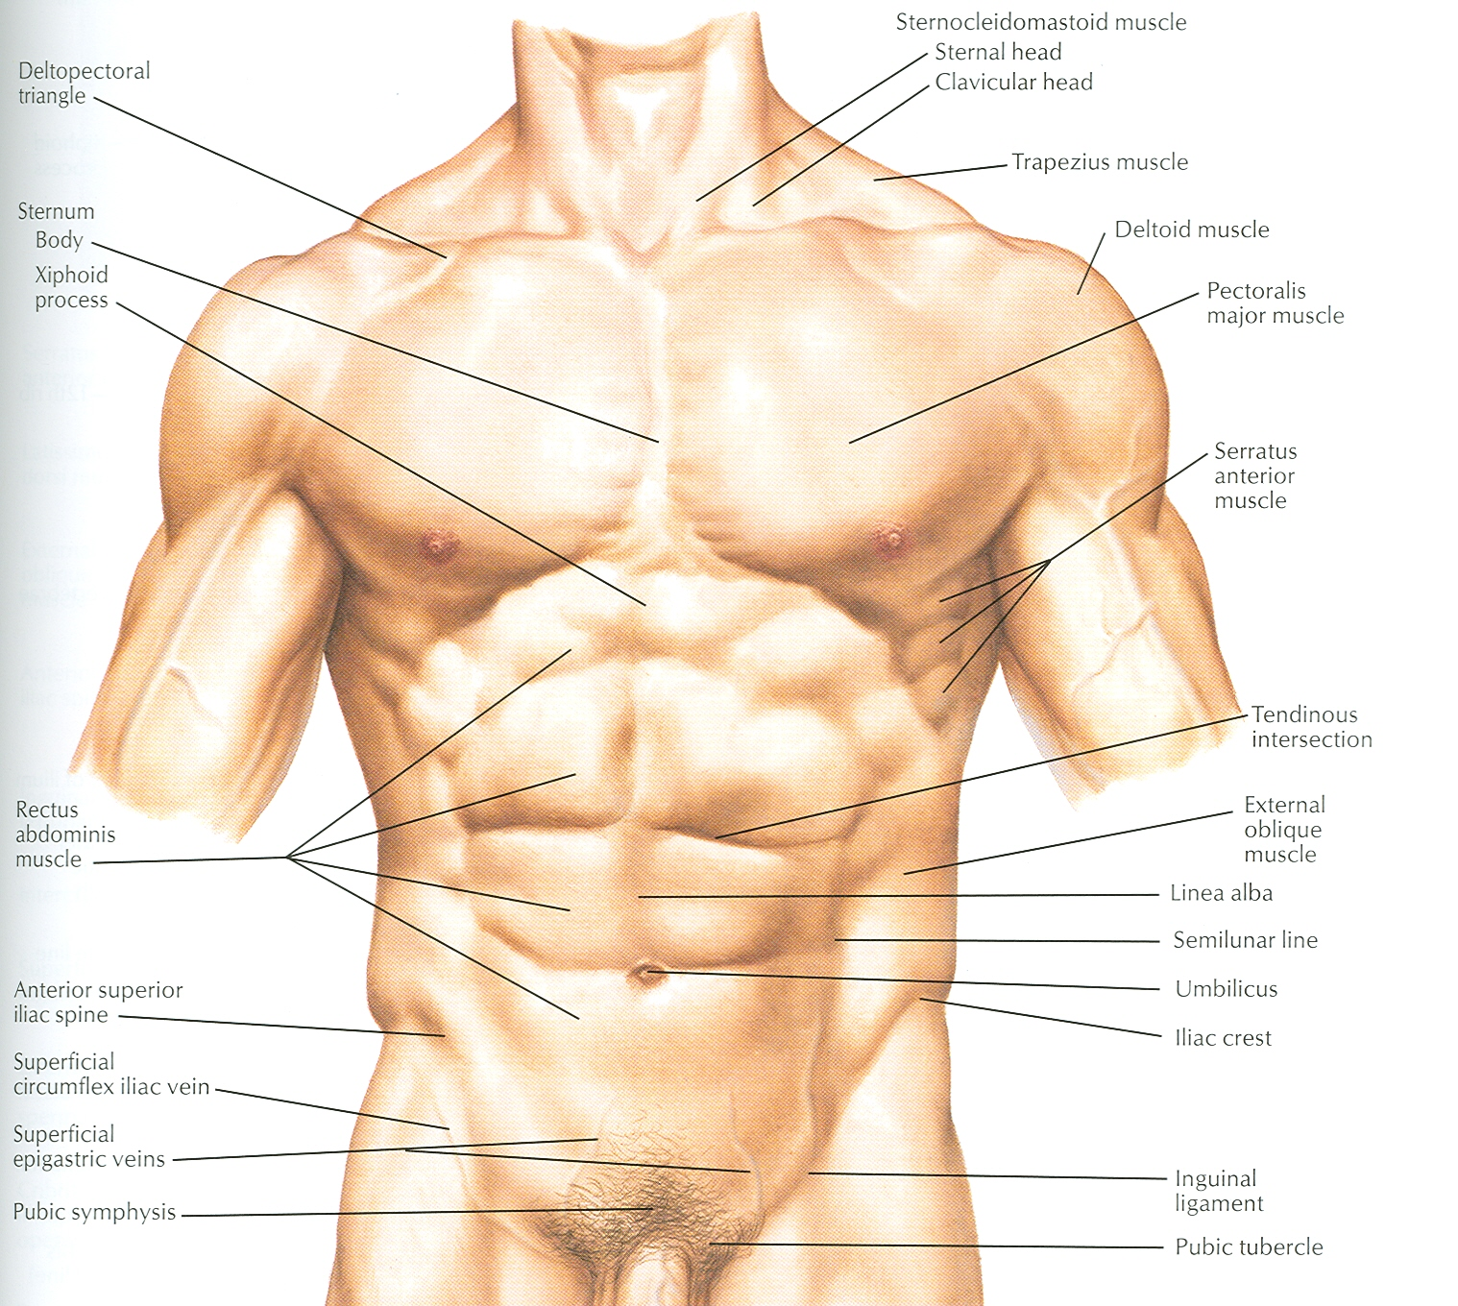

Slide 3
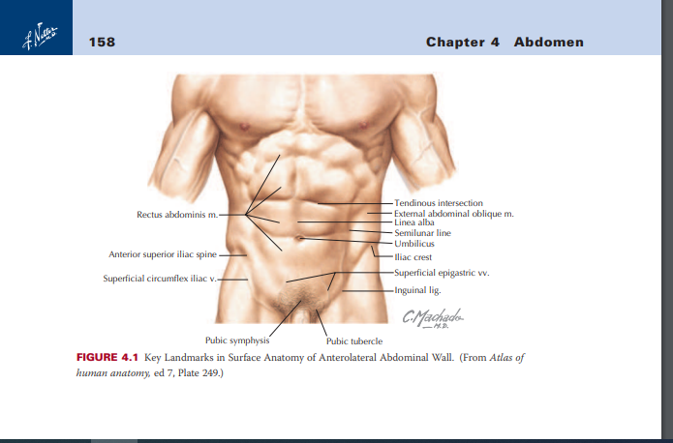

Slide 4
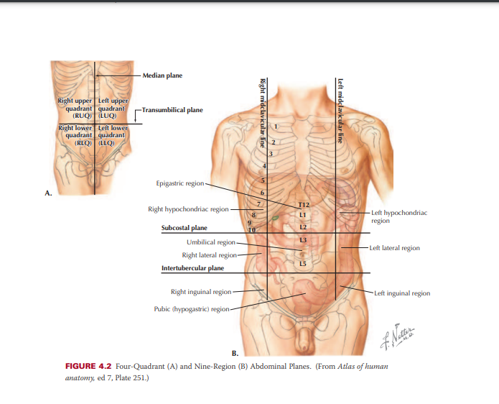

Slide 5
Structure of Abdominal Cavity
Superiorly it is formed by diaphragm which separates the abdominal cavity from the thoracic cavity
Inferiorly the abdominal cavity is continuous with the pelvic cavity through the pelvic inlet

Slide 6
Structure of Abdominal Wall
Anteriorly:
The abdominal wall is formed above by lower part of the thoracic cage
Below by the rectus abdominis, external oblique, internal oblique, and transversus abdominis muscles and fasciae

Slide 7
Structure of Ant. Abdominal Wall
It is made up of skin, superficial fascia, deep fascia, muscles, extraperitoneal fascia and parietal peritoneum
The abdominal walls are lined by a fascial envelope and the parietal peritoneum

Slide 8
Skin
Natural lines of cleavage in the skin are constant and run almost horizontally around the trunk
An incision along a cleavage line will heal as a narrow scar, while one that crosses the lines will heal as a wide scar

Slide 9
Cutaneous Nerve Supply
Is derived from the anterior rami of the lower six thoracic and first lumbar nerves
Thoracic nerves are the lower five intercostal and the subcostal nerves
First lumbar nerve is represented by the iliohypogastric and ilioinguinal nerves

Slide 10
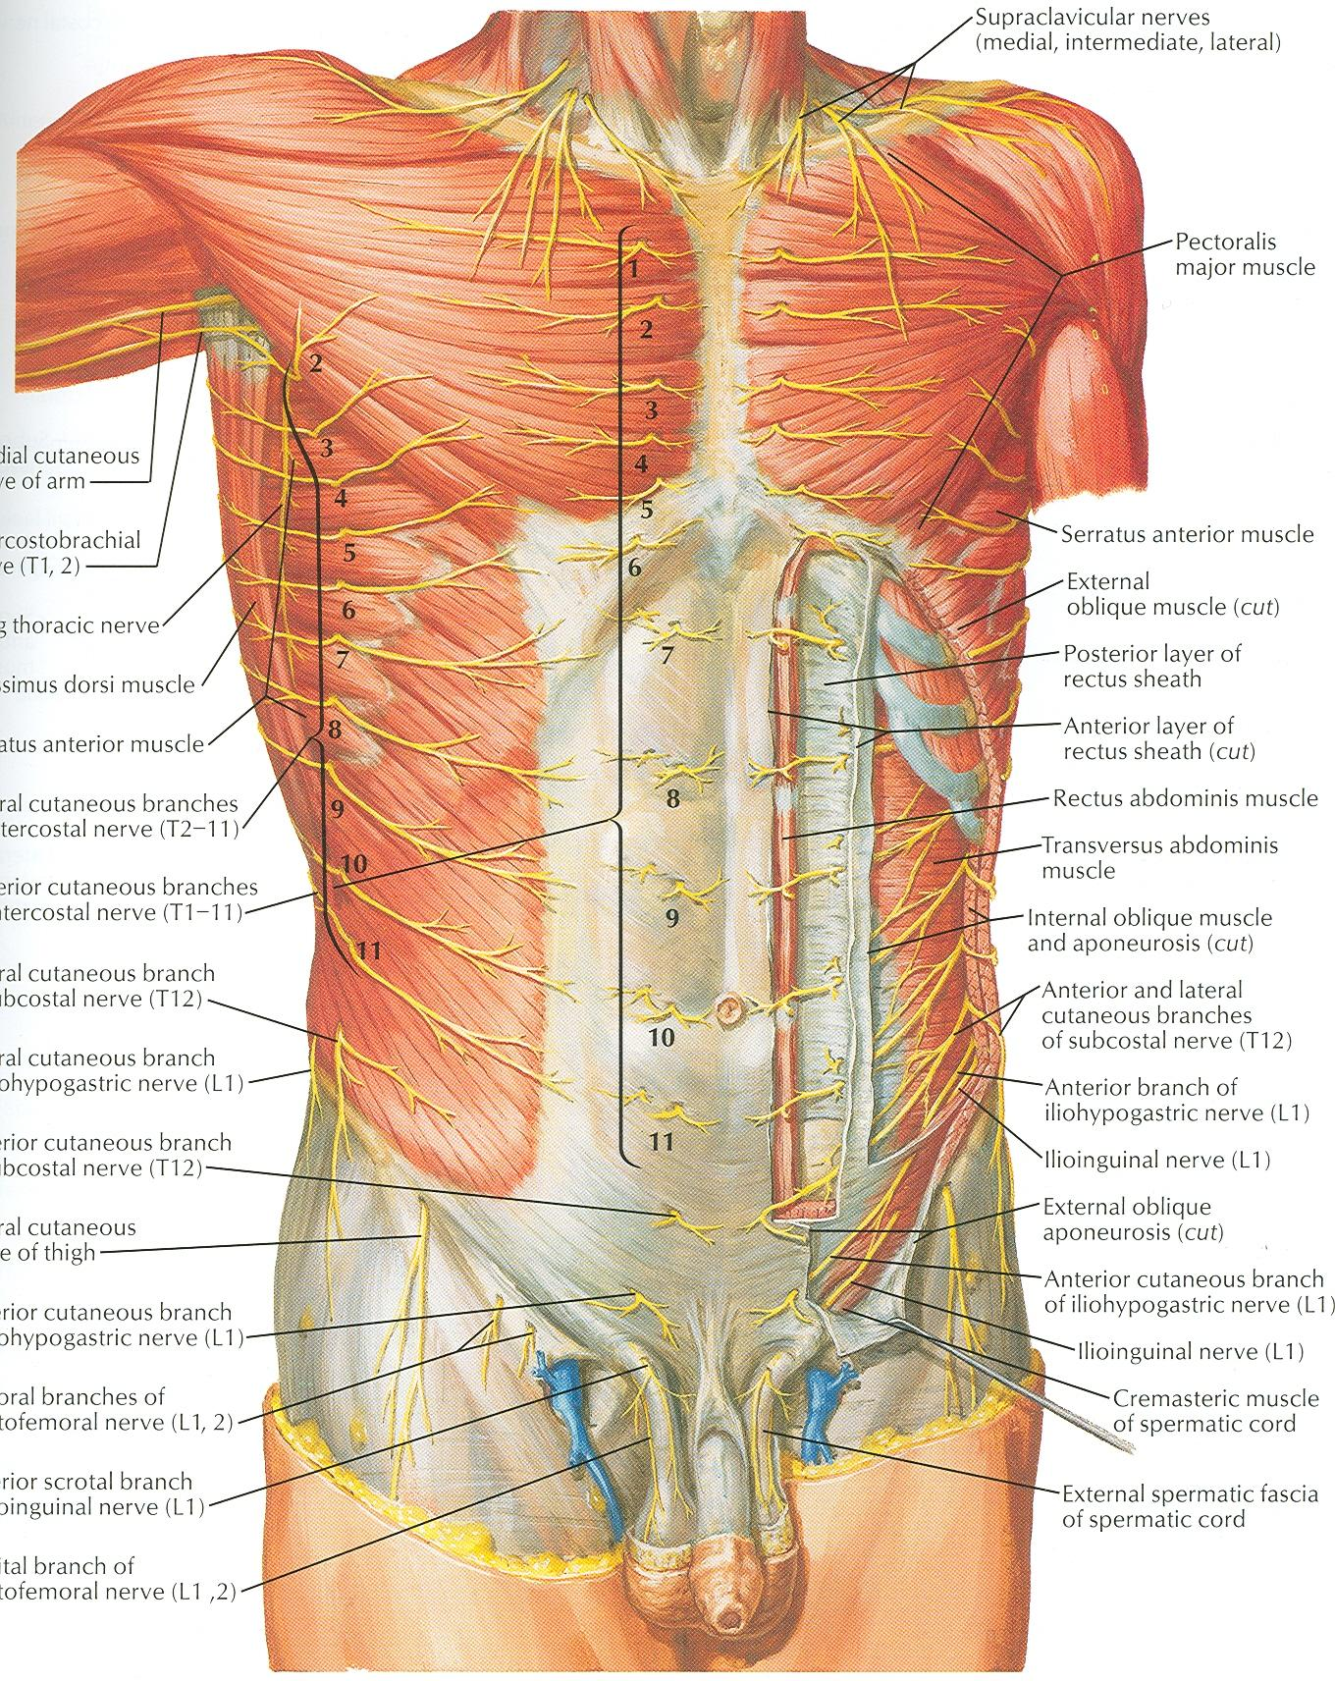

Slide 11
Blood Supply
Skin near the midline is supplied by branches of the superior epigastric artery (br. of int. thoracic artery) and the inferior epigastric artery ( br. of external iliac artery)
Skin of the flanks is supplied by branches from the intercostal, lumbar, and deep circumflex arteries

Slide 12
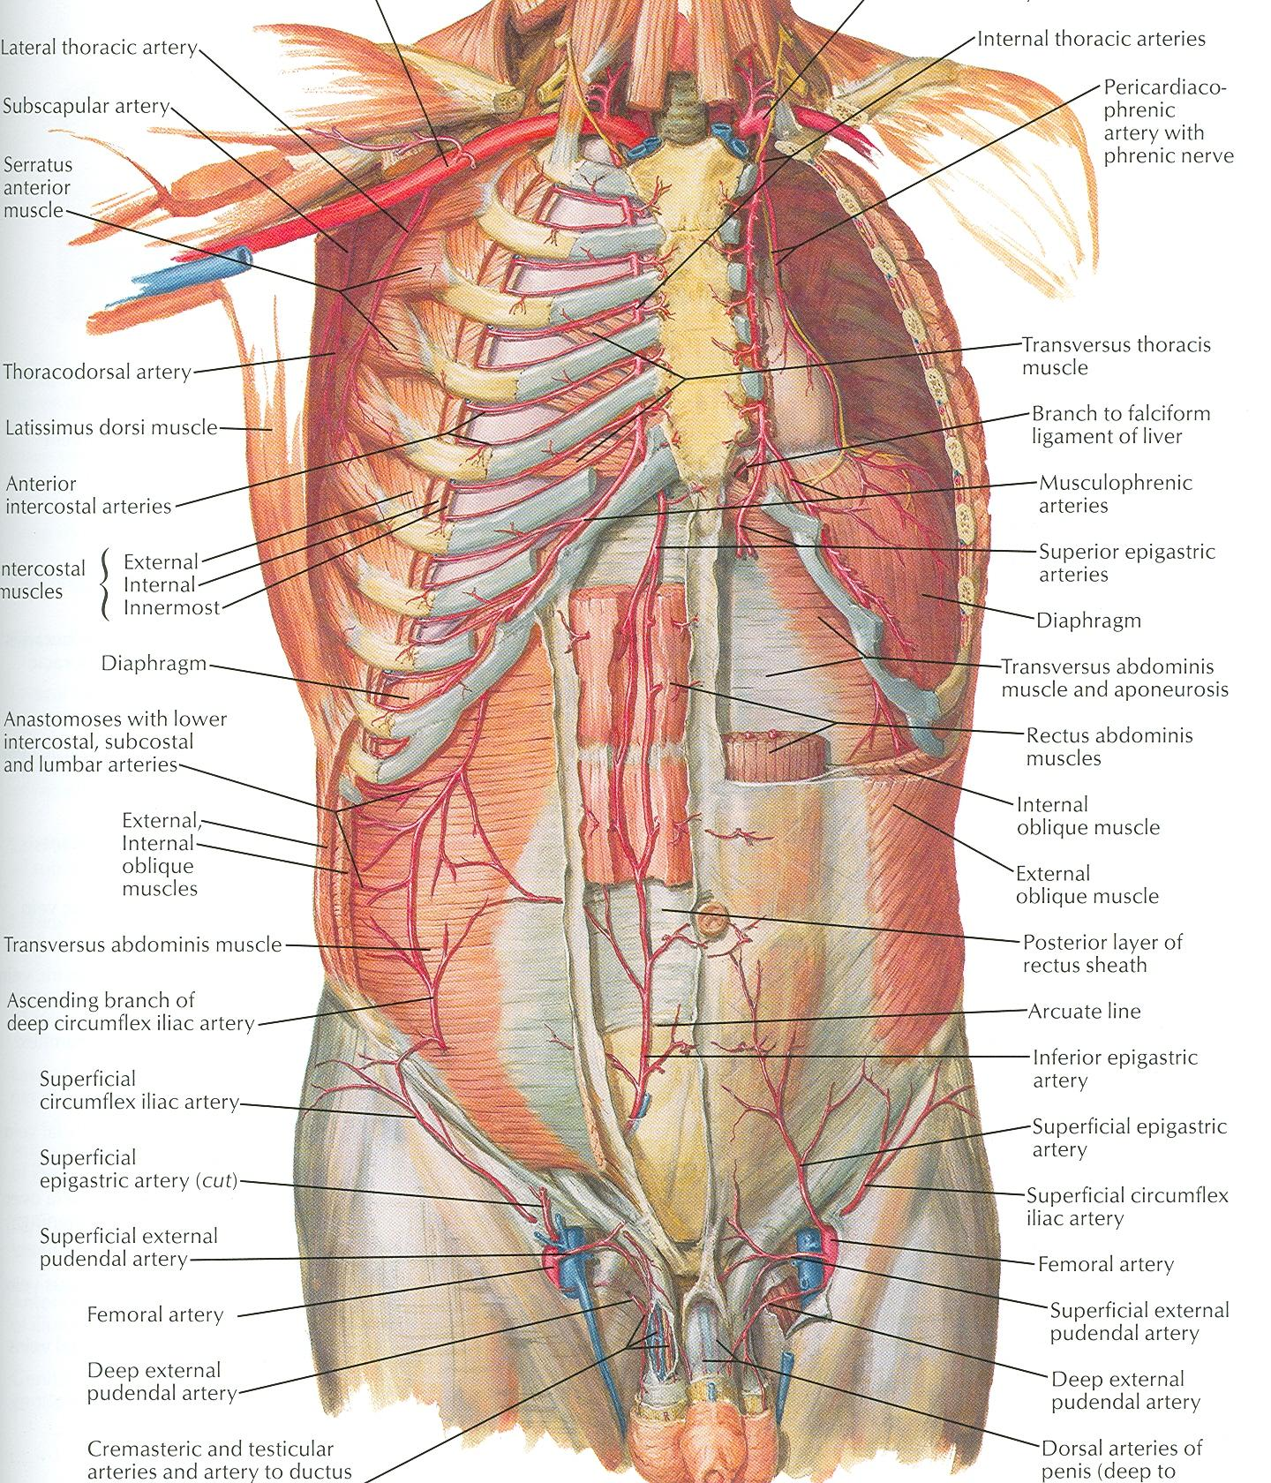

Slide 13
Superficial Fascia
Fatty layer or fascia of camper is continuous with the superficial fat over the rest of the body and may be extremely thick in obese patients
The membranous layer or scarpa’s fascia is thin and fades out laterally and above
Becomes continuous with the superficial fascia of the back and the thorax

Slide 14
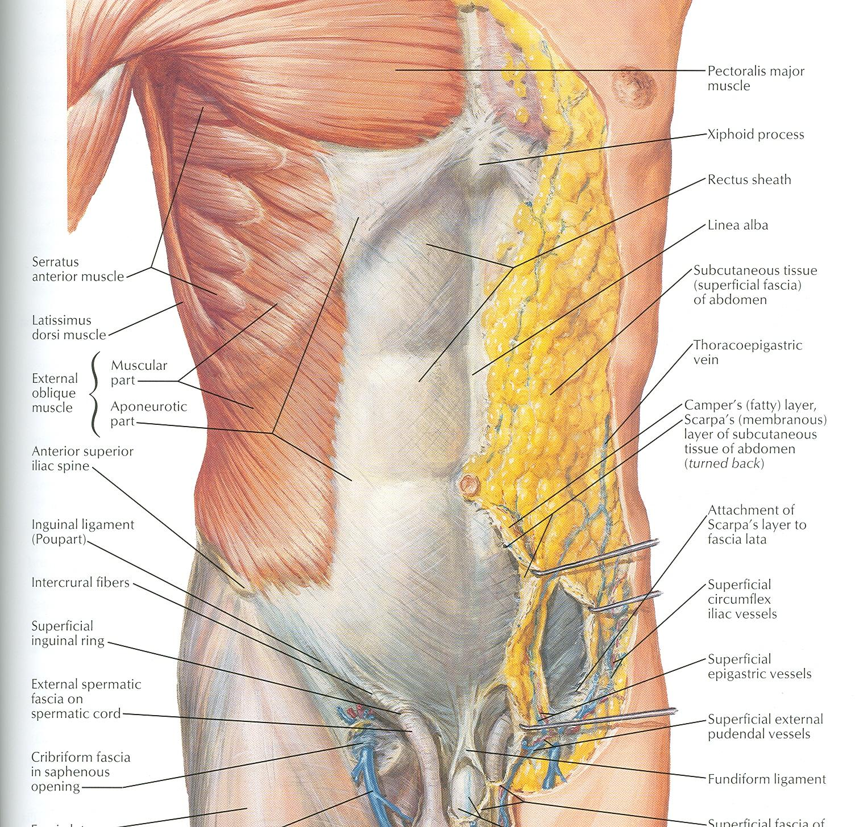

Slide 15
Superficial Fascia
Inferiorly the membranous layer passes onto the front of the thigh, where it fuses with the deep fascia
In the midline inferiorly forms a tubular sheath for the penis or clitoris
Below in the perineum, enters the wall of the scrotum or labia majora
From there it passes to be attached on each side to the margins of pubic arch, here it is called Colle’s fascia

Slide 16
Superficial Fascia
Posteriorly it fuses with the perineal body and the margin of the perineal membrane
The fatty layer is represented as a smooth muscle in the scrotum, the dartos muscle
The membranous layer persists as a separate layer

Slide 17
Deep Fascia
Deep fascia in the anterior abdominal wall is merely a thin layer of connective tissue covering the muscles
It lies immediately deep to the membranous layer of the superficial fascia

Slide 18
Muscles
Consists of Three broad thin sheets that are aponeurotic in front
From exterior to interior they are:
External oblique, internal oblique, and transverse
A wide vertical muscle, the rectus abdominis
They lie on either side of the midline anteriorly

Slide 19
Muscles
As the aponeurosis of three sheets pass forward, they enclose the rectus abdominis to form the rectus sheath
The cremaster muscle which is derived from the lower fibers of internal oblique, passes inferiorly as a covering of the spermatic cord and enters scrotum

Slide 20
External Oblique Muscle
Is a broad, thin, muscular sheet
Origin: Lower 8 ribs
Insertion: Xiphoid process, linea alba, pubic tubercle, iliac crest
Nerve Supply: Lower 6 thoracic nerves, iliohypogastric & ilioinguinal nerves
Action: Supports abdominal contents, assist in forced expiration, micturition, defecation, parturition, vomiting

Slide 22
External Oblique Muscle
A triangular shaped defect in the external oblique aponeurosis lies immediately above and medial to the pubic tubercle, known as superficial inguinal ring
Between the anterosuperior iliac spine and the pubic tubercle, the lower border of the aponeurosis is folded backward on itself, forming the inguinal ligament

Slide 23
Internal Oblique Muscle
Origin: Lumbar fascia, iliac crest, lateral two-thirds of inguinal ligament
Insertion: Lower three ribs and costal cartilages, xiphoid process, linea alba, symphysis pubis
Nerve Supply: Lower six thoracic nerves, iliohypogastric & ilioinguinal nerves
Action: Supports abdominal contents, assist in forced expiration, micturition, defecation, parturition, vomiting

Slide 24
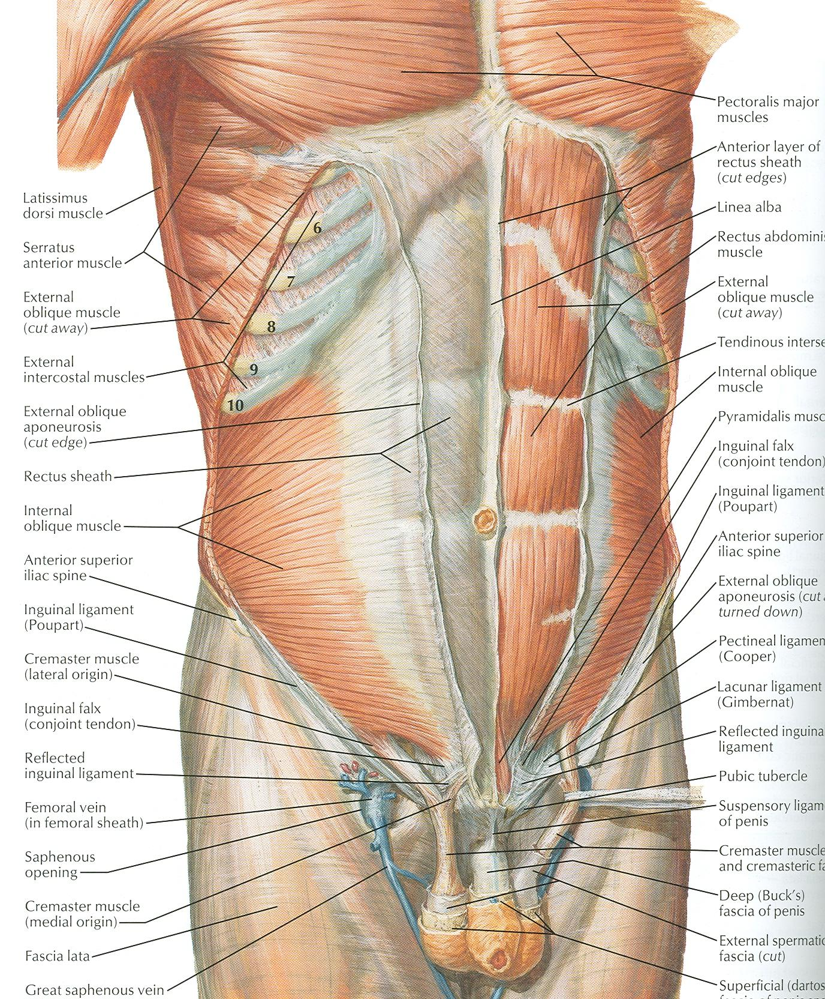

Slide 25
Transversus Abdominis
Origin: Lower six costal cartilages, lumbar fascia, iliac crest, lateral third of inguinal ligament
Insertion: Xiphoid process, linea alba, symphysis pubis
Nerve Supply: Lower six thoracic nerves, iliohypogastric & ilioinguinal nerves
Action: Compresses abdominal contents

Slide 26
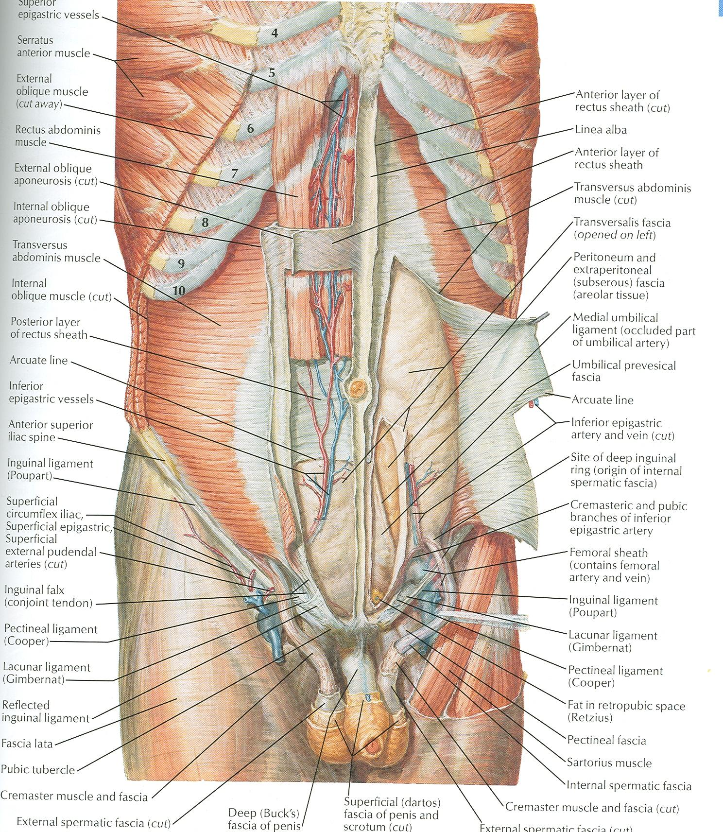

Slide 27
Rectus Abdominis
Origin: Symphysis pubis and pubic crest
Insertion: 5th, 6th and 7th costal cartilages and xiphoid process
Nerve Supply: Lower six thoracic nerves
Action: Compresses abdominal contents, flexes vertebral column, accessory muscle of expiration

Slide 29
Lymph Drainage
Lymph drainage of the skin of the anterior abdominal wall above the umbilicus is upward to the anterior axillary (pectoral group of nodes)
Below the level of umbilicus drains downward and laterally to the superficial inguinal nodes
Swelling in the groin is may be due to enlarged superficial inguinal node

Slide 30
Venous Drainage
Venous blood is collected into a network of veins that radiate from the umbilicus
The network is drained above into the axillary vein via the lateral thoracic vein
Below into the femoral vein via the superficial epigastric and the great saphenous veins
Few small veins, the paraumbilical veins form a clinically important portal-system venous anastomosis

Slide 31
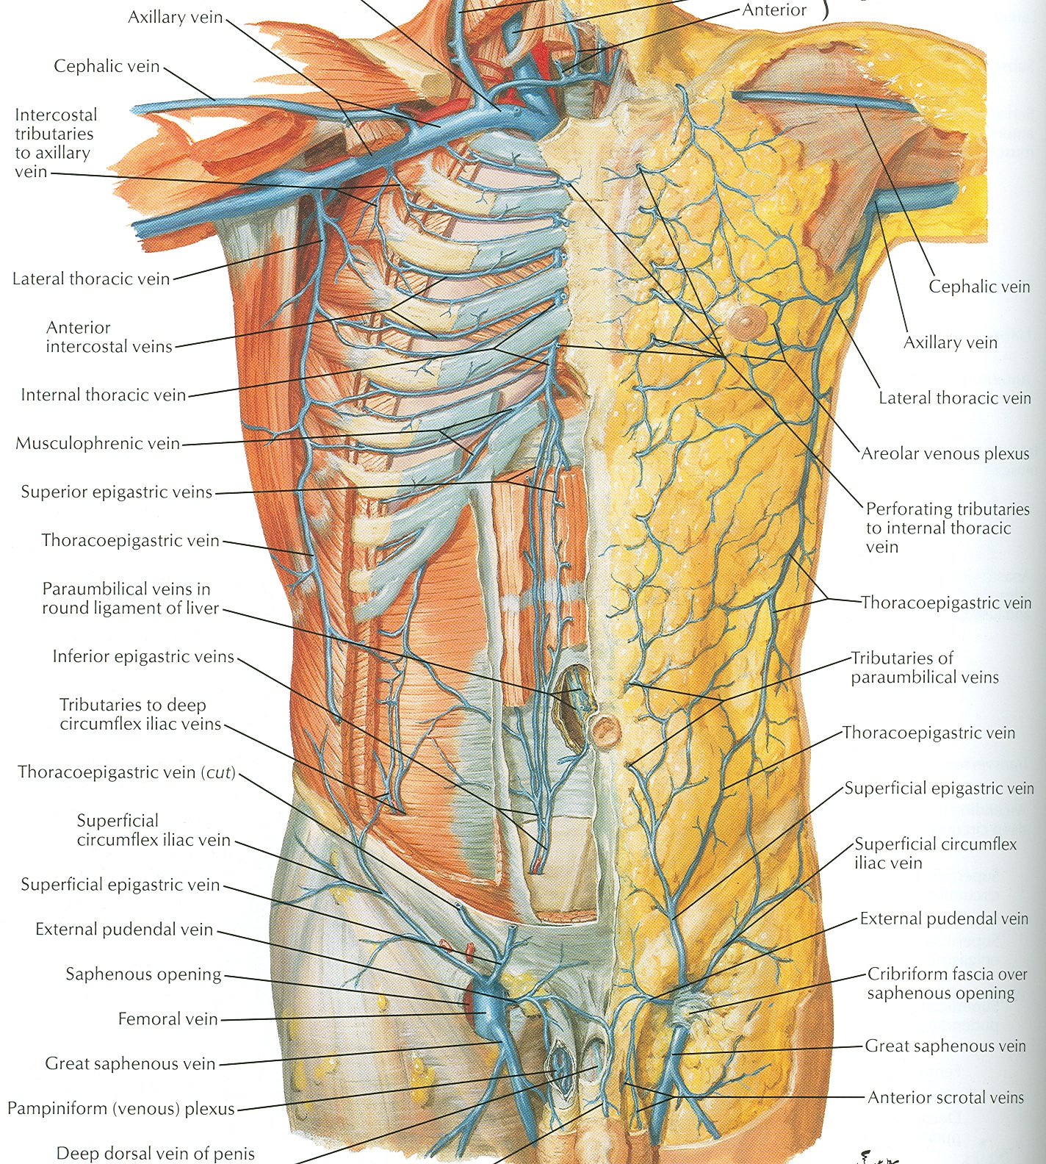

Slide 32
Caput Medusae
The superficial veins around the umbilicus and the paraumbilical veins connecting them to the portal vein may become grossly distended in case of portal vein obstruction
The distended subcutaneous veins radiate out from the umbilicus, producing in severe cases the clinical picture called Caput Medusae

Slide 33
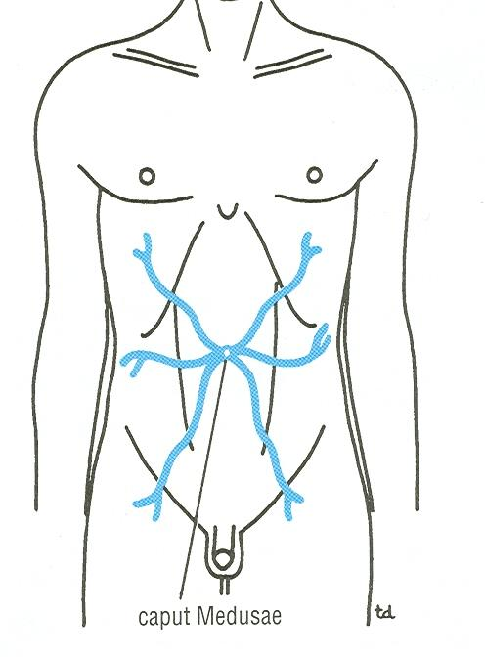

Slide 34
Nerves
Nerves of the anterior abdominal wall supply the skin, muscles and the parietal peritoneum
They are derived from the anterior rami of lower six thoracic and the first lumbar nerves
Inflammation of parietal peritoneum causes pain in the overlying skin and also a reflex increase in tone of the abdominal musculature in the same area

Slide 35
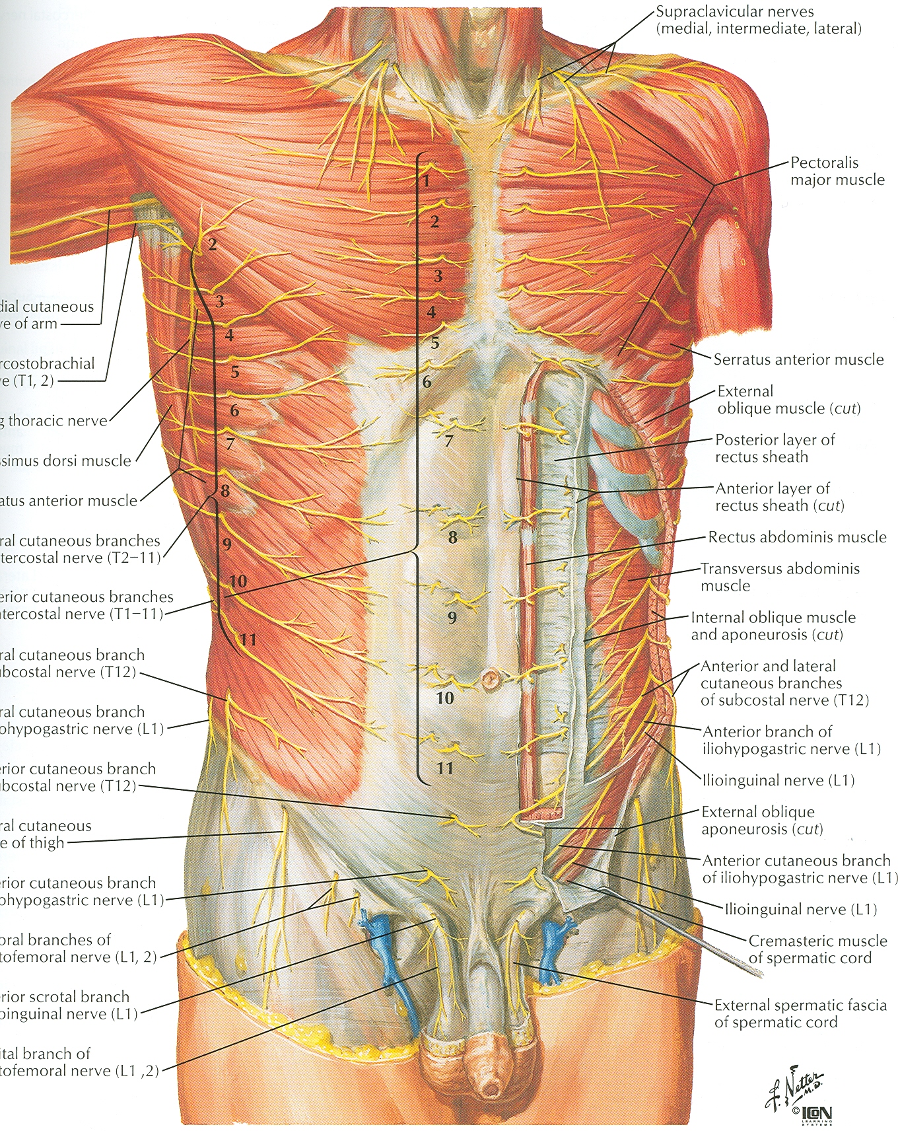

Slide 36
Rectus Sheath
Is a long fibrous sheath
Encloses the rectus abdominis and pyramidalis muscle (if present)
Contains the anterior rami of lower six thoracic nerves and the superior and inferior epigastric vessels and lymph vessels
Formed mainly by aponeurosis of three lateral abdominal muscles

Slide 37
Rectus Sheath
For description it is considered at three levels:
Above the costal margin the anterior wall is formed by the aponeurosis of the external oblique and posterior wall is formed by the thoracic wall
That is the 5th , 6th and 7th costal cartilages and the intercostal spaces

Slide 38
Rectus Sheath
Between the costal margin and the level of the anterosuperior iliac spine, the aponeurosis of the internal oblique splits to enclose the rectus muscle
The external oblique aponeurosis is directed in front of the muscle
Transversus aponeurosis is directed behind the muscle

Slide 39
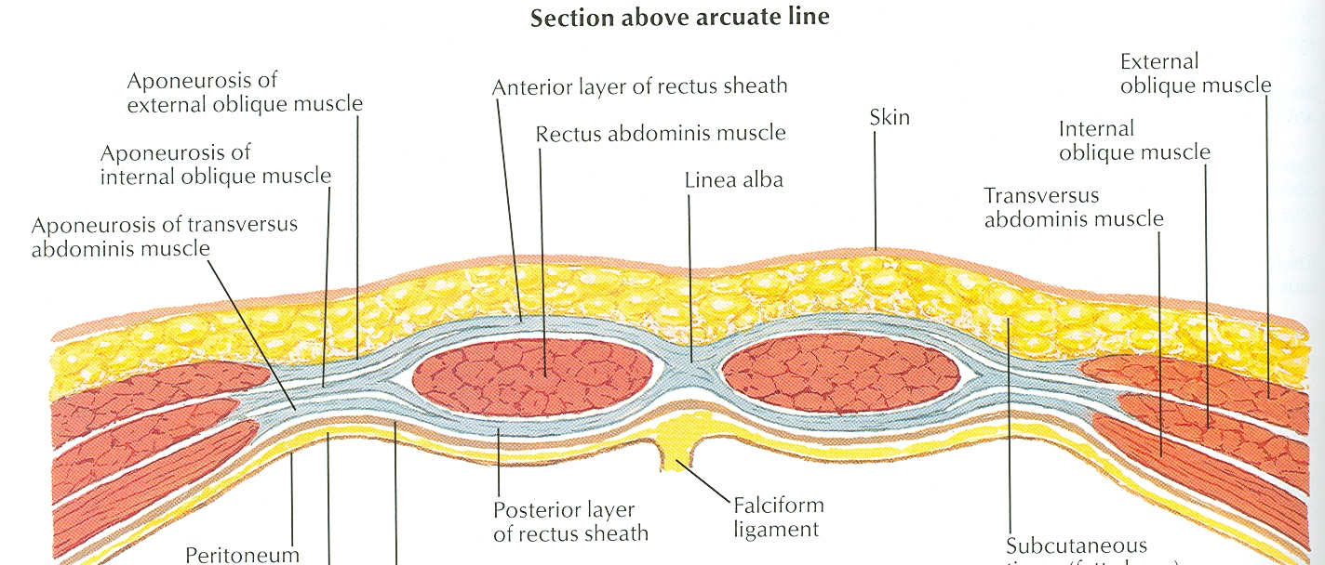

Slide 40
Rectus Sheath
Between the level of the anterosuperior iliac spine and the pubis, the aponeurosis of all three muscles form the anterior wall
The posterior wall is absent
The rectus muscle lies in contact with the fascia transversalis

Slide 41
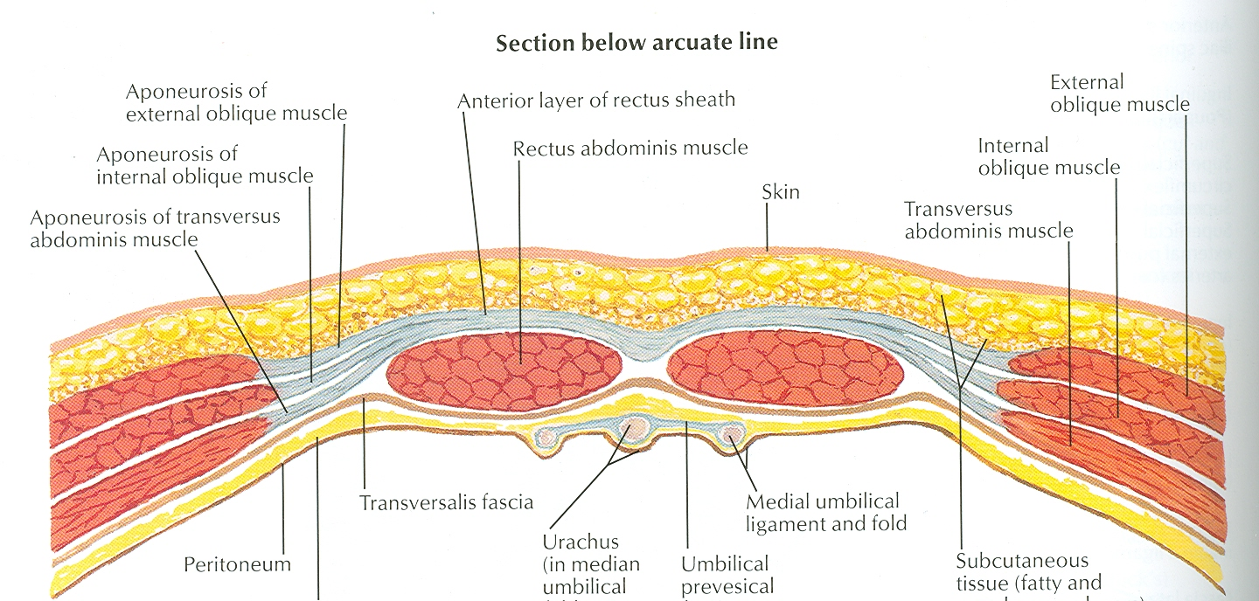

Slide 42
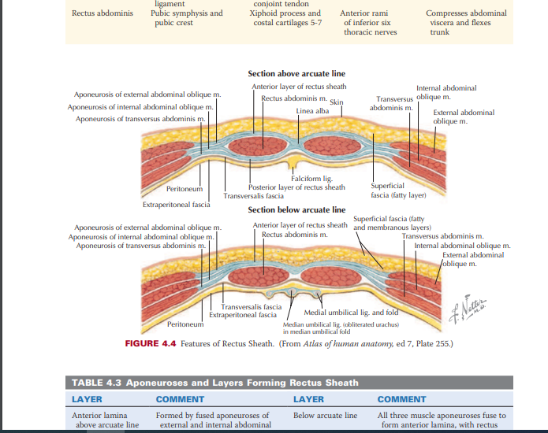

Slide 43
Rectus Sheath
The posterior wall of the rectus sheath is not attached to the rectus abdominis muscle
The anterior wall is firmly attached to it by the muscle’s tendinous intersections

Slide 44
Linea Alba
The rectus sheath is separated from its fellow on the opposite side by a fibrous band called the linea alba
Extends from the xiphoid process to the symphysis pubis

Slide 45
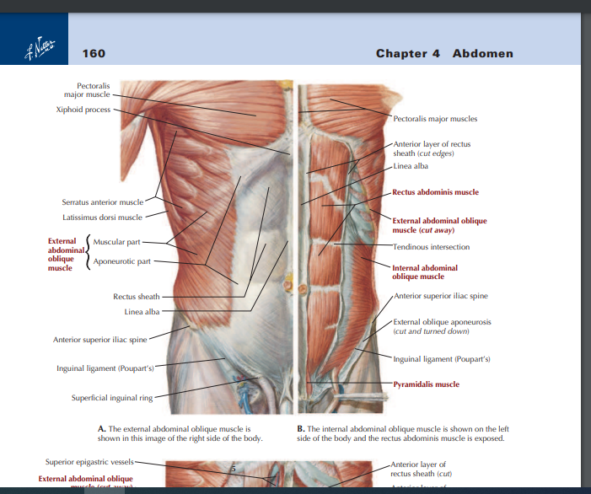

Slide 46
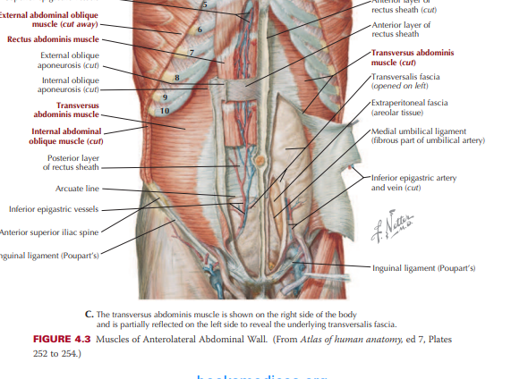

Slide 47
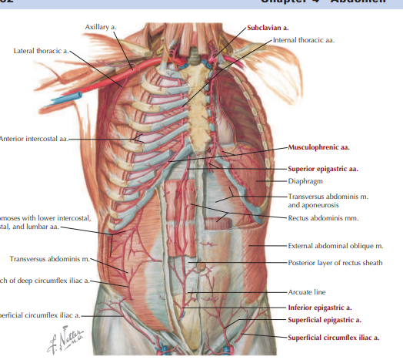

Slide 48
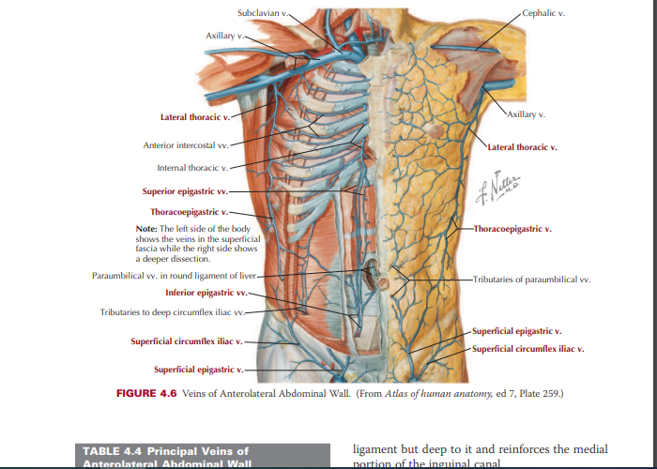

Slide 49
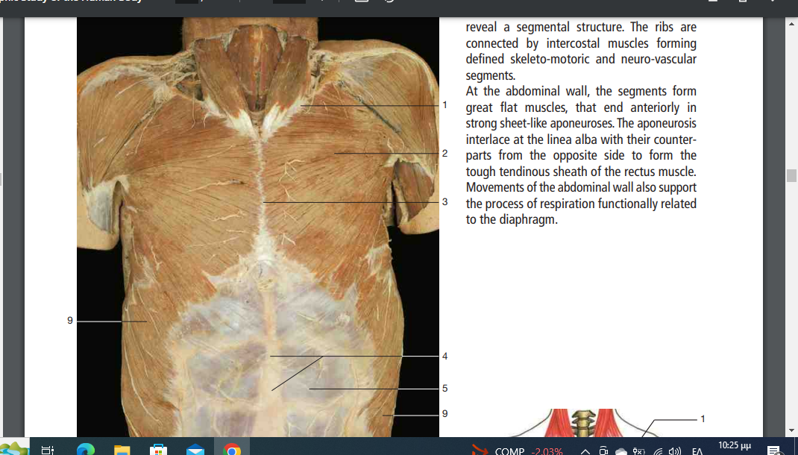

Slide 50
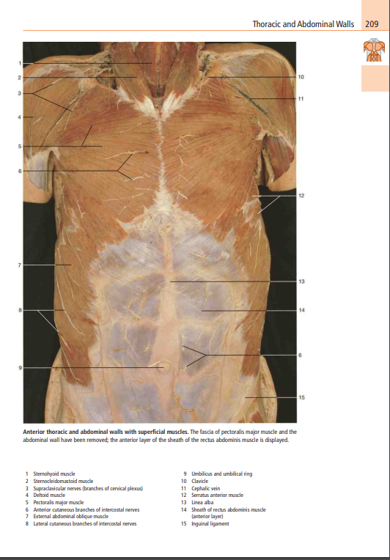

Slide 51
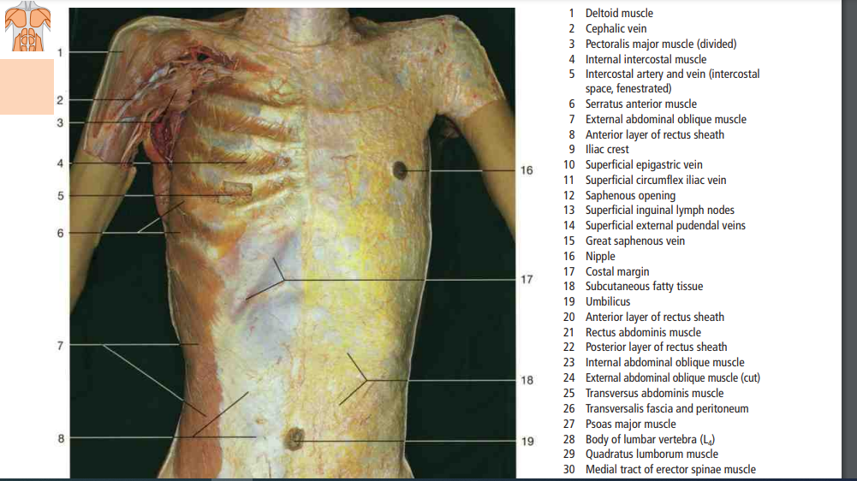

Slide 52
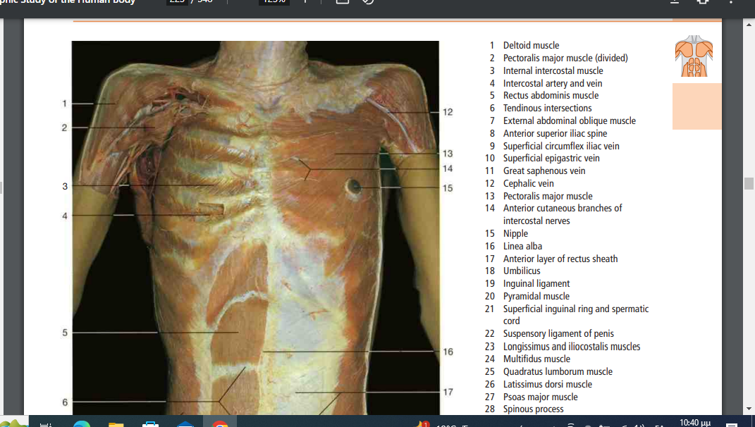

Slide 53
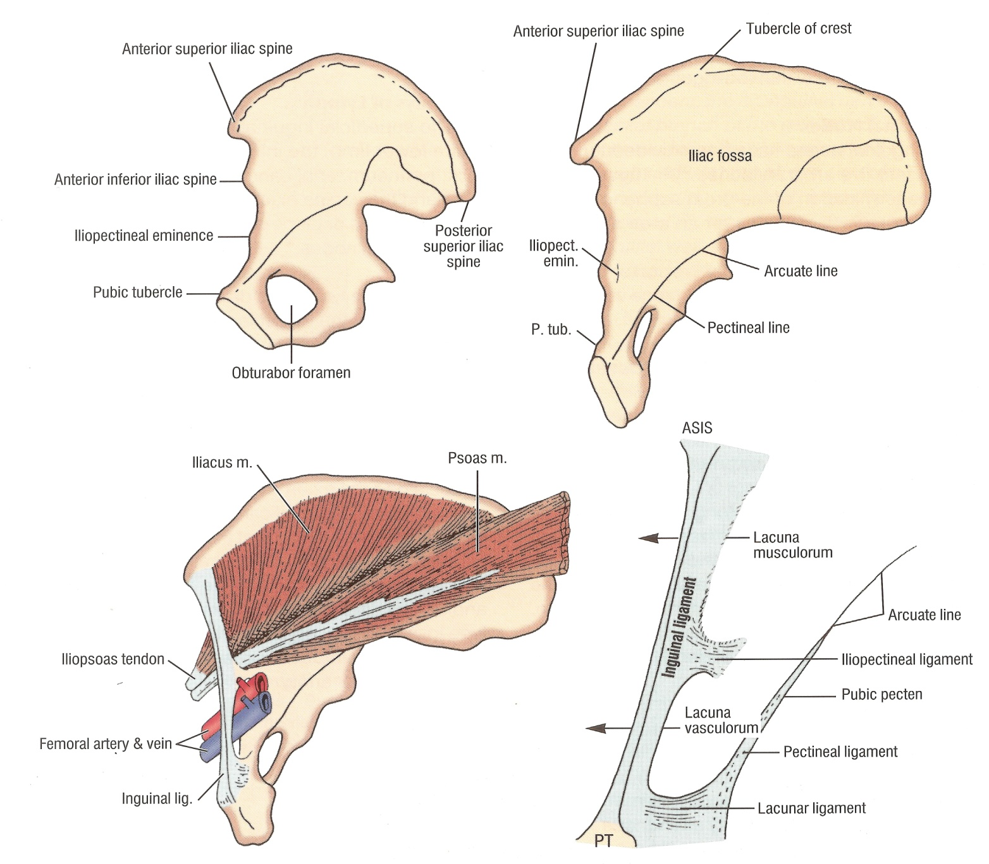

Slide 54
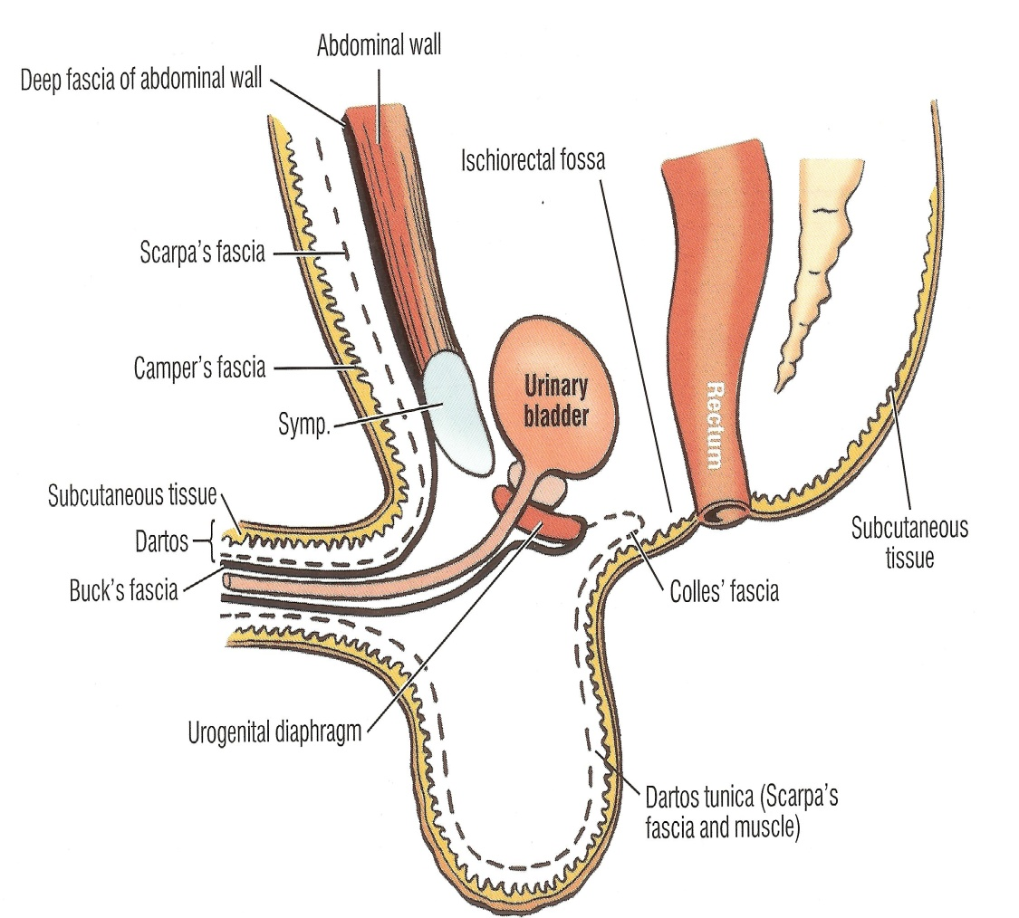
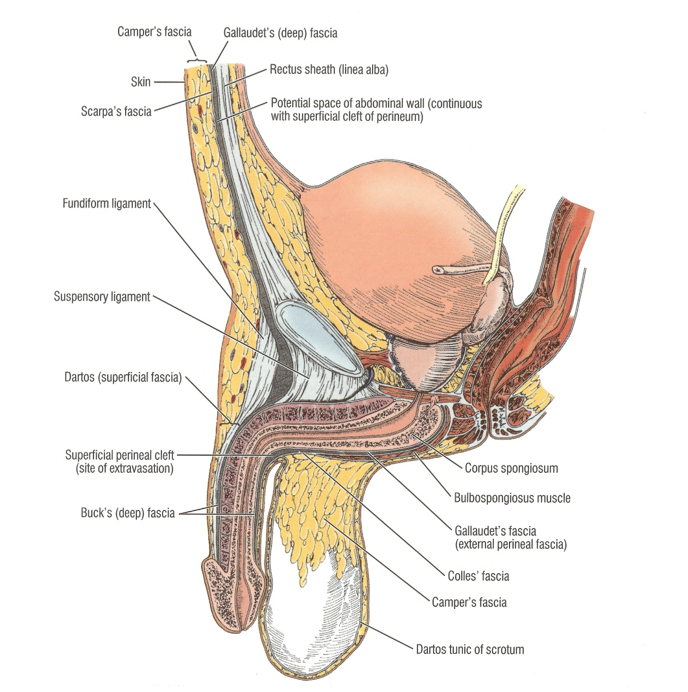

Slide 55
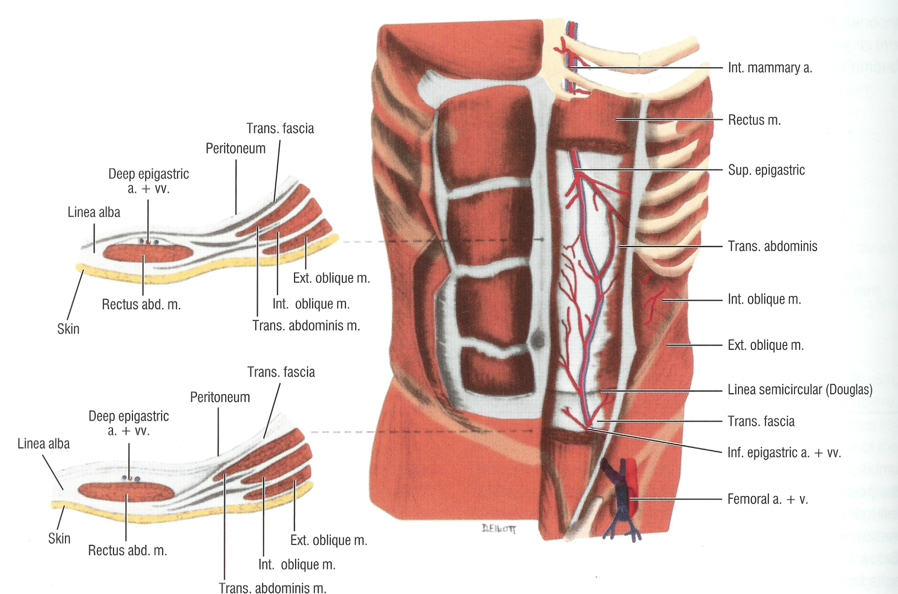

Slide 56
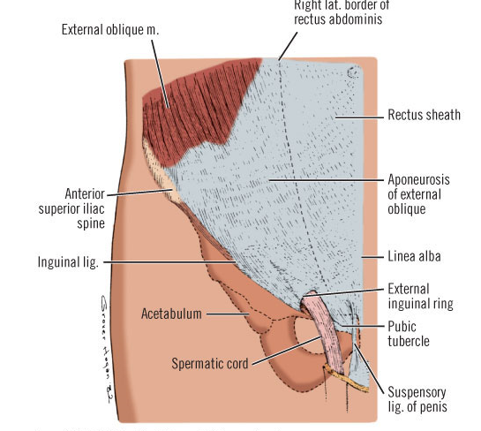
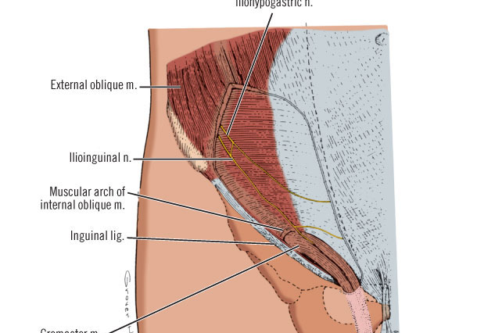

Slide 57
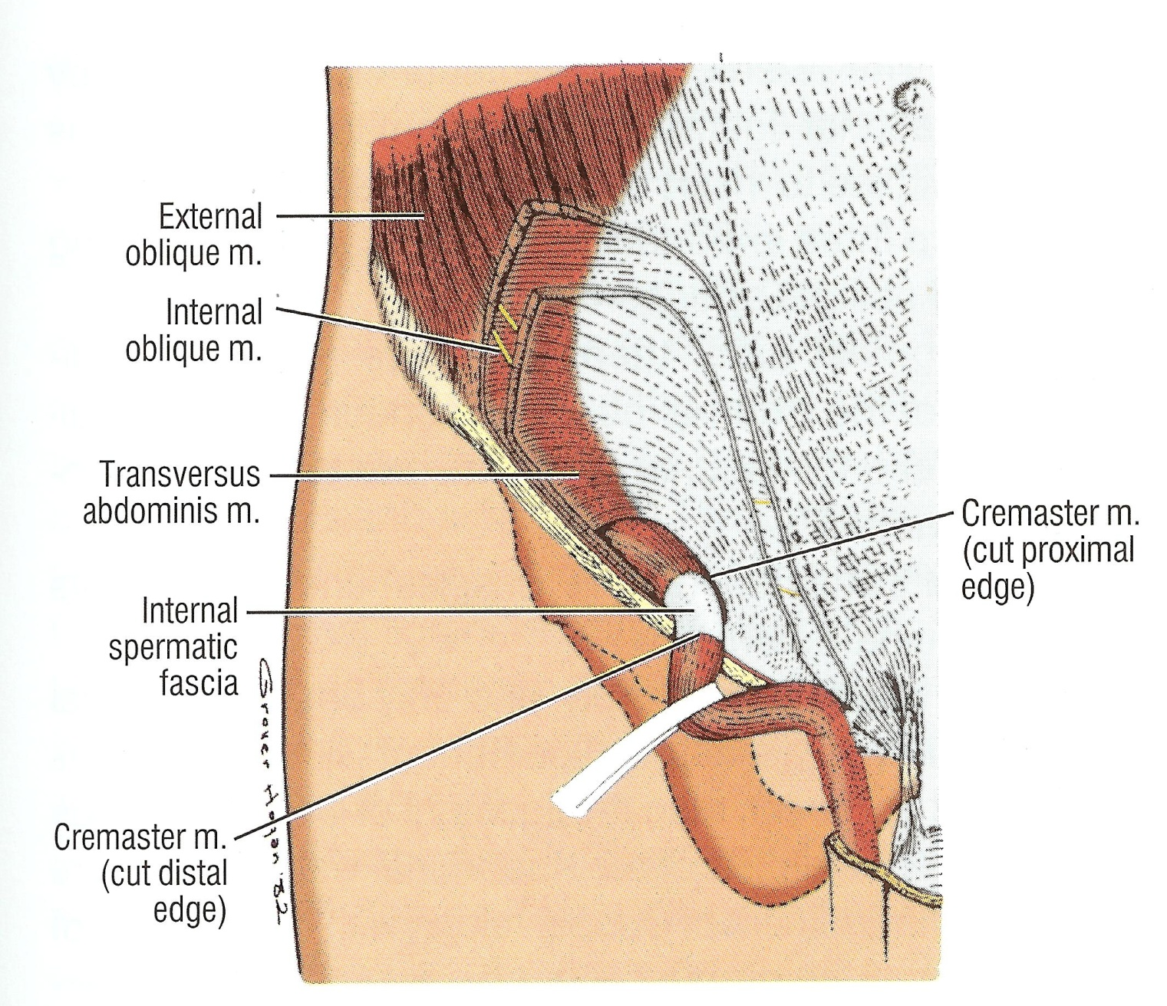

Slide 58
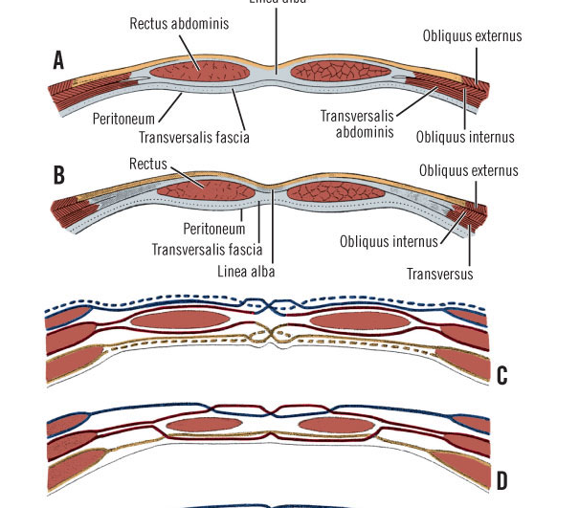
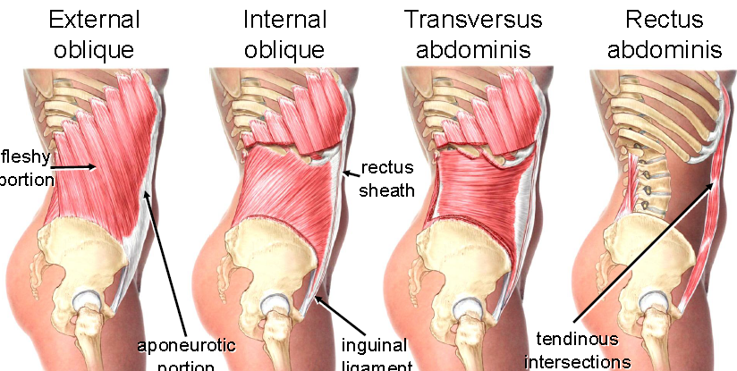

Slide 59
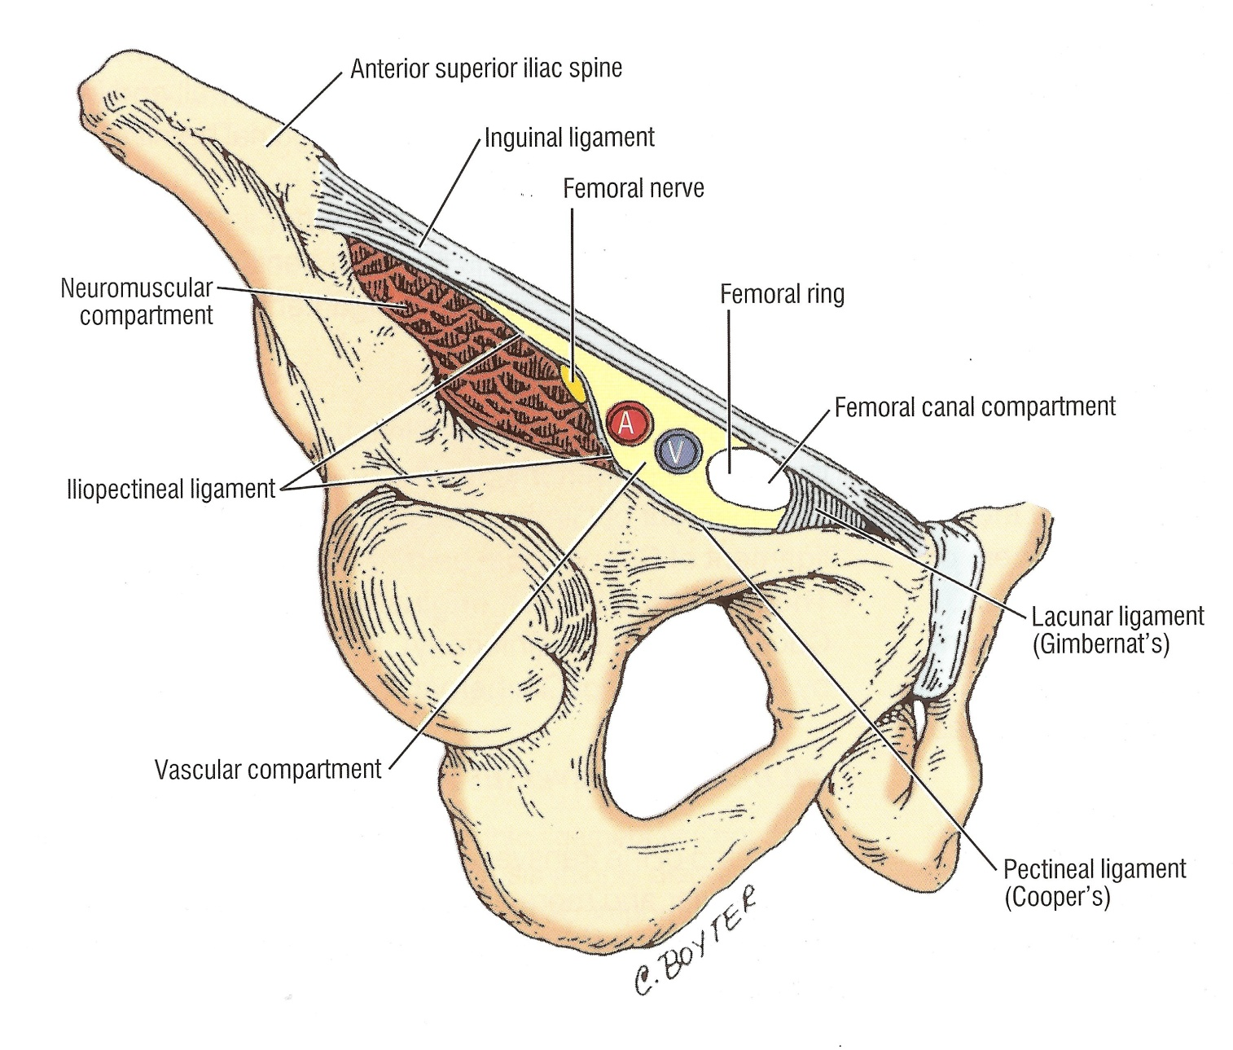

Slide 60
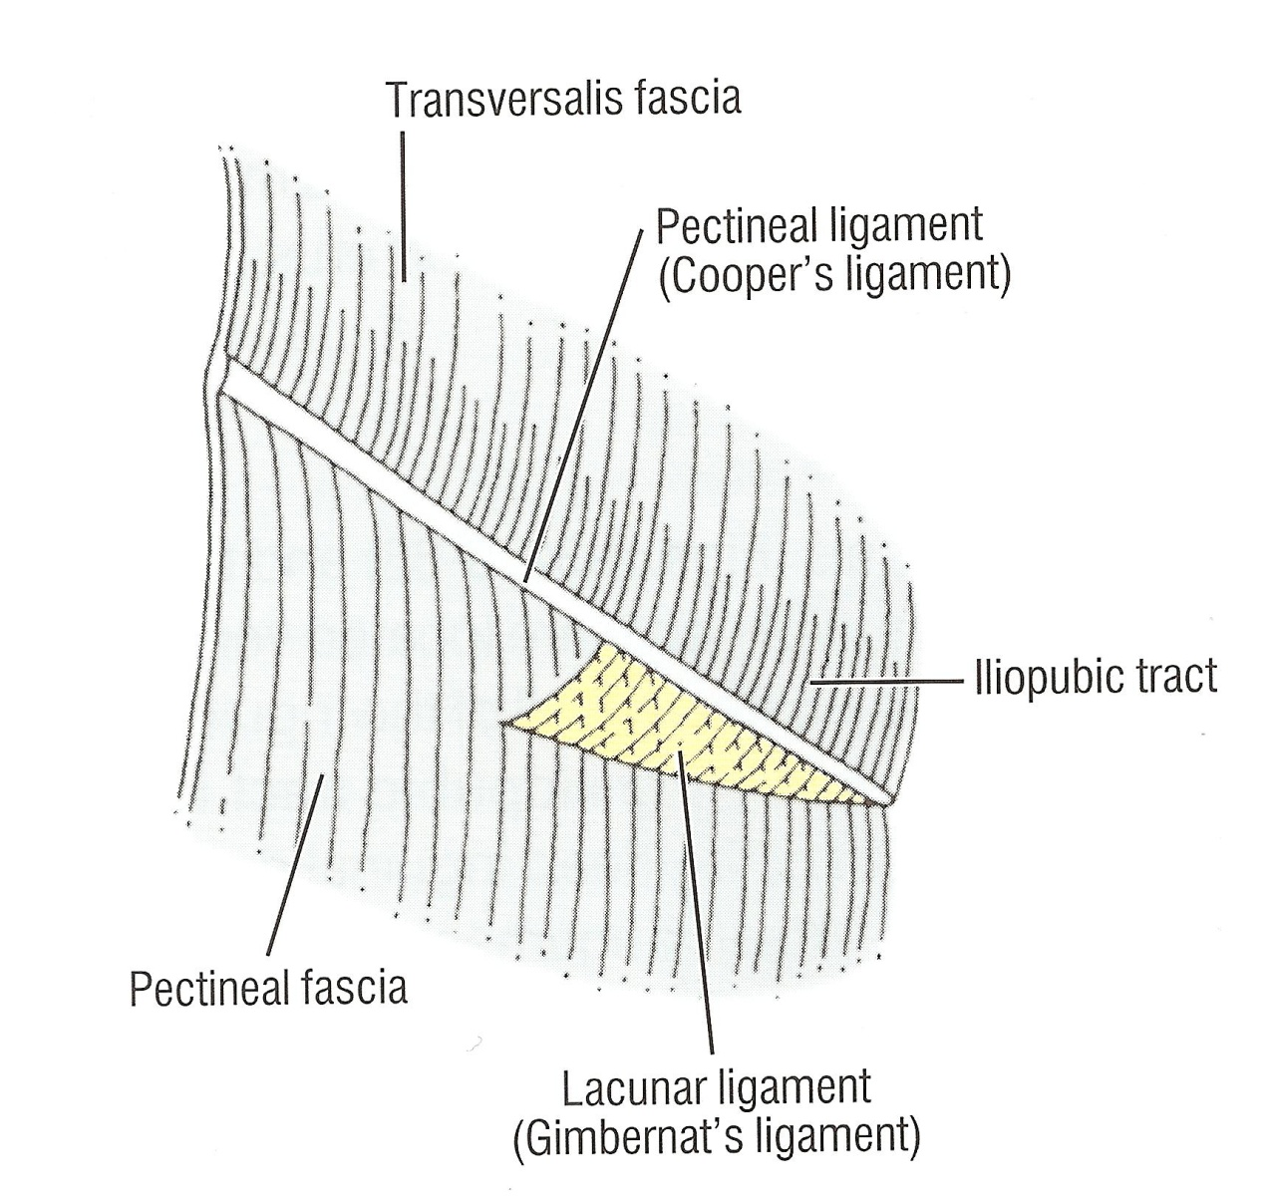

Slide 61
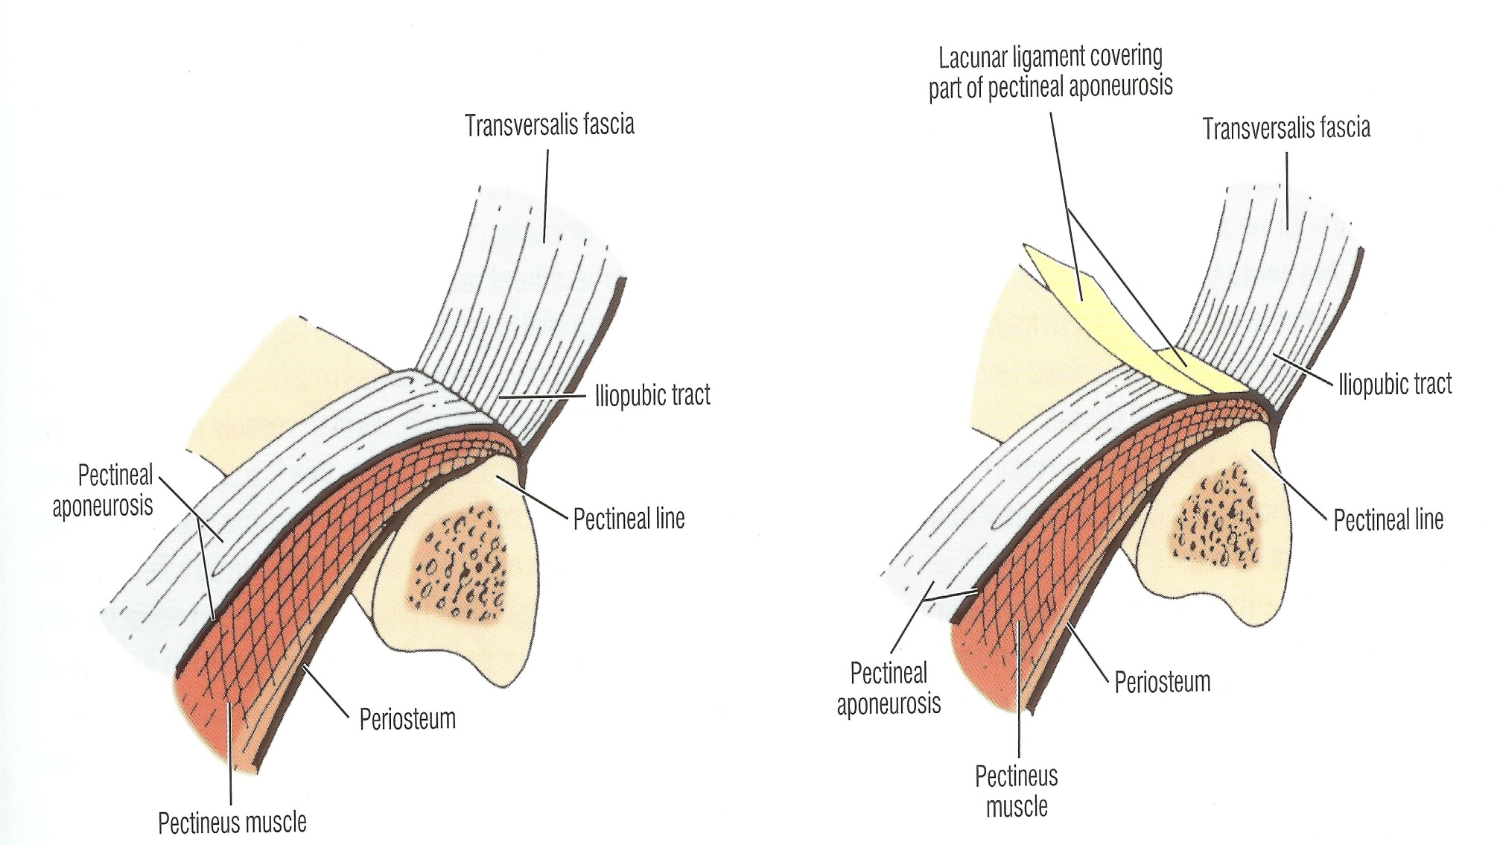

Slide 62
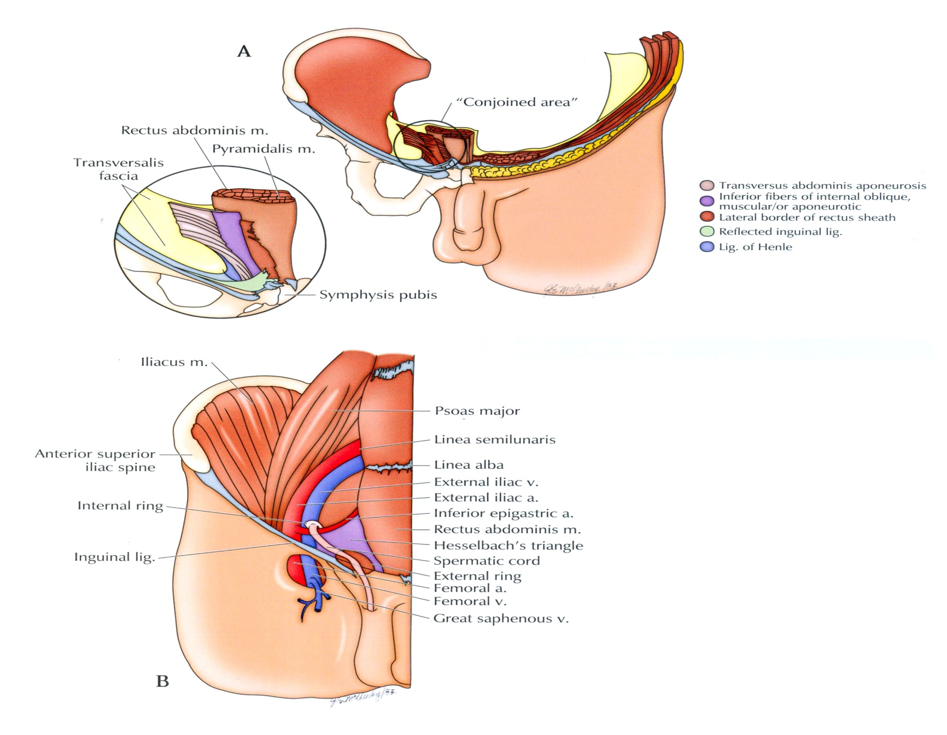

Slide 63
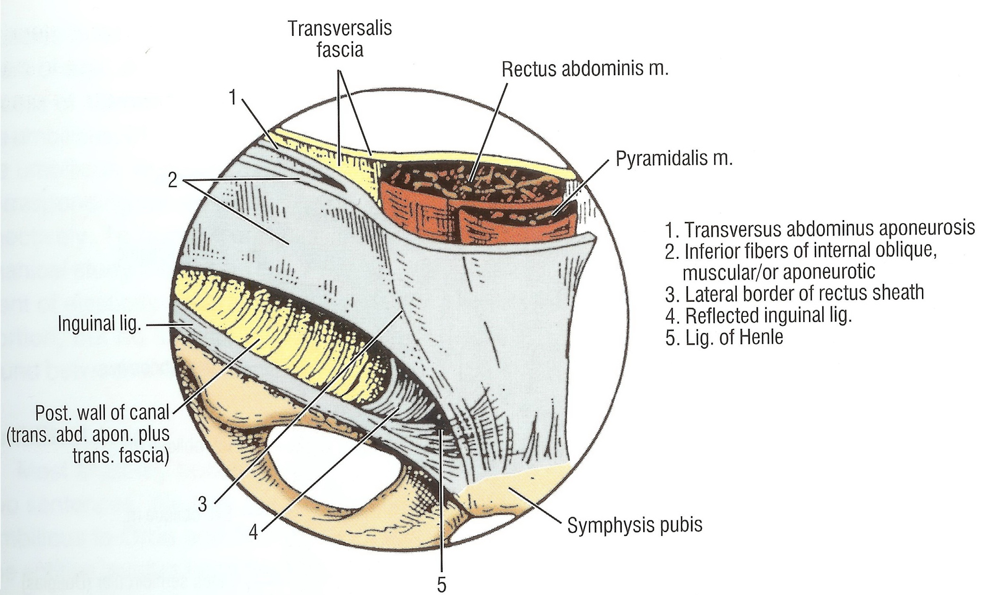
Conjoined area

Slide 64
Transverse Fascia

Slide 65
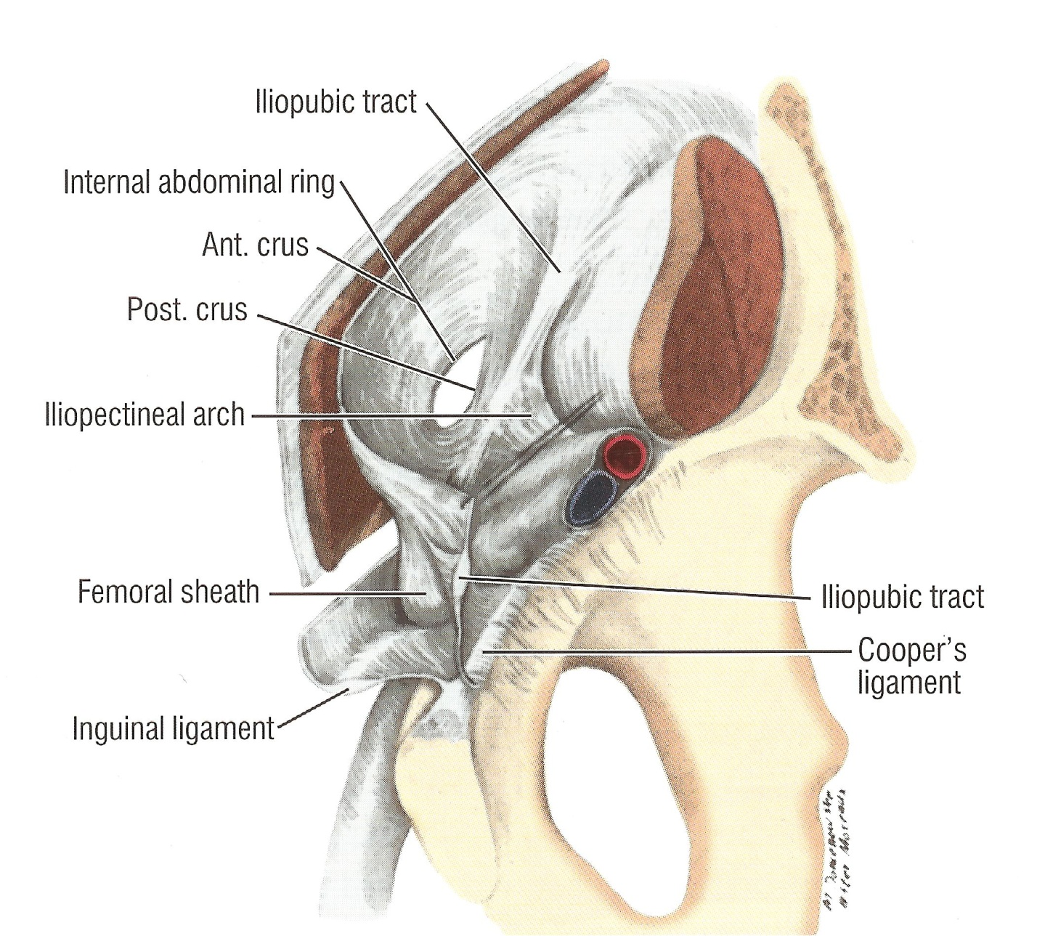
Iliobubic Truct

Slide 67
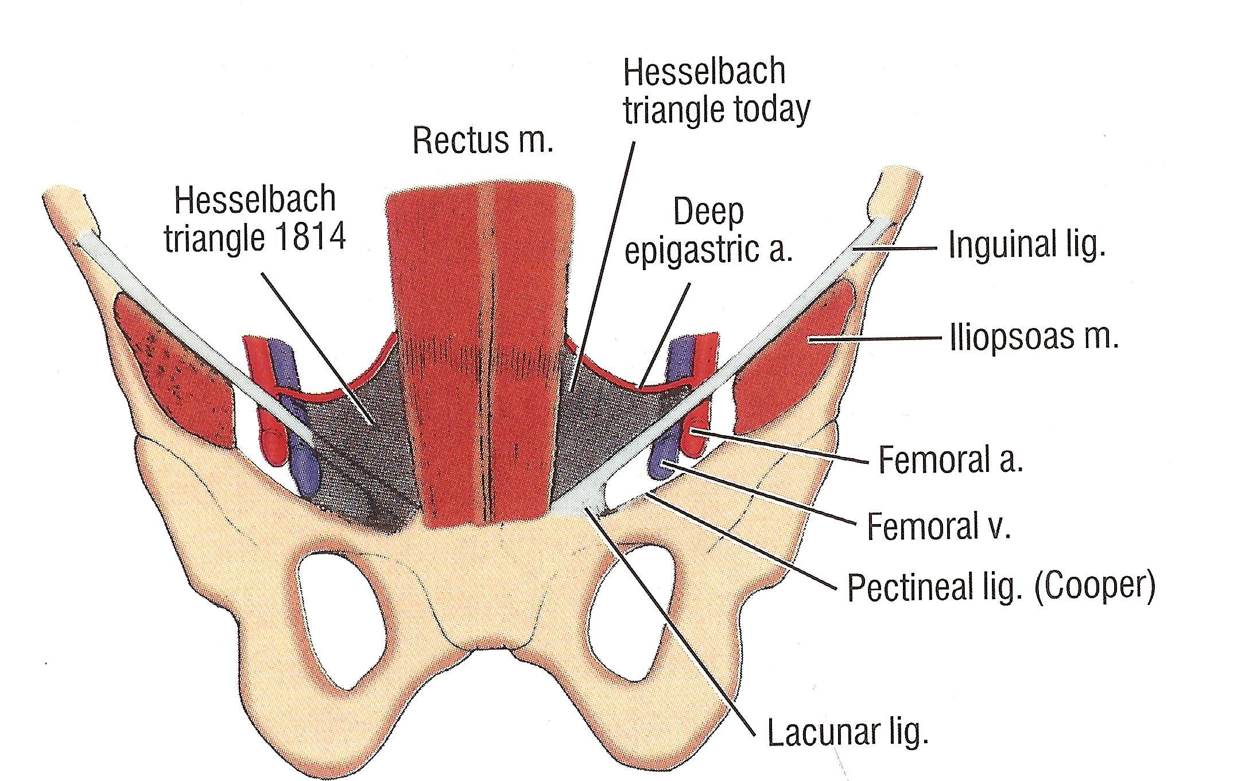
Τriangle of “Hesselbach”

Slide 68
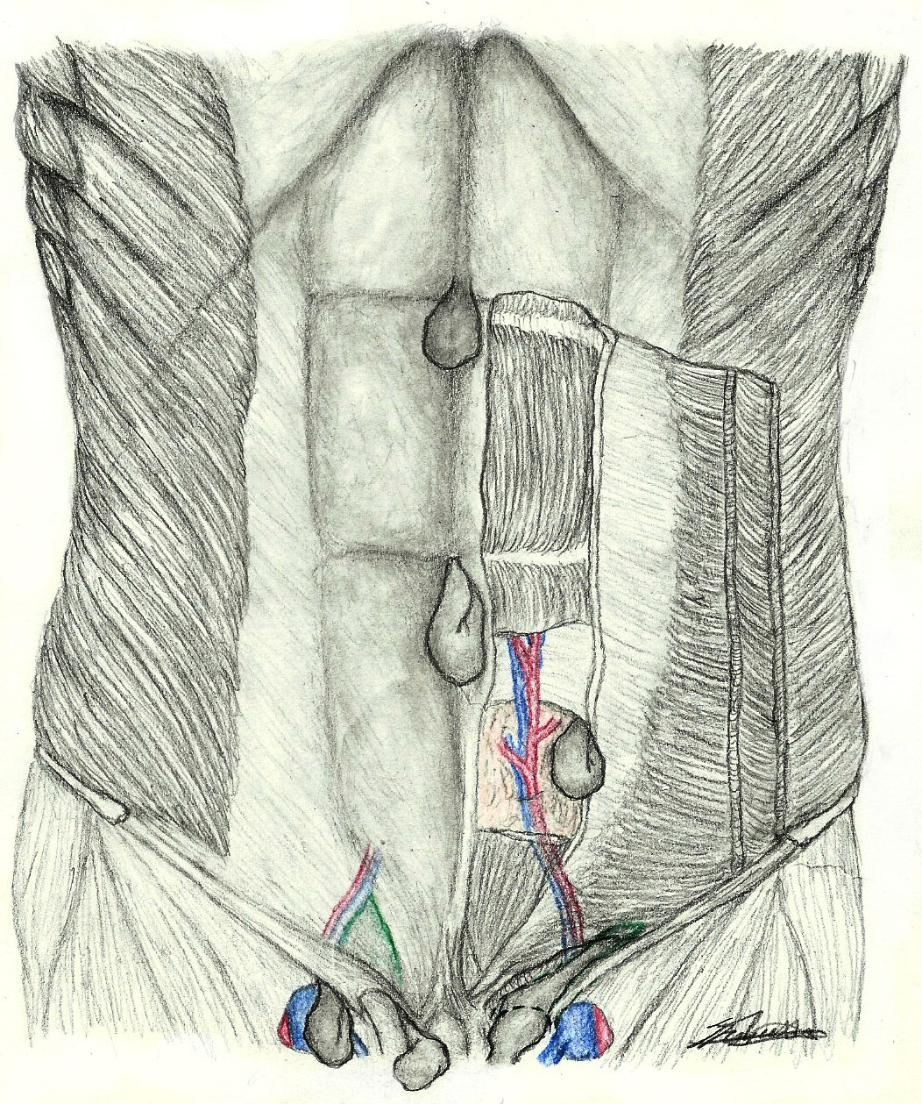

Slide 69
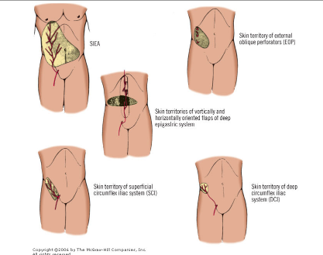

Slide 70
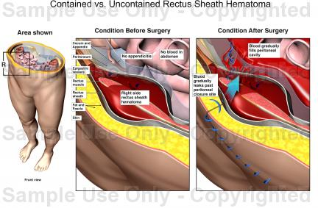
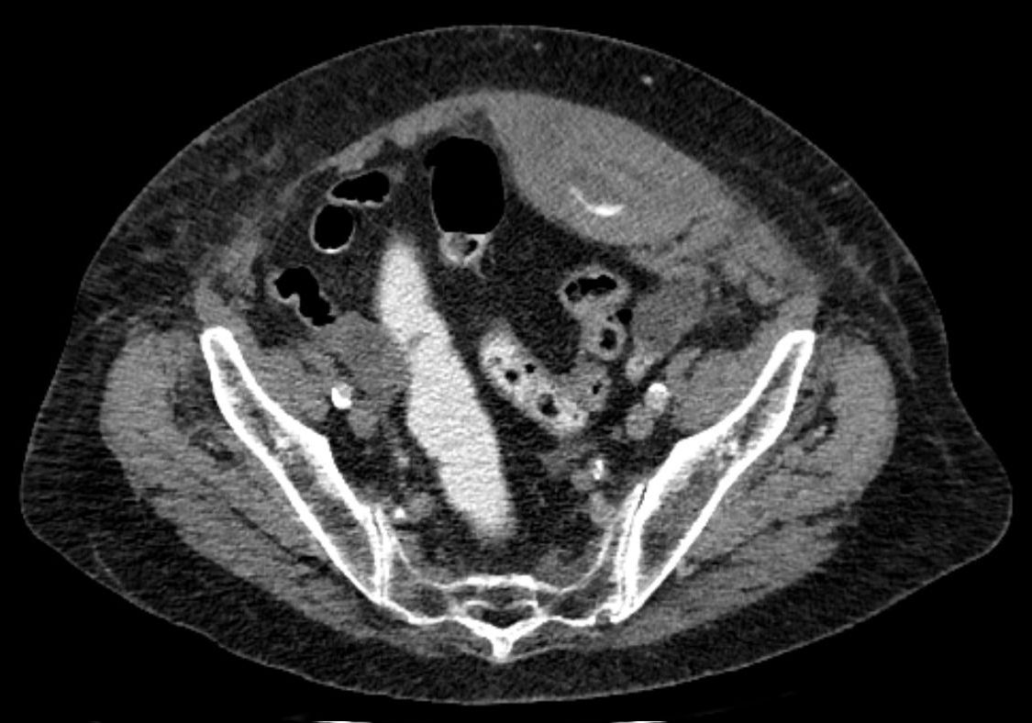
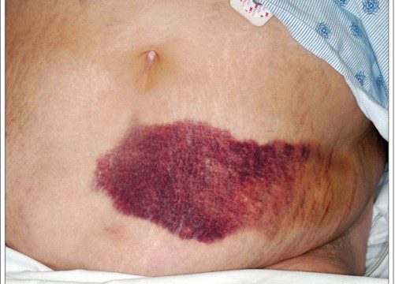

Slide 71
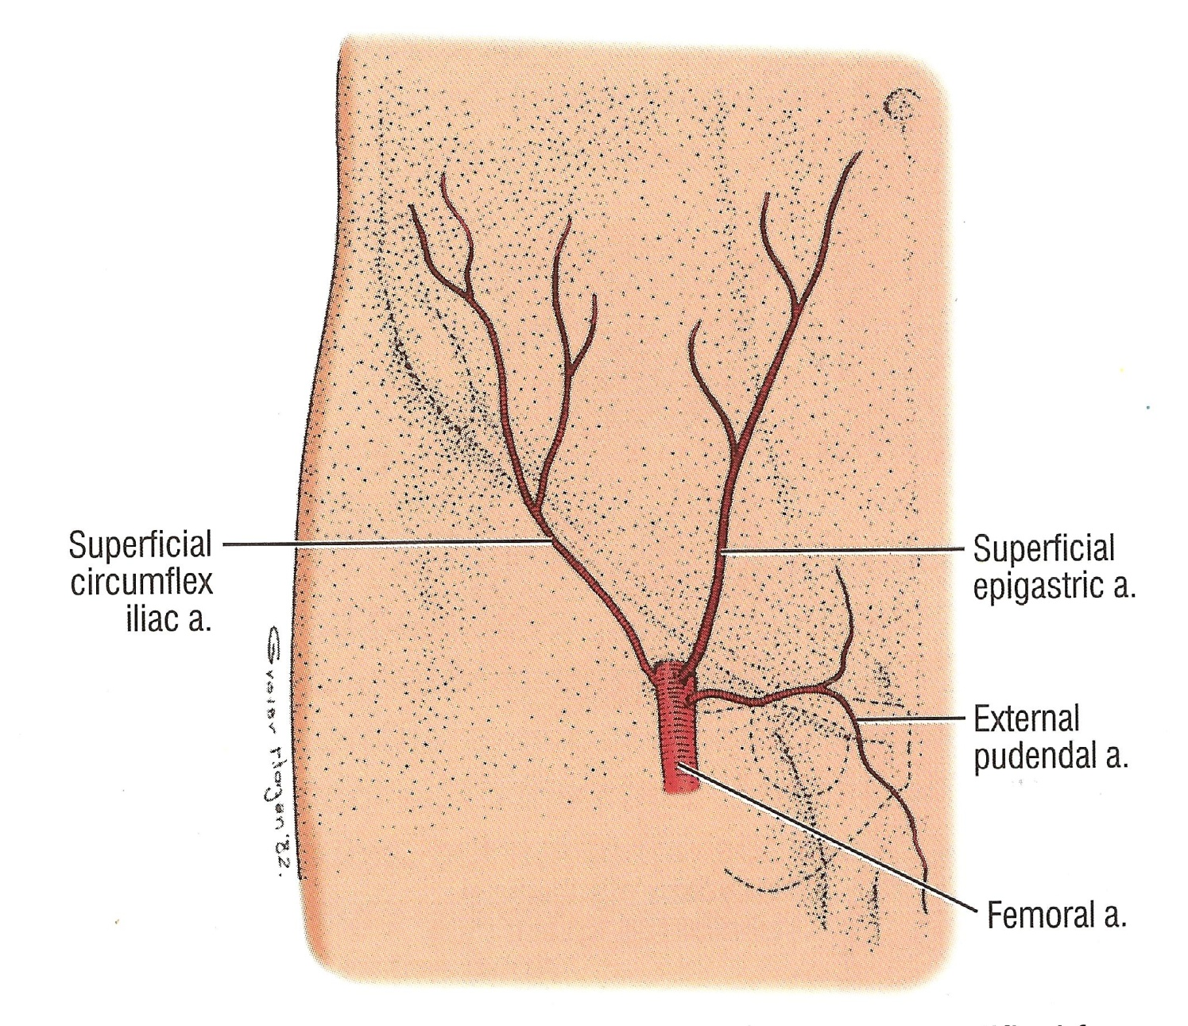

Slide 72
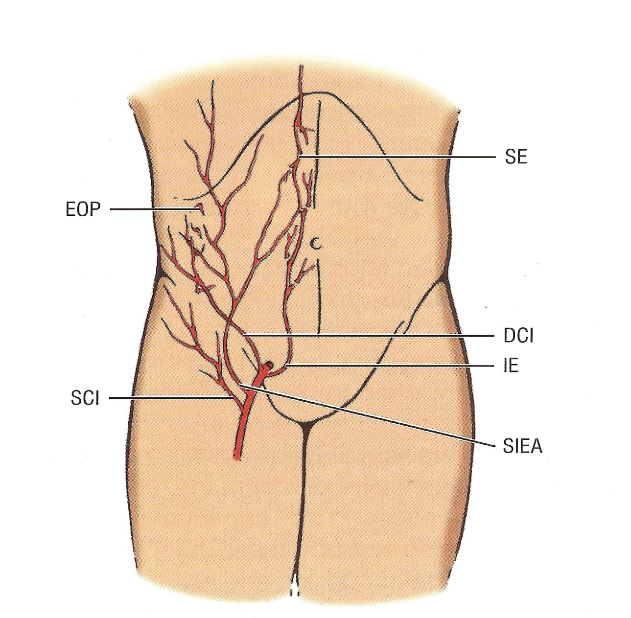

Slide 73
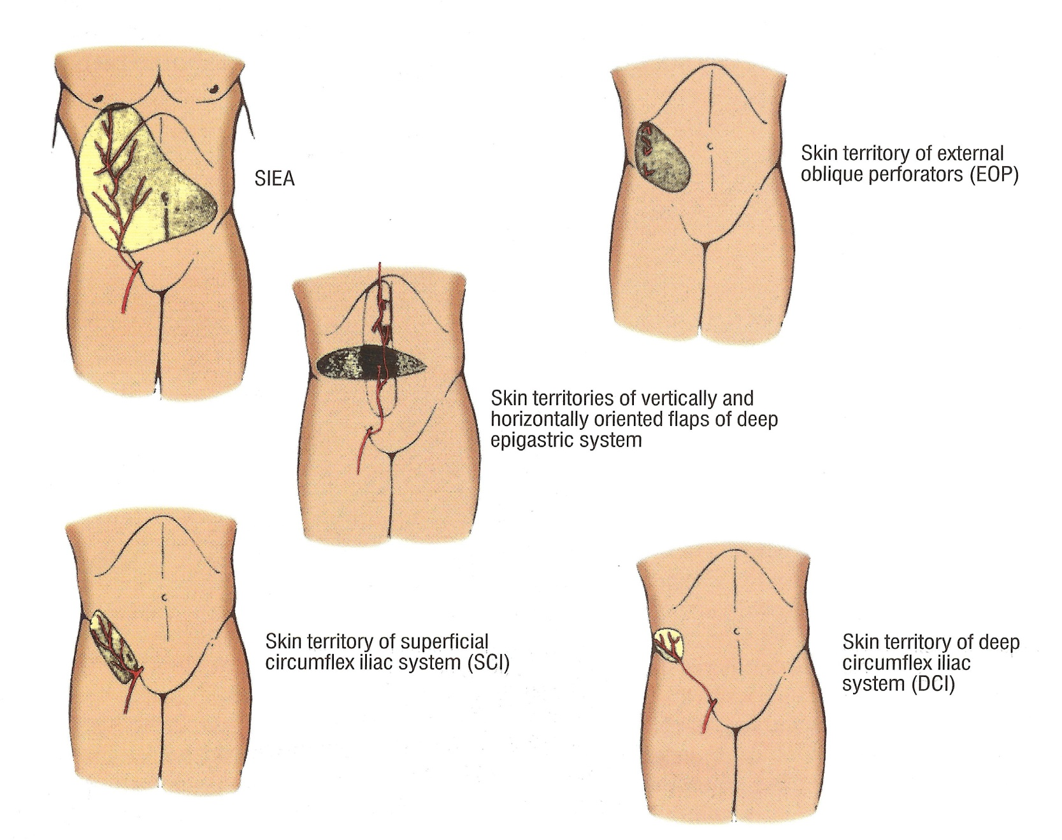

Slide 74
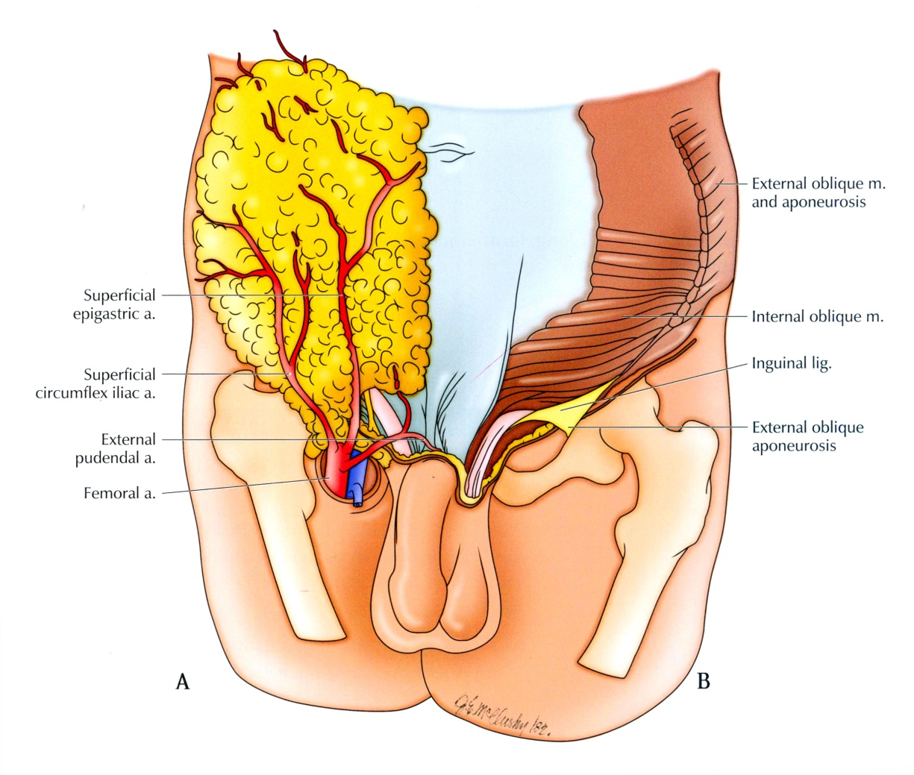

Slide 75
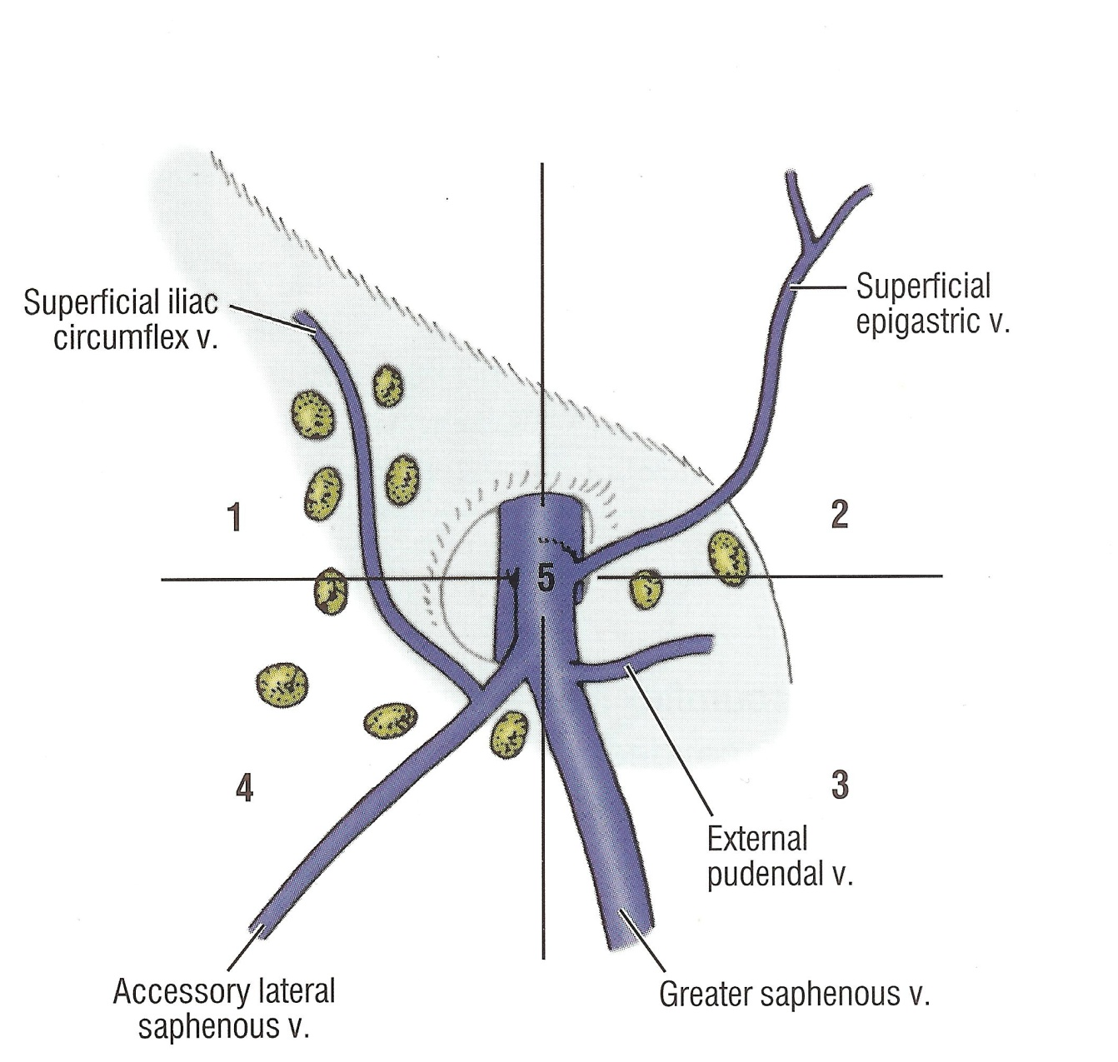
Lymph Node and distribution

Slide 76
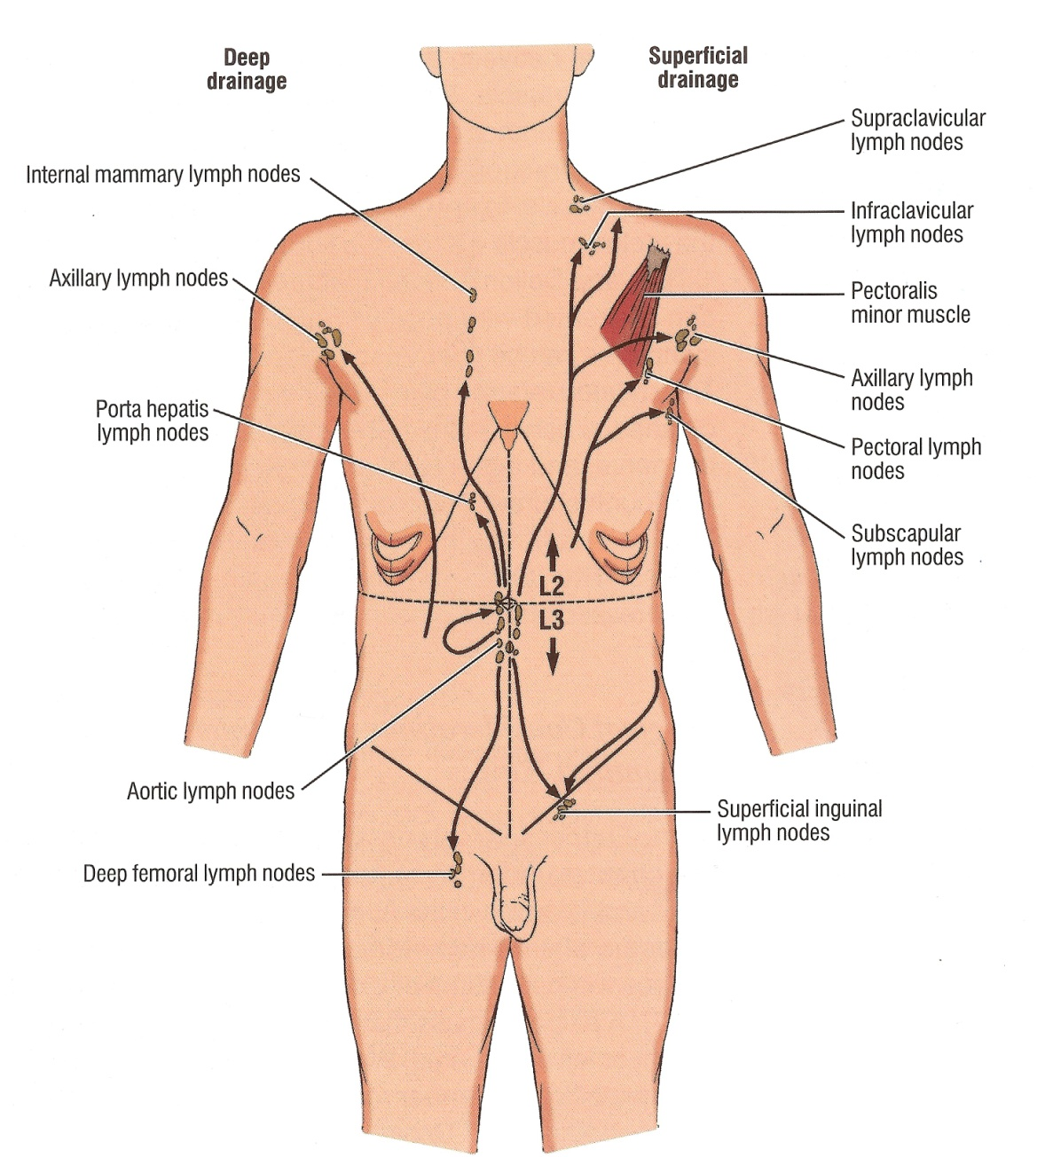

Slide 77
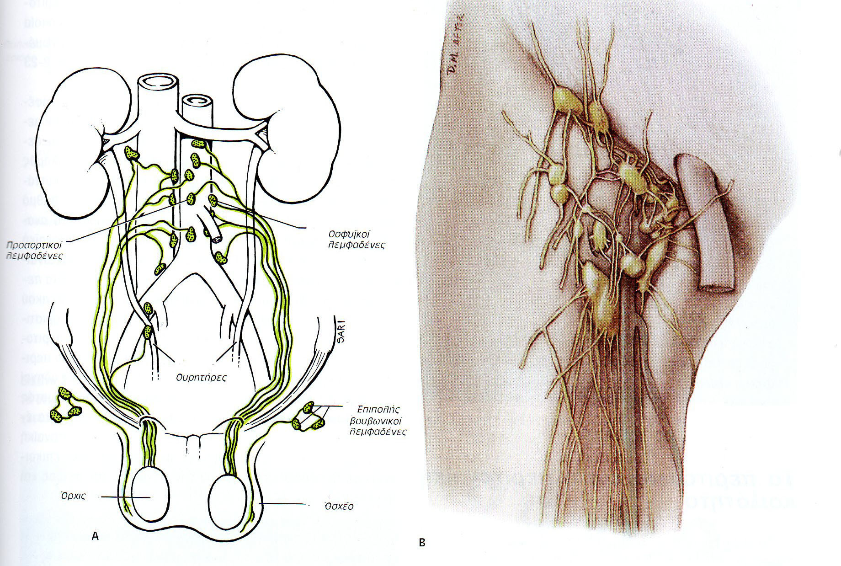

Slide 78


Slide 79


Slide 80


Slide 82
Deep inferior epigastric vessels
Deep opening
Conjoined tendon
Vas deferens
Transverce Fascia
Superficial foramern
Poupart ligament

Slide 84


Slide 85


Slide 86


Slide 88

Area of Bogros

Slide 89


Slide 90



Slide 91

Femoral Ring

Slide 92


Slide 93


Slide 94


Slide 95

Νerve distribution

Slide 96


Slide 97

Thyroid foramen

Slide 98

Spigeli Line

Slide 99
Umbilical region and Hernia

Slide 100


Slide 101


Slide 102

Τriangle of Grynfellt
Triangle of Petit

Slide 103


Slide 104

Abdominal Wall Hernias

Slide 105


Slide 106


Slide 107


Slide 108


Slide 109


Slide 110


Slide 111


Slide 112


Slide 113


Slide 114



Slide 115


Slide 116


Slide 117


Slide 118


Slide 119
Overview of the Pelvis
Recognize bony structures and borders of the pelvis.
Understand arterial branching patterns in the pelvis.

Slide 120

ANATOMY OF THE PELVIS

Slide 121
OBJECTIVES
At the end of the lecture, students should be able to:
Describe the anatomy of the pelvic wall, bones, joints & muscles.
Describe the boundaries and subdivisions of the pelvis.
Differentiate the different types of the female pelvis.
Describe the pelvic floor.
Describe the components & function of the pelvic diaphragm.
List the arterial & nerve supply
List the lymph & venous drainage of the pelvis.

Slide 122
The bony pelvis is composed of four bones:
Two hip bones, which form the anterior and lateral walls.
Sacrum and coccyx, which form the posterior wall.
These 4 bones are connected by 4 joints and lined by 4 muscles.
The bony pelvis with its joints and muscles form a strong basin-shaped structure (with multiple foramina),
The pelvis contains and protects the lower parts of the alimentary & urinary tracts & internal organs of reproduction.

Slide 123

FOUR JOINTS
1- Anteriorly:
Symphysis pubis (cartilaginous joint).
2- Posteriolateraly:
Two Sacroiliac joints. (Synovial joins)
3- Posteriorly:
Sacrococcygeal joint (cartilaginous),

Slide 124


The pelvis is divided into two parts by the pelvic brim.
Above the brim is the False or greater pelvis, which is part of the abdominal cavity.
Below the brim is the True or lesser pelvis.
Pelvic brim
The False pelvis is bounded by:
Posteriorly:
Lumbar vertebrae.
Laterally:
Iliac fossae and the iliacus muscle.
Anteriorly:
Lower part of the anterior abdominal wall.
It supports the abdominal contents.

Slide 125


The True pelvis has:
An Inlet.
An Outlet.
A Cavity:
The cavity is a short, curved canal, with a shallow anterior wall and a deeper posterior wall.
It lies between the inlet and the outlet.

Slide 126

PELVIC INLET
PELVIC OUTLET
Anteriorly: Symphysis pubis.
Posteriorly: Promontory of sacrum, ala of sacrum.
Laterally: Ileopectineal (arcuate) lines.
Anteriorly: Symphysis pubis.
Posteriorly : Coccyx,
Anterolaterally: ischiopubic ramus
Posterolaterally: Sacrotuberous ligament,

Slide 127

FEMALE
MALE
In female the Sacrum is usually wider and shorter.
Also, the Angle of the pubic arch is wider.
The promontory and the ischial spines are less projecting.

Slide 128




Types of Female Bony Pelvis
Information of the shape and dimensions of the female pelvis is of great importance for obstetrics, because it is the bony canal through which the child passes during birth.

Slide 129


The pelvis has 4 walls:
Anterior.
Posterior.
Lateral.
Inferior or floor.
The walls are formed by bones and ligaments that are lined with muscles covered with fascia and parietal peritoneum.
Pelvic walls
ANTERIOR PELVIC WALL
It is the shallowest wall and is formed by the posterior surfaces of the bodies of the pubic bones, the pubic rami, and the symphysis pubis.

Slide 130

Pelvic Landmarks
Notes:
First we can review the pelvis. Here are some landmarks that might come up again during this presentation that you should all be familiar with. The pelvic brim or pelvic inlet includes the sacral promontory, the ala of the sacrum, the arcuate line of the ilium, the ischiopubic rami and the pubic crest.
You can also palpate some of these structures on yourself- the iliac crest around L4, your ASIS above your legs, and (in private) the pubic crest, anterior and superior to the urethra.
Pelvic fracture typically involves the pubis. Thinking about the organs that sit in the pelvis, traumatic injury to the bladder, urethra, or vagina is possible. On test questions you might see words like “blood at the urethral meatus” or “seatbelt sign” when talking about pubic trauma, so that should get you thinking about the organs of the pelvis.

Slide 131


Blood Supply
Notes:
Take note of this laparoscopic drawing of the pelvis in a male. You can see how the blood flow and innervation to the bladder is supplied laterally. The ureters which are partially “cut” in this drawing, enter the bladder medial to the seminal vesicles.
Looking at the arterial branches, remember that the terminal bifuraction of the aorta is into R and L common iliac (at the top of this image). These then separate into external iliac (which you can see continuing straight down in the picture) to supply the leg, and the internal iliac which branches to supply the pelvis. Remember everything is named for the organs it supplies.
The circled branches are the important ones you should remember. Vesical means bladder, so the superior vesical supplies the top of the bladder. The inferior vesical in males and the vaginal in females supplies the neck of the bladder and other structures adjacent (so the prostate, seminal vesicles in men, and vagina/cervix in women) The uterine a and a to the ductus deferens also branch into the pelvis. The internal pudendal will provide blood flow to the perineum, so the penis and clitoris.
To put the other pelvic organs in perspective: relation of uterine artery to ureter -> “Water under the bloody bridge” so the ureter passes inferiorly to the uterine artery.
As you can see, there is a redundant vascular network from and supply from the other side of the body -> internal iliac ligation or embolization in case of a bleed does NOT cause necrosis

Slide 132

Pelvic Floor
Pelvic floor models
How might childbirth affect a women’s pelvic floor?
Notes:
Pelvic floor or diaphram is made of the levator ani and coccygeus. The levator ani has 3 portions- puborectalis, pubococcygeus and iliococcygeus. Functions to close the pelvic outlet, support viscera.
Lets take a moment to look at the 3D pelvis models. Try to see if you can find all the muscles and see how they make up a diaphragm.
Injuries during childbirth include laxity of pelvic floor and urethral hypermobility, tears of vaginal mucosa/pelvic diaphragm ligaments, traction injury to pudendal nerve (decreased external sphincter tone), pelvic organ prolapse.

Slide 133


Slide 134

Lumbar and sacral plexuses
Notes:
Our last topic! So let’s orient ourselves. The scrotum and testes are far outside the body to maintain optimal temperature for spermatogenesis.
The testicular artery is the main blood supply, from the aorta, which runs inside the spermatic cord. Looking at the green lines, which represent lymphatics, remember that because the testes originated in the abdomen, lymphatics from the testes will run to para-aortic LN.
The scrotum on the other hand is supplied by local arteries, and lymphatics run from the skin to the superficial inguinal LN.
The main innervation of importance is the pudendal nerve (which is sensory to the penis), the ilioinguinal nerve (which runs in the spermatic cord and is sensation lateral to the genitalia) and the genital branch of the genitofemoral nerve (cremaster reflex and sensory to the scrotum). These affect sensation to the scrotum and perineum.

Slide 135
The lumbar plexus is a complex neural network formed by the lower thoracic and lumbar ventral nerve roots. They are formed where T12 to L5 exit the spinal cord via intervertebral foramina. The supply motor and sensory innervation to the lower limb and pelvic girdle^{[1]}.
The nerves arising from the lumbar plexus are important for functioning of the lower extremity function and movement allowing knee extension, hip flexion and adduction of the thigh^{[2]}.

Slide 136


Slide 137
The origin of the lumbar plexus is within the psoas major muscle, anterior to the lumbar transverse processes. The dorsolumbar nerve, which joins the anterior ramus of spinal nerve L1, contributes to the creation of the lumbar plexus via the anterior ramus of spinal nerve T12. The iliohypogastric and ilioinguinal nerves are derived from a single trunk formed by these roots (T12, L1). The anterior rami of L1 and L2 each have a branch that merge to form the genitofemoral nerve.

Slide 138
The iliohypogastric nerve is created from spinal levels T12 and L1.
  Sensory input: lateral gluteal area.
  Motor innervation: internal oblique muscle; transverse abdominal muscles.
The ilioinguinal nerve derives from a branch of the L1 spinal nerve.
  Sensory input: anterior superior and medial parts of the thigh; males, the distal portions of the nerve become the anterior scrotal nerve that inputs sensory fibers to the root of the penis and the superior part of the scrotum; females, the distal portions of the nerve are the anterior labial nerves that help to provide sensory inputs to the skin covering the mons pubis and the labia majora.
  Motor innvervation: internal oblique muscle; transverse abdominal muscles.
The genitofemoral nerves arise from the superior aspects of L1 and L2 spinal nerves. The nerve divides into the genital and the femoral branch.
  Sensory input (genital branch): Skin of the scrotum in men and the mons pubis and labia majora in women
  Sensory input (femoral branch): innervation to the anterior and superior area of the thigh
  Motor innervation (genital branch): Cremaster muscle in men

Slide 139
The lateral femoral cutaneous nerve comes from the L2 and L3 spinal nerves.
  Sensory input: It's only function is to supply sensory innervation to most of the lateral portion of the thigh.
The obturator nerve arises from L2, L3, and L4 spinal nerves.
  Motor innervation: Primary motor supply to the medial (adductor) muscle compartment of the thigh. ^{[2]}.
The femoral nerve ranks as the largest nerve that arises from the lumbar plexus. It is created from lumbar spinal nerves L2, L3, and L4. It leaves the plexus and enters the femoral triangle, passing just lateral to the femoral artery.
  Sensory input: anterior compartment of the thigh. A portion of the cutaneous branch becomes the saphenous nerve - this provides sensory innervation to the skin over the patella, and portions of the medial and anterior aspects of the distal lower extremity.
  Motor innervation: There are four major branches: muscular (motor), cutaneous, articular, and vascular. They innervate the muscles quadriceps femoris, sartorius, and articularis genu
  Its principal function is to supply motor and sensory innervation to the anterior compartment of the thigh.

