Slide 1
SKULL BASE FORAMINA
Computed Tomography (CT) and Dried Skull Illustrations
George Triantafyllou

Slide 2
Posterior cranial fossa
Foramen Magnum
Jugular Foramen
Hypoglossal Canal
Internal Acoustic Meatus
Posterior Condylar Canal

Slide 3
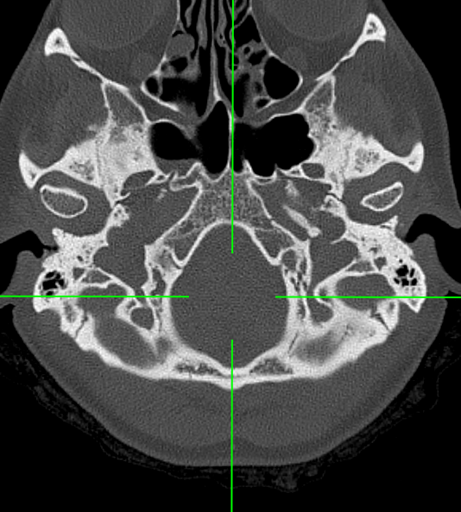
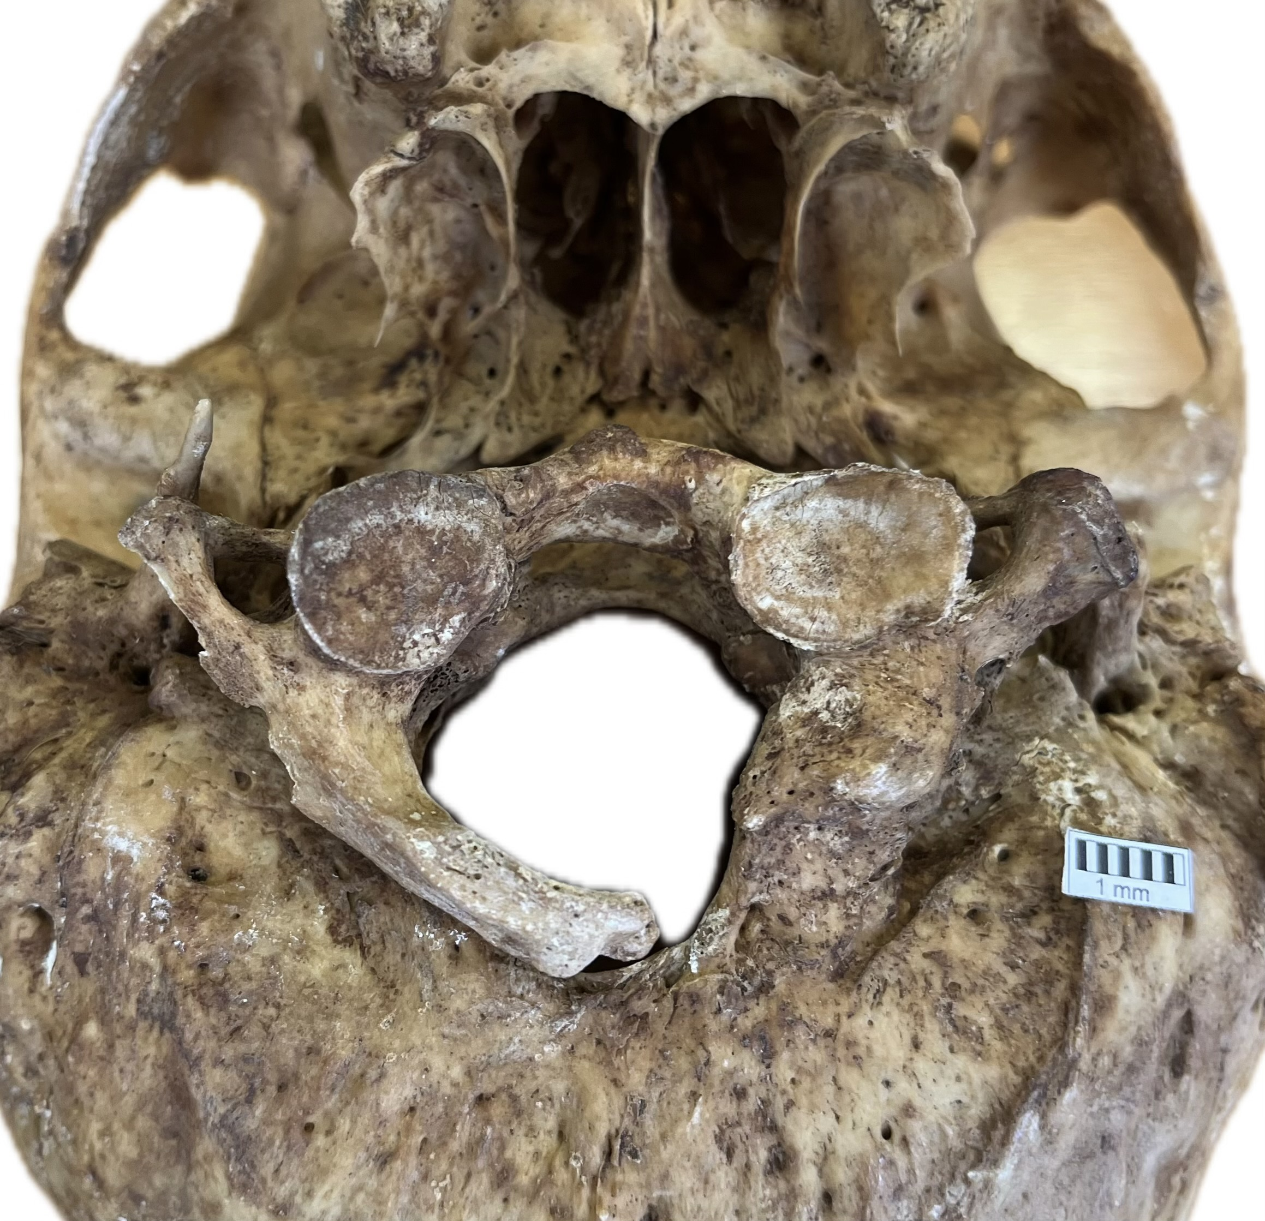
Foramen magnum
Personal Archive
Prof. Piagkou Osteological Collection
Prof. Piagkou Osteological Collection
Contents:
Vertebral Arteries and veins
Anterior + Posterior Spinal Arteries
Dural Veins
Accessory Nerve (CN XI) spinal roots
Meningeal coverings

Slide 4
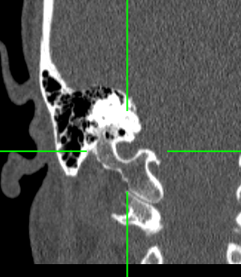
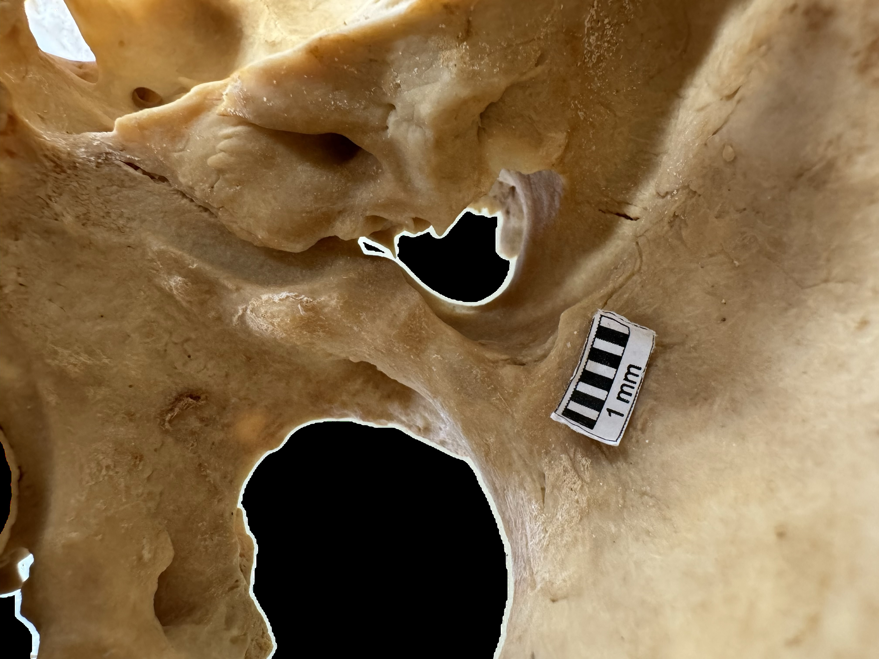
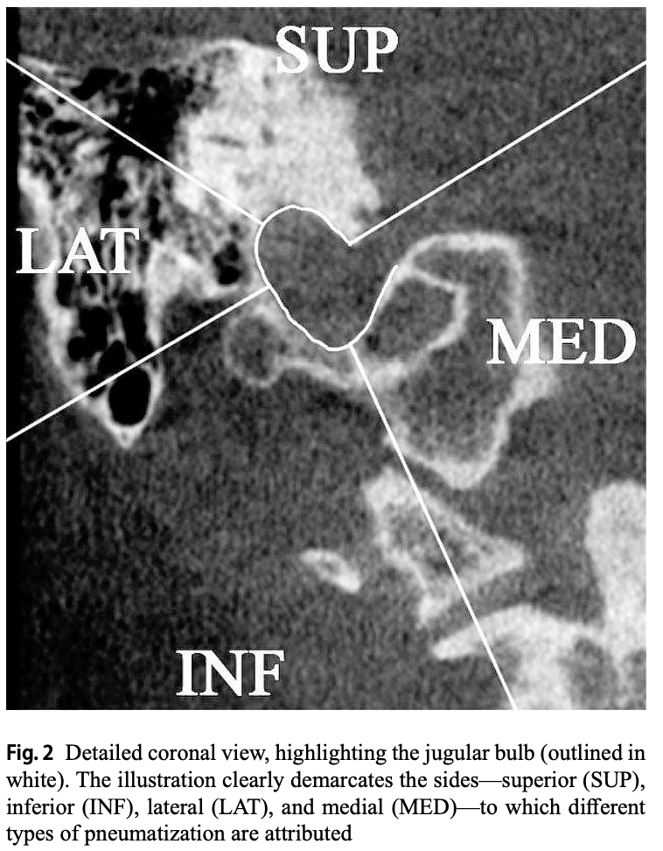
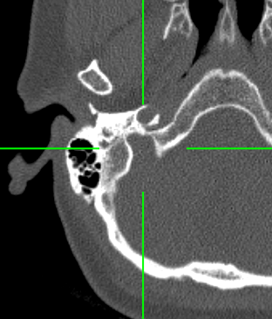
Jugular foramen
Personal Archive
Prof. Piagkou Osteological Collection
Contents:
Glossopharyngeal + Vagus + Accessory Nerves (CN IX, X, XI)
Jugular Bulb
Inferior Petrosal and sigmoid sinuses
Personal Archive

Slide 5
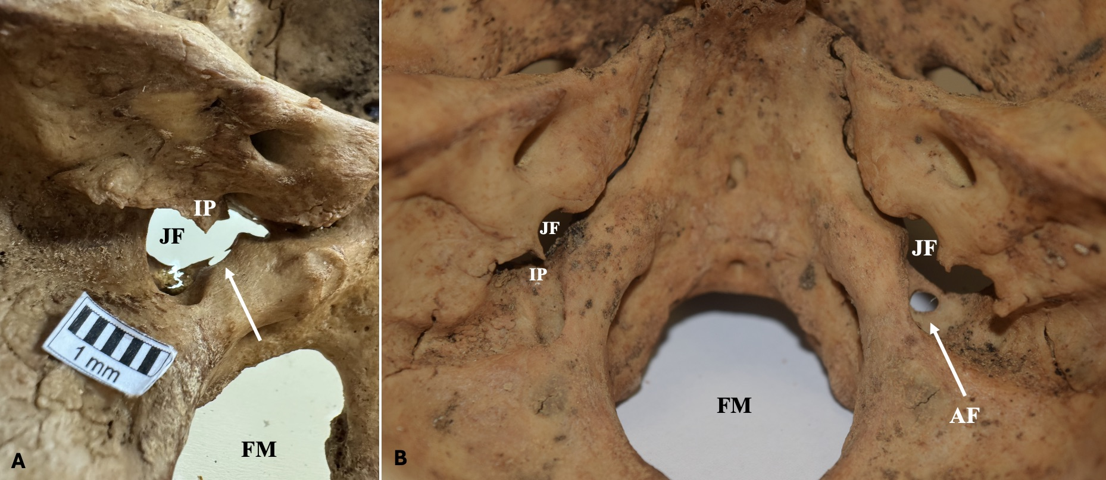
Prof. Piagkou Osteological Collection
Prof. Piagkou Osteological Collection
Triantafyllou et al. 2024
Prof. Piagkou Osteological Collection

Slide 6
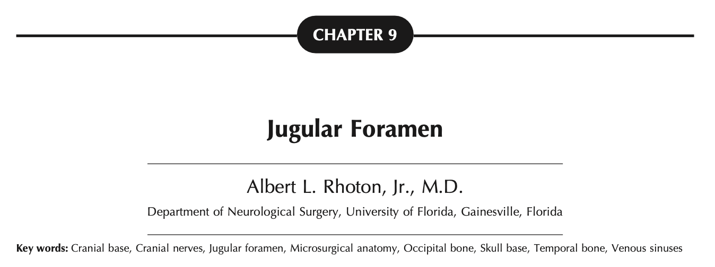
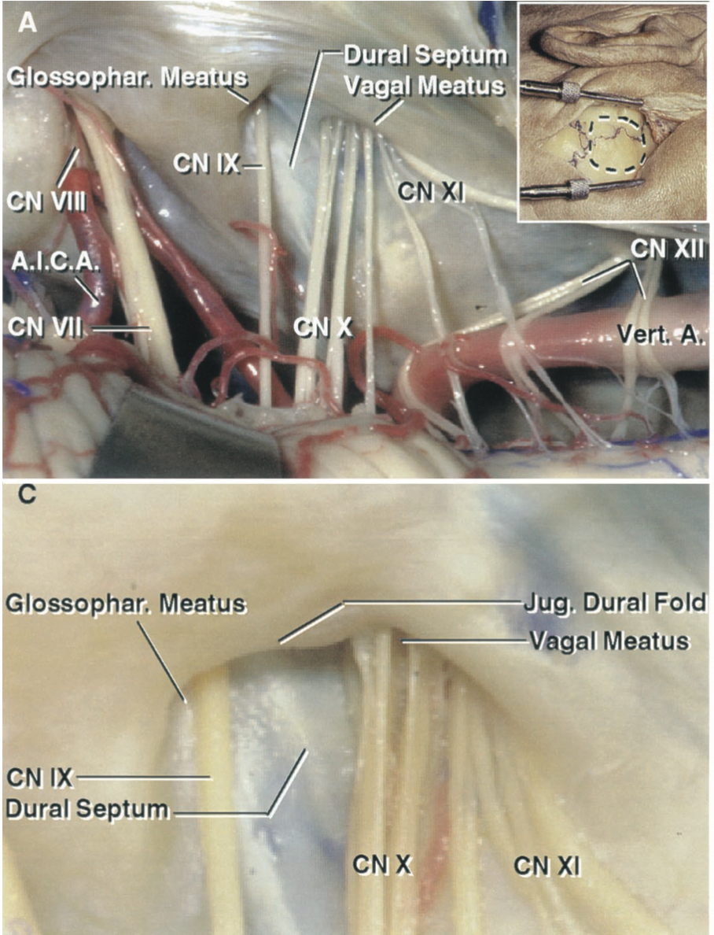
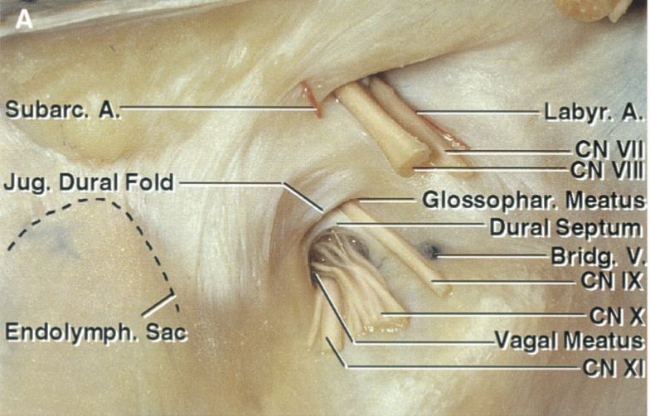
Notes:
Compartalization between the glossopharyngeal + Vagus + Accessory Nerves (CN IX, X, XI)

Slide 7
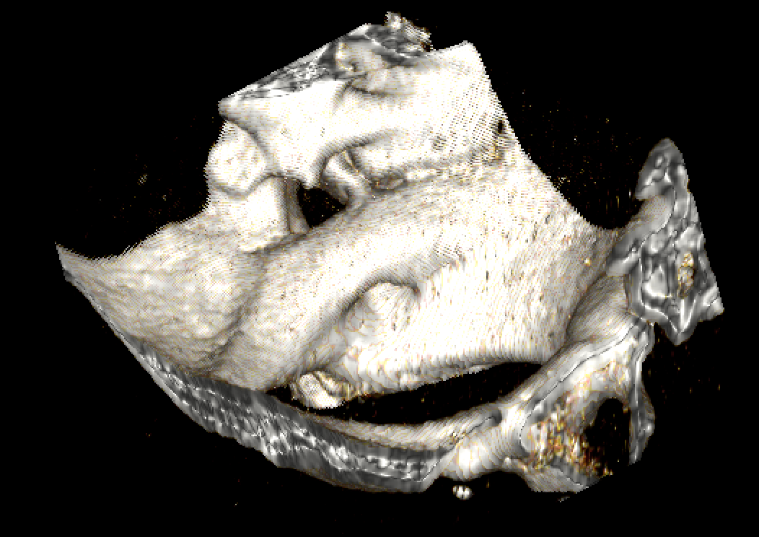
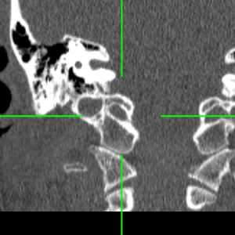
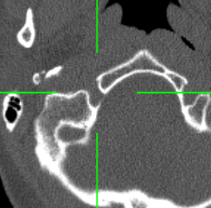
Hypoglossal canal
Personal Archive
Personal Archive
Contents:
Hypoglossal Nerve (CN XII)
Emissary Vein
Personal Archive

Slide 8
Lyrtzis et al. 2017

Slide 9
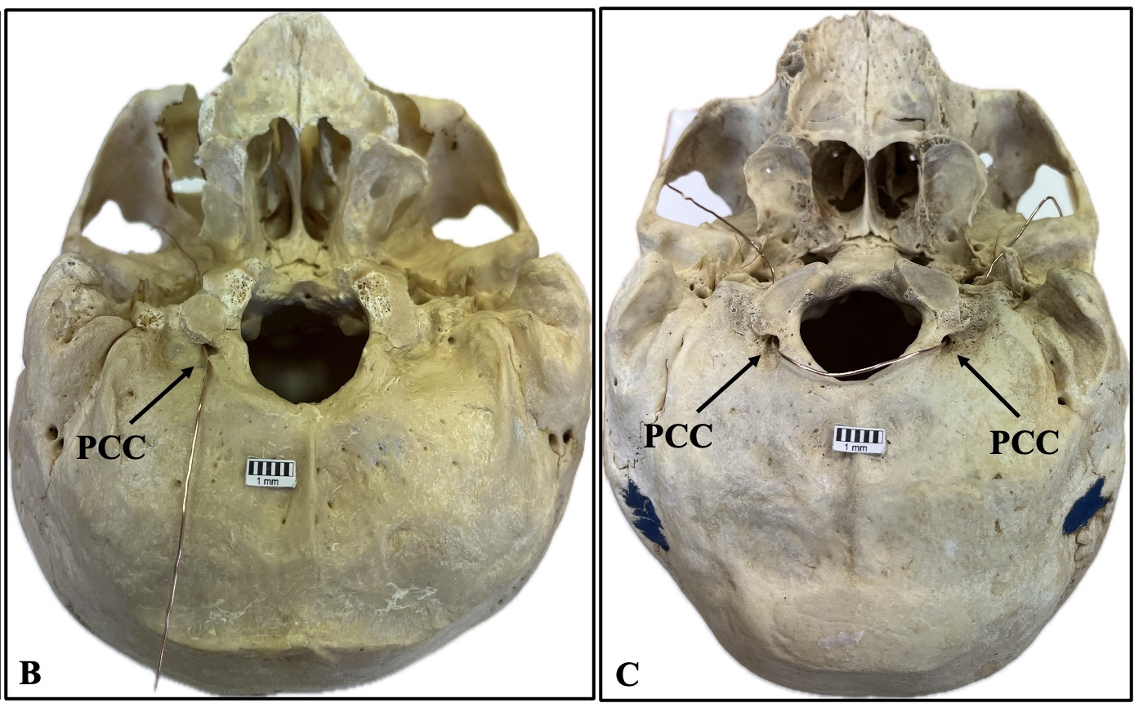
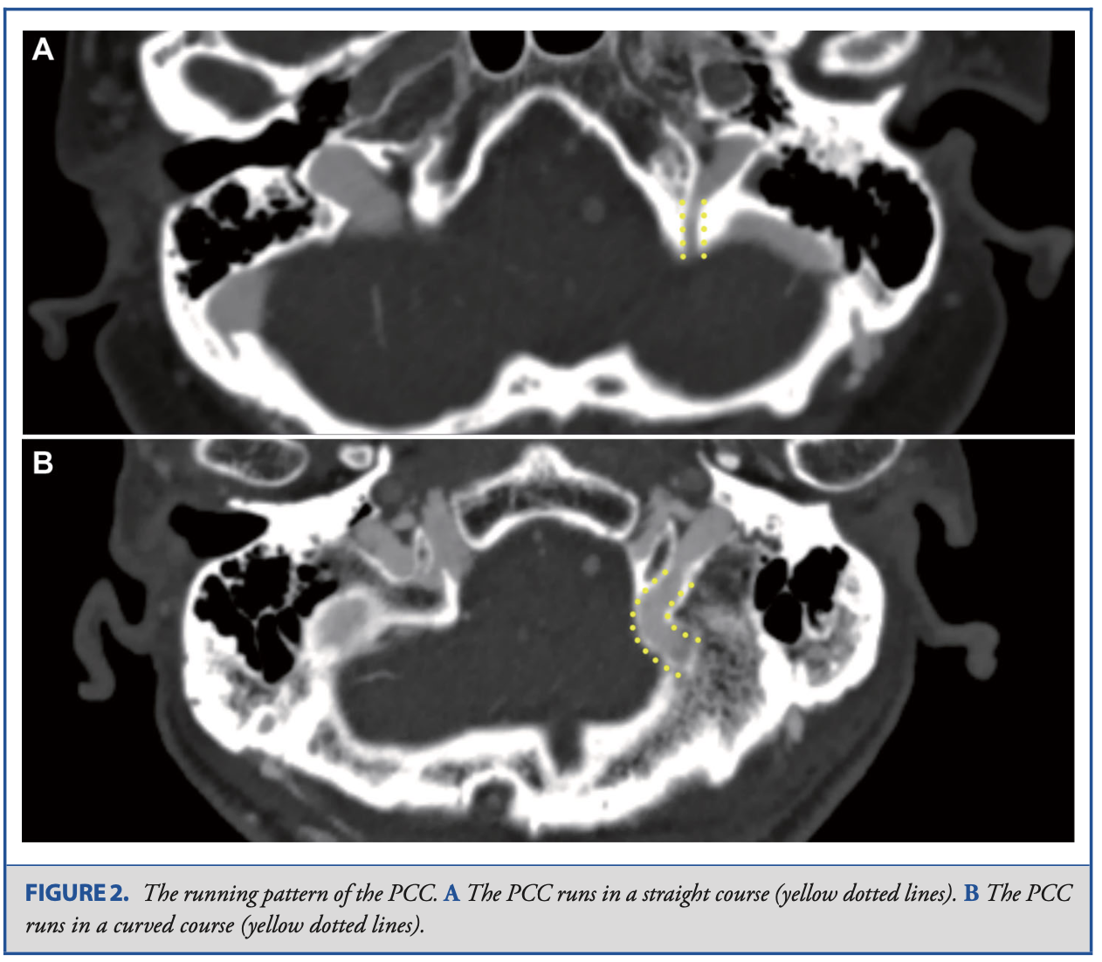
POSTERIOR CONDYLAR CANAL (inconstant)
Ota et al. 2017
Triantafyllou et al. 2024
Contents:
Emissary Vein: anastomosis between the jugular bulb or sigmoid sinus to suboccipital venous plexus

Slide 10
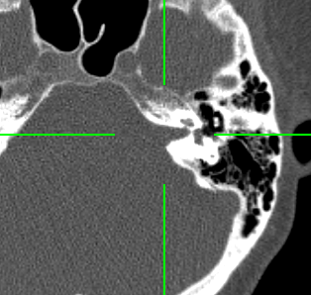
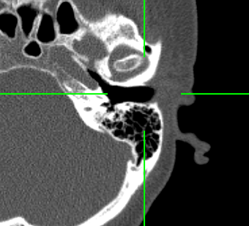
INTERNAL ACOUSTIC MEATUS
Personal Archive
Rhoton et al. 2000
Prof. Piagkou Osteological Collection
Contents:
Vestibulocochlear Nerve (CN VIII) division (cochlear and superior and inferior vestibular nerves)
Facial Nerve (CN VII) exits through the Stylomastoid Foramen
Labyrinthine Artery
Personal Archive

Slide 11
MIDDLE CRANIAL FOSSA
Optic Canal
Foramen Rotundum
Foramen Ovale
Foramen Spinosum
Foramen Lacerum
Carotid Canal

Slide 12
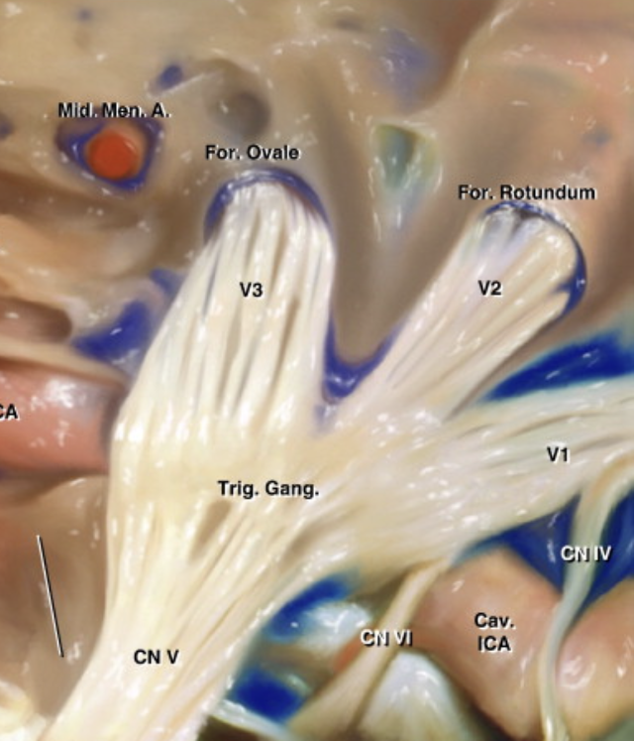
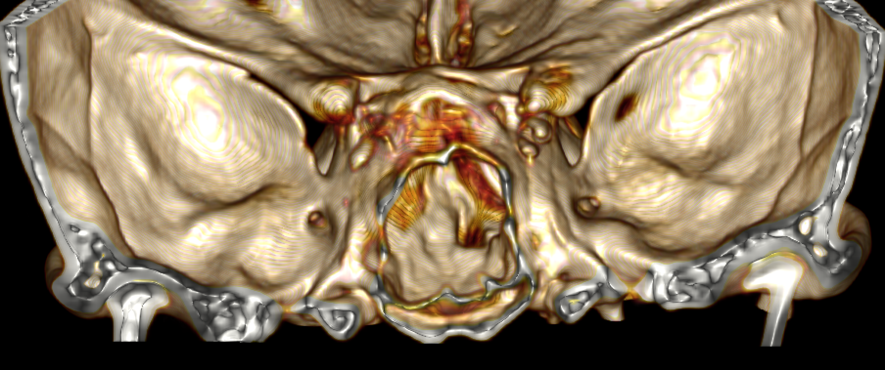
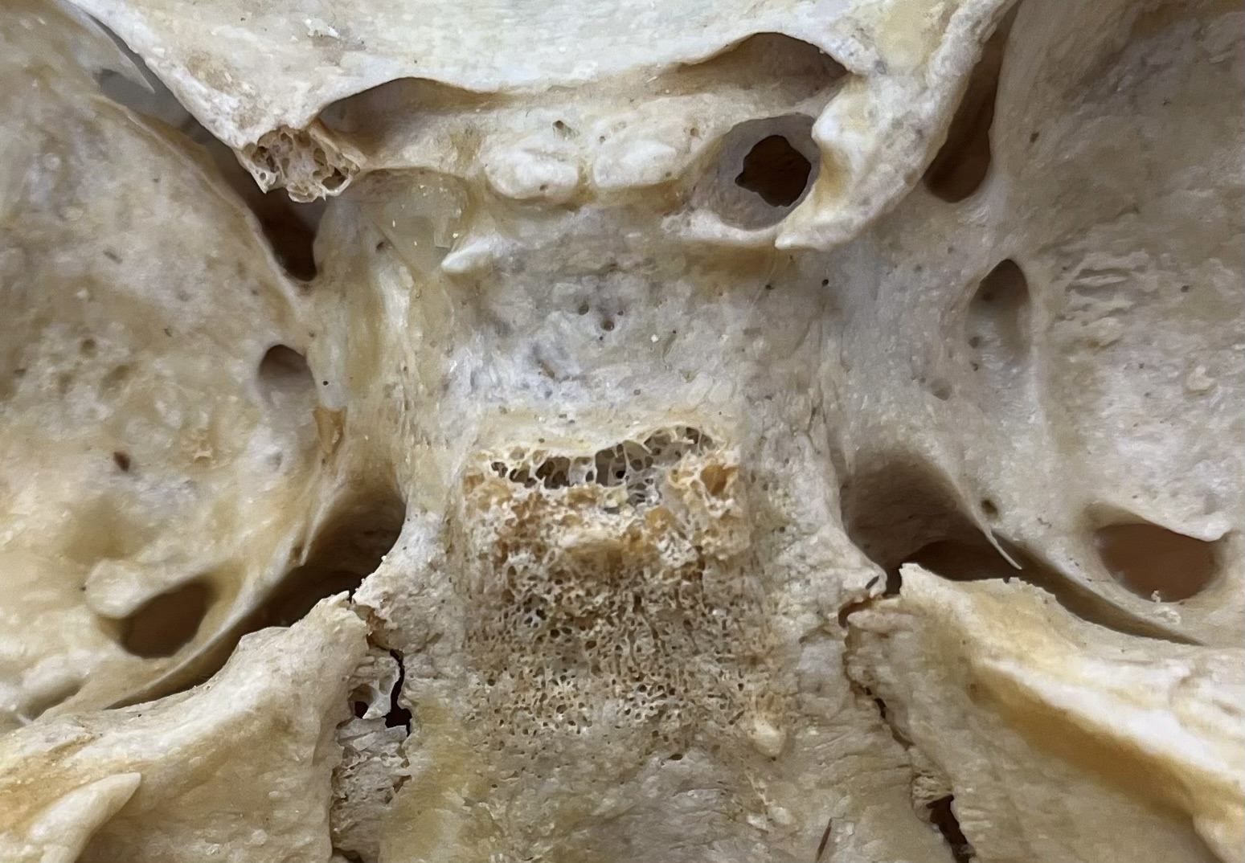
Foramen rotundum
Rhoton et al. 2000
Personal Archive
Connects: Middle Cranial Fossa + Pterygopalatine Fossa
Contents: Maxillary Nerve (CN V2)
Prof. Piagkou Osteological Collection
Notes:
V1 + Oculomotor (CN III) + Trochlear (CN IV) + Abducens (CN VI) => Superior Orbital Fissure

Slide 13
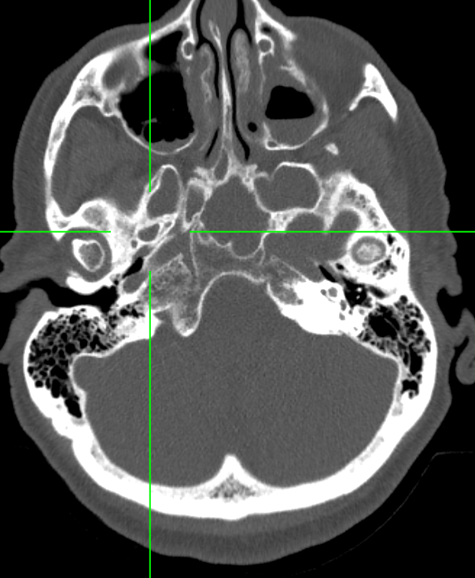
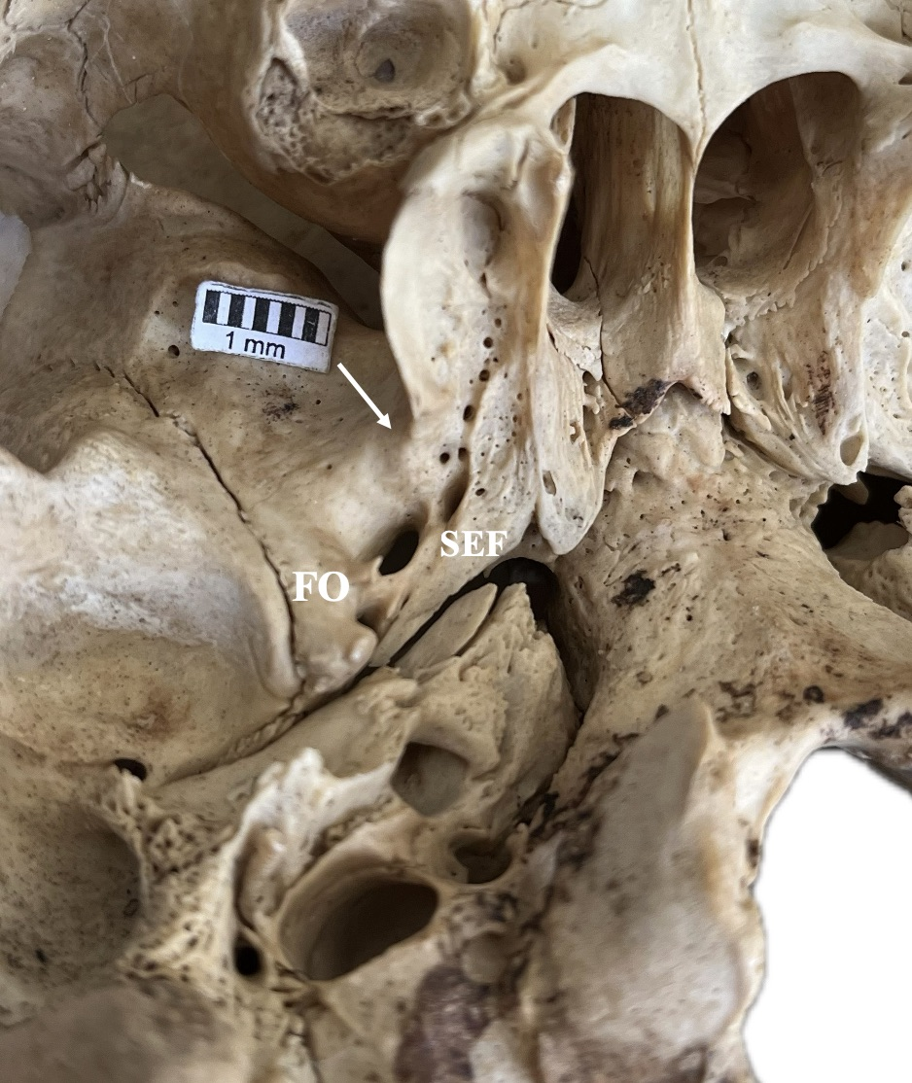
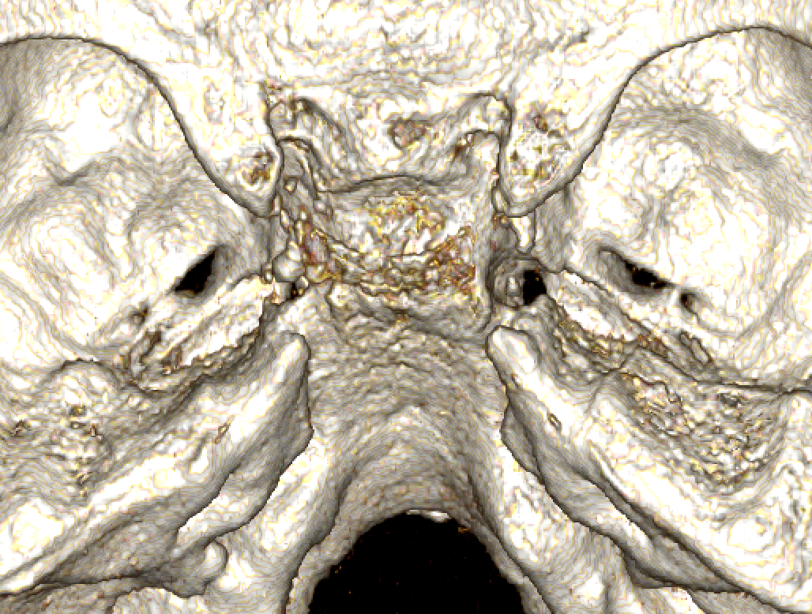
FORAMEN OVALE
Personal Archive
Rhoton et al. 2000
Personal Archive
Contents:
Mandibular nerve (CN V3)
Accessory meningeal artery
Lesser Petrosal nerve
Emissary vein (interconnecting cavernous sinus-pterygoid plexus)
Triantafyllou et al. 2024

Slide 14
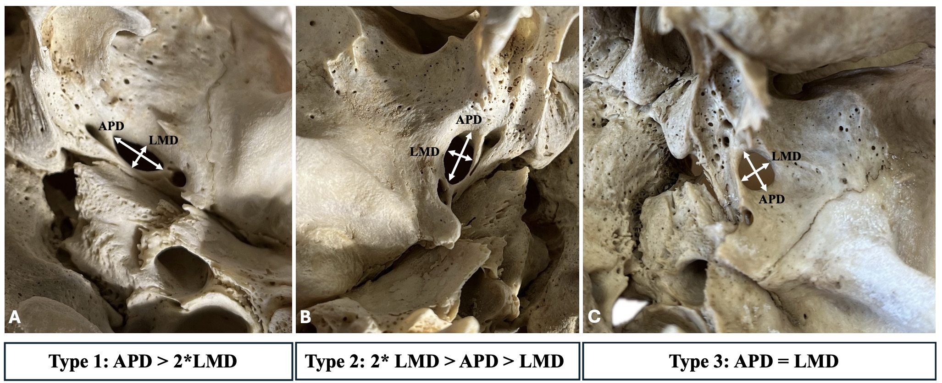
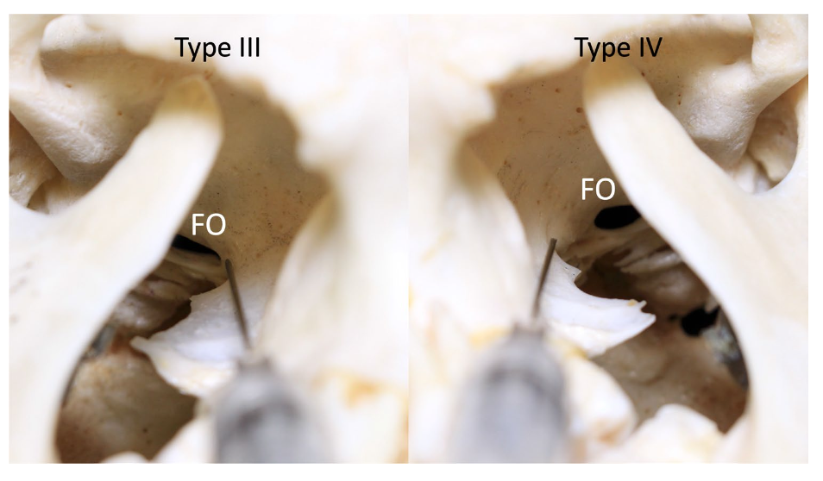
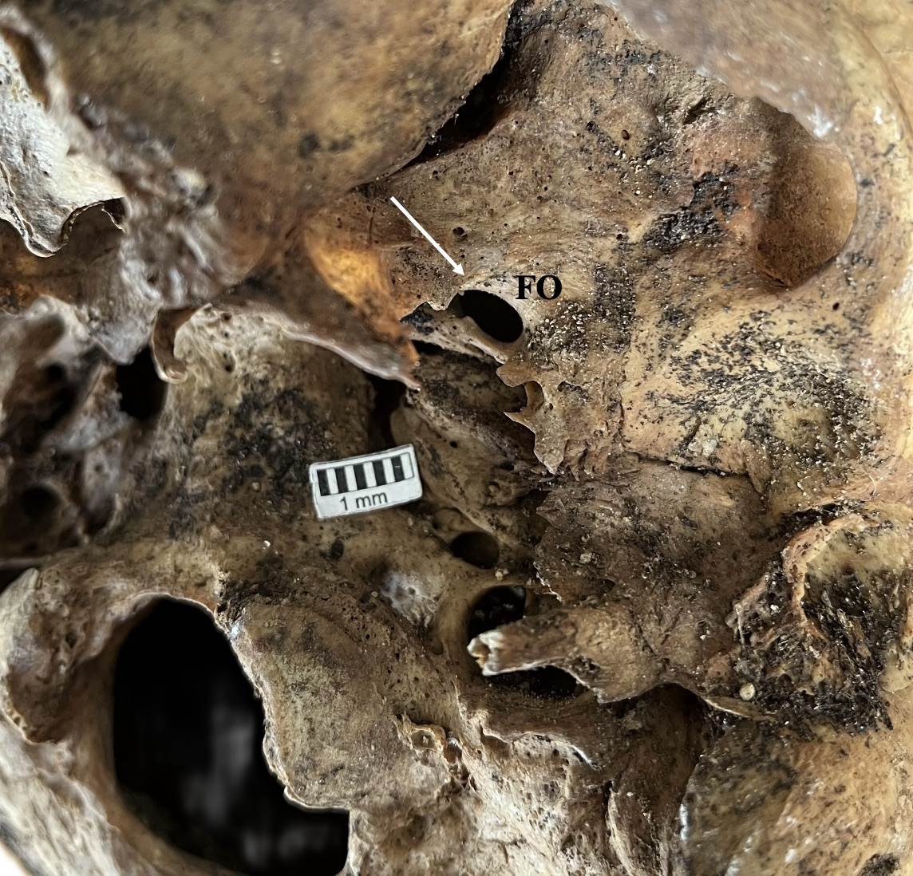
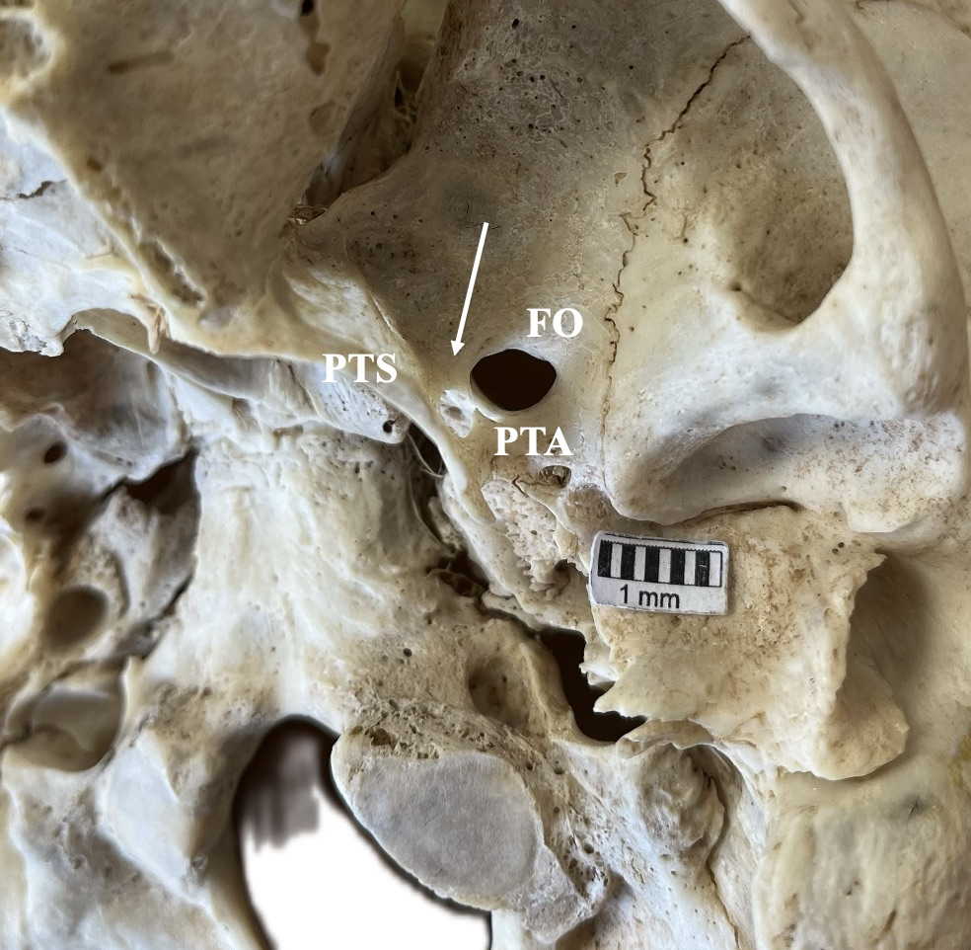
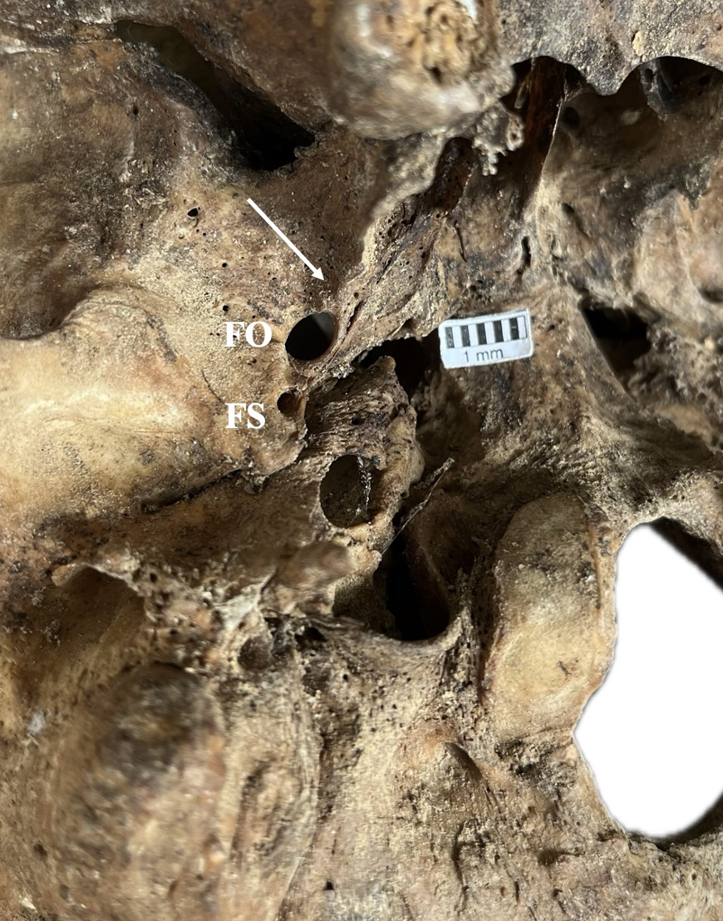
Triantafyllou et al. 2024
Iwanaga et al. 2022
Triantafyllou et al. 2024
Triantafyllou et al. 2024
Triantafyllou et al. 2024

Slide 15
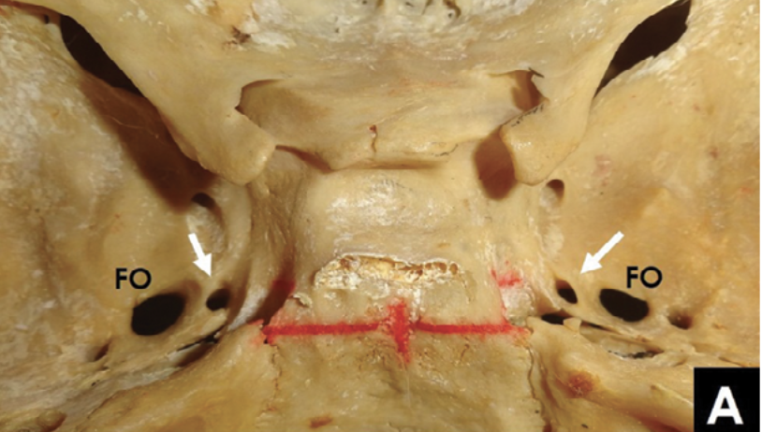
SPHENOIDAL EMISSARY FORAMEN- inconstant
Triantafyllou et al. 2024
Natsis et al. 2019
So-called “Foramen of Vesalius”
Presence: 38.1% pooled prevalence (Piagkou et al. 2023)
Location: Anteromedially to the foramen ovale
Contents: Emissary vein (interconnecting cavernous sinus-pterygoid plexus)
Personal Archive

Slide 16
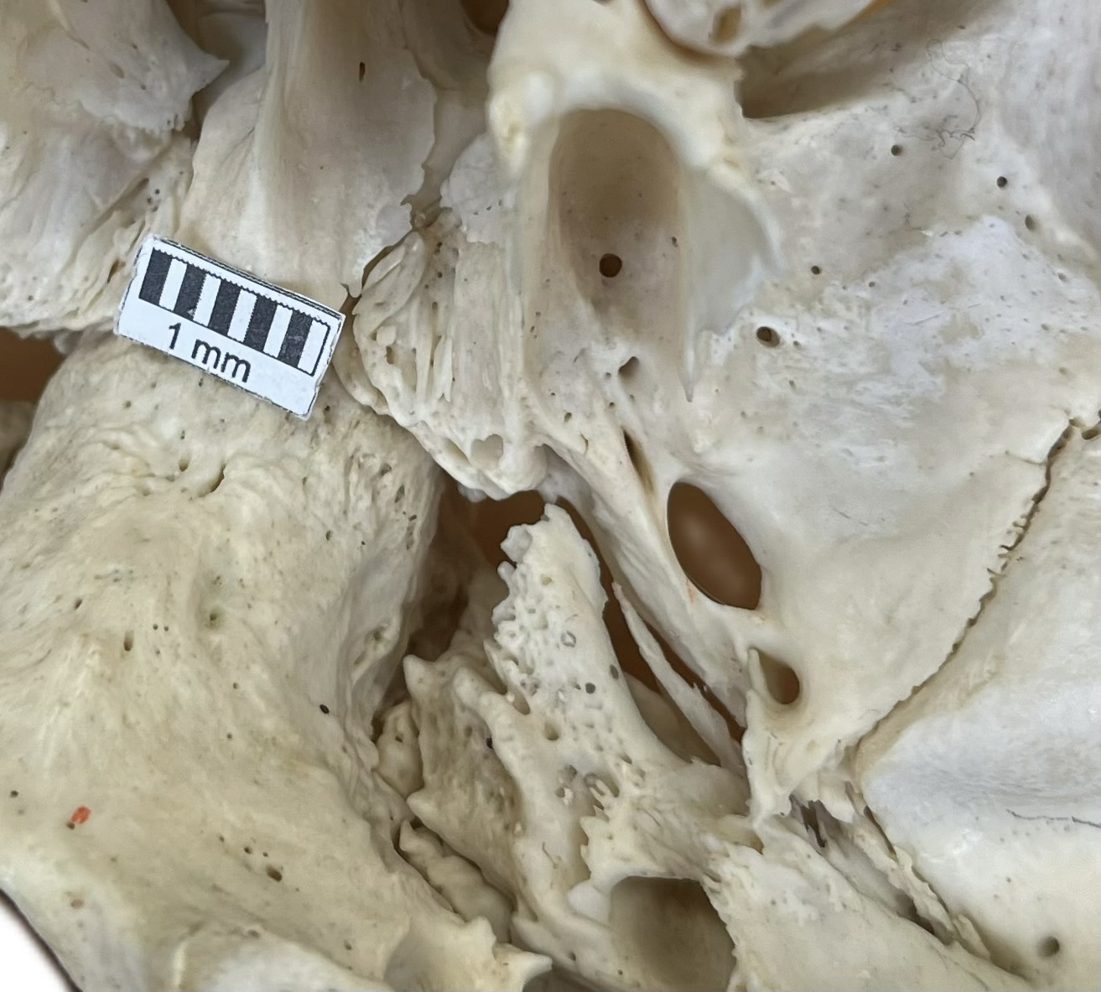
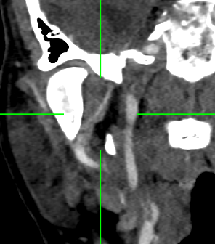
FORAMEN Spinosum
Prof. Piagkou Osteological Collection
Personal Archive
Personal Archive
Contents:
Middle Meningeal Artery + Vein
Meningeal branch of the Mandibular Nerve (sometimes through the foramen ovale)
Personal Archive

Slide 17
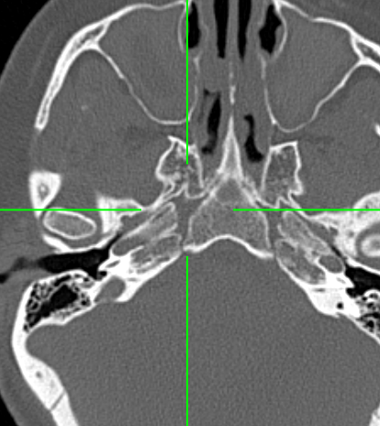
FORAMEN Lacerum covered extracranially
Personal Archive
Contents:
Greater Petrosal Nerve + Deep Petrosal Nerve = fuse to form the Nerve of the Pterygoid Canal
Prof. Piagkou Osteological Collection

Slide 18
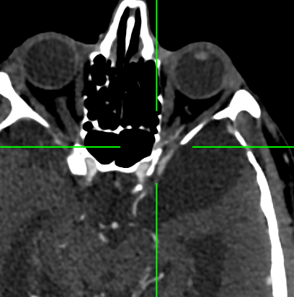
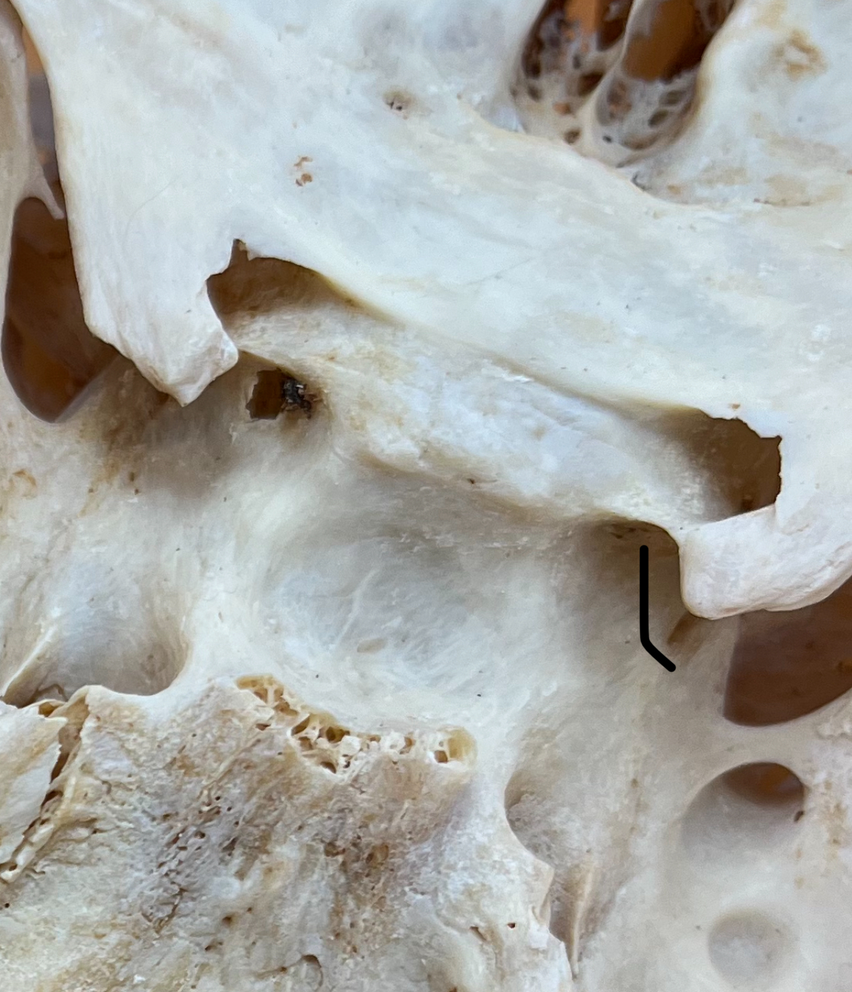
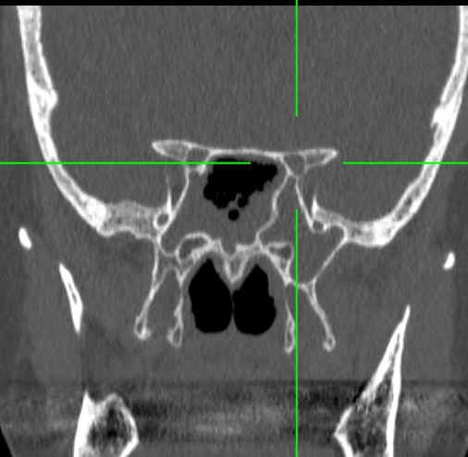
OPTIC CANAL
Personal Archive
Personal Archive
Contents:
Optic Nerve (CN II)
Ophthalmic Artery
Meningeal Sneaths + Sympathetic Nerve fibers
Prof. Piagkou Osteological Collection

Slide 19
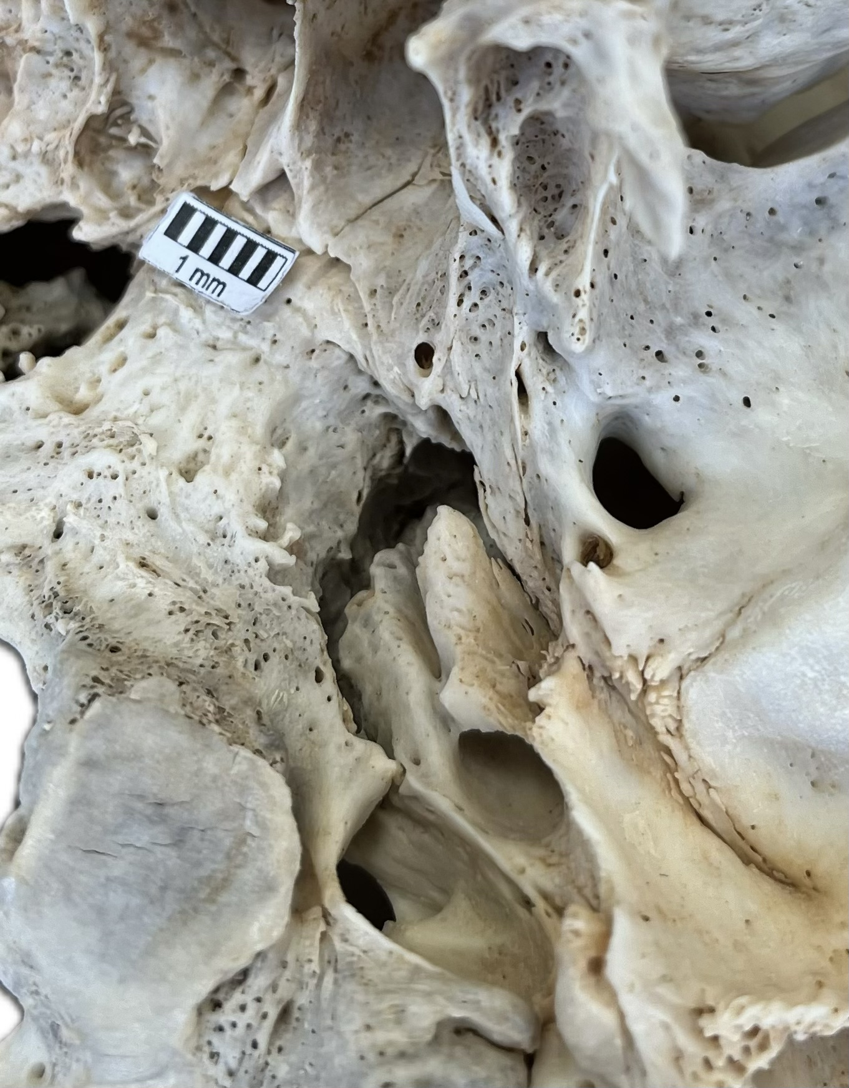
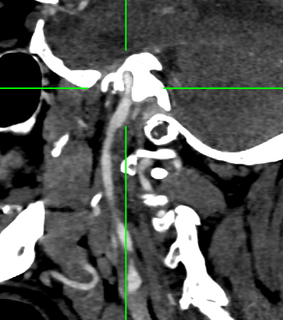
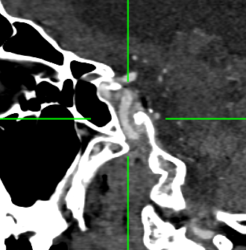
CAROTID CANAL
Personal Archive
Personal Archive
Contents:
Internal Carotid Artery
Internal Carotid Nervous Plexus
Prof. Piagkou Osteological Collection

Slide 20
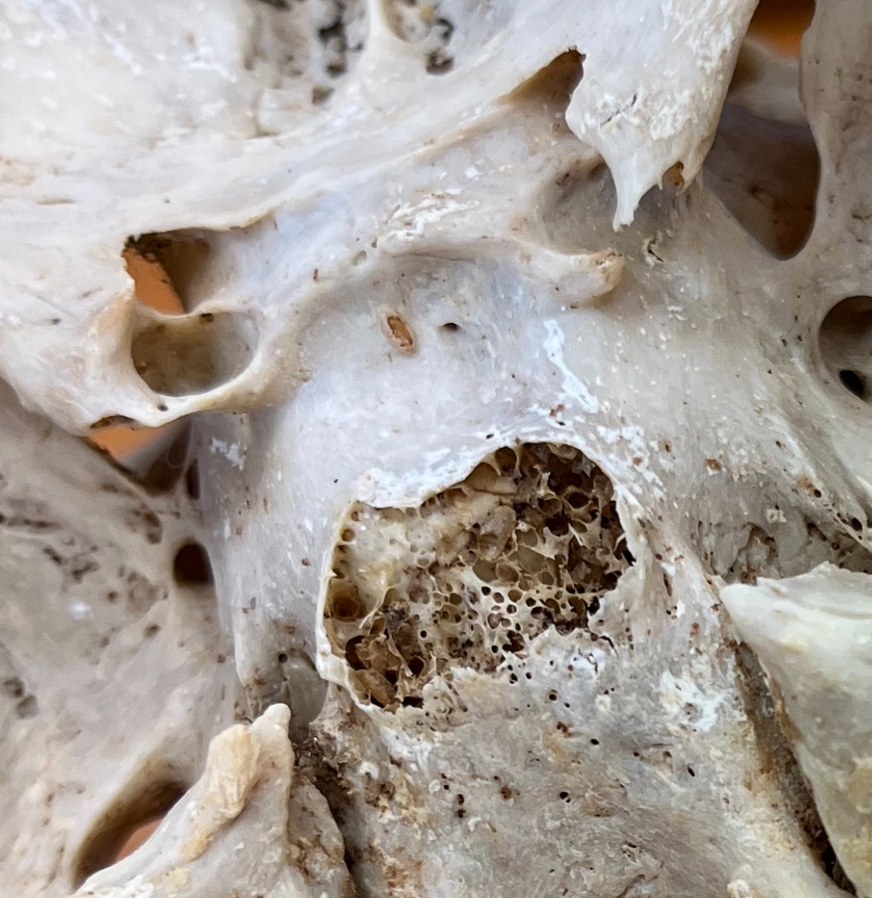
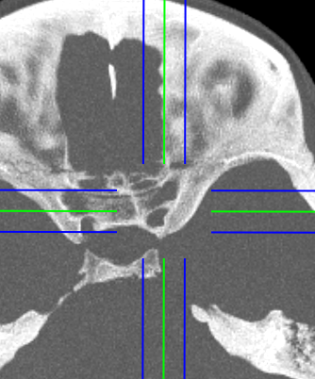
CAROTICOCLINOID CANAL
Personal Archive
Presence: 32.6% pooled prevalence (Skandalakis et al. 2020)
Osseous bridge between the Anterior – Middle Clinoid Processes
Around the Internal Carotid Artery
Prof. Piagkou Osteological Collection

Slide 21
VASCULAR ANATOMY OF THE HEAD & NECK
Computed Tomography Angiography (CTA) Illustrations
George Triantafyllou

Slide 22
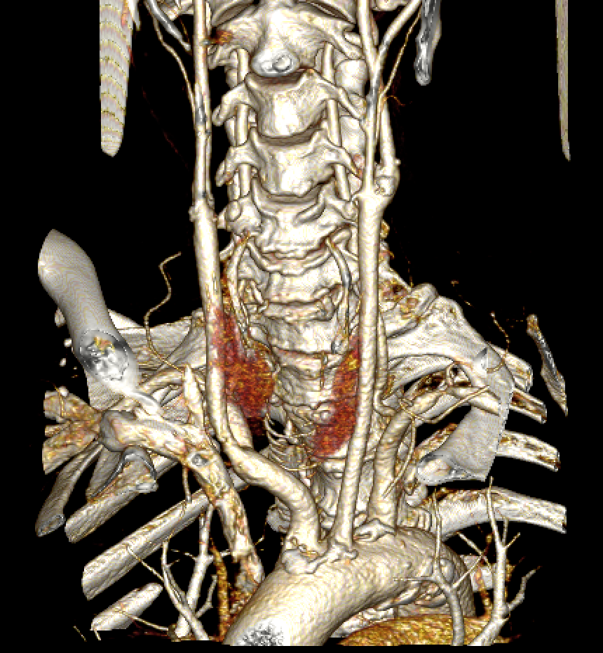
Common carotid artery
Personal Archive
Personal Archive

Slide 23
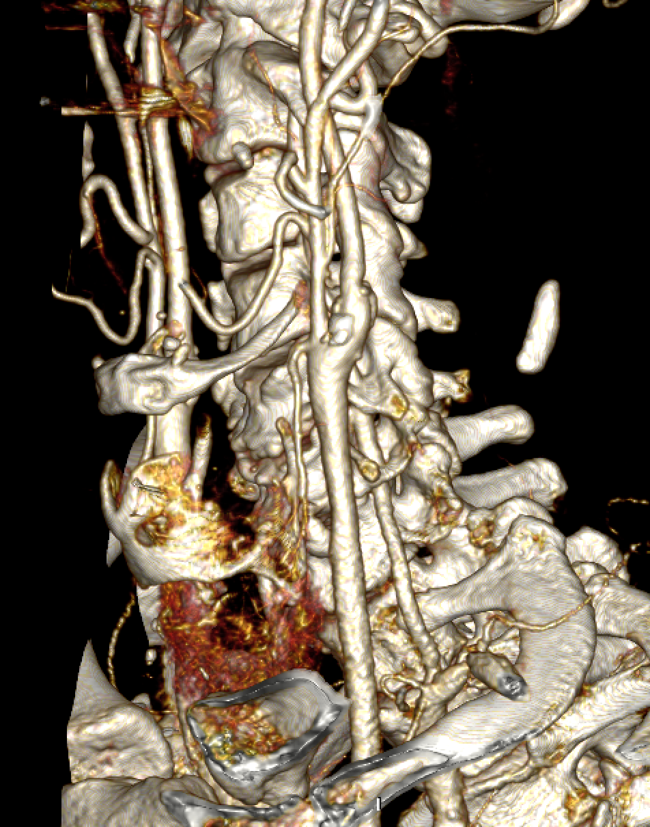
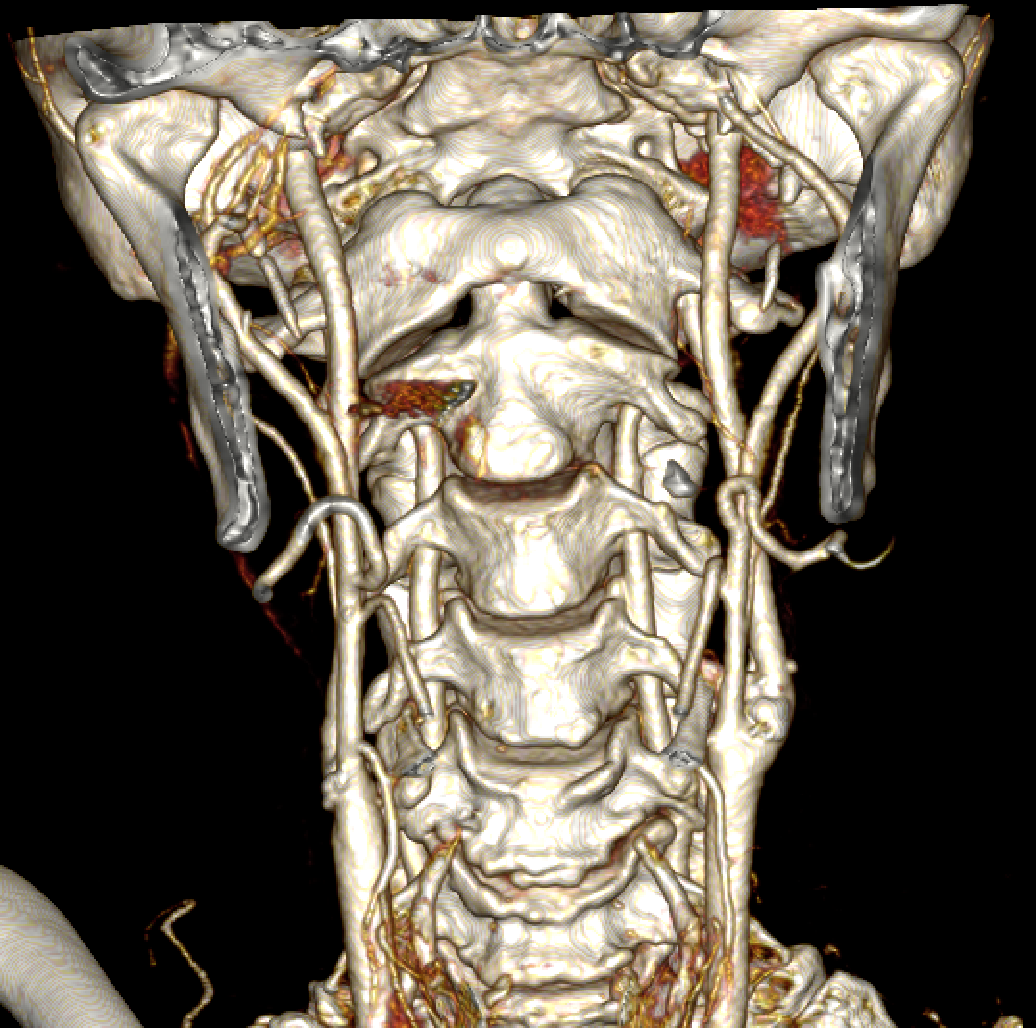
EXTERNAL CAROTID ARTERY
Personal Archive
Personal Archive

Slide 24
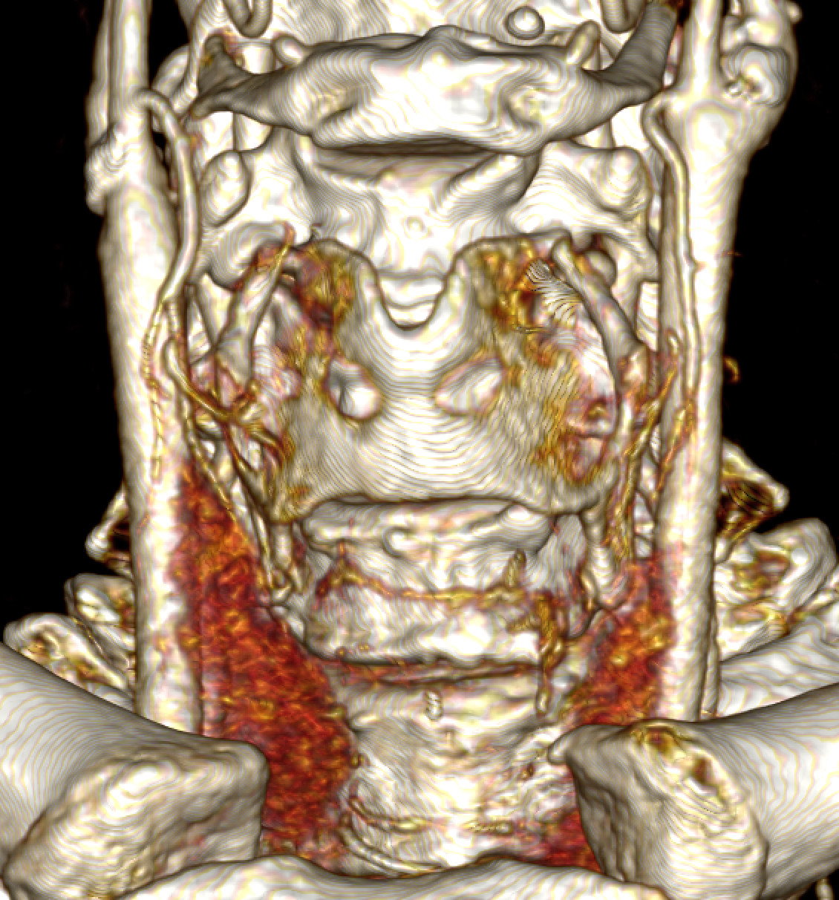
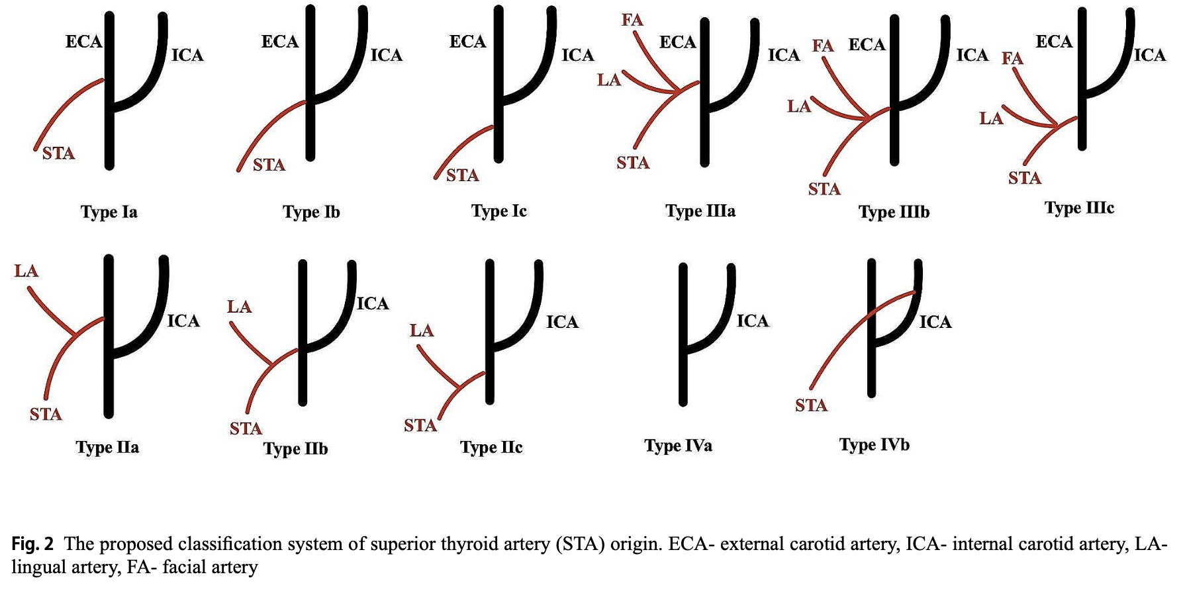
SUPERIOR THYROID ARTERY
Personal Archive
Notes:
Supply: Thyroid Gland, Cricothyroid and Infrahoid muscles

Slide 25
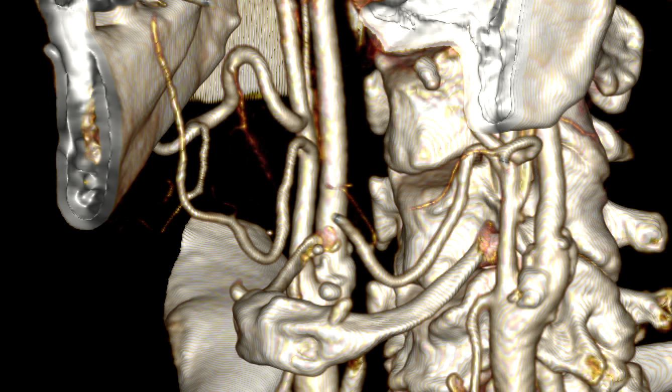
LINGUAL ARTERY
Personal Archive
Notes:
Supply: Tongue and Floor of the mouth

Slide 26
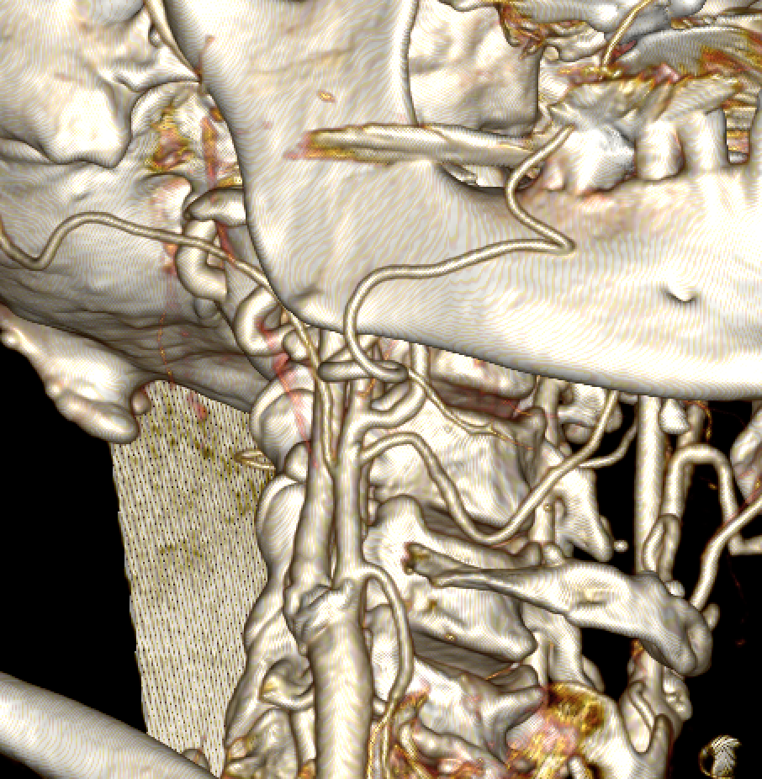
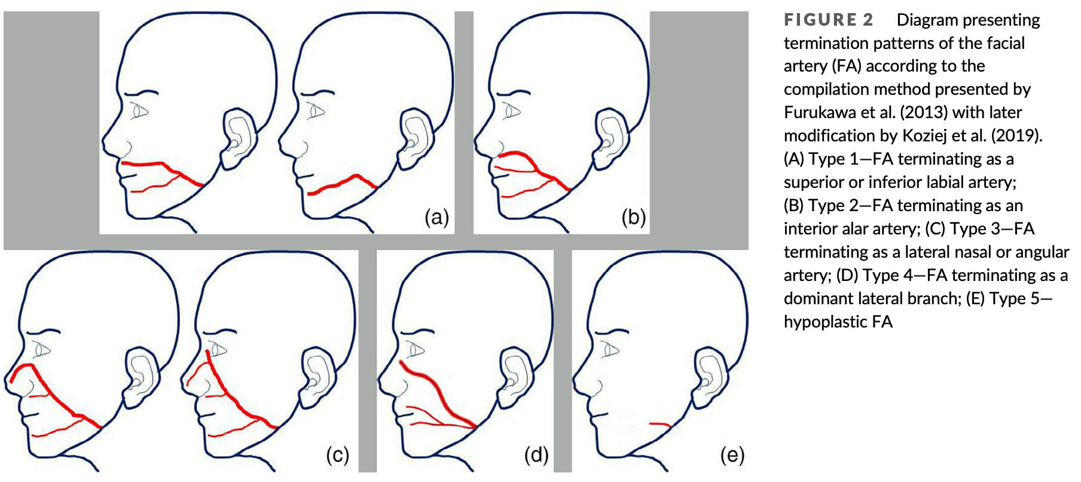
FACIAL ARTERY
Personal Archive
Notes:
Supply: Superficial Structures of the face

Slide 27
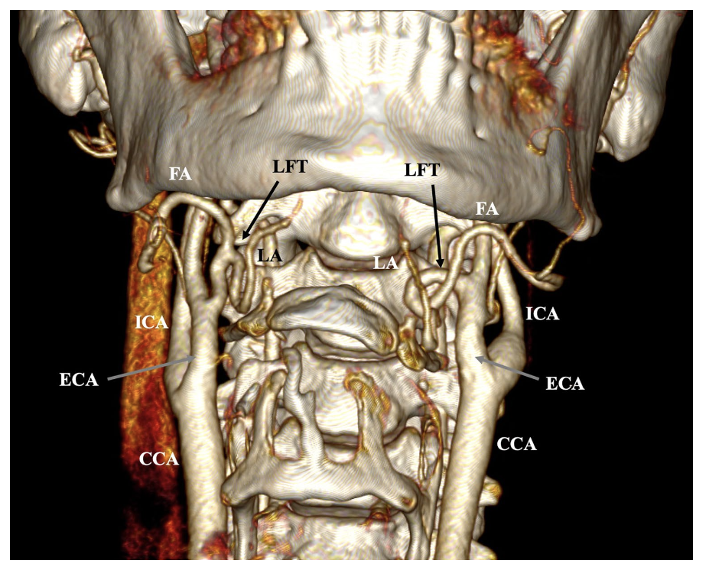
LINGUAL-FACIAL TRUNK
Presence: 16% pooled prevalence (Triantafyllou et al. 2024)
Common Trunk for Lingual + Facial Arteries

Slide 28
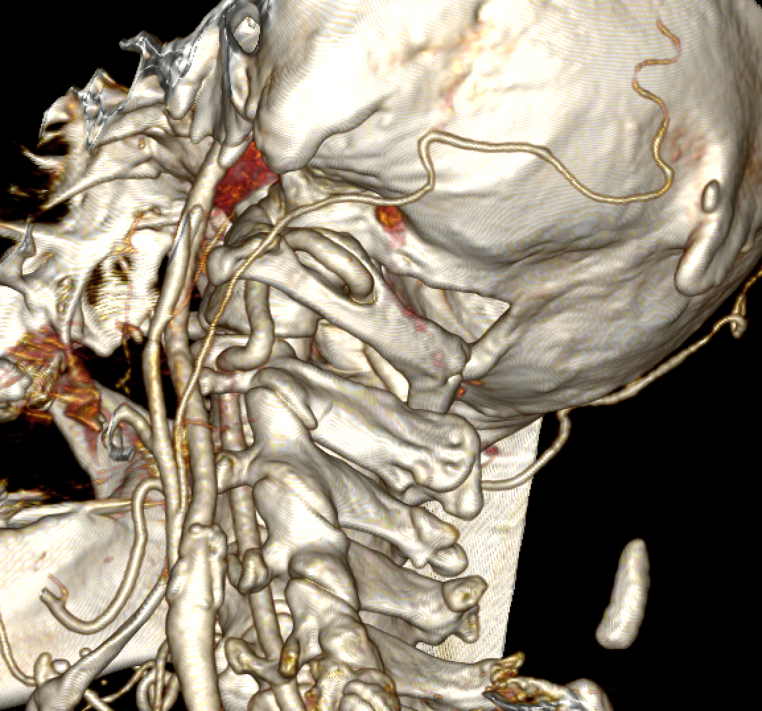
OCCIPITAL ARTERY
Personal Archive
Notes:
Supply: Muscles including the sternocleidomastoid, trapezius, deep muscles of the neck

Slide 29
SUPERFICIAL TEMPORAL ARTERY
Personal Archive
Notes:
Supply: Parotid Gland, Temporomandibular Joint, Several muscles of the head and neck

Slide 30
MAXILLARY ARTERY
Personal Archive
Notes:
Supply: Deep structures of the head (mandible, pterygoid and infratemporal fossa)

Slide 31
CERVICAL INTERNAL CAROTID ARTERY
Triantafyllou et al. 2024
Personal Archive

Slide 32
VERTEBRAL ARTERY
Personal Archive
Personal Archive

Slide 33
CEREBRAL ARTERIAL CIRCLE
Personal Archive
Personal Archive

