Slide 1
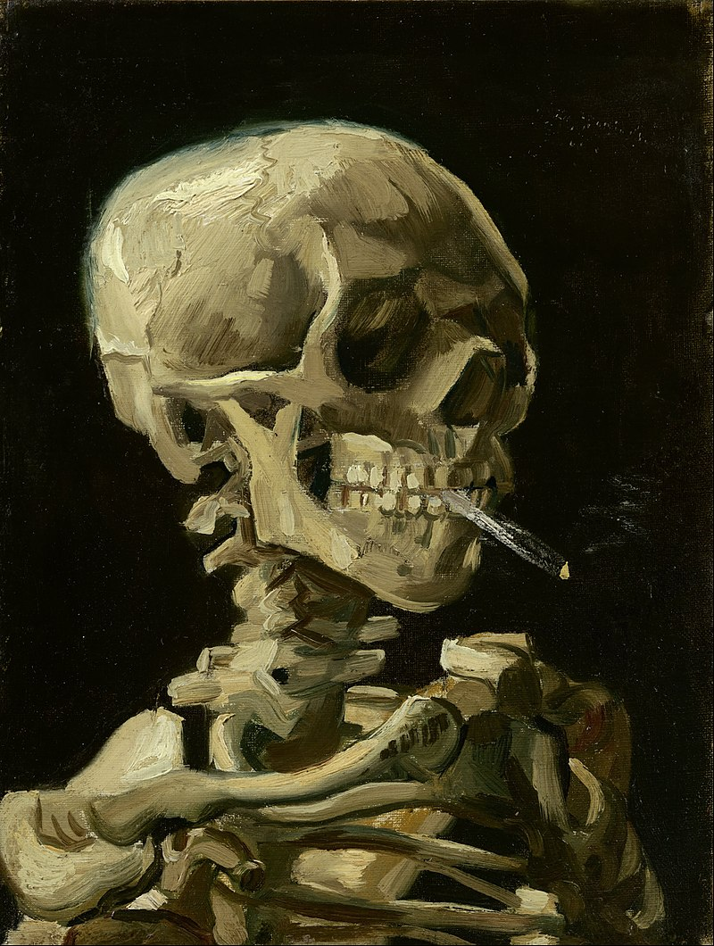
Skull embryology,
Viscerocranium (facial skeleton),
Bones. Muscles of the Head (Mimic and masseteric muscles), Vessels, and Nerves.
Cutaneous Innervation of the Head.
Regions of Interest
Professor Maria Piagkou

Slide 2
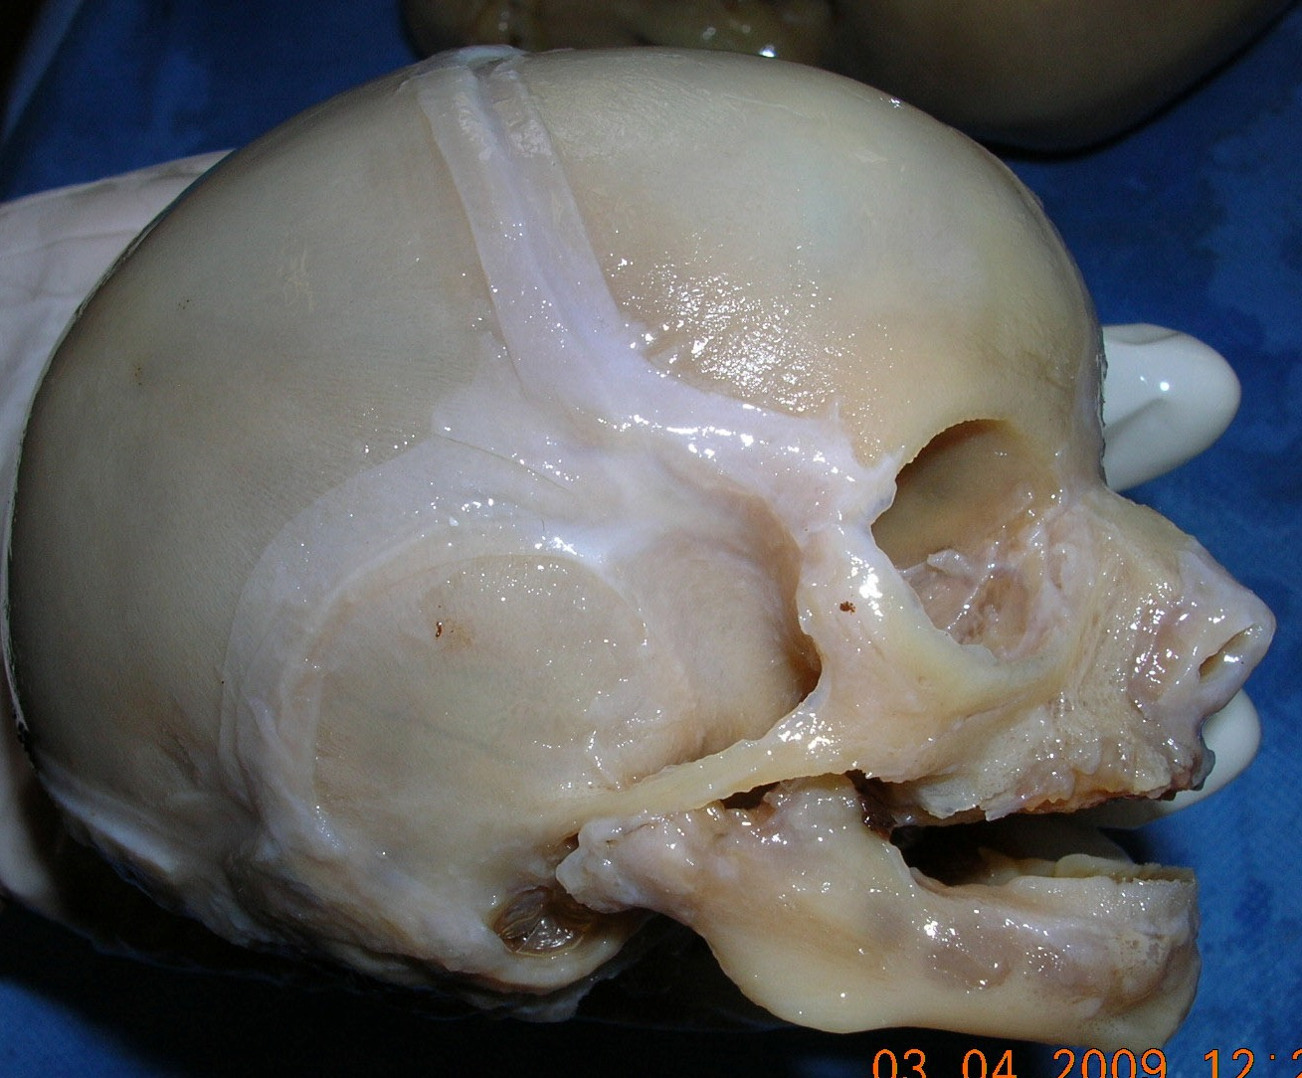
VISCEROCRANIUM
HYPOPLASTIC IN NEONATAL LIFE

Slide 3
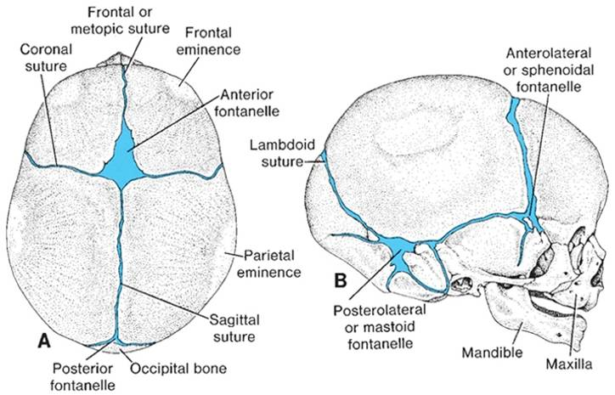

Slide 4
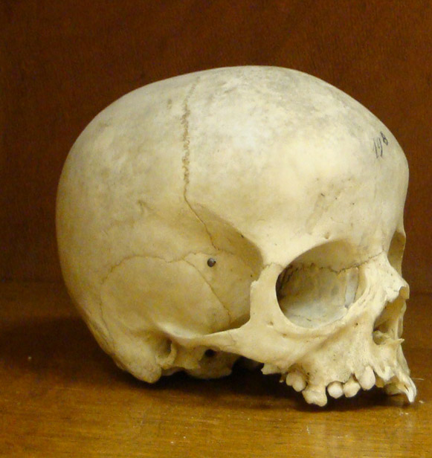
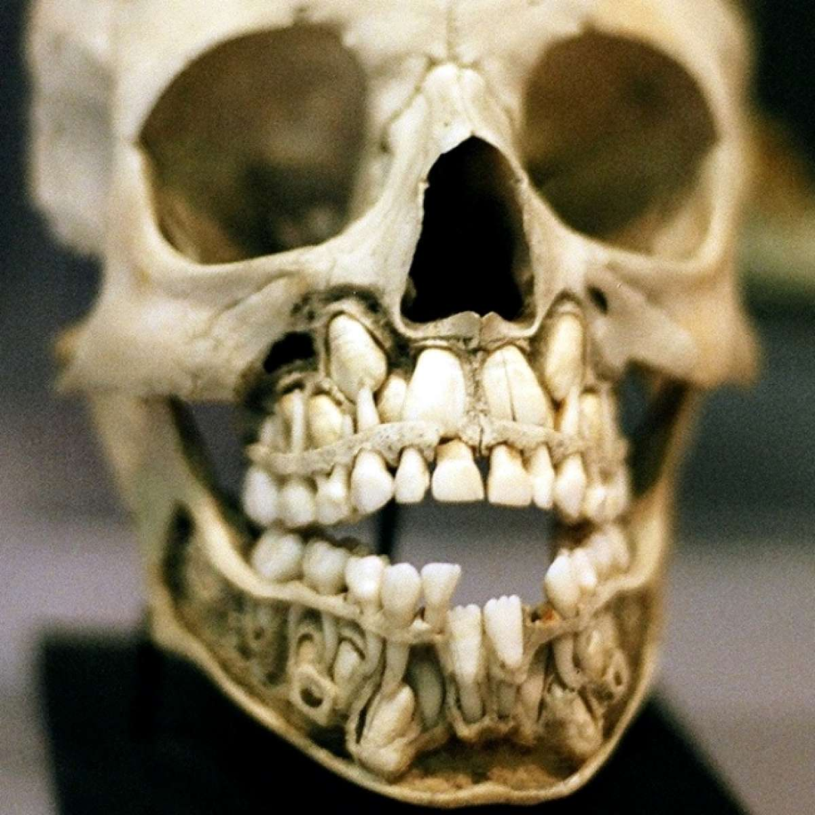
Infant skull

Slide 5
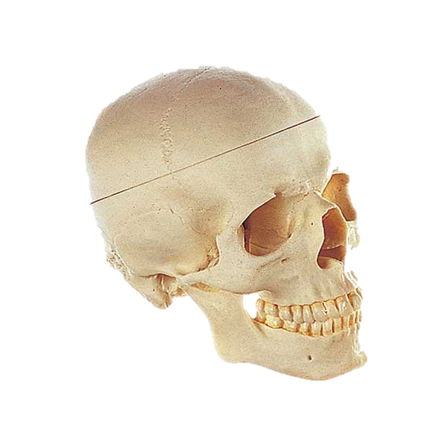
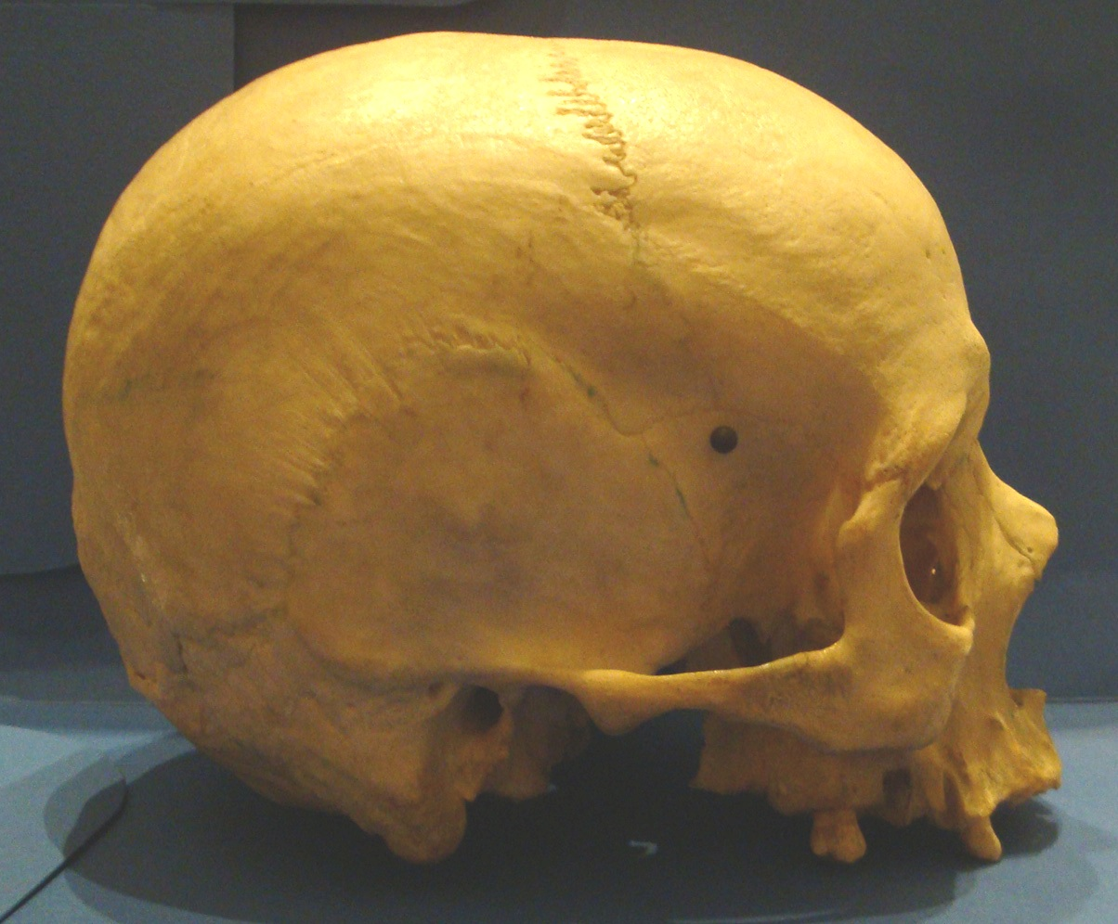
ADULT SKULL

Slide 6
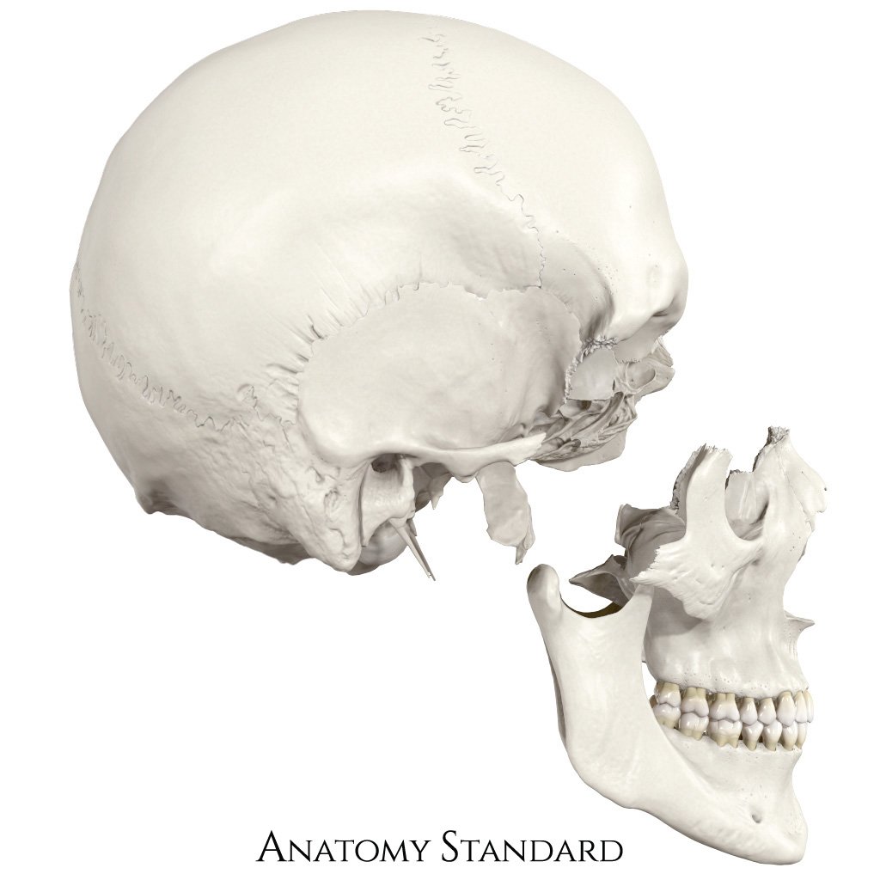

Slide 7
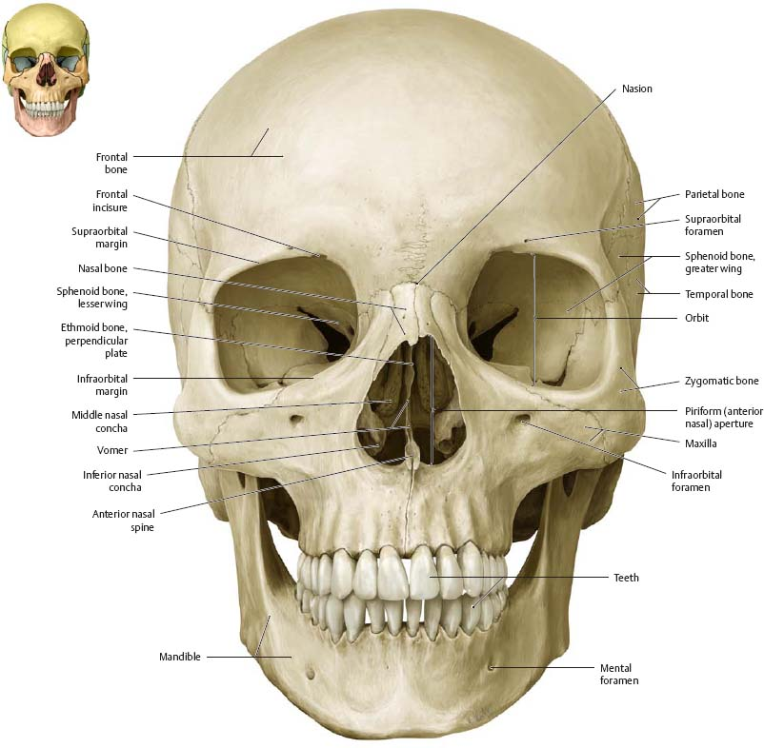
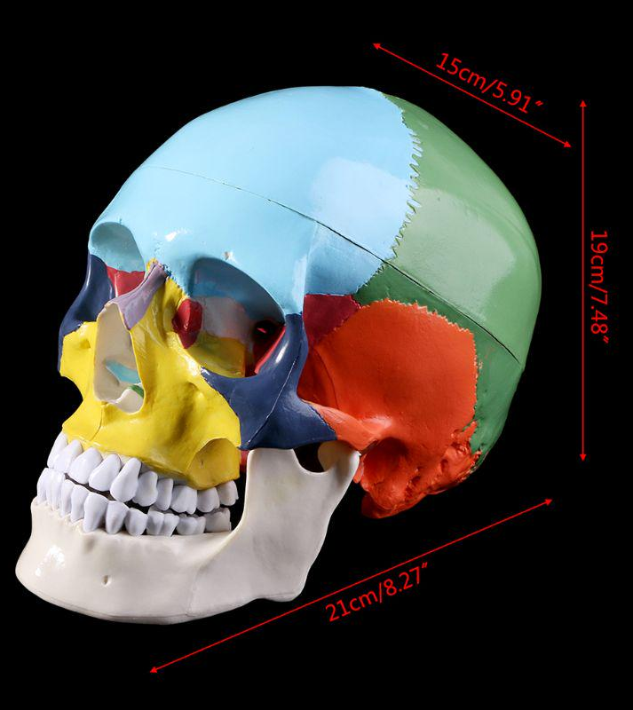

Slide 8
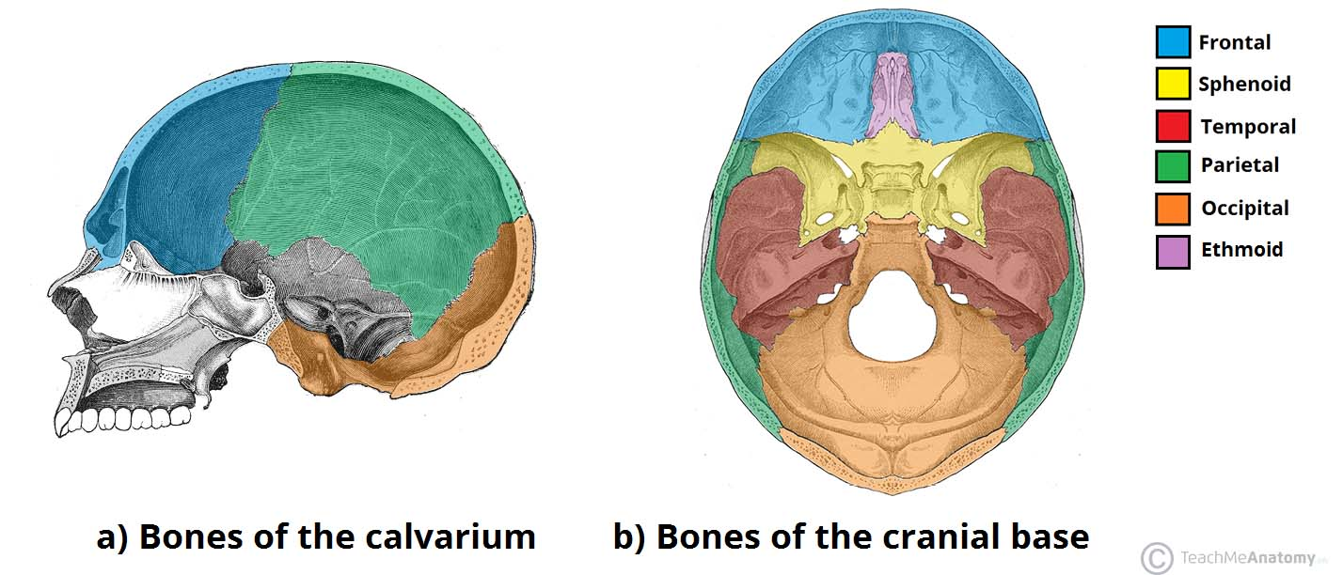

Slide 9
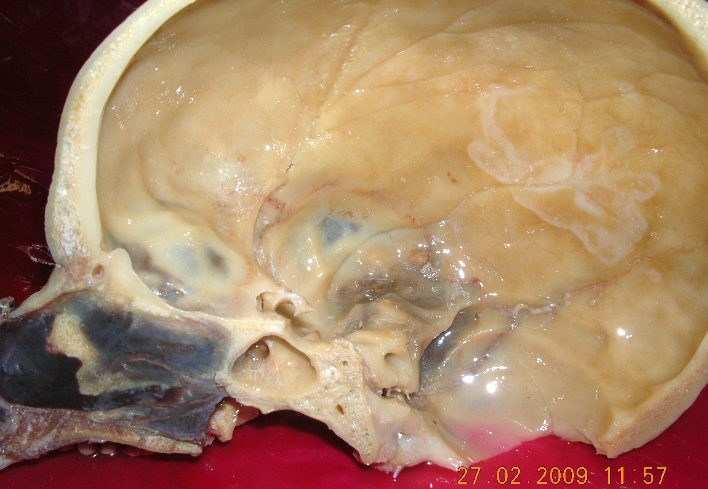
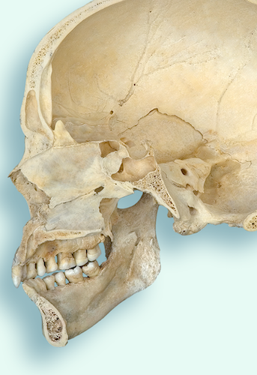

Slide 10
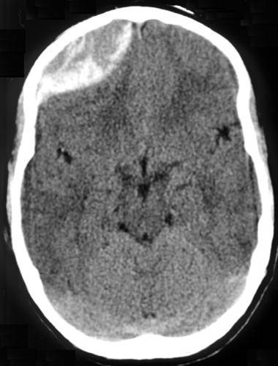
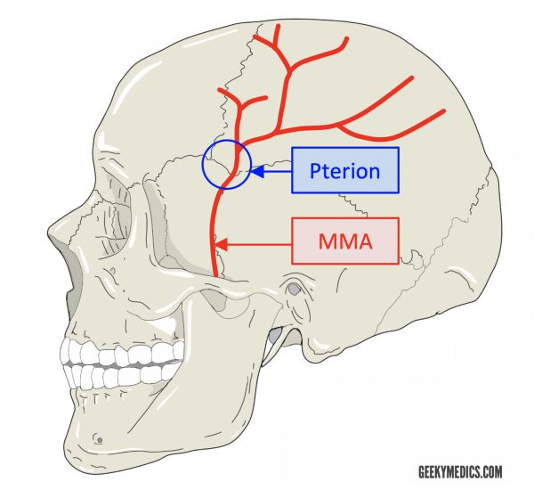
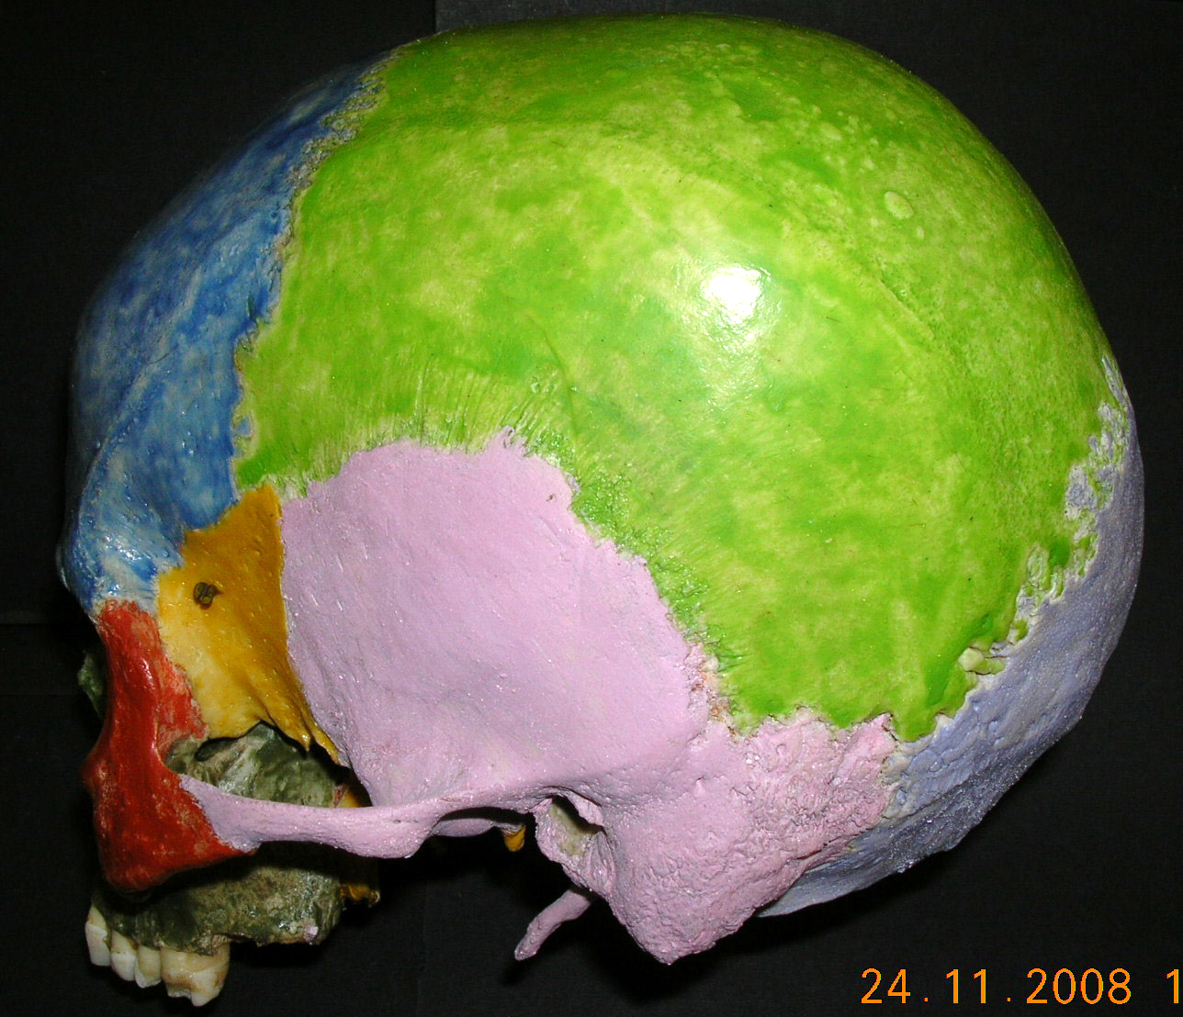

Slide 11
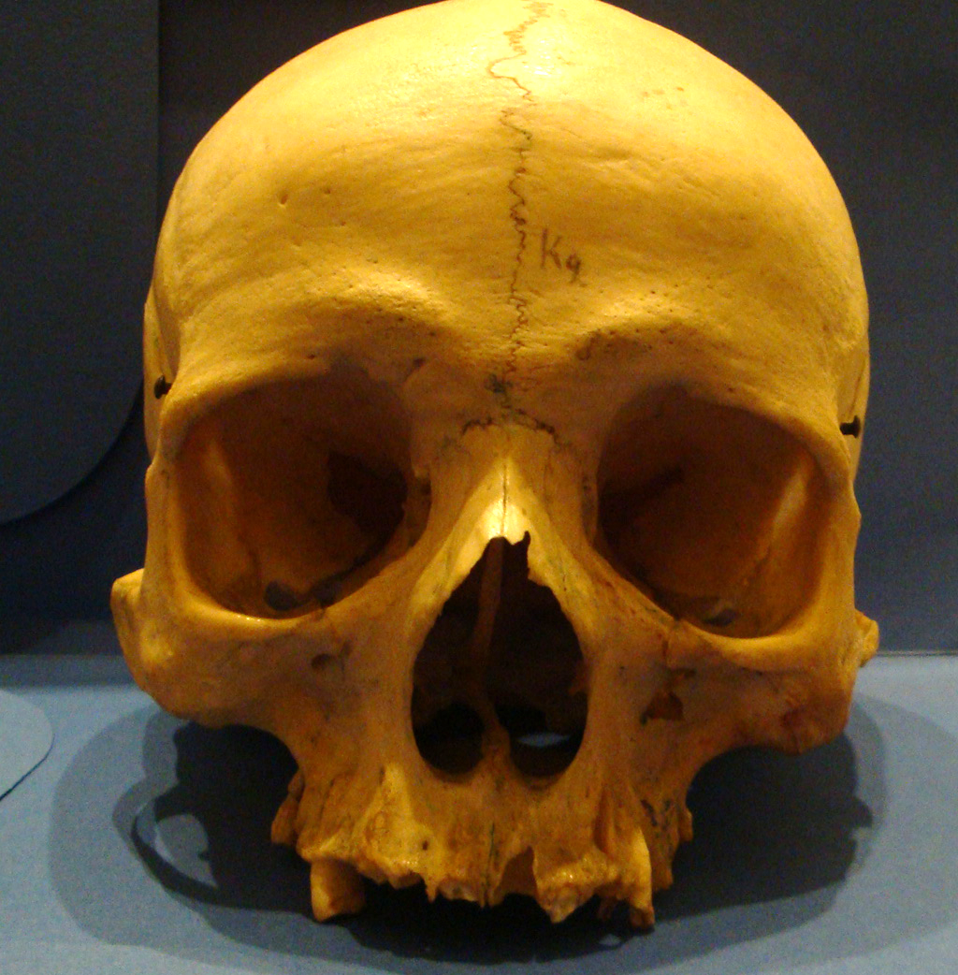
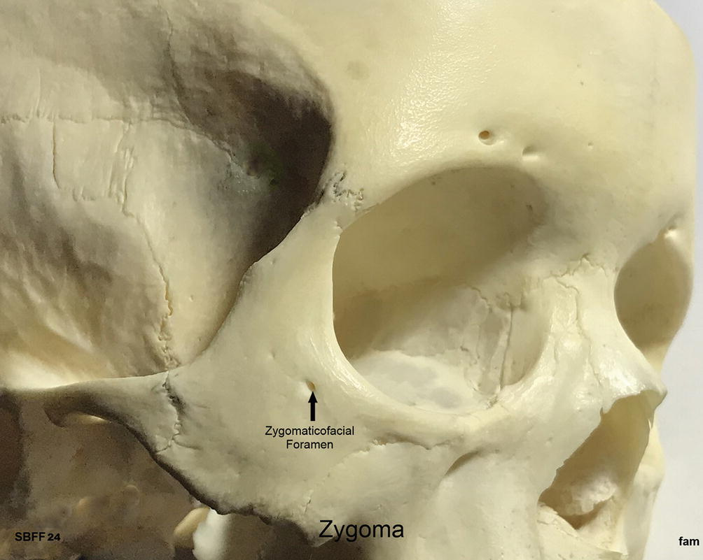

Slide 12
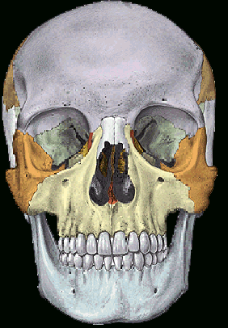
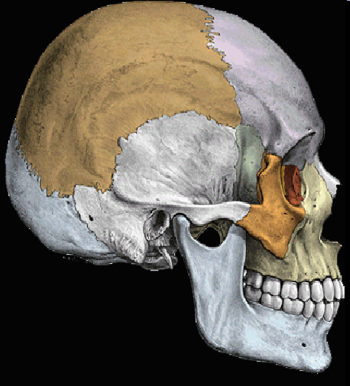
Skeleton of the viscerocranium
2 nasal bones
2 lacrimal bones
2 inferior nasal conchae
Vomer
2 maxillae
2 zygomatic bones
2 palatine bones
Mandible

Slide 13
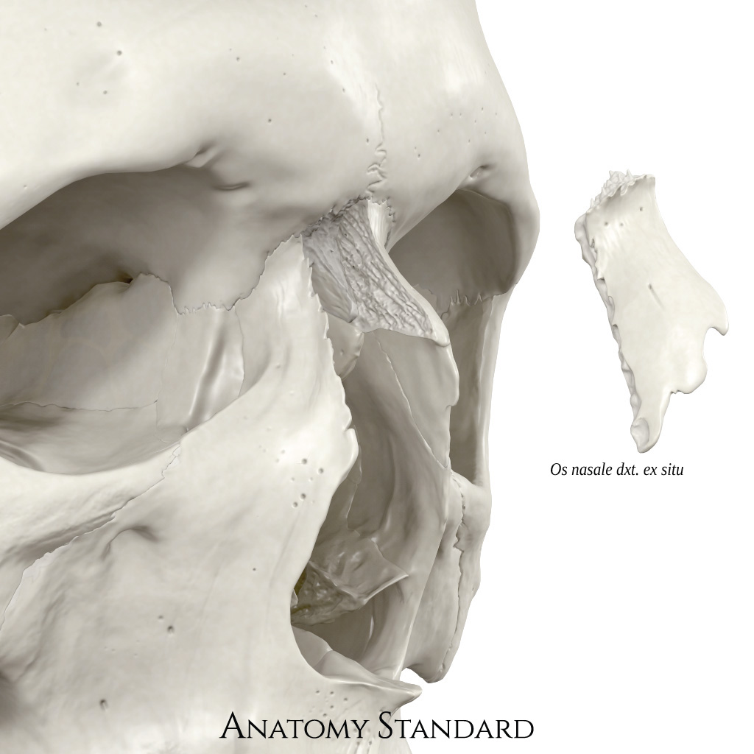
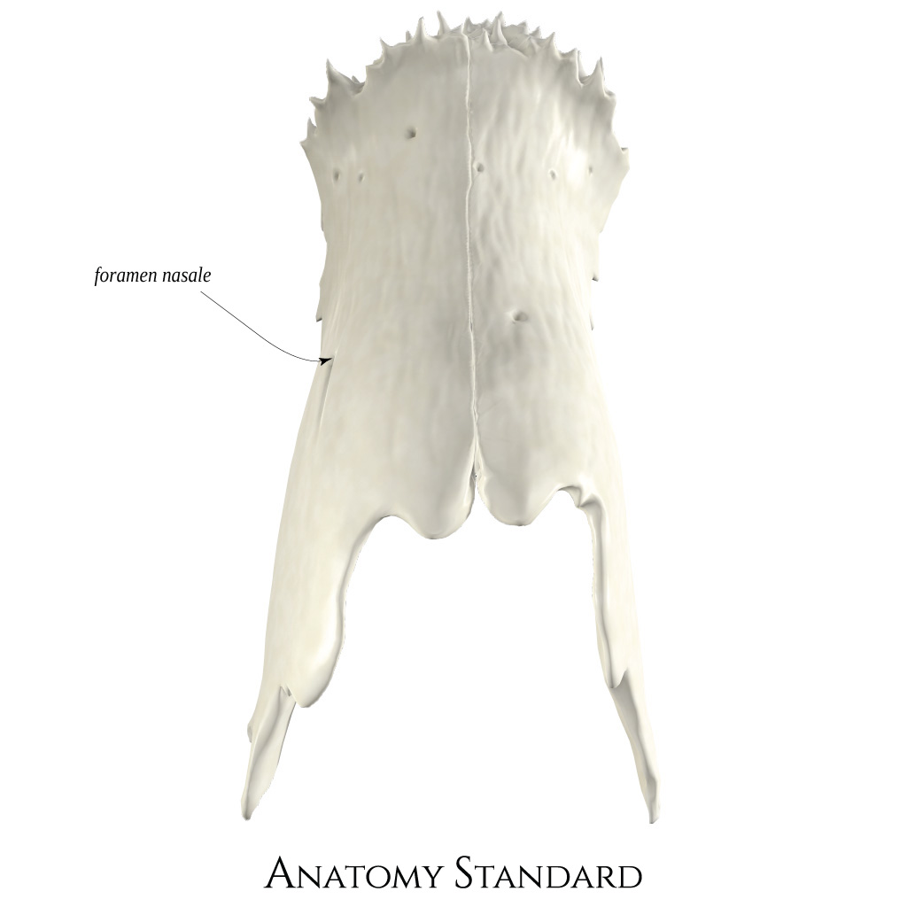
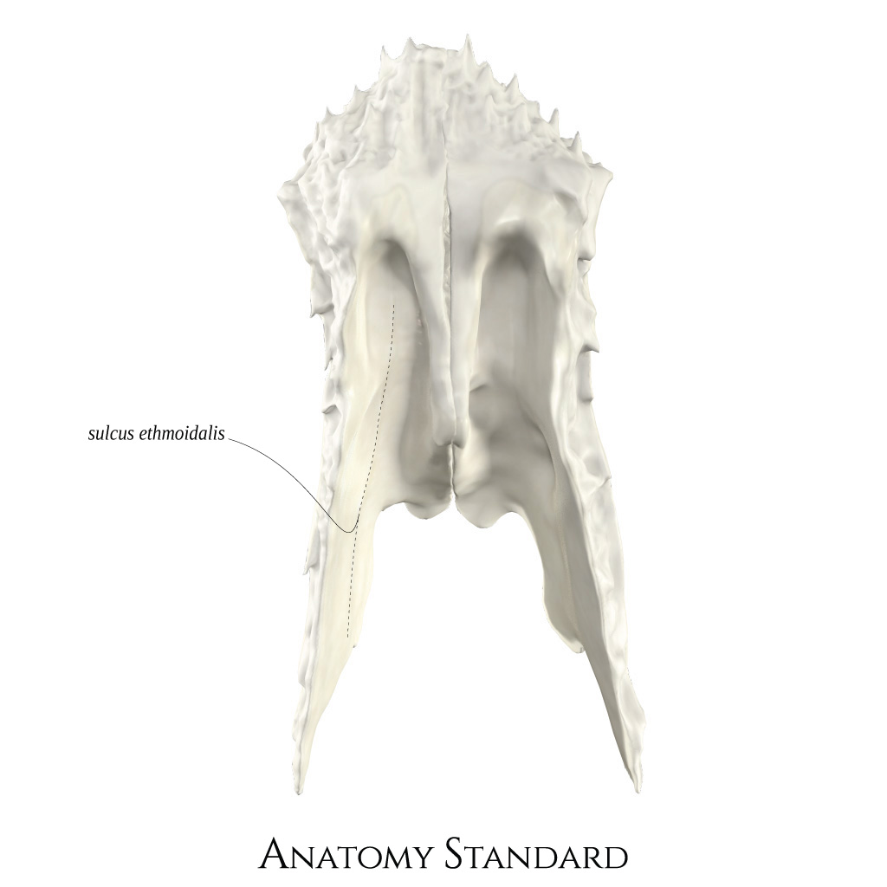
2 nasal bones
Nasomaxillary suture
Frontonasal suture

Slide 14
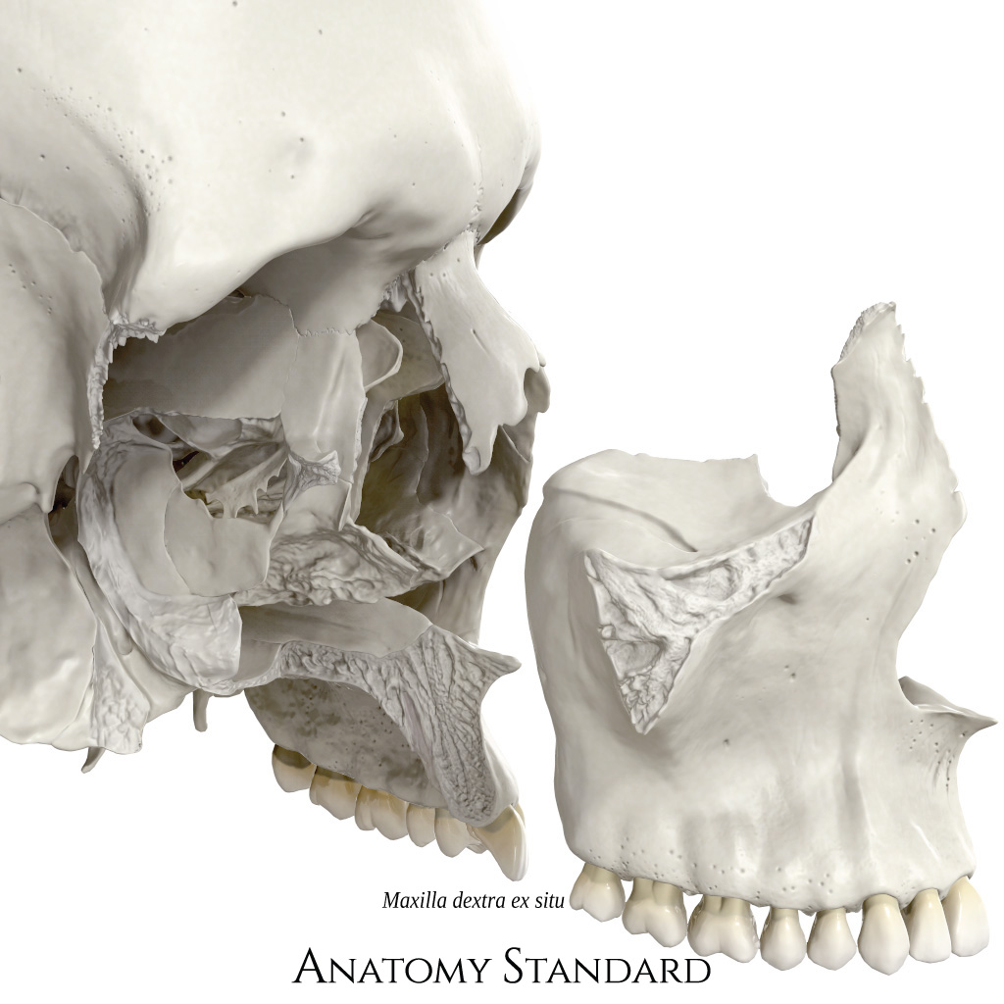
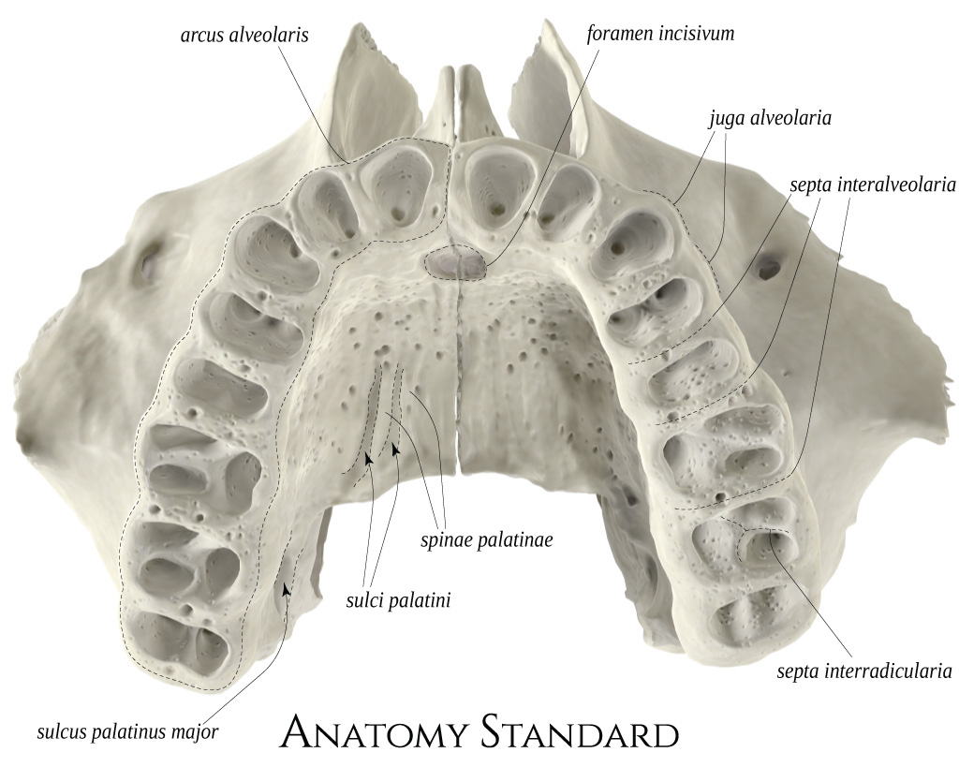
2 maxillae

Slide 15
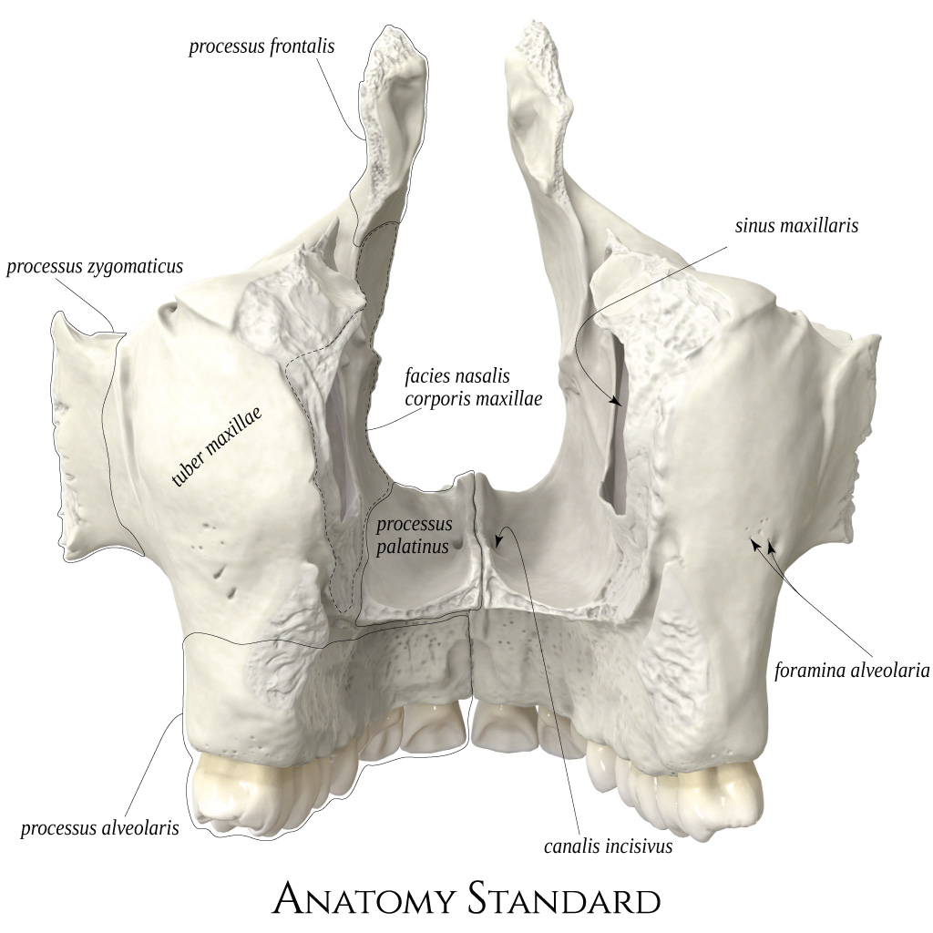
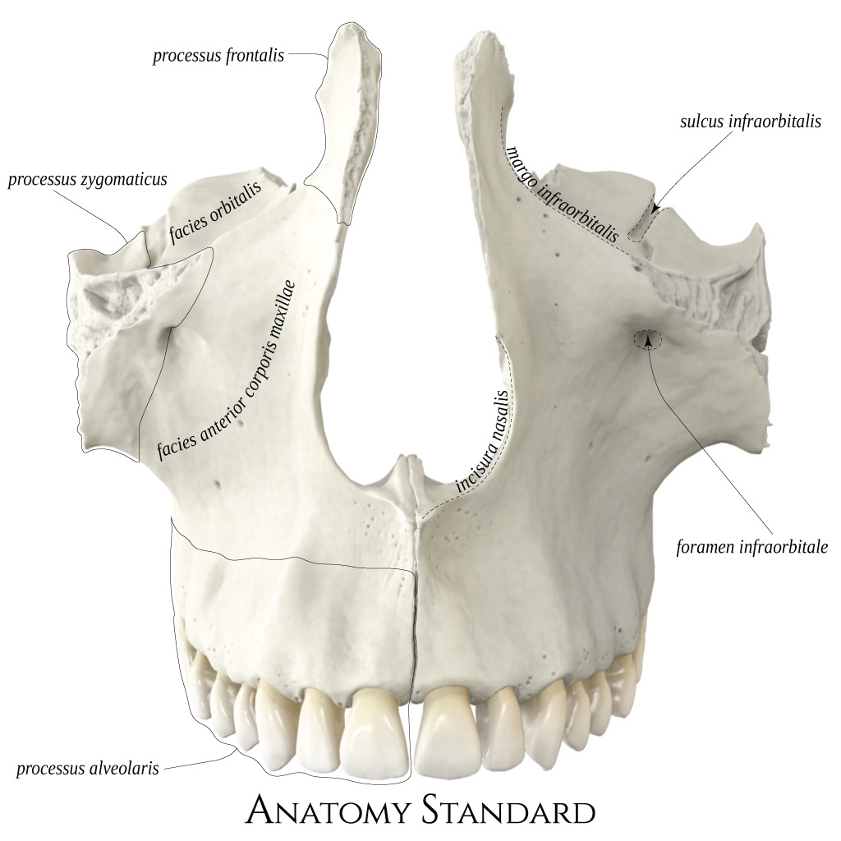
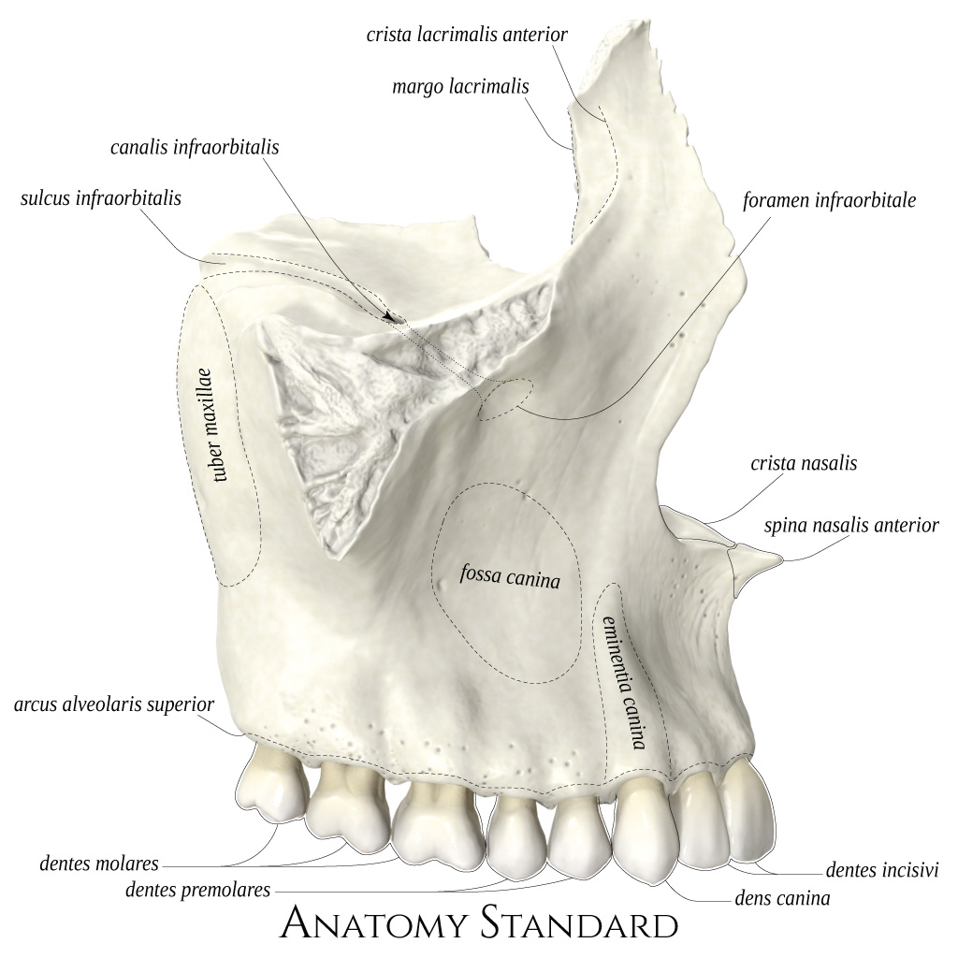

Slide 16
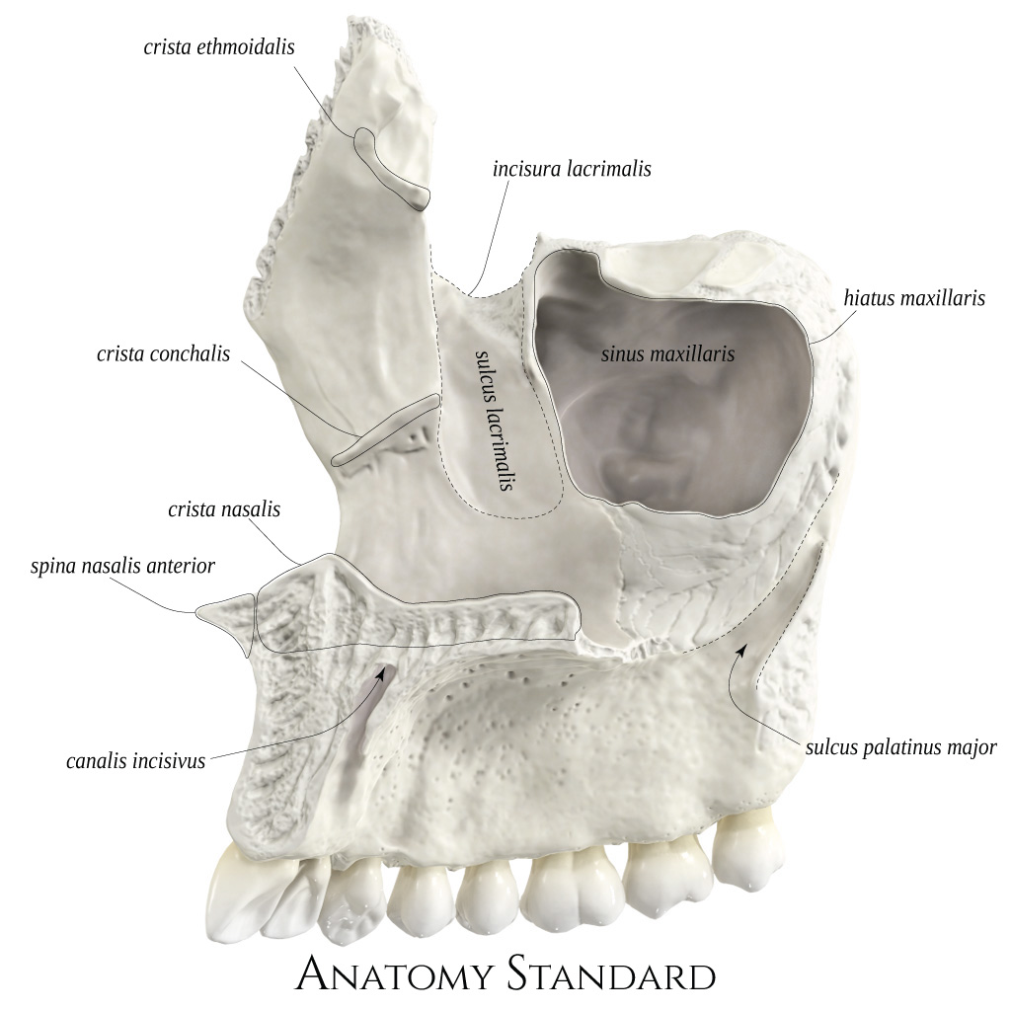

Slide 17
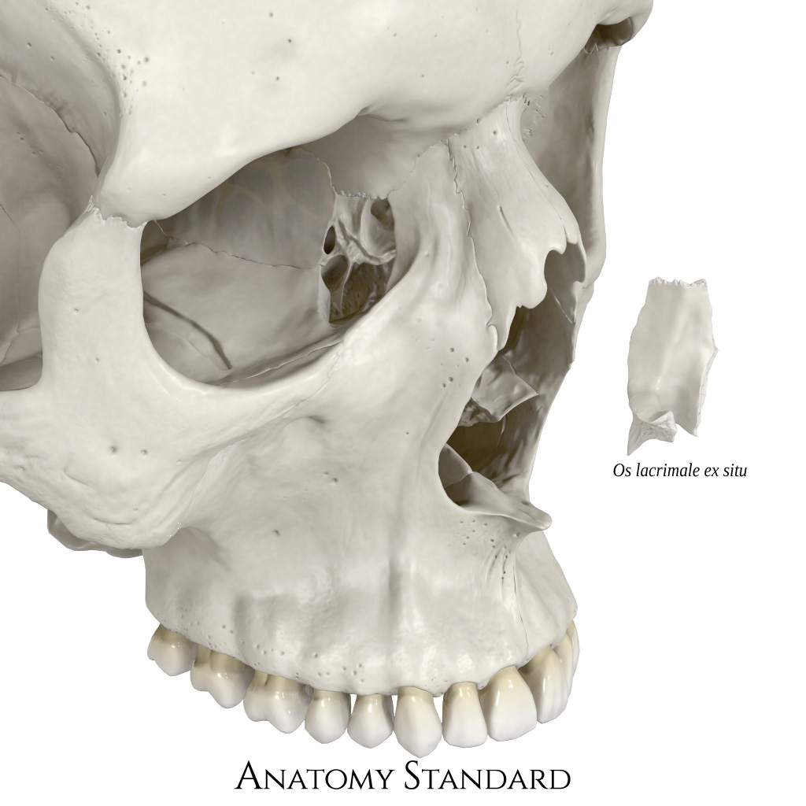
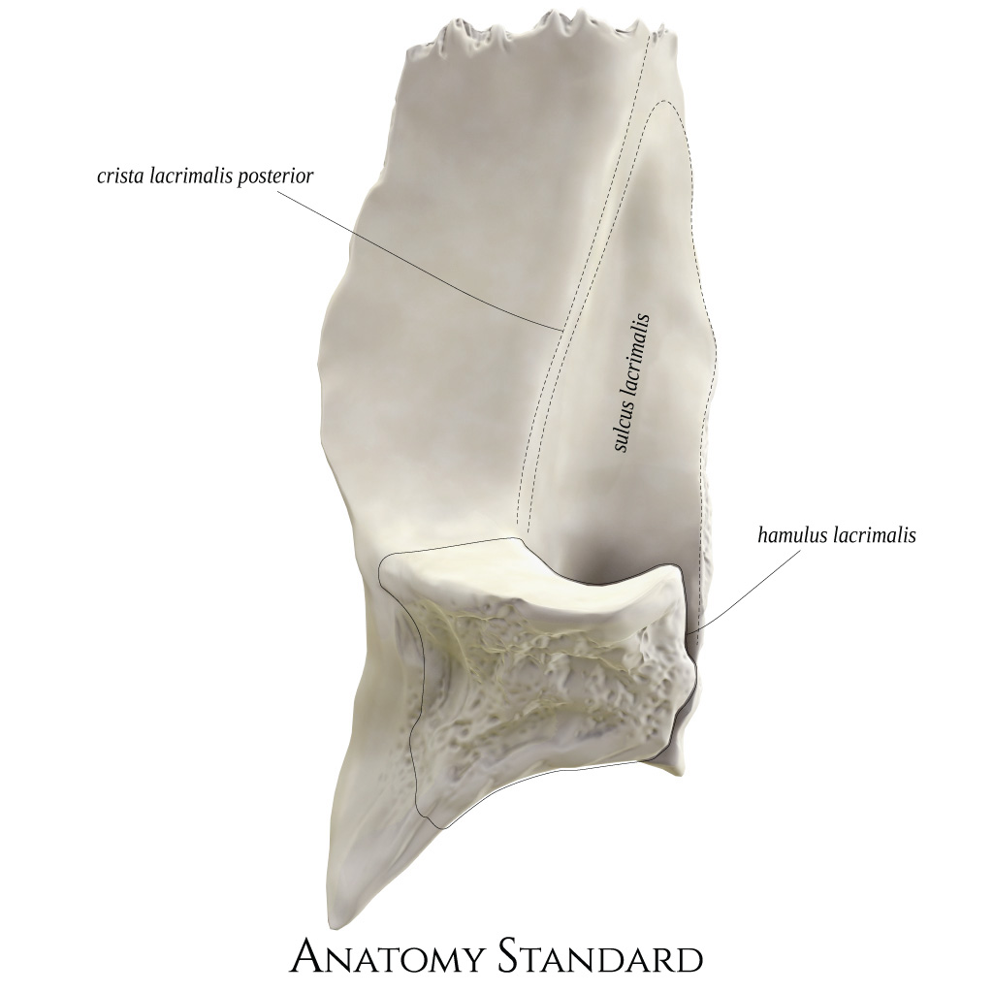
Lacrimal bone

Slide 18
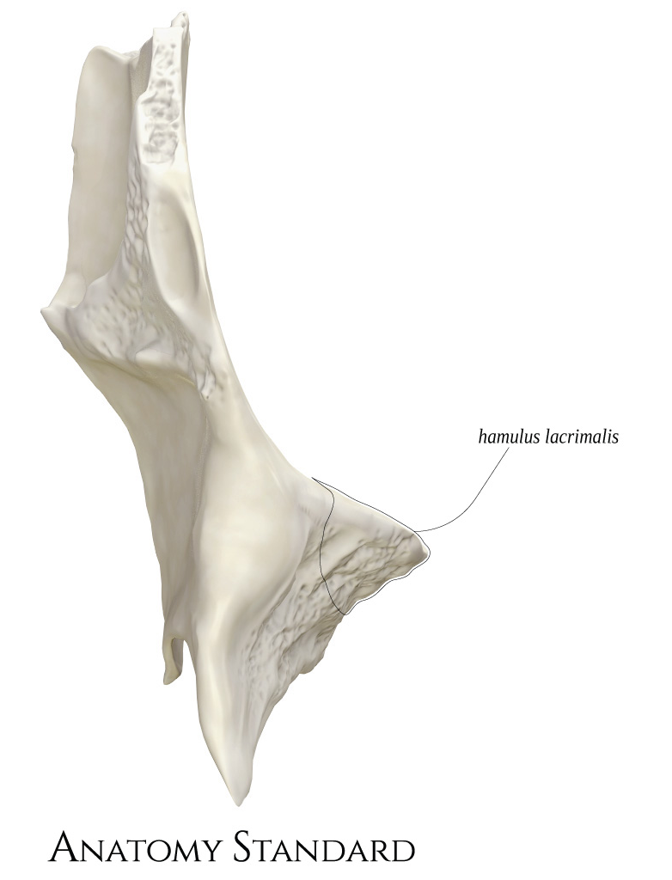
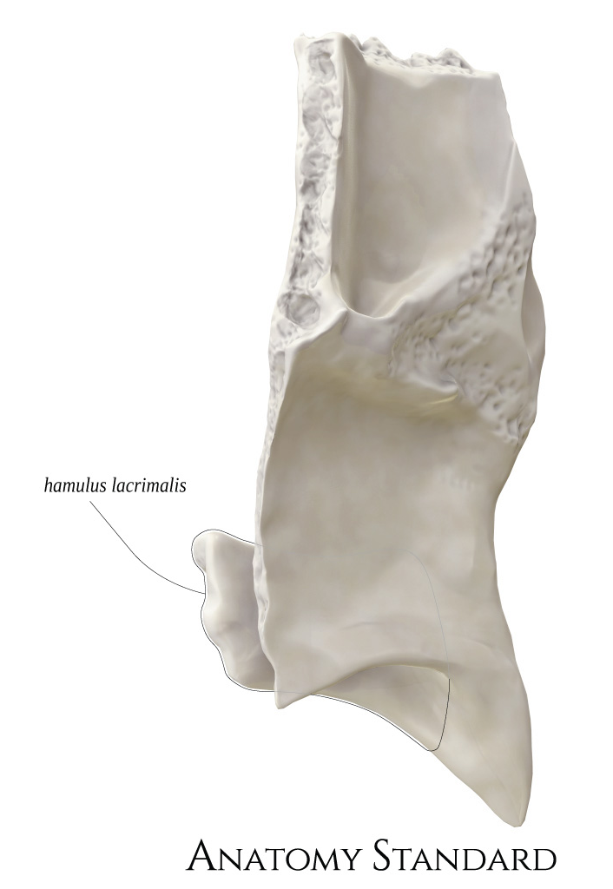
Lacrimal bone

Slide 19
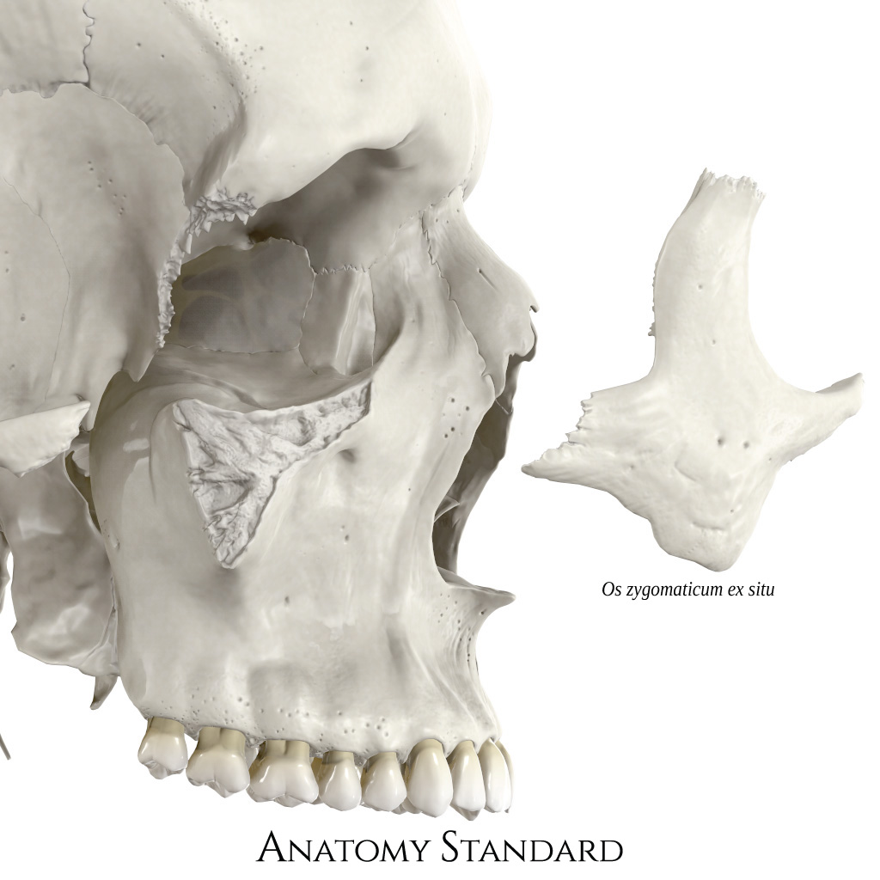
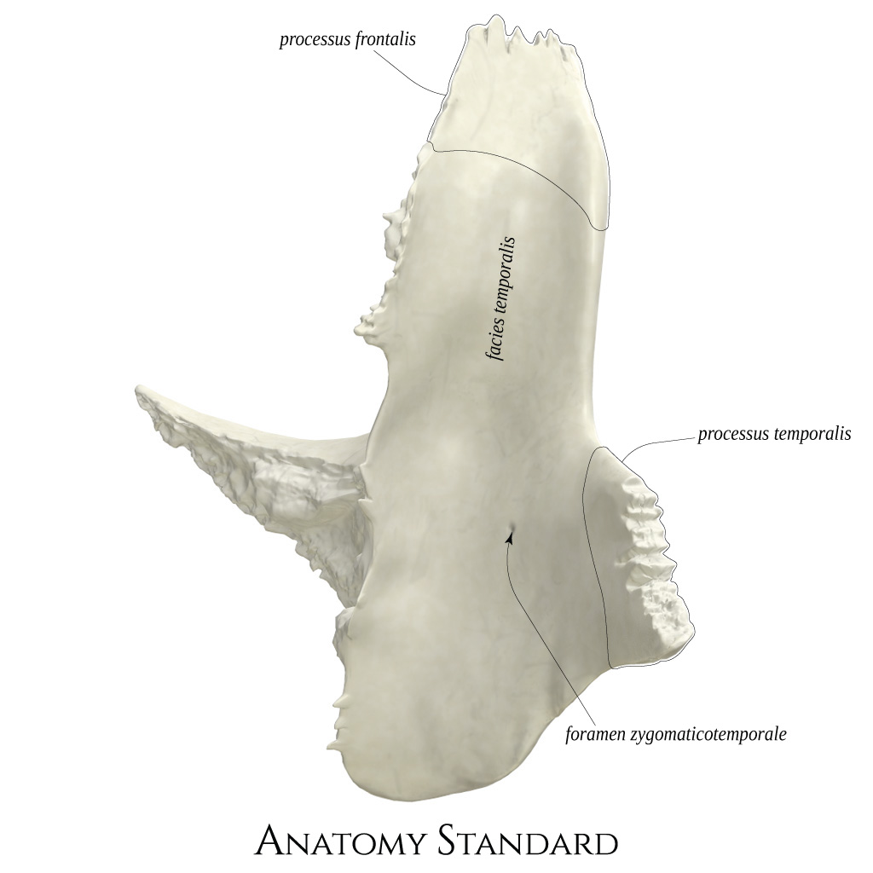
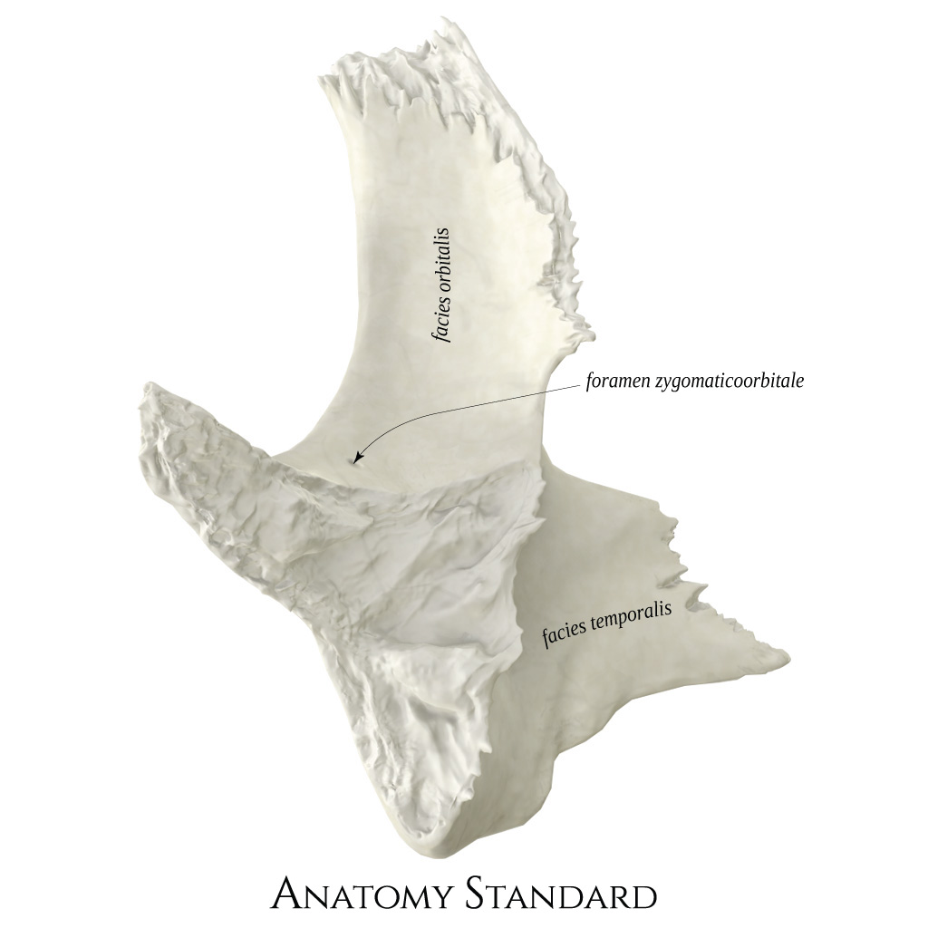
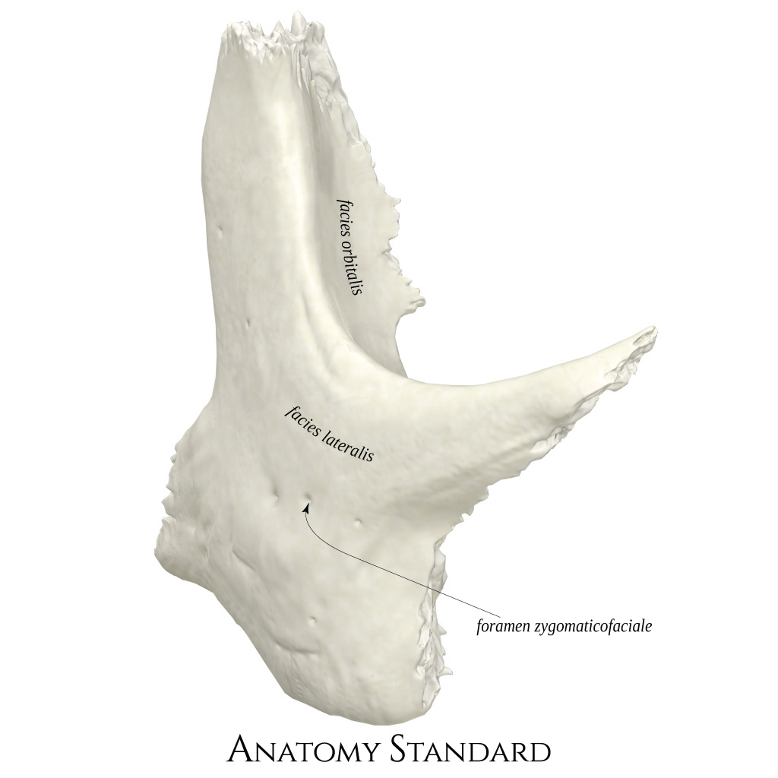
Zygomatic bone

Slide 20
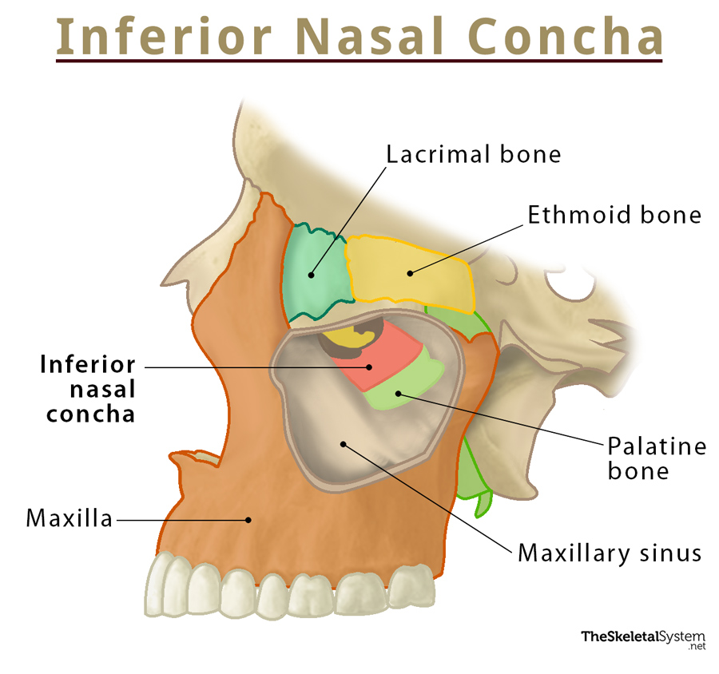

Slide 21
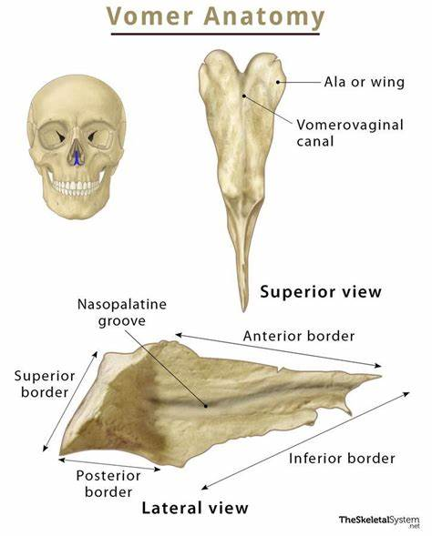
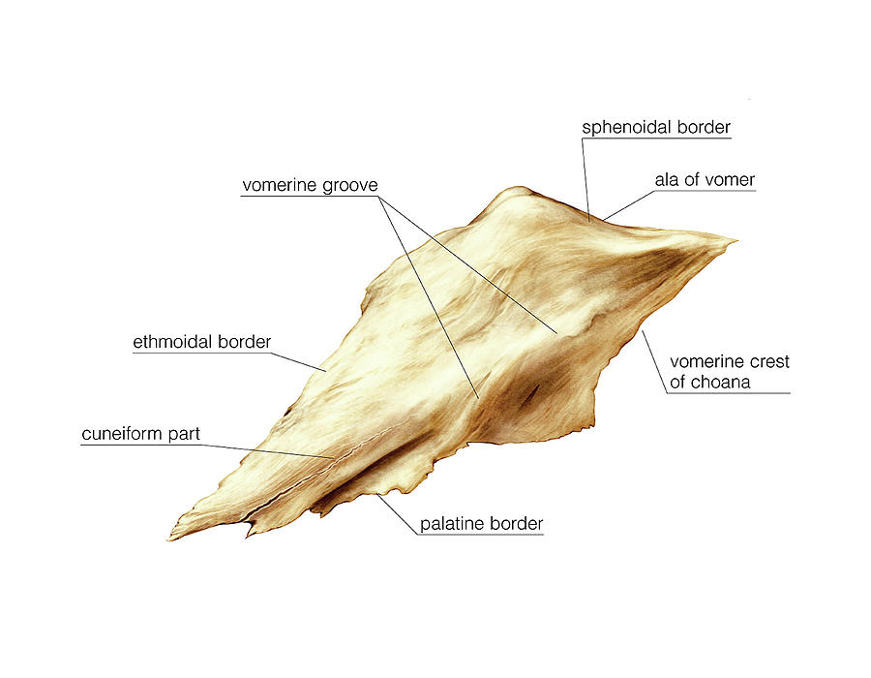

Slide 22
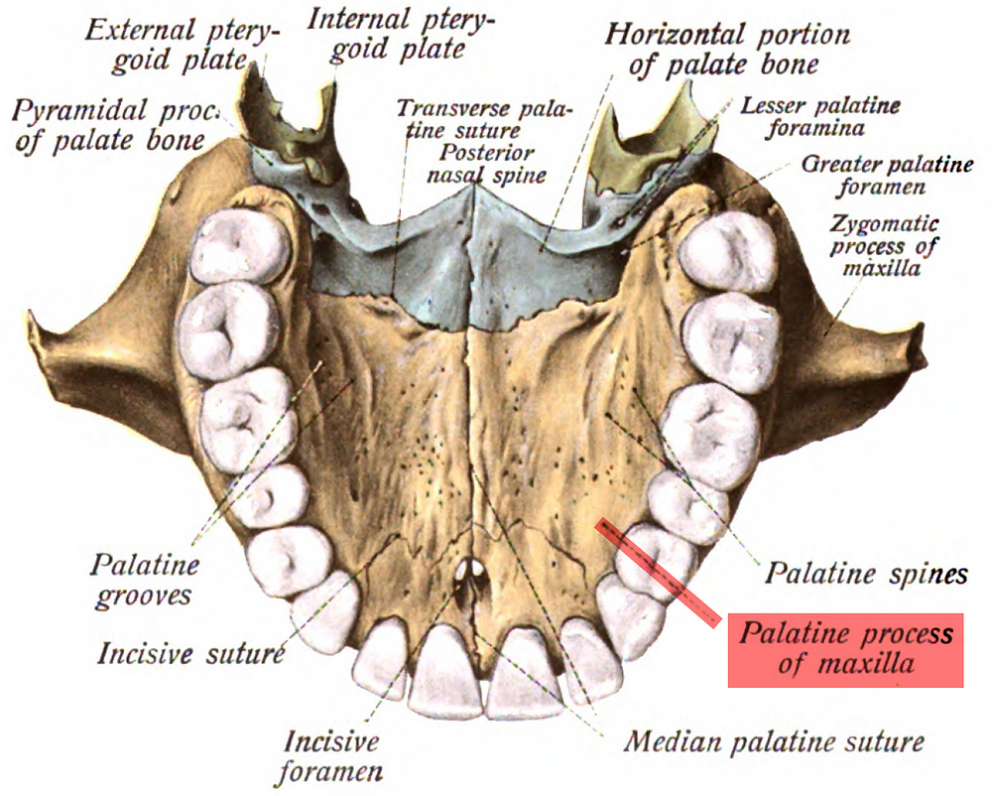
Incisive area

Slide 23
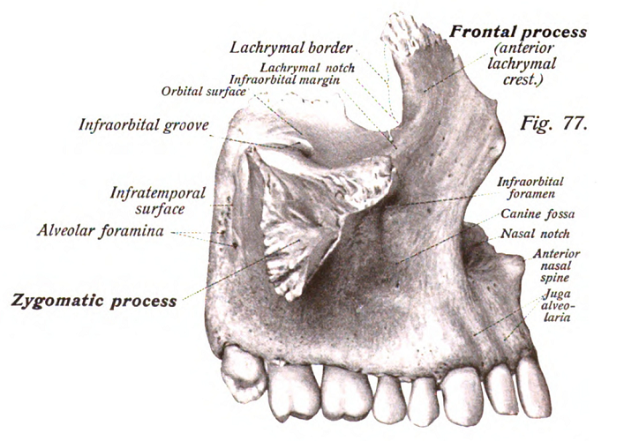

Slide 24
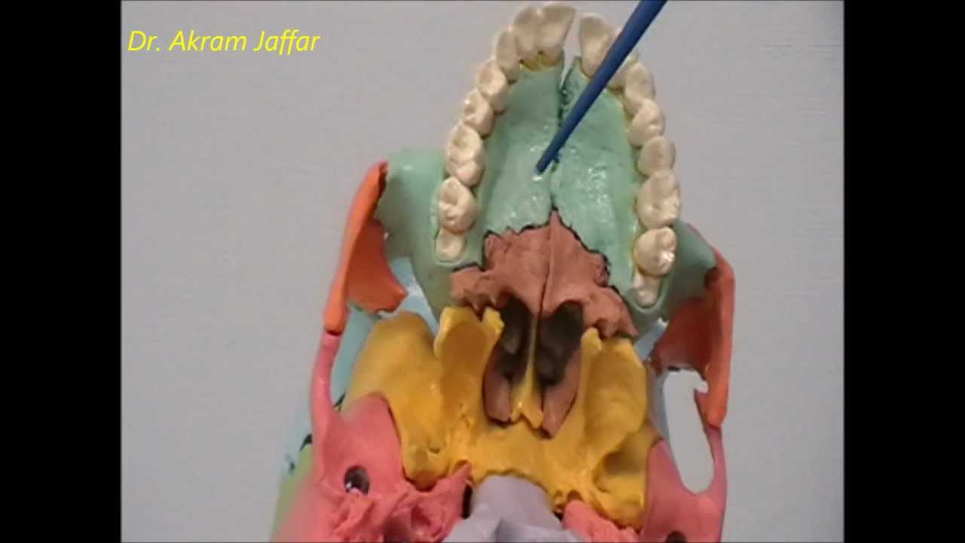
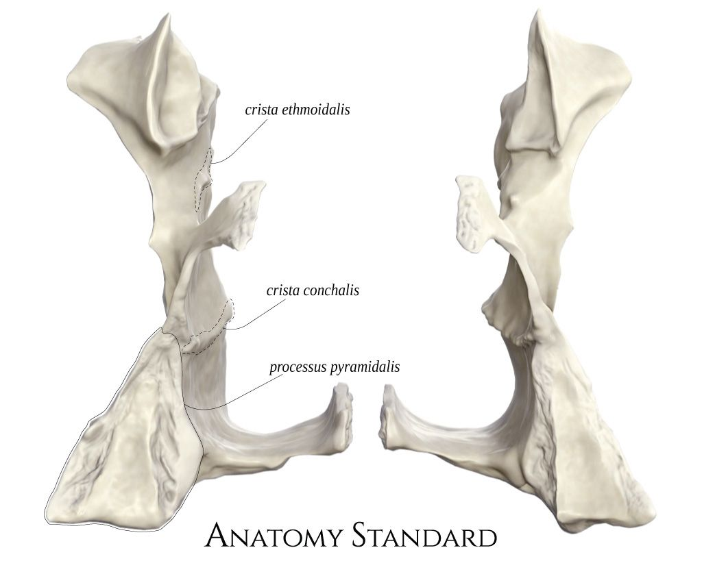

Slide 25
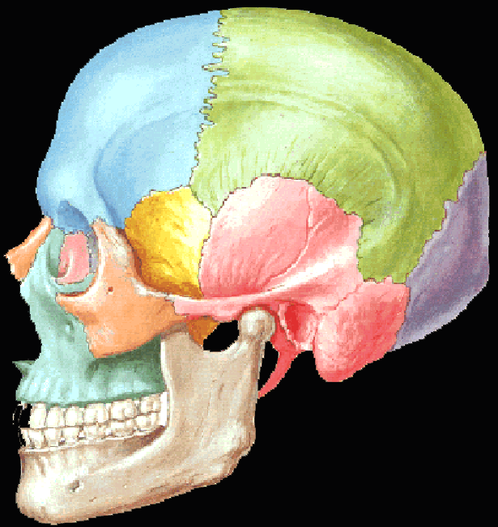
Bones of the facial skull are relatively fragile and can easily be fractured
Light bones
Rapid healing of fractures due to rich blood supply

Slide 26
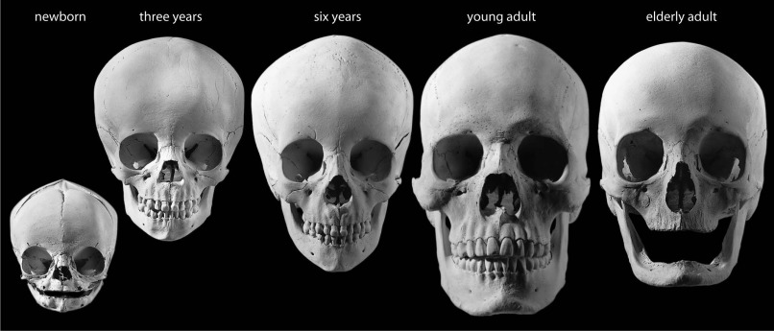
Remodeling of the skull
with the age

Slide 27
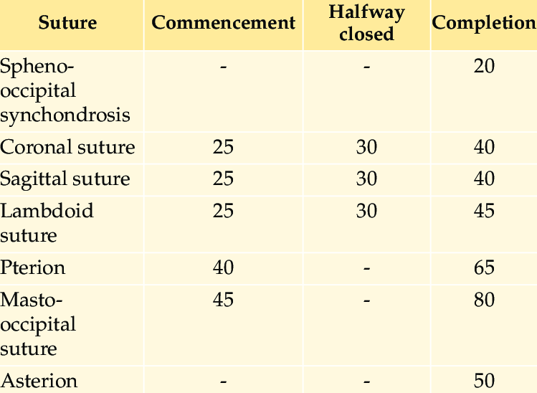
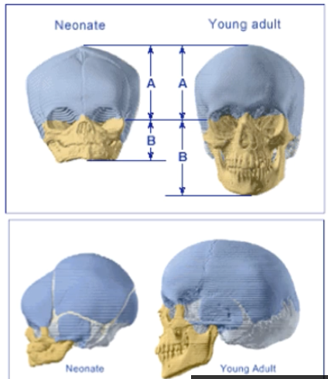

Slide 28
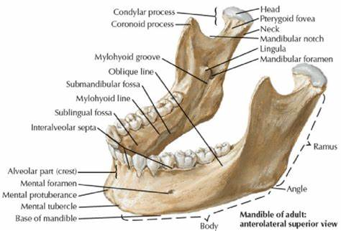
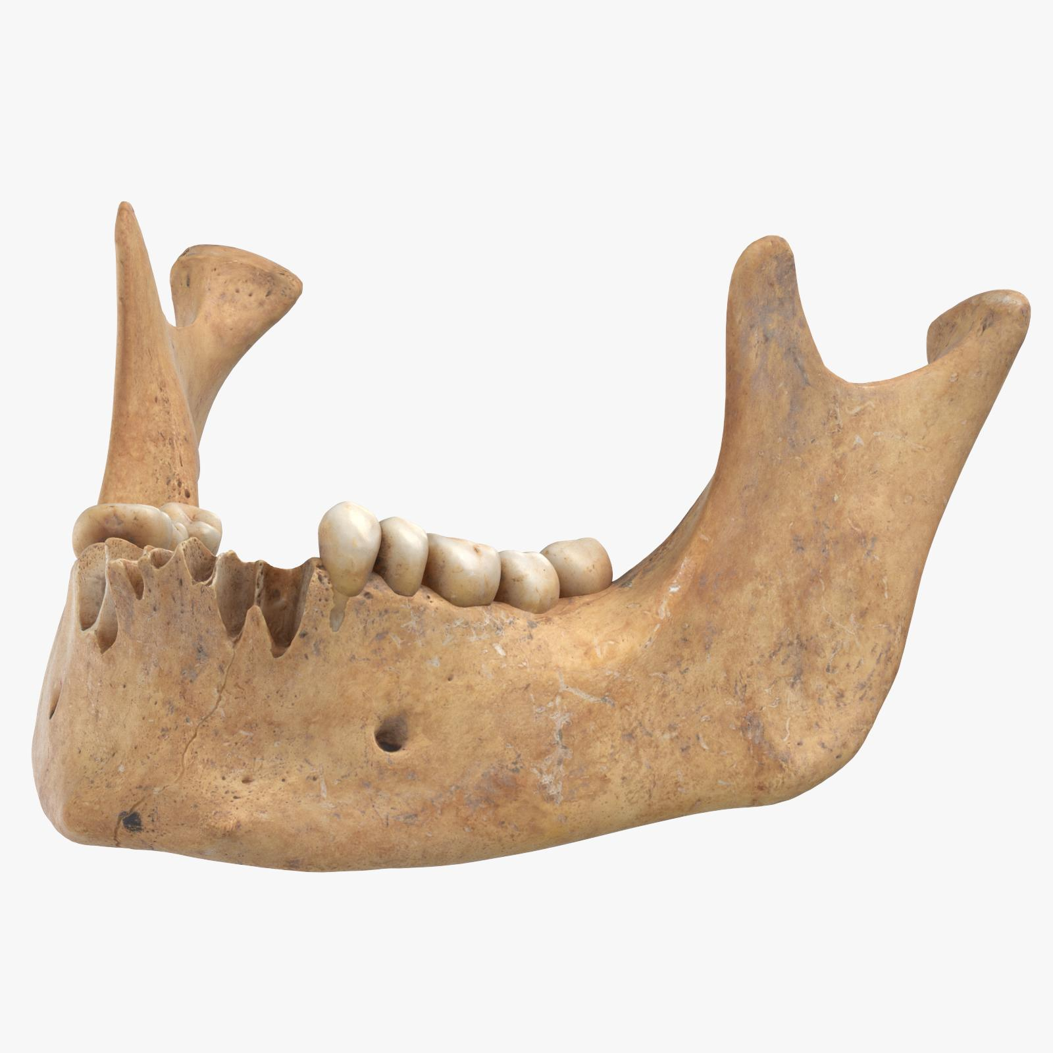


Slide 29




Slide 30


Insertions of the muscles

Slide 31

Face division
Upper third of the face
Middle third of the face
Lower third of the face

Slide 32


Orbit bones

Slide 33


Nasal septum
Osseous nasal septum (2 elements)
Nasal septum (3 elements)

Slide 34

Relationship of the osseous nasal septum with the sphenoid bone
Sinus of sphenoid bone

Slide 35


1
1
3
2
2
3
1+2 osseous nasal septum
1. Perpendicular ethmoidal plate
2. Vomer
3. Sphenoid sinus
Lateral wall
Superior nasal concha
2. Middle nasal concha
3. Inferior nasal concha

Slide 36




Pterygoid venous plexus
Triangle of death
The danger triangle of the face consists of the area from the corners of the mouth to the bridge of the nose, including the nose and maxilla. Due to the unique nature of the blood supply to the human nose and surrounding area, it is possible for retrograde infection from the nasal area to spread to the brain, causing cavernous sinus thrombosis, meningitis, or brain abscess.

Slide 37


Slide 38






Paranasal sinuses
Are a group of four paired air-filled spaces that surround the nasal cavity. The maxillary sinuses are located under the eyes;
the frontal sinuses are above the eyes;
the ethmoidal sinuses are between the eyes and
the sphenoidal sinuses are behind the eyes.
The sinuses are named for the facial and sphenoid bones in which they are located.
Their role is disputed.

Slide 39


Slide 40



Slide 41

The hard palate is a thin horizontal bony plate made up of two facial skeleton bones, located in the roof of the mouth. The bones are the palatine process of the maxilla and the horizontal plate of the palatine bone. The hard palate spans the alveolar arch formed by the alveolar process that holds the upper teeth (when these are developed).

Slide 42




Slide 43

Temporomandibular joint
The temporomandibular joints (TMJ) are the two joints connecting the jawbone to the skull. It is a bilateral synovial articulation between the temporal bone of the skull above and the condylar process of the mandible below; it is from these bones that its name is derived. The joints are unique in their bilateral function, connected via the mandible.

Slide 44



Slide 45


Slide 46




Slide 47


Mimic muscles (facial nerve)

Slide 48



Slide 49

Notes:
Διατάσσονται σε 4 στρώματα
Εν τω βάθει μύες (βυκανητής, ανελκτήρας άνω χείλους και γενειακός ) – στιβάδα 4

Slide 50



Slide 51


Slide 52


Slide 53


Mimic muscles (facial nerve)
Maseteric muscles (trigeminal nerve)

Slide 54





Slide 55



Slide 56




Slide 57



Slide 58




Slide 59


Slide 60





Slide 61




Slide 62



Slide 63



Slide 64


ΚΑΘΕΛΚΤΗΡΑΣ ΡΙΝΙΚΟΥ ΔΙΑΦΡΑΓΜΑΤΟΣ
ΤΟΜΙΚΟ ΒΟΘΡΙΟ ΆΝΩ ΓΝΑΘΟΥ- ΡΙΝΙΚΟ ΔΙΑΦΡΑΓΜΑ ΚΑΙ ΠΤΕΡΥΓΙΑ
ΣΥΓΚΛΕΙΣΗ ΜΥΚΤΗΡΩΝ
ΒΥΚΑΝΗΤΙΚΟΙ ΚΛΑΔΟΙ ΠΡΟΣΩΠΙΚΟΥ ΝΕΥΡΟΥ

Slide 65


Slide 66


Slide 67




Slide 68


Slide 69



Slide 70


Slide 71


Slide 73



Slide 74



Slide 75



Slide 76



Slide 77



Slide 78



Slide 79


ΚΡΟΤΑΦΙΚΟΣ ΒΟΘΡΟΣ-ΚΟΡΩΝΟΕΙΔΗΣ ΑΠΟΦΥΣΗ, ΠΡΟΣΘΙΟ ΧΕΙΛΟΣ ΚΛΑΔΟΥ ΚΑΤΩ ΓΝΑΘΟΥ
ΕΝ ΤΩ ΒΑΘΕΙ ΚΡΟΤΑΦΙΚΑ ΝΕΥΡΑ

Slide 80



Slide 81




Slide 82


Slide 83



Slide 84


Slide 85



Slide 87


Slide 88

Notes:
Πτερυγοακανθικός σύνδεσμος
Πτερυγογναθικός
Σφηνογναθικός

Slide 89

ΈΣΩ ΕΠΙΦΑΝΕΙΑ ΈΞΩ ΠΕΤΑΛΟΥ ΠΤΕΡΥΓΟΕΙΔΟΥΣ ΑΠΟΦΥΣΗΣ ΣΦΗΝΟΕΙΔΟΥΣ, ΥΠΕΡΩΙΟ ΟΣΤΟ, ΓΝΑΘΙΑΙΟ ΚΥΡΤΩΜΑ- ΈΣΩ ΕΠΙΦΑΝΕΙΑ ΚΛΑΔΟΥ ΚΑΙ ΓΩΝΙΑΣ ΚΑΤΩ ΓΝΑΘΟΥ
ΈΣΩ ΠΤΕΡΥΓΟΕΙΔΕΣ ΝΕΥΡΟ
Medial pterygoid muscle

Slide 90

- αγγειοβρίθεια περιοχής
Αναστόμωση έσω και έξω καρωτίδας

Slide 91


- Αγγείωση κεφαλής

Slide 92

Surface anatomy of the face

Slide 93




Slide 94



Slide 95




Subcutaneous fat pad
little subcutaneous fat and abundant vessels -pinkish color
Roundness of the cheek-adipose Bichat ball (outer surface of the buccinator muscle, at the angle between it and the anterior rim of the masseter) with upward extension to the temporal region
Tendency of adipose ball prolapse through intraoral incisions or fractured wounds of the cheek by crossing the buccinator

Slide 96

Cheek fat par of Bichat

Slide 97

Distribution of subcutaneous tissue in the face

Slide 98



The fat pads are located under the epidermis subdermatically and help in the volume, fullness of the face and its contour
As we age, fat thins and descends, as a result of which the face loses its roundness and "bags" form under the eyes.

Slide 99


Slide 100


Slide 101



Slide 102



Slide 103


Slide 104


Slide 105


Slide 106

Superficial fascia of the face
A very thin layer of subcutaneous tissue covers the mimic muscles
In most of the face there is no deep fascia
In the subcutaneous fascia go the thin branches of the facial nerve
In facial rectifications, it is possible to bluntly separate the skin from the subcutaneous fascia without damaging the branches of the facial nerve (through a preauricular incision in the preauricular fold that extends to the scalp and pulling upwards loose skin of the face that has detached)

Slide 107


Slide 108




Slide 109


Parotid gland and facial nerve

Slide 110


Slide 111



Slide 112




Slide 113




Slide 114



Slide 115



Slide 116

Stylomastoid foramen

Slide 117



Slide 118





Slide 119

Nerves of the face
By the trigeminal nerve

Slide 120


Slide 121


Greater auricular nerve

Slide 122


Syndrome Frey and
auriculotemporal nerve’s injury

Slide 123


Slide 124

Facial arteries

Slide 125



Slide 126


΄Εξω καρωτίδας - ΄Εσω καρωτίδας
ΑΡΤΗΡΙΕΣ ΠΡΟΣΩΠΟΥ

Slide 128


Slide 129


Slide 130


Slide 131


Facial artery
Notes:
Η προσωπική ή έξω γναθιαία αρτηρία ακολουθεί οφιοειδή πορεία στο πρόσωπο και αφού χορηγήσει τις χειλικές αρτηρίες (άνω και κάτω) συνεχίζει ως γωνιαία αρτηρία (στη βάση της μύτης). Κλάδοι της τραχηλικής μοίρας της αρτηρίας είναι η ανιούσα υπερώια και η υπογενείδια αρτηρία. Σε επεμβάσεις στην περιοχή του υπογναθίου τριγώνου απαραίτητη είναι η απολίνωση της προσωπικής αρτηρίας και της ομώνυμης φλέβας.

Slide 132


Slide 133



Slide 134


Slide 135


Slide 136


Slide 137



Slide 138


Slide 139



Slide 140


Slide 141


Slide 142




Slide 143


Slide 144



Slide 145


