Slide 1
Upper Extremity #1
Shoulder girdle – Arm – Elbow
Dr Georgios D. Tsikouris, MD, MSc, PhD Orthopaedic Surgeon, MSc in Sports Medicine (Univ. of Nottingham, UK) and in Surgical Anatomy (NKUA) P.G. Dip. In Musculoskeletal Ultrasound, Univ. of Bournemouth, UK PG Dip. In Aviation Medicine (HAF GH, GR)

Slide 2
Bones
Clavicle
Scapula
humerus
Joints
Sternoclavicular
Acromioclavicular
Glenohumeral
Elbow
Vessels
Axillary artery
Brachial artery
Veins and lymph vessels
Muscles
Of the Shoulder girdle
Posterior of the arm
Anterior of the arm
Nerves
Brachial plexus

Slide 3
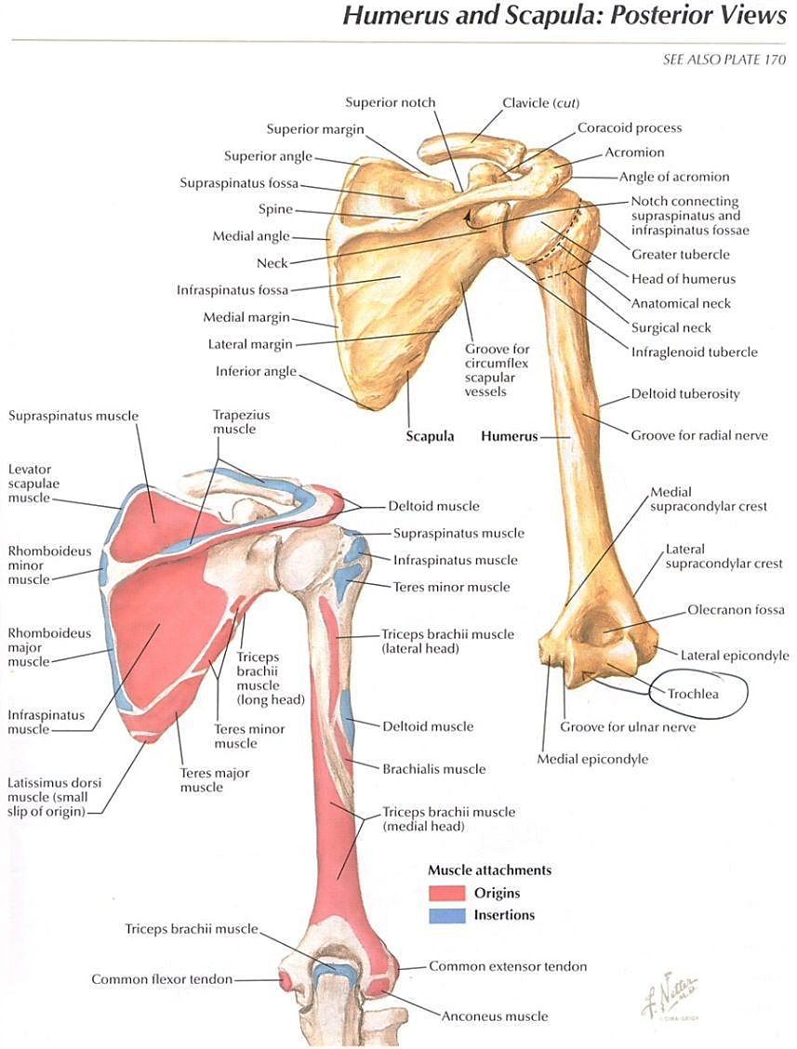
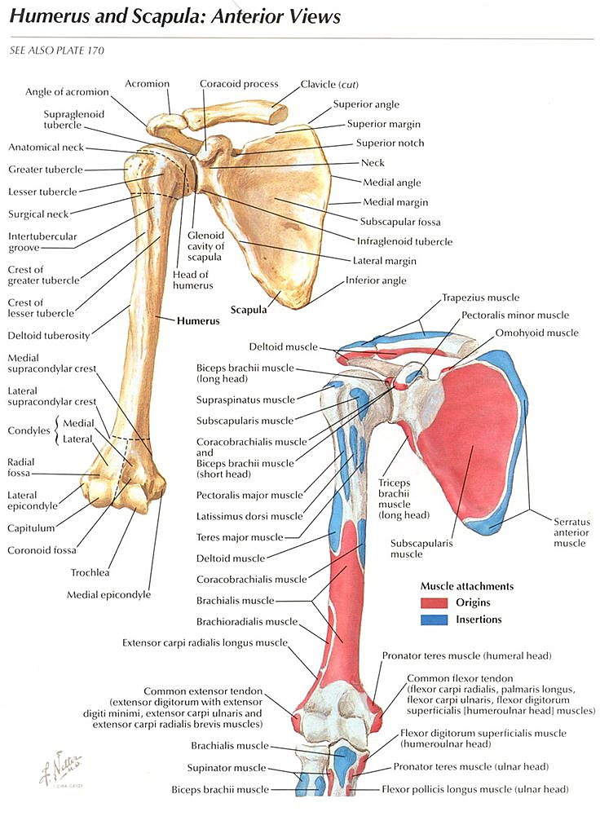
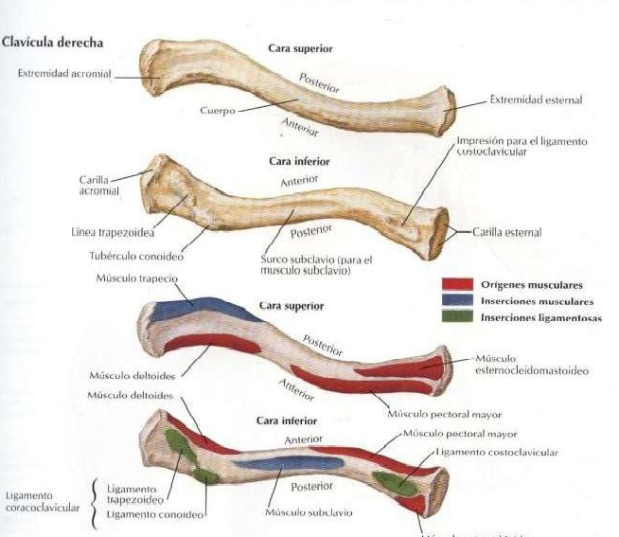
Bones

Slide 4
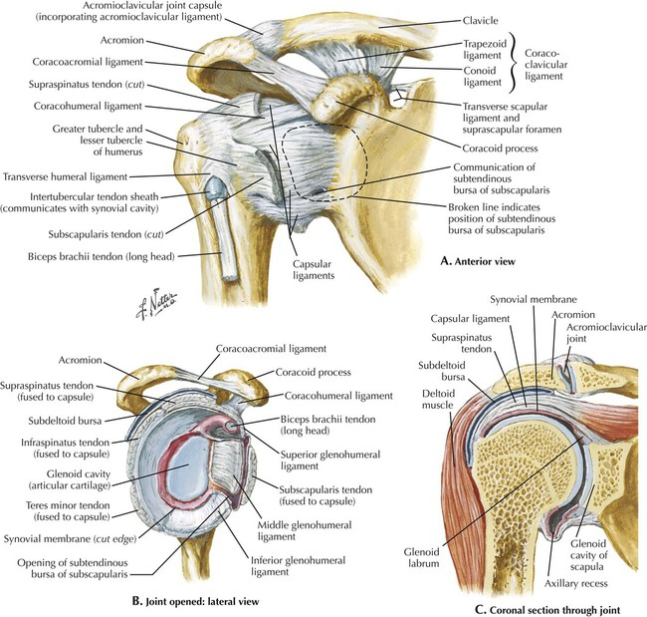
Joints

Slide 5
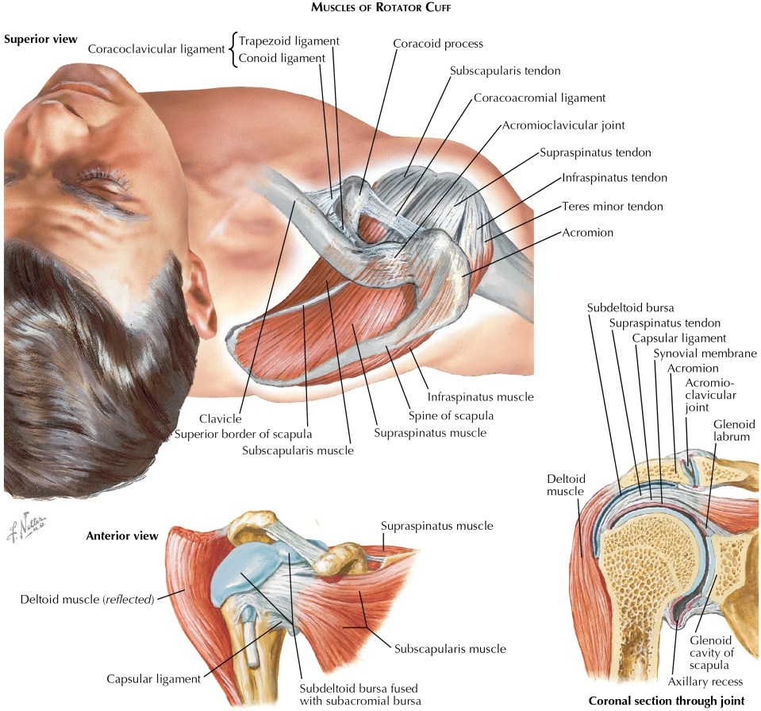

Slide 6
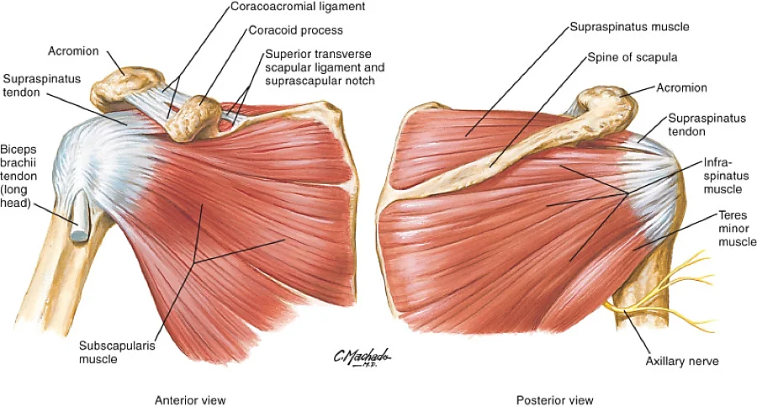
Muscles of the shoulder girdle

Slide 7
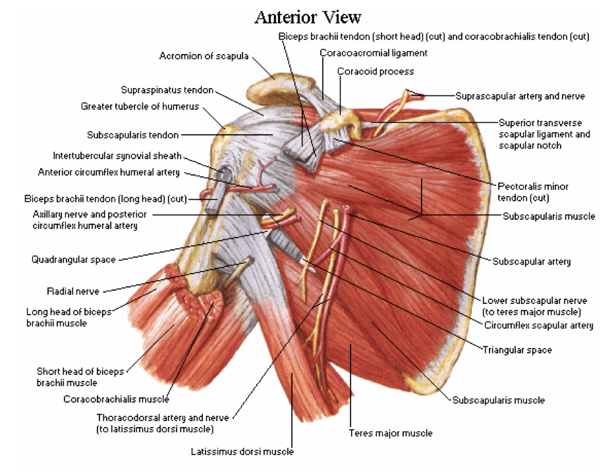
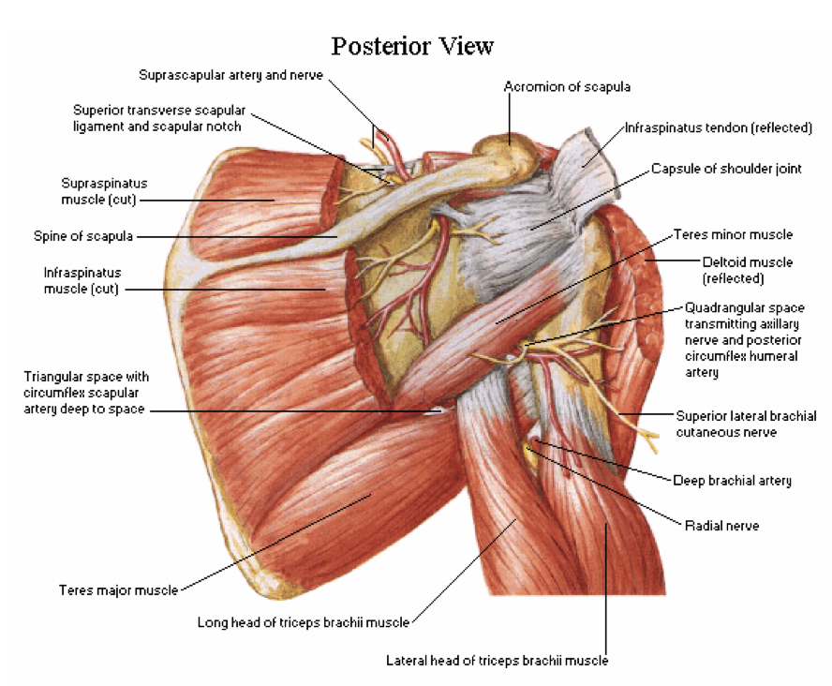

Slide 8
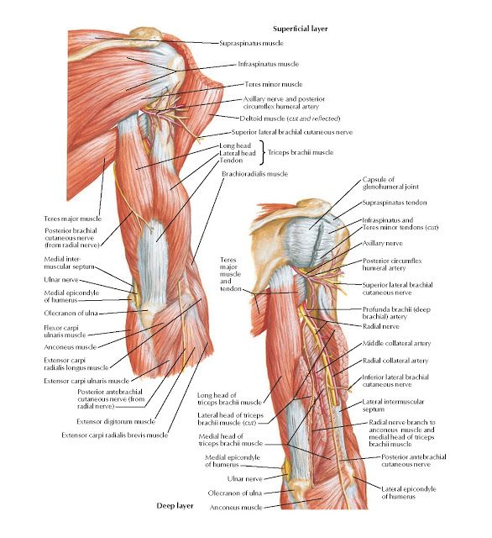
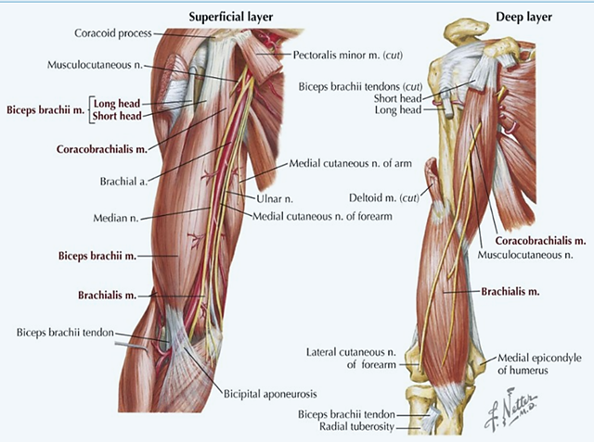
Muscles of the arm

Slide 9
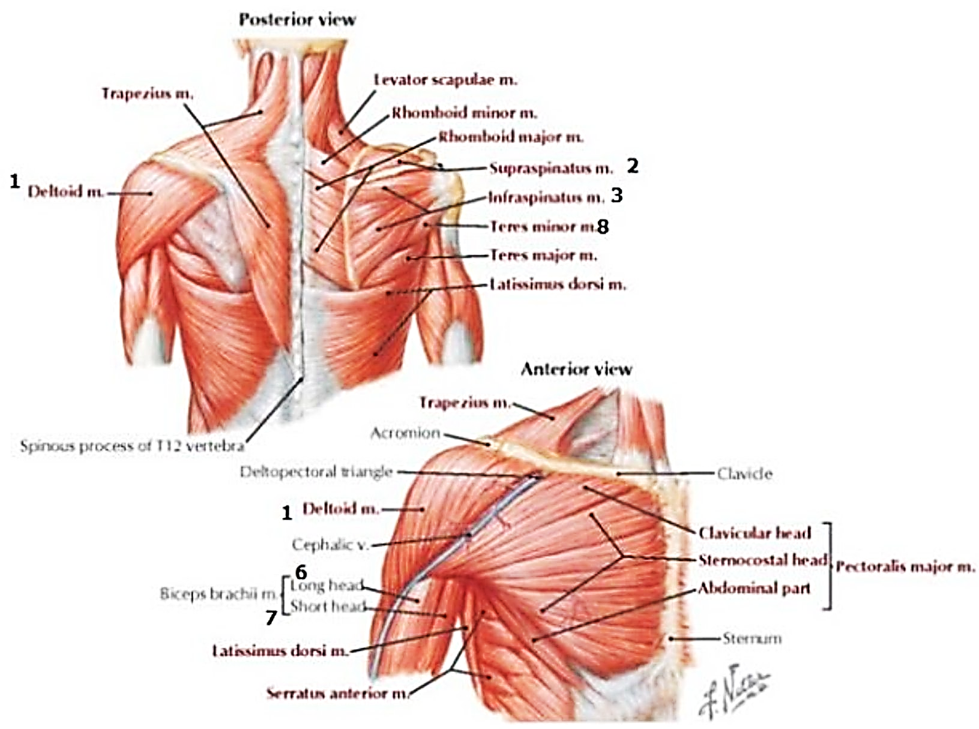

Slide 10
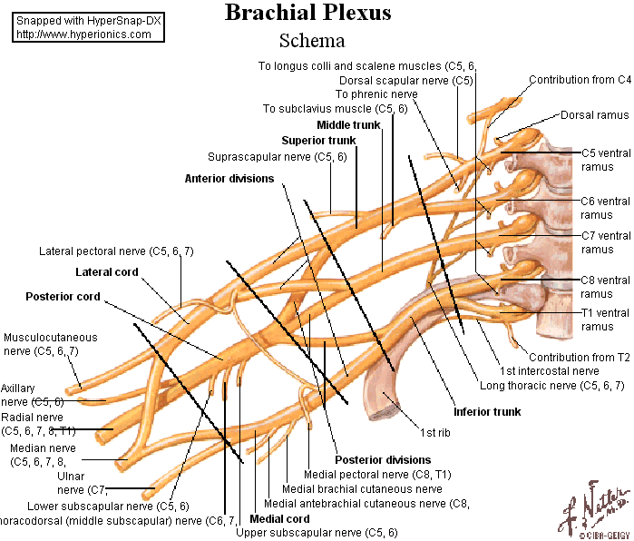
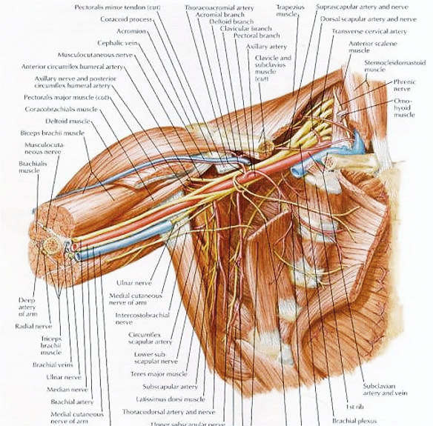
Brachial plexus

Slide 11
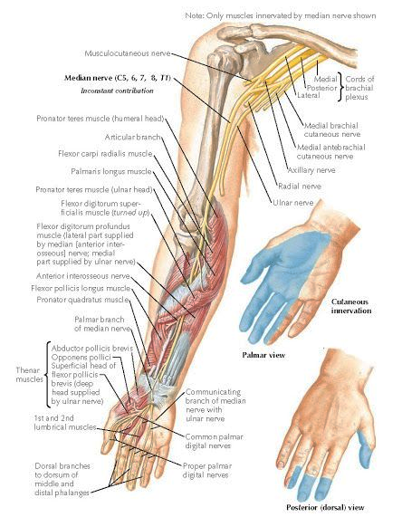
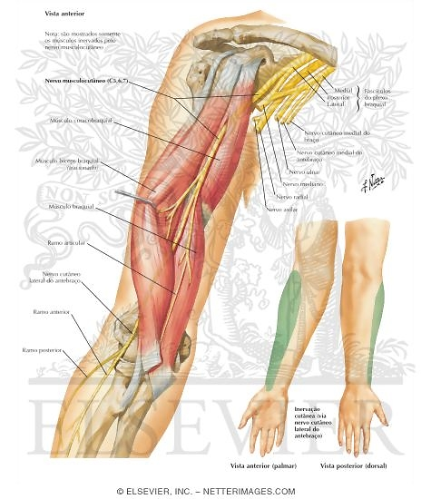

Slide 12
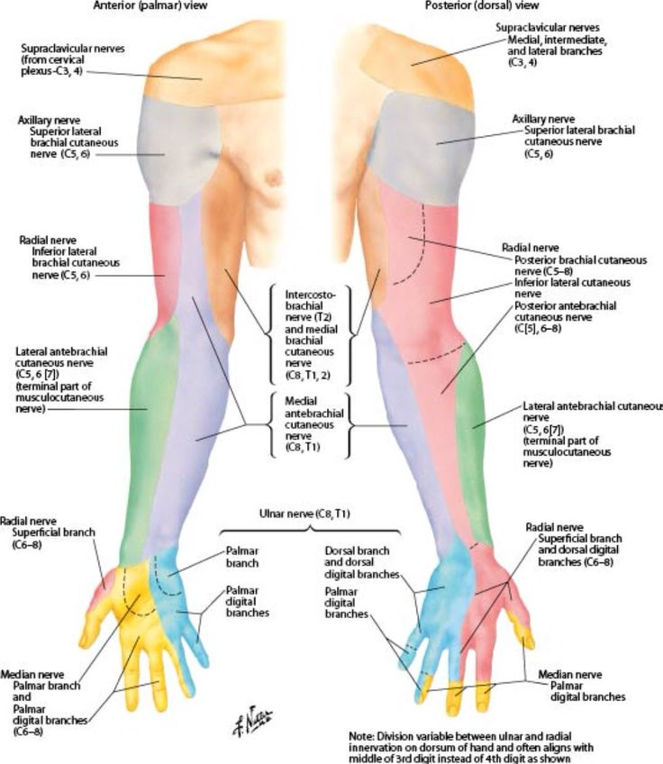
Sensory innervation of the upper extremity

Slide 13
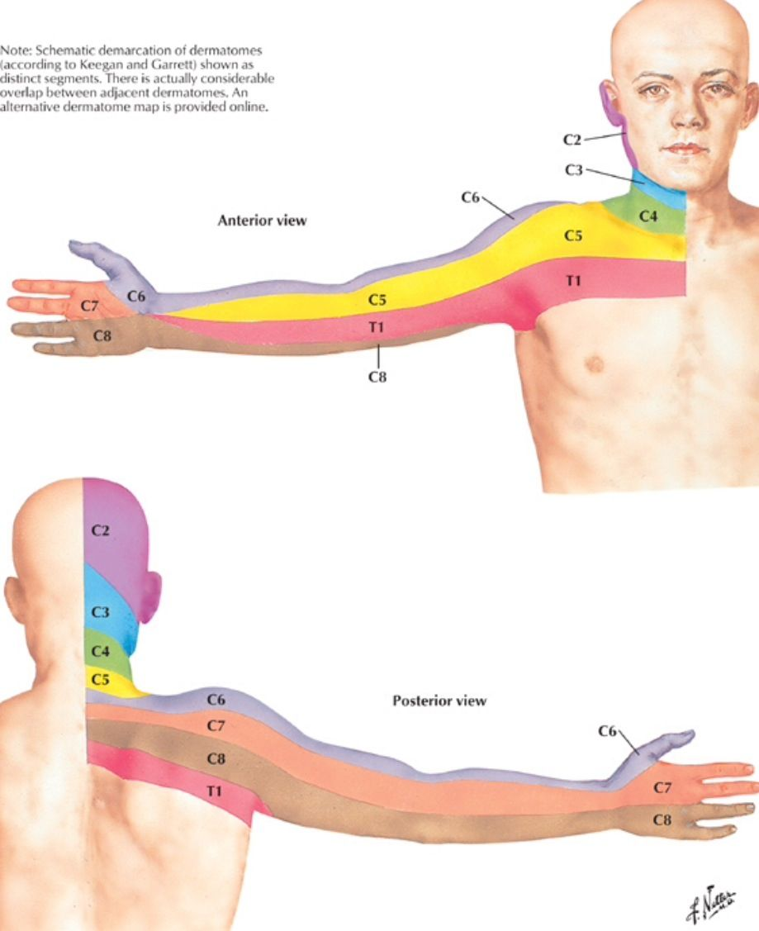

Slide 14
vessels

Slide 15
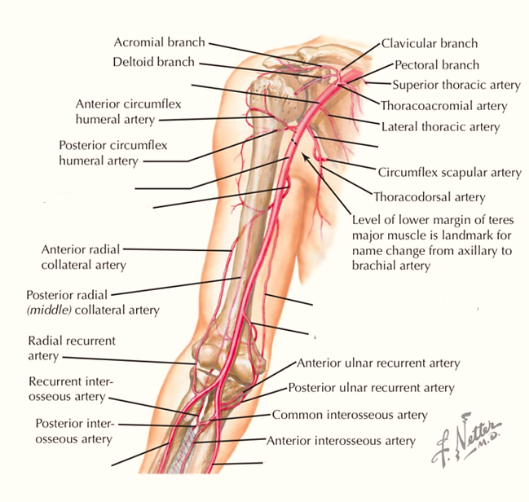
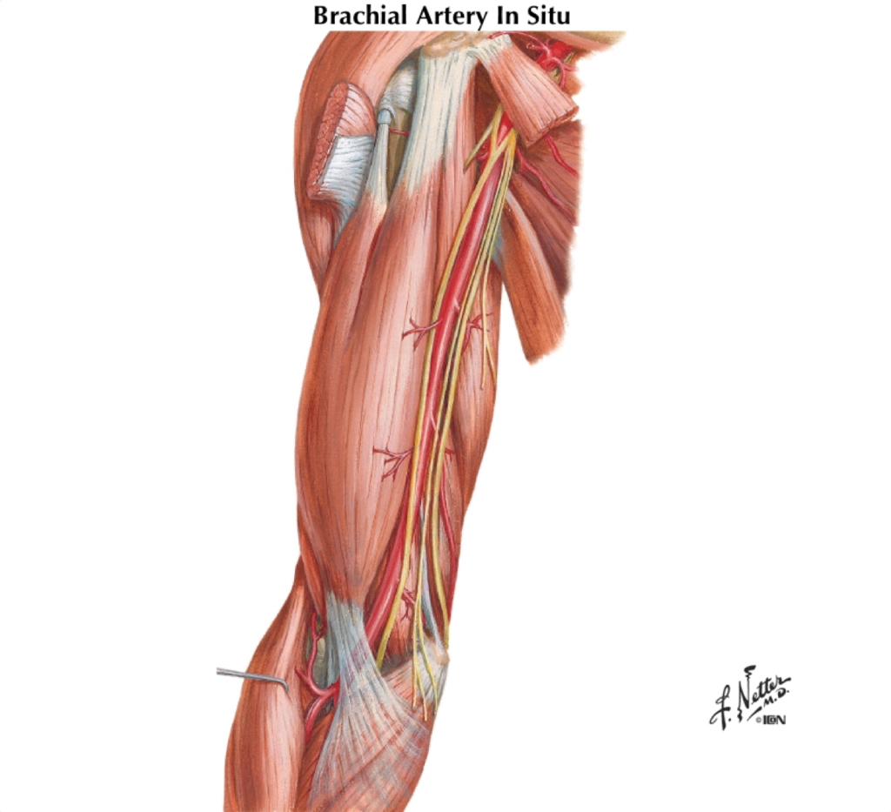
Brachial artery

Slide 16
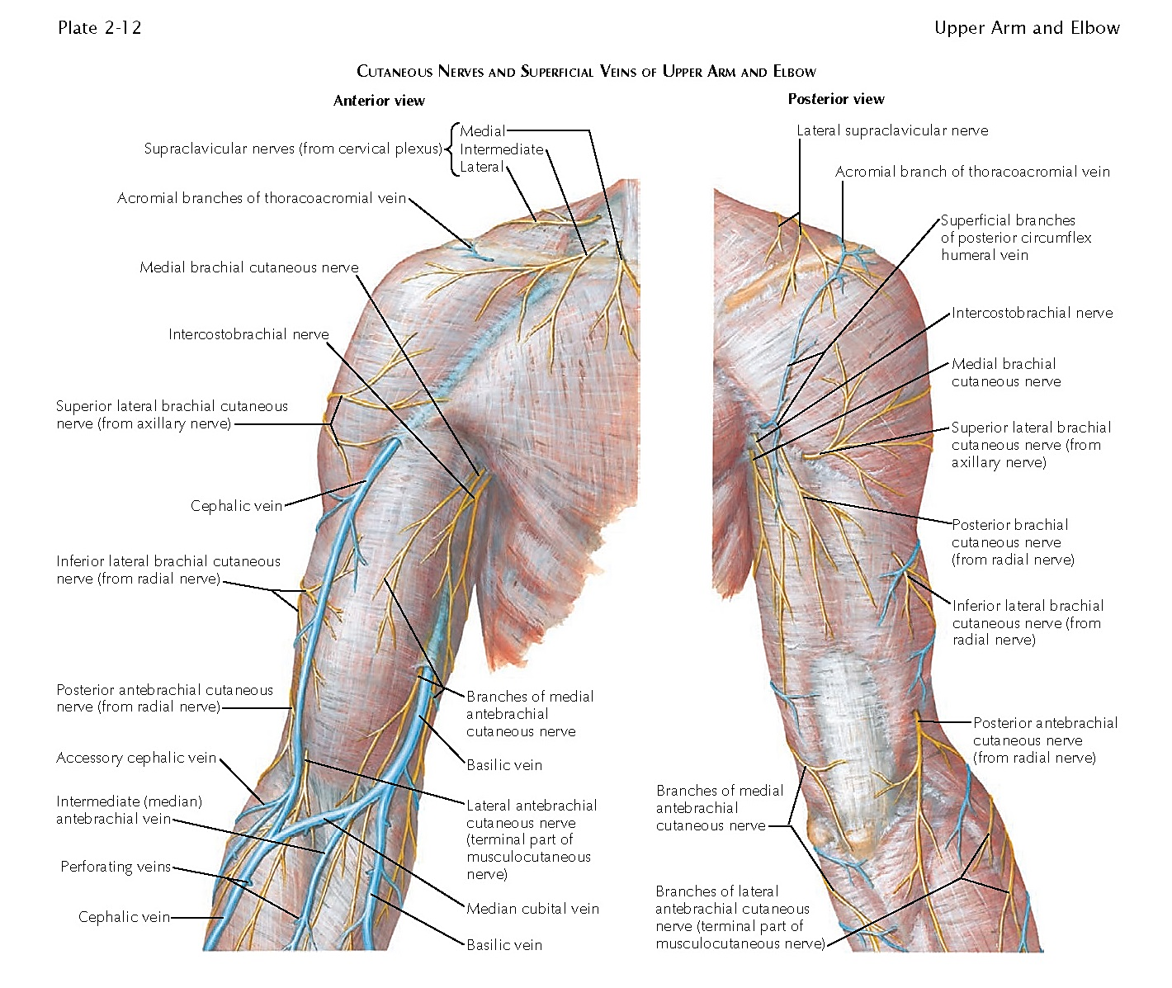
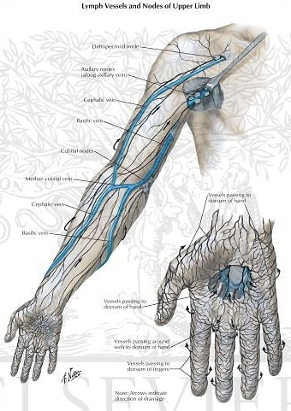

Slide 17
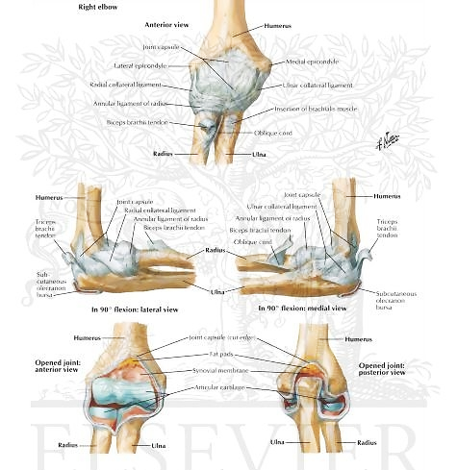
Elbow joint

Slide 18
To sum it up
What are the ligaments of the glenohumeral joints?
What neurovascular structures are at risk in a fracture of the humerus surgical neck?
What is the origin of the long head of the biceps brachii?
What innervates the median nerve in the arm?
Which muscles make up the rotator cuff?
What are the branches of the 2nd part of the brachial artery?
What vein runs along the deltopectoral (or thoracodeltoid) sulcus?

Slide 20
T h a n k y o u !!!

