Slide 1
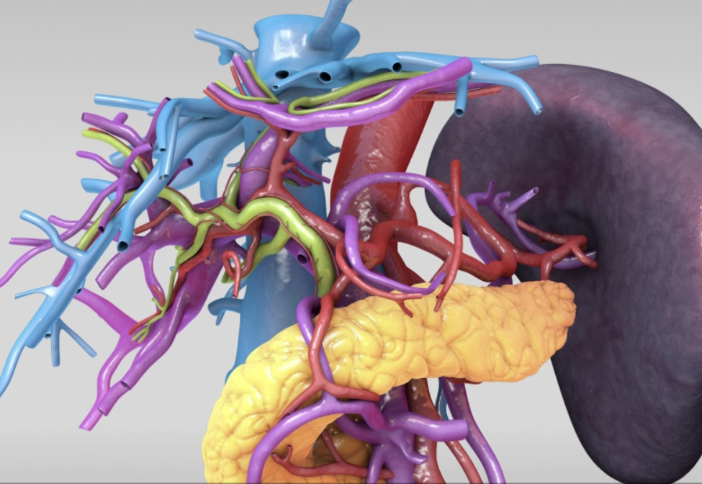
Anatomy of the Appendix
Athanasios Tampakis, MD, Dr med, PhD, Post Doc
General Surgeon
Lecturer and Attending Surgeon
University Hospital of Basel, Switzerland

Slide 2
Topography of the abdomen
Prometheus LernAtlas der Anatomie

Slide 3
Peritoneum
www.youtube.com Taim Talks med

Slide 4
Peritoneum
www.youtube.com Taim Talks med

Slide 5
Peritoneum
www.youtube.com Taim Talks med

Slide 6
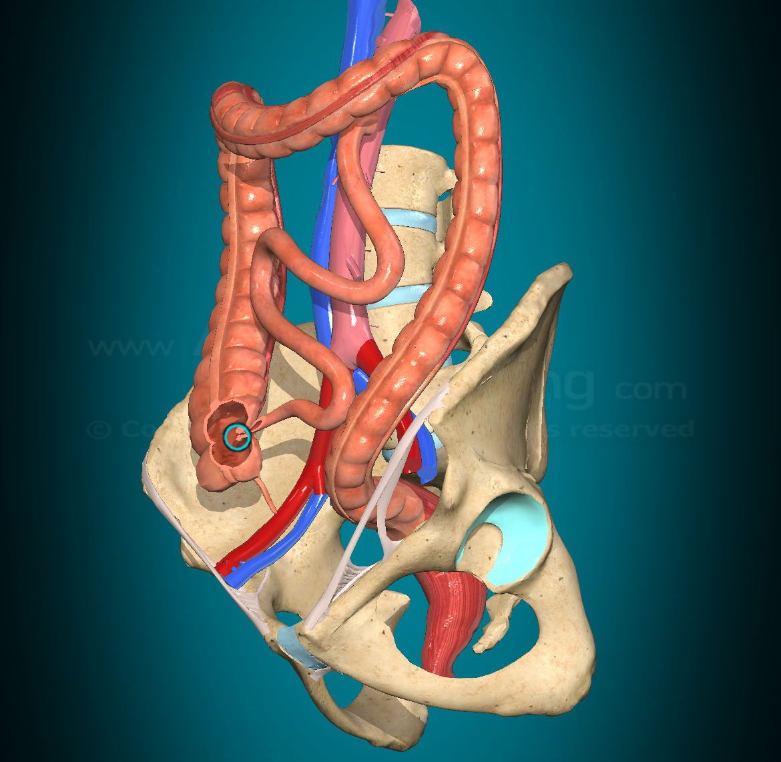
Appendix Vermiformis
Vermiform Appendix
Attached dorsomedially to the end of the cecum
Intraperitoneally
develops embryonically from the caecum.
average length of 9 cm (range 2 cm to 20 cm)
up to 6 mm wide.
Netter`s Surgical Anatomy and Approaches, 2020
Keith L. Moore, Clinically Oriented Anatomy, 8th Edition, 2017

Slide 7
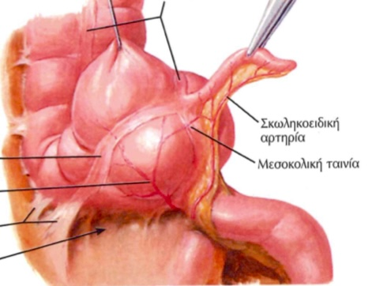
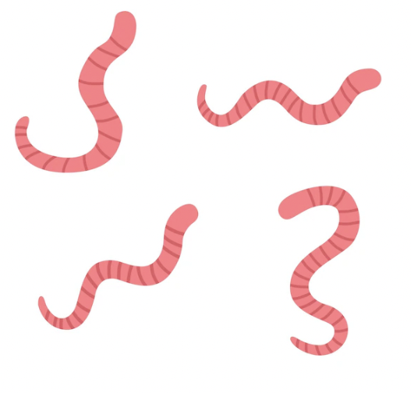
Appendix Vermiformis
Vermiform=worm shaped
Netter`s Surgical Anatomy and Approaches, 2020
Keith L. Moore, Clinically Oriented Anatomy, 8th Edition, 2017

Slide 8
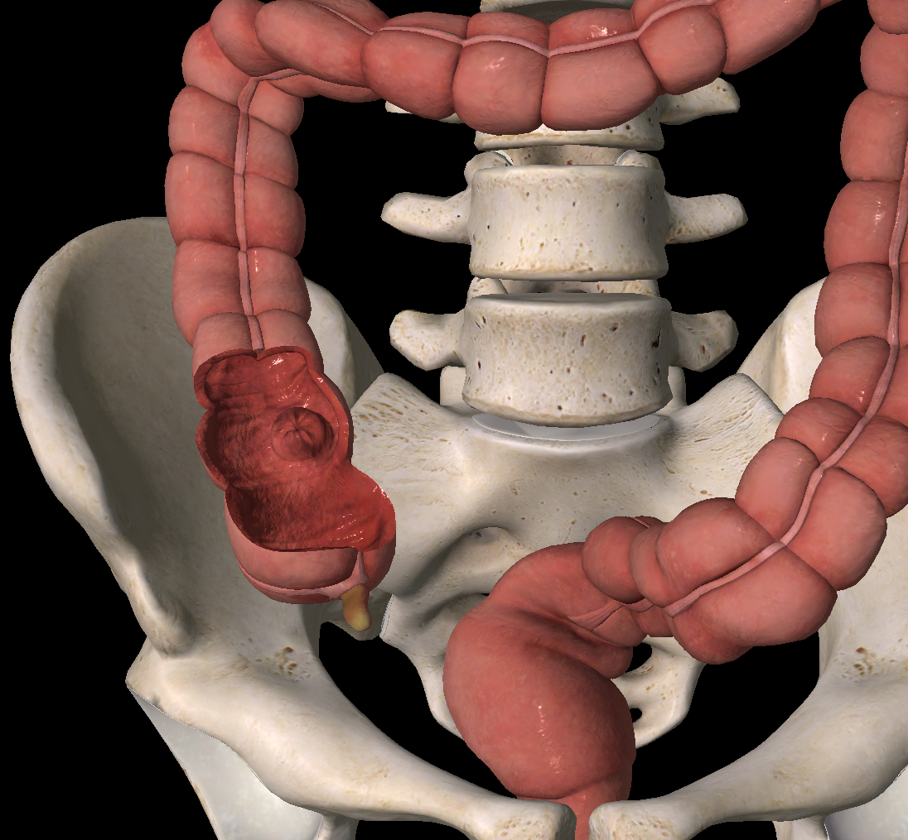
Appendix Vermiformis
Lacks taeniae, semilunar folds, appendices epiploicae
Netter`s Surgical Anatomy and Approaches, 2020
Keith L. Moore, Clinically Oriented Anatomy, 8th Edition, 2017

Slide 9
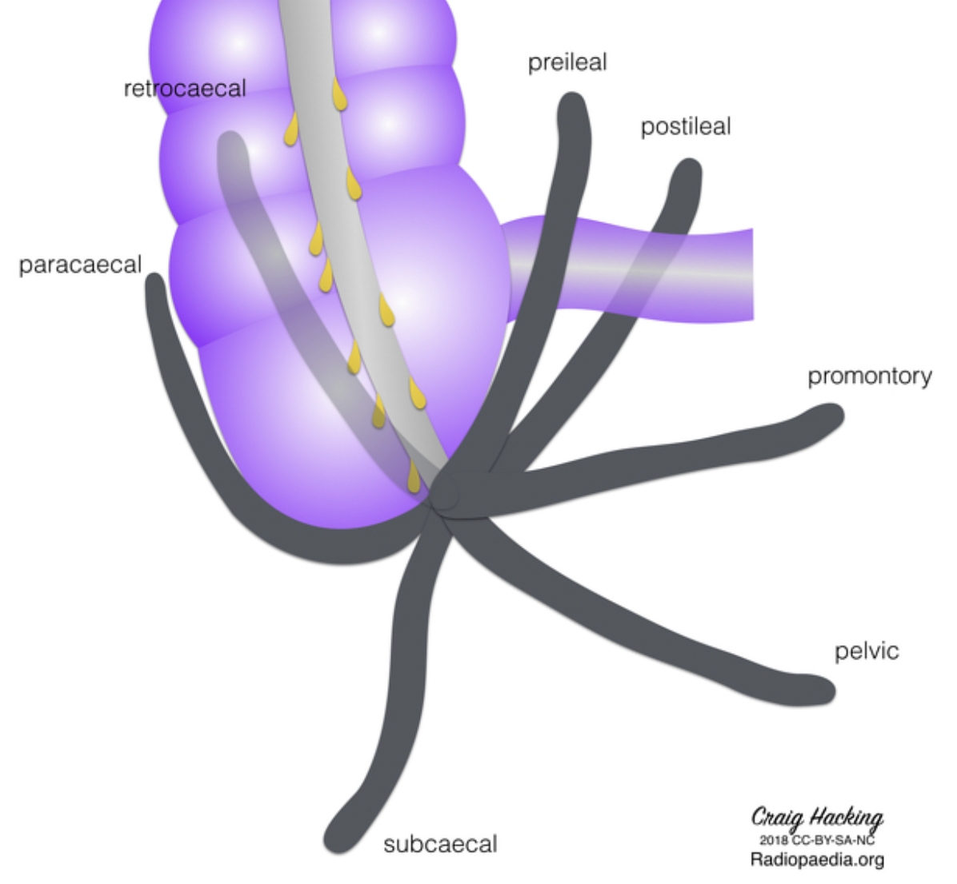
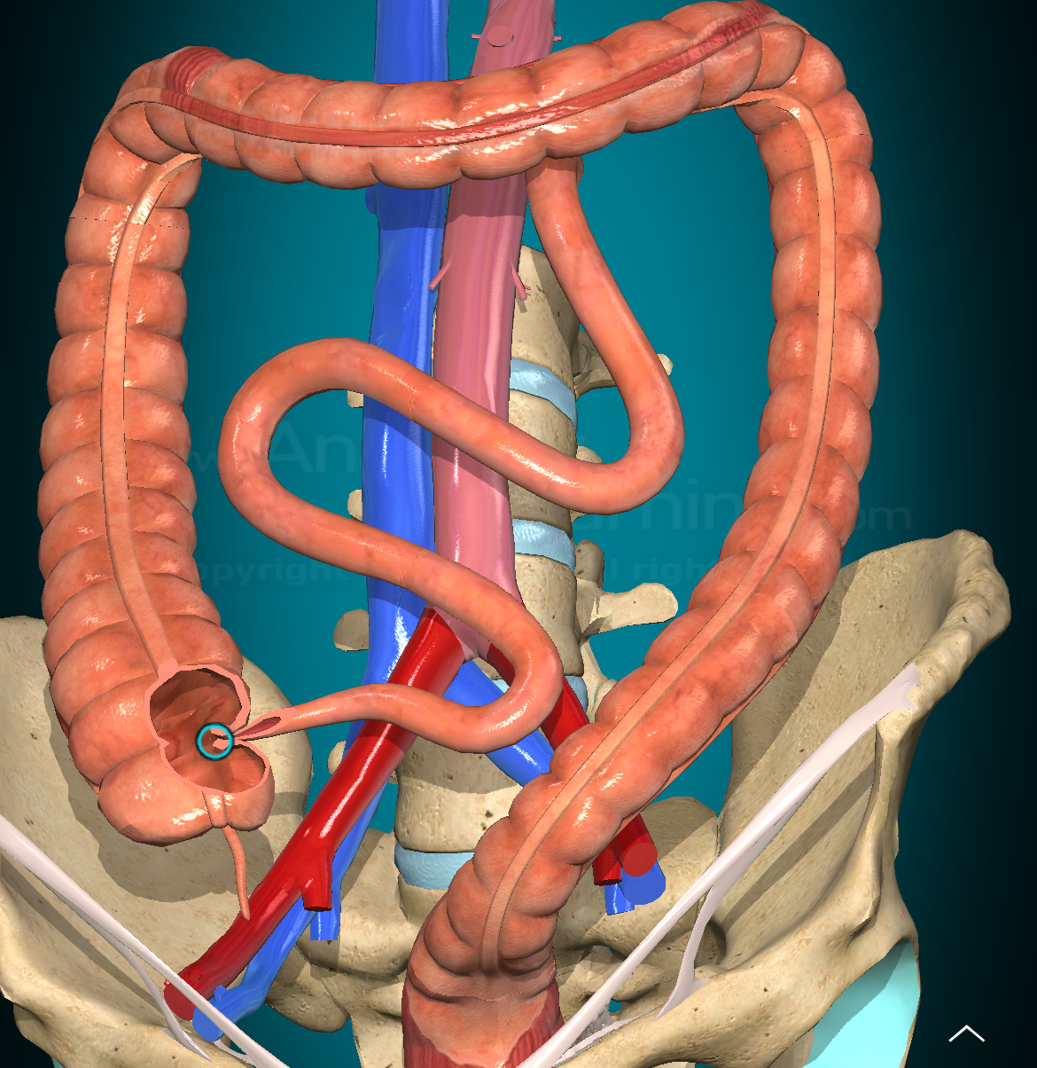
Appendix-Locations
Most common positions
Pelvic
Promontory
Retroileal
Preileal
Retrocecal
Paracaecal
Subcaecal
Radiopedia
Ghorbani et al. Anat Res Int 2014

Slide 10
Appendix-Anatomic Relationships
Most common positions
Pelvic (iliac vessels, sigmoid colon)
Promontory (iliac vessels, sigmoid colon)
Retroileal (mesentery)
Preileal (cecum)
Retrocecal (psoas muscle)
Paracaecal (lateral abdominal wall)
Subcaecal (lateral abdominal wall, iliac vessels)
Radiopedia
Ghorbani et al. Anat Res Int 2014

Slide 11
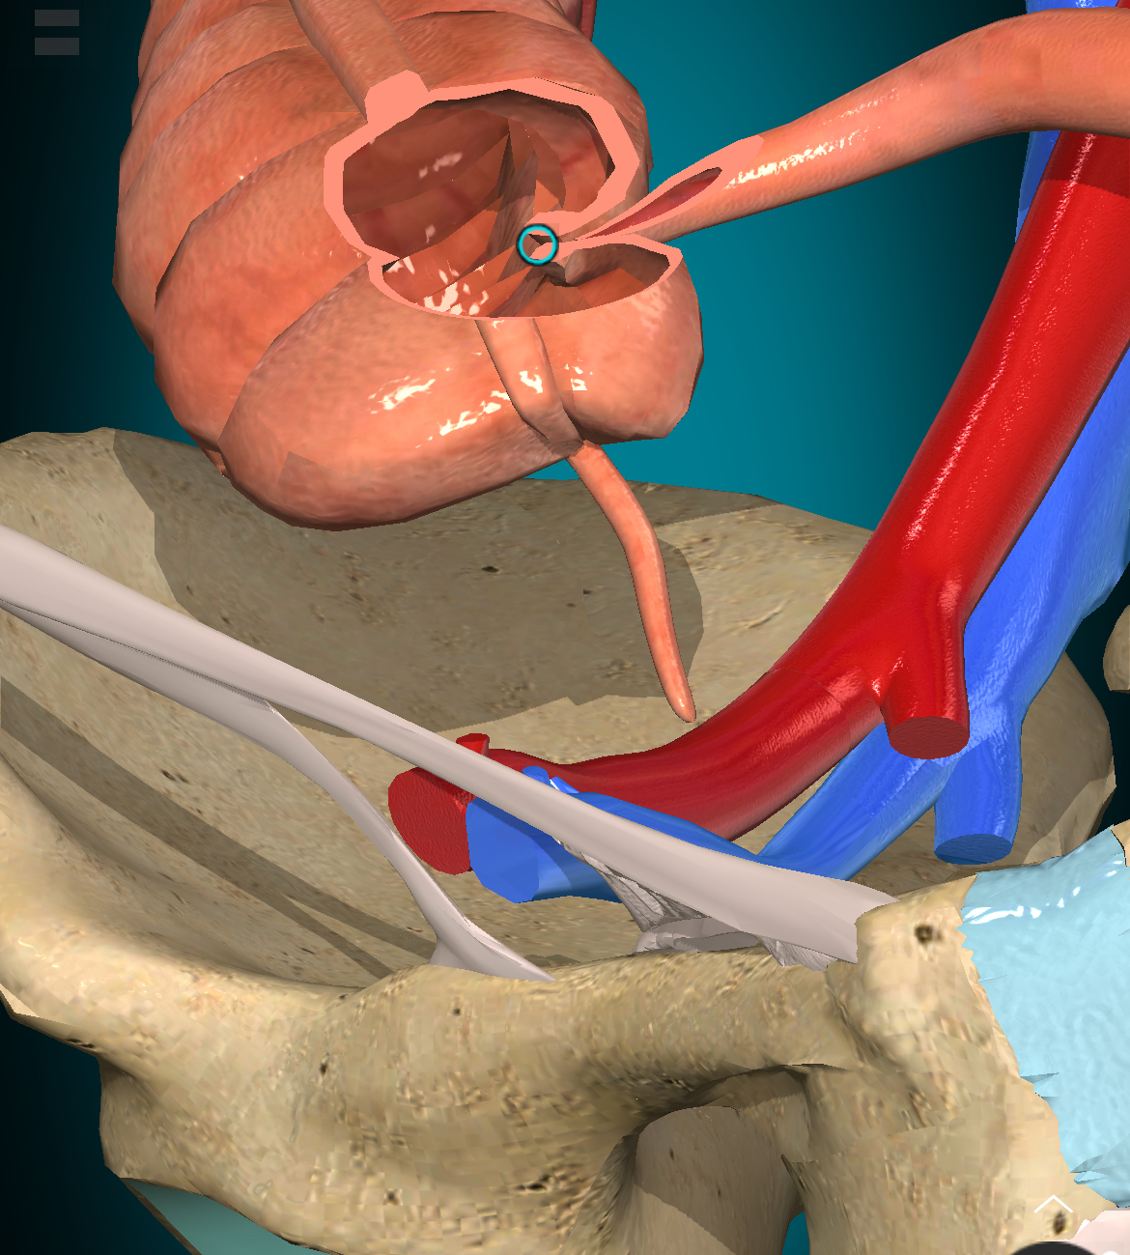
Appendix-Length
Mean length
Men 91,2mm
Women 80,3mm
Netter`s Surgical Anatomy and Approaches, 2020
Keith L. Moore, Clinically Oriented Anatomy, 8th Edition, 2017

Slide 12
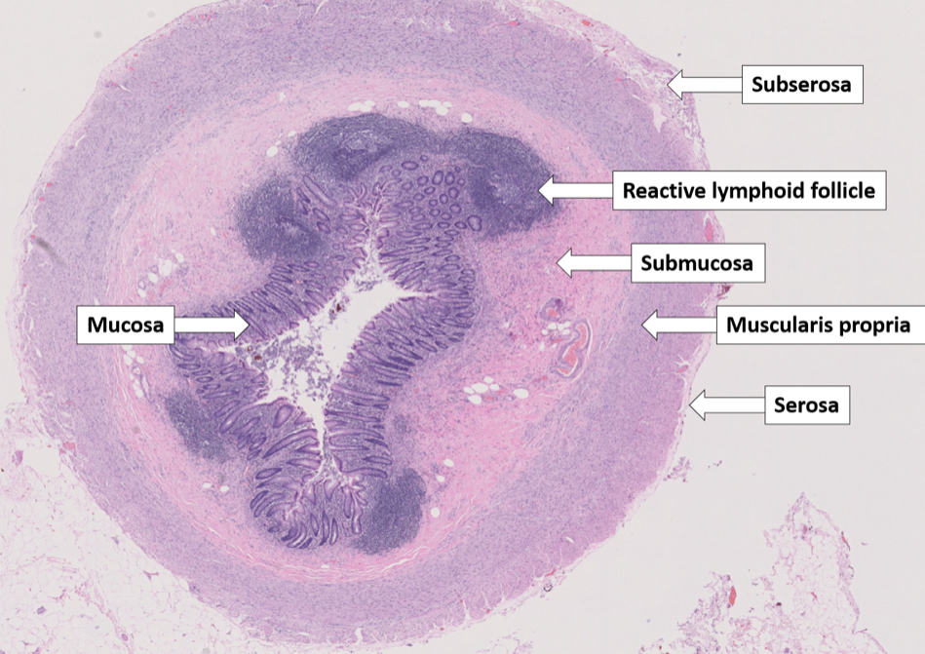
Appendix Histology
Mucosa lined with single-layered columnar epithelium
Submucosa /lymph follicles and parafollicular tissue
Muscularis
Serosa
Netter`s Surgical Anatomy and Approaches, 2020
Keith L. Moore, Clinically Oriented Anatomy, 8th Edition, 2017

Slide 13
Appendix-Role
Unkown
Part of the GALT (gut-associated lymphatic tissue)
Fulfills immunological functions.
It is assumed that it serves as a “safe house” for enterobacteria (e.g. in case of diarrhea)
Netter`s Surgical Anatomy and Approaches, 2020
Keith L. Moore, Clinically Oriented Anatomy, 8th Edition, 2017

Slide 14
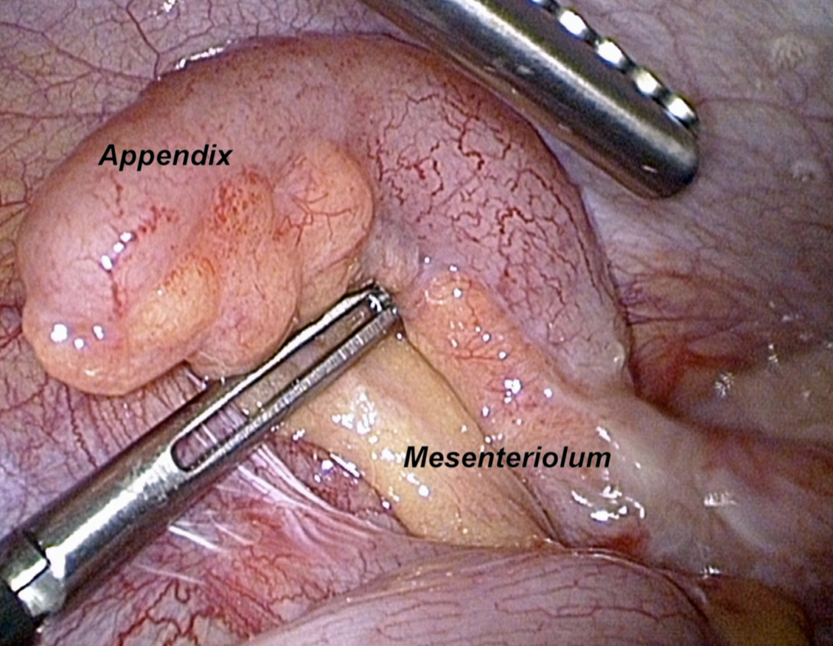
Appendix-Mesenteriolum
Mesenteriolum: Mesentery of the Appendix
Netter`s Surgical Anatomy and Approaches, 2020
Keith L. Moore, Clinically Oriented Anatomy, 8th Edition, 2017

Slide 15
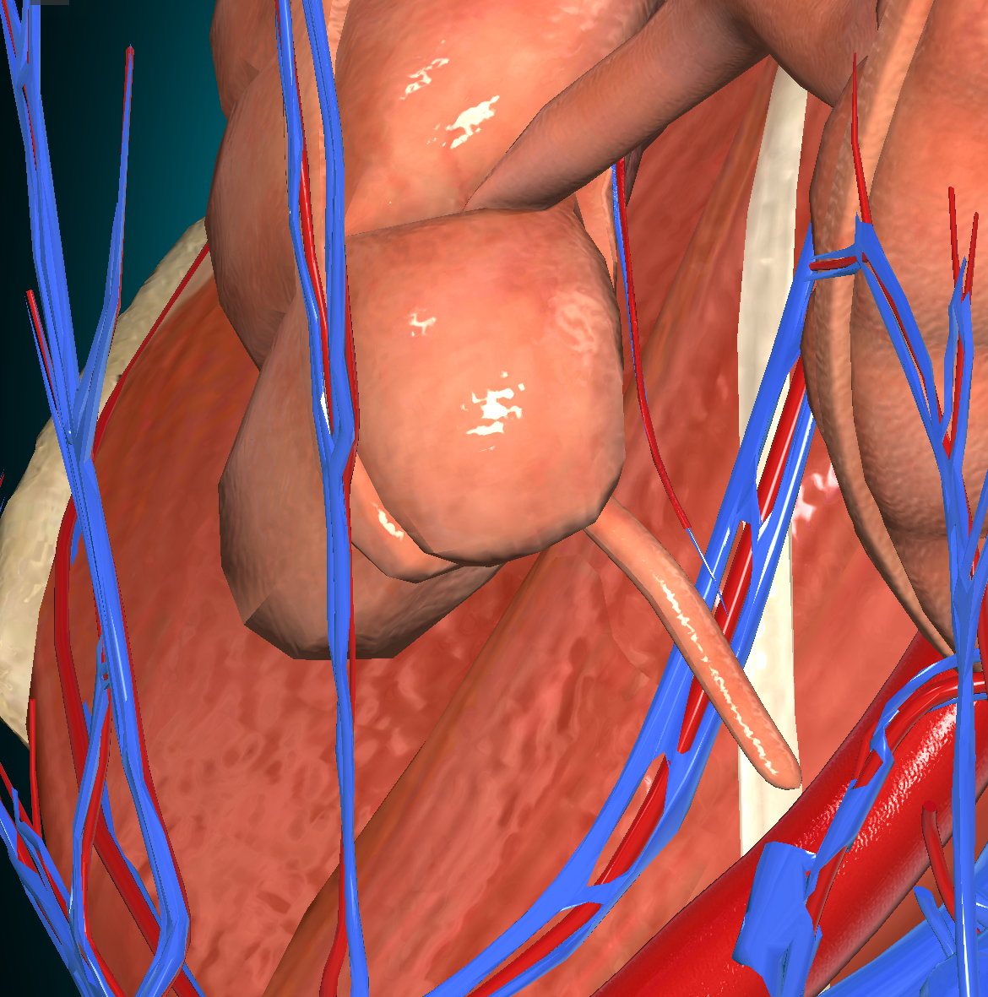
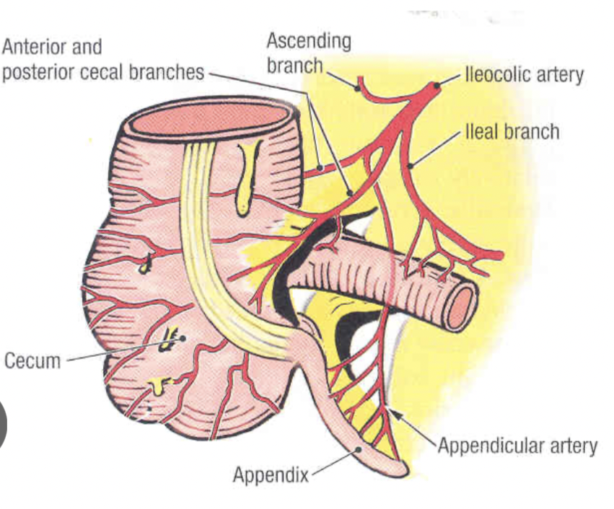
Appendix-Blood supply
Appendicular artery and vein
Branches of the ileocolic artery or anterior and posterior cecal branches
Netter`s Surgical Anatomy and Approaches, 2020
Keith L. Moore, Clinically Oriented Anatomy, 8th Edition, 2017

Slide 16
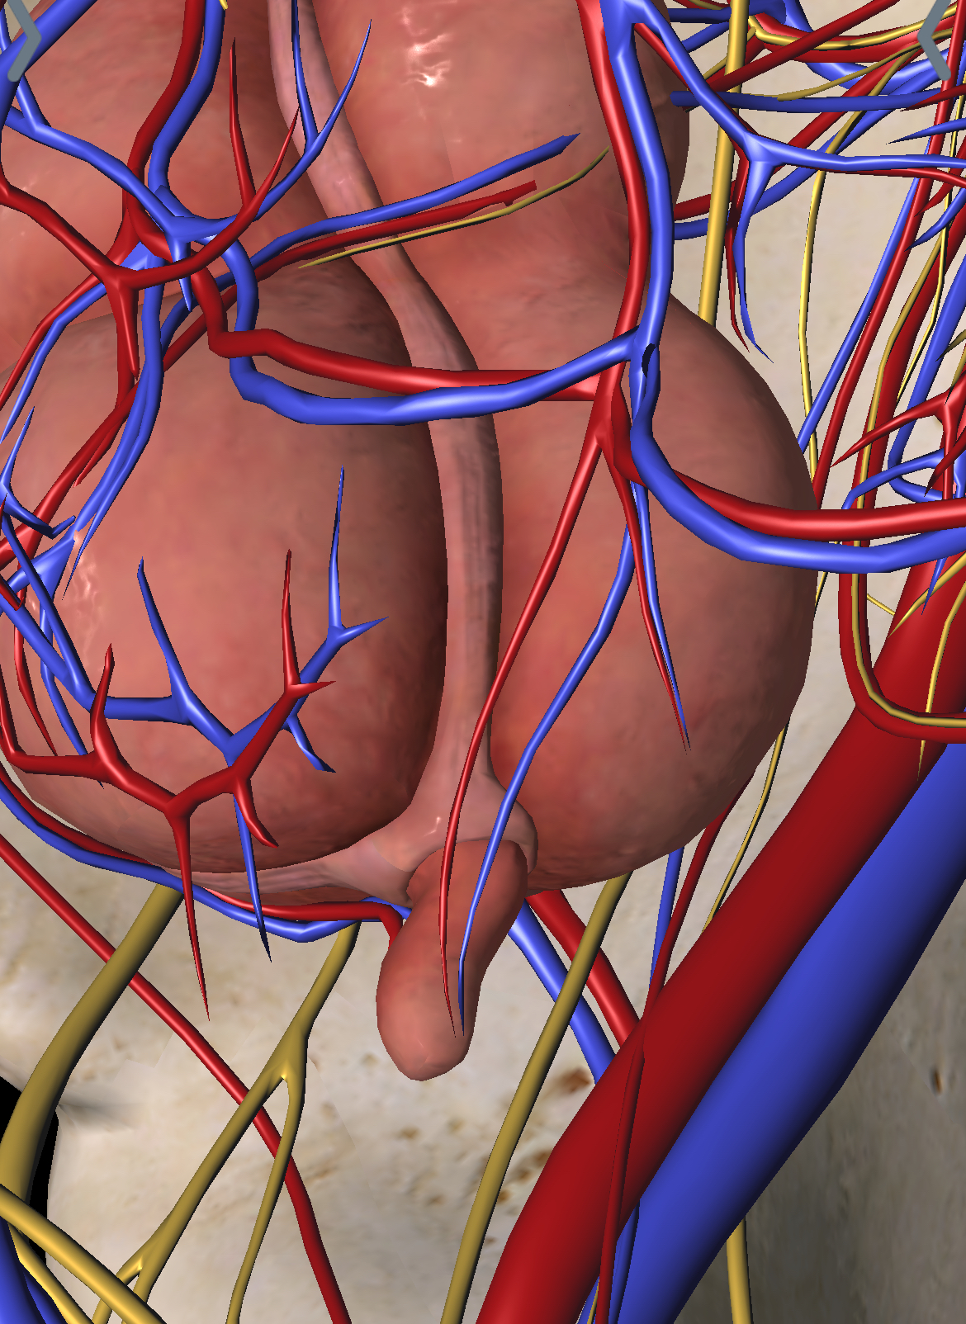
Appendix-Innervation
Sympathetic Nerve Supply, which carries the pain sensations from the appendix, is originated from the T10 spinal section via lesser splanchnic nerve and superior mesenteric plexus. Because of this, the pain of appendicitis is referred to the umbilical region.
The parasympathetic Nerve Supply is originated from both vagus nerves.
Netter`s Surgical Anatomy and Approaches, 2020
Keith L. Moore, Clinically Oriented Anatomy, 8th Edition, 2017

Slide 17
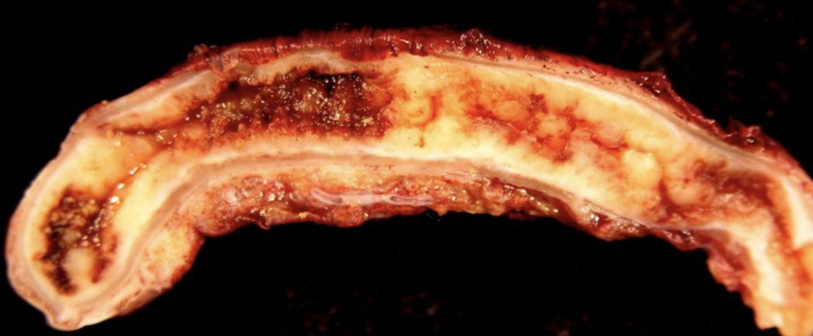
Appendicitis
Appendicitis is an acute inflammation of the appendix.
due to a blockage in the appendix lumen by
faecolith (mass of hard faeces)
lymphatic hyperplasia
Netter`s Surgical Anatomy and Approaches, 2020
Keith L. Moore, Clinically Oriented Anatomy, 8th Edition, 2017

Slide 18
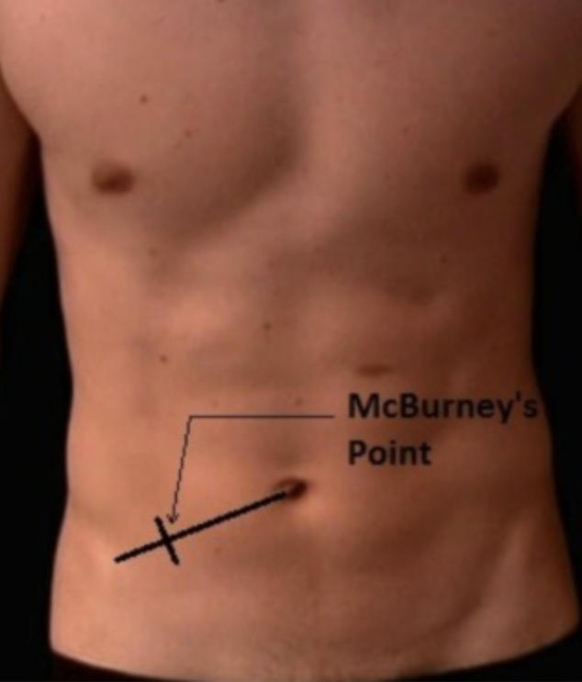
Appendicitis-McBurney`s sign
Mc Burney`s sign: McBurney's sign involves tenderness with palpation of McBurney's point, which is located at one-third of the distance from the anterior superior iliac spine to the umbilicus. McBurney's point is commonly the location of the base of the appendix
Netter`s Surgical Anatomy and Approaches, 2020
Keith L. Moore, Clinically Oriented Anatomy, 8th Edition, 2017

Slide 19
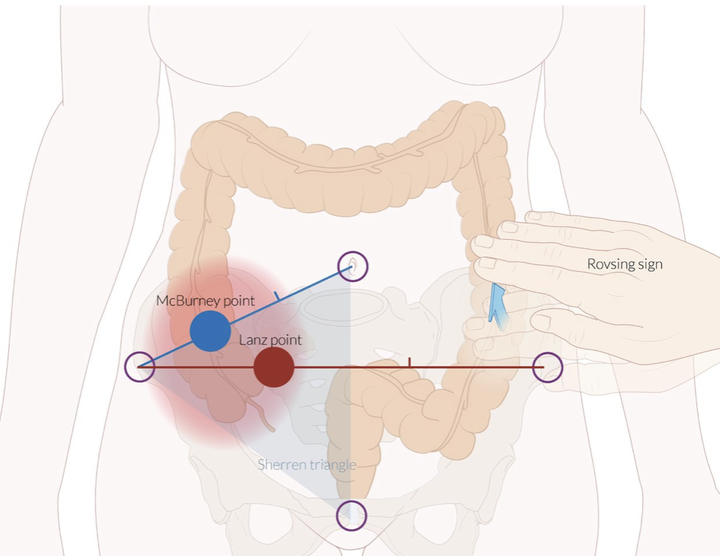
Appendicitis-Lanz sign
Lanz sign: tenderness at the Lanz point→at the end of the right third of the line connecting the right and left spina iliaca anterior superior
Netter`s Surgical Anatomy and Approaches, 2020
Keith L. Moore, Clinically Oriented Anatomy, 8th Edition, 2017

Slide 20
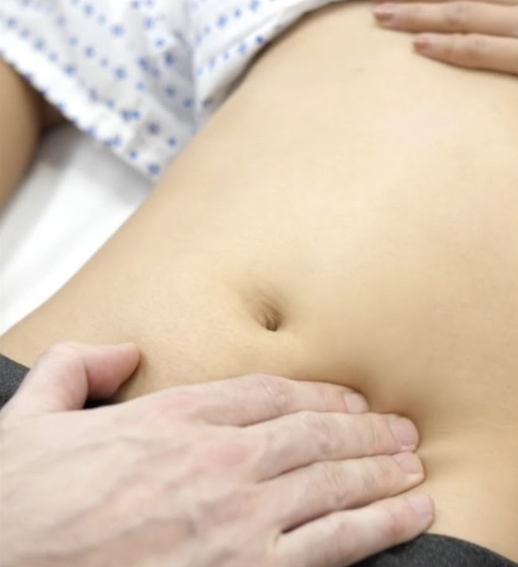
Appendicitis-Rovsing sign
Rovsing’s sign: On palpation you apply pressure to the left lower quadrant (left iliac fossa) on the abdomen, this will in turn elicit pain in the right lower quadrant (right iliac fossa). This due to bringing the swollen appendix against the peritoneal wall which elicits the irritative painful response. This sign occurs due to referred pain as the pain nerve fibres, which run deep in the gut
Netter`s Surgical Anatomy and Approaches, 2020
Keith L. Moore, Clinically Oriented Anatomy, 8th Edition, 2017

Slide 21
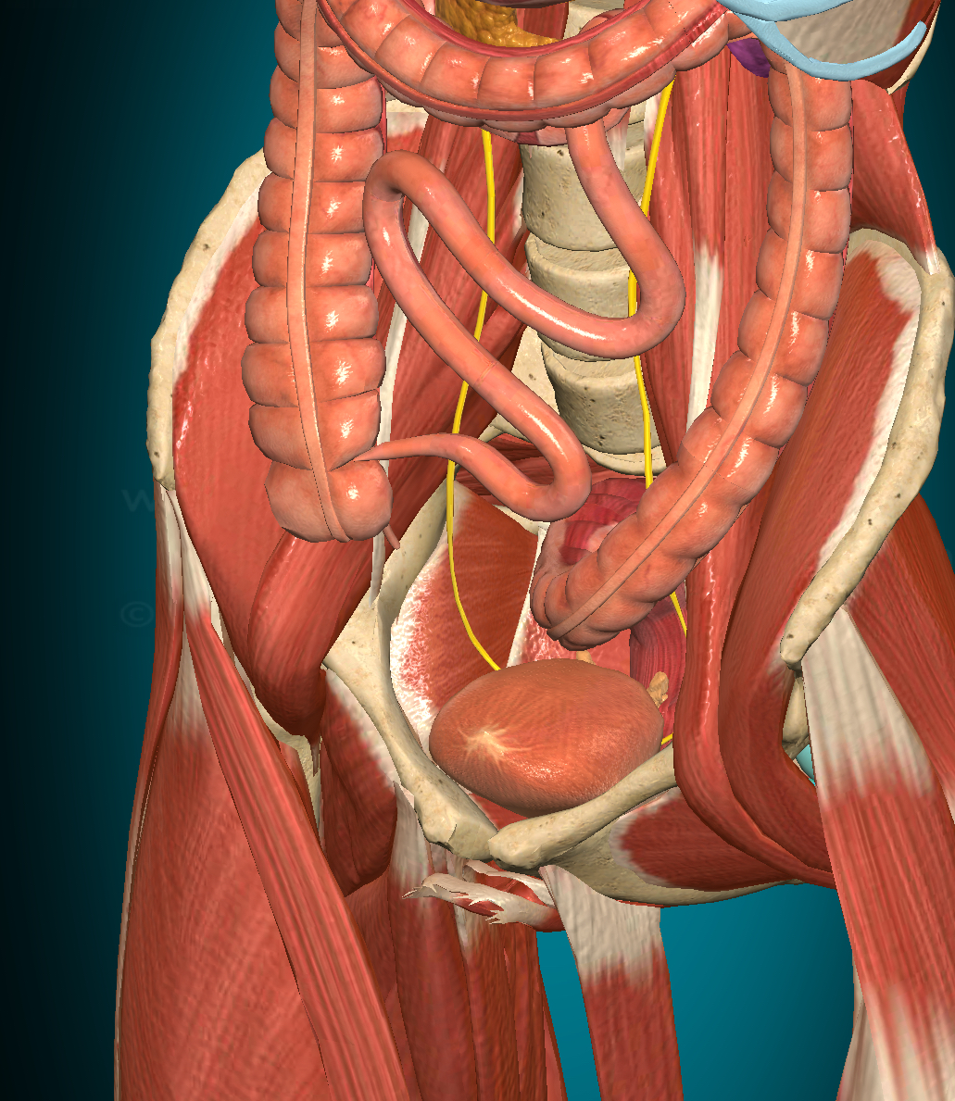
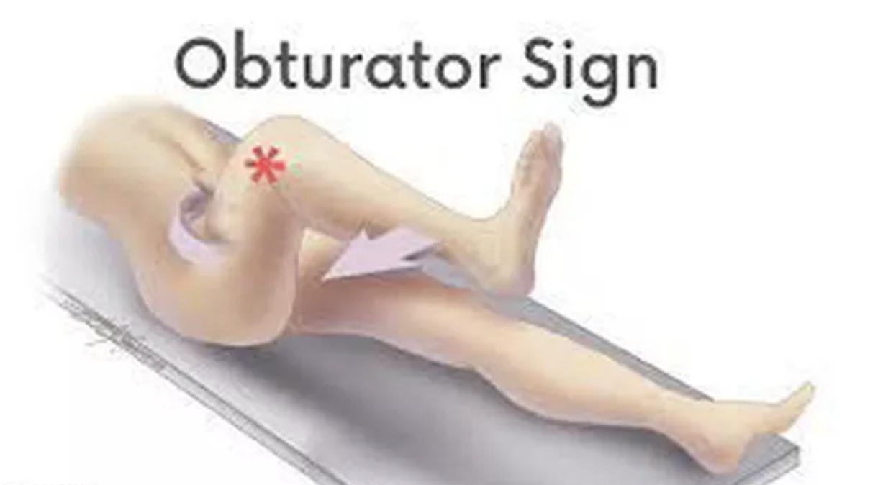
Appendicitis-Obturator`s sign
Obturator sign: The right hip is internally rotated and flexed which will elicit pain in the right lower quadrant (right iliac fossa) on the abdomen. This is an indicator of irritation of the Obturator internus muscle, if the inflamed appendix is in contact with the muscle.
Netter`s Surgical Anatomy and Approaches, 2020
Keith L. Moore, Clinically Oriented Anatomy, 8th Edition, 2017

Slide 22
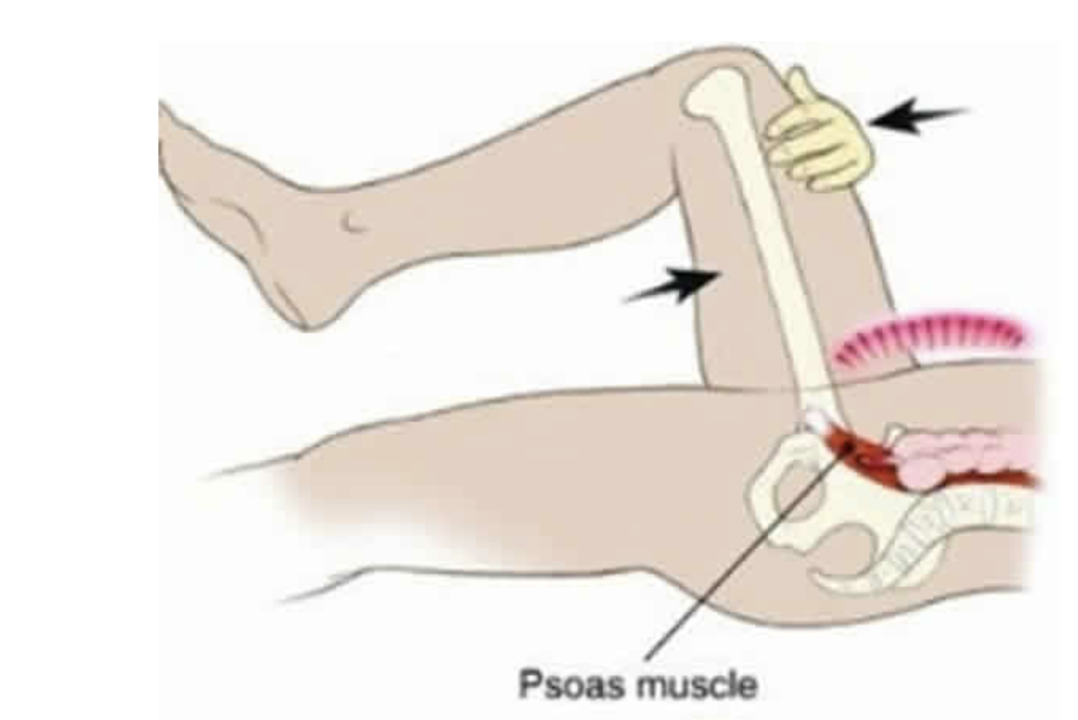
Appendicitis-Psoas sign
Psoas sign: To elicit this sign the patient needs to lie in the left lateral position then the right thigh is passively extended and raised which elicits pain in the right lower quadrant (right iliac fossa). A retrocaecal appendix, that is inflamed, will cause irritation to the iliopsoas group of muscles, which are retroperitoneal. The second technique is to ask the supine patient to actively flex their hips, which also elicits the painful stimulus.
Netter`s Surgical Anatomy and Approaches, 2020
Keith L. Moore, Clinically Oriented Anatomy, 8th Edition, 2017

Slide 23
Appendicitis-Videos
https://www.youtube.com/watch?v=MAppEy9Umcg
https://www.youtube.com/results?search_query=appendectomy
Netter`s Surgical Anatomy and Approaches, 2020
Keith L. Moore, Clinically Oriented Anatomy, 8th Edition, 2017

