Slide 1



ANATOMY OF THE MALE GENITAL SYSTEM
Dimosthenis Chrysikos
Surgeon
Assistant Professor
Department of Anatomy, School of Medicine, NKUA

Slide 2
Male Anatomy
Primary Organ
– testes, genetically determined in mammals
- testis releases hormones that then control the development of secondary sex characteristics
Secondary Organs
  internal duct system
    e.g., vas deferens, epididymus
  external genitalia
Secondary Sexual Characters
  e.g., antlers, coloration, facial hair

Slide 3
The male genital system consists of the following genital organs
:
Testis
Ejaculatory duct
Epididymis
Prostate
Ductus deferens (vas)
Bulbourethral gland
Spermatic cord
Male urethra
Scrotum
Penis
Seminal vesicle

Slide 4
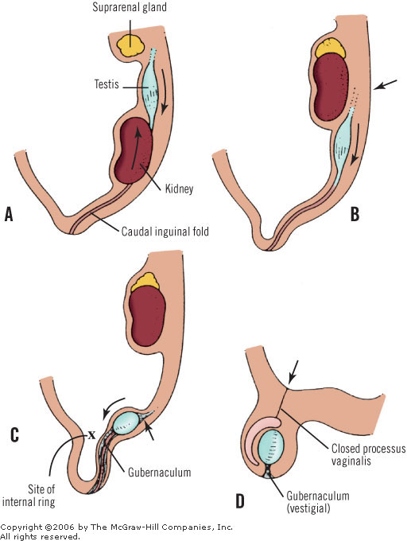
DESCENT OF THE GONADS

Slide 5
5TH WEEK
The testis that has not begun its descent is, together with the epididymis, attached to the posterior abdominal wall by a mesorchium that contains the blood vessels and the ductus deferens. It may lie at the level of the lower pole of the kidney, the iliac fossa, or in the pelvis

Slide 6
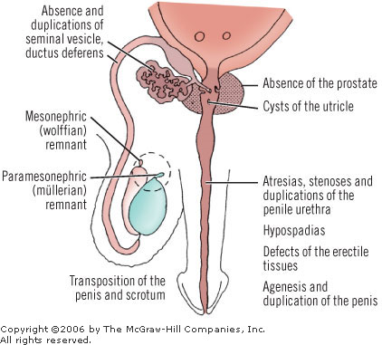

Slide 7
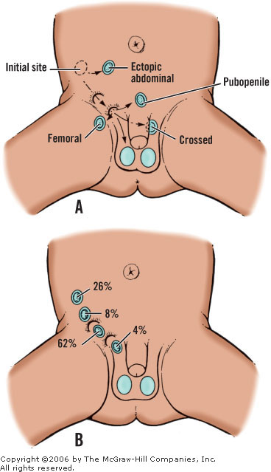
UNDESCENDED TESTIS

Slide 8
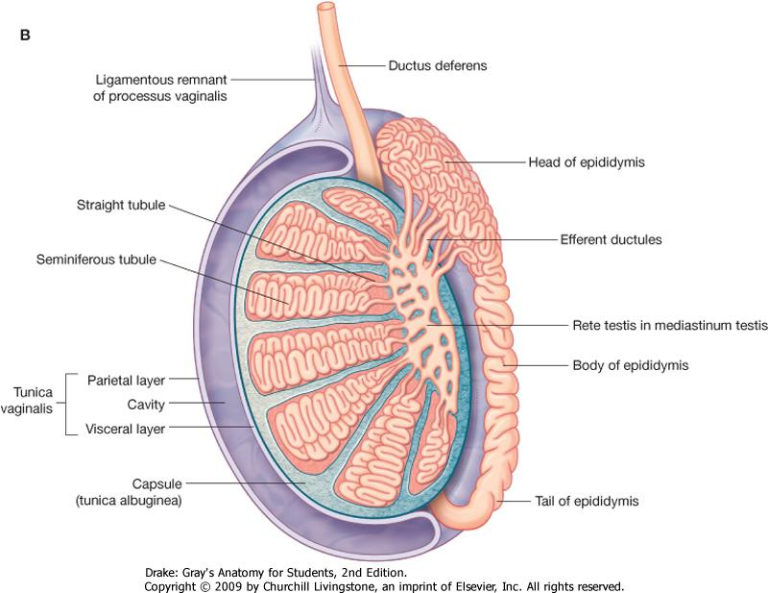
TESTES
Tunica albuginea
Seminiferous tubules
Rete testis
Head of epididymis
Body of epididymis
Tail of epididymis

Slide 9
Malignancy
There is definitely an increased incidence of malignancy in cryptorchid testes. It appears that an undescended testis is thirty-five times more likely to be found in those with testicular tumors than in the general male population

Slide 10
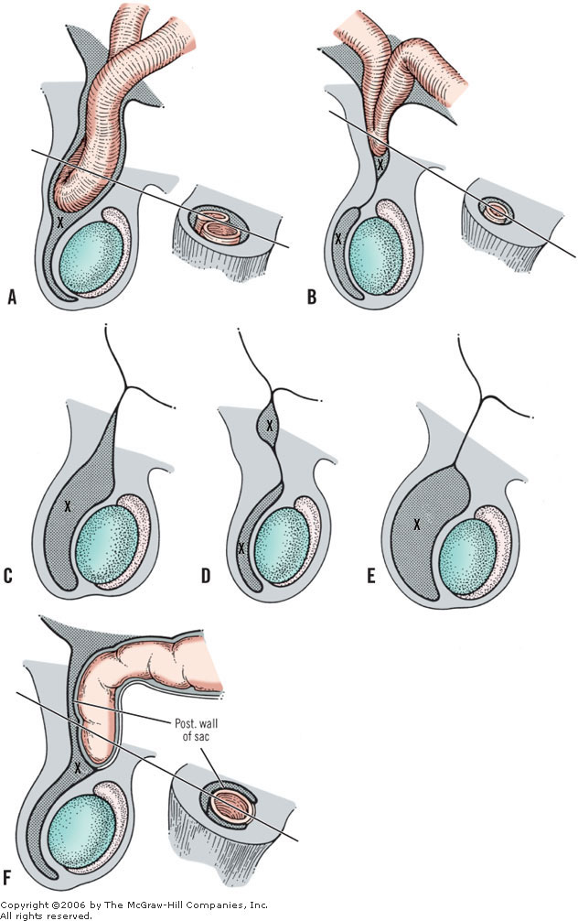
Defects of closure of processus vaginalis

Slide 11
Processus Vaginalis
The proximal part of the processus vaginalis (from the peritoneal cavity to the testis) closes after descent is complete. Closure is complete by birth in 50% to 75% of infants. Scorer believed that this closure may be recognized by palpating the spermatic cord shortly after birth.

Slide 12
testis
The normally descended testis is ovoid and about 4 cm in length. The tunica vaginalis of peritoneum envelops the whole testis except its posterior border and its superior pole.
The testis itself is surrounded by a dense, irregular connective-tissue capsule, the tunica albuginea. Posteriorly, the tunica forms a median septum, the mediastinum testis, from which more delicate connective tissue divides the parenchyma into 200 to 300 compartments that contain the seminiferous tubules. These coiled tubules anastomose in the mediastinum of testis to form the rete testis, from which 6 to 12 ductuli efferentia pass to the head of the epididymis.
The testis has two free surfaces, the medial and the lateral, and two borders, the anterior and the posterior. The posterior border has a superior portion that is related to the head of the epididymis, and an inferior portion that is related to the body and tail of the epididymis.
The right testicle, in most cases, is at a higher level than the left. Occasionally, the right testicle is lower in total situs inversus, and, according to Chang et al.,37 in left-handed men. For medicolegal reasons, this finding should be reported in the patient's chart.

Slide 13
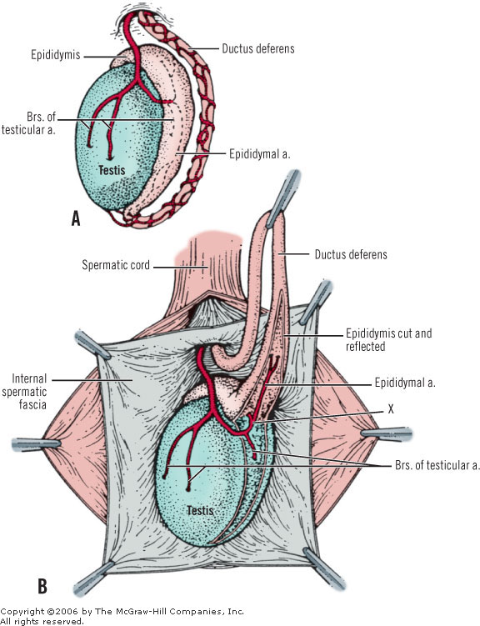

Slide 14
Epididymis
The head of the epididymis is firmly fixed to the upper pole of the testis (Fig. 25-5). The body and the tail are less firmly fixed to the posterior border of the testis. This posterior surface is not covered by the tunica vaginalis, but it is the site of the blood and nerve supply to both organs.

Slide 15
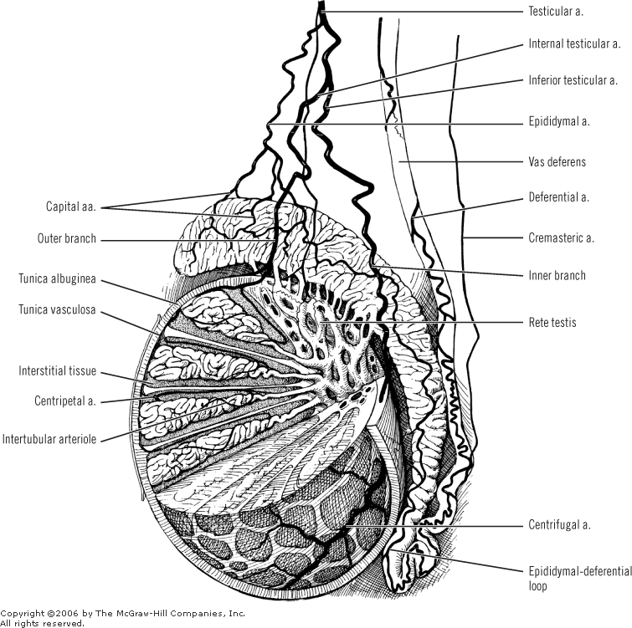
Surgical anatomy and vascular supply of testis

Slide 16
Spermatic cord
The spermatic cord is a matrix of connective tissue continuous proximally with the preperitoneal connective tissue. Concentrically invested by three layers of tissue, the cord contains the ductus deferens (vas), three arteries, three veins, the pampiniform plexus, and two nerves. One other nerve, the ilioinguinal, lies just lateral to the major layers of the cord.
The elements of the spermatic cord relate to each other as follows.
Anterior: pampiniform plexus
Posterior: ductus and remnant of processes vaginalis or hernial sac
These anatomic entities of the spermatic cord, as well as others, are covered by the spermatic fasciae. The spermatic cord on its way to the scrotum may be found deep under the fasciae of Scarpa and Colles.
The components of the spermatic cord are listed in Table 25-3. The key to remember is "three": three layers of fasciae, three arteries, three veins, three nerves, multiple lymphatics, and one ductus.

Slide 17
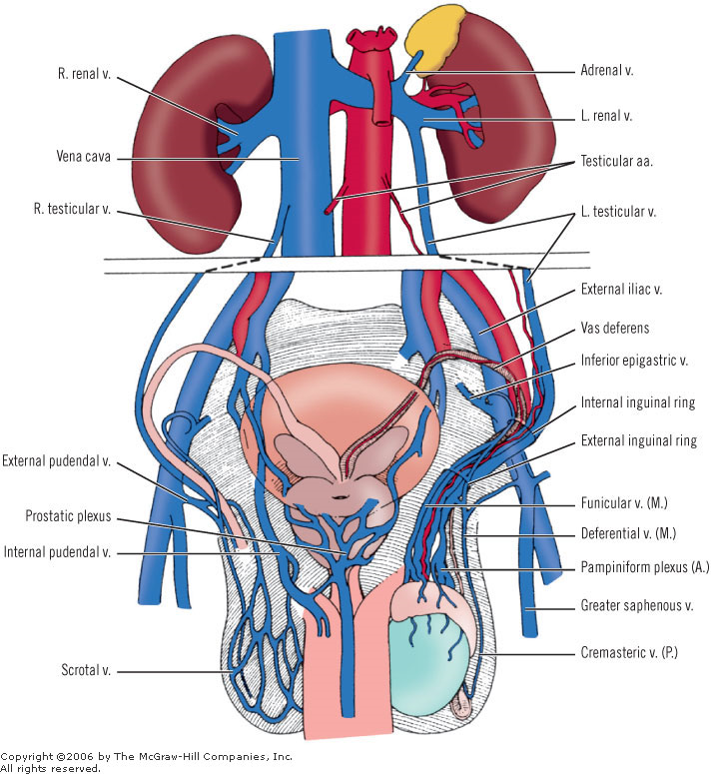
Vena cava and tributaries

Slide 18
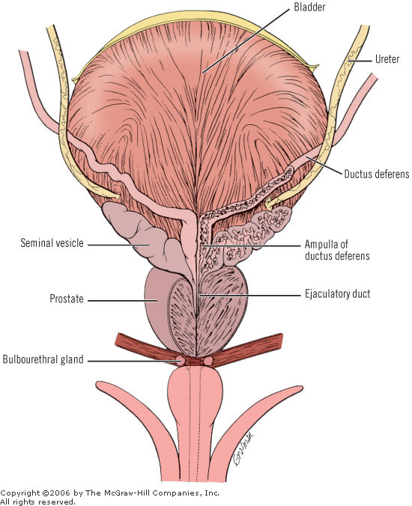
Male urogenital anatomy

Slide 19
VAS DEFERENS
The ductus deferens starts where the epididymal duct (epididymal tail) ends, and terminates at the ejaculatory duct (Fig. 25-12). The ductus has a length of about 45 cm. Characteristically, its tortuous proximal part and almost straight distal part are dilated.

Slide 20
Pathway
The pathway of the ductus is scrotal, inguinal, abdominal, and pelvic.
Within the scrotum, the ductus has an ascending course at the medial side of the epididymis and the posterosuperior area of the testicle.
Within the inguinal canal, the ductus is incorporated into the spermatic cord. It is located posteromedially in the cord, and is surrounded by the venous pampiniform plexus.
At the deep inguinal ring (abdominal), the ductus leaves the cord. It proceeds toward and into the pelvis after looping over the inferior epigastric artery and in front of the external iliac artery and vein. In the pelvis, the ductus descends from the pelvic sidewall with its deferential arterial supply, supported by a delicate mesentery.

Slide 21
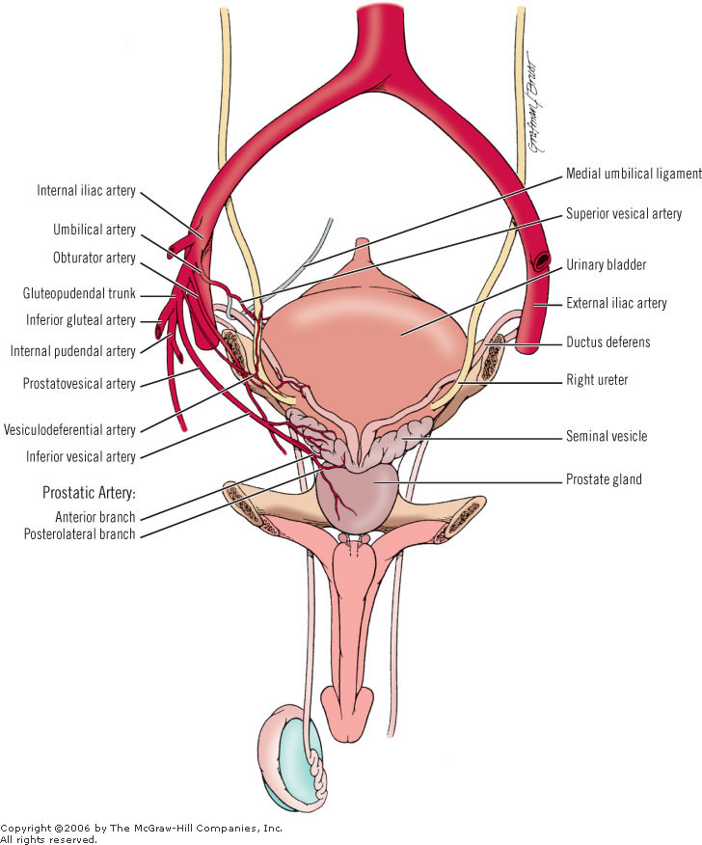
Relations and vasculature of prostate, seminal vesicles, and ductus deferens

Slide 22
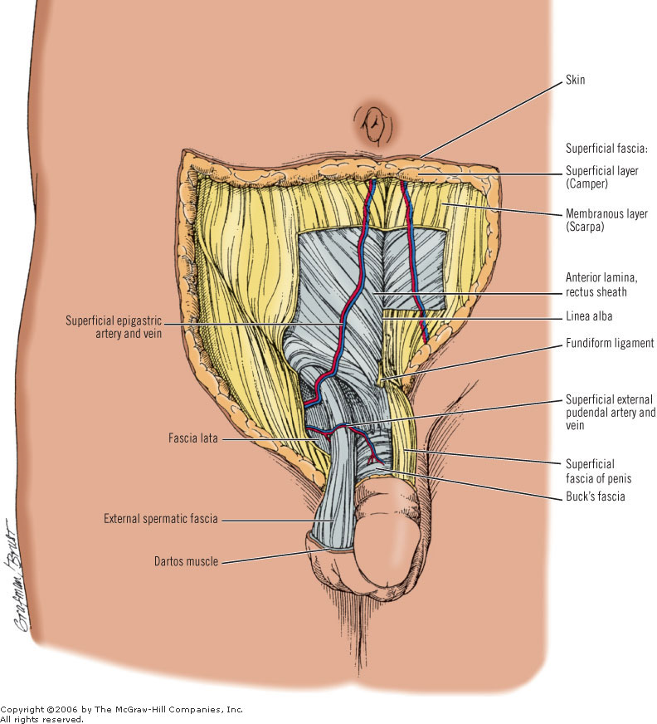
SPERMATIC
CORD

Slide 23
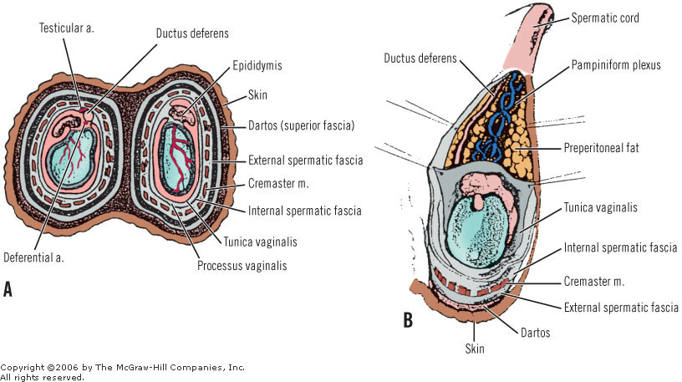
SCROTUM LAYERS

Slide 24
Layers of the Scrotum
Scrotal Skin (Layer 1)
Dartos (Layer 2)
External Spermatic Fascia (Layer 3)
Cremaster Muscle (Layers 4 and 5)
Internal Spermatic Fascia (Layer 6)
Preperitoneal Fat (Layer 7)
Tunica Vaginalis (Layer 8): a serous membrane of peritoneum. Layers 7 and 8 are constituents of the cord

Slide 25
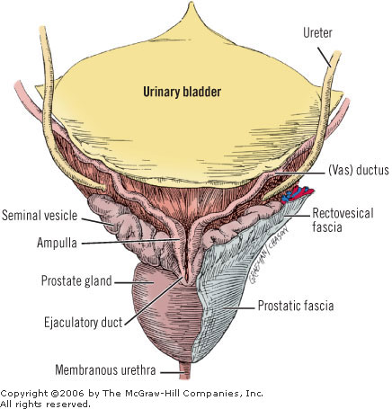
Seminal vesicles and deferent ducts.

Slide 26
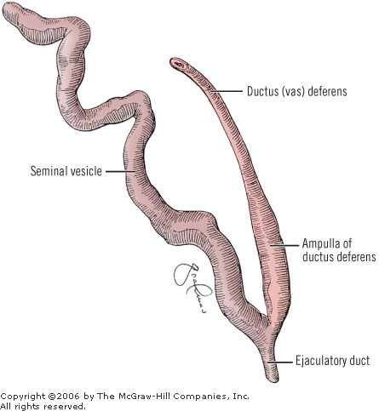
SEMINAL VESICLE

Slide 27
The topographic anatomy and relations of the seminal vesicles are as follows:
Anterior and superior: urinary bladder, occasionally fixed
Posterior and inferior: Denonvilliers' fascia (the rectovesical septum) and anorectum
Above: peritoneum in the rectovesical fossa (may be occasionally reached by the tip of the seminal vesicles)
Medial: ductus deferens
Lateral: multiple vesicle vessels and levator ani
Below: ejaculatory duct, where it unites with the ampulla of the ductus deferens

Slide 28
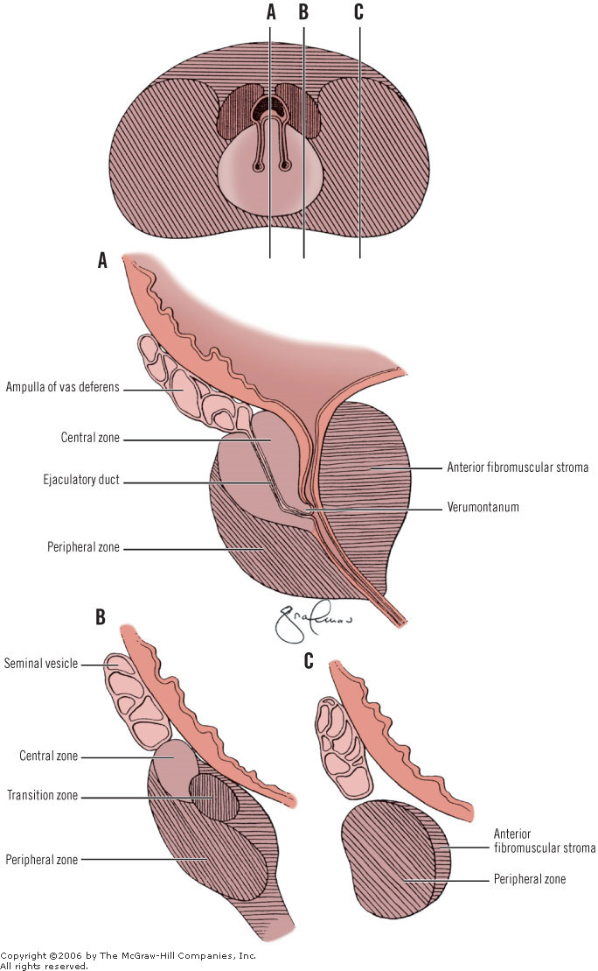
EJACULATORY
DUCTS

Slide 29
THE COURSE OF EJACULATORY DUCTS
The ejaculatory ducts pass distally through the prostate gland, with the posterior glandular part of the organ behind. The median lobe of the prostate is in front. The duct has a very thin wall, a length of approximately 2 cm, and a diameter of less than 1 mm. The ducts end as small openings on either side of the midline on the verumontanum of the urethral ridge

Slide 30
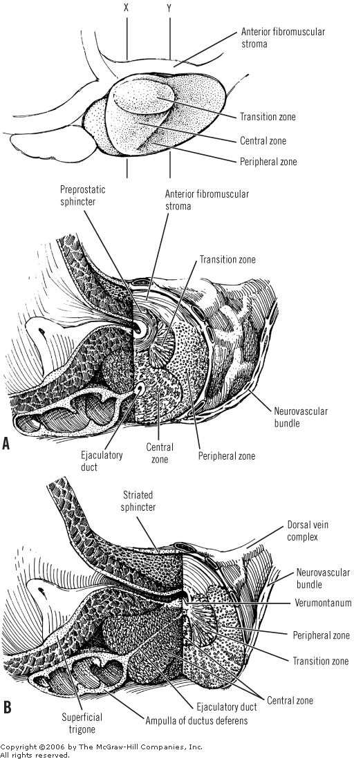
Ejaculatory duct shown in relationship to prostate

Slide 31
PROSTATE

Slide 32
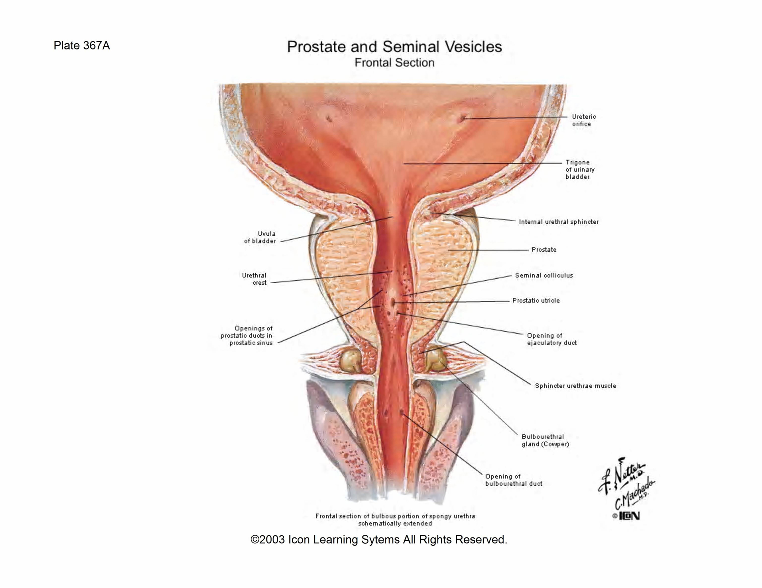
PROSTATE

Slide 33
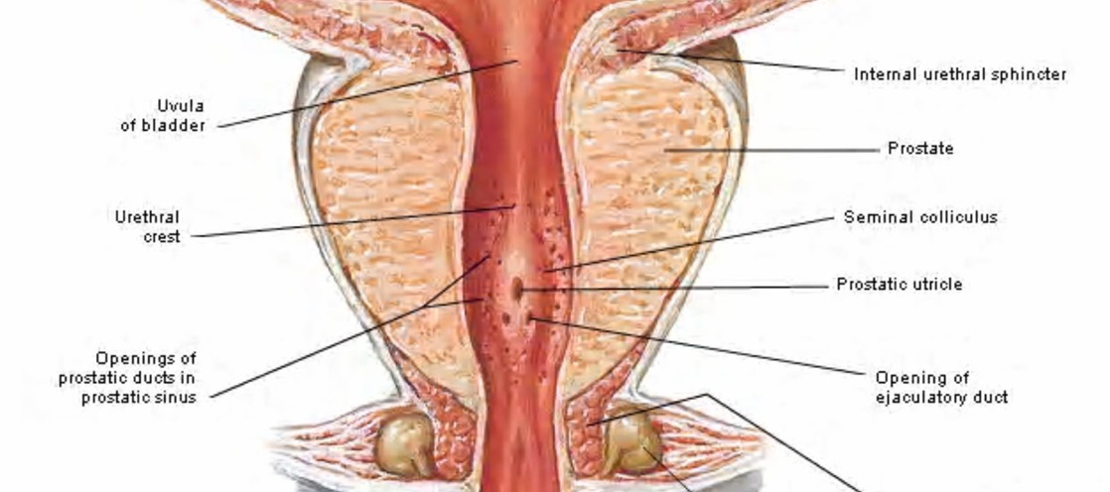

Slide 34
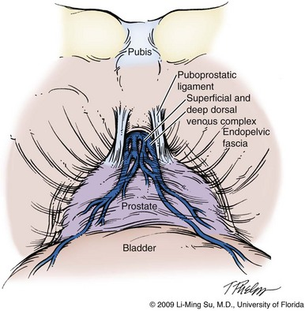

Slide 35
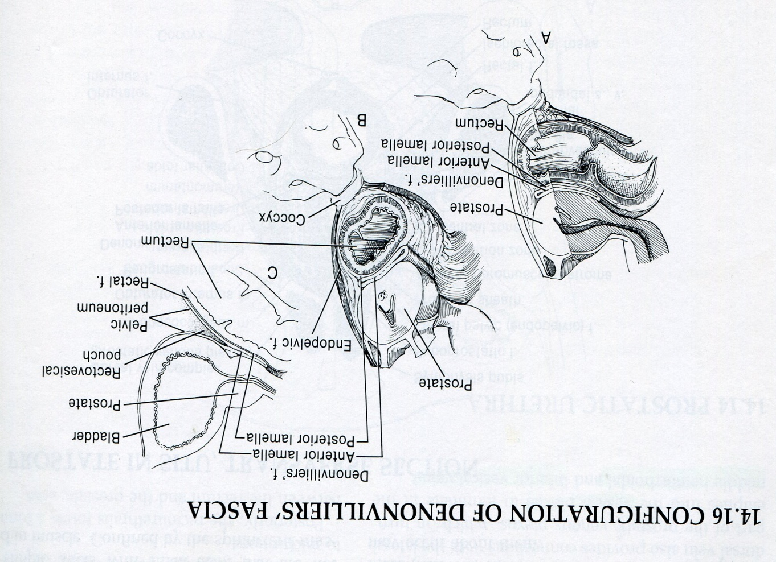
Denonvillier Fascia

Slide 36
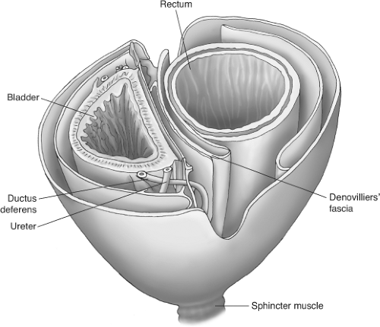
Denonvillier

Slide 37
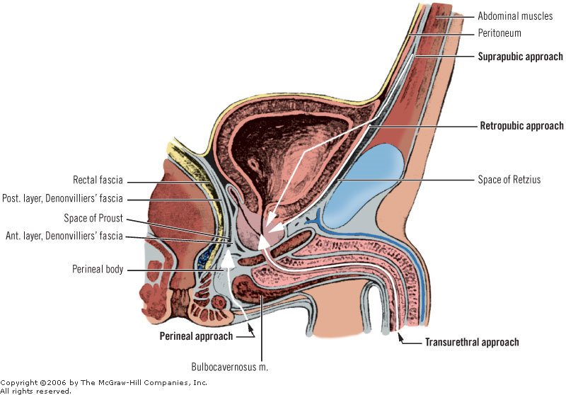

Slide 38
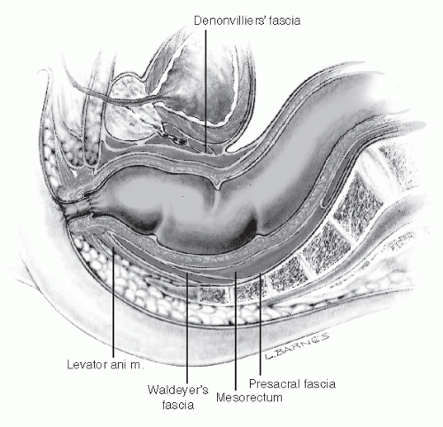
Denonvillier

Slide 39
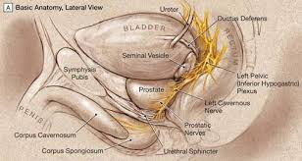
Prostate Nervous

Slide 40
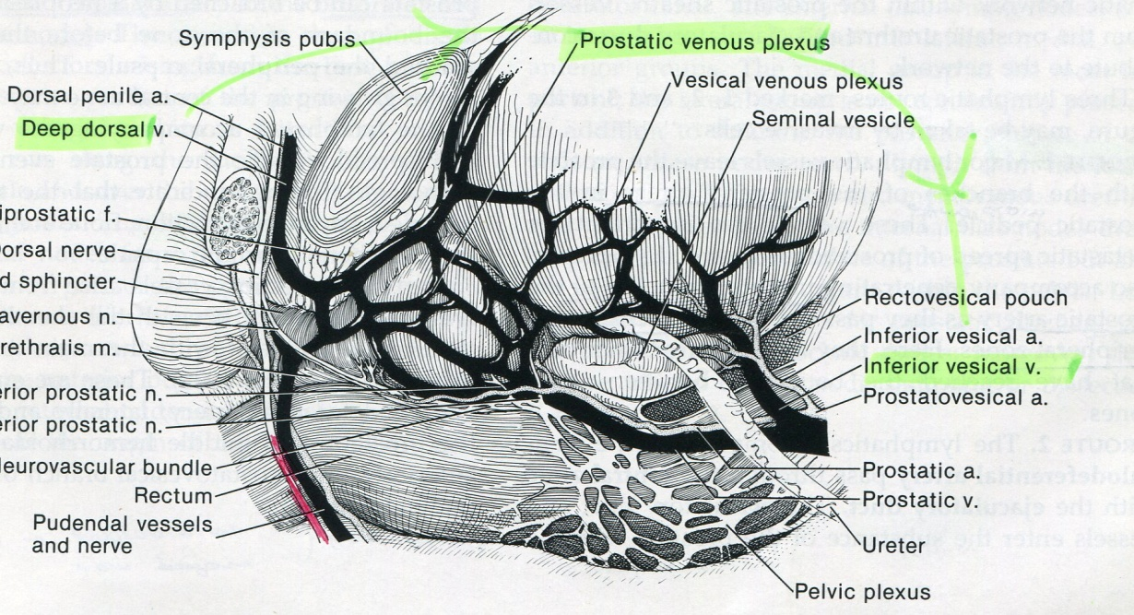

Slide 41
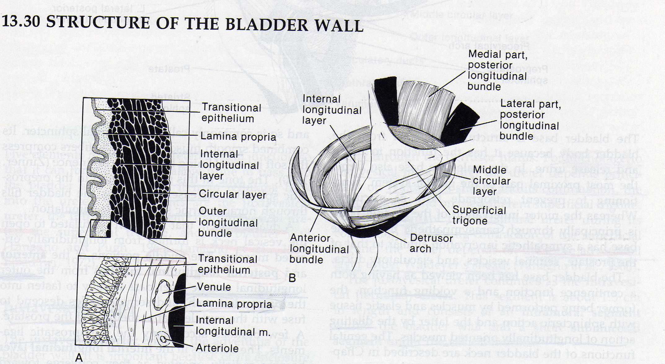

Slide 42
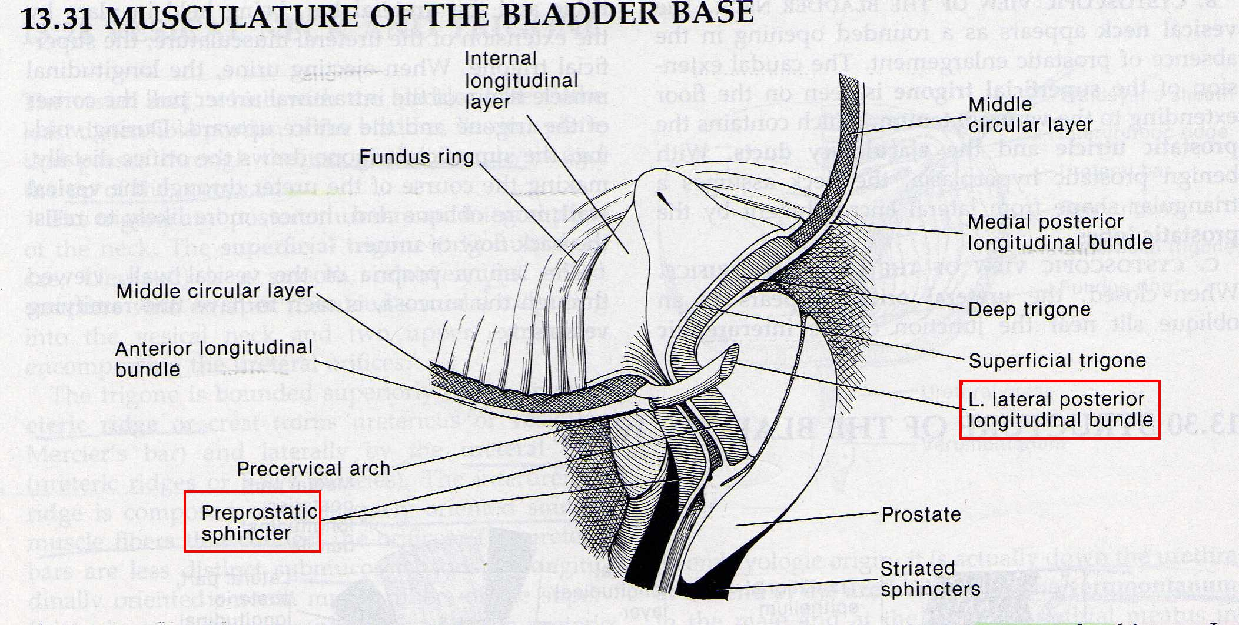

Slide 43
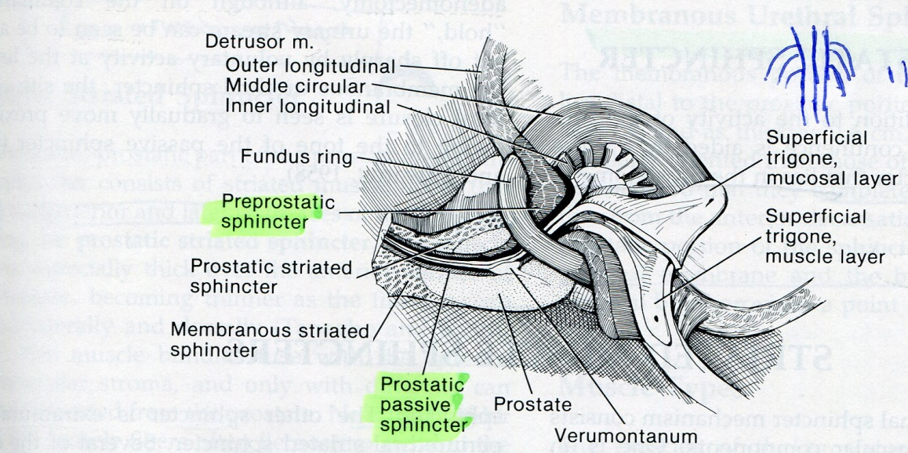

Slide 44
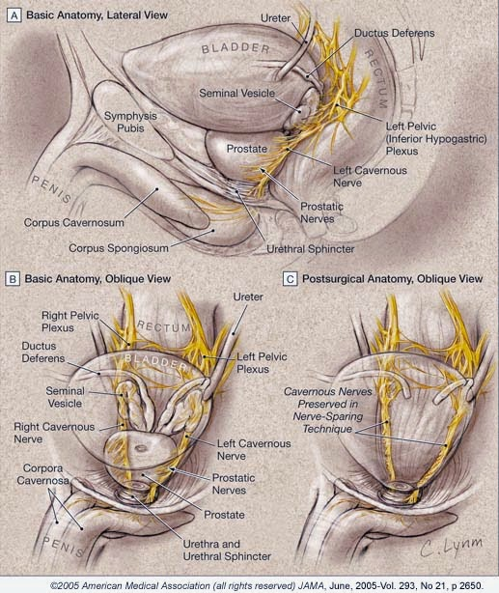
Prostate nervous

Slide 45
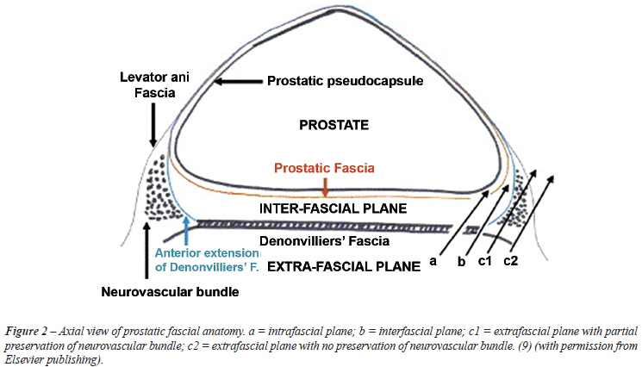

Slide 46
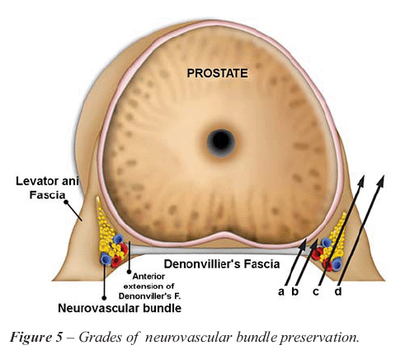

Slide 47
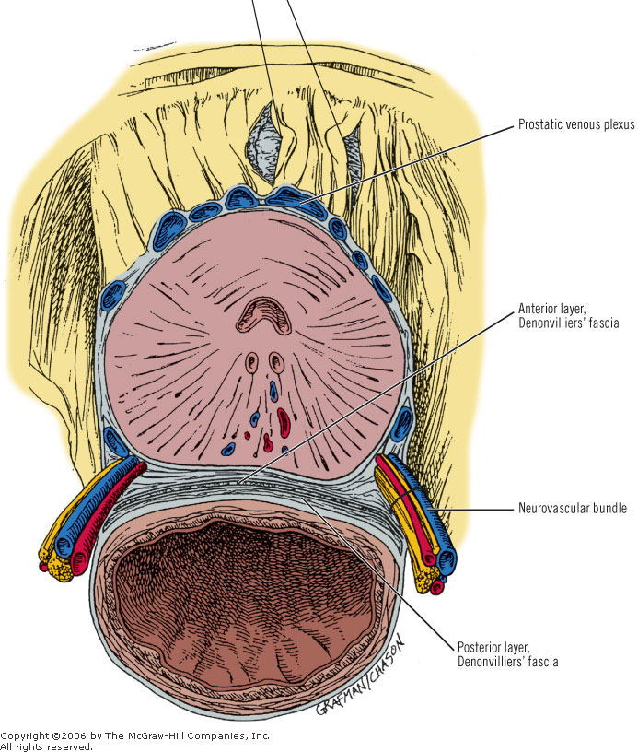

Slide 49
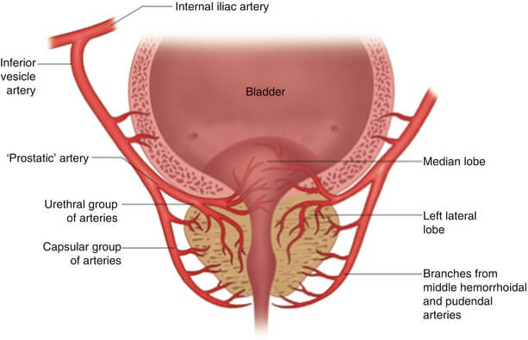
Prostate Blood Supply

Slide 50
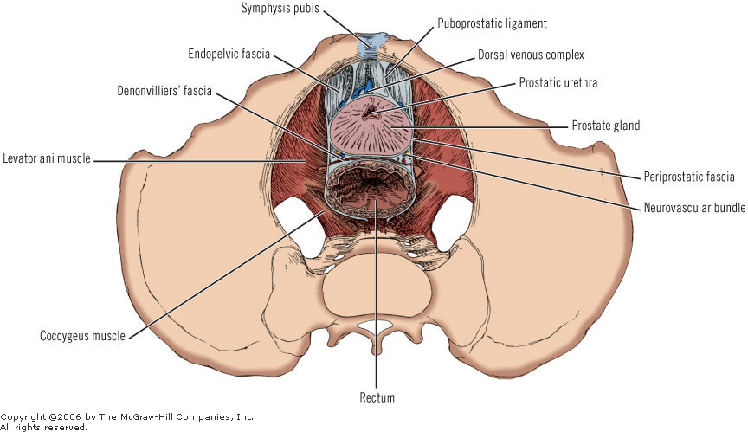
Puboprostatic ligaments and dorsal vein complex.

Slide 51
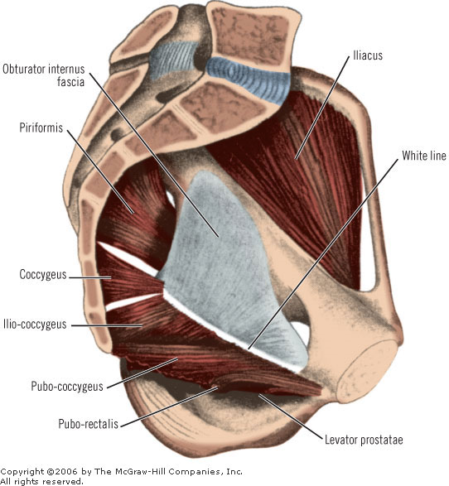
Levator ani muscle (left half), showing levator muscle of prostate

Slide 52
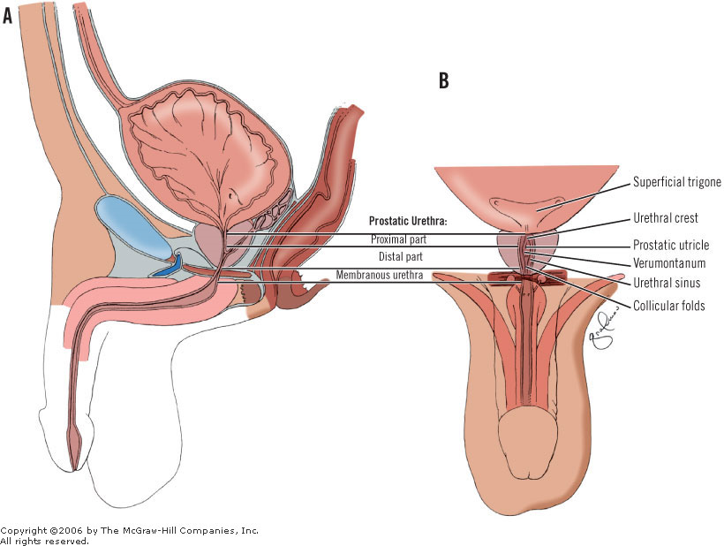
Prostatic urethra. A, sagittal section. B, Oblique coronal view

Slide 53
PROSTATIC SURFACES
There are four prostatic surfaces: one posterior, one anterior, and two inferolateral.
The posterior surface is flat transversely and convex vertically. It is separated from the rectal ampulla by the bilaminar fascia of Denonvilliers. This surface is characterized by a midline groove that is wider toward the base of the gland, and serves to partially separate the gland posteriorly into left and right lobes.
The posterior surface may be palpated by digital rectal examination. The vesicoprostatic junction is located at the upper border of the posterior surface.

Slide 54
The narrow and convex anterior surface is located between the apex and the base. Multiple large veins separate this surface from the symphysis pubis. According to Tanagho,71 the distance between the pubic symphysis and the anterior surface is approximately 2 cm.
The avascular puboprostatic ligaments are fibrous cords, wide or narrow. They connect the upper limits of the anterior surface of the prostate to the pubic bone, at the right and left sides of the cartilaginous area.
The right and left inferolateral surfaces are embraced by the anterior part of the levator ani muscles. They are fixed to the levator by the arcus tendineus of the fascia pelvis ("white line"), sagittal connective tissue bands between the ischial spine, and the pubic bone (Fig. 25-22). Here there is a very rich venous network and fibrous tissue which contributes part of the lateral prostatic sheath.

Slide 55
The “levator prostate” muscle
The levator prostatae muscle is the most anterior and most medial part of the levator ani muscle. These muscle fibers pass about the prostate gland and insert into the perineal body beneath the prostate gland, related to the anterior parts of the levator ani muscle. Thus, the muscle encroaches upon the prostate behind by a U-shaped sling (Fig. 25-22). Last79 astutely noted that "levator prostate" is not an apt term. We tend to agree; nonetheless, at orgasm, the pubococcygeus muscle contracts strongly and with this, the prostatic portion probably does, indeed, both lift and compress the prostate gland.

Slide 56
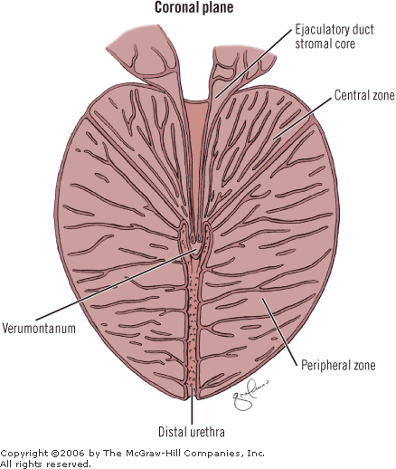
PROSTATIC ZONES

Slide 57
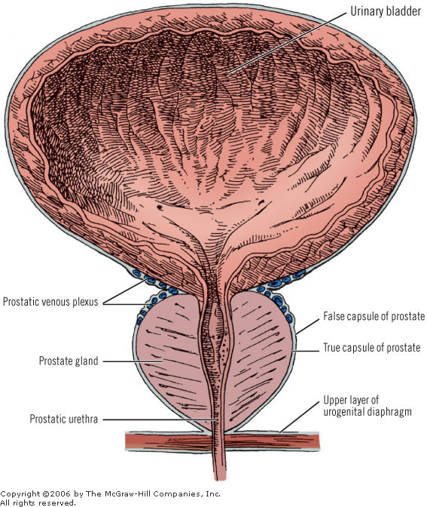

Slide 58
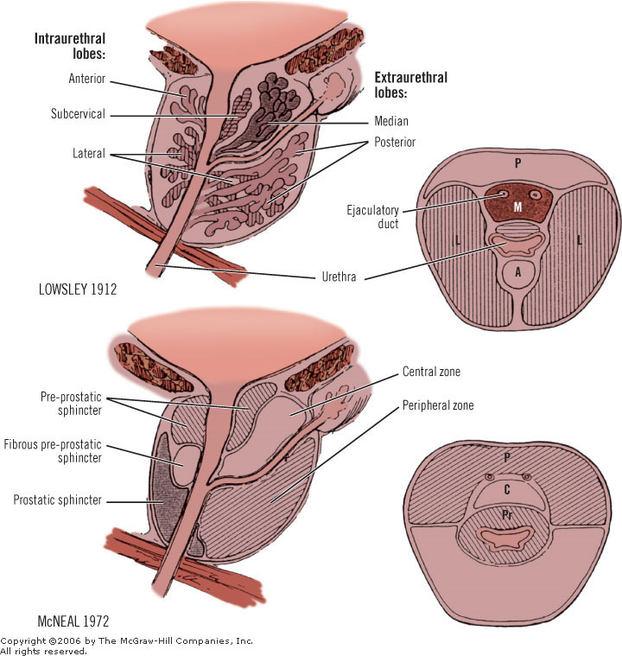

Slide 59
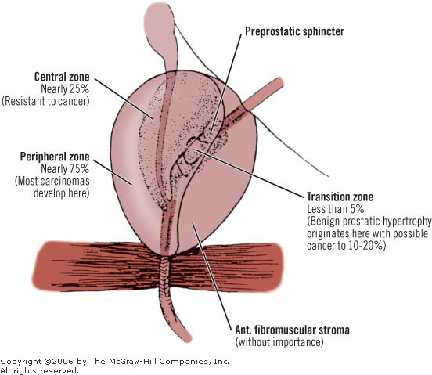

Slide 60
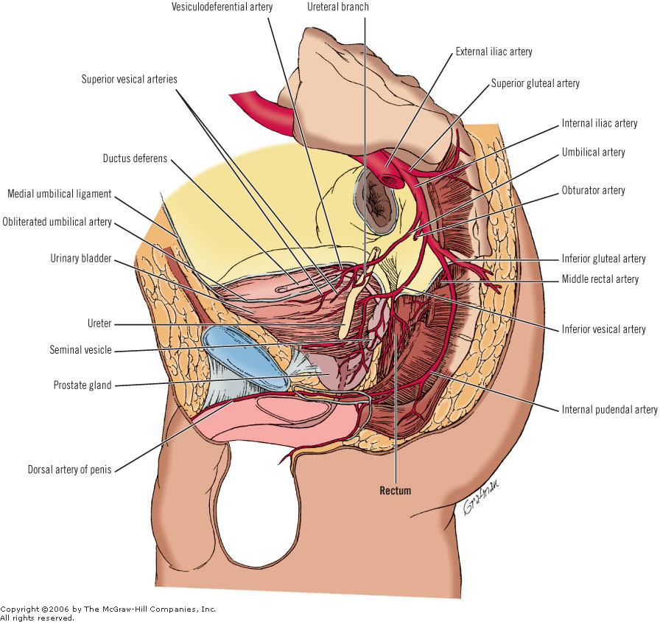

Slide 61
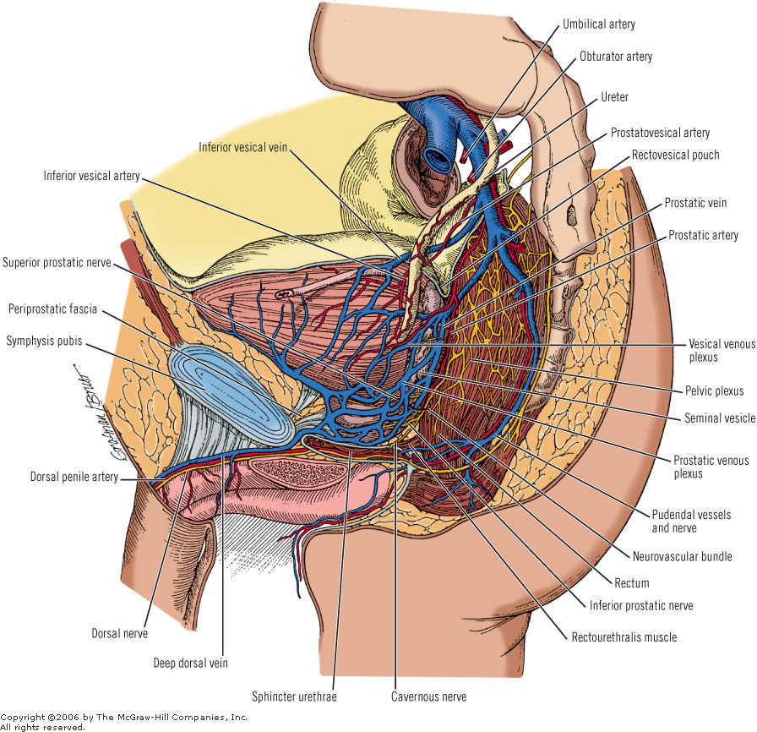

Slide 62
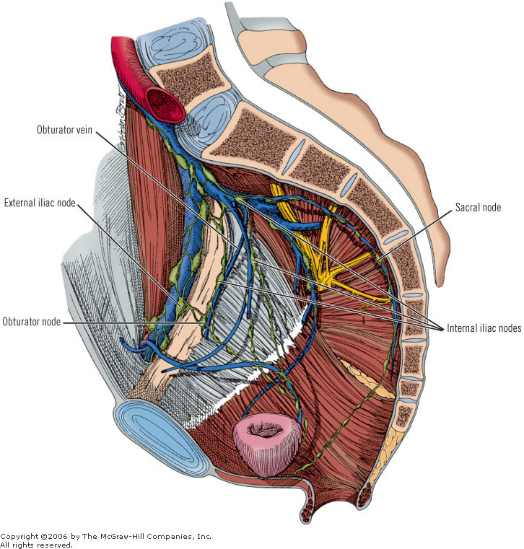
VENOUS DRAINAGE

Slide 63
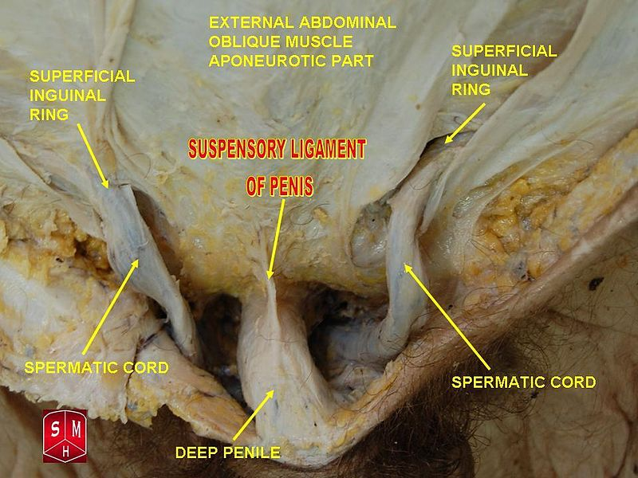

Slide 64
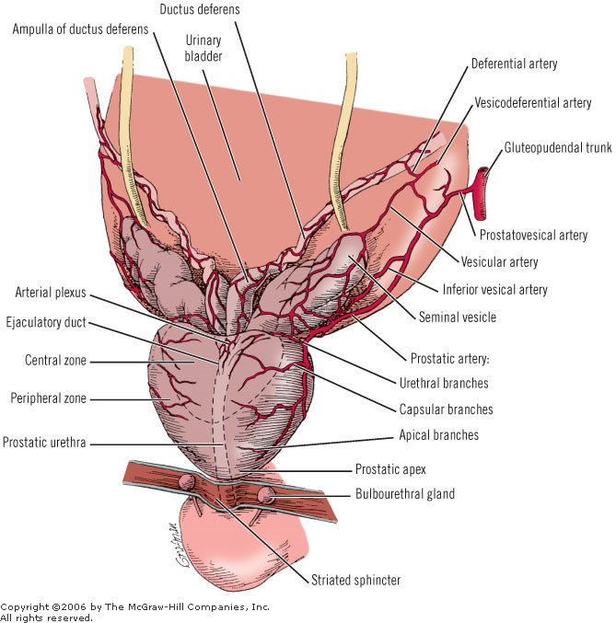

Slide 65
Male URETHRA

Slide 66
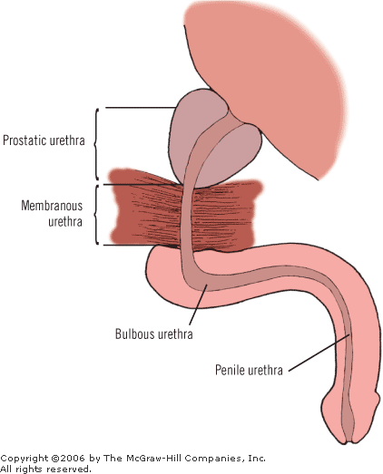

Slide 67
The urethra has 3 relatively narrow areas:
at the membranous part of the urethra
at the juncture of the glans penis with the corpus spongiosum
at the external urethral meatus

Slide 68
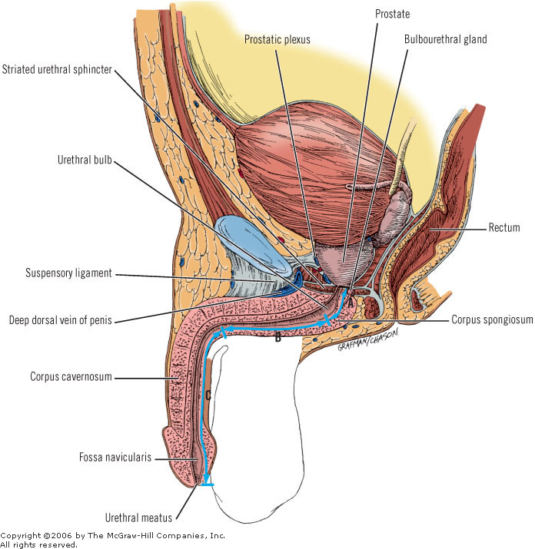

Slide 69
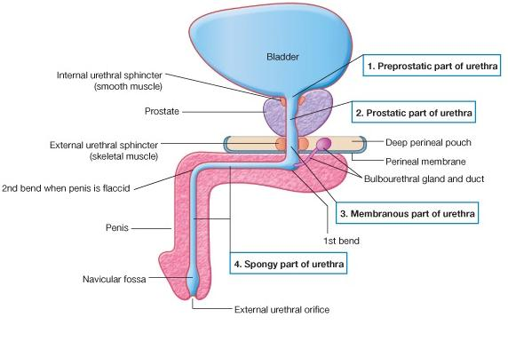
MALE URETHRA

Slide 70
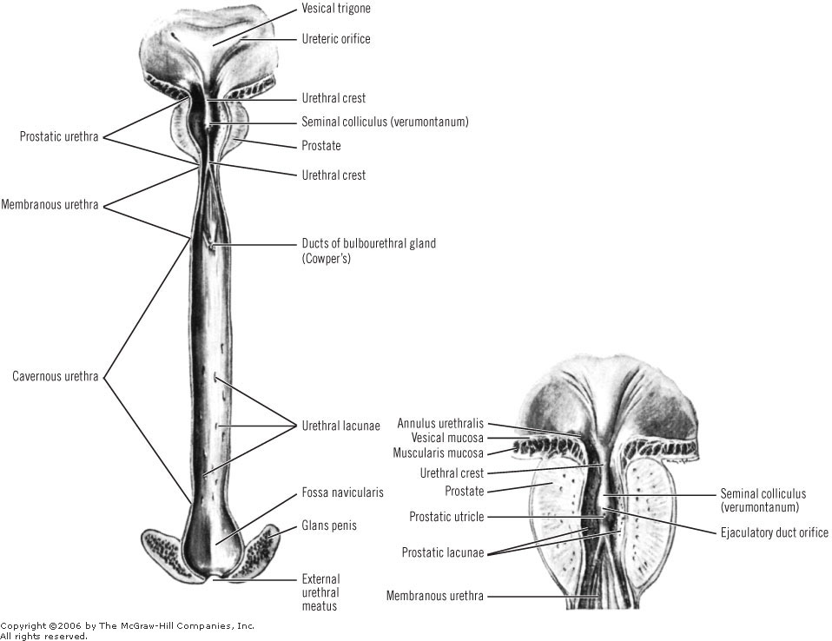

Slide 71
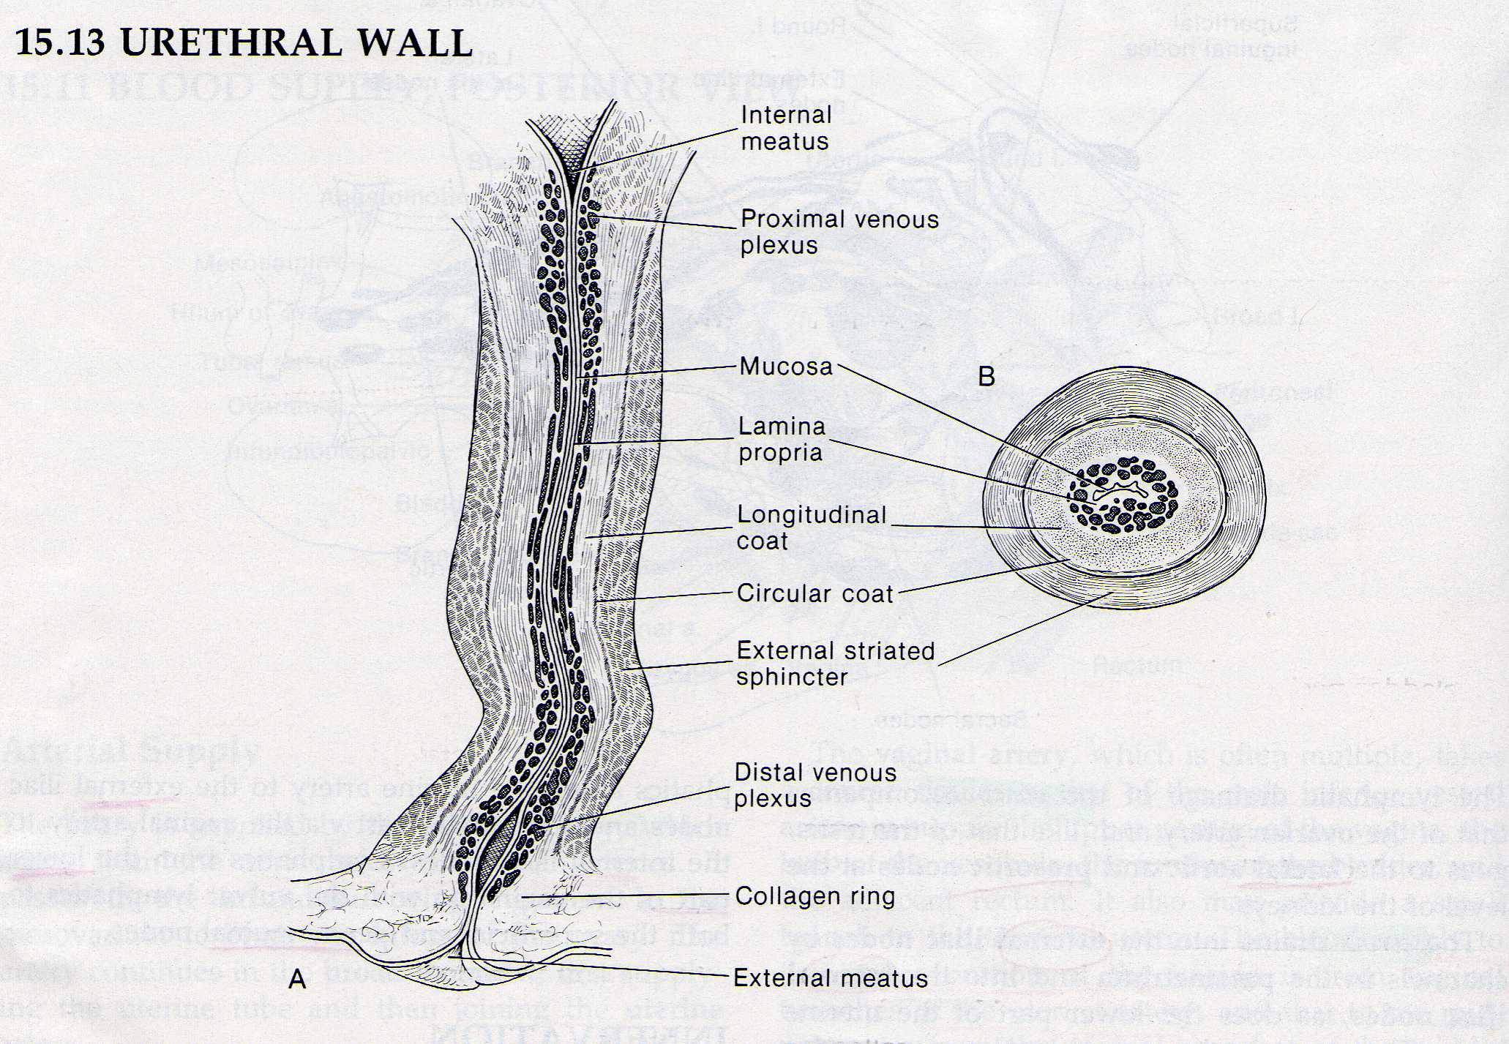
FEMALE URETHRA

Slide 72


URETHRA- SPHINCTERS

Slide 73


Slide 74
PENIS

Slide 75

PENIS
Cavernosal bodies (2) of the penis Spongiosum body of the urethra
Root: 2 crura
bulb of the penis (urethra)
Body : corpora cavernosa urethra, glans

Slide 76


Slide 77


Slide 78

PENIS
Skin
Dartos
Buck’s fascia
Cavernous bodies
two layers
- outer longitudinal
- inner circular

Slide 79


Slide 80

PENIS
BLOOD SUPPLY
Cavernous artery
Helicine artery
Sinusoids
Emissary vein
Circumflex vein

Slide 81

PENIS
VENOUS DRAINAGE
Skin, Dartos: Supeficial dorsal v.(Saphenous v.)
Cavernous b. (distal part), glans, urethra: deep dorsal v (prostatic plexus)
Cavernous bodies (proximal part), bulb: cavernous v. (int. pudendal v., prostatic plexus)

Slide 82

PUBIC PROSTATE LIGAMENTS

Slide 83


Slide 84


Slide 85


Slide 86
LIGAMENTS
The penis is supported by two ligaments, the fundiform and the suspensory. The fundiform ligament is a downward continuation of the superficial fasciae of Camper and Scarpa, which lose their individual identity as they merge to form the fundiform ligament (see "Potential Spaces Above the Urogenital Diaphragm" in this chapter). When approaching the penile dorsum, it splits, surrounds the body of the penis, and unites at the penile ventral area with the scrotal septum. The suspensory ligament under and deep to the fundiform ligament arises from the fascia of Gallaudet (deep fascia of the abdominal wall) and from the frontal aspect of the pubic bone and the symphysis, blending below with the deep penile fascia on each side.

Slide 87


Slide 88


Slide 89


Slide 90


Slide 91


Slide 92


Slide 93


Slide 94


Slide 95


Slide 96
Physiology
The anatomy and physiology of erection is presented in the blood circulation during tumescence and detumescence. In brief, in response to psychic and tactile stimuli, parasympathetic fibers act to cause vasodilation of the arterial branches supplying the spongy tissues of the corpora cavernosa and the corpus spongiosum, resulting in profuse inflow of blood to them. The relatively inelastic tunica albuginea impedes venous return as the erectile tissue becomes engorged with blood. Contraction of the overlying skeletal musculature is also a part of these processes.

Slide 97
TESTIS AND MALE PHYSIOLOGY
REVISED ANATOMY AND EMBRYOLOGY
MACROSCOPIC AND MICROSCOPIC ANATOMY
SPERMATOGENESIS

Slide 98

Eutherian Mammal Testes
Paired and oval shaped
Shiny connective covering called the Tunica Albuginea
Divided into testicular lobules
– Approximately 250 in human testis

Slide 99

Seminiferous tubules (ST)
Each testicular lobule contains several coiled seminiferous tubules (ST)
– ST site of sperm production
Each ST ~ 1.3 ft in humans
Total length of ST almost the length of a football field

Slide 100

Testis vascularization
Arterial supply
Venous supply

Slide 101

Testicular development
Develops in the abdominal cavity from the medulla of the primordial gonad

Slide 102
Testicular location
In most animals the testes lie in the scrotum
Exceptions:
  Lumbar: monotremes, elephants, hyraxes, reptiles, fishes
  Inguinal canal: hedgehogs, moles, some seals
  Seasonal migration: wild ungulates, most rodents
Reasons for scrotal position unclear
- sexual selection ?, cooling testis?

Slide 103

Models for testicular migration
Testis is firmly attached to abdominal wall by:
  Posterior gonad ligament (Gubernaculum) - as body
grows the gubernaculum does not, thus testis is drawn downward
-in females gubernaculum grows
Johnson and Everitt 1.8

Slide 104
Hormonal control of testicular migration
Migration of testis thought to involve 2 hormones produced by testis
  MIH – mullerian inhibiting hormone
    Involved in transabdominal migration
– Testosterone- stimulates genitofemoral nerve to produce nueropeptide calcitonin gene-related peptide (CGRP)
– CGRP stimulates transinguinal and scrotal migration

Slide 105


Hormonal control of testicular migration (2)
MIS
Androgens
Johnson and Everitt 1.8 & 1.9

Slide 106
Abnormalities in testis migration
Cryptorchism “abdominal” testis
-testis does not descend properly
  detrimental to spermatogenesis and normal testicular metabolism
  Rise in humans in US and Europe by about 250% in the last 30-40 years
  Leads to arrested spermatogenesis
- 4-7 degrees C below body temp ideal

Slide 107

Testicular Histology
Testis is made up of 2 major compartments
Region inside seminiferous tubules
Spermatozoa development
Interstitial space outside ST
  Leydig cells,
  Androgen Production

Slide 108

Seminiferous Tubules
Seminiferous tubules are lined by a germinal epithelium
Primary product is spermatozoa
Two cell types are found within ST
  Germ cells
  Sertoli cells

Slide 109

Interstitial space
Outside the ST lie Leydig cells
– Responsible for androgen production in response to LH

Slide 110

Blood testis barrier
Limits fluid transfer between adluminal and basal and interstitial compartments
Prevents gametes entering interstitial space
Johnson and Everitt 4.1

Slide 111
Blood testis barrier 2
The two compartments are separated by a blood testis barrier
  Consists of a series of gap and tight junctions that serve as a physiological barrier separating the sertoli cells from the capillaries located in the interstitial space.
  Function: prevents immune response to “foreign” protein of gametes
    Sperm granuloma

Slide 112
Ducts in males
All ducts in human males are derived from the primitive kidney
– termed the Wolffian ducts (or archinephric duct)

Slide 113

Ducts in males
1) Seminiferous tubules – 2)Tubuli recti (straight
tubules)
Rete testis- branched network of ducts
Vasa efferentia- carry to single common duct
Epidydmis- single duct (>15 ft in human male)
Vas deferens pass out scrotum through inguinal canal to the urethra.

Slide 114
Evolution and Embryonic development of the duct system in males
- pronephric kidney
-mesonephric kidney
- metanephric kidney

Slide 115

Pronephric kidney
1st kidney to form in humans
* It is the functional kidney of fish and larval amphibians
Develops anteriorly then degenerates in amniotes
Remaining duct called the Wolffian Duct (AD)
– Sperm transport in amniotes

Slide 116

Mesonephric Kidney
2nd kidney
30 tubules form in humans
As tubules form caudally the anterior ones die off
Female mammals- all tubules die
Male mammals- tubules become sperm ducts of testis
Functional Kidney: anamniotes

Slide 117

Metanephric kidney (metanephros)
Permanent kidney of amniotes
Serves both as an excretory and osmoregulatory organ
Ureter transports urine
Ductus Deferens (AD)transports sperm

Slide 118

Accessory Glands
Seminal Vessicles
Prostate gland
Bulbourethral glands
Involved in the production of semen

Slide 119
Seminal Vesicles
Secrete alkaline, viscous fluid
High fructose content
Comprises the majority of semen

Slide 120
Prostate Gland
Adds an alkaline solution to semen
Facilitates a favorable environment for sperm in the more acidic vagina and female reproductive tract
13-33% of semen

Slide 121
Bulbourethral Glands
Secrete lubricant

Slide 122
Function of Ducts and Accessory Glands
Sperm transport
Sperm Storage
Sperm maturation
Production of semen

Slide 123

Sperm anatomy
Head and tail components of mature spermatozoan
  Head contains genetic material (1N)
  Tail responsible for generating propulsive forces
Lombardi 5-2

Slide 124
Sperm Anatomy 2
Sperm head
  Lysosomal cap containing hydrolytic enzymes’: acrosome cap
  Nucleus containing chromatin
Lombardi 5-2

Slide 125

Sperm structures vary widely
Lombardi 5-1

Slide 126

Spermatogenesis
4 spermatids (1N) per meiotic cycle
Lombardi 5-5

Slide 127
3 phases of spermatogenesis
Mitotic proliferation
Meiosis
Codifferentiation
1
2
3.
Lombardi 5-5

Slide 128

Codifferentiation
Johnson and Everitt 4.5

Slide 129

Temporal organization of spermatogenesis
Spermatogenic cycle:
-Time for the completion of spermatogenesis very consistent within a species
Individual Spermatogonium begin to divide mitotically and meiotically at regular time interval for a given species
Johnson and Everitt Table 4.1

Slide 130
Temporal organization of spermatogenesis (2)
Duration of cycle of the seminiferous epithelium:
- spermatagonium starts to undergo new cycle after aprox. ¼ of the time for complete spermatogenesis has passed
Johnson and Everitt Table 4.1

Slide 131

Temporal organization of spermatogenesis (3)
Johnson and Everitt Figure 4.7

Slide 132

Spatial organization of spermatogenesis
Spermatogenic wave:
Each region of seminiferous tubule at a slightly different stage of spermatogenesis
-aids in providing a steady supply of sperm
Johnson and Everitt Figure 4.10

Slide 133

Spatial organization of spermatogenesis (2)
Johnson and Everitt Figure 4.9

Slide 134

Disruption of spermatogenesis?
Declining sperm counts since 1930s
Graph from report “ Male Reproductive Health and Environmental Chemicals with Estrogenic Effects” 1995 report by Danish EPA (students.whitman.edu/~cushinda/ mentrends.htm)

Slide 135
How might contaminants disrupt spermatogenesis?

Slide 136

Testicular Cancer
3 fold increase since 1940
Leading cancer in American males 15-35

Slide 137

Disruption of spermatogenesis?
http://www.nearingzero.net/screen_res/nz071.jpg

Slide 138

“SALVATOR MUNDI”
L.DA VINCI
THANK YOU FOR YOUR ATTENTION
IN DES. ANATOMY I !!!

