Slide 1
Female pelvis and urethra
Professor Mara Piagkou

Slide 2
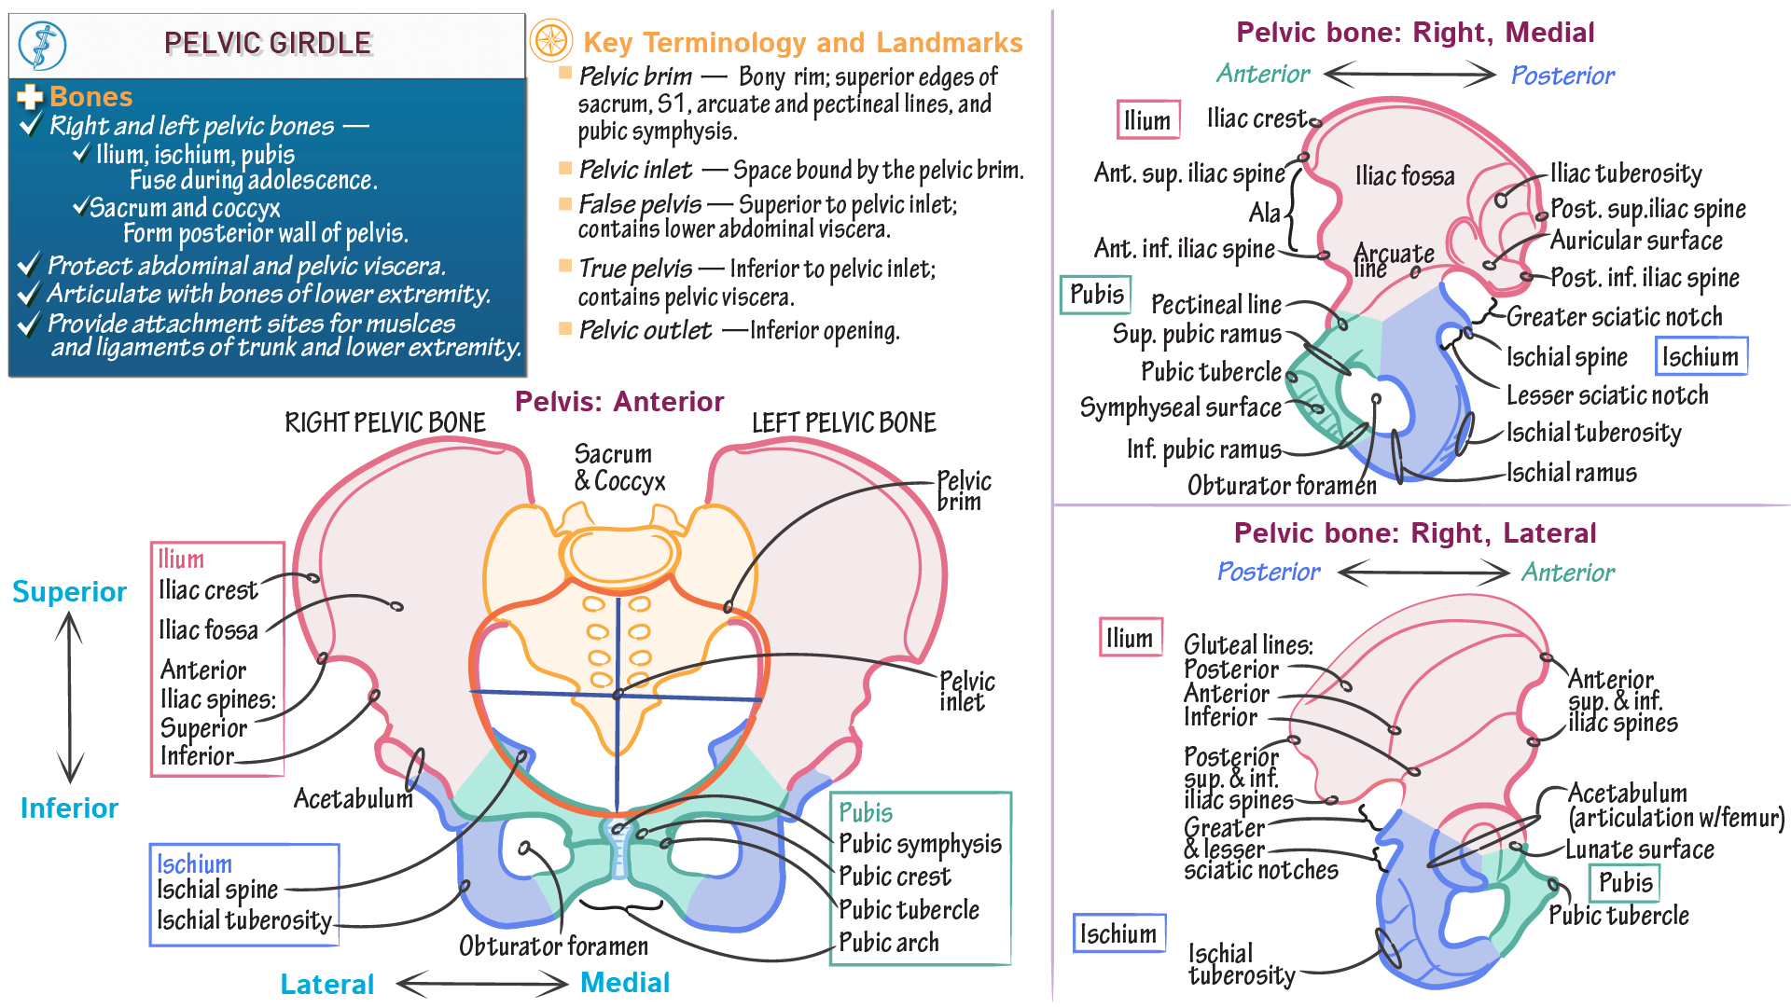

Slide 3
Multiple Choice Questions (MCQs)
(Each question has one correct answer)
The female urethra is derived from which embryological structure? A. Mesonephric duct B. Paramesonephric duct C. Urogenital sinus D. Genital ridge
The round ligament of the uterus is a remnant of: A. Paramesonephric duct B. Urachus C. Gubernaculum D. Cloacal membrane
The ovary receives its main arterial supply from the: A. Uterine artery B. Internal pudendal artery C. Ovarian artery D. Vaginal artery
Pain from the ovaries is typically referred to which dermatome level? A. T4–T5 B. T10–T12 C. L3–L4 D. S2–S4
Which of the following is not part of the female pelvic floor muscles? A. Pubococcygeus B. Coccygeus C. Iliococcygeus D. Obturator internus

Slide 4
Multiple Choice Questions (MCQs)
(one correct answer)
The rectouterine pouch (of Douglas) is located: A. Between the uterus and bladder B. Between the uterus and rectum C. Around the cervix D. Lateral to the uterus
The lymphatic drainage of the ovaries primarily goes to: A. Superficial inguinal nodes B. Internal iliac nodes C. Para-aortic (lumbar) nodes D. Obturator nodes
The uterine artery crosses superior to which important structure? A. Ovarian artery B. External iliac vein C. Ureter D. Round ligament
The external female genitalia do not include: A. Labia majora B. Clitoris C. Cervix D. Vestibular glands
Which ligament contains the ovarian vessels? A. Broad ligament B. Suspensory ligament of the ovary C. Ovarian ligament D. Round ligament

Slide 5
Learning Objectives: Female Genital System (FGS)
Anatomy
Describe the major structures of the external and internal female genitalia.
Describe the topographical relationships of pelvic reproductive organs (uterus, ovaries, tubes, vagina) within the pelvis.
Understand the supporting structures: ligaments, pelvic floor muscles, and endopelvic fascia.
2. Development Explain the embryological development of the female genital tract from the Müllerian (paramesonephric) ducts.
3. Vascular and Lymphatic Supply Outline the arterial, venous, and lymphatic drainage of female genital organs.
4. Innervation Describe the somatic and autonomic innervation of the female genital system.

Slide 6
External Genitalia
Topics
Overview of the female pelvis
Vulva and perineum: labia, clitoris, vestibule, glands
Perineal body and pelvic floor support
Learning Objectives
Identify the structures of the external genitalia and perineum.
Describe the role of the pelvic floor in continence and support.
Understand the innervation and blood supply of the perineal region.

Slide 7
External genitalia (vulva)
Collectively known as the vulva.
Forms the external part of the female reproductive system.
Located in the urogenital triangle of the perineum.

Slide 8
Major Structures
Mons Pubis
Fatty pad over the pubic symphysis.
Covered with pubic hair after puberty.
Cushions pubic bone during intercourse.
Labia Majora
Two thick, hair-bearing skin folds.
Homologous to the male scrotum.
Contain sweat and sebaceous glands; protect inner structures.
Labia Minora
Thin, hairless skin folds inside labia majora.
Rich in sebaceous glands and nerve endings.
Join anteriorly to form prepuce and frenulum of clitoris.

Slide 9
Major Structures
Clitoris
Erectile tissue, homologous to the male penis.
Contains glans, body, and crura.
Main sensory organ for sexual stimulation.
Vestibule of the Vagina
Space between labia minora.
Contains: External urethral orifice, Vaginal orifice, Openings of Bartholin’s glands (posterolateral), Skene’s (paraurethral) glands near urethra
Bartholin’s (Greater Vestibular) Glands
Located at 5 and 7 o'clock positions near vaginal opening.
Secrete mucus to lubricate the vestibule during arousal.
Can become cystic or infected (Bartholin's cyst/abscess).

Slide 10
SupplyArterial: Branches of internal pudendal artery
Venous: Drains into internal pudendal vein
Lymphatic Drainage primarily to superficial inguinal lymph nodes
Innervation Pudendal nerve (S2–S4) → primary somatic sensory and motorIlioinguinal nerve and genitofemoral nerve → contribute anteriorlyHighly innervated for sexual function and protective reflexes

Slide 11
Internal Genital Organs
Topics
Vagina: structure, relations, functions
Uterus: layers, positions, supporting structures
Fallopian tubes: segments and role in fertilization
Ovaries: histology, folliculogenesis
Learning Objectives
Describe the anatomy of the vagina, uterus, tubes, and ovaries.
Identify and explain the ligaments and peritoneal relations (e.g., broad ligament, uterosacral ligament).
Understand the vascular and lymphatic supply of each organ.

Slide 12
Development, Innervation & Clinical Relevance
Topics
Embryology of the female genital tract (Müllerian ducts)
Innervation of genital organs
Learning Objectives
Describe the embryological development of the female genital tract.
Understand somatic and autonomic innervation pathways and referred pain.

Slide 13
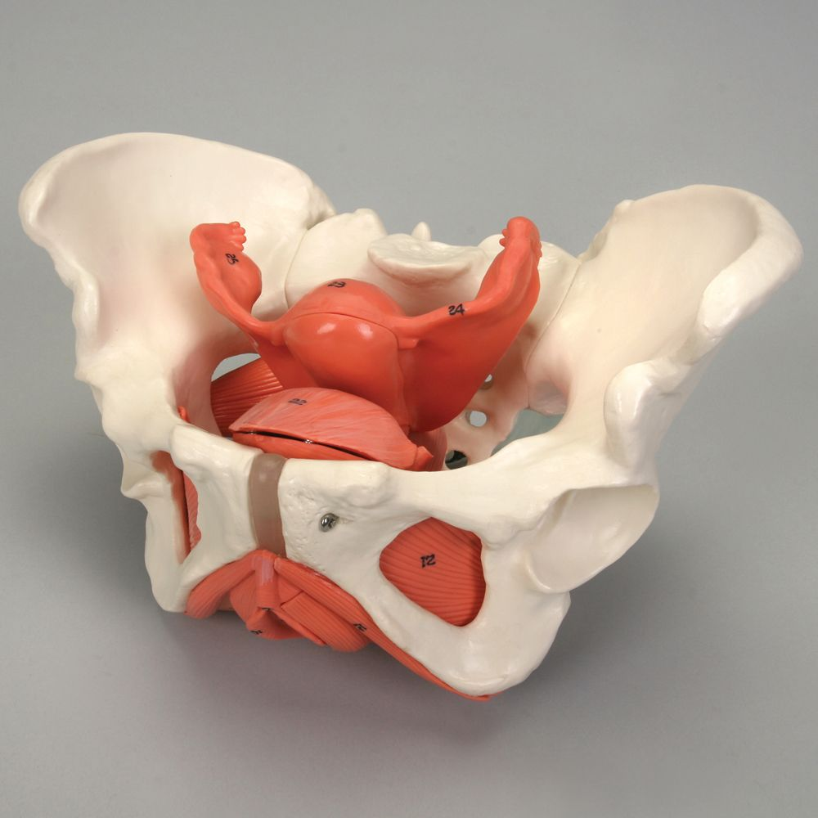
General Features of the female pelvis
Bony pelvis is broader, shallower, and more open than in males.
Pelvic inlet: Oval-shaped.
Pelvic cavity: More spacious to accommodate childbirth.
Pelvic outlet: Wider, with everted ischial tuberosities.

Slide 14
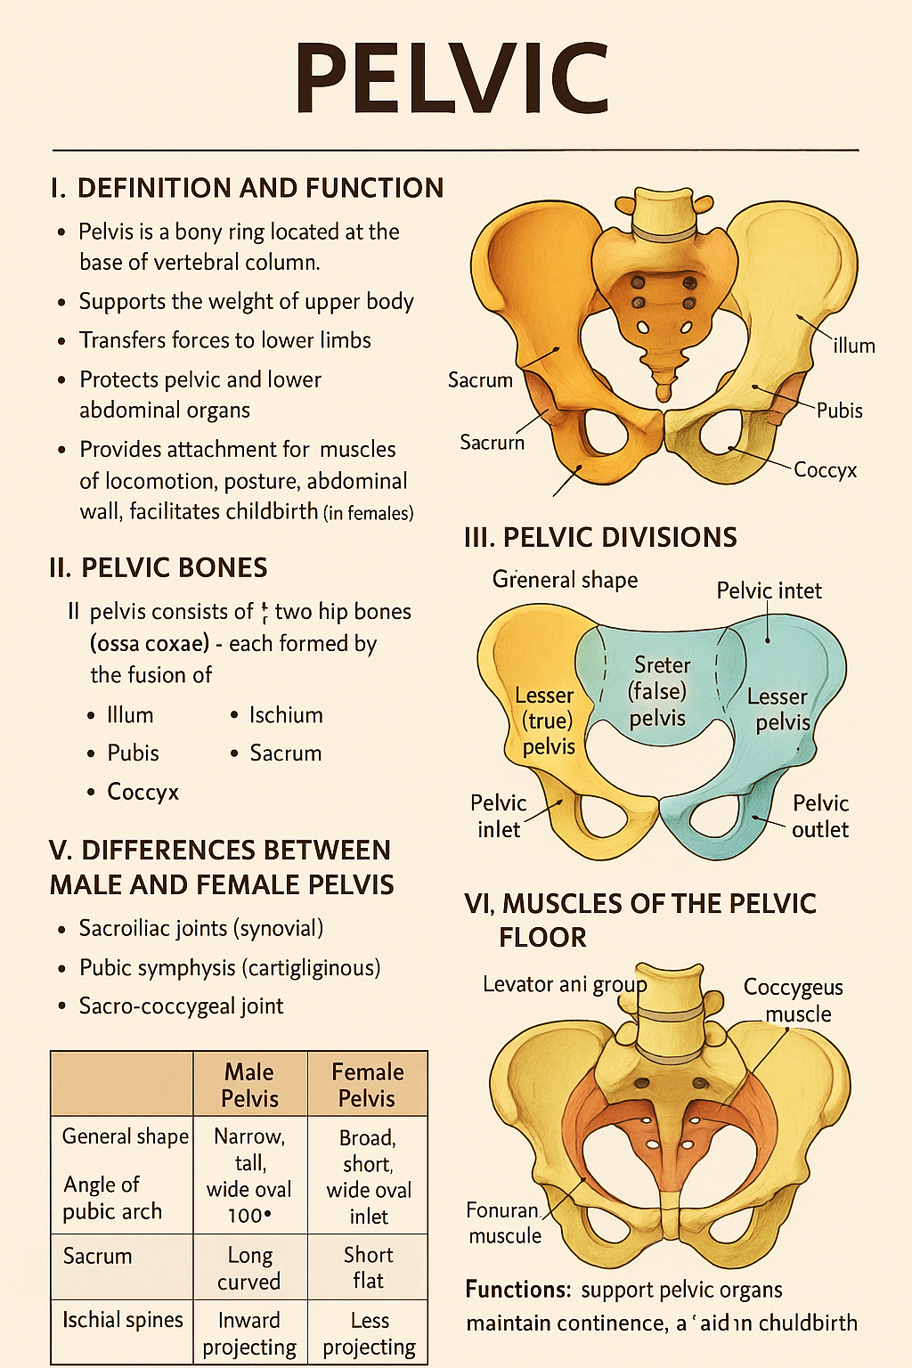
Definition & Boundaries
The pelvis is the region between the abdomen and the lower limbs. It contains and protects the pelvic organs and provides structural support for the spine and legs.
Divisions:
Greater (false) pelvis: Above pelvic brim; supports abdominal contents.
Lesser (true) pelvis: Below pelvic brim; houses pelvic organs.
Pelvic Brim (Inlet):
Bounded by sacral promontory, arcuate line, pectineal line, and pubic crest

Slide 15
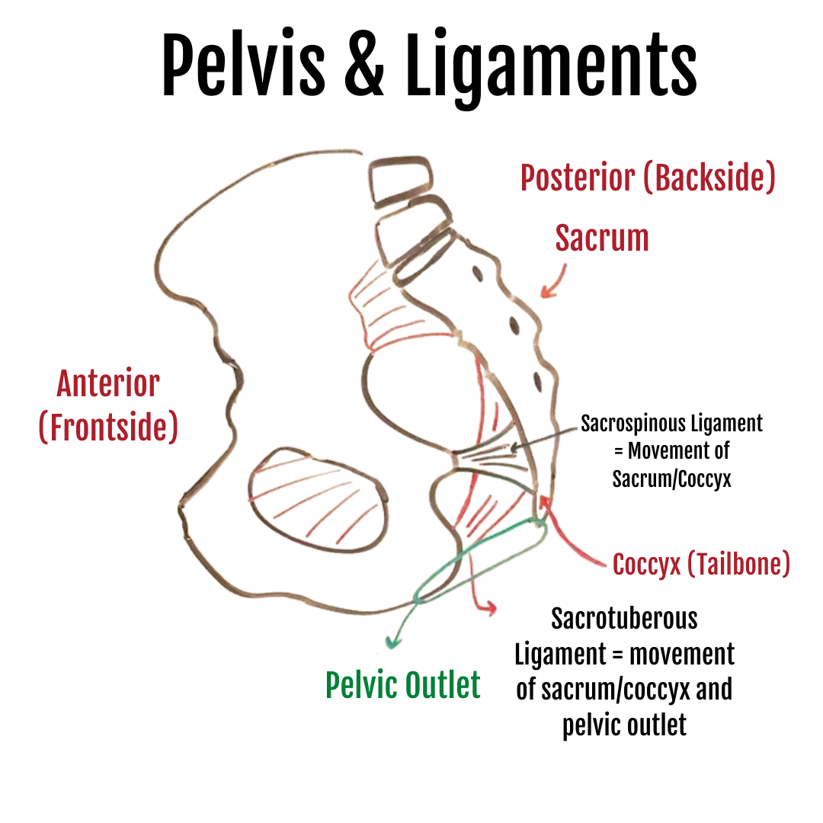
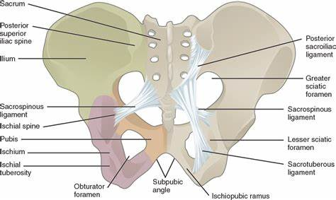
Ligaments
Sacrospinous: sacrum to ischial spine
Sacrotuberous: sacrum to ischial tuberosity
Broad ligament (female): peritoneal fold over uterus, tubes, and ovaries
Pubourethral, uterosacral, cardinal, and round ligaments (female support)

Slide 16
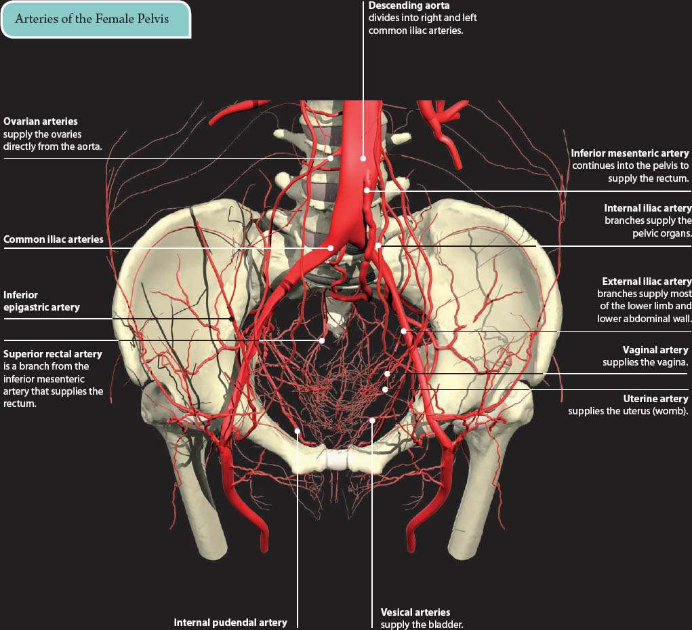
Vascular Supply of the pelvis
Internal iliac artery: main supply to pelvic organs
Branches: uterine, vaginal, vesical, rectal, pudendal, etc.
Venous drainage → internal iliac vein → common iliac vein

Slide 17
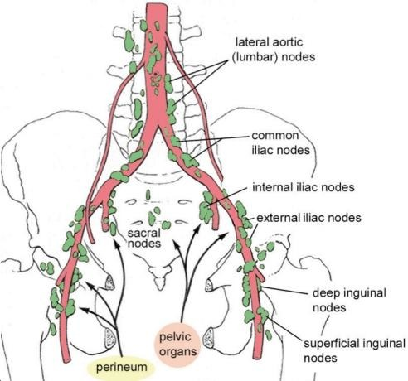
Lymphatic Drainage of the pelvis
Internal iliac nodes
External iliac nodes
Sacral nodes
Para-aortic nodes
(for ovaries/testes)

Slide 18
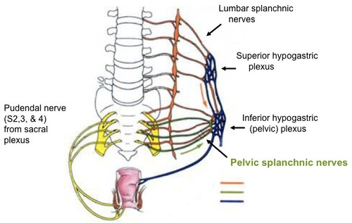
Innervation of the pelvis
Somatic: Sacral plexus (L4–S4), including pudendal nerve (S2–S4)
Autonomic:
Sympathetic: from T10–L2 via hypogastric plexuses
Parasympathetic: pelvic splanchnic nerves (S2–S4)

Slide 19
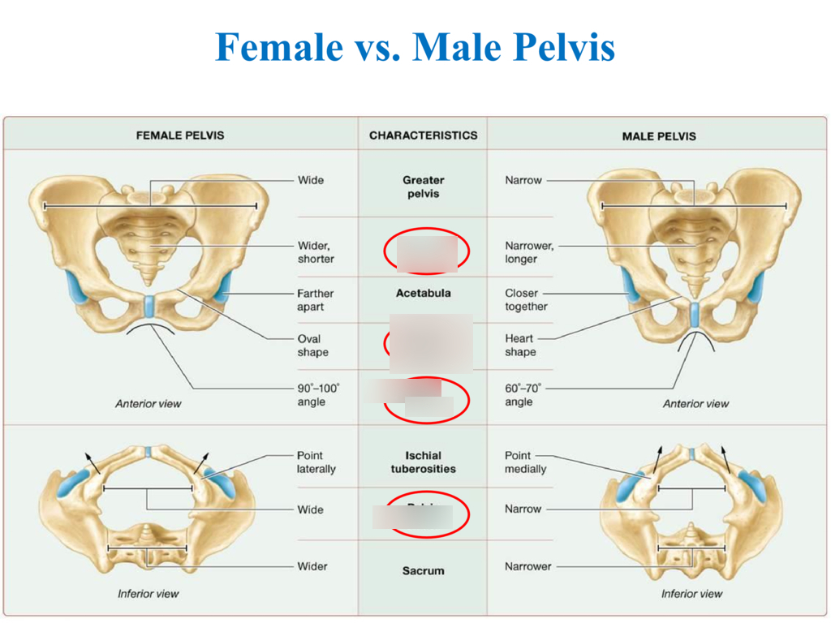
Feature | Female Pelvis | Male Pelvis
General Structure | Light, broad, shallow | Heavy, narrow, deep
Pelvic Inlet | Oval or round | Heart-shaped
Pelvic Outlet | Larger and wider | Smaller and narrower
Pubic Arch/Subpubic Angle | Wide (>80°–90°), forms an open angle | Narrow (<70°), forms a sharp angle
Sacrum | Short, wide, curved posteriorly | Long, narrow, curved anteriorly
Coccyx | More flexible, curves less forward | Less flexible, curves more forward
Greater Sciatic Notch | Wider and more open | Narrow and deep
Ischial Spines | Less prominent, farther apart | More prominent, closer together
Acetabula | Smaller and more widely spaced | Larger and closer together
Obturator Foramen | Oval | Round
Iliac Fossae | Shallower and more flared | Deeper and more upright
Pelvic Cavity | Roomier, cylindrical or shallow funnel shape | Narrower, deeper, more conical
Functionally Adapted For | Childbearing (wider canal for fetal passage) | Support of heavier musculature and stronger build

Slide 20
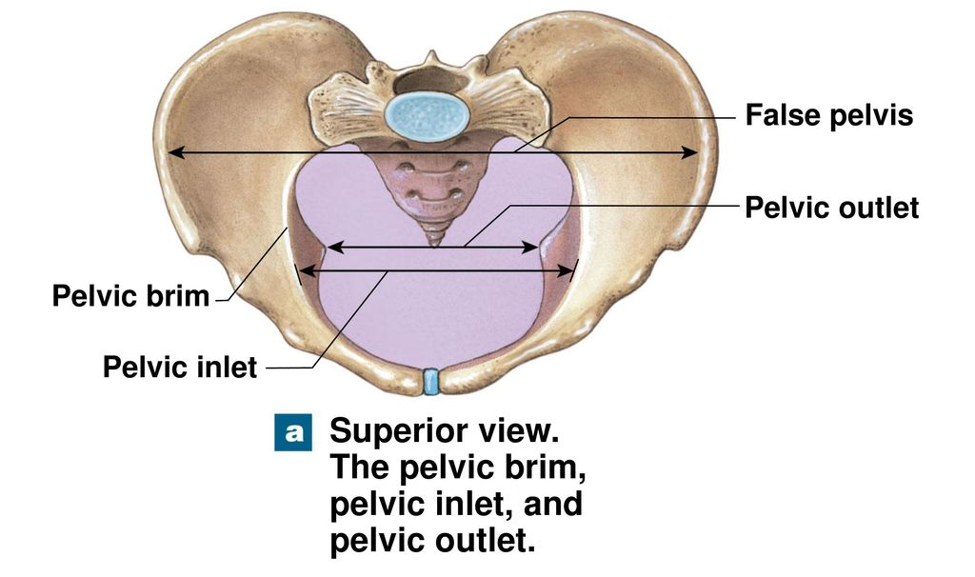
Divisions of the Pelvis
Greater (false) pelvis: Above pelvic brim; supports abdominal organs.
Lesser (true) pelvis: Below pelvic brim; contains pelvic organs.

Slide 21
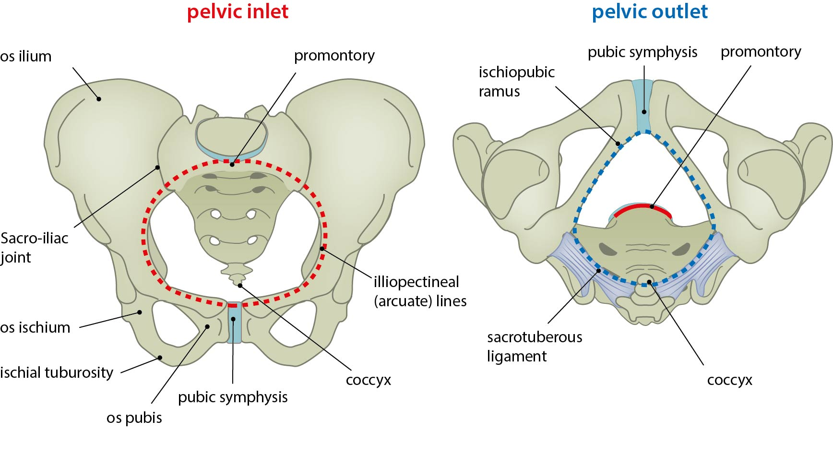

Slide 22
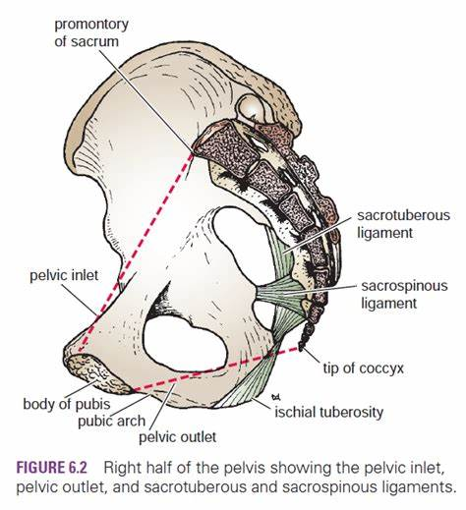
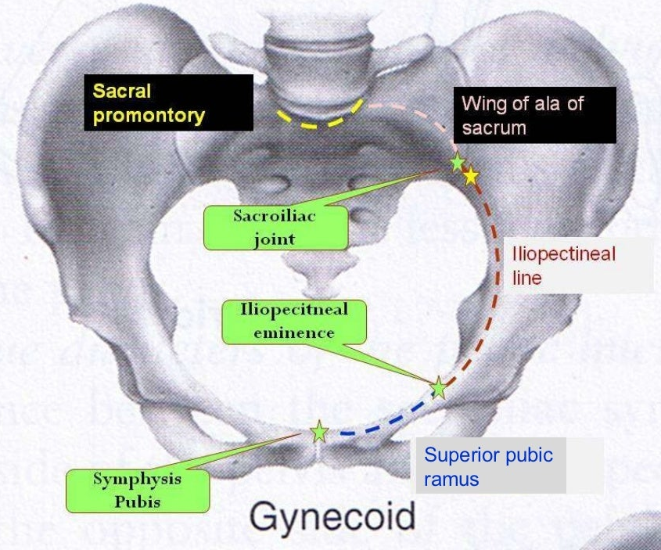

Slide 23
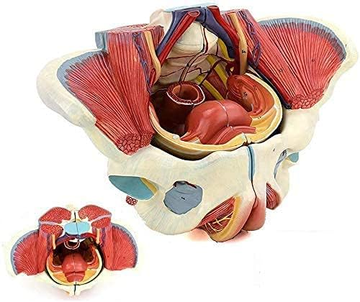
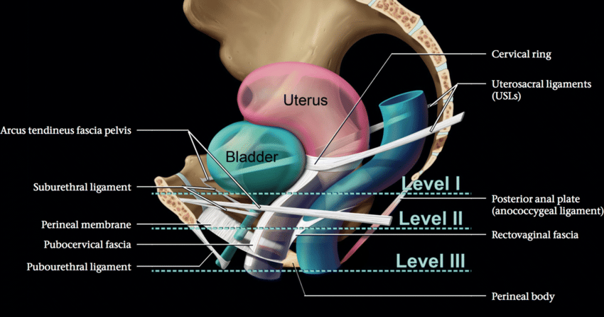
Contents of the Female Pelvis
Reproductive: Uterus, ovaries, fallopian tubes, vagina.
Urinary: Bladder, urethra.
Digestive: Rectum, anal canal.
Neurovascular: Internal iliac vessels, sacral plexus, autonomic nerves.
Lymphatic nodes: Internal iliac, external iliac, obturator, presacral, and para-aortic.

Slide 24
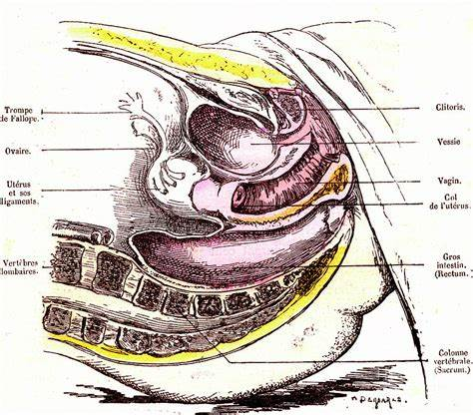
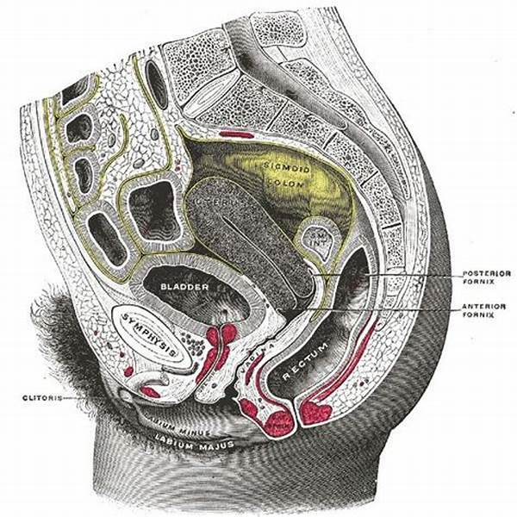
Pelvic Organs
Uterus
Hollow, muscular organ in the midline.
Normally anteverted and anteflexed.
Supported by ligaments (broad, uterosacral, round, cardinal).
Ovaries
Paired gonads in the ovarian fossa.
Attached to uterus by ovarian ligament; suspended laterally by suspensory ligament.
Fallopian Tubes
Conduct ova from ovary to uterus.
Divided into infundibulum, ampulla, isthmus, and intramural portions.
Vagina
Fibromuscular tube from cervix to vestibule.
Posterior to urethra and anterior to rectum.
Bladder
anteriorly behind the pubic symphysis.
Urethra passes below bladder neck.
Rectum
Posterior organ; follows curve of sacrum.
Joins anal canal at the anorectal junction.

Slide 25
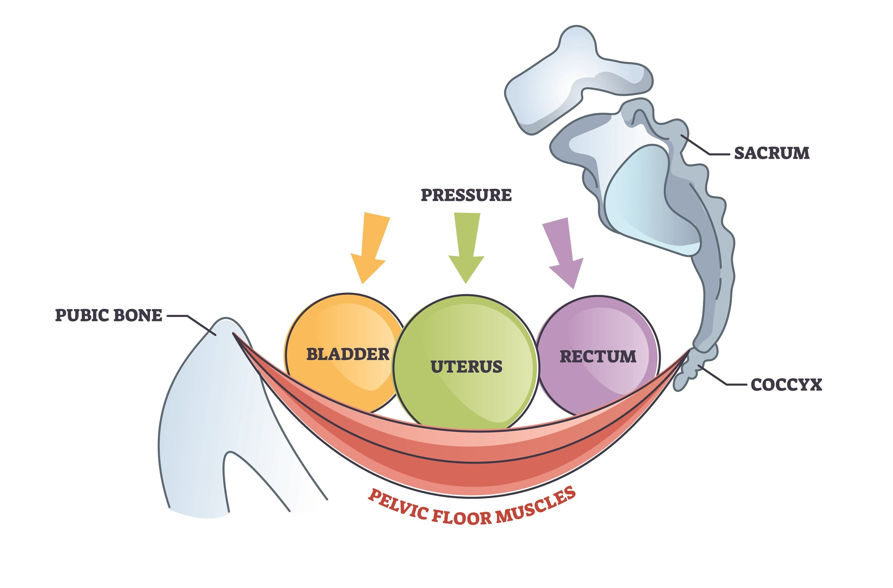
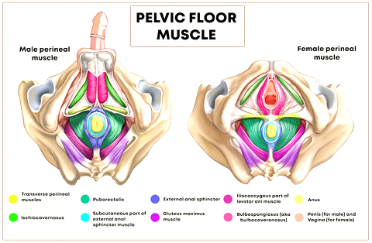
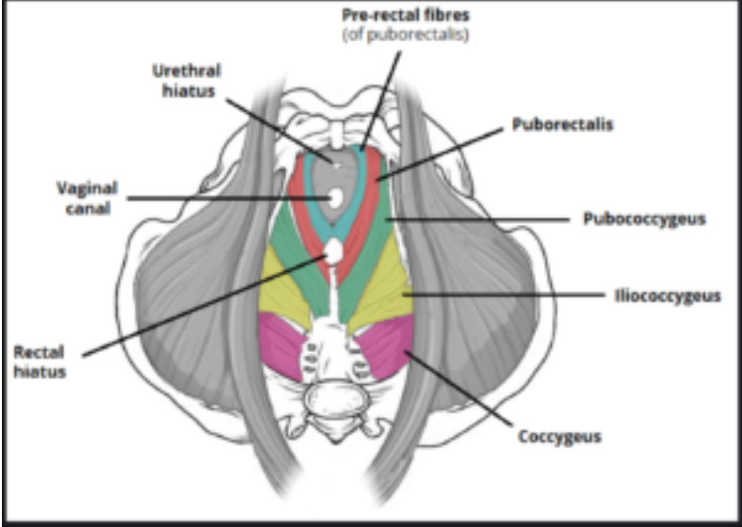
Pelvic Floor
Muscular diaphragm supporting pelvic organs.
Main muscles:
Levator ani (pubococcygeus, puborectalis, iliococcygeus).
Coccygeus.
Crucial for continence and pelvic organ support.

Slide 28
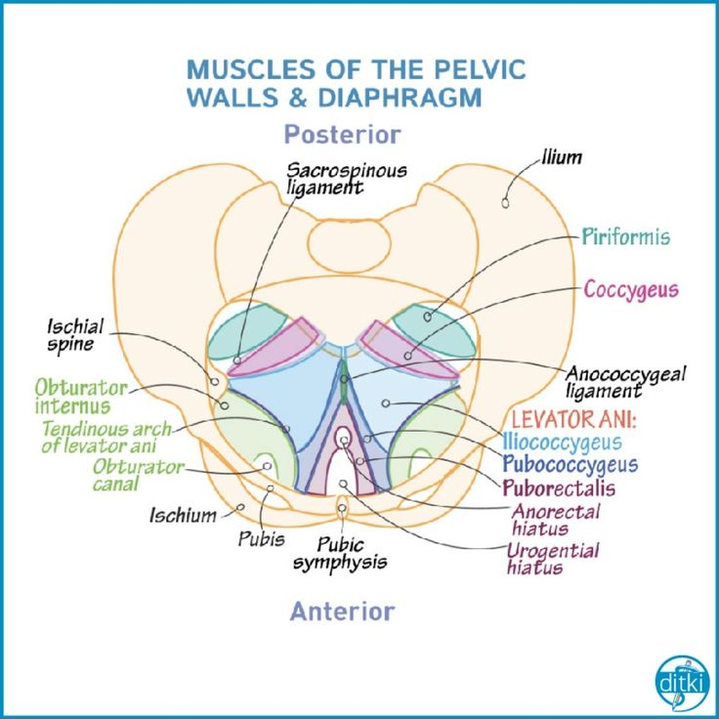

Slide 29
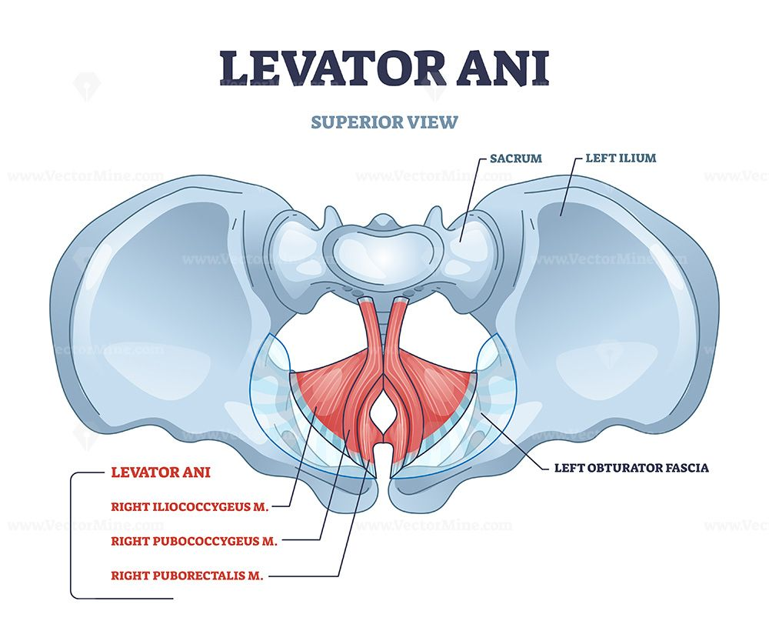
Levator Ani Group (most important for support and continence)
Pubococcygeus
From pubis to coccyx
Supports pelvic organs and helps control urine flow and vaginal tone
Puborectalis
Forms a sling around the rectum
Critical for maintaining the anorectal angle and fecal continence
Iliococcygeus
From fascia over obturator internus to coccyx
Lifts pelvic floor and supports viscera

Slide 30
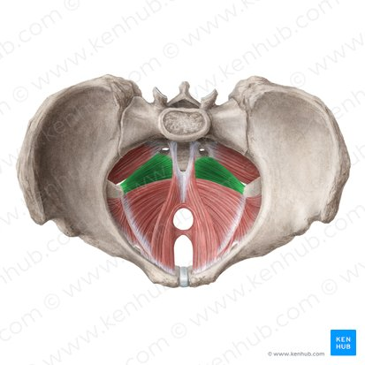
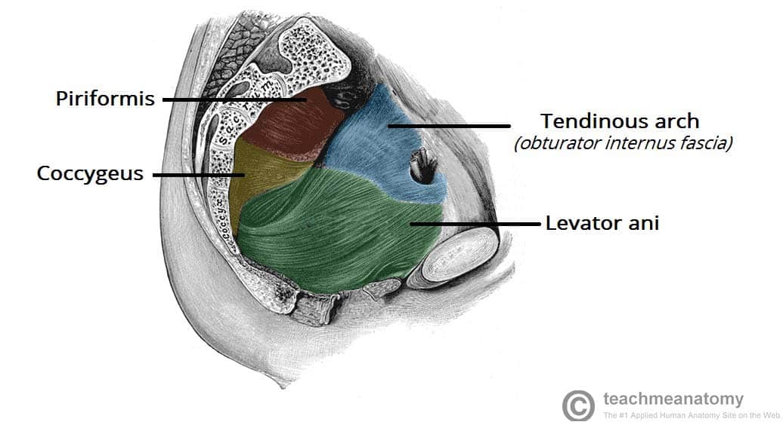
Coccygeus (Ischiococcygeus)
From ischial spine to sacrum/coccyx
Supports pelvic organs and contributes to the pelvic floor’s posterior wall

Slide 31
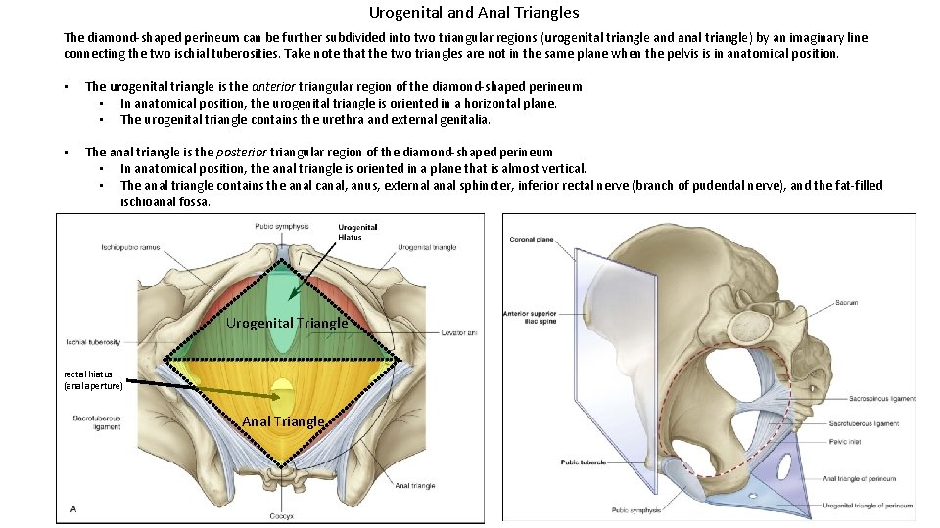
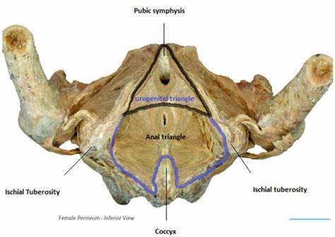
Associated Structures
Urogenital hiatus: Gap for urethra and vagina (females)
Anal aperture: Opening for the rectum
Perineal body: Fibromuscular node at the center of the perineum — critical for structural integrity

Slide 34
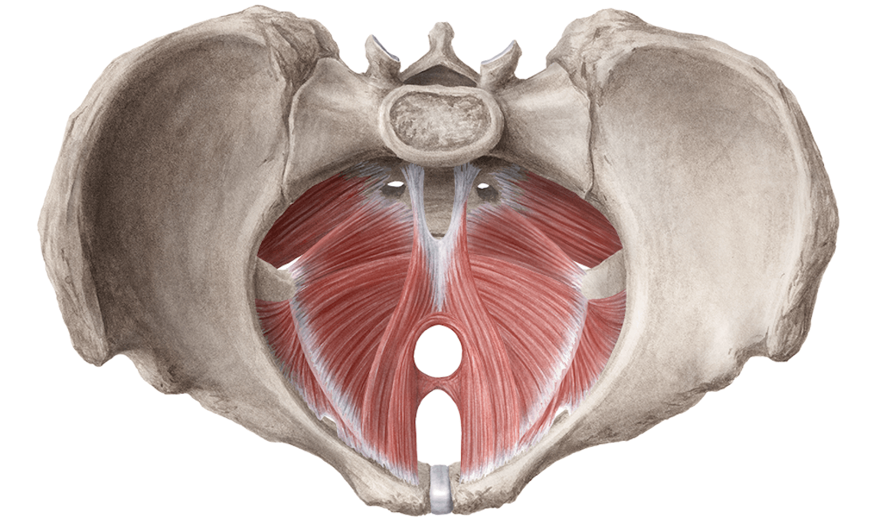
Functions of the Pelvic Floor Muscles
Support pelvic organs (bladder, uterus, rectum)
Maintain urinary and fecal continence
Aid in childbirth (resist downward pressure, stretch with fetal passage)
Stabilize the core during movement

Slide 35
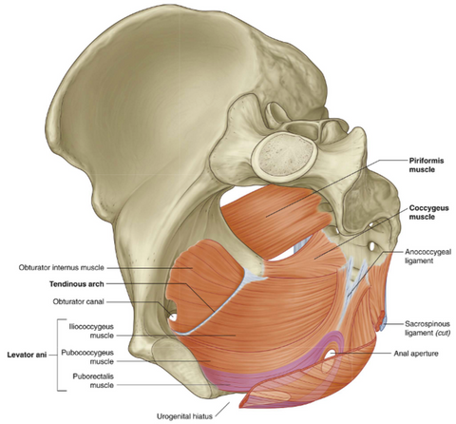
Pelvic Floor Muscles
Levator ani (especially pubococcygeus and puborectalis) supports the urethra and aids in continence.
Contraction increases urethral pressure and closure during stress.

Slide 37
Peritoneal Reflections & Pouches
Rectouterine pouch (of Douglas): Between uterus and rectum (lowest point in peritoneal cavity).
Vesicouterine pouch: Between bladder and uterus.

Slide 38
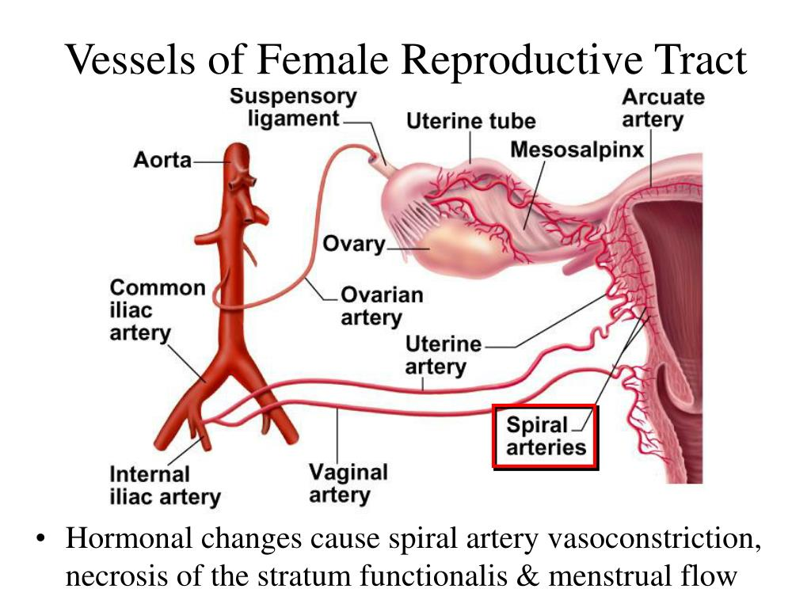
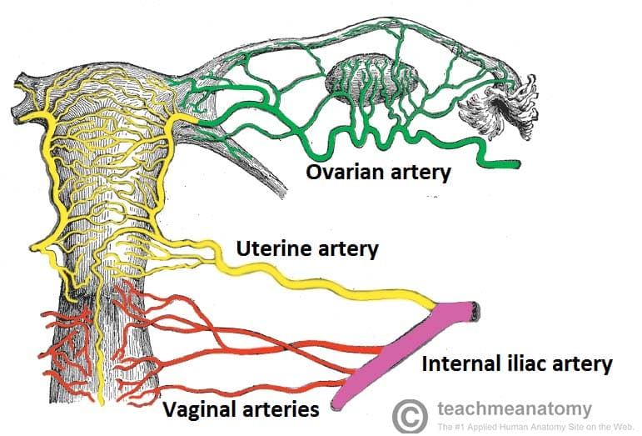
Arterial Supply
Arteries: Mainly from internal iliac artery (uterine, vaginal, pudendal).

Slide 39
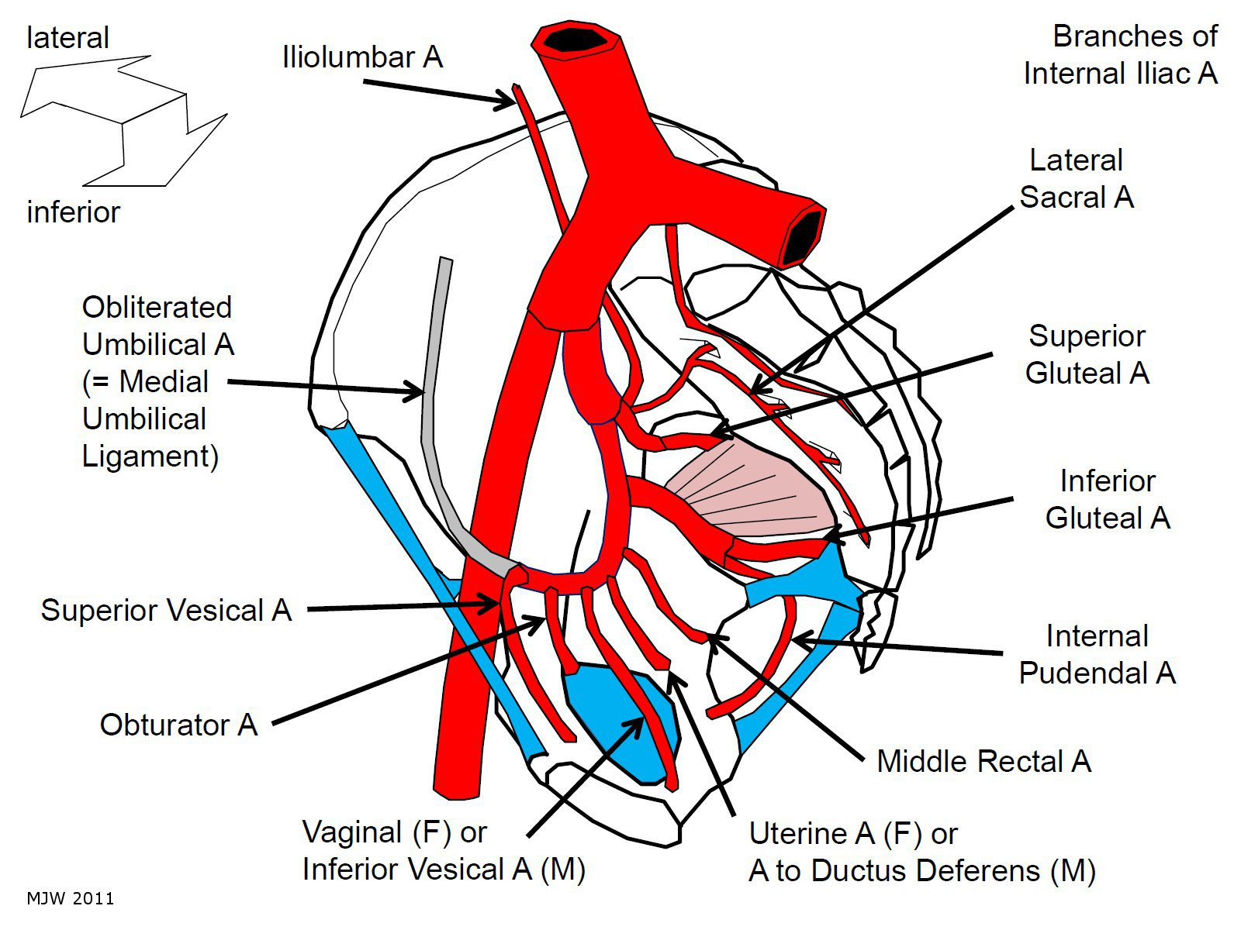

Slide 40
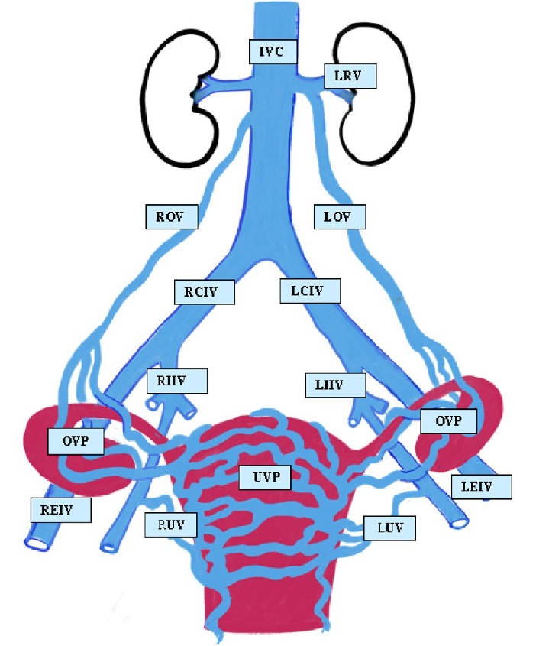
Vascular Supply
Veins: Drain to internal iliac veins, with rich venous plexuses.

Slide 41
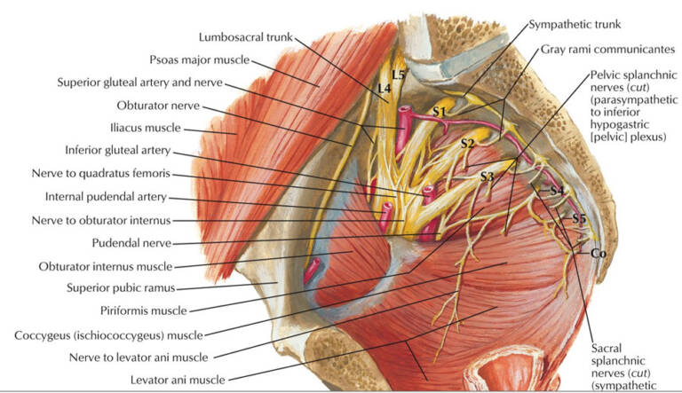
Innervation
Somatic: Pudendal nerve (S2–S4) → perineum, external sphincters.
Autonomic:
Hypogastric plexuses (superior and inferior).
Parasympathetic (S2–S4, pelvic splanchnics): motor to bladder, uterus.
Sympathetic (T10–L2): vasomotor and pain fibers.

Slide 42
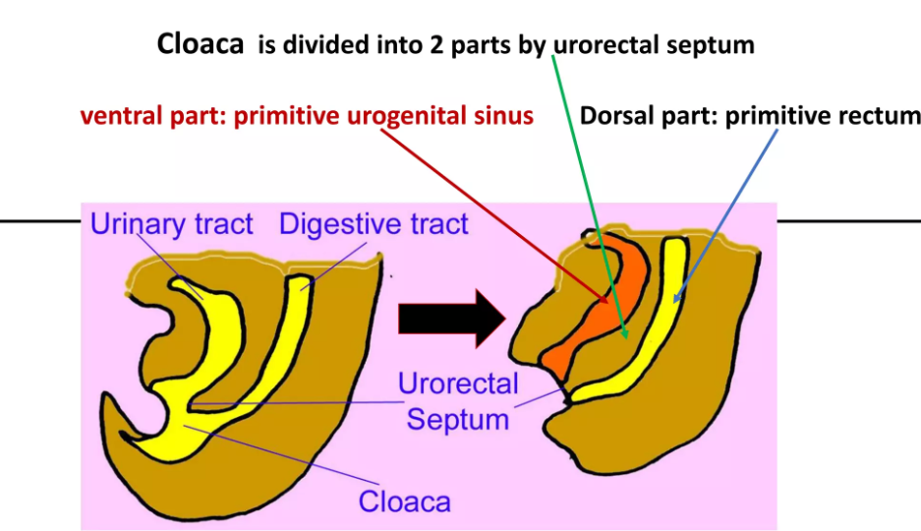
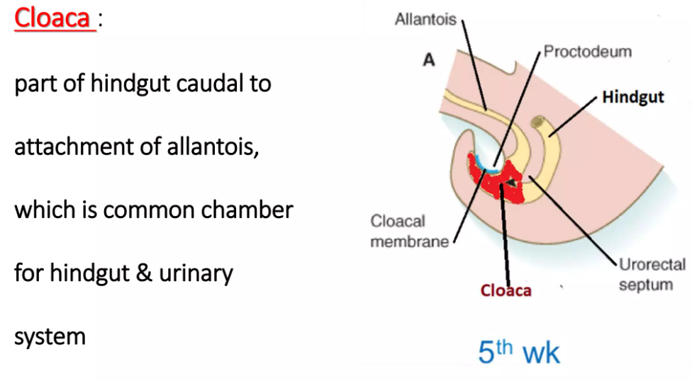
Development of the female urethra
Origin: The female urethra develops from the urogenital sinus, a derivative of the endoderm.
The bladder and urethra are formed from the vesicourethral part of the urogenital sinus.
The urogenital membrane breaks down to open the urethra to the perineum.
Mesenchymal interaction with endoderm is critical in defining length, patency, and surrounding musculature.

Slide 45
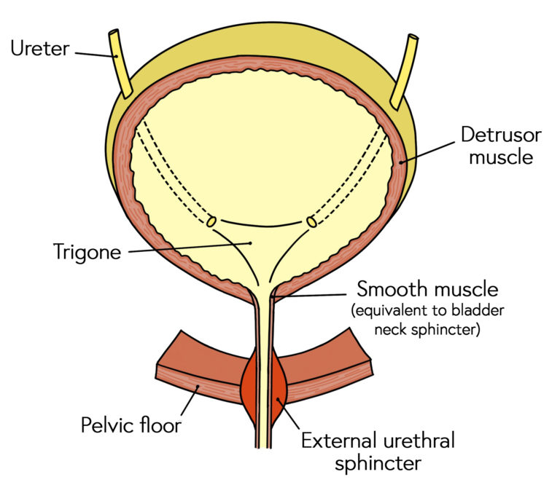
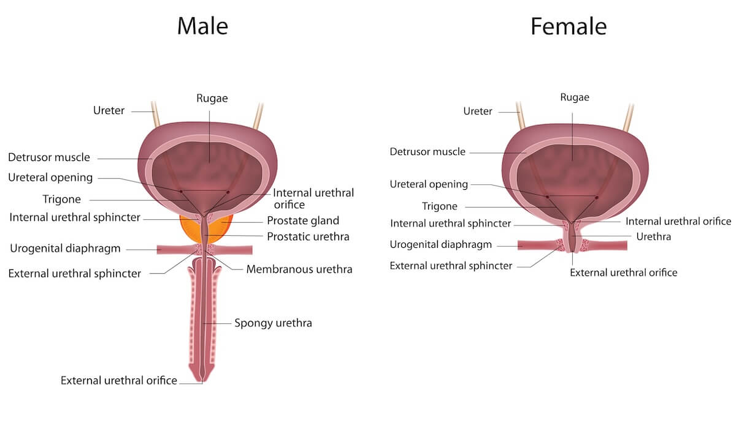
Topography and Relations of the female urethra
Length: ~4 cm (short compared to males).
Course: Passes downward and forward from the bladder neck to open in the vestibule between the clitoris and vaginal opening.

Slide 46
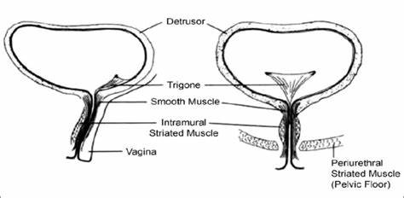
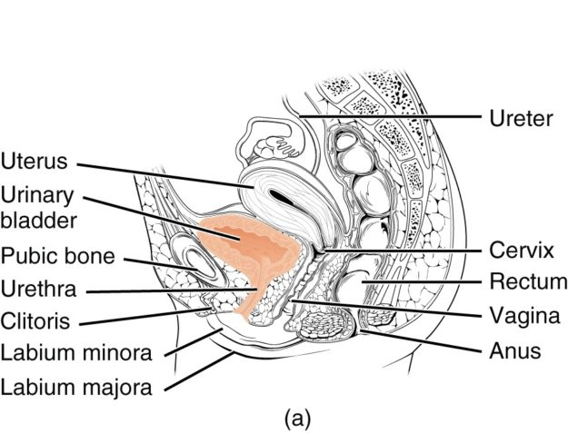
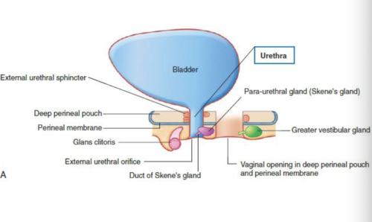
Topography and Relations of the female urethra
Length: ~4 cm (short compared to males).
Course: Passes downward and forward from the bladder neck to open in the vestibule between the clitoris and vaginal opening.
Anterior Relations: Pubic symphysis and retropubic space.
Posterior Relations: Vaginal wall.
Lateral Relations: Paraurethral glands (Skene's glands), connective tissue, and venous plexuses.

Slide 47
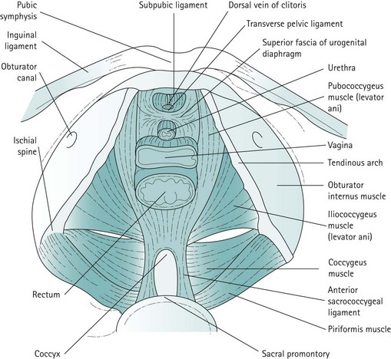
Female Continence Mechanism
a. Sphincters
Internal Urethral Sphincter
External Urethral Sphincter (EUS)
b. Endopelvic Fascia
c. Pelvic Floor Muscles

Slide 48
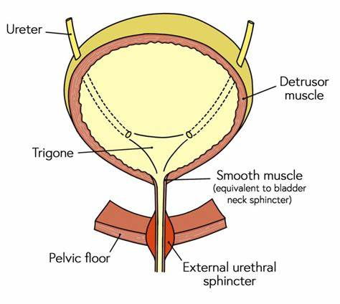
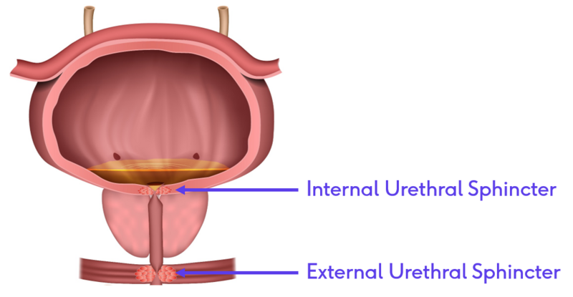
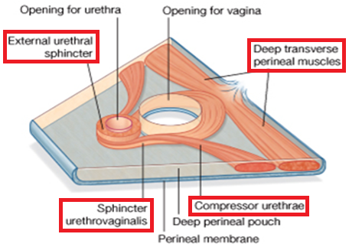
Sphincters of urethra
Internal Urethral Sphincter: Involuntary smooth muscle at bladder neck; not well-defined in females.
External Urethral Sphincter (EUS):
Compressor urethrae and urethrovaginal sphincter enhance continence.
Formed by striated muscle, under voluntary control, innervated by the pudendal nerve.

Slide 49
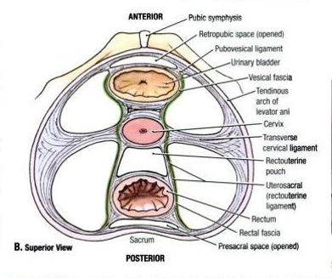
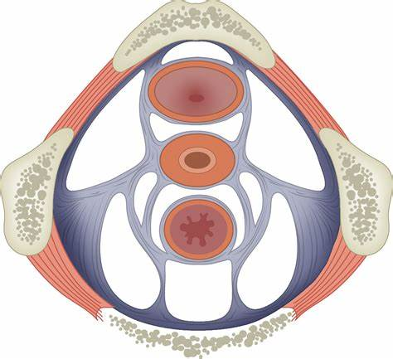
Endopelvic Fascia
Anchors urethra and bladder neck to the pubic bone and pelvic wall.
Contributes to the pubourethral ligament, supporting urethral closure.

Slide 50
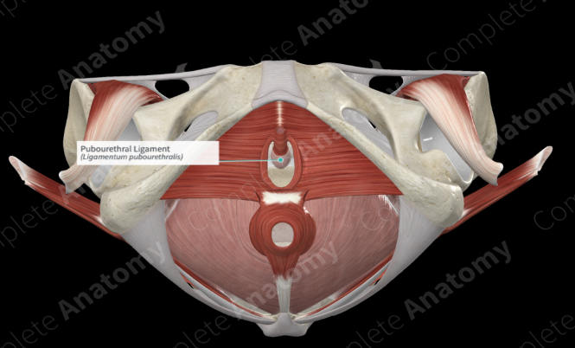

Slide 51
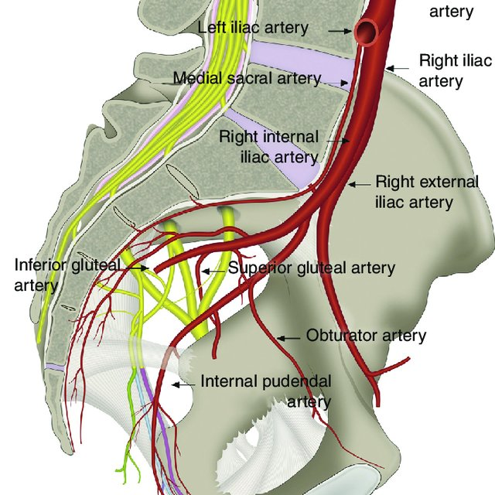
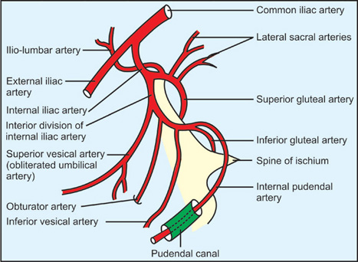
Vascular Supply
Arterial Supply:
Internal pudendal artery (via perineal branches).
Inferior vesical artery (sometimes via vaginal artery).

Slide 52
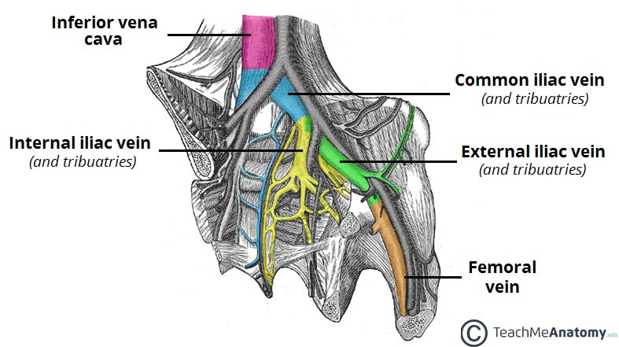
Vascular Supply
Venous Drainage:
Via pudendal venous plexus and vaginal venous plexus into the internal iliac vein.

Slide 53
Lymphatic Drainage
Primary nodes:
Internal iliac nodes
Obturator nodes
Some drainage may reach superficial and deep inguinal nodes, especially from the distal urethra.

Slide 54
Innervation of the urethra
Somatic: Pudendal nerve (S2–S4) → motor to external sphincter and sensory to urethra.
Autonomic:
Sympathetic (T11–L2): via hypogastric plexus, modulating smooth muscle tone.
Parasympathetic (S2–S4): via pelvic splanchnic nerves, supporting detrusor and urethral relaxation during voiding.

