Slide 1


ANATOMY OF THE LARGE INTESTINE
Stamatis Chatzikokolis MD.
General Surgeon
Department of Anatomy, School of Medicine, NKUA

Slide 2
EMBRYOLOGY DIGESTIVE SYSTEM
The colon is produced by both the midgut and the hindgut.The midgut is responsible for the genesis of the cecum, the ascending colon, and the proximal
⅔ of the transverse colon.The hindgut is responsible for the remainder of the colon, the rectum, and the proximal part of the anus.To be more specific, the distal ⅓ of the transverse colon, the descending colon, the sigmoid colon, the rectum and the proximal part of the anal canal develop from the hindgut.

Slide 3
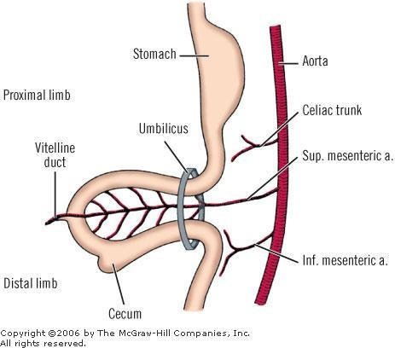

Slide 4
EMBRYOLOGY OF INTESTINE
In the fifth week, the embryonic cloaca is an endodermal sac receiving the hindgut dorsally and the allantoic stalk ventrally.The cloaca (Fig. 18-2A, B) is separated from the outside by a thin cloacal membrane (proctodeum), which occupies the embryo's ventral surface between the tail and the body stalk. During the sixth week, a septum of mesoderm divides the cloaca into a ventral urogenital sinus and a dorsal rectum (Fig. 18-2C) .This mesodermic septum fuses with the cloacal membrane in the seventh week to form the perineal body.The cloacal membrane is divided into a larger, ventral urogenital membrane and a smaller, dorsal anal membrane. Externally, the anal membrane becomes slightly depressed, forming the anal dimple.

Slide 5
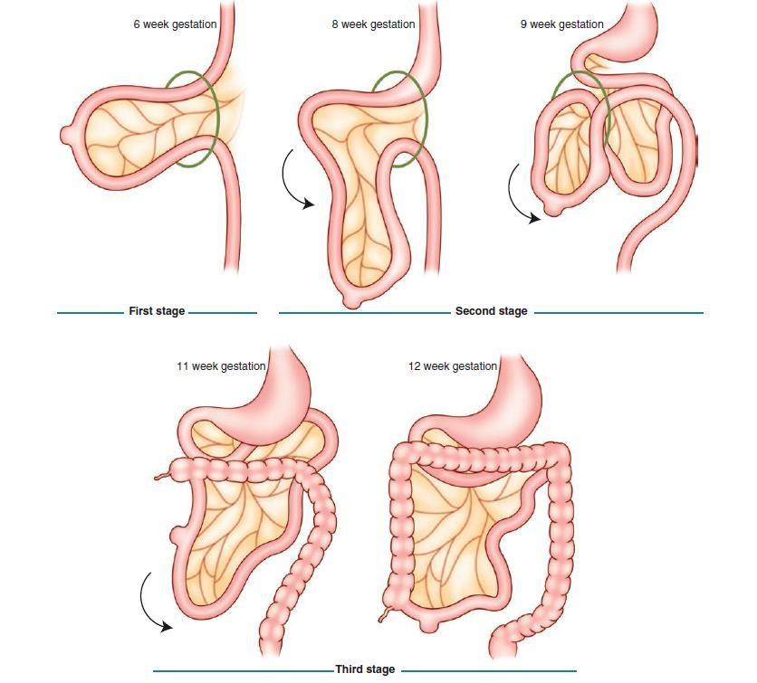
Embryology
Herniation
Return in the peritoneal cavity
Adhesion in the retroperitoneal area

Slide 6
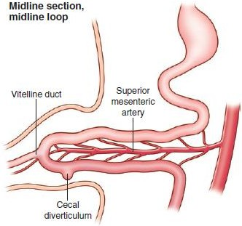
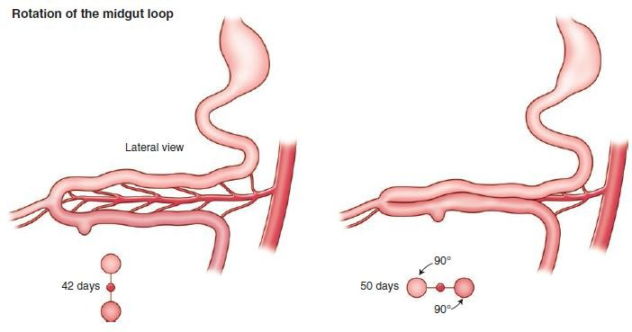
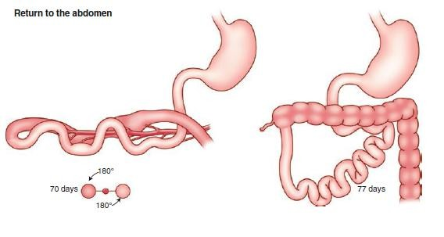




Anti clock rotation 270⁰

Slide 7
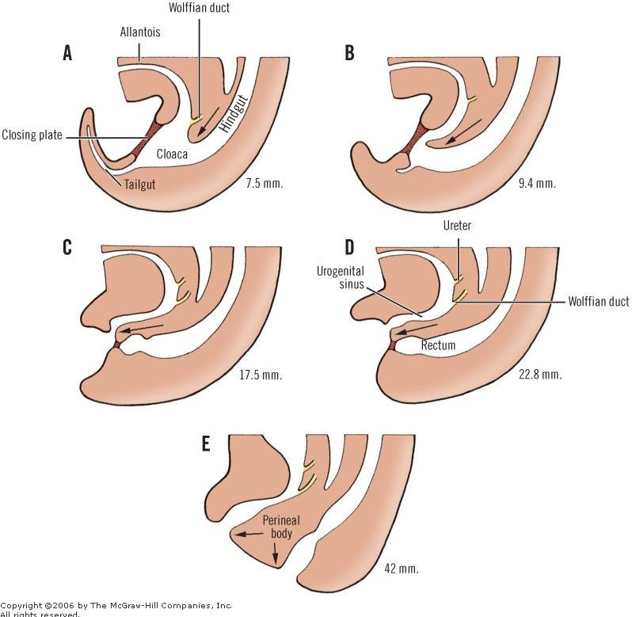

Slide 8


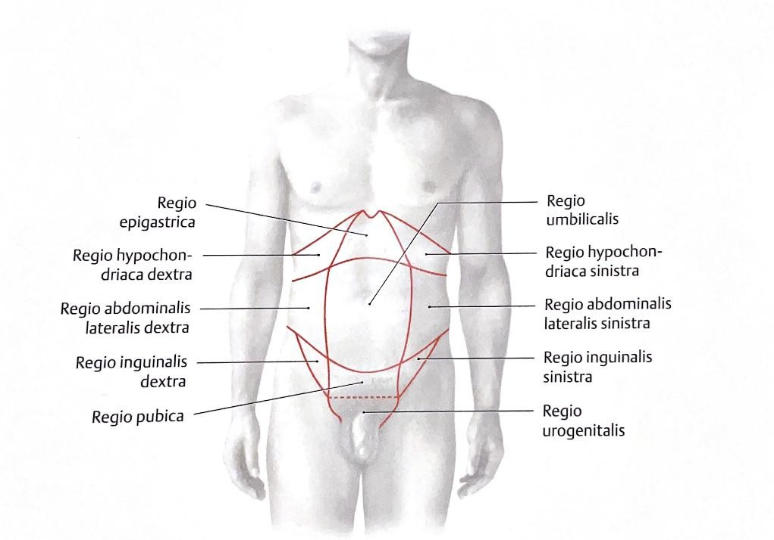
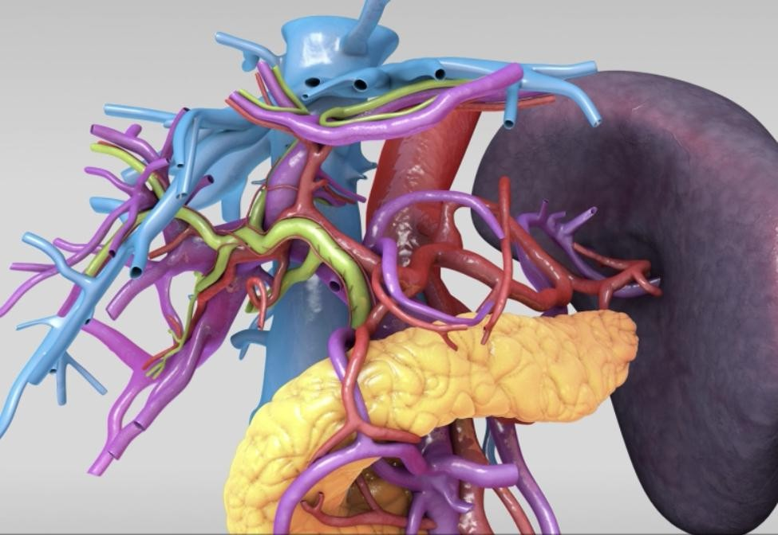

Topography of the Abdomen
Prometheus LernAtlas der Anatomie

Slide 9
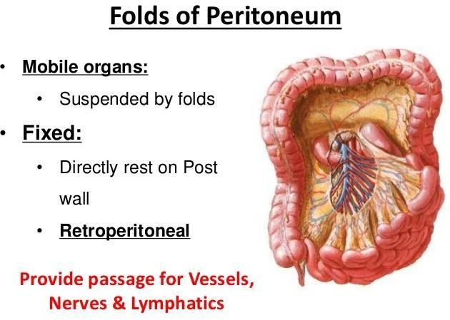

Slide 10
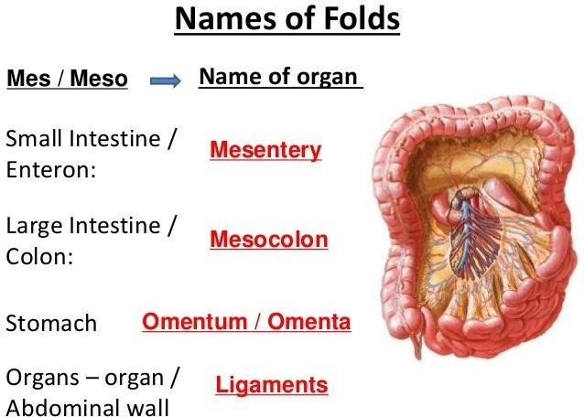

Slide 11
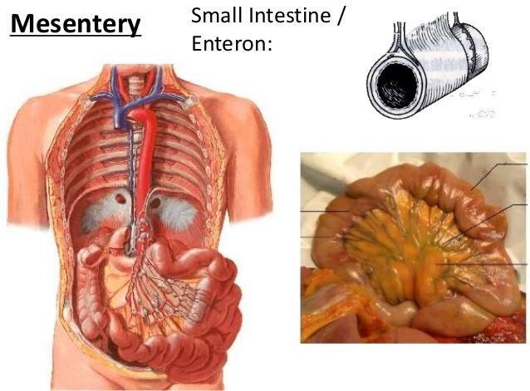

Slide 12
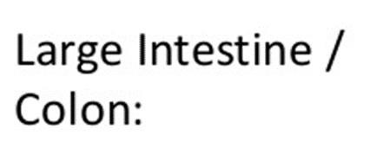
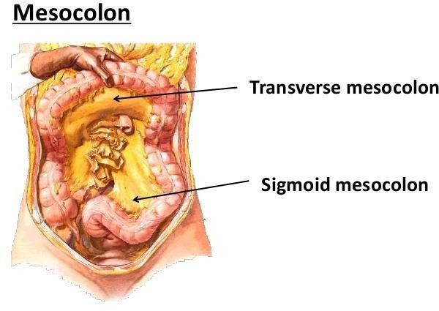

Slide 13
The mesocolon is a mesentery that attaches the colon to the posterior abdominal wall.
It results from the reflection of parietal peritoneum of the posterior abdominal wall.
The mesocolon contains a substantial amount of adipose tissue, as well as the neurovascular supply to the colon.
Where it is adhered to the posterior abdominal wall, it is held in place by a layer of
loose connective tissue ??
FASCIA TOLDT

Slide 14
The mesocolon extends along the entire length of the colon, from the distal root of the small intestine mesentery, along the ascending, transverse, colon, and sigmoid colons to reach the rectum, which is not surrounded by peritoneum, roughly at the level of the third sacral vertebra (S3).
Differing parts of the mesocolon that extend to portions of the colon that remain static become adherent with the parietal peritoneum and are called secondarily retroperitoneal (Standring, 2016). =ASCENDING AND DESCENDING COLON
Other parts retain their mobility and mesentery, thus staying intraperitoneal.

Slide 15
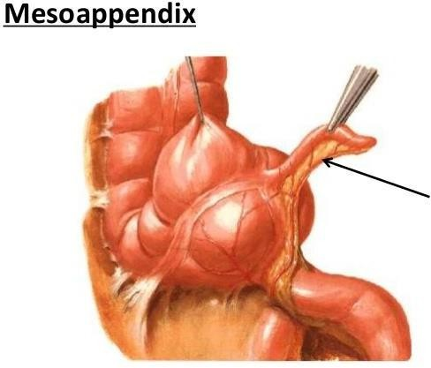

Slide 16
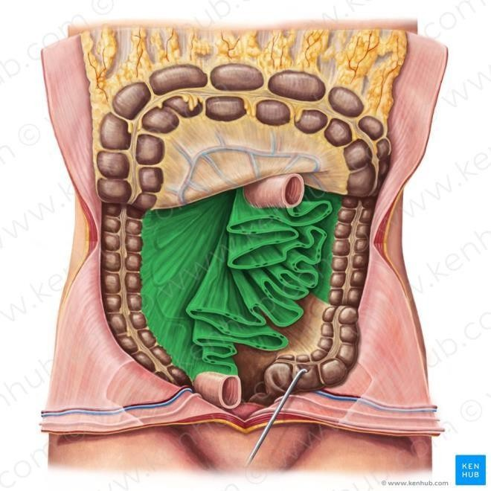
MESENTERY
The mesentery (Greek fold of intestine) of the small intestine or mesentery proper is a broad, fan-shaped fold of peritoneum
which suspends the coils of jejunum and ileum from the posterior
abdominal wall.
https://www.kenhub.com/en/library/anatomy/mesentery

Slide 17
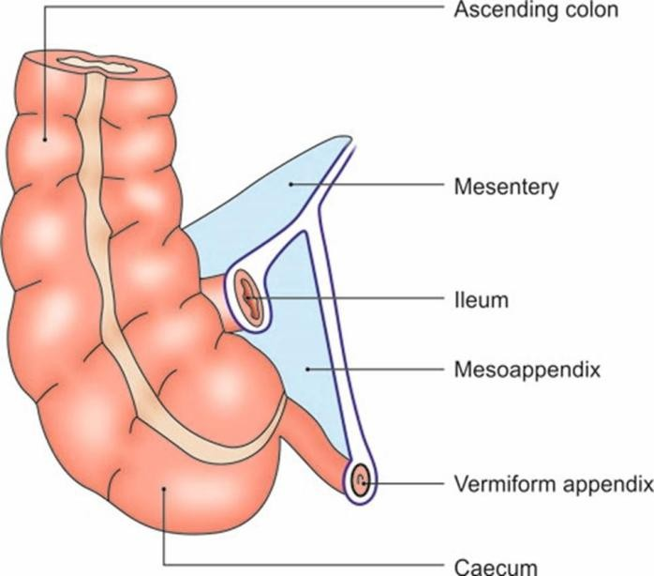
Mesoappendix
It is a small, triangular fold of peritoneum which suspends the vermiform appendix from the posterior surface of the lower end of the mesentery close to the ileocaecal junction.

Slide 18
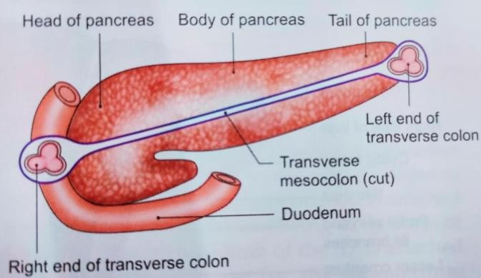
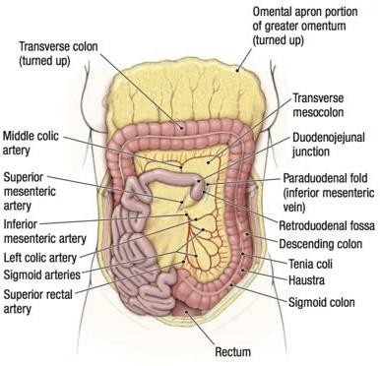
Transverse Mesocolon
Attachments
The root of the transverse mesocolon is attached to the anterior surface of the head, and the anterior border of the body of the pancreas.
Contents
It contains the middle colic vessels; the nerves, lymph nodes and lymphatics of the transverse colon.
https://www.memorangapp.com/flashcards/71585/Inferior+Mesenteric+Artery+and+Large+intestine/

Slide 19
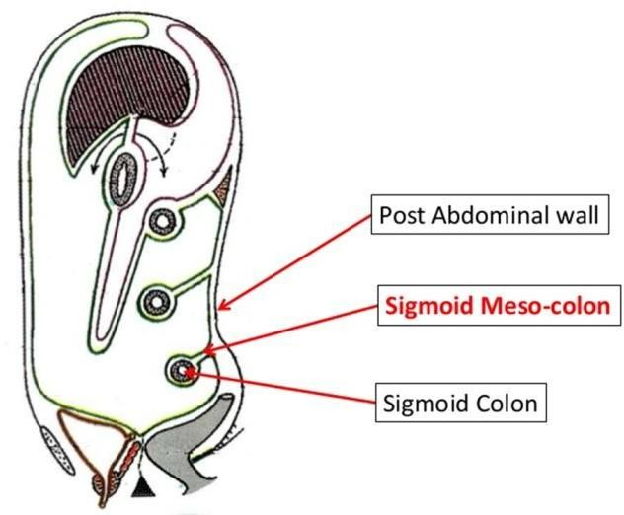
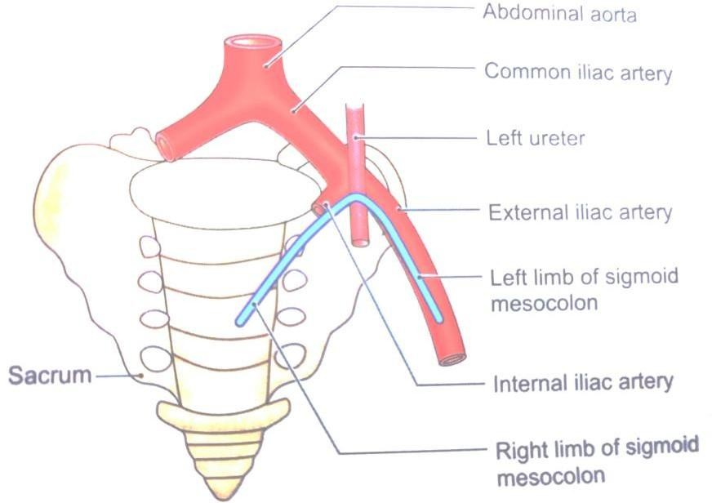
Sigmoid Mesocolon
Features
This is a triangular (Greek ‘S’ shape) fold of peritoneum which suspends the sigmoid colon from the pelvic wall.
Attachments
The root is shaped like an inverted ‘V’.
Contents
The sigmoid vessels in the left limb; superior rectal vessels, nerves, lymph
nodes and lymphatics in the right limb
of the sigmoid colon.

Slide 20
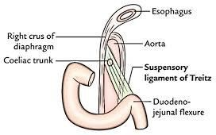
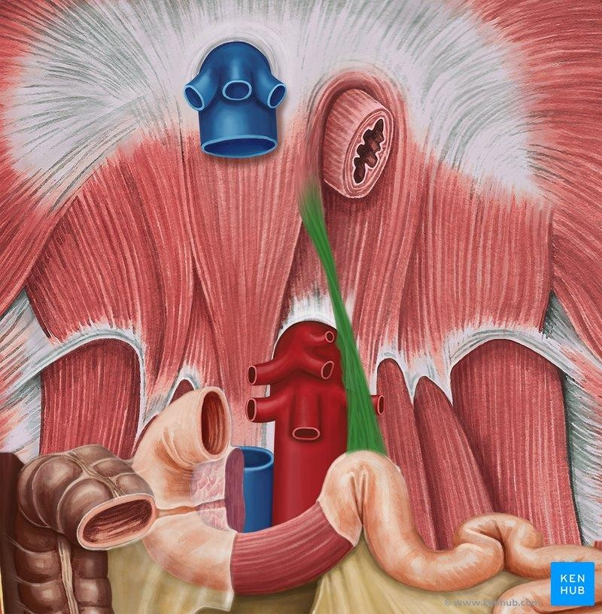
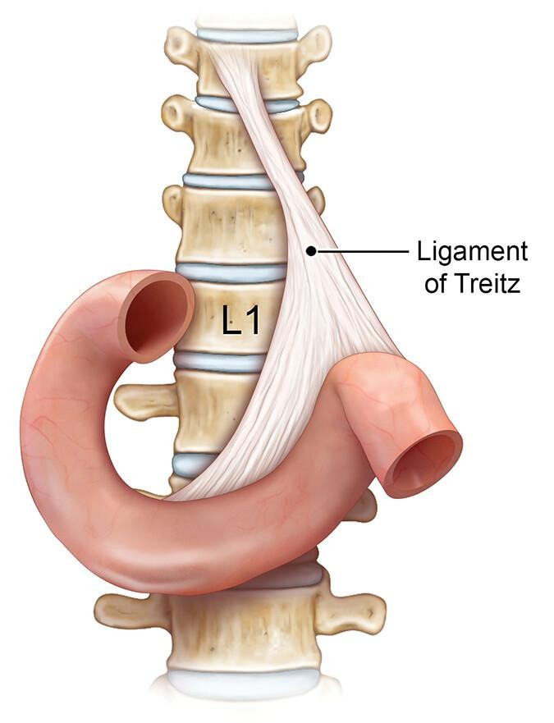
LIGAMENT OF TREITZ THE ANATOMICAL LANDMARK OF U-L GI

Slide 21
TOPOGRAPHIC ANATOMY
The large intestine extends from the terminal ileum to the anus.To be more embryologically and anatomically correct, it extends to the pectinate (dentate) line, in other words, to the proximal 2 cm of the anal canal.
The classic divisions of the colon are the cecum, the colon proper, the rectum, and the anal canal.The first 6 cm of the large intestine just below the ileocecal valve, the ascending colon, and the hepatic flexure form a surgical unit, the right colon (right colectomy).
The distal transverse colon, splenic flexure, and descending and sigmoid colons
constitute the left colon (left colectomy).

Slide 22
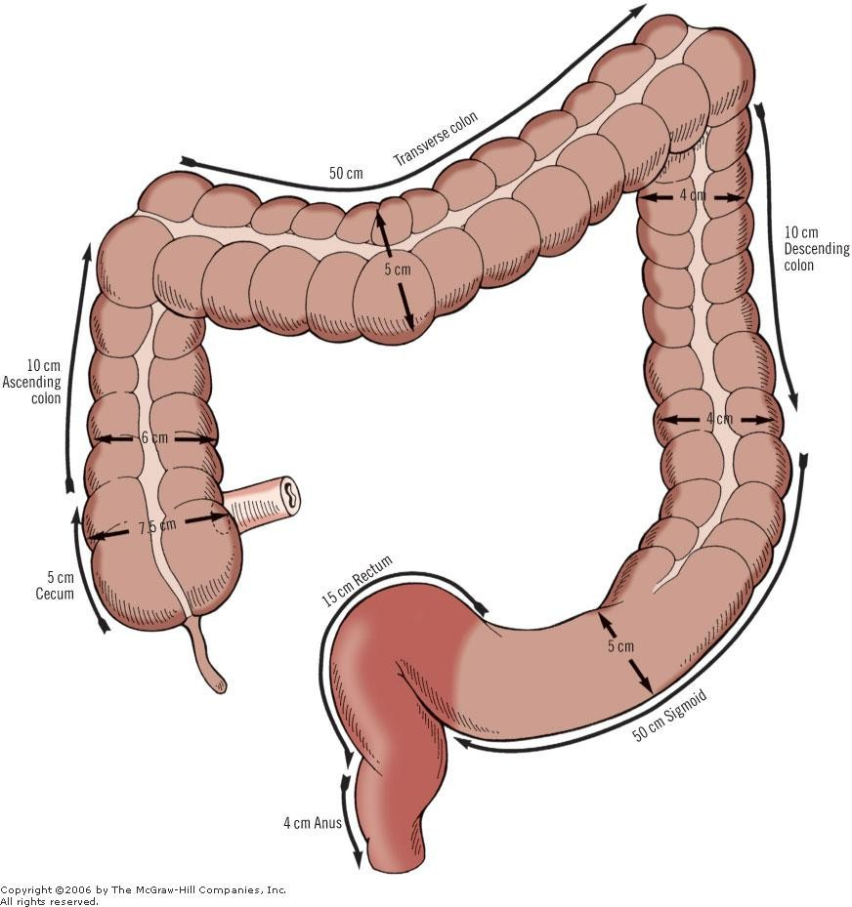
AVERAGE
LENGTHS AND DIAMETERS OF THE
SEGMENTS OF THE LARGE
INTESTINE

Slide 23
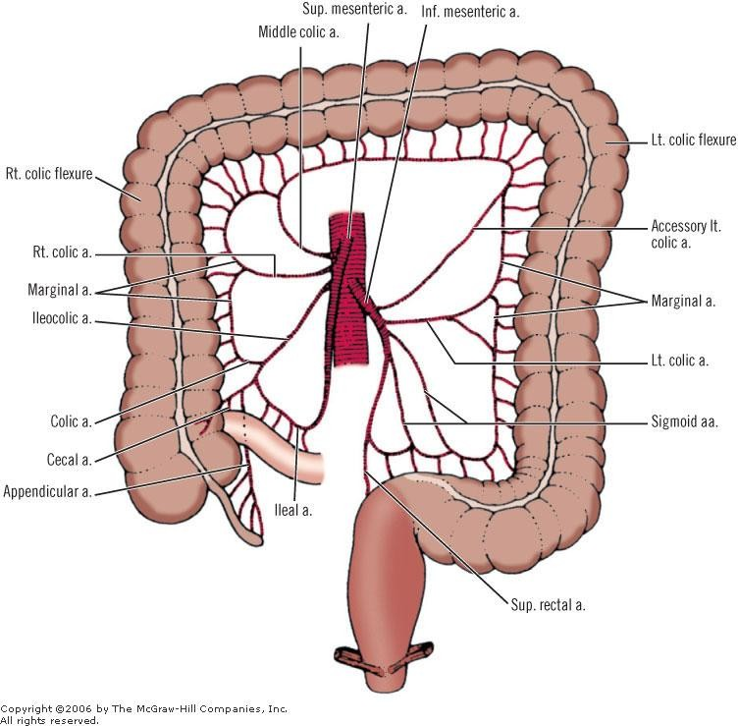
SCHEMA OF THE
ARTERIAL BLOOD
SUPPLY TO
THE LARGE INTESTINE

Slide 24
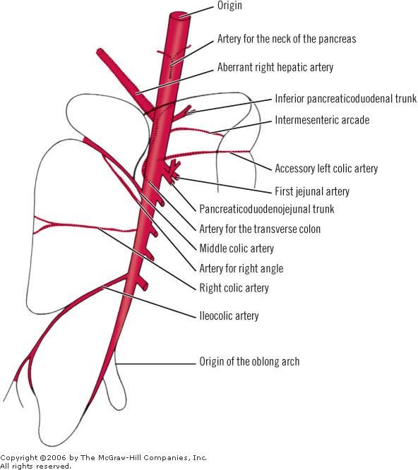
THE COLLATERAL
OF THE
SUPERIOR MESENTERIC ARTERY

Slide 25
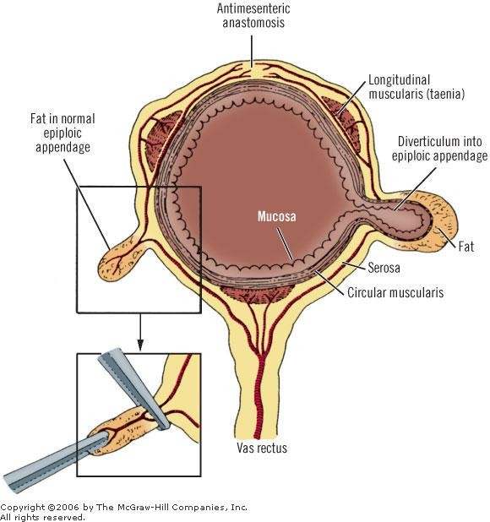
DIAGRAM OF THE TRANSVERSE
COLON SHOWING LONG AND SHORT BRANCHES OF THE
VASA RECTA

Slide 26
ARTERY OF DRUMMOND
The marginal artery (Fig. 18-17A, B, C) is composed of a series of anastomosing arcades between branches of the ileocolic, right colic, middle colic, left colic, and sigmoidal arteries.These form a single, looping vessel.The marginal artery courses roughly parallel with the mesenteric border of the large intestine, from 1 cm to 8 cm from the intestinal wall. It may or may not terminate at the superior rectal artery (Fig. 18-17C).
The blood supply to the colon is adequate, but without much margin of safety. Anastomosis between the right colic and ileocolic arteries is absent in 5 percent of subjects (Fig. 18-17B).³⁰
Griffiths³⁵ described a point of circulation weakness at the splenic flexure. In 200 subjects, Michels and colleagues³² found good anastomosis of arteries in this area in 61 percent, poor anastomosis in 32 percent, and no anastomosis in 7 percent.

Slide 27
COLONIC VENOUS DRAINAGE
Veins of the colon (Fig. 18-20) follow the arteries. On the right (the cecum, ascending colon, and right transverse colon), the veins join to form the superior mesenteric vein.Veins of the hepatic flexure and the right portion of the transverse colon enter the gastroepiploic vein or the anterior superior pancreaticoduodenal vein.Voiglio et al.⁴³ studied and defined the gastrocolic vein and reported two cases of avulsion secondary to abdominal trauma. It is present in 70% of patients, it is short (less than 25 mm), and its calibre ranges from 3 mm to 10 mm. It is located at the anterior surface of the head of the pancreas and beneath the root of the transverse mesocolon as a confluence between the right gastroepiploic and right upper colic veins.The above authors emphasize the surgical importance of this vein during surgery of the pancreas, in portal hypertension, and in abdominal trauma. Drainage from the left portion of the transverse colon enters the superior mesenteric vein.The superior rectal vein drains the descending and sigmoid colons; it passes upward to form the inferior mesenteric vein.

Slide 28
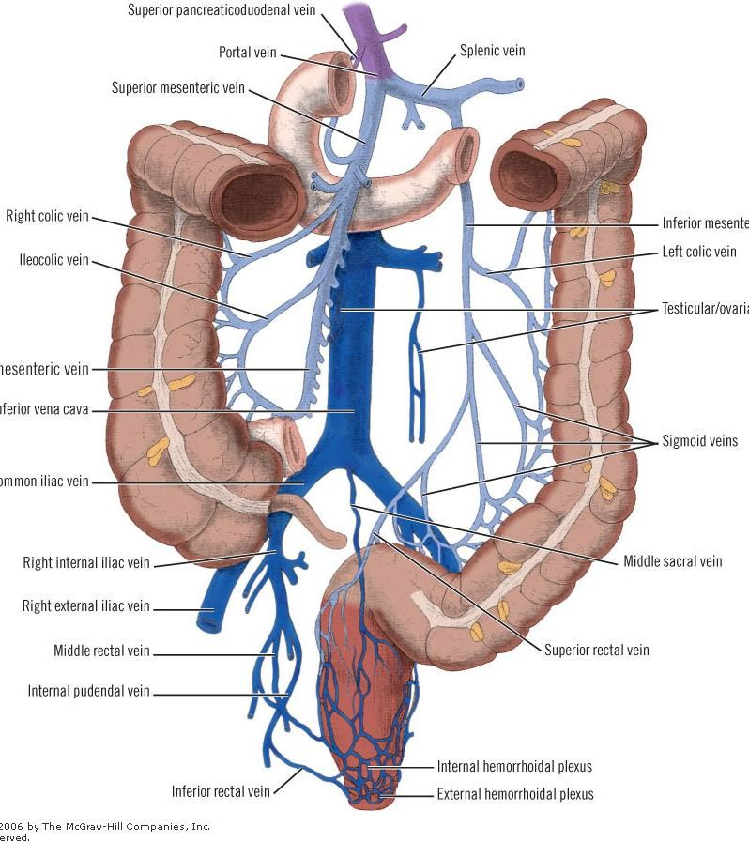
VENOUS DRAINAGE

Slide 29
LYMPH DRAINAGE
Lymph nodes of the large intestine have been divided into four groups (Fig. 18-22): epicolic (under the serosa of the wall of the intestine); paracolic (on the marginal artery); intermediate (along the large arteries [superior and inferior mesenteric arteries]); and principal (at the root of the superior and inferior mesenteric arteries).This last group includes mesenteric root nodes (which also receive lymph from the small intestine), aortic nodes, and left lumbar nodes.The number of nodes of the large intestine is shown in Table 18-4.

Slide 30
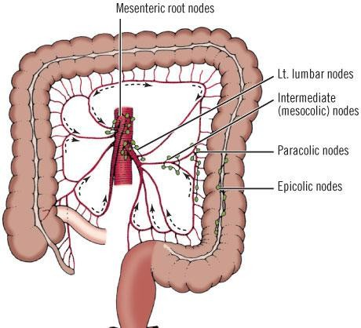
LYMPH NODES OF
THE COLON

Slide 31
INNERVATION I
The sympathetic supply to the right colon originates from the lower six thoracic segments of the spinal cord. Preganglionic fibers pass through the sympathetic chain ganglia, then pass as thoracic splanchnic nerves to synapse in the celiac, aortic, and superior mesenteric plexuses. From the plexuses, postganglionic fibers pass with the arteries in the mesentery to the small intestine and the right colon.
On the left, preganglionic fibers arise from the first two (or three) lumbar segments of the cord, then travel as lumbar splanchnic nerves to the aortic plexus and the inferior mesenteric plexus. From ganglia in this diffuse plexus, postganglionic fibers follow branches of the inferior mesenteric artery to the left colon and the upper rectum.

Slide 32
INNERVATION II
Vagal fibers from the posterior trunk pass as the celiac division to and through the celiac ganglion without synapse. From the ganglion, preganglionic fibers pass on the superior mesenteric artery to the small intestine and the right colon, where they synapse with ganglion cells of the intramural plexuses.
The left colon receives parasympathetic fibers from pelvic splanchnic nerves, which arise from the 2nd, 3rd, and 4th sacral nerves.These fibers follow the course of the presacral nerve to reach the inferior mesenteric plexus. From this plexus, the preganglionic fibers follow the branches of the inferior mesenteric artery to the left colon and the upper rectum.

Slide 33
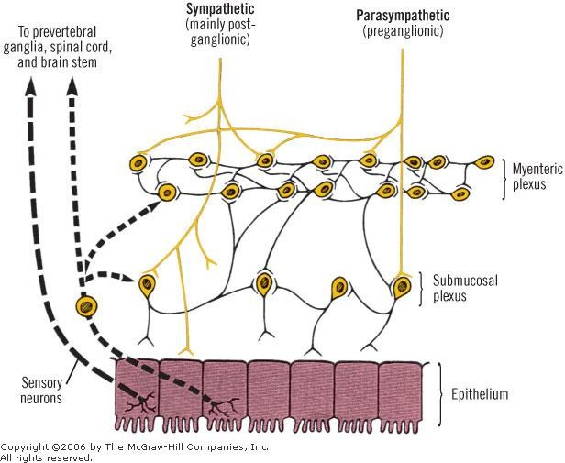

Slide 34
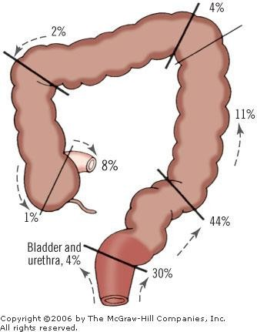
RELATIVE
FREQUENCY OF
AGANGLIONIC SEGMENTS BY LENGTH OF
SEGMENT AFFECTED

Slide 35
EXTERNAL DIFFERENCES
The small intestine (with the exception of the duodenum) is mobile, whereas the ascending and descending parts of the colon are fixed.
The caliber of the full small intestine is smaller than that of the filled large intestine.
The small intestine (with the exception of the duodenum) has a mesentery that passes
downward across the midline into the right iliac fossa.
The longitudinal muscle of the small intestine forms a continuous layer around the gut. In the large intestine (with the exception of the appendix), the longitudinal muscle is collected into three bands, the teniae coli .
The small intestine has no fatty tags attached to its wall.The large intestine has fatty tags, called the appendices epiploicae.
The wall of the small intestine is smooth, whereas that of the large intestine is sacculated .

Slide 36
INTERNAL DIFFERENCES
The mucous membrane of the small intestine has permanent folds, called plicae circulares, which are absent in the large intestine.
The mucous membrane of the small intestine has villi, which are absent in the large intestine.
Aggregations of lymphoid tissue called Peyer’s patches are found in the mucous membrane of the small intestine; these are absent in the large intestine.

Slide 37
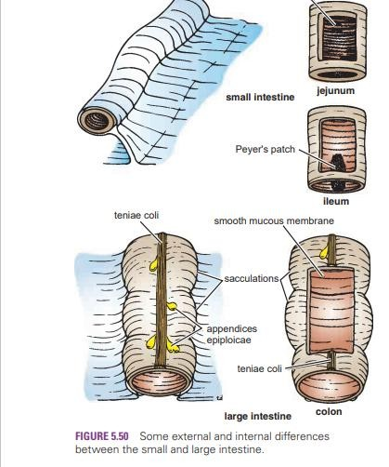

Slide 38


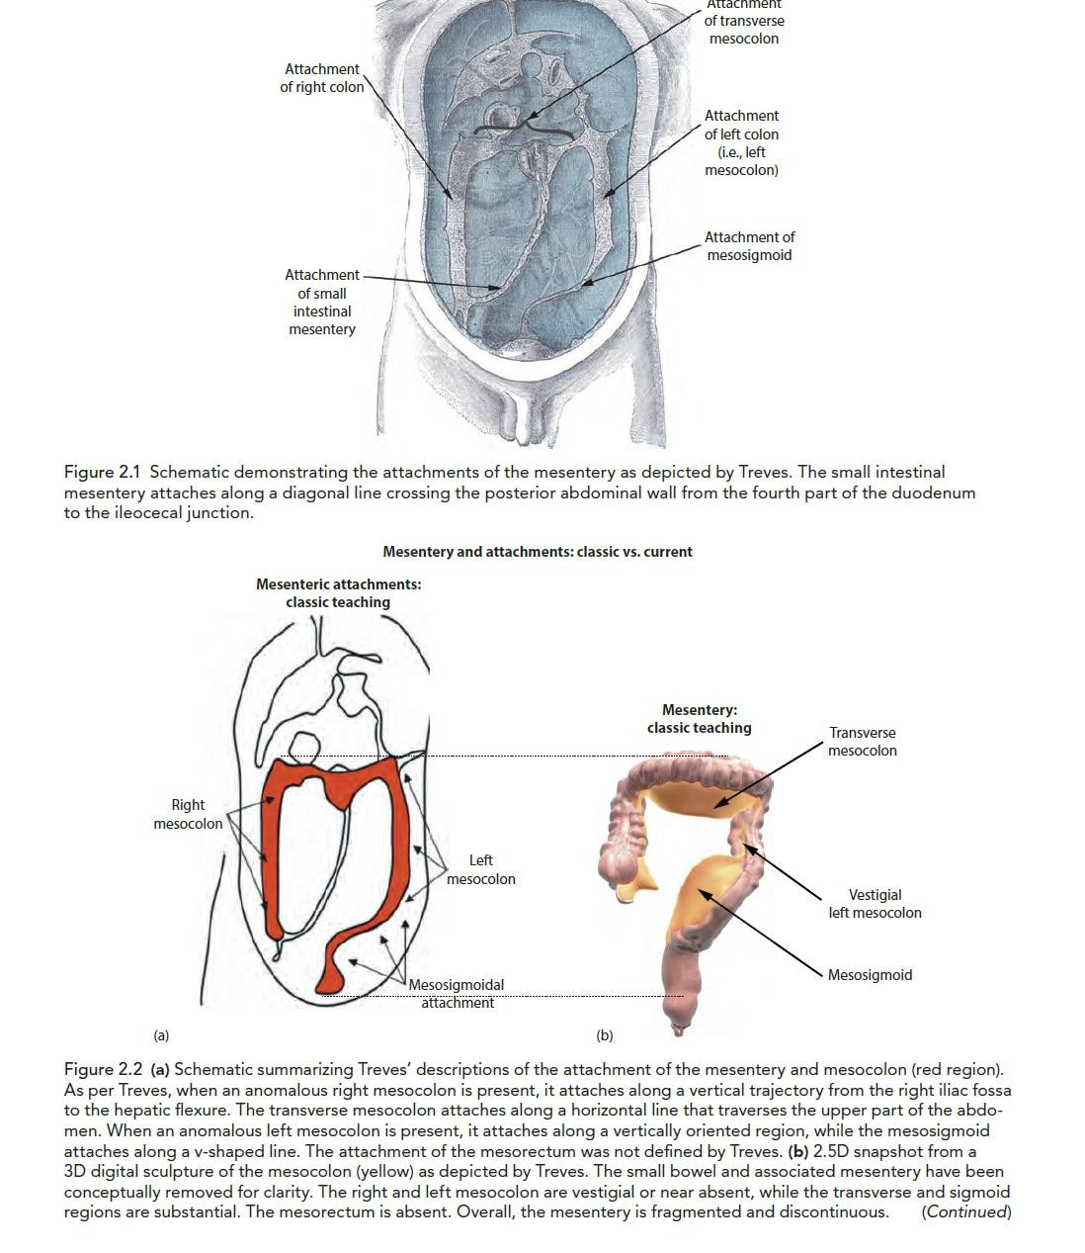

Slide 39

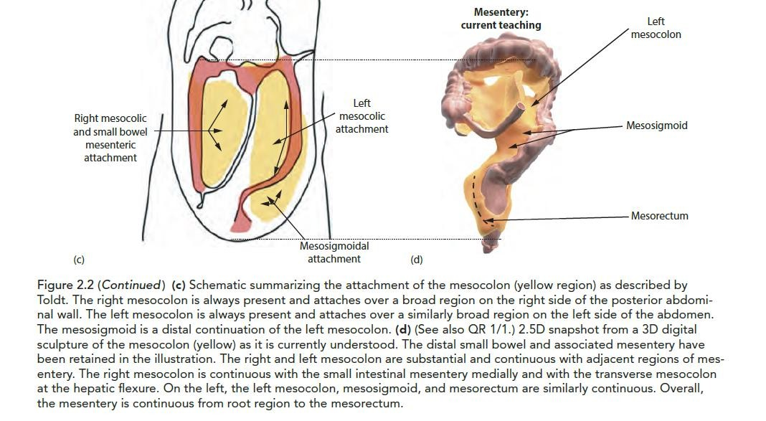

Slide 40

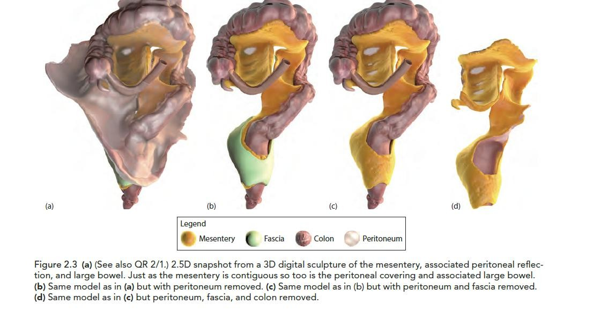

Slide 41
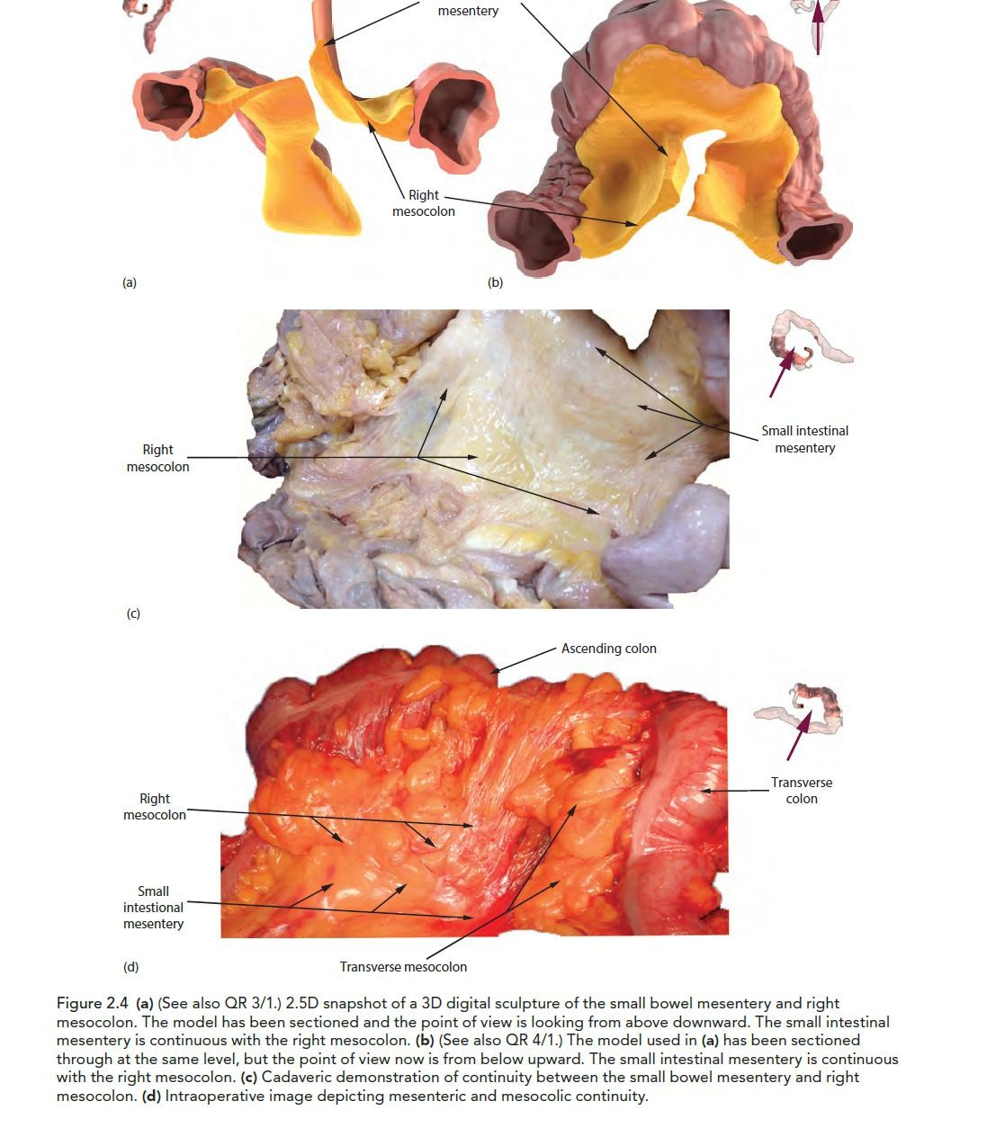

Slide 42
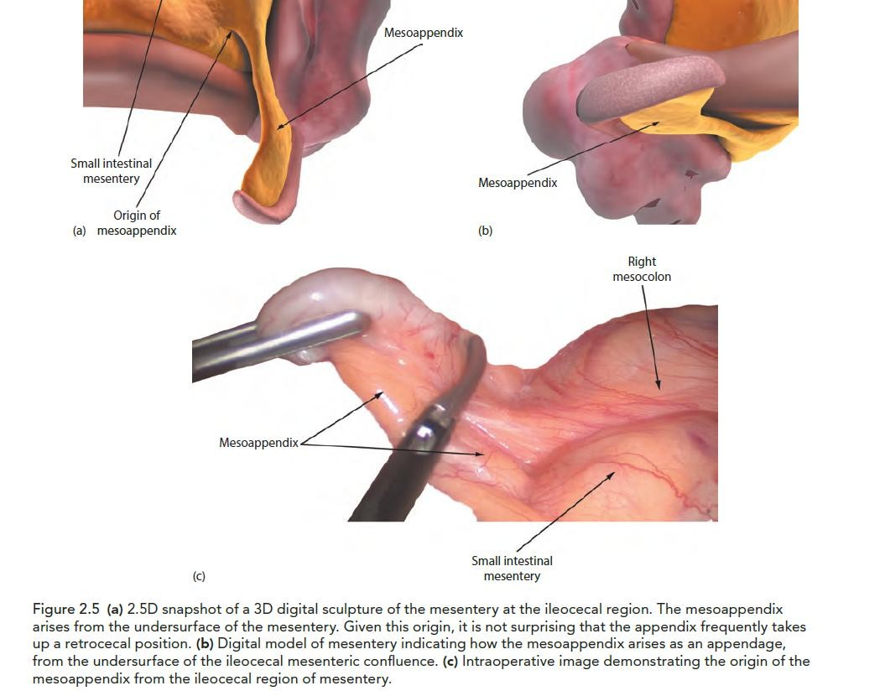

Slide 43
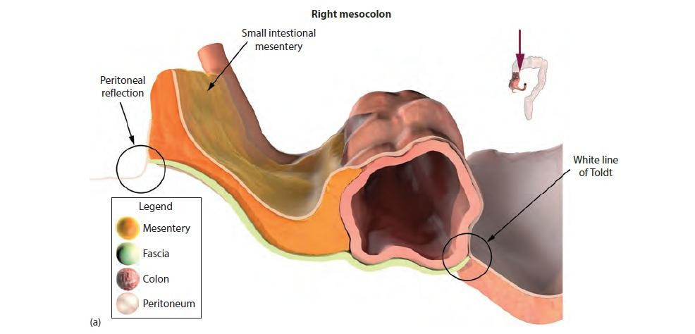

Slide 44
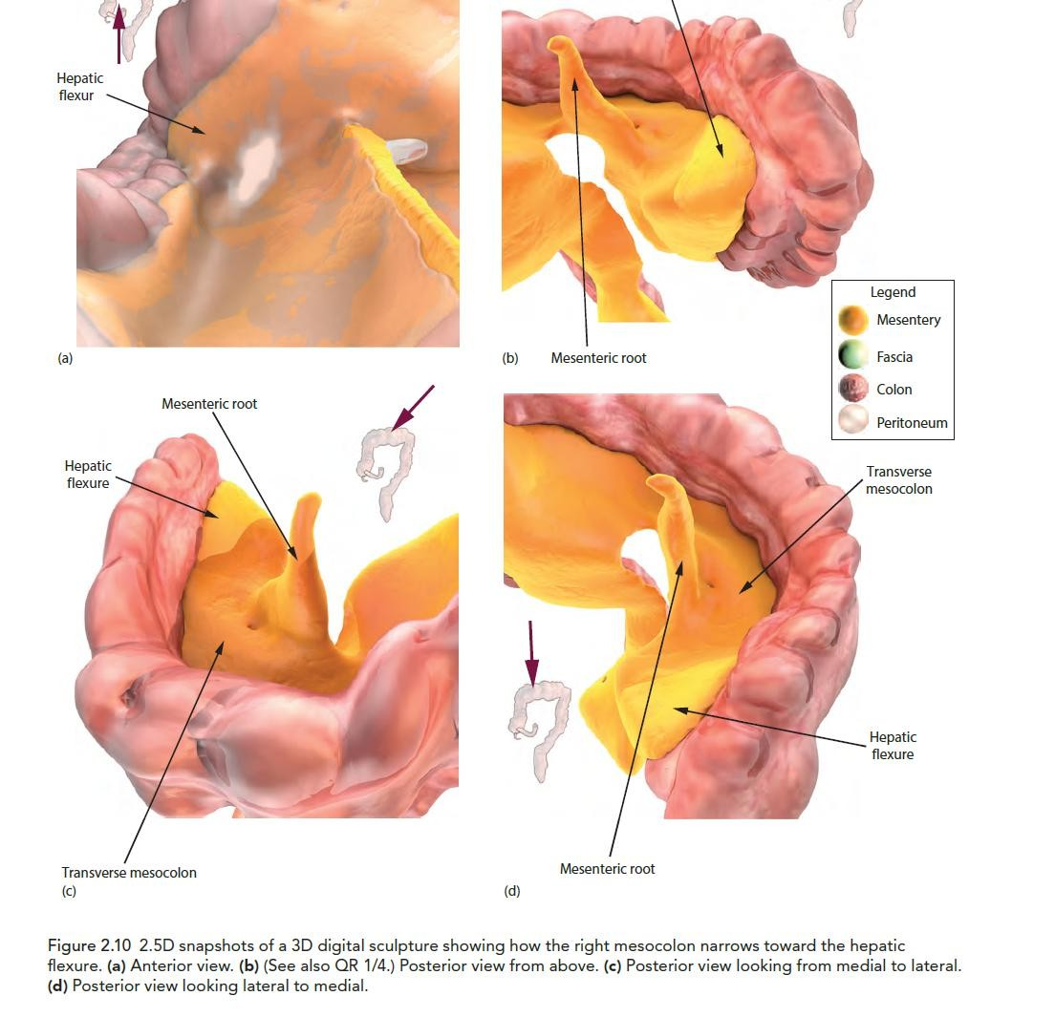

Slide 45
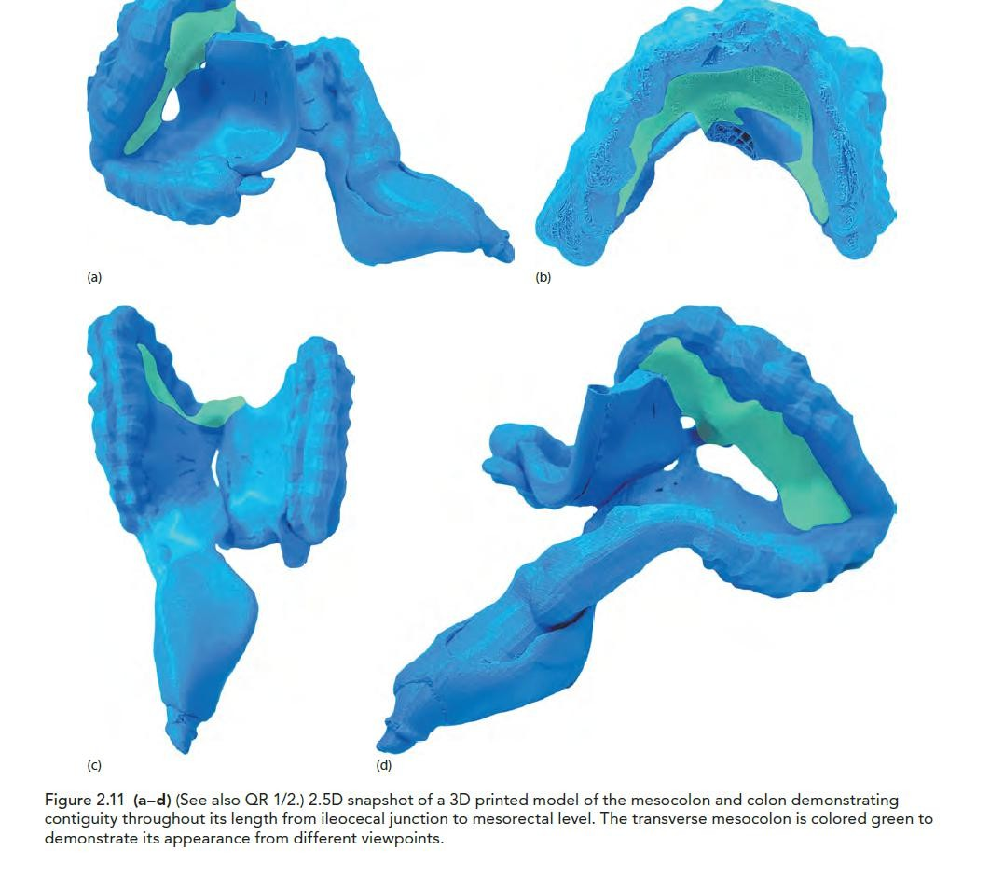

Slide 46
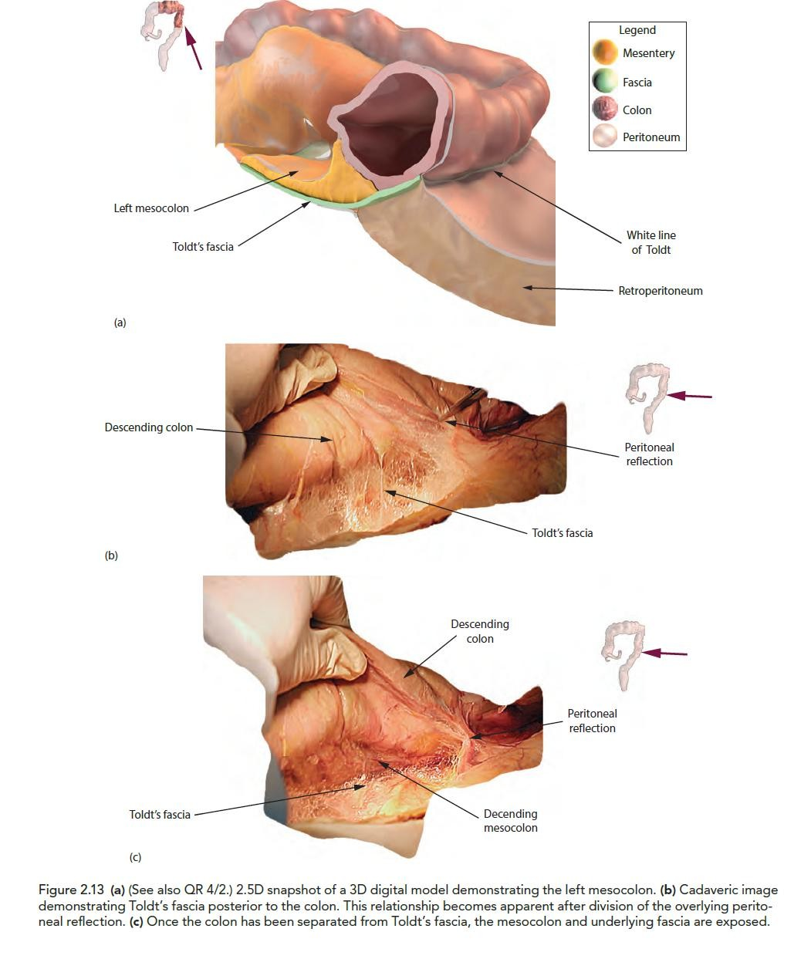

Slide 47
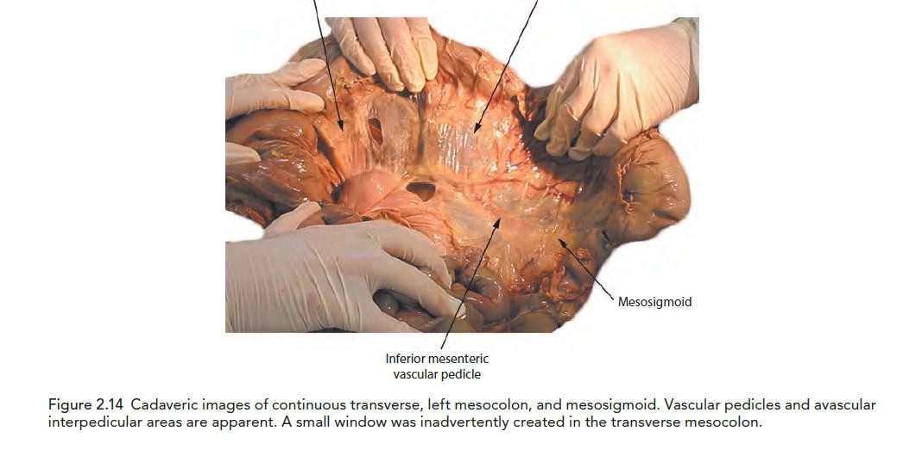

Slide 48
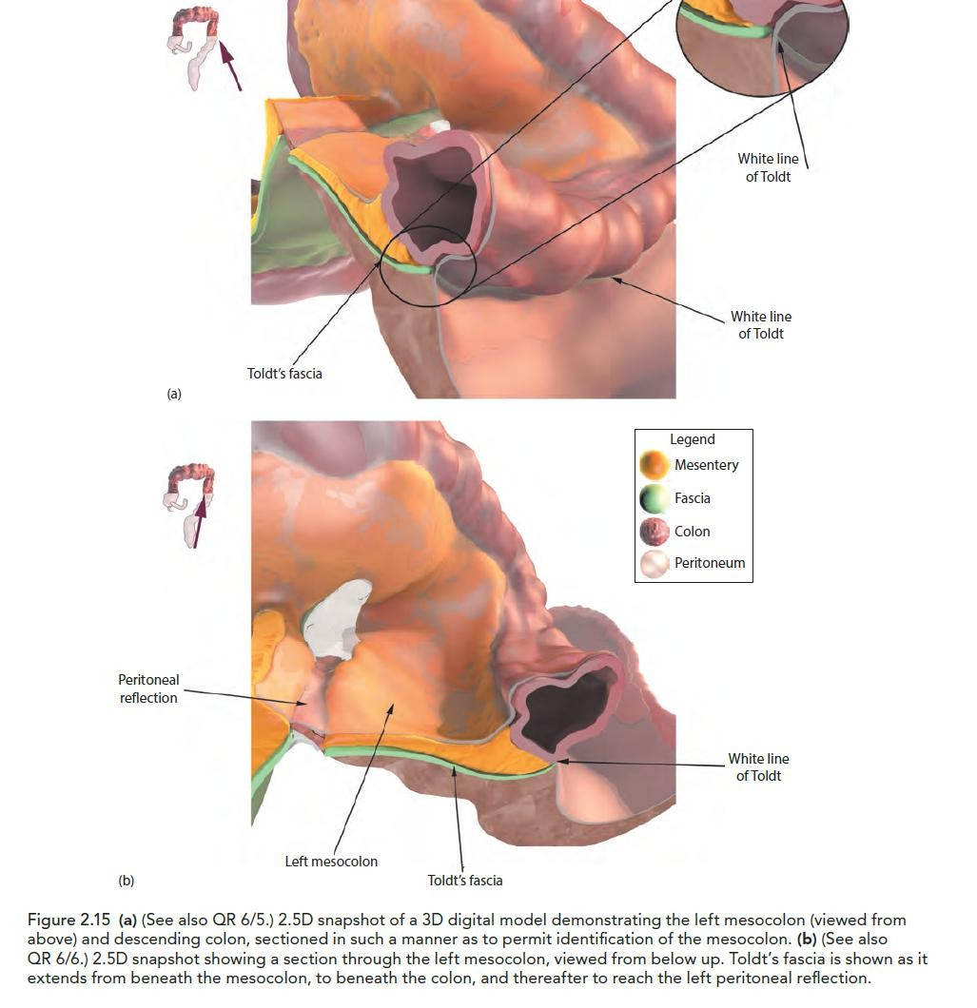

Slide 49
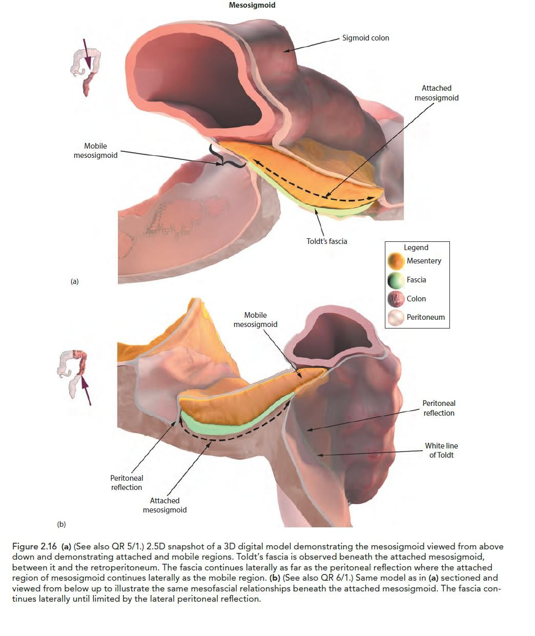

Slide 50
LARGE INTESTINE
The large intestine extends from the ileum to the anus.
Cecum
Appendix
Ascending colon
Transverse colon
Descending colon
Sigmoid colon

Slide 51
LARGE INTESTINE
The rectum and anal canal are considered in the sections on the pelvis and perineum.
The primary function absorption of water and electrolytes and the
storage of undigested material

Slide 52
CECUM
Lies below the level of the junction of the ileum with the large intestine
It is a blind-ended pouch that is situated in the right iliac fossa.
It is about 2.5 in. (6 cm) long and is completely covered with peritoneum.
It does not have a mesentery.
Attached to its posteromedial surface is the appendix.
The presence of peritoneal folds in the vicinity of the cecum creates the superior ileocecal, the inferior ileocecal, and the retrocecal recesses.

Slide 53
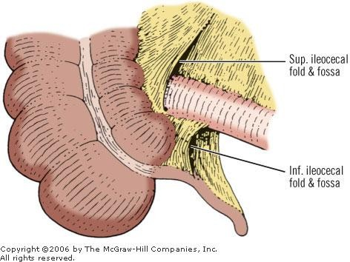

Slide 54
LOCATION,DESCRIPTION
The longitudinal muscle is restricted to three flat bands, the teniae coli, which converge on the base of the appendix.
The cecum is often distended with gas and can then be palpated through the
anterior abdominal wall in the living patient.
The terminal part of the ileum enters the large intestine at the junction of the cecum with the ascending colon.
The opening is provided with two folds, or lips, which form the so-called ileocecal valve.
The appendix communicates with the cavity of the cecum through an opening located below and behind the ileocecal opening

Slide 55
RELATIONS
Anteriorly: Coils of small intestine, sometimes part of the greater omentum, and the anterior abdominal wall in the right iliac region
Posteriorly:The psoas and the iliacus muscles, the femoral nerve, and the lateral cutaneous nerve of the thigh.The appendix is commonly found behind the cecum.
Medially:The appendix arises from the cecum on its medial side .

Slide 56
ILEOCECAL VALVE
Rudimentary structure, consists of two horizontal folds of mucous membrane that project around the orifice of the ileum.
The valve plays little or no part in the prevention of reflux of cecal contents into the ileum.
The circular muscle of the lower end of the ileum ( ileocecal sphincter) serves as a sphincter and controls the flow of contents from the ileum into the colon.
The smooth muscle tone is reflexly increased when the cecum is distended;
The hormone gastrin, causes relaxation of the muscle tone

Slide 57
The cadaveric valve is formed by two parallel transverse folds (labia, lips, or flaps) which project within the colon and form a transverse slit of 1-1.5 cm. At each end, the folds are united and form the frenulum. For all practical purposes, the protrusion of the small bowel into the colon is formed by the circular muscle of the terminal ileum which is covered by the mucosa.
In living subjects, the ileocecal valve has a papillary shape with a conoid ileal projection or
intrusion into the cecum.
Kumar and Phillips⁵³ stated that the superior and the inferior ileocecal ligaments are responsible for the competence of the ileocecal valve.
The purpose of the ileocecal valve is not definitely known. Bogers and Van Marck⁵⁴ stated that "the ileocecal junction remains a controversial region of the gut." They wrote in a review in 1993, "Based on the available data from the literature, evidence is accumulating for a sphincteric function."
The definition of the ileocecal valve differs with various specialties. Anatomists define it as a bilabial type with a horizontal slit, formed by the upper and lower lips which are united medially and laterally to form the frenula. Endoscopists consider it a papillary type, which is like a uterine cervix, a round or conical projection with a starlike orifice, but without the frenula.To radiologists,⁵⁵ the ileocecal valve appears as a round or oval protuberance, which usually arises from the posteromedial wall of the cecum. It is composed of superior and inferior lips which, at the corners of fusion, taper to form a part of the cecal wall.

Slide 58
BLOOD SUPPLY,NERVE SUPPLY
Arteries.
Anterior and posterior cecal arteries form the ileocolic artery, a branch of the superior mesenteric artery .
Veins.
The veins correspond to the arteries and drain into the superior mesenteric vein.
Lymph Drainage
The lymph vessels pass through several mesenteric nodes and finally reach the superior mesenteric nodes.
Nerve Supply
Branches from the sympathetic and parasympathetic (vagus) nerves form the superior mesenteric plexus.

Slide 59
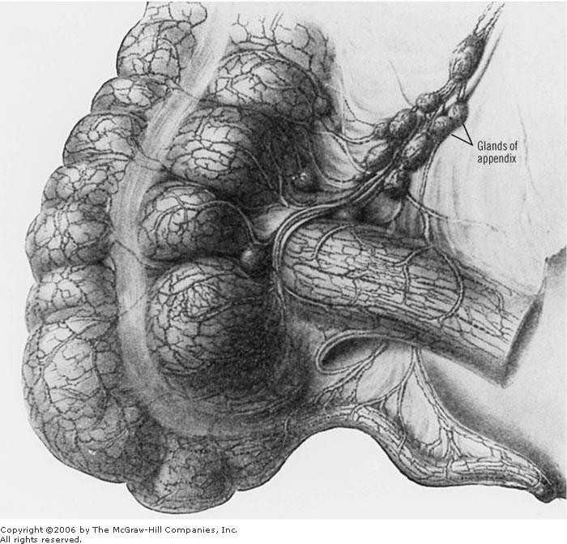
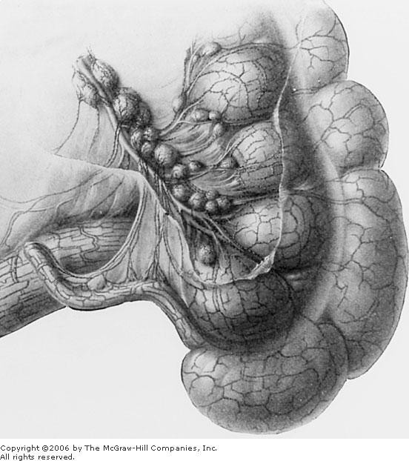

Slide 60
APPENDIX

Slide 61
LOCATION AND DESCRIPTION I
A narrow, muscular tube containing a large amount of lymphoid tissue.
It varies in length from 3 to 5 in. (8 to 13 cm).
The base is attached to the posteromedial surface of the cecum about 1 in.
(2.5 cm) below the ileocecal junction.
It has a complete peritoneal covering, which is attached to the mesentery of the small intestine by a short mesentery of its own, the mesoappendix.
The mesoappendix contains the appendicular vessels and nerves.

Slide 62
LOCATION AND DESCRIPTION II
The appendix lies in the right iliac fossa.
In relation to the anterior abdominal wall its base is situated one third of the way up the line joining the right anterior superior iliac spine to the umbilicus (McBurney’s point).
Inside the abdomen, the base of the appendix is easily found by identifying the teniae coli of the cecum and tracing them to the base of the appendix.

Slide 63
COMMON POSITIONS OF THE TIP OF THE APPENDIX
(a) hanging down into the pelvis against the right pelvic wall,
(b) coiled up behind the cecum,
(c) projecting upward along the lateral side of the cecum, and
(d) in front of or behind the terminal part of the ileum.
The first and second positions are the most common site.

Slide 64
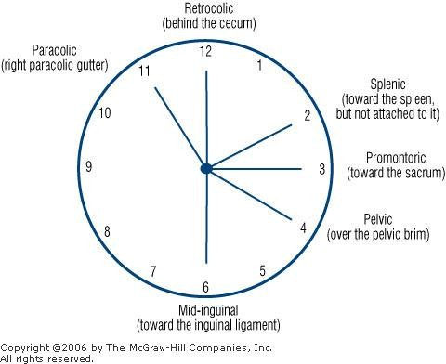
FREEQUENT LOCATIONS OF THE
APPENDIX

Slide 65
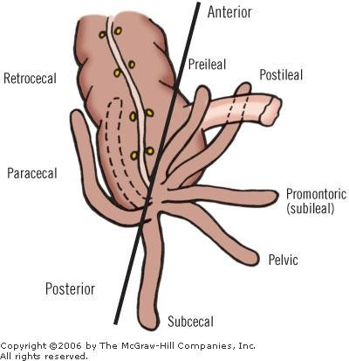

Slide 66
BLOOD SUPPLY,NERVE SUPPLY
Arteries.
The appendicular artery is a branch of the posterior cecal artery.
Veins.
The appendicular vein drains into the posterior cecal vein.
Lymph Drainage
The lymph vessels drain into one or two nodes lying in the mesoappendix and then eventually into the superior mesenteric node.
Nerve Supply
The appendix is supplied by the sympathetic and parasympathetic (vagus) nerves from the superior mesenteric plexus.

Slide 67
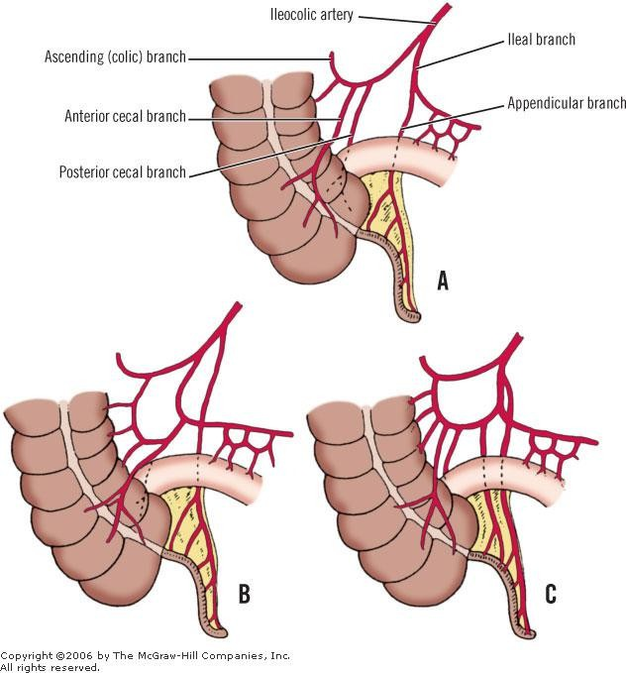
ARTERIAL BLOOD SUPPLY

Slide 68


Slide 69

LYMPHATICS

Slide 70

SURGICAL ANATOMY

Slide 71

APPENDIX AND
PREGNANCY

Slide 72
ASCENDING COLON

Slide 73
LOCATION AND DESCRIPTION
The ascending colon is about 5 in. (13 cm) long.
Lies in the right lower quadrant.
It extends upward from the cecum to the inferior surface of the right lobe of
the liver, where it turns to the left, forming the right colic flexure.
The peritoneum covers the front and the sides of the ascending colon, binding it to the posterior abdominal wall.

Slide 74

RELATIONS
Anteriorly: Coils of small intestine, the greater omentum, and the anterior abdominal wall.
Posteriorly:The iliacus, the iliac crest, the quadratus lumborum, the origin of the transversus abdominis muscle, and the lower pole of the right kidney.The iliohypogastric and the ilioinguinal nerves cross behind it.

Slide 75
Normally the ascending limb of the right colon is fused to the posterior body wall and covered anteriorly by the peritoneum (Fig. 18-32). There are variations of incomplete fusion, ranging from a deep lateral paracolic groove to the persistence of an entire ascending mesocolon.A mesocolon long enough to permit volvulus occurs in approximately 11 percent of cases.⁷² In cadavers, the ascending colon may be mobile in approximately 37 percent of cases.⁴⁸ A mobile cecum, together with a mobile right colon, may be present; this is the justification for volvulus of the right colon.

Slide 76



Slide 77


Slide 78
BLOOD SUPPLY,NERVE SUPPLY
Arteries.
The ileocolic and right colic branches of the superior mesenteric artery supply this area.
Veins.
The veins correspond to the arteries and drain into the superior mesenteric vein.
Lymph Drainage.
The lymph vessels drain into lymph nodes lying along the course of the colic blood vessels and ultimately reach the superior mesenteric nodes.
Nerve Supply.
Sympathetic and parasympathetic (vagus) nerves from the superior mesenteric plexus supply this area of the colon.

Slide 79
TRANSVERSE COLON

Slide 80

DIAGRAMM AT IC SAGITTAL SECTION SHOWING THE
DEVELOPMENTAL REL AT ION OF THE TRANSVERSE COLON
AND ITS MESENTE RY TO THE
OMENTUM.
THE TWO ARE FUSED AT " X" TO FORM THE TRANSVERSE MESOCOLON CONTAINING THE MIDDLE COLIC ARTE RY. SMA, SUPERIOR MESENTERIC ARTE RY.

Slide 81
LOCATION AND DESCRIPTION I
The transverse colon is about 15 in. (38 cm) long
Extends across the abdomen, occupying the umbilical region.
It begins at the right colic flexure below the right lobe of the liver and hangs
downward, suspended by the transverse mesocolon from the pancreas .
It then ascends to the left colic flexure below the spleen.
The left colic flexure is higher than the right colic flexure and is
suspended from the diaphragm by the phrenicocolic ligament .

Slide 82
LOCATION AND DESCRIPTION II
The transverse mesocolon, or mesentery of the transverse colon, suspends the transverse colon from the anterior border of the pancreas.
The mesentery is attached to the superior border of the transverse colon, and the posterior layers of the greater omentum are attached to the inferior border.
Because of the length of the transverse mesocolon, the position of the transverse colonis extremely variable.

Slide 83
RELATIONS
Anteriorly:The greater omentum and the anterior abdominal wall (umbilical and hypogastric regions)
Posteriorly:The second part of the duodenum, the head of the pancreas, and the coils of the jejunum and the ileum.

Slide 84
BLOOD SUPPLY,NERVE SUPPLY
Arteries .
The proximal two thirds are supplied by the middle colic artery, a branch of the superior mesenteric artery . The distal third is supplied by the left colic artery, a branch of the inferior mesenteric artery .
Veins.
The veins correspond to the arteries and drain into the superior and inferior mesenteric veins.
Lymph Drainage
The proximal two thirds drain into the colic nodes and then into the superior mesenteric nodes; the distal third drains into the colic nodes and then into the inferior mesenteric nodes.

Slide 85


Slide 86
NERVE SUPPLY
The proximal two thirds are innervated by sympathetic and vagal nerves through the superior mesenteric plexus;
The distal third is innervated by sympathetic and parasympathetic pelvic spalchnic nerves through the inferior mesenteric plexus.

Slide 87
SURGICAL CONSIDERATIONS

Slide 88
Mobilization of the hepatic flexure can be accomplished by: (a) incision of the upper right lateral peritoneal reflection (as is done for mobilization of the ascending colon), (b) placement of the colon in a medial position.
Mobilization of the right colon (cecum, ascending colon, hepatic flexure) can be combined with duodenal mobilization by kocherization (see the duodenum chapter).
The retroperitoneal anatomic entities with which the hepatic flexure is related are the right kidney and the ureter, and the descending part of the duodenum and the gonadal vessels.

Slide 89
The right gonadal vein is more vulnerable than the right gonadal artery.This is because the entrance of the vein to the inferior vena cava is higher, and the origin of the artery is lower. Both vessels are very close together just above the right iliac fossa.They travel downward together.
The anterior relations with the gallbladder can be seen very well by the orthodox or laparoscopic approach.
Separation of the posterior gastric wall from the transverse mesocolon requires great care.
It is also essential to separate the transverse mesocolon very carefully from the
pancreas at the neck of the pancreas.

Slide 90
The left mesocolon is less vascular than the right.These avascular areas should be used in surgery for posterior gastrojejunostomy, Roux-en-Y, and other procedures. Remember that the "arc of Riolan" may be present in the more cranial part of the mesocolon.This is an artery of respectable size interconnecting the inferior mesenteric or left colic arteries with the superior mesenteric or middle colic arteries. Hollinshead86 states that Griffiths reported the incidence of the arc of Riolan to be 10%.
The posterior area of the splenic flexure is usually not covered by peritoneum and is fixed to the posterior abdominal wall. Occasionally, it is covered completely by peritoneum and its mesocolon is fixed to the distal body and tail of the pancreas.
The splenocolic ligament, a remnant of the left end of the transverse mesocolon, is a peritoneal bridge between the splenic flexure and the lower spleen.The left gastroepipolic artery and some aberrant inferior polar vessels may be in the vicinity. Incise the ligament between clamps and ligate. Should excessive traction be applied to this ligament, tearing of the splenic pole can result, with profuse bleeding.

Slide 91
The phrenocolic ligament, between the splenic flexure and the diaphragm at the level of the 10th rib at the midaxillary line, forms a hammock in which the spleen rests.The ligament should be incised for mobilization of the splenic flexure.
Mesenteric cysts of the small or large bowel are uncommon, but may be benign or malignant; thus the surgeon should be alert to them. Horiuchi et al.87 state that retroperitoneoscopic resection of such cysts has a lower risk of traumatizing the bowel than laparoscopic intra-abdominal excision, with a further advantage of not compressing other intra-abdominal organs. Forty percent of all mesenteric cysts occur in the colon. A complete discussion of mesenteric cysts can be found in the chapter on the small intestine.

Slide 92
DESCENDING COLON

Slide 93

DESCENDI NG
SIGMOID COLON

Slide 94
LOCATION AND DESCRIPTION
The descending colon is about 10 in. (25 cm) long
Lies in the left upper and lower quadrants .
It extends downward from the left colic flexure, to the pelvic brim, where it
becomes continuous with the sigmoid colon.
The peritoneum covers the front and the sides and binds it to the posterior abdominal wall.

Slide 95
RELATIONS
Anteriorly: Coils of small intestine, the greater omentum, and the anterior abdominal wall.
Posteriorly:The lateral border of the left kidney, the origin of the transversus abdominis muscle, the quadratus lumborum, the iliac crest, the iliacus, and the left psoas.
The iliohypogastric and the ilioinguinal nerves, the lateral cutaneous nerve of the thigh, and the femoral nerve also lie posteriorly.

Slide 96
BLOOD SUPPLY,NERVE SUPPLY
Arteries.
The left colic and the sigmoid branches of the inferior mesenteric artery supply this area.
Veins.
The veins correspond to the arteries and drain into the inferior mesenteric vein.
Lymph Drainage
Lymph drains into the colic lymph nodes and the inferior mesenteric nodes around the origin of the inferior mesenteric artery.
Nerve Supply
The nerve supply is the sympathetic and parasympathetic pelvic splanchnic nerves through the inferior mesenteric plexus.

Slide 97
SIGMOID COLON

Slide 98
LOCATION AND DESCRIPTION
The sigmoid colon is 10 to 15 in. (25 to 38 cm) long
Begins as a continuation of the descending colon in front of the pelvic brim. Below, it becomes continuous with the rectum in front of the 3rd sacral vertebra.
The sigmoid colon is mobile and hangs down into the pelvic cavity in the form of a loop.
The sigmoid colon is attached to the posterior pelvic wall by the fan-shaped sigmoid mesocolon.

Slide 99
RELATIONS
Anteriorly: In the male, the urinary bladder; in the female, the posterior surface of the uterus and the upper part of the vagina.
Posteriorly:The rectum and the sacrum.The sigmoid colon is also related to the lower coils of the terminal part of the ileum.

Slide 100
BLOOD SUPPLY,NERVE SUPPLY
Arteries.
Sigmoid branches of the inferior mesenteric artery.
Veins.
The veins drain into the inferior mesenteric vein, which joins the portal venous system.
Lymph Drainage.
The lymph drains into nodes along the course of the sigmoid arteries; from these
nodes, the lymph travels to the inferior mesenteric nodes.
Nerve Supply.
The sympathetic and parasympathetic nerves from the inferior hypogastric plexuses

Slide 101


Slide 102


Slide 103


Slide 104


Slide 105
MECKEL’S DIVERTICULUM
Congenital anomaly, represents a persistent portion of the vitellointestinal duct.
The diverticulum is located on the antimesenteric border of the ileum about 2 ft (61 cm) from the ileocecal junction.
It is about 2 in. (5 cm) long and occurs in about 2% of individuals.
The diverticulum is important clinically, since it may possess a small area of gastric mucosa, and bleeding may occur from a “gastric” ulcer in its mucous membrane.

Slide 106
ANATOMY OF THE RECTUM

Slide 107
THE JUNCTION BETWEEN THE SIGMOID COLON AND THE RECTUM HAS BEEN VARIOUSLY DESCRIBED
A point opposite the left sacroiliac joint
Level of the 3rd sacral vertebra
Level at which the sigmoid mesentery disappears
Level at which sacculations and epiploic appendages disappear and taeniae broaden to form a complete muscle layer (long transition)
•

Slide 108
RECTOSIGMOID
Level at which the superior rectal artery divides into right and left branches
Construction with anterior angulation (proctoscopy)
Level of superior rectal fold (inconstant)
Transition between rugose mucosa of colon and smooth mucosa of rectum (cadaver)

Slide 109
PERITONEAL REFLECTIONS
The entire upper one-third of the rectum is covered by peritoneum (Fig. 18-38). As the rectum passes deeper into the pelvis, more and more fat is interposed between the rectal musculature and the peritoneum.The mesorectum, which suspends the rectum from the posterior body wall, comes off more laterally, leaving bare progressively more of the posterior rectal wall. The peritoneum finally leaves the rectum and passes anteriorly and superiorly over the posterior vaginal fornix and the uterus in females or over the superior ends of the seminal vesicles and the bladder in males.This creates a depression, the rectouterine or rectovesical pouch; with infection, this may become filled with pus.

Slide 110

MESORECTAL AREA

Slide 111


Slide 112


Slide 113


Slide 114


Slide 115


Slide 116


Slide 117


Slide 118


Slide 119


Slide 120
Male (extraperitoneal)
– Anterior: prostate, seminal vesicles, ductus (vas) deferens, ureters, urinary bladder
– Posterior: sacrum and fascia of Waldeyer, coccyx and its muscles, levator ani, median sacral vessels, roots of the sacral nerve plexus

Slide 121


Slide 122
FEMALE
Extraperitoneal
– Anterior: posterior vaginal wall
– Lateral: intestinal loops
Intraperitoneal
– Anterior: posterior vaginal wall, upper uterus, uterine (fallopian) tubes, ovaries
– Lateral: pelvic wall
– Posterior: as in the male

Slide 123


Slide 124

ARTERIAL
BLOOD SUPPLY

Slide 125


Slide 126

PELVIC NERVE PLEXUS

Slide 127
Fundamental Concepts of Cancer Surgery
Mesentery (meso-) Two sheets of peritoneum with blood vessels, lymph vessels, and nerves in between
Cancer Surgery Lymphatic Surgery
MESENTERIZATION=to set back the mesentery in the original form by releasing the rotation and the adhesion
Karolinska University, May 2018

Slide 128



Siani and Garulli, The Surgeon 2017

Slide 129



Slide 130


Slide 131
ANATOMICAL DISSECTIONS

Slide 132


Slide 133


Slide 134


Slide 135


Slide 136


Slide 137


Slide 138


Slide 139


Slide 140


Slide 141


Slide 142


Slide 143


Slide 144


Slide 145


Slide 146


Slide 147


Slide 148


Slide 149


Slide 150


Slide 151


Slide 152


Slide 153


Slide 154


Slide 155


Slide 156
OPERATIVE SPECIMENS

Slide 157

LAPAROTO MY

Slide 158

RIGHT
COLECTOMY

Slide 159


Slide 160

SUBTOT AL
COLECT OMY

Slide 161



Slide 162



Slide 163



Slide 164

APPENDICEC TOMY

Slide 165

LAPAROSC OPY

Slide 166



