Slide 1
Skin-Breast Structure and Function, Embryology, Axilla, and Related Muscles
IOANNIS DIMOVELIS
M.D.,M.Sc.,Ph.D.,FEBOPRAS
PLASTIC AND RECONSTRUCTIVE SURGEON

Slide 2
Introduction
The mammary gland is a modified sweat gland present in the superficial fascia of the pectoral region. The mammary gland is found in both sexes.
However, it remains rudimentary in male but becomes well-developed in female at puberty.
On rare occasions the breasts of male become enlarged, this condition is called gynecomastia.
In female, it forms an accessory sex organ of female reproductive system and provides milk to the newborn. The anatomy of breast is of great surgical importance, and therefore, needs to be studied in detail.

Slide 3
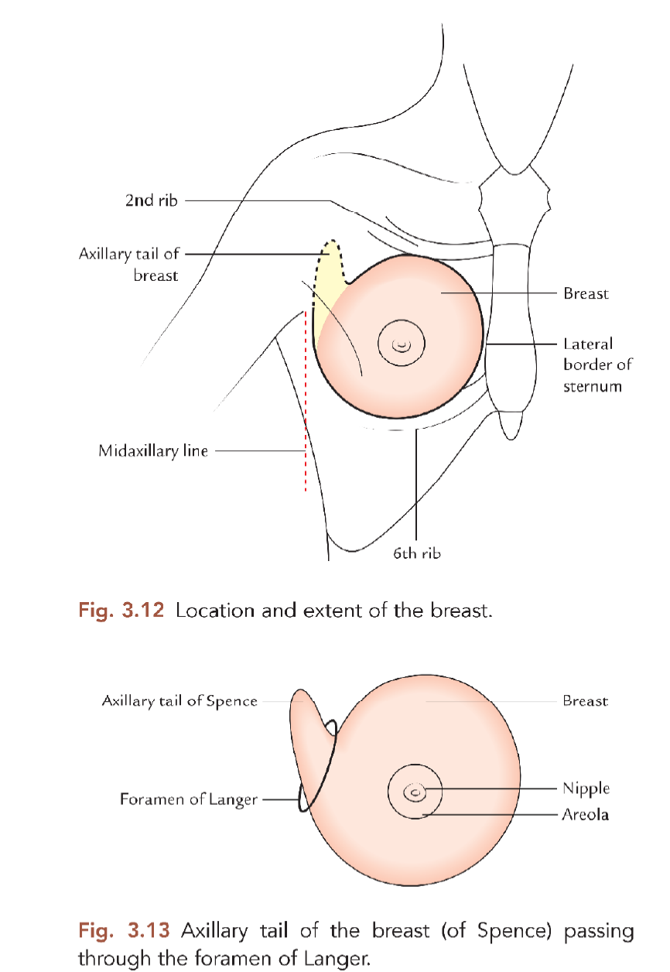
Location
The breast is located in the superficial fascia of the pectoral region.
A small extension from its superolateral part (axillary tail of Spence) however pierces the deep fascia and extends into the axilla.
The aperture in the deep fascia through which axillary tail passes into the axilla is called foramen of Langer.
The axillary tail is the site of high percentage of breast tumor.

Slide 4
Shape and extent
It has a shape of hemispherical bulge
It extends:
Vertically from 2nd rib to 6th rib.
Horizontally, from lateral border of the sternum to the midaxillary line.

Slide 5
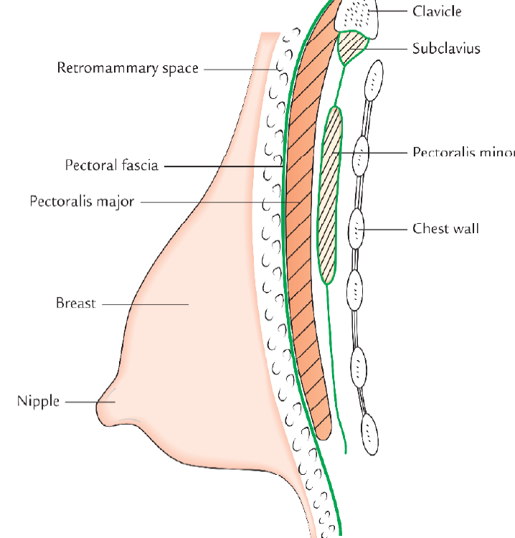
Relations
The deep aspect of the breast is related to the following structures superficially to deep
Pectoral fascia, the deep fascia covering the anterior aspect of pectoralis major
Three muscles: Pectoralis major,serratus anterior and external oblique

Slide 6
STRUCTURE
It consists of the following structures
Skin
Stroma
Breast parechyma

Slide 7
Skin
It is the covering for the breast and presents the following features:
Nipple: It is a conical projection below the center of the breast, usually at the level of the 4th intercostal space. It contains smooth muscle fibres, which can make the nipple stiff and erect or flatten it.
Being extensively innervated by sensory nerve endings, the nipple is the most sensitive part of the breast to tactile stimulation and become erect during sexual arousal.

Slide 8
Skin
Areola: It is the circular area of pigmented skin surrounding the base of the nipple. It contains large number of modified sebaceous glands, particularly at its outer margin.
They produce oily secretion, which lubricates the nipple and areola, and thus prevents them from drying and cracking.
The color of the areola and the nipple varies with the race
During pregnancy the areola becomes darker and enlarged.

Slide 9
STROMA
The stroma of breast consists of connective tissue and fat. It forms the supporting framework of the breast.
The connective tissue condenses to form fibrous strands/ septa, called suspensory ligaments of Cooper. The suspensory ligaments of Cooper are arranged in a radial fashion. They connect the dermis of the overlying skin to the ducts of the breast and pectoral fascia. The ligaments of the Cooper maintain the protuberance of the breast.
Their atrophy due to ageing makes the breast pendulous in old age.
The fat forms most of the bulk of the breast. It is distributed all over the breast except beneath the areola and the nipple.

Slide 10
BREAST PARENCHYMA
The parenchyma/glandular tissue of the breast secrete milk to feed the newborn baby.
It consists of about 15–20 lobes arranged in a radial fashion like the spokes of a wheel and converge towards the nipple. Each lobe is divided into lobules, which consist a cluster of acini
Each lobe is drained by a laciferous duct. The ducts from different lobes converge towards the nipple and open at its submit.
Near the termination, each duct expands into a laciferous sinuses which serves as a milk reservoir during lactation

Slide 11
Breast Embryology
Breast development begins prenatally, around 4–6 weeks of gestation
During this time, mammary progenitor cells of ectodermal origin form the mammary crest, which is a paired line that gently curves from the axilla to the inguinal region bilaterally
Most of the mammary crest atrophies to leave paired primary breast buds at the fourth intercostal space
These ectodermal cells subsequently invaginate into the underlying mesoderm and begin to form the network that will eventually become the lactiferous acini and ducts , or the gland itself .
The mesenchymal cells will eventually form into adipocytes, fibroblasts, and smooth muscle cells to become the future stroma surrounding the breast gland .

Slide 12
By the end of the first trimester, the mammary bud is largely formed. During the second trimester, secondary branching patterns off the initial mammary bud continue to invaginate into the underlying mesenchyme to form a more complex network of mammary ducts This continues into the third trimester until birth. By birth, the breast gland contains around 15–20 lobes, each with their own lactiferous duct drainage system that converges on the nipple
After birth and during the first 2 years of life, both male and female infants will have transient breast enlargement and some will secrete milk from the rudimentary breast gland All of these changes are dependent on fluctuating hormone levels in the newborn, in large part mediated by estradiol. By 2 years of age, however, the breast gland becomes quiescent until puberty
Breast development is the first sign of puberty in the female and is dependent not only on estrogen but also on growth hormone and insulin-like growth factor-1 . On average, the mature breast forms between 8 and 13 years of age and is considered pathological if no breast development occurs by 14 years.

Slide 13
Axilla
The axilla or armpit is a fat-filled pyramid-shaped space, between the upper part of the arm and the side of the chest wall
It contains the brachial plexus, axillary vessels, and lymph nodes.
It also acts as a funnel shaped tunnel for neurovascular structures to pass from the root of the neck to the upper limb and vice versa.
Groups of lymph nodes within it drain the upper limb and the breast. The study of axilla is clinically important because axillary lymph nodes are often enlarged and hence routinely palpated during physical examination of the patient.

Slide 14
Boundaries
The axilla resembles a truncated four-sided pyramid and presents an apex, a base and four walls (anterior, posterior, medial, and lateral)

Slide 15
Apex
Apex/cervico-axillary canal: It is a passageway between the neck and axilla.
It is directed upwards and medially into the root of the neck and corresponds to the triangular space bounded in front by the clavicle, behind by the upper border of the scapula and medially by the outer border of the first rib .
The axillary artery and brachial plexus enter the axilla from neck through this gap, hence it is also termed cervico-axillary canal. The axillary vein enters the neck from the axilla into the neck through this canal

Slide 16
Base/Floor
It is at the lower end of the axilla and directed downwards. It is formed by the axillary fascia. The base corresponds to the hollow bounded in front by the anterior axillary fold, formed by the lower border of the pectoralis major muscle,
Behind by the posterior axillary fold formed by the tendon of latissimus dorsi and teres major muscles, and medially by the lateral aspect of the chest wall.

Slide 17
Walls
Anterior wall: It is formed by the pectoralis major, subclavius, and pectoralis minor muscles.
Posterior wall: formed by the subscapularis muscle above and latissimus dorsi and teres major muscles below.
Medial wall: It is formed by the upper four or five ribs, and corresponding intercostal spaces covered by the serratus anterior muscle.
Lateral wall: It is formed by tendon of biceps brachii the bicipital groove of humerus coracobrachialis and short head of biceps brachii. The lateral wall is extremely narrow because anterior and posterior walls of the axilla converge at this site

Slide 18
Pectoralis Major
The largest and most superficial muscle of the anterior wall . Its inferior margin underlies the anterior axillary fold, which marks the anteroinferior border of the axilla.
The muscle has two heads: The clavicular head originates from the medial half of the clavicle. The sternocostal head originates from the medial part the anterior thoracic wall-often, fibers from this head continue inferiorly and medially to attach to the anterior abdominal wall, forming an additional abdominal part of the muscle.
The muscle inserts into the lateral lip of the intertubercular sulcus of the humerus. The parts of the muscle that have a superior origin on the trunk insert lower and more anteriorly on the lateral lip of the intertubercular sulcus than the parts of the muscle that originate inferiorly.
Acting together, the two heads of the pectoralis major flex, adduct, and medially rotate the arm at the glenohumeral joint. The clavicular head flexes the arm from an extended position, whereas the sternocostal head extends the arm from a flexed position, particularly against resistance.
innervation by the lateral and medial pectoral nerves, which originate from the brachial plexusthe axilla
in

Slide 19
Subclavius
The subclavius muscle is a small muscle that lies deep to the pectoralis major muscle and passes between the clavicle and rib I .
It originates medially, as tendon, from rib I at the junction between the rib and its costal cartilage. It passes laterally and superiorly to insert via muscular attachment into an elongate shallow groove on the inferior surface of the middle third of the clavicle.
The function of the subclavius is not entirely clear, but it may act to pull the shoulder down by depressing the pulling the clavicle medially.
The subclavius muscle is innervated by a small branch from the superior trunk of the brachial plexus.

Slide 20
Pectoralis Minor
The pectoralis minor muscle is a small triangular-shaped muscle that lies deep to the pectoralis major muscle and passes from the thoracic wall to the coracoid process of the scapula
It originates as three muscular slips from the anterior surfaces and upper margins of ribs III to V and from the fascia overlying muscles of the related intercostal spaces.
The muscle fibers pass superiorly and laterally to insert into the medial and upper aspects of the coracoid process he pectoralis minor muscle protracts the scapula (by pulling the scapula anteriorly on the thoracic wall) and depresses the lateral angle of the scapula.
The pectoralis minor is innervated by the medial pectoral nerve, which originates from the brachial plexus in the axilla.

Slide 21
Lateral wall
It is formed by tendon of biceps brachii the bicipital groove of humerus coracobrachialis and short head of biceps brachii.
The lateral wall is extremely narrow because anterior and posterior walls of the axilla converge at this site

