Slide 1
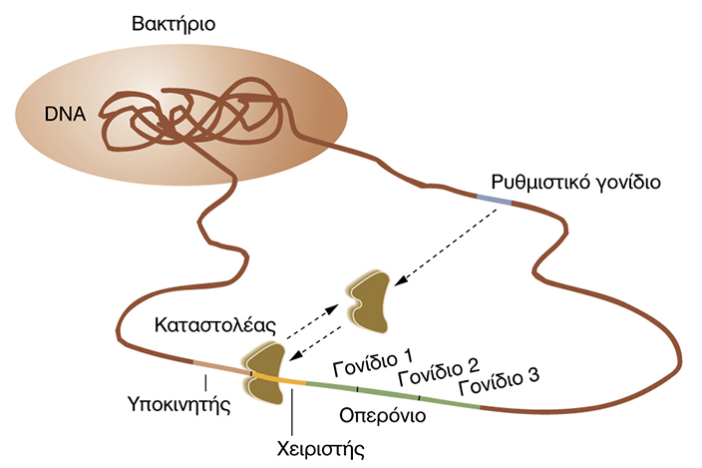

ΕΛΕΓΧΟΣ ΜΕΤΑΓΡΑΦΗΣ
Trans-Ρύθμιση

Slide 2
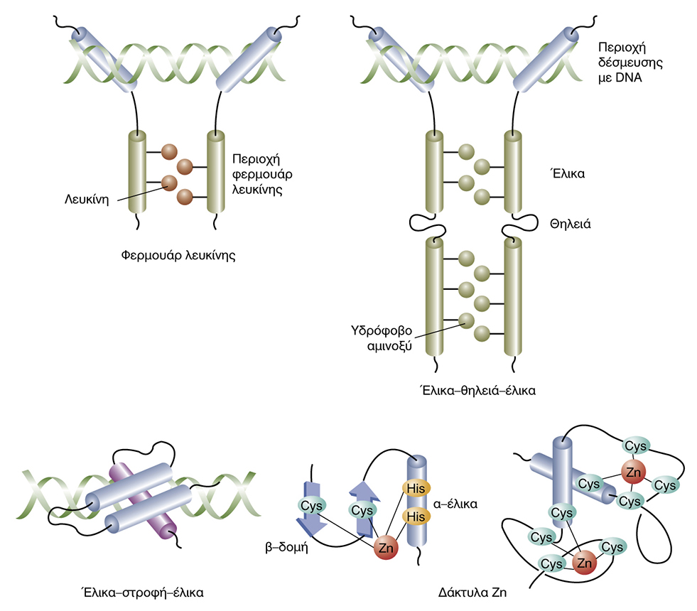
ΕΛΕΓΧΟΣ ΜΕΤΑΓΡΑΦΗΣ
ΜΕΤΑΓΡΑΦΙΚΟΙ ΠΑΡΑΓΟΝΤΕΣ

Slide 3
ΕΛΕΓΧΟΣ ΜΕΤΑΓΡΑΦΗΣ
Trans-Ρύθμιση

Slide 4
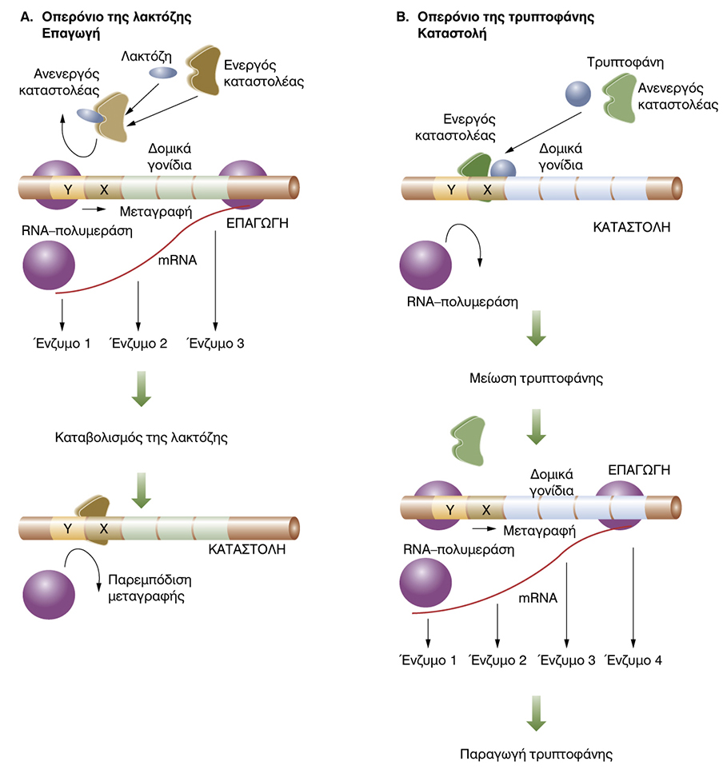

Slide 6
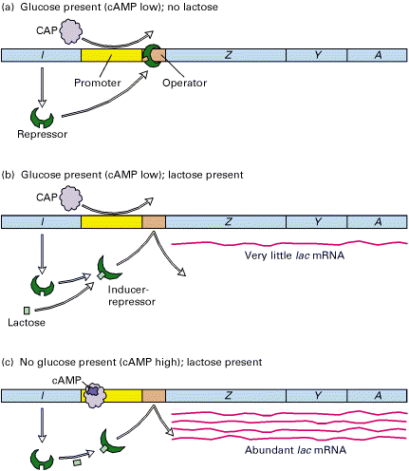
Notes:
Figure 10-16. Negative and positive transcriptional control of the lac operon by the lac repressor and cAMP-CAP, respectively. (a) In the absence of lactose, no lac mRNA is formed because repressor bound to the lac operator prevents transcription. (b) In the presence of glucose and lactose, the lac repressor binds lactose and undergoes a conformational change, so that it does not bind to the lac operator. However, cAMP is low, because glucose is present, and thus cAMP-CAP does not bind to the CAP site in the operator. As a result, RNA polymerase does not bind efficiently to the lac promoter and only a little lac mRNA is synthesized. (c) In the presence of lactose and the absence of glucose, maximal transcription of the lac operon occurs. In this situation, the lac repressor does not bind to the lac operator, the concentration of cAMP increases, and the cAMP-CAP complex that forms binds at the CAP site, stimulating binding and initiation by RNA polymerase.

Slide 7
Notes:
Figure 10-16. Negative and positive transcriptional control of the lac operon by the lac repressor and cAMP-CAP, respectively. (a) In the absence of lactose, no lac mRNA is formed because repressor bound to the lac operator prevents transcription. (b) In the presence of glucose and lactose, the lac repressor binds lactose and undergoes a conformational change, so that it does not bind to the lac operator. However, cAMP is low, because glucose is present, and thus cAMP-CAP does not bind to the CAP site in the operator. As a result, RNA polymerase does not bind efficiently to the lac promoter and only a little lac mRNA is synthesized. (c) In the presence of lactose and the absence of glucose, maximal transcription of the lac operon occurs. In this situation, the lac repressor does not bind to the lac operator, the concentration of cAMP increases, and the cAMP-CAP complex that forms binds at the CAP site, stimulating binding and initiation by RNA polymerase.

Slide 8
Notes:
Figure 10-16. Negative and positive transcriptional control of the lac operon by the lac repressor and cAMP-CAP, respectively. (a) In the absence of lactose, no lac mRNA is formed because repressor bound to the lac operator prevents transcription. (b) In the presence of glucose and lactose, the lac repressor binds lactose and undergoes a conformational change, so that it does not bind to the lac operator. However, cAMP is low, because glucose is present, and thus cAMP-CAP does not bind to the CAP site in the operator. As a result, RNA polymerase does not bind efficiently to the lac promoter and only a little lac mRNA is synthesized. (c) In the presence of lactose and the absence of glucose, maximal transcription of the lac operon occurs. In this situation, the lac repressor does not bind to the lac operator, the concentration of cAMP increases, and the cAMP-CAP complex that forms binds at the CAP site, stimulating binding and initiation by RNA polymerase.

Slide 10
Ωρίμανση μηνύματος RNA

Slide 11
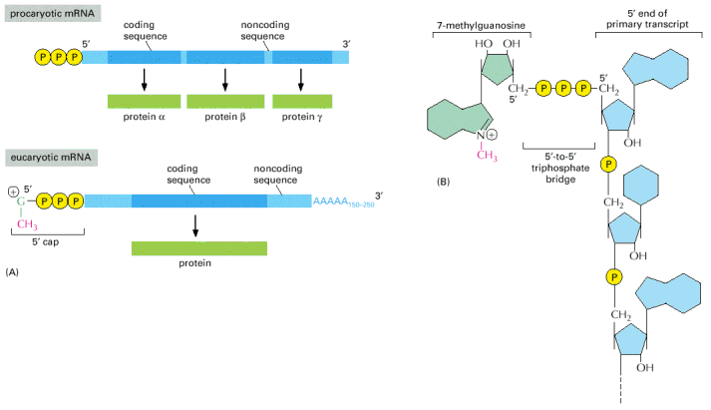
ΠΡΟΣΘΗΚΗ 5’ ΚΑΛΥΜΜΑΤΟΣ

Slide 12
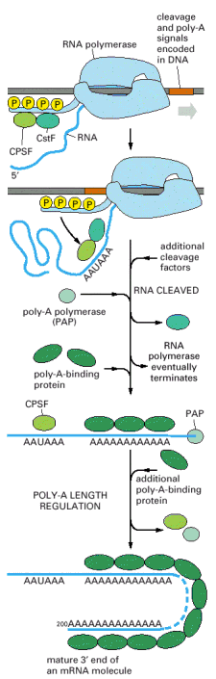
ΠΡΟΣΘΗΚΗ ΠΟΛΥ-A ΟΥΡΑΣ
Notes:
Figure 6-38. Some of the major steps in generating the 3 end of a eucaryotic mRNA. This process is much more complicated than the analogous process in bacteria, where the RNA polymerase simply stops at a termination signal and releases both the 3 end of its transcript and the DNA template.
CstF=cleavage stimulation factor
© 2002 by Bruce Alberts, Alexander Johnson, Julian Lewis, Martin Raff, Keith Roberts, and Peter Walter.

Slide 13
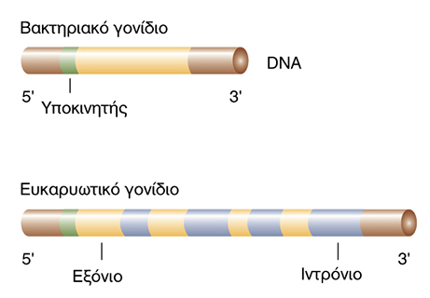

Slide 14
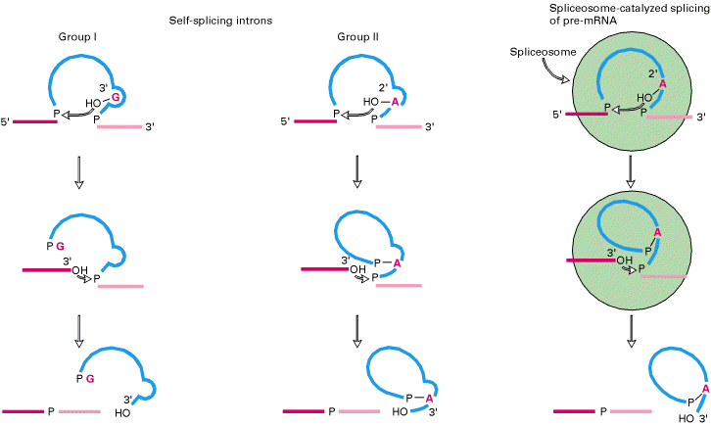
SPLICING / ΜΑΤΙΣΜΑ
Notes:
Figure 11-51. Splicing mechanisms in group I and group II self-splicing introns and spliceosome-catalyzed splicing of pre-mRNA. The intron is shown in blue; the exons to be joined in red. In group I introns, a guanosine cofactor (G) that is not part of the RNA chain associates with the active site. The 3 -hydroxyl group of this guanosine participates in a transesterification reaction with the phosphate at the 5 end of the intron; this reaction is analogous to that involving the 2 -hydroxyl groups of the branch-site A in group II introns and pre-mRNA introns spliced in spliceosomes (see Figure 11-16). The subsequent transesterification that links the 5 and 3 exons is similar in all three splicing mechanisms. Note that spliced-out group I introns are linear structures, unlike the branched intron products in the other two cases. [Adapted from P. A. Sharp, 1987, Science 235:769.] (Molecular Cell Biology, Lodish et al.)

Slide 15
SPLICING / ΜΑΤΙΣΜΑ
Notes:
Figure 11-51. Splicing mechanisms in group I and group II self-splicing introns and spliceosome-catalyzed splicing of pre-mRNA. The intron is shown in blue; the exons to be joined in red. In group I introns, a guanosine cofactor (G) that is not part of the RNA chain associates with the active site. The 3 -hydroxyl group of this guanosine participates in a transesterification reaction with the phosphate at the 5 end of the intron; this reaction is analogous to that involving the 2 -hydroxyl groups of the branch-site A in group II introns and pre-mRNA introns spliced in spliceosomes (see Figure 11-16). The subsequent transesterification that links the 5 and 3 exons is similar in all three splicing mechanisms. Note that spliced-out group I introns are linear structures, unlike the branched intron products in the other two cases. [Adapted from P. A. Sharp, 1987, Science 235:769.] (Molecular Cell Biology, Lodish et al.)

Slide 16
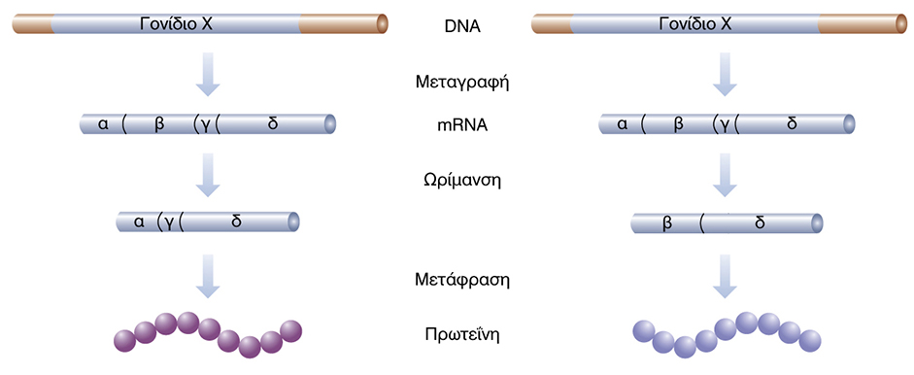
ΔΙΑΦΟΡΙΚΗ ΓΟΝΙΔΙΑΚΗ ΕΚΦΡΑΣΗ

Slide 17
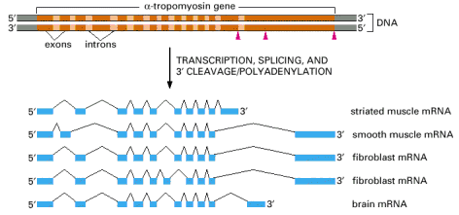
ΕΝΑΛΛΑΚΤΙΚΟ SPLICING

Slide 18
ΔΙΑΦΟΡΙΚΗ ΓΟΝΙΔΙΑΚΗ ΕΚΦΡΑΣΗ

Slide 19
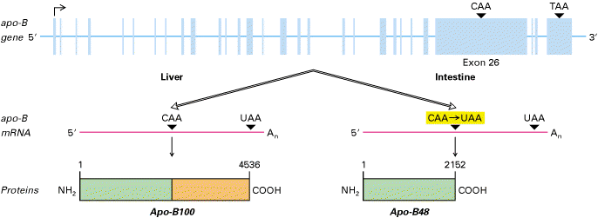
EDITING
Notes:
Figure 11-39. RNA editing of apo-B pre-mRNA. The apo-B mRNA produced in the liver has the same sequence as the exons in the primary transcript. This mRNA is translated into Apo-B100, which has two functional domains: a N-terminal domain (green) that associates with lipids and a C-terminal domain (orange) that binds to LDL receptors on cell membranes. In the apo-B mRNA produced in the intestine, the CAA codon in exon 26 is edited to a UAA stop codon. As a result, intestinal cells produce Apo-B48, which corresponds to the N-terminal domain of Apo-B100. [Adapted from P. Hodges and J. Scott, 1992, Trends Biochem. Sci. 17:77 . (Molecular Cell Biology, Lodish et al.)

Slide 20
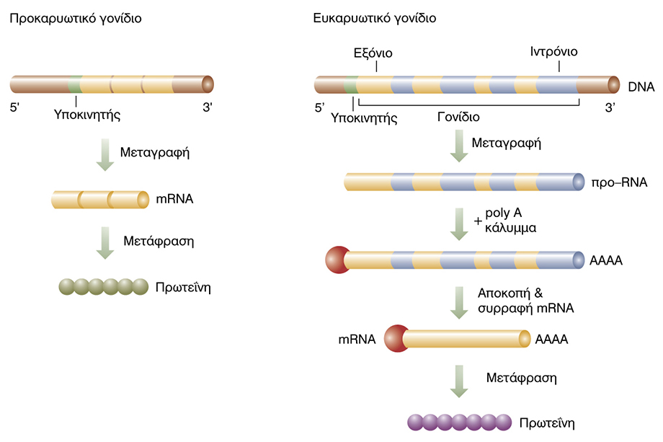

Slide 21
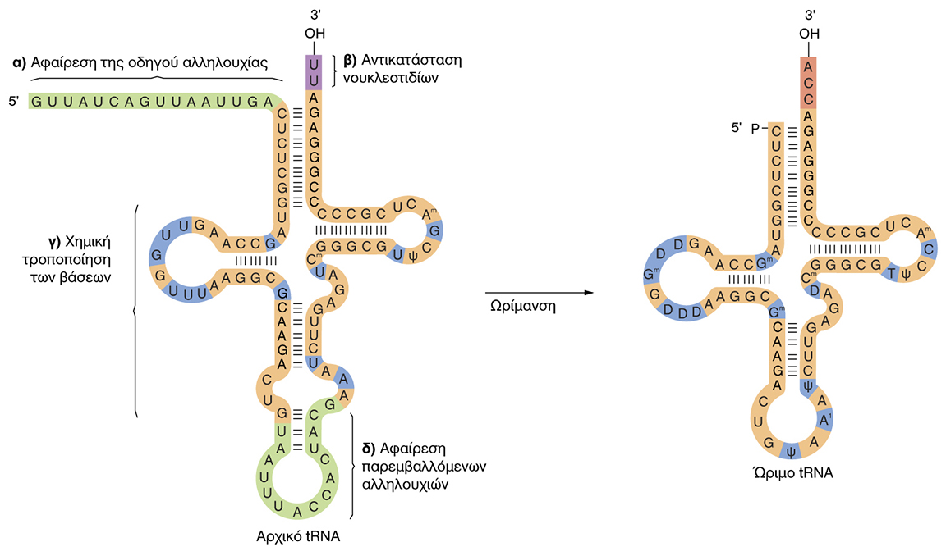

Slide 22
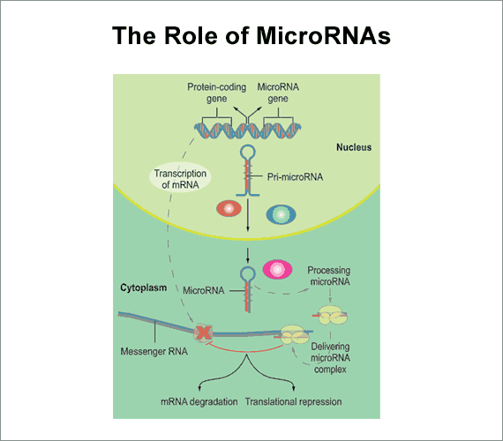

Slide 23
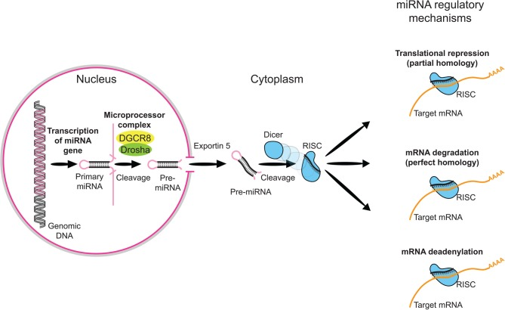
Επεξεργασία των μικρο-RNAs
Notes:
Overview of miRNA processing. MicroRNAs (miRNAs) comprise a growing class of endogenous molecules that regulate gene expression post-transcriptionally. By binding to partially complementary regions at the 3' end of messenger RNAs, these approximately 22-nucleotide single-stranded molecules direct target site recognition by the macromolecular RNA-induced silencing complex (RISC). RISC induces cleavage or translational repression of targeted transcripts. Mammalian miRNA biosynthesis begins with RNA polymerase II-dependent transcription, which yields long primary miRNA (pri-miRNA) transcripts. The pri-miRNA is processed in the nucleus to a pre-miRNA by the Microprocesser complex, which consists of Drosha, a member of ribonuclease III family (RNaseIII), and DGCR8 (also known as Pasha), which contains two double-stranded RNA binding domains and is responsible for pri-miRNA recognition. The pre-miRNA is then exported to the cytoplasm by Exportin-5 and further processed into a miRNA duplex by Dicer, another RNase III. One strand of the miRNA duplex is then incorporated into the RISC.

Slide 24
Πώς ρυθμίζονται τα οπερόνια της λακτόζης ή της τρυπτοφάνης;
Ποιες είναι οι μετα-μεταγραφικές τροποποιήσεις του mRNA;
Τι είναι το εναλλακτικό splicing;
Τι είναι τα microRNAs;

