Slide 1
NMR-based strategies for structure elucidation of small molecules
Prokopios MAGIATIS

Slide 2
To understand which are the basic NMR experiments mainly for small molecules
Which are the steps followed to find the structure of an unknown compound

Slide 3
Small molecules?
In molecular biology and pharmacology, a small molecule is a low molecular weight (<900 daltons) organic compound that may help regulate a biological process, with a size on the order of 10⁻⁹ m.
Most drugs are small molecules with MW<500.
The upper molecular weight limit for a small molecule is approximately 900 daltons, which allows for the possibility to rapidly diffuse across cell membranes so that they can reach intracellular sites of action

Slide 4
Small molecules are either products synthesized by medicinal/organic chemistry
or
Natural products
In the first case the synthesized structures are mostly expected, so NMR basically confirms the structure
In the second case, the structure is absolutely unknown and quite usually contains unprecedented moieties which are elucidated using a combination of several NMR experiments

Slide 5
When you have in your hands (isolated through a laborious procedure) a small quantity of something completely unknown you need to follow a number of steps
Depending on the MW and the available NMR magnet a structure can be elucidated even with <500 μg
Here the NMR puzzle starts

Slide 6
1st step
A simple 1D ¹H-NMR of an average MW (ca 250) can be observed even with 50 μg with high field magnet (>600 MHz)
It can give us an idea if the sample is pure and worthy for further study (by comparing the integrations of peaks)
It can give us a rough idea if it is a lipid, sugar, terpenoid, phenolic etc
How many protons (usually not clear due to overlapping)

Slide 7
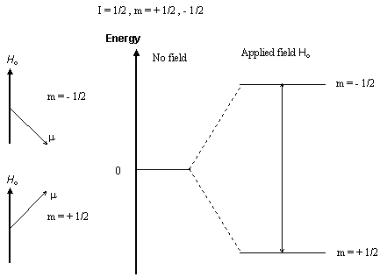
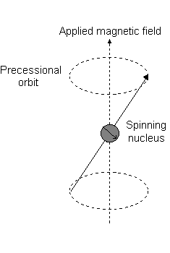
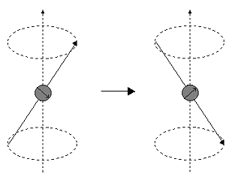
Nuclear magnetic moment
Only specific types of nuclei can be observed:
¹H, ¹³C, ¹⁵N (not ²H, ¹²C, ¹⁴N)

Slide 8
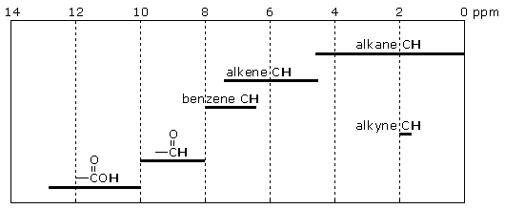
Chemical shift
The chemical shift (ppm) depends on the chemical environment of every proton in the molecule due to nuclear shielding

Slide 9
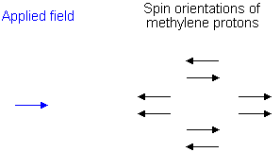
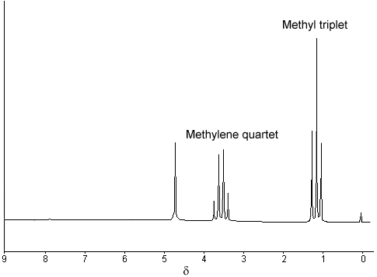
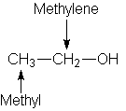
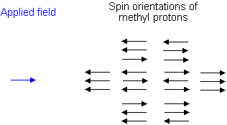
Spin-Spin coupling n+1

Slide 10
Example of aliphatic/terpenoid structure and 1H spectrum
Aliphatic region

Slide 11
Aromatic proton region
Caffeic acid

Slide 12
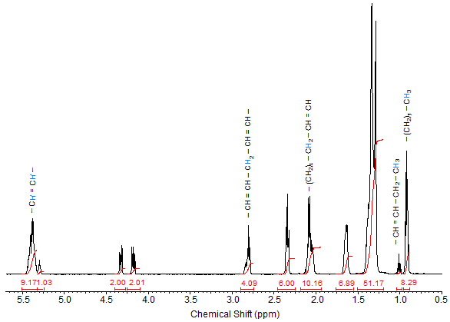
Example of lipid (olive oil)

Slide 13
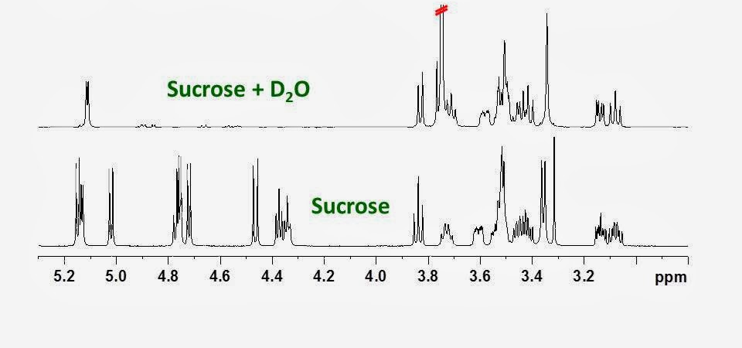
O-C-H (sugar) region
Exchangeable -OH

Slide 14
Step 1b: Exchangeable protons
Addition of D₂O or recording of a spectrum in solvent with exchangeable deuterium atoms (MeOD) leads to the disappearance of the exchangeable protons e.g
-OH, -NH, NH₂, COOH
Useful for molecules containing sugar moieties which give simplified spectra

Slide 15
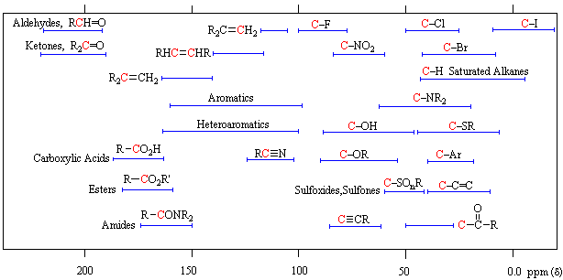
¹³C-NMR

Slide 16
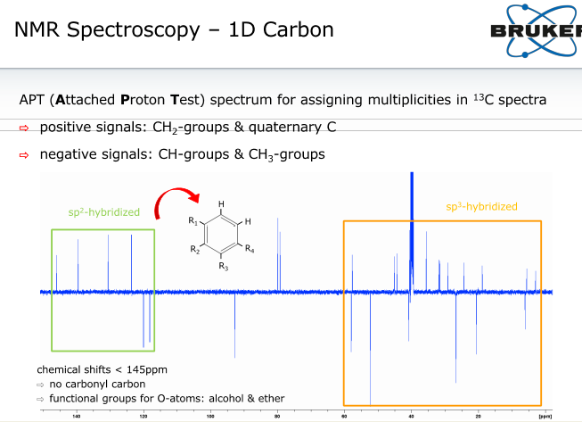
Aromatic / double bonds
aliphatic

Slide 17
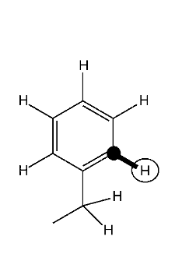
2nd step: Heteronuclear-Single- or -Multiple-Quantum-Coherence Spectroscopy: HSQC or HMQC
This experiment ideally identifies correlated H-atoms and the hetero-atomic nuclei (mainly C-atoms) directly attached to them. It conveniently allows transferring H-atom assignments to the C-skeleton, which helps one to exploit the usually much better signal dispersion in the 13C dimension.
HSQC Experiments also present a way to measure 13C-NMR chemical shifts of all protonated C-atoms, with a sensitivity much higher than in the direct measurement.
The use of 13C-NMR frequencies during assignment enables one to use databases for compound identification/elucidation.
HSQC-DEPT experiment

Slide 18
Hydroxydammarenone II
Aliphatic region

Slide 19
18
HSQC-DEPT
27
6b 6a
19
30
23
11b
11a
29
16b
21
16a
28
12b
26
12a
15b
15a
2
7b
7a
1b
1a
13
22
Methylenes CH2
Methyls CH3
Methines CH
9
17
5

Slide 20
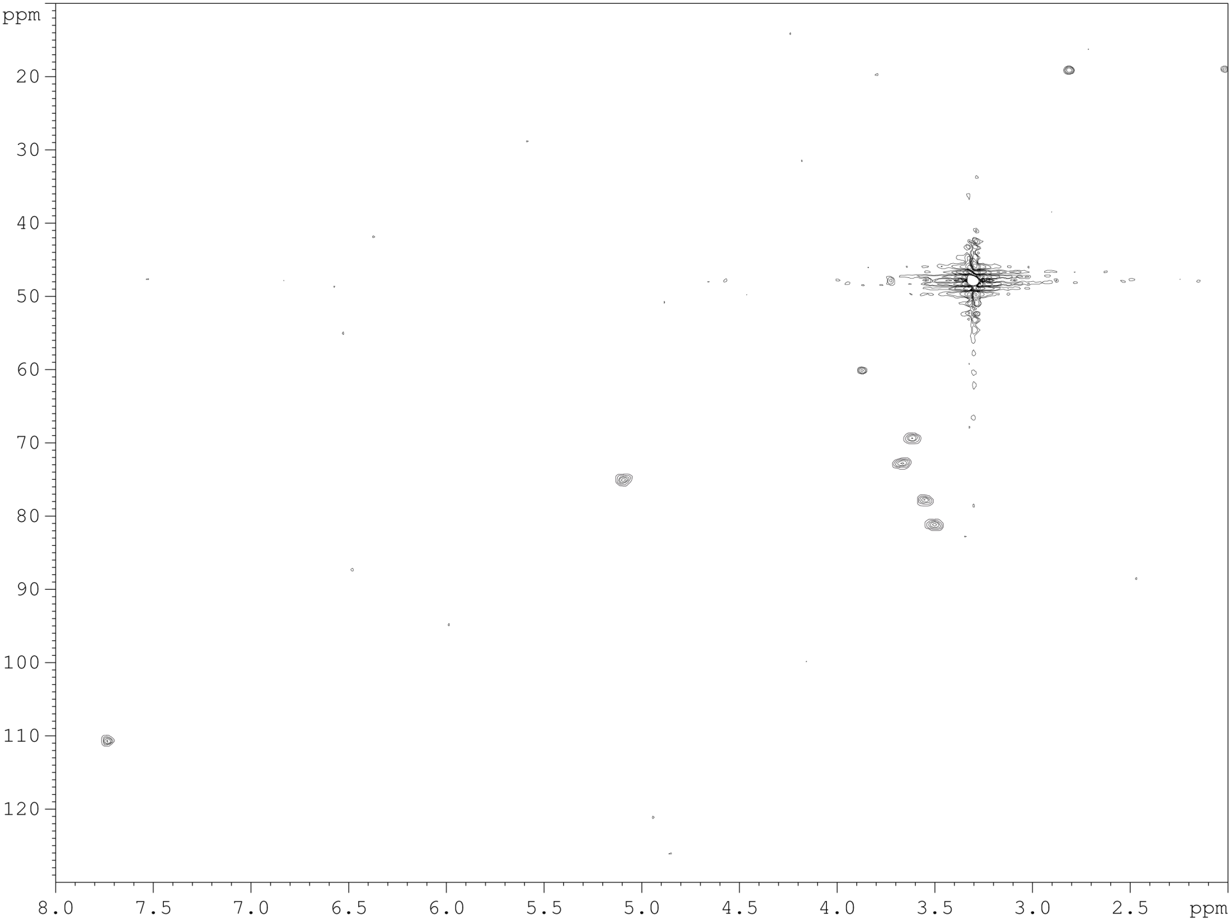
CH₃
Aliphatic
6’
4’
1’
2’
3’
5’
5
Sugar region
aromatic

Slide 21
With these type of spectra we can conclude how many are the protonated carbons and of which type: methylene or methyls/methines
We cannot see the non-protonated carbons
For this purpose we need direct observation through a 13C spectrum

Slide 22
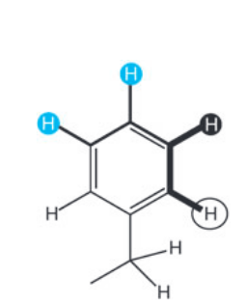
3d step: Double-Quantum-Filtered Correlated Spectroscopy: DQF-COSY
COSY
DQF-COSY is the prototype 2D-NMR experiment to identify correlations of scalar-coupled H-atoms. These are mainly vicinal; rarely, long-range couplings are also visible.
DQF-COSY is one of the most-important experiments for establishing fragment structures

Slide 23
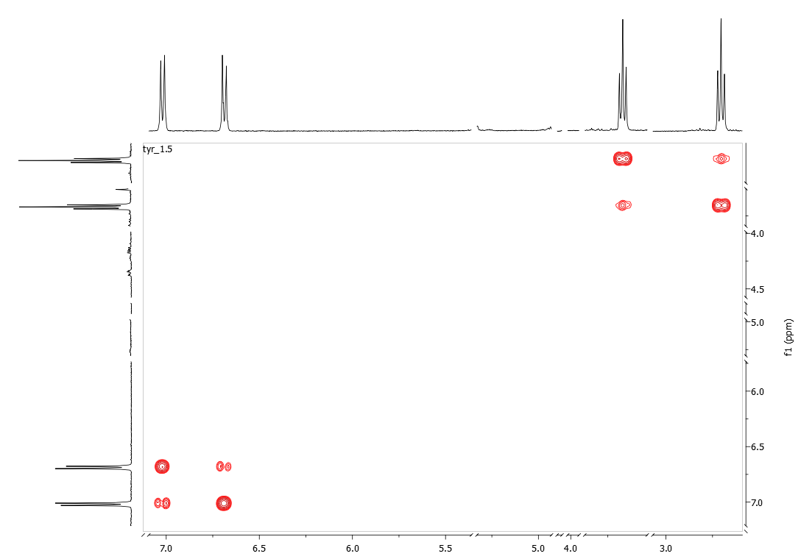
COSY

Slide 24
COSY-LR
Long range COSY
For ⁵J (mainly) and ⁶J correlations
⁵J
⁵J

Slide 25
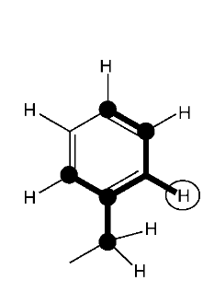
4th step: Heteronuclear-Multiple-Bond-Correlation Spectroscopy: HMBC
HMBC Experiments yield correlations between H- and C-atoms due to two-or three-bond scalar coupling. These couplings are usually small (<10 Hz).
Hence, these experiments are only capable of detecting correlations of reasonably sharp lines. The 3J couplings follow a Karplus-type dependence on the dihedral angle involved. Therefore, these couplings may be small (or even zero), so that certain correlations can be missing.
HMBC is important to derive chemical shifts of C-atoms lacking H-atoms (e.g., C=O groups), but also to link fragments.
The combination of DQF-COSY and HSQC/HMBC presents a convenient way to assign highly functionalized molecules comprising few H-atoms.
Sensitivity: -1

Slide 26
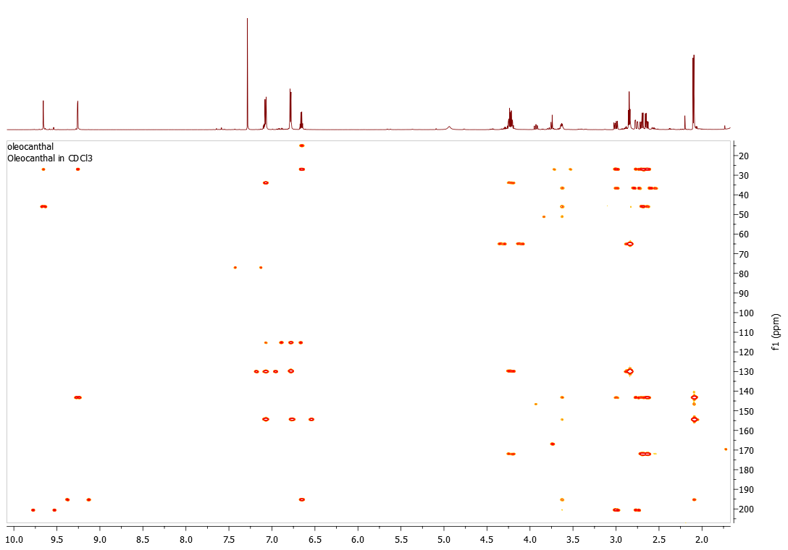

Slide 27
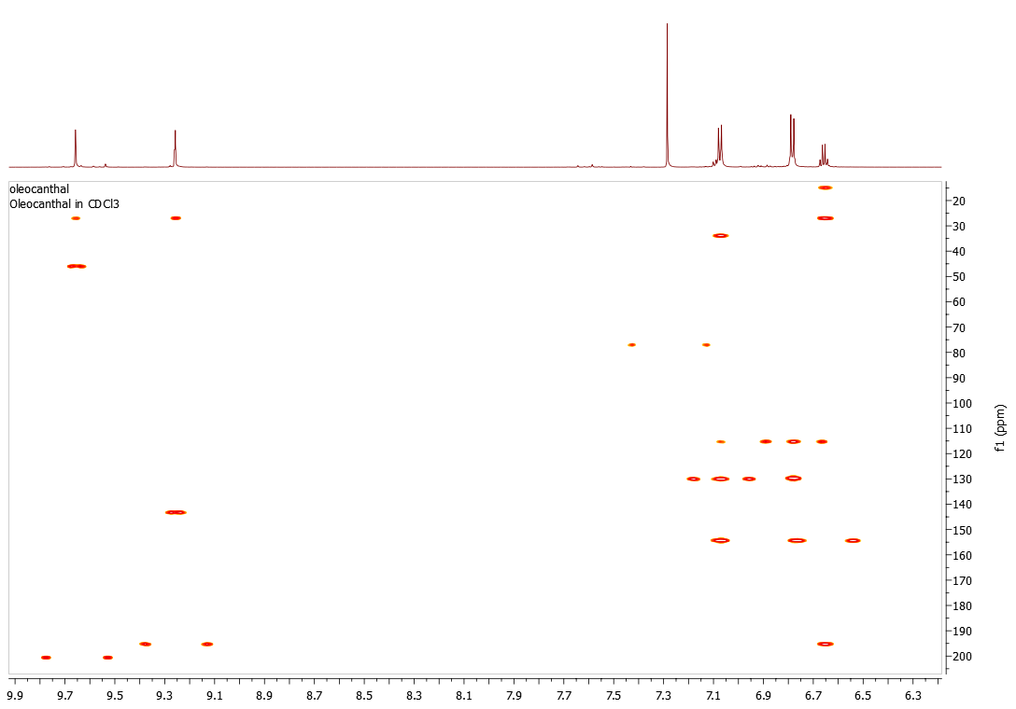

Slide 28
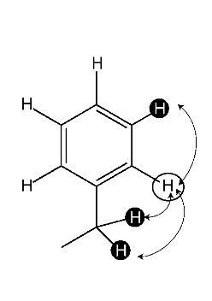
5th step
Two-Dimensional Nuclear-Overhauser-Effect Spectroscopy: NOESY
2D-NOE Experiments ideally yield correlations of dipolar-coupled H- atoms. The dipolar coupling depends on the distance (d) of spin, decreasing with 1/d⁶
Typically, only H-atoms with distances smaller than ca. 5 A give rise to such correlations, independent of the number of intervening bonds.
For small compounds, the mixing time should be adjusted to T1 (the longitudinal relaxation time), but for larger molecules, a much shorter value is recom- mended to avoid spin diffusion.
2D-NOE is the experiment proper to establish configurations or, together with HMBC, to link fragments. For molecules in a certain size range, the NOE can actually be zero, which calls for a ROESY experiment.
Sensitivity: +1

Slide 29
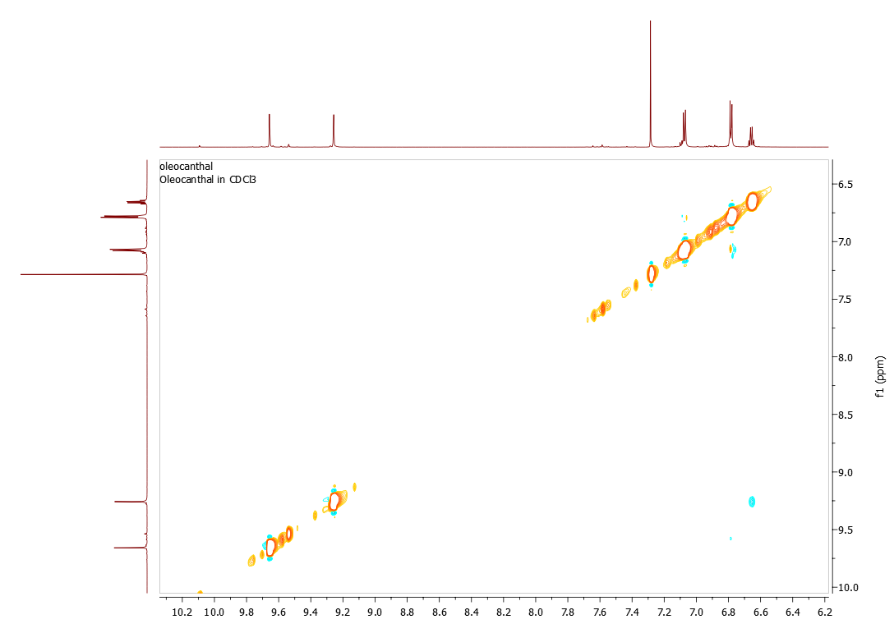
Geometric or Relative stereochemistry
or

Slide 30
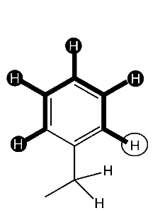
Total-Correlation Spectroscopy: TOCSY
TOCSY experiments ideally yield correlations of all bond-coupled H-atoms within a given spin system. By appropriate choice of the mixing time, either vicinal correlations (12 ms) or correlations throughout the complete spin system (e.g. 80 ms-> up to 5 bonds) are detected.
The spin systems are interrupted by non-protonated heteroatoms or quaternary carbons
Such experiments are very important to identify compounds with separate spin systems (such as carbohydrates or peptides), as well as in case of severe resonance overlap.
Sensitivity: +3

Slide 31
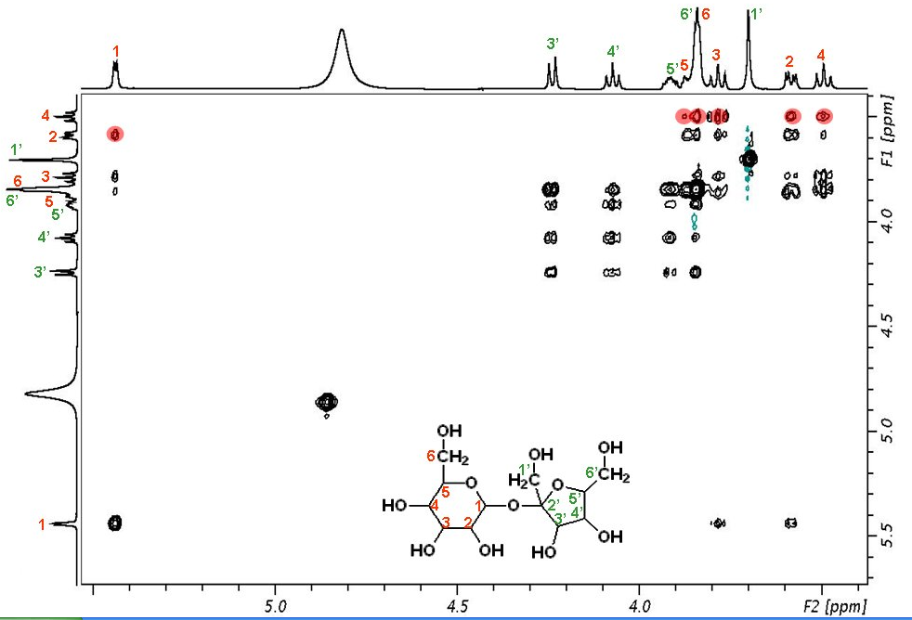

Slide 32
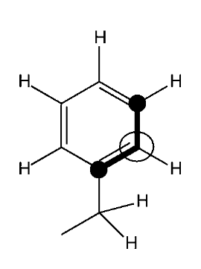
Incredible-Natural-Abundance-Double-Quantum-Transfer Spectroscopy: INADEQUATE
INADEQUATE is a homonuclear 2D shift-correlation experiment. It is a specially designed COSY experiment that yields 13C,13C correlations, efficiently suppressing the much more-abundant 13C,12C fragments.
The bottleneck of this highly versatile experiment is its extremely low sensitivity. Large sample quantities (typically>10 mg) are required. However, when spectra with a sufficient signal-to-noise ratio have been recorded, assignment is straightforward, even for extremely highly functionalized compounds. Recent improvements inprobe sensitivity have significantly increased the usefulness of this technique

Slide 33
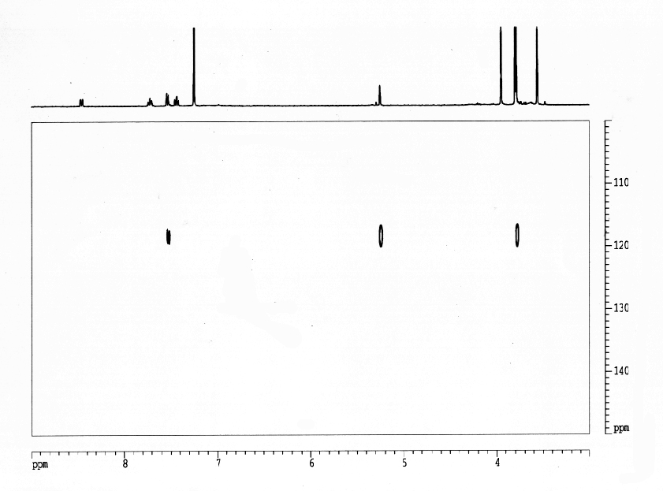
¹H-¹⁵N HMBC
N
X

Slide 34
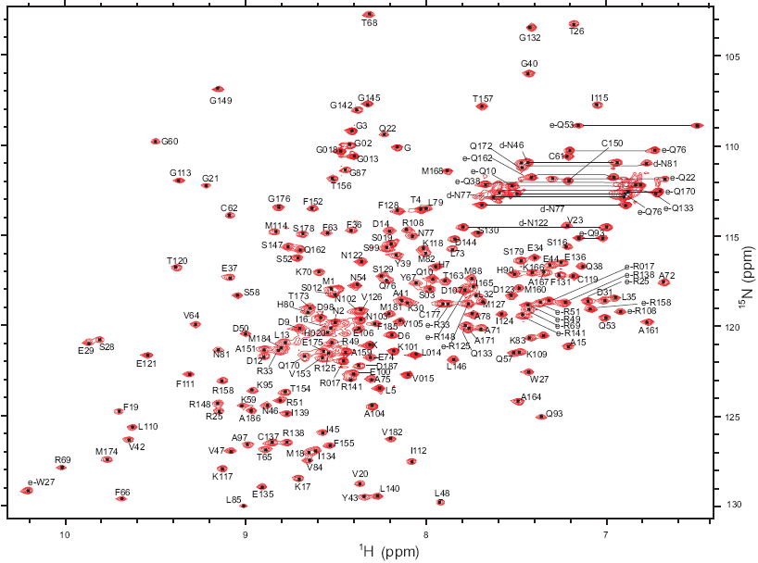
¹H-¹⁵N HSQC for proteins

Slide 35
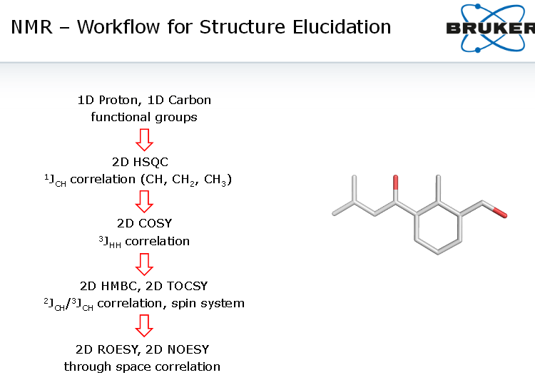

Slide 36
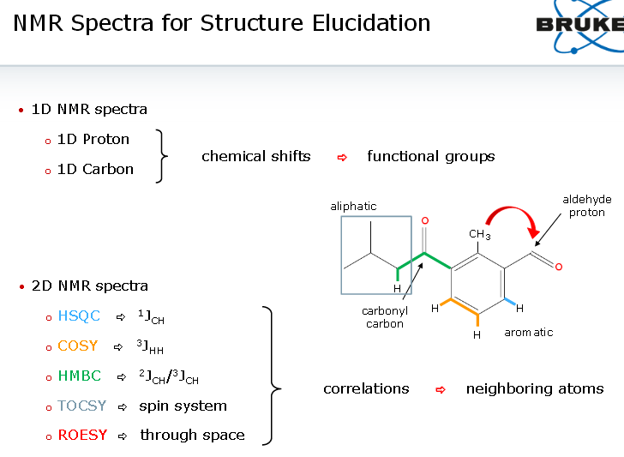

Slide 37

All the collected structural information are combined with mass spectroscopy data (Molecular weight or molecular formula by HRMS)
Atoms not observable in the NMR (e.g Oxygen, Sulphur, Halogens or nitrogen) are assumed in order to satisfy the MS data
The final structure should satisfy all NMR correlations and have the appropriate MW or MF

