Slide 1
ΦΑΡΜΑΚΕΥΤΙΚΗ ΒΙΟΤΕΧΝΟΛΟΓΙΑ
Δρ. Νικόλας Φωκιαλάκης
Αναπληρωτής Καθηγητής
Φαρμακογνωσίας & Χημείας Φυσικών Προϊόντων
Φαρμακευτικό Τμήμα, ΕΚΠΑ
ΓΟΝΙΔΙΑΚΗ ΘΕΡΑΠΕΙΑ & ΕΠΙΓΕΝΕΤΙΚΗ

Slide 3
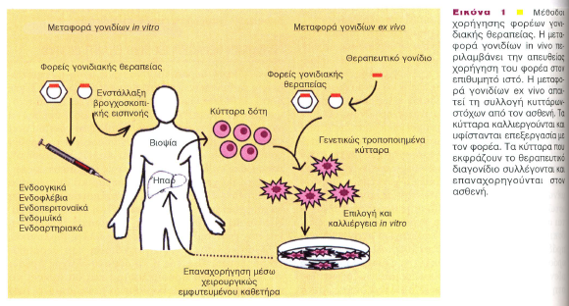

Slide 4
Ex-vivo

Slide 18
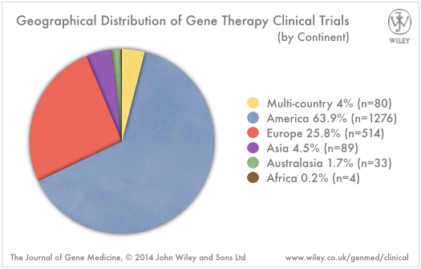
Σύνολο = 1970

Slide 19
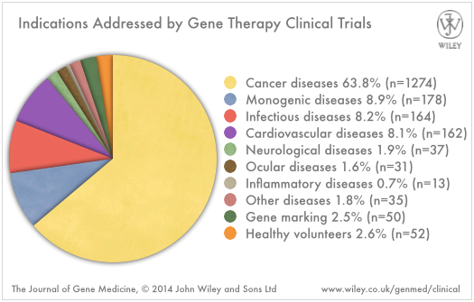

Slide 20
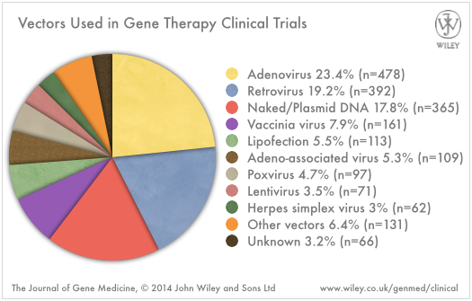

Slide 21
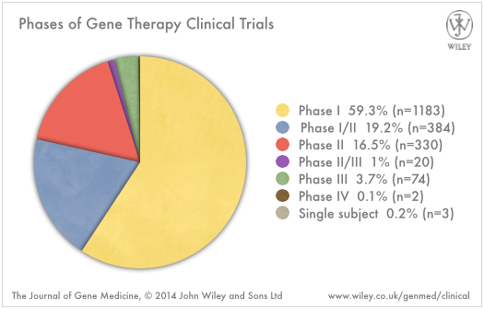

Slide 22
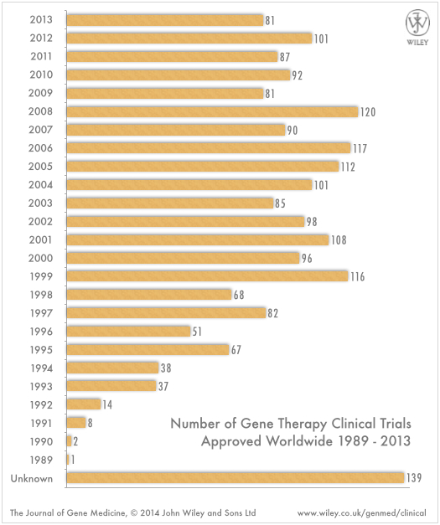

Slide 23
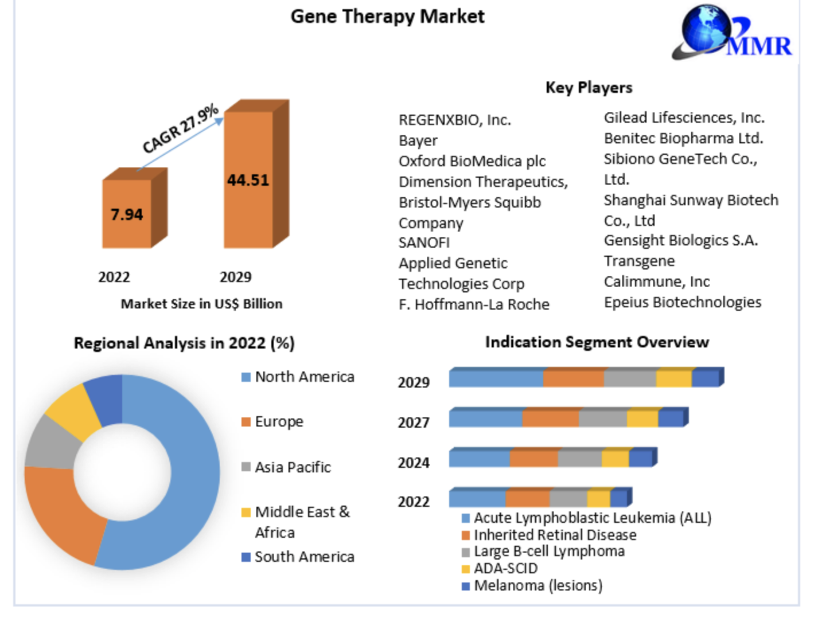

Slide 30
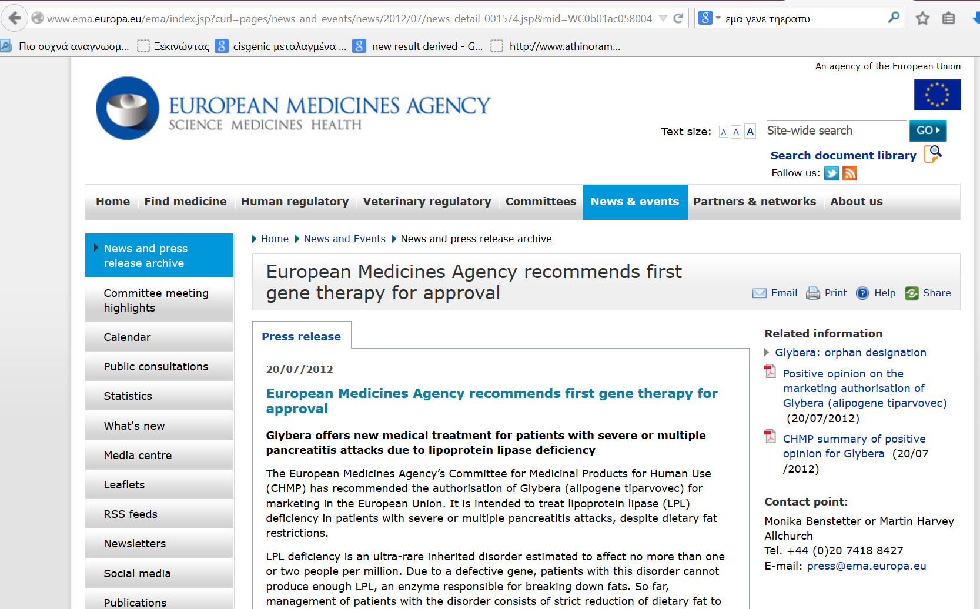
2012

Slide 31

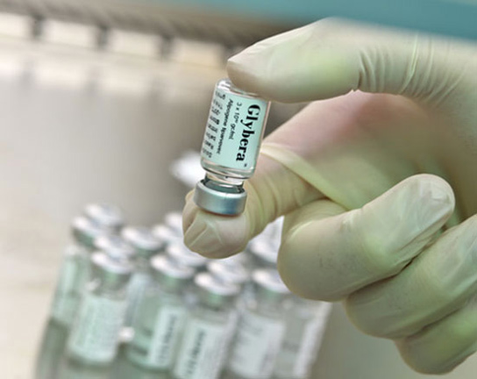
Στόχος : Ασθενής με έλλειψη μιας
λιποπρωτεινικής λιπάσης που μπορεί
να οδηγήσει σε σοβαρή παγκρεατίτιδα.
Αριθμός ασθενών 1.000 - 5.000 παγκοσμίως
Επένδυση για την ανάπτυξη του € 50 εκ.
Κόστος : € 1.2 εκ. / ασθενή

Slide 32
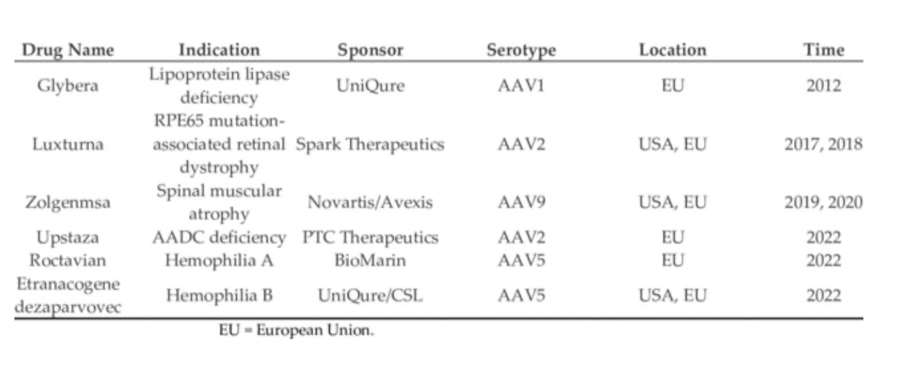

Slide 33
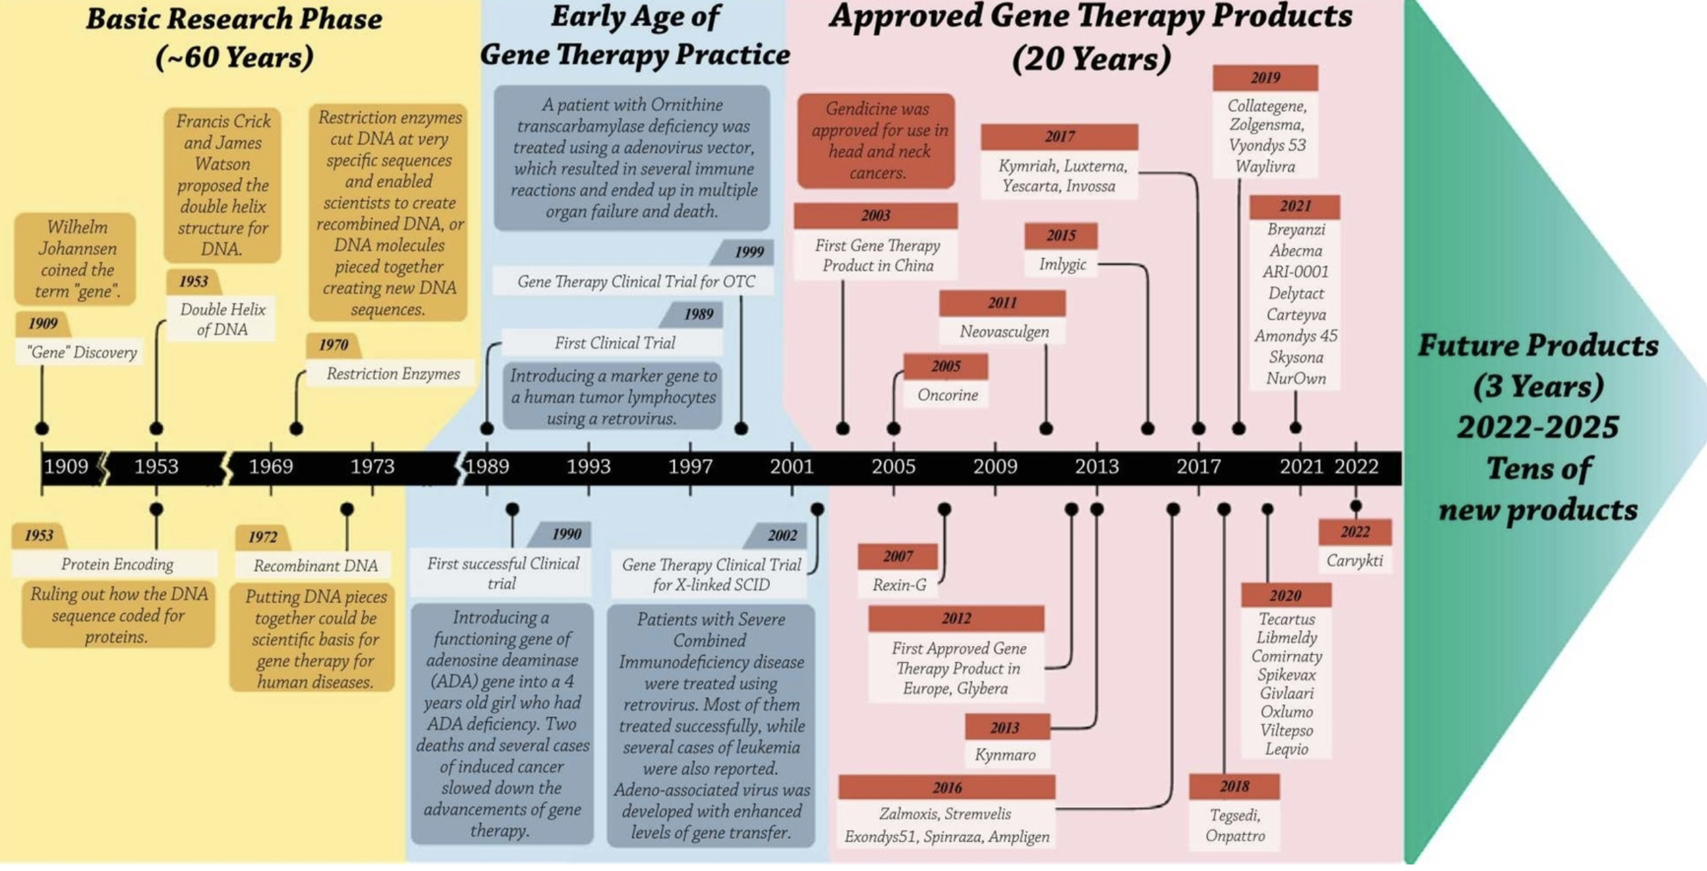

Slide 35
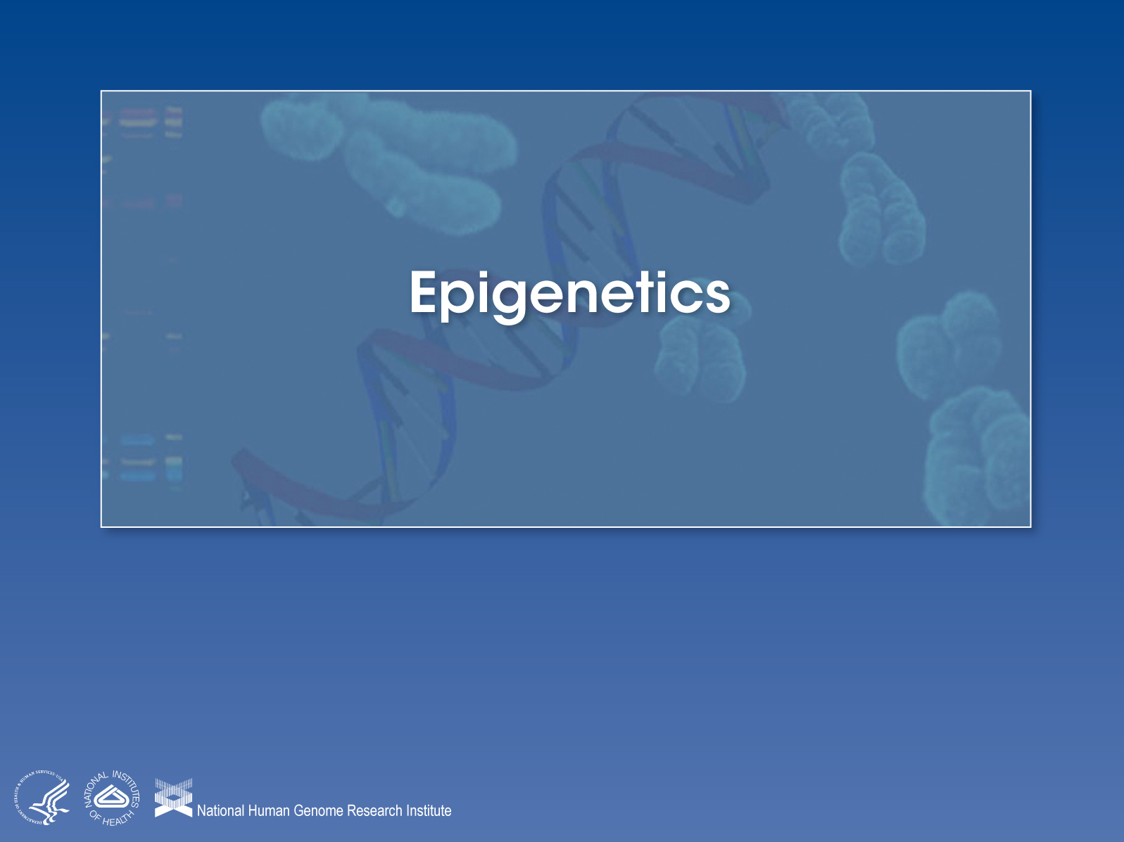

Slide 36
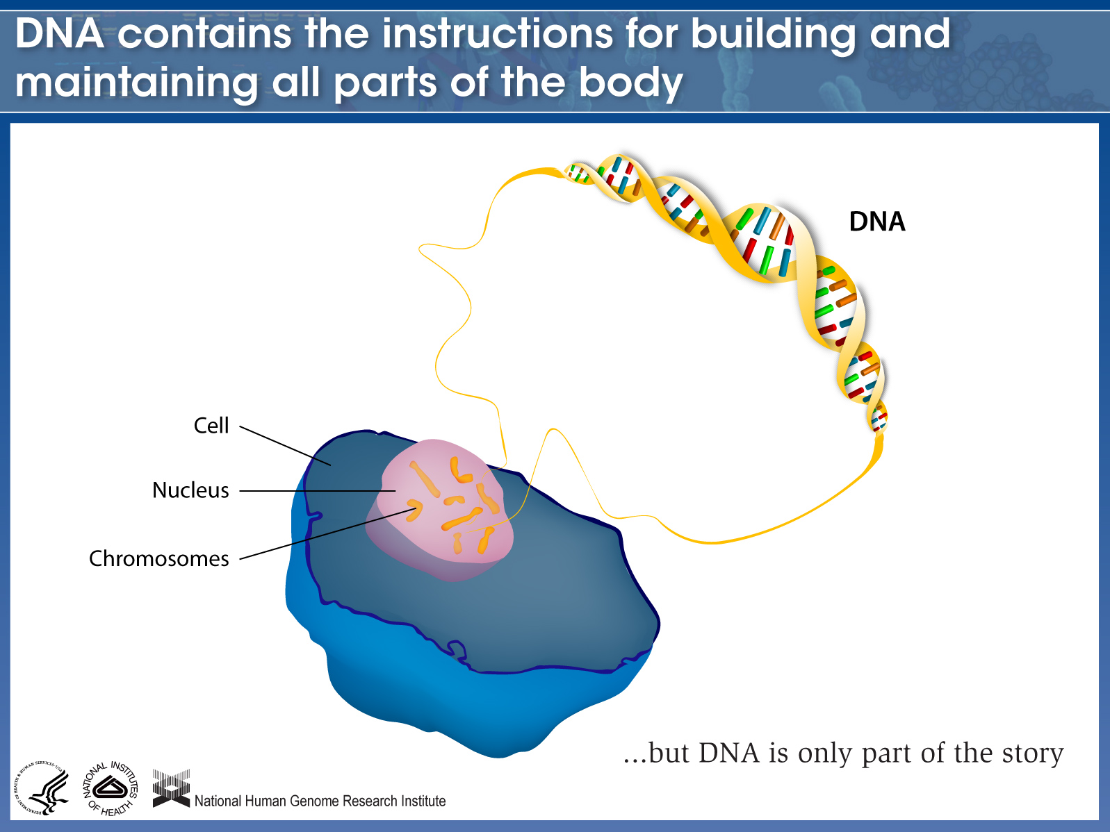

Slide 37
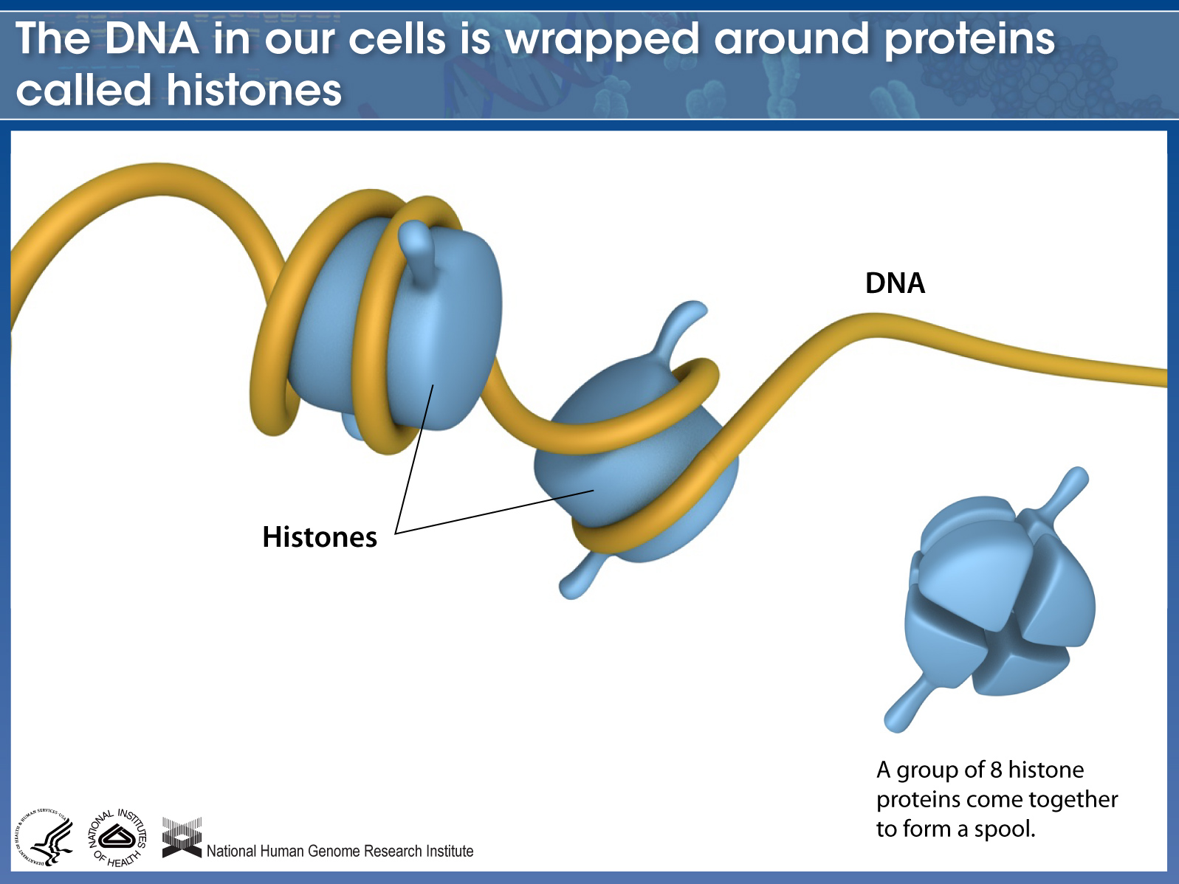
Notes:
By mass, chromosomes are made up of about 50% DNA and 50% protein.

Slide 38
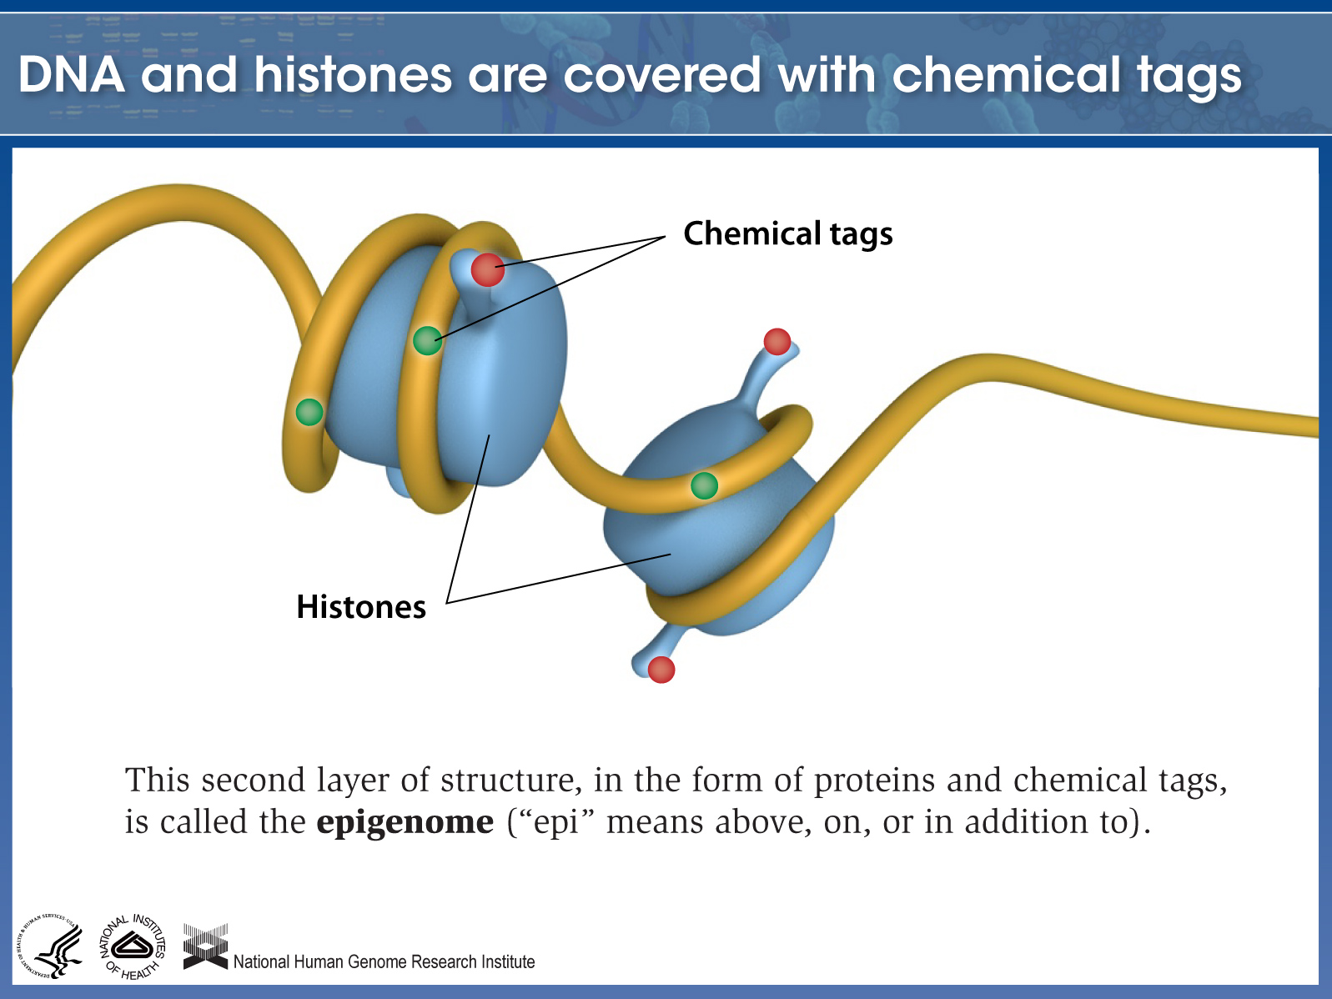

Slide 39
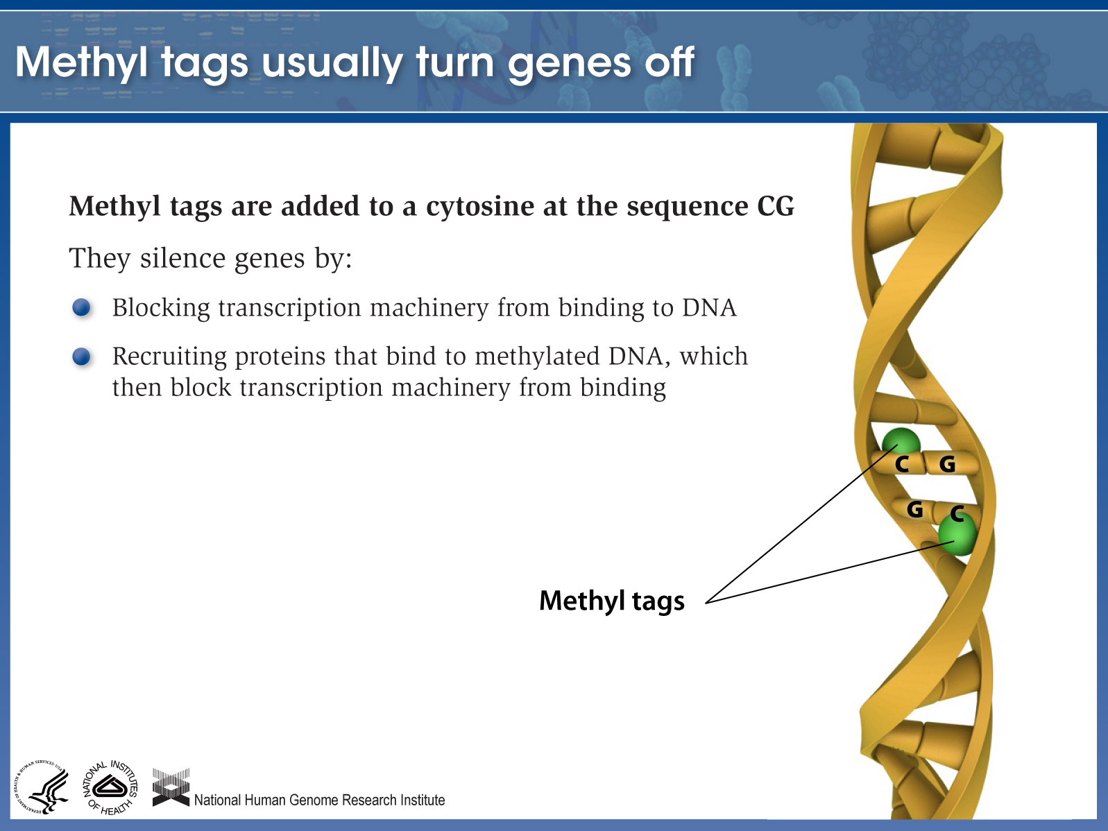

Slide 40
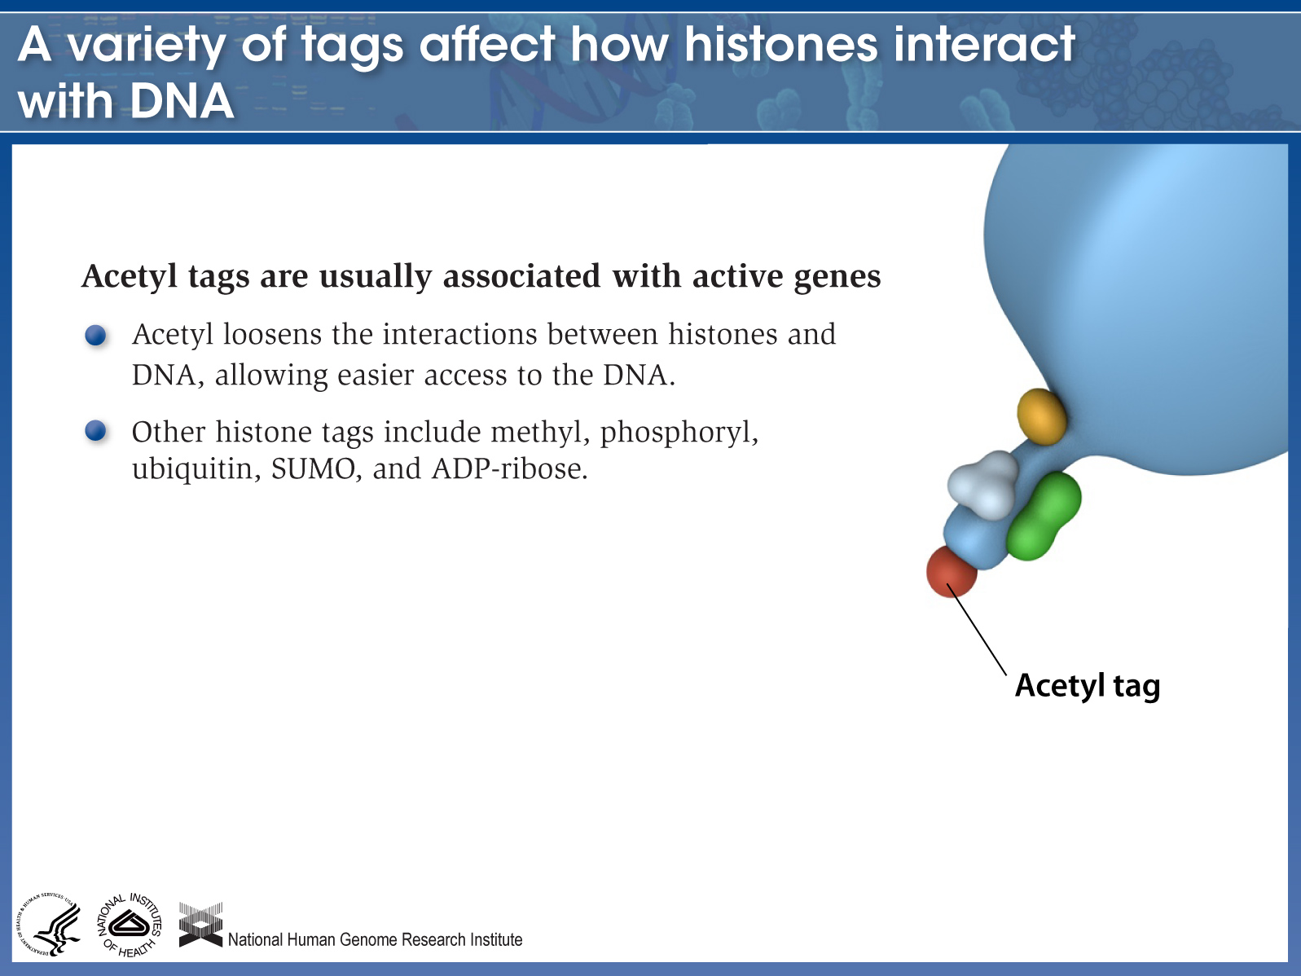

Slide 41
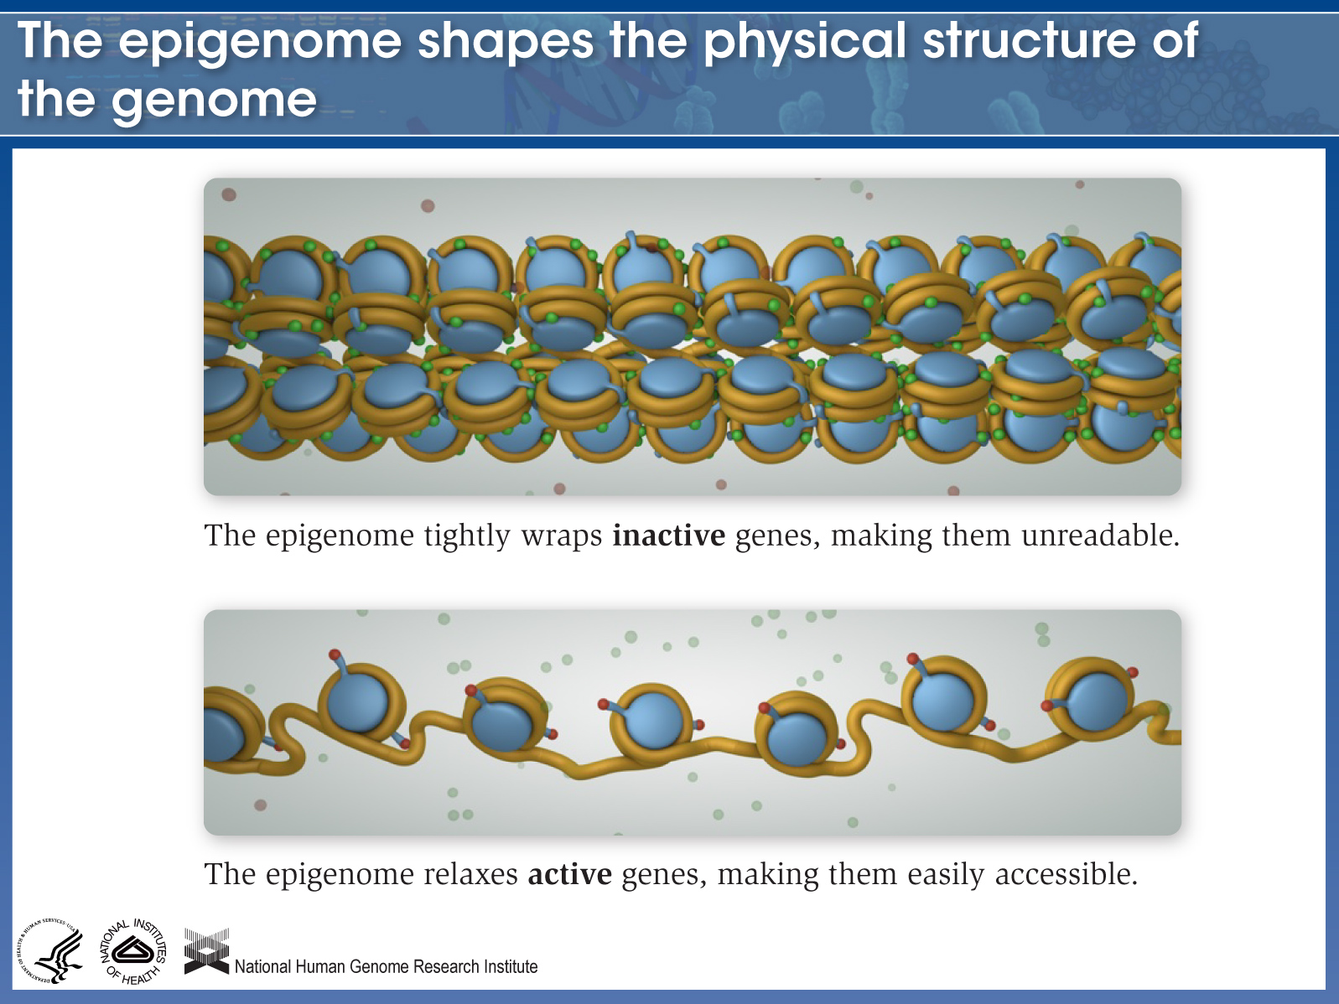

Slide 42
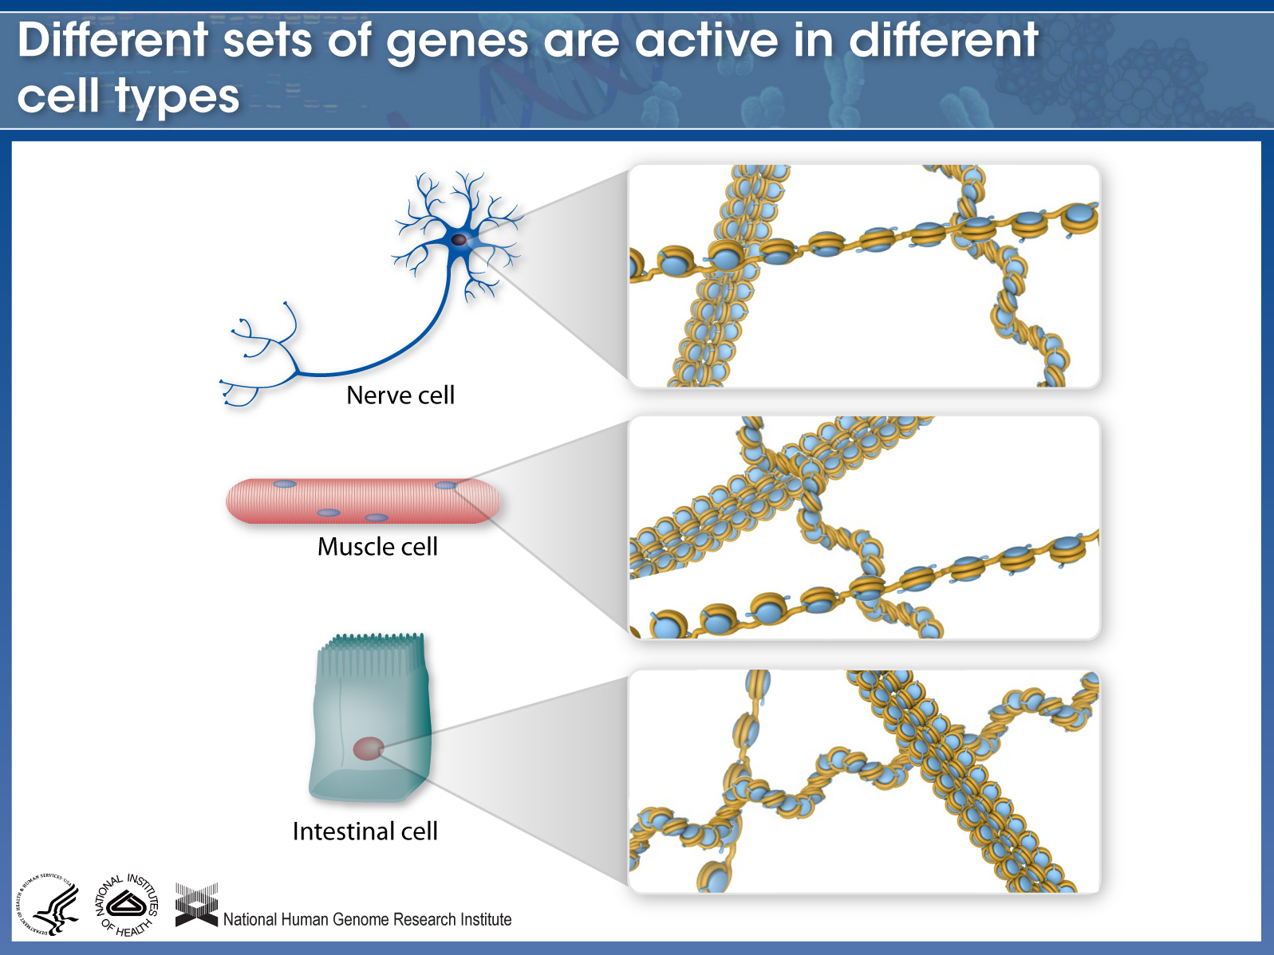

Slide 43
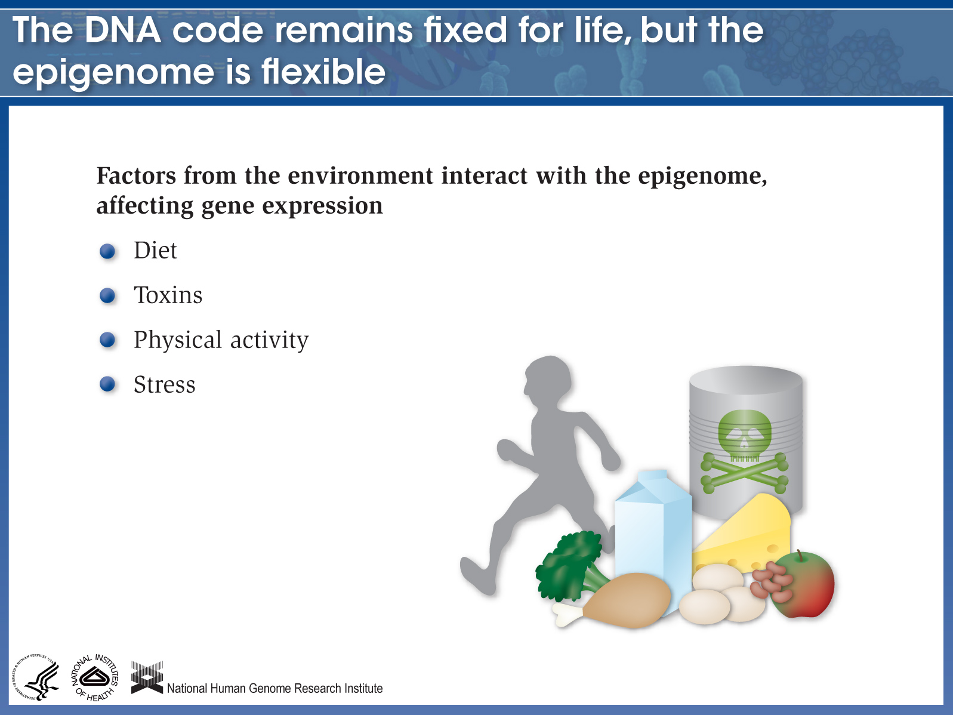

Slide 44
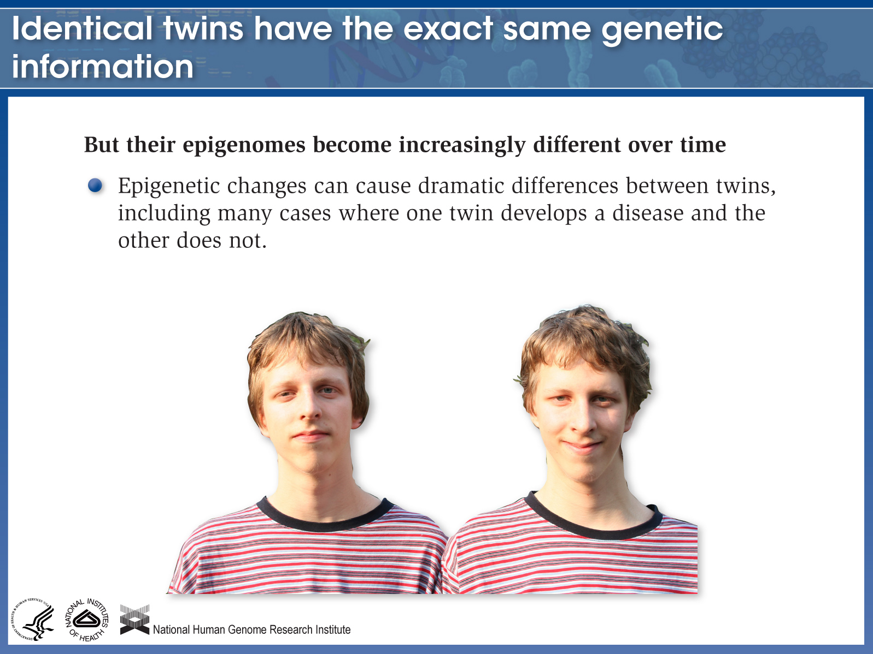

Slide 45
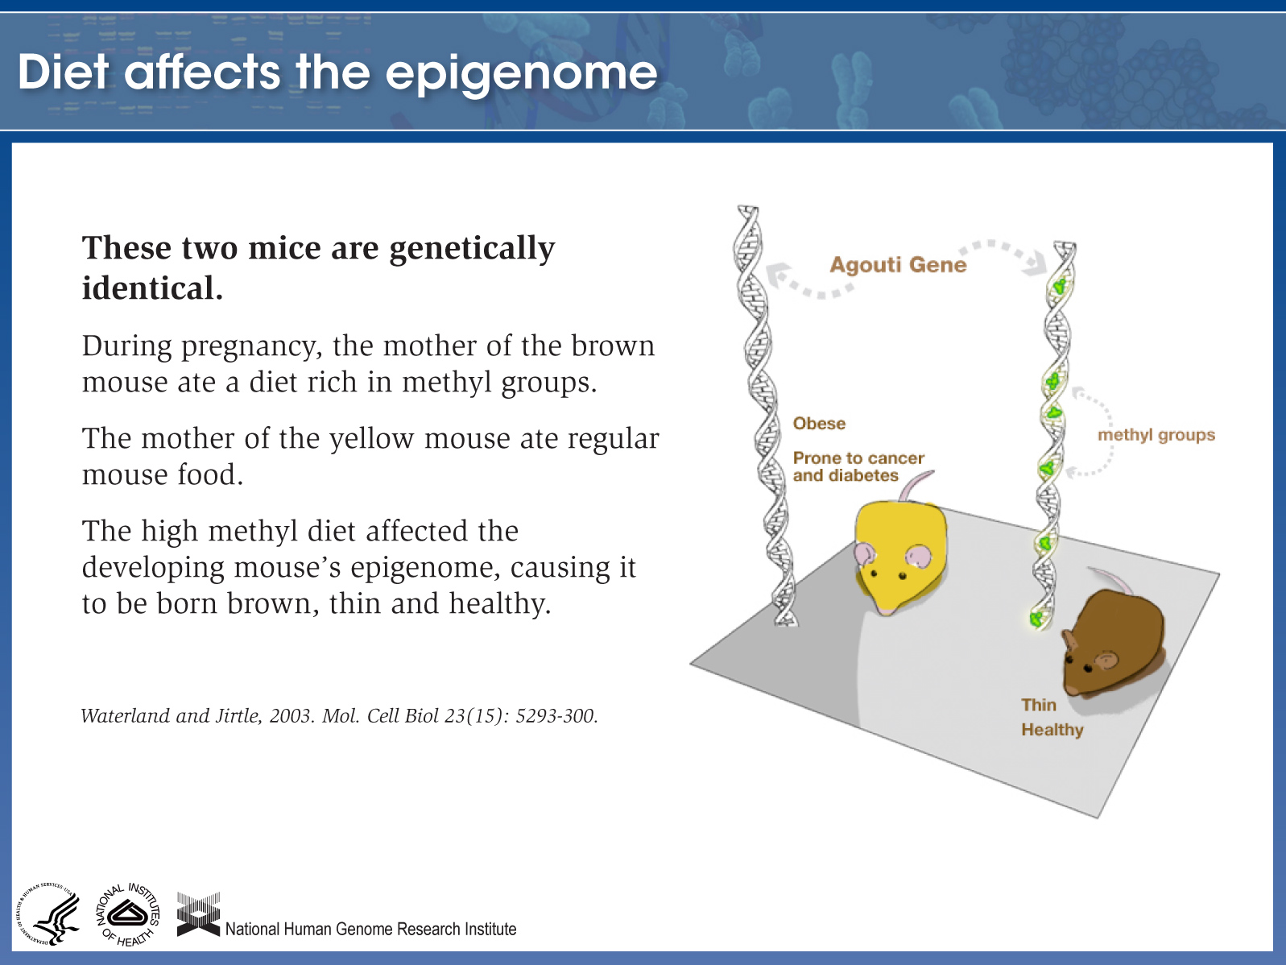

Slide 46
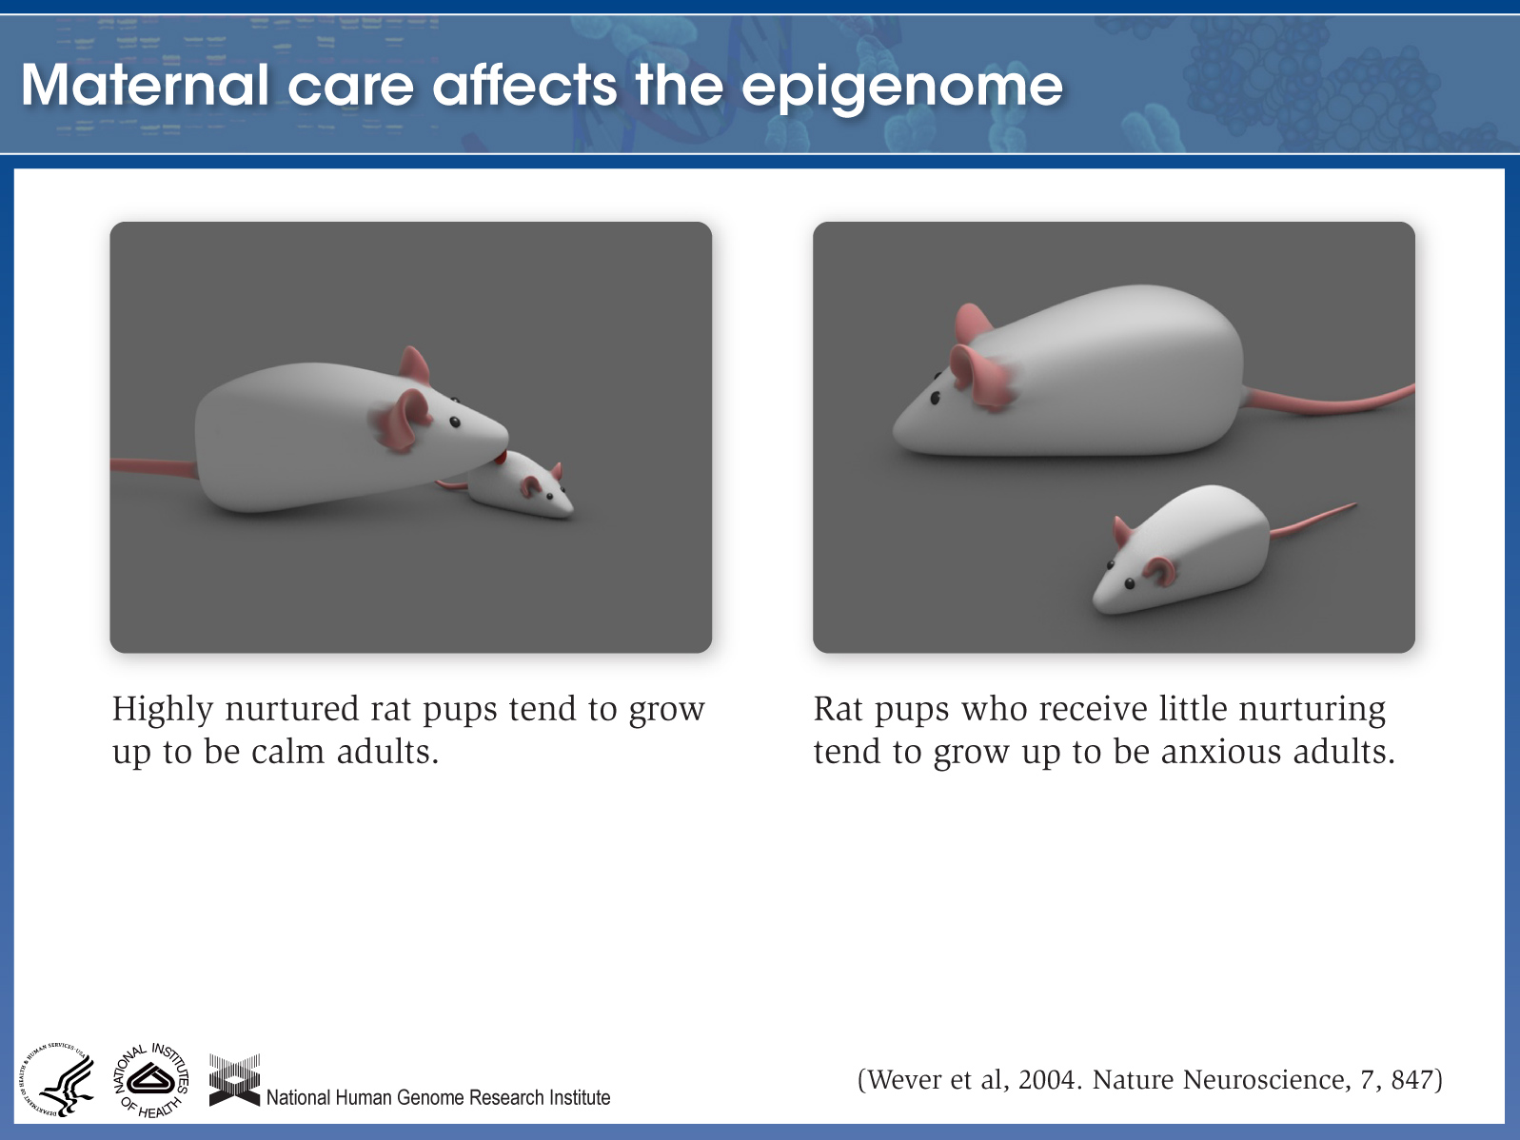

Slide 47
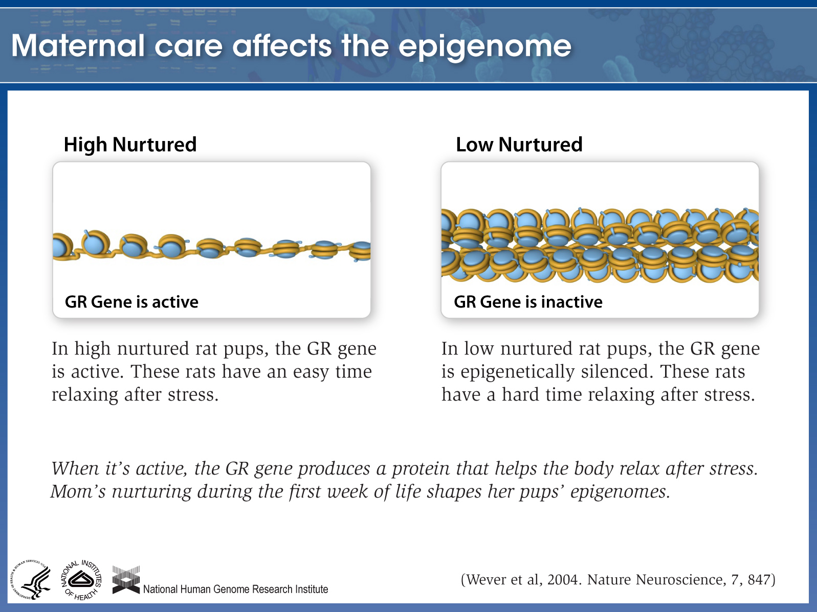

Slide 48
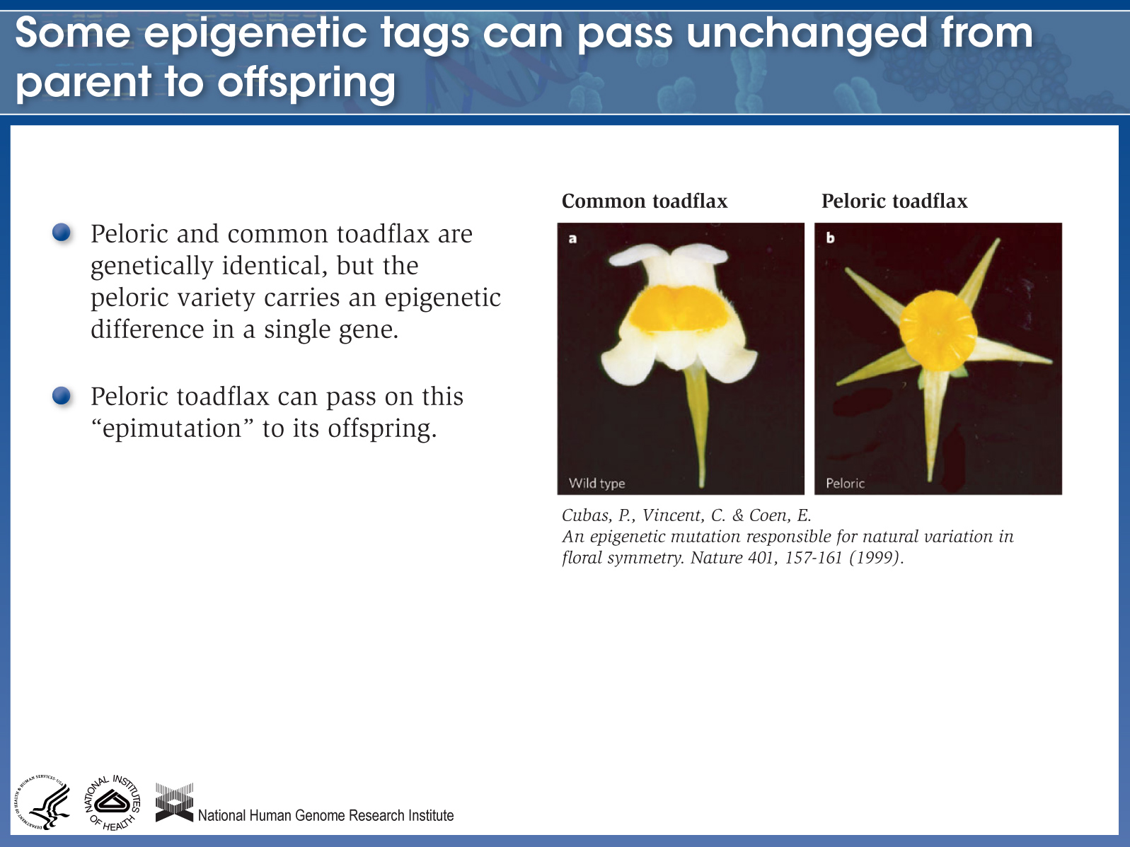

Slide 49
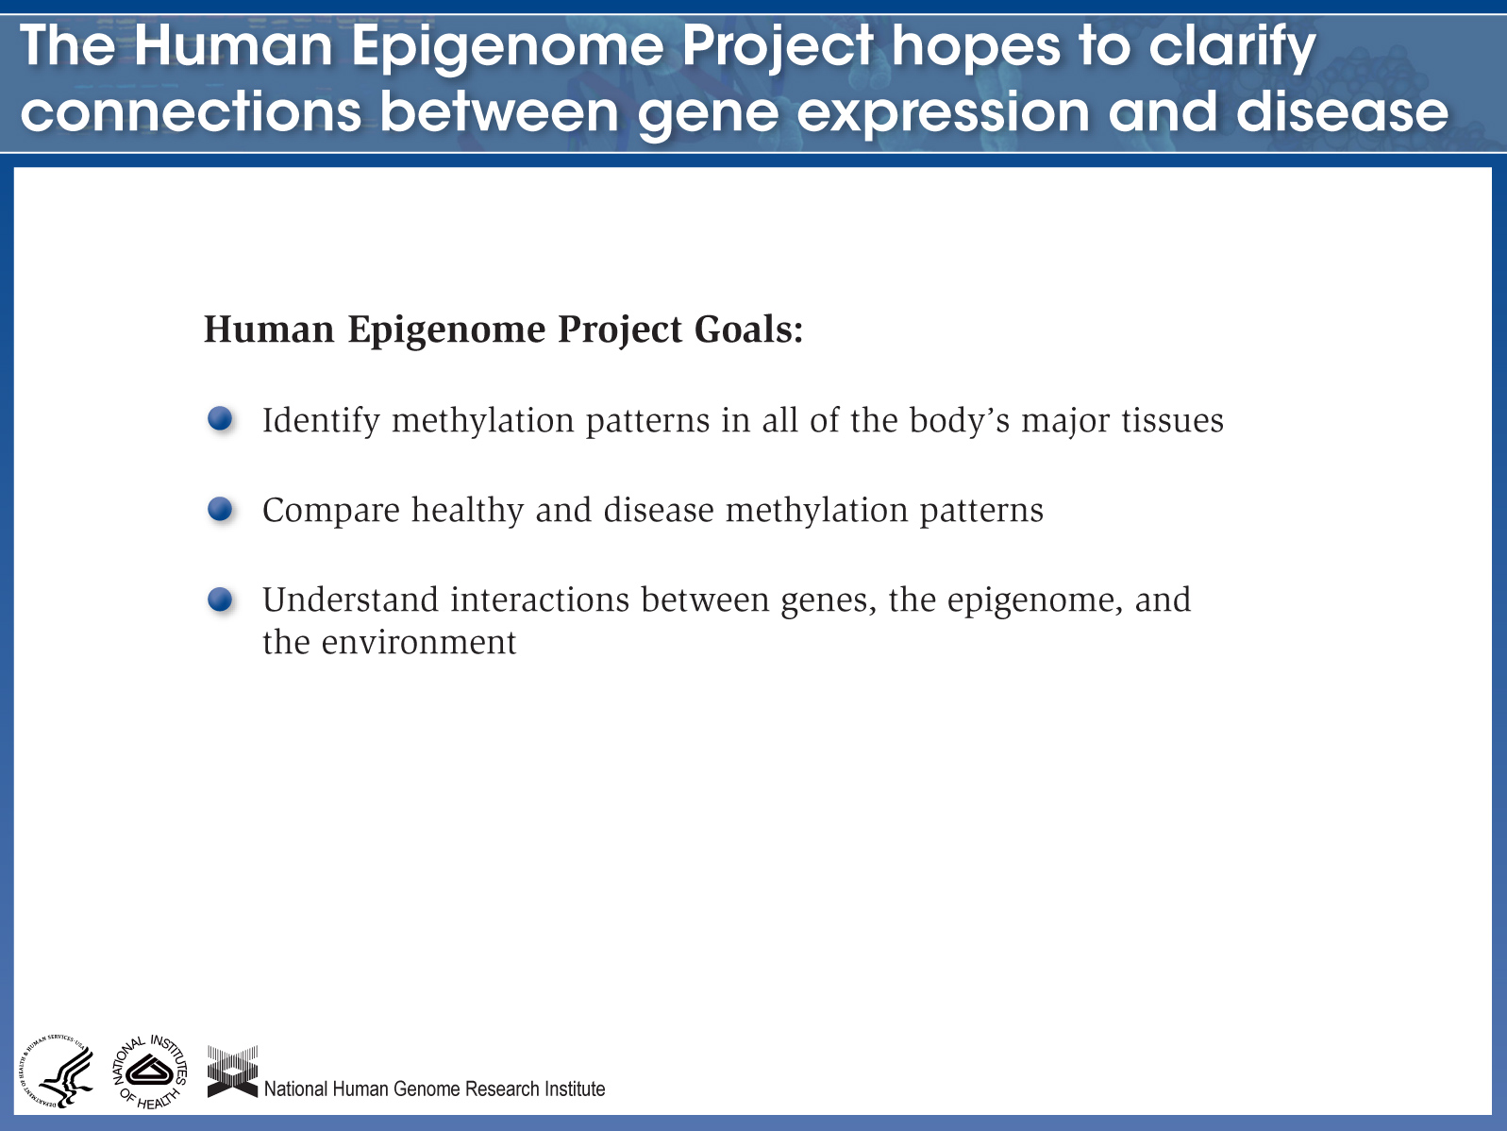

Slide 50
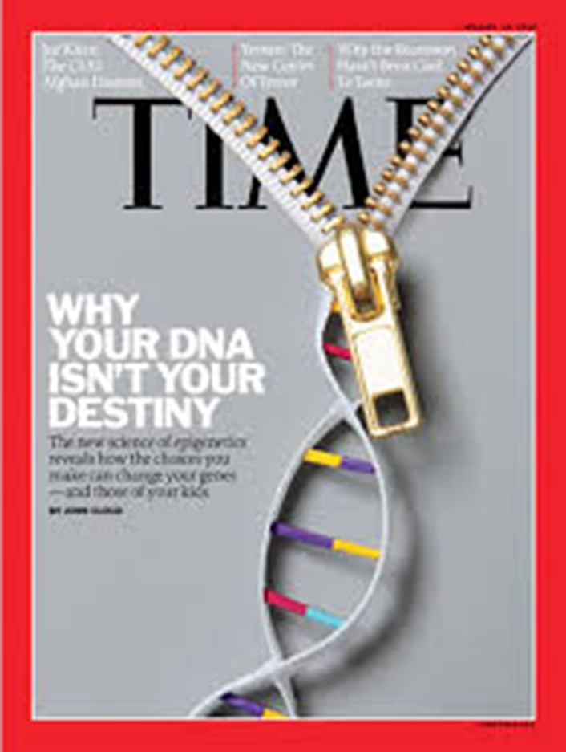
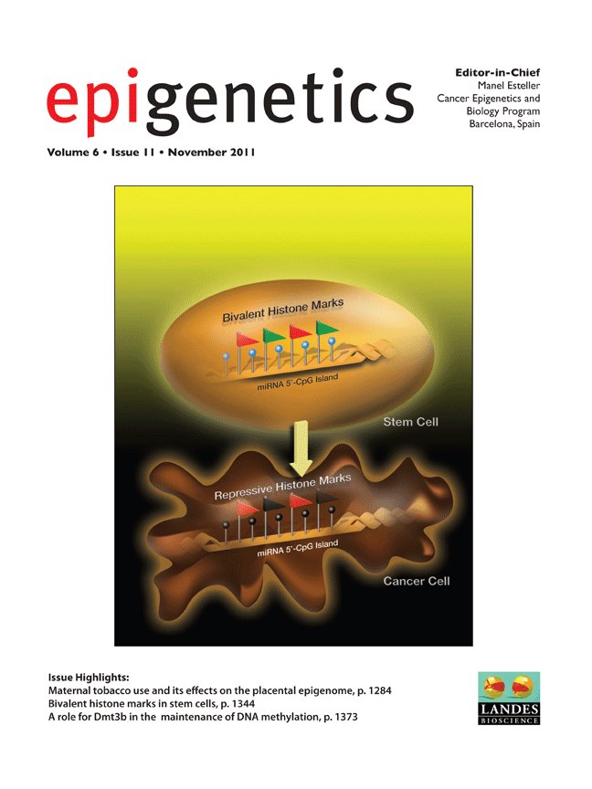

Slide 51
Epigenetic therapy
Histones can be modified by a number of ways like acetylation, methylation and phosphorylation.
Acetylation of histones which occurs at lysine residues and is catalysed by histone acetyltransferases (HATs), is associated with activation of gene transcription.
Deacetylation of histones, catalysed by histone deacetylases (HDACs), is associated with silencing of gene transcription.
It is now well established that methylation of DNA and modifications of histones are intimately interconnected.

Slide 52
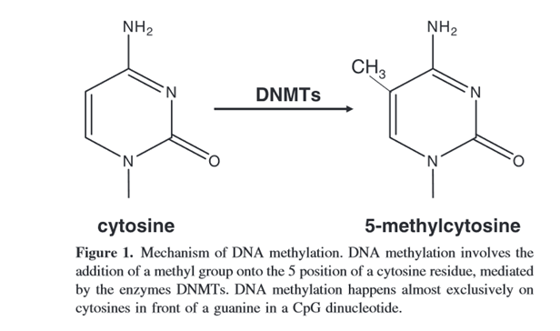
Epigenetic therapy
DNA methylation which usually, but not always, depending on the position of the
methylation change relative to the position of the transcription start site, inhibits gene transcription.
Four DNA methyltransferases (DNMTs) named DNMT1, DNMT2, DNMT3A DNMT3B have been found to be associated with the human genome

Slide 53
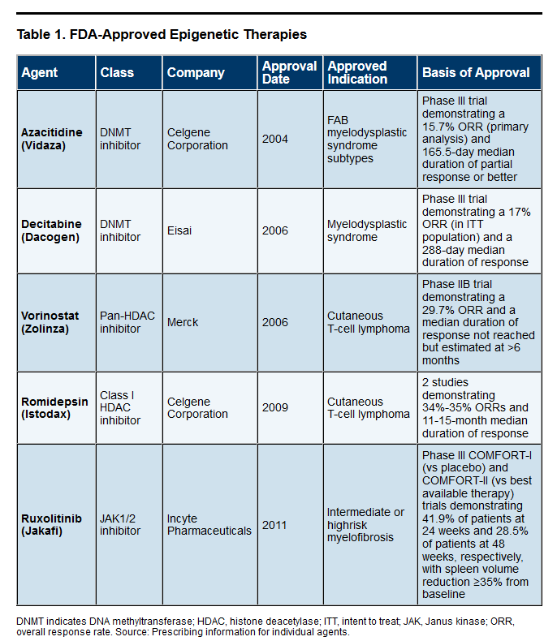

Slide 54
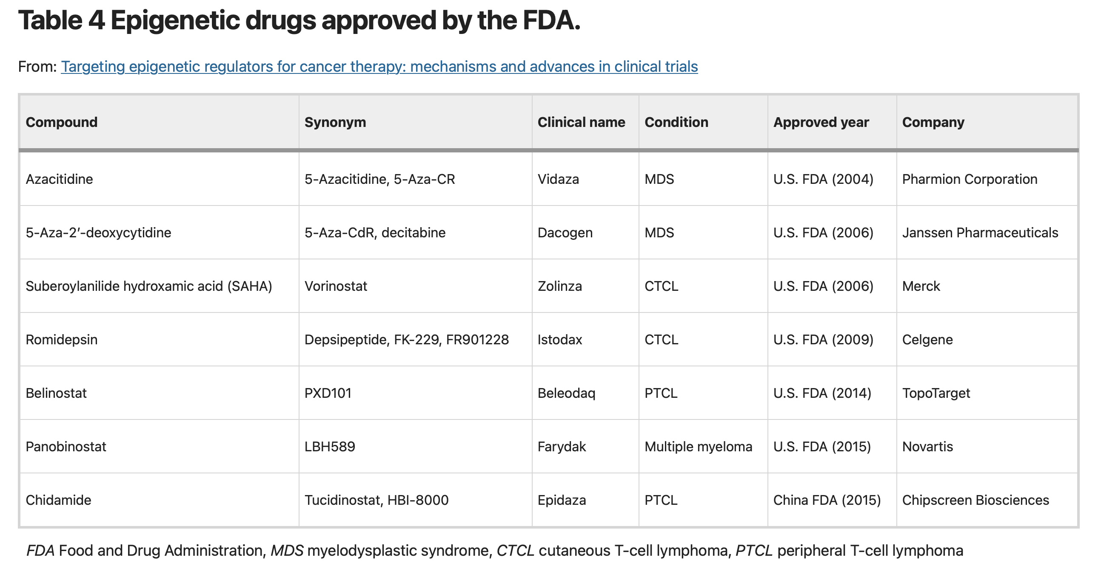

Slide 55
Epigenetic therapy
Epigenetic therapy: the pharmacological application of epigenetics.
Epigenetic therapy, the use of drugs to correct epigenetic defects, is a new and rapidly developing area of pharmacology. Epigenetic therapy is a potentially very useful form of therapy because epigenetic defects, when compared to genetic defects, are thought to be more easily reversible with pharmacological intervention. In addition to holding promise as therapeutic agents, epigenetic drugs may also be able to prevent disease.
However, epigenetic therapy has its limitations, such as the fact that both DNMT as well as HDAC inhibitors may activate oncogenes due to lack of specificity, resulting in accelerated tumour progression.

Slide 56
The Genomics
and post-Genomics Era

Slide 57
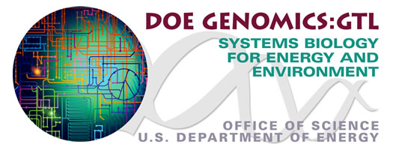
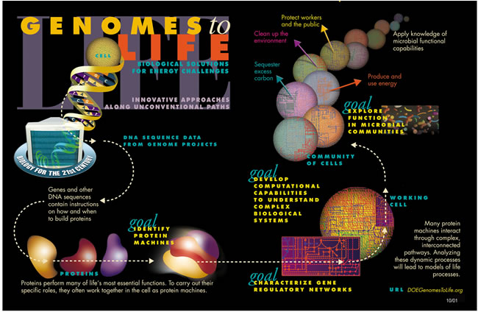

Slide 58
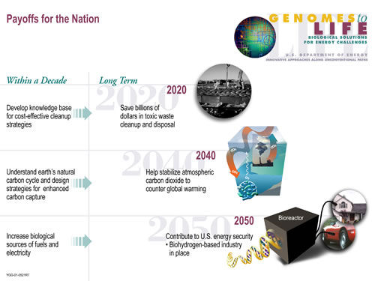
Genomics:GTL Program Payoffs

Slide 59
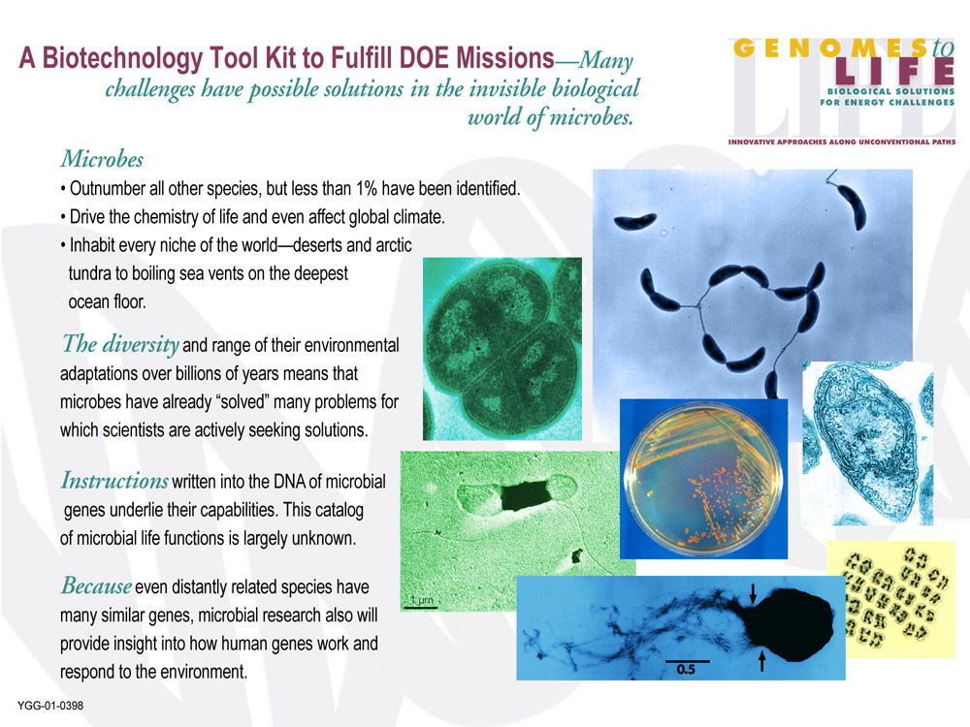

Slide 60
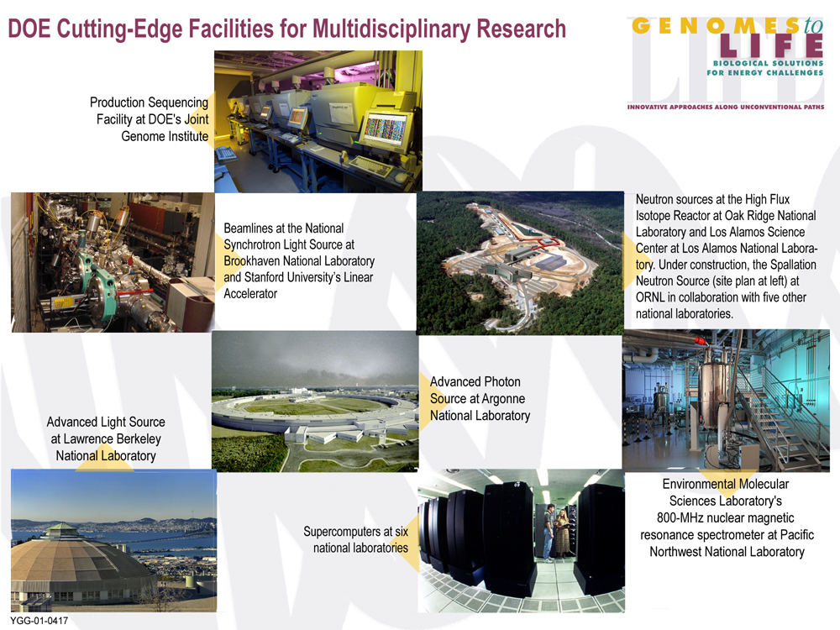
DOE's Cutting Edge Facilites for Multi-Disciplinary Research

Slide 61
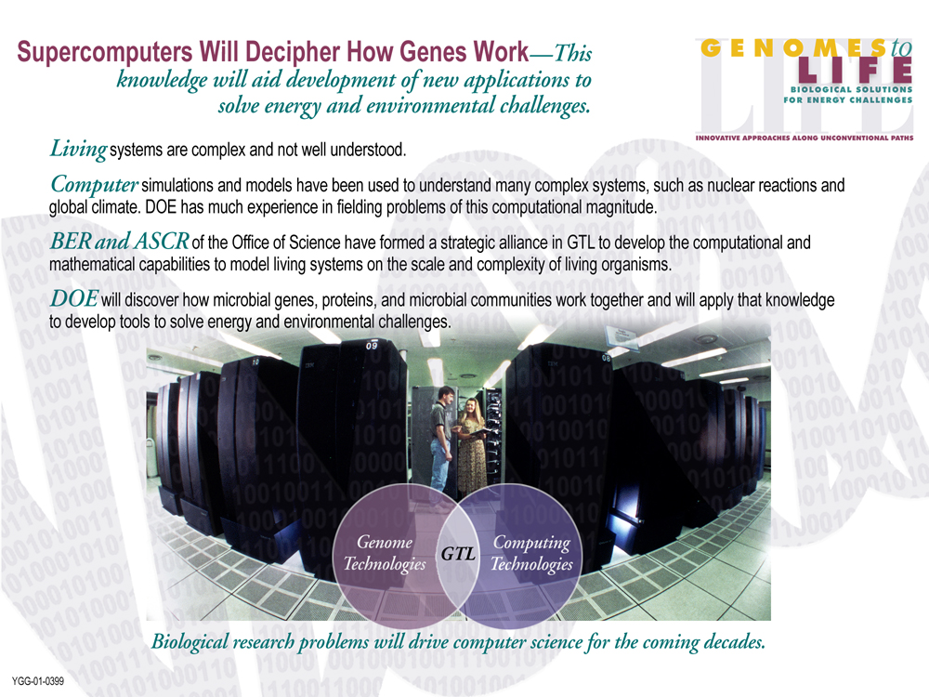

Slide 62
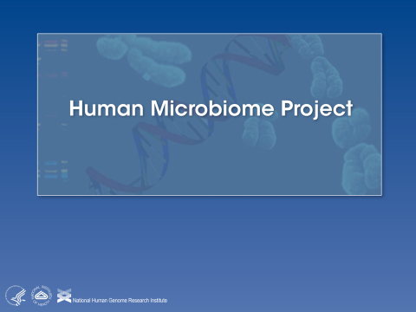

Slide 63
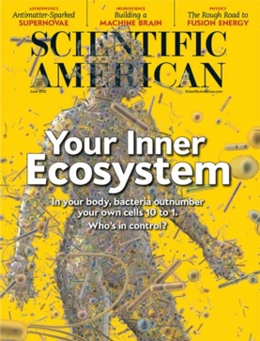
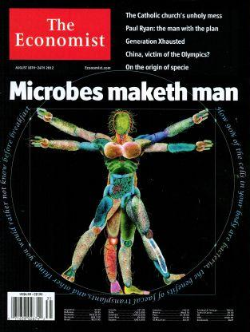

Slide 64
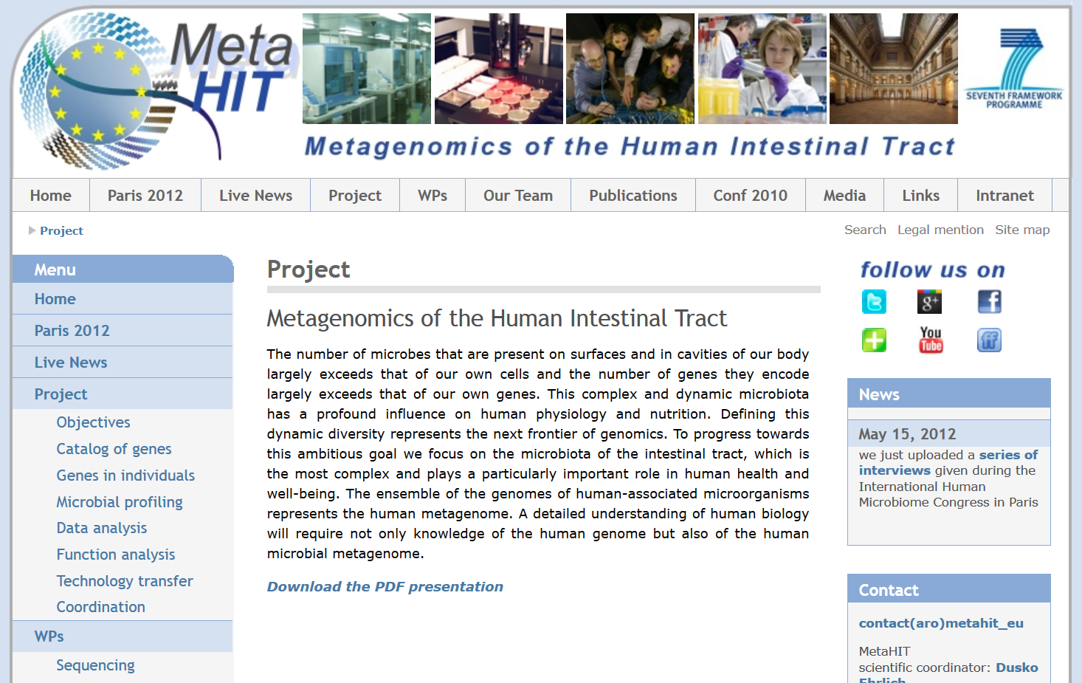

Slide 65
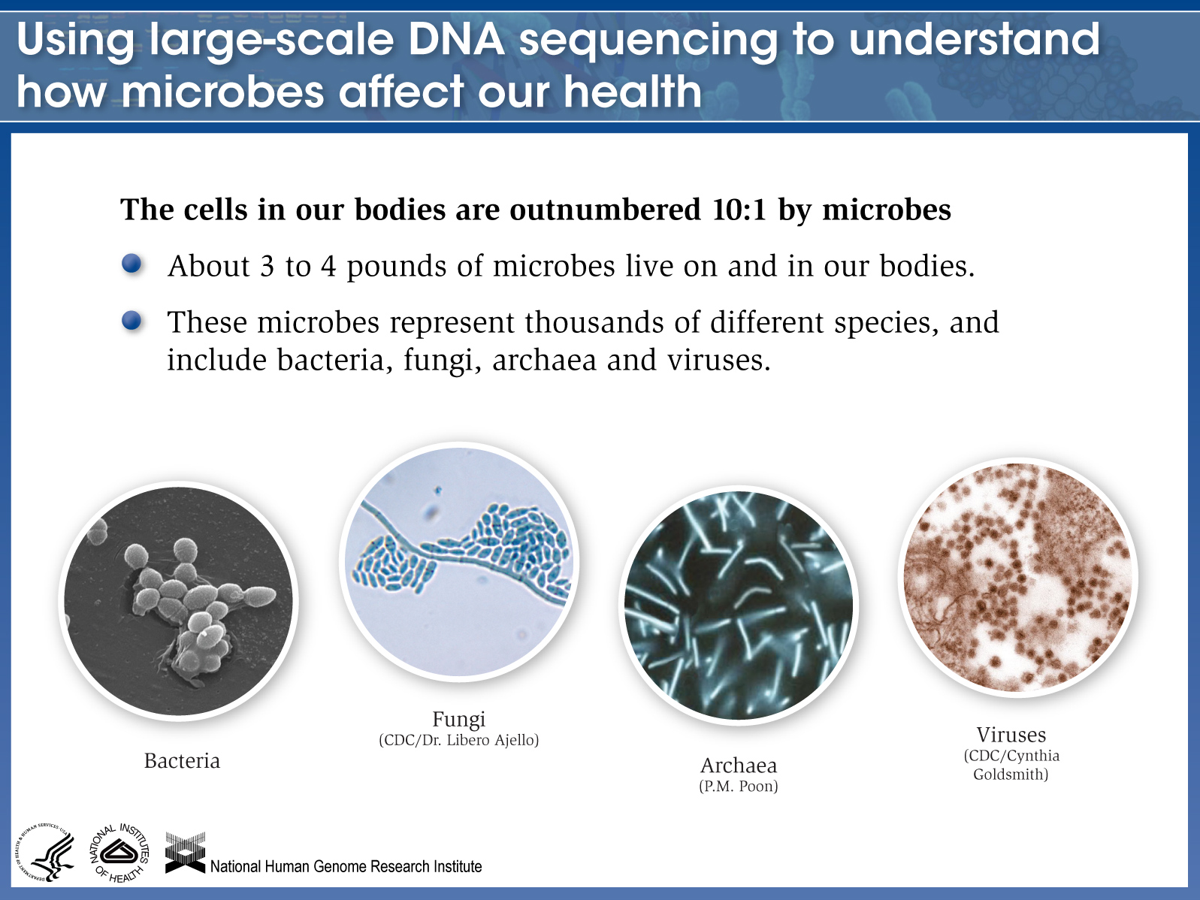

Slide 66
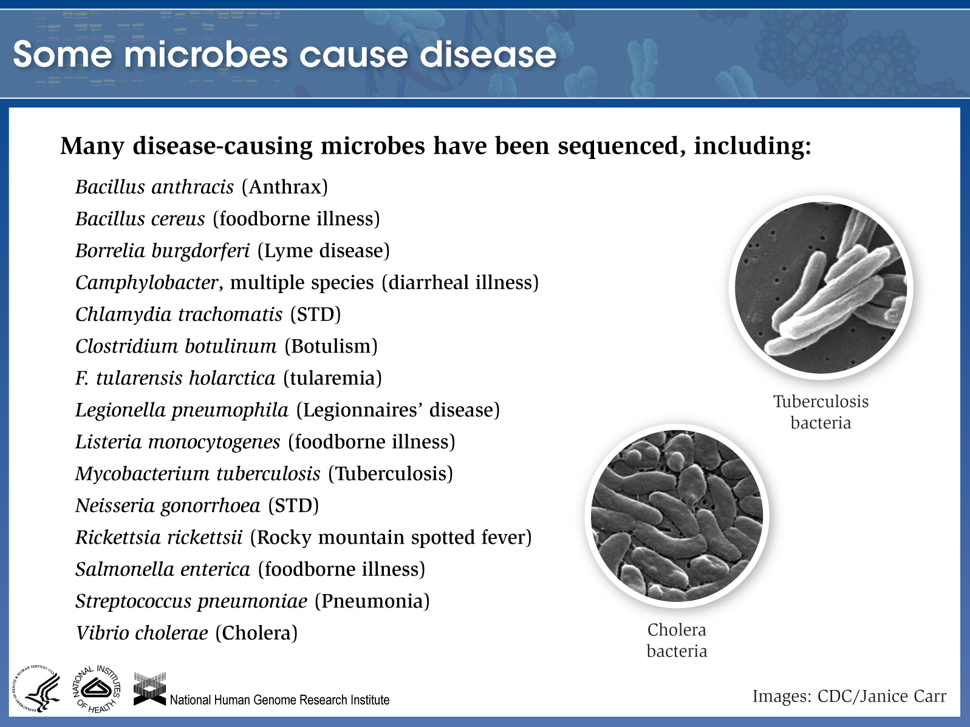

Slide 67
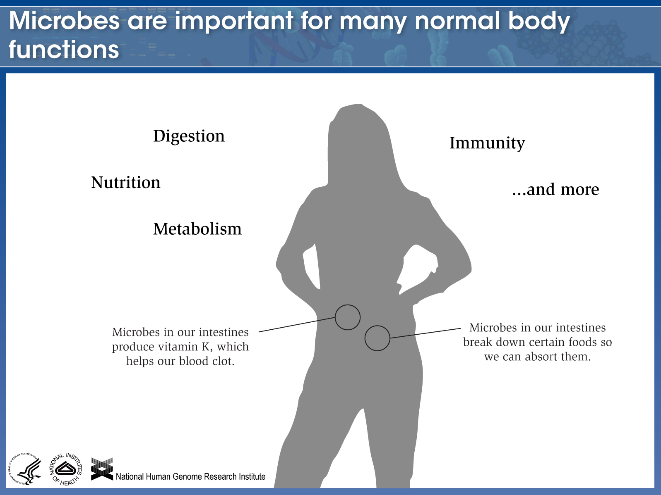

Slide 68
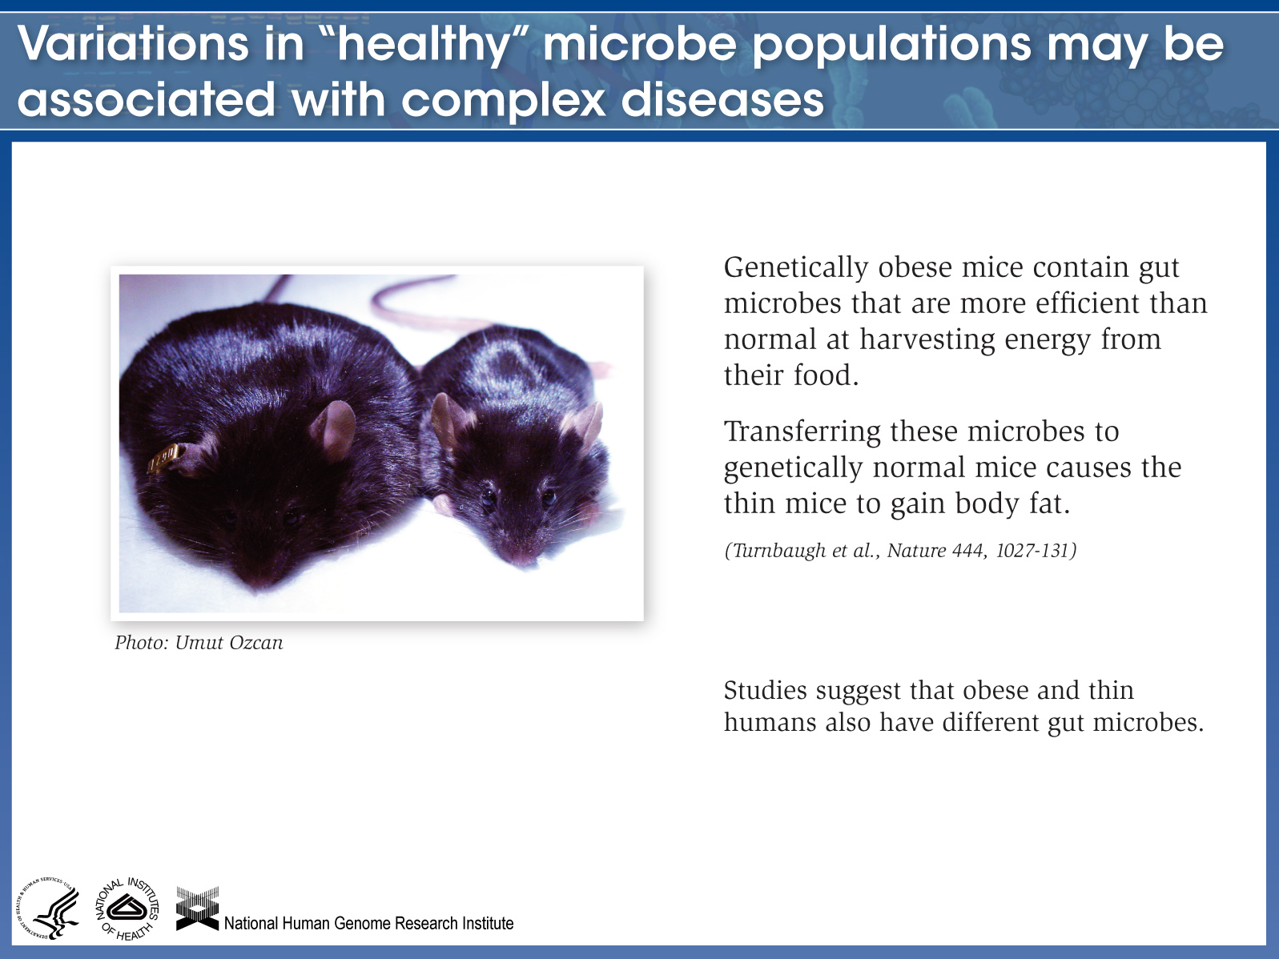

Slide 69
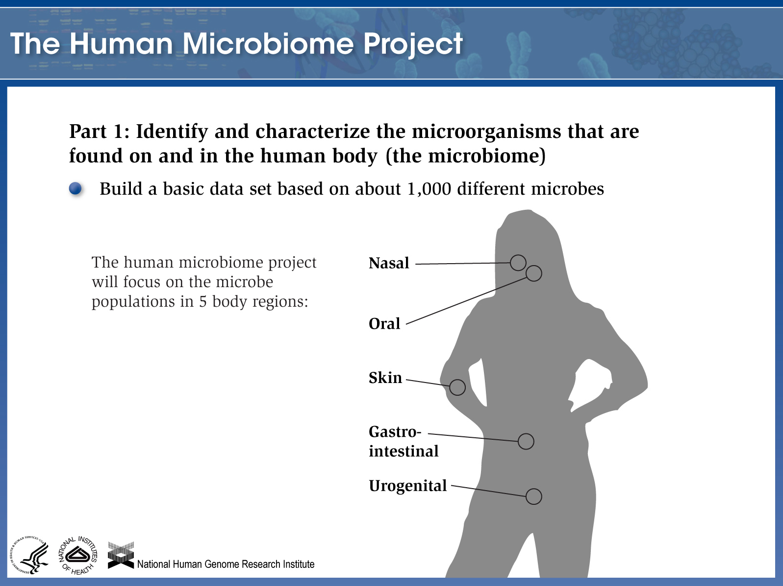

Slide 70
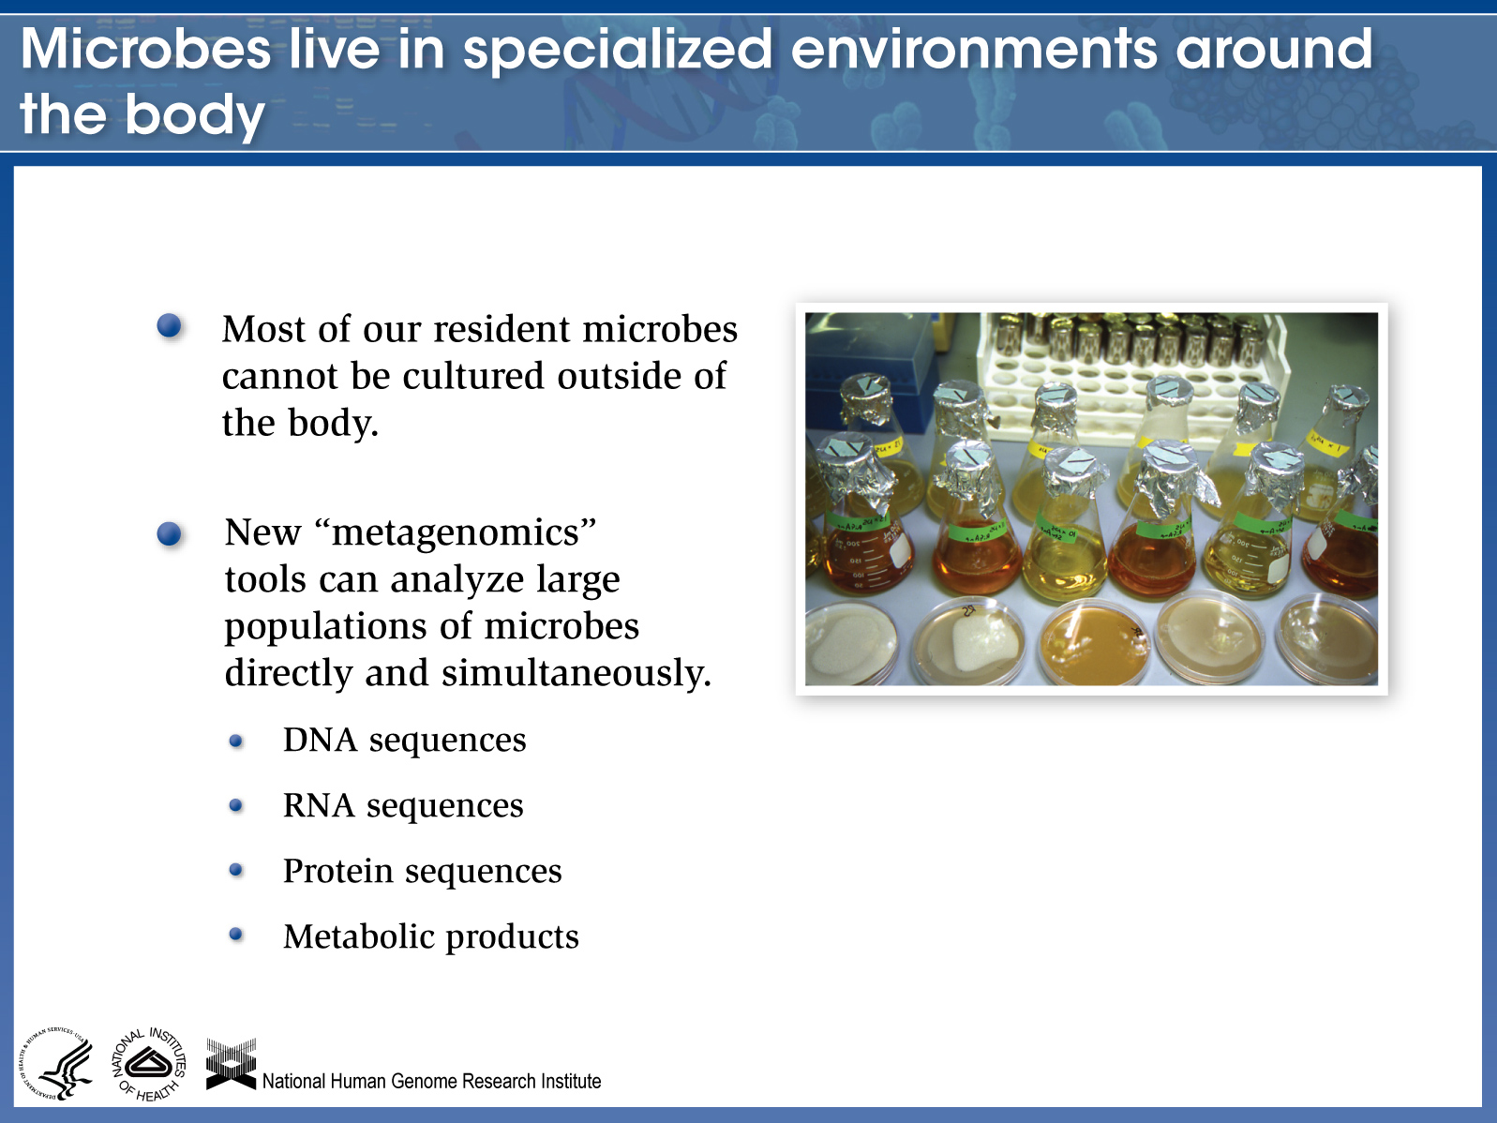

Slide 71
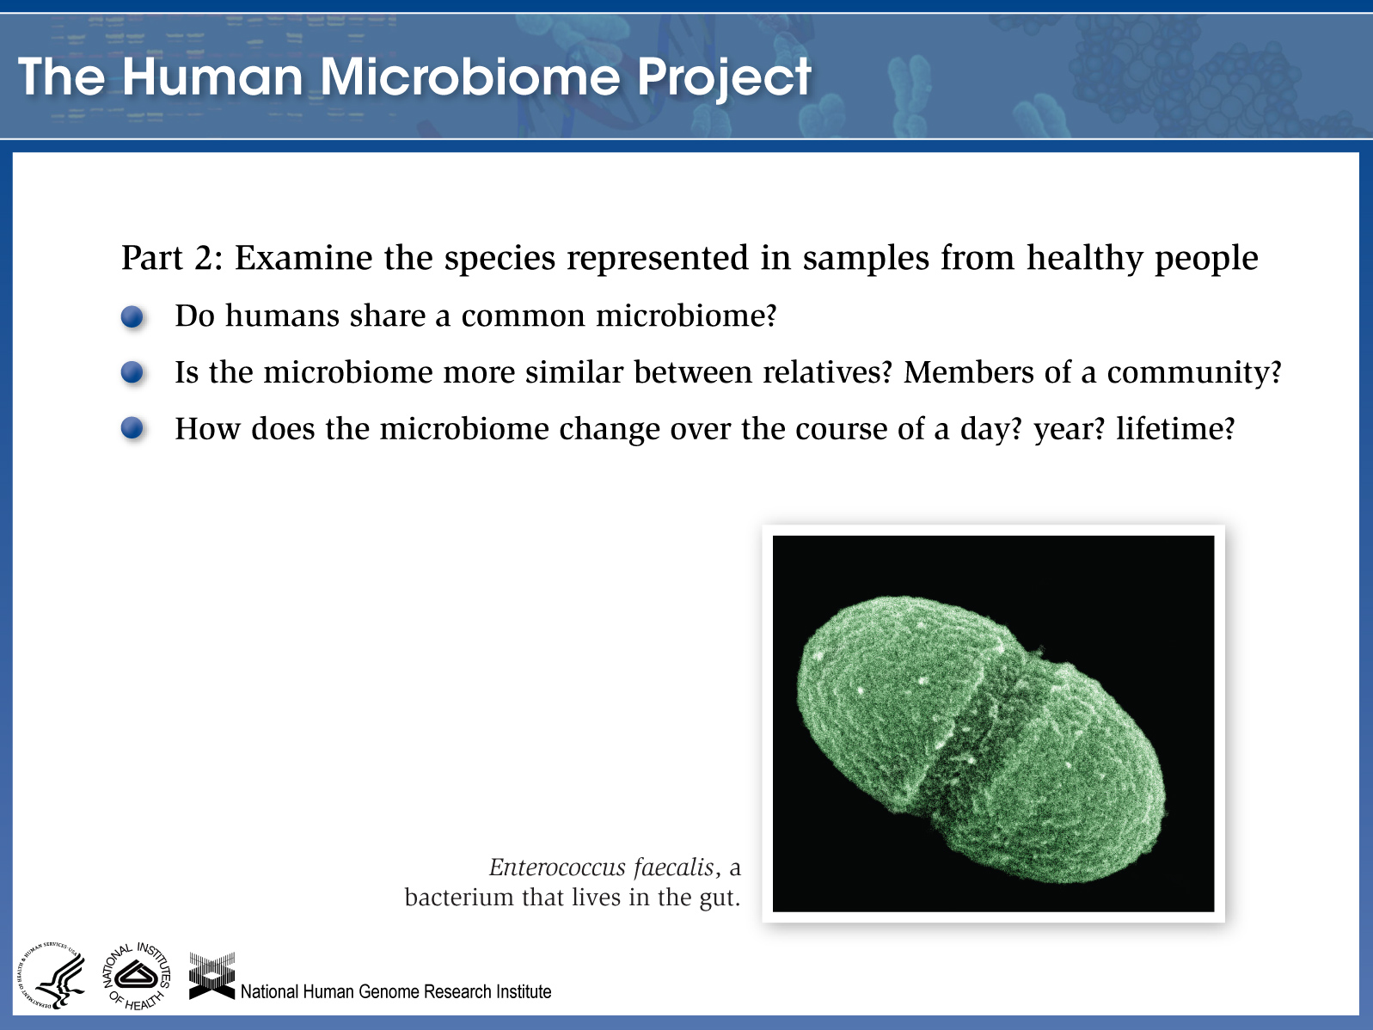

Slide 72
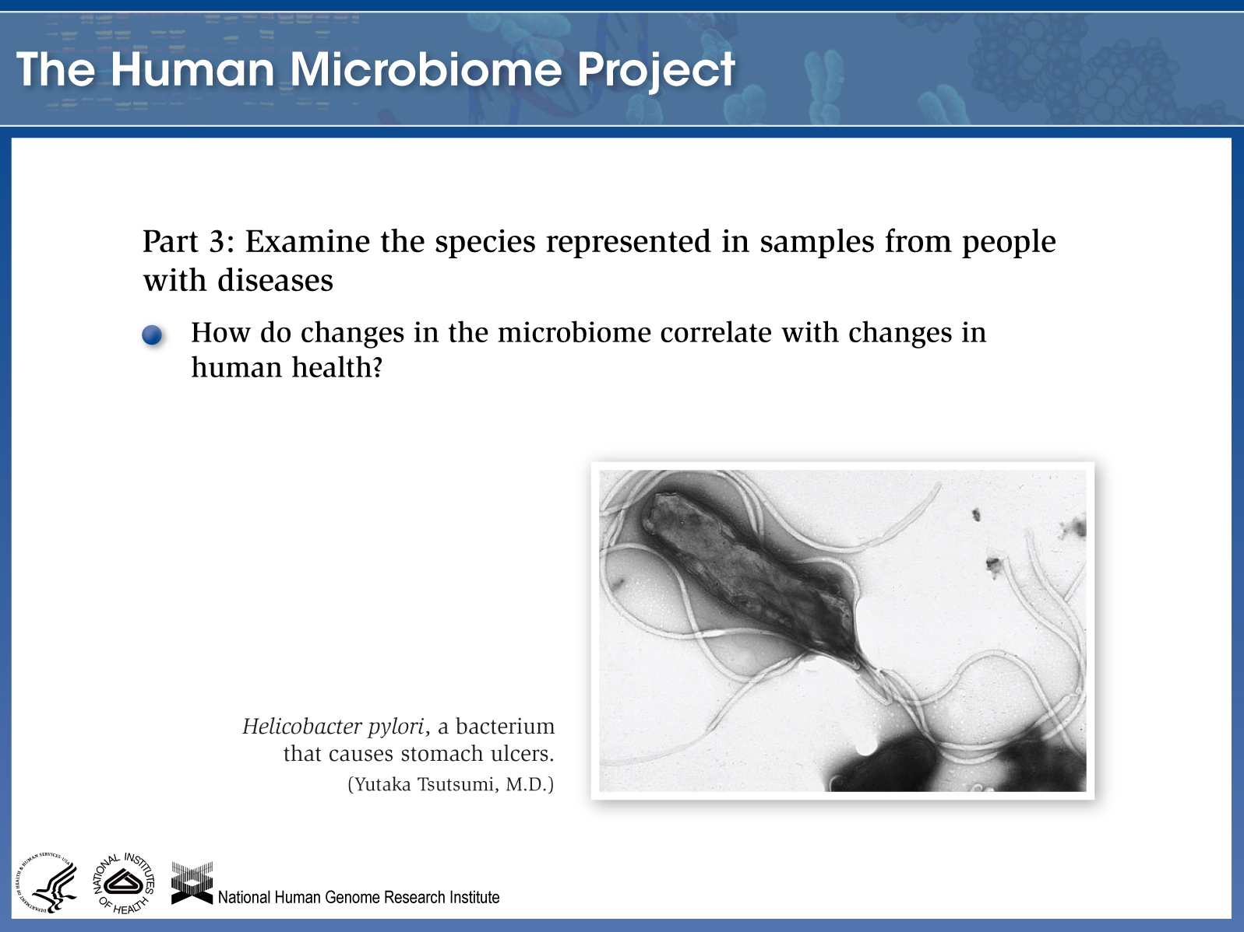

Slide 73
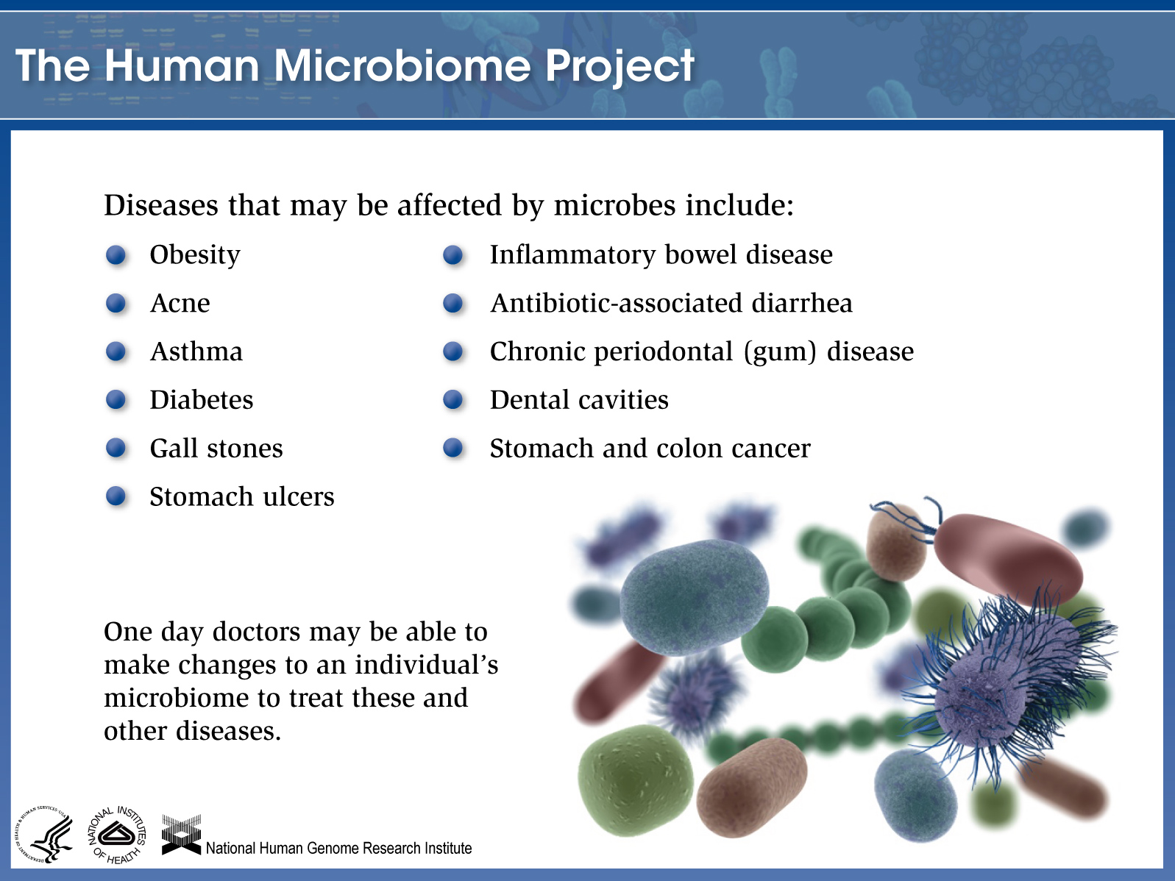

Slide 74
Metagenomics

Slide 75


“DNA is like a computer program but far, far more advanced than any software ever created.”
― Bill Gates, The Road Ahead
“Every time you understand something, religion becomes less likely. Only with the discovery of the double helix and the ensuing genetic revolution have we had grounds for thinking that the powers held traditionally to be the exclusive property of the gods might one day be ours. . . .”
― James D. Watson

