Slide 1


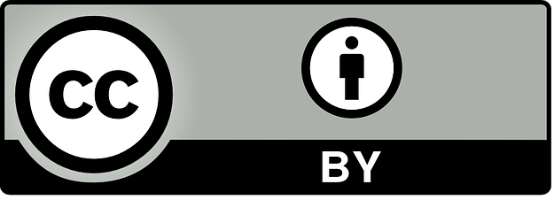







Section 5: Design activities
This work is licensed under the Creative Commons Attribution 4.0 International License. http://creativecommons.org/licenses/by/4.0/

Slide 2



Section 5: Design activities
Follow the link
https://app.animaker.com/animo/NF1sRqKSvIGceiYO/ or
Scan the QR code and find more about how to design activities for Outdoor adventure education and SEL

Slide 3
Section 5: Design activities
Teacher´s competences develop through section 5
Design initiative and outdoor activities using the module and unit templates make to develop SEL enhancing physical fitness and motor skill.

Slide 4
Section 5: Design activities
Content
Design OAE activities to promote SEL using module and unit templates.

Slide 5
Section 5: Design activities
TEACHER’S GUIDE
The "Handbook of Activities" section of the Teacher's Guide (Chapter 3) presents structured activities designed to help teachers apply these principles in practice.
MODULE
To facilitate the implementation of SEL in PE/OAE lessons, the project team created several modules with example of specific units within each module.
UNIT 1
UNIT 2
UNIT 3
UNIT 4

Slide 6
Section 5: Design activities
TEACHER’S GUIDE
(Chapter 3: Handbook activities)
MODULE 1
Jump, Explore, and Collaborate: Adventure through Movement and Teamwork
MODULE 2
Climb, curiosity and creativity: Adventure through Movement and Teamwork
MODULE 3
Basics of Trust, Challenge and Cooperation – Leave no Trace
MODULE 4
Hide, Balance and Collaborate: Sociability through Movement and Teamwork
MODULE 5
Orienteering

Slide 7
Section 5: Design activities
EXAMPLE “MODULE 1”
Jump, Explore, and Collaborate:
Adventure through Movement and Teamwork

Slide 8
Section 5: Design activities
MODULE TEMPLATE

Slide 9
Section 5: Design activities
EXAMPLE “UNIT 1: Who jumps”

Slide 10
Section 5: Design activities
EXAMPLE “UNIT 1: Who jumps”

Slide 11
Section 5: Design activities
EXAMPLE “UNIT 1: Who jumps”

Slide 12
Section 5: Design activities
EXAMPLE “UNIT 1: Who jumps”

Slide 13
Section 5: Design activities
UNIT TEMPLATE

