Slide 1
Isaios 6, On the Estate of Philoktemon
MIKE EDWARDS
HONORARY RESEARCH FELLOW
ROYAL HOLLOWAY, UNIVERSITY OF LONDON

Slide 2
Todd’s six questions about a forensic speech
Who wrote it?
Who was the speaker?
Who was the opponent?
What was the date?
Under what legal procedure did it take place?
What was the result?
S. C. Todd, ‘Lysias against Nikomakhos: the fate of the expert in Athenian law’, in L. Foxhall and A. D. E. Lewis (eds), Justifications not Justice: Greek Law in its Political Setting (Oxford, 1996), pp. 101-31

Slide 3
Who wrote it?
Isaios!
How does it come down to us?
Burney 95 (A), the Crippsianus, British Library
written in Konstantinopoli during the first quarter of the fourteenth century by Mikhael Klostomalles
Vatopedi monastery on Mt Athos, probably donated by the emperor Ioannes VI Katakouzenos between 1347 and 1354
sold to J. M. Cripps in about 1802, acquired by Charles Burney in 1808 and bought by the British Museum in 1818
See R. Hatzilambrou, Isaeus’ On the Estate of Pyrrhus (Oration 3) (Newcastle, 2018), pp. 42-51

Slide 4
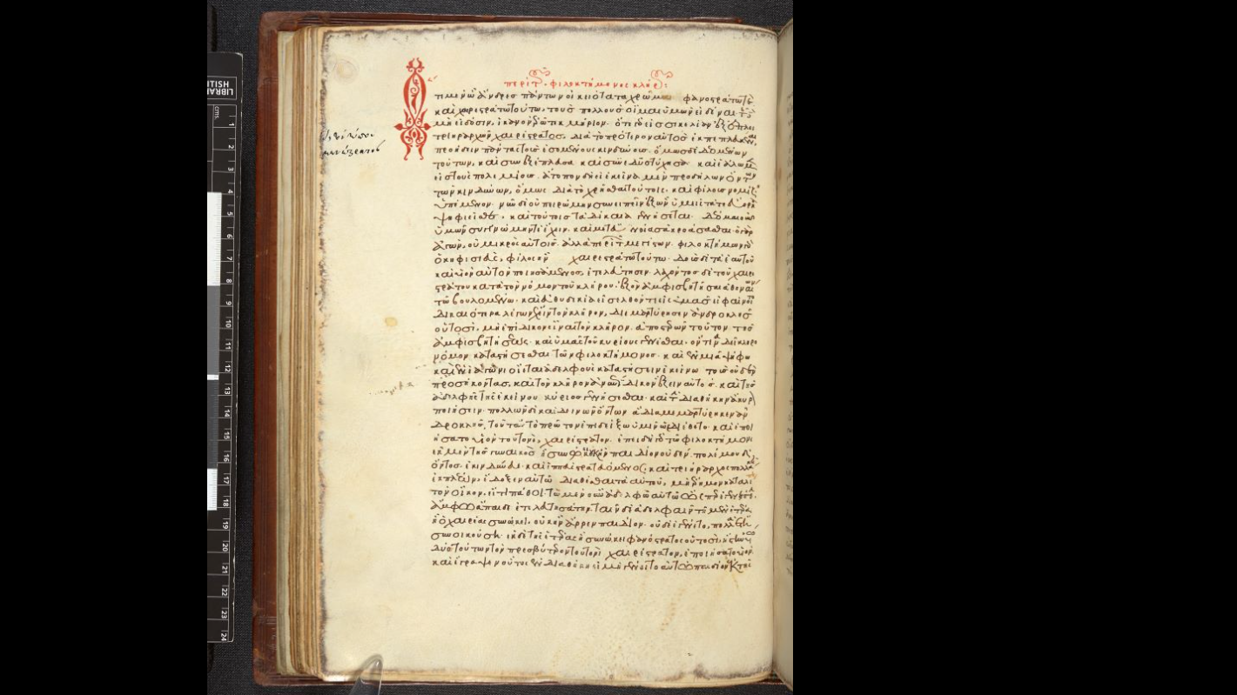
Burney 95

Slide 5
Synopsis of the case
Philoktemon, son of Euktemon of Kephisia, was killed on military service. He left a will in which he adopted his sister’s son, Khairestratos, as his son and heir. But Khairestratos’ claim to the estate was challenged by another family member, Androkles, who submitted a diamartyria in which he denied that Philoktemon had left a valid will and claimed that Euktemon had two legitimate sons by a second wife. Khairestratos prosecuted Androkles for false testimony, and Isaios 6 is the prosecution speech from the dike pseudomartyrion, delivered by a supporting speaker (synegoros).

Slide 6
STEMMA

Slide 7
Who was the speaker?
Khairestratos was the elder of two known sons of Phanostratos. He had already been trierarch and gymnasiarch by the time of the speech (60), and his trierarchy to Sicily (1, 60) should belong in 366/5 if Sundwall’s restoration [Χαιρέστρ]ατος Κ. for the name of the syntrierarch on Krete that year is correct (IG ii² 1609, lines 81-2). If so, his colleague on the ship, Aristomenes, should be the speaker of Isaios 6.
See J. K. Davies, Athenian Propertied Families 600-300 B.C. (Oxford, 1971) p. 564

Slide 8
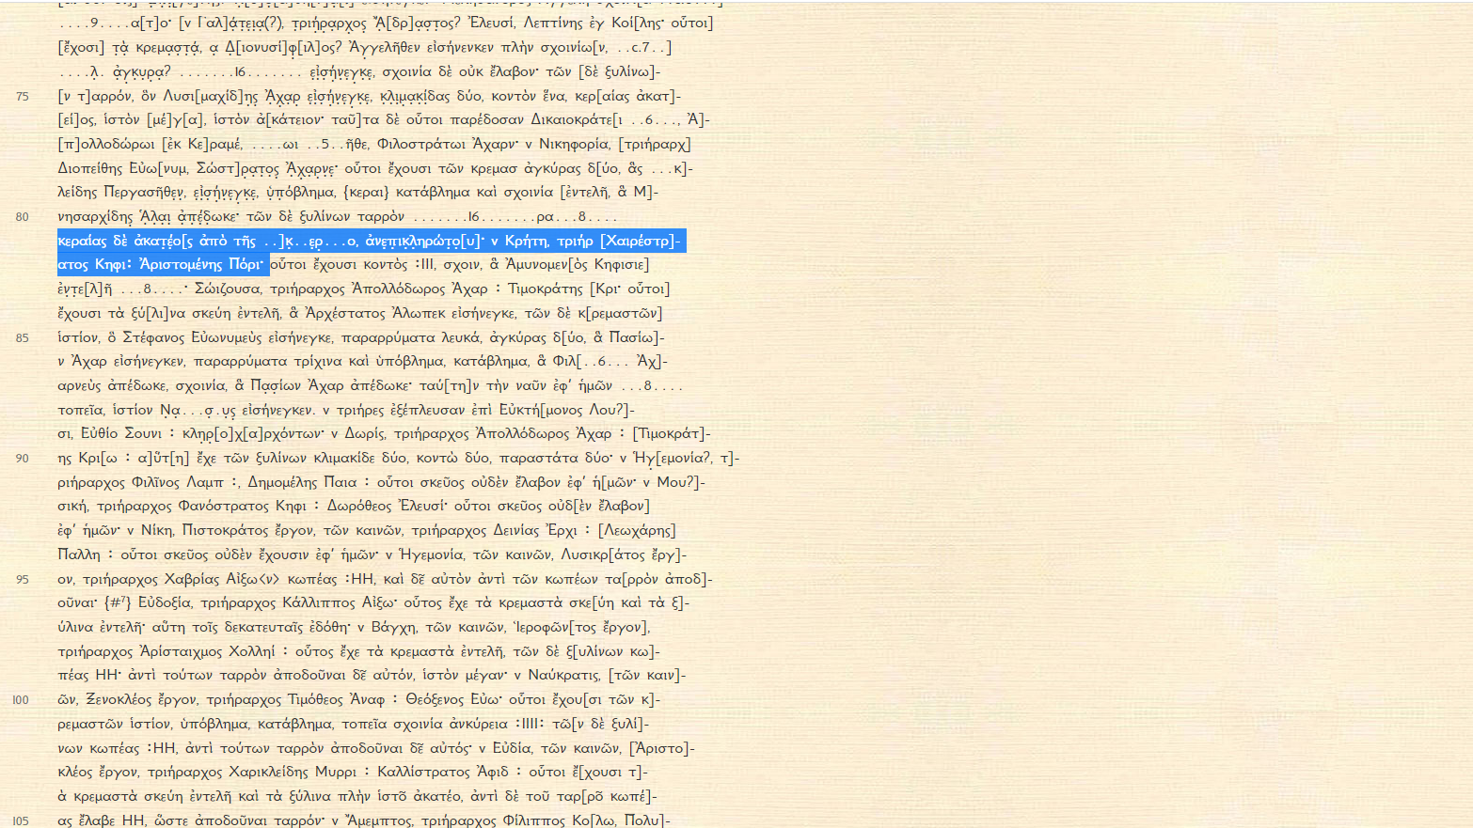
IG ii² 1609, lines 81-2

Slide 9
Who was the opponent?
Androkles
Diabole
Aristomenes claims that Androkles’ story is a fabrication. Not only was Euktemon’s will genuine, but the two boys were not the sons of Kallippe, but of a former prostitute named Alke by a freedman named Dion (20). Alke had worked in a brothel in Peiraias owned by Euktemon, and when she retired managed another brothel of his in Kerameikos (19-20).
Note that, as with the kalos k’agathos Philoneos in Antiphon 1, there is no problem with an Athenian gentleman owning a brothel, or even more than one – indeed, Aristomenes says to the jurors ‘and I think many of you know her’ (ἣν καὶ ὑμῶν οἶμαι πολλοὺς εἰδέναι).

Slide 10
Isaios 6.29-30
Κειμένου δὲ τοῦ γραμματείου σχεδὸν δύ’ ἔτη καὶ τοῦ Χαιρέου τετελευτηκότος, ὑποπεπτωκότες οἵδε τῇ ἀνθρώπῳ, καὶ ὁρῶντες ἀπολλύμενον τὸν οἶκον καὶ τὸ γῆρας καὶ τὴν ἄνοιαν τοῦ Εὐκτήμονος, ὅτι εἴη αὐτοῖς ἱκανὴ ἀφορμή, συνεπιτίθενται. καὶ πρῶτον μὲν πείθουσι τὸν Εὐκτήμονα τὴν μὲν διαθήκην ἀνελεῖν ὡς οὐ χρησίμην οὖσαν τοῖς παισί· τῆς γὰρ φανερᾶς οὐσίας οὐδένα κύριον ἔσεσθαι τελευτήσαντος Εὐκτήμονος ἄλλον ἢ τὰς θυγατέρας καὶ τοὺς ἐκ τούτων γεγονότας· εἰ δὲ ἀποδόμενός τι τῶν ὄντων ἀργύριον καταλίποι, τοῦτο βεβαίως ἕξειν αὐτούς.
When the document had been deposited for almost two years and Khaireas had died, my opponents fell under the influence of that woman and, seeing that the estate was going to ruin and that Euktemon’s old age and folly afforded them an ideal opportunity, made a concerted attack. First they persuaded Euktemon to annul the will on the ground that it was not advantageous to the boys; for nobody would have a right to the visible property when Euktemon died other than his daughters and their offspring; but if he sold part of the property and left a sum of money, they would get a secure hold on it.

Slide 11
Isaios 6.33-4
καὶ ἐν πάνυ ὀλίγῳ χρόνῳ, οὗπερ ἕνεκα οὗτοι λῦσαι αὐτὸν ἔπεισαν, ἀποδίδοται ἀγρὸν μὲν Ἀθμονοῖ πέντε καὶ ἑβδομήκοντα μνῶν Ἀντιφάνει, τὸ δ’ ἐν Σηραγγίῳ βαλανεῖον τρισχιλίων Ἀριστολόχῳ· οἰκίαν δὲ ἐν ἄστει τεττάρων καὶ τεσσαράκοντα μνῶν ὑποκειμένην ἀπέλυσε τῷ ἱεροφάντῃ. ἔτι δὲ αἶγας ἀπέδοτο σὺν τῷ αἰπόλῳ τριῶν καὶ δέκα μνῶν, καὶ ζεύγη δύο ὀρικά, τὸ μὲν ὀκτὼ μνῶν τὸ δὲ πεντήκοντα καὶ πεντακοσίων δραχμῶν, καὶ δημιουργοὺς ὅσοι ἦσαν αὐτῷ. σύμπαντα δὲ πλείονος ἢ τριῶν ταλάντων, ἃ ἐπράθη διὰ ταχέων πάνυ τελευτήσαντος Φιλοκτήμονος.
In a very short space of time - the reason why my opponents persuaded him to destroy the will - he sold a farm at Athmonon for seventy-five minas to Antiphanes and the bathhouse at Serangion for 3,000 drachmas to Aristolokhos; and he arranged a mortgage of forty-four minas on a house in the city with the hierophant. Further, he sold some goats with their goatherd for thirteen minas and two pairs of mules, one for eight minas, the other for 550 drachmas, and all the slave craftsmen he had. In all, more than three talents’ worth was sold as quickly as possible after the death of Philoktemon.

Slide 12
Isaios 6.35-7
Ταῦτα μὲν δὴ τοῦτον τὸν τρόπον εἶχε· περὶ δὲ τῶν ὑπολοίπων εὐθὺς ἐπεβούλευον, καὶ πάντων δεινότατον πρᾶγμα κατεσκεύασαν, ᾧ ἄξιόν ἐστι προσέχειν τὸν νοῦν. ὁρῶντες γὰρ τὸν Εὐκτήμονα κομιδῇ ἀπειρηκότα ὑπὸ γήρως καὶ οὐδ’ <ἐκ> τῆς κλίνης ἀνίστασθαι δυνάμενον, ἐσκόπουν ὅπως καὶ τελευτήσαντος ἐκείνου δι’ αὑτῶν ἔσοιτο ἡ οὐσία. καὶ τί ποιοῦσιν; ἀπογράφουσι τὼ παῖδε τούτω πρὸς τὸν ἄρχοντα ὡς εἰσποιήτω τοῖς τοῦ Εὐκτήμονος ὑέσι τοῖς τετελευτηκόσιν, ἐπιγράψαντες σφᾶς αὐτοὺς ἐπιτρόπους, καὶ μισθοῦν ἐκέλευον τὸν ἄρχοντα τοὺς οἴκους ὡς ὀρφανῶν ὄντων, ὅπως ἐπὶ τοῖς τούτων ὀνόμασι τὰ μὲν μισθωθείη τῆς οὐσίας, τὰ δὲ ἀποτιμήματα κατασταθείη καὶ ὅροι τεθεῖεν ζῶντος ἔτι τοῦ Εὐκτήμονος, μισθωταὶ δὲ αὐτοὶ γενόμενοι τὰς προσόδους λαμβάνοιεν. καὶ ἐπειδὴ πρῶτον τὰ δικαστήρια ἐπληρώθη, ὁ μὲν ἄρχων προεκήρυττεν, οἱ δ’ ἐμισθοῦντο. παραγενόμενοι δέ τινες ἐξαγγέλλουσι τοῖς οἰκείοις τὴν ἐπιβουλήν, καὶ ἐλθόντες ἐδήλωσαν τὸ πρᾶγμα τοῖς δικασταῖς, καὶ οὕτως ἀπεχειροτόνησαν οἱ δικασταὶ μὴ μισθοῦν τοὺς οἴκους· εἰ δ’ ἔλαθεν, ἀπωλώλει ἂν ἅπασα ἡ οὐσία.
This part of his property was handled in this way; and then they immediately began plotting about the rest, and they came up with the most dreadful scheme of all, to which you should pay close attention. Seeing that Euktemon was completely debilitated by old age and could not even get out of bed, they began looking for a way to get their hands on his property when he died. [36] So what did they do? They registered these two boys with the Arkhon as being adopted by the deceased sons of Euktemon, putting themselves down as their guardians, and they asked the Arkhon to lease out the houses as belonging to orphans, so that some of the property might be leased in their names and some might stand as security with mortgage stones placed on it, while Euktemon was still alive, and that they themselves might become lessees and obtain the income. And the first time the courts sat, the Arkhon put the lease up for auction, and they offered to take it on. But certain persons present reported the plot to the relatives, who came and revealed the affair to the jurors, and so they voted not to lease out the houses. If the plot had not been uncovered, the whole property would have been lost.

Slide 13
Isaios 6.38-9
Πρὶν μὲν τοίνυν τούτους γνωρίσαι τὴν ἄνθρωπον καὶ μετ’ ἐκείνης ἐπιβουλεῦσαι Εὐκτήμονι, οὕτω πολλὴν οὐσίαν ἐκέκτητο Εὐκτήμων μετὰ τοῦ ὑέος Φιλοκτήμονος, ὥστε ἅμα τά τε μέγιστα ὑμῖν λῃτουργεῖν ἀμφοτέρους τῶν τε ἀρχαίων μηδὲν πραθῆναι τῶν τε προσόδων περιποιεῖν, ὥστε ἀεί τι προσκτᾶσθαι· ἐπειδὴ δ’ ἐτελεύτησε Φιλοκτήμων, οὕτω διετέθη ἡ οὐσία, ὥστε τῶν ἀρχαίων μηδὲ τὰ ἡμίσεα εἶναι λοιπὰ καὶ τὰς προσόδους ἁπάσας ἠφανίσθαι.καὶ οὐδὲ ταῦτα ἐξήρκεσεν αὐτοῖς διαφορῆσαι, ὦ ἄνδρες, ἀλλ’ ἐπειδὴ καὶ ἐτελεύτησεν ὁ Εὐκτήμων, εἰς τοῦτο ἦλθον τόλμης ὥστ’ ἐκείνου κειμένου ἔνδον τοὺς μὲν οἰκέτας ἐφύλαττον, ὅπως μηδεὶς ἐξαγγείλειε μήτε τοῖν θυγατέροιν μήτε τῇ γυναικὶ αὐτοῦ μήτε τῶν οἰκείων μηδενί, τὰ δὲ χρήματα ἔνδοθεν ἐξεφορήσαντο μετὰ τῆς ἀνθρώπου εἰς τὴν ὁμότοιχον οἰκίαν, ἣν ᾤκει μεμισθωμένος εἷς τούτων, Ἀντίδωρος ἐκεῖνος.
Now, before my opponents made the woman’s acquaintance and plotted with her against Euktemon, Euktemon and his son Philoktemon possessed such a large fortune that both of them at the same time performed the most expensive public services for you without selling any of their assets and even saved some of their income, so that their wealth continually increased. But when Philoktemon died, the fortune was managed in such a way that less than half the capital remained and all the income had vanished. And they were not even content with plundering this much, gentlemen, but when Euktemon also died, they had the effrontery to shut in the slaves, while he was lying dead inside, so that none of them could announce the news to his two daughters or his wife or any of his relatives; and with the woman’s help they moved the furniture that was inside to the house next door, which one of these people, that man Antidoros, was leasing and living in.

Slide 14
Isaios 6.40-2
καὶ οὐδ’ ἐπειδὴ ἑτέρων πυθόμεναι ἦλθον αἱ θυγατέρες αὐτοῦ καὶ ἡ γυνή, οὐδὲ τότε εἴων εἰσιέναι, ἀλλ’ ἀπέκλεισαν τῇ θύρᾳ, φάσκοντες οὐ προσήκειν αὐταῖς θάπτειν Εὐκτήμονα· καὶ οὐδ’ εἰσελθεῖν ἐδύναντο, εἰ μὴ μόλις καὶ περὶ ἡλίου δυσμάς. εἰσελθοῦσαι δὲ κατέλαβον ἐκεῖνον μὲν ἔνδον κείμενον δευτεραῖον, ὡς ἔφασαν οἱ οἰκέται, τὰ δ’ ἐκ τῆς οἰκίας ἅπαντα ἐκπεφορημένα ὑπὸ τούτων. αἱ μὲν οὖν γυναῖκες, οἷον εἰκός, περὶ τὸν τετελευτηκότα ἦσαν· οὗτοι δὲ τοῖς ἀκολουθήσασι παραχρῆμα ἐπεδείκνυσαν τὰ ἔνδον ὡς εἶχε, καὶ τοὺς οἰκέτας πρῶτον ἠρώτων ἐναντίον τούτων ὅποι τετραμμένα εἴη τὰ χρήματα. λεγόντων δὲ ἐκείνων ὅτι οὗτοι ἐξενηνοχότες εἶεν εἰς τὴν πλησίον οἰκίαν, καὶ ἀξιούντων παραχρῆμα τῶνδε φωρᾶν κατὰ τὸν νόμον καὶ τοὺς οἰκέτας ἐξαιτούντων τοὺς ἐκφορήσαντας, οὐκ ἠθέλησαν τῶν δικαίων οὐδὲν ποιῆσαι.
And not even when the daughters and wife arrived after hearing the news from others, not even then did they allow them to enter but shut the door on them, declaring it was none of their business to bury Euktemon. They were only able to enter with considerable difficulty about sunset. On entering they found that he was lying inside dead for the second day, as the slaves said, and that everything in the house had been removed by these people. So the women, as was right, attended to the deceased, while my friends immediately showed the men who’d accompanied them the state inside the house and, in the presence of our opponents, first asked the slaves where the furniture had been taken. When they said our opponents had carried it off to the next house, my friends immediately claimed the legal right to search it and demanded the surrender of the slaves who had carried out the removal, but they refused to accede to any of their just demands.

Slide 15
Isaios 6.46
Ἔτι δὲ καὶ τοῦ μάρτυρος αὐτοῦ σκέψασθε τὴν τόλμαν καὶ ἀναίδειαν, ὅστις εἴληχε μὲν αὑτῷ τῆς θυγατρὸς τῆς Εὐκτήμονος ὡς οὔσης ἐπικλήρου, καὶ αὐτοῦ τοῦ κλήρου τοῦ Εὐκτήμονος πέμπτου μέρους ὡς ἐπιδίκου ὄντος, μεμαρτύρηκε δ’ Εὐκτήμονος ὑὸν εἶναι γνήσιον. καίτοι πῶς οὗτος οὐ σαφῶς ἐξελέγχει αὐτὸς αὑτὸν τὰ ψευδῆ μεμαρτυρηκότα; οὐ γὰρ δήπου γνησίου ὄντος ὑέος Εὐκτήμονι ἐπίκληρος ἂν ἦν ἡ θυγάτηρ αὐτοῦ, οὐδὲ ὁ κλῆρος ἐπίδικος.
Furthermore, consider the effrontery and shamelessness of the actual witness, who has claimed for himself the daughter of Euktemon, alleging that she is an heiress, and that a fifth of Euktemon’s estate should be adjudicated to her, but has also testified that Euktemon has a legitimate son. And yet how does he not clearly convict himself of giving false testimony? For obviously if Euktemon had a legitimate son, his daughter would not be an heiress, nor would the estate be adjudicable.

Slide 16
Isaios 6.60
τῆς δὲ τούτων οὐσίας, ὦ ἄνδρες, εἰς τὴν πόλιν πλείω ἀναλίσκεται ἢ εἰς αὐτοὺς τούτους. καὶ Φανόστρατος μὲν τετριηράρχηκεν ἑπτάκις ἤδη, τὰς δὲ λῃτουργίας ἁπάσας λελῃτούργηκε καὶ τὰς πλείστας νίκας νενίκηκεν· οὑτοσὶ δὲ Χαιρέστρατος τηλικοῦτος ὢν τετριηράρχηκε, κεχορήγηκε δὲ τραγῳδοῖς, γεγυμνασιάρχηκε δὲ λαμπάδι· καὶ τὰς εἰσφορὰς εἰσενηνόχασιν ἀμφότεροι πάσας ἐν τοῖς τριακοσίοις. καὶ τέως μὲν δύ’ ὄντες, νῦν δὲ καὶ ὁ νεώτερος οὑτοσὶ χορηγεῖ μὲν τραγῳδοῖς, εἰς δὲ τοὺς τριακοσίους ἐγγέγραπται καὶ εἰσφέρει τὰς εἰσφοράς.
But my friends’ fortune, gentlemen, is being spent more on the city than on themselves. Phanostratos has already been trierarch seven times; he’s performed all the public services and has in most cases won victories. Khairestratos here, despite his youth, has been trierarch, khorêgos in tragic contests and gymnasiarch at the torch race. Both have paid all the war taxes as members of the three hundred. For a while only the two paid, but now the younger son here is also khorêgos in tragic contests, has been registered among the three hundred, and pays the war taxes.

Slide 17
What was the date?
Aristomenes says (6.14) that 52 years have passed since the Sicilian expedition (τῇ μὲν γὰρ στρατιᾷ, ἀφ’ οὗ ἐξέπλευσεν εἰς Σικελίαν, ἤδη ἐστὶ δύο καὶ πεντήκοντα ἔτη, ἀπὸ Ἀριμνήστου ἄρχοντος). The expedition left Athens in the summer of 415, so the speech is datable to either 365/4 or 364/3, depending on when precisely (in the summer?) the trial was held.
Other dates and events mentioned in the speech: the sequence is clear enough, but the intervals between events are often described vaguely by expressions such as ‘after that’ or ‘some time later’.
The order of events: Euktemon introduced Alke’s (or Kallippe’s) son to his phratry (6.24). ‘After this’ (6.27) Philoktemon was killed in a naval battle off Chios. ‘Some time later’ (6.27), when Phanostratos was about to set off on an expedition with Timotheos, Euktemon made a written agreement (‘will’) about his gift of a single farm to Alke’s son, the arrangement that he came to with Philoktemon. He left the will with Pythodoros. After ‘almost two years’ (6.29) Euktemon revoked the will and ‘in a very short time’ (6.33) he sold off property to the value of over three talents. After an unspecified time, Euktemon died (6.39).

Slide 18
What was the date?
The legal proceedings described by Aristomenes in 6.12-14 took place in parallel, since they were initiated after Philoktemon’s death by Khairestratos’ claim to the estate. Androkles lodged a diamartyria to block this and Khairestratos prosecuted him for false testimony. There was a preliminary hearing (anakrisis) before the arkhon at which Androkles failed to prove his claim about the two boys, and after an adjournment Androkles provided further information which Khairestratos rejected. After Euktemon died, the case came to court.
See B. Griffith-Williams, Greek Orators VIII. Isaeus Orations 1, 2, 4 and 6 (Liverpool, 2022), p. 167ff.

Slide 19
When did Euktemon die?
The traditional view: some ten years or more after Philoktemon, and the estate in question here is Euktemon’s.
Griffith-Williams: Euktemon died between two and three years after Philoktemon. The estate in question is Philoktemon’s.
But then the legal proceedings over Philoktemon’s estate were still in progress two or three years after he died: ‘wholly implausible’? (months before the news of Philoktemon’s death reached Athens, Khairestratos could have been on military service, the adjournment of the anakrisis ‘must have caused a significant delay’).
See W. Wyse, The Speeches of Isaeus (Cambridge, 1904); M. Edwards, Isaeus (Austin, Texas, 2007)

Slide 20
When did Philoktemon die?
No record of a naval battle off Chios in this period, at which Philoktemon was killed.
The naval expedition of Phanostratos set off ‘some time later’: commanded by Timotheos, who was central to the establishment of the Second Athenian League/Confederacy (in the years 378-373), was then prosecuted and later went into exile until 366/5, when he returned and captured Samos. Most scholars therefore think that the expedition with Phanostratos took place in the 370s, during the Theban War (378-362), which in turn supports the view that Khairestratos did not submit his claim until after Euktemon’s death some ten years later.

Slide 21
When did Philoktemon die?
Griffith-Williams argues for a later date, after Timotheos’ return from exile: Euktemon left his will with Pythodoros when Phanostratos was setting off, and decided to revoke it ‘nearly two years later’. If Phanostratos went off with Timotheos in 373, Euktemon must have lived for at least six years after the will was revoked – but Aristomenes emphasises the speed with which Androkles and Alke intrigued against the old man, months rather than years.
Alke’s older son was first introduced to Euktemon’s phratry before Philoktemon died (6.22). Since he is ‘not yet twenty’ (6.14) and was probably fifteen or sixteen when he was first introduced, no more than two or three years can then have elapsed between his successful admission to the phratry, when Philoktemon was still alive (6.23-4), and the court hearing.
Phanostratos of Cephisia was trierarch in a naval record identified by Schweigert as relating to the first of three cleruchic expeditions to Samos, in 365/4 (IG ii² 1609, line 92). If there was a battle off Chios during the ten-month siege of Samos, Philoktemon could have died in 366/5, and Phanostratos sailed out on the cleruchic expedition to Samos. To accommodate a two year interval between the depositing of the will and its revocation, you have then to put the trial in the summer of 363: the siege of Samos ended in the spring of 365 and the cleruchic expedition of Phanostratos left soon after and returned by about July; Euktemon deposited the will in May or June 365 and revoked it in March or April 363, leaving an interval of three or four months in which Euktemon sold off his property.
E. Schweigert, ‘The Athenian cleruchy on Samos’, American Journal of Philology 61 (1940), pp. 194-8

Slide 22
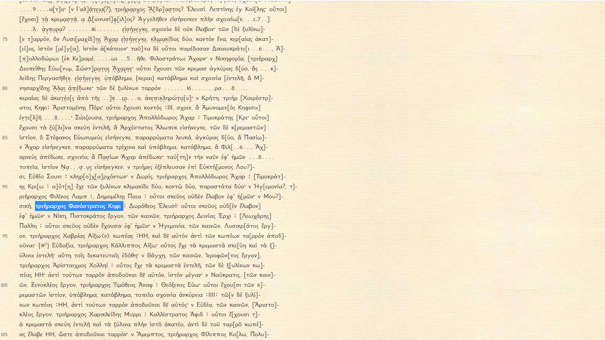
IG ii² 1609, line 92

Slide 23
Under what legal procedure did it take place?
A dike pseudomartyrion
Khairestratos submitted a lexis to the court to claim the estate as Philoktemon’s son adopted by will; same for those who claimed as next of kin; rival claimants each had to submit their own lexis for an epidikasia.
Natural sons or those who had been adopted when the adopter was still alive (inter vivos) simply took possession of the estate (embateusis).
But Androkles tried to block Khairestratos’ claim with a formal declaration (diamartyria) that Philoktemon had died childless and not left a will, and that Philoktemon’s father, Euktemon, had two surviving legitimate sons by a second wife.
Khairestratos therefore had to prosecute Androkles for giving false testimony in his diamartyria. This led to the anakrisis, and then to the trial for false testimony (dike pseudomartyrion).

Slide 24
Under what legal procedure did it take place?
Surprising that Androkles entered a diamartyria, usually used to enable a legitimate son to enter the estate by blocking a claim from a collateral relative.
Androkles’ diamartyria refers not to Philoktemon’s sons, but to sons of his father Euktemon. Griffith-Williams has to argue that this strategy was an abuse of the procedure (as Aristomenes repeatedly says).
Androkles’ litigation strategy irregular and inconsistent: he presented the two boys as legitimate sons of Euktemon and also as the adopted sons of Euktemon’s deceased sons Philoktemon and Ergamenes. He also claimed one of Euktemon’s daughters, the widow of Khaireas, in marriage as an epikleros (6.46), which contradicts the assertion in his diamartyria that Euktemon had legitimate sons.

Slide 25
Under what legal procedure did it take place?
Griffith-Williams argues there were separate proceedings over the two estates: Euktemon was still alive when the litigation about Philoktemon’s estate began, it was still in progress when he died, and Androkles claimed the epikleros after his death. He hoped to gain control of Euktemon’s estate if he won the dike pseudomartyrion, or, if he lost, at least to secure a share of it by marrying the widowed daughter.
But even if you agree that there were two legal processes, Androkles was nevertheless making contradictory claims.

Slide 26
What was the result?
We do not know the outcome of the case.
But an inscription from around the middle of the fourth century refers to a Khairestratos son of Phanostratos (IG ii² 2825, line 11). If he won, Khairestratos would have become the son of Philoktemon. So if the inscription is later than the trial, it suggests that Khairestratos lost.

Slide 27
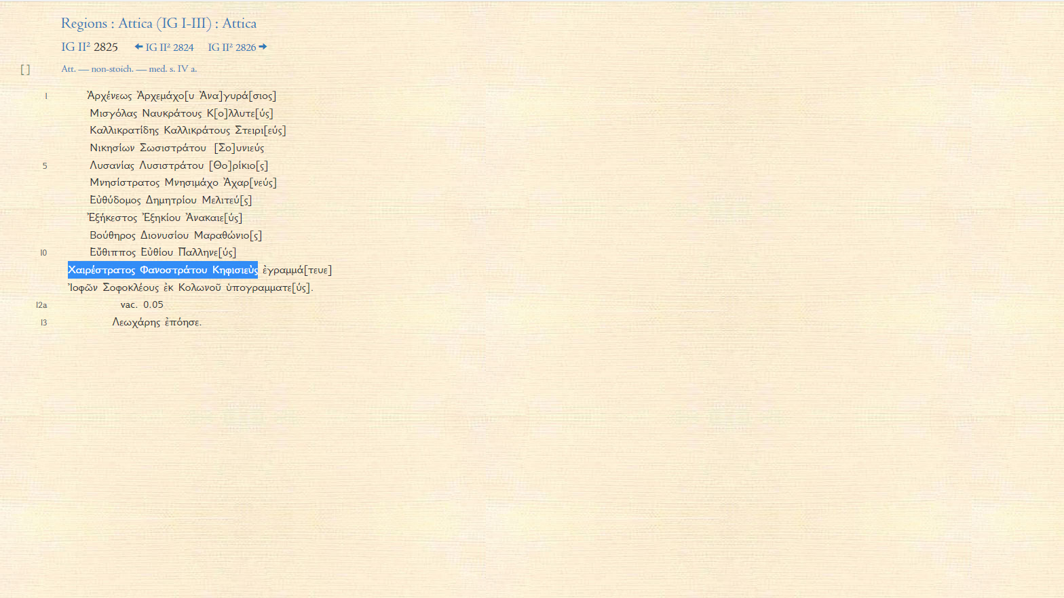
IG ii² 2825, line 1

Slide 28
What was the result?
Griffith-Williams suggests two other possibilities:
Khairestratos won this case, but Androkles reopened the litigation later and won (cf. 6.52: οὗτοι δὲ κἂν νῦν διαμάρτωσι τοῦ ἀγῶνος, δόξῃ δὲ ὁ κλῆρος ἐπίδικος εἶναι, ἀντιγραψάμενοι δὶς περὶ τῶν αὐτῶν ἀγωνίζωνται).
Khairestratos returned to the oikos of his natural father Phanostratos leaving behind a son of his own as heir to Philoktemon (cf. 6.44: ὁ γὰρ νόμος οὐκ ἐᾷ ἐπανιέναι, ἐὰν μὴ ὑὸν καταλίπῃ γνήσιον).
Nothing is easy with Isaios!

