Slide 1
The Bayesian Brain
A probabilistic approach to cognition

Slide 2
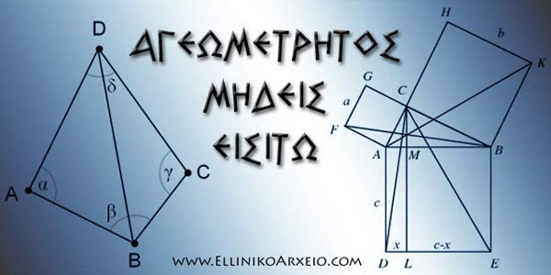

Slide 3
Background
Computational/Theoretical Neuroscience: describe the brain in the language of mathematics (as we do with the universe)
On top of giving a better explanation, could perhaps a (shared) mathematical description also bridge the brain/mind dichotomy?
Could such a description also relate brains to machines? (Neuroscience in Engineering Departments)?
The engineering approach to intelligence: the brain as a machine
The brain as a computational device – what are the computations?
Marr and his 3 level of studying the mind/brain
Lots of data available out there– try to find structure & a causal model of the world (making sense of data – statistical learning)
AI: give instructions vs. give data (program vs. train)
The Renaissanse of Artificial Intelligence (3+1) reasons)

Slide 4
The Bayesian approach
The Bayesian brain: a possible mathematical framework on how the brain works as a probabilistic inference machine (1990’s)
Helmholtz (born 1821): the brain as a device making unconscious inferences about the world - infer the state of the world from noisy and incomplete data (how? Using previous experience..)
Bayes’ (born circa 1701) Theorem
Probability Theory:
Coin flipping (HHHHH vs. HTTHT)
A system with no memory
Tree diagrams
Odds vs. Probability
Venn diagrams (e.g. dice rolling)
Probability of A&B being true (A OR B?)
Conditional probabilities (‘given that’)
Probability as a belief in every day life (‘Possibilianism’)
Diagnosed with the rare disease: The possibility of having a rare (?) disease can be checked with a medical test that is correct 90% of the time. If you take the test which then turns out to be positive, what is the probability that you have the disease?

Slide 5
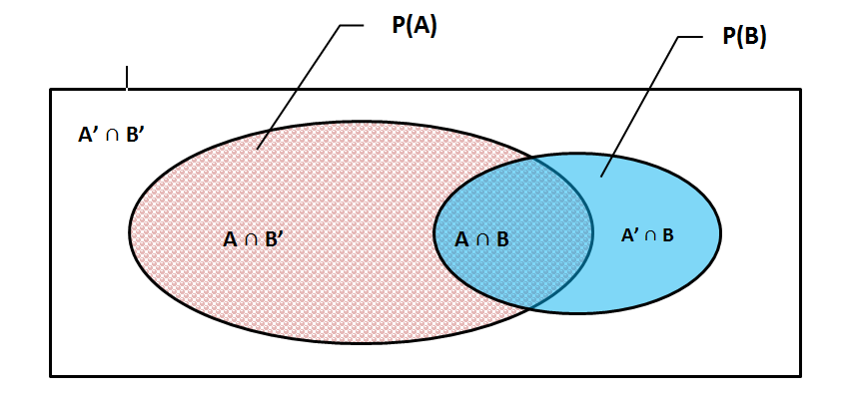
Venn diagram

Slide 6
ταβλάκι..
1 | 2 | 3
4 | 5 | 6
11 2 | 12 3 | 13 4 | 14 5 | 15 6 | 16 7
21 3 | 22 4 | 23 5 | 24 6 | 25 7 | 26 8
31 4 | 32 5 | 33 6 | 34 7 | 35 8 | 36 9
41 5 | 42 6 | 43 7 | 44 8 | 45 9 | 46 10
51 6 | 52 7 | 53 8 | 54 9 | 55 10 | 56 11
61 7 | 62 8 | 63 9 | 64 10 | 65 11 | 66 12

Slide 7
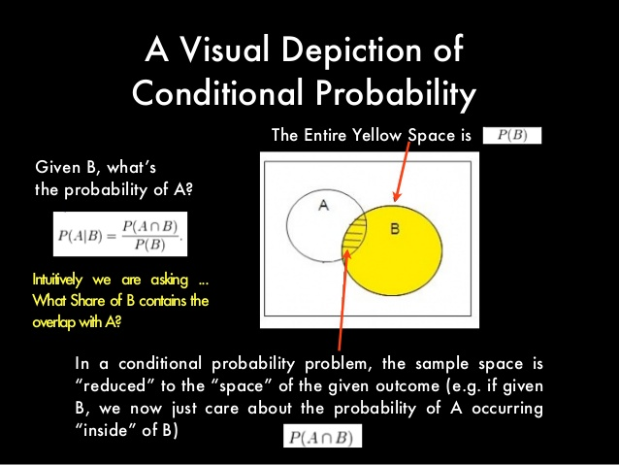

Slide 8
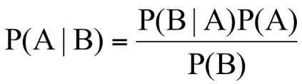
- Is this person holding a violin a musician?

Slide 9
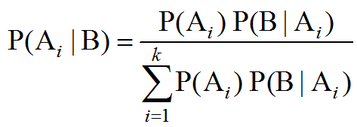

Slide 10
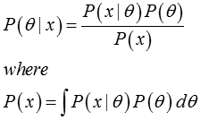

Slide 11
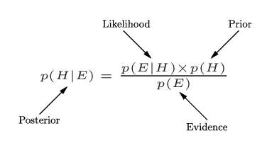
Bayes’ Law/Theorem

Slide 12
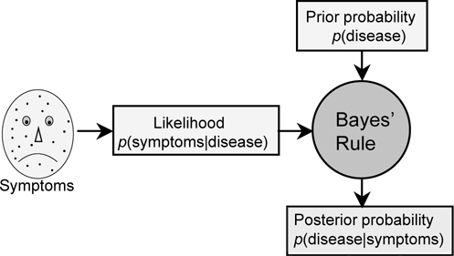

Slide 13
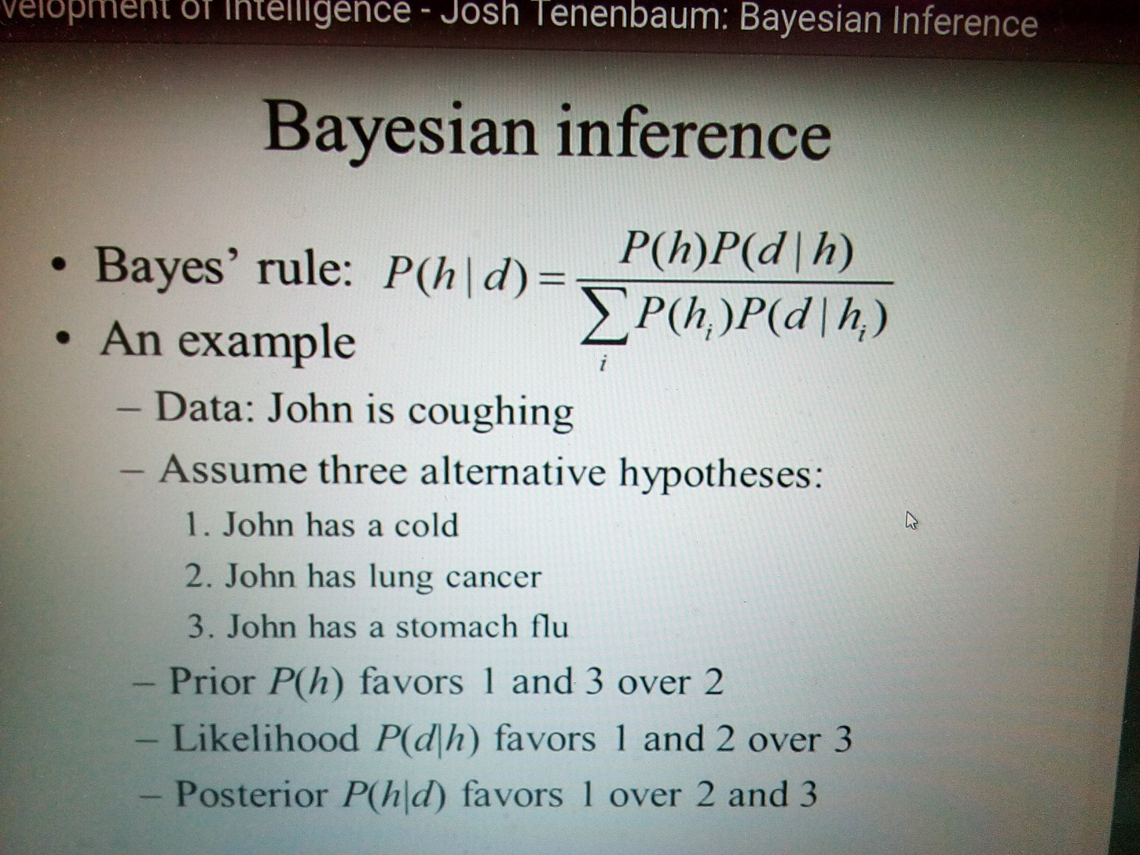

Slide 14
Bayes’ Law/Theorem

Slide 15
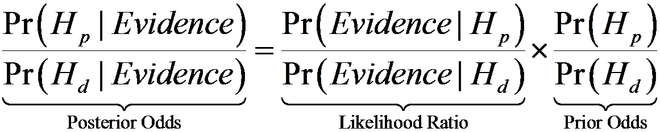

Slide 16
Bayes law makes sense & we use it to make (probabilistic) inferences of what is going on
Gestalt Psychology
Other examples from visual/sensory perception
The problem of forgetting priors
The problem of strong priors (Freud?)
The rare disease problem (test is 90% correct, disease is 1/100) (9/108)
The Monty Hall Example (2/3 win if change)
The cookie problem (30v/10c & 20v/20c: take 1, it is v, P it is from box1?) (3/5)
m&m (‘95 change G 10->20 & Y 20->14. ’94 & ’96 bags, P that Y is from ‘94?) (20/27)
Elvis Presley (P dead twin brother was identical? 1/125 fraternal, 1/300 identical) (5/11)

Slide 17

Kanizsa's Triangle

Slide 18
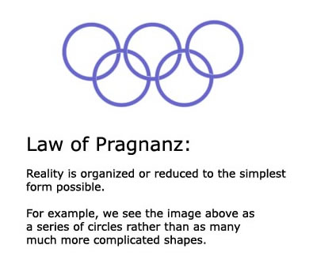
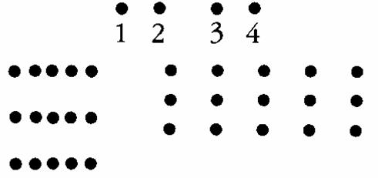
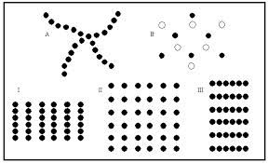
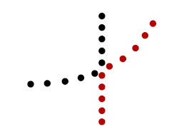
Gestalt Psychology

Slide 19
Bayes law makes sense & we use it to make (probabilistic) inferences of what is going on
Gestalt Psychology
Other examples from visual/sensory perception
The problem of forgetting priors
The problem of strong priors (Freud?)
The rare disease problem (test is 90% correct, disease is 1/100) (9/108)
The Monty Hall Example (2/3 win if change)
The cookie problem (30v/10c & 20v/20c: take 1, it is v, P it is from box1?) (3/5)
m&m (‘95 change G 10->20 & Y 20->14. ’94 & ’96 bags, P that Y is from ‘94?) (20/27)
Elvis Presley (P dead twin brother was identical? 1/125 fraternal, 1/300 identical) (5/11)

Slide 20
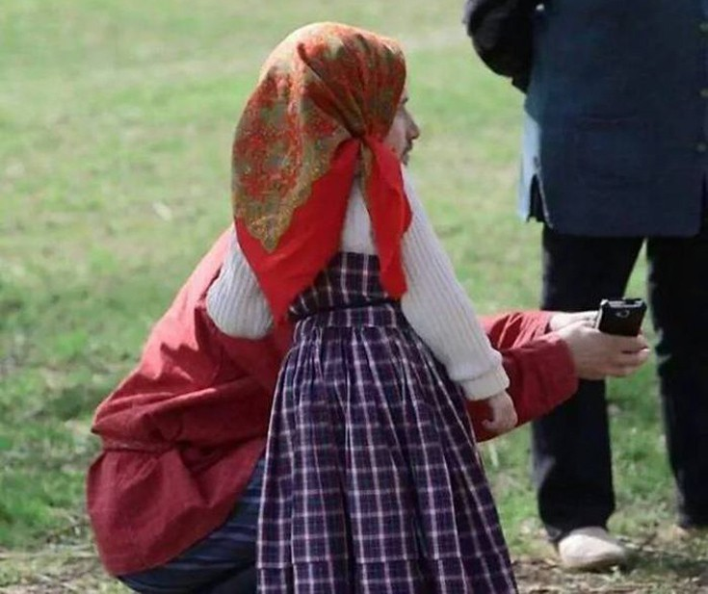

Slide 21
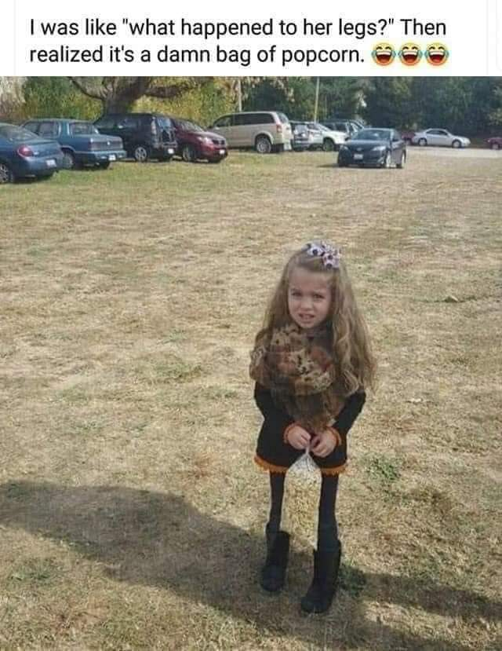

Slide 22


Slide 23
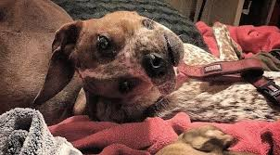

Slide 24
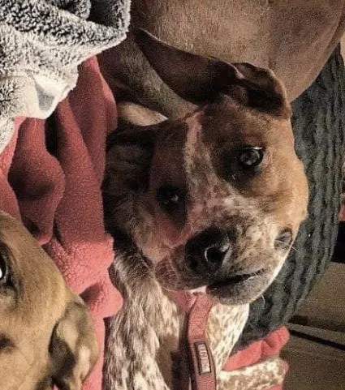

Slide 25
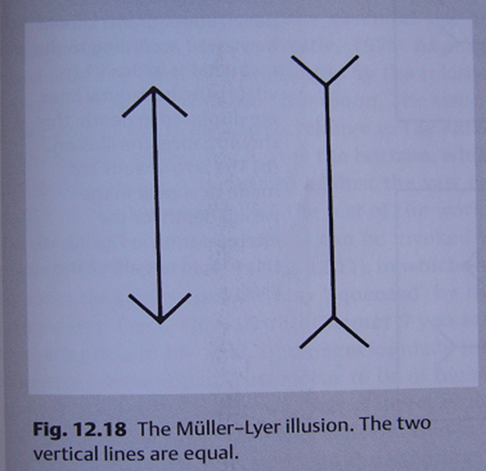

Slide 26
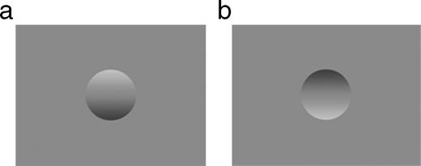

Slide 27
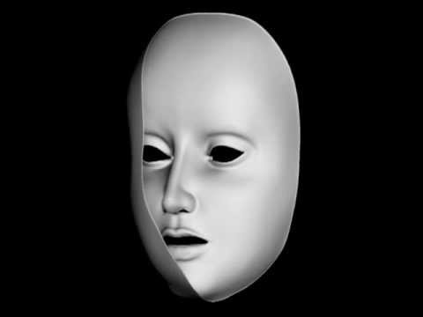
https://www.youtube.com/watch?v=sKa0eaKsdA0

Slide 28
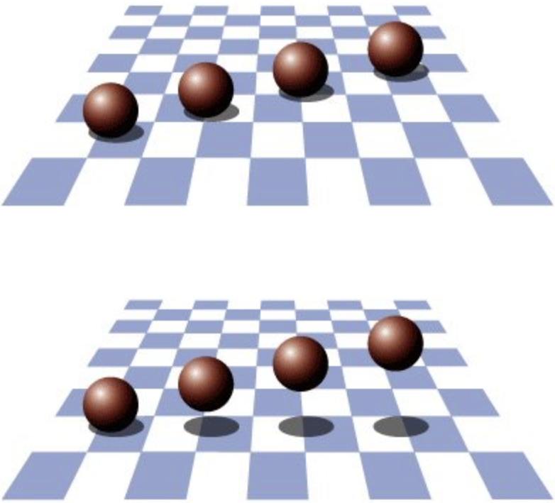
https://www.youtube.com/watch?v=V0WhU1KHd4M

Slide 29
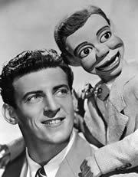
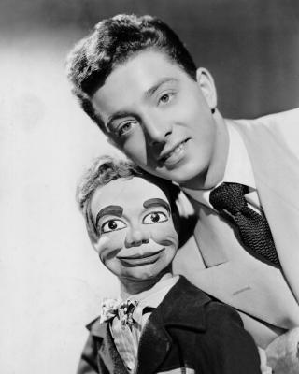
https://www.youtube.com/watch?v=MbPufI-ulAE

Slide 30
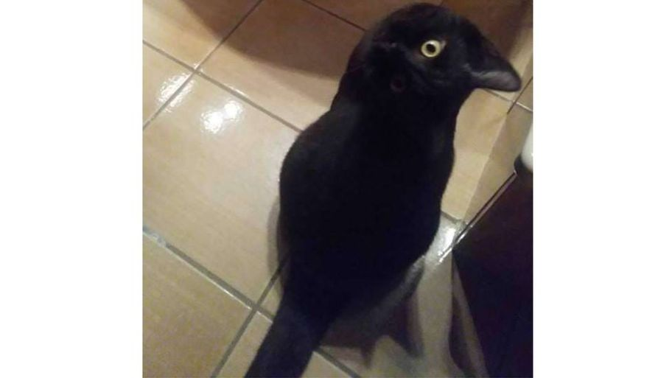
https://www.youtube.com/watch?v=2RSsoTJA6cA
https://www.youtube.com/watch?v=0KrpZMNEDOY

Slide 31
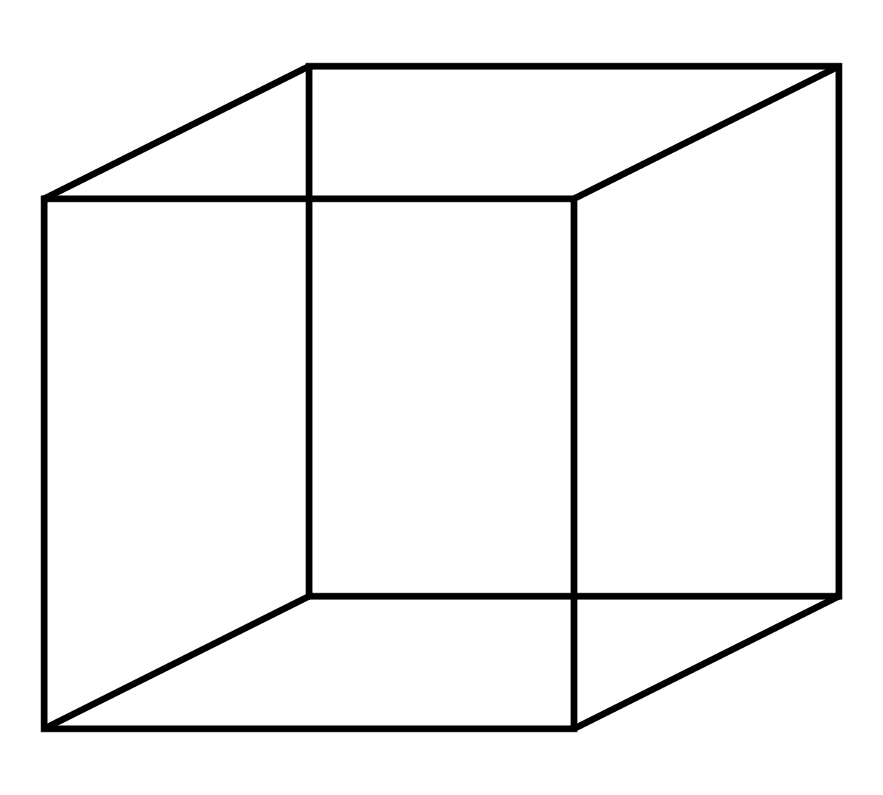
Necker cube (και άλλες αμφίσημες εικόνες)

Slide 32
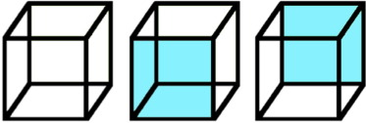

Slide 33


Slide 34
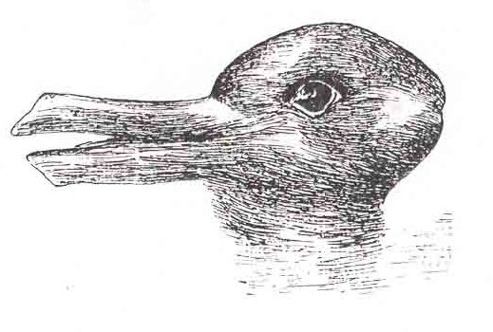

Slide 35

Notes:
Είναι όμως ο κόσμος που αντιλαμβανόμαστε πιστό αντίγραφο της πραγματικότητας;
Παλιό φιλοσοφικό πρόβλημα, που μας δείχνει ότι η αντίληψη υπάρχει γιατί έτσι είναι φτιαγμένο το νευρικό μας σύστημα,
Στη φύση υπάρχουν τα ερεθίσματα που προκαλούν αλλαγές στην πίεση του αέρα, ήχος είναι ο τρόπος με τον οποίο το νευρικό μας σύστημα ερμηνεύει
Αυτές τις αλλαγές
Μπορει πχ να βλέπω μια ντομάτα αλλά είναι η πρότερη γνώση μου που μου επιτρέπει να πω ότι είδα μια ντομάτα
Το ότι θα τη δω κόκκινη εξαρτάται απο την ίδια τη ντομάτα, αλλά το ότι θα την ονομάσω ντομάτα εξαρτάται απο την προϋπάρχουσα εμπειρία μου
Κίνητρα, εμπειρίες, προσδοκία, γενικότερη κατάσταση οργανισμού, γνώση, μνήμη όλα επηρεάζουν την αντίληψη
Τα χαρακτηριστικά του ερεθίσματος παίζουν πάντα ρόλο, πχ ένας πιο φωτεινός κύκλος είναι πάντα ένας πιο φωτεινός κύκλος
Εαν τώρα δεν φοράω τα γυαλιά μου ή είμαι πολύ κουρασμένος, μπορεί κ να μην αντιληφθώ τη διαφορά
Εαν όμως πχ το 13 ξαφνικά γίνει Β είναι επειδή επιδρά το πλαίσιο στο οποίο τοποθετείται
Πως επιδρα το πλαίσιο;

Slide 36


Slide 37
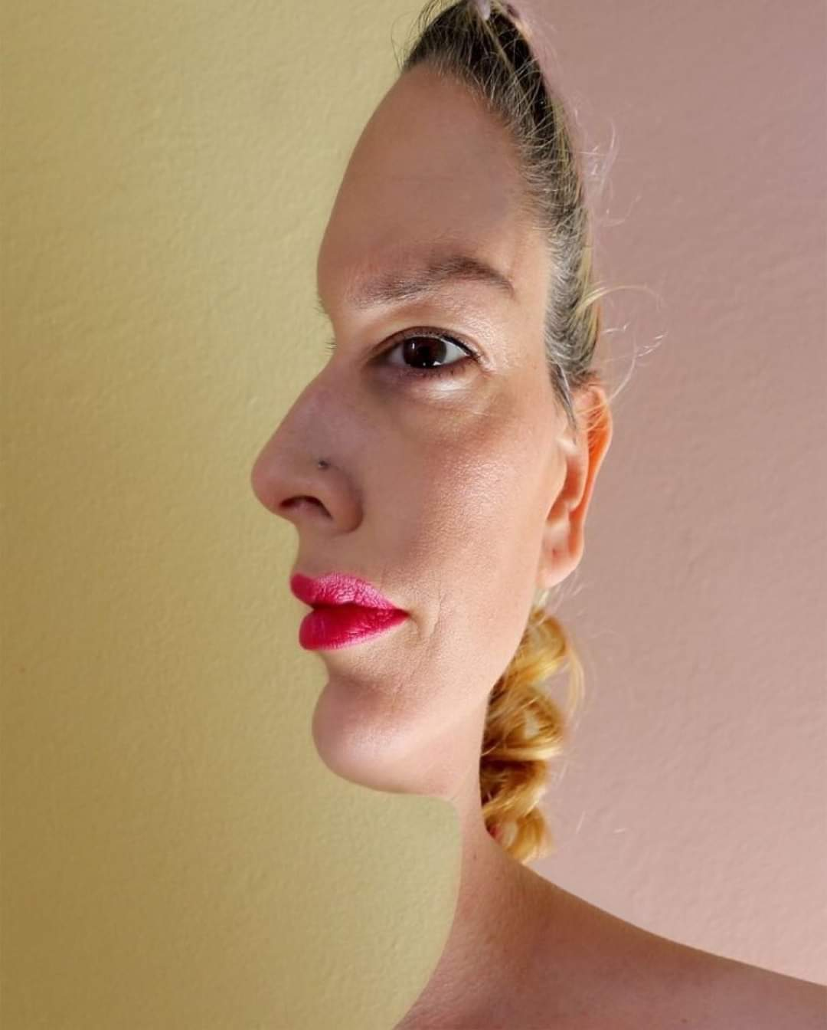

Slide 38
Bayes law makes sense & we use it to make (probabilistic) inferences of what is going on
Gestalt Psychology
Other examples from visual/sensory perception
The problem of forgetting priors
The problem of strong priors (Freud?)
The rare disease problem (test is 90% correct, disease is 1/100) (9/108)
The Monty Hall Example (2/3 win if change)
The cookie problem (30v/10c & 20v/20c: take 1, it is v, P it is from box1?) (3/5)
m&m (‘95 change G 10->20 & Y 20->14. ’94 & ’96 bags, P that Y is from ‘94?) (20/27)
Elvis Presley (P dead twin brother was identical? 1/125 fraternal, 1/300 identical) (5/11)

Slide 39
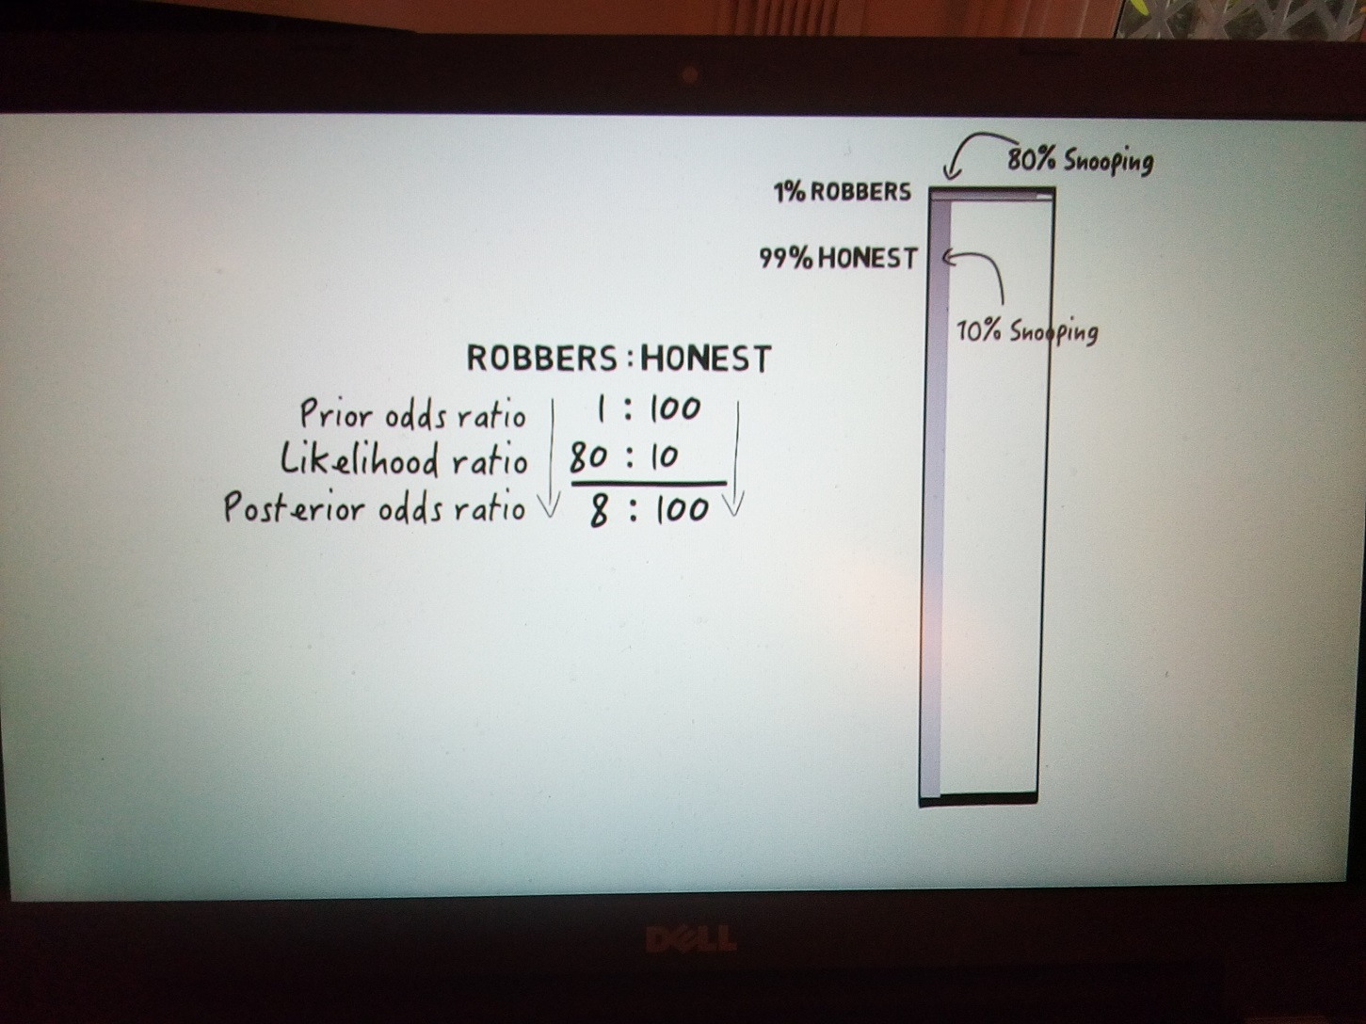

Slide 41
Bayes law makes sense & we use it to make (probabilistic) inferences of what is going on
Gestalt Psychology
Other examples from visual/sensory perception
The problem of forgetting priors
The problem of strong priors (Freud?)
The rare disease problem (test is 90% correct, disease is 1/100) (9/108)
The Monty Hall Example (2/3 win if change)
The cookie problem (30v/10c & 20v/20c: take 1, it is v, P it is from box1?) (3/5)
m&m (‘95 change G 10->20 & Y 20->14. ’94 & ’96 bags, P that Y is from ‘94?) (20/27)
Elvis Presley (P dead twin brother was identical? 1/125 fraternal, 1/300 identical) (5/11)

Slide 42
A very strong prior compensates for a weak likelihood

Slide 43
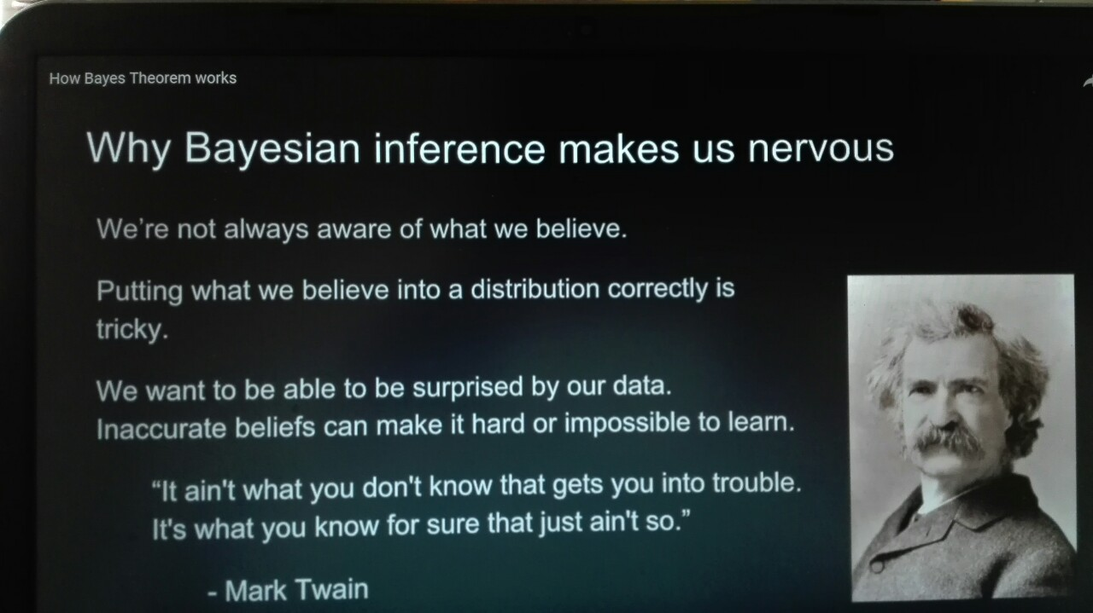

Slide 44
Bayes law makes sense & we use it to make (probabilistic) inferences of what is going on
Gestalt Psychology
Other examples from visual/sensory perception
The problem of forgetting priors
The problem of strong priors (Freud?)
The rare disease problem (test is 90% correct, disease is 1/100) (9/108)
The Monty Hall Example (2/3 win if change)
The cookie problem (30v/10c & 20v/20c: take 1, it is v, P it is from box1?) (3/5)
m&m (‘95 change G 10->20 & Y 20->14. ’94 & ’96 bags, P that Y is from ‘94?) (20/27)
Elvis Presley (P dead twin brother was identical? 1/125 fraternal, 1/300 identical) (5/11)

