Slide 1


Slide 2
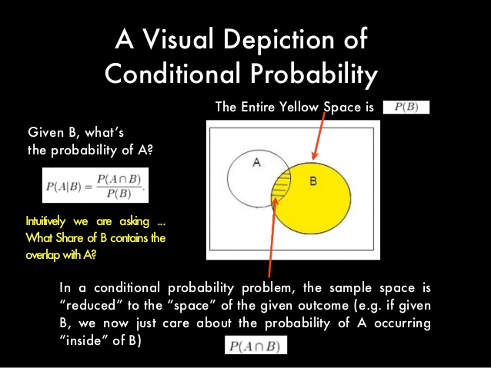

Slide 3
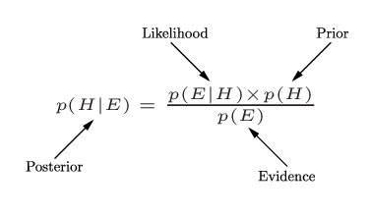
Bayes’ Law/Theorem

Slide 4


Slide 5
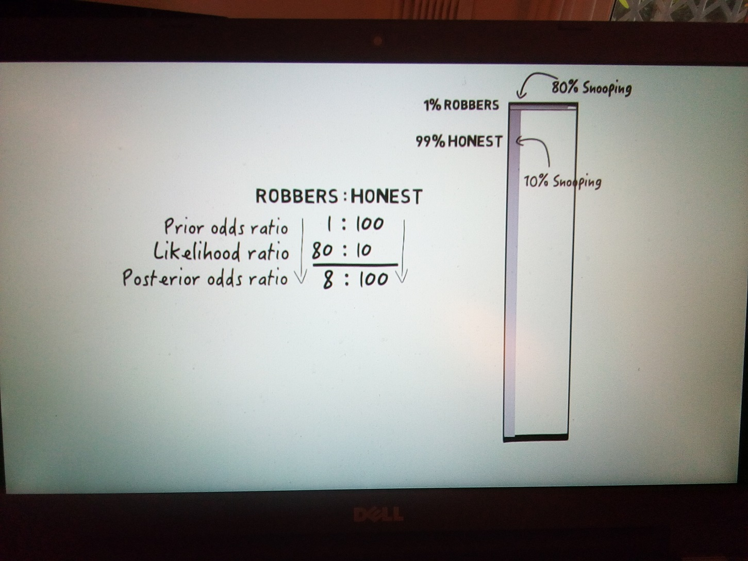
<= Wrong!!!

