Slide 1
There is no such thing as the Aristotelian Syllogistic
WORLD LOGIC DAY 2026
Doukas Kapantaïs
RCGPh
ACADEMY OF ATHENS
Athens, 14.1.2026

Slide 2
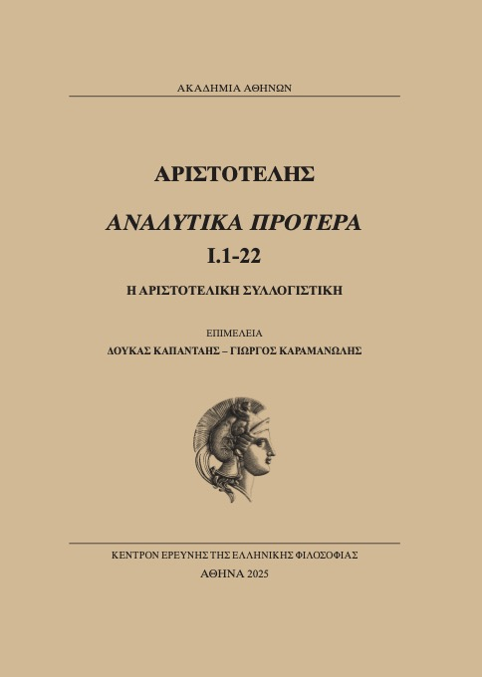

Slide 3
The metatheory belongs to intuitive and informal mathematics […] The assertions of the metatheory must be understood. The deductions must carry conviction. They must proceed by intuitive inferences, and not, as the deductions in the formal theory, by applications of stated rules. Rules have been stated to formalize the object theory, but now we must understand without rules how those rules work. An intuitive mathematics is necessary even to define the formal mathematics.
Kleene, 1952, p. 62

Slide 4
The Metalogic: Language
Possibly any natural language with a copula (English for our purposes today), enriched by a set of schematic letters for general terms (A, B, C, …), and some technical, albeit still contentual, jargon.

Slide 5
The Metalogic: Sentential Target
All statements of interest connect general terms A and B by the statement “All Bs are As”, or the statement “No B is A”, or the statement “Some Bs are As”, or the statement “Some Bs are not As”.
(For these statements, we will employ their traditional quasi-formal counterparts AaB, AeB, AiB, AoB, although in reality this is not even necessary.)
The Metalogic sets effective truth-conditions for these statements and then draws several valid contentual rules of inference concerning them, by clearly valid contentual rules of its own.

Slide 6
The Metalogic: Truth-Conditions for the relevant statements
The two dicta. These are the truth-conditions for the AaB and AeB statements.
dictum de omni (24b26–30) Truth-conditions for AaB:
The predicate term is universally predicated of every term of which the subject term is universally predicated.
dictum de nullo (24b30)
The predicate term is universally predicated of no term of which the subject term is universally predicated.
The truth-conditions for AiB and AoB follow directly from the dicta and the Square of Opposition.

Slide 7
The Metalogic: Rules of inference and the Square
The ekthesis rule. A pre-formal, contentual rule resembling what we nowadays call “proof by arbitrary object.”
A contentual reductio ad absurdum rule, according to which, if something false follows from a set of premisses, one of these premisses must be false.
Model-theoretic rules for proving non-validity and inconcludence.

Slide 8
Model proof-theoretic rules (examples)
If P, Q, R are syllogistic general statements, and you find an interpretation for the schematic letters such that P and Q come out true but R false, then P, Q ⊢ R does not hold.
If P, Q are syllogistic general statements, and you find (i) an interpretation of P, Q such that they are both true together with a syllogistic a-conclusion with these as premisses, and (ii) an interpretation of P, Q such that they are both true together with a syllogistic e-conclusion with these as premisses, then P and Q are inconcludent.

Slide 9
Inhabiting this contentual framework, Aristotle proves the validity of two among the so-called “perfect” Syllogisms:
Barbara (by the dictum de omni) 25b37–40:
Assume that AaB and BaC. By the dictum de omni, we get that A is universally predicated of everything of which B is universally predicated, and that B is universally predicated of everything of which C is universally predicated. Therefore, if X is a random term of which C is universally predicated, both B and A must be universally predicated of X. Since X is random, it follows that AaC.

Slide 10
Celarent (by the dictum de nullo) 25b40–26a2:
Assume that AeB and BaC. By the dictum de nullo, we get that everything of which B is universally predicated is such that A is not universally predicated of it. We also get that for everything of which C is universally predicated, B is universally predicated of it. Therefore, if X is a random term of which C is universally predicated, A is universally negated of X.

Slide 11
He also proves the validity of the so-called “conversion rules”:
e-conversion: If AeB, then BeA. For if not, some A, say this is X, is B. But then, a Β, i.e. X, is A, contrary to AeB. (This proof is by ekthesis and reductio 25a14-17, cf. Alexander, Philoponus ad loc.).
a-conversion: If AaB, then BiA. For if BeA, then, by e-conversion, we get AeB, which is inconsistent with AaB. (25b17-19).
i-conversion: If AiB, then BiA. For if BeA, then, by e-conversion we get AeB, which contradicts AiB. (24b20-22).

Slide 12
Some relevant proof-theoretic remarks
Notice that the valid inference rules proved so far in this Metalogic are (1) Barbara, (2) Celarent, and (3) the valid conversions.
Notice that all of these can be made part of a formal Logic. For example: you now know that once you come across an instance of AeB you can transform it into BeA salva veritate. Provided that the intended interpretation for AeB is respected, if AeB is true, BeA is true, no matter what the specific terms in this instance do mean. The same is mutatis mutandis the case for the rest of these rules.
(Put these remarks at rest for the moment. We will come back to them later on.)

Slide 13
A central proof-theoretic remark
Notice that among the five inference rules that have been proved valid by this Metalogic, there are two that fit the form of the traditional Aristotelian Syllogism. These are Barbara and Celarent, and this form is the following:
Premisses are two in number. They share one term in common and one term only (the “middle term”). The conclusion connects the two non-common terms of the premisses in such a way that the term of the first-in-order premiss (“major premiss”, “major term”) is the predicate and the term of the second-in-order premiss (“minor premiss”, “minor term”) is the subject.

Slide 14
A task for this Metalogic
With the equipment of the same Metalogic at hand, prove the validity of all schematic arguments of this form, i.e. the syllogistic form, that are valid, and the non-validity of all such arguments that are not valid.

Slide 15
Mission Accomplished
Up to the end of Chapter 6, Aristotle has effectively established that all valid schematic arguments of this form are the 14 traditional Syllogisms. He does this by considering all possible combinations of premisses in syllogistic form.
Regarding the proofs of non-validity, all proofs are model-theoretic.
Regarding the proofs of validity, he further establishes, by two central theorems in Chapter 7, that they can be proved valid in a Metalogic that contains either (1) Barbara, Celarent, Dario, and Ferio; the valid conversions; reductio ad absurdum; or (2) Barbara, Celarent; the valid conversions; reductio ad absurdum.

Slide 16
Back to the plan of formalizing the Metalogic
Remember that Barbara, Celarent, and the valid conversions can be made formal. Now add to these the following specific case of the reductio ad absurdum rule:
If (i) P, Q, R are syllogistic premisses, and (ii) the contradictory of R follows from P and the contradictory of Q, then (iii) Q follows from P and R.
Notice that this specific form of the reductio ad absurdum rule can be made formal as well. No meaning or interpretation is involved in this application. The reason is that “follows” in (ii) above is mechanical: it can be made to mean “follows by Barbara, Celarent, and the conversions,” which can all be made mechanical, as we have seen.

Slide 17
Two formal Syllogistics
We can now take stock and observe this. The validity and completeness regarding the 14 valid traditional Syllogisms can be performed in a formal (or at least easily formalizable) logical system that contains: (1) Barbara, (2) Celarent, (3) the valid conversions, and (4) the above-mentioned reductio ad absurdum rule. In that sense, it is no wonder that this system is exactly the same as the “Syllogistic,” according to T. Smiley. As a matter of fact, Smiley proposed that this is the “real” Syllogistic, as opposed to the traditional Syllogistic of the 14 Syllogisms.

Slide 18
There is a reason why Aristotle was fixated on traditional Syllogistic
Notice that all validity proofs in the Prior Analytics live a double life; in a sense, they serve two masters at once.
As put forward, they are valid proofs of the Metalogic Aristotle is living in; they establish the validity of the traditional Syllogisms.
BUT, as they stand, THEY ARE ALSO valid proofs in Smiley’s “Syllogistic”, which is not a Metalogic. As such, they represent valid arguments about everything whatsoever, not just validity itself.
(To make things clearer, we could disambiguate ad hoc by assigning different vocabularies for the above two points of view. For example, from the metalogical perspective we could employ metavariables instead of the schematic letters and names of the copulas instead of the copulas themselves.)

Slide 19
And so the Question
Why was Aristotle fixated on this form of the “Aristotelian Syllogism”, when at least an equipotent and more economical system was right at hand? To be precise, the “Syllogistic” of the moderns is even stronger. Notice, e.g., that AaB ⊢ BiA is a valid inference by all means, and traditional Syllogistic cannot capture it.

Slide 20
The Answer to this Question
In Kapantaïs/Karamanolis 2025, we argue that the reason lies in (i) an ingenious but invalid proof of the Metalogic in ch. 23, together with (ii) a valid proof that a mechanical apparatus (the pons asinorum) in chs. 27–30 is congruent with the traditional Syllogistic of the 14 Syllogisms.

Slide 21
The invalid proof in ch. 23
In ch. 23, and through a quite ingenious metalogical speculation, Aristotle erroneously arrives at the following conclusion:
[…] it is necessary that every demonstration and every syllogism come about through the three aforementioned figures. (41b1–3, translation by G. Striker).

Slide 22
The effective apparatus pons asinorum
In chs. 27–30, Aristotle constructs an apparatus consisting of inventories of general terms such that any proof procedure of the traditional Syllogistic can be mapped onto an effective term-search algorithm within the same inventories.
The inventories are three in number and are assigned to every general term, as follows.
For each general term X, we construct:
The inventory of terms that are a-predicated of X.
The inventory of terms of which X is a-predicated.
The inventory of terms that are e-predicated of X.

Slide 23
The metalogical proof about the pons asinorum
On this basis, Aristotle validly proves the following:
If there is a proof by the 14 Syllogisms of an assertoric syllogistic statement, then there is a procedure in the pons asinorum that effectively establishes the same statement if and only if a certain configuration obtains in the inventories.

Slide 24
The faulty maximalist claim in ch. 23 revisited
On the basis of the above valid proof, and if we also take into account the invalid proof in ch. 23, the following is now obvious: Aristotle was under the impression that any proof and/or demonstration is obtainable by the same apparatus.
This must be clear, since he believes that the traditional Syllogistic has maximal deductive strength. If he further believes that the pons asinorum is congruent with it, it follows that he also believes that for any proof of any valid system whatsoever there is a corresponding effective proof in the apparatus.

Slide 25
Thank you!

