Slide 1
Ancient Greek (Intermediate Level)
ATHENS MA IN ANCIENT PHILOSOPHY
NATIONAL AND KAPODISTRIAN UNIVERSITY OF ATHENS / Department of History and Philosophy of Science
In collaboration with:
•UNIVERSITY OF PATRAS / Department of Philosophy
•UNIVERSITY OF CRETE / Department of Philosophy and Social Studies

Slide 2
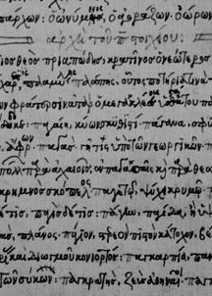
WEEK 1: BACK TO THE BASICS
The Greek Alphabet, Writing Greek Letters, Pronunciation, Ancient Greek Dialects, Important Dates (the periods of ancient Greek literature and important events in Greek history), Introduction to Greek Grammar and Syntax, Digital Tools, Basic Bibliography.

Slide 3
The Greek Alphabet
The History of the Greek Alphabet:
The first Greek texts were written in Linear B, the syllabic script that was used for writing Mycenaean Greek until the Late Bronze Age collapse and Greek Dark Age.
Mycenaean Greek, the earliest attested form of the Greek language.

Slide 4
The Greek Alphabet
The History of the Greek Alphabet:
The earliest known examples dating to around 1450 BC.
Adapted from the earlier Linear A, an undeciphered script perhaps used for writing the Minoan language, as is the later Cypriot syllabary, which also recorded Greek.
Linear B, found mainly in the palace archives at Knossos, Kydonia, Pylos, Thebes and Mycenae, disappeared with the fall of Mycenaean civilization during the Late Bronze Age collapse.
The succeeding period, known as the Greek Dark Ages, provides no evidence of the use of writing.

Slide 5
The Greek Alphabet
The History of the Greek Alphabet:
Deciphered in 1952 by English architect and self-taught linguist Michael Ventris.
Consists of around 87 syllabic signs and over 100 ideographic signs. These ideograms or "signifying" signs symbolize objects or commodities. They have no phonetic value and are never used as word signs in writing a sentence.
Administrative contexts, mainly at Mycenaean palatial sites.

Slide 6
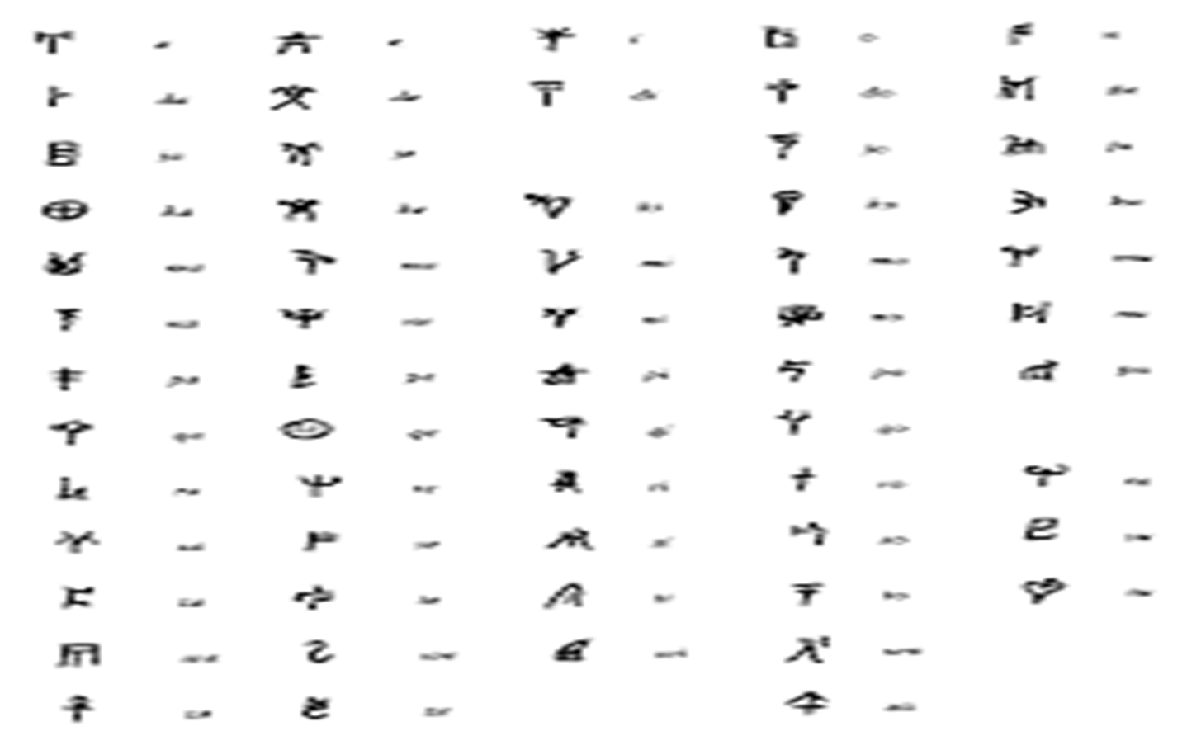
The Greek Alphabet

Slide 7
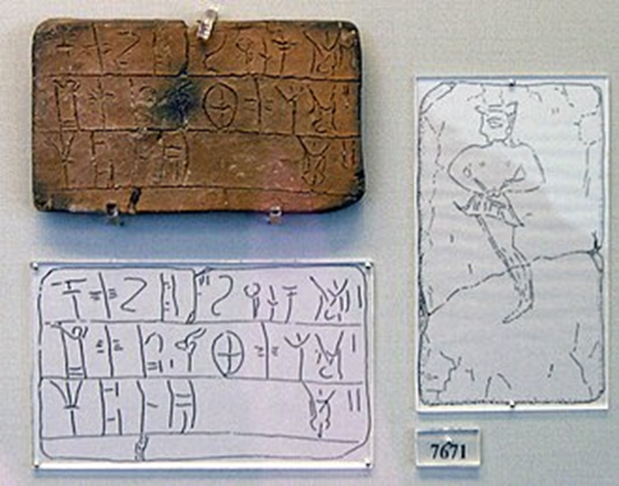
The Greek Alphabet

Slide 8
The Greek Alphabet
The History of the Greek Alphabet:
The Phoenician alphabet was adopted for Greek during the early 8th century BC, perhaps in Euboea.
The oldest substantial texts known to date are the Dipylon inscription and the text on the so-called Cup of Nestor, both dated to the late 8th century BC, inscriptions of personal ownership and dedications to a god.

Slide 9
The Greek Alphabet
The History of the Greek Alphabet:
The Dipylon Inscription:
Written on an ancient Greek pottery vessel dated to c. 740 BC.
Scratched on an oenochoe, which was found in 1871 and is named after the location where it was found, the ancient Dipylon Cemetery, near the Dipylon Gate on the area of Kerameikos in Athens.
It is now in the National Archaeological Museum of Athens (inv. 192).

Slide 10
The Greek Alphabet
The History of the Greek Alphabet:
The Dipylon Inscription:
The text is written from right to left, with the individual letters mirror-shaped in comparison with the modern forms. It is placed in a circle around the shoulder of the vessel.
Hexametric verse?
ΗΟΣΝΥΝΟΡΧΕΣΤΟΝΠΑΝΤΟΝΑΤΑΛΟΤΑΤΑΠΑΙΖΕΙΤΟΤΟΔΕΚΛ[?]ΜΙ[?]Ν
ὸς νῦν ὀρχεστôν πάντον ἀταλότατα παίζει, τô τόδε κλμιν[...]
ὃς νῦν | ὀρχη|στῶν πάν|των ἀτα|λώτατα | παίζει τοῦ τόδε ...
Whoever of all these dancers now plays most delicately, of him this (sc. pot)...

Slide 11
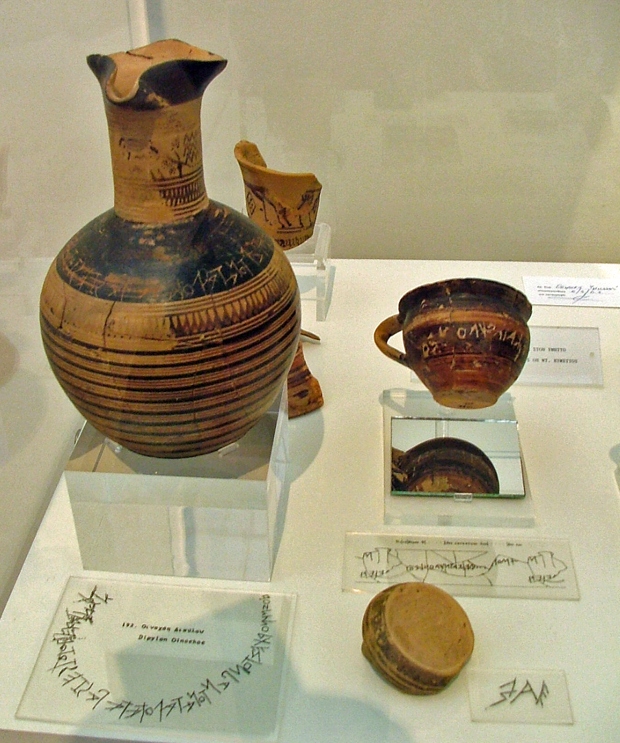
The Greek Alphabet

Slide 12
The Greek Alphabet
The History of the Greek Alphabet:
Nestor's Cup (Pithekoussai)
In the eighth century BC wine a cup discovered in 1954 in the San Montano cemetery associated with the ancient trading site of Pithekoussai in Magna Graecia, on Ischia.
It has a three-line inscription.
It is currently held by the Museo Archeologico di Pithecusae on Ischia.
Used in Symposia (skyphos or kotyle).

Slide 13
The Greek Alphabet
Νεστορος : ε[ιμ?]ι[d] : ευποτ[ον] : ποτεριον :
ͱος δ'α<ν> τοδε π[ιε]σι : ποτερι[ο] : αυτικα κενον
ͱιμερ[ος ͱαιρ]εσει : καλλιστε[φα]νο : Αφροδιτες
I am the cup of Nestor good for drinking.
Whoever drinks from this cup, desire for beautifully
crowned Aphrodite will seize him instantly.

Slide 14
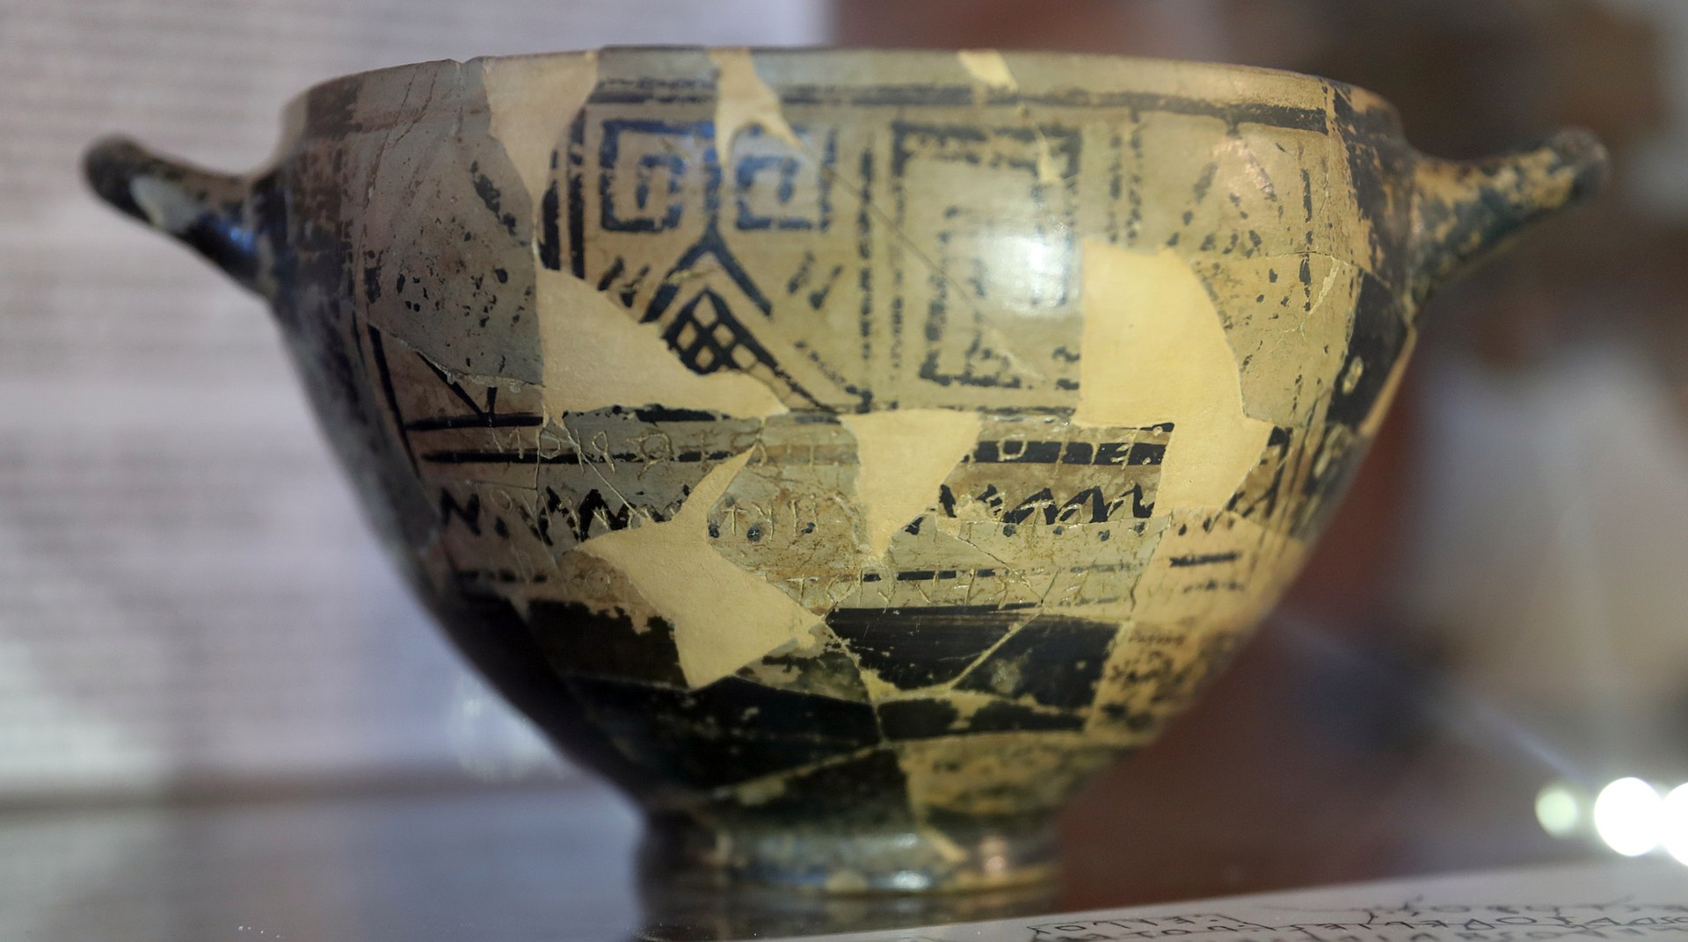
The Greek Alphabet

Slide 15
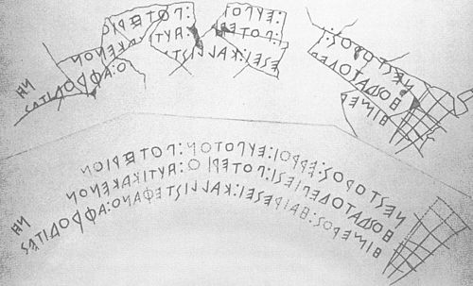
The Greek Alphabet

Slide 16
The Greek Alphabet
The History of the Greek Alphabet:
Standardization – the Ionic alphabet
In 403/2 BC, following the devastating defeat in the Peloponnesian War and the restoration of democracy, the Athenians voted to abandon the old Attic alphabet (Pre-Euclidean alphabet) and to introduce a standardized variant of the eastern Ionic alphabet, after a proposal by archon Eucleides. It spread gradually throughout the Greek world.
The Ionic alphabet included a new letter, omega, at the end of the alphabet.
By about 200 BC, a system of diacritical marks was invented, representing the tone accents in use in Ancient Greek. This also helped to indicate the length of the vowels Α, Ι, and Υ in certain cases (for instance a circumflex can only occur on a long vowel), but Greek orthography has never had a comprehensive way of indicating vowel length, and this distinction has in any case been lost in Modern Greek. This innovation of accents, as well as that of punctuation marks, has been credited to Aristophanes of Byzantium (257 – c. 185 BC).

Slide 17
The Greek Alphabet
The History of the Greek Alphabet:
By the time of late antiquity and the early Byzantine period, two different styles of handwriting had developed, both suitable to the act of writing with quill and ink on soft materials (paper or parchment).
Uncial script and cursive script.

Slide 18

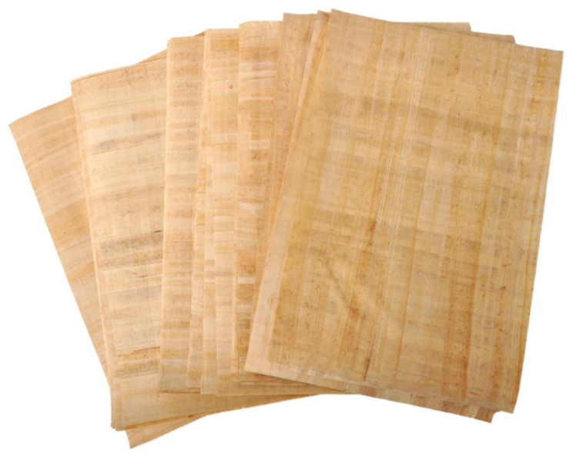
The Greek Alphabet

Slide 19
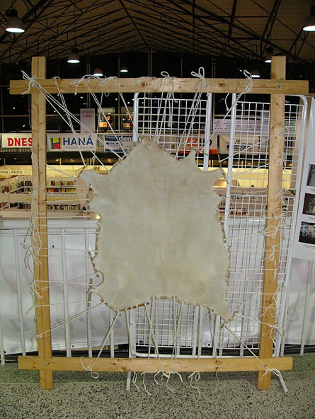
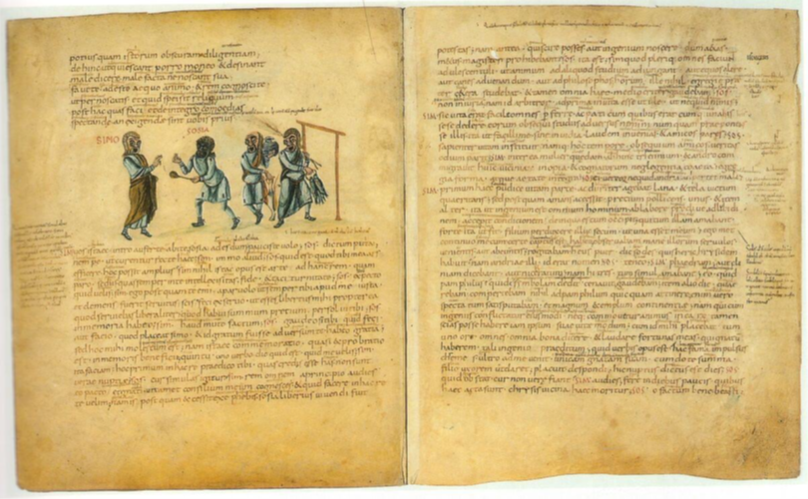
The Greek Alphabet

Slide 20
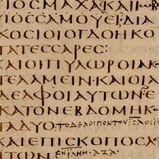
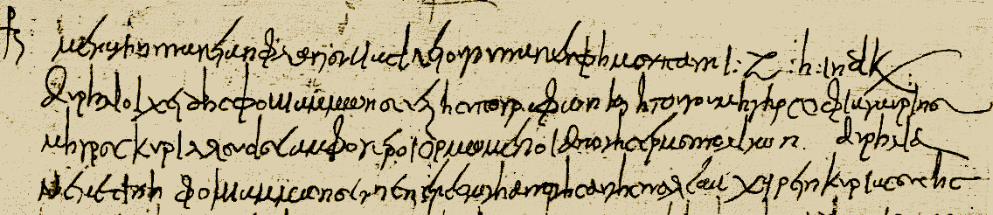
The Greek Alphabet
Uncial Script
Cursive Script

Slide 21
The Greek Alphabet
The History of the Greek Alphabet:
From the mid-9th century AD onwards, the uncial script was replaced in book writing by a new writing style, the Greek minuscule, which used more compact, rounded letter shapes and was partly based on the earlier cursive.
Together with the minuscule letter shapes, Greek writing also began to use word-boundary spaces and diacritics (i.e. the accent marks and breathings of polytonic orthography) more regularly. Some punctuation began also to be employed. The iota subscript was invented in the 12th century AD was employed from the 13th century onwards.

Slide 22
The Greek Alphabet
The History of the Greek Alphabet:
In 1982, the monotonic orthography was officially adopted, abandoning the rough and smooth breathings (since the [h] sound had long since disappeared) and reducing the three types of accent mark to one (since a stress accent had replaced the tone accent).
Greek pronunciation has also changed considerably since ancient times, but these changes have not been apparent from the orthography, which has remained conservative.

Slide 23
The Greek Alphabet
A α (alpha) pronounced ‘cup’ or ‘calm’
Β β (beta) pronounced ‘b’ as in English
Γ γ (gamma) a hard ‘g’, like ‘got’
Δ δ (delta) a clean* ‘d’, like ‘dot’
Ε ε (epsilon) short ‘e’ like ‘pet’
Ζ ζ (zeta) like ‘wisdom’
Η η (eta) pronounced as in ‘hair’
Θ θ (theta) – blow a hard* ‘t’ (‘tare’)
I ι (iota) like ‘bin’ or like ‘bead’
Κ κ (kappa) a clean* ‘k’ like ‘skin’

Slide 24
The Greek Alphabet
Λ λ (lambda) like ‘lock’
Μ μ (mu) like ‘mock’
Ν ν (nu) like ‘net’
Ξ ξ (xi) like ‘box’
Ο ο (omicron) a short ‘o’, like ‘pot’
Π π (pi) a clean* ‘p’, like ‘spot’
Ρ ρ (rho) a rolled ‘r’, like ‘rrat’
Σ σ ς (sigma) a soft ‘s’, like ‘sing’

Slide 25
The Greek Alphabet
Τ τ (tau) a clean ‘t’, like ‘sting’
ϒ υ (upsilon) French ‘lune’ or German ‘Müller’
Φ φ (phi) – blow a hard* ‘f’, like ‘foot’
Χ χ (khi) – blow a hard* ‘c’, like ‘cool’
Ψ ψ (psi) as in ‘lapse’
Ω ω (omega) like ‘saw

Slide 26
The Greek Alphabet
Diphthongs
αι as in ‘high’
αυ as in ‘how’
oι as in ‘boy’
Digraphs
ει (fiance) and oυ (boo) are single sounds
εὐ- pronounce both elements separately

Slide 27
The Greek Alphabet
Double-consonants
γγ as in ‘finger’; γ is sounded as ng in γκ , γχ , γξ , and γμ.
ττ as ‘rat-trap’, λλ as ‘wholly’, should be dwelt on.
Sigma and iota subscript
Observe that ς is used at the end of words, while σ is used elsewhere (e.g. στασις,‘revolt’).
Sometimes ι is printed underneath a preceding α (ᾳ), η (ῃ) and ω (ῳ), when it is called ‘iota subscript’ (Latin, ‘written under’).

Slide 28
The Greek Alphabet
Breathings
All words that begin with a vowel have a breathing.
‘Rough’ breathing = ‘
aboνe a lower-case vowel, or in front of a capital, indicates the presence of an ‘h’ sound, e.g. ὁρος = horos (‘marker’), ὁπλιτης = hoplite¯s (‘hoplite’), Ἑλλας = Hellas (‘Greece’).
‘Smooth’ breathing = ᾿ aboνe a lower-case vowel, or in front of a capital, indicates the absence of ‘h’ sound, e.g. ὀρος = oros (‘mountain’), ἀτομος = atomos (‘atom’).
Diphthongs
Note that, on a diphthong and digraph, the breathing comes on the second vowel, e.g. Αἰσχύλος, Aeschylus.

Slide 29
The Greek Alphabet
Punctuation
Greek uses ; for a question-mark (?) and · for a colon (:) or semi-colon (;).
Otherwise, punctuation is as in English.
Vowel-length
Diphthongs and the vowels η and ω are always pronounced long; ο and ε are always pronounced short. A macron is used to indicate where α, ι, υ are pronounced long (ᾱ, ῑ, ῡ) in learning vocabularies, total vocabularies and tables in the Grammar. A vowel with a circumflex accent ͠ or iota subscript ι is long, needing no macron to mark it.

Slide 30
The Greek Alphabet
Transliteration
Most Greek letters convert simply into English, e.g. β and τ become ‘b’ and ‘t’.
But some are not so obvious. Note in particular:
ζ = sd or z
γγ = ng
η = e
θ = th
κ = c or k
-oν = -um or -on
-oς = -us or -os
υ = y or u
χ = ch or kh
ψ = ps

Slide 31
WRITING GREEK LETTERS
Exercise: write your name in Greek.
Βασιλική

Slide 32
Pronunciation
Greek pronunciation has inevitably undergone deep changes over the centuries.
When teaching Ancient Greek pronunciation, Greece uses Modern Greek sounds as a basis. European and American countries use the Erasmian pronunciation, which was proposed by the Dutch scholar Erasmus in the late 15th century.
Is it possible to reconstruct the original pronunciation?
Evidence: General Phonetics tendencies, spelling errors recorded in ancient inscriptions, spelling of Greek loan words in other ancient languages as Latin, and even descriptions of the Greek phonetics by ancient Greek grammarians themselves.

Slide 33
Pronunciation
Erasmian Pronunciation
Erasmian (named for Desiderius Erasmus [1466-1536]), is the pronunciation traditionally taught in New Testament studies.
It is not an authentic Greek pronunciation and does not reflect a true spoken foreign language. It is an academic pronunciation which, though originally based on Classical pronunciation.

Slide 34
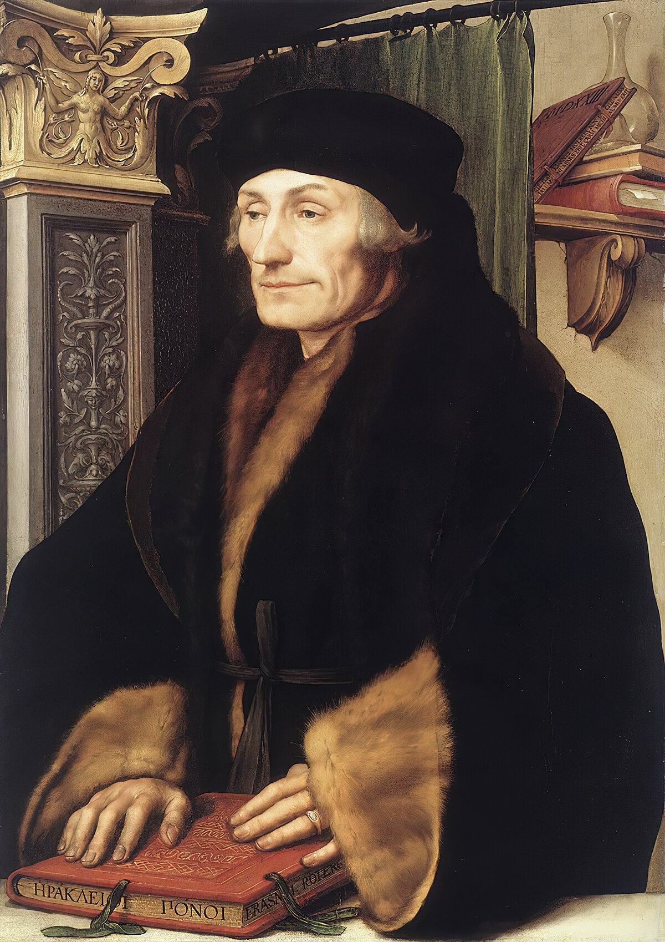
Pronunciation
Erasmian is particularly helpful for remembering spelling and for disambiguating word inflections when speaking or transcribing in the classroom. Unlike Modern Greek, Erasmian differentiates each Greek vowel, although not every diphthong (that is, if you are able to distinguish between \ah\ in father for the letter α, and \aw\ in caught for the letter ο).
De recta Latini Graecique sermonis pronuntiatione (1528).

Slide 35
PRONUNCIATION
Bibliography:
Allen, W. S. 1987. Vox Graeca: A Guide To The Pronunciation Of Classical Greek. Cambridge: CUP.
Devine, A. M. & Stephens, L. D. 1994. The Prosody of Greek Speech. New York / Oxford: OUP.

Slide 36
Ancient Greek Dialects
The ancient Greeks themselves traced their ethnic and linguistic heritage to Hellen, the eponym of both Greece (Hellas, Ἕλλάς) and the Greeks (Hellenes, Ἕλληνες). Hellen was said to be a son of Deucalion, a son of Prometheus and survivor of the great primeval flood of Greek tradition. The self-recognized diversity of Greek culture and language was attributed to descent from Hellen's three sons, Dorus, Xanthus, and Aeolus, being the alleged progenitors of the Dorian, Ionian, and Aeolian Greeks respectively.

Slide 37
Ancient Greek Dialects
The ancient Greek dialects (i.e., of the first millennium BC) were broadly separated into (i) Attic-Ionic; (ii) Arcado-Cypriot; (iii) Aeolic; (iv) Doric; and (v) Northwest Greek.

Slide 38
Ancient Greek Dialects
Attic-Ionic
Attic is the dialect of Athens and the surrounding region of Attica). Its closely related sister dialect of Ionic (language of epic, Herodotus, Hippocrates).
Arcado-Cypriot
Arcado-Cypriot is the dialectal subdivision to which belong the geographically far-flung but remarkably homogeneous dialects of the island of Cyprus and the mountainous region of Arcadia in the Peloponnese.

Slide 39
Ancient Greek Dialects
Aeolic
The Aeolic dialect is further divided into Lesbian (Anatolian Aeolic), Thessalian, and Boeotian (Balkan Aeolic).
The poets Sappho and Alcaeus of Lesbos composed in a literary form of their native dialect.
Language of epic.
Doric
Doric is the dialect that is attested in the greatest variety of distinct local forms.
In literary usage, Doric figures prominently in the language of Greek choral lyric.
Northwest Greek
The remaining dialect group is that of Northwest Greek, being clearly a close relative of Doric.

Slide 40
Important Dates
The periods of ancient Greek literature:
1) the Archaic Period (c. 800–500 BC).
2) the Classical Period (c. 500–323 BC).
3) the Hellenistic Period (c. 323–31 BC).
4) Roman Age (31 BC – 284 AD).
5) Late Antiquity (late 3rd century to the 7th century AD).

Slide 41
Important Dates
The rise of the polis:
621 BC: Draco replaces oral law with written law in Classical Athens, considered one of the earliest developments of the Athenian democracy.
594 BC: Solon appointed Archon of Classical Athens and begins issuing citizenship and judicial reforms, giving Athenian citizens the right to participate in government.
508 BC: Athenian democracy instituted at the Republic of Athens.

Slide 42
Important Dates
Conflicts:
499 BC: King Aristagoras of Miletus incites all of Hellenic Asia Minor to rebel against the Persian Empire, beginning the Greco-Persian Wars.
490 BC: Greek city-states defeat Persian invasion at Battle of Marathon.
480 BC: Persian invasion of Greece by Xerxes I; Battles of Thermopylae and Salamis.
465 BC: Murder of Xerxes I.
449 BC: The Greco-Persian Wars end.

Slide 43
Important Dates
The rise and fall of Athens:
447 BC: Building of the Parthenon at Athens started.
432 BC: Construction of the Parthenon is completed.
431 BC: Beginning of the Peloponnesian War between the Greek city-states.
404 BC: End of the Peloponnesian War.
399 BC: Trial of Socrates.

Slide 44
Important Dates
Macedonia:
384 BC: Birth of Aristotle.
331 BC: Alexander the Great defeats Darius III of Persia in the Battle of Gaugamela, completing his conquest of Persia.
326 BC: Alexander the Great defeats Indian king Porus in the Battle of the Hydaspes River.
323 BC: Death of Alexander the Great at Babylon.
322 BC: Death of Aristotle.

Slide 45
Introduction to Greek Grammar and Syntax
Basic Terms:
Noun
‘The woman persuades the man.’
1. In this sentence ‘woman’ and ‘man’ are NOUNS. Nouns name things or people, e.g. potato, telephone, Chloe, honesty, courage. Cf. ‘The dog pursues Charlotte.’
Gender
2. Gender is a grammatical term and has nothing to do with males and females.
Nouns come in three ‘genders’ in Greek – MASCULINE, FEMININE and NEUTER. Compare French or Spanish, which have two genders, masculine and feminine: ‘le soleil’ and ‘el sol’ [‘the sun’ in French and Spanish] are MASCULINE, but ‘la lune’ and ‘la luna’ [‘the moon’] are FEMININE. The gender of a noun in a given language DOES NOT CHANGE. So ‘the moon’ is ALWAYS feminine in Spanish and French.

Slide 46
Introduction to Greek Grammar and Syntax
Basic terms:
Verb and clause
‘The woman persuades the man.’
3. (a) The word ‘persuades’ is a VERB. Verbs are usually ‘action-words’ – bring, win, walk, complain: ‘I bring’, ‘you win’, ‘they complain’. They can also express a state: ‘she is’, ‘he remains’. The verb tells us what is being done or happening in a sentence: ‘The dog pursues Charlotte.’ All the verbs quoted here are FINITE verbs. This means they have a person(‘I’, ‘he’ etc.), a TENSE (all referring to present time in the examples given) and a MOOD (here ‘indicative’: they indicate something is the case).
(b) Sentences often contain numbers of CLAUSES. Each clause has a FINITE verb in it, e.g. ‘When Chloe left, although she forgot her glasses, she did not return to pick them up.’ The finite verbs here are ‘left’, ‘forgot’,‘return’ – but not ‘pick’.
(c) We define these clauses in relation to each other. ‘SUBORDINATE’ clauses are introduced by words like ‘when’, ‘although’, ‘so that’, ‘if’, ‘because’, ‘since’ and so on. When you have removed all the subordinating clauses, you are left with the MAIN CLAUSE and the MAIN VERB (or verbs). In the example in (b), ‘return’ is the main verb.

Slide 47
Introduction to Greek Grammar and Syntax
Basic terms:
Definite article
‘The woman persuades the man.’
4. ‘The’ is what is known as the DEFINITE ARTICLE in English. It plays an extremely important role in translation from Greek into English.
Subject and object
‘The woman persuades the man.’
5. The SUBJECT of the sentence above is ‘the woman’ – the woman is doing the persuading. The subject, in grammar, is the person or thing doing the action of the verb. The subject is NOT what the sentence is about, but is the person or thing performing the verb: ‘I bring the potatoes,’ ‘She wins the cup,’ ‘The dog pursues Charlotte.’
The OBJECT of the sentence above is ‘the man’ – the woman is persuading the man. The object is the person or thing on the receiving end of the verb. Examples: ‘You bite the apple,’ ‘Toby likes sport,’ ‘The dog pursues Charlotte.’

Slide 48
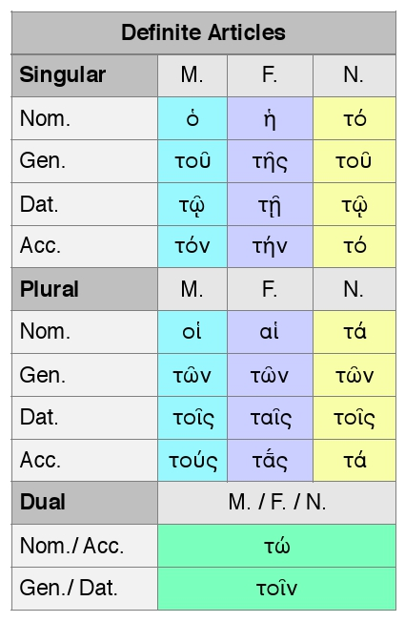
Introduction to Greek Grammar and Syntax

Slide 49
Introduction to Greek Grammar and Syntax
Word shape and word order:
One of the most important differences between Greek and English is that in English it is the order of the words which tells you what a sentence means, but in Greek it is the changing shape of the words. For example, in English the following two sentences mean very different things:
‘The woman persuades the man.’
‘The man persuades the woman.’

Slide 50
Introduction to Greek Grammar and Syntax
Word shape and word order:
The difference in meaning between these two sentences lies in the word order.
This tells you who or what is doing the persuading. In the first ‘the woman’ comes before ‘persuades’ and this tells you the woman is persuading. In the second ‘the man’ comes before ‘persuades’ and so it is the man who is persuading.
Now read the following two sentences in Greek:
ἡ γυνὴ πείθει τὸν ἄνθρωπον.
| | | | |
‘The woman persuades the man.’

Slide 51
Introduction to Greek Grammar and Syntax
Word shape and word order:
τὴν γυναῖκα πείθει ὁ ἄνθρωπος
| | | | |
‘The woman persuades the man.’ = NO
Both sentences have the same word order in Greek: woman – persuades – man. But the meaning is quite different: the first means ‘The woman persuades the man,’ but the second, despite the order of the words, in fact means ‘The man persuades the woman’.
What is going on? How can we tell which is which?

Slide 52
Introduction to Greek Grammar and Syntax
Word shape and order:
– In Greek it is the shape of the words which tells you what job any word is doing and therefore what a sentence as a whole means – in this case, who is persuading whom. The changes to words in Greek usually (but not always) come at the end of words.
Now look at the changes of word shape in the two sentences given above.
You will observe that ἡ γυνὴ contrasts with τὴν γυναῖκα, and τὸν ἄνθρωπον with ὁ ἄνθρωπος. The reason is as follows:
– In the first sentence ‘the woman’ is the subject (the woman is doing the
persuading) and the Greek form for ‘the woman-as-subject’ is ἡ γυνή.

Slide 53
Introduction to Greek Grammar and Syntax
Word shape and order:
– In the second, she is the object (she is on the receiving end of the persuasion) and the Greek form for that is τὴν γυναῖκα.
– In the same way, ‘the man’ is the subject in the second sentence and the Greek form is ὁ ἄνθρωπος;
– but when he is the object in the first sentence, the Greek is τὸν ἄνθρωπον.
– Notice also how the def. art. changes as well: it is ὁ (masculine) or ἡ (feminine) when its noun is the subject, but τόν (masculine) or τήν (feminine) when its noun is the object.

Slide 54
Introduction to Greek Grammar and Syntax
Case
The grammatical term for these different word shapes is CASE. Nouns in Greek have a different shape, a different CASE, according to whether they are subject or object in a sentence.
We have already met several examples of different cases in Greek:
ἡ γυνὴ πείθει τὸν ἄνθρωπον.
| |
‘The woman (subject) persuades the man (object).’
τὴν γυναῖκα πείθει ὁ ἄνθρωπος
| |
‘The woman (object) persuades the man (subject).’
The cases in Greek have different names:
The case of the subject is the NOMINATIVE case.
The case of the object is the ACCUSATIVE case.

Slide 55
Digital Tools
1. Perseus Digital Library: https://www.perseus.tufts.edu/hopper
2. Stanford Encyclopedia of Philosophy: https://plato.stanford.edu/
3. Internet Encyclopedia of Philosophy: https://iep.utm.edu/
4. JSTOR: https://www.jstor.org
5. Project Muse: https://muse.jhu.edu/
6. Thesaurus Linguae Graecae: https://stephanus.tlg.uci.edu/
7. Oxford Bibliographies: https://www.oxfordbibliographies.com/

Slide 56
Digital Tools
8. Liddell and Scott, Greek-English Lexicon (Perseus Digital Library): https://www.perseus.tufts.edu/hopper/text?doc=Perseus:text:1999.04.0057
9. A Platonic Lexicon (Lexeis): https://lexeis.org/plato/#/
10. Ancient Greek Language on the Web: A Critical Survey of Websites: http://greekgrammar.wikidot.com/
11. Bonifazi, Drummen and de Kreij, Particles in Ancient Greek Discourse: https://chs.harvard.edu/book/bonifazi-drummen-de-kreij-eds-particles-in-ancient-greek-discourse/

Slide 57
Digital Tools
12. Greek Core Vocabulary (Dickinson College): https://dcc.dickinson.edu/greek-core-list
13. Ancient Greek Tutorials @ AtticGreek.org: http://atticgreek.org/
14. Society for the Oral Reading of Greek and Latin Literature (SORGLL): https://rhapsodoi.org/
15. Some Greek Philosophical Terms: https://academic.mu.edu/taylorr/Ancient_Philosophy_Spring_2016/Greek_terms.html
16. Loebolus: https://ryanfb.xyz/loebolus/

Slide 58
Basic Bibliography
Blanshard, B. 1967. On Philosophical Style. Manchester: Manchester University
Press.
Biguenet, J, & Schulte, R. (eds.). 1992. Theories of Translation. An Anthology of Essays from Dryden to Derrida. Chicago: University of Chicago Press.
Brickhouse, T. S. & Smith, N. 1989. Socrates on Trial. Princeton, NJ: Princeton Univ. Press.
Burnett, J. 1905. Plato: Euthyphro; Apology of Socrates; and Crito. Oxford: Clarendon Press.
Fowler, H. N. 1914. Plato: Euthyphro, Apology, Crito, Phaedo, Phaedrus, Greek with translation by Harold North Fowler. Cambridge, MA: Harvard Univ. Press.
Helm, J. J. 2003. Plato, Apology, Text, Grammatical Commentary, Vocabulary, Revised Edition. Wauconda, IL: Bolchazy-Carducci Publishers.
Lengauer, W. 2013. ‘‘Traduttore Traditore: Is it Possible to Translate Ancient Greek Texts?’’, Przekładaniec. A Journal of Literary Translation (2013) 15–27.
Nails, D. 2006. ‘‘The Trial and Death of Socrates’’, in S. Ahbel-Rappe & R. Kamtekar (eds.), A Companion to Socrates, 5–20. Oxford: Blackwell.

Slide 59
Basic Bibliography
Parks, G. 2004. “The Translation of Philosophical Texts”, Rivista internazionale di tecnica della traduzione / International Journal of Translation 8 (2004) 1–10.
Peters, F. E. 1967. Greek Philosophical Terms. New York: NYU Press.
Reeve, C. D. 1989. Socrates in the Apology: An Essay on Plato’s Apology of Socrates. Indianapolis, IN: Hackett.
Steadman, G. 2020. Plato's Apology: Greek Text with Facing Vocabulary and Commentary. (free online).
Strauss, Leo. 1983. ‘‘On Plato’s Apology of Socrates and Crito’’, in T. Pangle (ed.), Studies in Platonic Political Philosophy, 38–66. Chicago: Univ. of Chicago Press.
Urmson, J. O. 1990. The Greek Philosophical Vocabulary. London: Duckworth.
West, T. G. 1979. Plato’s Apology of Socrates: An Interpretation, with a New Translation. Ithaca, NY: Cornell Univ. Press.

Slide 60
COURSE CONTENT
Week 1: Introduction
Week 2: Nouns, Pronouns, and Adjectives
Week 3: Adverbs, Prepositions, and Particles
Week 4: Numbers and Degrees of Comparison
Week 5: Verbal Adjectives ending in -τος, -τη, -τον and Verbal Adjectives ending in -τέος, -τέα, τέον
Week 6: Contract verbs and Verbs in -μι
Week 7: Participles and Infinitives (declension and syntax)

Slide 61
COURSE CONTENT
Week 8: Nouns, Pronouns, and their Case Functions
Week 9: Moods and Voices
Week 10: Subordinate clauses (temporal, causal, final, conditional, concessive, and relative clauses)
Week 11: Reading and Translating the Apology
Week 12: Reading and Translating the Apology
Week 13: Reading and Translating the Apology

Slide 62
Suggested readings
Palmer, D. 2021. Intermediate Ancient Greek Language. Acton: ANU Press.
JACT. 2007. Reading Greek: Grammar and Exercises (2nd ed.). Cambridge: CUP.

Slide 63
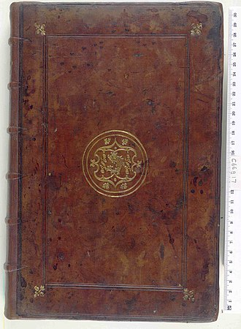
Thank you!
Have a nice evening!

