Slide 1
Computer Architecture
Data bus: No of bits (wires), one wire/bit = ??
Address bus: No of bits =??
Word-number
of bits
Central
Processing
Unit
Address Bus
Memory
Address 0
Data Bus
N=Number of
Word locations=
addresses
Address N-1

Slide 2
Computer Architecture
Data bus: No of bits (wires)= number of bits in the CPU/memory word
Address bus bits = ⌈log₂N⌉ =log₂N iff integer, else the next greater integer than log₂N (the ceiling of log₂N)
Word-number
of bits
Central
Processing
Unit
Address Bus
Memory
Address 0
Data Bus
N=Number of
Word locations=
addresses
Address N-1

Slide 3
Permutations (μεταθέσεις) with unlimited repetitions
Μεταθέσεις, arrangements, permutations, putting objects in a certain order.
How many distinct words (identification tags) are with n Greek letters? 24^{n}
Proof: Let the No of words with n-1 letters be T(n-1).
  For each word with n-1 letters we can create 24 new words by adding another letter in front.
  Then T(n)=24*T(n-1)
  T(n-1)=24*T(n-2)
  …..
  T(2)=24*T(1)
  T(1)=24
  Multiply the left and the right parts, T(n)=24^{n}
  For binary (the letters are bits {0, 1}) the number of words T(n)=2^{n} =N and n=log₂N
  Consequently: if we need N identifications (tags, addresses) we construct word-length ≥ log₂N (at least ⌈log₂N⌉ )

Slide 4
Introduction to binomial coefficients (διωνυμικοί συντελεστές)
We call the term n! “n factorial” (παραγοντικό του n). It denotes the number of distinct permutations (μεταθέσεις) that can be produced by n distinct elements of a set. We will use the notation for this number as P(n).
To form a line consisting of n positions with n distinct objects we use any of the n elements in the first place. Since we have removed one element (object) from the set they remain n-1 to choose for the second position. Since we have removed 2 elements from the set there are only n-2 available for the third place, etc. Therefore, the total number of permutations P(n) with n elements is n!=n*(n-1)*(n-2)….*2*1.

Slide 5
Permutations (μεταθέσεις)
Another similar proof:
  Assume the permutations of n-1 objects
  We call the number of possible permutations as T(n-1)
  Assume an arbitrary permutation of n-1 objects.
  In this permutation if we insert another object, the n^{th}, then for each permutation of n-1 objects we will produce n new permutations
  Example: 3 objects, a b c with T(3) and we insert d.
  For the arbitrary permutation a c b we will produce 4 new permutations:
  d a c b, a d c b, a c d b, a c b d
  T(4)=4*T(3)

Slide 6
Permutations (μεταθέσεις)
Therefore:
  T(n)=n*T(n-1)
  T(n-1)=(n-1)*T(n-2)
  T(n-2)=(n-2)*T(n-3)
  …….
  T(2)=2*T(1)
  T(1)=1
  Multiply left and right parts: T(n)=n*(n-1)*(n-2)*……*2*1=n!

Slide 7
Permutations with r elements out of n
Following the same reasoning if we are to choose r elements from a set with n elements and form lines with r elements, then the number of the distinct lines (permutations denoted as P(n,r)) will be n*(n-1)*(n-2)….(n-r +1),
which is obviously equal to n!/(n-r)! = P(n,r).

Slide 8
Permutations with repetitions P(n;q₁,q₂,…, q_{t}): Example
How many different routes from A to B can use a data-packet? (use moves: u, r)
How many through C ??
r
B
C
u
A

Slide 9
Permutations with repetitions P(n;q₁,q₂,…,q_{t})
What is the number of distinct words with a,a,a,b,c,d,d,e (using all the letters)?
If we could use a₁, a₂, a₃ (3 distinct a’s instead of 3 the same) and 2 distinct d’s (d₁, d₂) then there would be 8! words.
The 3 a’s if they were distinct they would produce 3! permutations
Since we cannot distinguish the a’s, we 8!/3! permutations and
for the d’s 2! permutations
Therefore the number of words is 8!/(3!*2!)
Accordingly, for n objects and using q₁ repetitions of the first, q₂ of the second,… q_{t} of the t^{th}, P(n;q₁,q₂,…,q_{t})=n!/(q₁! * q₂! *…..*q_{t}!)

Slide 10
Permutations with repetitions P(n;q₁,q₂,…, q_{t}): Example
How many different routes from A to B can use a data-packet? (use moves: u, r)
There are 10 r’s and 3 u’s to be used. Therefore, 13!/(10!*3!)
Equivalent: No of words with 13 letters, 10 r’s and 3 u’s to be used.
Question: how many routes from A to B, through C?
r
B
C
u
A

Slide 11
We would like to give user-id to subsets of the class for the network.
The set of all the subsets is the power set (δυναμοσύνολο)
How many bits do we need to describe the subsets?
In a set of N elements: how many subsets are there?
In a set of N elements: how many subsets of each kind (1-element, 2-element subsets, etc.) are there?

Slide 12
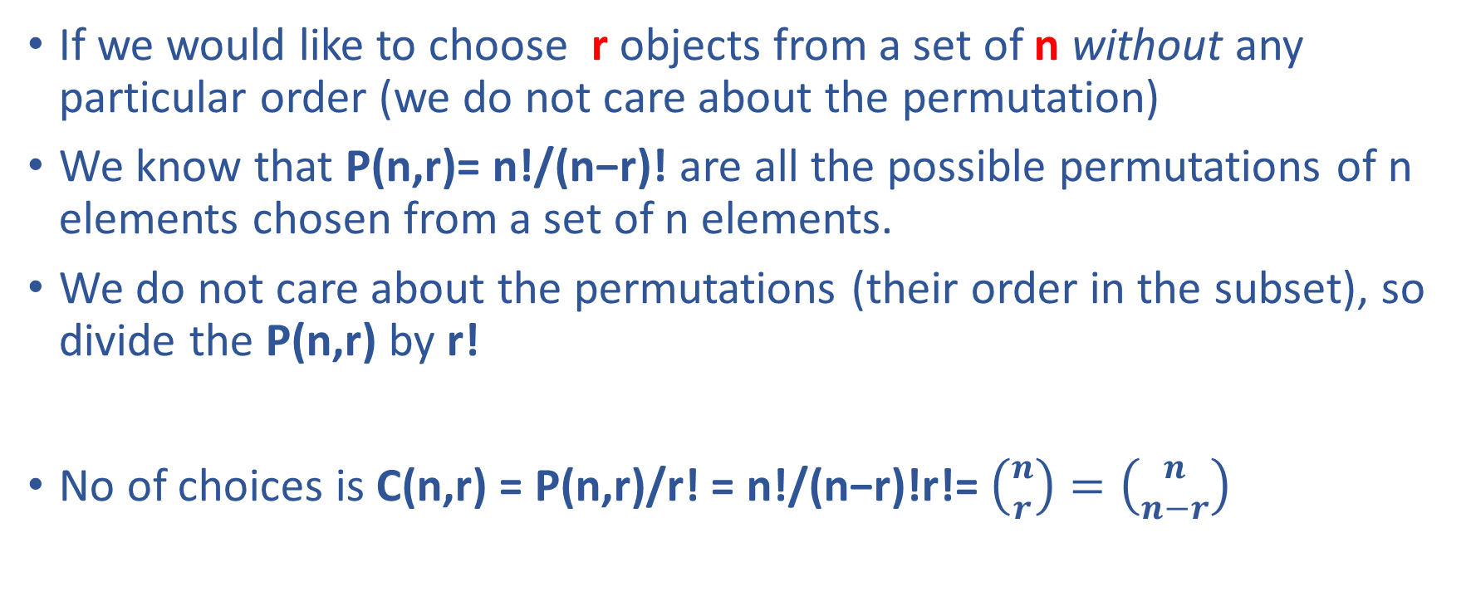
Combinations (Συνδυασμοί)
If we would like to choose r objects from a set of n without any particular order (we do not care about the permutation)
We know that P(n,r)= n!/(n−r)! are all the possible permutations of n elements chosen from a set of n elements.
We do not care about the permutations (their order in the subset), so divide the P(n,r) by r!
No of choices is C(n,r) = P(n,r)/r! = n!/(n−r)!r!=$\left({n \atop r}\right)=\left({n \atop n−r}\right)$

Slide 13
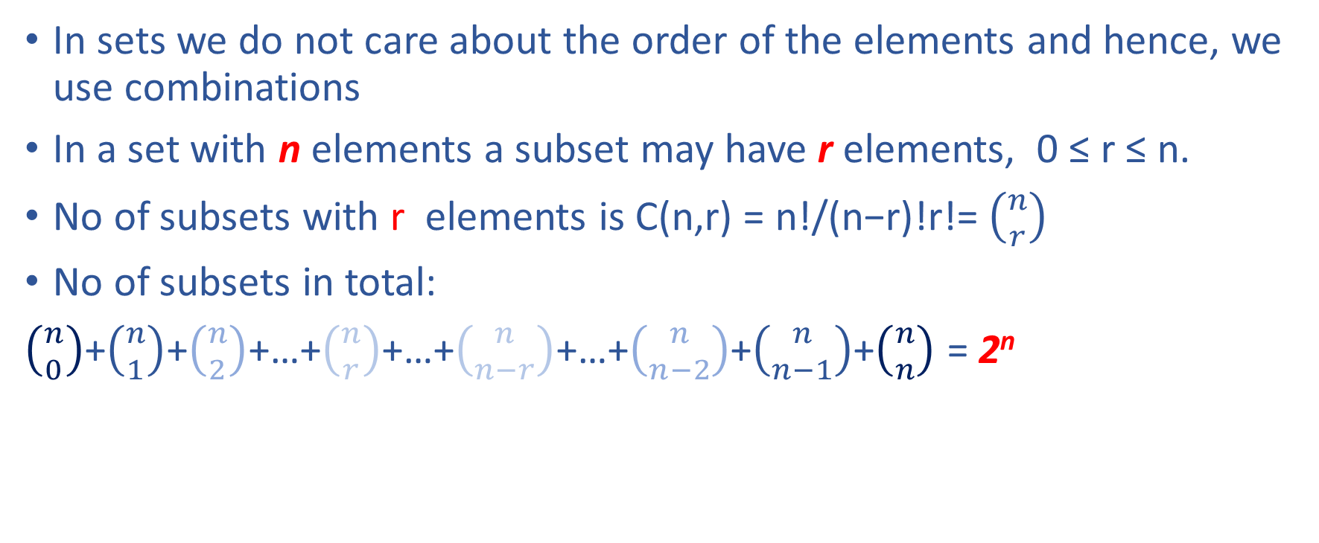
Subsets (Combinations)
In sets we do not care about the order of the elements and hence, we use combinations
In a set with n elements a subset may have r elements, 0 ≤ r ≤ n.
No of subsets with r elements is C(n,r) = n!/(n−r)!r!=$\left({n \atop r}\right)$
No of subsets in total:
$\left({n \atop 0}\right)$+$\left({n \atop 1}\right)$+$\left({n \atop 2}\right)$+…+$\left({n \atop r}\right)$+…+$\left({n \atop n−r}\right)$+…+$\left({n \atop n−2}\right)$+$\left({n \atop n−1}\right)$+$\left({n \atop n}\right)$ = 2^{n}

Slide 14
Subsets of a set with n elements
For a set S of n elements (distinct)
Construct a word of n bits such that:
Use a “1” in the position x iff the corresponding element (x) exists in the subset else use a “0”
Example: For the set {a, b, c, d, e} we represent the subset {a, d} as 10010, the {b, c, e} as 01101, the {a, b, c, d} as 11110, etc.
There is a one-to-one correspondence between the subsets and the binary words, hence the (δυναμοσύνολο) power set |S| has 2^{n} elements-subsets (need n bits to describe all the subsets).

Slide 15
Computer Architecture
Data bus: How do we use the computer data word (k bits)?
Word-number
of bits
Central
Processing
Unit
Address Bus
Memory
Address 0
Data Bus
N=Number of
Word locations=
addresses
Address N-1

Slide 16
Data Representation with k-bit words
Non negative integers with k bits, 2^{k} words mapped on: 0 to 2^{k}-1
Integers with k bits, words mapped on: -(2^{k-1}-1) to 2^{k-1}-1
Mapping of non negative integers: 0000…0_{B}→0_{D}, 11111…11_{B}→2^{k}-1_{D}
0
1
2
3
….
2^{k}-2
2^{k}-1
-(2^{k-1}-1)
0
2^{k-1}-1

Slide 17
Non negative reals with k bits, 2^{k} words, k-1 bits integer and 1 bit fractional
mapped on: 0 to 2^{k-1}-1+(1/2)
2^{k-1}-1+(1/2)
1/2
3/2
0
1
2
3
….
2^{k-1}-2
2^{k-1}-1

Slide 18
Non negative reals with k bits, 2^{k} words, k-2 bits integer and 2 bit fractional
mapped on: 0 to 2^{k-2}-1+(3/4)
Accuracy (resolution): the closest distance to 0: here is 1/4
2^{k-2}-1+(2/4)
1/4
5/4
0
1
2
3
….
2^{k-2}-2
2^{k-2}-1
2^{k-2}-1+(3/4)

Slide 19
Number Systems
A number representation at any base (b) system (non negative real):
a_{m-1}*b^{m-1}+a_{m-2}*b^{m-2}+…+a₂*b²+a₁*b¹+a₀*b⁰+a₋₁*b⁻¹+a₋₂*b⁻²+….+a_{-k}*b^{-k}
Integer part fractional part
Example Decimal: 1078.25_{D}
1*10³+0*10²+7*10¹+8*10⁰+2*10⁻¹+5*10⁻²
Example Binary: 10000110110.01_{B} (=1078.25_{D})
1*2¹⁰+0*2⁹+0*2⁸+0*2⁷+0*2⁶+1*2⁵+1*2⁴+0*2³+1*2²+1*2¹+0*2⁰+0*2⁻¹+1*2⁻²
Most Significant Bit (msb) Least Significant Bit (lsb)

Slide 20
Backup slides for Number Systems: multiplication/division by a base power (repetition from elementary school)
Decimal: 12300_{D}*100_{D}=1230000_{D} (shift left, symbol <<)
  12300_{D}/10_{D}=1230_{D} (shift right, >>)
Binary: 1100100_{B}*100_{B}=110010000_{B} (shift left, <<)
  1100100_{B}/10_{B}=110010_{B} (shift right, >>)

Slide 21
Backup slides for Number Systems: Addition/Subtraction example with positive numbers (repetition from elementary school)
137 Decimal: a) 7*10⁰+6*10⁰ =1*10¹+3*10⁰
+ 876 b) 3*10¹+7*10¹+1*10¹=1*10²+1*10¹
1013 c) 1*10²+8*10²+1*10²=1*10³+0*10²
1001 Binary: a) 1*2⁰+1*2⁰=1*2¹+0*2⁰
+1011 b) 0*2¹+1*2¹+1*2¹=1*2² +0*2¹
10100 c) 0*2²+0*2²+1*2² =1*2² (zero carry)
d) 1*2³+1*2³ =1*2⁴ +0*2³

Slide 22
Number Systems b=2: 1’s Complement (Συμπλήρωμα του 1)
For a binary number A with b=2
A=a_{m-1}*b^{m-1}+a_{m-2}*b^{m-2}+…+a₂*b²+a₁*b¹+a₀*b⁰+a₋₁*b⁻¹+a₋₂*b⁻²+….+a_{-k}*b^{-k}
A=a_{m-1}*2^{m-1}+a_{m-2}*2^{m-2}+…+a₂*2²+a₁*2¹+a₀*2⁰+a₋₁*2⁻¹+a₋₂*2⁻²+….+2_{-k}*b^{-k}
In 1’s C the negative of A is Ā=2^{m}-A-2^{-k}
Example with a 5-bit integer number (m=5) the A= 01011.
2^{m} 100000
-A - 01011
= 10101
-2^{-k} -00001
= 10100
The Ā has all the bits of A inverted.
With n bits we produce 2^{n}-1 numbers, because it has 0=00000=11111 (double 0)

Slide 23
Number Systems b=2: 2’s Complement (Συμπλήρωμα του 2)
For a binary number A with b=2
A=a_{m-1}*2^{m-1}+a_{m-2}*2^{m-2}+…+a₂*2²+a₁*2¹+a₀*2⁰+a₋₁*2⁻¹+a₋₂*2⁻²+….+2_{-k}*b^{-k}
In 2’s C the negative of A is Ā=2^{m}-A
Example with a 5-bit integer number (m=5) the A= 01011.
2^{m} 100000
-A - 01011
= 10101
The Ā has all the bits of A inverted and we add a “1” at the least significant bit (lsb)
OR: the 2’s C of A is the 1’s C with the addition of the “1” at the lsb.

Slide 24
Number Systems b=2: 1’s and 2’s Complements
In all systems (1’s C and 2’s C) the positive numbers have the same representation
Example with 4-bit integers
Positive Negatives 1’s C Negatives 2’s C (advantage: one representation for 0)
8 1000
0111 1000 1001
0110 1001 1010
0101 1010 1011
0100 1011 1100
0011 1100 1101
0010 1101 1110
0001 1110 1111
0 0000 1111

Slide 25
Number Systems b=2: 1’s and 2’s Complements
Using k bits to represent integers in 1’s and 2’s Complements
1’s Complement
1’s Complement
-(2^{k-1}-1)
0
2^{k-1}-1
-∞
∞
2’s Complement
-2^{k-1}

Slide 26
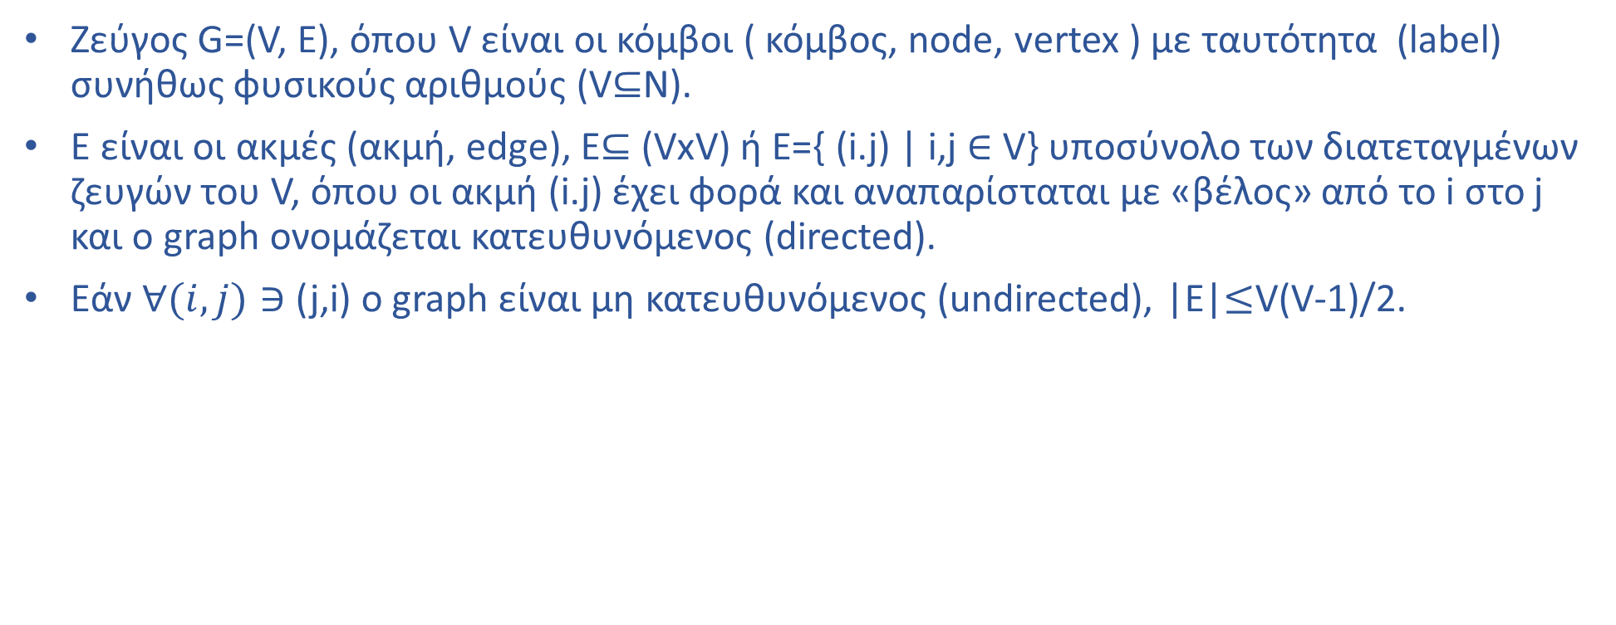
Graph (Γράφος, Γράφημα)
Ζεύγος G=(V, E), όπου V είναι οι κόμβοι ( κόμβος, node, vertex ) με ταυτότητα (label) συνήθως φυσικούς αριθμούς (V$⊆$N).
E είναι οι ακμές (ακμή, edge), Ε$⊆$ (VxV) ή Ε={ (i.j) | i,j $∈$ V} υποσύνολο των διατεταγμένων ζευγών του V, όπου οι ακμή (i.j) έχει φορά και αναπαρίσταται με «βέλος» από το i στο j και ο graph ονομάζεται κατευθυνόμενος (directed).
Eάν $∀(i,j)∋$ (j,i) ο graph είναι μη κατευθυνόμενος (undirected), |E|$≤$V(V-1)/2.
1
2
1
2
3
5
4
3
6
4
6
5
Α) Directed Graph Β) Undirected Graph

Slide 27
O γράφος αναπαρίσταται με ένα δι-διάστατο πίνακα “γειτνίασης” (adjacency matrix) με V γραμμές και V κολώνες, όπου η θέση (i,j) είναι “1” εάν υπάρχει η ακμή (i,j) και “0” αν δεν υπάρχει.
“Path” από το κόμβο i στο k υπάρχει εάν υπάρχουν όλα τα ενδιάμεσα edges από το κόμβο i στο k.
Adjacency Matrix
Adjacency Matrix
Nodes | 1 | 2 | 3 | 4 | 5 | 6
1 | 0 | 1 | 1 | 1 | 1 | 0
2 | 1 | 0 | 0 | 1 | 0 | 0
3 | 1 | 0 | 0 | 1 | 1 | 0
4 | 1 | 1 | 1 | 0 | 0 | 0
5 | 0 | 0 | 1 | 0 | 0 | 0
6 | 0 | 0 | 0 | 0 | 0 | 0
Nodes | 1 | 2 | 3 | 4 | 5 | 6
1 | 0 | 1 | 1 | 0 | 0 | 0
2 | 1 | 0 | 1 | 0 | 1 | 0
3 | 1 | 1 | 0 | 0 | 0 | 0
4 | 0 | 0 | 0 | 0 | 0 | 1
5 | 0 | 1 | 0 | 0 | 0 | 0
6 | 0 | 0 | 0 | 1 | 0 | 0
Adjacency Matrix Directed Graph (example A) Adjacency Matrix Undirected Graph (example B)

Slide 28
Cycle (κύκλος): ένα path που διασχίζει μια σειρά από κόμβους (από το κόμβο i στο k) και καταλήγει στον αρχικό κόμβο i μέσω ακμής (k,i).
Acyclic Graph (χωρίς κύκλο): Tree (δένδρο), στο παράδειγμα ο directed είναι acyclic και ο undirected έχει cycles: {1,3,4}, {1,2,4}, {1,2,4,3}. Αν αφαιρέσουμε τα (1,3) και (1,4) edges (διακεκομμένες ακμές) τότε ο γράφος μετατρέπεται σε δένδρο.
1
2
4
3
6
5

Slide 29
Tree with a root : ορίζεται ένας ξεχωριστός κόμβος του δένδρου “πρόγονος” (ancestor) όλων κόμβων το root.
Κάθε j : όταν υπάρχει edge (root,j) αποκαλείται “παιδί” (child) του root. Το k όταν υπάρχει (j,k) είναι child του j (το j είναι parent του k) και “απόγονος” (descendant) του root, αν υπάρχει (k,m) το m ειναι child του k, κλπ. Ο κόμβος χωρίς children αποκαλείται leaf (φύλλο). Το root έχει parent το ίδιο το root.
Height (ύψος του δένδρου): μέγιστη απόσταση (σε ακμές) του root από οποιοδήποτε κόμβο (leaf).
Παράδειγμα δένδρου με root:
Με root το 2, leaves είναι τα 1, 6 και 5.
Το height είναι 3= απόσταση του 2 (root) από το 5
Τα 1 και 4 είναι children του 2 (root)
Tα 3 και 6 είναι children του 4, το 5 child του 3.
1
2
4
3
6
5

Slide 30
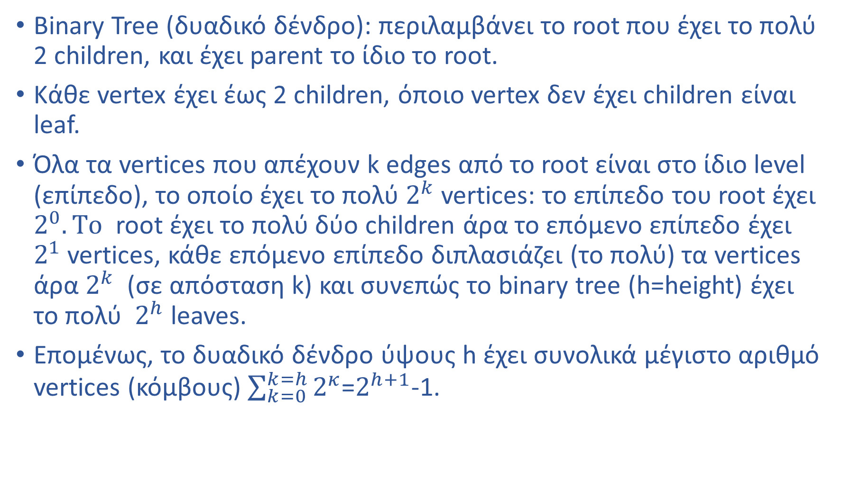
Binary Tree (δυαδικό δένδρο): περιλαμβάνει το root που έχει το πολύ 2 children, και έχει parent το ίδιο το root.
Κάθε vertex έχει έως 2 children, όποιο vertex δεν έχει children είναι leaf.
Όλα τα vertices που απέχουν k edges από το root είναι στο ίδιο level (επίπεδο), το οποίο έχει το πολύ $2^{k}$ vertices: το επίπεδο του root έχει $2^{0}. Το$ root έχει το πολύ δύο children άρα το επόμενο επίπεδο έχει $2^{1}$ vertices, κάθε επόμενο επίπεδο διπλασιάζει (το πολύ) τα vertices άρα $2^{k}$ (σε απόσταση k) και συνεπώς το binary tree (h=height) έχει το πολύ $2^{h}$ leaves.
Επομένως, το δυαδικό δένδρο ύψους h έχει συνολικά μέγιστο αριθμό vertices (κόμβους) $\sum_{k=0}^{k=h}{2^{κ}}$=$2^{h+1}$-1.

Slide 31
Complete Binary Tree
root
Pointer to parent
Height (h = 3)

Slide 32
Full Binary Tree
root
Pointer to parent
Height (h = 3)
Number of leaves = $2^{h}$ Number of nodes =$2^{h+1}−1$

Slide 33
Παράδειγμα
Δυαδικού Δένδρου:
Multiplexer 8-to-1:
Tree of MUX with h=2,
2-to-1 MUXs 2^{h+1}-1
AND gates 2(2^{h+1}-1)
OR gates 2^{h+1}-1
OR
Output
AND
AND
$C_{2}$ (control line)
$$C_{0}$$
$$I_{0}$$
$$I_{1}$$
Multiplexer (MUX) 2-to-1
$$C_{1}$$
$$C_{0}$$
$$I_{0}$$
$$I_{1}$$
$$I_{2}$$
$$I_{3}$$
$$I_{4}$$
$$I_{5}$$
$$I_{6}$$
$$I_{7}$$
2^{h} inputs

