Slide 1
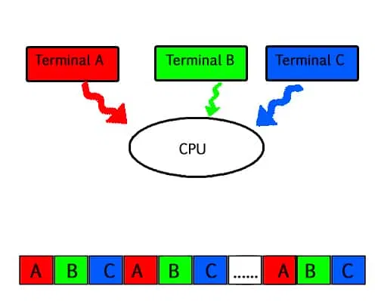
Process (es)
A process is just an instance of an executing program, including the current values of the program counter, registers, and variables.
Multiprogramming: divide the CPU time into slices, give each process a slice, e.g. assuming k processes then the first is executed during the slice Ts_1 the second during Ts_2 the kth during Ts_k, and the first starts again where it was interrupted at the slice Ts_k+1.

Slide 2
Process Creation
Four principal events cause processes to be created:
1. System initialization.
2. Execution of a process-creation system call by a running process.
3. A user request to create a new process.
4. Initiation of a batch job.
Daemon: Background Process handling activity such as email, Web pages, news, printing.
For UNIX†, use ps program can be used to list the running processes For Windows, the task manager

Slide 3
Process Termination
Normal exit (voluntary).
2. Error exit (voluntary).
3. Fatal error (involuntary).
4. Killed by another process (involuntary)
unix user command: >kill -9 process_id
Process States
1. Running (actually using the CPU at that instant).
2. Ready (runnable; temporarily stopped to let another process run).
3. Blocked (unable to run until some external event happens).

Slide 4
Process States

Slide 5
Process management Memory management File management
Registers Pointer to text segment info Root directory
Program counter Pointer to data segment info Working directory
Program status word Pointer to stack segment info File descriptors
Stack pointer User ID
Process state Group ID
Priority
Scheduling parameters
Process ID
Parent process
Process group
Signals
Time when process started
CPU time used
Children’s CPU time
Time of next alarm

Slide 6
CPU utilization wr Degree of Multiprogramming

Slide 8
Critical Region (Section) solution
1. No two processes may be simultaneously inside their critical regions.
2. No assumptions may be made about speeds or the number of CPUs.
3. No process running outside its critical region may block any process.
4. No process should have to wait forever to enter its critical region.

Slide 9
-Need an indivisible command: Test & Set Lock or TSL Rx
-Indivisible operation, needs hardware support
a straightforward example with a single FF.
-Write & Read at the same cycle: write a 1, read Q and possibly leave the CPU.
When it runs again If it has red: 0 the process locked the FF
1 another process has locked the FF and the FF
remains locked.
read
Write “1”
FF

Slide 10
Semaphores
An integer variable s
Two operations indivisible: up(s), down(s).
Can be included in the operations: wait(s), signal(s).
Mutex: shared variable that can be: unlocked or locked
Monitor: is a collection of procedures, variables, and data structures that are all grouped together in a special kind of module or package.
The procedures are executed upon the “set” of conditions.
Resembles a guide for execution. Hence, we avoid conflicts.

Slide 11
Deadlock

Slide 12
Example : Use of Semaphores in Files (Open, Close) for read & write operations
2 Semaphores: M for the counter, W for the file
Open File Close File
If Read then if Read then
{ wait(M) {wait(M)
counter++ counter=counter-1
if counter==1 then wait(W) if counter==0 signal(W)
signal(M) signal(M)
} }
Else wait(W) else signal(W)

Slide 13
Scheduler: runs in the Kernel
Responsible to forward processes into the CPU: decides which is Running, Ready-to-Run or it Blocks them
All systems
Fairness - giving each process a fair share of the CPU
Policy enforcement - seeing that stated policy is carried out
Balance - keeping all parts of the system busy
Batch systems
Throughput - maximize jobs per hour
Turnaround time - minimize time between submission and termination
CPU utilization - keep the CPU busy all the time
Interactive systems
Response time - respond to requests quickly
Proportionality - meet users’ expectations
Real-time systems
Meeting deadlines - avoid losing data
Predictability - avoid quality degradation in multimedia systems

Slide 14
Scheduler: runs in the Kernel
Responsible to forward processes into the CPU: decides which is Running, Ready-to-Run or it Blocks them
Shortest Job first
Round Robin
Multiple Queue
Multiple Queues with Interrupt-Timer

Slide 15
Single Queue Low Level Scheduler

Slide 16
Scheduler with Multiple Queues

