Slide 1
Input & Output
Considers communication of the CPU & main memory system to other systems called Peripherals.
Block device: stores information in fixed-size data blocks with their addresses. HDs, USB sticks,etc.
Character device: stream of characters, not addressable and does not have any seek operation. Printers, network interfaces, etc..
Synchronous IF: uses clocks to synchronize the transmission
Asynchronous IF: start/stop bits
Polling: the CPU “asks” each device for communication
Interrupt: each device “asks” the CPU for communication
Buffer: a memory used to isolate each device and/or decouple transfer speed
Controller (adapter): the electronic part that handles the device.

Slide 2
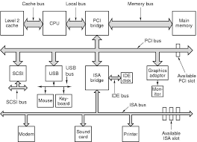
Peripheral Component Interconnect
Industry Standard Architecture
Intelligent Drive Electronics
Small Computer System Interface
Universal Serial Bus
Serial Advanced Technology Attachment
Redundant Array of Inexpensive Disks

Slide 3
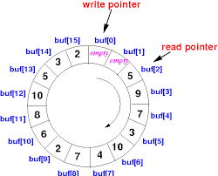
Circular Buffer: the read pointer follows the write pointer

Slide 4
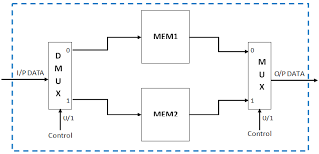
Double Buffer: the source writes to MEM1, the destination reads from MEM2

Slide 5
Peripherals have Control/Status Registers & Buffer:
  I/O port: read/write the registers and the buffer separately.
  Memory Map: the registers are addressed as part of the memory (buffer).
Protocol: a set of rules or procedures for transmitting data between electronic devices.
  Handshaking: signal exchange to start/finish full communication.
Bridge: connects two different networks-and see each other as a single network.
Router: connects networks that remain independent.
Direct Memory Access (DMA): use a controller, a counter, start & finish addresses to transfer N data from one device to another. The counter generates the addresses.

Slide 6
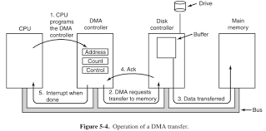

Slide 7
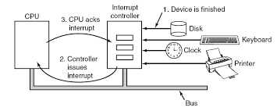
Interrupt: each device has a pin for interrupt
Interrupts have priorities
Interrupts can be masked by the programmer.

Slide 8
In pipelined architectures we may encounter problems because of interrupts
An interrupt that leaves the machine in a well-defined state is called a precise interrupt. Such an interrupt has four properties:
1. The PC (Program Counter) is saved in a known place.
2. All instructions before the one pointed to by the PC have completed.
3. No instruction beyond the one pointed to by the PC has finished.
4. The execution state of the instruction pointed to by the PC is known.
Kernel of the OS has at least:
I. Low level scheduler
II. Interrupt Service Routines
III. Timers

Slide 9
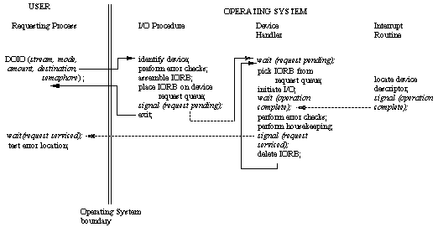

Slide 10
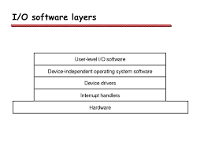

Slide 11
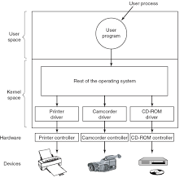
Drivers are sw
entities that adapt the device’s features to those of the computer

Slide 12
Buffer for great transfer speed differences
  System Peripheral Operation Off-Line (Spool-spooler)
  Example the Printer: we set a memory space to store the data blocks that the printer will print and shut the process that initiated the printing (off-line). Read & Write pointers apply as in all the buffers.
For handling the I/O devices we use an I/O processor
  The input/output processor or I/O processor is a processor separate from the CPU designed to handle only input/output processes for a device or the computer.
  The CPU only needs to initiate the I/O processor by telling it what activity to perform.
HD Access time: the time required to prepare for transfer.
  Seek Time
  Rotational Latency
  Command processing time
  Settle time

Slide 13
Data Protection
Error detection and correction or error control are techniques that enable reliable delivery of digital data
Add redundant data to a message & check consistency
  Example: for each byte (8-bit word) use the 7 bits for payload
  the 8th is the XOR (parity) of the payload.
  Assuming the 8th is always correct, it can detect 1 error-bit
  E.g if w=1011001 its XOR is 0.
  If we read w’=1011001 with XOR=0 we assume it is correct
  If we read w’=1011000 we check the XOR of w’ and there is an error
  If we read w’=1001000 we cannot detect that there are 2 errors.

Slide 14
Convolutional Code: processed on a bit-by-bit basis. They are particularly suitable for implementation in hardware (telecommunications)
Block Code: they process an entire block of bits mainly with parity check techniques. Types are:
  Reed-Solomon (CDs, HDs, telecommunications)
  Turbo, in telecommunications
  Low-Density Parity-Check (LDPC), in telecommunications

