Slide 1

Embedded Systems
  Based on Cortex-M4 and the Renesas Synergy Platform
2020
Prof. Douglas Renaux, PhD
Prof. Robson Linhares, Dr.
UTFPR / esystech
Renesas Electronics Corporation

Slide 2
12 Week COURSE OUTLINE (1/2)
  Introduction
    What are embedded systems
    Characteristics
    Sample Market Segments
    The IoT Era
  Computer Architecture
    RISC vs CISC
  ARM Cortex-M Architecture
    Block Diagram
    Registers
    Instruction set
    Memory access
    Exception handling
  Memory
    SRAM
    DRAM (SDRAM, DDR)
    ROM/EEPROM/Flash
  Timer and GPIO
    Timer
    PWM
    GPIO
    Simple drivers (e.g. LED, Relay)
    Power drivers (motors)
  Interrupt Controller

Slide 3
12 Week COURSE OUTLINE (2/2)
  Analog Interfacing
    ADC / DAC
  Serial Communication
    UART
    SPI
    I2C
  CAN
    Physical interface
    Stack
  USB
    Physical interface
    Stack
  Ethernet
    Physical interface
    Stack
  Software Development
    Software Process
    UML Class Diagram
    UML State Machine Diagram
  Concurrent Programming
    Tasks / Context Switching, Scheduling
    Semaphores, Signals / Messages
    Common problems to avoid: deadlock, priority inversion
  RTOS
    Thread Management
    Inter-thread communication and synchronization
    Timing Services
    Memory Management

Slide 4
LIST OF LABS – BASED ON SK-S7G2
  Lab1 – Synergy Installation - try demo program on the S7G2 board. Requirements: none.
  Lab2 – Sample C program - means to access hardware peripherals; memory organization of a C program. Requirements: Section 5.
  Lab3 – Assembly Programming ATPCS - access from C a function written in assembly. Requirements: Section 5.
  Lab4 – Peripheral Sample device driver. Requirements: Section 6.
  Lab5 – Serial Communication. Requirements: Section 8.
  Lab6 – Display and Touch. Requirements: Section 8.
  Lab7 – RTOS. Requirements: Section 14.
  Lab8 – USB Device. Requirements: Section 14.
  Lab9 – IoT. Requirements: Section 14.

Slide 5
Disclaimer
  This course material was developed to contribute to the several forms of training in the area of Embedded Systems, but particularly with undergraduate courses such as Electrical Engineering, Computer Engineering and Computer Science.
  Contents can be freely copied and distributed to students both for commercial and non-commercial purposes, as long as:
    Credit to original work mentioning authors and Renesas as the distributor of this work.
    The contents can be freely modified to suit the needs of specific courses, all figures made by the authors may be freely used without modification as long as credited; likewise, all figures authored by Renesas may be freely used without modification as long as credited. All figures from other sources, if used in derived work or in other works must request authorization from the original author/copyright holder.

Slide 6
Authors
  The authors: Douglas Renaux and Robson Linhares are faculty at UTFPR in the subjects of Embedded Real-Time Systems and Computer Architecture and Organization.
  UTFPR is the Brazilian Federal University of Technology.
  eSysTech – Embedded Systems Technologies is a company providing engineering and training services in the area of Embedded Systems. It is a spin-off of the Laboratory of Innovation and Technology in Embedded Systems of UTFPR.
  Renesas is a major player in the semiconductor market. They have been providing significant support for educational material such as this one. Renesas has worldwide non-exclusive distribution rights for this material.

Slide 7
Overview and prerequisites
  This Embedded Systems course is organized into theory and practice parts. There are 12 theory sections and 9 labs. The labs solutions can be made available to instructors. All labs are conceived to be developed on the Renesas SK-S7G2 board, based on an ARM Cortex-M4F MCU.
  The course assumes that the students have previous knowledge on:
    C programming for embedded systems
    Microcontrollers and assembly programming (on an architecture other than ARM)
    Digital Systems
    Digital communications and networks

Slide 8
1 – Introduction
  What are Embedded Systems
  Characteristics
  Market Segments
  The IoT Era

Slide 9
What are embedded Systems?
  An Embedded System (a.k.a. Embedded Computing System) is a computing system that is built-into (i.e. embedded) a larger device, such as an equipment, a system, or a vehicle.
  Embedded Systems (ES) are usually application-specific and have real-time constraints; thus, many ES are also real-time systems. Often, ES are used in control loops: reading sensors, processing data, and generating outputs that control the device they are embedded into. Finite State Machines are commonly used to model the behavior of ES.

Slide 10
Characteristics of Embedded Systems (1/4)
  Typical characteristics of an Embedded System are:
  Microcontroller based system consisting of a processor,
  non-volatile memory (Flash), volatile memory (RAM), and a large number of inputs and output interfaces as well as communication channels.
  Cost effective implementations as many device architectures are cost-driven.
  Energy efficient solutions as many devices are battery powered. Current trend is to develop battery-less devices that harvest energy from the environment.

Slide 11
Characteristics of Embedded Systems (2/4)
  Heterogeneous. While desktop computers are based on standard platforms (Windows PC, Apple IOS, ...) there is a large variety of hardware and software for embedded systems.
  Variety of restrictions to the design solutions, such as:
    Physical: Size, Weight, Temperature Range, Vibration, Dust, Spills, Water;
    Computational resources: processing speed, non-volatile memory, RAM, available I/O;
    Response time.
  Interconnected. Embedded devices and systems are ever more interconnected to each other. Trend is to increase the interconnection rate (IoT).

Slide 12
Characteristics of Embedded Systems (3/4)
  Reliability
  The ability of a system or component to function under stated conditions for a specified period of time.
  Availability
  The ability of a system or component to function at a specific moment of interval of time.
  Maintainability
  Measures how easily and how fast a system can be restored to operational status after a failure.
  Testability
  The degree to which a system or component facilitates the establishment of test criteria and the performance of tests to determine whether those criteria have been met.

Slide 13
Characteristics of Embedded Systems (4/4)
  Scalability
  The ability of a system to handle increased workload by repeatedly and cost-effectively adding components to extend the system´s capacity.
  Safety
  Concerns the requirement: not to harm people, the environment or other assets.
  Security
  The ability of a system to protect information and system resources with respect to integrity and confidentiality.

Slide 14
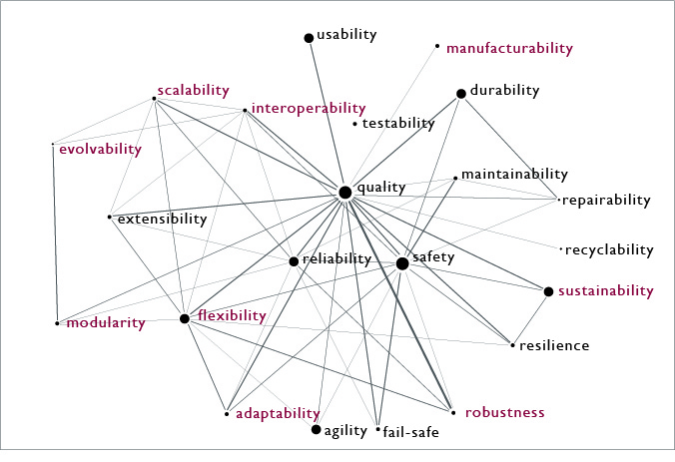
Characteristics of Embedded Systems
  Relationship among 22 of the most common ilities:
  to read about this graph: Book Chapter about the Ilities: Chapter 4 from "Engineering Systems: Meeting Human Needs in a Complex Technological World" by de Weck O., Roos D. and Magee C, MIT Press, January 2012 (http://strategic.mit.edu)

Slide 15
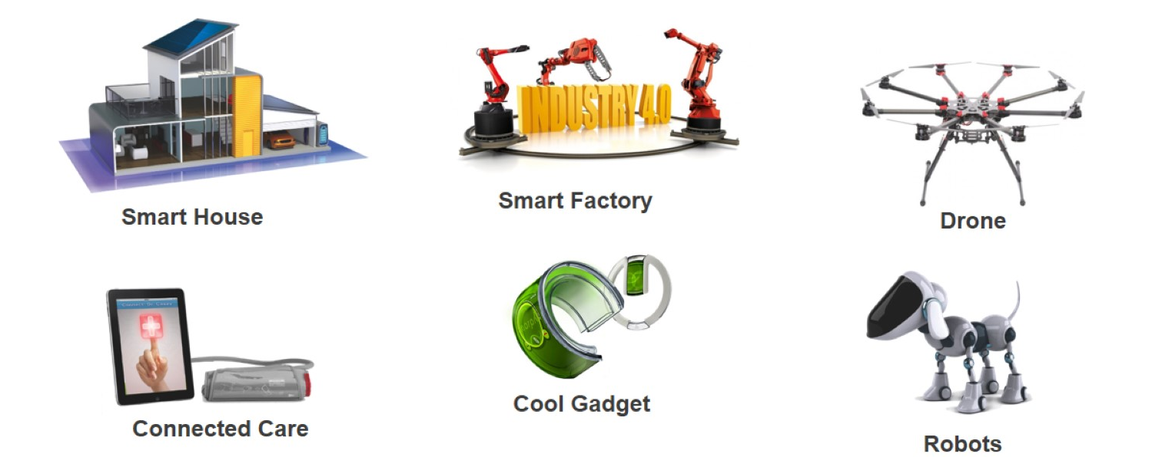
Sample Market segments
  Consumer Electronics
  Telecommunications
  Home Automation
  Industrial Automation
  Transportation
    Avionics
    Navigation
    Electric Vehicles
  Defense
  Medical Equipment
  ??? (many new areas to come)
source: Renesas DevCon2015

Slide 16


Consumer Electronics
  Phones
  Videogame consoles
  Printers
  Digital cameras
  Audio/Video:
    Television
    Music Players
    Home Entertainment Systems
    BRD players
source: pixabay.com (CC)

Slide 17

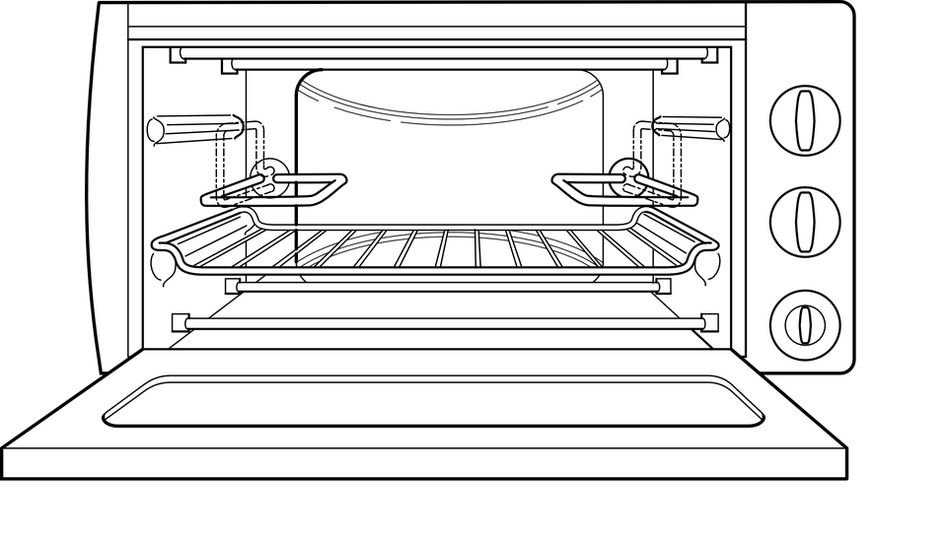
Household Appliances
  Washing Machines
  Dishwasher
  Air Conditioners
  Microwave Oven
source: pixabay.com (CC)

Slide 18


Telecommunications
  Routers
  Satellite Phones
  Switches
source: wikimedia.org (CC)
source: pixabay.com (CC)

Slide 19
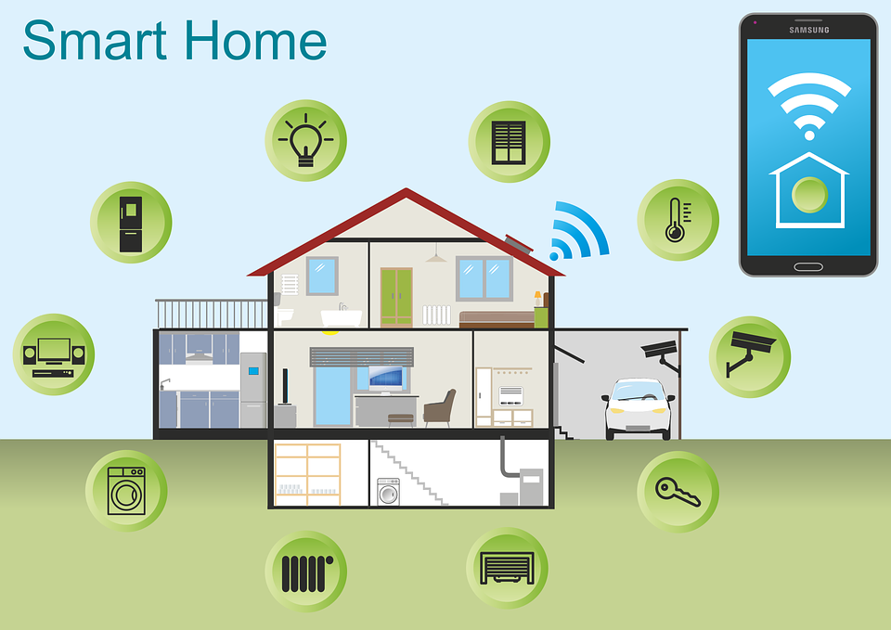
home Automation
source: pixabay.com (CC)
Notes:
https://pixabay.com/p-2005993/?no_redirect

Slide 20

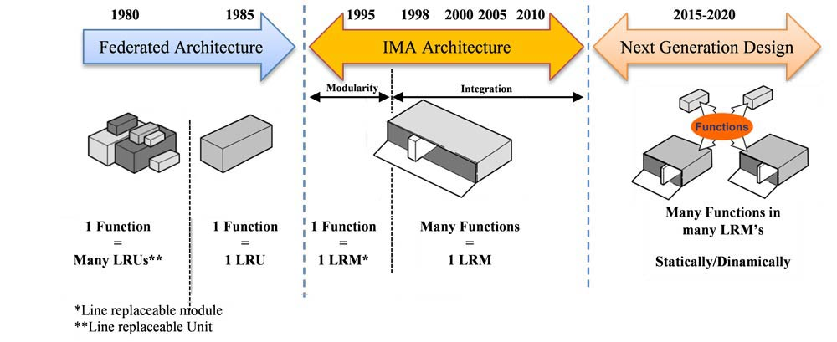
Transportation – Avionics
  Glass cockpit of the
  Airbus A350 XWB
source: flickr (CC)
Notes:
https://en.wikipedia.org/wiki/Airbus_A350_XWB#/media/File:Airbus_A-350_XWB_F-WWYB_cockpit_view.jpg
https://upload.wikimedia.org/wikipedia/commons/4/4e/Avionics-Architecture.jpg

Slide 21
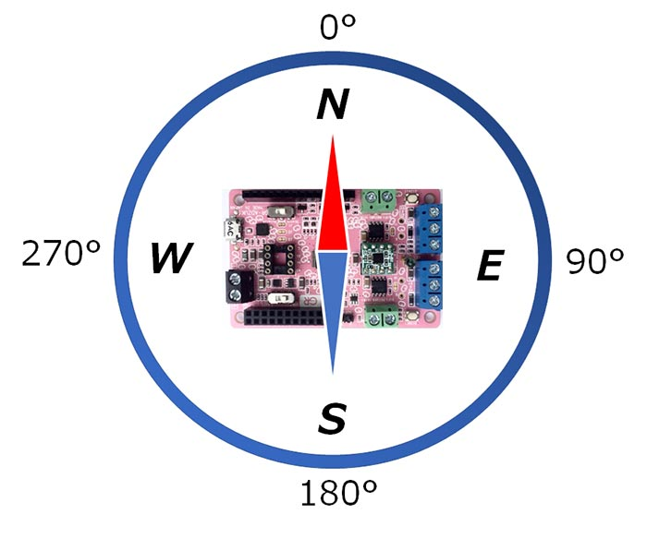
Transportation – navigation
  Automotive GPS
  Electronic Compass
source: Renesas
Notes:
https://www.renesas.com/br/en/products/gadget-renesas/boards/gr-adzuki/project-play-with-digital-compass.html

Slide 22
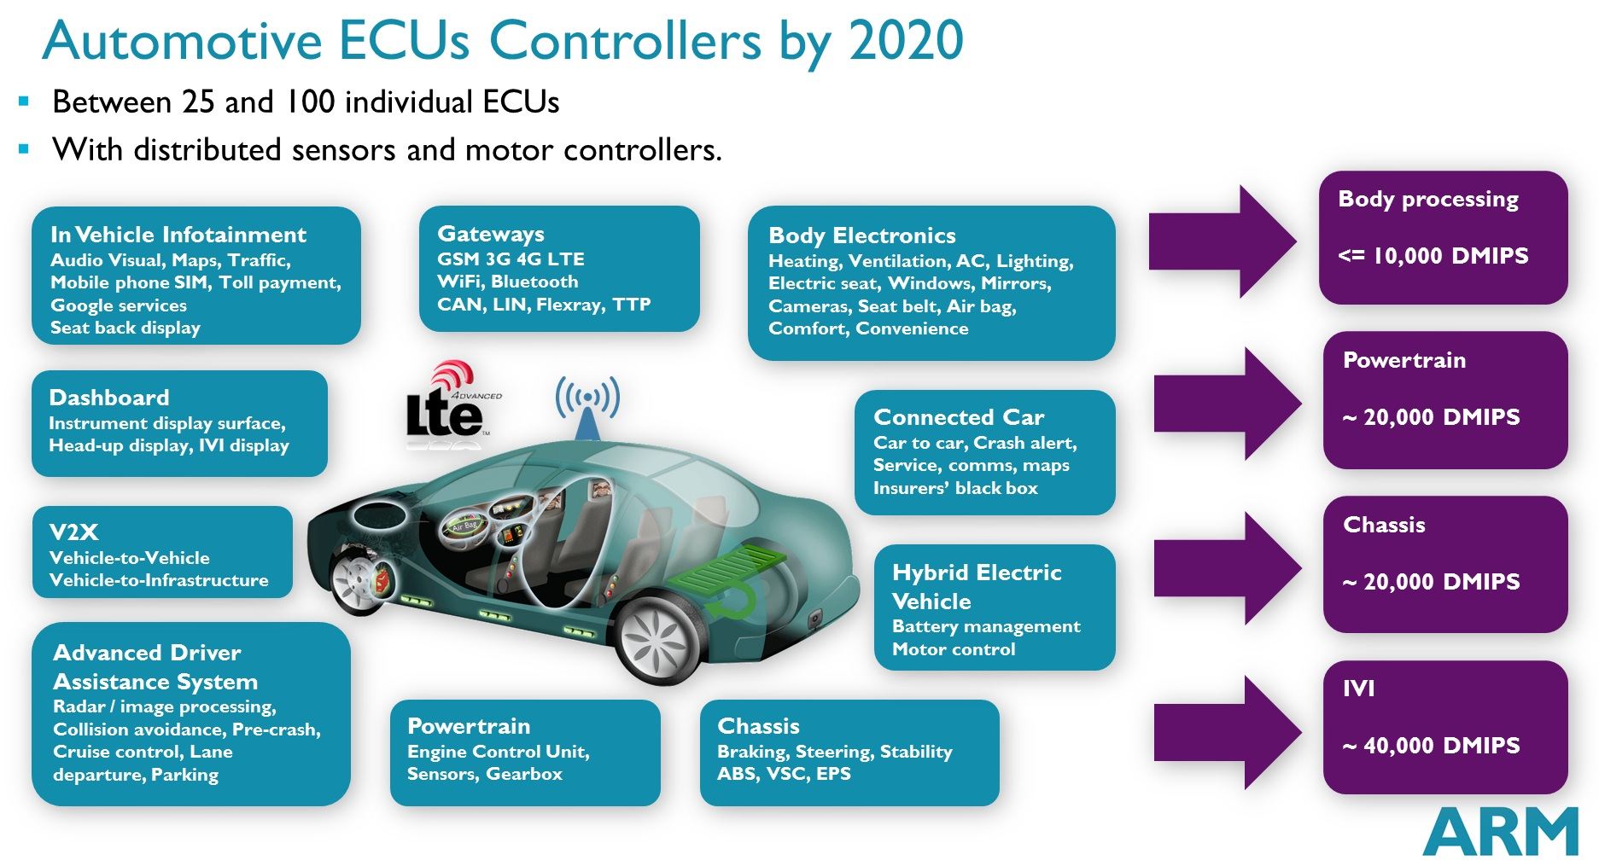
transportation – automotive
source: community.arm.com

Slide 23
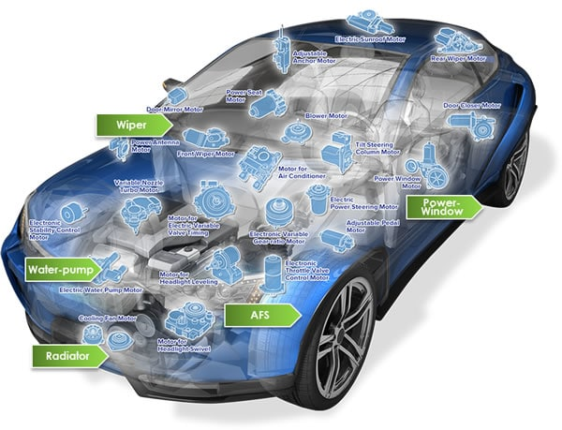
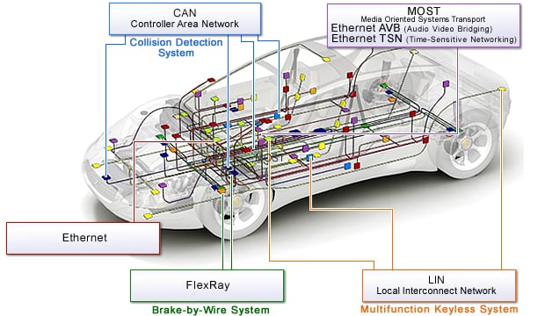
transportation – automotive
source: Renesas
Notes:
https://www.renesas.com/en-us/solutions/automotive/technology/networking.html

Slide 24
Medical Equipment
  CT Scanners
  ECG (Electrocardiogram)
  Blood Glucose Monitor
  Blood Pressure Monitor
  Body Composition Analyzer
source: Renesas
Notes:
https://www.renesas.com/br/en/img/misc/catalogs/pdf/r01pf0176eu0000-synergy.pdf

Slide 25
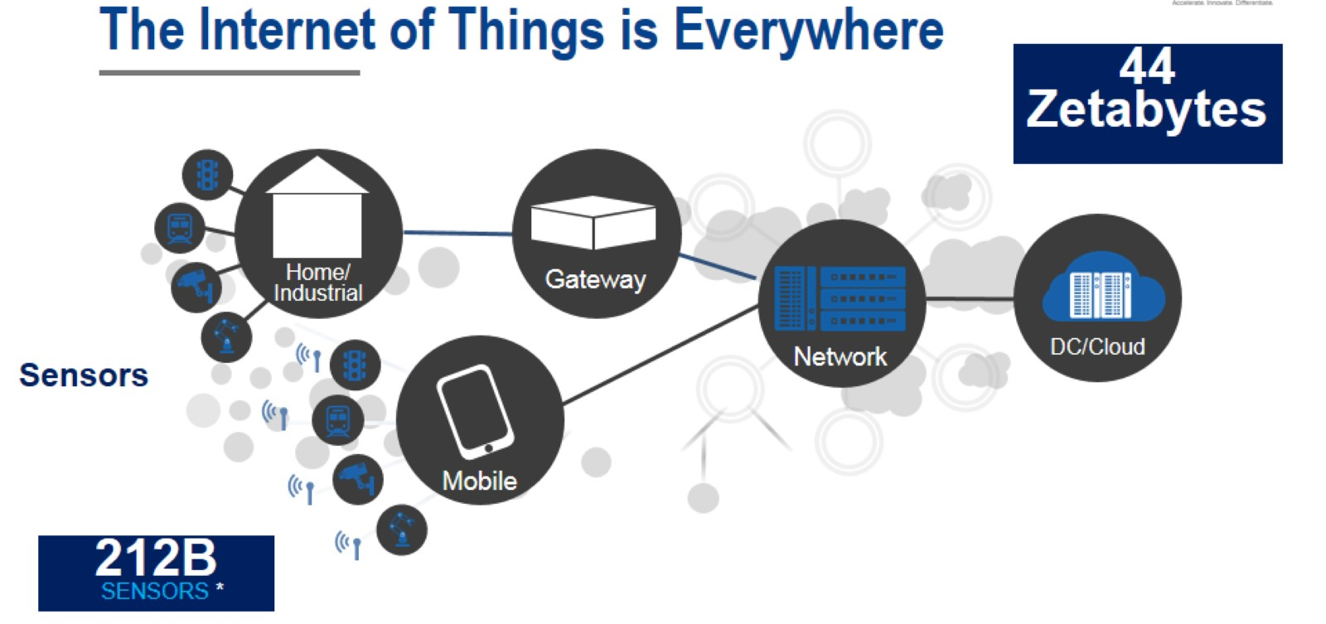
The IoT era
source: Renesas
Notes:
Renesas DevCon 2015: FC05BA Overcoming the Challenges of Building IoT Applications

Slide 26
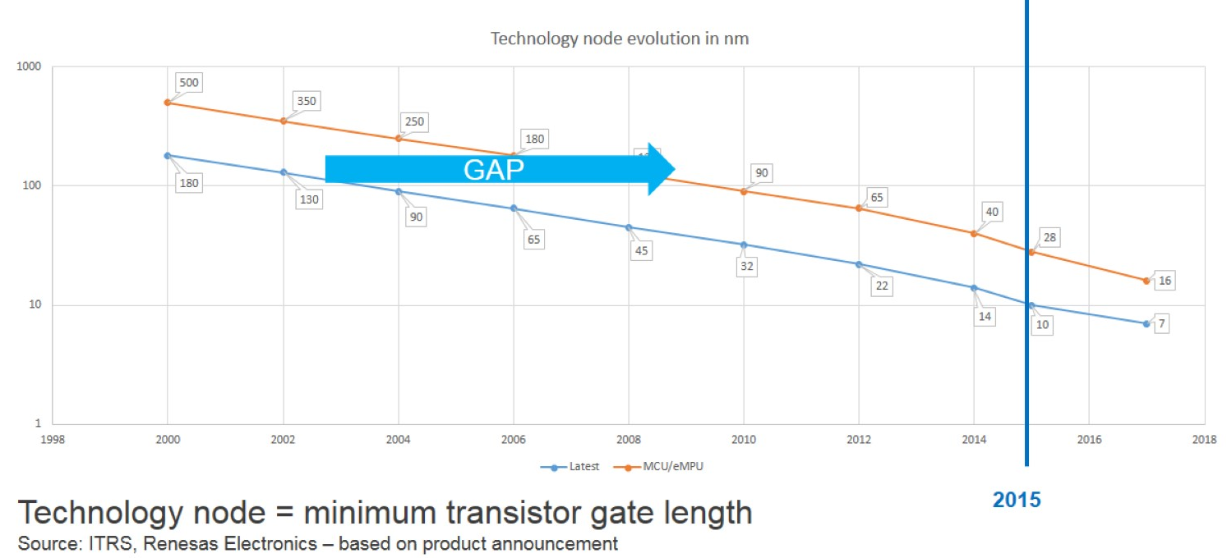
Trends
Five-year gap from state of the
art to MCU technology
source: Renesas
Notes:
Renesas DevCon 2015: 6C04BA Renesas Next generation Microcontroller and Microprocessor Solutions Technology Roadmap

Slide 27
Embedded systems architecture – Generic model
  One of the important characteristics of Embedded Systems (ES) is its diversity. Hence, a truly generic model for an ES does not exist.
  The model presented here attempts to represent a large set of the existing ES. Hence, it is adequate to understand Embedded Systems concepts.
suggested reading: (see IEEEXplore.ieee.org)
D. Renaux, F. Pottker, "Applicability of the CMSIS-RTOS Standard to the Internet of Things", 10th Workshop on Software Technologies for Future Embedded and Ubiquitous Systems - SEUS/ISORC 2014, June 2014.

Slide 28
Embedded systems architecture Generic model
source: Authors

Slide 29
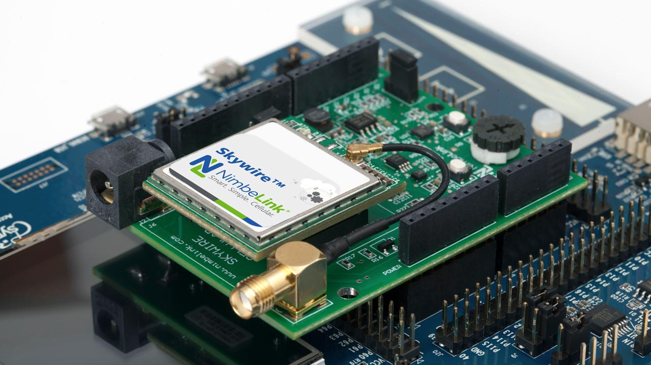
1. Hardwired HW
  This level is composed of hardware devices
  (MCU, Memory, I/O, connectors) whose
  connection is determined by the copper
  traces on a PCB, hence, not changeable after fabrication.
  Currently, a significant portion of the HW functionality of an ES is integrated into a SoC (System on Chip). External HW consists of the remaining HW not in the SoC and comprises, among others, sensors, actuators, Human-Machine Interface devices, Storage devices, and a large variety of communication interfaces.
Skywire Renesas Synergy PMOD Kit

Slide 30
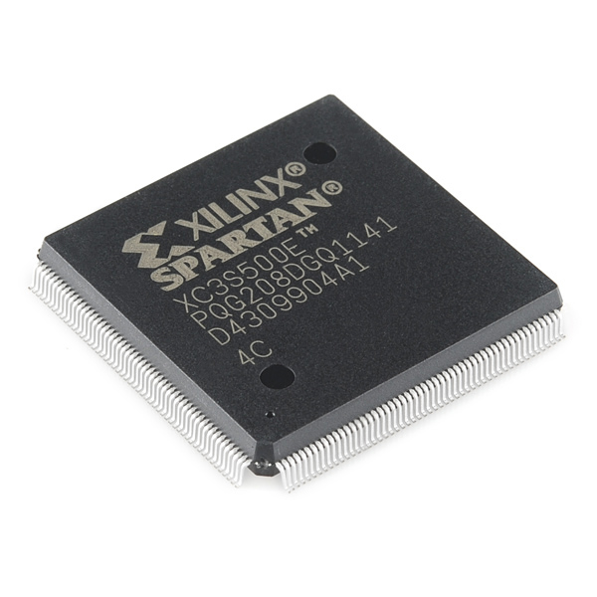
2. Soft wired HW
  In contrast to Level 1, the soft wired HW level consists
  of components whose connection is programmable,
  hence, can be modified at any time.
  Currently, the most common programmable devices
  are FPGAs, however, a variety of programmable logic devices (PLD) are available: FPGA, CPLD, GAL, PAL, PLA, and even ROM.
  The two hardware layers (1 and 2) compose the physical part of an embedded system. The remaining layers (3 to 9) are software layers.

Slide 31
Software Layers
The upper layers (3 to 9) are software layers.
Embedded Systems Software have two distinct characteristics:
  Typically the development environment (compiler toolchain) generates a single binary file that integrates all software components: device drivers, libraries (RTOS, Services, ...) and the Application. Hence, avoiding the process of reading an executable file and loading it on memory.
  While on desktops applications are changed and upgraded quite frequently, in embedded systems, typically a single multitasking application is executed along the life of the device. Upgrades may occur but are much less frequent.

Slide 32
3. Hardware Abstraction Layer
  The HAL is comprised of a set of functions that directly access the hardware devices. These functions are also called device drivers.
  A well-designed HAL provides to the upper levels a standardized interface, providing an easy interchange of devices. For instance, if all communication devices have the same API then replacing a comm. interface (such as SPI) for another (such as I2C) is straightforward. The Renesas SSP (Synergy Software Package) is an example of such.
  Developing a device driver for the HAL requires expertise in both hardware and software. Such a development is a complex and time-consuming task typically performed in C and sometimes mixing with assembly language.

Slide 33
4. Adaptation Layer
  An Adaptation Layer (or Wrapper) is a means of providing a common interface for different device drivers.
  If a HAL is not carefully designed, or if device drivers from different vendors are integrated in the same solution, then the software interface to the upper level may not be regular, meaning that different devices have access functions with different signatures. Such a scenario poses severe difficulties for portability and changes.
  The adaptation layer is a simple translation layer aiming at converting the non-standard interface to a standardized one. Such a translation can often be done at compile time, hence, not imposing any runtime penalty.

Slide 34
5. and 6. RTOS
  Embedded Operating Systems have significant differences to O.S. used in desktop computers, including a very small memory footprint and a reduced amount of functionality. Most embedded O.S. have to provide support for real-time systems, hence, they are termed RTOS (Real-Time Operating System).
  The implementation of a well designed RTOS has at least two layers, so that different software modules implement the architectural dependent code and the architectural independent code. This approach improves modularity and improves the portability to other architectures.

Slide 35
7. RTOS Adaptation Layer
  This is a wrapper that translates the API of a given RTOS to a standard API, such as CMSIS-RTOS. Once a standard API is provided to the upper levels, all of the software in the Services and Application layers can be reused in different platforms without rewriting the calls to the RTOS.
Notes:
Cortex Microcontroller Software Interface Standard.

Slide 36
8. Services
  To cope with the large amount of functionality implement by software in current Embedded Systems, code reuse is almost mandatory. Thus, off-the-shelf software components are integrated to form the final solution. Typically, these components come in the form of libraries that are linked at compile time.
  A large variety of software components is available providing functionality for: TCP/IP stacks, USB stacks, communication protocols, georeferencing, navigation, security, storage, among many others.
Notes:
Universal Sysncronous Bus
Transmission Control Protocol/Internet Protocol

Slide 37
9. Application layer
  The top layer of the model is the Application Layer. This is the software layer that implements the specific functionality of each embedded system.
  In this layer, several concurrent tasks cooperate to provide the required functionality. Concurrent programming is the most common approach to cope with the software complexity of current Embedded Systems.
  The RTOS provides the management of the concurrency, among many other services.

Slide 38
2 – Computer Architecture – Risc vs CISC
  Computer Generations
  The RISC Paradigm

Slide 39
Defining “computer”
Computer =
a device, or person, who performs a computation, i.e. a sequence of calculations according to an algorithm.
Hence, we consider Generation 0 of computers the generation that precedes the electronic device currently known as computer.

Slide 40
Computer Generations
Generation | Description
0 | Mechanical and Electromechanical Devices
1 | 40’s – Vacuum tubes ENIAC, Zuse
2 | 50’s – Transistors Manchester University, IBM 350
3 | 60’s – SSI Integrated Circuits (logic gates) Apollo Guidance Computer IBM System/360, Digital VAX
4 | 70’s – Microprocessor
5 | 2010’s? – quantic / organic / optical??? AI
Notes:
Not clear yet what the 5th generation will be

Slide 41
research preceding the risc paradigm shift
  Careful examination of the execution of actual programs concluded that:
    Often, complex instructions were not used and the equivalent effect was obtained by a sequence of simpler instructions.
    The inclusion of a single complex instruction in the instruction set could impact overall performance by imposing a lower clock rate.
    Since the instructions did not have a regular execution sequence (i.e. each one had its execution determined by its microcode) the implementation of a pipeline was close to impossible.

Slide 42

research preceding the risc paradigm shift
What is the final goal?
  From the user’s perspective, the goal is performance of the application programs
  RISC thesis: a processor whose instruction set is made of simple instructions with a regular execution, allowing the implementation
  of a pipeline, will have a higher performance than a CISC
  (Complex Instruction Set Computer)
recommended reading:
Computer Architecture: A Quantitative Approach 6th Edition
by John L. Hennessy, David A. Patterson

Slide 43
risc architectural features
Features that characterize the RISC paradigm are:
  An instruction set with a reduced number of very simple instructions.
  LD/ST architecture, meaning that only two instructions (and their variants) access memory: LD (load) reads data from memory, and ST (store) saves data to memory.
  All other instructions operate on registers. There is a large number of general-purpose registers, avoiding access to memory.
  All instructions follow the same logical execution sequence. Hence, a pipelined architecture can be implemented, significantly improving performance. Typically 1 instruction is executed every clock cycle.

Slide 44
Pipelining
Requirements for the implementation of a Pipeline in a processor:
  The instruction set must be designed so that all instructions have the same execution steps
  Instructions must be regular with respect to:
    Size
    Addressing modes
    Decoding
    Operands

Slide 45
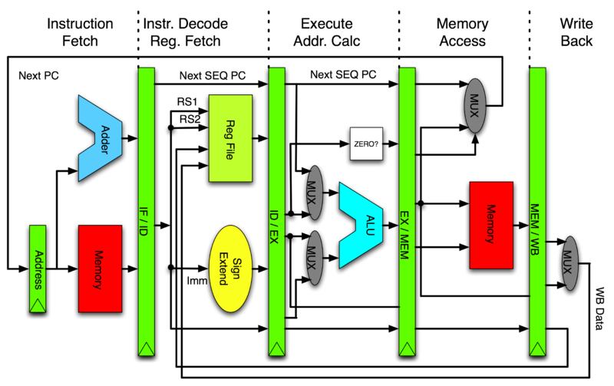
Pipelining
Example of a Pipeline with 5 stages:
  Fetch
  Decode and read operands in registers
  Use ALU to execute instruction or to calculate memory address
  Read or Write to memory
  Write result back to Register file
Remark: not all instructions use step 4 and 5
source: wikimedia.org (CC)
Notes:
Notation: the green blocks represent registers that store the result of a pipeline stage
1- Fetch: use the PC as the address to access memory and get the code of an instruction. Result: binary instruction code
2- Decode: interpret the binary instruction code to determine the operation to be performed and its operands; access the register file to obtain the instruction operands. Result: values to be sent to ALU, control signals to the datapath
3- Execute: perform a logic/arithmetic operation on the operands; OR calculate the address to access data memory. Result: ALU output (operation result or memory address)
4- Memory Access: if the instruction is a LD (memory read) or ST (memory write), access memory
5- Write Back: if the instruction produces a result to be stored in a register, the result being either the result of the ALU calculation or a value read from memory, write to the register file.

Slide 46
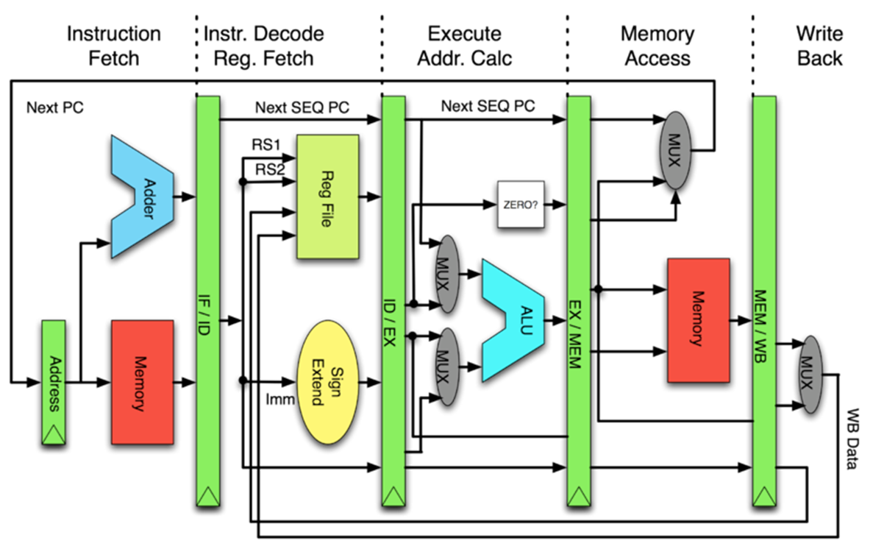
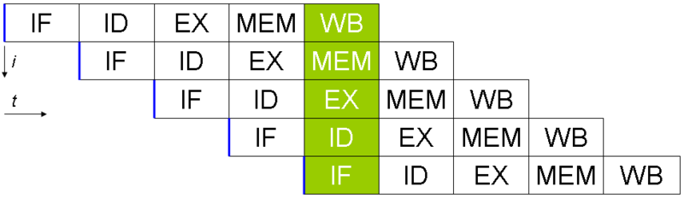

benefits of Pipelining
For the previous example of a 5 stage pipeline, the
execution over time is presented in this diagram.
Note that although each instruction
takes 5 clock cycles to execute, due
to pipelining, after filling the pipeline,
on every clock another instruction
finished its execution.
Effectively, the number of instructions
executed per second is the same as
the clock rate.

Slide 47
limitations of pipelining
Consequence:
the average number of instructions
executed per second is lower than
the clock rate.
  Data Hazard:
  if an instruction requires as input a value produced by the previous instruction, this value may not be available at stage 2 (decode and fetch operands) since the previous instruction only saves its results at stage 5.
  Solutions: stall the pipeline (instruction must wait for result of previous)
  OR use a technique called bypassing to forward the result of the
  previous instruction at stage 3 of its execution
  OR reorder instructions to avoid this dependency
  Control Hazard:
  a change of control flow (e.g. a branch instruction) causes the pipeline to be flushed, meaning that following instructions that already were fetched and decoded will be discarded.

Slide 48
comparing risc x cisc
RISC | CISC
Instruction set has a reduced number of instructions | Instruction set has a large number of instructions
Instructions are very simple | Instructions are complex, i.e. have a high semantic content
Large number of general purpose register | Small number of registers
Instruction codes have fixed size | Instructions are coded in a variable number of bytes
Instruction decoding is very simple and typically performed by a table in ROM | Instruction decoding is complex
Instruction execution is simple, typically requiring a single clock cycle | Instruction execution is complex and typically uses microprogramming, i.e. interpretation by microcode
Regular execution of the instructions | Execution steps varies from instruction to instruction
Execution time is regular, typically a single clock cycle | Execution time varies significantly among instructions
Architecture is prone to the use of a pipeline in the implementations, resulting in N times performance improvement (N is the number of pipeline stages). | Architecture is not prone to the use of Pipeline.

Slide 49
comparing risc x cisc
When the same source program is compiled to a RISC processor and to a CISC processor:
  The number of machine instructions of the compiled program is typically larger on the RISC
  The size of the compiled program (measured in bytes) is typically larger on the RISC
  The performance (inverse of the time to execute the program) is typically better on the RISC

Slide 50
comparing risc x cisc
From a HW perspective, the design of a RISC processor is significantly simpler than that of a CISC:
  Shorter design cycle,
  Lower number of transistors to implement,
  Less area on silicon die.

Slide 51
economics of integrated circuits manufacturing
The cost of a chip is determined mainly by:
  Cost of the die (cost of manufacturing a wafer divided by the number of good dies per wafer)
  Testing costs (both for die testing and testing after packaging)
  Packaging costs
  Yield (percentage of functional chips).

Slide 52
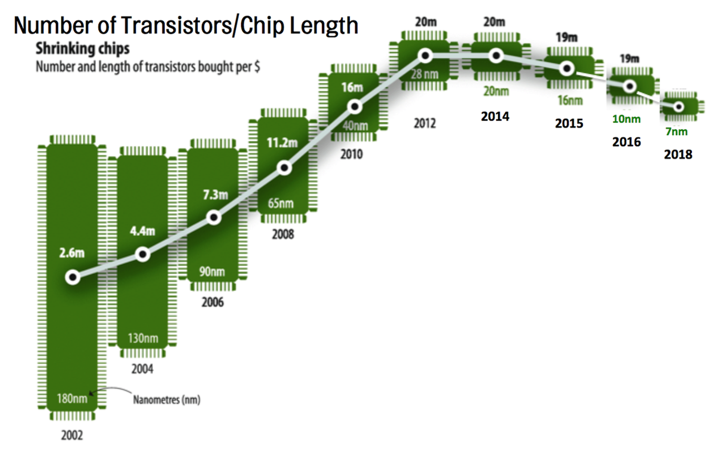
economics of integrated circuits manufacturing
Curve shows how many transistors can be purchased with one dollar for each manufacturing technology over time.
This graph represents the situation in 2018. At the time, the most cost-effective technology was 20 nm.
Over time, as the processes mature, transistors cost lowers. Until a given technology enters obsolescence.
source: economist.com

Slide 53
economics of integrated circuits manufacturing
Key design decision:
If currently the “sweet spot” (best value for money) is a given manufacturing technology and a transistor count of T millions transistors, what is the best use for this asset?
  CISC core + little Cache/Memory/Peripherals
  RISC core + large amount of Cache/Memory/Peripherals
Most silicon vendors select the second alternative

Slide 54
risc vs cisc today
Currently, there is a trend to mix the best features of both paradigms. The convergence of RISC and CISC has not been named yet, but the characteristics of novel processors are:
  Large instruction set
  Regular instructions, prone to pipelining
  Pipelines from 3 to 20 stages
  No microcode

Slide 55
risc vs cisc today
Instruction set of Cortex-M
including Cortex-M23 and
Cortex-M33
source: ARM
ARM Cortex-M for Beginners - Yiu

Slide 56
3 – ARM Cortex-M architecture
  History of ARM
  Cortex-M Features
  Cortex-M Instruction Set Architecture
  Instruction Set
  Memory Access
    Memory-mapped I/O
  Exception Handling

Slide 57
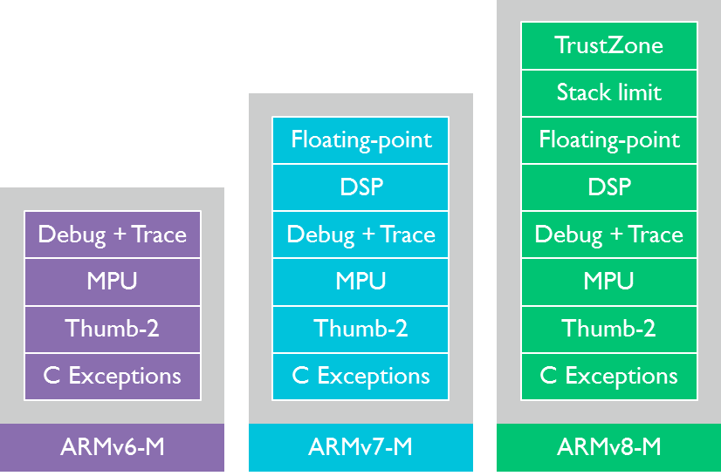
3.1 – arm history
  Over time, several ARM architecture versions were released. From the seminal ARMv1 to the ARMv8.3-A, released in 2017. The documentation of these standards is available on the arm.com website.
  For each architectural version there are several implementations
Cortex-M0 Cortex-M3 Cortex-M23
Cortex-M0+ Cortex-M4 Cortex-M33
Cortex-M7
Notes:
For the Cortex-M family, the architectures of interest are: ARMv6-M, ARMv7-M and ARMv8-M

Slide 58
source: ARM
The Future is in Your Hands - Peter Middleton
Notes:
By 2010, 20 billion ARM cores were produced. At that time, ARM predicted that by 2020 the number will reach 100 billion.
They miscalculated. 50 billion were reached by the end of 2013 and in 2016 ARM reached 100 billion cores.
Horizontal axis represents time.
Yellow lines are the architecture versions
ARM7, ARM9, ARM11, Cortex are the families of HW devices plotted at the time they were introduced. Vertical axis represents performance.
Blue bars represent total sales of ARM chips on each quarter. Vertical axis represents quantities.

Slide 59
ARM Processor family
source: ARM
ARM Cortex-M for Beginners - Yiu
Notes:
The three Cortex families are presented:
Cortex-A
Cortex-R
Cortex-M
horizontal axis is time (when a core was released)
vertical axis is capability and performance

Slide 60
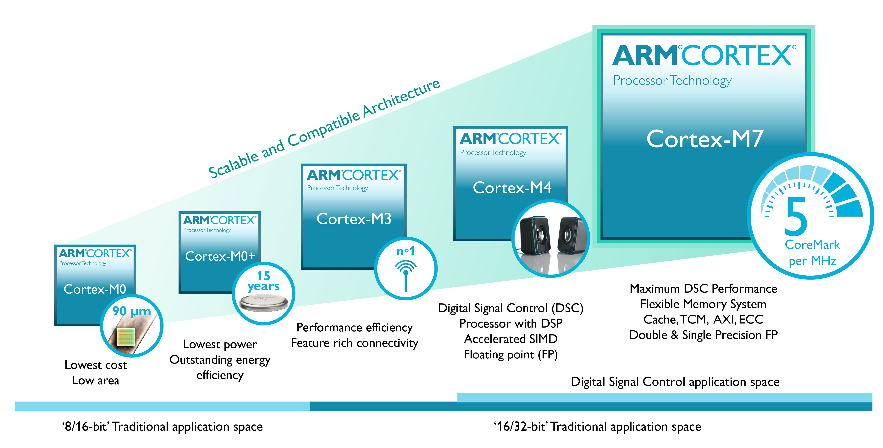
The cortex-m family
source: community.arm.com

Slide 61
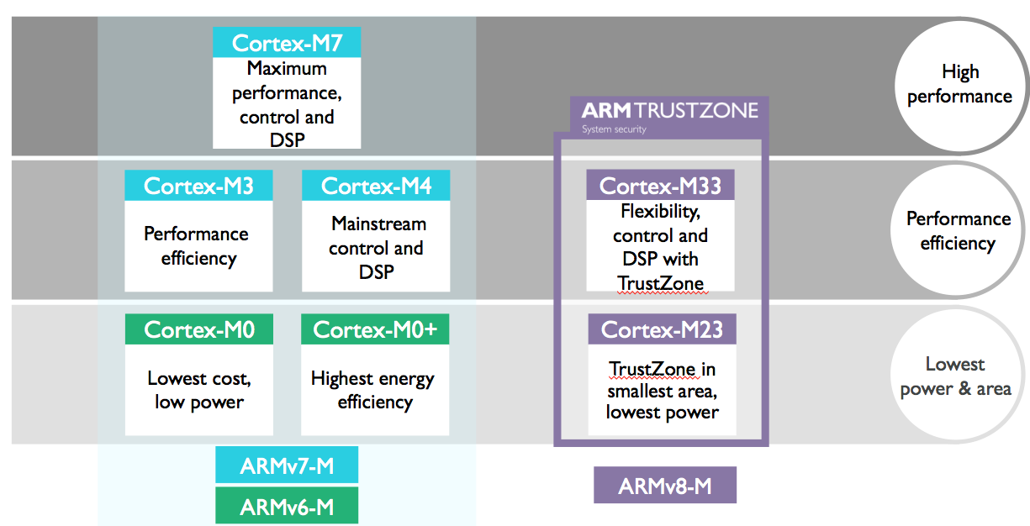
The cortex-m family
In 2016, the Cortex-M33 and Cortex-M23 were added to the Cortex-M family.
source: community.arm.com

Slide 62
3.2 – cortex-M features
Among the distinguishing features of the Cortex-M architecture are:
  3-stage pipeline (except for Cortex-M7): Fetch, Decode, Execute,
  Harvard architecture (except for Cortex-M0 and M0+),
  Designed for power efficiency (includes an ultra low-power deep sleep),
  Thumb-2 instruction set, combining ARM performance and Thumb code density,
  Interrupt Controller (NVIC) is defined in the architecture; low latency vectored interrupt servicing,
  Interrupt servicing with tail-chaining and late arrival functionalities,
  Bit-banding to provide faster bit operations in memory and memory mapped I/O,
  MPU = Memory Protection Unit,
  Most instructions can be conditional.

Slide 63
3.2 – cortex-M features
  The ARM7TDMI had two instructions sets:
  ARM - with 32-bit instructions, higher performance and lower code density,
  Thumb - with 16-bit instructions, lower performance and higher code density.
  Cortex-M has a single instruction set: Thumb-2
  It mixes 16-bit and 32-bit instructions. Its code density is similar to Thumb and its performance is similar to ARM.
source: ARM
The ARM Architecture - Joe Bungo

Slide 64
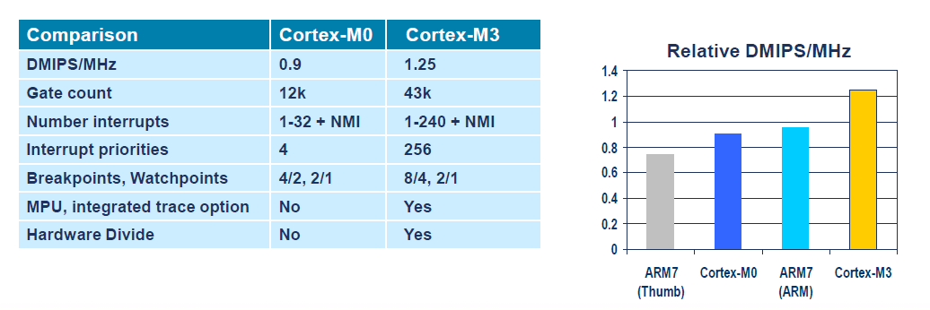
3.2 – cortex-M features
source: ARM
ARM Cortex-M Processor Family
Notes:
Remark the impressive low gate count on Cortex-M devices

Slide 65
source: ARM
The ARM Architecture - Joe Bungo

Slide 66
3.2 – cortex-M features
source: ARM
The ARM Architecture - Joe Bungo
Notes:
AMBA = Advanced Microcontroller Bus Architecture. An open standard that includes AHB and APB
AHB = Advanced High-Performance Bus - The main system bus in microcontroller usage
APB = Advanced Peripheral Bus - Minimal gate count for peripherals

Slide 67
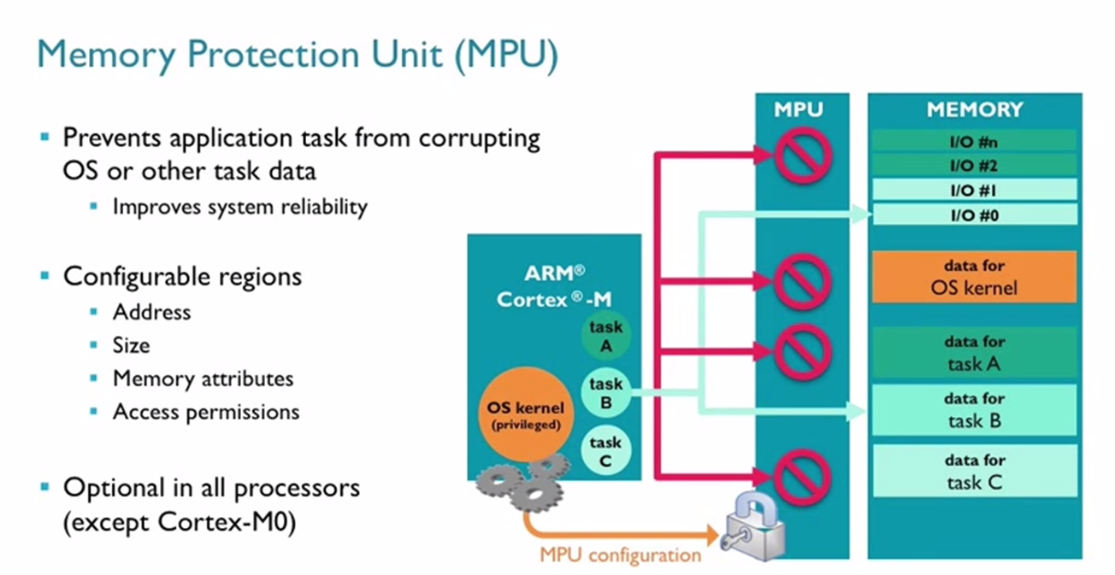
3.2 – cortex-M features
source: ARM
How to Choose Your ARM Cortex-M Processor - Tim Menasveta

Slide 68
3.2 – cortex-M features
Cortex-M4 Pipeline
source: ARM
The ARM Architecture - Joe Bungo

Slide 69
3.2 – cortex-M features
Cortex-M4 Pipeline – example for optimal execution
source: ARM
ARM Cortex-M3 Introduction - ARM University Relations

Slide 70
3.2 – cortex-M features
Cortex-M4 Pipeline – pipeline flush due to indirect branch (no forwarding)
source: ARM
ARM Cortex-M3 Introduction - ARM University Relations

Slide 71
3.2 – cortex-M features
Cortex-M4 Pipeline – Harvard architecture allows for concurrent access to code and data memory.
source: ARM
ARM Cortex-M3 Introduction - ARM University Relations

Slide 72
3.3 – Cortex-M4 Instruction Set architecture
The Instruction Set Architecture (ISA) presents the Programmer’s View of the processor, including:
  Data types
  Processor Modes
  Processor Registers
  Instruction Set
  Memory Accessing
  Exception Processing

Slide 73
3.3 – Cortex-M4 ISA
The Cortex-M4 instruction set can operate on the following data types:
  bit: stores a single bit of information (0 or 1).
  Bit banding instructions can set or clear bits in specific memory regions.
  byte: 8-bit. Each byte in memory is individually addressable.
  half-word: 16-bit. The address of a half-word in memory is the address of its least significant byte.
  word: 32-bit. The address of a word in memory is the address of its least significant byte.
  double-word: 64-bit. Requires a register pair to be stored, such as R1:R0 (concatenation of R1 and R0 with R1 being the most significant word). The address of a double-word in memory is the address of its least significant byte.

Slide 74
3.3 – Cortex-M4 ISA
The Cortex-M4 processor modes are:
  Privileged Thread -
  mainly for OS execution
  Unprivileged Thread -
  mainly for Application code
  Privileged Handler -
  for exception handling code
Remark: there are two stacks: Main and Process.
The usage of these stacks is related to the
processor mode.
source: ARM
ARM Cortex-M for Beginners - Yiu
Notes:
Privilege Code can execute as privileged or unprivileged. Unprivileged execution limits or excludes access to
some resources. Privileged execution has access to all resources.
Execution in Handler mode is always privileged. Execution in Thread mode can be privileged or unprivileged.

Slide 75
3.3 – Cortex-M4 ISA
The Cortex-M4 has two stacks:
  Main stack - addressed by MSP (Main Stack Pointer)
  mainly to be used by the Operating System (OS) and exception handlers.
  Process stack - addressed by PSP (Process Stack Pointer)
  mainly to be used by the Application threads.
Only one stack is active at any given time, as selected by the CONTROL register. Register R13 (SP) maps to the active stack pointer, either MSP or PSP.

Slide 76
3.3 – Cortex-M4 ISA
source: ARM
ARMv7-M Architecture Reference Manual
Notes:
These are the 5 possible combinations of processor mode, privilege and stack.

Slide 77
3.3 – Cortex-M4 ISA – Registers
The register set of the Cortex-M4 consists of:
  General Purpose Registers (R0-R15)
  Floating Point Registers (S0-S31)
  Special Registers (xPSR, PRIMASK, FAULTMASK, BASEPRI, CONTROL)
All registers are 32-bit wide. Not all bits of the Special Registers are implemented.
source: ARM
ARM Cortex-M for Beginners - Yiu

Slide 78
3.3 – Cortex-M4 ISA – Registers
General Purpose Registers:
  32-bit wide
  Low registers: R0 .. R7
  High registers: R8 .. R15
  Special usage:
  R13 or SP is the Stack Pointer - points to the top of the stack
  R14 or LR is the Link Register - stores the procedure return address
  R15 or PC is the Program Counter - stores the address of the next instruction fetch

Slide 79
3.3 – Cortex-M4 ISA – Registers
General Purpose Registers:
  the general-purpose registers are accessible by most instructions;
  b0 is the Least Significant Bit (LSb) and b31 is the Most Significant Bit (MSb);
  a register can hold an unsigned integer with values from 0 to ‭4,294,967,295
  or a signed integer with values from ‭-2,147,483,648‬ to ‬‭2,147,483,647‬;
  when using hexadecimal notation, a 32-bit register holds 8 hex digits. E.g. 0x1234 5678;
  Cortex-M architecture uses 32-bit memory addresses, hence, a single general-purpose register can hold a memory address.

Slide 80
3.3 – Cortex-M4 ISA – Registers
Special Purpose Registers - XPSR
  The three registers APSR, IPSR and EPSR can be accessed individually or combined as XPSR.
source: ARM
ARMv7-M Architecture Reference Manual

Slide 81
3.3 – Cortex-M4 ISA – APSR
APSR = Application Program Status Register
Flag | bit | Description
N | 31 | Negative. For two’s complement results this bit is set to indicate that the result is negative.
Z | 30 | Zero. This bit is set when the result is zero. After a comparison, this bit is set to indicate that the compared values are equal.
C | 29 | Carry. Set to indicate that the result of an unsigned addition produced overflow. Also set to indicate that un unsigned subtraction underflowed.
V | 28 | Overflow. Set to indicate overflow in a signed arithmetic operation.
Q | 27 | Saturation bit. For DSP extension instructions.
GE | 19:16 | Greater than or Equal. For SIMD instructions.
source: ARM
ARMv7-M Architecture Reference Manual

Slide 82
3.3 – Cortex-M4 ISA – IPSR
IPSR = Interrupt Program Status Register
Field | bit | Description
Exception Number | 8 : 0 | This field identifies the exception that is currently active (being serviced). The value 0 indicates that no exception is currently active. If this value is non-zero the processor is in Handler mode. If this value is zero the processor is in Thread mode.
source: ARM
ARMv7-M Architecture Reference Manual

Slide 83
3.3 – Cortex-M4 ISA – EPSR
EPSR = Execution Program Status Register
Field | bit | Description
T | 24 | Thumb. This bit is set to indicate that the instruction set in use is Thumb. On Cortex-M this bit must be set all the time or an exception occurs. On ARM7TDMI, Cortex-R and Cortex-A this bit is 0 when the ARM instruction set is in use.
ICI/IT | 26:25 15:10 | ICI - used for a interrupted exception-continuable multi-cycle load or store. IT - provide context information for instructions in an IT block.
source: ARM
ARMv7-M Architecture Reference Manual

Slide 84
3.3 – Cortex-M4 ISA – XPSR
Mnemonics used to combine the XPSR component registers:
source: ARM
ARMv7-M Architecture Reference Manual

Slide 85
3.3 – Cortex-M4 ISA – special registers
Field | bit | Description
PM | PRIMASK[0] | Set to mask exceptions with configurable priority (priority 0 and lower). Reset to unmask.
FM | FAULTMASK[0] | Set to mask the HardFault exceptions and the configurable priorities (prio -1 and lower).
BASE PRI | BASEPRI[7:0] | Changes the priority level required for exception preemption. Affects only the currently executing code with lower priority than BASEPRI.
source: ARM
ARMv7-M Architecture Reference Manual

Slide 86
3.3 – Cortex-M4 ISA – control register
CONTROL Register
Field | bit | Description
nPRIV | 0 | When the processor is in Thread mode. 0 = privileged mode; 1 = unprivileged mode.
SPSEL | 1 | Stack selection. 0 = use MSP (Main Stack); 1 = use PSP (Process Stack). In Handler mode this bit is always 0.
FPCA | 2 | Implemented only when floating point is available. 0 = do not save floating point registers on exception; 1 = save floating point context on exception.
source: ARM
ARMv7-M Architecture Reference Manual

Slide 87
3.3 – Cortex-M4 ISA – Registers
Floating Point Registers:
  The Cortex-M4 with optional floating-point extension, implements 32 32-bit floating point registers named S0 to S31.
  These can be combined two by two forming 16 double precision (64-bit) floating point registers named D0 to D15. D0 is formed by S1:S0 (the concatenation of the registers S1 and S0 where S1 is the most significant word, i.e. the leftmost word).

Slide 88
3.4 – instruction set
Before presenting the instruction set, lets examine:
  Assembly syntax
  3-operand instructions
  Conditional instructions
  Instructions that affect the flags

Slide 89
3.4 – instruction set
The most common instruction formats are: (format)
label: MNEMONIC Destination, Operand1, Operand2 ;comment
label: MNEMONIC Destination, Operand2 ;comment
Examples:
fmt1: ADD R2, R4, R5 ;R2 = R4 + R5
fmt2: ADD R2, R4 ;R2 = R2 + R4

Slide 90
3.4 – instruction set
Suggested assembly source file layout:
fmt1: ADD R2, R4, R5 ;R2 = R4 + R5
By setting the TABs to 4 spaces, these positions can be easily obtainable.
Only labels should begin on column 1.
Only mnemonics are compulsory. Labels, operands and comments are optional, although they are all very frequent.
col 1
col 5
col 13
col 21

Slide 91
For an instruction with two operands, the first operand (Op1) is always a register. The second operand (Op2) may be a register, or a register that had its contents shifted or rotated, or an immediate value coded in the instruction.
source: Authors

Slide 92
3.4 – instruction set
Examples of Operand 2
ADD R2, R4, R5 ;Operand 2 is a register (R5)
ADD R2, R4, R5,LSL #2 ;Operand 2 is a shifted register
;R5 is shifted left by 2 bits
;this corresponds to multiplying its value by 4
ADD R2, R4, #0xFF ;Operand 2 is an immediate value
;the hexadecimal value 0xFF

Slide 93
3.4 – instruction set
In the Cortex-M4 instruction set, the programmer explicitly controls if the result of an instruction should affect the flags: N,Z,C,V.
Most instructions have a variant with the letter S appended to the mnemonic. The S variant means: “set the flags”.
ADD R2, R4, R5 ;the result of this addition does
;not affect the flags.
ADDS R2, R4, R5 ;the result of this addition
;affects the N,Z,C and V flags.

Slide 94
3.4 – instruction set
Many Cortex-M4 instruction can be conditional, meaning that the instruction only executes if the flags are in a given state. Except for branch instructions, an instruction must be in an IT block to be conditional. The condition is specified by two letters appended after the mnemonic (see condition table on next slide).
ADD R2,R4,R5 ;the result of this addition does
;not affect the flags.
ADDS R2,R4,R5 ;the result of this addition
;affects the N,Z,C and V flags.
ITT EQ ;start of an IT block with 2 instructions
ADDEQ R2,R4,R5 ;if Z is set, execute the ADD
ADDSEQ R2,R4,R5 ;if Z is set, execute the ADD and change
;flags according to result of this instruction
Notes:
Remark: in most architectures, only the branches are conditional.

Slide 95
3.4 – instruction set
Suffix | Flags | Meaning
EQ | Z = 1 | Equal
NE | Z = 0 | Not equal
CS or HS | C = 1 | Higher or same, unsigned
CC or LO | C = 0 | Lower, unsigned
MI | N = 1 | Negative
PL | N = 0 | Positive or zero
VS | V = 1 | Overflow
VC | V = 0 | No overflow
HI | C = 1 and Z = 0 | Higher, unsigned
LS | C = 0 or Z = 1 | Lower or same, unsigned
GE | N = V | Greater than or equal, signed
LT | N != V | Less than, signed
GT | Z = 0 and N = V | Greater than, signed
LE | Z = 1 and N != V | Less than or equal, signed
AL | Can have any value | Always. This is the default when no suffix is specified.
Condition codes mnemonics suffixes
Notes:
Remark: in most architectures, only the branches are conditional.

Slide 96
3.4 – instruction set
Code examples for conditional instructions.
cmp R12,R10 ;compare the unsigned values in R12 and R10, change flags
beq op1 ;branch to op1 if the values of R12 and R10 are equal
ite hi ;two-instruction IT block with HI condition
addhi R12,R12,#1 ;if R12 > R10 then increment R12
addls R10,R10,#1 ;else increment R10
op1:
...
Notes:
Remark: in most architectures, only the branches are conditional.

Slide 97
3.4 – instruction set
An immediate value is a constant whose value is encoded in the instruction. Hence, a limited range of values is allowed.
The notation for immediate values is #value.
The notation for negative values is #-15.
The notation for hexadecimal values is #0xFA0.
Example:
ADD R2,R4,#5 ;R2 = R4 + 5

Slide 98
3.4 – instruction set
  Cortex-M4 instruction codes are either 16-bit or 32-bit.
  16-bit instructions are called narrow and may have a .N suffix.
  32-bit instructions are called wide and may have a .W suffix.
  Some mnemonics may be coded either in narrow or wide format, for example:
  0x37a: 0x1840 ADDS.N R0, R0, R1 //16-bit code
  0x37c: 0xeb10 0x0001 ADDS.W R0, R0, R1 //32-bit code
  16-bit and 32-bit instruction code can be freely intermixed in a program.
  All instructions must be halfword aligned, i.e. must be stored on an even address.

Slide 99
3.4 – instruction set
  Hence, PC will never hold an odd address => bit 0 of PC is always 0.
  When writing a 32-bit value to PC, bit 0 is ignored => can be used for other purpose.
  In other ARM processors, use bit 0 for interworking (i.e. change of instruction set).
  On Cortex-M, bit 0 must be a 1. This value is stored to the T flag in XPSR.
  Instructions that can be used for interworking (i.e. write to T flag):
    BX
    BLX
    pop {PC}
  Instructions that have as destination register the PC, cause a branch
    MOV PC, LR
    ADD PC, PC,R1
  There are restrictions on which instructions may write to PC.

Slide 100
3.4 – instruction set
Arithmetic instructions
Instruction | Description | Action
ADD Rd, Rn, Op2 | Add a register to Operand2 | Rd = Rn + Op2
ADC Rd, Rn, Op2 | Add a register to Operand2 and to Carry | Rd = Rn + Op2 + CY
SUB Rd, Rn, Op2 | Subtract from a register the Operand2 | Rd = Rn - Op2
SBC Rd, Rn, Op2 | Subtract from a register the Operand2 and the Borrow (negation of Carry) | Rd = Rn - Op2 - /CY
RSB Rd, Rn, Op2 | Subtract from Operand2 a register | Rd = Op2 - Rn
RSC Rd, Rn, Op2 | Subtract from Operand2 a register and the Borrow | Rd = Op2 - Rn - /CY
MOV Rd, Op2 | Move to Rd from Operand2 (put a copy of Operand2 into Rd) | Rd = Op2
MVN Rd, Op2 | Move to Rd /Operand2 | Rd = /Op2
MOVT Rd,<imm16> | Move to Rd[31:16] from imm16. Lower bits of Rd are unaffected | Rd[31:16] = imm16 Rd[15:0] unchanged
Notes:
Not all instructions are presented in these slides, just the ones considered more representative
/CY represents the negated carry ( NOT CY )

Slide 101
3.4 – instruction set
Compare and Test
Instruction | Description
CMP Rn, Op2 | Compare: Subtract from Rn the Operand2, discard result, change flags
CMN Rn, Op2 | Compare negative: Add Rn to Operand2, discard result, change flags
TST Rn, Op2 | Test: Rn AND Operand2, discard result, change flags
TEQ Rn, Op2 | Test equivalence: Rn EOR Operand2, discard result, change flags
Notes:
Not all instructions are presented in these slides, just the ones considered more representative

Slide 102
3.4 – instruction set
Logical
Instruction | Description | Action
AND Rd, Rn, Op2 | AND: bitwise logical AND a register to Operand2 | Rd = Rn AND Op2
ORR Rd, Rn, Op2 | OR: bitwise logical OR a register to Operand2 | Rd = Rn OR Op2
EOR Rd, Rn, Op2 | Exclusive OR: bitwise logical XOR a register to Operand2 | Rd = Rn XOR Op2
ORN Rd, Rn, Op2 | OR NOT: bitwise logical OR a register to NOT(Operand2) | Rd = Rn OR /Op2
Notes:
Not all instructions are presented in these slides, just the ones considered more representative

Slide 103
3.4 – instruction set
Shift Instructions
Instruction | Description | #imm Sh range
ASR Rd, Rn, Sh | Arithmetic Shift Right (preserves signal) | 1..32
LSL Rd, Rn, Sh | Logical Shift Left | 0..31
LSR Rd, Rn, Sh | Logical Shift Right | 1..32
ROR Rd, Rn, Sh | Rotate Right | 0..31
RRX Rd, Rn | Rotate Right Extended
Remark: Sh is either | the lower 8 bits of a register (value from 0..255)
 | a 5-bit immediate value representing either 1..32 or 0..31
Notes:
Not all instructions are presented in these slides, just the ones considered more representative

Slide 104
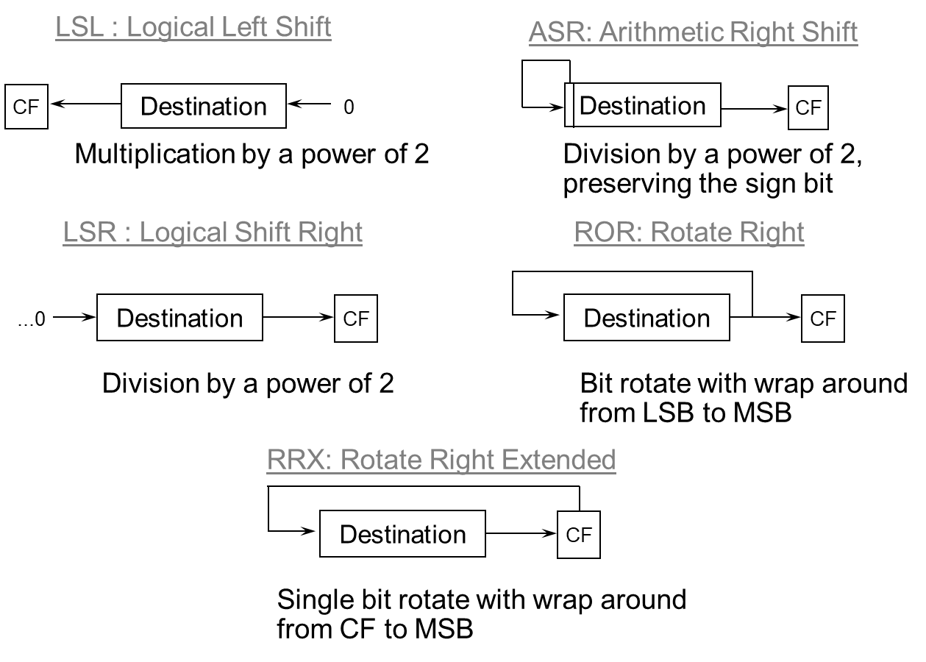
3.4 – instruction set
source: ARM
The ARM Architecture
Notes:
Visual explanation of the shift operations

Slide 105
3.4 – instruction set
Shift Operators to be used in Operand2
Operator | Description | #imm Sh range
ASR Sh | Arithmetic Shift Right (preserves signal) | 1..32
LSL Sh | Logical Shift Left | 0..31
LSR Sh | Logical Shift Right | 1..32
ROR Sh | Rotate Right | 0..31
RRX | Rotate Right Extended
Remark: Sh is either | the lower 8 bits of a register (value from 0..255)
 | a 5-bit immediate value representing either 1..32 or 0..31
Usage: | R4, LSL #3 (Operand2 is R4 << 3)
Notes:
Not all instructions are presented in these slides, just the ones considered more representative

Slide 106
3.4 – instruction set
Multiply
Instruction | Description | Action
Instructions that multiply 32-bit by 32-bit resulting 32-bit with wrapping (LSW is preserved and higher bits are discarded)
MUL Rd, Rm, Rs | Multiply | Rd = Rm * Rs
MLA Rd, Rm, Rs, Rn | Multiply and accumulate | Rd = Rm * Rs + Rn
MLS Rd, Rm, Rs, Rn | Multiply and subtract | Rd = Rm * Rs - Rn
Long multiplication: multiply 32-bit by 32-bit resulting 64-bit
UMULL RdLo, RdHi, Rm, Rs | Unsigned long multiply | RdHi:RdLo = unsigned(Rm*Rs)
UMLAL RdLo, RdHi, Rm, Rs | Unsigned long multiply and accumulate | RdHi:RdLo = unsigned(RdHi:RdLo + Rm*Rs)
UMAAL RdLo, RdHi, Rm, Rs | Unsigned long multiply and accumulate double | RdHi:RdLo = unsigned(RdHi+RdLo + Rm*Rs)
SMULL RdLo, RdHi, Rm, Rs | Signed long multiply | RdHi:RdLo = signed(Rm*Rs)
SMLAL RdLo, RdHi, Rm, Rs | Signed long multiply and accumulate | RdHi:RdLo = signed(RdHi:RdLo + Rm*Rs)
Notes:
Not all instructions are presented in these slides, just the ones considered more representative

Slide 107
3.4 – instruction set
Divide
Instruction | Description | Action
UDIV Rd, Rn, Rm | Unsigned divide | Rd = Rn / Rm
SDIV Rd, Rn, Rm | Signed divide | Rd = Rn / Rm
Notes:
Not all instructions are presented in these slides, just the ones considered more representative

Slide 108
3.4 – instruction set
Bit field operations
A bit field is a sequence of bits in a register.
A bit field is characterized by two values:
  Width: the number of bits in the bit field (1..32);
  lsb: the position of the least significant bit in the bitfield (0..31).
Instruction | Description | Action
BFC Rd,#<lsb>,#<width> | Bit field clear | clear Rd[(width+lsb-1)..lsb], others unchanged
BFI Rd, Rn,#<lsb>,#<width> | Bit field insert. Copy the <width> LSb of Rn to Rd | Rd[(width+lsb-1)..lsb] = Rn[(width-1)..0]
SBFX Rd, Rn,#<lsb>,#<width> | Signed bit field extract. | Copy bitfield from Rn to LSb of Rd and sign extend.
UBFX Rd, Rn,#<lsb>,#<width> | Unsigned bit field extract. | Copy bitfield from Rn to LSb of Rd and zero extend.
Notes:
Not all instructions are presented in these slides, just the ones considered more representative

Slide 109
3.4 – instruction set
Memory access instructions
Instruction type | Description
LDRB | Load byte. Read a byte from memory and store in the LSB of a register.
LDRH | Load half word. Read a half-word from memory and store in the lower half-word of a register.
LDR | Load register. Read a word from memory and store in a register.
LDRD | Load double. Read a double word form memory and store in two registers.
STRB | Store byte. Store the LSB of a register into memory.
STRH | Store half-word. Store the lower half of a register into memory.
STR | Store register. Store a register into memory.
STRD | Store double. Store the two registers into memory.
LDM | Load multiple. Read several (up to 16) registers from memory.
STM | Store multiple. Store several (up to 16) registers into memory.
Notes:
Not all instructions are presented in these slides, just the ones considered more representative

Slide 110
3.4 – instruction set
Memory access instructions – addressing
For the purposes of addressing, memory is just a very large vector of bytes. For Cortex-M, it is a vector with 4G entries.
The four data types that can be accesses with LDR/STR instructions are shown here. In a little-endian memory system, when a data type occupies more than 1 byte in memory, its address is the address of the LSB (Least Significant Byte).
shown: byte at 0x0, half-word at 0x2, word at 0x4, and double-word at 0x8
source: Authors
Notes:
Not all instructions are presented in these slides, just the ones considered more representative

Slide 111
3.4 – instruction set
source: DDI0403E.B ARMv7-M Architecture Reference Manual
Notes:
Different memory mapping systems. Renesas Cortex-M4 uses little-endian.

Slide 112
3.4 – instruction set
source: DDI0403E.B ARMv7-M Architecture Reference Manual
Notes:
Different memory mapping systems. Renesas Cortex-M4 uses little-endian.

Slide 113
3.4 – instruction set
Memory access instructions – addressing modes
Indexing Mode | Example | Action | Change in base register
Pre-index with writeback (!) | LDR R0,[R1,#4] ! | R0 = [R1 + 4] (R0 gets the contents of memory location at address R1+4) | R1 = R1 + 4
 | LDR R0,[R1,R2] ! | R0 = [R1+R2] | R1 = R1 + R2
 | LDR R0,[R1,R2,LSL #2] ! | R0 = [R1 + (R2 << 2)] | R1 = R1 + R2 << 2
Pre-index | LDR R0,[R1,#4] | R0 = [R1 + 4] | no change
 | LDR R0,[R1,R2] | R0 = [R1+R2] | no change
 | LDR R0,[R1,R2,LSL #2] | R0 = [R1 + (R2 << 2)] | no change
Pre-index | LDR R0,[R1],#4 | R0 = [R1] | R1 = R1 + 4
 | LDR R0,[R1],R2 | R0 = [R1] | R1 = R1 + R2
 | LDR R0,[R1],R2,LSL #2 | R0 = [R1] | R1 = R1 + R2 << 2
Notes:
Not all instructions are presented in these slides, just the ones considered more representative

Slide 114
3.4 – instruction set
Execution flow control instructions
Instruction | Usage | Branch Range
B.N <label> | 16-bit Branch to target address. | -256 to 254 bytes
B.W <label> | 32-bit Branch to target address. | +/–1 MB
CBNZ <label> CBZ <label> | Compare and Branch on Nonzero. Compare and Branch on Zero. | 0-126 B
BL <label> | Call a subroutine. | +/–16 MB
BLX <register> | Call a subroutine, optionally change instruction set. | Any
BX <register> | Branch to target address, optionally change instruction set. | Any
TBB | TBB: Table Branch, byte offsets. | 0-510 B
TBH | TBH: Table Branch, halfword offsets. | 0-131070 B
Notes:
Not all instructions are presented in these slides, just the ones considered more representative

Slide 115
3.4 – instruction set
Miscellaneous instructions
Instruction | Usage
CPSID | Change Processor State, Disable Interrupts.
CPSIE | Change Processor State, Enable Interrupts.
DMB | Data Memory Barrier.
DSB | Data Synchronization Barrier.
ISB | Instruction Synchronization Barrier.
MRS | Move to Register from Special Register.
MSR | Move to Special Register from Register.
NOP | No Operation.
SVC | Supervisor Call.
WFI | Wait for Interrupt.
Notes:
Not all instructions are presented in these slides, just the ones considered more representative

Slide 116
3.5 – exceptions
The normal flow of execution of a program is to execute the next instruction in memory, unless a Branch, Subroutine Call or Return is executed. Hence, a human processor could execute the same program in the same order.
An exception if a break in this normal flow of execution. Such a break can be caused by:
  Hardware interrupt,
  Fault (e.g. memory access error, divide by 0, invalid instruction code),
  Software generate exception.

Slide 117
3.5 – exceptions
Exceptions occur asynchronously, this is, at any point of the execution. They may occur many time and on successive executions of the program they usually occur at different places of this program.
When an exception occurs it must be serviced. Meaning that a software routine must either respond to the interrupt request or take steps to resolve or mitigate the fault.
This routine is called: exception handler routine, interrupt service routine, or interrupt handler.

Slide 118
3.5 – exceptions – Interrupts
Hardware Interrupts are one of the kind of exceptions.
Interrupts are an efficient way for a peripheral to inform the processor that it requires servicing. If interrupts were not available, the processor would have to periodically poll the peripherals (thus termed polling) to check if service is required. Polling is an inefficient technique.

Slide 119
3.5 – exceptions – Interrupts
Basic concepts of interrupts:
  Peripheral sends an
  Interrupt Request (IRQ) to
  an Interrupt Controller
  Interrupt Controller selects the
  highest priority non-masked
  interrupt request and informs
  the core.
  If the priority of the IRQ is sufficiently high, when the instruction currently in execution finishes then the
  IRQ is serviced.
source: ARM
ARM Cortex-M for Beginners - Yiu

Slide 120
3.5 – exceptions – Interrupts – detailed process
1- An external device, such as a peripheral, requests an interrupt (IRQ) by signaling to the interrupt controller.
The input lines of the interrupt controller (240 in the NVIC of a Cortex-M4) can be either level sensitive of edge sensitive.

Slide 121
3.5 – exceptions – Interrupts – detailed process
2- Upon receiving an IRQi (hardware signal on input i of the interrupt controller - IC) then the IC performs two checks:
  if input i is masked or not;
  if there is another request (IRQj on input j) already being sent to the processor.
If IRQi is not masked and if its priority is higher than IRQj’s priority (or no request is currently being sent to the processor)
then IRQi is forwarded to the processor.

Slide 122
3.5 – exceptions – Interrupts – detailed process
3- The processor, upon receiving an IRQ verifies if its priority is sufficiently high:
  PRIMASK and FAULTMASK,
  when set, impose a priority
  level of 0 or -1 respectively.
  Hence, when FAULTMASK
  is set, all exceptions from
  3 on are masked.
  If an exception is active
  (being serviced) then only a
  higher priority exception may
  preempt its handler.
If both these conditions are met,
servicing starts at the end of the
current instruction.
source: ARM
Cortex™-M4 Devices Generic User Guide

Slide 123
3.5 – exceptions – Interrupts – detailed process
4- Eight registers are pushed onto the Stack
The Interrupt changes state to
Active.
Since R0-R3 and R12 are stacked,
any C procedure following ATPCS
can be registered as a handler.
source: ARM
Cortex™-M4 Devices Generic User Guide

Slide 124
3.5 – exceptions – Interrupts – detailed process
5- Register LR is loaded with one of the EXC_RETURN values, depending on the current state of the processor.
Note that EXC_RETURN
represents memory addresses
in a region where code is not
allowed.
source: ARM
Cortex™-M4 Devices Generic User Guide

Slide 125
3.5 – exceptions – Interrupts – detailed process
6- The processor reads from the vector table
the initial address of the handler for the
Interrupt. This value is loaded to PC and the
execution of the handler starts.
Important: since the handler is Thumb-2 code
the addresses in the vector table must have
its LSb set to 1.
source: ARM
Cortex™-M4 Devices Generic User Guide

Slide 126
3.5 – exceptions – servicing
Exception Servicing
The handler must service the interrupt request, in this process at least three actions must be taken:
  The interrupt request signal must be deactivated, otherwise the processor would continuously be servicing this interrupt.
  Any volatile data (such as a byte that arrived on the UART and is available in the Receiving Register) must be saved.
  Apart from the registers saved in Step 4 of the entry process, any other register must be saved by the handler before modifying it and these registers must be restored before returning to the interrupted code.

Slide 127
3.5 – exceptions – RETURN
Exception Return
The instruction that causes the return from the handler to the interrupted code is either:
BX LR or
POP {...,PC} // if this instruction is used the the entry of the handler must be PUSH {...,LR}

Slide 128
3.5 – exceptions – RETURN
Exception Return
What happens when a value such as 0xFFFF FFF1 is loaded to the PC?
Being an invalid code address, the processor detects that this is an EXC_RETURN code and proceeds with the actions described in the table in the slide Step 5 of the Interrupt Entry.

Slide 129
3.5 – exception handling
Tail Chaining: optimization that avoids registers pop followed by registers push when one exception is handled right after another.
source: ARM
An Introduction to the ARM Cortex-M3 Processor - Shyam Sadasivan

Slide 130
3.5 – exception handling
Late arrival: optimization where a higher priority interrupt is serviced first even if it arrives while a prior lower priority interrupt is already in the stage of pushing registers.
source: ARM
An Introduction to the ARM Cortex-M3 Processor - Shyam Sadasivan

Slide 131
4 – Memory
  Introduction
  Non-Volatile Memory
  Static RAM
  Dynamic RAM

Slide 132
memory – introduction
Semiconductor Memory
  Electronic components that store information.
  Memory is an essential part of a microprocessor-based system.

Slide 133
memory – introduction
Types of Memory devices:
  Volatile: memory devices that do not retain information when power is removed.
  Example: PC main memory
  Non-volatile: memory devices that retain information even when not powered.
  Example: flash drive

Slide 134
memory – introduction
Types of Volatile Memory:
  Static: retain information as long as the device is powered.
  Dynamic: do not retain information, even when powered. Hence, dynamic memories do need to be constantly “remembered” of the information they store. This process is called refresh. It must occur every few milliseconds in order not to loose information.

Slide 135
Types of non-volatile memory
Some of the types of non-volatile memory are:
  ROM: (or masked ROM) - Read Only Memory,
  EPROM: Erasable Programmable Read Only Memory,
  EEPROM: Electrically Erasable Programmable Read Only Memory,
  NOR Flash,
  NAND Flash,
  FeRAM: Ferro Electric Random Access Memory.

Slide 136
Types of volatile memory
Some of the types of volatile memory are:
  SRAM: Static Random Access Memory
  DRAM: Dynamic Random Access Memory
  DDR: Double Data Rate

Slide 137
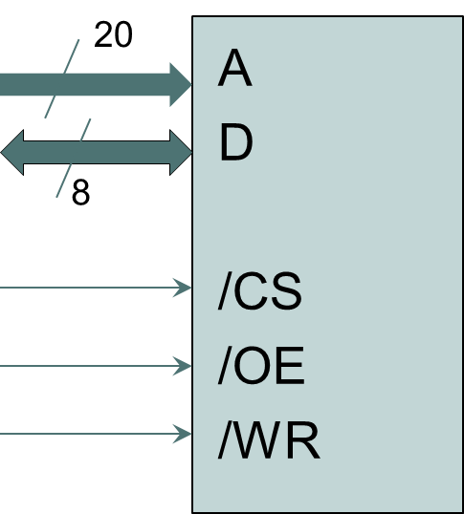
memory – concept
A memory device behaves like an array in C.
The memory device that is pictured here has size 2²⁰ and every addressable location can store 8 bits. The three control lines indicate when the memory is being addressed, if it is being read or written.
A – address bus. Input. With N address lines it is possible
to index 2^{N} unique locations.
D – data bus. Bidirectional. Width corresponds to the number of
bits stored in each addressable location.
/CS – active low chip select. When active, this device is selected.
/OE – active low output enable. When active, indicates the
device is being read.
/WR – active low write. When active, indicates the device is being written to.
source: Authors

Slide 138
memory – concept
Logical view
1 MByte
Addressing
Space
Byte 0xFFFFF
0xFFFFF
Byte 0xFFFFE
Byte 0xFFFFD
A memory device behaves like an array in C
Physical view
2²⁰ = 1,048,576
= 1 Mega
addressable locations
each location holds 8 bits
hence, total storage is 1 Mbyte
corresponding to a vector of
1,048,576 8-bit cells
Byte 1
Byte 0
0x0
source: Authors

Slide 139
memory – concept
1 MByte
Addressing
Space
Byte 0xFFFFF
0xFFFFF
Byte 0xFFFFE
Byte 0xFFFFD
From an external perspective, e.g. the perspective of the processor. This device is an array of 2²⁰ locations of 8 bits each.
Hence, the size of the memory is 1 MByte (1,048,576) and the width is 8 bits. Or, 1 M x 8 bits resulting in 8 Mbits of total storage capacity.
Internally the organization is different. Possibly this memory is organized as a matrix of 1024 line and 1024 columns with 8 bits in each position. Resulting in the capacity of 1024 x 1024 x 8 = 8 Mbits.
Byte 1
Byte 0
0x0
source: Authors

Slide 140
sample problem
Assume the only memory chip available is 1 M x 8 bits. How to implement 2M x 32bits = 8 MBytes of memory to a Cortex-M4 with data bus width of 32-bits?
Memory should be located from address 0x1000 0000 on.

Slide 141
sample problem
Byte at address
0xFFFF FFFF
Memory lines addresses
4 GBytes
addressing space
0xFFFF FFFC
The addressing space of a Cortex-M is 4 GBytes, i.e. 2³² = 4,294,967,296.
If physical memory is 32-bit wide (4 bytes) then there are 1 G lines (1,073,741,824). Each of these lines is addressable by its LSByte address.
Hence, 30 address lines are required to select a single
memory line (as 2³⁰ = 1 G)
The address lines A31-A2 are used to select on of the
1G lines while address lines A1 and A0 are used to
select a byte in the memory line
Memory address lines have their A1-A0 addresses set to 0.
Hence, the first memory line is at address 0x0000 0000, the second at address 0x0000 0004 and so on.
source: Authors
Byte 3
Byte 2
Byte 1
Byte 0
0x0

Slide 142
sample problem
0xFFFF FFFC
Since the capacity of each chips is 1 Mbit and 8 Mbits are required, 8 chips must be used.
Since the processor data bus is 32-bit wide and the memory is 8-bit wide, 4 chips are put side-by-side to complete one 32-bit wide memory line.
The first set of 4 chips have a combined capacity of 8 MWords and are mapped from address 0x1000 0000 to 0x103F FFFF.
The second set of 4 chips are mapped from 0x1040 0000 to 0x107F FFFF.
Byte at address
0x107F FFFF
B:1 MWord
0x107F FFFC
0x1040 0000
A:1 MWord
0x103F FFFC
0x1000 0000
source: Authors
Byte 3
Byte 2
Byte 1
Byte 0
0x0

Slide 143
sample problem
Selecting the address lines for CS (Chip Select) and for memory line addressing.
These are the 32-bit addresses from the Cortex-M processor:
...
A₃₁
A₃₀
A₂₉
A₂₈
A₂₇
A₂₆
A₂₅
A₂₄
A₂₃
A₂₂
A₂₁
A₄
A₃
A₂
A₁
A₀
these 10 address lines identify each of the 1 MWord regions.
In region A these address lines must be at 0001 0000 00 b
( 0x100)
While for region B:
0001 0000 01 b (0x104)
(these addresses are constant inside each of the 1MWord regions)
these 20 lines select one of the 1 G memory lines
these address lines select
the byte in the memory line
source: Authors

Slide 144
/CS1 must be active
in the range
0x1000 0000 to
0x103F FFFF
/CS2 must be active
in the range
0x1040 0000 to
0x107F FFFF
source: Authors
Notes:
BS - byte lane select
BS0 is active when the processor accesses the LSByte in a line
...
BS3 is active when the processor accesses the MSByte in a memory line
for a 32-bit access, all BSi are active simultaneously

Slide 145
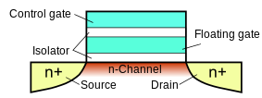
nor Flash memory
NOR Flash memory is frequently used in embedded systems to store non-volatile data, particularly code and constants.
Each bit of a NOR Flash memory is implemented by a single floating gate MOS. The floating gate may be charged and, since the floating gate is isolated, the charges are trapped into de gate. Hence, the two possible states are: charges trapped in the floating gate vs no charges trapped in the floating gate.
source: wikimedia.org (CC)
Notes:
https://en.wikipedia.org/wiki/Floating-gate_MOSFET#/media/File:Floating_gate_transistor-en.svg

Slide 146
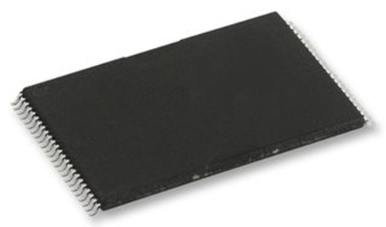
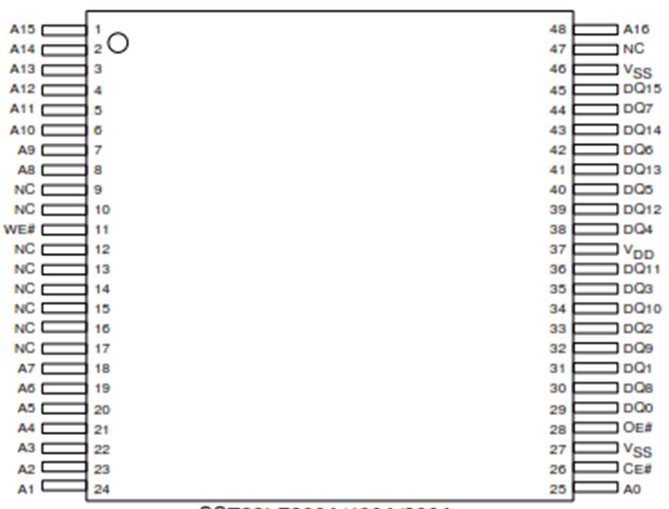
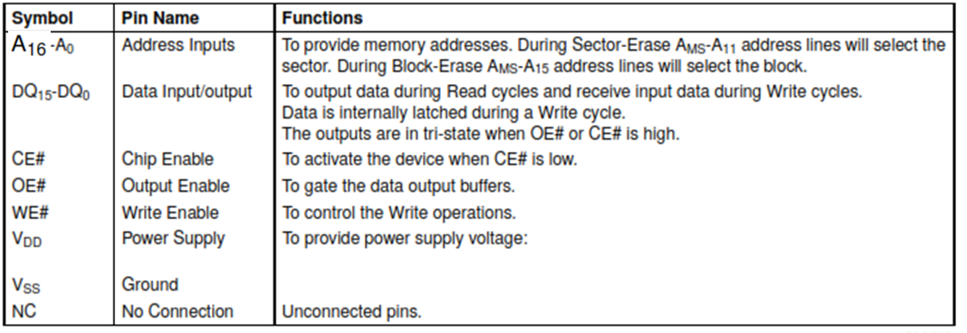
Example of a flash memory device 128K x 16 bits

Slide 147
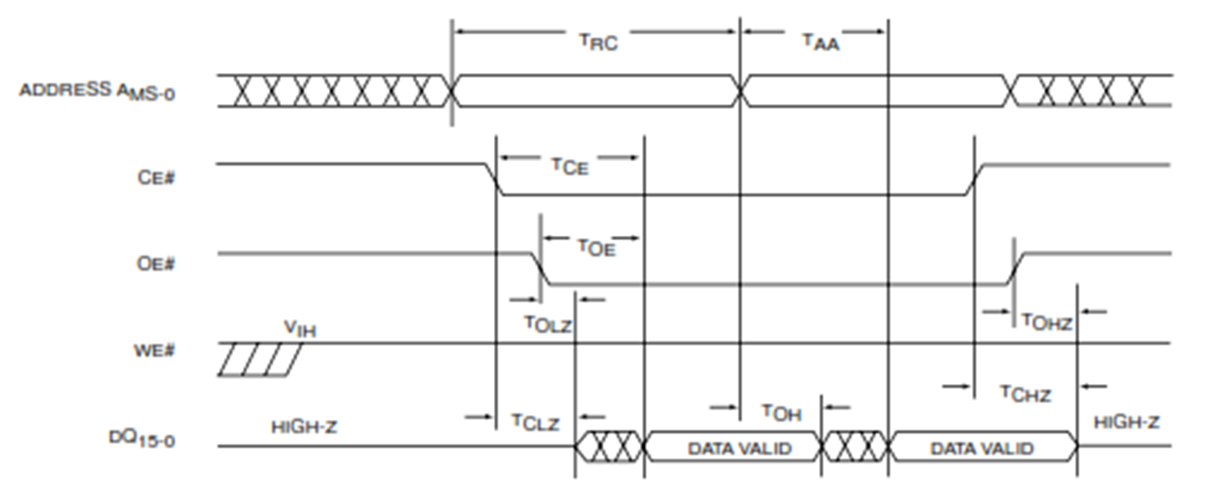
Example of a flash memory device 128K x 16 bits
The operation of a NOR Flash memory is straightforward: the processor sets the address to be read, and activates Chip Select (CE#) and Output Enable (OE#) after a delay (TCE of TOE) valid data is presented on the data bus.

Slide 148
SRAM example
source: Renesas
Notes:
https://www.renesas.com/en-us/doc/products/memory/r10ds0269ej0100-memory.pdf

Slide 149
internal organization

Slide 150
read cycle
Read Cycle timing diagram
Notes:
Read cycle:
1- processor sets the desired read address
2- processor activates CS
3- processor activates OE
4- after a maximum delay of 30 ns (tOE) the memory responds with the contents of the addressed location

Slide 151
write cycle
Write Cycle timing diagram
Notes:
Write cycle:
1- processor sets the desired write address
2- processor activates CS
3- processor puts data to be written on the address bus
4- processor activates WE indicating a write to the memory. This signal must be kept for 40 ns (tWP). Other signals must remain stable during this time.

Slide 152
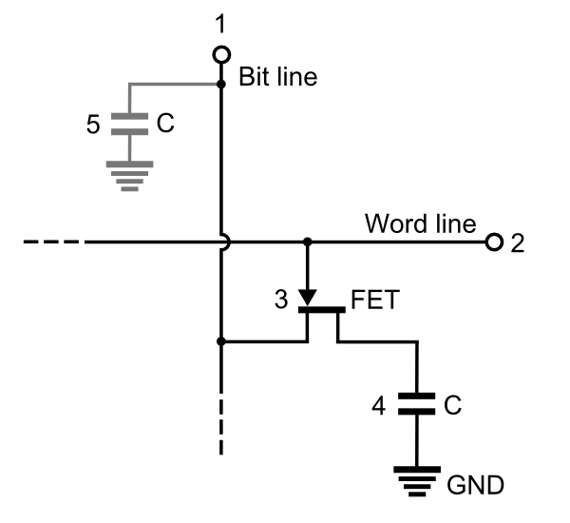
dynamic ram
In a dynamic RAM, each bit is implemented by a circuit consisting of a capacitor and a transistor.
The capacitor stores de information (charged vs discharged) and the transistor acts as a switch that connects the capacitor to the Bit Line when that particular bit is accessed.
Because the capacitance is very small and because of leakage, the charge of the capacitor only holds reliably for a few milliseconds, hence, this memory bit must be constantly refreshed.
Also, every read of a memory cell is destructive, hence, after a read the value must be rewritten.
source: wikimedia.org (CC)
Notes:
https://upload.wikimedia.org/wikipedia/commons/b/bd/DRAM_Cell_Structure_%28Model_of_Single_Circuit_Cell%29.PNG

Slide 153
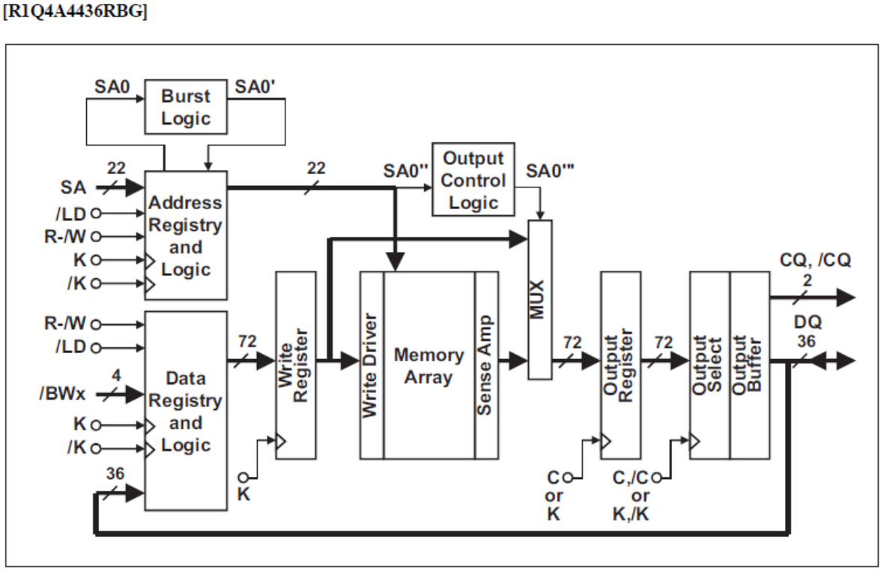
DDR – double data rate
Notes:
https://www.renesas.com/en-us/doc/products/memory/r10ds0146ej0102_memory.pdf

Slide 154
5 – Timer and GPIO
  Introduction - Peripherals
  Timer
  PWM – Pulse Width Modulations
  GPIO
  Low-power Drivers (LED, Relay)
  Power Drivers (DC Motor)

Slide 155
5.1 – peripherals
A Microprocessor-based system consists of three types of components:
  Microprocessor (the core of the MCU) - executes the instructions of a program;
  Memory - store code and data;
  Peripherals - perform specific functions particularly related to I/O. Peripherals provide the means for the system to sense, actuate and communicate with the world.
A microprocessor-based system without peripherals would be unable to interact with the rest of the world!
Notes:
Sections 5 to 11 of this course are on the subject of PERIPHERALS

Slide 156
peripherals
  Classes of peripherals in a microprocessor-based system:
  Digital I/O: input/output of digital signals,
  Analog I/O: input/output of analog signals,
  Timing: pulse generation, pulse measurement, PWM, ...
  Storage: non-volatile memory, file system, ...
  Communications: RS-232, SPI, I2C, CAN, USB, Ethernet, ...
  HMI: touch-screen, keyboard, ...
  Imaging: camera interface, ...
  System management: clock generation, watchdog, power management, ...

Slide 157
5.2 – Timers/Counters
  Timers/Counters are essential components of a Microcontroller Unit (MCU). They consists of a digital counter circuit that counts pulses on their input. Timers count clock pulses and Counters count pulses of a signal present on their input pin.
  Timers/Counters are used for:
  Measuring time, particularly time intervals,
  Counting events,
  Keeping track of current date and time (Real-Time Clock - RTC),
  Generating digital waveforms (PWM - Pulse-Width Modulation),
  Generating periodic interrupts to the MCU (Operating System Clock),
  Generating periodic signals to other peripheral, such as the command to start an Analog-to-Digital Conversion,
  Restart the MCU if software is unable to periodically restart a WATCHDOG timer.

Slide 158
TIMERS
  Timers/Counters vary in their characteristics, such as:
    edge of the input signal used for counting: positive, negative, or both edges;
    count direction: up, down, or both;
    what is being counted: clock pulses (timers) or other input signal (counters);
    periodic timers vs single-shot;
    a number of actions can be taken at the end of the timing period: change state of GPIO pin, generate IRQ, stop the timer, reload the timer;
    number of bits of the counter circuit: typically 32 bits for ARM MCUs;
    since the frequency of the input signal and number of bits of the counter determine the maximum timing period, a prescaler may be used to reduce the input frequency.

Slide 159
Timing sample problem 1
Consider the problem where an LED, connected to a pin on an MCU, must be on during 0.9 second.
The first solution to be presented is a software-based solution:
  Turn the LED on by activating the MCU pin connected to it;
  Execute a loop N times, where N is chosen so that the execution of the loop takes 0.9 second;
  Turn the LED off by deactivating the MCU pin connected to the LED

Slide 160
software-based solution
void hal_entry(void)
{
// pins 0,1,2 are output, reset pin 0 to 0 to turn green led ON
R_IOPORT6->PCNTR1 = 0x00060007;
__asm(" ldr r4,=72000000-2");
__asm("loop: ");
__asm(" subs r4,r4,#1 ");
__asm(" bne loop ");
// pins 0,1,2 are output, set pin 0 to 1 to turn green led OFF
R_IOPORT6->PCNTR1 = 0x00070007;
}

Slide 161
software-based solution
  This is the Timing Diagram for the execution of the code of the previous slide.
  Due to branch forwarding at the decode stage of the BNE instruction, each loop takes 3 clock cycles.
  At 240 MHz (period of 4.16ns),
  it takes 12.5 ns for each
  loop; hence, 0.9 second
  takes 72,000,000 loops.
  Remark: the loop_count must
  be reduced by 2 to compensate
  for GPIO and load instructions.
source: Authors

Slide 162
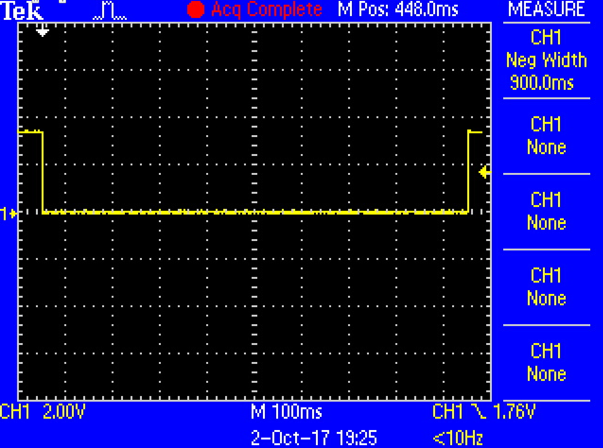
software-based solution
  Connecting a scope to the LED allows us to verify the timing of the software-based solution.
source: Authors

Slide 163
software-based solution
Evaluation of the software-based solution:
  100% of the MCU processing capability was used for counting so that the exact timing of 0.9 seconds was obtained.
  No other activities where executed by the processor during this time.
  If interrupts where allowed, there would have been an error in timing.
    This software-based solution is called busy-wait. It should be avoided as it wastes processor cycles and energy.

Slide 164
A very simple timer
  To avoid the drawbacks of the software-based solution, a small piece of hardware is added to an MCU: a counter.
  This circuit performs the function of counting clock cycles, freeing the processor to perform other tasks.

Slide 165
A very simple timer
Description:
  The counter decrements its value on every positive edge of the CLK.
  The processor can write an initial count value by performing a load followed by a start command.
  When the count reaches 0 the Z output is activated.
  The Z output may command a change to the GPIO pin, generate an Interrupt Request (IRQ), and stop the counter.
source: Authors

Slide 166
A very simple timer
  clk 1 - the value 5 is loaded to the counter.
  clk 2 - the processor commands the start of the counting.
  clk 3 to 7 - count value is decremented on every positive edge of the CLK.
  clk 7 - count reaches 0 activating the Z output.
source: Authors

Slide 167
solving the Timing sample problem 1 using the simple timer
Solution:
  Load the value 72,000,000 to the timer and start it.
  When the count reaches zero:
    Option 1: timer commands LED pin to turn LED off;
    Option 2: generate an IRQ and its service routine turns the LED off.
  Remark: for option 2, the value loaded to the timer should be lower to compensate for the entry into the interrupt service routine.

Slide 168
solving the Timing sample problem 1 using the simple timer
Evaluation:
  The solution using a timer requires significantly less processing power, just a few cycles to configure the timer and to perform an action when the timing period finishes.
  Processor is free to perform other tasks OR
  processor can be put into a low energy sleep state.
  If interrupts are serviced during the timing period, this will not affect the timing precision.

Slide 169
timer case study 1 – systick
  The SYSTICK is a timer available in all Cortex-M processors.
  It is a simple 24-bit counter with auto-reload.
  Its main use is to generate periodic interrupts required by most Embedded Operating Systems.
  Since its structure and operation is defined by ARM, its interface is standard, regardless of MCU supplier.

Slide 170
timer case study 1 – systick
SysTick auto-reload has a period
of SYST_RVR + 1 clock cycles.
source: Authors
(based on ARM documentation:
DDI0403D ARMv7-M Architecture Reference Manual)
Notes:
LOCO - Low-speed on-chip oscilator, available on the S7G2 MCU, typically running at 32768 Hz
ICLK - System clock of the S7G2 core, typically running at 240 MHz
SYST_CSR - is one of the four registers of the SysTick Timer, next slide presents these register.
SYST_CSR has 4 bits with individual funtions
When the load input of the 24-bit counter is activated, the value of the SYST_RVR is loaded on the NEXT CLOCK, hence, the counting cycle starts at the reload value and decrements up to 0. Total of SYST_RVR + 1 clock cycles.

Slide 171
timer case study 1 – systick
SYST_CSR controls de operation of SysTick. When this register is read, COUNTFLAG is cleared.
SYST_RVR holds de 24-bit reload value. Writing a 0 to this register disables SysTick.
SYST_CVR is the current count value. By writing any value to it the register is cleared.
SYST_CALIB values are factory defined. TENMS, if available, holds the reload value corresponding to 10 ms for the reference clock.
source: DDI0403D ARMv7-M Architecture Reference Manual

Slide 172
timer case study 1 – systick
  Timing diagram for the scenario where SYST_RVR holds the value 2.
  As the reload occurs on the next positive edge of the clock, the SysTick period is of 3 clock cycles.
  If enabled, every reload generates a SysTick interrupt request (IRQ).
source: Authors

Slide 173
5.3 – pwm
  Pulse Width Modulation (PWM) is a modulation technique that allows the encoding of analog information in a binary digital signal.
  This is achieved by encoding the information in width of a pulse while maintaining the pulse frequency constant.
  A low pass filter with cut-off frequency way below the PWM frequency restores the analog information.
  PWM has several applications including: control of power electronics including switched power supplies, motor control, temperature control and light dimmering; audio power-amplifiers; and analog signal generation.
  Often, a low-pass filter is not required as the load itself performs this function.

Slide 174
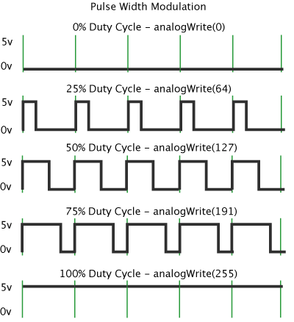
pwm
The effect of 5 different duty cycles after passing a low-pass filter:
0 V
1.25 V
2.5 V
3.75 V
5V
low-pass filter
source: commons.wikimedia.org (CC)
Notes:
source: https://commons.wikimedia.org/wiki/File:Pwm_5steps.gif (CC)

Slide 175
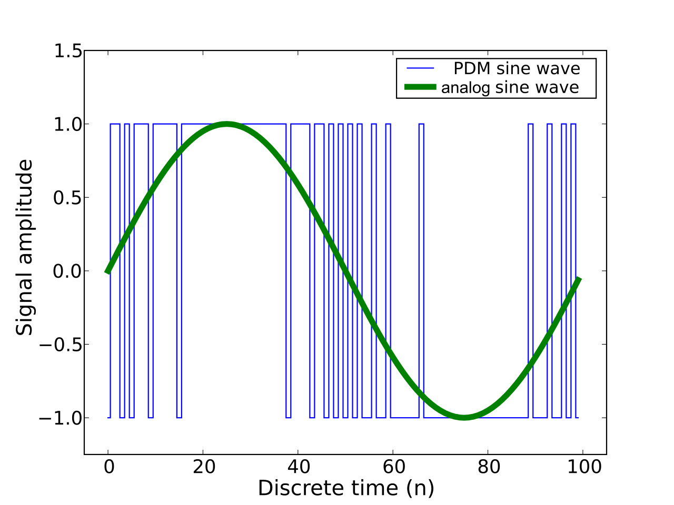
pwm
  If the duty cycle of a PWM signal is varied on every PWM period, an analog signal can be produced (after a low-pass filter).
  The higher the frequency of the PWM signal when compared to the frequency of the analog signal, the better (less noisy) the analog signal will be.
source: commons.wikimedia.org (CC)
Notes:
https://commons.wikimedia.org/wiki/File:Pulse_density_modulation.svg

Slide 176
a pwm timer
Operation:
  at start of period set the GPIO pin.
  counts up from 0.
  when counter matches Match Reg
  then reset GPIO pin.
  when counter matches Limit Reg
  then:
  set GPIO pin;
  generate IRQ;
  reset counter.
  interrupt service routine may
  reprogram the match register.
source: Authors

Slide 177
TIMER case study 2 – S7G2 GPT
The Renesas S7G2 MCU has 14 timers of the type GPT (General PWM Timer).
Each one is a complex circuit that provides significant flexibility for a variety of applications.

Slide 178
TIMER case study 2 – S7G2 GPT
Diagram shows the hardware modules of the S7G2 MCU.
General PWM Timers (GPT) are identified.
source: Renesas S7 Series Microcontrollers User’s Manual

Slide 179
TIMER case study 2 – S7G2 GPT
There are 14 timers, grouped into:
  4x EH - enhanced high resolution
  4x E - enhanced
  6x - conventional
source: Renesas S7 Series Microcontrollers User’s Manual

Slide 180
TIMER case study 2 – S7G2 GPT
source: Renesas S7 Series Microcontrollers User’s Manual

Slide 181
TIMER case study 2 – S7G2 GPT
source: Renesas S7 Series Microcontrollers User’s Manual
Notes:
List of the registers that compose the interface of EACH General PWM Timer
Note that register names start with GT

Slide 182
TIMER case study 2 – S7G2 GPT
Simplified view of a GPT
source: Authors
Notes:
see next slide for an explanation of this block diagram

Slide 183
TIMER case study 2 – S7G2 GPT
GPT characteristics and operation:
  The counter (GTCNT) can count up (from 0 to GTPR), count down (from GTPR to 0) or up and down (from 0 to GTPR and back to 0).
  Hence, the period is either GTPR+1 or 2x GTPR;
  Due to a prescaler, the clock source can be selected from PCLKD to PLCKD/1024;
  A GPT can be used to trigger the start of an AD conversion, registers GTADTR are used to determine the timing to command the start;
  8 compare registers are available. On match, a number of actions can take place: set, reset, toggle an IO pin, generate an interrupt request, generate an event, ...

Slide 184
5.4 – GPIO
General Purpose Input/Output (GPIO) is possibly the simplest form of I/O in a system.
An input pin can be connected to a key, a push-button, or any other digital signal. By reading the pin the program can detect if it is on high or low level and take appropriate action.
Input pins can generate interrupt requests (IRQ) when a required transition or level is detected.
An output pin can be connected to an LED, to a switch (transistor, relay) or any other device to be controlled by.

Slide 185
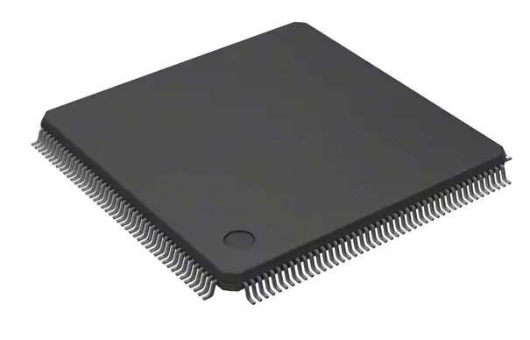
gpio case study – s7g2 i/o ports
The MCU used in the lab experiments (kit SK-S7G2) is the R7FS7G27H3A01CFC. Its packaging is a 176 pins LQFP (Low-profile Quad Flat Package).
Of its 176 pins, 126 are available either for I/O or to be used by the integrated peripherals.
The I/O pins are grouped into 12 ports
(P0 to PB) each with up to 16 pins.
Port | pins |  | Port | pins
P0 | 13 |  | P6 | 16
P1 | 16 |  | P7 | 8
P2 | 10 |  | P8 | 7
P3 | 16 |  | P9 | 6
P4 | 16 |  | PA | 5
P5 | 11 |  | PB | 2

Slide 186
gpio case study – s7g2 i/o ports
source: Renesas S7 Series Microcontrollers User’s Manual
I/O pins can be configured in several ways:
  inputs may have an internal pull-up;
  outputs may be open-drain;
  output current capacity may be selectable:
  2, 4, 16/20 mA;
  some inputs are 5V tolerant.
Remarks:
  total current provided by the MCU is restricted to 80 mA;
  configuration capabilities vary from pin to pin, see table on the right.
rem: not all pins listed above are available on the part number R7FS7G27H3A01CFC

Slide 187
gpio case study – s7g2 i/o ports
Simplified block diagram
of an I/O pin
Reg | Description
PODR | Port output data
PDR | Port direction
PIDR | Port input data
PMR | Port mode: I/O vs periph.
source: Authors
Notes:
Operation:
to operate as output pin, PMR is 0, selecting the value present at PODR to go to the output amplifier; PDR is 1 (direction = out)
to operate as input, PMR is 0 and PDR is 0. In this case the output amplifier is not enabled. When a pin read is requested the input amplifier is enabled and the logic value at the pin is copied to PIDR
When PMR is 1, the pin is connected to the peripheral. It can operate as input, output, or bidirectional
Signals at the pin may generate events or interrupts.
Events may change the value of PODR affecting the output.

Slide 188
gpio case study – s7g2 i/o ports
source: Renesas S7 Series Microcontrollers User’s Manual
Block diagram for an I/O pin
Reg | Description |  | Reg | Description
PCR | Pull-up control |  | PODR | Port output data
PDR | Port direction |  | PSEL | Peripheral sel.
DSCR | Drive capabil. |  | PIDR | Port input data
NCODR | open-drain ctr |  | ISEL | interrupt enable
EOSR | evt output set |  | ASEL | analog select
EORR | event output reset |  | PMR | Port mode: I/O vs periph.
POSR | port output set |  | EIDR | event input data
PORR | port output reset |  | EOF/ EOR | event on falling/ rising edge

Slide 189
5.5 – low-power drivers
When a device connected to an output pin has low input current requirements (low typically means below 1 mA) then it can be directly connected to the I/O pin.
Example: the Renesas Development Kit for S7G2 has an audio amplifier and a speaker connector.
This audio amplifier is controlled
by an output pin:
  P902 is an I/O pin of the S7G2 microcontroller that controls if
  the amplifier is enabled or not.
source: Renesas Development Kit S7G2 (DK-S7G2) User’s Manual

Slide 190
low-power drivers
In the case of a small LED, which typically requires current around 2 to 5 mA to light up, a limited number can still be connected directly to output pins.
The S7G2 MCU has the same source and sink capability, meaning that an output pin configured for middle drive capacity can source 4mA when its output is high and can sink 4mA when its output is low.
This symmetry is not a rule, many digital logic ICs are capable to sink much higher currents than to source them. Hence, quite often, devices such as LEDs are turned on by an output pin sinking current, i.e. with a logic level 0.
P6.0 = 0 (0V) LED is ON
P6.0 = 1 (3.3V) LED is OFF
source: Authors
Notes:
What is the current through the LED when P6.0 is at level 0?
LED voltage drop = 1.7V
P6.0 low level output voltage = 0.1V
(3.3 - 1.7 - 0.1)/470 = 3.2 mA

Slide 191
5.6 – Power drivers
Loads that require higher currents than in the previous examples are controlled by output pins connected to interface circuits, such as:
  Transistor (bipolar, MOS, or BICMOS),
  Relay,
  H-Bridge,
  Other power electronics circuits.
Such interface circuits also allow the use of much higher voltages on the load.

Slide 192
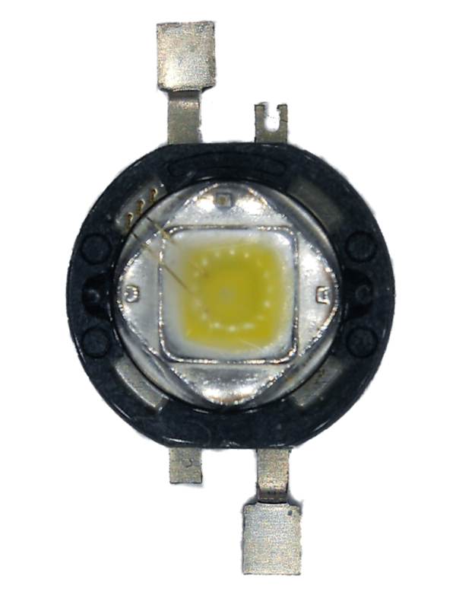
Power drivers
Example 1 - Power LED
Consider a Power LED requiring
a forward current of 500mA with a
forward voltage of 3.2V ± 0.15V
(varies with ambient temperature
and component sample).
source: wikimedia.org (CC)
Notes:
https://commons.wikimedia.org/wiki/File:SSC_(Seoul_Semiconductor)_Z-Power_P4_LED_white.png

Slide 193

Power drivers
source: wikimedia.org (CC)
Example 1 - Power LED
A low-cost solution consists of a transistor,
acting as a power switch, and a series
resistance, to limit the forward current.
When P6.0 is at logic level 1, Q1 is on and LED is on.
When P6.0 is at logic level 0, Q1 and LED are off.
Drawbacks:
R1 dissipates 1W when LED is on.
LED current, and brightness, vary with LED forward voltage.
Advantages:
Load can operate from a power source with different voltage.
(in this example, MCU VDD is 3.3V and LED is powered from 5V)
source: Authors
Notes:
Q1 is a N-channel power MOS FET
R2 keeps the transistor OFF if P6.0 is floating (high-Z)
Current calculation:
(5V-3.2)/3.6 = 500 mA
when led voltage is 3.05, current goes up to 540 mA
when led voltage is 3.35, current is 460 mA

Slide 194
Power drivers
Example 2 - Relay
If galvanic isolation between the MCU and the load is required, a solution is the use of a relay.
When P6.0 is at logic level 1, the transistor is ON, current flows through the relay coil and the contact closes, turning the electric motor ON.
When P6.0 is at 0, the motor is off.
Since the relay coil is an inductive load to the transistor, the diode is required to avoid voltage spikes when the transistor switches off.
Q1: n-channel MOS FET
source: Authors

Slide 195
Power drivers
Example 3 - H-Bridge
An H-Bridge consists of four switches (in this case four n-mos). The load is a DC motor. When Q1 and Q4 are ON, the motor is energized. When Q2 and Q3 are ON the polarity is reversed.
Q1 and Q2 should never be ON at the same time as this would short circuit the power supply. For the same reason, Q3 and Q4 should never be ON at the same time.
Typically, the four switches are driven by PWM signals to control the current and the speed of the motor.
Notes:
further reference: http://www.modularcircuits.com/blog/articles/h-bridge-secrets/h-bridges-the-basics/

Slide 196
Power drivers
Example 4 -
Power LED driver using a switching power supply.
GPIO can turn LED on or OFF.
Alternatively, PWM can dimmer the LED.
When compared to Example 1, this circuit does not waste energy on a current limiting resistor, hence, it is energy efficient.
source: Authors
Notes:
R1 and R2 are low value resistors used for current sensing
Q1 is part of a Boost DC-DC converter
Q2 works as a switch used to dimmer the LED

Slide 197
6 – Interrupt Controller
  NVIC
    Structure
    Registers
  CMSIS interface for NVIC operations

Slide 198
NVIC
The Nested Vectored Interrupt Controller (NVIC) is an integral part of the Cortex-M4 architecture. Hence, all Cortex-M4 have the same interrupt controller.
Exception handling was examined in Section 3 (link)
Functionality of the NVIC:
  Detect interrupt requests (IRQ) at its inputs and combine them into a single interrupt request to the microprocessor core
  Capability to mask any given input
  Associate inputs to interrupt priority levels

Slide 199
NVIC
The Cortex-M4 NVIC may have up to 240 IRQ inputs.
Each input is an interrupt request coming from an integrated peripheral, an external pin, or even from the core itself to inform of a system exception.
The operation of the NVIC is configured by the core via a set of NVIC registers that provide the functionality of:
  input masking
  IRQ priority assignment
  check status of input
  (is there a pending IRQ?)
source: Authors

Slide 200
nvic characteristics
The Nested Vectored Interrupt Controller provides support for:
  Nested exceptions – each exception has an associated priority level. Nesting means that when an exception is being serviced, it can be interrupted by a higher priority exception that was activated. Once the higher priority exception has its service completed, the lower priority service resumes.
  Vectored exceptions – the starting addresses of the service routines (handlers) are stored in a table (vector table). When IRQi is detected the processor simply reads entry i of the table and starts servicing, avoiding delays to start the handler.
  Interrupt masking – each IRQi can be individually masked, i.e. ignored.

Slide 201
vector table
By default, its start address is 0x0.
The table has a 31-bit address for each of the possible exceptions (number is implementation dependent).
The 32th bit (the LSb) is used to identify the instruction set (ARM or Thumb) and must be always set in a Cortex-M processor
The first entry in the table is the initial value of the SP.
The next 15 entries are for the system exceptions
(Reset, NMI, … SysTick).
Then follow up to 240 entries for IRQ0 to IRQ239.

Slide 202
vector table for the renesas s7g2
On the S7G2 the interrupt sources are managed by the ICU – Interrupt Control Unit.
The ICU sits between the peripherals and the NVIC, preprocessing the interrupt requests before sending them to the NVIC.
…

Slide 203
exception handling state machine
Exception
Request
Inactive
Pending
Exception
Servicing starts
Exception
Servicing finishes
Active
Exception
Servicing finishes
Exception
Request
Active and Pending
source: Authors
Notes:
DDI0403E_B p 569
Inactive An exception that is not pending or active.
Pending An exception that has been generated, but that the processor has not yet started processing. An
exception is generated when the corresponding exception event occurs.
Active An exception for which the processor has started executing a corresponding exception handler, but
has not returned from that handler. The handler for an active exception is either running or
preempted by a the handler for a higher priority exception.
Active and pending
One instance of the exception is active, and a second instance of the exception is pending.
Only asynchronous exceptions can be active and pending. Any synchronous exception is either
inactive, pending, or active

Slide 204
functional model of the nvic
source: Authors
Notes:
This diagram presents an equivalent functionality to what is implemented in the NVIC
- internal interrupt request signals arrive via IRQi (I = 0..239); actual number of IRQ lines is implementation dependent and varies among Cortex-M4 MCUs.
- IRQi lines can be individually masked (when masked, NVIC ignores their state)
- the NVIC input lines are level sensitive (high level) and edge sensitive (positive edge)
- inputs are sampled on every processor clock, hence, a pulsed IRQ must have a minimum duration of 1 clk
- the edge detector circuit detect a sample at low level followed by a sample at high level (samples are taken on the positive edge of the processor clock). Its output is 1 when an positive edge of IRQi is detected.
- the level detection circuit outputs a 1 if IRQi is high when the current state of this interrupt is NOT Active
- either way, the FF is set on the next clk indicating that IRQi is pending
- the priority arbitration circuit will select the highest priority pending IRQ and informs the core
- if PRIMASK and BASEPRIO determine that IRQi has sufficient priority then some registers are stacked and the ISR is started
- the start of the ISR clears the pending-status-latch and sets the active-status-latch
- NMI and HardFault have similar circuitry but NMI cannot be masked.
P-FF can be set/cleared by SW using the registers of NVIC

Slide 205
nvic – arm documentation
ARMv7-M Architecture Reference Manual (2014)
ARM DDI 0403E.b
ARM® Cortex® -M4 Processor Revision: r0p1 (2015)
Technical Reference Manual
ARM 100166_0001_00_en
Cortex™-M4 Devices Generic User Guide (2011)
ARM DUI 0553A

Slide 206
nvic registers
source: ARM® Cortex® -M4 Technical Reference Manual
Notes:
NVIC’s operation is very simple, there are few registers to control it.

Slide 207
nvic registers – ictr
Since the number of input lines
(IRQi) to the NVIC is implementation dependent, so is the number of registers to control the NVIC.
ICTR informs how many control registers are actually implemented in any given NVIC.
For the Renesas S7G2, ICTR.INTLINESNUM holds the value 2, meaning that there are 3 registers of each type (ISER, ICER, ISPR, ICPR, IABR, with indexes 0..2; and 24 registers IPR, with indexes 0..23). The number of input lines IRQi on this processor is limited to 96.
source: ARM® Cortex® -M4 Technical Reference Manual

Slide 208
nvic registers – iSER – s7g2
In a Renesas S7G2, each bit of registers ISER[0] to ISER[2] corresponds to one of the 96 IRQi lines.
on write: 1 enables the interrupt line, 0 has no effect
on read: returns the current state of each IRQi line
0 = disabled, 1 = enabled

Slide 209
nvic registers – ICER/ISPR/ICPR/IABR – s7g2
Same bit assignment as for ISER.
ICER: on write: 1 disables the interrupt line, 0 has no effect
on read: report the current state of each IRQi line, 0 = disabled, 1 = enabled
ISPR: on write: 1 sets the interrupt line to pending, 0 has no effect
on read: report the current state of each IRQi line, 0 = not-pending, 1 = pending
ICPR: on write: 1 clears the pending state of the interrupt line, 0 has no effect
on read: report the current state of each IRQi line, 0 = not-pending, 1 = pending
IABR: read only: report the current state of each IRQi line, 0 = not-active, 1 = active

Slide 210
NVIC priorities
On the Cortex-M4, each IRQi line has a register that defines its priority level in relation to the other IRQi lines. This register may have up to 8 bits (implementation defined).
On the S7G2, 4-bit registers are implemented, allowing the definition of up to 16 priority levels. 0 is the highest priority and 15 is the lowest. Since these bits are left aligned, the actual values are 0, 0x10, 0x20, 0x30, … 0xF0.
A higher priority interrupt preempts a lower priority interrupt whose handler is being executed.

Slide 211
NVIC priorities
The bits of the priority register are divided into:
  Priority Group
  Priority Subgroup
The bits in the Priority Group define the number of priority levels for the purpose of preemption.
The bits in the Priority Subgroup define the number of sub-levels for the purpose of selecting which IRQi will be serviced first if two IRQi are simultaneously pending when the core accepts an interrupt.

Slide 212
NVIC priorities
The PRIGROUP bits of the AIRCR register are used to configure the division of bits among Priority Group and Subgroup.
AIRCR.PRIGROUP may be written with values in the range of 0 .. 7
On the S7G2, programming PRIGROUP with 0, 1, 2 or 3 has the effect of using the four bits for Priority Group and none for the Subgroup.
For PRIGROUP = 4 the division is 3.1 (3 for Group and 1 for Subgroup)
For PRIGROUP = 5 the division is 2.2, and so on…

Slide 213
cmsis-core interrupt functions
These is a partial list of the functions available in
CMSIS-CORE that provide access to the NVIC as well
as to other interrupt functionality.
Next slides detail these functions
source: infocenter.arm.com
Notes:
http://infocenter.arm.com/help/index.jsp?topic=/com.arm.doc.100235_0002_00_en/fbx1478878011595.html

Slide 214
cmsis-core interrupt functions
typedef enum {
/* ------------------- Cortex-M4 Processor Exceptions Numbers ------------------- */
Reset_IRQn = -15, /*!< 1 Reset Vector, invoked on Power up and warm reset */
NonMaskableInt_IRQn = -14, /*!< 2 Non maskable Interrupt, cannot be stopped or preempted */
HardFault_IRQn = -13, /*!< 3 Hard Fault, all classes of Fault */
MemoryManagement_IRQn = -12, /*!< 4 Memory Management, MPU mismatch, including Access Violation
and No Match */
BusFault_IRQn = -11, /*!< 5 Bus Fault, Pre-Fetch-, Memory Access Fault, other address/memory
related Fault */
UsageFault_IRQn = -10, /*!< 6 Usage Fault, i.e. Undef Instruction, Illegal State Transition */
SVCall_IRQn = -5, /*!< 11 System Service Call via SVC instruction */
DebugMonitor_IRQn = -4, /*!< 12 Debug Monitor */
PendSV_IRQn = -2, /*!< 14 Pendable request for system service */
SysTick_IRQn = -1, /*!< 15 System Tick Timer */
} IRQn_Type;
This is the IRQn_Type enumeration defined in file S7G2.h
Notes:
The CMSIS-Core interrupt functions have a parameter of type IRQn_Type. This is the exception identifier that uses the constants defined here or the IRQ numbers managed by the Renesas Synergy SSP.

Slide 215
cmsis-core interrupt functions
void __enable_irq(void)
Resets PRIMASK in the core, allowing interrupts from NVIC to be serviced.
Example: __enable_irq( );
void __disable_irq(void)
Sets PRIMASK in the core, preventing exceptions with configurable priorities (exceptions 4 and up) to be serviced.
Example: __disable_irq( );

Slide 216
cmsis-core interrupt functions
void NVIC_EnableIRQ(IRQn_Type)
Enables (unmask) a specific IRQi line
Example: NVIC_Enable(SysTick_IRQn);
void NVIC_DisableIRQ(IRQn_Type)
Disables (mask) a specific IRQi line
Example: NVIC_Disable(SysTick_IRQn);

Slide 217
cmsis-core interrupt functions
uint32_t NVIC_GetPendingIRQ(IRQn_Type)
Reads the Pending status (P_FF) returning 0 (not pending) or 1 (pending)
Example: uint32_t pend = NVIC_GetPendingIRQ(SysTick_IRQn);
void NVIC_SetPendingIRQ(IRQn_Type)
Sets the Pending status (P-FF) of a specific IRQi line
Example: NVIC_SetPendingIRQ(SysTick_IRQn);
void NVIC_ClearPendingIRQ(IRQn_Type)
Clears (resets) the Pending status (P-FF) of a specific IRQi line
Example: NVIC_ClearPendingIRQ(SysTick_IRQn);

Slide 218
cmsis-core interrupt functions
void NVIC_SetPriority(IRQn_Type IRQn, uint32_t priority)
Sets the priority of a specific IRQi line
Example: NVIC_SetPriority(SysTick_IRQn,4);
uint32_t NVIC_GetPriority(IRQn_Type IRQn)
Get the priority level of a specific IRQi line
Example: uint32_t prio = NVIC_GetPriority(SysTick_IRQn);
Rem: The integer value of the priority must be in the range of 0 .. 2N-1, where
N is the number of priority bits implemented. For S7G2 the range is 0..15.

Slide 219
cmsis-core interrupt functions
uint32_t NVIC_GetActive(IRQn_Type)
Reads the Active status (ACTIVE_FF) returning 0 (not active) or 1 (active)
Example: uint32_t act = NVIC_ GetActive(SysTick_IRQn);

Slide 220

7 – Analog Interfacing
  ADC – Analog to Digital Converter
  DAC – Digital to Analog Converter
recommended readings:
1- http://www.analog.com/en/analog-dialogue/articles/the-right-adc-architecture.html
2- The Data Conversion Handbook, Edited by Walt Kester, Analog Devices Inc.

Slide 221
Analog VS DIGITAL
  Real world phenomena, such as audio, images, temperature, forces, pressure, and so, can be represented by waveforms that are continuous both in time and amplitude with an infinite resolution.
  Sensors are able to convert these physical quantities into analog electrical signals that can be processed by analog circuits. This was the most common case a few decades ago: radio, audio amplifiers, television, ...
  Nowadays, these physical quantities are converted to a sequence of numbers, i.e. they were digitized, so that they can be processed by a computer (digital processor).

Slide 222
Analog VS DIGITAL
Analog | Digital
Physical quantities are converted to electrical signals that are continuous both in time and amplitude. | Physical quantities are converted into numeric codes after being discretized both in the time (sampling) and in amplitude (quantization).
Analog signal are prone to noise and distortion during processing and transmission. Hence, signal quality decreases as the signal travels through a system. | Digital signals are much more robust to noise and distortion. They can be restored to their original value after a noisy system stage.
Analog processing is typically done by a hardwired circuit that performs a predefined processing function. | Digital signal processing is typically performed in software, thus, its function can be changed dynamically.

Slide 223
interacting with an analog world
source: Authors
To interact with the physical quantities in the real world, sensors and actuators are required.
Sensors perceive (“read”) a phenomena and translate it to an electrical signal. The output of a sensor can be an analog signal or a digital signal.
Analog sensors require an Analog-to-Digital conversion before the information is digitally processed.
Actuators act upon (“write to”) the environment. The input of an actuator may be an analog or digital signal. To connect a digital processor to an analog actuator a Digital-to-Analog conversion is required.

Slide 224
sensors
Two alternatives to the implementation to a sensor in a microprocessed system:
  Digital Sensor
  Analog Sensor + ADC
a)
b)
source: Authors

Slide 225

Example of a digital sensor - encoder
A rotary optical encoder is an angular position sensor. It consists of a disc with transparent and opaque areas that are detected by a photodetector.
The disc show is of an absolute rotary encoder.
Alternatively, an incremental (or relative) rotary encoder generates pulses to represent angular movement of its axis. A set of two pulse stream, shifted by 90 degrees, allows the detection of the direction of movement in an incremental rotary encoder.
source: wikimedia.org (CC)
Notes:
Disc of an absolute rotary encoder:
https://commons.wikimedia.org/wiki/File:Encoder_Disc_(3-Bit).svg
Photograph of a rotary encoder.
By IP83 - Own work, CC BY-SA 3.0, https://commons.wikimedia.org/w/index.php?curid=131620

Slide 226
example of an audio processing system
source: Authors
In this example, the microphone is an analog sensor;
the speaker is an analog actuator and its driver is the amplifier.

Slide 227
the analog-to-digital conversion process
The conversion of an analog signal to digital requires several steps:
  Low-pass filter to guarantee that the input signal spectrum is limited to a given frequency (f_{signal})
  Sampling (time discretization) - at periodic intervals take samples of the analog signal. The signal amplitude is still an analog value.
  Quantization (amplitude discretization) - mapping of the continuous amplitude range into a set of discrete values.

Slide 228
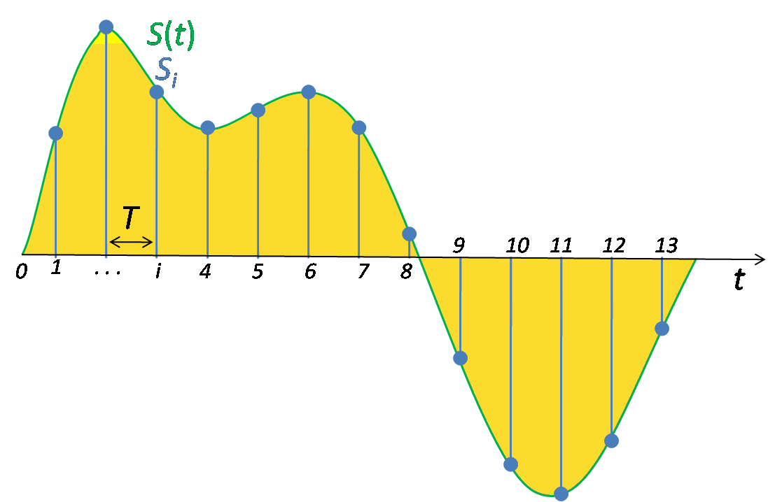
sampling
source: wikimedia.org (CC)
The green curve represents an analog signal S(t).
This signal is sampled periodically, T being the sampling period, resulting in a discrete sequence of samples Si (i = 1,2,3,...).
The amplitude of each sample is an analog value.
Sampling is performed by a Sample-and-Hold (S&H) circuit, represented by a switch and a capacitor. The switch closes momentarily, the capacitor is charged with the current value of the input signal, the switch opens and the value remains “memorized” by the capacitor.
source: Authors
Notes:
sampled waveform
https://upload.wikimedia.org/wikipedia/commons/5/50/Signal_Sampling.png

Slide 229
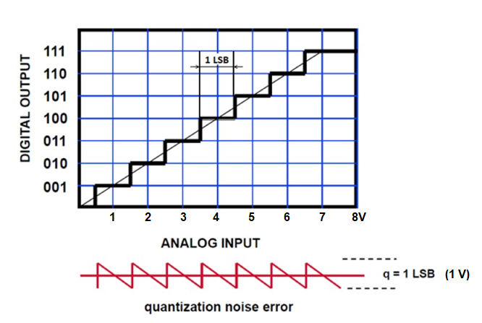
Quantization
To illustrate de quantization performed by an ADC, consider the transfer function on the right. The horizontal axis is the analog input values to the ADC and the vertical axis are the digital codes produced by the ADC.
In this example the ADC has 3 bits, hence, it is able to represent 8 binary values, from 0 (000) to 7 (111). The input range for this example is from 0 to 8 volts.
The bold line in the graph is the transfer function. If the input voltage is 3.8 volts, the output code will be 4 (100), representing 4 volts. The difference between the actual input value (3.8) and the output value (4) is the quantization error and it is due to the output assuming only a discrete set of values.
source: Renesas DevCon2015
Mitch Ferguson - ADC Specifications
Notes:
1 LSB represents the input voltage corresponding to the least significant bit of the output code. In this example, since there are 8 output codes and the input range is 8V, the LSB represents 1V. The maximum quantization error in an ideal ADC is ½ LSB. In this example, the maximum quantization error is +/- 0.5V

Slide 230
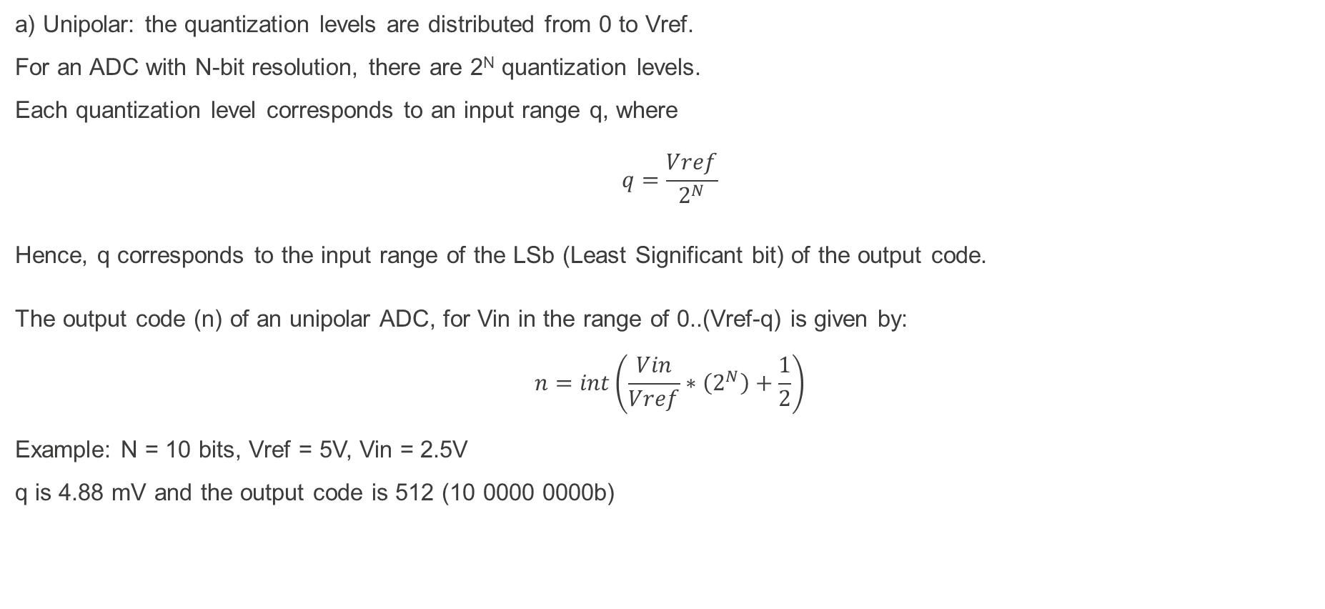
Output value calculation
a) Unipolar: the quantization levels are distributed from 0 to Vref.
For an ADC with N-bit resolution, there are 2^{N} quantization levels.
Each quantization level corresponds to an input range q, where
$$q=\frac{Vref}{2^{N}}$$
Hence, q corresponds to the input range of the LSb (Least Significant bit) of the output code.
The output code (n) of an unipolar ADC, for Vin in the range of 0..(Vref-q) is given by:
$$n=int\left(\frac{Vin}{Vref}∗\left(2^{N}\right)+\frac{1}{2}\right)$$
Example: N = 10 bits, Vref = 5V, Vin = 2.5V
q is 4.88 mV and the output code is 512 (10 0000 0000b)
int(x) results in the integer part of x by truncation.
Hence, for x ≥ 0, int(x) = floor(x)
and for x < 0, int(x) = ceiling(x)
Notes:
For a reduced number of quantization levels, it is feasible to use a graph representation of the transfer functions, as in the slide about Quantization.
For a large numbers of quantization levels, a formula is best suited.
Another example, that can be seen on the graph on the previous page.
N = 3, Vref = 8, Vin = 3.8
q is 1V, n is int(3.8/8*8+.5) = int(4.3) = 4

Slide 231
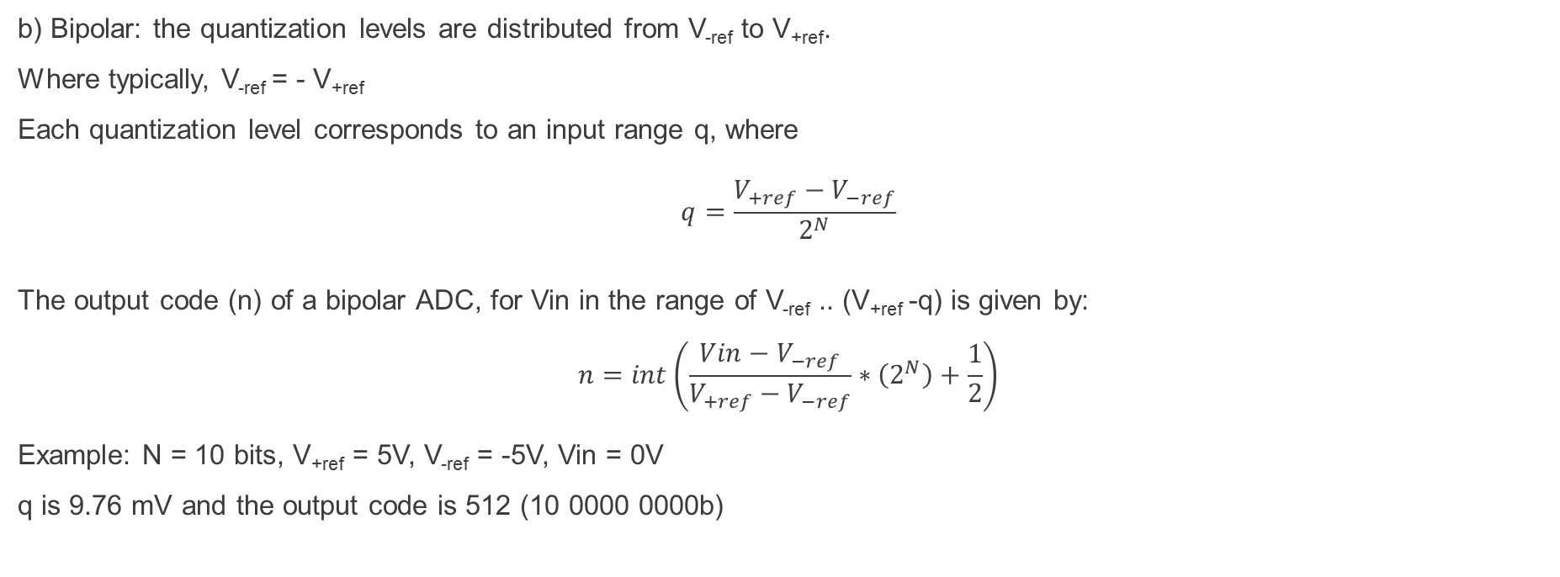
Output value calculation
b) Bipolar: the quantization levels are distributed from V_{-ref} to V_{+ref}.
Where typically, V_{-ref} = - V_{+ref}
Each quantization level corresponds to an input range q, where
$$q=\frac{V_{+ref}−V_{−ref}}{2^{N}}$$
The output code (n) of a bipolar ADC, for Vin in the range of V_{-ref} .. (V_{+ref} -q) is given by:
$$n=int\left(\frac{Vin−V_{−ref}}{V_{+ref}−V_{−ref}}∗\left(2^{N}\right)+\frac{1}{2}\right)$$
Example: N = 10 bits, V_{+ref} = 5V, V_{-ref} = -5V, Vin = 0V
q is 9.76 mV and the output code is 512 (10 0000 0000b)

Slide 232
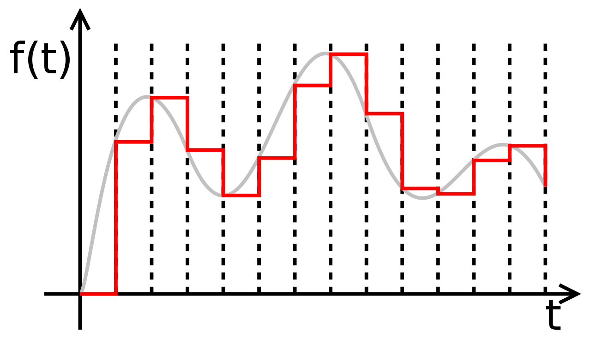
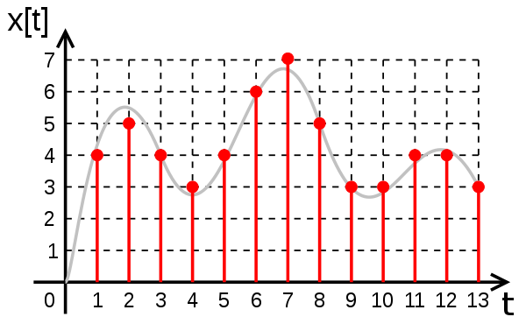
Analog-to-digital conversion example
On the upper figure, the grey line represents the input analog signal. The dashed lines indicate the sampling times. The red line is the output of the sample-and-hold. It changes value exactly at the sampling times.
In the lower figure, the red dots represent the output of the ADC. The effect of the quantization error is noticeable as the distance between the red dot and the input signal.
The output of the ADC is the following numeric sequence: 4,5,4,3,4,6,7,5,3,3,4,4,3.
source: wikimedia.org (CC)
Notes:
upper figure:
https://upload.wikimedia.org/wikipedia/commons/1/15/Zeroorderhold.signal.svg
lower figure:
https://upload.wikimedia.org/wikipedia/commons/0/04/Digital.signal.discret.svg

Slide 233
simple adc (3-bit FLASH)
This circuit implements a 3-bit Flash ADC. It is the fastest ADC topology. Vin is in the range 0..Vref and Vref is 8V.
For an ADC with 2N possible output values, 2N -1 comparators are required. Thus, Flash ADCs are usually implemented for a small number of bits.
The resistor ladder provides the appropriate reference voltages for each comparator. In this case: 0.5V, 1.5V, 2.5V, ... 6.5V.
When a comparator detects that the input voltage (Vin) is higher than its reference voltage, its output changes to level 1.
The priority encoder (I7 is highest priority and I0 is lowest) generates the binary code corresponding to the highest priority active input.
source: Authors

Slide 234
ADC Characteristics
Resolution: the number of bits (N) of the output code of the ADC. The number of quantization levels is given by 2^{N}. A 10-bit ADC has 1024 quantization levels. Hence, for a reference voltage of 1V, each quantization level is 0.97mV (1V/1024). The quantization error is up to ± 0.485mV (.97/2).
Conversion time: how long does it take to the ADC to perform a conversion. Currently, most ADCs integrated in MCUs take from 0.1µs to 1µs. Flash ADCs may take less than 10 ns. The conversion time determines the maximum sampling frequency (f_{sampling}). By the Nyquist theorem, the sampling frequency should be larger than twice the highest frequency in the input signal, i.e. f_{sampling} > 2 * f_{signal.}

Slide 235
adc characteristics
DC (and low frequency) errors.
The green line represents the ideal transfer function.
The black line represents the actual transfer function including offset errors and non-linearity errors.
The red line corrects non-linearities but offset errors are still present.
source: Renesas DevCon2015
Mitch Ferguson - ADC Specifications

Slide 236
adc characteristics
Differential non-linearity (DNL)
The ideal transfer function is shown as the dotted line.
Actual transfer function is shown in bold line.
DNL causes wider or narrower code widths. Also, increases quantization noise.
source: Renesas DevCon2015
Mitch Ferguson - ADC Specifications
Notes:
see pg 95 of s7g2 datasheet

Slide 237
ADC Implementations
The most common ADC architectures (topologies) are:
Description
It is the fastest but also the one that requires the most circuitry (2^{N} comparators and resistors).
Two ADCs in sequence, the first resolves the MSb and the second the LSb.
Resolves bit-by-bit, thus, requiring a single comparator. Takes N clock cycles to generate the result.
Based on sigma-delta modulation, it is a 1-bit ADC that tracks the signal. It is based on oversampling, digital filtering and decimation.
Uses a single comparator whose reference voltage is a ramp. Counts the number of clock pulses to the ramp to reach the value of the input signal.
Integrates the input signal then integrates -Vref until the result of the integration reaches 0. Measures the time for the -Vref integration which is proportional to the amplitude of Vin.

Slide 238
SAR ADC
A SAR ADC (Successive Approximation Register Analog-to-Digital Converter) is based on a SAR, a Digital-to-Analog Converter and a Comparator.
The basic operation is to sequentially compare in input value to half of the analog range, decide if the input is in the upper or lower half, store this bit of information and move to the next comparison.
source: Authors

Slide 239
operation of the sar ADC
The same example as in the slide Quantization.
Vin = 3.8V, Vref = 8V, 3-bit ADC.
On the first clock cycle (Clk0):
  The SAR consists of a Shift Register (top) and a register holding the partial results (bottom).
  The start input of SAR is 1, this sets the first bit of the Shift Register in the SAR.
  The bit of the shift-register that is set, is used to compose the current reference value.
  The output 100 of the SAR is converted by the DAC to 4V, producing a 3.5V reference.
  The 3.8V input is compared to the 3.5V reference producing a 1 at the output of the comparator.
  This is the MSb of the result that is latched in the SAR at the start of Clk1.
source: Authors

Slide 240
operation of the sar ADC
On the second clock cycle (Clk1):
  The start input of SAR is 0.
  The SARs Shift Register shifted the 1 bit to the next position.
  The partial result register holds a 1 at b2 that was latched at the start of the cycle, while b1 holds a 1 from the middle bit of
  the shift-register.
  The output 110 of the SAR is converted by
  the DAC to 6V, producing a 5.5V reference.
  The 3.8V input is compared to the 5.5V reference
  producing a 0 at the output of the comparator.
  This is the next bit of the result that is latched in the SAR at the start of Clk2.
source: Authors

Slide 241
operation of the sar ADC
On the third clock cycle (Clk2):
  The start input of SAR is 0.
  The SARs Shift Register shifted the 1 bit to the next position.
  The partial result register holds a 10 at b2 b1 from the two previous comparisons,
  while b0 holds a 1 from the last bit of the shift-register.
  The output 101 of the SAR is converted by the DAC to 5V, producing a 4.5V reference.
  The 3.8V input is compared to the 4.5V reference producing a 0 at the output of the comparator.
  This is the next bit of the result that is latched in the SAR at the start of the next clock
source: Authors

Slide 242
operation of the sar ADC
On the next clock cycle the result is available.
  The last bit of the shift-register is shifted out to EOC (end-of-conversion).
  The result of the conversion is presented at b2 b1 b0 that hold the results of the three previous comparisons.
source: Authors

Slide 243

digital To analog conversion
The Digital to Analog Converter (DAC) performs the opposite conversion of the ADC, i.e. it converts a digital value into the corresponding analog value according to the formula:
for an N-bit DAC whose input value is Digital Value and its analog reference voltage is V_{ref}
$$Analog output \left(V\right)= \frac{Digital Value}{2^{N}}V_{ref}$$

Slide 244
digital To analog conversion
The schematics symbol for a DAC is:
The number of digital input lines is N for an N-bit DAC.
source: Authors

Slide 245
single-bit digital to analog converter
A single-bit DAC is the simplest form of a DAC. A single switch, which is controlled by the digital input, either connects the input of the analog amplifier to Vref or to ground. Hence, the possible analog output values are either 0 or Vref.
source: Authors
Notes:
A single-bit DAC is often used in delta-sigma architectures using oversampling. The DAC is followed by a low-pass-filter whose analog output is proportional to the density of 1 or 0 in the input value stream.

Slide 246
using a pwm as a dac
The effect of 5 different duty cycles after passing a low-pass filter whose cutoff frequency is much lower than the PWM frequency.
0 V
1.25 V
2.5 V
3.75 V
5V
low-pass filter
source: commons.wikimedia.org (CC)
Notes:
source: https://commons.wikimedia.org/wiki/File:Pwm_5steps.gif (CC)

Slide 247
using a pwm as a dac
The topology presented is a Kelvin Divider DAC, also called a string DAC. Among its advantages are its monotonicity and low-glitch.
It requires 2^{N} resistors and switches for an N-bit DAC, which makes it impractical for a larger number of bits.
source: Authors

Slide 248
Operation of the 3-BIT DAC
In this example, Vref is 8V and the digital input has the value 4 (100b).
Output O4 of the decoder is active and commands the corresponding switch. The resistor string has values 1V apart
at each of its taps.
The output analog amplifier simply provides isolation, avoiding that the impedance of the load affects the analog value at the taps of the resistor string.
source: Authors

Slide 249
r2r ladder dac
The R2R resistor ladder topology has the advantages of requiring only 2N resistors in the ladder and the values of these resistors are either R or 2R, avoiding components with a significant difference in value, as would be the case for the binary-weighted DAC that requires values of R, 2R, 4R, 8R, 16R, ...
source:
The Data Conversion Handbook, Edited by Walt Kester, Analog Devices Inc.

Slide 250
DAC CASE STUDY the s7g2 dac
Characteristics:
  Two 12-bit DACs available: DAC0 and DAC1,
  The 12-bit value present at the DADRi register is converted to an analog value of 𝑉_(𝑟𝑒𝑓 ) 𝐷𝐴𝐷𝑅𝑖/4096,
  Output amplifier is available, may be enabled under SW control,
  DAC operation may be synchronized to ADC1,
  DAC conversion may be started by an ELC event.

Slide 251
DAC CASE STUDY the s7g2 dac
DAC0 and DAC1
block diagram
source: Renesas S7G2 user’s manual

Slide 252
DAC CASE STUDY the s7g2 dac
Renesas S7G2 DAC characteristics:
source: Renesas S7G2 datasheet

Slide 253
8 – Serial Communications
  Serial Communications - Introduction
  UART
    Concepts, Block Diagram, Registers
  SPI
    Concepts, Block Diagram, Registers
  I2C
    Concepts, Block Diagram, Registers

Slide 254
8.1 – Introduction to serial communications
Concept:
  In serial communications ONE bit is transmitted at a time, from the transmitter device (TX) to the receiver device (RX). As opposed to parallel communications where several bits, e.g. 8 bits or 1 byte, are transmitted concurrently.
  In serial communications a reduced number of wires are required.
  Long distance wired communications typically use serial communication.

Slide 255
Examples of serial communications standards
  UART: Universal Asynchronous Receiver Transmitter
  SPI: Serial Peripheral Interface
  I2C: Inter-Integrated Circuit
  USB: Universal Serial Bus
  Ethernet

Slide 256

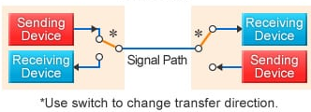
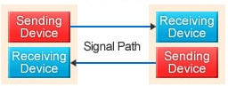
direction of communication
  Simplex: the communication occurs in a single direction – one device transmits and the other receives.
  Half-Duplex: the communication occurs in both directions but not simultaneously. Both communicating devices (DevA and DevB) have transmitters and receivers. At a given time, either DevA transmits and DevB receives or vice-versa. A single wire is needed to carry the communication.
  Full-Duplex: the communications occurs in both directions and can be simultaneous. Usually two wires are used: one to transmit from DevA to DevB and another to transmit from DevB to DevA.
  rem: a transceiver consists of a transmitter and a receiver.
source: Renesas
Notes:
https://www.renesas.com/en-us/support/technical-resources/engineer-school/mcu-programming-peripherals-03-serial-communication.html

Slide 257
synchronous vs asynchronous communications
  Synchronous: there is clock signal that identifies the time instances when a data bit is valid. Thus, the receiver uses the clock signal to recover the transmitted information. SPI and I2C are examples of synchronous communication protocols.
  Asynchronous: there is no common clock signal, thus, the two communicating devices must previously agree on a mechanism to identify each bit in the data stream. Therefore, the synchronization information must be embedded in the data signal. Quite often there are transitions in the data signal to identify the time slot of each bit in the data stream. RS-232 is an example of asynchronous communication.

Slide 258
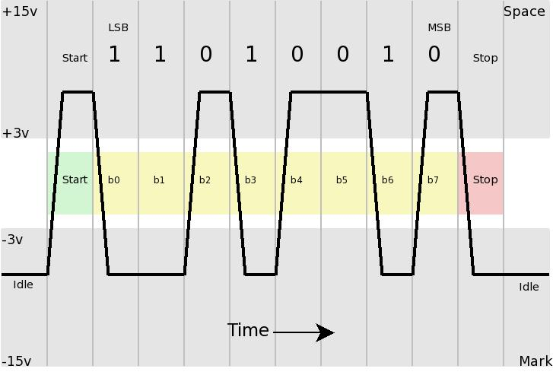
bit rate vs baud rate
  Symbols: when transmitting signals over a wire, each possible combination of amplitude, phase and frequency is called a symbol. Simple schemes use only two symbols: for instance 0V and 3.3V to
  represent 0 and 1, or the coding used by
  RS-232 where amplitudes from -3 to -15
  represent a 1 while +3 to +15 represent a 0.
source: commons.wikimedia.org (CC)
Notes:
https://commons.wikimedia.org/wiki/File:Rs232_oscilloscope_trace.jpg

Slide 259
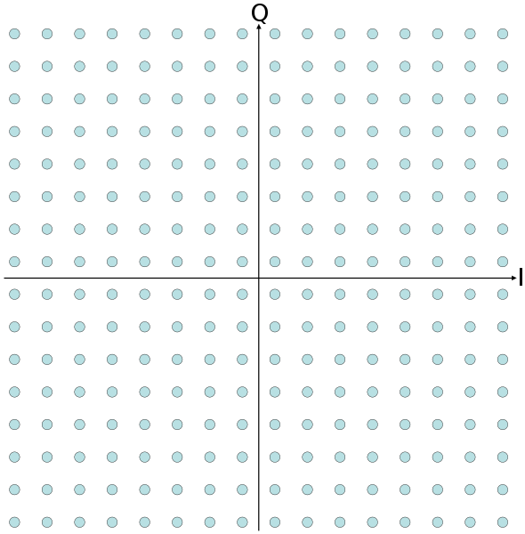
bit rate vs baud rate
  Symbols(cont): a much larger set of symbols is also possible, for instance, 256QAM, one of the many encodings used for high speed ethernet, has 256 possible symbols, hence, each symbol encodes 8 bits.
  Bit rate: is the number of bits that are transmitted
  per time unit. Expressed in bits/s.
  Baud rate: is the number of symbols that are
  transmitted per time unit. Expressed in baud/s.
  If a symbol encodes a single bit, such as the
  case for RS-232, then the baud rate and the
  bit rate are the same.
  Yet, for 256QAM, the bit rate is 8 times higher
  than the baud rate.
source: commons.wikimedia.org (CC)
Notes:
https://commons.wikimedia.org/wiki/File:256qam.svg

Slide 260
8.2 – uart
A UART is a peripheral present in most MCUs. Typically it receives data from the processor over the bus, hence, in parallel format, and handles the serialization and frame formatting.
A UART (Universal Asynchronous Receiver Transmitter) is capable of transmitting asynchronous data frames to another device as well as receiving. Both devices must be configured for the same speed and frame format.
Typical speeds used for asynchronous serial communication are: 110, 150, 300, 600, 1200, 2400, 4800, 9600, 19200, 38400, 57600, 115200 bits per second. Higher speeds may also be used as long as agreed among transmitter and receiver.
Typically, the bit encoding defined by the RS-232 standard is used.
RS-232 defines separate lines for transmission and reception, thus, it is full duplex communication.

Slide 261
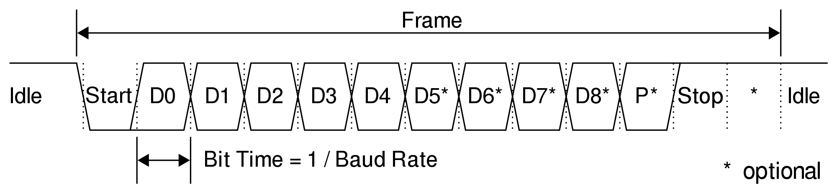
uart
Asynchronous frame format – consists of a start bit, data bits, an optional parity bit and stop bits.
The frame format is configurable:
  number of data bits: 5 to 8,
  number of stop bits: 1, 1.5 or 2,
  parity: none, odd, even.
source: commons.wikimedia.org (CC)
Notes:
https://commons.wikimedia.org/wiki/File:UART_Frame.svg

Slide 262
uart
How does the receiver synchronize with the transmitter?
  Both the transmitter and the receiver are configured in the same way: speed and frame format.
  Maximum clock skew allowed between the two sides is typically lower than 2%.
  Receiver samples at a higher rate (e.g. 16 times de baud rate) for the start-bit transition. A delay of half-bit period determines the mid-bit position. From then on, sample every one-bit time.

Slide 263
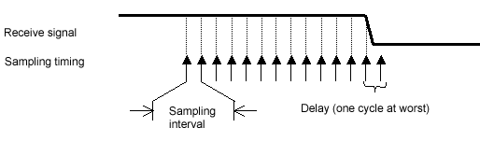
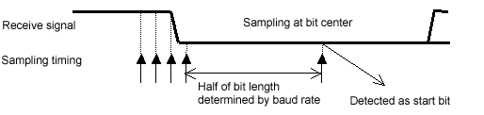
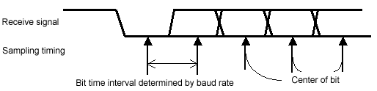
uart
How does the receiver synchronize with the transmitter?
source: Renesas
Notes:
https://en-eu.knowledgebase.renesas.com/English_Content/MCUMPU/Basic_Information/What_are_the_detection_methods_for_UART_reception_function.

Slide 264

uart
Example of the transmission of the character G (ASCII code 0x47) over an asynchronous line. Note that the LSb is transmitted first.
Upper figure shows UART levels while lower figure shows RS-232 levels.
Configuration: 8O1.5 (eight bits, odd parity, 1.5 stop bits).
For a 9600 bps, the duration of each bit is 104.16 us.
source: commons.wikimedia.org (CC)
Notes:
https://commons.wikimedia.org/wiki/File:RS-232_timing.svg

Slide 265


uart
A frequently used connector for RS-232 is the DB-9. Shown here are the signals on each pin. TxD carries the transmitted data and RxD carries incoming data to the receiver.
male
female
source: commons.wikimedia.org (CC)
Notes:
https://commons.wikimedia.org/wiki/File:RS-232_DE-9_Connector_Pinouts.png

Slide 266
8.3 – spi: Serial Peripheral Interface
SPI = Serial Peripheral Interface
  Is a synchronous serial communication intended to be used to connect an MCU to external memory devices and peripherals such as: Flash EEPROM, ADC, DAC, temperature sensor, digital potentiometer, Real-Time Clock, …
  The topology is based in master and slave devices. There can be a single master, but multiple slaves are allowed.
  It uses 4 wires: data from master to slave, data from slave to master, clock and slave select. It is full duplex communication.
  There are many possible configurations; it has been reported that not all SPI devices are compatible, i.e. have a common configuration.

Slide 267

spi
Single-slave connection:
  SCLK: Serial Clock. Generated by the master;
  MOSI: Master Out Slave In;
  MISO: Master In Slave Out;
  SS: Slave Select (active low).
source: commons.wikimedia.org (CC)
Notes:
https://upload.wikimedia.org/wikipedia/commons/thumb/e/ed/SPI_single_slave.svg/1280px-SPI_single_slave.svg.png

Slide 268

Spi – operation
  The Master selects a Slave by
  activating the /SS line.
  On every clock cycle, one bit is
  transferred from the master to
  the slave and another bit is transferred
  from the slave to the master.
  Not every transfer is significant.
  Typically the transfers occur in multiples
  of 8 bits.
source: commons.wikimedia.org (CC)
Notes:
https://upload.wikimedia.org/wikipedia/commons/thumb/b/bb/SPI_8-bit_circular_transfer.svg/1280px-SPI_8-bit_circular_transfer.svg.png

Slide 269

Spi – configuration
  CPOL:
  clock polarity selection
  CPHA:
  clock phase selection
Observe that bits change on one clock edge and they are sampled on the other.
source: commons.wikimedia.org (CC)
Notes:
https://upload.wikimedia.org/wikipedia/commons/thumb/6/6b/SPI_timing_diagram2.svg/1280px-SPI_timing_diagram2.svg.png

Slide 270

Spi – multi-slave
  MISO lines must be tri-state to be interconnected. They must go to high-impedance when the /SS line is not active.
  The Master selects one of the slaves to exchange data with it. Hence, separate Slave Select lines are required.
source: commons.wikimedia.org (CC)
Notes:
https://upload.wikimedia.org/wikipedia/commons/thumb/f/fc/SPI_three_slaves.svg/1200px-SPI_three_slaves.svg.png

Slide 271
8.4 – i2c: Inter-Integrated Circuit
  Synchronous half-duplex communications among multiple devices on a bus.
  Developed by a division of Philips in the 80’s. This division is now NXP.
  Needs only two wires: data and clock.
  Bus drivers are open-drain with pull-up resistors, allows for multiple transmitters connected to the same line.
  Multiple masters are allowed on a bus. A master is the one that initiates a data transfer. Addressing modes use 7-bit and 10-bit addressing.
  Data rates: 100kbps, 400 kbps, 1 Mbps, 3.4 Mbps. (version 4 added a 5 Mbps data rate using push-pull drivers on a unidirectional bus).
  Recommended reading: UM10204 – I2C-bus specification and user manual. Rev 6 – 4-April-2014. NXP.

Slide 272

i2c – operation
  The SCL line (Serial Clock) is driven by the bus master. When SCL is high the data line (SDA) is stable and can be read. When SCL is low then the data line can change.
  The exception of this rule is the signaling of the start-bit (negative edge of SDA while SCL is high) and stop-bit (positive edge of SDA while SCL is high).
source: commons.wikimedia.org (CC)
Notes:
https://upload.wikimedia.org/wikipedia/commons/thumb/6/64/I2C_data_transfer.svg/2000px-I2C_data_transfer.svg.png

Slide 273
i2c – operation (7-bit addressing mode, master write)
  Master: sends the start bit.
  Master: sends 7-bit slave address.
  Master: sends the direction bit (0 = write).
  Addressed slave: sends an ACK bit (0 = acknowledge).
  Master: sends 8-bit data.
  Addressed slave: sends ACK bit.
  repeat steps 5 and 6 while there is data to transmit.
  Master: sends stop bit.

Slide 274
i2c – operation (7-bit addressing mode, master write)
  I2C peripheral of Renesas S7G2 MCU
  Timing diagram of a master sending data to a slave:
source: Renesas S7 Series Microcontrollers User’s Manual

Slide 275
i2c – operation (7-bit addressing mode, master read)
  Master: sends the start bit.
  Master: sends 7-bit slave address.
  Master: sends the direction bit (1 = read).
  Addressed slave: sends an ACK bit (0 = acknowledge).
  Addressed slave: sends 8-bit data.
  Master: sends ACK bit.
  repeat steps 5 and 6 while there is data to transmit.
  Master: sends stop bit.

Slide 276
i2c – operation (7-bit addressing mode, master read)
  I2C peripheral of Renesas S7G2 MCU
  Timing diagram of a slave sending data to a master:
source: Renesas S7 Series Microcontrollers User’s Manual

Slide 277
i2c case study – s7g2 iic
Register | Name
ICCRx | I2C Control Register 1,2
ICMRx | I2C Mode Register 1,2,3
ICFER | I2C Function Enable Register
ICSER | I2C Status Enable Register
ICIER | I2C Interrupt Enable Register
ICSRx | I2C Status Register 1,2
ICWUR | I2C Wakeup Unit Register
SARLx | Slave Address Register L 0,1,2
SARUx | Slave Address Register U 0,1,2
ICBRL | I2C Bit Rate Low-Level Register
ICBRH | I2C Bit Rate High-Level Register
ICDRT | I2C Transmit Data Register
ICDRR | I2C Receive Data Register
ICDRS | I2C Shift Register
source: Renesas S7 Series Microcontrollers User’s Manual

Slide 278
i2c case study – s7g2 iic
  Characteristics of the I2C Bus Interface of the Renesas S7G2 MCU:
  May operate as master or as slave of an I2C bus with data rates up to 1 Mbps.
  Up to 3 different slave addresses may be configured, 7-bit or 10-bit.
  Digital noise filters for SCL and SDA signals.
  Four interrupt sources: Receive data full, Transmit data empty, Transmit end, Error (NACK, timeout, …).
Notes:
Table 36.1 IIC specifications (1/2)
Communications format • IIC-bus format or SMBus format
• Master or slave mode selectable
• Automatic securing of the setup times, hold times, and bus-free times for the transfer rate.
Transfer rate Fast-mode Plus supported, up to 1 Mbps.
SCL clock For master operation, the duty cycle of the SCL clock is selectable in the range from 4% to 96%.
Issuing and detecting
conditions
Start, restart, and stop conditions are automatically generated. Start conditions (including restart conditions)
and stop conditions are detectable.
Slave address • Configurable to up to three different slave addresses
• 7-bit and 10-bit address formats supported, including simultaneous use
• General call addresses, device ID addresses, and SMBus host addresses detectable.
Acknowledgment • For transmission, automatic loading of the acknowledge bit
Transfer of the next transmit data can be automatically suspended on detection of a not-acknowledge bit.
• For reception, automatical transmission of the acknowledge bit.
If a wait between the eighth and ninth clock cycles is selected, the software can control the value in the
acknowledge field in response to the received value.
Wait function • During reception, the subsequent wait periods are available by holding the SCL clock low:
- Waiting between the eighth and ninth clock cycles
- Waiting between the ninth clock cycle and the first clock cycle of the next transfer
SDA output delay
function
Output timing of transmitted data, including the acknowledge bit, can be delayed.
Arbitration • For multi-master operation:
- SCL clock synchronization is possible when conflict occurs with the SCL signal from another master.
- When issuing the start condition would create conflict on the bus, loss of arbitration is detected by
testing for non-matching between the internal signal for the SDA line and the level on the SDA line.
- In master operation, loss of arbitration is detected by testing for non-matching between the signal on the
SDA line and the internal signal for the SDA line.
• Loss of arbitration because the start condition occurs while the bus is busy is detectable, to prevent the
issuing of double start conditions.
• Loss of arbitration is detectable on transfer of a not-acknowledge bit because the internal signal for the
SDA line and the level on the SDA line do not match.
• Loss of arbitration because non-matching of internal and line levels for data is detectable in slave
transmission.
Timeout function Internal detection of long-interval stops of the SCL clock.
Noise cancellation • Digital noise filters for both the SCL and SDA signals
• Programmable window for noise cancellation by the filters.
Interrupt sources • Four sources:
Error in transfer or occurrence of events
Detection of arbitration, NACK, timeout, a start condition including a restart condition, or a stop condition
• Receive data full (including matching with a slave address)
• Transmit data empty (including matching with a slave address)
• Transmit end
Module-stop function Module-stop state can be set.
IIC operating modes Four modes: master transmit, master receive, slave transmit, and slave receive
Event link function
(output)
Four sources:
• Transfer error or occurrence of events: arbitration detection, NACK, timeout, start or restart condition, or
stop condition
• Receive data full, including matching with a slave address
• Transmit data empty, including matching with a slave address
• Transmit end.
Wakeup function*1 • CPU can return from sleep state using a wakeup event.

Slide 279
i2c case study – s7g2 iic
Connection of multiple
devices on the I2C bus.
Notice open-drain outputs
and pull-up resistors
forming a wired AND.
source: Renesas S7 Series Microcontrollers User’s Manual

Slide 280
9 – CAN
  Introduction
  Block Diagram
  Registers
  SW Stack

Slide 281
9.1 – Introduction
CAN is an acronym for Controller Area Network. It is defined by the ISO-11808: 2003 standard and has been mainly motivated by the needs of the automotive industry, such as the ever increasing use of embedded sensors into the vehicles and the need to optimize the internal space and reduce costs with cabling.
Characteristics of CAN:
  Two-wire multi-master serial bus
  Message-based protocol
  Contention resolution via decentralized arbitration
  All messages are broadcast and processed by the nodes only if needed
  Speeds up to 1 Mbps

Slide 282
CAN topology
CAN nodes are interconnected in a bus topology.
CAN physical layer is implemented with two wires (CANH and CANL).
A logical 0 (called “dominant”) is obtained when CANH is approx. 3.5V and CANL is approx. 1.5V.
A logical 1 (called “recessive”) is obtained when both CANH and CANL are at approx. 2.5V.
Node
Node
    Bus
    CANH
    R_{L}
    R_{L}
    CANL
Node
Node
Node
source: Authors

Slide 283

CAN Bus Frame
The standard CAN frame is defined as follows:
  Arbitration field (Identifier) → defines the message identifier and its priority;
  Data → data to be transmitted (0 to 64 bits);
  SOF, CRC, ACK and End of Frame → error checking and synchronization;
  IFS (Interframe Space) → idle time used to process buffers.
Source: CAN Bus (https://en.wikipedia.org/wiki/CAN_bus)
Notes:
https://commons.wikimedia.org/wiki/File:CAN-Bus-frame_in_base_format_without_stuffbits.svg

Slide 284
CAN Bus Frame (cont.)
Control → define the following sub-fields:
  Data length (0 to 8 bytes),
  Requ. Request (RTR) → used to identify a Remote Frame → see following slides,
  ID Ext. (IDE) → used to identify a Standard or Extended Frame:
    Standard Frame → IDE is dominant “0”, 11-bit identifier as shown in picture,
    Extended Frame → IDE is recessive “1”, 29-bit identifier. The remaining 18 bits of the identifier are placed right after the IDE bit, followed by an extra RTR bit. The original RTR is called SRR (Substitute Remote Request) and acts as a placeholder.

Slide 285
CAN Message Types
  Data Frame → carries data sent by a Node:
    The RTR bit is dominant “0” to identify a Data Frame;
    It is always preceded by an Interframe Space.
  Remote Frame → carries a request for a transmission of data from another Node:
    The Arbitration/Identifier field carries the Identifier of the requested Node;
    The RTR bit is recessive “1” to identify a Remote Frame;
    The Data field is empty and the Data Length part of Control field determines the length of the requested message;
    It is always preceded by an Interframe Space.

Slide 286
CAN Message Types
  Error frame → special format used to signal an error;
    Not preceded by an Interframe Space.
  Overload frame → special format used to provide an extra delay between messages (receiver too busy);
    Not preceded by an Interframe Space.

Slide 287
CAN Arbitration Process
  Every message has a priority level corresponding to its identifier (arbitration field) → the lower the value, the higher the priority.
  When two or more nodes try to transmit at the same frame time:
    Identifier bits 0 are “dominant” over identifier bits 1 “recessive”;
    The node that sends a 1 and reads back a 0 stops transmitting on that frame → retries on the next frame;
    The node that sends a 0 and reads back a 0 retains control and goes on to send the next identifier bit;
    After all the identifier bits are tested, the node that keeps on retaining control (i. e. the node whose message identifier has the highest priority) sends the message contents.

Slide 288

9.2 – block diagram
Implementation for the CAN Module of the S7G2 MCU.
Message reception and transmission organized in mailboxes → configurable as single or FIFOs for different types of messages.
Source: Renesas Synergy MCUs User’s Manual: Hardware
Notes:
Figure 37.1

Slide 289
9.3 – Registers – Case Study
Implementation for the CAN Module of the R7FS7G27H3A01CFC Renesas ARM Cortex-M4 MCU:
  CTLR → mailbox mode, bus operation and/or reset, timestamp configuration;
  BCR → data transfer rate configuration;
  MKR[0…7] → define masks for reception of specific messages (IDs) into specific mailboxes (depending on MKR index);
  FIDCR[0..1] → similar to MKR but for FIFO mailboxes;
  MKIVLR → enables or disables masking (via MKR) for message acceptance;
  MIER → enable/disable mailbox interrupts;
  MCTL_TX[0..31] → transmission control for each mailbox;
  MCTL_RX[0..31] → reception control for each mailbox;

Slide 290
9.3 – Registers – Case Study
  MB[0..31] → register groups for each mailbox:
    MB[0..31].ID → received or transmitted message identifiers;
    MB[0..31].DL → data length;
    MB[0..31].D[0..7] → received or transmitted data;
    MB[0..31].TS → timestamp for received messages.
  RFCR, TFCR → receive and transmit FIFO control;
  RFPCR, TFPCR → increment of the CPU-controlled pointer for receive and transmit FIFOs;
  STR → global CAN status register (new data received, receive and transmit FIFO status, CAN mode status and error status);
  EIER → enable / disable error interrupts;
  EIFR → status of error detection.

Slide 291
9.3 – Registers – Case Study
  RECR, TECR → receive / transmit error count;
  ECSR → status of CAN bus errors;
  TSR → stores the timestamp;
  TCR → test control.

Slide 292

9.4 – Software Stack – Case Study
Example of CAN stack for Renesas Synergy microcontroller hardware.
(https://www.renesas.com/en-us/software/D6001427.html)
Source: Renesas Synergy CAN HAL Driver Module Guide
r11an0065eu0101-synergy-can-hal-mod-guide

Slide 293


9.4 – Software Stack – Case Study
Example of CAN API for Renesas Synergy microcontroller hardware
      Basic API functions
Source: Renesas Synergy CAN HAL Driver Module Guide
r11an0065eu0101-synergy-can-hal-mod-guide
Notes:
https://www.renesas.com/us/en/doc/products/renesas-synergy/apn/r11an0065eu0101-synergy-can-hal-mod-guide.pdf

Slide 294
10 – USB
  Introduction
  Block Diagram
  Registers
  SW Stack

Slide 295
10.1 – Introduction
USB is an acronym for Universal Serial Bus. It has been proposed by a consortium of companies, such as Microsoft, Intel, IBM, Compaq and NEC and is designed to support a wide range of applications that require communication with distinct characteristics (real-time, high or low bandwidth, with or without message delivery guarantee etc.).
Current specification is 3.2 (Sep, 2017).

Slide 296
10.1 – Introduction
Examples of devices that make use of USB:
  Printers
  Cameras → interface for photo and video upload
  Smartphones → interface for battery charging and file transfer
  Human Interface Devices → keyboard, mouse etc.
  Development electronic boards → debug interface (JTAG emulation)
  Game joysticks
  …

Slide 297
10.1 – Introduction
Characteristics of USB:
  Four (or five)-wire serial bus with single master (host) and up to 127 slaves (devices);
    Exception → USB On-The-Go (OTG) → allows negotiation between two devices (point to point) to be a temporary host;
    Example of OTG use: a camera device connected to a printer device to print photos;
  Defines low speed (1.5 Mbps), full speed (12 Mbps) and high speed (up to 5 Gbps at version 3.0) bandwidth
  Rem: USB 3.0 uses a 9-pin connector (USB-A 3.0 connector) or a 24-pin USB-C connector.

Slide 298
10.1 – Introduction
  Four types of data transfers → meet the requirements of different communication types
  Device class identification by the host via enumeration protocol → allows plug-and-play and hot swap capabilities, as well as instantiation of the proper class driver software by the host
  Bus power capabilities → some USB devices do not need an extra power source
    USB host is able to detect overcurrent conditions, so that power can be removed from the device causing the problem without affecting the other devices already connected

Slide 299
USB topology
  USB Host Controller is the master and generates transactions (via Root Hub).
  Each Hub is physically connected (by wire) to a Node or another Hub.
  Nodes are slaves which perform the functions → also known as Devices.
  Each level defines a tier → maximum of 7 as USB 2.0 Specification.
  Nodes can be inserted or removed when necessary → upon insertion, the enumeration process is executed to identify the device class and configure it.
USB Host Controller
    Tier 1
Root Hub
Hub
Node
    Tier 2
Node
Node
Hub
    Tier 3
Node
Node
    Tier 4
source: Authors
Notes:
Based on fig 4.1, USB 2.0 Specification

Slide 300


USB Physical interface
USB 1.1 and 2.0 → 4 shielded wires.
  2 wires for data → differential
  2 wires for power (5 Vdc and GND)
Type A → host.
Type B → device.
Mini and Micro variations use the same electrical interface in smaller form factors.
OTG → extra pin to identify the role of the device (A or B). The receptacle is called Micro-AB and accepts both Micro-A and Micro-B connectors.
USB 3.0 → 5 extra wires.
Source: By Milos.bmx (Own work) [CC BY-SA 3.0 (https://creativecommons.org/licenses/by-sa/3.0)], via Wikimedia Commons
https://commons.wikimedia.org/wiki/File%3AUSB3.0_connectors.svg
USB-C
CC0
https://commons.wikimedia.org/wiki/File:USB_Type-C_icon.svg

Slide 301
USB Logical View
Host side
Device (function) side
App software
Communication flows are performed via pipes → composed of endpoints → unidirectional data paths.
Endpoint / pipe bundles form an interface → a view to the function / device behavior as it is exposed to the host.
The host side instantiates a class driver during device enumeration → manages the interfaces and provides an API to the app level.
Default pipe is bidirectional (endpoint 0 in both directions) and is used for device configuration.
Class driver API
Interface 1 (pipe bundle)
Class driver
Function SW (Device)
Buffers
Interface N (pipe bundle)
Buffers
USB System SW
USB driver
Default pipe (endpoint 0)
USB Device Ctrl Driver (DCD)
USB System SW
USB Host Ctrl driver (HCD)
USB transfers
USB transfers
USB Host Ctrl
USB Dev
Ctrl
USB HW
SIE
USB wire
SIE
USB HW
Transactions (USB frames)
Transactions (USB frames)
source: Authors
Notes:
Based on Fig 5.9 and Fig 10.2, USB 2.0 Specification

Slide 302
USB Host Controller
  The USB Host Controller hardware layer offers an HCI (Host Controller Interface) to the Host Controller Driver in software → standardizes the register access and allows interoperability between the host OS and different hardware implementations.
  Some HCI standards have been historically defined:
    OHCI (Open Host Controller Interface) → defined for USB 1.1, manages the USB bus mainly in hardware (internal FIFO descriptors management)
    UHCI (Universal Host Controller Interface) → proprietary interface by Intel, defined for USB 1.1, manages most of the USB bus operation in software (HCD level)

Slide 303
USB Host Controller
  EHCI (Enhanced Host Controller Interface) → defined for USB 2.0, manages high-speed communication on a USB bus. EHCI controllers have been usually implemented in PC motherboards in conjunction with UHCI or OHCI drivers (that managed the low and full-speed devices).
  xHCI (Extensible Host Controller Interface) → defined for USB 3.0, manages all the USB bus speeds. It is meant to replace the previous UHCI/OHCI/EHCI standards.

Slide 304
USB Packets
USB Transfers are performed by a sequence of transactions, which are composed of:
  A Token packet, carrying addressing, direction and packet type information (IN, OUT or SETUP). The token can be of PID type Start-Of-Frame (SOF), issued every 1 ms (full-speed) or 125 us (high-speed) and used for synchronization.
    Frame → interval during which a sequence of transactions is performed for the endpoints controlled by the host..
Field | PID | ADDR | ENDP | CRC5
Bits | 8 | 7 | 4 | 5
Desc | Type of packet | Device address | Endpoint address | CRC of ADDR and ENDP
Token packet
Field | PID | Frame number | CRC5
Bits | 8 | 11 | 5
Desc | Type of packet | Current frame | CRC of Frame Number
SOF packet

Slide 305
USB Packets
  A Data packet, carrying the effective data being transferred. Data packets are issued either by the host or the device, depending on the endpoint direction (identified by the previous Token packet). PID indicates type DATA0 or DATA1 (toggling for full-speed transfers) or DATA2 (high-speed transfers).
  A Handshake packet, used to report the status of a data transaction. Handshake packets are issued by the receiver of the Data packet. PID indicates ACK, NACK, a halt condition (STALL) or no response yet (NYET).
Field | PID | DATA | CRC16
Bits | 8 | 0-8192 | 16
Desc | Type of packet | Data | CRC of DATA
Data packet
Field | PID
Bits | 8
Desc | Type of packet
Handshake packet

Slide 306
USB Transfers
USB defines four types of data transfers:
  Control → control commands to configure device, delivery guaranteed, low bandwidth required.
    Control transfers are performed in three stages:
      A Setup stage, starting with a token packet of type SETUP and a data packet containing a USB device request → see following slides.
      An optional Data stage, starting with a token packet of type IN or OUT (depending on direction) and a data packet containing the data pertaining to the USB device request.
      A Status stage, starting with a token packet of type IN or OUT (inverse of Data direction) and containing request status information.

Slide 307
USB Transfers
  Bulk → large amounts of data, non real-time, delivery guaranteed, variable use of bandwidth → used for reliable data transfers, such as mass storage data.
    Token packets for bulk transfers are of type IN or OUT, depending on transfer direction.
  Interrupt → real-time, small and periodic amounts of data → used for event notification (e.g. key typed on a keyboard).
    Token packets for interrupt transfers are of type IN or OUT, depending on transfer direction.

Slide 308
USB Transfers
  Isochronous → large amounts of data, delivery not guaranteed, steady rate of transmission and reception, bandwidth depending on sampling characteristics → used for streaming data, such as voice or video.
    Token packets for isochronous transfers are of type IN or OUT, depending on transfer direction.
    Isochronous transfers do not use Handshake packets.
Individual endpoints are configured to a specific type of data transfer, depending on the class driver loaded by the host during the enumeration process → see following slides.

Slide 309
USB Transfers SCHEDULING
Rules for transfer scheduling:
  Periodic transfers (isochronous and interrupt) → limited to 90% of the bandwidth of a frame.
  Control → use as much as necessary of the remaining 10% (plus the remaining amount in the 90% of the bandwidth that is not used for periodic transfers).
  Bulk → use the bandwidth that is left.

Slide 310
USB Enumeration
The USB enumeration protocol is executed whenever a new device is inserted into the bus. This protocol comprises the following steps:
  USB root hub detects when a device is connected (D- or D+ are pulled up with resistors).
  USB host powers and resets the device.
  USB host issues device requests through the Default Control Pipe (default address 0) to get the Device Descriptor → see following slides.
  USB host assigns a unique address to the device.
  USB host issues device requests through the Default Control Pipe to get the Configuration Descriptors → see following slides.
  USB host enables a valid configuration → all corresponding interfaces and endpoints are configured, and the device may draw the current described in the descriptor for the selected configuration.

Slide 311
USB Enumeration
Some steps of the enumeration protocol require issuing USB device requests to the device being enumerated.
The USB device requests are issued during the Setup stage of a Control transfer. A device request is 8 bytes long and contains the following fields:
  bmRequestType (1 byte) → request direction, type (standard, class, vendor, reserved) and recipient (device, interface, endpoint, other).
  bRequest (1 byte) → specific request (set address, get and set configuration, get and set descriptor, get and set interface etc.).
  wValue (2 bytes), wIndex (2 bytes) → value and index that depend on request.
  wLength (2 bytes) → number of bytes to transfer if there is a data stage.
Refer to USB 2.0 Specification, Section 9.3 for more detailed information.

Slide 312
USB Enumeration
Device Descriptor
Field | Size (bytes) | Descr
bLength | 1 | Size of descriptor
bDescriptorType | 1 | DEVICE descriptor type
bcdUSB | 2 | USB Spec Relase Number in BCD
bDeviceClass | 1 | Class code
bDeviceSubClass | 1 | Subclass code
bDeviceProtocol | 1 | Protocol code
bMaxPacketSize0 | 1 | Max packet size for endp 0
idVendor | 2 | Vendor ID
idProduct | 2 | Product ID
bcdDevice | 2 | Device release number in BCD
iManufacturer | 1 | Index of string desc for manufacturer
iProduct | 1 | Index of string desc for product
iSerialNumber | 1 | Index of string desc for serial
bNumConfigurations | 1 | Number of possible configurations
Descriptors sent by the device during enumeration process (in response to GET_DESCRIPTOR requests):
  Device descriptor → defines the device class, device subclass, device protocol, max packet size for default endpoint, vendor, product, release number, indices for manufacturer, product and serial number strings, and the number of configurations.
Source: USB 2.0 Specification, Table 9-8

Slide 313
USB Enumeration
  Configuration descriptor → defines the number of interfaces for this configuration, the configuration value and an index for this configuration’s string, if the device is self-powered when running that configuration and the max power consumption (in case it is bus powered).
    A GET_DESCRIPTOR request to a Configuration Descriptor returns also the Interface and Endpoint descriptors pertaining to the given Configuration, in sequential order → see next slides.
Configuration Descriptor
Field | Size (bytes) | Descr
bLength | 1 | Size of descriptor
bDescriptorType | 1 | CONFIGURATION descriptor type
wTotalLength | 2 | Total length of configuration data (includes Interface and Endpoint descriptor sizes)
bNumInterfaces | 1 | Number of interfaces
bConfigurationValue | 1 | Configuration ID
iConfiguration | 1 | Index of string desc for this config
bmAttributes | 1 | Configuration characteristics
bMaxPower | 1 | Max power consumption in mA when operating on this configuration
Source: USB 2.0 Specification, Table 9-10

Slide 314
USB Enumeration
  Interface descriptor → defines the interface number, the number of endpoints, the interface class, subclass and protocol, and an index to a string describing this interface.
Interface Descriptor
Field | Size (bytes) | Descr
bLength | 1 | Size of descriptor
bDescriptorType | 1 | INTERFACE descriptor type
bInterfaceNumber | 1 | Zero-based number of this interface
bAlternateSetting | 1 | Value to select this alternate setting
bNumEndpoints | 1 | Number of endpoints used by this interface
bInterfaceClass | 1 | Class code for this interface
bInterfaceSubClass | 1 | Subclass code for this interface
bInterfaceProtocol | 1 | Protocol code for this interface
iInterface | 1 | Index of string desc for this interface
Source: USB 2.0 Specification, Table 9-12

Slide 315
USB Enumeration
Endpoint Descriptor
  Endpoint descriptor → defines the endpoint address and direction, the endpoint type (control, isochronous, bulk or interrupt), the max packet size and the polling interval for periodic endpoints (isochronous and interrupt).
  Refer to USB 2.0 Specification, Section 9.6 for more detailed information.
Field | Size (bytes) | Descr
bLength | 1 | Size of descriptor
bDescriptorType | 1 | ENDPOINT descriptor type
bEndpointAddress | 1 | Address for this endpoint
bmAttributes | 1 | Endpoint attributes (type etc.)
wMaxPacketSize | 2 | Max packet size for this endpoint
bInterval | 1 | Polling interval in frames
Source: USB 2.0 Specification, Table 9-13

Slide 316
USB Enumeration
bNumEndpoints
Endpoint
Descriptor
Interface
Descriptor
bNumInterfaces
Endpoint
Descriptor
USB Descriptor hierarchy
Configuration
Descriptor
bNumEndpoints
Endpoint
Descriptor
Interface
Descriptor
bNumConfigurations
Endpoint
Descriptor
Device
Descriptor
bNumEndpoints
Endpoint
Descriptor
Interface
Descriptor
bNumInterfaces
Endpoint
Descriptor
Configuration
Descriptor
bNumEndpoints
Endpoint
Descriptor
Interface and endpoint descriptors are sequentially retrieved, right after their corresponding configuration descriptor, during the same GET_DESCRIPTOR request
Interface
Descriptor
Endpoint
Descriptor
Source: Authors

Slide 317

10.2 – Block Diagram – case study
The R7FS7G27H3A01CFC Renesas ARM Cortex-M4 MCU implements two USB modules:
  USB 2.0 FS → operates only on low and full speed modes. Based on registers and a FIFO controller to manage buffers to be received / transmitted.
Source: Renesas Synergy MCUs User’s Manual: Hardware

Slide 318

10.2 – Block Diagram – case study
  USB 2.0 HS → operates in high speed mode (480 Mbps). Uses DMA FIFOs to maximize memory transfer speed.
Source: Renesas Synergy MCUs User’s Manual: Hardware

Slide 319
10.3 – Registers – case study
Implementation for the USB 2.0 FS Module of the R7FS7G27H3A01CFC Renesas ARM Cortex-M4 MCU:
  SYSCFG → enabling/disabling USB, pull up / pull down resistor config
  SYSSTS0 → line status, overcurrent status (from an external overcurrent detector), status bits for entering / exiting the “suspended” mode
  DVSTCTR0 → connection status (reset, low-speed or full-speed), wakeup detection, enable / resume / reset control
  CFIFO, D0FIFO and D1FIFO → read/write from/to FIFOs associated to control pipe and to other communication pipes
  CFIFOSEL → configure control pipe and associate to CFIFO
  D0FIFOSEL, D1FIFOSEL → associate pipes to D0FIFO and D1FIFO, configure DMA

Slide 320
10.3 – Registers – case study
  CFIFOCTR, D0FIFOCTR, D1FICOCTR → received data length, status of FIFO read
  INTENB0, INTENB1 → enable / disable USB interrupts
  BRDYENB → enable / disable BRDY (data transfer successful) interrupt for each USB pipe
  NRDYENB → enable / disable NRDY (data transfer not successful) interrupt for each USB pipe
  BEMPENB → enable / disable BEMP (buffer empty or incorrect packet size) interrupt for each USB pipe
  SOFCFG → configuration for SOF (start-of-frame) and frame timing (LS and FS)
  INTSTS0, INTSTS1 → status of several interrupt sources (SOF, resume, BRDY, NRDY, overcurrent, disconnection etc.)

Slide 321
10.3 – Registers – case study
  BRDYSTS → status of BRDY interrupt for each USB pipe
  NRDYSTS → status of NRDY interrupt for each USB pipe
  BEMPSTS → status of BEMP interrupt for each USB pipe
  FRNUM → frame number, status of CRC error and overrun/underrun in isochronous transfers
  DVCHGR → used when device recovers from deep software standby mode due to USB events
  USBADDR → USB device address, configuration for recovery from deep software standby mode
  USBREQ → fields of setup requests used for control transfers.
  USBVAL → stores the wValue field of setup transactions (received and for transmitting)

Slide 322
10.3 – Registers – case study
  USBLENG → stores the wLengths field of setup transactions (received and for transmitting)
  DCPCFG → enabling and direction of the Default Control Pipe
  DCPMAXP → maximum packet size for the Default Control Pipe
  DCPCTR → controls transfers for the Default Control Pipe
  PIPESEL → select pipe to be configured by PIPECFG, PIPEMAXP etc.
  PIPECFG → configures selected pipe (endp number, direction, transfer type etc.)
  PIPEMAXP → configures maximum packet size for selected pipe
  PIPEPERI → configures error detection interval for isochronous pipes
  PIPECTR[1..9] → controls transfers for the corresponding pipe
  PIPETRE[1..5] → enables / disables transaction counter

Slide 323
10.3 – Registers – case study
  PIPETRN[1..5] → transaction counters for the corresponding pipes
  DEVADD[0..5] → configures the transfer speed for the device to which the corresponding pipe is communicating
  PHYSLEW → adjust the physical driver to host or function operation
  DPUSR0R → configures pull-up / pull-down resistors, reads status of overcurrent and VBUS inputs
  DPUSR1R → configures and reads status concerning deep software standby mode
  USBMC → enables / disables battery charging mode and regulator circuit
  USBBCCTRL0 → configures parameters for battery charging mode

Slide 324

10.4 – Software Stack – Case Study
  Example of USB Host stack for Renesas microcontroller hardware (part of SSP – Synergy Sofware Package):
  Uses a Mass Storage Module on top as class driver.
  Uses Thread X RTOS to manage the threads concerning USB components.
  (https://www.renesas.com/en-us/software/D6001255.html)
Source: Renesas Synergy USBX Host Class Mass Storage Module Guide
r11an0173eu0100-synergy-ux-host-class-mass-storage-mod-guide

Slide 325

10.4 – Software Stack – Case Study
  The application for the shown example uses the top-level API provided by the USBX Host Class Mass Storage component:
  This component instantiates a file manager (FileX) when a mass storage device (e. g. an USB memory) is inserted.
  The application uses the API provided by FileX to access the mass storage device contents → file open, close, read, write etc.
      Basic API functions
Source: FileX Services
(https://rtos.com/wp-content/uploads/2017/10/EL-filex-programmers-guide.pdf)

Slide 326
11 – Ethernet
  Introduction
  Block Diagram
  Registers
  SW Stack

Slide 327
11.1 – Introduction
Ethernet is a wired network technology used to interconnect devices in a Local Area Network (LAN). It has been standardized as IEEE802.3, comprising the physical and data link layers of the OSI model.
Main characteristics:
  Packet-based protocol,
  All messages are broadcast and processed by the nodes only if needed,
  Nodes can transmit at any time → Ethernet provides for automatic collision management (electrical or logical),
  Up to 10 Gbps (10GBASE-SR and further).

Slide 328
11.1 – Introduction
Ethernet standard has evolved across different versions:
  Ethernet (IEEE 802.3) standard → makes use of coaxial connections (named 10BASE2 and 10BASE5) to achieve bandwidths up to 10 Mbps;
  Fast Ethernet (IEEE 802.3u) → evolved from 10BASE-T (4-pair unshielded twisted pair) to 100BASE-TX and 100BASE-FX (fiber-optic cable) to achieve bandwidths up to 100 Mbps;
  Gigabit Ethernet (IEEE 802.3z) → variation of Fast Ethernet (1000BASE-T); that supports full duplex operation to provide higher data rates (up to 1 Gbps);
  10 Gigabit Ethernet (IEEE 802.3ae) → entirely based on optical fiber (10GBASE-SR), up to 10 Gbps.

Slide 329
Ethernet topology
Node
Node
Earlier Ethernet versions (10BASE2 and 10BASE5) used coaxial cables to interconnect nodes in a physical and logical bus topology.
Later versions (10BASE-T) rely on a physical star topology based on hubs → connected to nodes with twisted pair cabling.
Current versions (100BASE-TX and further) rely on a physical star topology based on switches → physically isolate the nodes so that a packet is delivered solely to its destination node → minimizes the network congestion due to packet collision.
Ethernet is always a bus topology from the logical point-of-view.
    Bus
Node
Node
Node
Node
Node
Hub / Switch
    Star
Node
Node
source: Authors

Slide 330
Ethernet Connection Infrastructure
A Hub acts as a repeater:
  Data received by the hub from an Ethernet node is sent to all other Ethernet nodes connected to the hub.
  Therefore, multiple simultaneous transmissions are mixed and equally propagated to all connected nodes → possibility of collisions.
A Switch acts as a filtered repeater:
Destination address of every transmitted Ethernet packet (frame) is checked by the switch.
  The frame is forwarded only to the corresponding Ethernet node.
  This allows multiple simultaneous transmissions to succeed, provided that the pair of source-destination nodes for each of the transmissions is different.
  Packet collisions are avoided, as the switch is able to enqueue and serialize multiple frames addressed to the same destination node.

Slide 331

Ethernet Collision management
Because multiple Ethernet nodes share a logical bus, it is possible that more than one node try to transmit at the same time → collision.
To manage collisions, Ethernet uses the Carrier Sense Multiple Access / Collision Detection (CSMA/CD) protocol.
  The sender node starts transmitting a packet (frame) and uses carrier-sensing to detect if other nodes are trying to transmit at the same time.
  While no collision is detected, the sender node keeps on sending the frame bits until the end.
  If a collision is detected, a jam signal is sent to warn the other nodes about the collision, a retransmission counter is incremented, and the frame transmission is restarted after a random amount of time.
  If the retransmission counter reaches the maximum number of attempts, the transmission is aborted.
Source: https://upload.wikimedia.org/wikipedia/commons/3/37/CSMACD-Algorithm.svg

Slide 332
Ethernet Packet
An Ethernet frame encapsulates the data packet.
The frame includes addressing information (MAC) and error detection features.
  CRC checking is performed over all fields (except Preamble and SFD) and compared to FCS.
Dest addr defines special values for broadcast (all nodes receive and process the packet) and multicast (a group of nodes receives and processes the packet).
Field | Preamble | Start of Frame Delimiter | Dest MAC addr | Src MAC addr | Length/ type | Data | Frame Check Seq
Bytes | 8 | 1 | 6 | 6 | 2 | 46 to 1500 | 4
802.3 packet

Slide 333

11.2 – block diagram – Case Study
Implementation for the Ethernet Controller Module of the R7FS7G27H3A01CFC Renesas ARM Cortex-M4 MCU.
  Two-channel controller → can operate two independent ETH interfaces.
  Depends on a DMA controller (EDMAC) to handle the TX and RX buffers without CPU intervention.
MII (Media Independent Interface) and RMII (Reduced MMI) are used to connect the ETH controller to the PHY hardware that implements the electrical interface.
Source: Renesas Synergy MCUs User’s Manual: Hardware

Slide 334
11.3 – Registers – Case Study
Implementation for the Ethernet Controller Module of the R7FS7G27H3A01CFC Renesas ARM Cortex-M4 MCU:
  ECMR → enable / disable, operation mode configuration
  RFLR → maximum frame length (between 1518 and 2048 bytes)
  ECSR → detection of line events (e. g. false carrier)
  ECSIPR → enable/disable line events interrupt
  PIR → access PHY registers
  PSR → status of PHY
  RDMLR → upper limit for random number generation
  IPGR → sets the interpacket gap (in bit times)

Slide 335
11.3 – Registers – Case Study
  APR → set pause time for an automatic PAUSE frame (used for flow control)
  MPR → set pause time for a manual PAUSE frame (used for flow control)
  RFCF → number of received PAUSE frames
  TPAUSER → max number of PAUSE frame retransmission
  TPAUSECR → PAUSE retransmit counter
  BCFRR → max number of received broadcast frames
  MAHR → upper bits of MAC address
  MALR → lower bits of MAC address
  TROCR → number of frames that failed to be retransmitted

Slide 336
11.3 – Registers – Case Study
  CDCR → number of late collisions detected
  LCCR → number of losses of carrier detected
  CNDCR → number of times a carrier is not detected
  CEFCR → number of received frames with CRC error
  FRECR → number of times a frame receive error has occurred
  TSFRCR → number of short frames received
  TLFRCR → number of long frames (longer than RFLR value) received
  RFCR → number of frames received with alignment error (not integral number of octets)
  MAFCR → number of multicast frames received

Slide 337

11.4 – Software Stack – Case Study
  Example of Ethernet stack for Renesas microcontroller hardware (part of the SSP → Synergy Software Package).
  The Ethernet layer depends on upper layers to manage the network protocols that generate or consume the data encapsulated into Ethernet packets → the “Application” layer.
  (https://www.renesas.com/en-us/software/D6001601.html)
Source: Renesas Synergy NetX Port Module Guide
r11an0218eu0101-synergy-sf-el-nx-mod-guide

Slide 338
11.4 – Software Stack – Case Study
  Example of Ethernet API for Renesas microcontroller hardware → part of NetX Framework for Renesas Synergy Software Package (SSP).
Renesas Synergy Software Package v1.7.5 User’s Manual
r11um0140eu0106-synergy-ssp-v175
      Basic comm API functions
Notes:
https://synergygallery.renesas.com/media/products/1/384/en-US/r11um0140eu0106-synergy-ssp-v175.pdf

Slide 339
12 – Software Development process
  Software Process Overview
  UML Class Diagram
  UML State Machine Diagram

Slide 340

Waterfall process
Notes:
https://commons.wikimedia.org/wiki/File:Waterfall_model.svg

Slide 341

Software process
V-cycle
Notes:
https://commons.wikimedia.org/wiki/File:Systems_Engineering_Process_II.svg

Slide 342
UML
Unified Modeling Language
  Originally by Grady Booch, James Rumbaugh and Ivar Jacobson
  Based on the integration of several existing modeling languages
  OMG standard (www.omg.org) in 1998
  Language based on visual models
  Current version: 2.5 (March 2015)
  Non-proprietary language

Slide 343
Modeling
The basic elements of a structural model are:
  THINGS
  Interaction among THINGS

Slide 344
things
Physical things:
  Coffee bean, processor, equipment , vehicle, planet ...
Logical things:
  Bank account, contract, variable stored in memory ...

Slide 345
Interaction among things
Examples:
processor is connected to memory
personA and personB are married
personX is responsible for bank_account_12345

Slide 346
Class / Object
A cohesive entity that has attributes, behavior and (optionally) state.
Characteristics of a Class / Object:
  Data - attributes
  Behavior - operations, methods, services, functions
  State - memory of its past
  Identity - unique identifier
  Responsibilities
Notes:
class - is a compile time concept
object - is a run time entity

Slide 347
Class / Object in programming languages
Class | Object
example: a type in C | example: a variable in C
Compile time existence | runtime existence
 | Ocupies memory
the design of an object | an instance of a class

Slide 348

Class Representation
Radar
Radar
attributes
methods
Notes:
3 possible representations for a class

Slide 349

Stereotype
An additional (informal) form of classification.
Notation:
  text: <<stereotype_name>>
  icon
  class is represented by an icon

Slide 350

Attributes / Methods – Visibility
A typical class representation has:
  class name (+ stereotype)
  attributes
  methods
The visibility of the methods and attributes is indicated by:
Symbol | Meaning | Visibility
+ | public | accessible to all
# | protected | accessible by derived classes
- | private | accessible only by this class
~ | package scope | accessible to the other classes in this package

Slide 351
interaction among things
Relationships:
  Association
  Aggregation
  Composition
  Generalization
  Dependency

Slide 352
Association
A and B know of the existence
of each other and may interact:
  access to public methods
  access to public attributes

Slide 353
navigability
Who has access to whom?
A has access to B, but
B does not have access to A
class A;
class B;
class A {
B * pB;
int a_attr;
};
class B {
public:
int b_attr;
};

Slide 354
Multiplicity
How many objects of each class participate of this relationship?
class A;
class B;
class A {
B * pB[10];
int a_attr;
};
class B {
public:
int b_attr;
};
1 | exactly one
* | many (0 or more)
n | many (0 or more)
1..* | 1 or more
3..20 | from 3 to 20
4,6,8 | 4 or 6 or 8

Slide 355
aggregation
Whole
This relationship represents a weak
part-whole or part-of.
The parts lifetime are different from the
lifetime of the whole.
Read as:
Whole has a Part.
class Whole;
class Part;
class Whole {
Part * pP[10];
int a_attr;
};
class Part {
public:
int b_attr;
};
Part
Notes:
since the aggregation relationship does not specify a given quantity, in the implementation the developer decide to limit to 10 parts

Slide 356
composition
  Strong whole-part relationship.
  The whole and the parts form
  a single entity.
  Same lifespan for the whole
  and the parts.
Whole
Whole
class Part {
public:
int b_attr;
};
class Whole {
Part obj;
int a_attr;
};
Part
Whole::Part
Notes:
class Todo can access class Parte attributes using: obj.b_attr;

Slide 357
generalization
  Represents inheritance.
  The derived class inherits all
  methods and attributes of the
  base class.
  Reading:
  Derived is-a Base.
class Base {
protected:
int base_attr;
void base_meth(int);
};
class Derived : public Base {
int der_attr;
};
Derived

Slide 358
using uml to design an embedded solution
  Classes may represent: classes (e.g. C++), set of cohesive functions in C, hardware components, ...
  Since classes represent such a variety of things, the use of stereotypes is encouraged to inform the type: «HW», «ISR», «device driver»,...
  Associations also have several possible interpretations, from actual physical connections to pointers (e.g. in C). The use of stereotypes is also encouraged.
  A common mistake is to consider the navigation adornment as an indication of the direction of flow of data. It is not!

Slide 359

This is an example of a class diagram representing the components of a very simple digital scope.
Stereotypes are used to document what type of thing is being represented by each class: HW, Device Driver, ISR, ...

Slide 360
13 – Concurrent Programming
  Tasks
    Processes vs Threads
    Context Switching
    Scheduling
  Inter-task Communications and Synchronization
  Caveats

Slide 361

understanding concurrency
  Consider a single-person company. Suppose you could specify his activities by writing a program-like script. Wouldn’t it be very complex? Full of interleaved chores that would be hard to specify in a single script?
source: pixabay.com

Slide 362
understanding concurrency
Now, consider a simple embedded system with:
  3 serial ports operating at 115 Kbps (aprox. 1 char every 87us);
  USB, requiring processing every 125 us for packets with about 1KBytes;
  IHM: touch screen plus LCD;
  activities implemented in SW:
    A1: every 2 ms – process data from the touch screen;
    A2: every 7 ms – process USB data;
    A3: every 500 us – manage the USB protocol;
    A4: every 100 ms – manage the menu system.
Wouldn’t it be very hard to program a single sequential code to execute all these tasks, even more if several possible interleavings could occur?

Slide 363
understanding concurrency
As embedded systems increase constantly in complexity and code size, this complexity can be better managed if a single program (responsible for all activities) could be divided into many smaller programs, each one responsible for a single activity. Each one of these small programs is called a task. The multiple tasks that compose a concurrent program execute concurrently and cooperate among them to achieve the desired functionality.
It is TEAM WORK!!

Slide 364
understanding concurrency
How can multiple tasks execute concurrently on a single processor?
Answer: each task will execute on a “virtual processor”. The combined performance of all virtual processors is about the same as the performance of the actual processor, as the virtual processor share the physical resources: processor, memory and peripherals.

Slide 365
understanding concurrency
The sharing of the actual hardware (processor, memory, peripherals) is managed by an embedded operating system (or RTOS - Real-Time Operating System).
Virtual Processor 1
VP2
VPn
RTOS
HW
…

Slide 366
understanding concurrency
The storage regions of a single sequential program (e.g a C-program) are:
Flash
Registers
CPU
STACK
HEAP
RAM
CODE
(.text)
(.const)
DATA
(.data)
(.bss)

Slide 367
multithreading
For simplicity and to reduce the usage of computational resources, RTOS for MCUs typically rely on multithreading to implement concurrency.
A thread is a program segment that executes concurrently to other threads (program segments). Hence, each thread is characterized by its own PC (program counter), its own set of processor registers and its own stack, while sharing the other memory regions with the other threads.
On MCUs, each task (abstract concept) is implement by one thread.

Slide 368
multithreading
notation
Shared
Exclusive use
Some sections of RAM (shown in red) are of exclusive use of a thread. These sections hold the stacks and a copy of the set of processor registers.
Other sections of Memory (shown in blue) are shared among all threads. While this sharing provides efficient access to shared data, it does not provide means of protection among threads.
Flash
Registers
CPU
HEAP
RAM
CODE
(.text)
(.const)
DATA
(.data)
(.bss)
RAM
RAM
Regs 1
Regs n
…
STACK 1
STACK n

Slide 369
multithreading
Differences between threads and processes:
  On processors with MMUs (Memory Management Units), it is possible to create an exclusive addressing space for each task. This type of implementation is called process. In a process, it is possible to host several threads, hence, there are single-threaded processes and multi-threaded processes.
  On processors without MMUs, all tasks share the available memory. This type of implementation is called thread.
  A task is a logical concept that can be implemented by a process or by a thread.

Slide 370
multithreading – concepts
Context Switch
How do multiple threads share a single processor?
  An RTOS manages the physical resources (processor, memory, peripherals).
  A context switch consists of saving the state of the processor when one thread is executing and restoring the state of another thread:
    Task A is executing;
    All CPU registers are saved onto the stack of Task A;
    The RTOS executes and selects another task to execute: Task B. The criteria for selecting another task is defined by the scheduling policy;
    The state of task B is restored from Task B stack onto the CPU registers. Execution proceeds on Task B’s code and using Task B’s stack.

Slide 371
multithreading – concepts
Preemptive vs Non-Preemptive RTOS
  A preemptive RTOS has control of the processor during all times. It releases the processor to a thread and at any time may get back the control of the processor to releases to another thread. This is the case when a higher priority thread becomes ready to run.
  When a non-preemptive RTOS releases control to a thread, it is unable to regain control of the processor until that thread, voluntarily, releases the processor back to the RTOS.

Slide 372

multithreading – concepts
Task Priority
  Each task is created with a defined priority level, which typically can be changed during execution. When a task of higher priority than the running task becomes ready, a priority-based preemptive scheduler will interrupt the running task and context switch to the higher priority task. Once this task releases the processor, the preempted task can resume its execution.
source: ARM, CMSIS-RTOS specs
http://www.keil.com/pack/doc/CMSIS_Dev/RTOS2/html/theory_of_operation.html

Slide 373
multithreading – caveats
If all tasks in a concurrent program are independent, then the only control that is needed is the allocation of the processor to the tasks (scheduling).
However, if tasks share resources (memory regions or peripherals) then an adequate control of resource sharing must be performed to guarantee exclusive access to shared resources and to avoid deadlocks and priority inversion.

Slide 374
14 – RTOS – Real-Time Operating System
  Introduction
  Thread Management
  Inter-thread communication and synchronization
  Timing Services
  Memory Management

Slide 375
RTOS – Introduction
  An RTOS is a layer of Software between the hardware and the application software that allows the implementation of concurrent tasks implemented by multithreading.
  The RTOS manages the hardware, sharing resources among multiple “virtual processors”: VP1 to VPn so that each thread has the illusion of owning a processor and stack while sharing global data, heap, code area and peripherals.
  The RTOS implements sharing of the processor via context switching and provides several important functionalities for the threads: timing, inter-thread communication and synchronization, and thread management.
VP1
VP2
VPn
RTOS
HW
…

Slide 376
thread execution – large grain view
Observing at a time scale of seconds, one has the impression that all threads execute in parallel.
Thread 1
Thread 2
Thread 3
Thread 4
t₀
t₀ +1s
t₀ +2s
t₀ +3s

Slide 377
thread execution – FINE grain view
Observing on a fine grain scale (milliseconds) it is possible to realize that the tasks share the processor as the RTOS switches among them the utilization of the CPU.
t₀
t₀ +1ms
t₀ +2ms
t₀ +3ms

Slide 378

task states
A typical state diagram of a task in a multithreaded environment:
  Ready: tasks that is willing to use the processor and is expected to be scheduled.
  Running: the state of the task that is using the processor.
  Waiting: tasks whose execution is blocked due due to time, synchronization or communication.
Notes:
Wait: can be due to semaphore, message, signal, ...

Slide 379

CMSIS (Cortex Microcontroller Software Interface Standard)
v 1.0 (2008)
  Drivers API
v 2.0
  DSP Lib
v 3.0 (2012)
  API RTOS
  DAP (Debug)
V 4.0 (2014)
  CMSIS-Driver
  CMSIS-Pack
V 5.0 (2016)
CMSIS-RTOS v2
As of March,2020, CMSIS is at version 5.6
Notes:
There are literally hundreds of options of RTOS with similar functionality and different APIs.
CMSIS-RTOS is an RTOS standard proposed by ARM that provides a common API for the RTOS.
http://www.arm.com/products/processors/cortex-m/cortex-microcontroller-software-interface-standard.php
CMSIS-CORE: API for the Cortex-M processor core and peripherals. It provides at standardized interface for Cortex-M0, Cortex-M3, Cortex-M4, SC000, and SC300. Included are also SIMD intrinsic functions for Cortex-M4 SIMD instructions.
CMSIS-Driver: defines generic peripheral driver interfaces for middleware making it reusable across supported devices. The API is RTOS independent and connects microcontroller peripherals with middleware that implements for example communication stacks, file systems, or graphic user interfaces.
CMSIS-DSP: DSP Library Collection with over 60 Functions for various data types: fix-point (fractional q7, q15, q31) and single precision floating-point (32-bit). The library is available for Cortex-M0, Cortex-M3, and Cortex-M4. The Cortex-M4 implementation is optimized for the SIMD instruction set.
CMSIS-RTOS API: Common API for Real-Time operating systems. It provides a standardized programming interface that is portable to many RTOS and enables therefore software templates, middleware, libraries, and other components that can work across supported the RTOS systems.
CMSIS-Pack: describes with a XML based package description (PDSC) file the user and device relevant parts of a file collection (called software pack) that includes source, header, and library files, documentation, Flash programming algorithms, source code templates, and example projects. Development tools and web infrastructures use the PDSC file to extract device parameters, software components, and evaluation board configurations.
CMSIS-SVD: System View Description for Peripherals. Describes the peripherals of a device in an XML file and can be used to create peripheral awareness in debuggers or header files with peripheral register and interrupt definitions.
CMSIS-DAP: Debug Access Port. Standardized firmware for a Debug Unit that connects to the CoreSight Debug Access Port. CMSIS-DAP is distributed as separate package and well suited for integration on evaluation boards. This component is provided as separate download.

Slide 380

CMSIS-RTOS documentation
Available online
CMSIS code is available in GITHUB
Notes:
https://www.keil.com/pack/doc/CMSIS/RTOS2/html/modules.html

Slide 381

Planning a multithreaded application
Notes:
Notation presented in previous section:
icons represent stereotyped objects

Slide 382
CMSIS-RTOS: Overview 1/4
Kernel Information and Control
  osKernelInitialize : Initialize the RTOS kernel.
  osKernelStart : Start the RTOS kernel.
  osKernelRunning : Query if the RTOS kernel is running.
  osKernelSysTick $ : Get RTOS kernel system timer counter.
  osKernelSysTickFrequency $ : RTOS kernel system timer frequency in Hz.
  osKernelSysTickMicroSec $ : Convert microseconds value to RTOS kernel system timer value.
Thread Management
  osThreadCreate : Start execution of a thread function.
  osThreadTerminate : Stop execution of a thread function.
  osThreadYield : Pass execution to next ready thread function.
  osThreadGetId : Get the thread identifier to reference this thread.
  osThreadSetPriority : Change the execution priority of a thread function.
  osThreadGetPriority : Obtain the current execution priority of a thread function.

Slide 383
CMSIS-RTOS: Overview 2/4
Generic Wait Functions
  osDelay : Wait for a specified time.
  osWait $ : Wait for any event of the type Signal, Message, or Mail.
Timer Management $
  osTimerCreate : Define attributes of the timer callback function.
  osTimerStart : Start or restart the timer with a time value.
  osTimerStop : Stop the timer.
  osTimerDelete : Delete a timer.

Slide 384
CMSIS-RTOS: Overview 3/4
Signal Management
  osSignalSet : Set signal flags of a thread.
  osSignalClear : Reset signal flags of a thread.
  osSignalWait : Suspend execution until specific signal flags are set.
Mutex Management $
  osMutexCreate : Define and initialize a mutex.
  osMutexWait : Obtain a mutex or Wait until it becomes available.
  osMutexRelease : Release a mutex.
  osMutexDelete : Delete a mutex.
Semaphore Management $
  osSemaphoreCreate : Define and initialize a semaphore.
  osSemaphoreWait : Obtain a semaphore token or Wait until it becomes available.
  osSemaphoreRelease : Release a semaphore token.
  osSemaphoreDelete : Delete a semaphore.

Slide 385
CMSIS-RTOS: Overview 4/4
Memory Pool Management $
osPoolCreate : Define and initialize a fix-size memory pool.
osPoolAlloc : Allocate a memory block.
osPoolCAlloc : Allocate a memory block and zero-set this block.
osPoolFree : Return a memory block to the memory pool.
Message Queue Management $
  osMessageCreate : Define and initialize a message queue.
  osMessagePut : Put a message into a message queue.
  osMessageGet : Get a message or suspend thread execution until message arrives.
Mail Queue Management $
  osMailCreate : Define and initialize a mail queue with fix-size memory blocks.
  osMailAlloc : Allocate a memory block.
  osMailCAlloc : Allocate a memory block and zero-set this block.
  osMailPut : Put a memory block into a mail queue.
  osMailGet : Get a mail or suspend thread execution until mail arrives.
  osMailFree : Return a memory block to the mail queue.

Slide 386
CMSIS-RTOS – inter-task communications
Source: ARM, CMSIS documentation
Notes:
http://www.keil.com/pack/doc/CMSIS/RTOS/html/group__CMSIS__RTOS__Mail.html

Slide 387
CMSIS-RTOS – inter-task communications
Source: ARM, CMSIS documentation
Notes:
http://www.keil.com/pack/doc/CMSIS/RTOS/html/group__CMSIS__RTOS__Mail.html

Slide 388
Lab1 – Synergy platform
Objectives:
  Execute the e2_studio and SSP installation procedures.
  Setup the development environment for the S7G2 kit.
  Run a sample program to verify the installation.
  Overview of e2_studio.
  Overview of SSP.

Slide 389
Lab1 – Synergy platform
Activities:
  Create an account on Renesas, Install e2_studio (including SSP and tools);
  Setup the SK-S7G2 board;
  Run a sample program to verify ISDE setup;
  Overview of the Synergy Platform;
  Overview of the e2 studio ISDE;
  Overview of the SSP (Synergy Software Package).

Slide 390
Lab1 – Synergy platform
Activity 1 – Create an account on Renesas, Install e2_studio
(including SSP and tools)
  Register an account at https://www.renesas.com
  Sign in
  Download Platform Installer
  Execute the installation
  Execute e2_studio

Slide 391

LAB 1 – Activity 1 – Step 1
Register
a) create an account with
Renesas
- click on sign in
https://www.renesas.com/

Slide 392

LAB 1 – Activity 1 – Step 1
Register
click on Register now
follow the registration process

Slide 393


click on the link sent to your mail address
to activate the account

Slide 394



by clicking on the link sent by mail, the registration process proceeds

Slide 395

LAB 1 – Activity 1 – Step 2
Sign In:
return to renesas.com and sign in with your
mail address and the password you defined

Slide 396

LAB 1 – Activity 1 – Step 3
Download platform installer
(further registration info may be
requested)

Slide 397

LAB 1 – Activity 1 – Step 3
Download platform installer
(further registration info may be
requested)

Slide 398

LAB 1 – Activity 1 – Step 3
Download platform installer
(further registration info may be
requested)

Slide 399

LAB 1 – Activity 1 – Step 3
Download platform installer
(further registration info may be
requested)

Slide 400

LAB 1 – Activity 1 – Step 3
Download platform installer
(further registration info may be
requested)

Slide 401

LAB 1 – Activity 1 – Step 3
Download platform installer
(further registration info may be
requested)

Slide 402

LAB 1 – Activity 1 – Step 3
Download platform installer
(further registration info may be
requested)

Slide 403

LAB 1 – Activity 1 – Step 3
Download platform installer
(further registration info may be
requested)

Slide 404

LAB 1 – Activity 1 – Step 3
Download platform installer
(further registration info may be
requested)

Slide 405

LAB 1 – Activity 1 – Step 3
Download these two PDFs:
getting started and release notes
they contain important information about
the tools and their installation.
platform installer download in progress

Slide 406

LAB 1 – Activity 1 – Step 4
Installation process
Unzip the downloaded file to obtain the installation executable,
run it.

Slide 407

LAB 1 – Activity 1 – Step 4
Installation process
Note in red where the user must make appropriate selections

Slide 408

LAB 1 – Activity 1 – Step 4

Slide 409

LAB 1 – Activity 1 – Step 4

Slide 410


LAB 1 – Activity 1 – Step 4

Slide 411

LAB 1 – Activity 1 – Step 4

Slide 412








LAB 1 – Activity 1 – Step 4

Slide 413

LAB 1 – Activity 1 – Step 4

Slide 414




LAB 1 – Activity 1 – Step 5
execute e2studio: C:\Renesas\Synergy\e2studio_v7.5.1_ssp_v1.7.5\eclipse\e2studio.exe

Slide 415

LAB 1 – Activity 1 – Step 5

Slide 416


LAB 1 – Activity 1 – learn your configuration!
  From e2studio | Help | About - get the version of e2studio: 7.5.1
  In C:\Renesas\Synergy\e2studio_v7.5.1_ssp_v1.7.5 the folder name indicates the version of the SSP: 1.7.5
  In C:\Renesas\Synergy\e2studio_v7.5.1_ssp_v1.7.5\toolchains\gcc_arm see the version of the GCC tools: 7.2.1.2017
  From the microcontroller chip on the development board: S7G27H3CFC

Slide 417

Lab1 – Synergy platform
Activity 2 – Setup the SK-S7G2 board
  Verify the position of the jumpers on the board.
  Connect the micro-USB cable to the DEBUG_USB port on the board and to your PC.
  Verify the setup of the board and e2Studio by running a sample demo (Blinky).
source: Renesas.com

Slide 418
SK-S7G2 Board Features
SK-S7G2 board block diagram
Uses a 176-pin LQFP MCU
240 MHz S7G2 Cortex-M4 based microcontroller.
All pins of the MCU are accessible via header pins
(access to CAN, SPI, UART, I2C).
Resistive touch TFT colour LCD ( 320 x 240 pixels).
Capacitive touch slider.
Connectors:
  USB Host - High speed
  USB Device - Full speed.
  Ethernet 10/100
  2 PMOD type 2A
  audio connector
  CAN, RS-232/RS-485
  Arduino shields compatible connector
Wireless connectivity: on-board Bluetooth Low Energy (BLE) device
QSPI flash memory (8 MBytes).
USB - JTAG (on-board Segger JLink).
3 user leds and 2 push buttons.
WiFi connectivity using add-on boards (e.g. AE-CLOUD1).
source: Renesas Starter Kit SK-S7G2 User’s Manual

Slide 419
LAB 1 – Activity 2 – Step 1
J8
J9
J13
J15
Verify the position of the jumpers on the board:
pin 1 is marked by a triangle next to the connector
J9 (double row of pins is numbered as: 2 4 6
1 3 5
Suggested reading: Renesas Synergy Starter Kit SK-S7G2 User’s Manual (r12um0004eu0100)
(https://www.renesas.com/us/en/doc/products/renesas-synergy/doc/r12um0004eu0100_synergy_sk_s7g2.pdf)
this manual has detailed explanation on the board functionality, schematics and configuration
Jumper | Position
J1 | 1-2: normal boot
J2 | open (reset released)
J8 | 1-2: signals a GPIO pin that RS-232 should be selected instead of RS-485
J9 | 1-3 and 2-4: use RS-232 driver
J13 | 1-2: output 3V3 to PMODA connector
J15 | 1-2: output 3V3 to PMODB connector
J31 | closed - used for current measurement to MCU
J31
J1
J2

Slide 420

LAB 1 – Activity 2 – Step 2
Connect the micro-USB cable to the
DEBUG_USB port on the board and to your PC.
LED 4 should light up to indicate that the board
powered up.
LED 4
source: Renesas Starter Kit SK-S7G2 User’s Manual
DEBUG_USB port

Slide 421



LAB 1 – Activity 2 – Step 3
  Run e2studio
  (StartMenu | Renesas Synergy v1.7.5 | e2 studio 7.5.1)
  if the welcome screen shows up then click on Workbench.
  File | New | Synergy C/C++ Project
  Renesas Synergy C Executable Project
  Project name: Blinky

Slide 422

LAB 1 – Activity 2 – Step 3
  Select board: S7G2 SK
  Select the MCU that is used in your board
  Select the toolchain version that was installed during Activity 1 of this Lab
  Select J-Link ARM as the debugger interface

Slide 423


LAB 1 – Activity 2 – Step 3
  Select Blinky as the Template
  Finish (press Finish button)
  accept the suggested perspective

Slide 424


LAB 1 – Activity 2 – Step 3
  On the Project Explorer
  right click on the Blinky project
  Build Project
  (should compile without errors or warnings).
  Right click again on Blinky project
  Debug As | Debug Configurations...
  On the Debug Configurations Window
  expand Renesas GDB Hardware Debugging
  select Blinky Debug.
  Debug (press Debug button)
  if offered to upgrade the J-Link firmware, accept
  if offered to change perspective, accept.

Slide 425

LAB 1 – Activity 2 – Step 3
  The debug perspective should be
  presented at this time
  (see on upper right )
  Press Resume ( ) and the code
  is executed up to the start of the
  main function - green line
  Press Resume again and the code
  executes: three leds blink near the
  LCD of the board.
  You succeeded in the installation
  of e2studio!

Slide 426
Lab1 – Synergy platform
Activity 3 – Overview of the Synergy Platform
  How platform is defined in this context
  What is included in the Synergy Platform
  Effect on the development process

Slide 427
Lab1 – Activity 3
Concept of the Synergy Platform
  In this context, Platform is defined as a complete set of hardware and software components that can be easily combined to form the foundation upon which a solution is built. Furthermore, the Platform also provides the infrastructure for development (development tools, example of end-product design, technology building-block examples, web accessible repository of tools and software).

Slide 428

Lab1 – Activity 3
What is included in the Synergy Platform?
  A family of Microcontrollers (S1, S3, S5, S7)
  SSP (Synergy Software Package)
  complete package of qualified software
  Development tools
  (e.g. the e2studio ISDE)
  Development Boards (e.g. SK-S7G2)
  Product examples
  Application examples
  Synergy Gallery
  (web accessible repository)
source: Renesas, Synergy Platform Architecture

Slide 429

Lab1 – Activity 3
source: Renesas, Synergy Platform Architecture

Slide 430

Lab1 – Synergy platform
Activity 4 – Overview of e2studio
  Understanding the organization of e2studio
  Common tasks in e2studio

Slide 431

Lab1 – Activity 4
The e2studio ISDE
(Integrated Solutions Development Environment)
Features:
  Built on the Eclipse Framework
  Compiler/Linker - GNU or IAR
  Editor (with syntax highlighting and auto-complete)
  Configuration tools (pin, clock, interrupt, ...)
  SSP module selector and configurator
  RTOS awareness, execution profiler, tracing
  JTAG debugger interface (J-Link)

Slide 432

Lab1 – Activity 4
Eclipse is a framework upon which many open source development environments are built.
Some important concepts of eclipse are:
  The workbench window (identified by an orange border)
  Several areas in the workbench, in this example the areas are identified in red
  In each area, several parts can be superimposed, selectable by a tab

Slide 433

Lab1 – Activity 4
A part is either an editor or a view.
An editor area (shown here) may have many open files, selectable by a tab (in red). In this example the file startup_S7G2.c is shown on the editor panel.
The eclipse editor uses syntax highlighting, hence, comments are in green, types are in magenta, function names in bold, header blocks are in blue, ...

Slide 434
Lab1 – Activity 4
A view is used mainly to present information.
The project explorer view presents the files that compose the Blinky project.
The outline view presents the elements (variable, constants, functions, ...) that compose the file that is open in the currently active editor pane (in this example the startup_S7G2.c file of the previous slide).
Each view may have its own menu. Accessible by the icon identified in a red box.
There are hundreds of views available in the submenu of Window | ShowView.

Slide 435
Lab1 – Activity 4
Parts (editors and views) can be freely rearranged and grouped to fit the user needs.
A given organization of parts is called a perspective. Some are predefined, but the user can create his own perspectives.
Perspectives are selected by buttons on the upper right (C/C++ perspective identified in red). Each perspective is conceived to fit a given activity, such as source file editing, synergy platform configuration, debugging, ...
Choose Window | Perspective | Reset Perspective...
to restore a perspective back to its default organization.

Slide 436
Lab1 – Activity 4
A project consists of a set of inputs files (source files and configuration files) as well as the output files generated during the compile/link process.
A project is presented in the Project Explorer window in the form of a tree with files and folders.
The user can create folders to better organize the files of a project
A project generates a single binary executable or a library.
Several configurations of a project may be stored for easy access. Such as: a configuration that generates debug info vs one that does not.
Here shown is the Blinky project in its Debug configuration.

Slide 437
Lab1 – Activity 4
A workspace is a set of projects.
Typically, projects in the same workspace share common features such as libraries and hardware platforms.
For instance, you can create a single workspace for all projects of this Embedded Systems course, since they all will be running on the SK-S7G2 board and may share libraries.
On the file system a workspace corresponds to a folder and each of its projects is a folder therein.
(figure shows two projects in the same workspace)
Notes:
To copy workspaces or projects to e2studio on other computers we use the Import/Export functionality.
Projects should be exported as Renesas Synergy Archive File

Slide 438

Lab1 – Activity 4
The Synergy Configuration perspective.
Select this perspective when using the Synergy Configuration Tool to configure the SSP, define pin functions, create threads, ...

Slide 439

Lab1 – Activity 4
SSP Configuration Tool
(Synergy Configuration)
The user selects the desired configuration of a module of the SSP (in this example the clock) using a graphical tool.
Generate Project Content will
produce the corresponding C code.
source: Renesas Synergy ISDE Tour

Slide 440


Lab1 – Activity 4
Another example of the usage of the
Synergy Configuration Tool
The graphical tool is used to define the
function of each pin.
Configuration errors (e.g. pin conflicts) are identified and can be corrected.
Again, Generate Project Content will generate the corresponding C code.
source: Renesas Synergy ISDE Tour

Slide 441

Lab1 – Activity 4
Use the Synergy Configuration tool to chose HAL modules, to create threads and configure
them.
HAL =
Hardware Abstraction Layer
see Embedded Systems Architecture starting on slide arch
source: Renesas Synergy ISDE Tour

Slide 442

Lab1 – Activity 4
To start a debug session use the debug icon.
A debug configuration window is used to setup the debug configuration

Slide 443
Lab1 – Activity 4
debug perspective
When entering a debug session,
the current perspective changes to Debug.
Several debug buttons become available.
source (also for some other figures in this section):
e² studio Integrated Development Environment User's Manual: Getting Started Guide
r20ut2771ej0400_e2_start_s.pdf
https://www.renesas.com/us/en/doc/products/tool/doc/006/r20ut2771ej0400_e2_start_s.pdf

Slide 444
Lab1 – Synergy platform
Activity 5 – Overview of the SSP
  Synergy Software Package
  How to use the SSP

Slide 445
Lab1 – Activity 5 – Step 1
The ThreadX RTOS, and the aggregated FileX, USBX, GUIX, NetX are part of the SSP providing multitasking, communication, file system and user interface.
The Synergy Software Package (SSP) internal structure is presented inside the red box; the grey and purple boxes contextualize its usage.
The Hardware Abstraction Layer provides an abstraction of the internal peripherals of the MCU: timer, communication interfaces, gpio, ADC, DAC, ...
The device drivers that compose the HAL are independent of the RTOS.
Unified interfaces provide portability.
BSP - Board Support Package
is the part of SSP that provides an abstraction to the functionality implemented on a board, outside the MCU. Such as: leds, push-buttons, ...
The Application Framework provides commonly used system services and frameworks. It provides a unified interface to higher level functionality, such as: touch screen, audio, block media, ...
Renesas Synergy MCUs have an ARM Cortex core and several peripherals.
Development boards and Starter Kits are available to support development and training.
source: Renesas

Slide 446

Lab1 – Activity 5 – Step 1
The Synergy Software Package (SSP)
internal structure is further detailed here:
source: Renesas SSP v 1.7.5 documentation

Slide 447

Lab1 – Activity 5 – Step 1
The Synergy Software Package (SSP) is downloadable from the Renesas website (see Lab 1, Activity 1, Step 5).
It is installed in C:\Renesas\Synergy\e2studio_v7.5.1_ssp_v1.7.5.
The ISDE e2studio will access the SSP directly from there.
The HTML documentation for SSP is installed in C:\Renesas\Synergy\e2studio_v7.5.1_ssp_v1.7.5\SSP_Documentation.
By opening in a browser the file
ssp-user-manual-html-v1.00-sspv1.7.5.html
the doxygen generated documentation is presented.
SSP documentation is also available in pdf from the Renesas website
source: Renesas Synergy ISDE Tour

Slide 448

Lab1 – Activity 5 – Step 2
Using the Synergy Software Package (SSP)
The SSP is made available as a large set of source files that implement its functionality.
The SSP is also highly configurable to the application needs.
The task of configuring the SSP is significantly simplified by the use of the Synergy Configuration Tool available in e2studio.
This tool provides a graphical interface for the programmer to select the proper configuration. Once selected, the button Generate Project Contents will generate the appropriate C files that match the selected configuration.

Slide 449
Lab2 – sample c program
Objectives:
  In Lab 2, the student will develop a simple game. The game’s objective is simply to respond as fast as possible to a visual stimulus. A led goes on after a random time and the player has to press a button. The current response time is presented.
  The main objective of this Lab is to guide the student through a proposed development process that should be used in the following labs.

Slide 450
Lab2 – sample c program
Learning Objectives:
  Project planning
  Problem definition, specification, hardware platform study, software framework study, design
  Project generation
  SSP Configuration
  Threads configuration
  Source code editing
  Compile/Link
  Debug

Slide 451
Lab2 – sample c program
Activities:
  Plan the phases of the development process
  Problem definition
  Specification
  Hardware platform study
  Software framework study
  Design
  Use the Wizard to generate a Synergy C Project
  Configure the SSP
  Use the Editor
  Compile and link the project
  Debug on the SK-S7G2 board
further reading for this Lab:
e² studio Integrated Development Environment User's Manual: Getting Started Guide
r20ut2771ej0400_e2_start_s.pdf
https://www.renesas.com/us/en/doc/products/tool/doc/006/r20ut2771ej0400_e2_start_s.pdf
(it is also the source of some figures of this section)

Slide 452
Lab2 – Activity 1
Activity 1 – Plan the phases of the development process
In Lab2, the student is faced with a simple problem to be implemented in C, using many of the functionalities made available in e2studio. The objectives in this lab are not limited to understanding the functionality of the tool, but also to follow a planned approach to a software development activity.
  Problem definition: the problem statement should clearly define the scope of the problem.
  Specification: a clear and precise set of statements that define the functionality of the resulting software as well as its non-functional characteristics (performance, ...)
  Study of the hardware platform: one must have a clear understanding of the features of the MCU and of the board that will be used in this development
  Software framework study: some of the functionality needed for the solution is available in the form of software components in the SSP, these must be identified and understood
  Design: identification of the SW components that need to be developed, their interfaces, algorithms and interfaces to other software components.
  Tool usage: project generation, SSP configuration, source code editing, compilation, linkage, debug

Slide 453
Lab2 – Activity 2
Activity 2 – Problem Definition
Game objective: to respond as fast as possible to a visual stimulus
Game operation: once the game is turned on, after 1 second an LED is turned on, the player must respond by pressing a button.
Game cycle repeats indefinitely.
Game presents the player response time.
Basic solution: response times are saved in variables and can be visualized in the debugger

Slide 454
Lab2 – Activity 3
Activity 3 – Specification
S1 - The ResponseTimeGame console shall provide an LED, a push-button and an LCD.
S2 - The operation of the ResponseTimeGame, after power up, is:
          wait for 1 second
          turn on LED
          start measuring time
          wait for player to press the push-button
          stop measuring time, save measure as current response time
          turn off LED
          a variable should hold the current response time
          go to step 1
S3 - discard response time measurements above 3 seconds

Slide 455
Lab2 – Activity 4
Activity 4 – Study the Hardware platform (SK-S7G2 board and S7G2 MCU)
The first manual to be studied is the Starter Kit SK-S7G2 User’s Manual.pdf
Relevant information in this manual concerning the current project is:
  Block diagram
  LEDs
  push-button
  LCD

Slide 456
Lab2 – Activity 4
Relevant blocks of the SK-S7G2 board are marked in red
source: Starter Kit SK-S7G2 User’s Manual

Slide 457
Lab2 – Activity 4
There are two push-buttons on the SK-S7G2: S4 and S5.
They are directly connected to GPIO pins: P0.6 and P0.5 respectively. There is no debounce circuit between the push-buttons and the MCU pins.
P0.6 (P006) can generate interrupts at IRQ11.
P0.5 (P005) can generate interrupts at IRQ10
source: Starter Kit SK-S7G2 User’s Manual

Slide 458
Lab2 – Activity 4
There are three LEDs on the SK-S7G2 that are controllable by GPIO pins: LED1 (green), LED2 (red), and LED3 (yellow).
They are connected to GPIO pins P6.0, P6.1 and P6.2 respectively.
The LEDs turn on when a logic level 0 is written to the pin and they turn off writing a logic level 1.
source: Starter Kit SK-S7G2 User’s Manual

Slide 459
Lab2 – Activity 4
Activity 4 – Study the Hardware platform (SK-S7G2 board and S7G2 MCU)
The next manual to be studied is the Renesas S7 Series Microcontrollers User’s Manual.pdf
Relevant information in this manual concerning the current project is:
  Overview
  CPU
  Clock Generation
  Event Link Controller
  I/O Ports
  Timers

Slide 460
Lab2 – Activity 4
S7G2 microcontroller’s block diagram with indication of blocks of interest.
Since the user’s manual of the S7G2 has more than 2000 pages, it is important to keep focus on what is relevant to this project.
source: Renesas S7 Series Microcontrollers User’s Manual

Slide 461
Lab2 – Activity 4
The S7G2 microcontroller’s clock generation circuit is very flexible and can provide several different clock frequencies to different parts of the MCU. Following limits must be observed:
Flash clock (FCLOCK) - 60 MHz
Core clock (ICLOCK) - 240 MHz
PCLKA - 120 MHz
PCLKB - 60 MHz
PCLKC - 60 MHz
PCLKD - 120 MHz
Fig 9.1 (partial)
source: Renesas S7 Series Microcontrollers User’s Manual

Slide 462
Lab2 – Activity 4
source: Renesas S7 Series Microcontrollers User’s Manual

Slide 463
Lab2 – Activity 4
The ELC (Event Link Controller) connects events generated by peripheral modules to other peripheral modules. This direct communication among modules does not require intervention from the CPU.
The ELC is not required in this project, however, it is a compulsory module in the configuration of the SSP.
source: Renesas S7 Series Microcontrollers User’s Manual

Slide 464
Lab2 – Activity 4
The block diagram of a GPIO pin.
Among the configurable features of a pin are:
  Input or output,
  Enable a pull-up on input,
  Output drive capability: low, medium, high
  Use pin for analog function (ADC or DAC);
  Use pin for peripheral function (e.g. SPI);
  Some inputs are 5V tolerant;
  Pins can generate interrupt on edges of input signal.
source: Renesas S7 Series Microcontrollers User’s Manual

Slide 465
Lab2 – Activity 4
The block diagram of GPT
(General PWM Timer).
GPT characteristics:
  32-bit counter
  Counts up or down
  Can generate interrupts
  Can start an ADC conversion
  Counts PCLKD pulses
  Periodic or single-shot
  14 channels, each is a 32-bit counter
source: Renesas S7 Series Microcontrollers User’s Manual

Slide 466
Lab2 – Activity 4
The 14 timer channels are grouped into:
  4x EH – enhanced high resolution
  4x E – enhanced
  6x – conventional
source: Renesas S7 Series Microcontrollers User’s Manual

Slide 467
Lab2 – Activity 5
Activity 5 – Software Framework Study
Study the Renesas Synergy Software Package v1.7.5 (link) available in the Synergy Gallery; specifically Section 4.2.21 about the HAL GPT (General PWM Timer).
https://synergygallery.renesas.com/media/products/1/384/en-US/r11um0140eu0106-synergy-ssp-v175.pdf
Also, study the Module Guide for the GPT HAL (link).
https://www.renesas.com/us/en/doc/products/renesas-synergy/apn/r11an0091eu0101-synergy-gpt-hal-mod-guide.pdf

Slide 468
Lab2 – Activity 6
Activity 6 – Design
(identification of the SW components that need to be developed, their interfaces, algorithms and interfaces to other software components)
Components of the SSP to be used:
  Timer Driver on r_gpt. This component uses one of the 14 channels of the General PWM Timer. We selected channel 8 for no particular reason.
  External IRQ Driver on r_icu. This component manages the interrupt generated by one of the GPIO lines. Here we select IRQ 11 because on the SK-S7G2 board, the S5 push-button is connected to the IRQ11 pin.

Slide 469

Lab2 – Activity 6
Timer Driver
on r_gpt

Slide 470

Lab2 – Activity 6
External IRQ Driver
on r_icu

Slide 471
Lab2 – Activity 6
Algorithm:
  Initialize the components for the Timer Driver and the External IRQ Driver by calling their open API functions. This also starts the timer on its 1 second period as configured in the Synergy Configuration Tool.
  Turn off the LEDs
  Wait for the timer to expire. Its callback function informs via a flag (shared volatile global variable).
  Reprogram the timer for 3 seconds and restart count (API functions reset, periodSet, restart).
  Wait for the push-button to be pressed. Again, its callback function informs via another flag.
  Get the current count of the timer (API functions counterGet) and save this value to a variable (this variable will be examined with the debugger).
This algorithm is to be implemented by modifying the function hal_entry, adding two callback functions and the required global variables.

Slide 472
Lab2 – Activities 7 to 11
Based on the previous study:
  After creating a new Synergy C project (lab2) based on the Blinky template, on the Threads tab of Synergy Configuration, add a Timer Driver (on r_gpt) and configure its properties to: channel 8, single shot, period of 1 second, callback cb0, interrupt priority 4.
  Modify the file hal_entry.c to:
    Turn off all three LEDs, a LED is turned off by writing IOPORT_LEVEL_HIGH to the GPIO pin.
    Call the GPT API function open(g_timer0.p_ctrl,g_timer0.p_cfg) to configure and start the timer. The two parameters of this function are created by the Synergy Configuration tool when the button “Generate Project Content” is pressed.
    Create a callback function named cb0. This function must inform the hal_entry function that the timer expired by setting a flag. This flag must be a volatile global variable. Reminder: volatile informs the compiler that its value changes outside the control of the hal_entry function.

Slide 473
Lab2 – Activities 7 to 11
Modify the file hal_entry.c to (cont.):
  In function hal_entry, wait for the flag to change value, meaning 1 second has passed;
  Turn LEDs on;
  Reset the timer (API function reset);
  Set a new period of 3 seconds (API function periodSet);
  Start the timer again (API function start);
  Make sure the timer is operating by making successive calls to API function counterGet;
  Test if the program is operating correctly up to this point.

Slide 474
Lab2 – Activities 7 to 11
  In the Synergy Configuration tab, add an input driver of type external IRQ driver on r_icu. Configure its properties to: channel 11, callback function switch_callback, interrupt priority 5. Recall that, from the study of the board manual, we learned that push-button S4 is connected to IRQ 11.
  Modify the file hal_entry.c to:
    In the hal_entry function, call the open API function of the g_external_irq0 to configure this component;
    Create a callback function named switch_callback. This function also informs the hal_entry function that the timer expired by setting another volatile flag;
    In the hal_entry function, wait for this flag to change then get the number of ticks from the counter up to this point. Save it to a variable;
    Put a breakpoint right after the variable is updated and play the game.

Slide 475
Lab3 – assembly programming and atpcs
Objectives:
  Develop an assembly routine that is callable from a C program. The assembly routine must follow the ATPCS standard.
  The function to be implemented in assembly generates the histogram of an 8-bit grayscale image.

Slide 476
Lab3 – assembly programming and atpcs
Learning Objectives:
  Apply the embedded software development process presented in Lab 2
  Define the interface between the C program (caller) and the Assembly function (callee)
  Plan the data structures to be used
  Devise an algorithm to generate a histogram
  Implement, Test, Debug

Slide 477
Lab3 – assembly programming and atpcs
Activities:
  Understanding the Problem Domain
  Problem definition
  Designing the Data Structures
  Parameter passing and return of the result
  Algorithm
  Implementation
  Test cases

Slide 478
Lab3 – Activity 1
Activity 1 – Understanding the Problem Domain
  A raster image or bitmap is composed of dots, or pixels, lay out as a matrix. On a grayscale image, each pixel is represented by a number indicating the level of lighting of that pixel.
  On an 8-bit grayscale image, each pixel is represented by an 8-bit value. Hence, there are 256 levels of gray, ranging from 0 (black) to 255 (white).
  Shown below is a 3 x 3 8-bit grayscale image (9 pixels in total)
  and the corresponding 9-pixel image.
0 16 32
64 96 128
160 224 255

Slide 479
Lab3 – Activity 1
Activity 1 – Understanding the Problem Domain
A histogram is a graphical representation of the tonal distribution of an image. On the horizontal axis there are the possible values that a pixel can have (0-255 in this example) and the vertical axis presents the quantities of pixels with a given luminosity level.
An image with N pixels were half of them are white and half of them are black would have a histogram like this:
Histograms are very useful in digital image processing, to determine
thresholds, to adjust brightness and contrast, to identify problems,
and many more.
To construct a histogram, all pixels of an image have to be processed,
hence, it is desirable to have efficient algorithms and implementations
for better performance.
pixel
count
N/2
0
128
255
pixel
value

Slide 480
Lab3 – Activity 2
Activity 2 – Problem Definition 1/2
Develop a function, to be implemented in assembly, that constructs the histogram of an
8-bit grayscale bitmap image.
Input parameters:
  Image width - number of pixels across the image.
  Image height - height of image in pixels
  Starting address - address of the first pixel in memory. Each pixel occupies one byte. The image is represented by a matrix were image[0][0] is the upper left pixel of the image. The matrix is stored by rows, hence, the next address holds image[0][1] (next pixel on the upper row).
  Histogram - address of a 256-position vector holding 16-bit unsigned integers that hold the pixel counts. The histogram has invalid data when the function is called.
  Output: 16-bit unsigned integer indicating the total number of pixels processed.

Slide 481
Lab3 – Activity 2
Activity 2 – Problem Definition 2/2
Restrictions:
The total number of pixels in the image (i.e. width x height) must be less than 64K (65,536)
Error codes:
Function returns 0 to indicate an error (e.g. image too large)
Function prototype
uint16_t EightBitHistogram(uint16_t width, uint16_t height, uint8_t * p_image, uint16_t * p_histogram);

Slide 482

Lab3 – Activity 3
Activity 3 – Designing the Data Structures
The two important data structures for this problem are the matrix that holds the bitmap and the vector that stores the histogram.
The bitmap matrix has its number of columns equal to the width of the image and its number of rows equal to the height of the image. Each element stored in the matrix is an 8-bit unsigned integer (uint8_t) that represents the gray level of the corresponding pixel, 0 being black and 255 being white.
The histogram vector has size 256, hence, its
indexes run from 0 to 255. The i_{th} element of the
vector stores the count of pixels at value i.
histogram[i] = number of pixels whose value is i.
Hence, adding up all elements of the vector must
result in a number equal to width x height.
For a 2-pixel high by 3-pixel wide
image the matrix would be:
uint8_t bitmap[2][3] = {
{64,96,128},
{160,224,255}};

Slide 483
Lab3 – Activity 4
Activity 4 – Parameter passing and return of the result
Considering that the function prototype is:
uint16_t EightBitHistogram(uint16_t width, uint16_t height, uint16_t * p_image, uint8_t * p_histogram);
By ATPCS the parameters are in registers R0 to R3:
width - in R0 (upper half of R0 is 0)
height - in R1 (upper half of R1 is 0)
p_image - in R2
p_histogram - in R3
The result is passed by R0 (upper half is 0)

Slide 484
Lab3 – Activity 5
Activity 5 – Algorithm
One possible solution design is presented here using the UML 2.5 Activity diagram notation.
If the implementation requires registers other than R0..R3 and R12 then there is the need to push these registers at the start and restore them at the end.
Note that the histogram is constructed in a very efficient way by simply using the value of each pixel as an index to the position in the histogram that must be incremented.

Slide 485
Lab3 – Activity 6
Activity 6 – Implementation
A possible organization of the source files is:
  hal_entry.c this is the C program that calls the assembly function
  hal_entry is executed after initialization;
  it calls EightBitHistogram
  then presents the results on the virtual console.
  histogram.asm this is the assembly source file where
  EightBitHistogram is defined.
  images.c holds the matrices with the test images.
Tips on how to use the Renesas Virtual Console are in slide: LAB 5 - Activity 3

Slide 486
Lab3 – Activity 6
Activity 6 – Implementation
The assembly source file requires assembler directives at the start, as shown here.

Slide 487

Lab3 – Activity 7
Activity 7 – Test Cases
Two test cases are provided. The first is matrix image0 that has only 3 lines and 4 columns. Such a small test case is important to debug the implementation on a step-by-step execution.
Shown here is the contents of image0 and the corresponding histogram.
#define WIDTH0 4
#define HEIGTH0 3
const uint8_t image0[HEIGTH0][WIDTH0] = {
{ 20, 16, 16, 18},
{255, 255, 0, 0},
{ 32, 32, 32, 32}
};
Notes:
The file lab3_images.zip is made available to students. It contains the file images.c that should be included in Lab3 project as part of the source files.
images.c has the definition of two test images: image0 and image1 (see next slide)

Slide 488


Lab3 – Activity 7
Activity 7 – Test Cases
The second test case is the test image presented here. Its pixels are encoded in the matrix image1. Its size is 160 x 120 pixels.
The corresponding histogram is presented below:
Notes:
Histograms were build by copying the values from the virtual console of e2studio into an excel spreadsheet and generating a chart.

Slide 489
Lab4 – timer device driver
Objectives:
Use a GPT (General PWM Timer) to generate a 100 Hz rectangular waveform with a 25% duty cycle. The SSP components for the GPT are NOT to be used. Here, the student is to exercise the direct interaction with the GPT hardware.

Slide 490
Lab4 – timer device driver
Learning Objectives:
  Study a hardware peripheral with the objective to develop its device driver
  Identify the relevant registers of a peripheral for a given application
  Design an algorithm of a device driver
  Evaluate alternatives of means to interact with the registers of hardware peripheral

Slide 491
Lab4 – timer device driver
Activities:
  Study the GPT (General PWM Timer of the S7G2 MCU)
  Determine the sequence that the GPT registers must be programmed and the respective values
  Design an algorithm to achieve the purpose
  Implement and test
further reading for this Lab:
Renesas Synergy Software Package v1.7.5 User’s Manual
r11um0140eu0106-synergy-ssp-v175
GPT HAL Module Guide
r11an0091eu0101-synergy-gpt-hal-mod-guide.pdf

Slide 492
Lab4 – Activity 1
Activities:
  S7G2 microcontroller’s block diagram with indication of blocks of interest.
  Since the user’s manual of the S7G2 has more than 2000 pages, it is important to keep focus on what is relevant to this project.
source: Renesas S7 Series Microcontrollers User’s Manual

Slide 493
Lab4 – Activity 1
The block diagram of GPT
(General PWM Timer).
  GPT characteristics:
  32-bit counter
  counts up or down
  can generate interrupts
  can start an ADC conversion
  counts PCLKD pulses
  periodic or single-shot
  14 channels, each is a 32-bit counter
source: Renesas S7 Series Microcontrollers User’s Manual

Slide 494
Lab4 – Activity 1
The 14 timer channels are grouped into:
  4x EH – enhanced high resolution
  4x E – enhanced
  6x – conventional
source: Renesas S7 Series Microcontrollers User’s Manual

Slide 495
Lab4 – Activity 1
Registers of the GPT
source: Renesas S7 Series Microcontrollers User’s Manual

Slide 496
Lab4 – Activity 2
Some registers outside GPT must be configured first:
  PWPR must be set to 0 and then to 0x40 to write-enable the register P107PFS
  (PWPR is a byte-wide register at 0x4004085C).
  P107PFS must have its field PMR set to 1 and its field PSEL set to 00011b to enable the output signal GTIOCA to be available on P107. Hence, P107 is no longer a GPIO pin but it became a pin connected to the GPT channel 8 peripheral.
  (P107PFS is a word-wide register at 0x4004085C).
  bit-6 of MSTPCRD must be reset to 0 to enable GPT channel 8, otherwise it remains in low power state, hence, not operational
  (MSTPCRD is a word-wide register at 0x40047008);
source: Renesas S7 Series Microcontrollers User’s Manual

Slide 497
Lab4 – Activity 2
GTWP - General PWM Timer Write-Protection Register
Most registers of the GPT are protected against accidental modification, these can only be written to after write-enabled by GTWP. After reset the registers are write-enabled.
To write-enable, GTWP must be written with (0xA5 << 8 | 0)
The affected registers are: GTSSR, GTPSR, GTCSR, GTUPSR, GTDNSR, GTICASR, GTIBCSR, GTCR, GTUDDTYC, GTIOR, GTINTAD,GTST, GTBER, GTITC, GTCNT, GTCCRA, GTCCRB, GTCCRC, GTCCRD, GTCCRE, GTCCRF, GTPR, GTPBR, GTPDBR, GTADTRA, GTADTBRA, GTADTDBRA, GTADTRB, GTADTBRB, GTADTDBRB, GTDTCR, GTDVU, GTDVD, GTDBU, GTDBD, GTSOS, GTSOTR
Since the default value of GTWP is write-enable, there is no need to change this register.
source: Renesas S7 Series Microcontrollers User’s Manual

Slide 498
Lab4 – Activity 2
GTSTR - General PWM Timer Software Start Register
One bit for each channel.
Write 1 to start that channel.
Write 0 has no effect.
Bit i controls channel i
A channel may be started by GTCR as well.
source: Renesas S7 Series Microcontrollers User’s Manual

Slide 499
Lab4 – Activity 2
GTUDDTYC - General PWM Timer Count Direction and Duty Setting Register
bit 0 - UD - set to count UP
bits 17,16 - OADTY - 00 = GTIOCA duty cycle depends on compare match
other bits must remain 0
GTUDDTYC is a word-wide register at 0x40078830.
source: Renesas S7 Series Microcontrollers User’s Manual

Slide 500
Lab4 – Activity 2
GTIOR - General PWM Timer I/O Control Register
bits 4..0 - 11001b - Initial output is high, low output at GTCCRA compare match,
high output at cycle end.
bit 8 - OAE - set to 1 to enable the GTIOCA pin output
other bits must remain at 0.
GTIOR is a word-wide register at 0x40078834.
source: Renesas S7 Series Microcontrollers User’s Manual

Slide 501
Lab4 – Activity 2
GTCCRA - General PWM Timer Compare Capture Register A
Holds the number of PCLKD ticks at the moment when the PWM signal changes to low, this is, after 25% of the cycle, considering that the cycle starts at high (configured in GTIOR) and remains high for the first 25% of the cycle.
When PCLKD is configured for 120 MHz, and the desired PWM cycle is 10 ms, 25% corresponds to 7.5ms. It is required 300,000 PCLKD cycles for the high time and 1,200,000 PCLKD cycles for the PWM cycle. Since the counting starts at zero, the actual value programmed to GTCCRA is 299,999 (or 0x493DF).
GTCCRA is a word-wide register at 0x4007884C.
source: Renesas S7 Series Microcontrollers User’s Manual

Slide 502
Lab4 – Activity 2
GTPR - General PWM Timer Cycle Setting Register
Considering the calculation presented for GTCCRA, GTPR must be configured with the value 1.200,000 -1 (or 0x124F7F).
GTPR is a word-wide register at 0x40078864.
source: Renesas S7 Series Microcontrollers User’s Manual

Slide 503
Lab4 – Activity 2
GTCR - General PWM Timer Control Register
Bits 0 - CST - 1 means count in progress
Bits 18..16 - MD - 000 means saw-wave PWM
Bits 26..24 - TPCS - Timer Prescaler - 000 means PCLKD/1
GTCR is a word-wide register at 0x4007882C.
source: Renesas S7 Series Microcontrollers User’s Manual

Slide 504
Lab4 – Activity 3
Algorithm
  Program PWPR to write-enable P107PFS. Write 0 then 0x40 to PWPR.
  Program P107PFS to put P107 into GTIOCA mode. PSEL = 3, PMR =1
  Program MSTPCRD bit 6 to enable the power to GPT channel 8. MSTPD6 = 0.
  Program GTUDDTYC so that the timer counts up and GTIOCA duty cycle depends on compare match to GTCCRA. GTUDDTYC = 1.
  Program GTIOR so that the cycle starts high and changes to low when a match to GTCCRA occurs. Also, enable GTIOCA output. GTIOR = 0x119.
  Program GTCCRA to 25% of the cycle (300,000 -1).
  Program GTPR to the cycle period (1,200,000-1).
  Start the timer in saw-wave mode with PCLKD/1.

Slide 505

Lab4 – Activity 4
Verify the operation of the PWM.
Connect a scope to pin P107 (labeled P17 on the board) and verify that a 100 Hz rectangular waveform with a 25% duty cycle is present.

Slide 506
Lab5 – serial communications
Objectives:
In the Serial Communications lab, the objective is to utilize the software components of the SSP to build a simple application to transmit and receive via an UART. The actual communication signals are monitored with a scope.

Slide 507
Lab5 – serial communications
Learning Objectives:
  Selecting software components in the SSP
  Planning a solution
  SSP Configuration
  Threads configuration
  Implementation/Test/Debug
  Checking serial comm signals with a scope

Slide 508
Lab5 – serial communications
Activities:
  Problem definition
  Hardware platform study
  Software framework study
  Configure the SSP
  Build/Test/Debug
  Check signals with scope
further reading for this Lab:
Renesas Synergy Software Package v1.7.5 User’s Manual
r11um0140eu0106-synergy-ssp-v175
UART Communications Framework Module Guide
r11an0192eu0100-synergy-uart-comms-fw-mod-guide.pdf

Slide 509
Lab5 – Activity 1
Activity 1 – Problem Definition
Transmit the string “Lab5: Serial Comm over RS-232” using the SCI3 TX channel of S7G2
Receive bytes over the RX channel of the same SCI3 port.
Present the received chars on the virtual comm console of e2studio
Non-functional requirements:
make use of the SSP components for UART communication

Slide 510
Lab5 – Activity 2
Activity 2 - Hardware Platform Study (SK-S7G2 board and S7G2 MCU)
Information obtained from the Starter Kit SK-S7G2 User’s Manual.pdf
  Block diagram
  RS-232 interface and related jumpers

Slide 511
Lab5 – Activity 2
relevant blocks of the SK-S7G2 board
are marked in red
source: Starter Kit SK-S7G2 User’s Manual

Slide 512
Lab5 – Activity 2
U7 converts TTL signals to RS-232, these signals are available on J7, pins 5 (TX) and 6 (RX).
J9 must have jumpers on 1-3 and 2-4 so that the board is configured for RS-232.
The UART_RXD and UART_TXD signals are connected to P7_6 and P7_7 of the MCU.
source: Starter Kit SK-S7G2 User’s Manual

Slide 513
Lab5 – Activity 2
P7_6 and P7_7 are RX and TX for SCI 3 of the MCU
source: Renesas S7 Series Microcontrollers User’s Manual

Slide 514
Lab5 – Activity 2
One of the operating modes of an SCI is asynchronous communications (UART).
Among the possible interrupt sources of the SCI are end of transmission and char received (receive data full).
source: Renesas S7 Series Microcontrollers User’s Manual

Slide 515
Lab5 – Activity 3 – Study
These are the services available in the UART Framework of the SSP.
source: UART Communications Framework Module Guide
r11an0192eu0100-synergy-uart-comms-fw-mod-guide.pdf

Slide 516
Lab5 – Activity 3
How to use the Renesas Debug Virtual Console so that printf() messages appear onto a console of e2studio?
  follow instructions from the Renesas Knowledge Base link
  basically:
    #include <stdio.h>
    call initialise_monitor_handles(); during thread inicialization
    confirm that --specs=rdimon.specs is part of the linker flags
  open a Renesas Debug Virtual Console during debugging and pin it (so that it is always visible).

Slide 517

Lab5 – Activity 4 – configuration
  Create new Synergy C project, use
  Blinky with ThreadX as template.
  Build and run to verify it is operational.
  In the Synergy Configuration tab,
  add to the Blinky Thread a
  Connectivity Framework called
  sf_uart_comms
  Configure g_uart0 to Channel 3 and
  all four interrupt priorities to Priority 3
  Verify that the Pins for SCI3 are
  P707 (TXD) and P706 (RXD)

Slide 518

Lab5 – Activity 4
  The Module Guide has important configuration information for each SSP component
click to access Module Guide

Slide 519
Lab5 – Activity 4
    In blinky_thread_entry.c make the changes required for the Renesas Debug Virtual Console
    Modify blinky_thread_entry to include the appropriate calls to the API of g_sf_comms0:
    write to send the string and read to receive it.
    Use printf() to show the transmitted and received strings in the virtual console

Slide 520

Lab5 – Activities 5 and 6
    Code running
    Virtual Console in operation

Slide 521

Lab5 – Activities 5 and 6
    With a scope examine the transmitted signal on J9-pin 3
    The first transmitted char is shown
    between the two cursor lines. Takes
    1.04ms to transmit 10 bits: start, 8 data
    bits and the stop bit.

Slide 522
Lab5 – Activities 5 and 6
    With a scope examine the transmitted signal on J7-pin 5
    On this pin the signal is at RS-232
    levels. Logic 1 is represented by -6V
    and Logic 0 is represented by +6V.

Slide 523
Lab5 – Activities 5 and 6
    Place a jumper on pins 5 and 6 of J7 so that the transmitted signal is received back.
    The Virtual Console must present the same strings being transmitted and received
    Include a counter in the transmitted string to verify that every transmitted message is different from the previous

Slide 524
Lab6 – display and touch
Objectives:
Perform the process of creating a two screen Graphical User Interface making use of the graphical LCD and Touch Screen available on the SK-S7G2 board.

Slide 525
Lab6 – display and touch
Activities:
  Study the physical connection of the LCD and Touch Screen to the MCU
  Study the SSP API for graphical interfaces and input via touch screen
  Perform the experiment described in the Renesas Application Note: GUIX “Hello World” for the SK-S7G2.

Slide 526
Additional Reading for Lab6
  Renesas Synergy Starter Kit SK-S7G2 User’s Manual (r12um0004eu0100) (https://www.renesas.com/en-eu/doc/products/renesas-synergy/doc/r12um0004eu0100_synergy_sk_s7g2.pdf)
  Renesas S7 Series Microcontrollers User’s Manual
  Renesas Synergy Software Package v1.7.5 Manual (link) available in the Synergy Gallery
  (https://synergygallery.renesas.com/media/products/1/384/en-US/r11um0140eu0106-synergy-ssp-v175.pdf)
  Renesas Application Note R12AN0021EU0118 (link)
  (https://www.renesas.com/us/en/doc/products/renesas-synergy/apn/r12an0021eu0118-synergy-sk-s7g2-pk-s5d9-guix-hello-world.pdf)
  Sample Software for GUIX “Hello World” from:
  https://www.renesas.com/us/en/doc/products/renesas-synergy/apn/r12an0021eu0119-synergy-sk-s7g2-pk-s5d9-guix-hello-world.pdf
  https://www.renesas.com/us/en/software/D6003641.html

Slide 527
Lab6 – Activity 1
S7G2 microcontroller’s block diagram with indication of blocks of interest.
Since the user’s manual of the S7G2 has more than 2000 pages, it is important to keep focus on what is relevant to this project.
source: Renesas S7 Series Microcontrollers User’s Manual

Slide 528
Lab6 – Activity 1
Relevant blocks of the SK-S7G2 board
are marked in red
source: Starter Kit SK-S7G2 User’s Manual

Slide 529
Lab6 – Activity 1
The LCD is connected directly to the
LCD Interface of the MCU
source: Starter Kit SK-S7G2 User’s Manual

Slide 530
Lab6 – Activity 1
The LCD uses an Ilitek driver connected to an SCI (Serial Communications Interface) of the MCU. The serial communication is configured to 4-wire 8 bits.
source: Starter Kit SK-S7G2 User’s Manual

Slide 531
Lab6 – Activity 1
The Touch Screen is connected to the MCU via an I2C interface.
source: Starter Kit SK-S7G2 User’s Manual

Slide 532
Lab6 – Activity 1
The GLCD (Graphics LCD Controller) of the MCU is configurable to many different LCDs. Its physical interface may be up to 24 data bits plus several synchronization and clock signals.
source: Renesas S7 Series Microcontrollers User’s Manual

Slide 533
Lab6 – Activity 2
The Renesas Synergy Software Package v1.7.5 Manual (link), available in the Synergy Gallery, describes the API for:
  The Graphics Display, on section 4.2.14
  The Touch Panel, on section 4.1.19

Slide 534
Lab6 – Activity 3
  Download the zip file available at:
  https://www.renesas.com/us/en/software/D6004128.html
  this zip includes the pdf with the application note R12AN0021EU0118 and the source files for the corresponding lab experiment.
  The pdf is also available at: link
  The sample code may be also obtained by accessing page:
  https://www.renesas.com/us/en/products/synergy/hardware/microcontrollers.html#productinfo
  and searching for r12an0021
  The aim here is to go through the 48 pages describing in detail how to build a very simple Graphical User Interface.
  This lab requires the GUIX Studio, a tool that was installed as part of Lab1.

Slide 535
Lab7 – rtos
Objectives:
Create a simple multithreaded application that uses mutex and message queue. Make use of RTOS-aware debugging.

Slide 536
Lab7 – rtos
The diagram (next slide) presents the desired application.
  Thread Sender1 - sends messages to RX_Thread via queue0, workload is simulated by 40 ticks delay and green led on.
  Thread Sender2 - sends messages to RX_Thread via queue0, workload is simulated by 60 ticks delay and yellow led on.
  Thread RX_Thread - receives messages from both sender threads
  mutex0 - prevents simultaneous execution of Sender 1 and Sender 2 (while LEDs are on)
  red led - indicates one of the sender threads is blocked on the mutex

Slide 537
Lab7 – rtos
Diagram presenting the architecture of Lab 7 (UML class diagram notation).

Slide 538
Lab7 – rtos
Adding additional threads and ThreadX object (Mutex and Queue) using the Synergy Configuration tab.

Slide 539




Lab7 – rtos
The Partner OS | RTOS Resources view allows the visualization of the state of the threads and of the objects (Queue and Mutex).

Slide 540
Lab7 – rtos
Observe that due to the Mutex, it never happens that the green LED and the yellow LED are on at the same time.
If, however, you disable (comment out) the calls to the Mutex, then the behavior is quite different.

Slide 541
Lab8 – usb device
Objectives:
In Lab 8, the student will be presented to an e2 Studio project which uses the USBX and related components of the SSP to implement an USB Device.
The SK-S7G2 board is configured by this application to respond to USB requests as a Communication Device. That means, the OS installed in a PC, to which the SK-S7G2 board is connected, will handle the device as a virtual COM port, allowing a terminal application running on the PC to send and receive bytes to/from the device.
To do this lab you will need the following materials:
  SK-S7G2 kit with the USB Micro-B debug cable.
  An extra USB Micro-B cable to connect the kit to a PC.

Slide 542
Lab8 – usb device
Activities:
  Tool setup and new project creation.
  Setup of Synergy Configuration to use the Communications Framework on USB.
  Low-level function prototyping.
  Application requirements, coding and testing.
  Challenge: multi-threaded version.

Slide 543
Lab8 – Activity 1
Activity 1 – Tool setup and new project creation
  Ensure that the e2 Studio and the SSP are properly installed. If necessary, (re)run the activities 1 to 5 of Lab 1 to do so.
  Create a new Renesas Synergy Project for the SK-S7G2 board and name it "Lab8_USB“.
    This project can be based on the “Blinky” template project

Slide 544

Lab8 – Activity 2
Activity 2 – Setup of Synergy Configuration to use the Communications Framework on USB
  Create a new Thread using the Synergy Configuration and add the Communications Framework on sf_el_ux_comms (New Stack → Framework → Connectivity).
  Rename the thread to "Lab8_Thread".
Source: Authors

Slide 545

Lab8 – Activity 2
  Click on "Add USBX Port DCD" and select the "USBX Port DCD on sf_el_ux for USBFS". This will select the Full-Speed Device Controller Driver for the R7FS7G27H3A01CFC Renesas ARM Cortex-M4 MCU Device Controller.
  See Section 10, “USB Logical View”, to review the exact role of each of the component blocks included by Synergy Configuration.
Source: Authors

Slide 546

Lab8 – Activity 2
  Set the USBX Port DCD Property “Full Speed Interrupt Priority" to a priority level compatible with Cortex-M4 (e. g. Priority 3).
Source: Authors

Slide 547

Lab8 – Activity 2
  Build the project. Verify that the files Lab8_Thread.c and Lab8_Thread.h were created into the src/synergy_gen folder. These files contain the initialization for the Communications Framework and the other common HAL modules.
Source: Authors

Slide 548

Lab8 – Activity 3
Activity 3 – Low-level function prototyping
Our Lab8 application will make use of the SK_S7G2 onboard LEDs and communication port via USB.
The next step for this lab consists on prototyping the low-level functions to control the LEDs and USB and doing basic tests before dealing with the application requirements and full coding.
Source: Authors

Slide 549

Lab8 – Activity 3
  Create a function to turn the LEDs on/off at Lab8_Thread_entry.c.
  Hints:
  The hardware mapping for each LED can be done in two ways:
    The GPIO pin for each LED can be explicitly mapped to constants. Refer to Lab 2, Activity 4, to learn how to discover which of the GPIO pins are mapped to the LEDs on the SK-S7G2 board. Constant definitions for the GPIO can be found in the r_ioport_api.h file.
Source: Authors

Slide 550

Lab8 – Activity 3
  The BSP function R_BSP_LedsGet () (defined in bsp_common_leds.c) can be called to fill an instance of bps_leds_t with the LED information.
Source: Authors

Slide 551

Lab8 – Activity 3
  The g_ioport instance of the I/O port driver (included as a HAL component into the Synergy Configuration) should be used to command the GPIO pins concerning the LEDs.
  Reference the p_api field to access the API and then the pinWrite() function to write to the LED pin.
Source: Authors

Slide 552

Lab8 – Activity 3
  The g_ioport instance of the I/O port driver (included as a HAL component into the Synergy Configuration) should be used to command the GPIO pins concerning the LEDs.
  Reference the p_api field to access the API and then the pinWrite() function to write to the LED pin.
Source: Renesas Synergy Software Package v1.7
Source: Authors

Slide 553

Lab8 – Activity 3
  Insert at Lab8_Thread_entry() the API calls to send and receive data through the Communications port.
  Hints:
    use the instance g_sf_comms0 of the Communications Framework component that is configured in the Synergy Configuration Tool
Source: Authors

Slide 554

Lab8 – Activity 3
  Reference the p_api field and then the functions read() and write() to receive and send data to the PC, respectively. The first parameter for the read() and write() functions is a pointer to a sf_comms_ctrl_t structure, which is a device control block previously initialized for communication. This pointer can be obtained from the p_ctrl member of the g_sf_comms0 instance
Source: Renesas Synergy Software Package v1.7
Source: Authors

Slide 555
Lab8 – Activity 3
  The last parameter for the read() and write() functions defines the timeout for the read and write operations. To command a transmission and wait as long as necessary for the driver access to be scheduled, use TX_WAIT_FOREVER. In case of reception, use TX_NO_WAIT to return immediately regardless of the number of received bytes.
Source: Renesas Synergy Software Package v1.7
Source: Authors

Slide 556
Lab8 – Activity 3
  Start a debug session. Refer to Lab 1, Activity 4 for details on debugging.
  Connect the SK-S7G2 board to the PC via USB interface (connector J5). This will allow the OS installed on the PC to enumerate the board as an USB Communication Device.
    If the installed OS is Windows 10, the Device Manager will show a new “Communication Device” under “Ports (COM & LPT)”, after the proper USB enumeration and driver installation that follows the first execution of debugging application.
    In this case, there is a driver issue that may prevent the USB COM port to be opened by a terminal application on the PC. To fix it, select the driver for the enumerated COM port, right-click on "Update driver", search for drivers installed on the computer, uncheck the “Show compatible hardware” option and select SEGGER → JLink CDC UART Port.
  Open a Terminal Application on the PC and connect it to the enumerated COM port.
  Test the LED control and USB communications prototype functions.

Slide 557
Lab8 – Activity 4
Activity 4 – Application requirements, coding and testing
  Use the prototyped low-level functions, implemented to control the LEDs and access the USB communications port, to implement an application logic that performs the following operations:
  Turn on the LEDs in a binary pattern given by a counter (0 to 7 – 0b000 to 0b111)
  Increment the counter and sleep for an interval of N ticks (hint: use tx_thread_sleep(N)).
  For every increment of the counter, send the current counter value to the terminal application running on PC via the USB communications port.
  Repeat steps 1 to 3 in 16 iterations.
  Check if the user has typed and sent a character from the PC via the terminal application connected to the USB communications port. If so, test the character and increase or decrease the number N of ticks of the sleep interval, depending on the typed character.
  Repeat this process (steps 1 to 5) in an infinite loop.
  Test the application and check the resulting behavior.

Slide 558
Lab8 – Activity 4
HINTS:
  If an error condition occur, such as arriving on error_callback function, or on a call to BSP_CFG_HANDLE_UNRECOVERABLE_ERROR (0); or if nothings shows up on the terminal, then:
  both micro-USB ports of the S7G2 must be connected to the PC,
  one for debugging and the other for USB communications
  check is the COM port was correctly enumerated by the PC and if the driver in use is actually the SEGGER JLink CDC Uart.
  check if the terminal is configured for 115K baud and 8N1 frame format
  reset the terminal, possibly closing and reopening the terminal application

Slide 559


Lab8 – Activity 4
Example of output on a terminal emulator.
In this example, when the second USB cable was connected and the software executed on the S7G2, Windows identified the board as COM5.

Slide 560
Lab8 – Activity 5
Activity 5 – Challenge: multi-threaded version
  Modify the application structure to separate the logic into two different threads:
  Thread #1 → increments the counter and sends its current value via the USB Communications port.
    Remove the limit of 16 iterations, allowing the counter to increase limited only by the size of the counter variable.
  Thread #2 → waits for user input and changes the sleep interval (counting period).
  The sleep interval will be able to be changed while the counter is still running.
  Hint: the g_sf_comms0 instance is defined in one of the threads (depending on Synergy Configuration). To access this instance in the other thread, use the #include preprocessor directive to include the header file of the thread where the instance has been created and initialized.

Slide 561

Lab8 – Activity 5
Activity 5 – Challenge: multi-threaded version

Slide 562
Lab9 – IOT
Objectives:
In Lab 9, the student will be presented to an e2 Studio project that makes use of the Renesas Synergy Wi-Fi Framework to implement an example of IoT (Internet-Of-Things) application.
The SK-S7G2 board is configured to act as an IoT node that reads some sensors (internal CPU temperature) and writes to an actuator (a LED). The commands to read / write are sent to the node by a Remote Client application running on a PC or a smartphone, by means of the network infrastructure (LAN) to which both the IoT node and the Remote Client are connected.
To do this lab you will need the following materials / resources:
  SK-S7G2 kit with the USB Micro-B debug cable
  A GT202 Wi-Fi module with a PMOD plug-in
  A Local Area Network (LAN) with an accessible (i. e. known SSID and password) Wi-Fi AP/Router

Slide 563
Lab9 – IOT
Activities:
  Hardware setup.
  Follow Renesas application note R12AN0055EU0106 to build a thermostat application.
  Based on Renesas application note R12AN0034EU0105, modify this project to include WiFi and access the temperature sensor and the LEDs from a web page.
  Note: LAN SSID and password shall be set in the file src\wifi_app_thread_entry.c

Slide 564

Lab9 – Activity 1
Activity 1 – Hardware Setup:
  Connect the GT202 Module to SK-S7G2 PMOD B interface.
  Make sure that jumper J15 is at 3V3 position → provides the correct voltage level (3.3V) to the module.
  Caution! If J15 is not properly configured, the Wi-Fi module can be damaged!
Source: Synergy Wi-Fi Application Project for SK-S7G2
r11an0082eu0101-synergy-wifi-framework-app-note.pdf

Slide 565
Lab9 – Activity 2
Activity 2 –
  The application note R12AN0055EU0106 is provided as part of the lab files for this course in pdf format. Follow the instructions therein.
  Note: this AN is applicable to four different boards. Make sure to target it to the SK-S7G2.

Slide 566
Lab9 – Activity 3
Activity 3 –
  The application note R12AN0034EU0105 is provided as part of the lab files for this course in pdf format. Based on its contents, modify your project to include a WiFi framework and the functionality of remote accessing a sensor and an actuator (LEDs).

Slide 567
Lab9
The Wi-Fi Framework is designed as a layered architecture that is integrated to other SSP components as shown in the figure.
Notice that it can provide a low-level network layer to NetX protocol stack, as well as be directly accessed by an application via its APIs (including on-chip stack implementations).
The IoT Example Project makes use of the NetX Protocol Stack, as shown in the next slides.
Source: Renesas Synergy Software Package v1.7 Manual (link)

Slide 568

Lab9
Build and run the application. Verify that the SK-S7G2 kit shows information on the display. If the kit is successfully connected to the Wi-Fi AP, the IP address leased by the DHCP server can be identified in the settings | Network menu entry.
The temperature sensor and the LEDs are configured as a “sensor” and an “actuator” that can be accessed / controlled by the Remote Client via Wi-Fi interface.
settings
Source: Authors

Slide 569

Lab9
The IoT Node can be remotely accessed by the Remote Client, via HTTP, by browsing its IP address.
Use the web page to control the IoT "actuator" (the LED) and check the status of the "sensor" (thermostat).
The web page also shows date/time as provided by the IoT Node.
Source: Authors

Slide 570

Lab9
The HTTP server thread configured into the WiFI Application Project (http_server_thread_entry.c) sends the contents defined in http_server.c as an HTML page to the web browser.
Try editing the HTML contents in http_server.c, rebuilding and running the project, and check the results.
Source: Authors

Slide 571
Renesas.com

