Slide 1
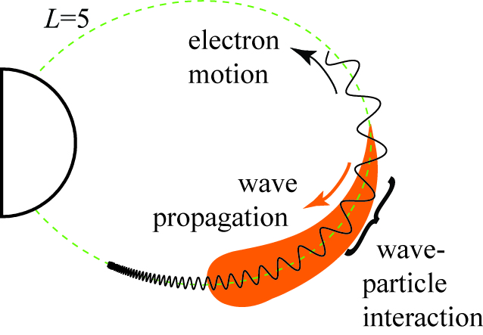
Space Physics Master’s Course
Lecture 10
Van Allen Belts Part 3

Slide 2



The storms, the substorms and the waves
ULF: Pc5 and EMIC waves
VLF: Whistler-mode chorus waves

Slide 3
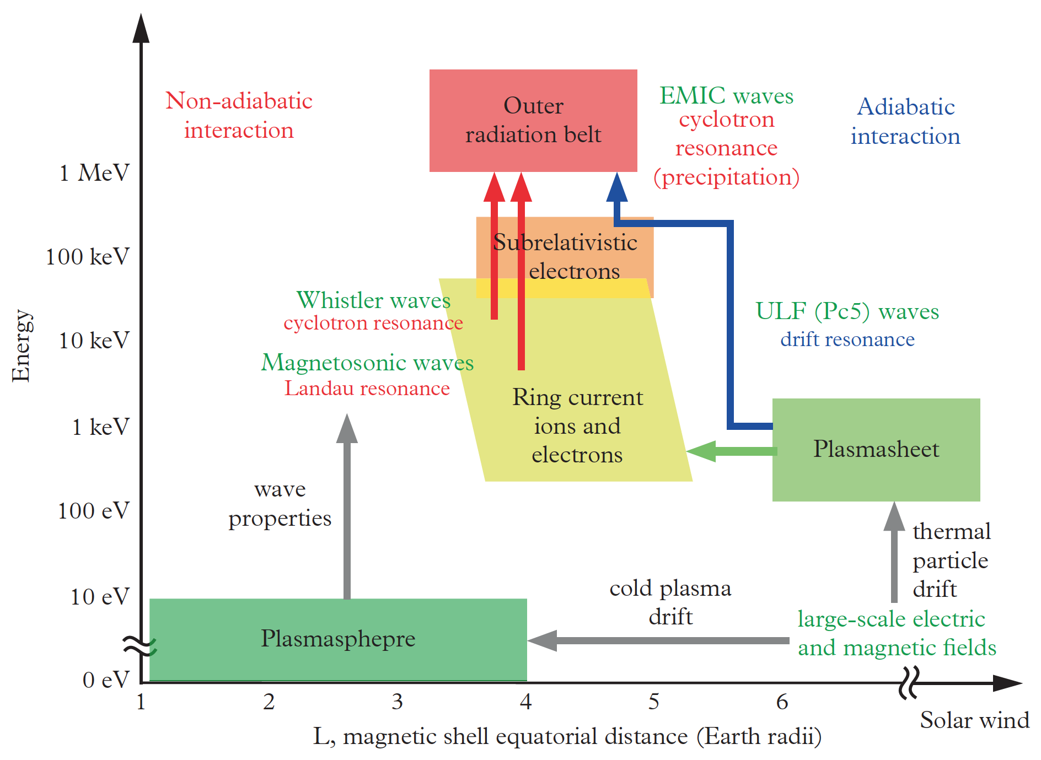
Takahashi and Miyoshi, 2016
Interaction of various waves
(in various ways)
with various particle populations
during storms/substorms
Notes:
Published November 24, 2 years ago.

Slide 4
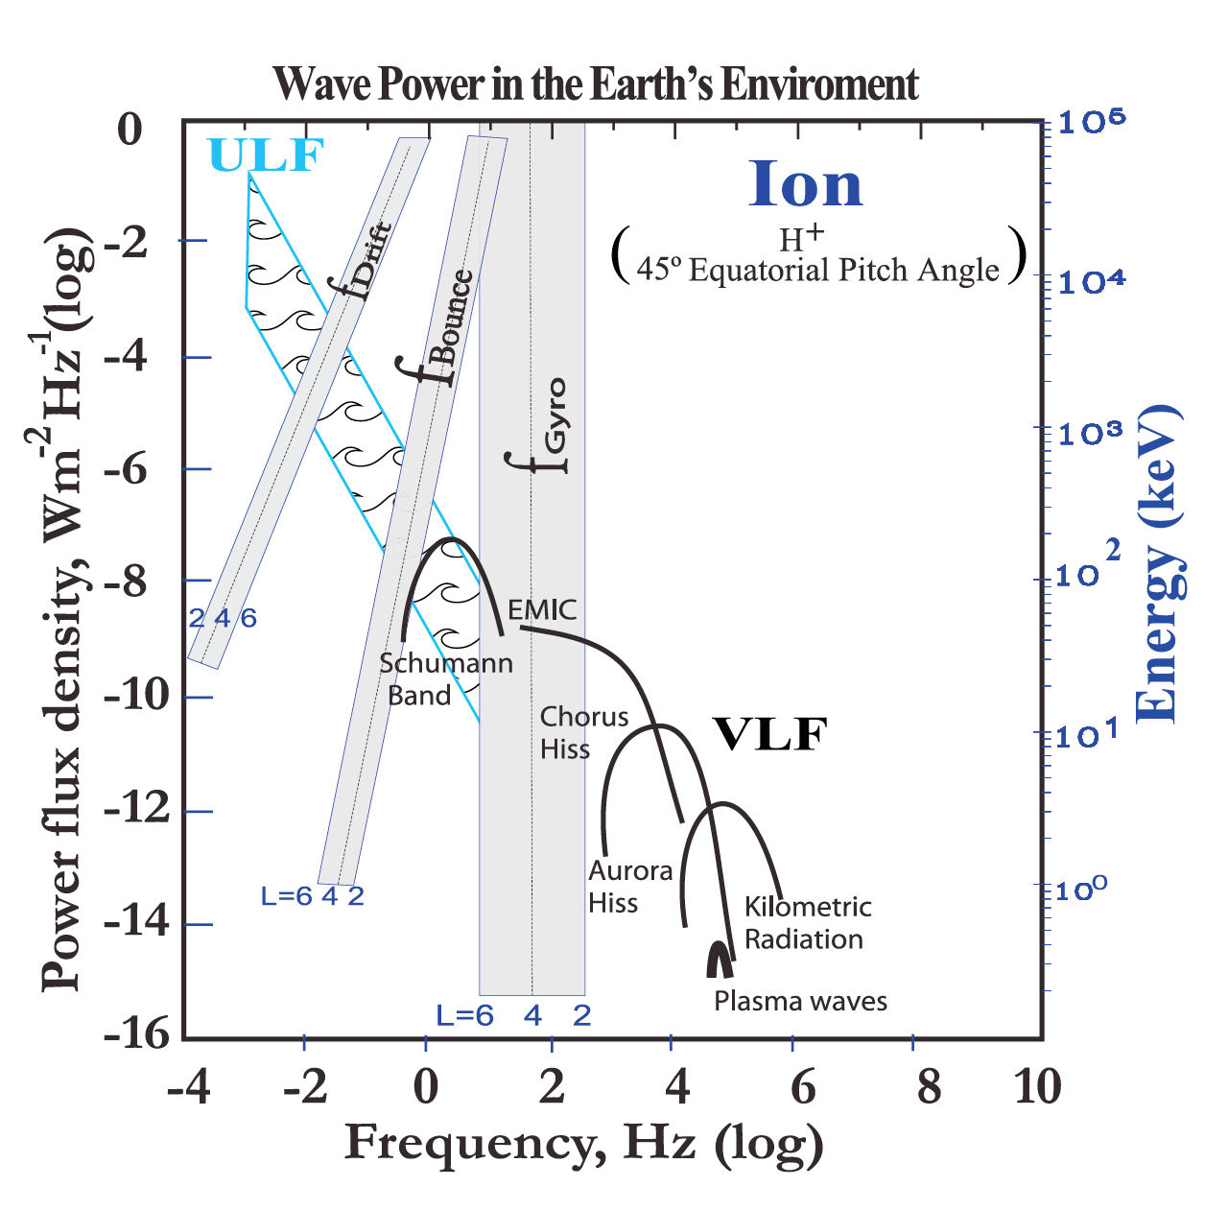

Slide 5
ULF Pc5 waves result from:
solar wind pressure
magnetopause shear flow instabilities
mirror/drift-bounce instabilities
anisotropies in the ring current

Slide 6
ULF Pc5 waves result from:
solar wind pressure
magnetopause shear flow instabilities
mirror/drift-bounce instabilities
anisotropies in the ring current
RC O⁺ ions, in particular, provide a source of free energy to drive Pc5 waves
Notes:
RC O⁺ ions in particular have an unstable distribution function in the energy range of 10s of keV and can therefore provide a source of free energy to drive Pc5 waves

Slide 7
Solar Wind Driving of ULF Pulsations
SW
SW
ULF Waves Driven by Kelvin-Helmholtz Instability
ULF Waves Driven by Solar Wind Dynamic Pressure Fluctuations

Slide 8
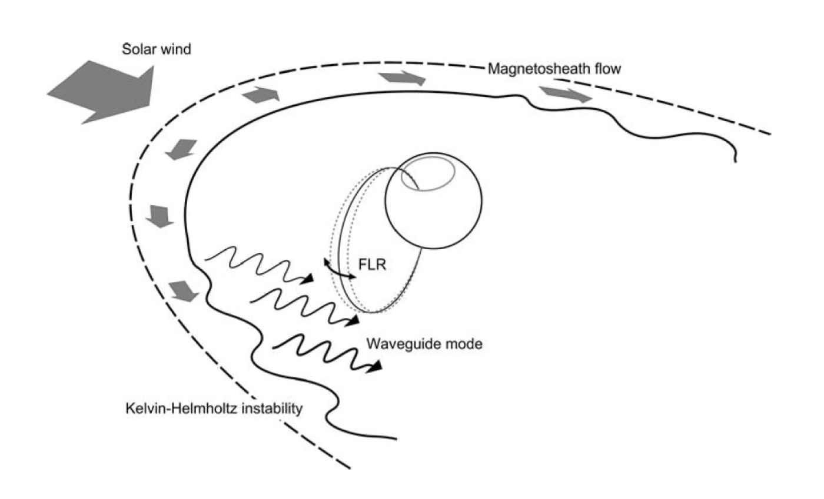
Notes:
Kelvin-Helmholtz instability at the magnetopause flanks and compressions of the dayside magnetopause are the two main generation mechanisms.
The internal waves draw their energy from low-frequency instabilities of the ring current ions.

Slide 9

Kelvin-Helmholtz instability

Slide 10
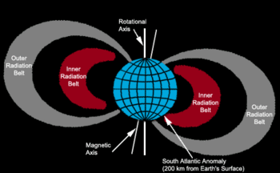
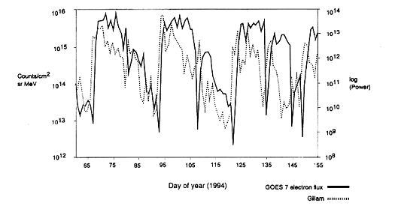
ULF Pulsations and the Radiation Belts
ULF pulsation power is well-correlated with RB electron flux enhancements (e.g. Rostoker, 1998).
Enegization and transport of RB electrons via ULF waves is mediated through a drift-resonant type interaction (Elkington, 1999; Hudson, 2000):
An electron drifting in the equatorial plane with drift frequency ω_{d} can be energized by a ULF wave with frequency ω = mω_{d} where m is the azimuthal mode number of the wave.
We need: frequency and azimuthal mode number spectrum of the ULF waves
Notes:
Say what ULF freqs are (less than 20)

Slide 11
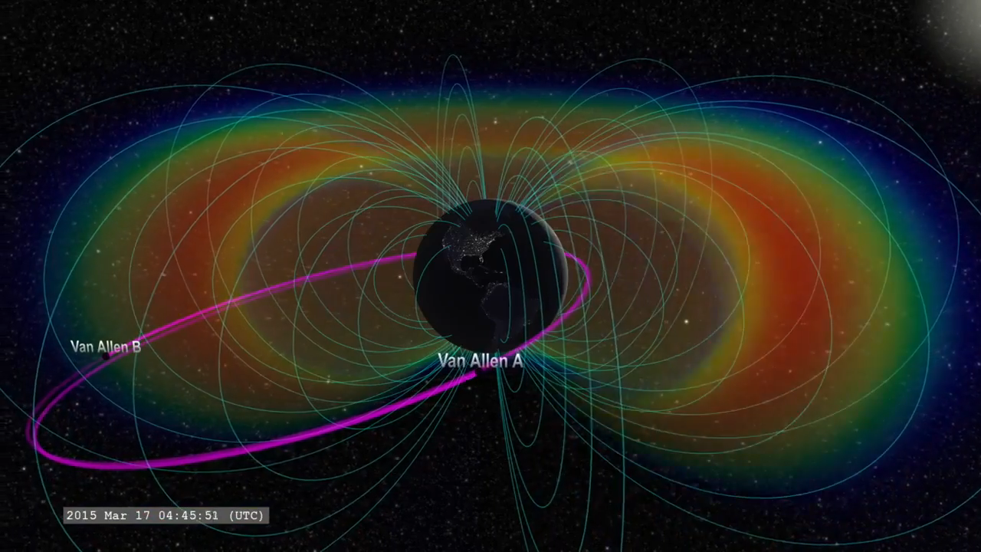

Slide 12

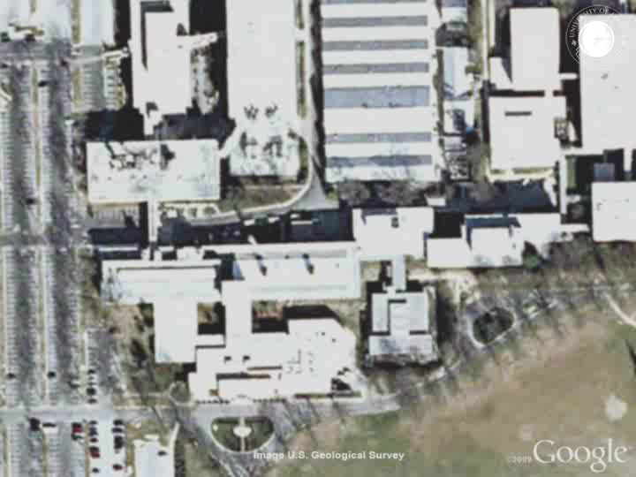

Slide 13
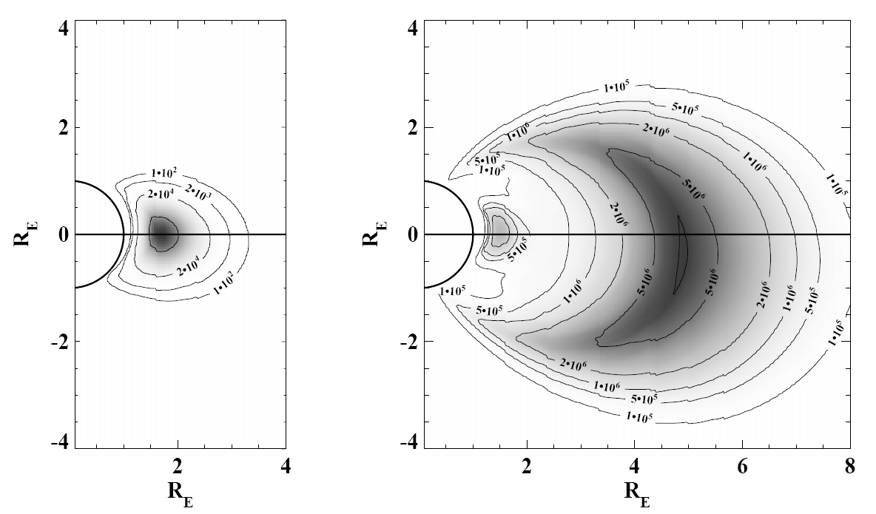
Radiation Belts: Inner, Outer
Protons
Electrons
slot

Slide 14
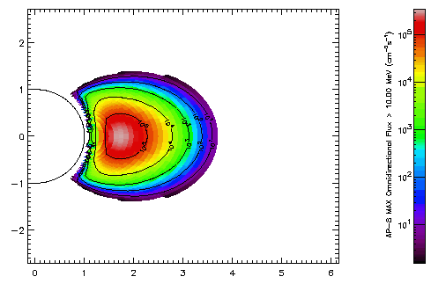
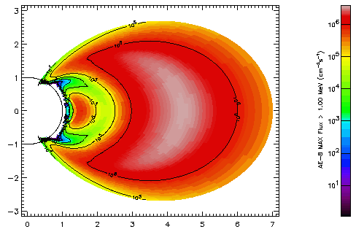
Radiation Belts: Inner, Outer

Slide 15
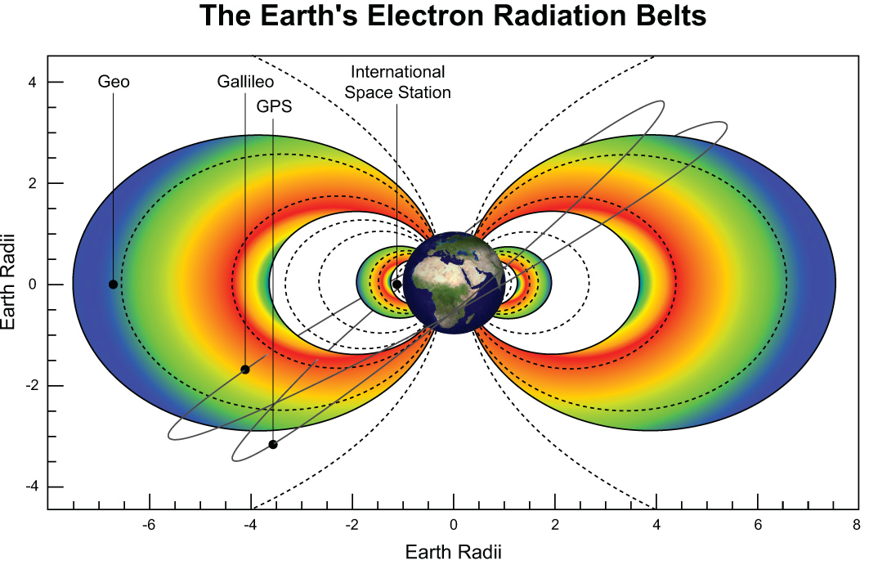
Notes:
Οι ζώνες και οι τροχιές των δορυφόρων. Να τονίσω το ευτύχημα της θέσης των LEO & GEO. Και θα επανέλθουμε.

Slide 16
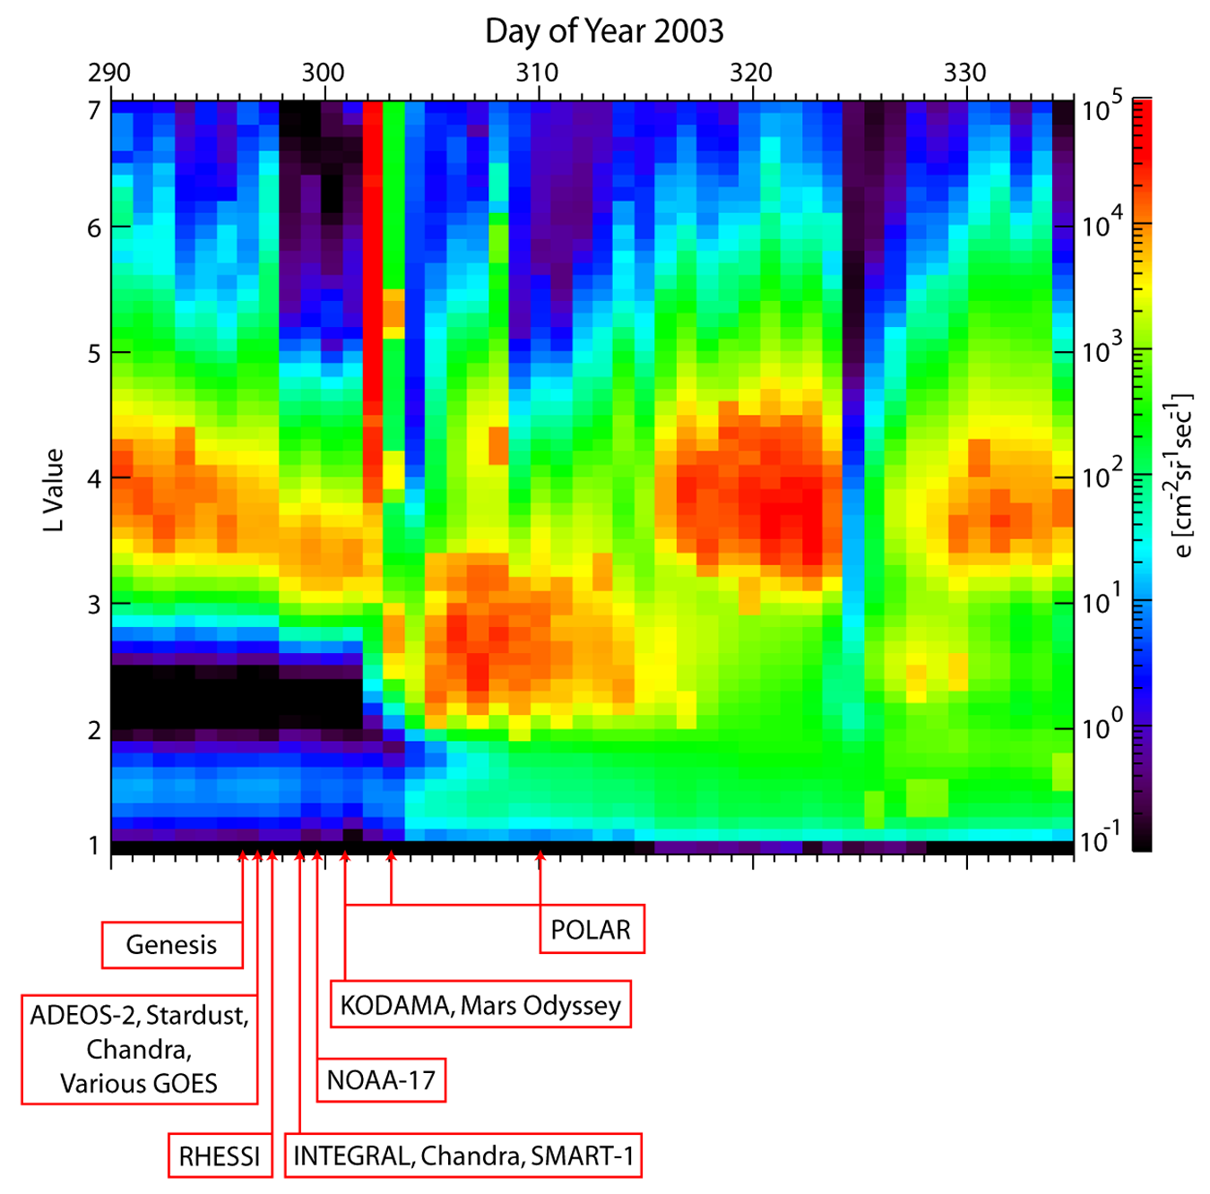
Close association
of storm-time enhancements
of relativistic electron fluxes
with spacecraft failure.
Spacecraft operational
anomalies, SAMPEX data
[Baker & Daglis, 2006]
Notes:
The October-November 2003 interval was quite prominent from a space weather standpoint: Several spacecraft anomalies and failures occurred [Lopez et al., 2004]. Most of these spacecraft problems occurred near geostationary orbit or elsewhere in the outer magnetosphere. Figure 10 shows a detail of relativistic electron fluxes (2-6 MeV) measured by SAMPEX at L=6.6 for the period 17 October through 15 December 2003. As can be seen, the electron flux, after being relatively low in early October, went up abruptly to high levels in late October. With some fluctuations in absolute intensity, the fluxes remained elevated until the end of the year. As discussed by Lopez et al. [2004], numerous failures may have been related to deep dielectric charging from the elevated electron flux

Slide 17

March/April 2001 Storms
j > 5 orders of magnitude, e– penetrate into slot and ΙΒ Georgiou+ ANGEO2015
Notes:
Coming back to the April 2001 storms …

Slide 18
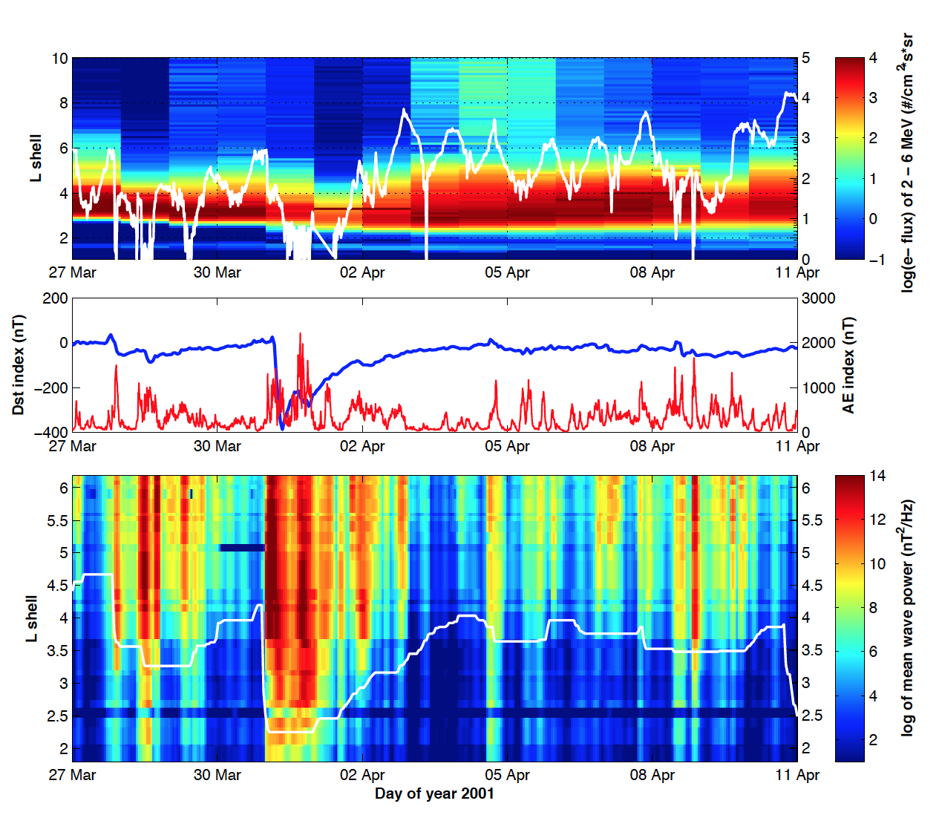
Georgiou+ ANGEO2015

Slide 19

Radiation belt formation
Which mechanism(s) can efficiently accelerate charged particles, leading to enhanced fluxes of MeV radiation belt particles?

Slide 20
Radiation belt formation
The most obvious driver,
the magnetospheric substorm,
appears to be insufficient.
Typical substorms seldom directly accelerate electrons to energies much above ~300 keV

Slide 21
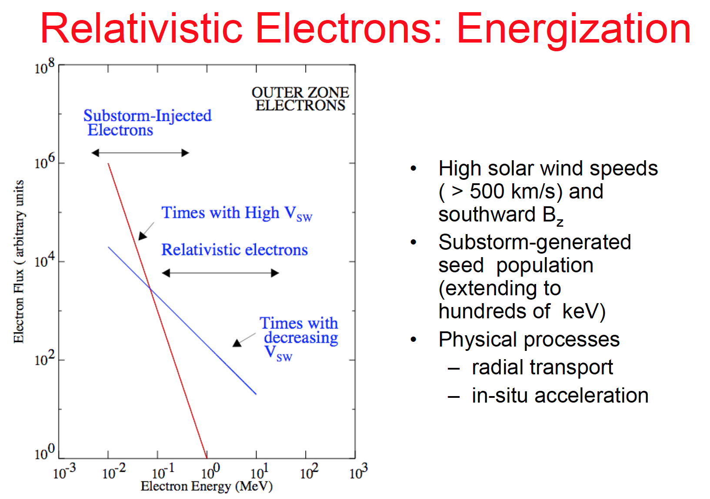

Slide 22
Radiation belt formation
A pre-requisite of relativistic (MeV) electron enhancement is typically
an interval of southward IMF
along with a period of
high solar-wind speed
(V_{SW} ≥ 500 km/s).

Slide 23
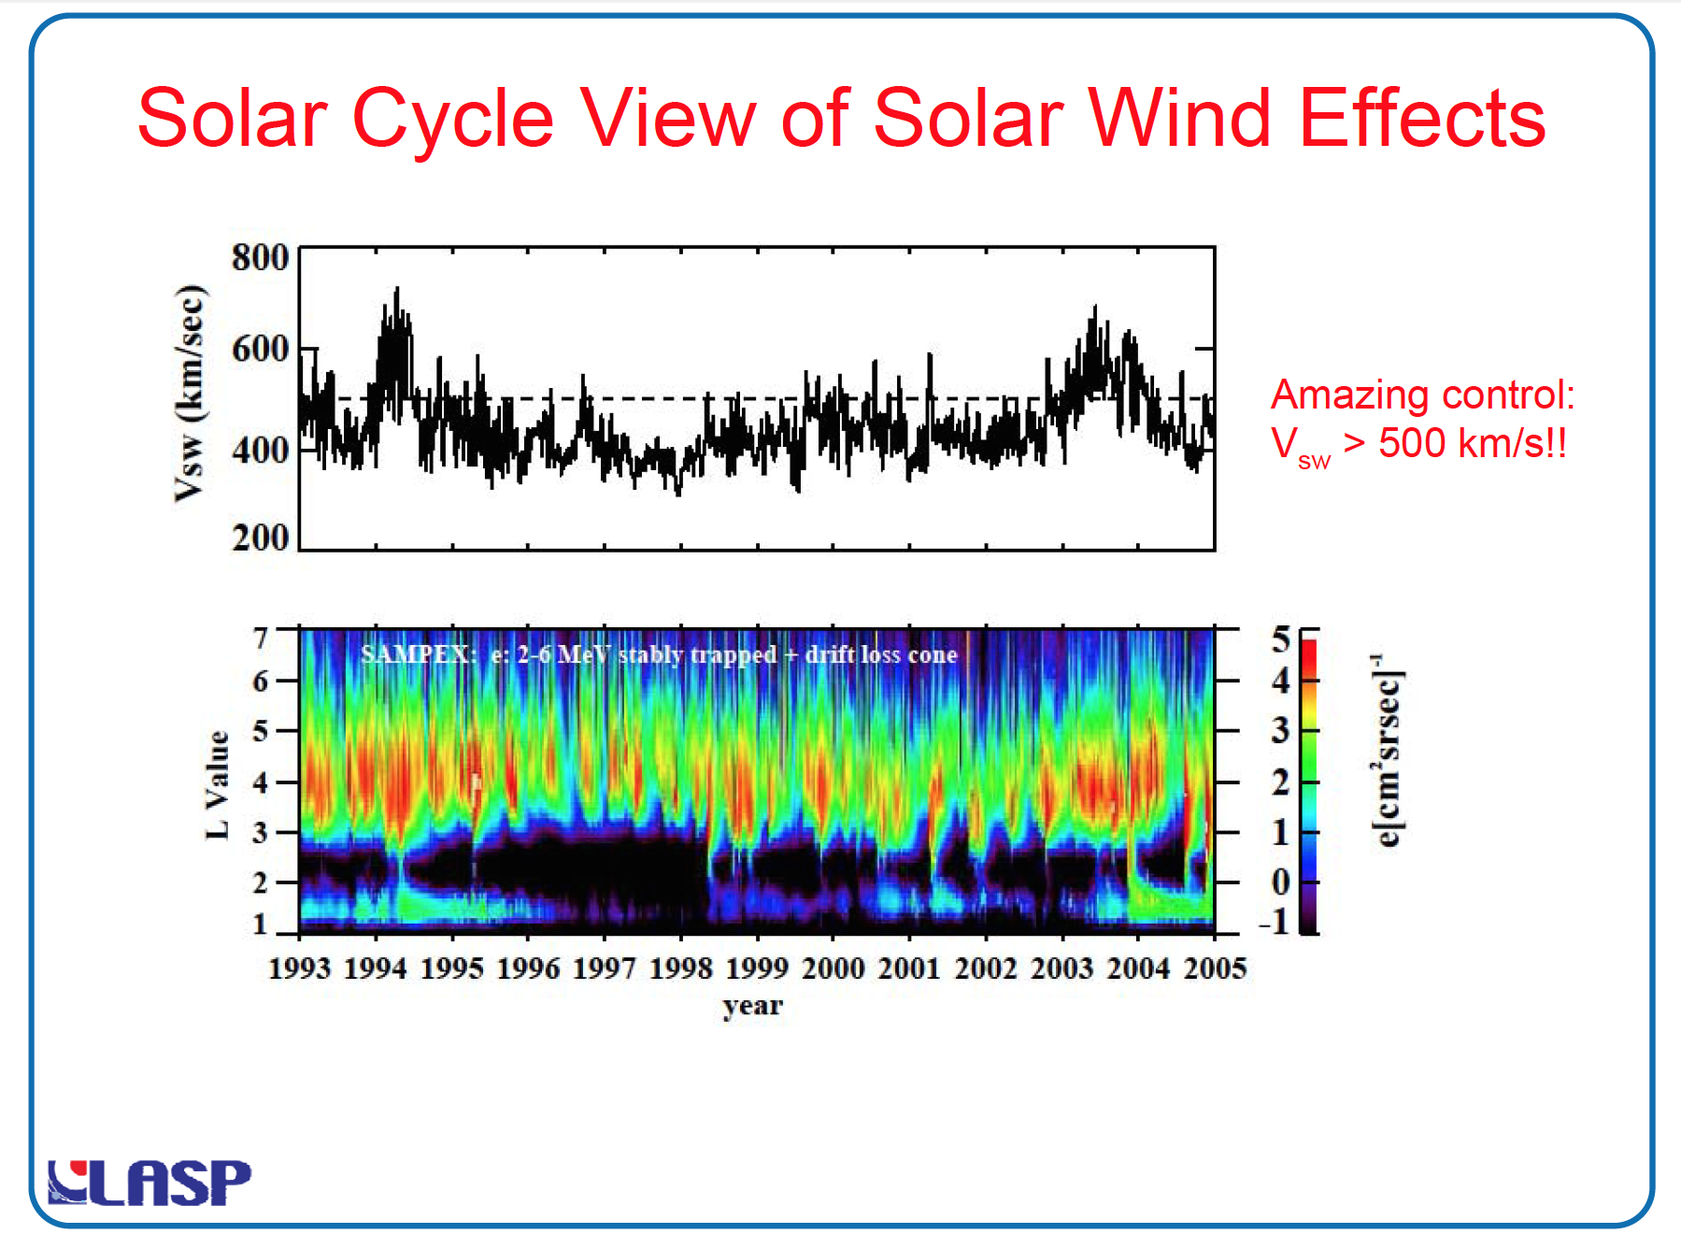

Slide 24
SAMPEX and Van Allen Probes (25 years!)

Slide 25
Radiation belt formation
Hence, observations have led to the view that an enhancement in magnetospheric activity (substorms) - driven by southward IMF - is a key first step in the acceleration of magnetospheric electrons to high energies.
A second step is found to be a period of intense wave activity - which is closely related to high values of V_{SW}

Slide 26
Radiation belt formation
Two-step process:
Substorms provide a “seed” population,
while high-speed solar wind decisively contributes to the acceleration to relativistic energies – through the excitation of waves and the consequent wave-particle interactions.

Slide 27
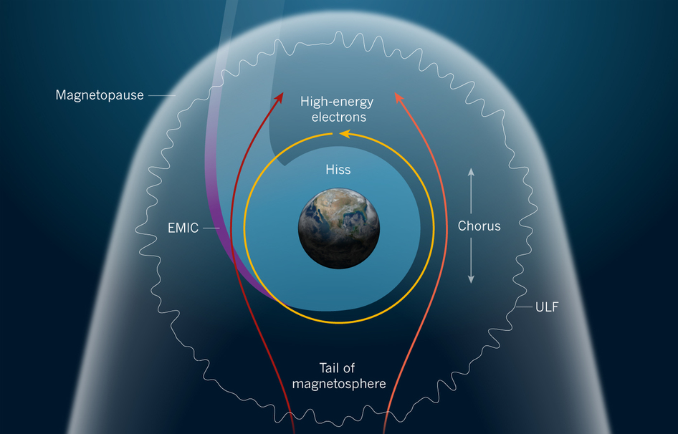

Slide 28
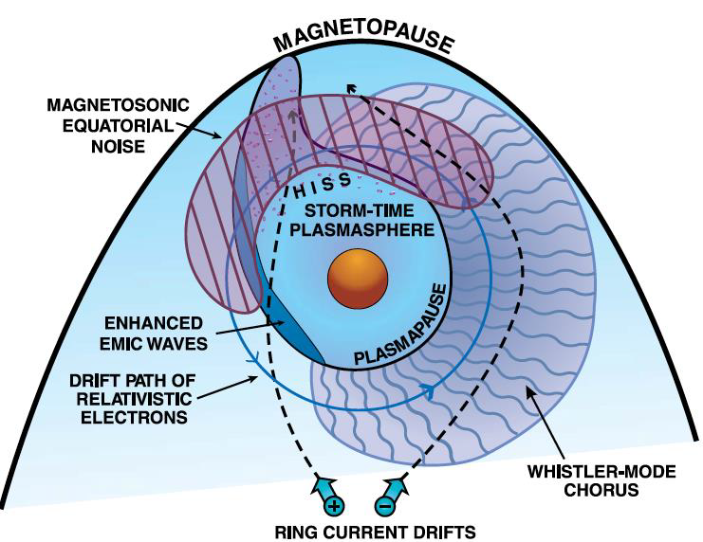

Slide 29
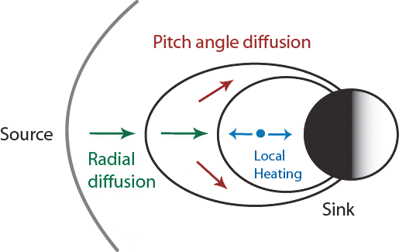

Slide 30
