Slide 1
International Baccalaureate
1968

Slide 2
Τετάρτη 8 Ιούλη 2009ΡΙΖΟΣΠΑΣΤΗΣ Σελίδα 14
Περί «μπακαλορεά»...
Μέγα θέμα έγινε τα τελευταία εικοσιτετράωρα η διαρροή θεμάτων στις εξετάσεις του προγράμματος Διεθνούς Απολυτηρίου («International Baccalaureate» - ΙΒ). Το πρόγραμμα, που προσφέρεται από ορισμένα μεγάλα ιδιωτικά σχολεία, αφορά μαθητές της Β' και Γ' Λυκείου που έχουν προαποφασίσει ότι δε θα ακολουθήσουν τη διαδικασία των πανελλαδικών εξετάσεων, αλλά θα συνεχίσουν τις σπουδές τους μετά το Λύκειο στο εξωτερικό. Διαλέγουν, λοιπόν, το συγκεκριμένο πανάκριβο πρόγραμμα, όπου παρακολουθούν μόλις έξι μαθήματα με κάποια συμπληρώματα και δίνουν κάποιες ειδικές εξετάσεις προκειμένου να αποκτήσουν το Διεθνές Απολυτήριο και να φύγουν στο εξωτερικό. Υπεύθυνος φορέας για το πρόγραμμα και τη διαδικασία των εξετάσεων είναι ένας οργανισμός που εδρεύει στη Γενεύη. Από αυτόν τον οργανισμό, ανακοινώθηκε στα ιδιωτικά εκπαιδευτήρια που παρέχουν το πρόγραμμα ότι εντοπίστηκε διαρροή θεμάτων στις φετινές εξετάσεις, με συνέπεια να παγώσει η έκδοση των αποτελεσμάτων και να αναμένονται νέες ανακοινώσεις για το τι μέλλει γενέσθαι με τους 2.000 περίπου μαθητές που συμμετείχαν στις εξετάσεις. Για τη διαρροή κατηγορείται Ελληνας υπάλληλος του οργανισμού στη Γενεύη, ενώ για το θέμα παρενέβη χτες και ο εισαγγελέας.

Slide 3
Το όλο θέμα έσπευσαν από χτες να το καλύψουν εκτενώς ηλεκτρονικά και έντυπα ΜΜΕ, διανθίζοντάς το με χαρακτηρισμούς του τύπου «εκπαιδευτικό και κοινωνικό σκάνδαλο», «αγωνία για τους μαθητές και τις οικογένειές τους»... ενώ την ίδια στιγμή διαφήμιζαν το πρόγραμμα ως «ισχυρό διαβατήριο» για τα «καλύτερα πανεπιστήμια»... Αποκρύπτουν όμως την ουσία: Το θέμα αφορά ένα μικρό αριθμό οικογενειών που αγοράζουν το συγκεκριμένο πρόγραμμα - εμπόρευμα, προκειμένου να αγοράσουν στη συνέχεια ένα πρόγραμμα σπουδών σε κάποιο ξένο πανεπιστήμιο, προκειμένου να αγοράσουν ένα πτυχίο κ.ο.κ. Προβλήματα και ρίσκα στις εμπορικές συναλλαγές υπάρχουν πάντα και το γνωρίζουν καλά όσοι «αγωνιούν» τάχα τώρα κι όσοι συμπάσχουν με τις οικογένειες που... δεν ξέρουν αν θα λειτουργήσει το προϊόν που αγόρασαν, αν θα αποκτήσουν τα παιδιά τους το Διεθνές Απολυτήριο και μετά από ποια διαδικασία. Οταν η εκπαίδευση πέφτει στα επίπεδα μιας χυδαίας εμπορικής διαδικασίας, βρίσκονται διάφοροι που προσπαθούν με πλάγιους τρόπους να αποκτήσουν κέρδος (σύμφωνα με τα όσα έχουν διαρρεύσει, τα θέματα των εξετάσεων κάποιοι επιτήδειοι τα πουλούσαν σε μαθητές!).

Slide 4
Είναι αποκαλυπτικές αυτές οι εξελίξεις και για όλους αυτούς που παρουσιάζουν τάχα ως ανώτερη και υψηλού επιπέδου την εκπαίδευση που παρέχεται από διάφορα ιδιωτικά μαγαζιά (της χώρας μας και του εξωτερικού, όποια ταμπέλα κι αν φέρνουν). Είναι αποκαλυπτική ακόμα και η απάντηση του υπουργείου Παιδείας για το όλο ζήτημα, που δηλώνει αναρμόδιο, αφήνοντας να εννοηθεί ουσιαστικά ότι το θέμα θα το λύσει η αγορά... Γιατί; Γιατί ουσιαστικά πρόκειται για ένα ξένο πρόγραμμα σπουδών, στο οποίο το υπουργείο δεν μπορεί να έχει κανέναν, ούτε καν τυπικό, έλεγχο, όπως ακριβώς θα γίνει μεθαύριο με τα ψευτοκολέγια που θα συνεργάζονται με ξένα πανεπιστήμια, αν εφαρμοστεί η ευρωπαϊκή οδηγία που θα τα αναγνωρίζει (36/05). Γ. Σ.

Slide 5

Notes:
The organisation's name and logo were changed in 2007 to reflect a reorganisation. Consequently, "IB" can refer to the organisation itself, any of the four programmes, or the diploma or certificates awarded at the end of the programme.^{[4]}

Slide 6
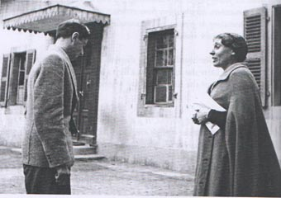
Notes:
Along with other founders of the International School of Geneva, Marie-Thérèse Maurette responded to a unique opportunity to bring together students from all parts of the globe in an environment that builds upon mutual understanding and cooperation. As headmaster, Maurette accomplished the daunting task of putting these principles into practice even as the international situation cascaded into the abyss. She maintained the school during the darkest period in world history when others around her had by necessity abandoned the scene.

Slide 7
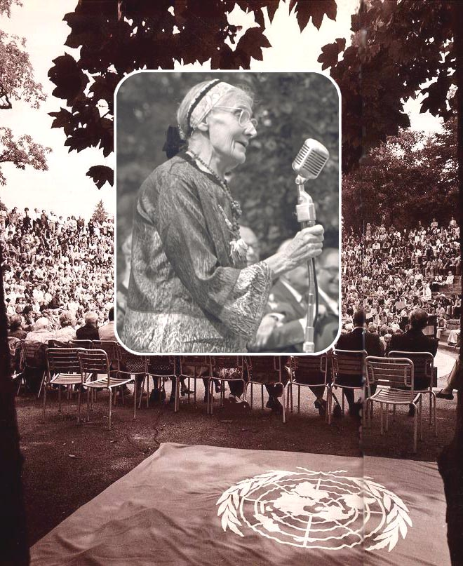
Notes:
This report to UNESCO addresses the central question of how to educate people to become members of the human race as a whole in addition to being citizens of separate nations. She wanted to enrich her students' shared experience, living and working among widely differing cultures, together with the art, literature, and traditions which characterize them.
Maurette emphasized the active personal development of respect for others who are different from ourselves, reinforcing this personal development through the learning of languages other than one's own in order to minimize the fear and resentment that can be exhibited towards strangers. To this end, she believed passionately in the memorable quotation attributed to the American poet Archibald McLeish that is embodied in the preamble to the UNESCO charter:

Slide 8
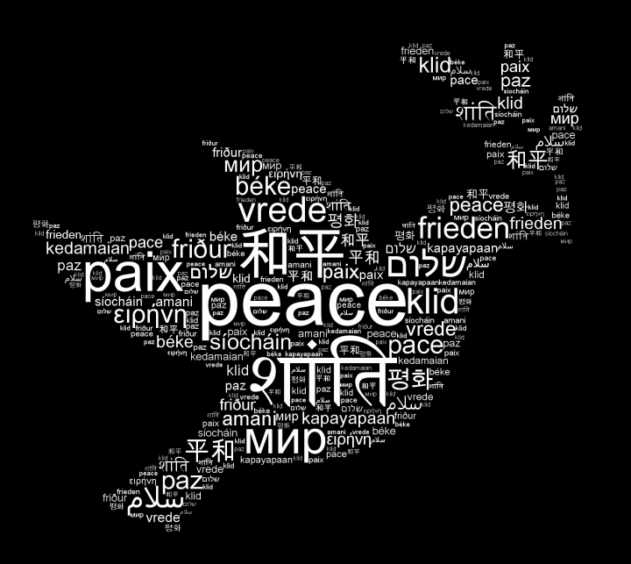
Notes:
Maurette emphasized the active personal development of respect for others who are different from ourselves, reinforcing this personal development through the learning of languages other than one's own in order to minimize the fear and resentment that can be exhibited towards strangers. To this end, she believed passionately in the memorable quotation attributed to the American poet Archibald McLeish that is embodied in the preamble to the UNESCO charter:
Since wars begin in the minds of men, it is in the minds of men that the defences of peace must be constructed.

Slide 9

Notes:
Marie-Thérèse Maurette[5] created the framework for what would eventually become the IB Diploma Programme in 1948 when she wrote Is There a Way of Teaching for Peace?, a handbook for United Nationsite.[6] In the mid-1960s, a group of teachers from the International School of Geneva (Ecolint) created the International Schools Examinations Syndicate (ISES), which would later become the International Baccalaureate (IB).[7] by Peter Nehr, International Baccalaureate Africa, Europe and Middle-East (IBAEM) was established in 1986,[8] and International Baccalaureate Asia Pacific (IBAP) established during the same period.[9]

Slide 10
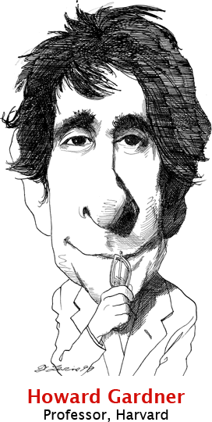
'less parochial than most American efforts.'' It also helps students ''think critically, synthesize knowledge, reflect on their own thought processes and get their feet wet in interdisciplinary thinking.''
Professor Gardner and others applaud course work that requires students to make connections within and between disciplines. They also admire exit exams, each as long as five hours, that combine persuasive writing and an oral defense of a portfolio of work; a 4,000-word research essay; fluency in at least two languages and a signature course that explores the process rather than the content of learning -- how we know what we know.
Gross, Jane (21 June 2003). "Diploma for the 'Top of the Top'; International Baccalaureate Gains Favor in Region". The New York Times. Retrieved 27 July 2009.
Notes:
The IB Middle Years Programme (MYP) adheres to the study of eight subject areas and was developed and piloted in the mid-1990s. Within five years 51 countries had MYP schools.^{[10]} The IB Primary Years Programme (PYP) was piloted in 1996 in thirty primary schools on different continents, and the first PYP school was authorised in 1997,^{[11]} with as many as 87 authorised schools in 43 countries within five years.^{[12]} The newest offering from the IB, the IB Career-related Programme (formerly IB Career-related Certificate^{[13]}) is designed for students of ages 16 to 19 who want to engage in career-related learning. The IB introduced its newly reviewed MYP for first teaching in September 2014.^{[14]}

Slide 11
Χώρα | Primary | Middle | Diploma | Σχολεία
USA | 444 | 544 | 830 | 1,575
Canada | 74 | 166 | 156 | 348
Australia | 95 | 41 | 63 | 155
Ecuador | 7 | 8 | 150 | 150
United Kingdom | 13 | 12 | 134 | 142
India | 51 | 11 | 100 | 113
Mexico | 53 | 35 | 65 | 105
China | 32 | 24 | 67 | 82
Spain | 8 | 10 | 74 | 76
Germany | 23 | 9 | 60 | 64
Hong Kong | 29 | 9 | 29 | 53
Turkey | 19 | 9 | 33 | 49
Argentina | 7 | 2 | 47 | 48
Switzerland | 18 | 11 | 41 | 48
Indonesia | 28 | 13 | 26 | 44
Poland | 6 | 7 | 37 | 42
Total schools | 1,207 | 1,120 | 2,642 | 3,966
Countries | 104 | 97 | 140 | 147

Slide 12
American Community Schools of Athens (Χαλάνδρι 1976)
Κολλέγιο Ανατόλια – Αμερικανικό Κολλέγιο Θεσσαλονίκης (ACT Πυλαία, 1997)
Campion School (Παλλήνη, 2000)
Εκπαιδευτήρια Κωστέα-Γείτονα (Παλλήνη, 1994)
Εκπαιδευτήρια Δούκα (Μαρούσι, 2001) www.doukas.gr
Εκπαιδευτήρια Γείτονα (Κορωπί, 1996)
Ελληνοαμερικανικόν Εκπαιδευτικόν Ίδρυμα - Κολλέγιο Ψυχικού (1996)
Σχολή Ι.Μ. Παναγιωτόπουλου (Ψυχικό, 1996)
ISA - International School of Athens (Κηφισιά, 2000)
Σχολή Μωραϊτη (Παλαιό Ψυχικό, 1994)
Pinewood - American International School of Thessaloniki (Θέρμη, 1999)
St. Catherine's British Embassy School (Λυκόβρυση, 2002)

Slide 13

Notes:
US Declaration of Independence[edit]
The opening of the United States Declaration of Independence, written by Thomas Jefferson in 1776, states as follows:
We hold these truths to be self-evident, that all men are created equal, that they are endowed by their Creator with certain unalienable Rights, that among these are Life, Liberty, and the Pursuit of Happiness. That to secure these rights, Governments are instituted among Men, deriving their just powers from the consent of the governed;[26]

Slide 14
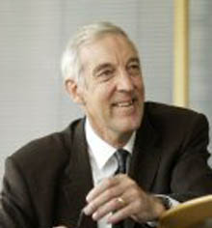
Notes:
George Walker was himself a successor to Marie-Thérèse Maurette, serving as Director General of the International School for eight years before becoming Director General of the International Baccalaureate. In his early years, he studied chemistry at Exeter College, Oxford, gaining both MA and MSc degrees, and went on to become a lecturer in the department of education at the University of York. Extending a distinguished career in comprehensive education, Walker was appointed Officer of the Order of the British Empire (OBE) for his contributions. George Walker was awarded the honorary degree of Doctor of Education from the University of Bath, where he is a currently a visiting professor.

Slide 15
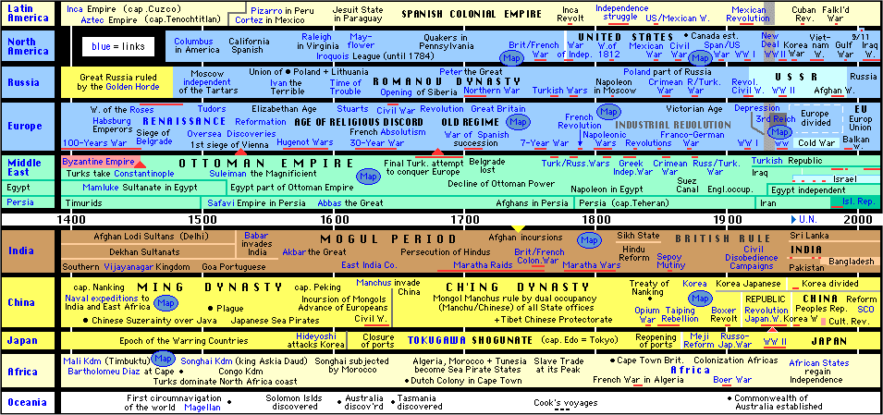
Notes:
The International Baccalaureate Organization officially formed in 1968 to serve the children of UN diplomats who traveled around the globe and were in need of a recognizable standard for admission into Universities. According to former IBO Director General George Walker, the intellectual process which would culminate in the IB Diploma Programme was begun by Marie-Therese Maurette in 1948 when she wrote a paper for UNESCO called “Ways for
Educating for Peace: do they exist?” Maurette had outlined a program and pedagogy which included the following elements:
Geography should be taught starting not with the student’s country of origin but with the whole World History should not be taught before the age of 12 to avoid it becoming a catalogue of national heroes and patriotic celebrations. When introduced, it must be world history Each week there should be an hour’s lesson of “national culture” taught to classes divided into small national groups, but this will be deliberately subordinated to international geography and history. Promotion of bilingualism
Regular debates should encourage students to think about world affairs
Students should take part in sports, community service and in the life of the school.
According to Ian Hill, Deputy Director General of IBO, “The primary goal of IBO is the
promotion of world citizenship.” Currently, IBO is a signatory to a Peace Education agreement
with UNESCO through the year 2010 whereby IBO agrees to integrate the UNESCO
educational goals into every aspect of its curriculum:
http://www3.unesco.org/iycp/Report/IBO.pdf . IBO and its representatives often publicly
deny a relationship with the UN, but it is there in black and white in addition to annual funding
of IBO by the UN which can be viewed in any of its annual reports..
IBO bills its PYP as a program for children ages 3-12. IBO describes the PYP as “a
transdisciplinary programme of international education designed to foster the development of
the whole child.” Big words, sounds impressive, but exactly what does a school get when it
buys the PYP?

Slide 16
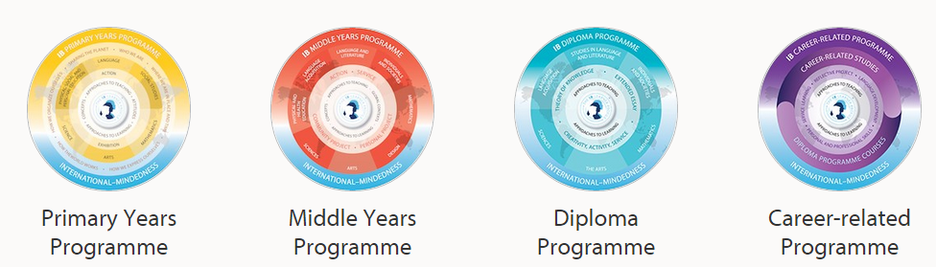
Notes:
IBO claims a “rigorous” approval process which takes approximately two years. Actually, there is nothing terribly rigorous about the process except the strain it puts on a district’s budget. There is absolutely no evidence of a school ever being denied IBO authorization. The cost of the application is $17,000 for Parts A & B. At the PYP level, IBO requires every teacher and the school administrator to receive IB training. These three day training sessions are rarely held locally and require teachers to fly to locations all over the U.S. and Canada. There are three (3) levels of training. Each session, per teacher, per level, averages $1,500. A school of average size will invest approximately $50,000-60,000 training teachers before a single class is taught. An additional $6,620 membership fee is required annually to maintain IBO authorization. IBO also requires a school to establish an IB Coordinator position for the school. In the United States, there are currently only 165 schools with the IB PYP. Globally, there are 538 PYP schools

Slide 17
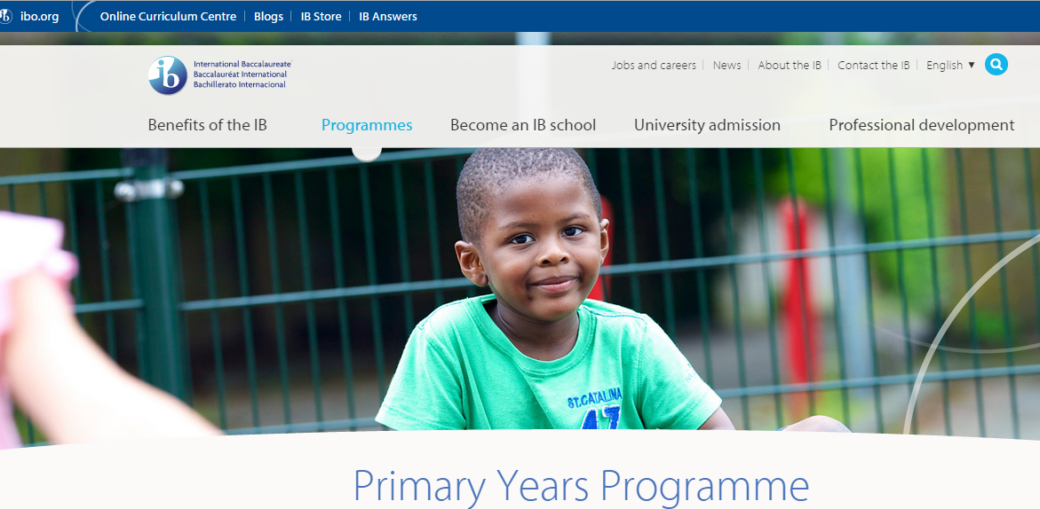
Notes:
Press releases celebrating IB authorization often boast of implementing a “rigorous curriculum”. Parents, eager for greater challenges for their children, often accept this rhetoric without question. But is the PYP really a “curriculum”? The answer is no, it is not. According to IBO: The curriculum framework consists of five essential elements: concepts, knowledge, skills, attitudes, action. The knowledge component is developed through inquiries into six transdisciplinary themes of global significance, supported and balanced by six subject areas. These six themes include: Who we are, Sharing the planet, How we organize ourselves, How the world works, Where we are in space and time and How we express ourselves. Each of these themes are incorporated into the core subjects, the REAL curriculum, which your child’s school is required to offer as per individual State standards. To further obfuscate a parent’s impression of what PYP is, IBO adds: The curriculum framework is further structured around three interrelated questions. What do we want to learn? The written curriculum. How best will we learn? The taught curriculum. How will we know what we have learned? The assessed curriculum. What does this really mean? The school writes the curriculum, which translates into a teacher’s daily lesson plans. The teacher teaches. The teacher/State creates and grades student exams. IBO seeks to influence the “flavor” of traditional education with its themes and questions, but provides nothing of substance when it comes to math, science, language, physical education and history.

Slide 18
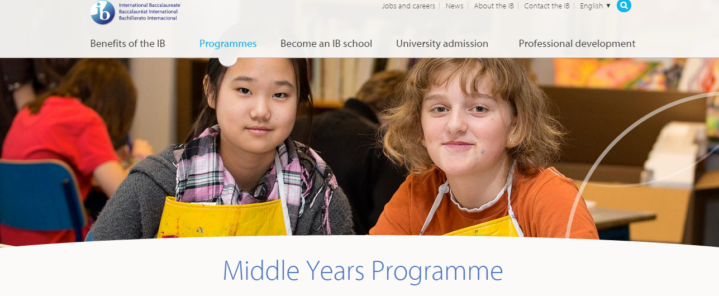

Slide 19
Αnnual school fee | EUR
Diploma Programme | 7,490
Middle Years Programme | 6,270
Primary Years Programme | 5,475
IB Career-related Programme* | 950

Slide 20
Το Διεθνές Απολυτήριο, το οποίο με τον ξενόγλωσσο τίτλο INTERNATIONAL BACCALAUREATE χορηγεί ο Οργανισμός Διεθνούς Απολυτηρίου, θεωρείται ισότιμο και αντίστοιχο του απολυτήριου τίτλου που χορηγούν τα λύκεια της ημεδαπής.
β) Στις τάξεις Β' και Γ' των δημόσιων και ιδιωτικών λυκείων μπορεί να λειτουργεί τμήμα για την απόκτηση Διεθνούς Απολυτηρίου. Στους μαθητές των τμημάτων αυτών διδάσκεται οπωσδήποτε, πέραν του προγράμματος σπουδών του Διεθνούς Απολυτηρίου, το μάθημα της Νεοελληνικής Γλώσσας και Λογοτεχνίας και της Ιστορίας των τάξεων αυτών, κατά το πρόγραμμα των δημόσιων σχολείων που ισχύει.
δ) Για την ίδρυση του τμήματος Διεθνούς Απολυτηρίου σε ιδιωτικά λύκεια απαιτείται προηγούμενη έγκριση του Οργανισμού Διεθνούς Απολυτηρίου και ακολούθως άδεια της οικείας διεύθυνσης δευτεροβάθμιας εκπαίδευσης.

Slide 21
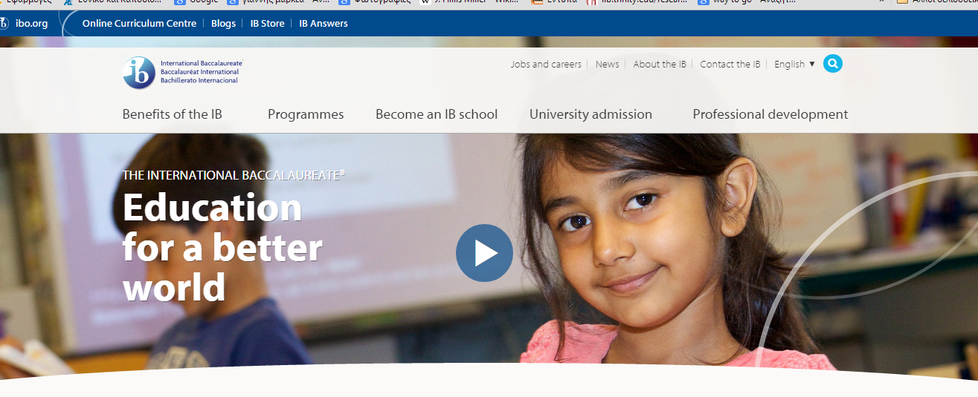
Ας δούμε τα προγράμματα του ΙΒ

