Slide 1
Connecting Embodied Learning in educational practice to the realisation of science educational scenarios through performing arts Smyrnaiou Z. ¹, Sotiriou M. ², Georgakopoulou E.¹, Papadopoulou O. ¹ ¹National and Kapodistrian University of Athens (NKUA), ²Science View
Mind
Emotional
Body
Olistic
Digital
Environment
Dialog
Interest

Slide 2
Embodied Learning has influenced human-computer interaction (HCI) …
… and the design of technological environments and objects.
Studies in education address the benefits of learning environments designed to incorporate embodied interaction (Dourish, 2001) in children’s learning processes (Marshall, Price, and Rogers, 2003; O’Malley and Stanton-Fraser, 2004).
We have studied language and full-body motion as an integral means through which students express thoughts and meanings when they interact with a set of collaborative digital games which we designed (http://www.youtube.com/watch?v=d8AJwADKd90).
The games rely on bodily expression based on the kinaesthetic recognition of the movement (Smyrnaiou & Kynigos, 2012; Kynigos, et al., 2010).

Slide 3
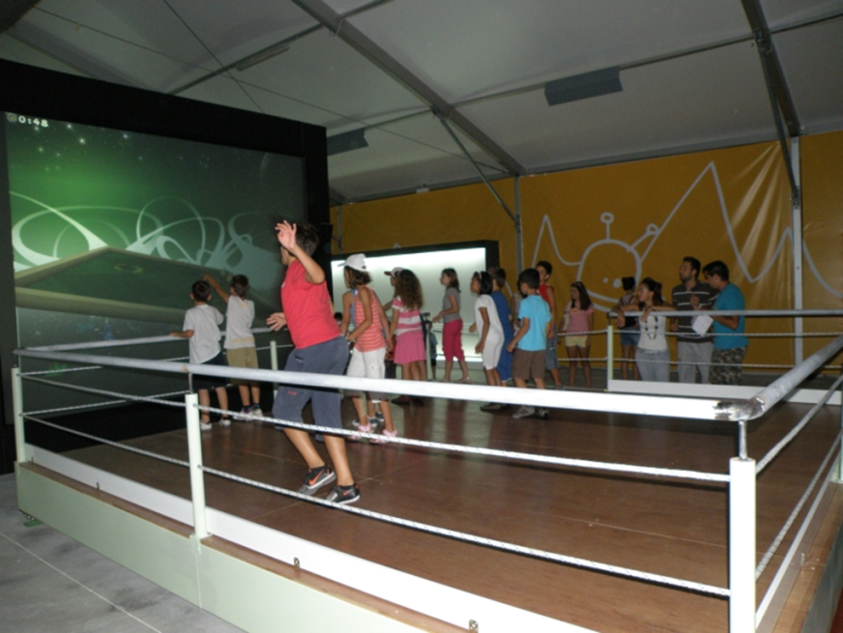
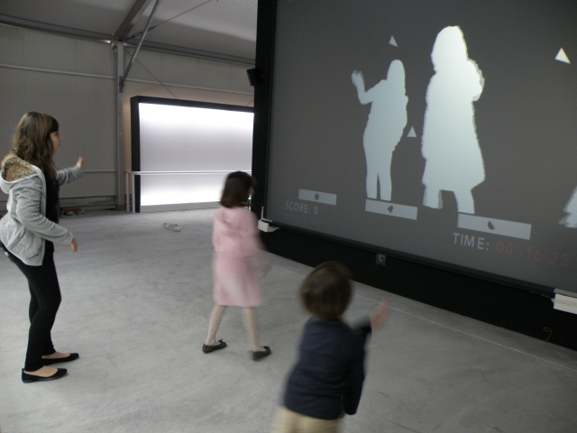
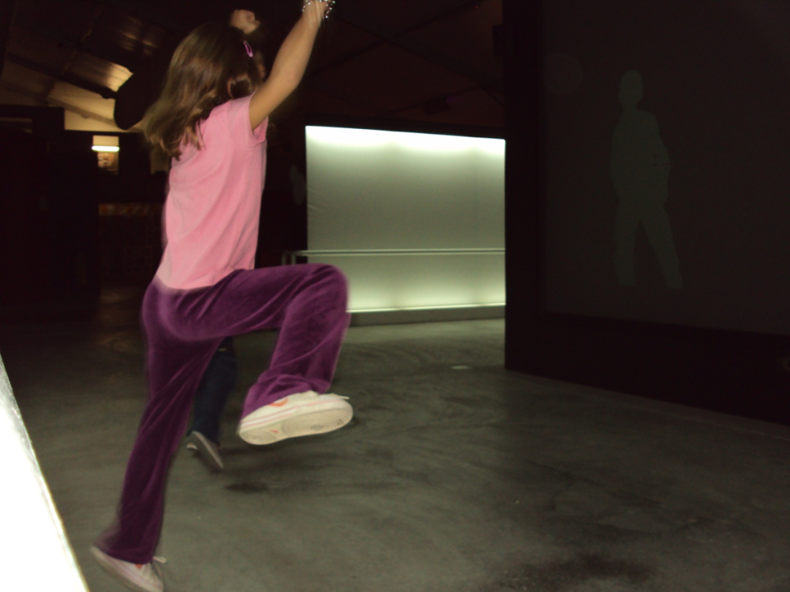
Move away from the individualistic and interactionist
metaphors of kinect-like games and
adopt a social collaborative paradigm
for movement recognition games.
We perceived verbal communication,
body movement and the use of digital screen
representations as semiotic systems used by children to
communicate gaming parameters and explain the simulated
phenomena on the screen.

Slide 4
Defining Embodied Learning
The primary characteristics of embodied learning
Epistemological Background of Embodied learning, History
Traditional Pedagogy, Philosophy (Kant, Merleau-Ponty, Heidegger, Dewey, Freire, Bernstein, Cognitive Psychology, Piaget, Vygotsky, Barsalou, Neurosciences, Socio/Embodied Constructivism
Connection of Embodied Learning with New Learning Theories and Practical Applications
Transformational Education
Research
Learning Science Through Theatre
Gestured- Based Theory
Grounded Theory
Theory of Multimodal Social Semiotics
Situated Learning
Cognitive Load
Action- Based Language Theory Scaffolding Strategy

Slide 5
Embodied Learning constitutes a contemporary pedagogical theory of learning…
… which emphasizes the use of the body in the educational practice.
Several researches related to various areas of expertise (such as dance theatre, kinesiology, athletics even Mathematics and Physics) highlight the usefulness and the necessity of the body itself as a learning tool.
Despite this, until recently the body was mostly used as a means to enable students’ experiential participation and to attract their interest.
Traditionally the body has not been used in education. The notion of Embodied Learning was not known and therefore not acceptable by the educational community.

Slide 6
Embodied + Learning Theories
Embodied Learning is closely related to constructivist models and to modern educational theories regarding the role of the teacher, of the student and of learning itself in the educational practice.
Embodied Education has been defined as the basic concept which includes Embodied Teaching and Embodied Learning (Lindgren & Johnson- Glenberg, 2013; Wilcox, 2009).
The principles of Embodied Learning provide answers to questions related to the ways knowledge is constructed by students while they view everyone’s body as a tool for knowledge construction and as a knowledge carrier (Caine & Caine,1997; Kalantzis & Cope, 2013).

Slide 7
Forum Theatre, Drama, Role Playing
Gestured-Based Theory
Problem solving, gestures students, teachers, parents
Multimodal Social Semiotics
Symbolic systems, images, animations, Μetaphor: Represents a different meaning, Αvatars, virtual world: transport a person in the reality real world
Grounded Theory
Our experiences are grounded in our body
Τransformativepedagogy, Critical Pedagogy
Τhe construction of theory through the analysis of data

Slide 8
Situated Learning
Knowing and doing
Cognitive Load
Increase cognitive load through activities
Scaffolding Strategies
Educational games, graded difficulty with missions
Action- Based Language Theory
Content Performance of a word with body movements and emotions
Unclear Environment - Scenarios

Slide 9
Defining Embodied Learning
Body
Emotions
Cognition
kinesthetic skills
Gestural relevance
Emotional deepening
mental and
kinesthetic skills (sensorimotor activity)
Physical machine of meaning generation
Coordinated movements of body parts or whole body

Slide 10
Defining Embodied Learning (1/2)
The body can be defined based on two parameters. There is the embodied/biological/ sensual way of being, but at the same time there is also the sociocultural and relational/interactive way in which skills are developed.
The notion of body in Embodied Learning includes the body, the senses, the mind, and the brain, that is the whole of the student’s personality.
The body is defined as the human corporeal experience and the subsequent psychological consequences, while others state that the unconscious aspects of corporeal experience constitute the basis of cognitive activity and linguistic expression (Nunez, Edwards and Matos,1999).

Slide 11
Defining Embodied Learning (2/2)
According to Robb, Lindgren and Johnson-Glenberg (2013) the primary characteristics of embodied learning are the following:
sensorimotor activity
relevance of gestures to the theme that is to be reproduced
emotional involvement
Both the sensorimotor system and body movements are involved in the process of Embodied Learning and the perceived stimuli can be transformed into a more stable memory and cognitive representations (Abrahamson, Gutiérrez, Charoenying, Negrete, & Bumbacher, 2012).
As Segal mentions (2011) relevance of gestures refers to the analog or structural correlation of symbols and their meanings.

Slide 12
Traditional Pedagogy (dualism):
Body dualism of the mind / brain / logic
Invisible body / inferior instrument
Throughput transmitter of knowledge
Dewey: Sensory experience and action becomes memory, mind and body, build/construct knowledge,
The body feels the knowledge, internalizes and turns it into memory.
Exploration of the environment & Experience, Knowledge
Freire: The coupling of the mind and body called “Praxis“,
Action /practice, simultaneous action-reaction, mind and body

Slide 13
Bernstein: Physical device, body exploitation of students, reducing social inequalities
Body pedagogies: Curriculum, perfect body, perfect code
Body Pedagogics: Society
Cognitive Psychology:
Piaget: 1st level: the body movements associated with the cognitive load of student cognitive structures, the emotional involvement and kinesthetic skills, signifiers for the real world
2nd level: symbolic representations, signifiers, transformation, building new knowledge
3rd level: application of new knowledge to new environments
Barsalou: Cognitive processes, Memory: negative memory - intense movements, positive recollection - loose motions
Six types: combination / procedural memory, memory depending on the circumstance, endosomal, embodied, reactive, traumatic (Barsalou, 2000)

Slide 14
Neuroscience Neuroeducation:
Field, which is interested to collect and present information about embodied feelings
Working memory: The acquisition of knowledge derived from the interaction will have the physical actions of the student with the episodic and working memory in the analog design of the program environment.
WORKING MEMORY: belongs to the short-time of memory and type of memory that stores cognitive information that is relevant and from body movements eg meanings of sign language words.
EPISODIC MEMORY: it belongs to a long term memory and has more the form of revocation despite the active form of information storage
Green Thinking intellect, mind, emotion, physical movement

Slide 15
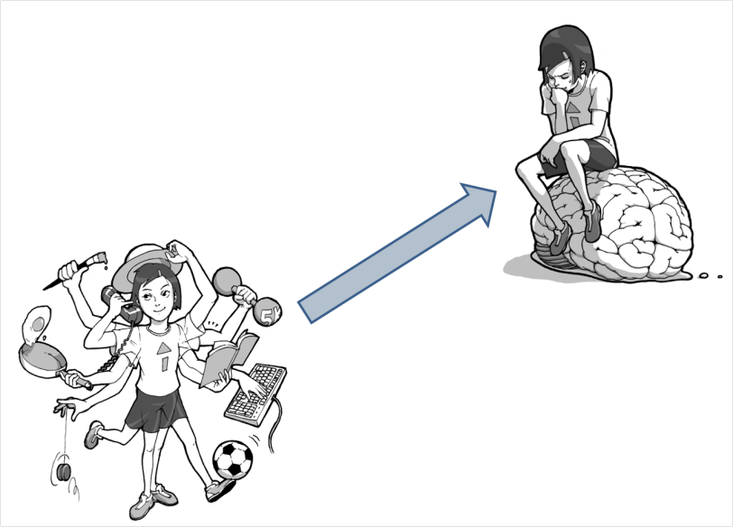
Embodied Learning (entirety):
Connection body-mind / brain
visible body
Interaction with the environment
Emphasis in the world of student experience

Slide 16
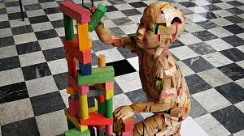
Research Question:
How embodied learning influences the representation of scientific concepts and cultural context in the Art & Science Framework;
Embodied Learning and Learning Science Through Theatre

Slide 17
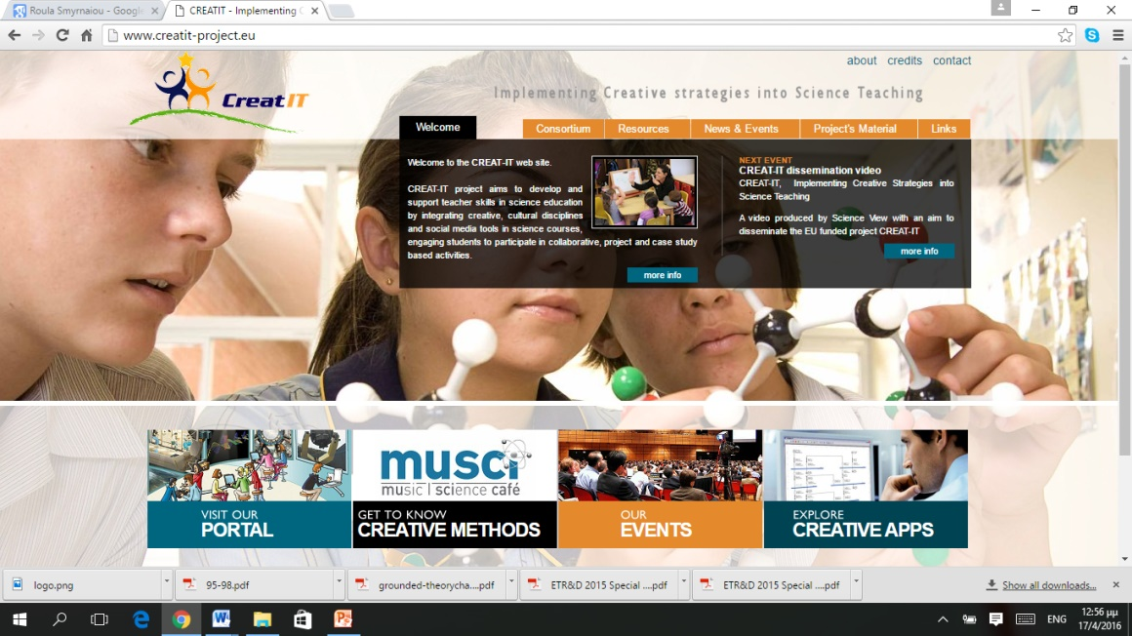
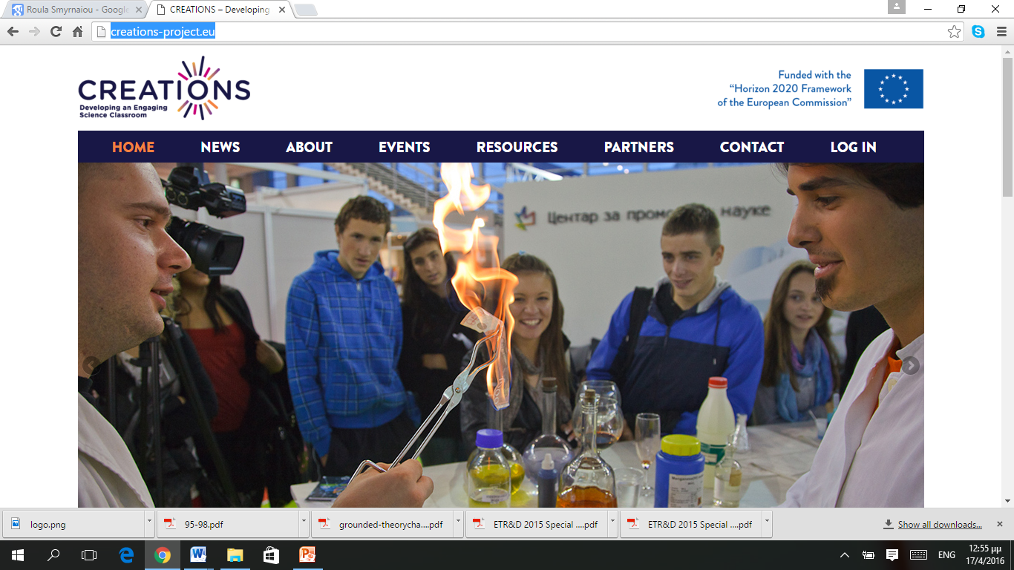
Learning Science through Theatre
It is based on the pedagogical framework which has been developed by the European CREAT-IT project (http://creatit-project.eu/ ) and continues to be applied in the concept of the European CREATIONS project (http://creations-project.eu/).
It follows the principles of the Science Education Declaration, of creativity, of effective and efficient research and aims at enhancing creativity in classroom (http://www.opendiscoveryspace.eu/community/culture-creativity-curiosity-413201 ).

Slide 18
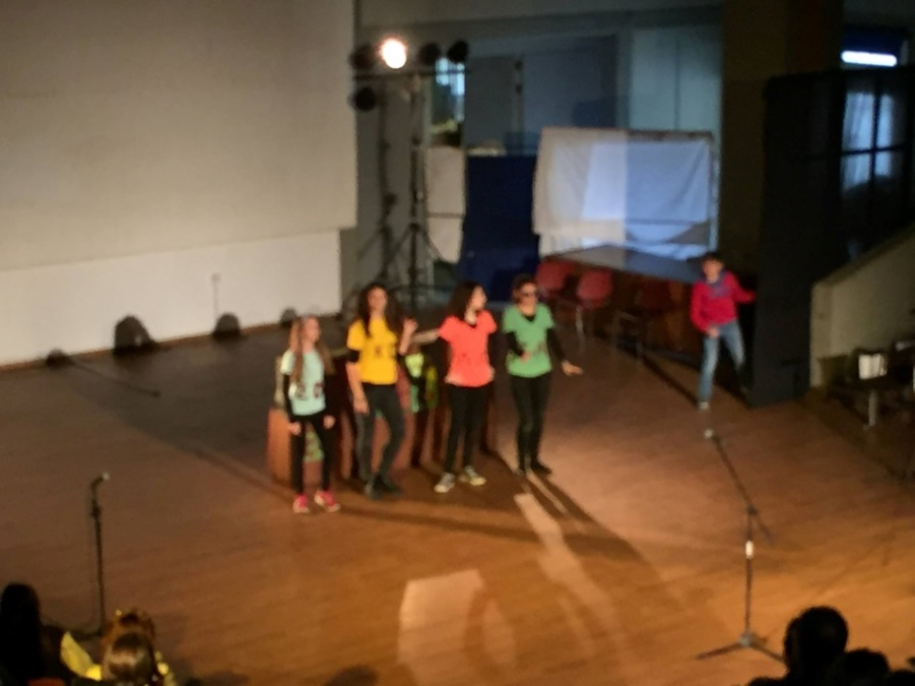
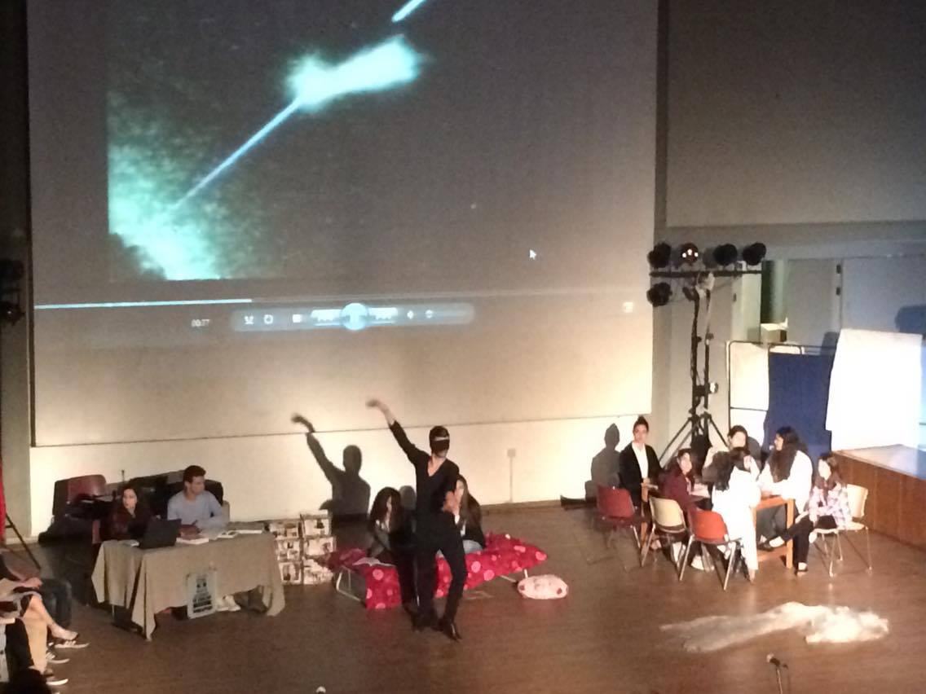
http://lstt2.weebly.com

Slide 19
Participants, Sampling
Data was collected from 13 theatrical performances which were organized by secondary education students (500 subjects, 2014-2015) and have filmed during the final event (April 2015).
High school students dramatized scientific concepts and knowledge related to their course syllabus, which related to the scientific fields of Biology, Astronomy, and Physics.

Slide 20
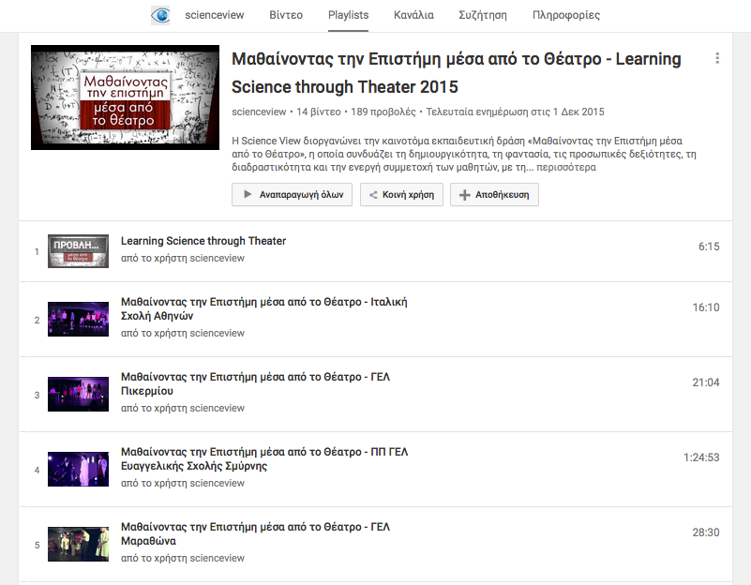
Methodology
The methodological tool of content analysis was used to analyze the data collected from the observation of the dramatized scenarios (are filmed) and to connect them to the characteristics of Embodied Learning.
Α system of categorizing the ways which students through Embodied Learning: a) represent scientific content/generate meaning, b) communicate with each other, c) entertain the audience while they dramatize scientific scenarios which take into account both the science education and theatre techniques.
https://www.youtube.com/watch?v=-IXsrCnaPnk&list=PL6s6-1JKu8YWITHHrfcgk_i6bSaceX0O2

Slide 21
Overall assessment (1/2)
The performances realised by schools combining art and science was very good as a whole.
The scientific concepts are represented with highly original, imaginative and innovative ways.
The embodied learning helped in most cases to describe the concepts in another way more descriptive.
Where there was a connection between the embodied representation - in its entirety (+ emotion), the scientific concept and verbal description then the result was robust. And it was excellent if there was extra music or choreography as a representational or embodied system.
Where there is an interdisciplinary and multidisciplinary approach the scientific concepts are strengthened as they were in a rich context where apart from the Art and Science was Literature, Philosophy, Culture (this season or season that Scientist lived) and Society –that means All subjects (for example a scientific performance made reference to refugee involving harmoniously all previous fields).

Slide 22
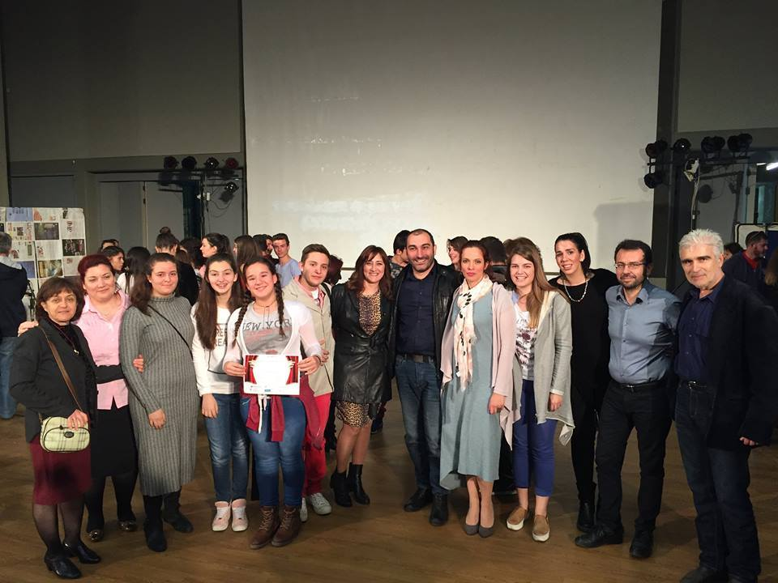
Οverall assessment (2/2)
Science won from the embrace with the Art. Science –in this new context-became a vehicle for scientific, social and other messages (and challenges). In addition, science acquired emotion and vitality through multiple representations (embodied, verbal, etc.).

Slide 23
Embodied representation | Scientific Concepts (1st School) | Scientific Concepts (2nd School)
Isolated gestures | The student to represent the meaning of the rise and fall of temperature (0:55) or the concept of Big Bang (0:56) uses his hand | Students wearing sunglasses to welcome to interview the Sun (8:50).
Full body Movements | The student who plays Mars (10:39) to capture militancy of Mars god is engaged in gymnastic exercises | the schoolgirl who plays Aristarchus explains his theory by showing the Sun and Moon (10: 38, 10:44)
Emotional Involvement | The student which portrays Sun reflects a complacent behavior to indicate the power of the Sun (4:51). | Students in the interview with the Sun (7:54) laugh and humorous

Slide 24
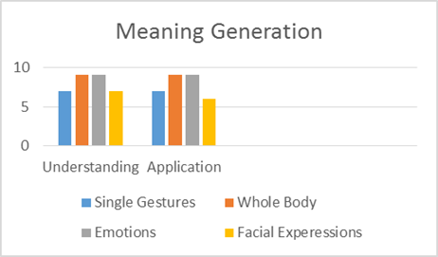
Results (1/3)
Regarding to the category “Representation of scientific context/ meaning generation” Embodied Learning can contribute a lot both to the understanding and to the application of knowledge.
Students seem to be able to understand the key features of each notion, using scientific terminology and simple vocabulary at the same time, to reliably describe notions and to use their past experience so as to describe scientific knowledge.
For instance, in a theatrical scenario students sat next to each other and another student revolved around them in order to represent the movements of atoms, electrons, protons, neutrons, etc.
Another student impersonated a shooting star and used her whole body when other students pulled her from the scene so as to represent the fall of the star.

Slide 25
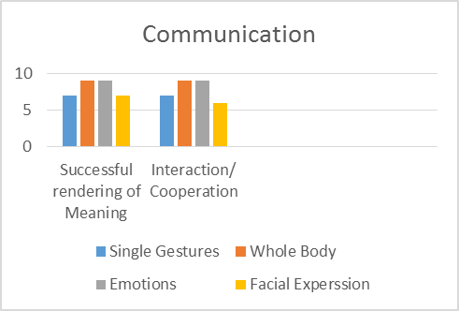
Results (2/3)
As far as “Communication” is concerned, Embodied Learning facilitated communication among students.
For instance, regarding the successful rendering of meaning is concerned a scientist explains the rising temperature because of the Big Bang and his assistant shows the red table where the rise is described while at the same time she moves according to the music.
Successful rendering of meaning is possible both through verbal and through non-verbal communication.

Slide 26
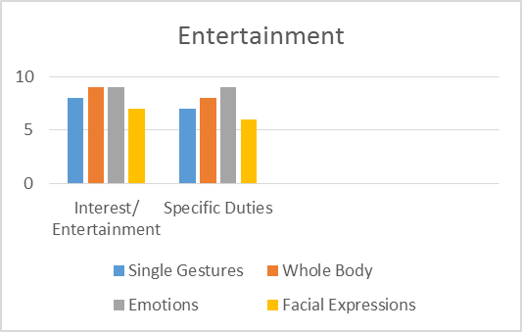
Results (3/3)
Since “Entertainment” is an important part of the theatrical performance, it is worth mentioning that students retained their interest throughout and enjoyed the whole procedure.
Student creativity and imagination is evident in most theatrical performances.
A student talks with Einstein and asks for his autograph while another student points to the Scorpius constellation while the planets dance hugging.
In another performance, planet Pluto appears last on stage and being short of breath, which signifies that he is the last planet in our solar system, while another student-researcher is trying hard as we can infer from his facial expressions to discover the God particle, highlighting the importance of its existence.

Slide 27
Conclusion (1/2)
The findings suggest that Embodied Learning leads students to the most successful representation of scientific concepts, enables the connection of student to modern forms of Art while even the unconscious movements performed by the students may be indicative of the degree of appropriation and embodiment of scientific concepts. Furthermore, collaborative learning is supported while student creativity is enhanced.
The learning environment of the “Learning Science though Theatre” project included authentic theatrical scenarios which were performed by the students and were in accordance with their interests and cognitive load.

Slide 28
Conclusion (2/2)
Finally, we examined the students’ cognitive involvement, the representation of scientific content using their cognitive processes,
their sensorimotor involvement using their bodies or gestures, their emotional involvement, social interaction and communication between the students,
the use of past experiences and creation of new ones based on sociopolitical and historical framework and on beliefs and behaviors,
their brain-body-emotion coordination, the holistic use of their personality and their motives.

Slide 29
Limitations & Perspectives
We continue …..
data analysis with the mapping of all scientific concepts modeled in tangible or other embodied representation,
Recording different representation systems separately for each concept.
Studing cultural elements and issues or challenges facing citizens and society and how they integrated harmoniously in to scenario.
Studieng the articulation between the different semiotic or representational systems.
Studying the involuntary or unconscious embodied (kinesthetic, tangible, etc.) representations

Slide 30
Some true words…. “The process of living your life is a process of embodiment, the process of working through your life in a body, it’s not an abstract thing where the body and the head are separate, you live in your life, and you live in other peoples lives and you live multiple lives as many as you can appreciate having, that is the purpose of education, to expose people to these experiences and doing that changes you, I am not who I was, and there is a little sense of me that still lives there, the very bottom of your brainsteam, an sense of your survival….” (Mary Helen, Immordino, Yang, Embodied Brains, Social Minds, TeDxManhattanBeach, 2011), https://www.youtube.com/watch?v=RViuTHBIOq8

Slide 31
Thank you
Contact:
zsmyrnaiou@ppp.uoa.gr
http://creations-project.eu/

