Slide 1


Student performance in the Postgraduate Program: “STEM Education and Educational Robotics Systems” - Univ of Athens
Kostas Skordoulis
National & Kapodistrian University of Athens

Slide 2
The Program and its pre-History
2016 – 2020
Joint Masters Program of the Departments of Primary Education of the Universities of Patras & Athens: “Interdisciplinary approaches of Science, Mathematics, Technology and Engineering – STEM Education” – Director: Prof Eugenia Koleza
2018 – 2021
Postgraduate Seminar: “STEM Education – Educational Robotics”
Duration: 8 months – 420 hours
Center of Lifelong Learning – NKUA
Total 64 students

Slide 3

The structure of the Program
(12 compulsory Modules)
2 Pedagogy Modules:
Introduction to Psycho-pedagogy; Educational Design
2 Humanities Modules
Epistemology – Theory of Knowledge ; Science & Technology in European Civilization
2 Technology & Engineering Modules
Simple Machines; Introduction to Robotics & Automatic Control Systems
4 Laboratory Modules
Modern Digital Technology Systems; Measurements & Sensors; Educational Robotics I, II
2 General Modules
Introduction to STEM Education; Postgraduate Seminar

Slide 4
Student Population Demography
1st Year
31 Students (: 27 F + 4 M)
UnderGrad Degrees:
Education (Primary + Pre-School): 27
Engineering: 2
Mathematics: 1
Psychology: 1
2nd Year
34 Students (: 31 F + 3 M)
UnderGrad Degrees:
Education (Primary + Pre-School): 28
Engineering: 2
Mathematics , Physics: 2
Humanities: 2

Slide 5
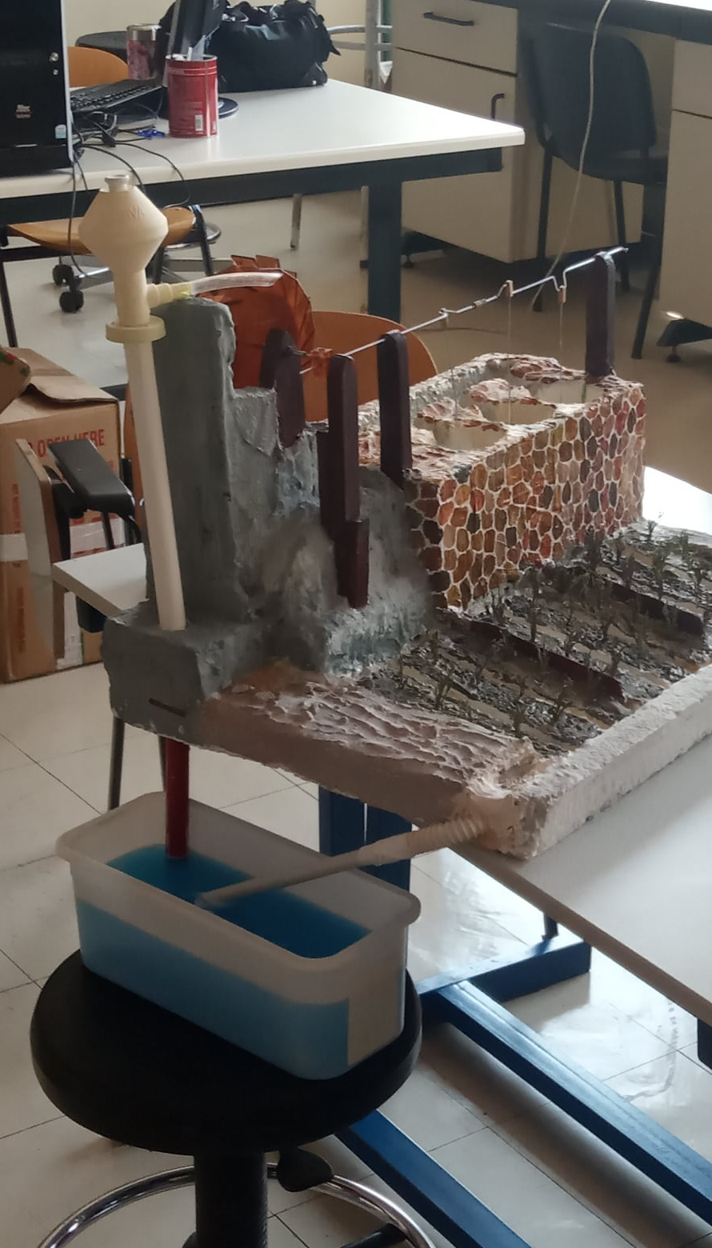
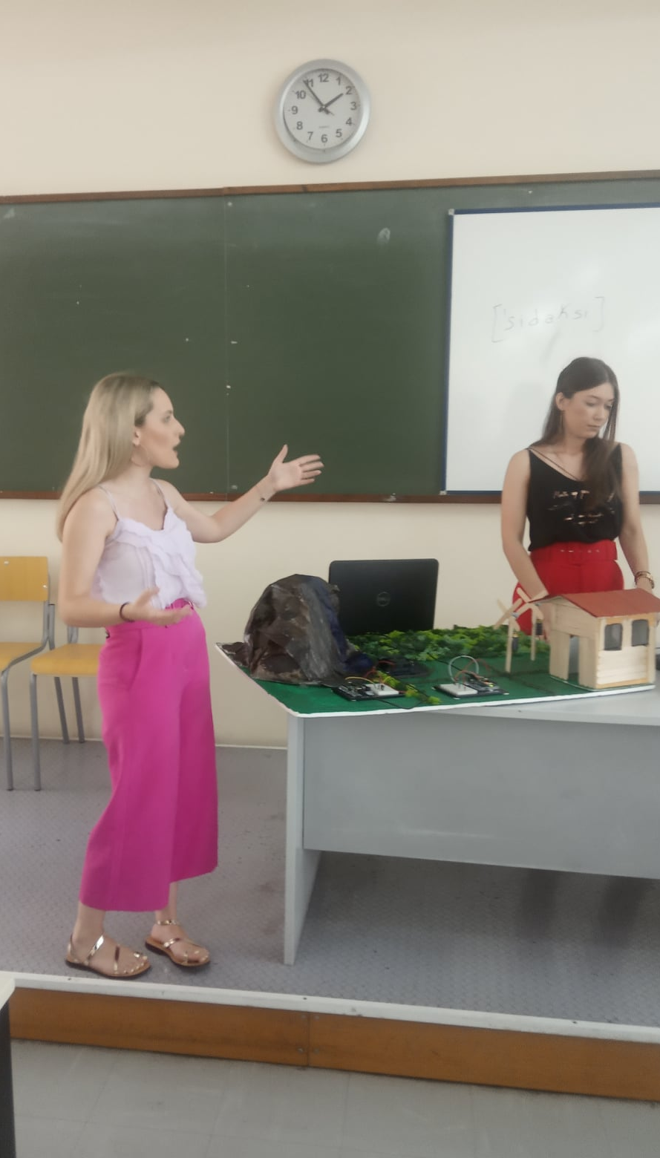
Student performance: Design and Development of prototypes

Slide 6
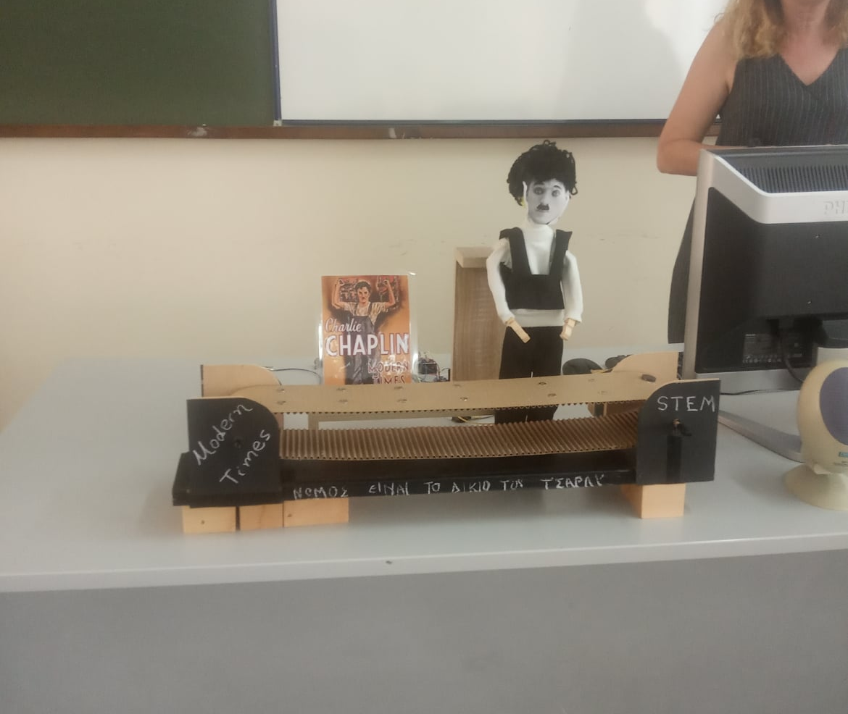
Student Project STEMAC
“Modern Times”

Slide 7
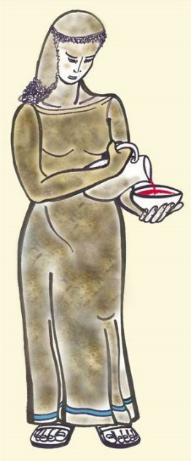
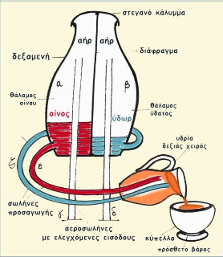
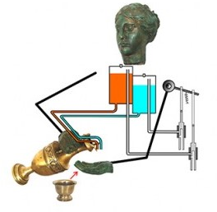
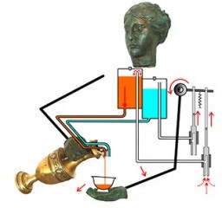
Module: Science & Technology in European Civilization
Student final Essay: “Ancient Machines: The Servant by Philo (3rd c BC)”

Slide 8
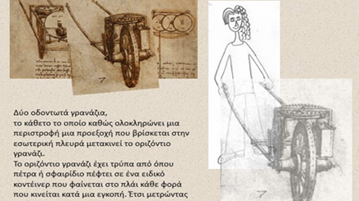
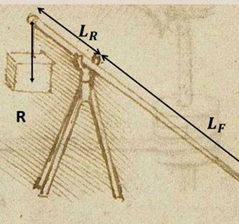
The Manuscripts of Leonardo DaVinci as a teaching tool
This research focuses on improving pre-service primary teachers’ scientific and technological literacy combining the introduction of the history of technology and especially using the manuscripts of Leonardo da Vinci with the storytelling, as a teaching tool

Slide 9
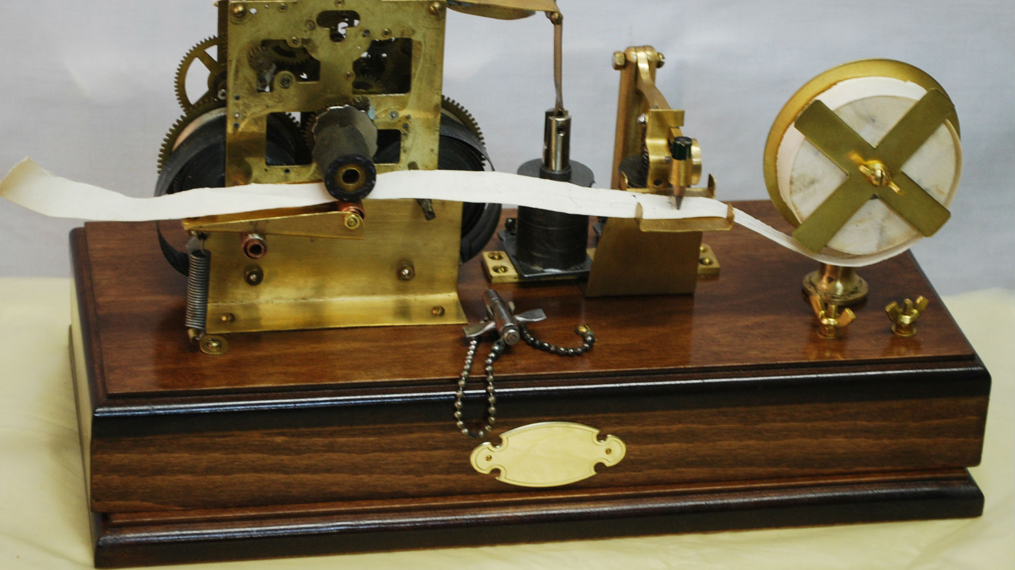
The Morse Telegraph: How it works? How is it used?

Slide 10
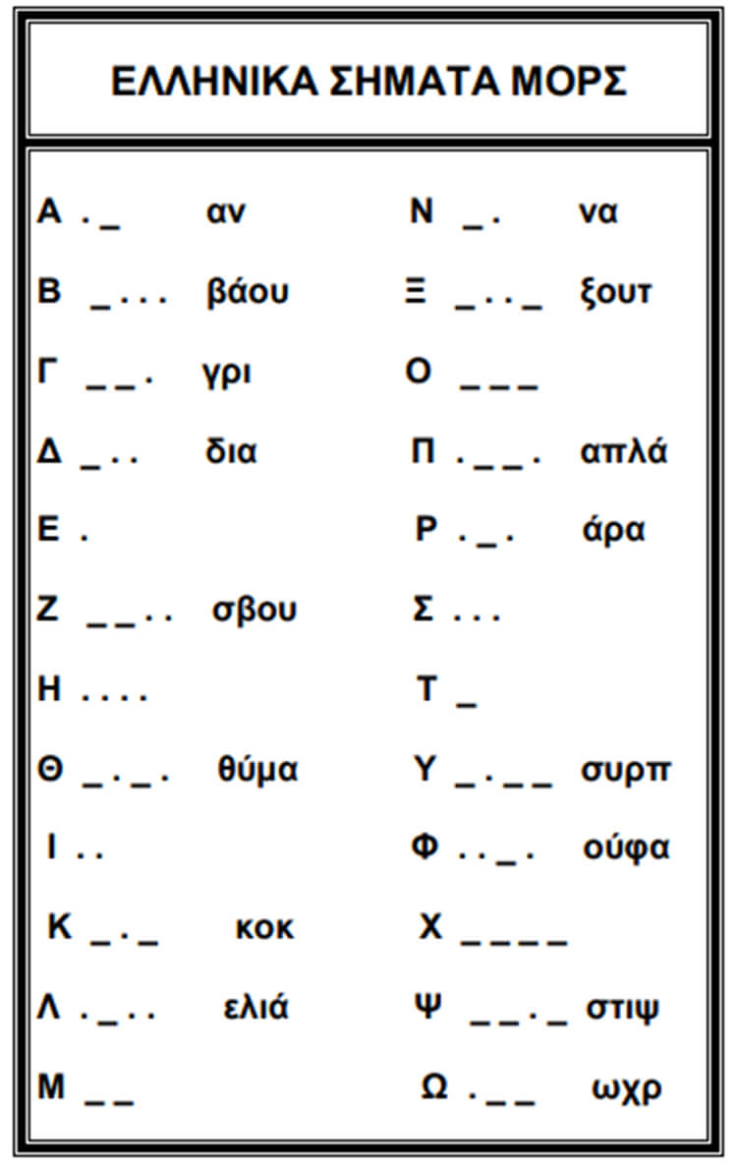
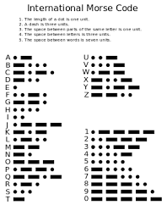

Slide 11
Method of Analysis – Teaching approach
Context of Invention
Context of Operation
Context of Manifacture
Context of Use

Slide 12
The transition from STEM to STEAM / STEMAC
STEM
History of Science & Technology
STEAM
STEMAC

Slide 13
STEM Education and Critical Pedagogy
How STEM scholars engage in Teaching for Gender and Racial Equity? For Social and Environmental justice?

Slide 14
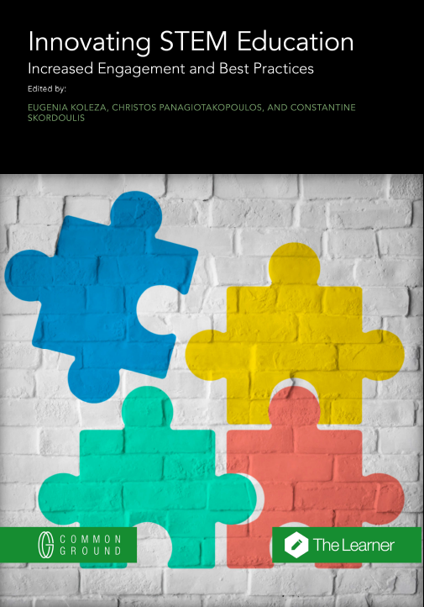
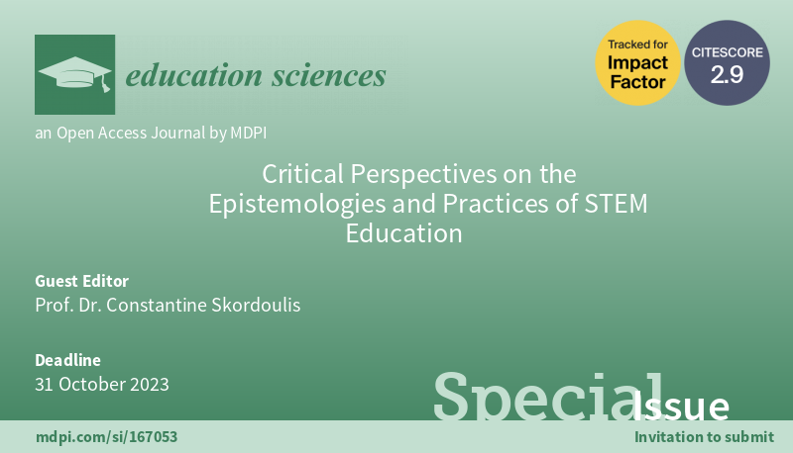
The Postgrad Program as a Research Field

Slide 15

Thank you for your attention!!!

