Slide 1
The Historical Context: Great Debates in American FP, 1789-1945
W - 3

Slide 2
Six debates
Isolationism vs. internationalism
Power and Peace debates over how big a military and how much to spend
How true USFP has been to its democratic principles
Whether USFP has been imperialistic
Relations with Latin America
US as a Pacific Power

Slide 3
Three debates over FP Politics
PAD struggles over going to war
National security vs. civil liberties
Free-trade vs. protectionism

Slide 4
Major events and their FP significance
The Revolutionary War and the consolidation of independence 1776-1800
Expansion and preservation 1801-1865
Global emergence 1865-1919
Isolationist retreat 1919-1941
WWII 1941-1945

Slide 5
1776-1800
Date | Event | FP significance
1776 | Declaration of Independence | Revolutionary War, support from France
1781 | Articles of Confederation | Failed effort at creating a union
1783 | Treaty of Paris | Britain defeated
1787 | Constitution ratified | USA created
1789 | George Washington, 1st President | Thomas Jefferson, 1st Sec. of State
1796 | Jay Treaty | US avoids another war with Britain
1796 | Washington’s Farewell Address | Warns against entangling alliances
1798 | Alien and Sedition Acts | National security – civil liberties

Slide 6
1801 - 1865
Date | Event | FP significance
1803 | Louisiana Purchase from France | Doubles size of the US
1803-5 | Military action against Barbary pirates in Mediterranean | Early presidential use of force
1812-14 | War of 181 vs. Great Britain | August, 14-15, 1814:Washington, DC burned, WH included
1823 | Monroe Doctrine proclaimed | US hegemony in W. Hemisphere
1845 | Manifest Destiny proclaimed | Basis for US expansion across the continent
1846-48 | War with Mexico | Texas, other territories annexed
1853-54 | Commodore Perry’s voyage to Japan | Some commercial and other relations
1860 | Abraham Lincoln elected president | Southern states secede, form Confederacy, seek European support and recognition

Slide 7
1865 - 1919
Date | Event | FP significance
1882 | Chinese Exclusion Act passed | Severely limits Chinese immigration
1890 | McKinley tariff passed | Protectionism
1898 | Spanish-American War | US occupies Cuba (until 1922), Philippines becomes US colony, other pacific territories acquired from Spain
1899 | Sec. of State Hay’s “Open Door” policy | US competes with European powers for access and influence in China
1903 | Panama Canal construction begins | Ted Roosevelt aupports Panamanian independence from Colombia, strikes deal on canal
1904 | Roosevelt Corollary | Reassertion of Monroe Doctrine including right to intervene militarily

Slide 8
Cont.
Date | Event | FP significance
1905 | Roosevelt’s diplomacy helps end Russo-Japanese War | Roosevelt wins Nobel Peace Prize
1909 | Occupation of Nicaragua | Until 1933
1909-12 | President Taft’s “Dollar Diplomacy” | Emphasis on economic interests in L. America and China
1910-17 | Mexican Revolution | US involvement includes occupation of Veracruz, military pursuit of Pancho Villa
1914 | WWI begins | US declares neutrality
1915 | US occupies Haiti | Until 1934
1916 | US occupies Dominican Republic | Until 1924

Slide 9
Cont.
Date | Event | FP significance
1917 | German hostilities against US increase, including submarine warfare and pursuing alliance with Mexico | Wilson proposes and Congress approves declaration of war
1917 | October Revolution in Russia | USSR formed
1918 | US part of anti-Bolshevik military intervention in Russia | Intervention fails
1918 | WWI ends
1919 | Paris peace conference, Treaty of Versailles | Wilson’s 14 points

Slide 10
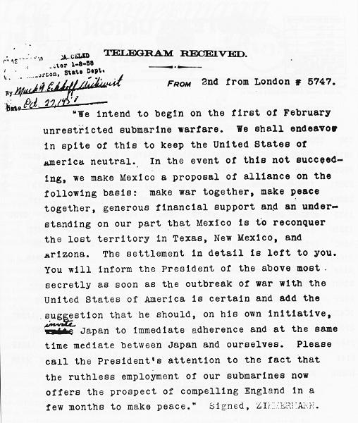
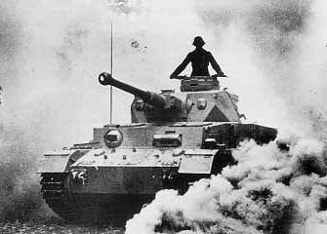
Zimmerman note intercepted by a British agent and decoded

Slide 11
1919 - 1941
Date | Event | FP significance
1919 | US Senate rejects Versailles Treaty | LoN membership rejected, Wilson’s global leadership discredited
1920 | “Palmer raids”, Red Scare | National Security – civil liberties tension
1921-22 | Washington Conference limiting navies | US, Britain, France, Italy, Japan
1928 | Kellogg-Briand Pact outlawing war | France-US-led mix of diplomacy and isolationism
1929 | US stock market crash | Great Depression
1930 | Smoot-Hawley Tariff | Protectionism, exacerbates Great Depression
1933 | Good Neighbor policy by FDR | Major shift toward L. America, including ending most occupations

Slide 12
Cont.
Date | Event | FP significance
1933 | Diplomatic recognition of USSR | FDR initiative
1933 | Hitler come to power | Road to WWII
1935 | Congress imposes neutrality | FDR objects
1936 | Spanish Civil war | Franco comes to power
1938 | Munich Agreement | Appeasement
1939 | WWII begins | US stays out
1940 | Lend-Lease and other aid to Britain and USSR

Slide 13
Cont.
Date | Event | FP significance
1940 | Congress approves military draft | First peacetime draft in US history
1940 | FDR elected to a third term
1941 | FDR inaugural address, “Four Freedoms” | Global US role based on core values and pronciples
1941 | FDR and Churchill issue “Atlantic Charter” | US-British alliance and vision for world order
Dec 7, 1941 | Japan attacks Pearl Harbor | Congress declares war the next day
Dec 11, 1941 | Germany declares war on US | US fully enters WWII

Slide 14
1941 - 1945
Date | Event | FP significance
1942 | Initial Japanese victories in the Pacific | General Douglas MacArthur forced to flee the Philippines
1942 | Internment of 120.000 Japanese-Americans | National security-civil liberties tension
1942 | Battle of Midway (June) | US victory, the tide is turned
1942 | Manhattan Project stepped up | Development of A bomb
1942 | Germany invades USSR | Stalingrad
1942 | US and British troops land in North Africa | Victory in May 1943
1943 | FDR and Churchill meet in Casablanca | Wartime summit

Slide 15
Cont.
Date | Event | FP significance
1943 | FDR, Churchill and Stalin meet in Tehran | Postwar planning
1944 | June 6, D-Day | Landing in Normandy
1944 | Bretton Woods conference, 44 countries | Planning post-war international economic system
1945 | Yalta conference | Postwar Planning
1945 | May 8, V-E day, Germany divided, UN created | US, Britain, France, USSR
1945 | August 6-9, US drops atomic bombs | First uses of nuclear weapons
1945 | August 15, V-J day | Japan surrenders

Slide 16
Isolationism vs. internationalism
“Steer clear of permanent alliances” (GW, 1798)
“entangling alliance with none… peace, commerce and honest friendship with all nations” (TJ)

Slide 17
How big a military, how much for defence
Constitution
Alfred Thayer Mahan
The pattern until late 1940s: “low troop levels – massive mobilization”

Slide 18
Wartime Mobilization, Peacetime Demobilization
 | Prewar troop levels | Wartime mobilization | Postwar demobilization
War of 1812 | 12,000 | 36,000 | n/a
Civil war, 1861-65 | 16,000 | 1,000,000 | 25,000
WWI, 1917-18 | 130,000 | 2,000,000 | 265,000
WWII, 1941-45 | 175,000 | 8,500,000 | 550,000

Slide 19
Principles: True to American Ideals?
American Exceptionalism
Manifest Destiny
FDR and “Four Freedoms”

Slide 20
Prosperity: US imperialism?
“the flag follows the dollar”
Interventions in Latin America
Nicaragua 1909-10, 1912-25
Honduras 1924-25
Haiti 1915-24
Dominican Republic 1916-24
Cuba (Platt Amendment)

Slide 21
Debates on FP Politics: Going to war
War of 1812
Mexican War 1846-48
WWI
WWII

Slide 22
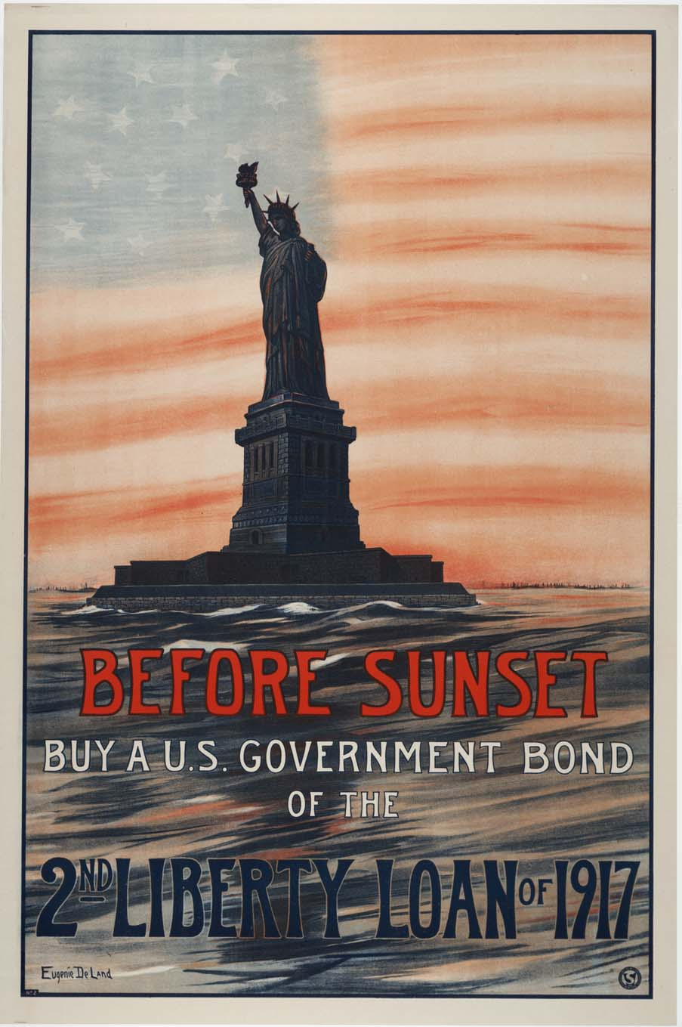
THE WAR AT HOME
The entire U.S. economy was focused on the war effort
The shift from a consumer economy to war economy required a collaboration between business and government
In the process, the power of the U.S. government expanded
Congress gave President Wilson direct control over the economy

Slide 23
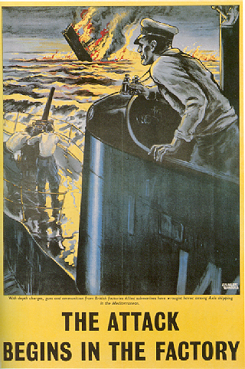
WAR INDUSTRIES BOARD
The War Industries Board (WIB) encouraged companies to use mass-production techniques
Under the WIB, industrial production and wages increased 20%
Union membership almost doubled during the war years – from 2.5 million to 4 million
To deal with disputes between management and labor, President Wilson set up the National War Labor Board in 1918
Poster encouraging production

Slide 24
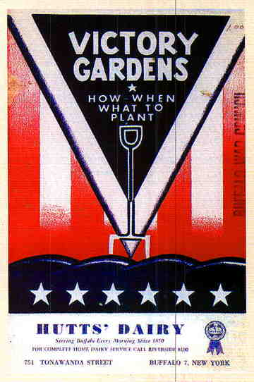
VICTORY GARDENS
To conserve food, Wilson set up the Food Administration (FA)
The FA declared one day a week “meatless” another “sweetless” and two days “wheatless”
Homeowners planted “victory gardens” in their yards
Schoolchildren worked after-school growing tomatoes and cucumbers in public parks
Farmers increased production by almost 30% by adding 40 million acres of farmland

Slide 25
National security vs. the Bill of Rights
1798 Alien and Sedition Acts
The Espionage and Sedition Acts 1917-18
Red Scare 1919-20
Executive Order 9066, 19-2-1942

Slide 26
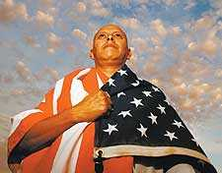
ATTACK ON CIVIL LIBERTIES
As the war progressed, Civil Liberties were compromised
Anti-Immigrant feelings were openly expressed especially anti-German and Austrian- Hungarian
Espionage and Sedition Acts were passed by Congress
These acts were designed to prevent anti-war protests but went against the spirit of the First Amendment (Free speech)
Socialists and labor leaders were targeted
Any anti-American sentiments were targeted during wartime

Slide 27
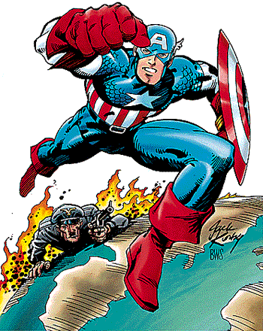
WWII: THE HOME FRONT
The war provided a lift to the U.S. economy
Jobs were abundant and despite rationing and shortages, people had money to spend
By the end of the war, America was the world’s dominant economic and military power

Slide 28
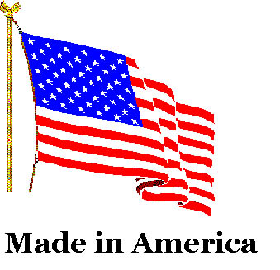
ECONOMIC GAINS
Unemployment fell to only 1.2% by 1944 and wages rose 35%
Farmers too benefited as production doubled and income tripled

Slide 29

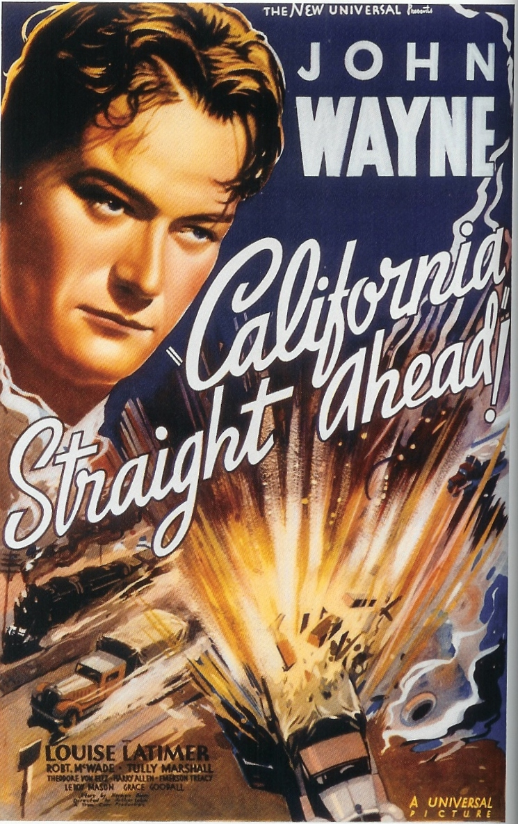
POPULATION SHIFTS
The war triggered the greatest mass migration in American history
More than a million newcomers poured into California between 1941-1944
African Americans again shifted from south to north

Slide 30
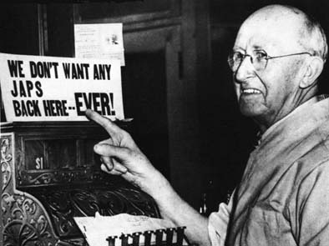
INTERNMENT OF JAPANESE AMERICANS
When the war began, 120,000 Japanese Americans lived in the U.S. – mostly on the West Coast
After Pearl Harbor, many people were suspicious of possible spy activity by Japanese Americans
In 1942, FDR ordered Japanese Americans into 10 relocation centers
Japanese Americans felt the sting of discrimination during WWII

Slide 31
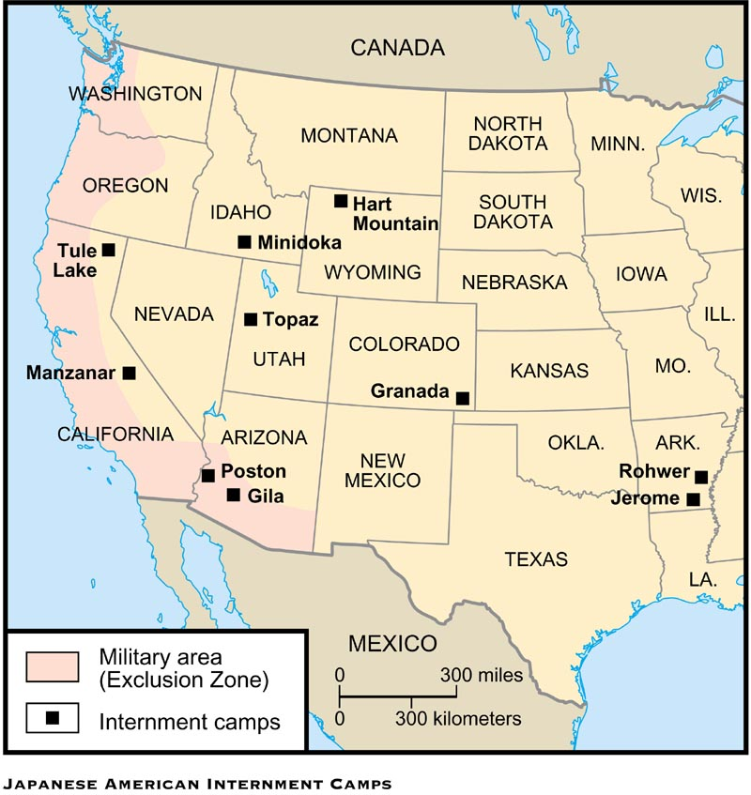
Location of the 10 Internment camps

Slide 32
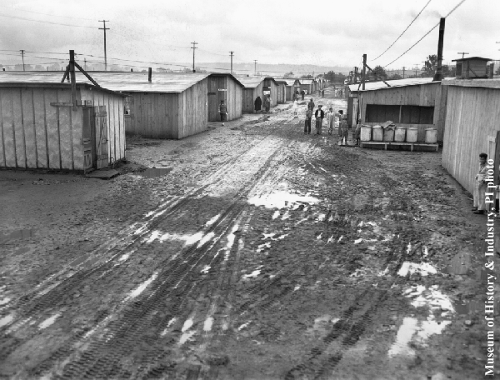
Jerome camp in Arkansas

Slide 33

U.S. PAYS REPARATIONS TO JAPANESE
In the late 1980s, President Reagan signed into law a bill that provided $20,000 to every Japanese American sent to a relocation camp
The checks were sent out in 1990 along with a note from President Bush saying, “We can never fully right the wrongs of the past . . . we now recognize that serious wrongs were done to Japanese Americans during WWII.”
Today the U.S. is home to more than 1,000,000 Japanese-Americans

Slide 34
Free trade vs. Protectionism
Before the Civil War divisions followed regional lines
Late 19th century, along party lines
Reciprocal Trade Agreements Act (1934): shift toward free trade

