Slide 1
Aμερικανική Εξωτερική Πολιτική
W1

Slide 2
Θεματικές
Το Στρατηγικό πλαίσιο
Το Εσωτερικό πλαίσιο
Το Ιστορικό πλαίσιο (1789-1945)
Το πλαίσιο του Ψυχρού Πολέμου
Στρατηγική και η Πολιτική της Εξωτερικής Πολιτικής μετά τον ΨΠ
Μεταψυχροπολεμική γεωπολιτική
Η Μέση Ανατολή
Η άνοδος της Κίνας και ασφάλεια στην ΝΑ Ασία
Η ατζέντα της παγκοσμιοποίησης

Slide 3
Το στρατηγικό πλαίσιο:Στρατηγική εξωτερικής πολιτικής και η «ουσία της επιλογής»
Απειλές ασφάλειας
Διεθνοποίηση της Αμερικανικής οικονομίας
Εσωτερική πολιτική VS Εξωτερική Πολιτική
Φυλετική και Εθνική Ποικιλία
Εσωτερικές αξίες VS Εξωτερικές παραβιάσεις

Slide 4
Οι δυναμικές της επιλογής
Στρατηγική εξωτερικής πολιτικής
Πολιτική εξωτερικής πολιτκής
Foreign policy strategy – the essence of choice
Foreign policy politics – the process of choice

Slide 5
Το πλαίσιο του Διεθνούς Συστήματος
Αναρχία (Quasi – anarchy)
Η δομή του ΔΣ (system structure)
Η θέση του κράτους στο σύστημα (state structural position)

Slide 6
Το εθνικό συμφέρον: “4Ps”
Power
Peace
Prosperity
Principles

Slide 7
Διλήμματα στην «Επιλογή»
Συμπληρωματικότητα “4Ps”: ιδανικό αλλά σπάνιο
Ιεράρχηση μεταξύ “4Ps”: Συχνό αλλά προβληματικό
Διαφορετική ερμηνεία “4Ps”: Σύγκρουση

Slide 8
Μετά τον ΨΠ
“a time of great promise… unparalleled opportunity… to work toward transforming this new world into a new world order, one of governments that are democratic, tolerant and economically free at home and committed abroad to settling differences peacefully, without the threat or use of force” (George H.W. Bush, 1993)

Slide 9
Μετά τον ΨΠ
“the train of globalization cannot be reversed… global trade will lift hundreds of millions of people out of poverty… but globalization needs a more human face” (Bill Clinton, 2000)

Slide 10
Μετά τον ΨΠ
“It will not end until every terrorist group of global reach has been found, stopped and defeated” (George W. Bush, 2002)

Slide 11
Μετά τον ΨΠ
“This century’s threats are at least as dangerous as and in some ways more complex than those we have confronted in the past… not to give way to pessimism. Rather it is a call to action… to a new vision of leadership in the 21st century… geared towards a common security for our common humanity” (Barack Obama, 2007.

Slide 12
Τρεις σχολές σκέψης για το μέλλον των ΗΠΑ

Slide 13

America’s Future
1. Declinism – one side in the persistent “debate” about the future of American power and influence. Declinists believe that the relative power position of the U.S. is waning.

Slide 14

America’s Future
Major Text:
Kennedy’s The Decline and Fall of the Great Powers
Thesis: Corroding effects of “imperial overstretch”

Slide 15
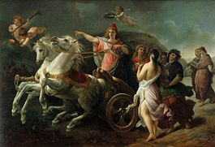
America’s Future
2. American Exceptionalism – the other side of the debate on the future of America’s power. They believe that America is unique in world history, and thus will continue to grow in power and influence.

Slide 16

America’s Future
Major Text: Nye’s Bound to Lead
Thesis: American leaders will take the “long view” and will seek to adapt to changing future circumstances

Slide 17

America’s Future
Major Text: Fukuyama’s The End of History and the Last Man
Thesis: The fall of the Soviet Union and U.S. victory in the Persian Gulf are proof that there is no better system in history than democracy and capitalism. Hence, history will “end” with these systems

Slide 18

America’s Future
3. Neoimperialism – an alternative to both theories. This theory suggests that while American leaders focus on global leadership, they are ignoring pressing social, economic, and political problems at home

Slide 19

America’s Future
Major Text: Petras and Morley’s Empire or Republic?
Thesis: As empire expands, the republic declines

Slide 20
US Foreign Policy
Walter Russell Mead’s Four Schools
of
American Foreign Policy
“The Jacksonian Tradition”, The National Interest, 58, Winter 1999/2000

Slide 21
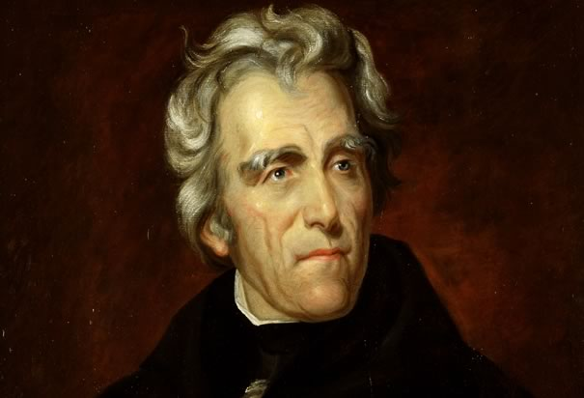
US Foreign Policy
1. Jacksonian (7th President, 1829-1837)
a. First priority – physical security and economic well-being of the American populace
b. US should not seek out foreign quarrels but should fight to win if war starts
c. Values – self-reliance above all
d. Jacksonian presidents – Reagan; Bush II

Slide 22
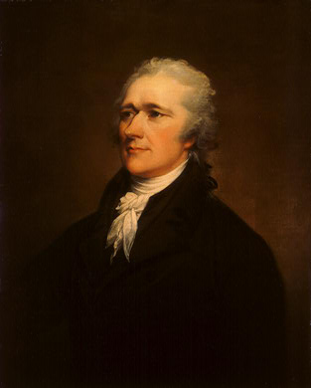
US Foreign Policy
2. Hamiltonian
a. First priority – economic primacy of the US (mercantilism)
b. The relationship between government and big business is key to survival and success of a country
c. Legacies – IMF, World Bank, NAFTA, WTO
d. Hamiltonian presidents – Bush I; Clinton

Slide 23
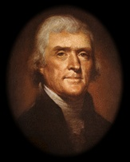
US Foreign Policy
3. Jeffersonian (3rd President, 1801-1809)
a. First priority – protection of American democracy on the home front
b. Foreign entanglements always bad for democratic systems and highly skeptical of projects that involve the US abroad
c. Legacies – ACLU
d. Jeffersonian presidents – none in the 20th century

Slide 24
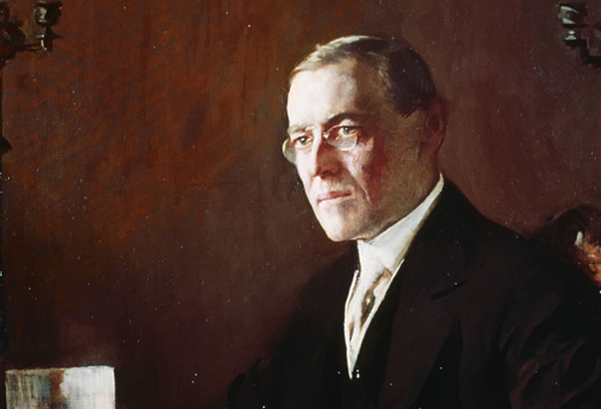
US Foreign Policy
4. Wilsonian (28th President, 1913-1921)
a. First priority – spreading American democratic and social values throughout the world
b. US should be involved in the world with a peaceful international community based on the rule of law
c. Legacies – the United Nations
d. Wilsonian presidents – McKinley; Carter

