Slide 1
Κονστρουκτιβισμός
2013-2014

Slide 2
Constructivism
Social Constructivism
Newest theory of IR
Draws on sociology
  Max Weber
  Immanuel Kant
  Anthony Giddens
Focuses on power of shared ideas

Slide 3
Social construction
To construct something is an act which brings into being a subject or object that otherwise would not exist.
Once something is constructed, it has a particular meaning and use within a context.
It is a social construct in so far as its shape and form is imbued with social values, norms and assumptions.
Social phenomena (states, alliances, international institutions) - collective subjects of international relations - take specific historical, cultural and political forms that are a product of human interaction in the social world.

Slide 4

wood

Slide 5
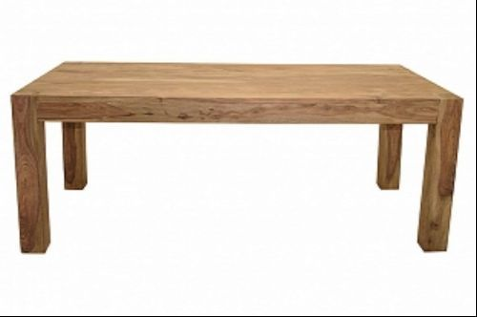
Wooden object

Slide 6
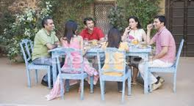
Dinning table

Slide 7
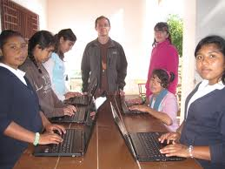
Working table

Slide 8
Social constructivist theories outside IR
Social constructivist theories developed in sociology and history before IR
Notably Invention of childhood studies
‘In medieval society the idea of childhood did not exist.’

Slide 9
Constructivism
Nation-states are not all alike
Political culture shapes foreign policy
Form of government shapes foreign policy
History shapes foreign policy
Domestic political trends and debates shape foreign policy

Slide 10
Constructivism
States have identity
State identity influences the way states interact with each other
Examples:
  China sensitivity to any policies of other states that threaten its unity and sovereignty
  US desire to transform the world

Slide 11
Identity
Definition: Understanding of who self is in relation to “other”
Inherently social
Identity creates interests

Slide 12
What are IR social constructivist theories?
Idealist
Far from an objective reality, international politics is ‘a world of our making’ (Onuf 1989)
Ideas shape reality
Social reality is not objective or external to the observer
Social world is recreated through intersubjectivity

Slide 13
A View of the World
Not a theory of international relations, but a set of assumptions about how to study it.
Realist power politics is one possible scenario of world politics, but not the only one. Reality is a social, not an objective fact.
  The Soviet Union disappeared, because people stopped believing in it (constructivist view)
  The Soviet Union disappeared, because she could not compete with the US and the West (realist view)

Slide 14
The Role of Ideas
Ideas important in their own right
International Norms: shared expectations about appropriate behavior held by the International Community
Changes in norms lead to changes in state behaviors
Examples: Sovereignty, Colonialism, Land Mine Treaty

Slide 15
The Role of Ideas II
Identities and interests of states are not simply structurally determined, but are rather produced by interactions, institutions, norms, cultures.
It is process, not structure, which determines the manner in which states interact.
See Alexander Wendt, 'Anarchy is What States Make of It', International Organisation, 46/2, 1992.

Slide 16
Four types of ideas
Ideologies or shared belief systems
Normative (or principled) beliefs
Causal beliefs
Policy prescriptions

Slide 17
Ideologies or shared belief systems
Are a systematic set of doctrines or beliefs that reflect the social needs and aspirations of a group, class, culture or state.
Examples include the Protestant or Islamic ethics or political ideologies such as liberalism, Marxism, and fascism

Slide 18
Normative (or principled) beliefs
beliefs about right and wrong.
They consist of values and attitudes that specify criteria for distinguishing right from wrong or just from unjust and they imply associated standards of behaviour
(for example) the role of human rights norms at the end of the Cold War

Slide 19
Causal beliefs
Are beliefs about cause-effect, or means-end relationships.
They provide guidelines or strategies for individuals on how to achieve their objectives.
(example) Soviet leaders’ changing beliefs about the efficacy (or the non-efficacy) of the use of force influenced their decision in 1989 not to use force to keep Eastern Europe under Soviet control (compare to Hungary 1956 or Czechoslovakia 1968).

Slide 20
Policy prescriptions
specific programmatic ideas that facilitate policymaking by specifying how to solve particular problems.
They are at the center of policy debates and are associated with specific strategies and policy programs (tax cuts or tax increases, public investment and unemployment).

Slide 21
Norms
Actors' behavior is guided by norms.
  Constitutive norms are standards of behavior that define the identity of an actor.
    Sovereignty is a constitutive norm of statehood.
  Regulative norms are appropriate standards of behavior for an actor with a given identity (capitalist states and free market)

Slide 22
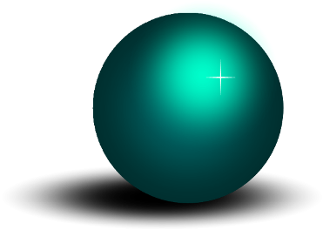
Norms and State Behavior
State Behavior and International Norms “Mutually
Constituted”
ACTORS
(States)
•Behavior
•Interests
•Identities
CONTEXT
(System)
•Ideas
•Meanings
•Rules

Slide 23
From norms to institutions
States (and other entities) act not primarily in response to material needs and interests, but to social norms.
International institutions are neither insignificant (neorealism), nor are they only reflections of the cooperation among self-interested states (liberal institutionalism).
Instead, they are fully autonomous and the primary carriers of world cultural principles.

Slide 24
The Power of Norms: Constructivism
Norms
The International System
Global governance
International institutions
From norms to governance
Power
Expectations promoted by IGOs and NGOs
Cooperation
Socialization

Slide 25
What institutions do
Punish and shame violators
Result: States are constituted by norms and ideas
Establish rules of appropriate conduct
Create transparency
Legitimize the mobilization of NGOs
  Express a global consensus among all states
>>> Socialization of states

Slide 26
Constructivism: Summary
States and international system mutually constituted in IR
Ideas (separate from power) are important in shaping international relations
Whether IR take place in an anarchical system of states or a legally ordered society of states is a function of divergent or convergent national identities

Slide 27

Break!

Slide 28
Nature of the International System
The international system is not something ‘out there’ like the solar system
It is Socially Constructed/Contingent
  A human invention, a set of ideas, a body of thought, a system of norms, which has been arranged by certain people at a particular time and place
  It can be changed by new ideas
  Unlike realism and liberalism, whose causal epistemology draws from positivist (scientific) and structuralist (empirical) traditions, constructivism is post-positivist, deconstructing the ontological assumptions of other IR theories.
  “Anarchy is what states make of it…” –Alexander Wendt

Slide 29
(Socially) Constructed reality
Anarchy is neither destiny (realism), nor a disincentive to cooperation (institutionalism).
“Anarchy is what states make of it.”
Alexander Wendt

Slide 30
Constructivist approaches to security
states want security
but concept of security not fixed
security identities, interests and policies constructed through interactions between states (Wendt)

Slide 31
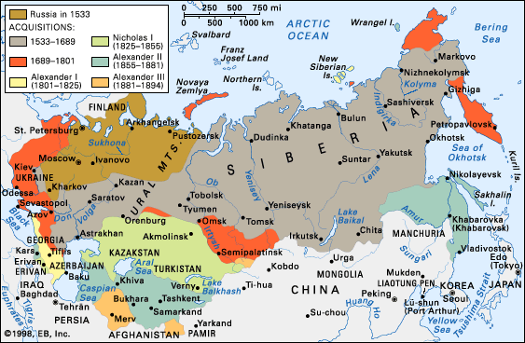
Russian fear of invasion

Slide 32
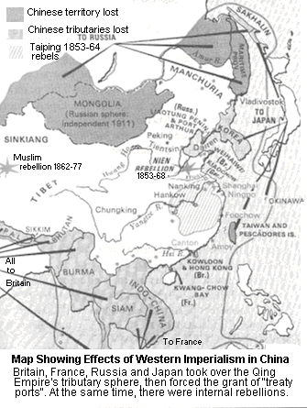
China: Colonized

Slide 33
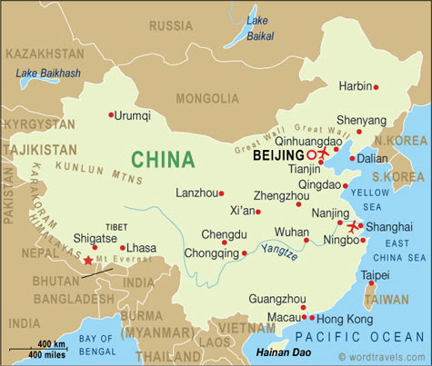
China 21st Century

Slide 34
Comparing the Theories:
Human Nature
Realism: People are aggressive.
Liberalism: People are acquisitive.
Constructivism: People are shaped by their culture.

Slide 35
Comparing the Theories: Structure
Realism: The anarchic structure of the international system dictates state behavior.
Neo-liberalism: The anarchic structure of the international system constrains state behavior.
Constructivism: The anarchic structure of the international system was created and is perpetuated by the very states it constitutes.

Slide 36
Comparing the Theories: Domestic Politics
Realism: Domestic politics are unimportant. States are rational, unitary actors.
Neo-liberalism: Domestic politics determine state attributes such as preferences and credibility. The behavior of domestic actors is funnelled through state hierarchy into a unitary, though not always collectively rational, policy.
Constructivism: Domestic politics are integrated with global politics.

Slide 37
Comparing the Theories:
Non-state Actors
Realism: Non-state actors are unimportant.
Neo-liberalism: States are the most important actors, but international organizations also matter.
Constructivism: States are the most important actors, but international organizations and non-governmental organizations also matter.

Slide 38
Comparing the Theories:
Key Questions
Realism
  How can states best defend themselves?
  What kinds of international systems are most stable?
Neo-liberalism
  How can states provide global public goods?
  How can states maximize their overall utility?
Constructivism
  How do actors self-identify, and what action is produced by that identity?
  How do identities and value systems change?

Slide 39

Visualizing Theory
REALISM
Power
Anarchy = Security
Dilemma = Emphasis on Power
CONSTRUCTIVISM
Ideas
Anarchy vs. Society
National Identity
Institutions
LIBERALISM
Anarchy mitigated by IGOs/INGOs/Intl. Regimes, Interdependence, Common Values, International Law etc

Slide 40
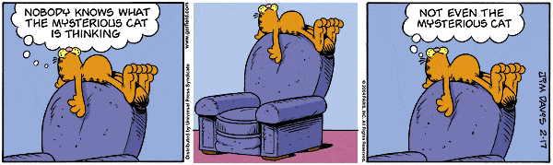
That‘s it – folks…

