Slide 2
Structure
Introduction
Historical Context: The Kosovo War and NATO’s Intervention
International Organizations and the Attempt to Manage and Resolve Intra-State and Inter-Ethnic Conflict
UNMIK and KFOR from 1999-2008
Critical Assessment of UNMIK: Why Did it Fail?
Conclusion: The Developments after 2008
Bibliography

Slide 3
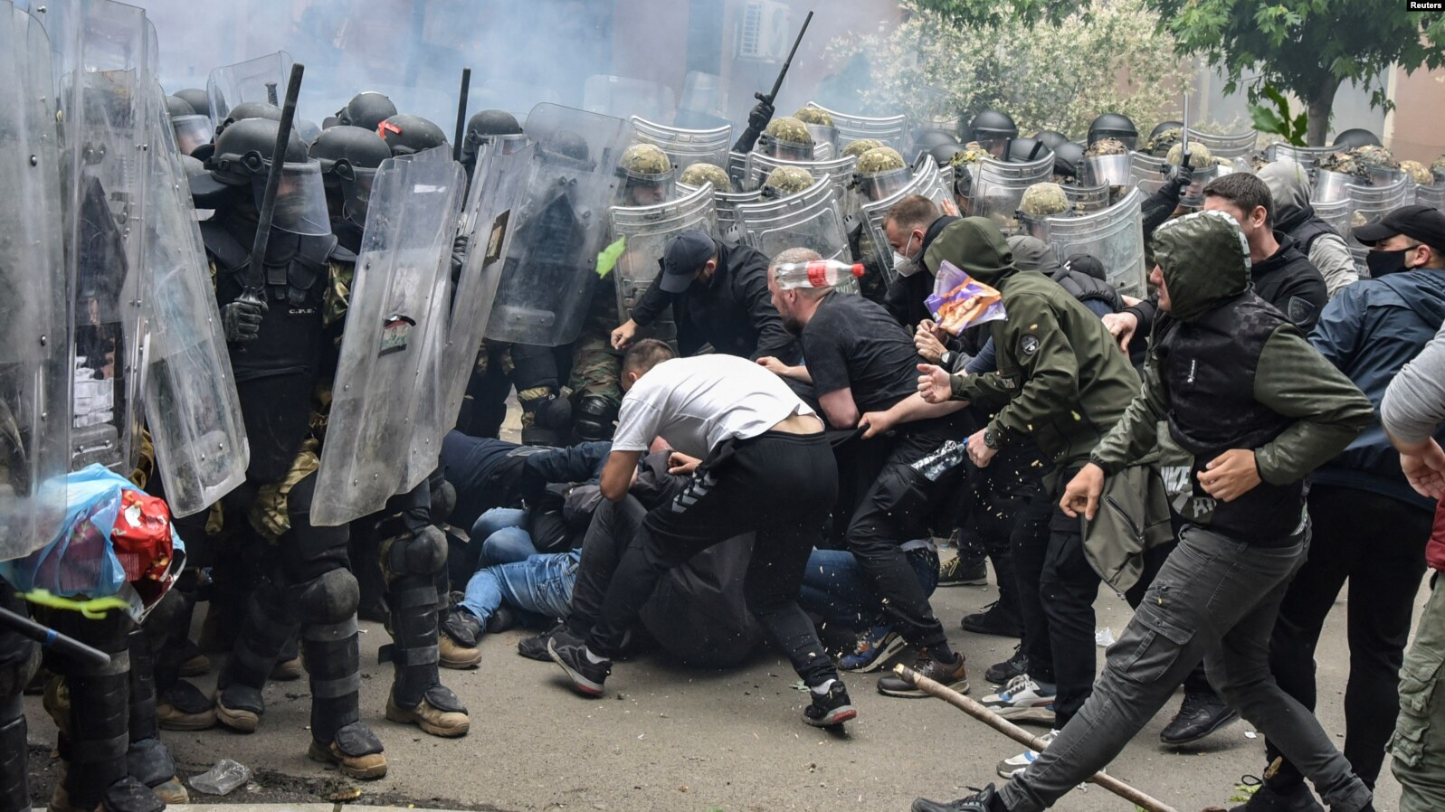
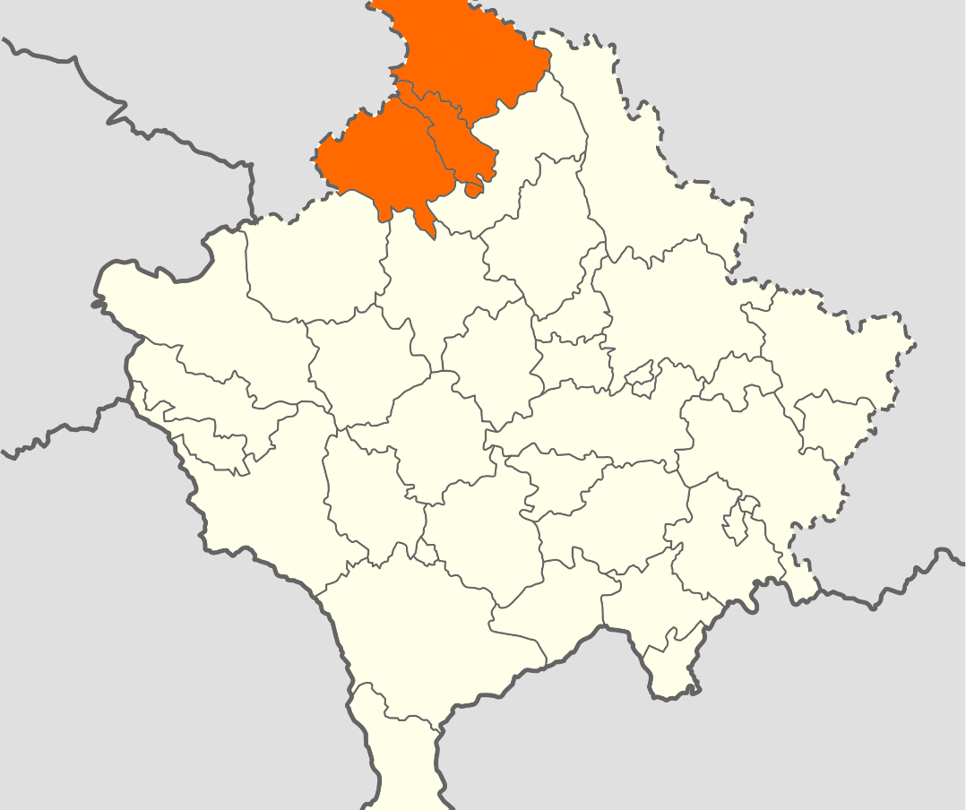
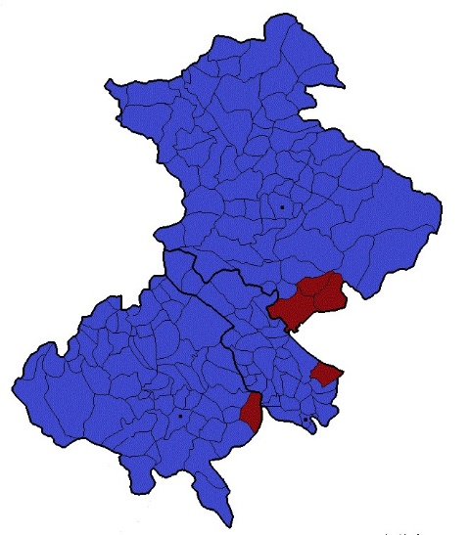
1. Introduction
Source: https://apnews.com/article/kosovo-serbia-tension-eu-us-cf2637072cd88f3bcf0d902236d3631b.
Kosovo by Ethnicity Albanians: 92.9%; Serbs: 1.5%
  Riots in Northern Kosovo, May 2023
Kosovo
Northern Kosovo by Ethnicity
Albanians: 10%, Serbs: 87%

Slide 4
2. Historical Context: The Kosovo War and NATO’s Intervention
March 1999: Peace Treaty of Rambouillet fails
Escalation of the conflict between Yugoslav Army and KLA summer/ autumn 1998
15 January 1999: „Massacre“ of Râcak as „turning point“.
24 March until 9 June 1999: NATO-bombing of Serbia
October 1998: Ceasefire Agreement and OSCE-Verification (KVM)
10 June 1999: UNSC Resolution 1244, withdrawal of the Serbian Army from Kosovo

Slide 5
3. International Organizations and the Attempt to Manage and Resolve Intra-State and Inter-Ethnic Conflict
International Organizations becoming more and more present in the field of peace-building and peace-keeping
NATOs war against Yugoslavia and the administration of UN and NATO relied mostly on humanitarian motives and objectives
‚Humanitarian Intervention‘
the use of military force on the territory of a third state in pursuit of humanitarian objectives
Highly controversial and contested

Slide 6
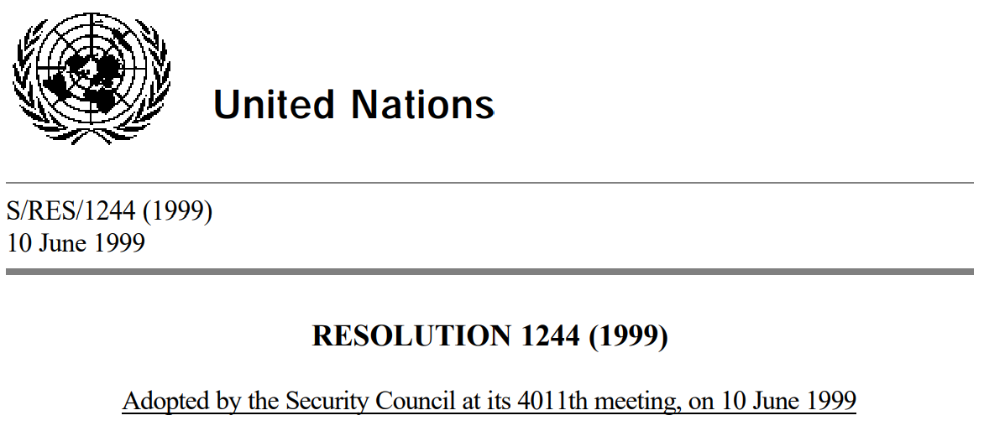
4. United Nations Interim Administration Mission in Kosovo (UNMIK) and Kosovo Force (KFOR) from 1999-2008
UNMIK’s wide-reaching mandate is threefold:
(1) to establish a functioning interim civil administration, while fully replacing Yugoslav authorities in Kosovo, including law and order
(2) to promote the establishment of substantial autonomy and self-government; and, finally,
(3) to facilitate a political process to determine Kosovo’s future international status.
KFOR was asked to assist in this process through the establishment of a secure environment.
Regulation No. 1999/1 of 25 July 1999 ( “The mother of all Regulations”) stated that all legislative and executive authority with respect to Kosovo, including the administration of the judiciary, is vested in UNMIK.

Slide 7
5. Critical Assessment of UNMIK: Why Did it Fail?
UNMIK and KFOR: unprecedented scale and nature of the project and internal problems (poor funding, institutional problems in cooperation, …)
Low and Contested Legitimacy
Legitimacy paradox of international administration
Lack of cultural sensitivity
Expansive and unaccountable international executive, legislative, judicative
Dissatisfaction and resistance rose, for example riots 2004
Identifying Ethnicity as the main, ancient reason for conflict and hatred and adopting ethnic categorization it in the administration was the main failure of UNMIK. Ethnic conflict, nationalism and insecurity could not be tackled. effectively

Slide 8
6. Conclusion: The Developments after 2008
Co-ordinated declaration of independence by the Pristina government in 2008
UNMIK and Resolution 1244 are still in force
Most of UNMIKs functions are now executed by EU’s rule-of-law mission EULEX
US, Kosovo and wester allies want UNMIK to withdraw, Serbia and Russia block this plan
UNMIK has failed in the long-term, since ethnic Kosovar Serbs do not recognize Kosovar authorities; nationalism and ethnic violence remain as driving political factors in the region.

Slide 9
5. Bibliography
Akkaya, Yaprak. ‘Kosovo 1999: An Example of Effective Humanitarian Intervention?’, 2022. https://www.byarcadia.org/post/effectiveness-of-humanitarian-intervention-in-kosovo-case.
Beha, Arben, Adem. ‘Soft Competitive Authoritarianism and Negative Stability in Kosovo: Statebuilding from UNMIK to EULEX and Beyond’. In Illiberal Politics in Southeast Europe. Routledge, 2021.
Gow, James. ‘Kosovo – The Final Frontier? From Transitional Administration to Transitional Statehood’. Journal of Intervention and Statebuilding 3, no. 2 (2009): 239–57.
Haxhiaj, Serbeze. ‘Has the UN’s Kosovo Mission Become Obsolete?’ Balkan Insight (blog), 2018. https://balkaninsight.com/2018/12/18/has-the-un-s-kosovo-mission-become-obsolete-12-17-2018/.
Hehir, Aidan. ‘Autonomous Province Building: Identification Theory and the Failure of UNMIK’. International Peacekeeping, 2006.
———. ‘The Impact of Analogical Reasoning on US Foreign Policy Towards Kosovo’. Journal of Peace Research 43, no. 1 (2006): 67–81.
Heywood, Andrew. Global Politics. Bloomsbury Publishing, 2014.
Ivanov, Ivan Dinev. ‘Emergence, Dynamics and Institutionalisation of Un-Nato Cooperation in Kosovo and Afghanistan’. European Review of International Studies 2, no. 3 (2015): 69–85.
Lemay-Hébert, Nicolas. ‘State-Building from the Outside-In: UNMIK and Its Paradox’. Journal of Public and International Affairs 20 (2009): 65–86.
Mustafa, Artan. ‘Kosovo’s Social Policy during Self-Management, UNMIK and Independence: Persisting High Inequality and Social Exclusion’. International Journal of Social Welfare 29, no. 1 (2020): 96–108.
Press, Associated. ‘25 NATO-Led Peacekeepers Injured in Kosovo in Clashes with Serbs Outside Municipal Building | AP News’. AP News, 2023. https://apnews.com/article/kosovo-serbia-tension-eu-us-cf2637072cd88f3bcf0d902236d3631b.
Yannis, Alexandros. ‘The UN as Government in Kosovo’. Global Governance 10 (2004): 67.

