Slide 1
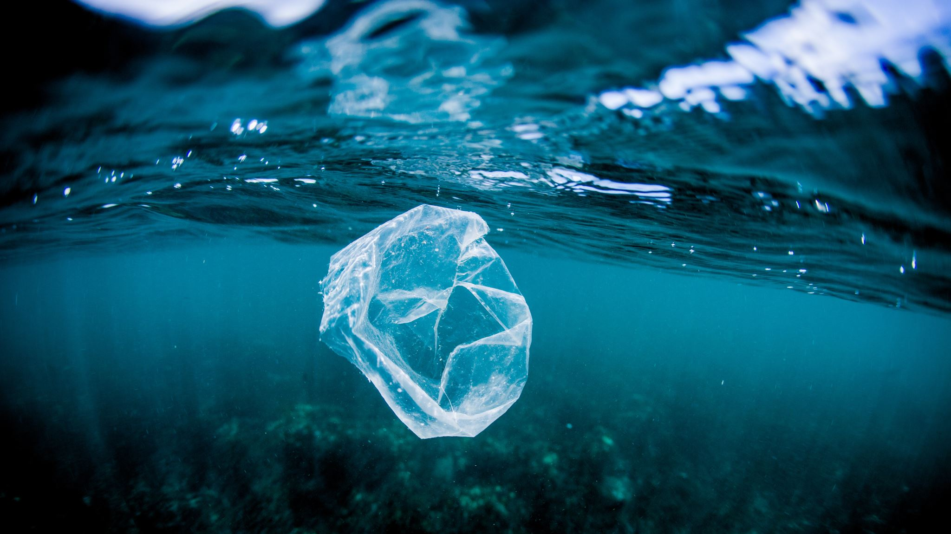

Marine Pollution Crime
Jurisdiction

Slide 2
General provisions losc
Territorial Sea: Sovereignty
Exclusive Economic Zone/Continental Shelf: Sovereign Rights
High Seas: Freedom of the high seas with due regard of the rights of other States

Slide 3
Jurisdiction: general observations
Jurisdiction in international law is divided between prescriptive and enforcement
It, typically, also includes: territoriality, nationality, passive personality, protective principles
It is contingent upon a legal basis in international law (LOSC, MARPOL etc.)
In the law of the sea it is directly connected to the zonal approach

Slide 4

Flag States
Flag States
As to the prescriptive leg of flag State jurisdiction, it is submitted in general that by dint of the nationality of the vessel, the flag State enjoys the full gamut of prescriptive powers related to the vessel, ‘everything on it, and every person involved or interested in its operations’.
That is an obligation to effectively exercise their jurisdiction and control in administrative, technical, and social matters over ships flying their flag.
Due diligence obligations of the flag state relating to article 94(3) and 211 UNCLOS, to IUU, and to MARPOL and London Conventions.
In foreign EEZs and the High Seas
Notes:
Nationality of Vessels = genuine link, nationality under international law
Obligation to exercise jurisdiction and control, not an option
Due diligence obligations

Slide 5
Flag states (ii)
Enforcement jurisdiction on the high seas (art. 92 LOSC) and in foreign EEZ’s
To enhance compliance by flag States, MARPOL Convention has been included in the IMO Instruments Implementation Code and flag States parties are subjected to mandatory periodic audits regarding the implementation and enforcement of the Convention.

Slide 6
Coastal States (i)
Coastal States
Jurisdiction is dependent on the zone exclusively, as opposed to the case of flag states where it is based on the relationship between the state and the vessel as well as the zone
Internal waters, archipelagic waters, and territorial sea, sovereignty subject to the right of vessels to innocent passage. The passage however is never innocent when it involves harm to the environment. The coastal State has the power to stop and detain the ship under Section 3 of Part II of UNCLOS (‘innocent passage’)

Slide 7
Coastal states (ii)
Article 21 of UNCLOS serves as the basis for the prescriptive jurisdiction of the coastal States (maritime traffic; conservation of the living resources of the sea; preservation of the environment)
But NO Construction, Design, Equipment and Manning Standards + innocent passage
Article 211 (4): Coastal State MAY adopt laws re pollution including criminal legislation in the territorial sea
If read alongside MARPOL that creates an obligation – then parties to MARPOL must adopt laws and take measures

Slide 8
Coastal states (iv)
Enforcement jurisdiction
Art. 220 (2): ‘where there are clear grounds for believing that a vessel navigating in the territorial sea of a State has, during its passage therein, violated laws and regulations of that State adopted in accordance with this Convention or applicable international rules and standards for the prevention, reduction and control of pollution from vessels, that State, without prejudice to the application of the relevant provisions of Part II, section 3, may undertake physical inspection of the vessel relating to the violation and may, where the evidence so warrants, institute proceedings, including detention of the vessel, in accordance with its laws, subject to the provisions of section 7.’
Art.230 limits non-monetary penalties only to cases of willful and serious pollution committed by foreign vessels within the territorial sea.
Is that so? What does the practice tell us?

Slide 9
Coastal states (v)
Art. 220 (3): Where there are clear grounds for believing that a vessel navigating in the exclusive economic zone or the territorial sea of a State has, in the exclusive economic zone, committed a violation of applicable international rules and standards for the prevention, reduction and control of pollution from vessels or laws and regulations of that State conforming and giving effect to such rules and standards, that State may require the vessel to give information regarding its identity and port of registry, its last and its next port of call and other relevant information required to establish whether a violation has occurred.
Limitation to ‘international rules and standards’
Art. 228: Suspension of proceedings if the flag State institutes proceedings itself
Enforcement measures by coastal States should not be adopted, unless the violation has resulted in a substantial discharge causing or threatening significant pollution of the marine environment and the ship refused to give information
Art.220(5): the coastal State may undertake physical inspection of the ship if there is substantial discharge OR the vessel does not provide the requisite information
High threshold of enforcement in the EEZ

Slide 10

coastal STATES (VI)
Art. 220 (6): in order to detain the ship = major pollution AND most importantly: there seems to be no protection of the environment as such, but protection of the environment of the coastal state from damage to the EEZ
MARPOL/Ballast water conventions.
Either proceedings or referral to the flag state

Slide 11
Port state
Art.218: 1. When a vessel is voluntarily within a port or at an off-shore terminal of a State, that State may undertake investigations and, where the evidence so warrants, institute proceedings in respect of any discharge from that vessel outside the internal waters, territorial sea or exclusive economic zone of that State in violation of applicable international rules and standards established through the competent international organization or general diplomatic conference.
2. No proceedings pursuant to paragraph 1 shall be instituted in respect of a discharge violation in the internal waters, territorial sea or exclusive economic zone of another State unless requested by that State, the flag State, or a State damaged or threatened by the discharge violation […]
3. When a vessel is voluntarily within a port or at an off-shore terminal of a State, that State shall, as far as practicable, comply with requests from any State for investigation of a discharge violation referred to in paragraph 1 […]
4. […] Any proceedings instituted by the port State on the basis of such an investigation may, subject to section 7, be suspended at the request of the coastal State when the violation has occurred within its internal waters, territorial sea or exclusive economic zone. The evidence and records of the case, together with any bond or other financial security posted with the authorities of the port State, shall in that event be transmitted to the coastal State. Such transmittal shall preclude the continuation of proceedings in the port State

Slide 12

Port states (ii)
Art. 220
1. When a vessel is voluntarily within a port or at an off-shore terminal of a State, that State may, subject to section 7, institute proceedings in respect of any violation of its laws and regulations adopted in accordance with this Convention or applicable international rules and standards for the prevention, reduction and control of pollution from vessels when the violation has occurred within the territorial sea or the exclusive economic zone of that State
Art. 228
Suspension and restrictions on institution of proceedings
1. Proceedings to impose penalties in respect of any violation of applicable laws and regulations or international rules and standards relating to the prevention, reduction and control of pollution from vessels committed by a foreign vessel beyond the territorial sea of the State instituting proceedings shall be suspended upon the taking of proceedings to impose penalties in respect of corresponding charges by the flag State within six months of the date on which proceedings were first instituted, unless those proceedings relate to a case of major damage to the coastal State or the flag State in question has repeatedly disregarded its obligation to enforce effectively the applicable international rules and standards in respect of violations committed by its vessels.

Slide 13
Beyond losc nationality principle
Art. 97 (1) --jurisdiction to the State of nationality of the master or the crew of the ship regarding an incident of navigation on the high seas.
Any State may enact criminal laws concerning marine pollution caused by its nationals

Slide 14

Beyond losc(ii) objective territoriality principle
Art. 220 (6) suggests that the principle may apply regarding pollution discharges committed outside its territorial waters, as long as the harmful effects extend within its territory
Also a general international law principle

Slide 15

Beyond losc(iii) passive personality & protective principle
Either the victim is a national of the State that prosecutes, or the crime has two elements one committed outside the territory with a view to commit a serious crime within the territory of the prosecuting State

