Slide 2
a. Characteristic passages of the Gospel
b. The treatment of the foreigner -ΧΕΝΟΣ as opposed to the barbarian in the Roman Empire
c. How New Rome ultimately addressed the "foreigner-barbarian" dichotomy in texts of worship popular to this day

Slide 3
1. Matthew as the “Gospel of the Immigrant”

Slide 4
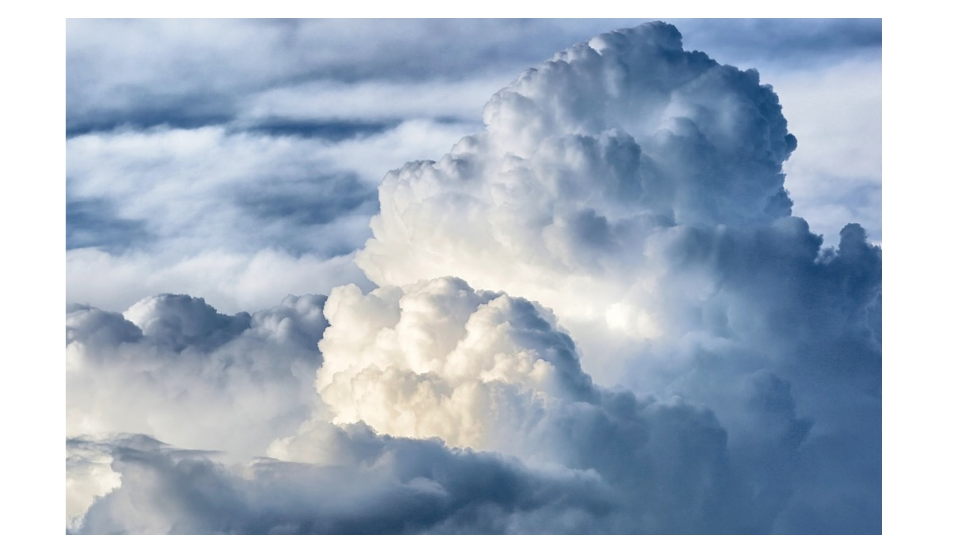
The Messiah - Emmanuel as Refugee
Τhe figure of Ruth, the primary foreigner of the Old Testament (the Moabites), predominates in His genealogical tree.
The Messiah Jesus, in order to avoid Herod's persecution, flees to Egypt, a classic country of refuge in the Bible.
A foreigner who struggles with Christ for the cure of her daughter also dominates the heart of the Gospel: The Canaanite lady from what is now Lebanon.

Slide 5
Messiah = Stranger
Α. 25:35 ἐπείνασα γὰρ καὶ ἐδώκατέ μοι φαγεῖν, ἐδίψησα καὶ ἐποτίσατέ με, ξένος ἤμην καὶ συνηγάγετέ με,³⁶γυμνὸς καὶ περιεβάλετέ με, ἠσθένησα καὶ ἐπεσκέψασθέ με, ἐν φυλακῇ ἤμην καὶ ἤλθατε πρός με.
For I was hungry, and you gave Me something to eat; I was thirsty, and you gave Me something to drink; I was a stranger, and you invited Me in; (Mat 25:35 NAU)
Β. 27:6-7 Οὐκ ἔξεστιν βαλεῖν αὐτὰ εἰς τὸν κορβανᾶν͵ ἐπεὶ τιμὴ αἵματός ἐστιν. συμβούλιον δὲ λαβόντες ἠγόρασαν ἐξ αὐτῶν τὸν Ἀγρὸν τοῦ κεραμέως εἰς ταφὴν τοῖς ξένοις. διὸ ἐκλήθη ὁ ἀγρὸς ἐκεῖνος Ἀγρὸς Αἵματος ἕως τῆς σήμερον.
The chief priests took the pieces of silver and said, "It is not lawful to put them into the temple treasury, since it is the price of blood". And they conferred together and with the money bought the Potter's Field as a burial place for strangers. (Mat 27:6-7 NAU)

Slide 6
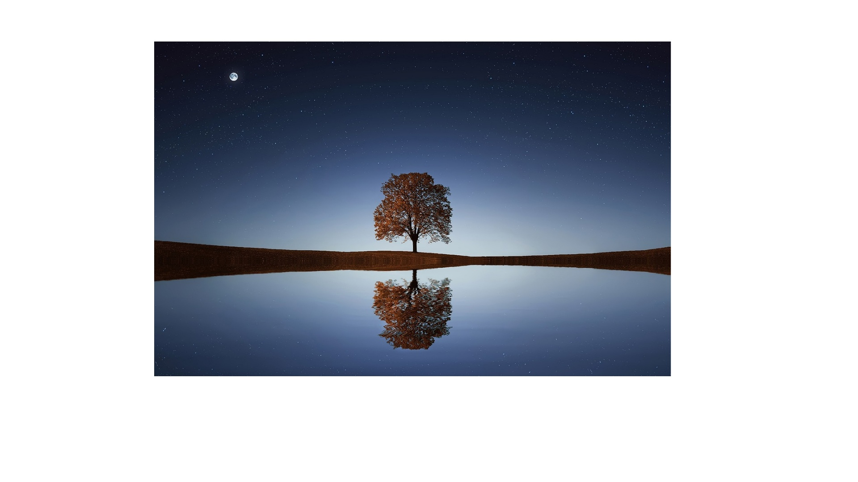
τὸ αἷμα Ιησού Μεσσία = λύτρωση the blood of Jesus Messiah = redemption
Comment on the Graves of Foreigners:
Mt. 27:7 raises a question: "Who are the strangers who shall be buried in this field?" The most likely explanation—Israelites temporarily in Jerusalem, proselytes temporarily resident there, or Gentiles—is that the field was constructed for impure Gentiles, who are thus separated from the rest of the people even in death (ThWNT).

Slide 7
2. The Stranger/Foreigner and the Barbarian in the Pax Romana

Slide 8
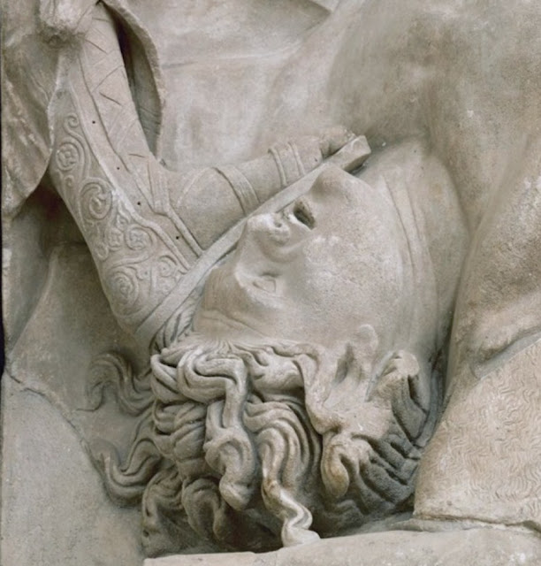
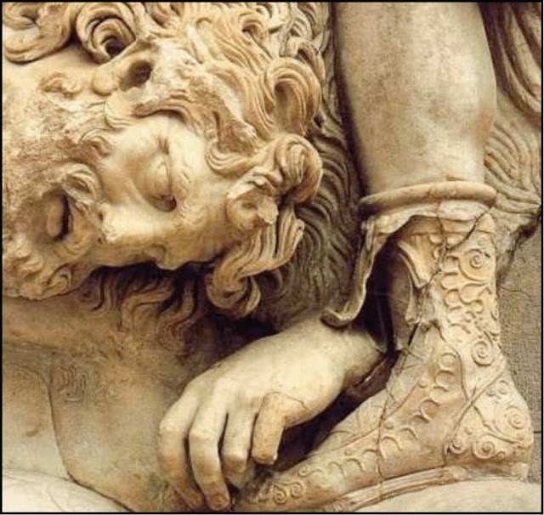
Greeks and Barbarians
http://users.sch.gr/ipap/Ellinikos_Politismos/Pergamon/Pergamon-gigantomachy.htm
https://ellinondiktyo.blogspot.com/2015/10/blog-post_13.html

Slide 9
Suppliant Tragedies
In these tragedies, Athens embraces the pleas of persecuted Greeks from other regions and serves as the guardian of panhellenic values, violated during times of crisis, as well as the guarantor of piety and the normal relationship between gods and men, which war and human empathy have disrupted.
Aeschylus' Iketides: they invoke shared descent, which was not uncommon during the extended Hellenistic period.
Euripides' Iketises + Motif of the burial of the dead (Oedipus on Colonus)

Slide 10
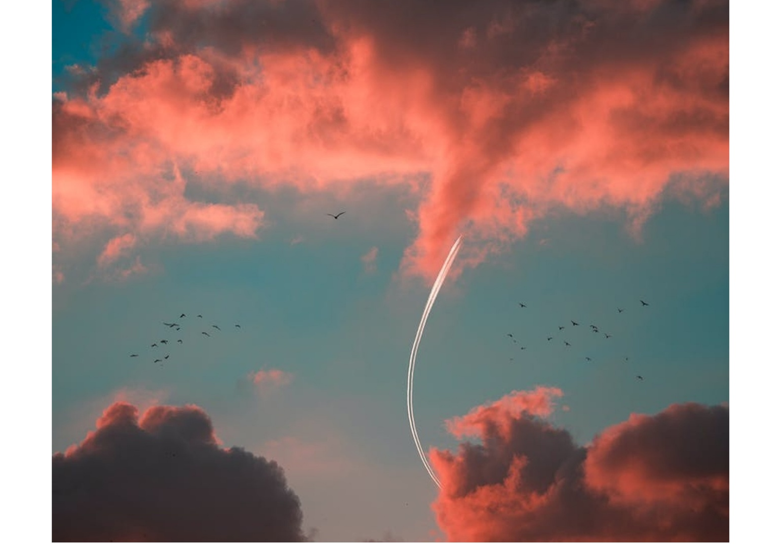
Imperial Years
The gift of foreignness and hospitality is distinct from the devaluation of any barbarian element in both Hellenistic novel and in Philo.
Compare the Hellenistic and Jewish prayer formulae, in which the Greek man thanks fate for not making him an animal, a woman (gunh,) or a barbarian (cf. Diogenes Laertius 1:33) or where the Jewish man thanks God for not creating him as a gentile (gōj or nokri), a woman ('išāh) or an ignorant man (bōr; variant: as a slave /‛aebaed), i.e. as a "Torah alien" (cf. tBer 7:18; pBer 9:13b,48; bMen 43b).

Slide 11
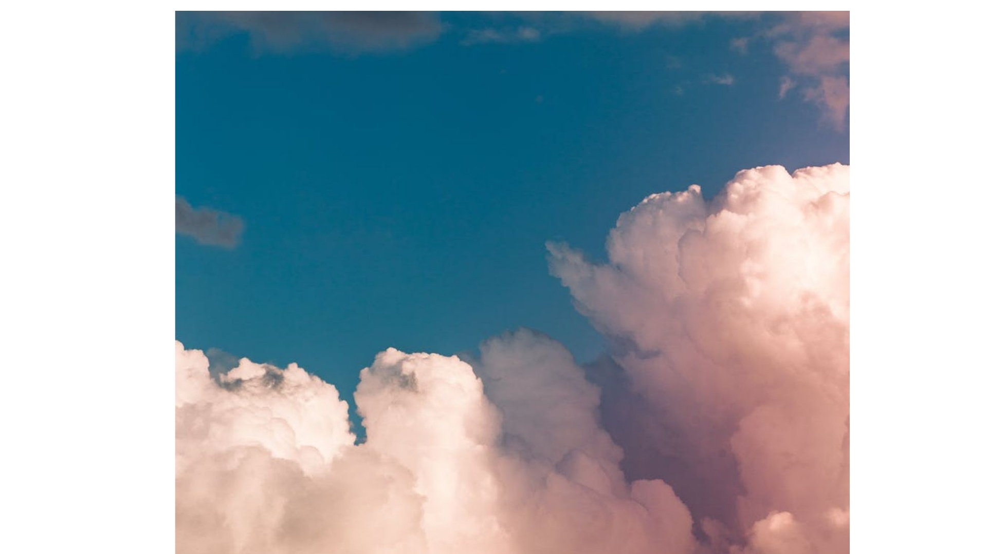
Christians= Strangers In The World
Νέον Έθνος (New Nation): «Ξένον» (foreign) – Ξένων (strangers) < Matthew 21:43 (NAU)
"Therefore I say to you, the kingdom of God will be taken away from you and given to a people, producing the fruit of it".
Christians are strangers in this world, for God has given them a new home in heaven (Heb. 11:15-16; Eph. 2:6; Phil. 3:20). In legal terms, they belong to the city of God (Heb. 11:10,16; 12:22-23). Formerly outlaws, they now have civil rights there (Eph. 2:19). They are thus aliens in the world (Jn. 15:19; 17:14, 16). They live as sheep among wolves (Mt. 10:16). The world is offended by them (1 Pet. 4:4). They can only live there as aliens (2:11). In the apostolic fathers, Diog. 5.5 stresses this point forcefully, and cf. Hermas Similitudes 1.1; 2 Clem. 5.1.
xénos [foreigner, stranger, guest], xenía [hospitality, affability, guestroom], xenízō [to surprise, entertain], xenodochéō [to show hospitality], philoxenia [hospitality], philóxenos [host, hospitable]

Slide 12
3. The PARADOXON in the Worship of the Eastern Church

Slide 13
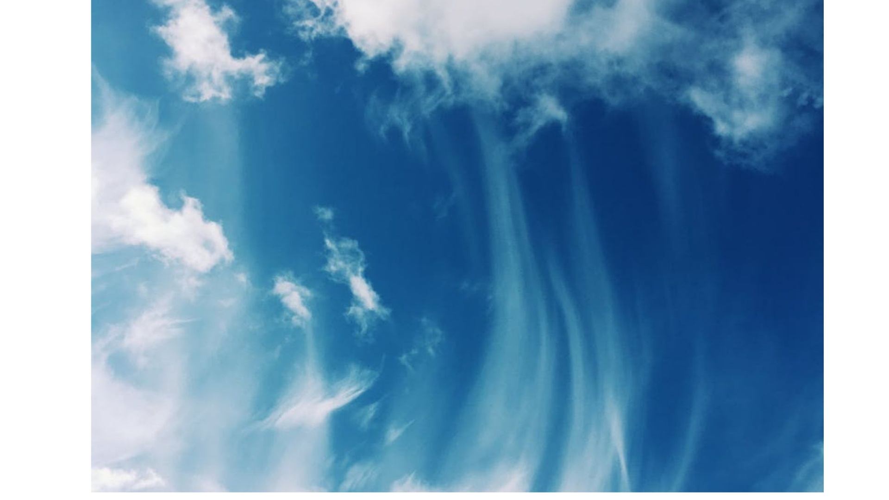
THE PARADOXON
The first Christian communities saw the face of the Crucified in every "other" person, regardless of whether he was a foreigner or a barbarian.
In the 6th century, on the occasion of the wars against the Persians, the very popular hymn "Save, O Lord, the people [....] victorious over the kingdom against the barbarians" is established.
≠

Slide 14
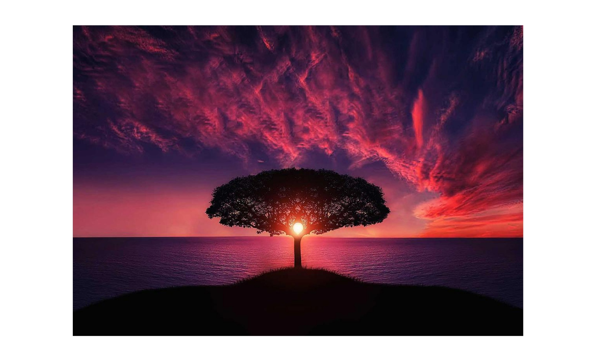
Give me this Stranger
Having seen the sun hiding its rays and the curtain of the temple torn apart, after the death of the Savior
Joseph (of Arimathea) came to Pilatus, and he is begging him with these words:
Give me this stranger, who has been a stranger since He was a baby
Give me this stranger, whom His compatriots, hating Him, killed Him as if He was a stranger
Give me this stranger, whose strange death surprises me
Give me this stranger, who knew how to welcome poor people and strangers
Give me this stranger, whom Jews, out of envy, estranged from this world
Give me this stranger, so that I hide Him in a tomb, since as a stranger He had no place where He could lay His head onto

Slide 15
Give me this Stranger
whom His Mother, having seen Him dead, was moaning saying:
“Oh, my Son and my God, even if my entrails are consumed by pain, even if my heart is shaking seeing you dead, I glorify you, hoping for your resurrection’’.
And with these words, having convinced Pilatus, the revered man, he takes the body of the Savior, which he wraps with awe in a sheet and smears with perfume before laying it in the tomb.
He, who has offered everyone eternal life and His great blessings.

