Slide 1
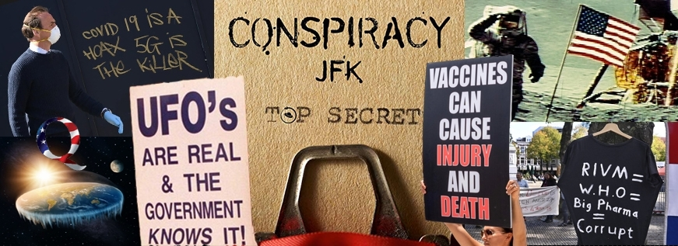
Photo © Universiteit Leiden Bizarre, but fascinating: What can We Do against Conspiracy theories? NKU Athens, March 2024
The definition problem: What should count as a Conspiracy Theory [CT]?
Theoretical Arguments Against CT’s
Quality Criteria of Theories: a Comparison
Practical guidelines for talking with CT-ists
Winfried Löffler
Associate Professor
University of Innsbruck
Department of Christian Philosophy
Karl-Rahner-Platz 1
6020 Innsbruck, Austria
winfried.loeffler@uibk.ac.at
www.uibk.ac.at/philtheol/loeffler

Slide 2
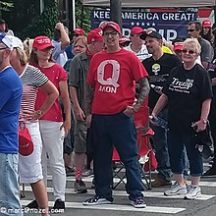
1. The definition problem: What should count as a CT?
Examples: “Plandemics”, “The Great Reset”, “the Great Population Exchange”,
QAnon, “Pizzagate”, “The Ukraine war was begun by the NATO”, “the high number of vaccination damages is systematically concealed”, “chemtrails poison us systematically or modify our genome”, “Reptiloids appear as politicians”, “Bill Gates is the hidden Satan”…
The usefulness of the term “CT” is controversial:
For many ears, “CT” is a sort of invective / curse word. (too good a word?)
Are CT’s really “theories”? Does this bestow them too much of “scientific dignity”? (CT’s typically infringe the quality criteria of scientific theories!) (too bad a word?)
Terminological alternatives: “Conspiracy thinking” / “Conspiracy ideology” / “Conspiracy believers” / ???
For simplicity, I will simply use “CT” (but I connect no claims with that!).

Slide 3
1. The definition problem: What should count as a CT?
[…]
A proposal for distinctions: Different scopes of CTs:
- Event CTs (“the moon-landing was fake”, “9/11 was orchestrated by the US government”, “Obama was not born on US soil”, etc. …)
- mid-scale CTs: “Chemtrails”, “the pharma industry pays governments to keep upright the Corona fiction, to save their vaccine business”
- global CTs: The “Great Reset”, “Jewish circles steer the world”, “New World Order” (High finance & illuminati/freemasons, GATT, NAFTA, UN; “globalists” versus “localists”, national sovereignty), …
Attention: surely not every form of corruption, bribery, fraud, illegal agreement, government scandal is also a “conspiracy”!

Slide 4
Example of an implausible definition¹:
“CT = a theory that says that (1) There is some secretly operating group that seeks control/destruction of institutions/states/the world. (2) Nothing is as it seems. (3) Everything hangs together. (4) Nothing happens just by chance / accident.”
Comments: A rather implausible definition! Clauses (2), (3), (4) are imprecise and (taken literally) probably exaggerated. (“Everything…”, “nothing…”)
This definition seems to think of large-scale/global CTs only. (For event/mid-scale CTs, clauses (2-4) must be constrained/restricted: (2) Nothing that concerns event/institution x is as it seems. (3) Everything that concerns x hangs together. (4) Nothing that concerns x happens just by chance / accident.”
Question: Should event CT’s really be called “CT”? (moon landing, Obama’s birth in Africa?) Not every plan to hide/conceal something is already a “conspiracy”!
¹ Michael Barkun, A Culture of Conspiracy (2013) / Michael Butter, »Nichts ist, wie es scheint.« Über Verschwörungstheorien (⁵2021).

Slide 5
A better definition: Via a flexible phenomenological list of features (partly along: Harder, Verschwörungstheorien ²2020, 14ff, simplified and modified)
A construction of ideas/claims is the more a CT, the more it fulfils most of the following claims / features (i.e., “CT” comes in degrees, it is not a Y/N quality)
An Elite with power deceives the public about its illegitimate intentions (By the way: typically, the exact identity of the conspirators is not laid open.)
A small minority understands what’s going on and warns others
Repetition of the ever same “critical questions”, ignoring of counter-arguments, repeated use of long-rejected “facts”
Monocausal explanations, but the ways/chains of explanation are complicated and with a lot of additional assumptions
Dualism: the good / the bad; “we, the people” / “the system”
Denouncing of opponents, explaining their views by the theory (as “main-stream media”, “system scientists”, “lying press”, “illegitimate government”)

Slide 6
2. Theoretical arguments against Conspiracy Theories
In a big conspiracy, a great number of people must be involved and informed at least a bit. This would make us expect that someone defects and “blows the whistle” (someone who feels unjustly rewarded, not respected enough etc.) (Niccolò Machiavelli, Discorsi saw that: not more than 3 or 4 conspirators!)
Realizing a large-scale conspiracy would require the unification of many individual interests over longer time. This is implausible in modern, highly individualist societies.
CTs assume the large-scale steerability of (complex, global) societal / economic processes. Perhaps possible in the long past, implausible for modern societies! Karl Popper, The Open Society: complexities of the “situation logic”, lots of contingencies, all results are never plannable. (Examples: Decades-long attempts of European traffic regulations, migration/asylum management, climate
[…]

Slide 7
2. Theoretical arguments against Conspiracy Theories (continued)
[…]
CTs are implausible because of the “principle of shrinking probabilities”: they consist of a lot of massive and astonishing claims. Logically, this means that they are huge conjunctions of claims, which must all be true. But with every new independent claim, the conjunction gets more improbable.
Contradiction in itself (1): If it’s indeed so secret, why and how does an increasing minority know anyway?
Contradiction in itself (2): If it’s indeed so secret, isn’t it improbable that just you of all people know, or your friend?
Contradiction in itself (3): If it’s indeed so effective, why is just the basis of the conspiracy known, but the center of the conspiracy remains unknown?

Slide 8
3. Quality criteria of theories: a comparison (from: K.H. Sager, Lecture Special Epistemology summer term 2022)
Criterion | Scientific Theories | Conspiracy Theories
Truth | Direction of Fit: Theory → Reality | Direction of Fit: Reality → Theory
Simplicity | Ideal of parsimonious theory | Tendency to increasing complexity via Ad-hoc-assumptions
Scope and explanatory power | Is limited by the theory | “overwhelming”
Methodology | Scientific methods, public standards | no standards
Consistency and Coherence | with adjacent theories and background knowledge, an important desideratum | No important role, no big desideratum
Corroboration / Refutation | Empirical evidence | Any new empirical evidence “con-firms” the CT, partly by ad-hoc-Hypo-theses, elastic interpretation of reality
Usual Checking Strategy | Attempts of falsification | Attempts of verification/confirmation (boosted by confirmation bias, homo-geneous groups, familiarity bias etc.)
Notes:
.

Slide 9
4. Practical guidelines for talking with CT-ists
Arguments alone will not do. Rather practical experiences; feelings of doubt.
More a matter of psychology than of science! (Direct Arguments may harden.)
Be polite and patient, avoid the negatively-connotated term “CT”. Don’t foster “encapsulation” of your opponent by emotional attacks.
Try to keep upright a bridge, if this is important for you. (“We disagree here, but I appreciate our friendship …”)
Ask more than you claim (“Why do you believe that? Who exactly says this? Why do you think s/he is so competent? Would you believe him/her in other important matters?”) etc. – let your opponent discover the weak points.
With some people, discussion is useless, waste of time. (Consider that truth is not the only motivation for CT, it is also about identity, getting attention etc.)
See numerous practical guides on the www!

