Slide 1
The Epistemology of Fake News NKU Athens, 5 March 2024
A short look at “Social Epistemology”
“Fake News”
Changes in the media world
Producing Fake News as business model: the supply side of Fake News
The demand side of Fake News: Why people believe in them
What can we do?
Winfried Löffler
University of Innsbruck
Karl-Rahner-Platz 1
6020 Innsbruck, Austria
winfried.loeffler@uibk.ac.at
www.uibk.ac.at/philtheol/loeffler

Slide 2
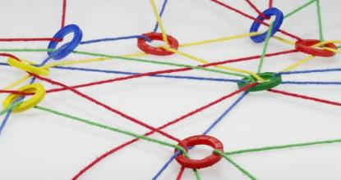
1. A short look at Social Epistemology
Epistemology: What is “knowledge”, “justified believing”, “experience”, “truth”, “probability”, “appearance”, “illusion”, etc.
Traditional epistemology (with few exceptions): atomized, isolated subjects; how do (individual!) subjects get cognition of the world? (Exception: testimony/witness discussed by Locke, Hume, Reid, Bolzano etc.)
Social Epistemology: The cognition of real people is always embedded in the influxes of others. (Triangle: me – world – others)
Topics of Social Epist.: testimony, contradiction of witnesses, consent and disagreement; “epistemic authorities”, expert knowledge and expert disagreement, “epistemic injustices”, “epistemic minorities”, conspiracy theories, “trust” (in persons and institutions), “resilient beliefs”, etc.

Slide 3
“Fake News”
Phenomena we all know…
Donald Trump’s lies, lies on Putin’s war, the Corona pandemic, QAnon, …
Massive disinformation campaigns by some political parties, TV networks, associations, single citizens (“mRNA vaccines change your DNA and make women infertile”, “the US election was stolen”, “anthropogenic climate change is a lie”, etc.) ; uncontrollable flood of wrong information
Science-related populism: “normal people and common sense get it better than the experts”
Result: some people have increasing mistrust in medicine and science as a whole
Readiness to believe in “felt truths”, without or even against the evidence
…
Questions:
Why do people believe Fake News, why do others produce them?
what can we (as critical people) do? … A topic also for epistemology!

Slide 4
But: What exactly are “Fake News”? (a surprisingly difficult question!)
Fake News = News that has two defects:
Defect of truth: false OR misleading
AND
Defect of veracity / truthfulness: Spreaders want to deceive others OR they don’t care about truth
(Jaster / Lanius (⁶2021), 31f]

Slide 5
But: When exactly is news “misleading”?
Telling “the truth, nothing but the truth and the whole truth” is an impossible ideal for most news-situations. News must mostly be short.
“Adequate” news tell “a segment of the truth which an informed, good-willed, rational observer of the situation would find informative, and which would not invite him to wrong conclusions”.
“Misleading news” is news that is not adequate.
Fake News may have various forms:
Lies (claiming facts that don’t obtain; “the biggest inauguration ever”), or choosing clearly false descriptions of facts (“a recent MIT study found out that anti-vaxxers are better informed” – no, they just deal more with Covid data to underpin their view; “being informed” was not the study topic)
“Cherry picking”: mentioning only partial aspects, those which fit to your message (“new medicament proves effective” (= it reduces average hospitalisation from 13 to 12 days…)); citing dramatic singular cases
“Framing tricks”: choosing a tendentious linguistic description (“One quarter of the infected are not infectious” – “Three quarters of the infected are infectious”)

Slide 6
3. Changes in the media world
Fake News are not a new phenomenon:
“In any war, the first victim is truth.”
Newspapers etc. were mostly opinion-driven, world-view driven, partisan until the 20th century
(The ideal of “journalistic objectivity” is a product of the mid 20th century, also the development of “journalist ethics”, “media ethics”.)
This partisanship in earlier times was outbalanced by a common life-world, occasions to discuss. No segregated society.
And there were less media available. Number of “world versions” limited.
Crucial new developments:
The internet, cable TV, Social Media (Web 2.0)
Producing and spreading news became incredibly cheap.
Newsfeeds can be adjusted to the consumer’s interests in new degrees – news distribution follows similar logic to consumer research.
Traditional criterion “we bring what is probably true (perhaps with little bias…)” replaced by “we bring what my audience wants to hear/see/read”.
Broad range of news suppliers: traditional media, bloggers, parties, … anybody!
[…]

Slide 7
[…]
Anybody can select the news s/he wants, from a vast array of possibilities, at any time.
Not only that: “Micro-targeting” by algorithms of youtube, Facebook etc.: the citizen gets his individually adjusted news according to the (huge!) data stored about him at news suppliers: search keywords, living-place, reading-times, accounts & memberships, postings, friendships, …
Reinforcement effects by the search-proposals of youtube, Facebook etc. – try it yourself! (Type in a controversial topic, follow a first link to “one side”, the proposals in the menu on the right will bring you deeper and deeper into an “opinion bubble”. (And every click can bring some people money! Commercials!)) Youtube, Facebook etc. could easily adjust these criteria.
Impossibility to block problematic content. (Telegram etc.) […]

Slide 8
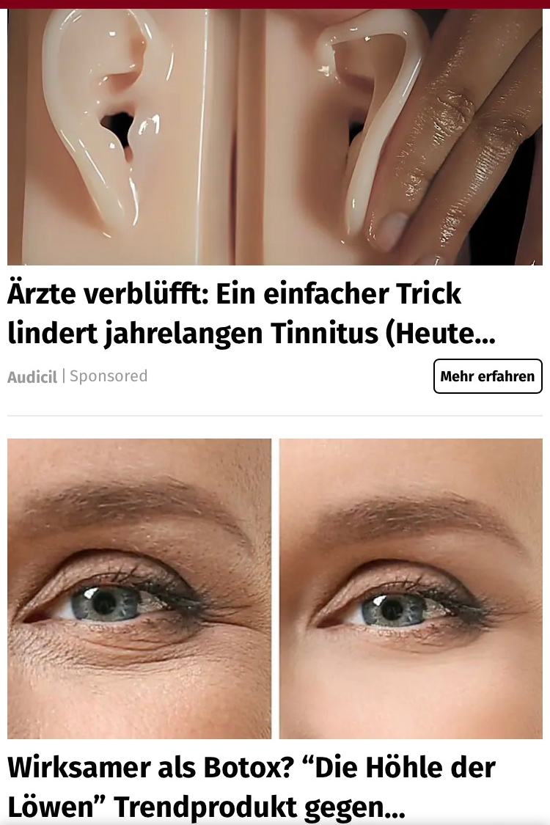
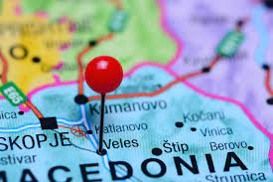
[…]
The economic side of internet surfing: “Click-baiting”: Combination with commercials;
Re-distribution of “news” as a business-model: new production of similar websites, with similar content, almost all Fake News, and full of commercials. Every click counts & is rewarded!
Spectacular Fake News earn a lot of clicks!
⇨ Example: The young people of Veles North Macedonia and the US Election 2016, production of 100s of similar incendiary pro-Trump-/anti-Democrats Websites, by “copy & paste”, for money.
(see, e.g., Hughes/Waismel-Manor 2020, The Macedonian Fake News Industry and the 2016 US Election, free on the www)

Slide 9
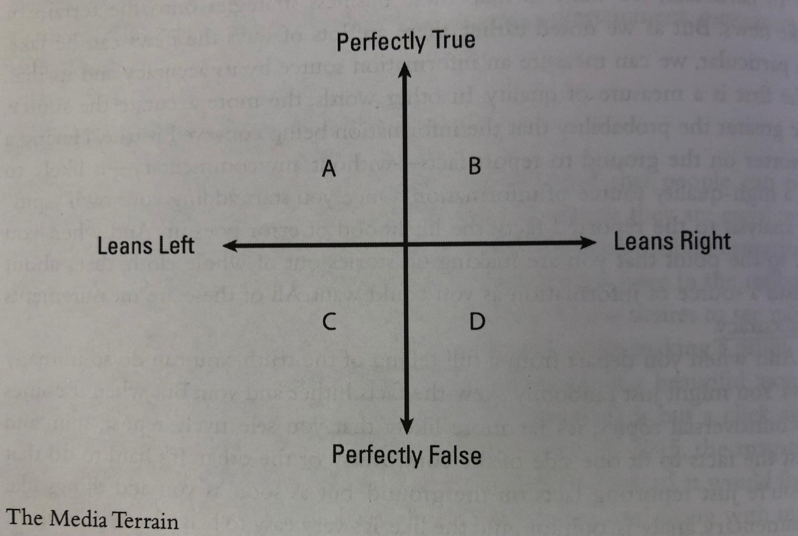
4. Producing Fake News as business model: the supply side of Fake News
Why does the production of Fake News work at all? (What did the youngsters of Veles live from?)
The media terrain, sorted along two criteria (McBrayer, Beyond Fake News, 33; for American circumstances, but adjustable to other countries):
Main goal of media, if they want to survive: maximizing profit in this landscape (by fees & ads). → What to do? For what type of news could there be market?

Slide 10
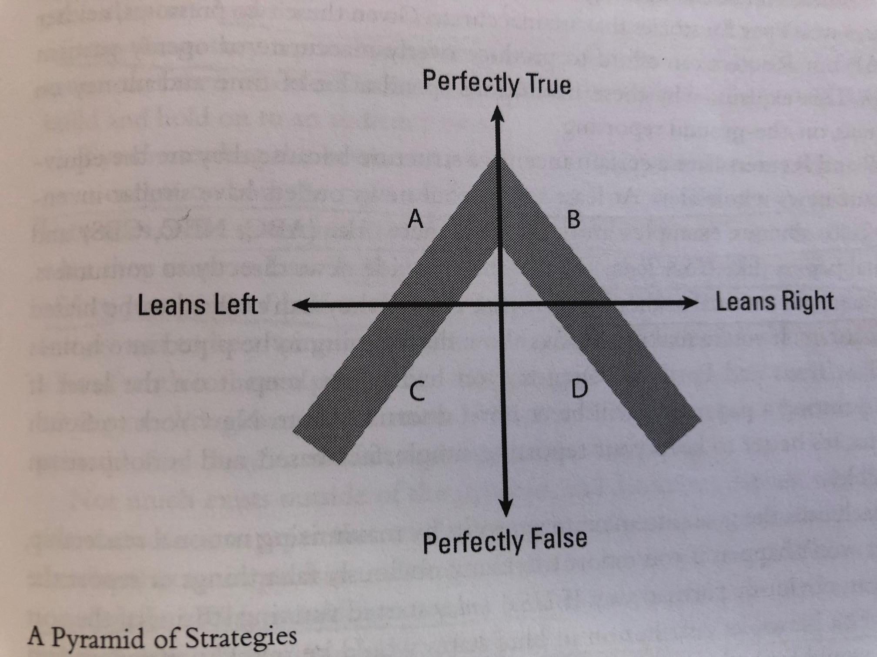
Media strategies that will (not) work (economic survival only in the grey areas):
Reuters, Assoc. Press
New York Times, CNN Wall Street Journal
Fox News
(McBrayer 35)
The few news agencies (Reuters, Associated Press etc.) are on the top of the pyramid – they must sell their news to both, left-wing and right-wing media.
There is a market for mainline facts, presented in a reliable way, perhaps with a little political “colouring”: The New York Times, CNN, The Wall Street Journal etc.
There is a market for less reliable news which, however, certain groups like to hear/read.
There is no market for low accuracy news without partisanship.
There is no market for high accuracy news with partisanship (example: The Weekly Standard, reliable, clearly conservative, but not pro-Trump, had to close in 2018…)
The less truthful a news source is, the more partisan it must be to survive.
The more partisan a news source is, the less truthful it will be, since it must adjust to its partisan audience. --- And the journalists?? They tend to obey to these incentives....

Slide 11
5. The demand side of Fake News: Why people believe in them
Summary so far: there is an economic incentive structure to produce, distribute and redistribute Fake News, and technology and deregulation make it easier.
But now let’s ask: why do so many people believe in them so easily?
A look into social psychology and its frontier areas to epistemology.
Incentives of news consumption; error costs and benefits
Information/news is “consumed” like other intakes (no purely “rationalist” approach!). And truth is not the only incentive which guides this consumption.
Cognition follows two (!) incentives: - truth
- “costs” and “benefits”
In many cases, truth is not so important, and the “direct error costs” are minimal. E.g., it does not directly damage me personally if I deny climate change, have terribly wrong ideas about the causes of the Ukraine war, or believe in a world conspiracy. (Compare: Correct information about bus departures has high direct error costs.)
What we saw so far: We are not so much out for truth as we believe.
But it is even worse: There are even strong non-truth-related incentives to believe.

Slide 12
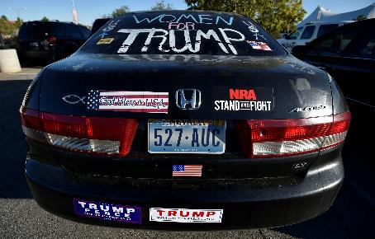
Big and little questions: “Little”: Problems which we oversee, and have competence and a chance to solve ourselves. “Big”: Problems which we don’t oversee, beyond our own competence. Crucial: In many cases, big questions have low error costs.
But: Tendency to have opinions also in “big” questions… = the main field of fake news!
(No fake news in weather forecasts, football results, road closing announcements, etc.)
“Tribal cognition”, pressure to conformity, belonging to a community, team mentality: we strive for opinions as “identity markers”. Powerful especially in “big problems”, in areas “at the edge” without clear empirical control, rational structure, accessible evidence. ⇒ The primary incentives are: Harmony, identity, loyalty, reduction of “cognitive dissonance”, “complexity reduction”. (And not: truth…)
Think of the costs & benefits! No direct costs of an error, but high
personal benefit in terms of harmony, social integration, identity etc.
Consequence: Low-accuracy, but high-interest news “sells”!
⇒ Outrage / scandalization journalism sells
In low-quality media, “fiction” sometimes overrules “fact”, to fit audience interests
But even high-quality media can indirectly be affected: In order to be quick (“Breaking News”!), the risk of insufficient investigation is taken, → unintended fake news!

Slide 13
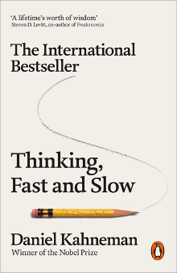
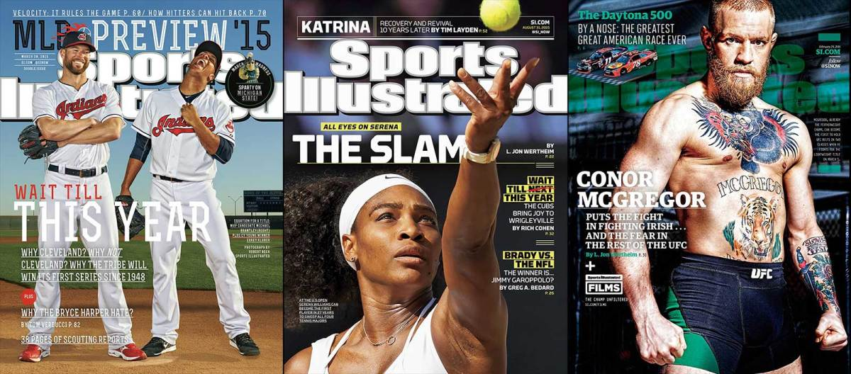
b. Cognitive biases
= “built-in”, “hardwired” tendencies of mistaken belief formation. Only some examples.
We know already one of them: The tendency to answer “big questions” beyond own competence. (And most of media coverage refers to “big questions”.)
“Archaic” forms of thinking (probably with an evolutionary backing): - “fast thinking” versus “slow thinking”, - “felt truths” / an “air of truthiness”, “intestinal reasoning”, - believing and re-telling what others told us, - identifying actors/culprits behind complex happenings (“it’s his fault!!!”)
Short-cut thinking, logical mistakes: E.g. you have a cold, after a few days, at the climax of your pain you consult the doctor, he prescribes an antibiotic, it’s getting better – “the antibiotic helped”; (if p, then q; now q; hence p); the “Sports Illustrated cover jinx”: After appearing on the SI cover, your career goes down…
One special case: concluding from singular cases to the totality: “Smoking can’t be that dangerous, my uncle got 90 with 20 cigarettes a day.” “My grandma easily survived Corona at 89”; “But Peter died at 41, and he had no overweight”. […]

Slide 14
[…]
Self-overestimation of competence: 90% of professors believe to be above average…
Confirmation bias (we see what we want, what fits to our theories, we over-weigh fitting evidence). We prefer information confirming our assumptions. E.g. family names of persons influence police officers suspicions, “racial profiling” etc.
Myside bias: We under-weigh unfitting evidence. E.g. When the topic is controversial, we tend to reject logically correct arguments with “unfavourable” conclusion.
Anchoring effects / errors: the first information guides your perception for long.
Availability heuristics: Where examples are easily available, claims are more credible. → Social media redistribute countless drastic examples, authentic or faked.
Familiarity heuristics: What you have heard/read often, is familiar and more credible; can solidify into a narrative. “A lie told once remains a lie, but told a thousand times it becomes the truth.” (Joseph Goebbels) – Continued exposure to “opinion bubbles”, “echo chambers” etc. strengthens your beliefs.
[Science-related populism (“common sense gets it better than the so-called experts”) rests on all these cognitive biases!]

Slide 15
6. What can we do? (McBrayer, 154ff)
Individually: cultivate your media behavior!
Limit your exposure to bad sources (remember the familiarity bias!); i.e.
Read widely! Read quality!
Observe yourself: are you emotionally involved? If so, be especially careful!
Ask: Cui bono? Who might profit if you read that, and agree to this news? In whose interests might the news be? Is it editorial content or sponsored content? Do the “experts” look radical, black-and-white style, exaggerating, bellicose?
Is it a big or a little question? If it is “big” and if there are no good experts or no clear “bridges” to other reliable bases of information (science, authorities…): forget it!
Are there clear indications of the mistake-tendencies discussed above?
Fact-check it, as good as you can:
Check the URL (… .com.co etc. are suspicious!
google “suspicious passages” of the text in “…” (to see where it was copied from)
Use neutral search strategies: “corona vaccination” instead of “vaccine deaths”
Do not only read the top findings in your google searches
Read laterally, try to find serious “other sides”
Use professional “Fact-checking” sites
Breath, read and think once again – before sharing, re-posting, commenting etc.
If you have energy: Oppose in a polite way, to prevent that others believe in fake news.
Don’t support bad sources by reading and rewarding them, clicking their commercials.

Slide 16
Politically
Some companies (Facebook, Youtube etc.) flag or even ban problematic content. Problem of course: censorship, free speech; proportionality
(Perhaps): Tools of credibility ranking [could partly be done by algorithms, according to words (“really”, “very”, …) and by patters of redistribution in the www]
(Keep upright) public subsidy of high-quality journalism
Provide serious information from states’ side (very different performance of states)
News & information education at schools, “digital literacy”
(Perhaps): Intelligent, soft forms of “censorship”, e.g. German Netzwerkdurch-setzungsgesetz (NetzDG, “Network execution act”) 2017: Fines for Hate-speech longer than 24hrs on the web, obligation to lay open data of origin. → E.g. 1000 “Content Moderators” at Facebook. Problem: who draws the line of what is (not) allowed – is that in the end a mere question of power? Problematic content migrates (Telegram etc.), gets clandestine.

