Slide 1
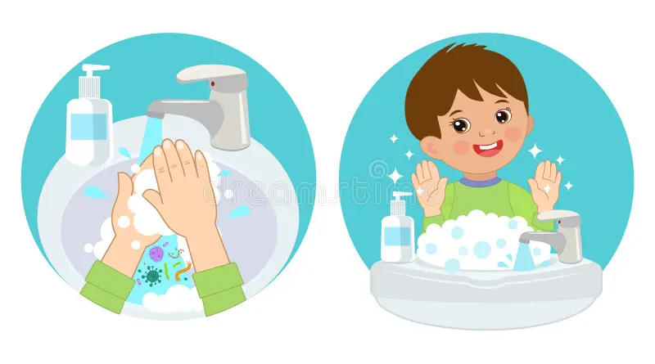
Me and my health
Clean hands, healthy heart

Slide 2
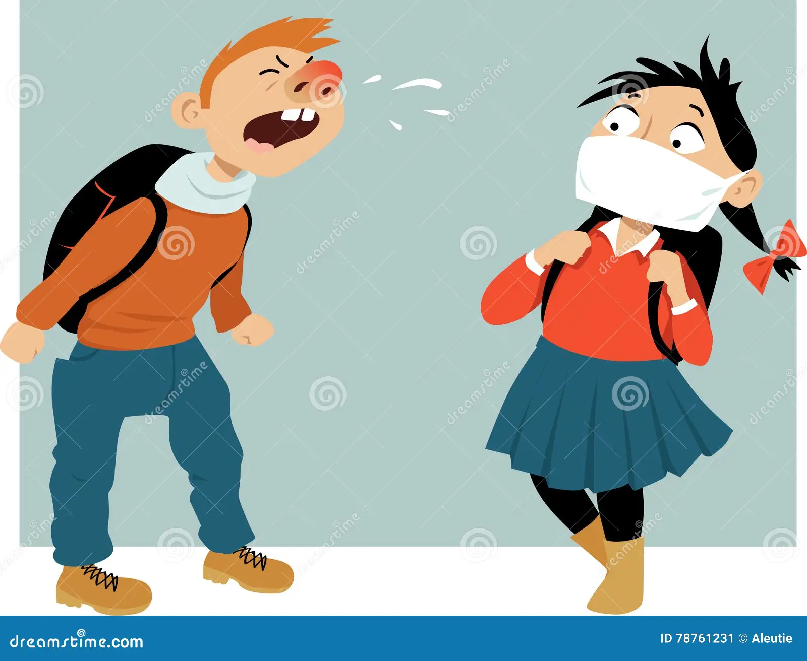
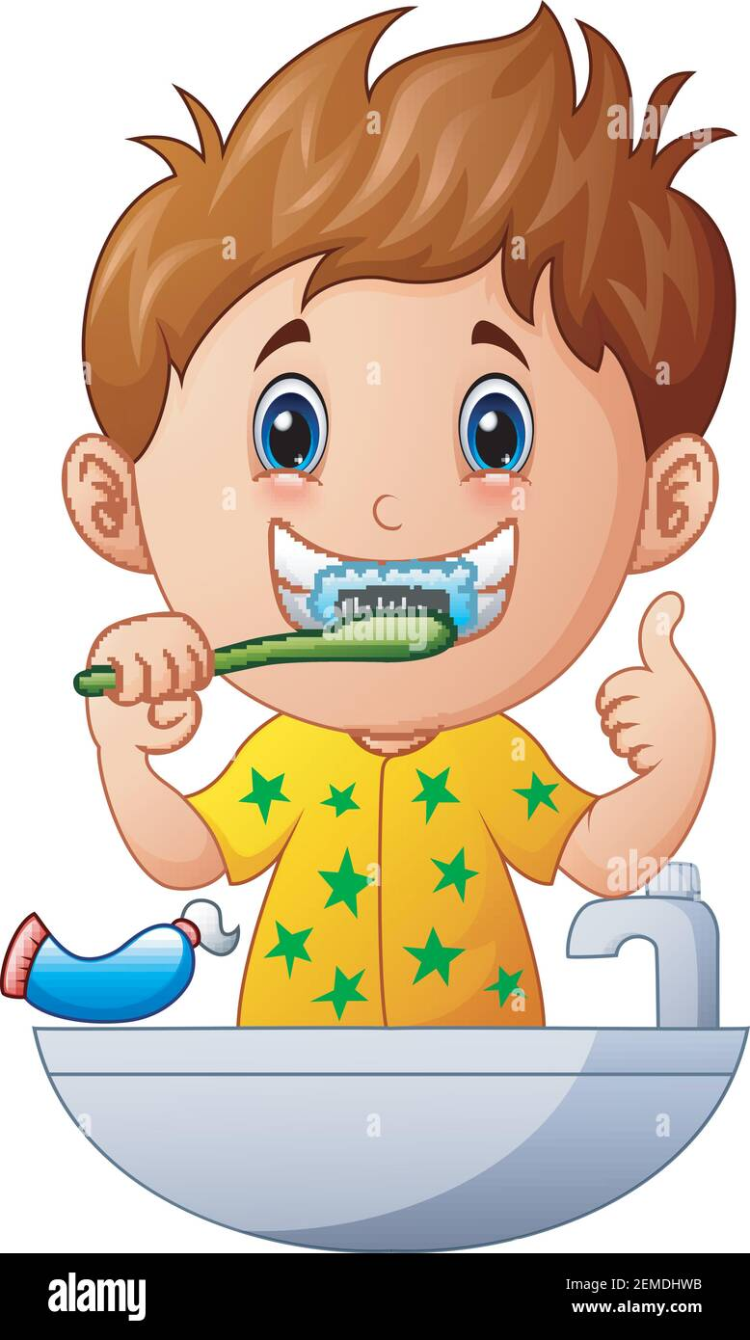
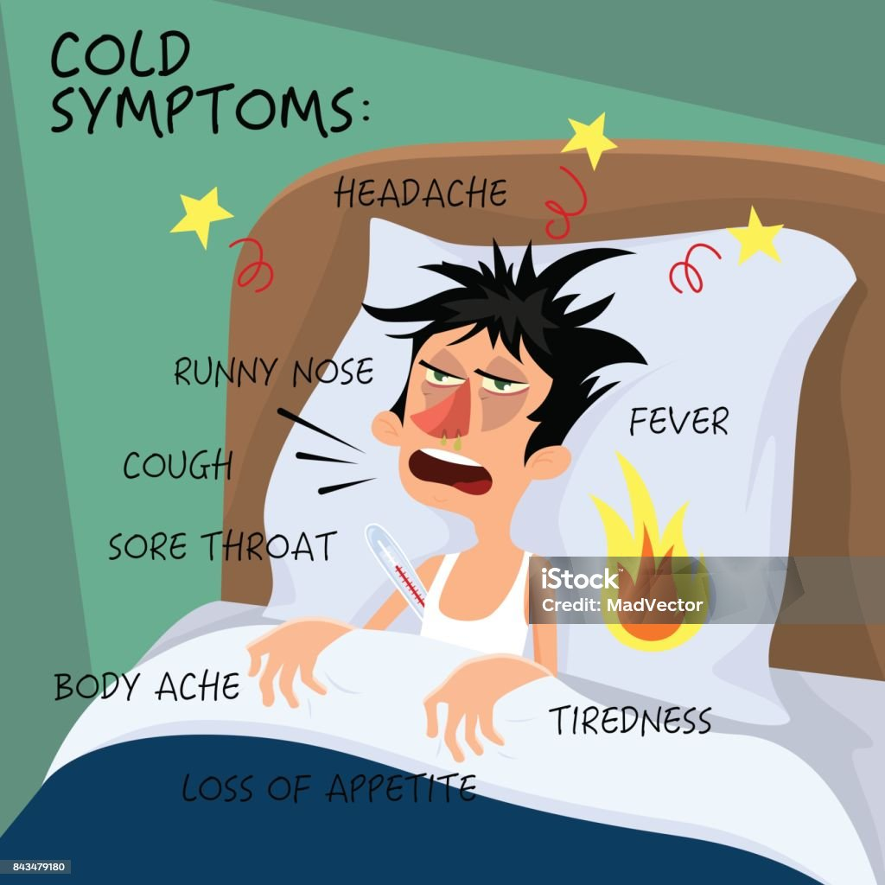
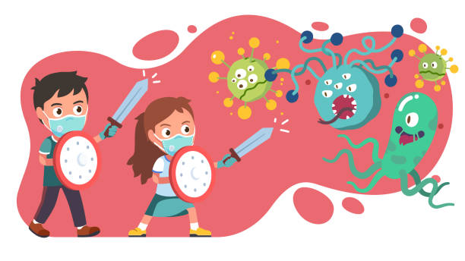
Educational Goals
We will learn:
✓ What cleanliness and hygiene mean
✓ Why personal hygiene is important for health
✓ Basic hygiene habits (handwashing, brushing teeth, clean clothes)
✓ How germs spread and how to prevent illness

Slide 3
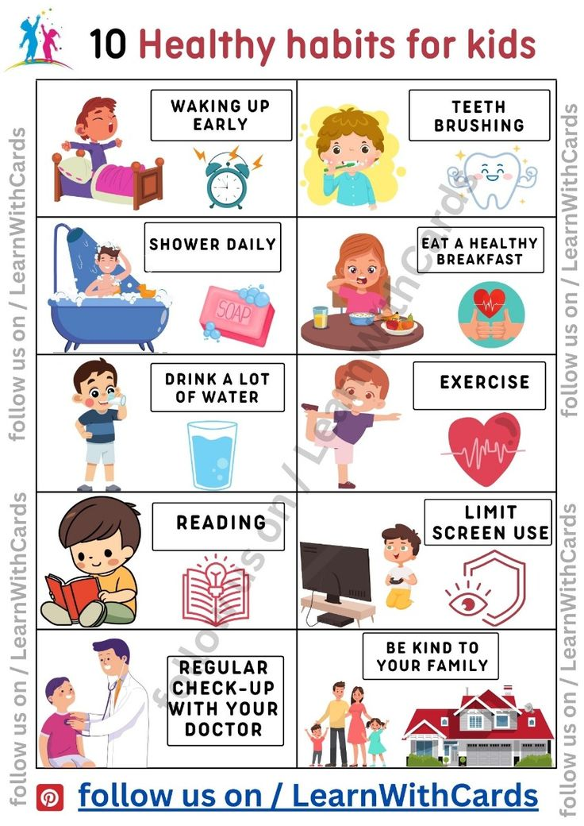
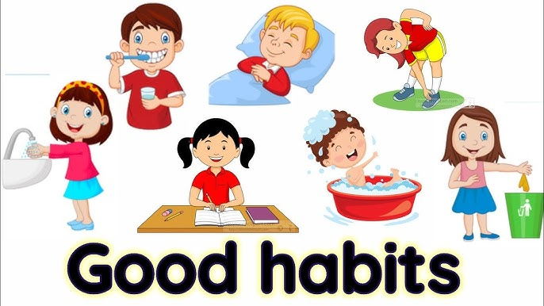
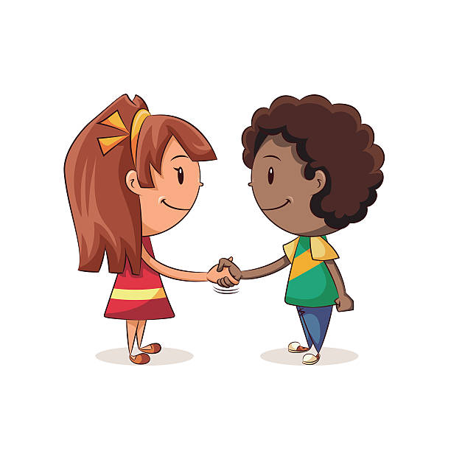
Formational Goals
We will learn:
✓ Develop healthy daily routines
✓ Take responsibility for their own body
✓ Respect others by staying clean
✓ Build self-care habits
✓ Connect physical cleanliness with well-being
✓ Practice discipline and responsibility

Slide 4
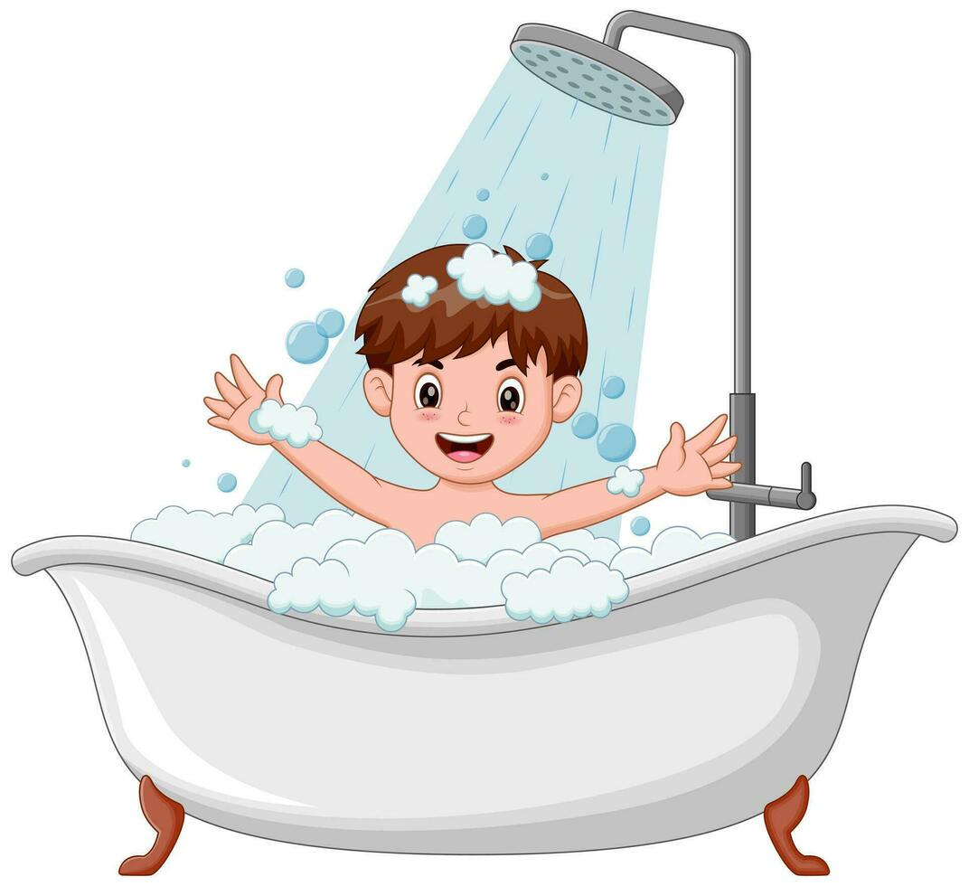

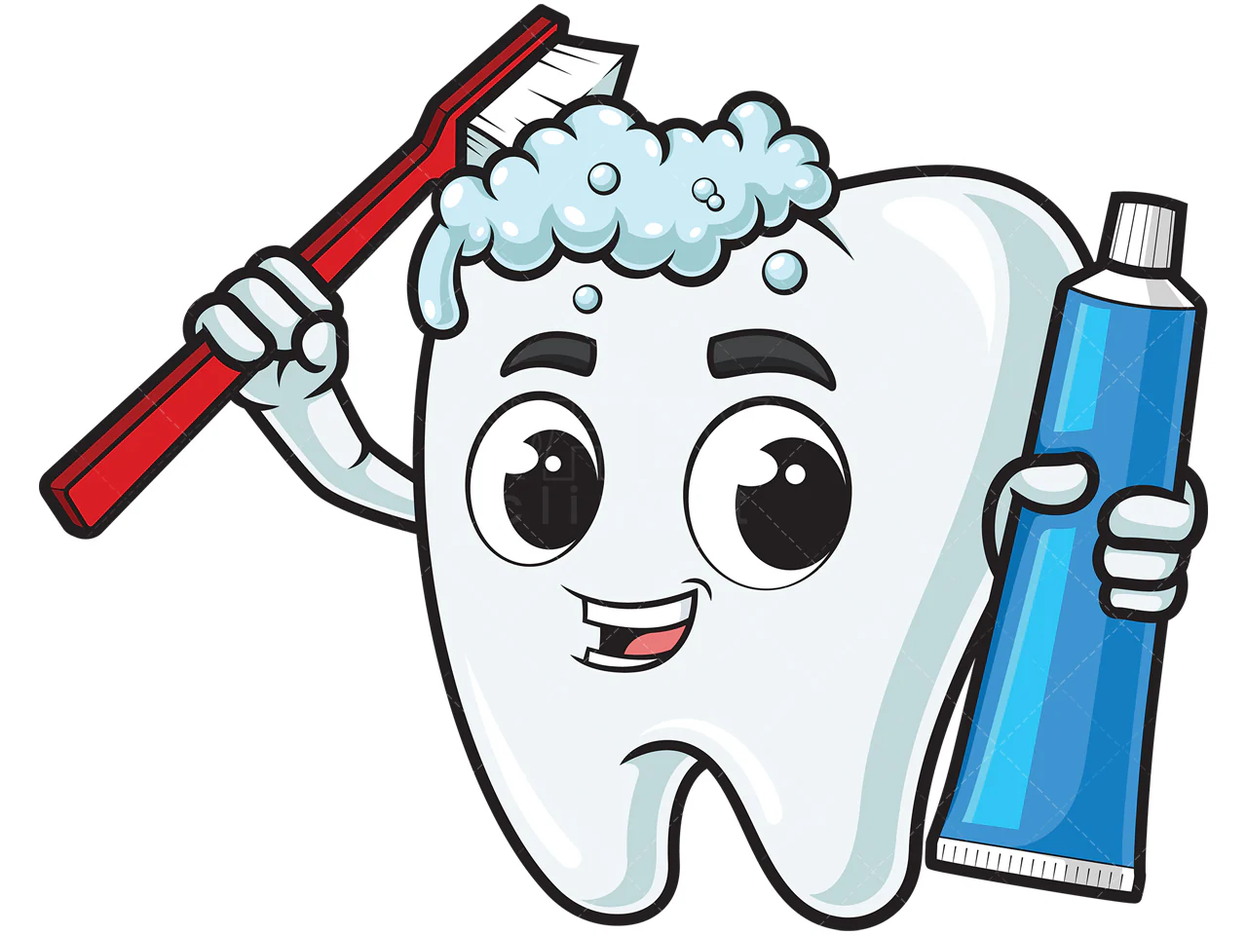
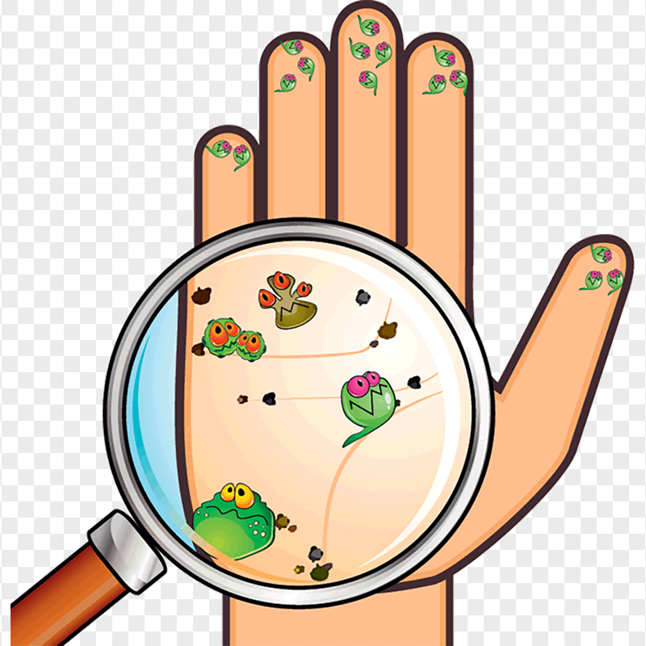
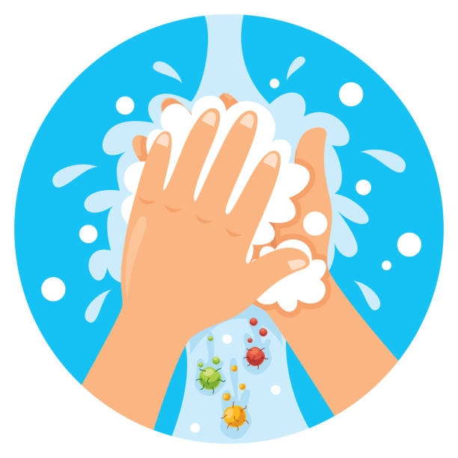
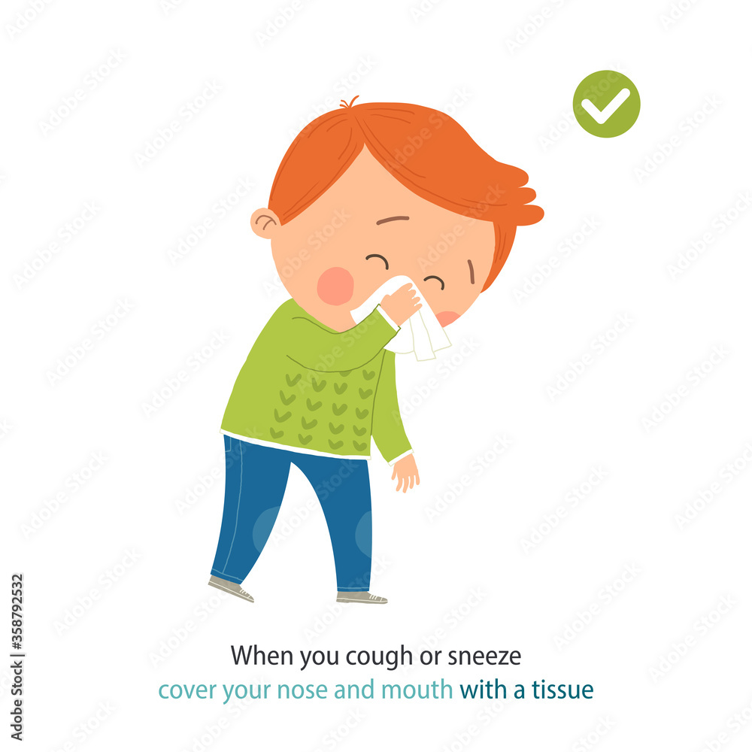
Basic terms
Cleanliness - the habit of keeping your body, clothes, and surroundings neat, tidy, and free from dirt or germs to stay healthy.
Hygiene - practicing daily habits to keep their bodies clean and healthy.
Germs - tiny living things, too small to see without a microscope, that live all around us in the air, water, and on surfaces.
Health - feeling good in body, mind, and spirit, not just being free from sickness.
Habit - a behavior or action that you repeat regularly, often without thinking about it.
Body care - the daily practice of maintaining personal hygiene and physical health to ensure well-being.

Slide 5
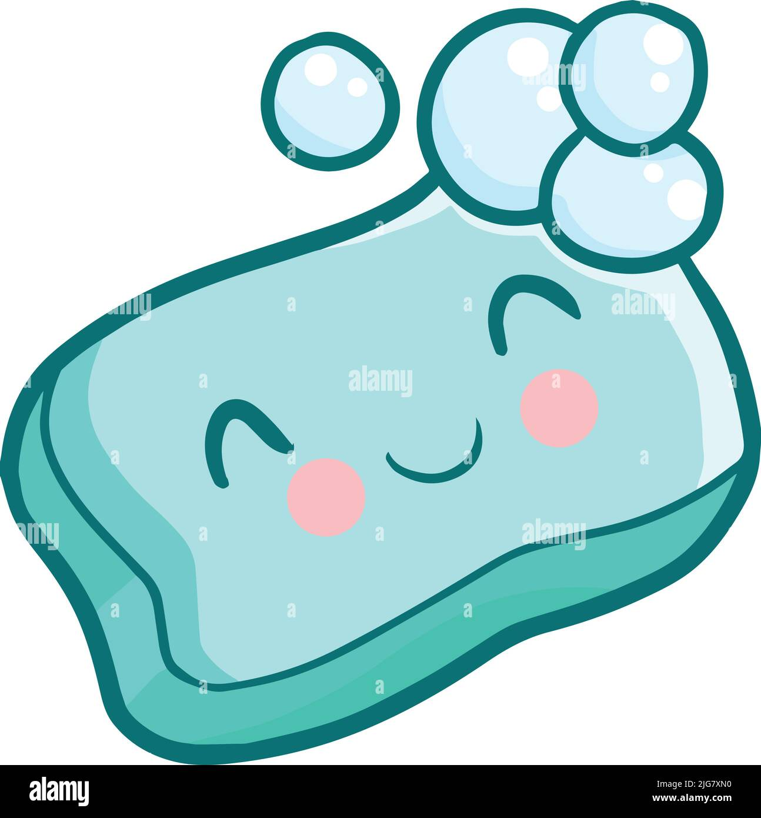
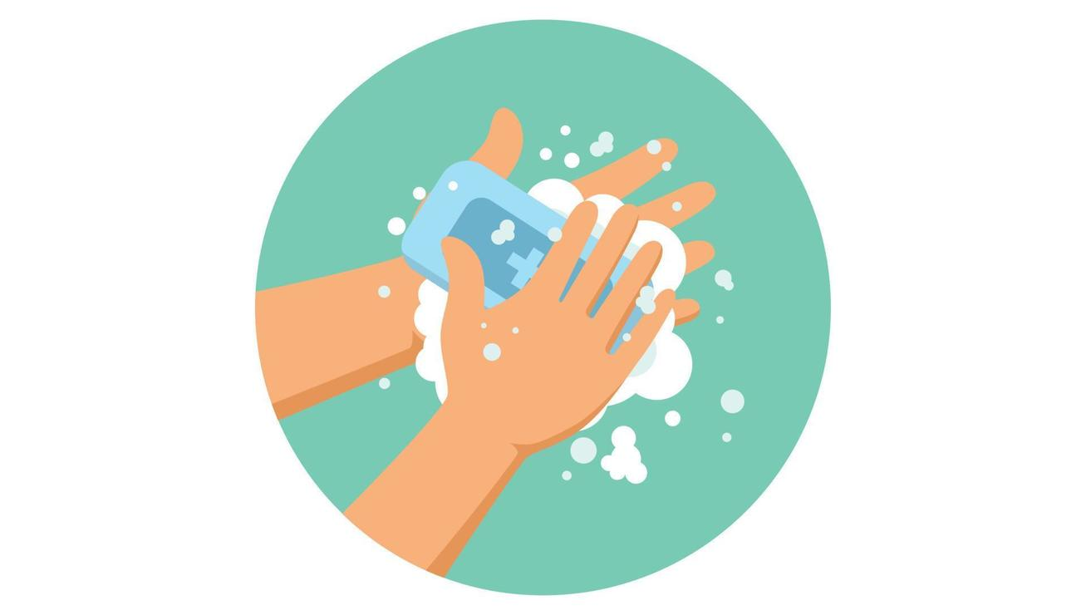
,,The Little Drop of Soap’’
Story
A little drop of soap lived near a sink.
One day it said, “I am too small. I don’t matter.”
But when children washed their hands, the soap helped chase away invisible germs.
The children stayed healthy and happy.
The soap learned that even small habits protect the whole body.
Notes:
NOTE: To change images on this slide, select a picture and delete it. Then click the Insert Picture icon in the placeholder to insert your own image.

Slide 6
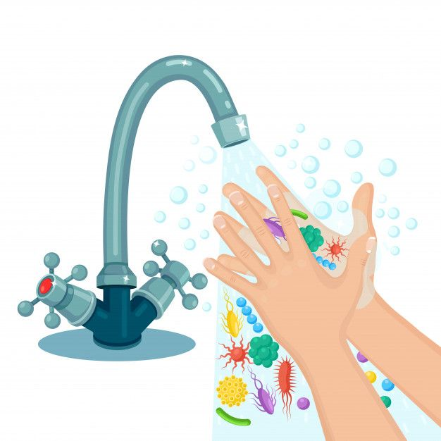
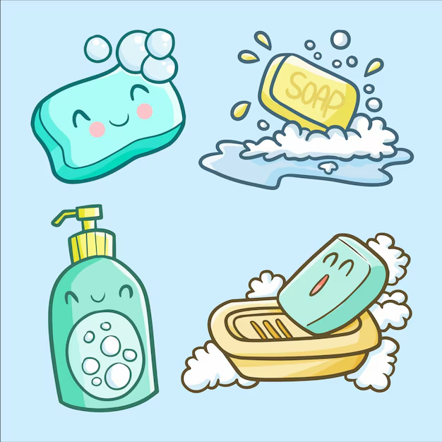
• Why was the soap important?
• Can we see germs?
• How do small habits help us stay healthy?
Notes:
NOTE: To change images on this slide, select a picture and delete it. Then click the Insert Picture icon in the placeholder to insert your own image.

Slide 7
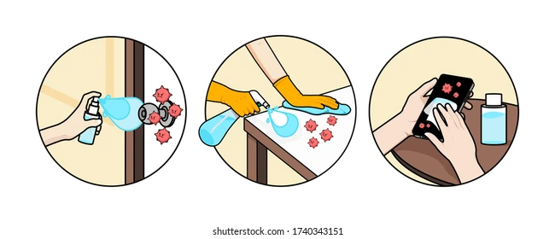
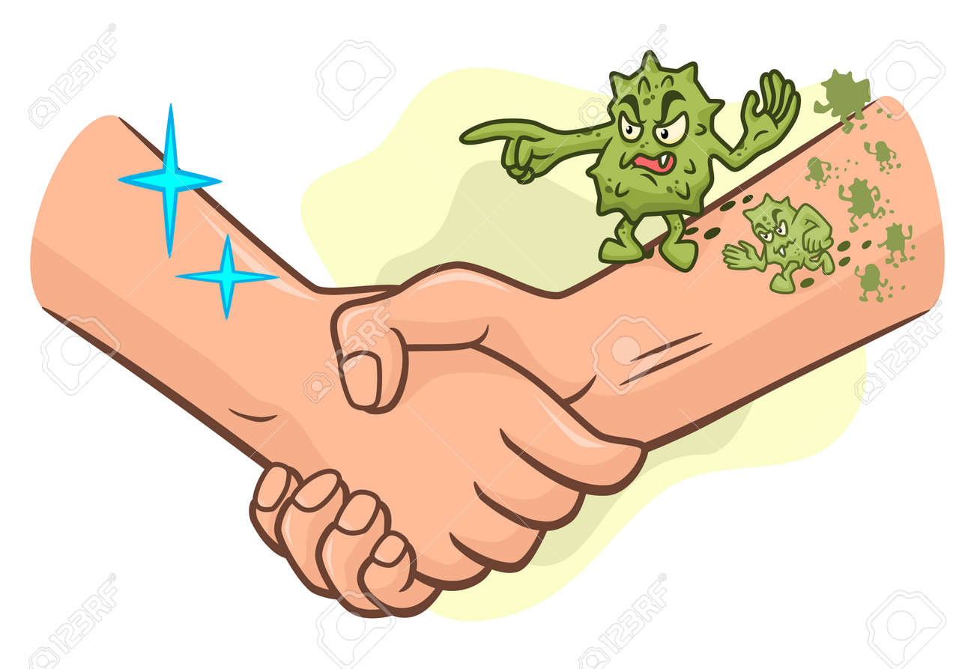
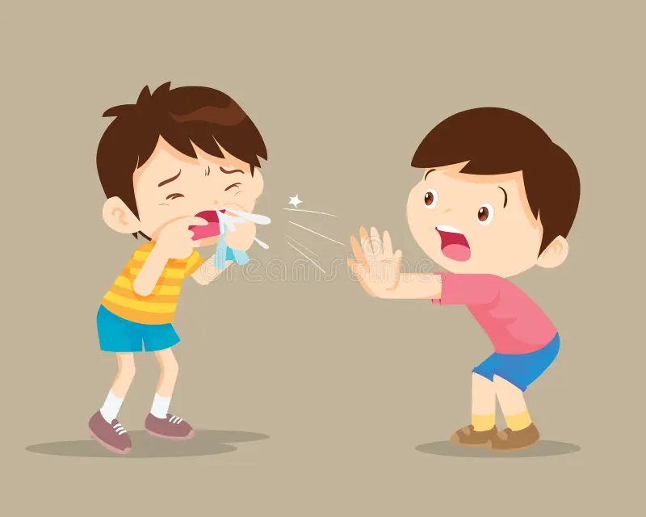
• Dirty hands
• Sneezing and coughing
• Unclean surfaces
Germs are tiny organisms that can cause illness.
They spread through:
Notes:
NOTE: To change images on this slide, select a picture and delete it. Then click the Insert Picture icon in the placeholder to insert your own image.

Slide 8
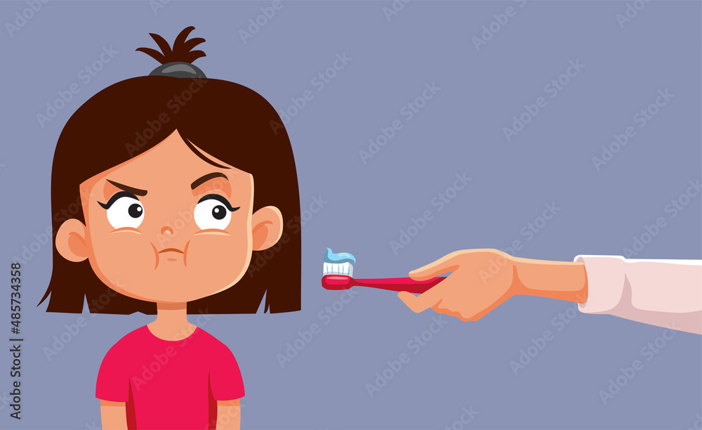
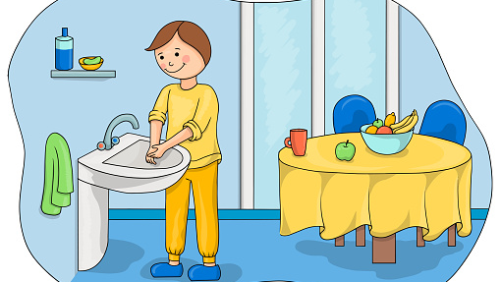
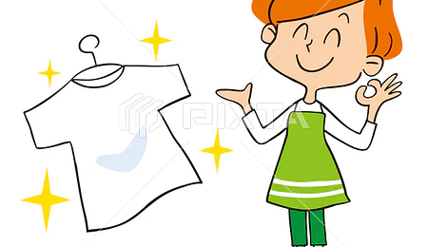
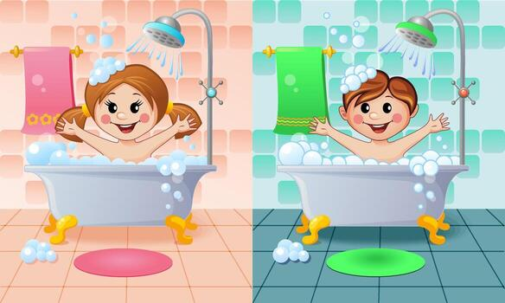
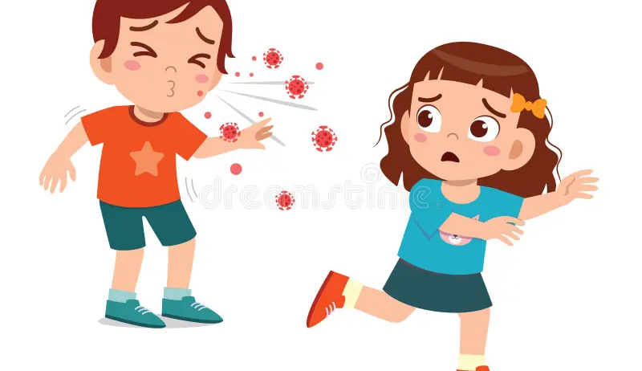
Clean or not clean?
Notes:
NOTE: To change images on this slide, select a picture and delete it. Then click the Insert Picture icon in the placeholder to insert your own image.

Slide 9
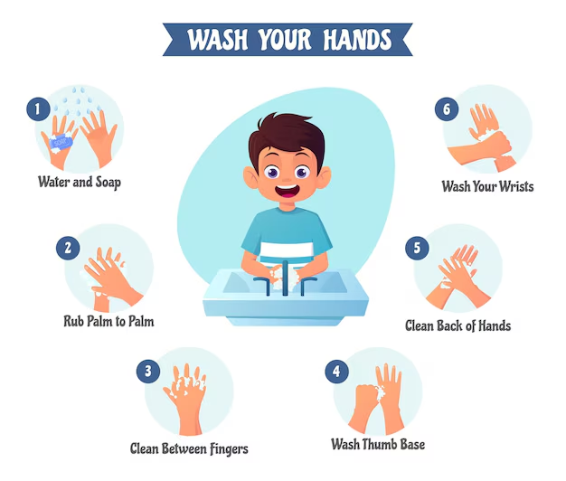
“How to Wash Hands Properly”

Slide 10
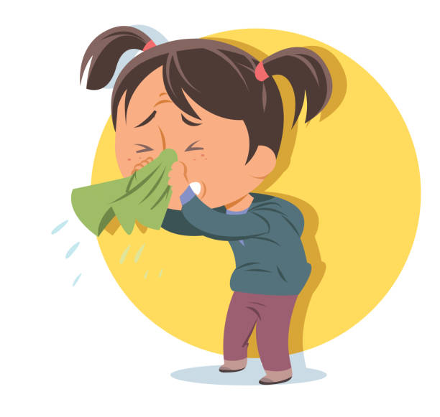
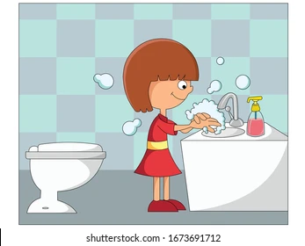
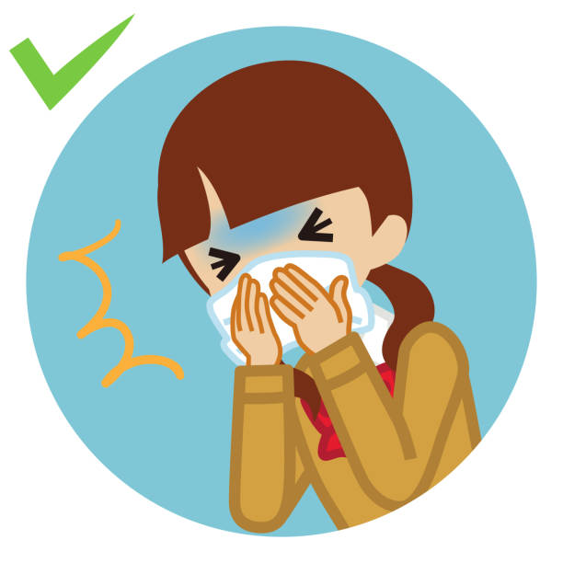
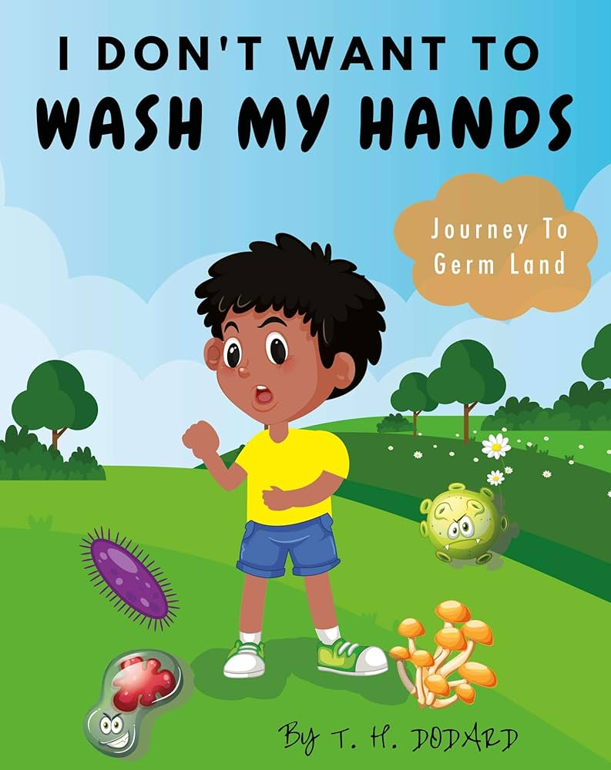
“Stop the Germs!”
clap if the action stops germs.
stay silent if it spreads germs.
– Washing hands after the toilet
– Sharing a dirty tissue
– Covering mouth when coughing
– Not washing hands before eating

Slide 11
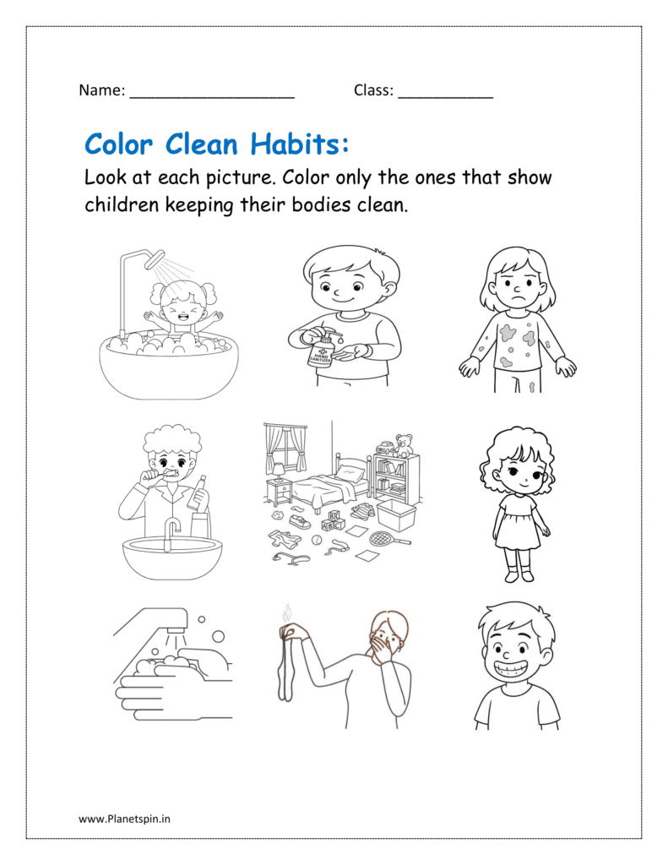
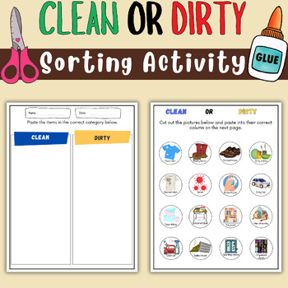
Worksheet -,,My Clean Day’’
-Color the clean habits
-Match pictures to ,,clean’’/,,not clean’’
-Draw yourself doing one hygiene habit

Slide 12
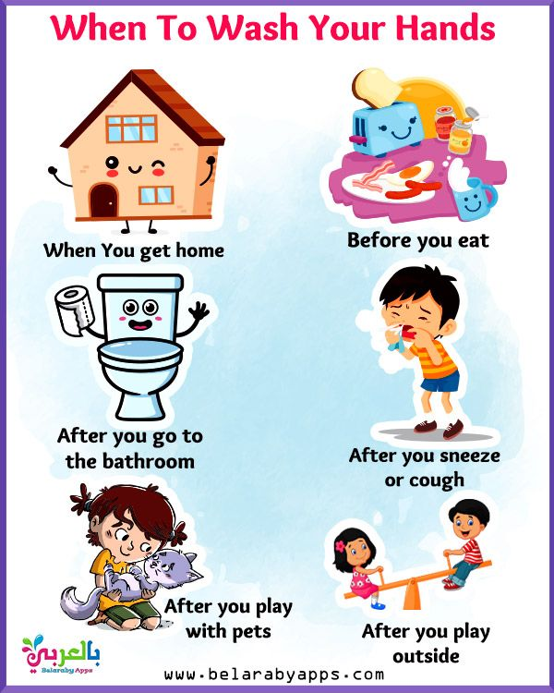
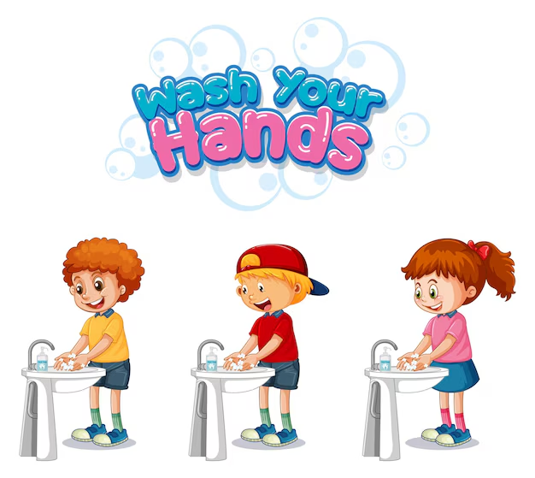
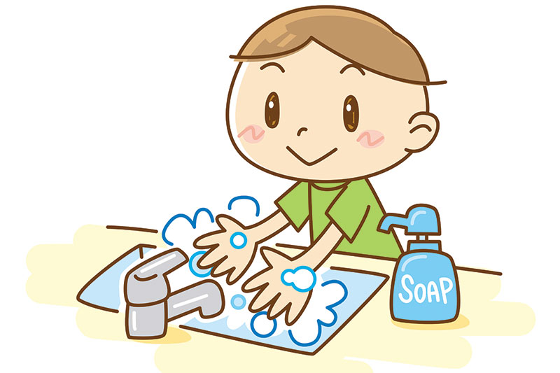
Reflection circle
• “I stay healthy when I…”
• “One clean habit I will practice every day is…”
Taking care of your body is a way to respect yourself and others.

Slide 13
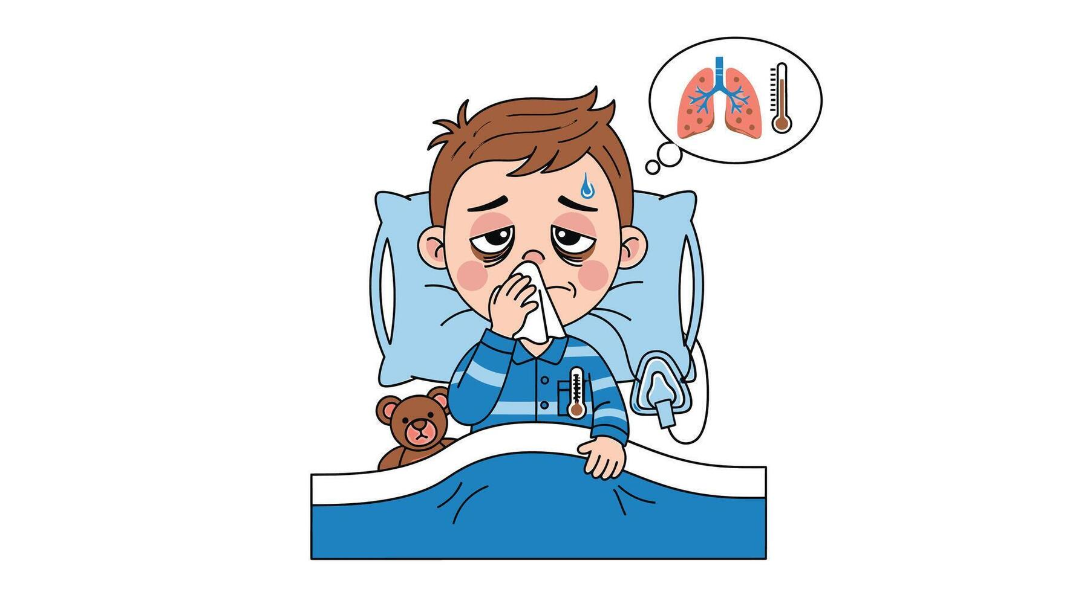
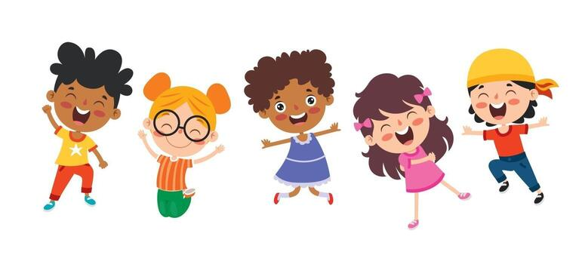
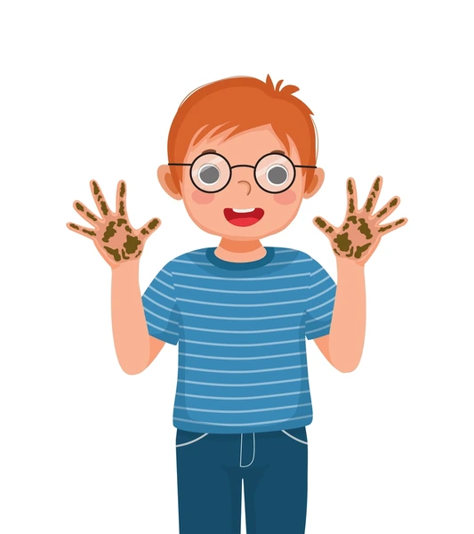
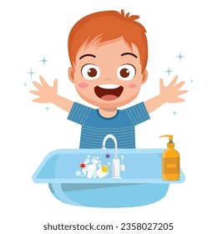
The dirty hands
A child did not wash hands and became sick.
Hygiene protects health.

Slide 14
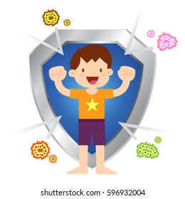
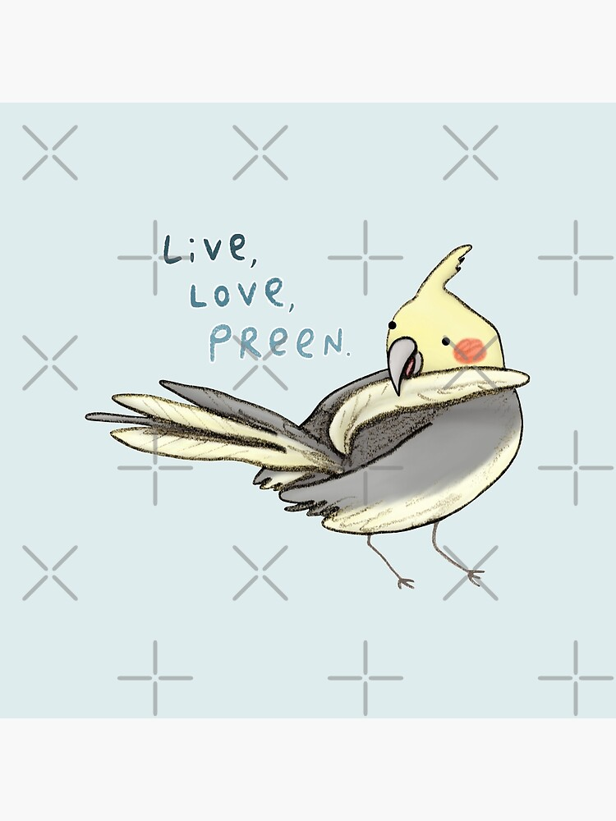
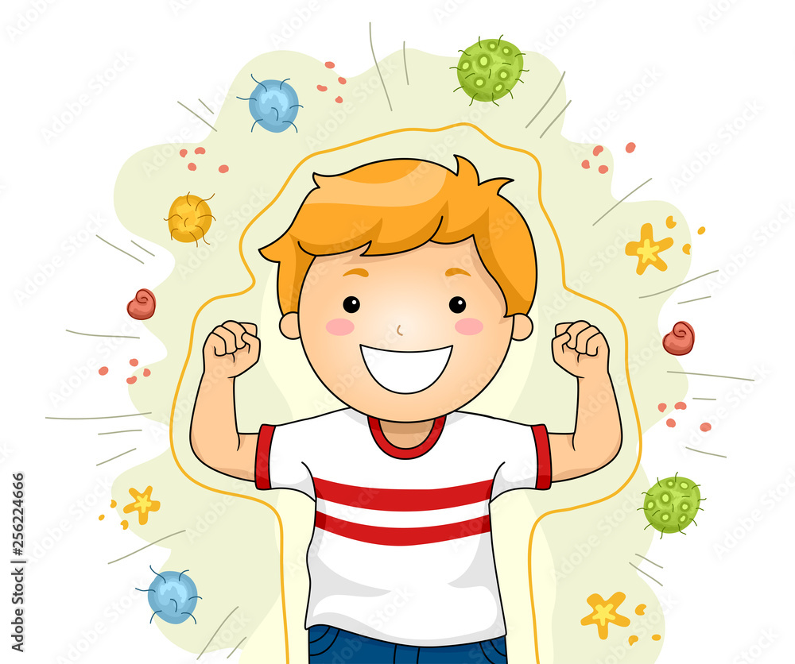
The clean bird
A bird cleaned its feathers daily and stayed strong.
Care brings strength.

Slide 15
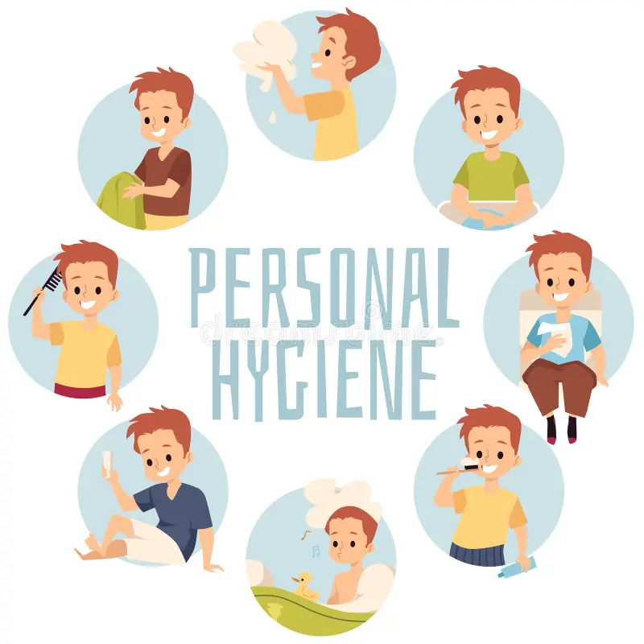
Personal hygiene is very important and it does not include one thing.
When we take care of our hygiene we take care of our health and that of others.

