Slide 1
Contemporary Greece
History: 19th – 20th cent.
Anna Karakatsouli
ankaraka@theatre.uoa.gr

Slide 2
19th century
Building a modern State

Slide 3
Modern Greek History
In 1830, the Kingdom of Greece was established.
This era was marked by revolutionary upheavals across Europe, including in France, Belgium, the Italian States, the German Confederation, and Poland.
The process of nation-building unfolded:
  The historical background served as a foundation for national pride and a key reference point in shaping national identity.
  The strength and endurance of Greek culture and traditions persisted through various invasions and foreign occupations, evident in language, folk songs, and religion.
  There emerged a strong conviction of a unique national mission that bridged the East and West.

Slide 4
Recurring Themes of the 19th Century
Active role of Great Powers, foreign dependency
Definition of Greek identity at the crossroads of Asia, Africa and Europe
Creating a national state and expanding its borders to include all Greek nationals (“Megali Idea”)
Role of the Greek Diaspora
Constant strive for the modernization of the Greek society/State/economy

Slide 5
Mid-15th century - 1821: Under Ottoman rule
Ottoman Empire, a theocracy
  Sultan, divine-right absolute ruler
  Darülislam, the domain of the faithful, i.e., Moslems,
  Darülharb, the domain of war, the non-Moslems subdivided into millets
    Jewish, Gregorian Armenian, Catholic, Orthodox (Millet-I Rum) millets
Millet system based on religious confession rather than ethnic origin

Slide 6
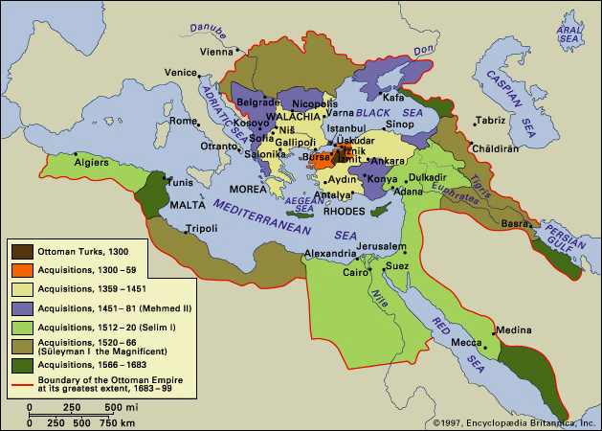
Imperial history of the Middle East

Slide 7
Under Ottoman rule
Decentralized empire, autonomy of local communities
  Orthodox priests and Christian notables collected taxes, settled disputes, and effectively governed at the local level
Arbitrary character of Ottoman rule, heavy taxation, inferior status of non-Muslims
Complexity and much room for abuse, protection through interpersonal bonds of patronage
Sporadic revolts against Ottoman rule, klefts
Ottoman religious tolerance
  Orthodox church kept Greek language alive and helped foster a Greek cultural identity

Slide 8
Early 19th century
As the Ottoman Empire waned, there was a notable rise of Greeks, especially the Phanariots, who took on significant positions within the Ottoman administrative system.
This era witnessed the growth of a prosperous and enterprising mercantile class that became widespread and wealthy.
A robust commercial fleet emerged during this time, with notable contributions from Hydra, Spetses, and Psara.
The Napoleonic Wars and the Continental Blockade (1806-1814) led to considerable profits through smuggling operations.
Greek Diaspora communities, referred to as paroikies, expanded throughout the Mediterranean, the Balkans, Central Europe, and Southern Russia.
These communities benefited from the organized commerce that was characteristic of Western Europe.

Slide 9
Modern Greek Enlightenment
Prior isolation of the Greek world from the great Western historical cultural movements (i.e., Renaissance, Reformation, 17th century Scientific Revolution, Industrial Revolution)
A newfound self-consciousness of the Greeks as heirs to a universally admired classical past
Awareness of a specifically Greek rather the merely Orthodox Christian identity
Transfer of the ideas of the French Enlightenment and the French Revolution
Adamantios Korais, Rigas Velenstinlis

Slide 10
Diaspora
A significant number of Greek merchants and artisans established themselves in Romania, along the Black Sea coast, and in major cities across the Empire.
Greeks progressively dominated trade interactions between the Empire and foreign nations.
The Greek diaspora engaged with Western intellectual movements and concepts.
There was financial backing for educational institutions and charitable organizations in Ottoman Greece.
A dual identity encompassing both Balkan and Mediterranean influences.
The emergence of a distinctly Greek national identity began in the late 18th and 19th centuries.

Slide 11
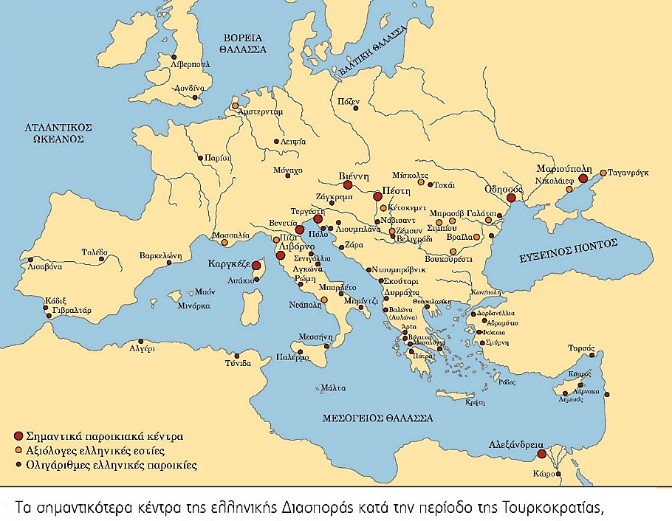

Slide 12
Birth of the Modern Greek State
The Greek War of Independence (1821-1828)
The first major successful war of independence by a subject population against an imperial power since the American Revolution of 1776
The first successful nationalist uprising that provided a model for later nationalist struggles in Europe
The first real test of the conservative Concert of Europe that emerged out of the Congress of Vienna in 1815

Slide 13
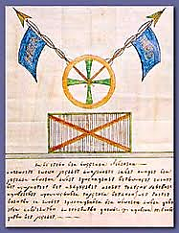
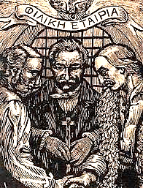
Filiki Etaireia (Odessa, 1814)

Slide 14
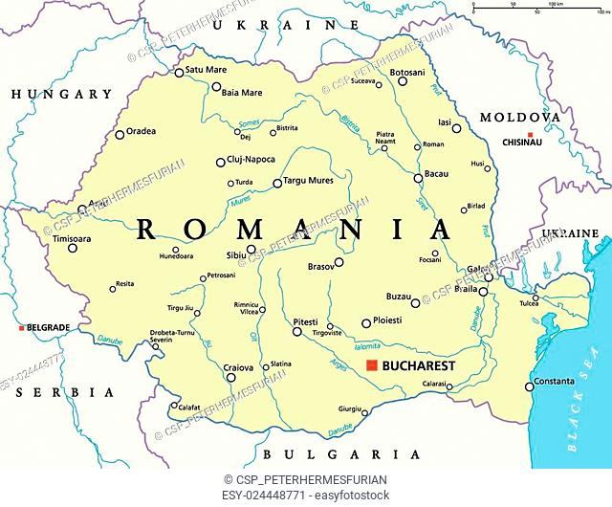
The Greek War of Independence
In February 1821, Alexander Ypsilantis crossed the Prut River, located in present-day Romania.
By March 1821, a full-scale uprising erupted in the Peloponnese.
There was a legacy of guerrilla warfare and naval dominance in the Aegean Sea.
The Western European public showed enthusiasm, leading to a philhellenic movement where supporters volunteered for the Greek cause.
The 1820s witnessed a convergence of liberal revolutions, including those in Spain, Naples, and Sicily in 1820, followed by Piedmont and Greece in 1821, and Brazil in 1822.

Slide 15
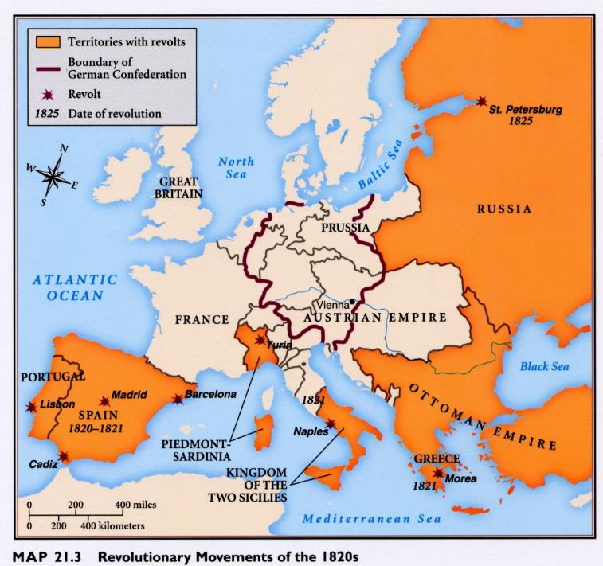

Slide 16
The Greek War of Independence
To gain support among European Powers Greek cause cast not as a national struggle based on liberal principles, which would have won few supporters in post-Napoleonic Europe, but as a religious conflict of an oppressed Christian population against their Islamic oppressors
Ongoing political unrest in Portugal, Spain, Piedmont, Naples, and Belgium
December 1821, Epidavros National Assembly, after weeks of intense debate, passes a national constitution, modelled on the 1795 French one
  A democratic republic founded on the principles of civil liberties and equality for all

Slide 17
The Greek War of Independence
1823, creation of a unified government
1824-25, fractional intrigue and civil war. Clash between modernizers and traditional elites
  19/4/1824, death of Lord Byron at Missolonghi
  1825, Ibrahim Pasha of Egypt invades the Peloponnese. “Act of Submission” to the Great Britain
  10/4/1826, fall of Missolonghi after long siege
4/4/1826, Anglo-Russian Protocol of London:
  Greece to become an autonomous state within the Empire, and to pay a tribute to the Porte. Its ruler to be designated by the Sultan. In return, the Sultan was to withdraw his troops.

Slide 18
The Greek War of Independence
May 1827, Ioannis Kapodistrias elected as the first Governor (Kyvernitis) of Greece
July 1827, the Treaty of London signed by Great Britain, the Russian Empire and France, called for an immediate armistice
October 1827, Battle of Navarin (“The last great battle of the age of sail”). Defeat of the Ottomans by the combined British, French and Russian fleets
3.2.1830, Protocol of the Independence (London)
  Greece should be a hereditary monarchy, whose king should be drawn from one of the royal houses of Europe not directly connected with those of the ‘Protecting Powers’, i.e., Russia, France and the United Kingdom
Ioannis Zelepos, Greek War of Independence (1821–1832), EGO

Slide 19
The Kingdom of Greece
Greece not a party to the Treaty of May 1832 that fixed the terms of the new king’s rule. Country placed under guarantee of the three ‘Protecting Powers’ (Russia, England, France)
February 1833, arrival in Nafplion of King Otto of Wittelsbach, the 17-year-old 2nd son of King Ludwig of Bavaria
Greece lacked the basic infrastructure of a state. Great damages after ten years of warfare, devastated economy
The state contained within its borders less than one-third of the Greek population of the Middle East. Dominant irredentist policy of ‘Great Idea’ (Megali Idea)
Greece as a European project

Slide 20
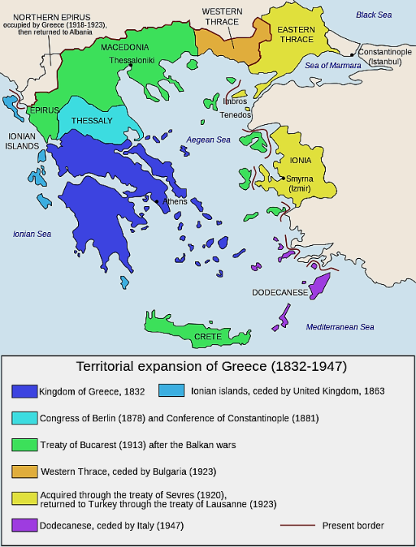

Slide 21
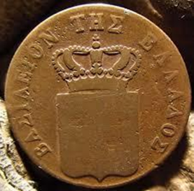
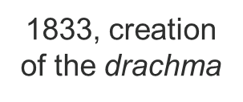
King Otto’s rule (1832-1862)
1832-1835: Regency (strong and much resented Bavarian influence – ‘Bavarocracy’)
Introduction of western European models for law, education, Church status. Legal and educational systems were thus heavily influenced by German and French models
  Onerous tax burdens
  Little sensitivity to Greek traditions and communal organization
  Party politics dominated by the Great Powers (‘French’, ‘English’ and ‘Russian’ party)
September 1834, Athens becomes the capital of the new Kingdom
  Fixation on classical past
  Katharevousa
  Neoclassical style
1835-1843: Absolute Monarchy

Slide 22
King Otto’s rule (2)
Otto’s firm refusal to grant a Constitution, as had been provided for in the negotiations preceding independence
  Growing disaffection among the Greek people
Conspiracies and popular messianic prophecies
Resentment against heterochthons
3/9/1843, military coup enjoying widespread popular support
March 1844, promulgation of the Constitution (Syntagma)
  Instauration of a liberal parliamentary regime, universal manhood suffrage
1843-1862: Constitutional Monarchy

Slide 23
Otto’s overthrow (1862)
Parliamentary dictatorship, extensive use of patronage. Unpopular foreign policy
1854, outbreak of the Crimean War
Unrest at the northern borderline. Infiltration of Thessaly, Epirus and Macedonia by armed guerilla bands from Greece
May 1854 - Feb. 1857, blockade of Piraeus by British and French vessels to defend the integrity of the Ottoman empire. Cholera epidemic (casualties 1/10 of the population)
Otto had still not converted to the Orthodox church, nor had he an heir.
1862, coup by the garrison of Athens

Slide 24
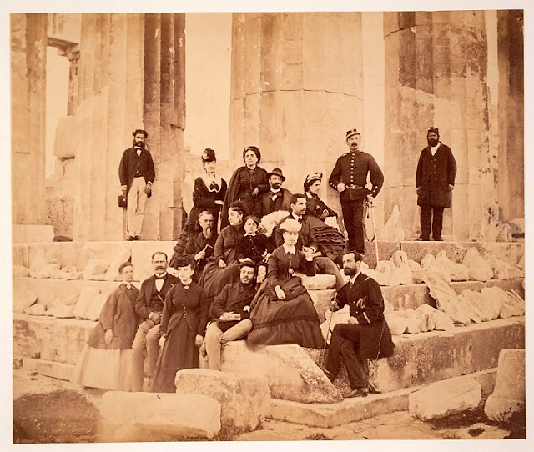
Tourists on Parthenon, Athens, Greece, circa 1860

Slide 25
2nd half of 19th century: Main issues
Political life
  Principle of the declared confidence of the Parliament, obliging the king to appoint the leader of the party with a plurality of parliamentary votes as the Prime Minister (“dedilomeni”).
  Role of the Palace
National question
  Inner affairs: Modernization
  Foreign affairs: Irredentism (Crete, Macedonia)
Social issues
  Currant crisis, Thessaly farmers
  Emigration
  Mass demonstrations, the first strikes

Slide 26
Constantine Paparrigopoulos (1815-91)
1830s, Jacob Philip Fallmerayer debate
  The ancient, "Hellenic", population of the south Balkans would have been replaced by Slavic peoples during the Migration Period (Geschichte der Halbinsel Morea)
  The race of the Hellenes has been wiped out in Europe. Physical beauty, intellectual brilliance, innate harmony and simplicity, art, competition, city, village, the splendour of column and temple — indeed, even the name has disappeared from the surface of the Greek continent.... Not the slightest drop of undiluted Hellenic blood flows in the veins of the Christian population of present-day Greece.
1860-77, History of the Greek Nation
  Tripartite examination of historical periods: Antiquity, Byzantium, Modern Greece
  Instead of revival, continuity of the Greek nation from the classical past to present
  Byzantine empire becomes the model for Greece’s territorial expansion

Slide 27
King George I of the Hellenes
1864, Britain cedes the Ionian Islands to Greece
New constitution amplifies the democratic freedoms conceded in 1844
State remains the most important source of employment
Patron-client political system, shifting coalitions and unstable governments
  Till 1875, King George had the power to appoint or dismiss ministers
  1875, the majority leader should form the government
Open society, freedom of the press

Slide 28
Modernization
Two-party system
Kharilaos Trikoupis (“New Party”)
  The leading modernizer of the second half of the century, austere reforming programs
  The strengthening of the state as basic precondition of territorial expansion
  Westernizing policy
Theodoros Deliyannis (“National Party”)
  Flamboyant populist rhetoric, enthusiastic supporter of a ‘Greater Greece’; traditionalist politician

Slide 29
Population growth
 | Area (km²) | Population | Urban (> 10.000 ) | Semi-urban (2.000-9.999) | Rural (< 2.000 )
1870 | 50.211 | 1.457.894 | 8,65 % | 15,83 % | 75,52 %
1896 | 63.606 | 2.433.806 | 13,65 % | 17,36 % | 68,98 %
1907 | 63.211 | 2.631.952 | 16,59 % | 16,11 % | 67,30 %
1920 | 149.150 | 5.531.474 | 19,78 % | 22,23 % | 57,99 %
2011 | 131.990 | 10.787.690 | 46 % | 11 % | 43 %
Source: Χρήστος Χατζηιωσήφ (επιμ.), Ιστορία της Ελλάδας του 20^{ού} αιώνα, τ. Α₁: Οι Απαρχές, 1900-1922, Βιβλιόραμα, χ.χ, σ. 42

Slide 30
Larger Greek Cities
 | 1870 | 1879 | 1889 | 1896 | 1907
Athens | 44.510 | 65.499 | 110.262 | 123.001 | 167.479
Piraeus | 10.963 | 21.618 | 34.327 | 50.200 | 72.579
Patras | 16.642 | 25.494 | 33.529 | 37.985 | 37.724
Tripoli | 7.020 | 10.057 | 10.698 | 10.465 | 10.789
Lamia | 4.873 | 5.506 | 6.888 | 7.414 | 9.685
Source: Γ. Β. Δερτιλής, Ιστορία του ελληνικού κράτους, 1830-1920, τ. Α΄, Εστία, ³2005, σ. 244

Slide 31
Trikoupis’ modernization projects
Land distribution (formerly Ottoman-held land and monastic properties). Large number of small family farmers, self-sufficiency rather than marketability
Reform of public sector
Expansion of public education
Extensive public works program
Great strain on weak Greek economy. Heavy taxation and indebtedness. State bankruptcy (1893)

Slide 32
Trikoupis’ public works programme
Corinth canal
Draining of the Lake Copais (Thessaly)
Development of communication networks (railways, motorways, telegraph, post office) to facilitate exports
Establishment of cotton, wool and olive oil refining mills

Slide 33
Foreign policy
Irredentist concept known as ‘Megali Idea’
Greece's role within the context of the ‘Eastern Question’
Participation in the crisis of 1875-78, with the Great Powers concerned about Russia's support for a ‘Great Bulgaria’
In 1881, the Congress of Berlin resulted in the transfer of the fertile region of Thessaly and part of Epirus to Greece, effectively doubling its population and expanding its territory by 32%
Several conspiracies orchestrated by Greek nationalist secret societies
Recurrent uprisings on the island of Crete aiming for union (Enosis) with Greece, occurring in 1841, 1858, 1866-9, 1877-8, 1888-9, and 1896-7

Slide 34
Foreign policy (2)
Competing nationalisms in Macedonia claimed by Greeks, Bulgarians and Serbs
1870, creation of an independent Bulgarian Church (Exarchate)
Fluid frontier zone, movements of rebels and brigands
Escalation to armed struggle between guerilla bands, infiltration by armed warriors into Epirus, Thessaly and Macedonia
Intense popular pressure

Slide 35
1897 Greco-Turkish War
1897, general mobilization and declaration of war to the Ottoman empire over the status of Crete
  “Unfortunate war” (Ατυχής Πόλεμος)
Greece wholly unprepared for war, humiliating defeat in 30 days
Greece forced to cede minor border areas and pay heavy reparations
  International Financial Commission that remained in Athens till 1936
  Rather positive IFC action for public administration
An autonomous Cretan State under Ottoman suzerainty was nevertheless established the following year, owing to the intervention of the Great Powers after the war

Slide 36
Social/agrarian issues
Currant Crisis
Between 1861 and 1863, the phylloxera epidemic devastated French grapevines, leading to a significant increase in vine production in the Peloponnese.
As a result, currants emerged as the primary export commodity for Greece.
By 1893, the epidemic in France came to an end, resulting in a decline in demand that left Greek vine producers in dire straits.
This situation prompted widespread emigration.
In 1898, King George I visited the Peloponnese, where he was the target of an assassination attempt.
The following year, 1899, saw the establishment of a specialized bank known as Stafidiki Trapeza.

Slide 37
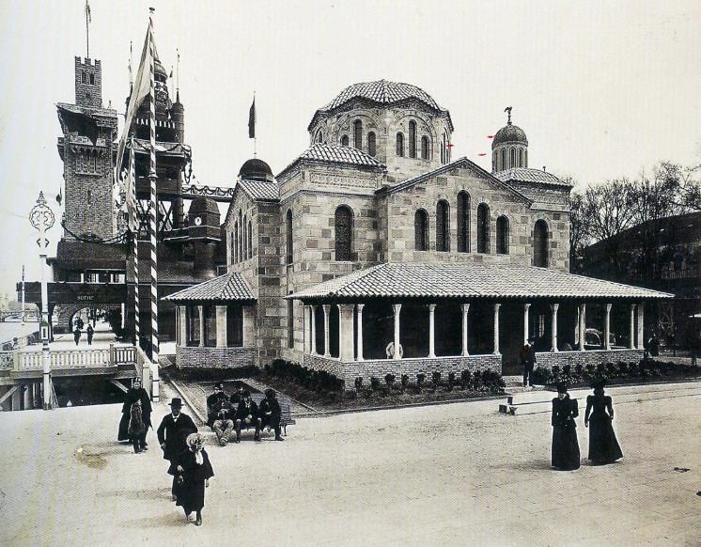
Aghios Sostis, Syggrou ave. (1900)
Exposition Universelle de Paris (1900) - Quai des Nations

Slide 38
Emigration
Mass overseas emigration
  1890-1914, about 350.000 Greeks emigrated (¹/₆ of the entire population)
Male emigration because of poor economic prospects in Greece
Intended to be a short emigration, however most of the migrants became permanently established in their host countries
Remittances constitute thereafter a key element in the balance of payments
Expansion of the notion of "Hellenism" and "Hellenic diaspora" to the ‘New World’

Slide 39
Greek descend immigrants to the USA
 | Men |  | Women
 | Persons | % | Persons | %
1896 | 2.124 | 97,6 | 51 | 2.4
1898 | 2.246 | 96,0 | 93 | 4,0
1900 | 3.655 | 96,9 | 118 | 3.1
1902 | 7.854 | 96,8 | 261 | 3,2
1904 | 12.106 | 95,9 | 519 | 4,1
1906 | 22.266 | 96,3 | 861 | 3,7
1908 | 26.972 | 93,6 | 1.836 | 6,4
1910 | 36.738 | 93,5 | 2.555 | 6,5
Source: Χρήστος Χατζηιωσήφ (επιμ.), Ιστορία της Ελλάδας του 20^{ού} αιώνα, τ. Α₁: Οι Απαρχές, 1900-1922, Βιβλιόραμα, χ.χ, σ. 48

Slide 40
Thessaly issue
Agrarian unrest resulted from shifts in the institutional and social structures following the annexation of new territories.
Within tschiftliks, landowners possessed property that was farmed by peasants under a sharecropping arrangement, receiving a portion of the yield.
This arrangement represented a sort of "ongoing partnership" between the landowner and the peasant.
  As stipulated by Ottoman and customary laws, the peasant was permanently tied to the land, holding a transferable hereditary right to it, in addition to customary rights related to their home, forests, pastures, vineyards, and freshwater sources located within the tschiftliks.
Significant Ottoman landholdings in Thessaly were acquired by magnates from the Diaspora in 1881.

Slide 41
Thessaly issue
Following 1881 annexation landowners enjoyed bare and complete ownership according to the Roman-German law of the Greek State
Absentee landlords
Lack of investment, bad management, high international competition
Strong resistance of land laborers against attempts of eviction
6/3/1910, big peasant rally and uprising in Kileler demanding expropriation and land distribution

Slide 42
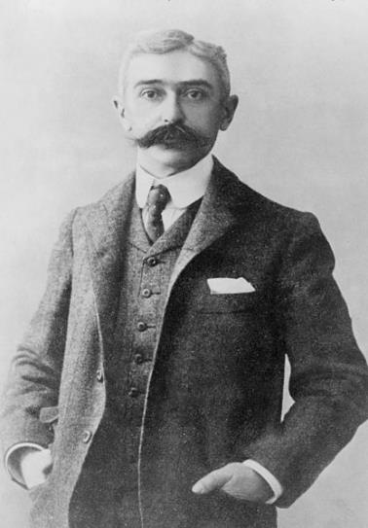
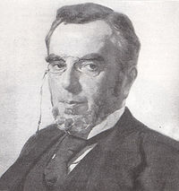
Revival of the Olympic Games
April 6-15, 1896
The first international Olympic Games held in the modern era
Pierre de Coubertin (1863-1937)
Demetrius Vikelas (1835-1908)

Slide 43
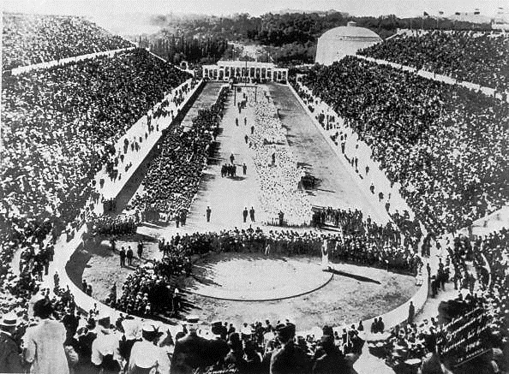
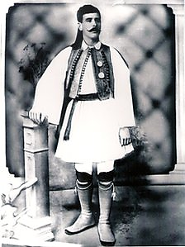
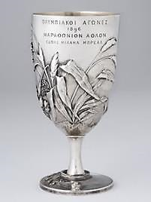
Spyros Louis
1896 Olympics Games Revival

Slide 44
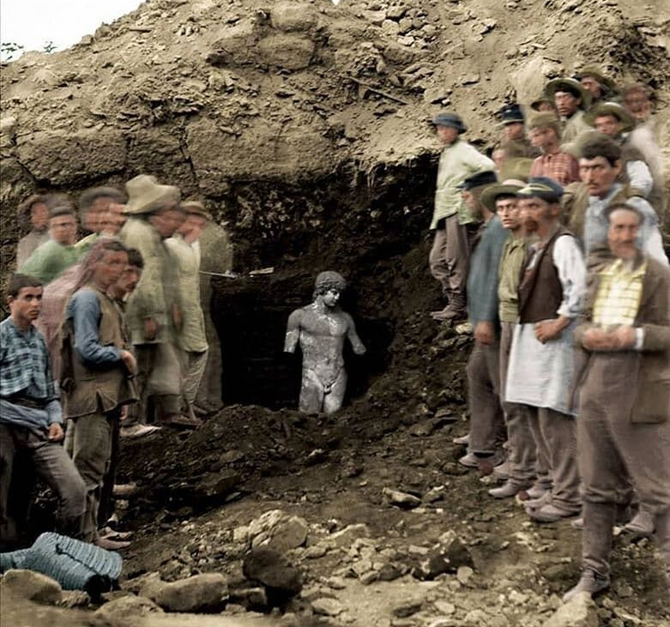
The discovery of the ancient Statue of Antinous found in Delphi, Greece during an excavation in 1894. (Colorized)

Slide 45
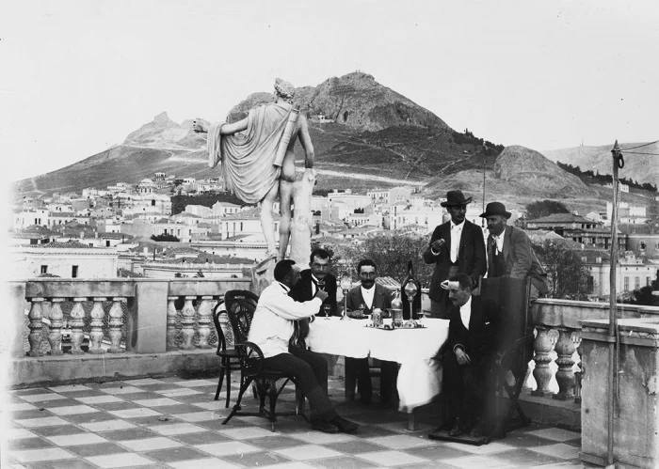
Athens, 1895 (DAI)

Slide 46
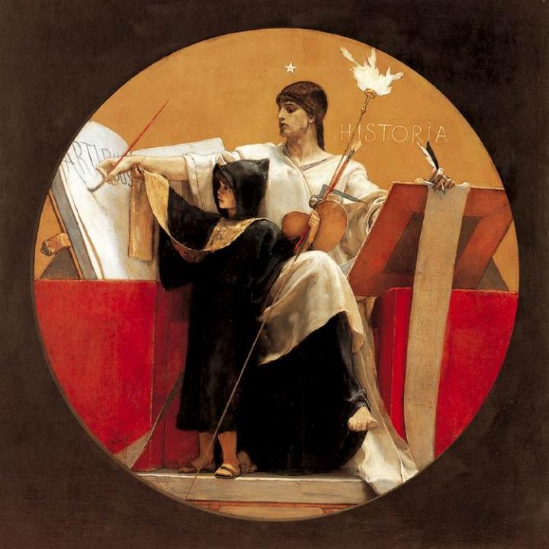
Nicolaos Gyzis, Historia (1892)

