Slide 1
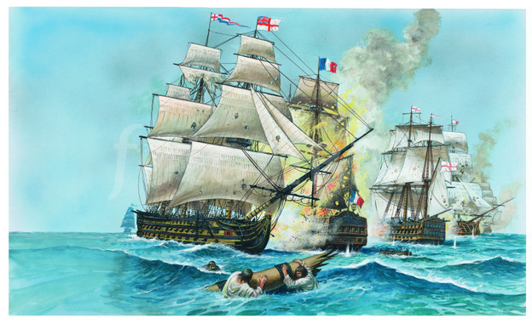

Slide 2
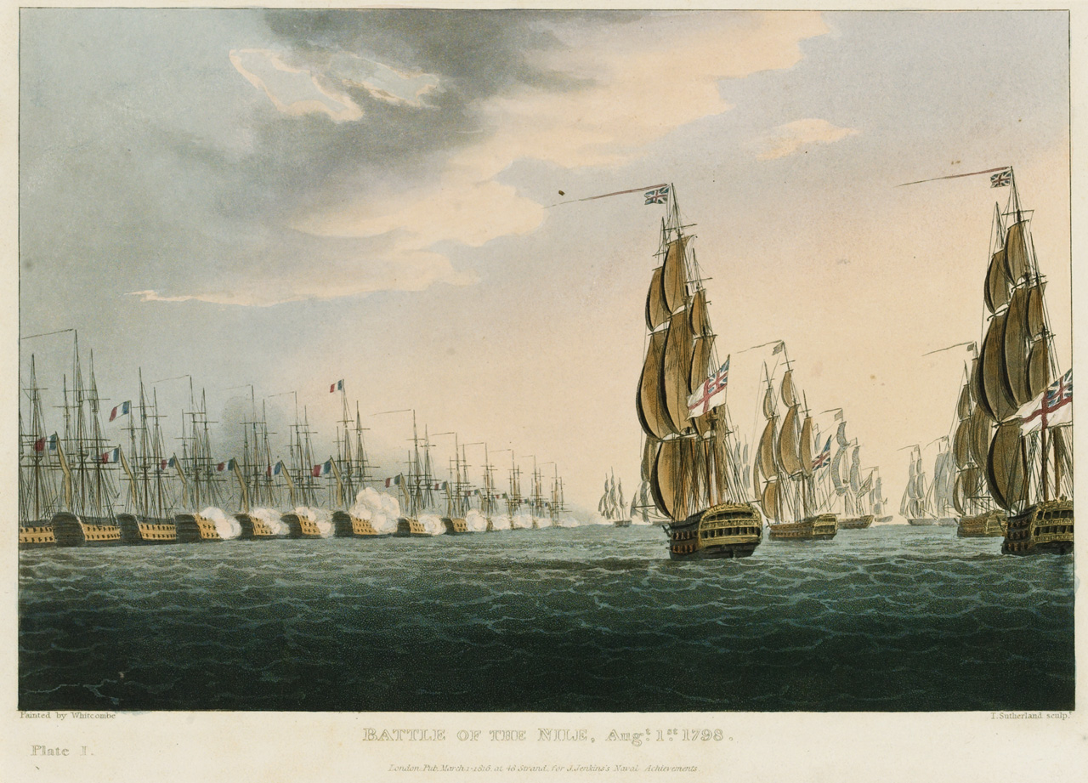
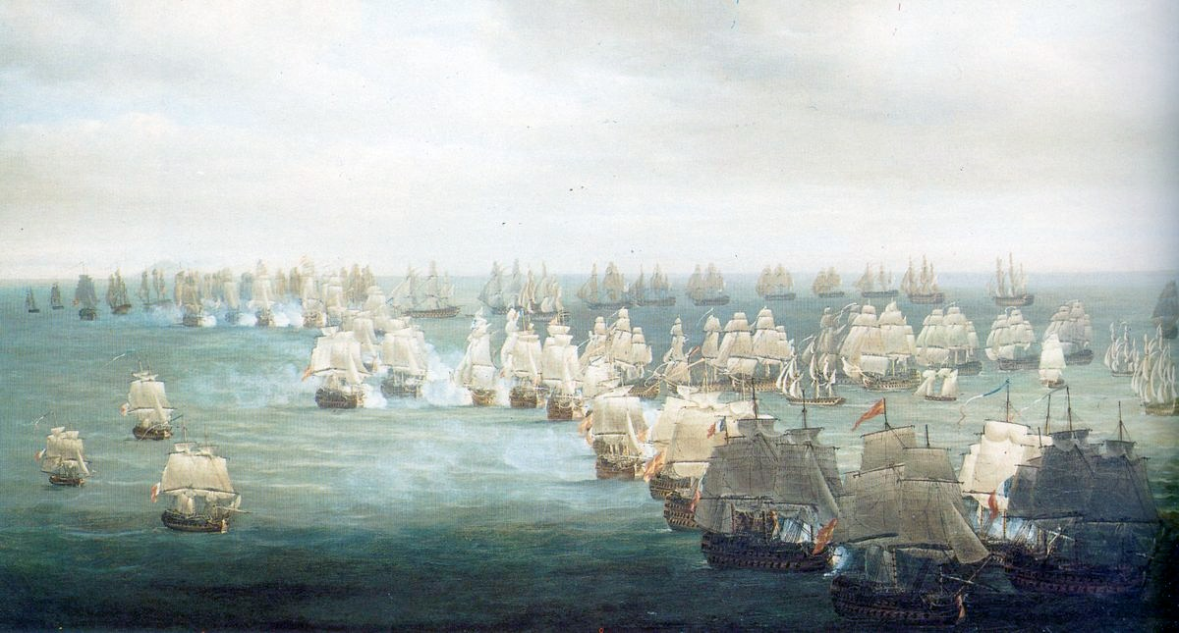
Britain as the very epitome of geopolitics and strategy of a maritime power.
1-3 August 1798: Battle of Aboukir Bay‎, Bataille d'Aboukir‎, معركة أبي قير البحرية‎‎
Decisive Sea Battle; British Admiral Horatio Nelson destroyed French fleet,
thus isolating Napoleon’s army in Egypt, ensuring its ultimate disintegration,
and securing British strategic control of the Mediterranean.
“For 400 years the foreign policy of England has been to oppose the strongest,
most aggressive, most dominating Power on the Continent…
Observe that the policy of England takes no account of which nation it is
that seeks the overlordship of Europe.
The question is not whether it is Spain, or the French Monarchy, or the French Empire,
or the German Empire or the Hitler regime.
It has nothing to do with rulers or nations; it is concerned solely with whoever is the strongest
or the potentially dominant tyrant.” (Sir Winston Churchill)

Slide 3
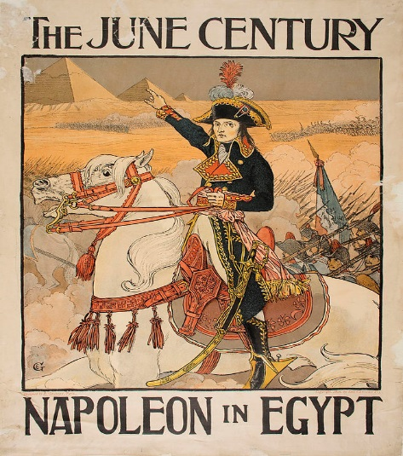
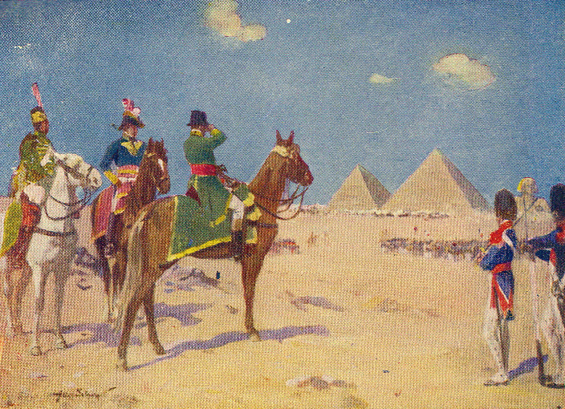
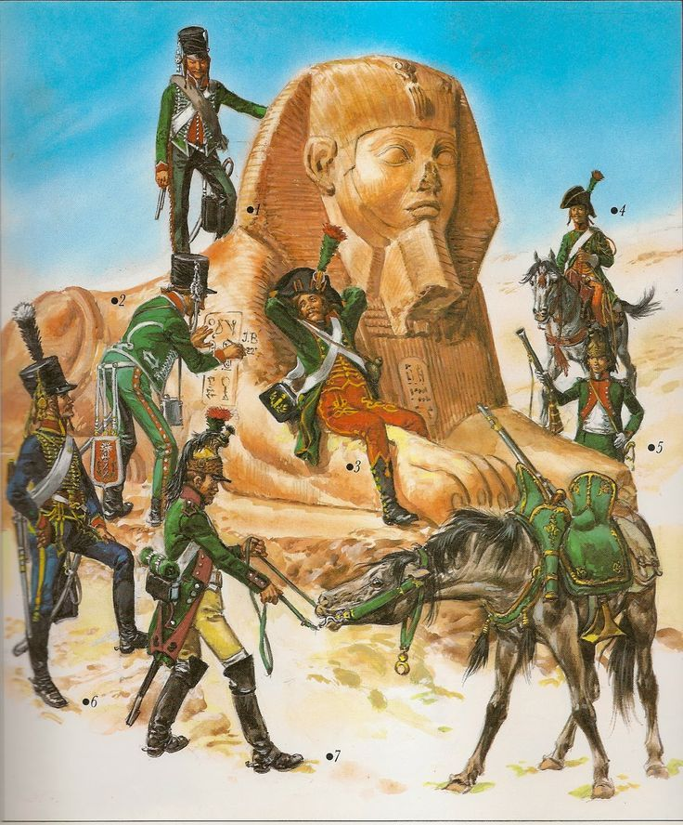
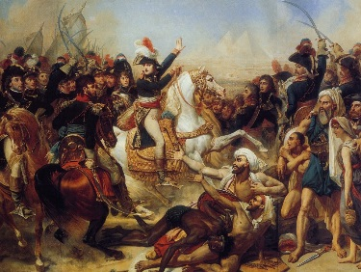

Slide 4
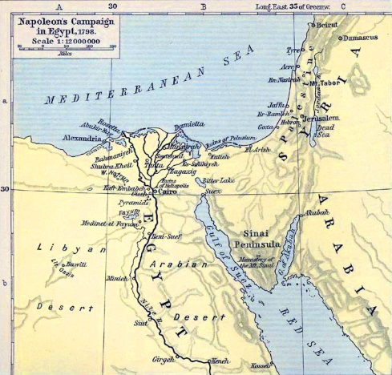
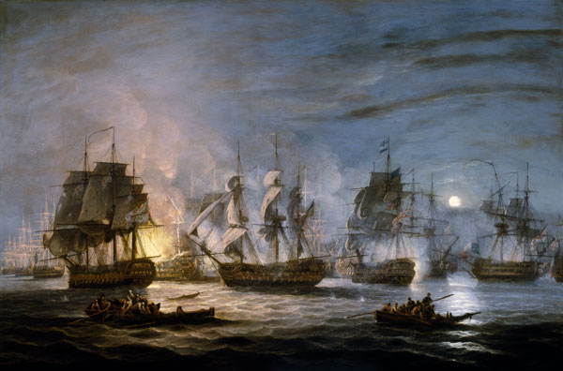

The defeat of the French fleet eliminated France as a major strategic challenger to Britain and gave Britain dominance in the Mediterranean & the North Atlantic and control over sea trade routes into the Indian and Pacific oceans.

Slide 5
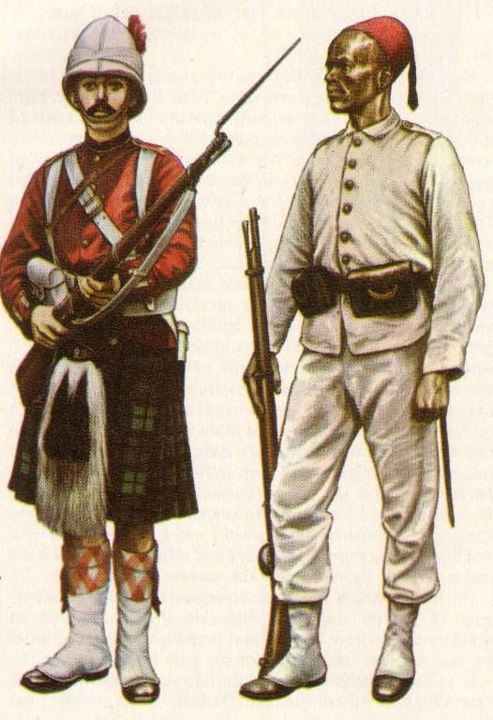
Geo-strategic game of Great Powers in the Middle East
in the late 19th & early 20th c.
“The Eastern Question”; The era of “New Imperialism”:
  French acquisition of Tunis (1881)
  British intervention in Egypt (1882)
  Anglo-Russian conflict over Afghanistan (1885)
  Anglo-Persian Oil Company
  Security of Ottoman oil for Britain

Slide 6
Geo-strategic game of Great Powers in the Middle East
in the late 19th & early 20th c.
  Disintegration of the Ottoman Empire (from 1878 onwards)
  German penetration of the Ottoman Empire; “Berlin-Baghdad Bahn Plan” (from 1903 onwards)
  Besides: “Scramble for [tropical] Africa” (from 1884 onwards).

Slide 7
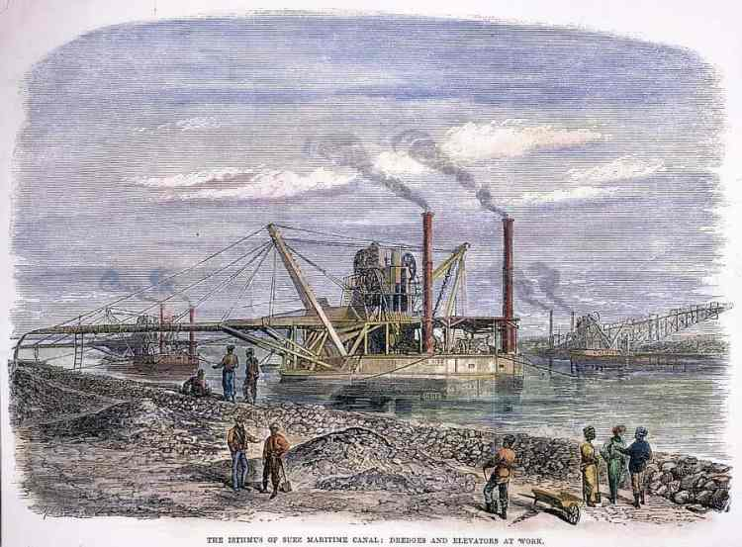
- With the growth of European industry and seaborne commerce, one began to think of building canals.
One such initiative aimed at connecting the Red Sea with the Mediterranean Sea directly, thus saving time either to sail around Africa or trans-shipping freight or passengers across the Suez Peninsula.
-A French enterprise took the initiative in obtaining a 99-year concession for the Canal & organizing the Suez Canal Co., mainly with European capital, to build and operate it.
-Canal completed in 1869 under leadership of French promoter Ferdinand de Lesseps despite numerous obstacles.
More serious was the opposition of Great Britain.

Slide 8
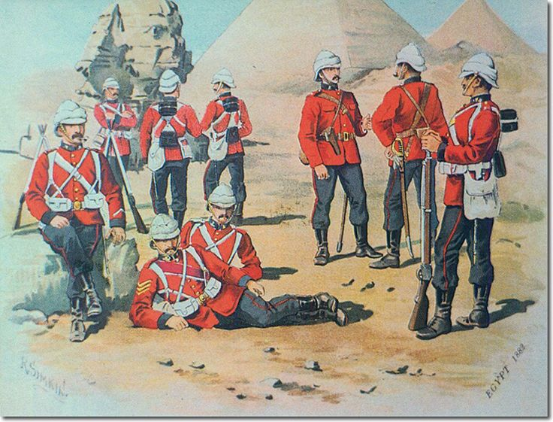
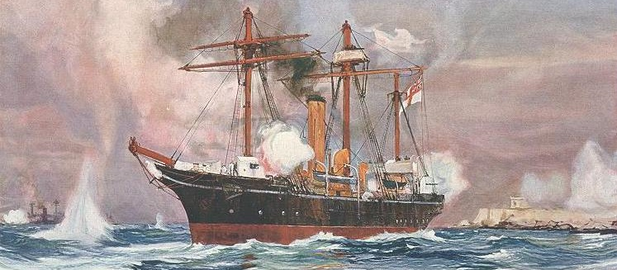
British PM Lord Salisbury admitted in 1898 that the world was divided into the “living” and “dying” Powers. British political leaders, intellectuals, opinion leaders seemed to be absolutely convinced of their “natural” mission to lead the world.

Slide 9
Long-established vs. emerging Powers:
- For the long-established Powers (Great Britain, France, Russia, etc.)
the issue was whether they could maintain themselves
in the face of the new challenges to the international status quo.
- For the new Powers (Germany, Italy, etc.) the problem was
whether they could break through to what Berlin termed
a “world political freedom” (weltpolitische Freiheit)
before it was too late.

Slide 10
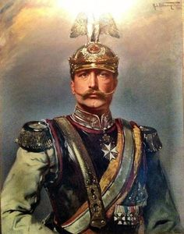
Wilhelm (William) II ,
Emperor (Kaiser) of the German Reich (1888-1918).
Concerning the Middle East/Eastern Mediterranean:
The Ottoman Empire – which had been the Apple of Discord
between London and St. Petersburg –
now became the bone of contention
between the British Empire and the German Reich.

Slide 11
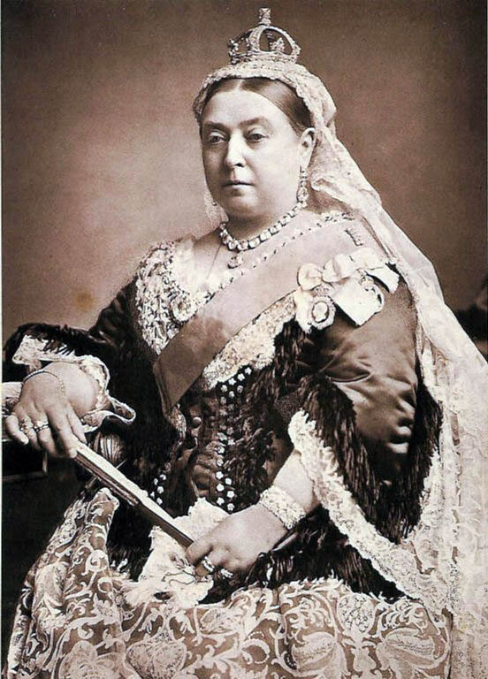

Victoria (1819-1901),
Queen of Great Britain
& Ireland (1837-1901) and Empress of India.

Slide 12

As a maritime and industrial nation, Britain needed:
raw materials available only abroad,
markets to absorb British production
sea trade routes supported by strategically located naval outposts
and supply stations.
The British Empire was foremost a sea-based trading bloc.

Slide 13
Maritime Power Britain resisted encroachment
by integrating potential adversaries
into trade relationships with the Empire.
- In addition, the colonies,
which saw the benefits of increased trade,
would reinforce the defence of the Empire.

Slide 14
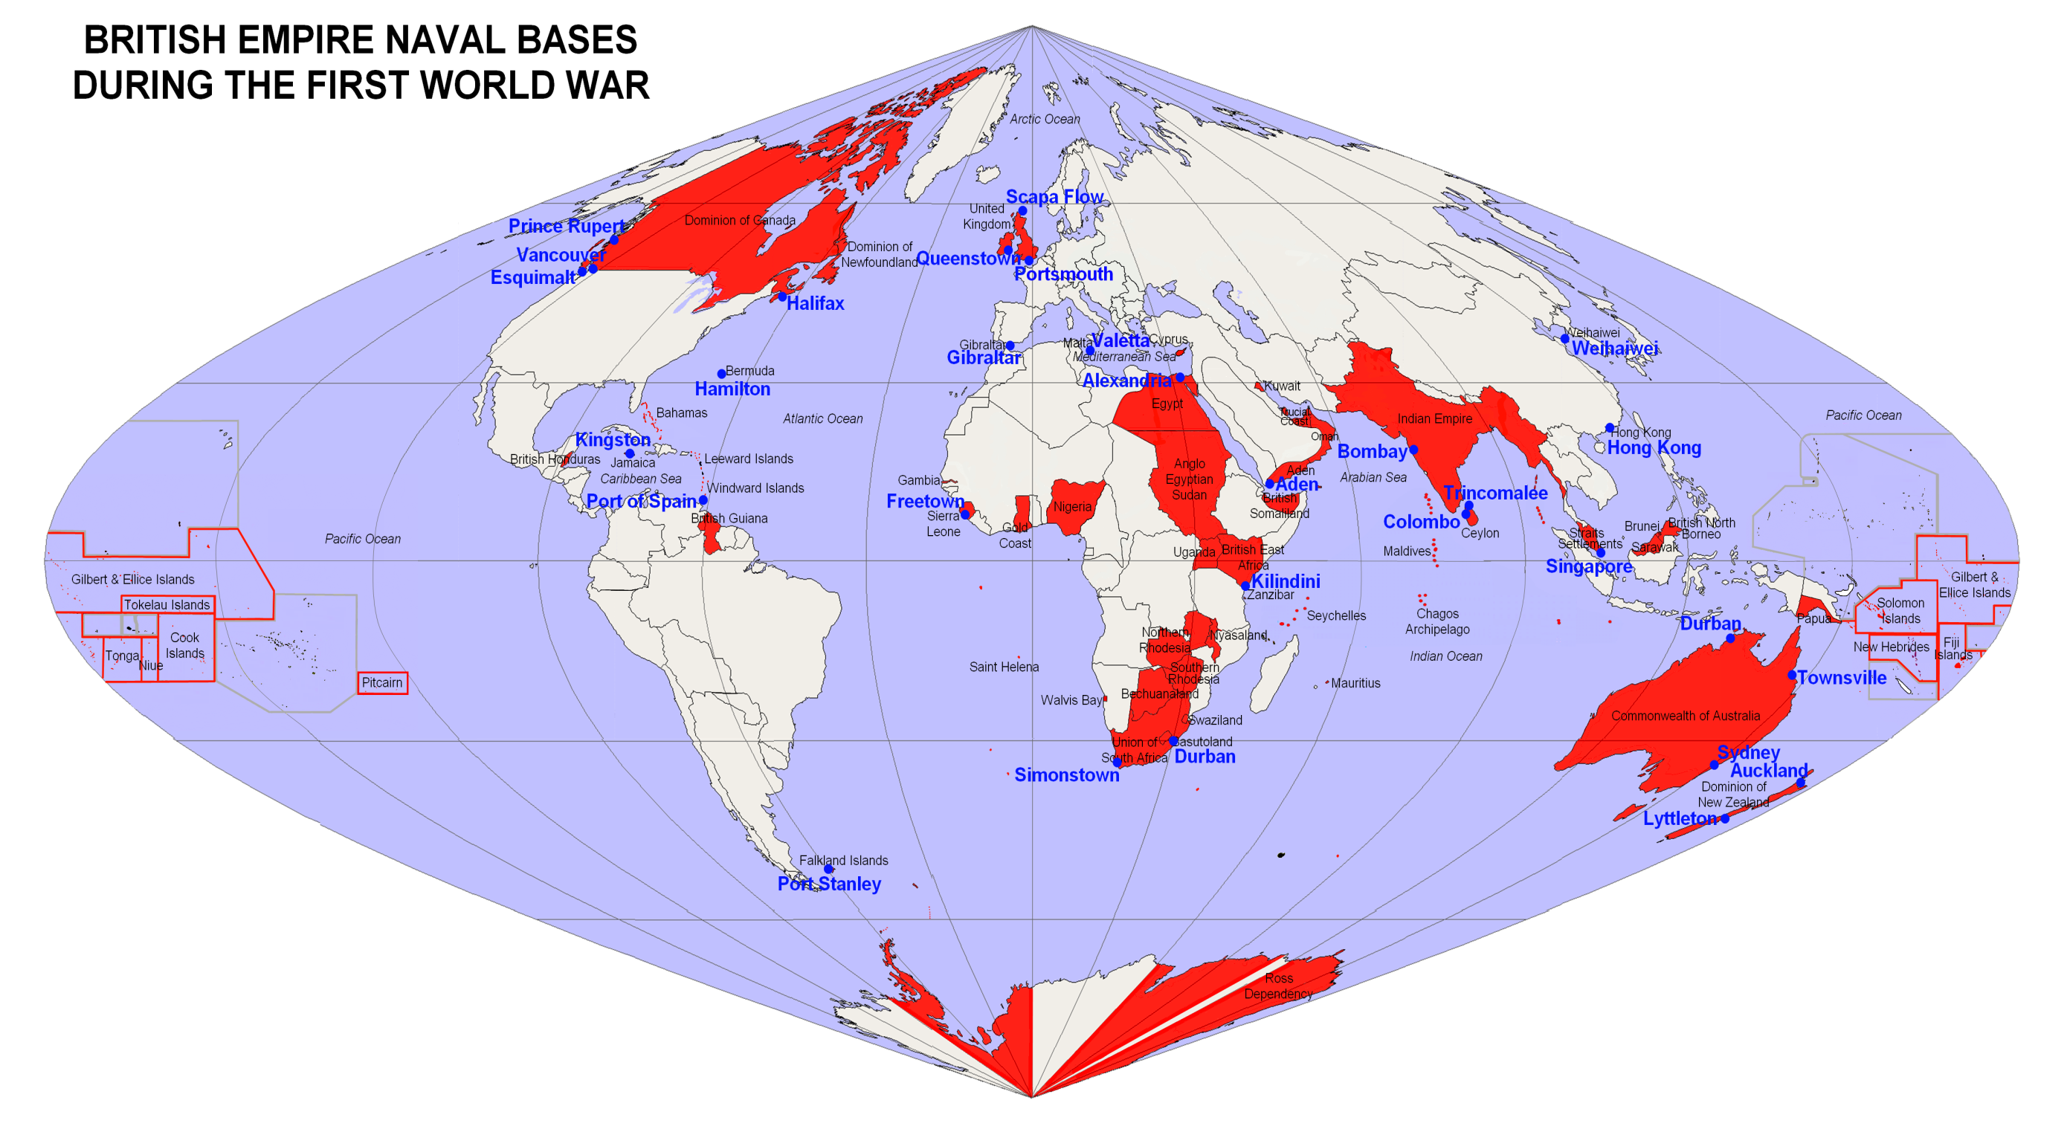


Slide 15
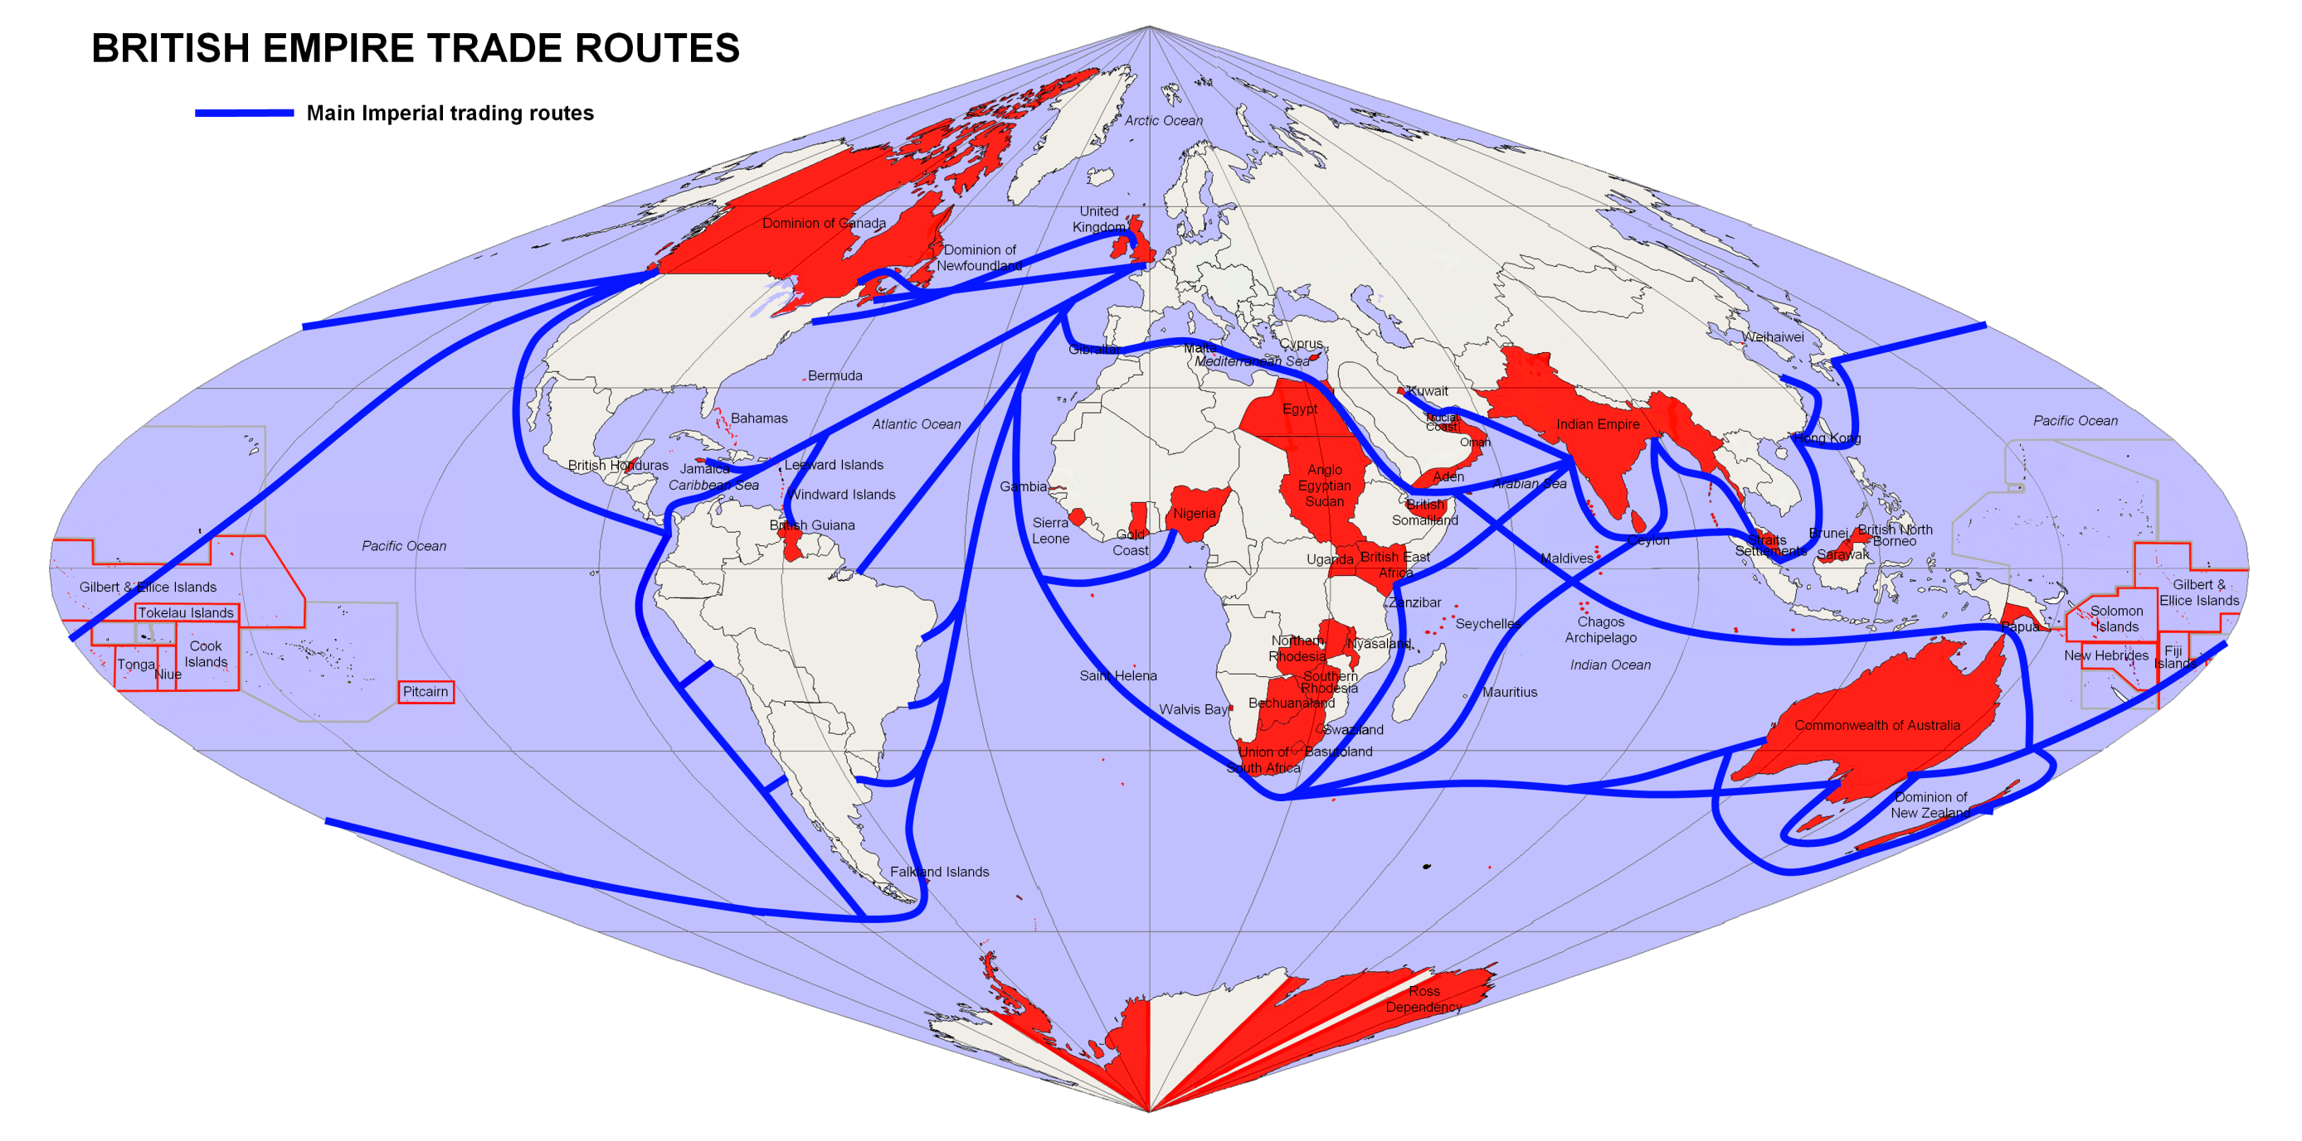
The key of success of Maritime Powers: Sea power, maritime supremacy, and strategic control of both the oceans and the Rimland (the Earth’s Ring).

