Slide 1
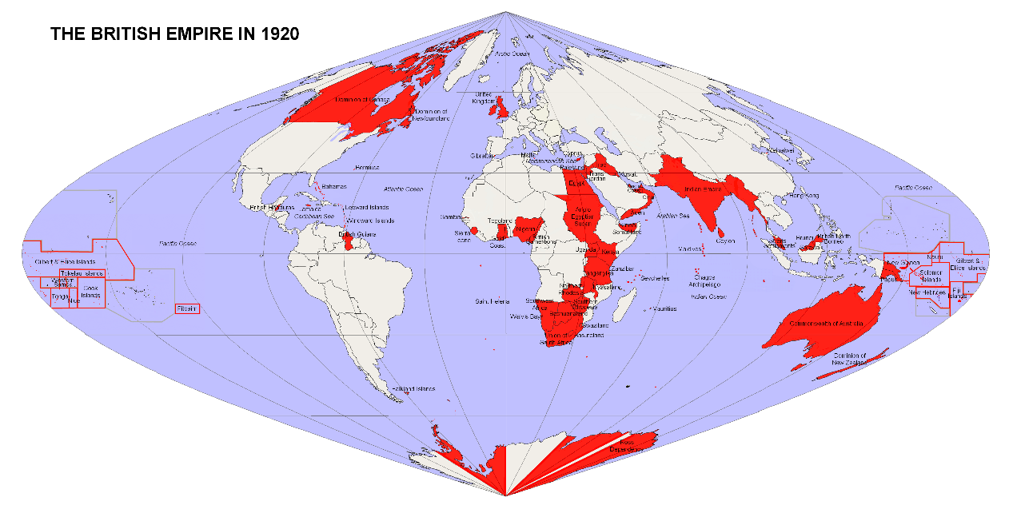

Slide 2
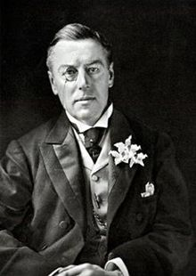
At its peak, the British Empire was the largest formal empire that the world had ever known; also the largest sea-based, maritime & oceanic empire in history.
Its power & influence stretched all over the globe, shaping it in all manner of ways.
Joseph Chamberlain, British Minister for the Colonies (1897):
“It seems to me that the tendency of the time is to throw all power into
the hands of the greatest empires,
and the minor kingdoms – those which are non-progressive –
seem to face into a secondary and subordinate place.”

Slide 3
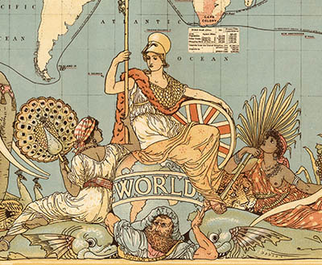
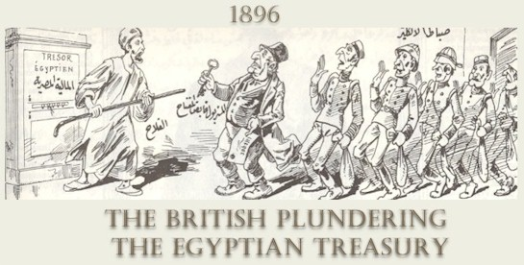
Leo Amery, chief representative of
the British Imperialists:
“These peoples who have the industrial power and the power of invention & science will be able to defeat all others”.

Slide 4
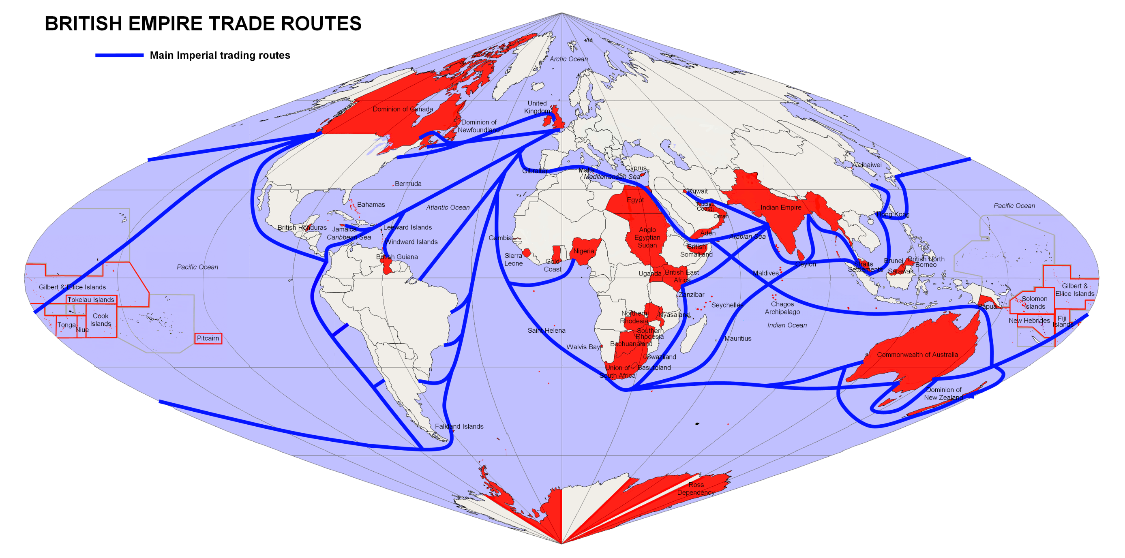
An axiom of the British Naval leadership read as follows,
“All war is a question of communications. The Power controlling communications
holds in the hollow of his hand the Power to whom communications are denied”.

Slide 5
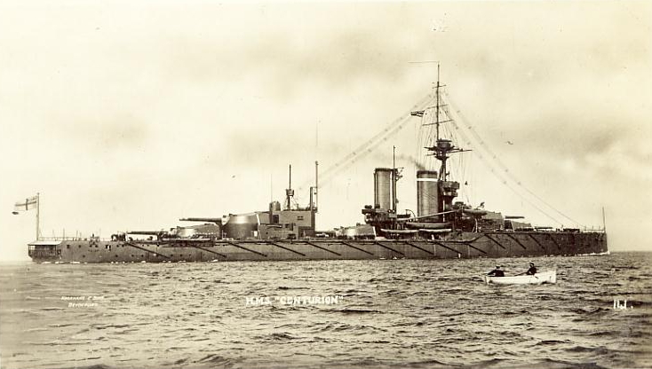
In the framework of the Royal Navy’s planning,
only oil-burning ships would be built from 1912 on.
In 1911, when Winston S. Churchill was appointed to
the office of the First Lord of the Admiralty,
the Royal Navy had already built or was in the process of building
56 destroyers dependent exclusively on oil and 74 submarines
powered only by oil.

Slide 6
What is more, a proportion of oil was used
to spray the coal furnaces of almost all the other ships.
Why so?
Because immense were the advantages conferred by
“liquid fuel” on ships: speed first of all,
and capability of being easily re-fueled at sea as well.

Slide 7
But: Oil was NOT to be found in considerable quantities
in the British Isles.
Continuing British naval supremacy would depend on oil.
-The very beginning of the 20th c. witnessed the commencement
of Britain’s rush for petroleum.

Slide 8
The first steps aimed to control the relevant deposits of the Middle East.
In 1901, Britain concluded an agreement with Shah Mozzafar-al-Din Shah Qajar:
A concession encompassing the whole extent of Persia. As a result,
the “Anglo-Persian Oil Company” began to exploit the Iranian substratum.
Afterwards, it was the turn of Mesopotamia’s petroleum wealth to be exploited. The first oil well was drilled there by the “Turkish Oil Company”:
The drilling started as early as 1902.

Slide 10
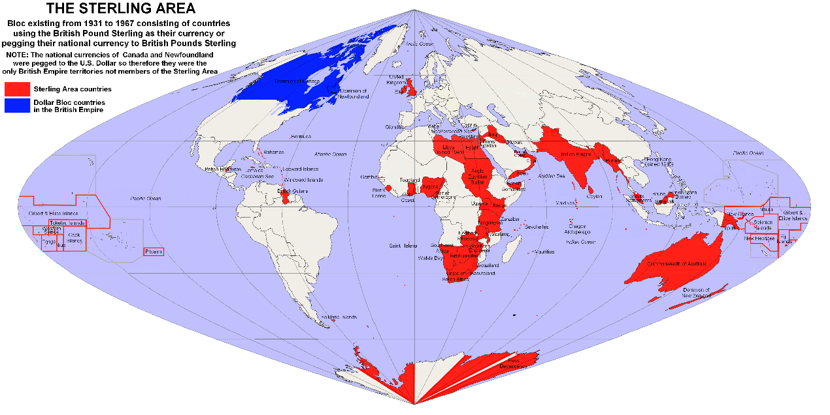

Slide 11
The rich Caucasus deposits were exploited by famous oil-dynasties such as the Rothschild and the Nobel families.
As a corollary, only the petroleum in Ottoman territory was ‘available’.
Thus, in the first ten years of the 20th century
the Persian Gulf was actually under British control.

Slide 12
The disintegration of the Ottoman Empire was in sight;
in fact, the main British desideratum with regard to
the 1914-1918 fighting (WWI) between Britain and Turkey
was the “final recognition and consolidation of…
[the British] position in the Persian Gulf.”

