Slide 1
GEOPOLITICS
OF THE MIDDLE EAST
AND TURKEY
Dr. ILIAS ILIOPOULOS
Dr. phil, Ludwig-Maximilian University of Munich
Ass. Prof., National University of Athens
Former Professor, Hellenic Naval War College
and American College of Greece

Slide 2
The Development of
Islamic Civilization to the Eighteenth Century
Chapter 1-a:
The Rise and Expansion of Islam:
The Pre-Islamic Middle East

Slide 3
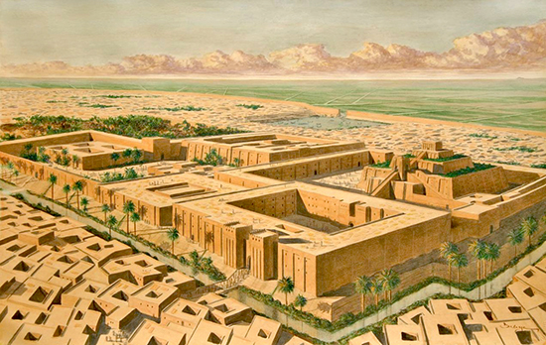
3500 BC (Neolithic era): City-states appeared in Mesopotamia (Greek word meaning “between rivers,” referring to the land between the Tigris & Euphrates rivers;
Broadly defined, it includes most of modern Iraq, eastern Syria, and southeastern Turkey.
Alphabets, governing institutions, religious ritual developed
From 2400 BC onwards:
Emergence of regional empires
(Egyptian/Sumerian/
Akkadian/Assyrian/Hittite)

Slide 4
Imperial consolidation led, later on, to religious consolidation which led to the emergence of Monotheism:
Zoroastrianism (Zoroaster/Zarathustra; dualistic cosmology; eternal struggle between the forces of Good and Evil)
Judaism
Christianity – Would suffer a split in Near & Middle East:
Division on the nature (divine and/or human?) of Jesus Christ
Council of Chalcedon (451 AD): Both natures
Monophysites (one nature): Coptic Church / Armenian Church
Serious division which Islam would take advantage of: It would unify Graeco-Christian territories with Iranian-Zoroastrian lands creating new civilization, accumulating practices that had preceded it

Slide 5
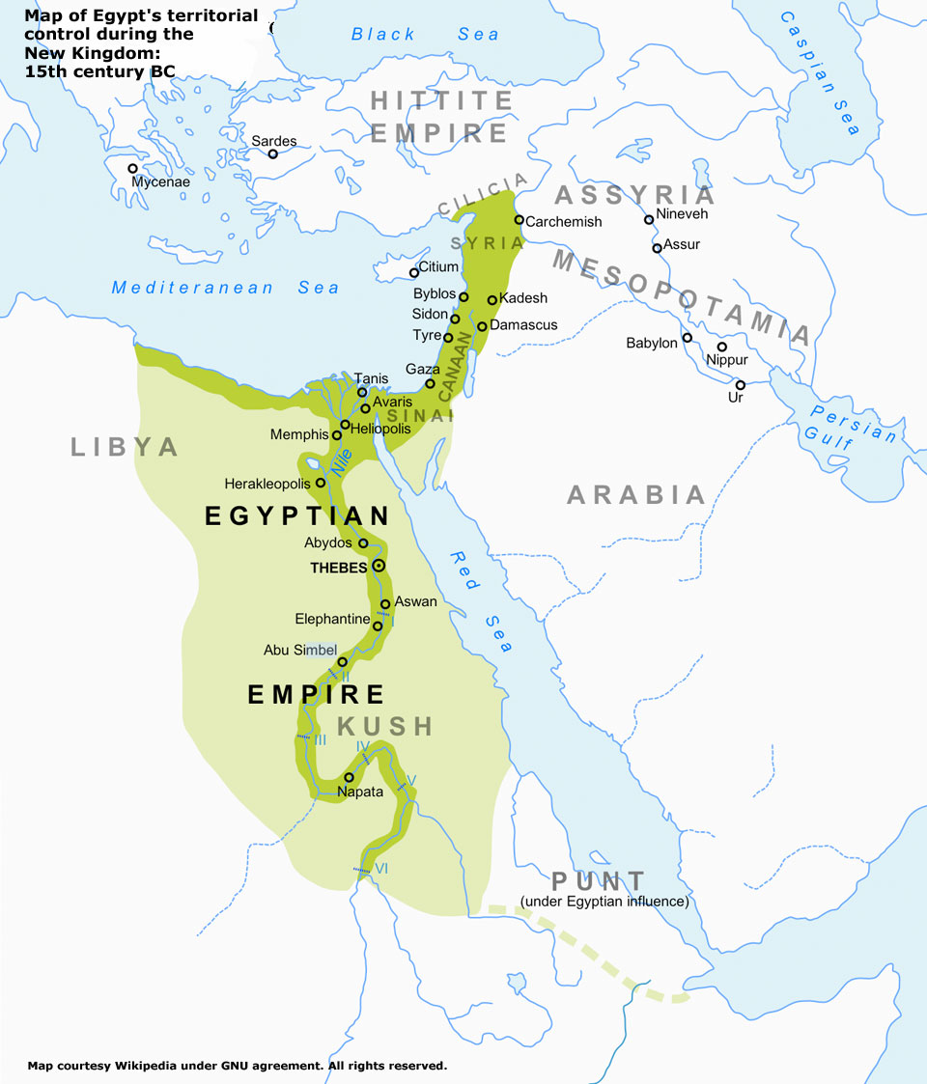
Ancient Egypt & Mesopotamia
The Egyptian civilization emerged around 3150 BC
with the political
unification of Upper
and Lower Egypt
under the first Pharaoh.

Slide 6
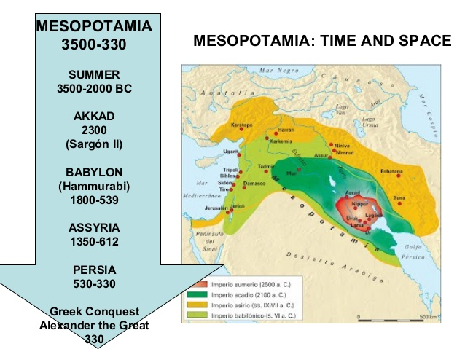
Ancient Egypt & Mesopotamia

Slide 7
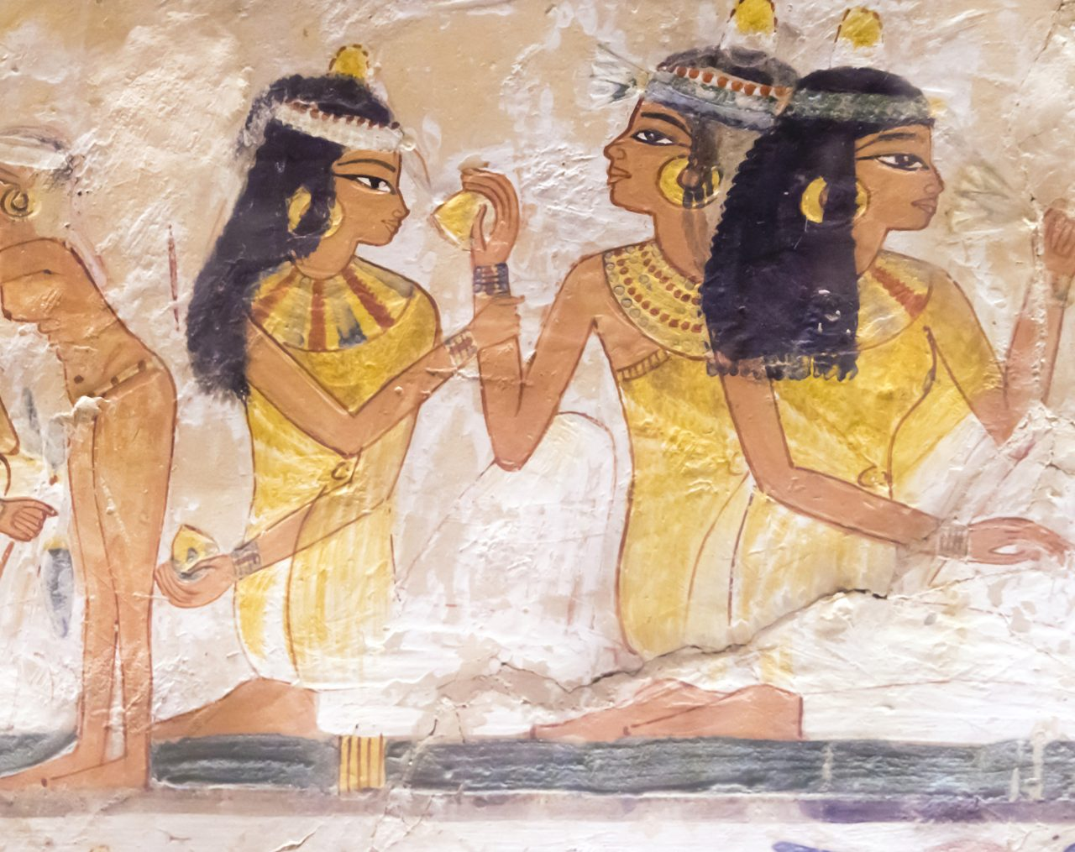
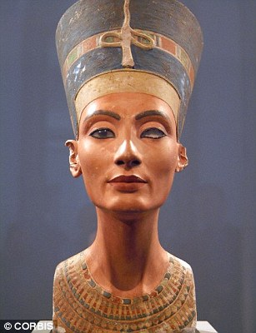
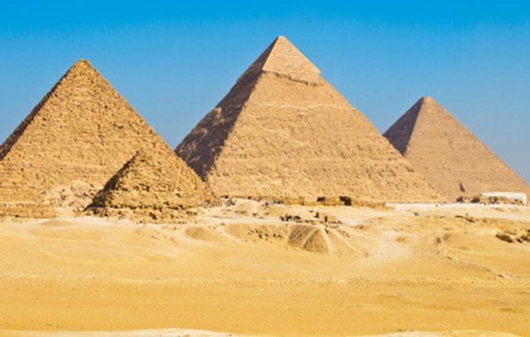
Egypt
R.: Nefertiti (Neferneferuaten) c. 1370 – 1330 BC)
Notes:
An Egyptian queen and the Great Royal Wife of Pharaoh Akhenaten. Both known for they worshiped one god only, Aten, or the sun disc. With her husband, she reigned at the wealthiest period of Ancient Egyptian history. Succeeded by Tutankhamun. Nefertiti had many titles: Hereditary Princess; Lady of Grace, Sweet of Love; Lady of The Two Lands; Lady of all Women; Mistress of Upper and Lower Egypt, etc. She was made famous by her painted stone bust, or statue of the queen's head - one of the most copied works of ancient Egypt. Discovered 1912 by Ludwig Borchardt, now in Berlin's Neues Museum

Slide 8

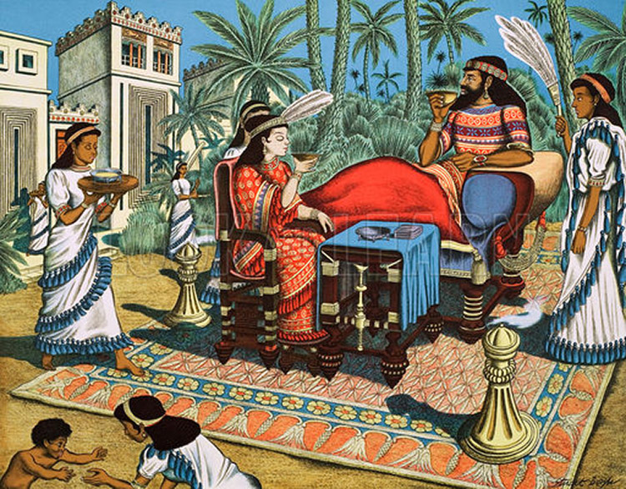
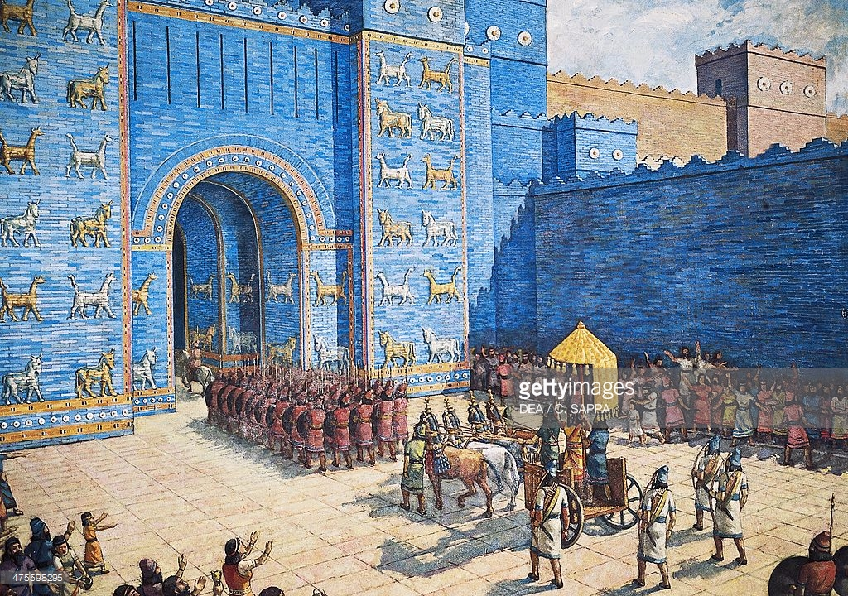
Babylon
Notes:
The Hanging Gardens of Babylon evoke a romantic picture of lush greenery and colorful flowers cascading from the sky. The grandeur of their sight must have been awe-inspiring, which is why Herodotus would have considered them one of his Seven Wonders of the Ancient World. Berossus, a Chaldaean priest (c. 280 BC), describes the gardens and attributes them to the great Babylonian king Nebuchadnezzar II (Nabucodonosor). He had the Hanging Gardens built around 600 BC for his wife Amytis. The Hanging Gardens did not actually hang at all. They were made up of a simulated mountain with rooftop gardens. They would have likely been multi-level terraces supported by baked brick columns. These columns would have been filled with dirt to allow large plantings & trees to root & grow. The effect of the plants hanging down over the years gave the effect of a lush mountain landscape, seemingly hanging in mid-air. It would have been spectacular to behold.

Slide 9
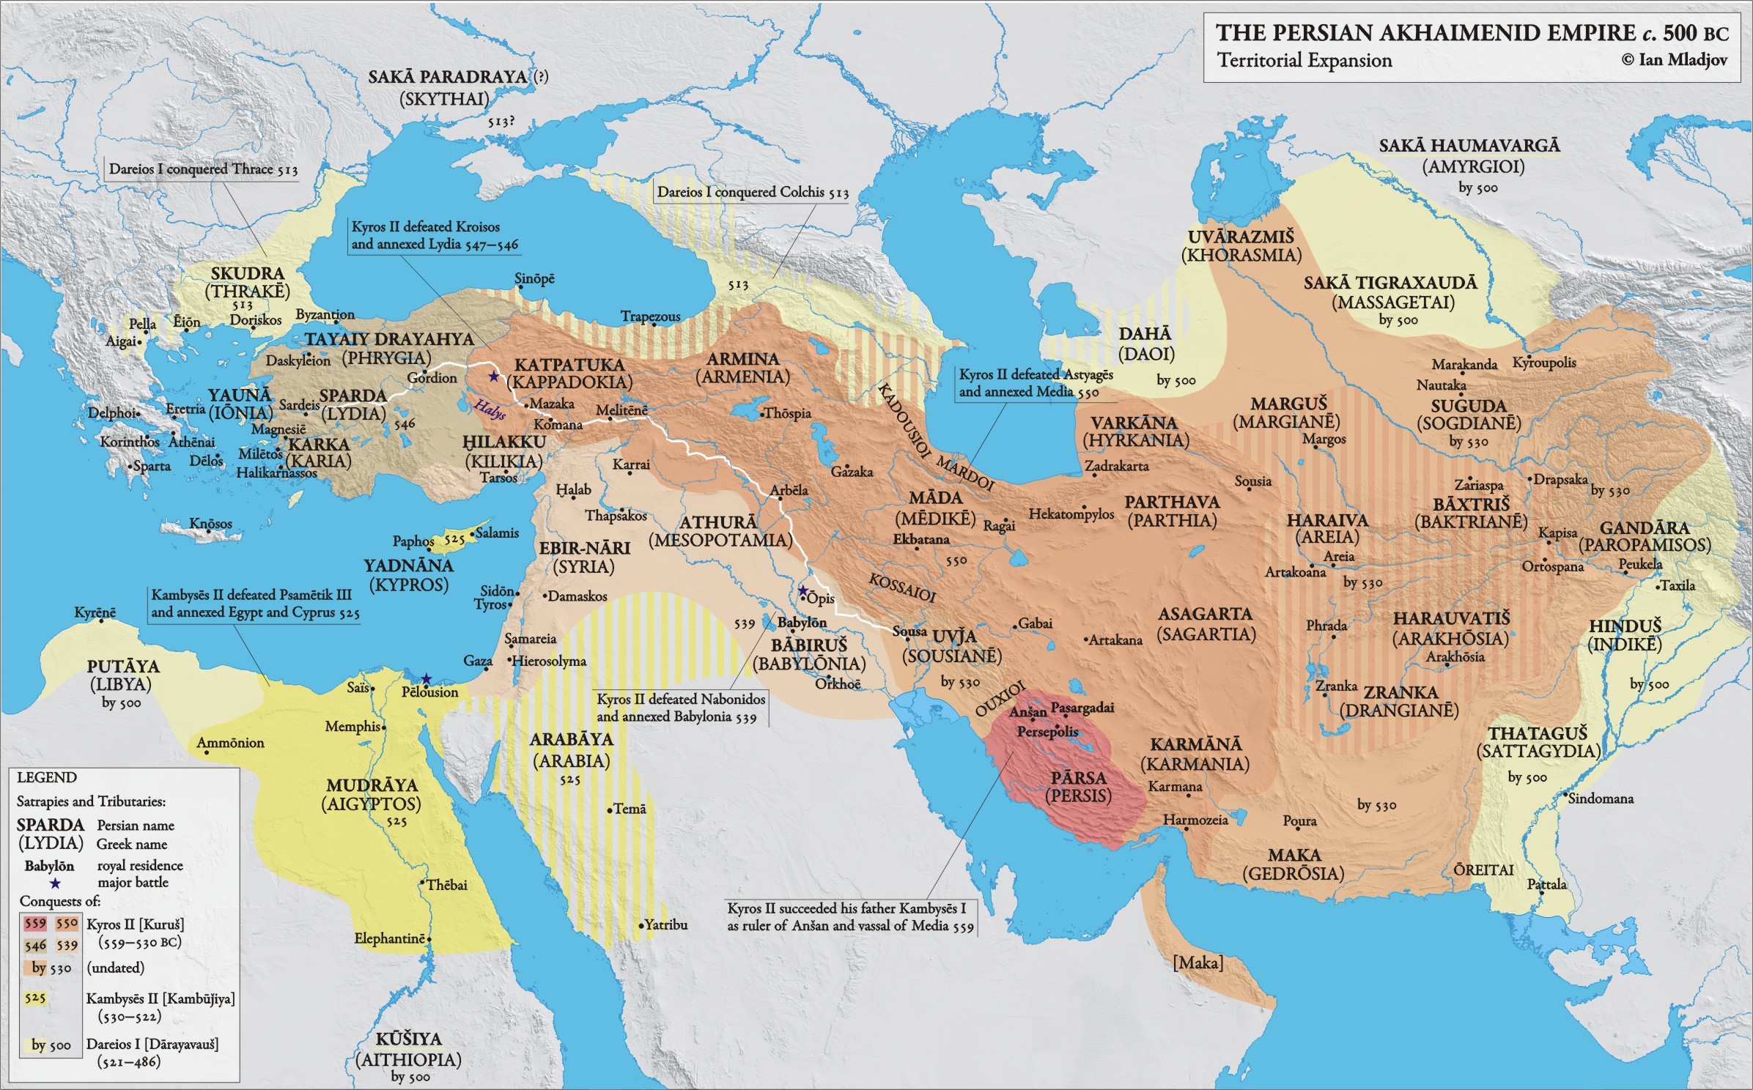
Persian (Achaemenid) Empire (550 – 331 BC)

Slide 10
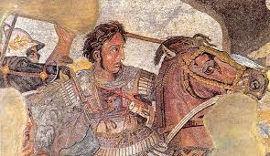
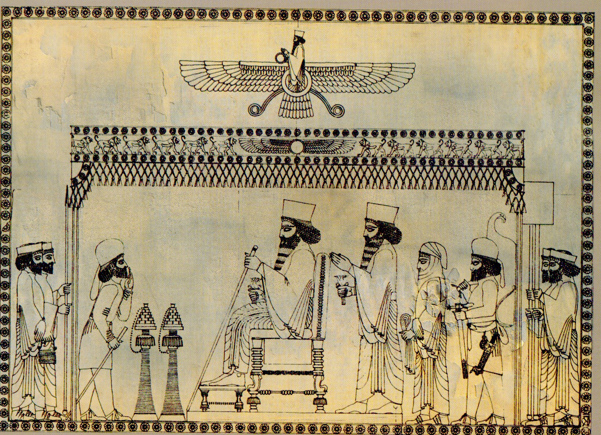
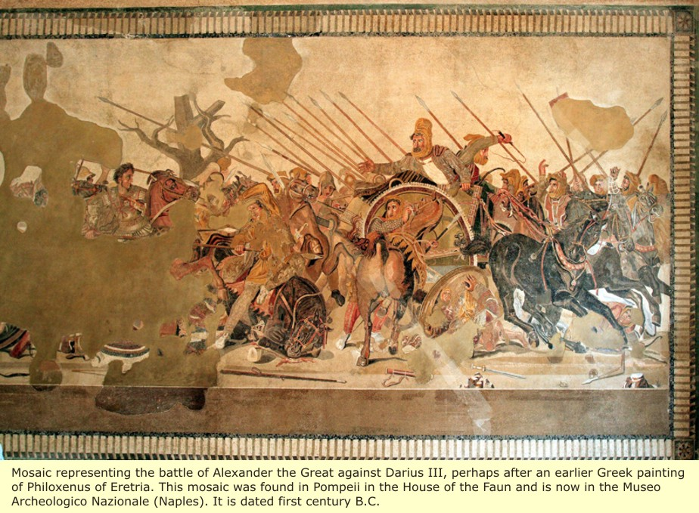
Notes:
Alexander III, the Great. King of Macedon. Born in Pella in 356 BC, succeeded his father Philip II to the throne at the age of 20. He spent most of his ruling years on an unprecedented military campaign through Asia and North-East Africa; created one of the largest empires of the ancient world by the age of 30, stretching from Greece to NW India. He was undefeated in battle and is widely considered one of history's greatest military commanders.
During his youth, Alexander was tutored by Aristotle. When he succeeded Philipp, Alexander was awarded the generalship of Greece and used this authority to launch his father's pan-Hellenic project to lead the Greeks in the conquest of Persia. In 334 BC, he invaded the Achaemenid Empire (Persian Empire) and began a series of campaigns that lasted ten years. Following the conquest of Asia Minor (Anatolia, he broke the power of Persia in a series of decisive battles, most notably the battles of Issus and Gaugamela (Erbil). He overthrew Darius III and conquered the Achaemenid Empire in its entirety. At that point, his empire stretched from the Adriatic Sea to the Indus River.
He endeavored to reach the ends of the world & the Great Outer Sea and invaded India BUT eventually turned back at the demand of his homesick troops. Died in Babylon 323 BC - without executing a series of planned campaigns that would have begun with an invasion of Arabia. In the years following his death, a series of civil wars tore his empire apart, resulting in the establishment of several kingdoms ruled by the Epigones or Diadochi, Alexander's surviving generals and heirs.
Alexander's legacy includes the cultural diffusion & syncretism which his conquests engendered, such as Greco-Buddhism. He founded 20 cities that bore his name, most notably Alexandria/Egypt. Settlement of Greek colonists and the resulting spread of Greek culture in the east resulted in a new Hellenistic civilization, aspects of which were still evident in the Byzantine Empire in 15th c. and the presence of Greek speakers in central & eastern Anatolia until the 1920s. Alexander became legendary as a classical hero in the mold of Achilles, and he features prominently in the history and mythic traditions of both Greek and non-Greek cultures. He became the measure against which military leaders compared themselves; military academies throughout the world still teach his tactics. He is often ranked among the most influential people in history. He created the first ecumenical empire in history.

Slide 11
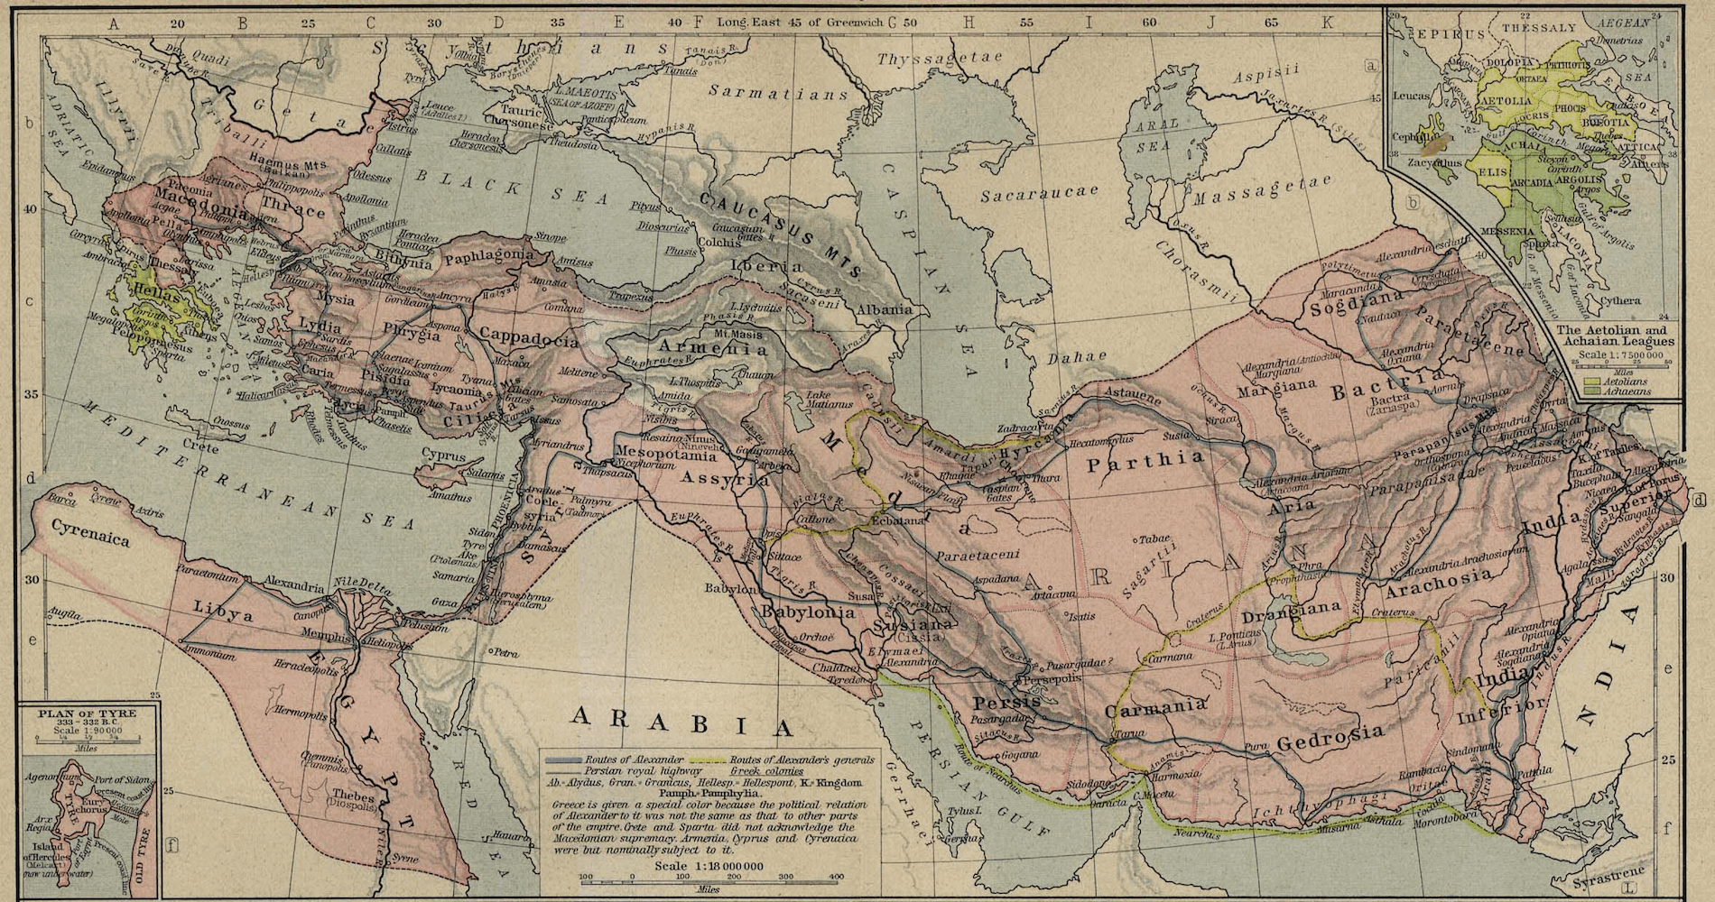
Hellenistic World (331-31 BC)

Slide 12
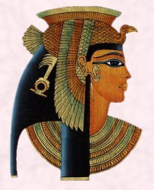
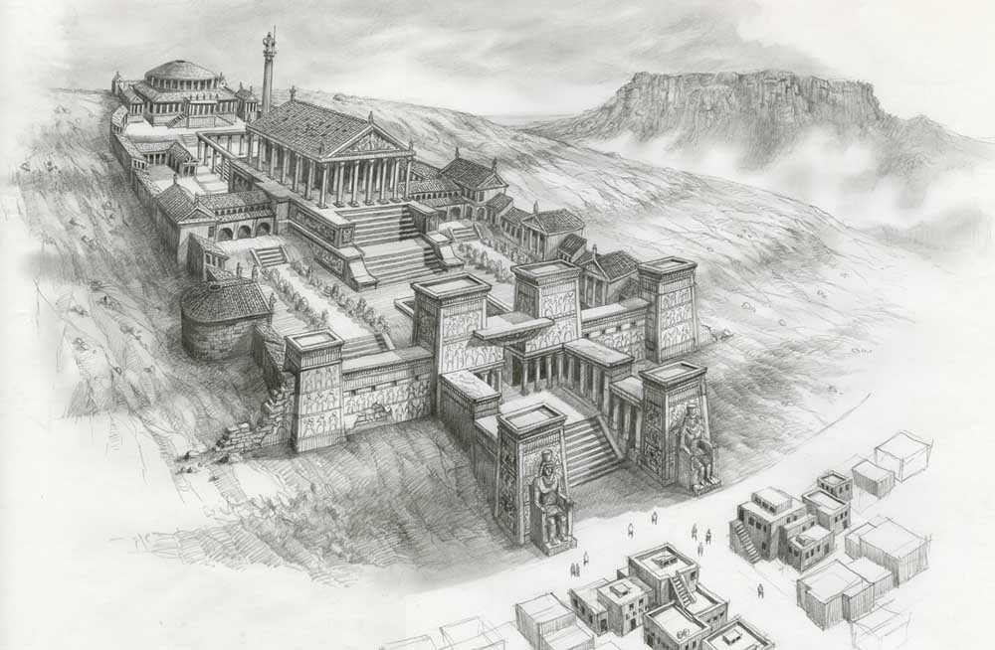
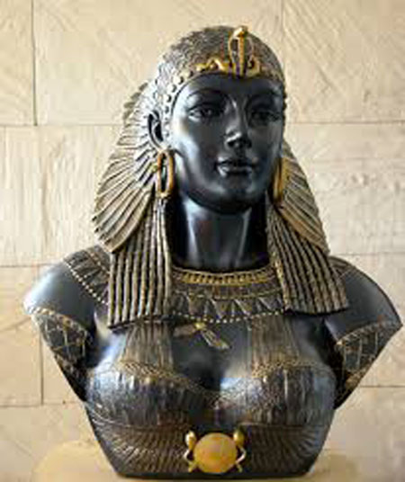
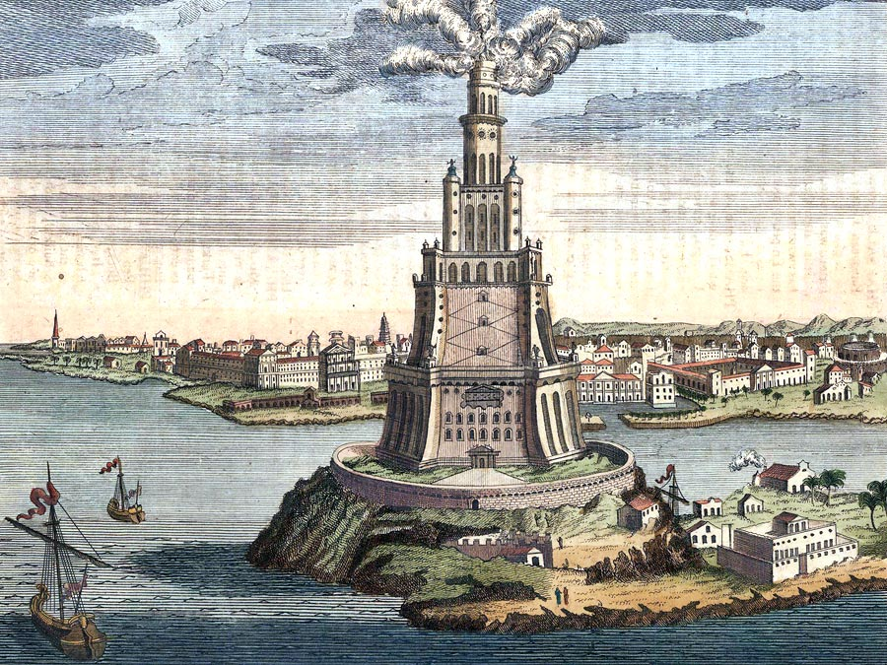
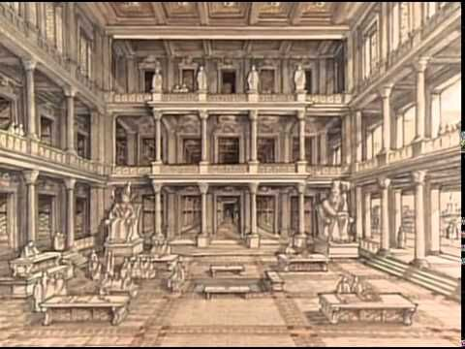
Cleopatra VII (70/69 BC – 30 BC), last queen of the (Greek-Macedonian) Ptolemaic Kingdom of Egypt.
Alexandria,
Lighthouse.
Alexandria, Library.
Notes:
Cleopatra (Greek: “Famous in Her Father”), famous in history & drama as the lover of Julius Caesar and later the wife of Mark Antony. After the Roman armies of Octavian (future emperor Augustus) defeated their combined forces, Antony and Cleopatra committed suicide and Egypt fell under Roman domination. Cleopatra represented, as did no other woman of antiquity, the prototype of the femme fatale. (a woman who is very attractive in a mysterious way, usually leading men into danger or causing their destruction)

Slide 13
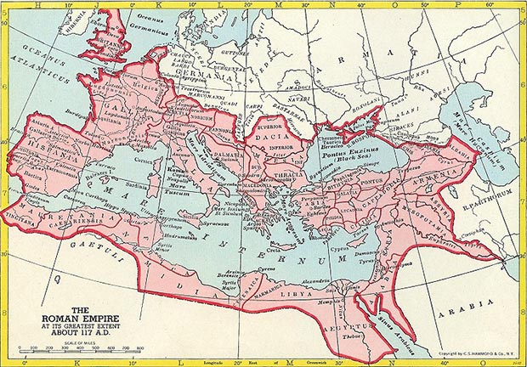
Roman Empire (27 BC – 395 AD)

Slide 14
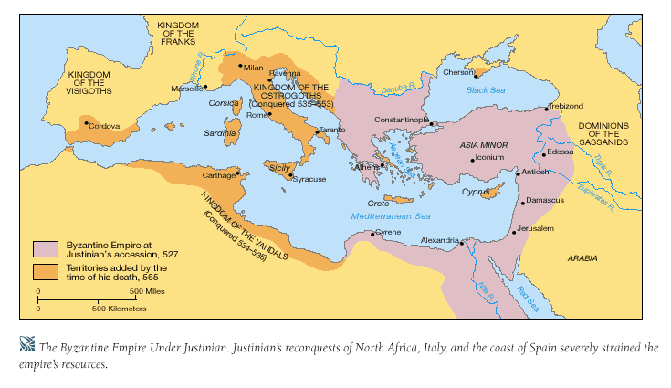
Map of Byzantine Empire under Justinian (527–565 AD)

Slide 15
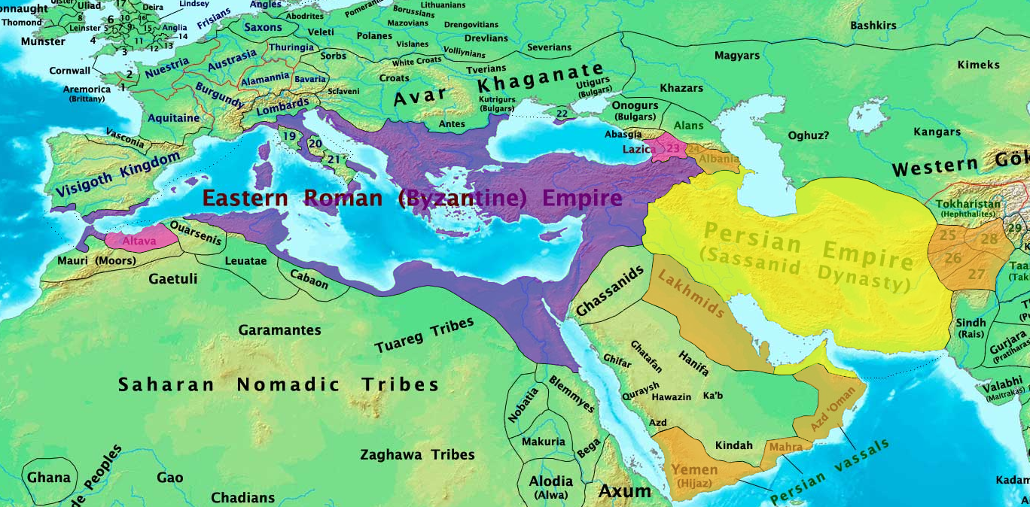
Pre-Islamic Arabia:
Between the Great Powers of that Era

Slide 16
Pre-Islamic Arabia: The Society
The Arabian Peninsula of the early 7th century [A.D.] lacked any central organizing authority.
Tribes were the largest units of social and political organization.
  Family, clan, tribe, confederation
  Virtues of tribal solidarity: bravery, loyalty, honor
  Arabic poetry qasidah facilitated the spread of Islam (a common language understood in the peninsula)
Polytheism in Arabia reflected tribal realities.
  Ka`ba: central shrine 360 idols of tribal deities

Slide 17
Regional Importance of Arabia
Arabia − commercial transit route between the Middle Eastern empires (Eastern Roman / Byzantine and Persian / Sasanian Empires) and Yemen.
North-south caravan trade through the Hijaz.
Mecca: the commercial center of the peninsula
(leading clans of the Quraysh tribe).

Slide 18
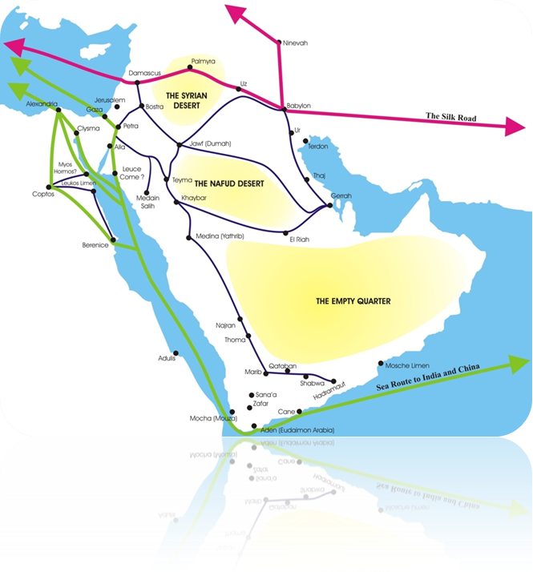

Slide 19
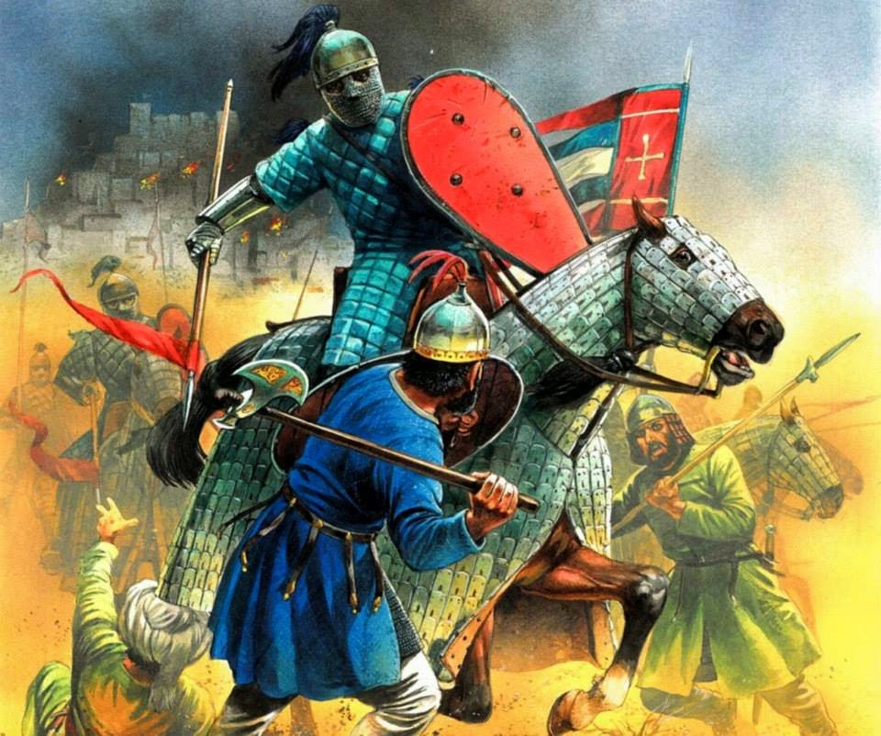
Pre-Islamic Arabia:
Byzantium vs Persia (the Sasanians) 540-629 AD
Byzantine (Eastern Roman, Greek-Christian) Empire
(330 AD –1453 AD):
  Greek culture-language
  Roman administration
  Greek-Orthodox Christianity
  Professional Army

Slide 20
Pre-Islamic Arabia:
Byzantium vs Persia (the Sasanians) 540-629 AD
Sasanian Empire (234-634 AD):
  Heir of the Achaemenides
  Shahanshah (King of Kings) at Ctesiphon (near Baghdad)
  Advanced bureaucracy
  Religion: Zoroastrianism (no strong affiliation with the people)
  Professional Army

Slide 21
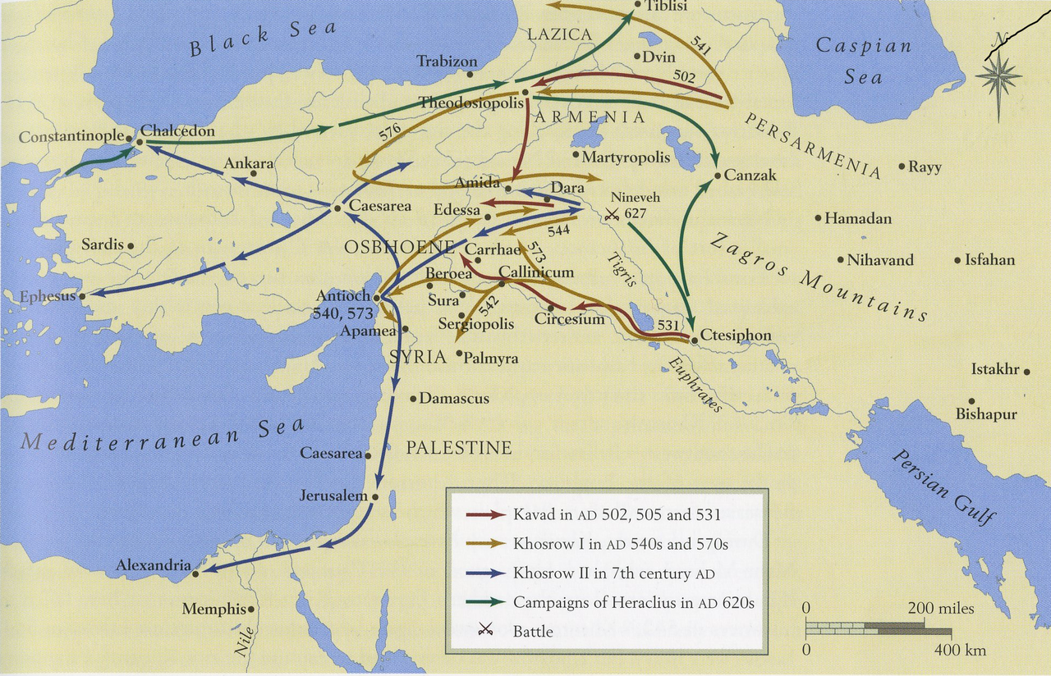
Pre-Islamic Arabia: Byzantine Empire vs Persian (Sasanian) Empire 540–629 AD

Slide 22
Formative Islam would be influenced
  by the Greek legacy of Byzantium,
  by the bureaucratic tradition of Iran,
  and by the concepts of empire
that had been developed in the courts of
Constantinople and Ctesiphon.

Slide 23
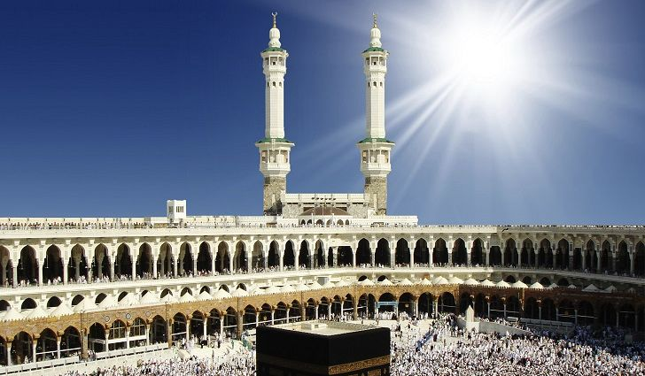
Islam must be understood
(in historical & cultural terms)
as a product of the societies
into which it spread
as well as of the society
in which it originated.

