Slide 1
GEOPOLITICS OF TURKEY AND THE MIDDLE EAST
Prof. Dr. ILIAS ILIOPOULOS

Slide 2
The Palestine Mandate
and the Birth of the State of Israel

Slide 3
The British Mandate of Palestine
Historians have offered numerous perspectives on
why the Palestinian mandate became the source of
so much discord
The mandate for Palestine was founded on
a unique premise:
  A small territory that had been inhabited by Arab majority for 1,200 years was promised by Britain (third party) as a national shelter to the international Jewish community, the majority of whom lived in Eastern Europe

Slide 4
Political Zionism
Jewish communities kept dream of returning to Holy Land alive through centuries— Palestine occupied special place
Political Zionism—inspired by nationalism + religious belief—spawned by conditions in 19th century Europe
Leo Pinsker’s: Autoemancipation (1882) argued that anti-Semitism was so deeply embedded in European society that Jews would never be treated as equals

Slide 5
Political Zionism
Theodor Herzl (1860-1904), author of “The Jewish State” (1896), turned Zionist ideology into a coherent international movement
  He believed Jews constituted a nation, but lacked a political state within which they could express their national culture

Slide 6
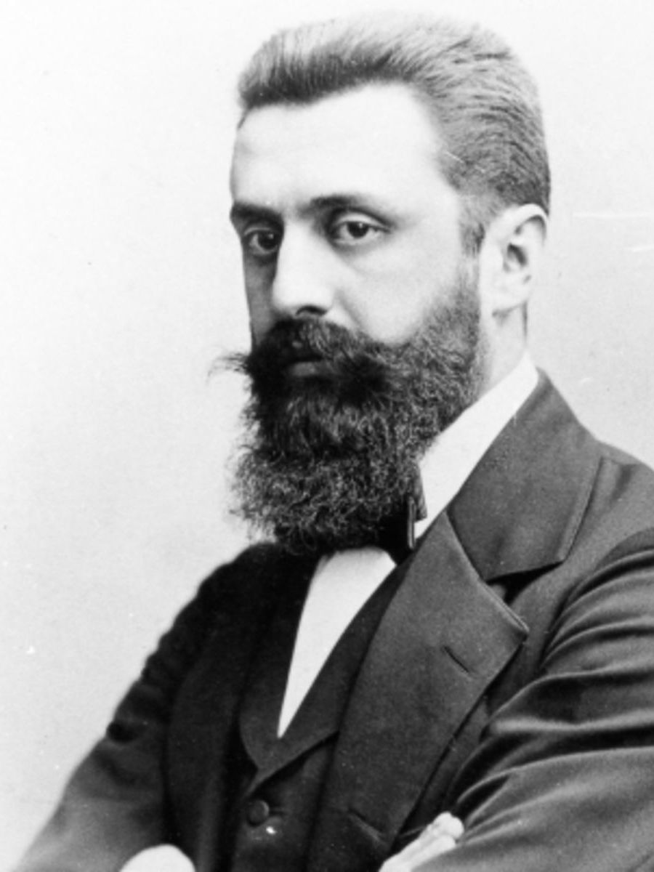
Anti-Semitism would never be eliminated by legislation
Motivated by modern ideas of nationhood than religion
Not insisting on Palestine as the place for the Jewish state (i.e. “Uganda project”)
Theodor Herzl (Benjamin Ze'ev Herzl, 1860-1904):
Middle class family, Budapest; studied Law at University of Vienna; worked as a journalist

Slide 7
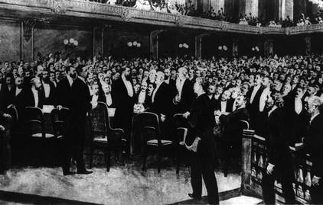
First Zionist Congress (Basel, 1897)

Slide 8
Milestone for the Zionist movement
200 delegates
Program: Legally recognized home in Palestine
Established the World Zionist Organization (set up committees to give cohesion & direction)
Crucial element: Diplomatic support of a Great Power and financial assistance by Western Jewish community

Slide 9
The Balfour Declaration
2 Nov. 1917: British foreign secretary Arthur Balfour wrote declaration of sympathy for Zionist aspirations
Unilaterally issued by Britain
Britain’s reasons for Balfour Declaration: strategic interests, sympathy for the Zionist cause, and the search for concrete wartime alliances (i.e. US Jewish community)

Slide 10
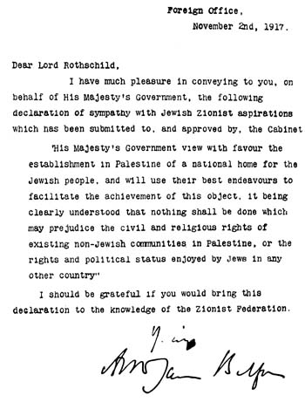
The insoluble contradiction in the Balfour Declaration: How could Britain facilitate the establishment of a Jewish national home while ensuring that the rights of the Arab majority would not be threatened?

Slide 11
The Palestinian Mandate
High Commissioner Sir Herbert Samuel (Jewish) believed that without Arab political participation, the mandate would be unworkable
White Paper 1922: Balancing between Jews & Arabs
Jews have the right to be in Palestine

Slide 12
The Palestinian Mandate
Constitution, 1922: Proposed unitary representation in a legislative council composed of elected Muslim, Christian, and Jewish representatives
Arab leaders rejected the plan, unable to compromise on annulling the Balfour Declaration

Slide 13
Without institutions representing the population as a whole, the Arab and Jewish communities became increasingly hostile to one another
Palestine governed by High Commissioner alone

Slide 14
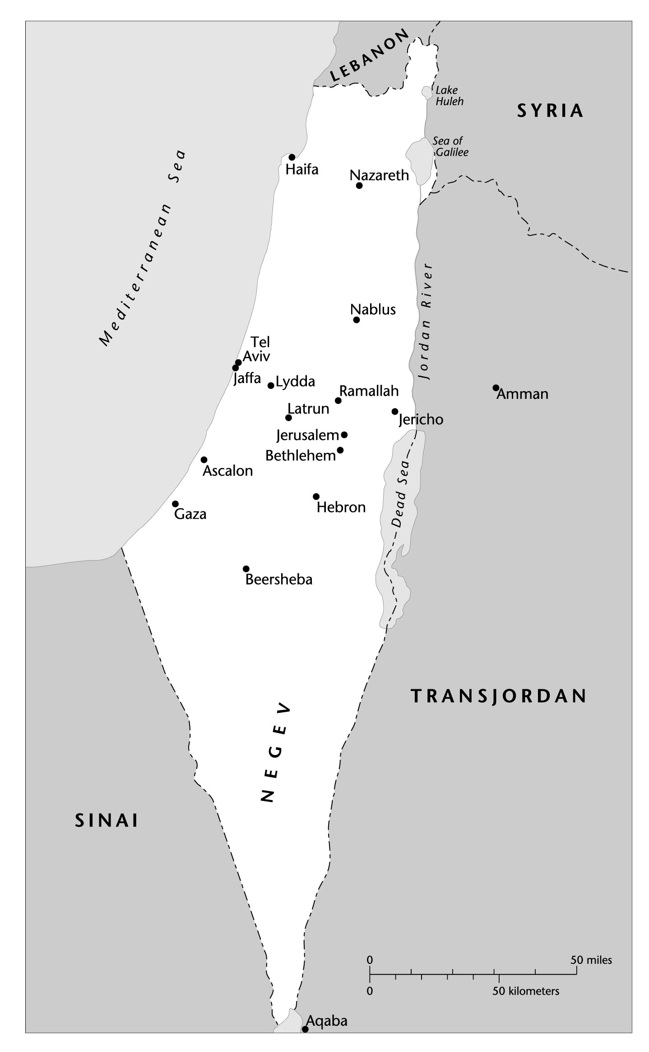
The Boundaries of the Palestine Mandate, 1923-1948

Slide 15
The Palestinian Arab Community: Leadership & Institutions
At the 3rd annual meeting of the Palestinian Arab Congress, the Arab Executive was established (1920). It claimed to represent all Palestinians, but:
  It was not an authoritative body and it lacked structure.
  The British refused to acknowledge its legitimacy.
The Arab Executive failed to secure mass support and formal access to the High Commissioner’s office. It fell apart in 1934.

Slide 16
The Supreme Muslim Council (1921):
  The authority of Hajj Amin al-Husayni (1895-1974), mufti of Jerusalem, expanded with its creation.
  The mufti at first urged restraint and demonstrated a willingness to cooperate with the British in seeking a negotiated solution to the question of Jewish immigration

Slide 17
Zionist organizations more extensive than those of the Arabs, reflecting the differences in resources.
The Jewish Agency (1929): the quasi-government (developing services) of the Jewish community
The Federation of Jewish Labor, Histadrut, represented labor unions and gradually expanded to exercise influence over ideology and politics of Yishuv (Jewish community in Palestine before 1948)

Slide 18
The Federation of Jewish Labor, Histadrut:
Control over Haganah (1920) [Jewish defense force]
  Acted as trade union and largest employer in the Mandate
  In 1930, two labor groups merged to form the Mapai Party, which dominated political life of the Yishuv and the state of Israel until 1977.
Kibbutz: Collective agricultural settlements.

Slide 19

Haganah fighters guarding Migdal Tzedek, 1936

Slide 20
Outside Support for Zionist Cause
1920: The World Zionist Organization transferred its headquarters to London and made Chaim Weizmann (1874-1952) president
  He was able to interfere quickly when British policy towards Palestine veered from what he wanted
Zionist Organization of America was founded in 1917
  With US rise after WWII, American Jewry would play vital role in shaping the Palestinian conflict

Slide 21
Divisions within the Yishuv
A splinter group, the Revisionists, condemned Weizmann’s approach as too hesitant and too dependent on Britain
Founder of Revisionism, Vladimir Jabotinsky (1880-1940), called for massive Jewish immigration into Palestine and the immediate proclamation of a Jewish commonwealth.

Slide 22
Revisionism lost much of its force with Jabotinsky’s death.
Two of his disciples, Menachem Begin and Yitzhak Shamir, later became Israeli prime ministers and revived their former leader’s uncompromising Zionism

Slide 23
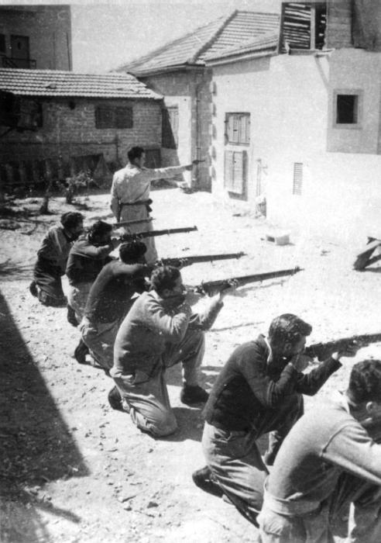

Revisionists
Irgun (1931-1948): Separate military force independent of Hagahah

Slide 24
Land Acquisition
Jewish National Fund: Zionist organization responsible for negotiating land purchases.
It bought land they regarded as belonging to the Jewish people
and leased it exclusively to Jews

Slide 25
The cumulative effect of land transfers, British policy, and Arab notables’ attitudes → increasing impoverishment and marginalization of the Palestinian Arab peasantry
The Palestinian Arab peasantry expressed their discontent in outbreaks of violence against Arab elites, Zionists, and the British.

Slide 26
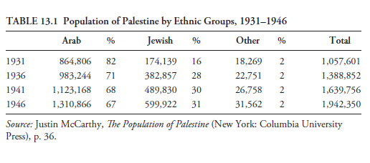
Population of Palestine by Ethnic Groups, 1931-1946

Slide 27
Tensions within the Mandate
Two major eruptions of communal violence during the interwar years of the mandate were directly related to dislocation caused by immigration and land transfers

Slide 28
  1. The Wailing Wall Disturbances of 1929:
    Dispute over Jewish and Muslim access to overlapping holy sites in Jerusalem, leading to (casualties: 133 Jews – 116 Arabs):
      Two Commissions of Inquiry
      1930 White Paper: Restrict Jewish immigration.
      1931 Black Letter (For the Arabs): The White Paper effectively repudiated.

Slide 29
  2. The Great Revolt of 1936-1939: (3,000 Arabs - 2,000 Jews - 600 British killed)
  Locally-led Arab revolt against Britain & Zionists
  One Arab response was the creation of the Arab Higher Committee
  Resulted in 1939 White Paper

Slide 30
    The 1939 White Paper:
    British rejection of a Jewish state in Palestine;
    limited Jewish immigration (15,000 per annum over the next 5 years);
    restricted land transfers;
    Palestinian independence in 10 years
    BUT History would take a different path…

